Slide 1


Progress and Plans for NSTX Upgrade and
Kinetic Resistive Wall Mode Stability
Jack Berkery, Columbia University
and the NSTX-U team
Auburn University,
Auburn, AL
April 15, 2016

Slide 2
Outline
National Spherical Torus Experiment – Upgrade
  ST Overview and Motivation, NSTX-U Mission
  NSTX-U Upgrades, Status
  NSTX-U Research Focus
Modifications to Ideal Stability by Kinetic Effects
  Includes rotation, collisionality, and energetic particle effects
  Benchmarked MISK code calculations can explain experimental stability
Summary

Slide 3
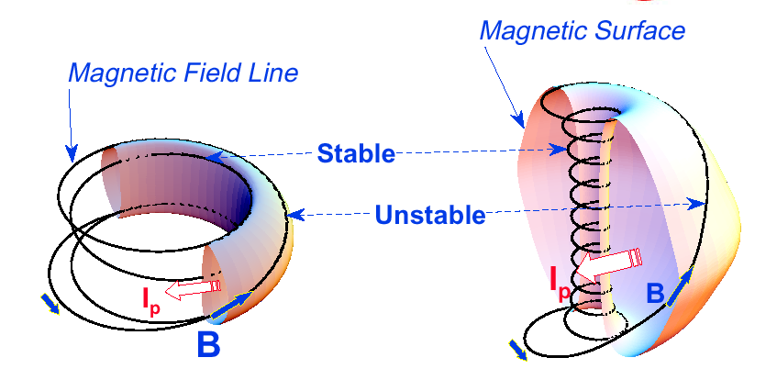
“Spherical” tokamak (ST) has aspect ratio A < 2
Aspect Ratio A = R /a
Elongation κ = b/a
Toroidal beta β_{T} = ⟨p⟩ / (B_{T0}²/2μ₀)
Tokamak
ST
A ~ 3-4,
κ = 1.5-2,
q₉₅ = 3-4,
β_{T} = 3-10%
A ~ 1.2-2,
κ = 2-3,
q₉₅ = 6-20,
β_{T} = 10-40%
• ST has high I_{P}, economically, due to high κ and low A
I_{P} ~ I_{TF} (1 + κ²) / (2 A² q*)
Energy confinement time τ_{E} ∝ I_{P}
• Favorable average curvature improves stability at high beta
Access high pressure, rapid rotation, low collisionality

Slide 4
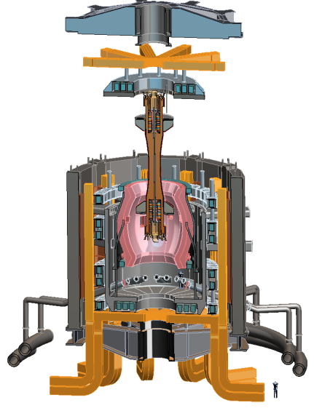
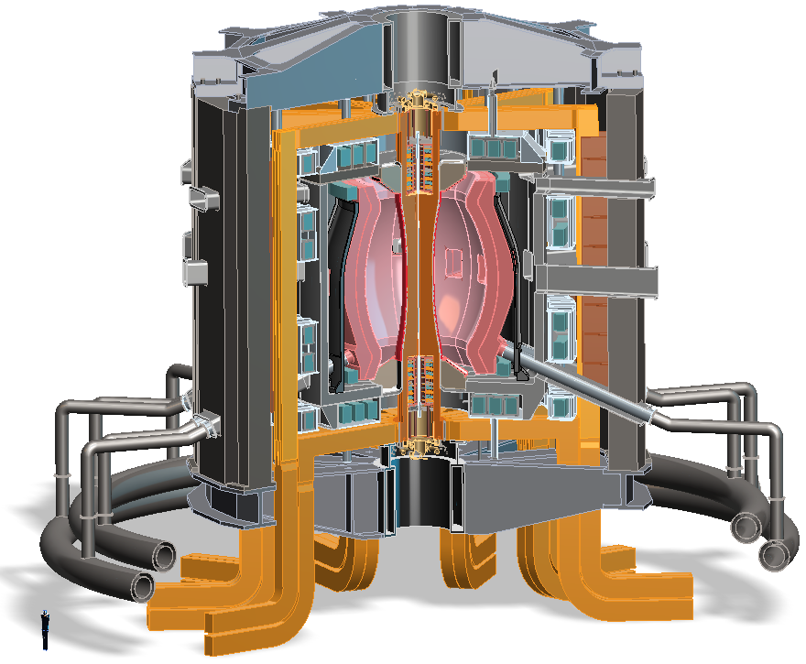
Design studies show ST potentially attractive as
Fusion Nuclear Science Facility (FNSF)
FNSF: Provide neutron fluence for material/component R&D
Projected to access high neutron wall loading at moderate R, P_{fusion}
  W_{n} ~ 1-2 MW/m² , P_{fus} ~ 50-200MW, R ~ 0.8-1.8m
Modular, simplified maintenance
FNSF with
copper TF coils
A=1.7, R₀ = 1.7m Fluence = 6MWy/m²
Tritium breeding ratio ~ 1

Slide 5
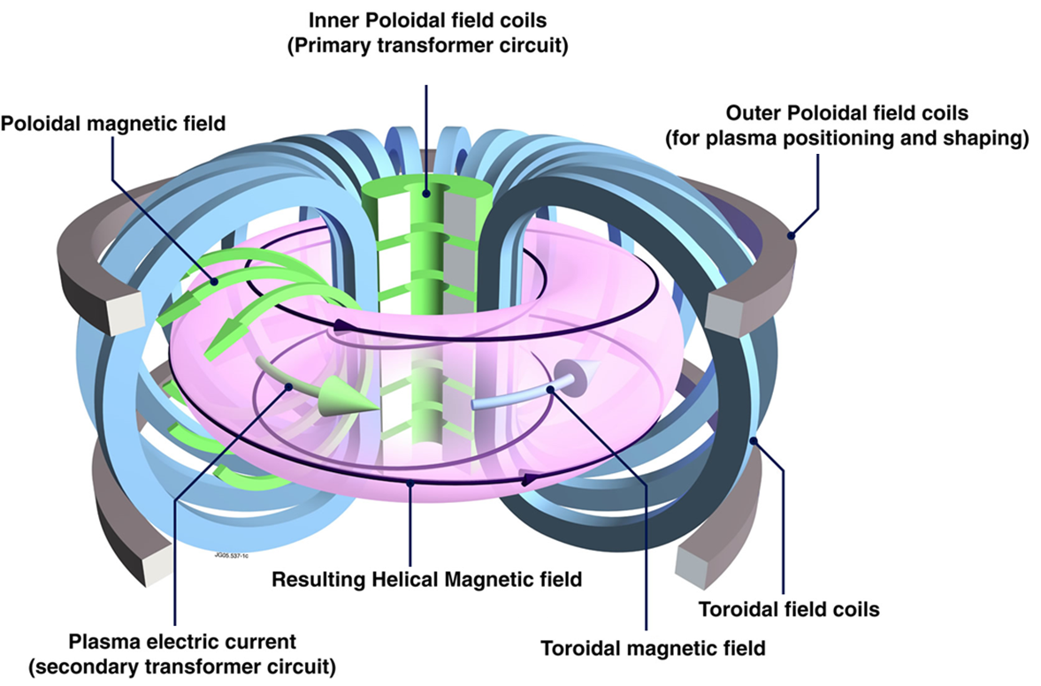
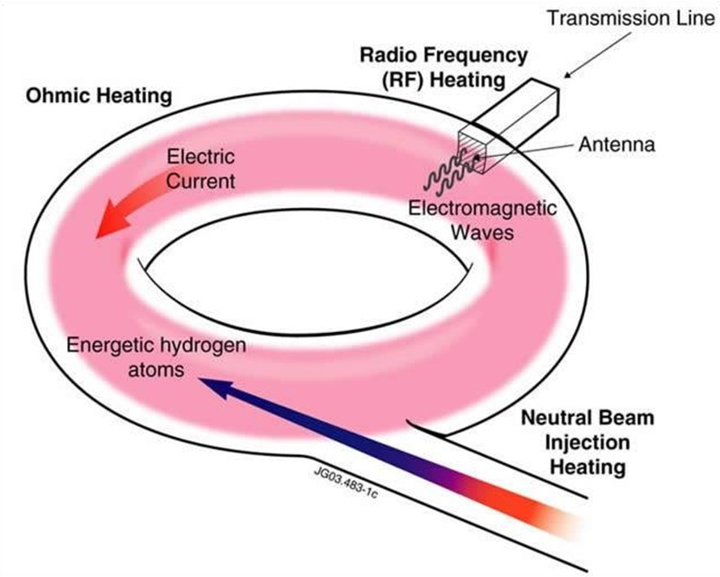
Tokamaks are not presently steady-state, but in the future will operate without transformer
Conventional Tokamak
Primary transformer coils drive toroidal current in plasma
Must stop when transformer coils reach current/force limits
Advanced Tokamak
External: wave and beam current drive
Self-generated: high pressure plasmas make “bootstrap” current
Inner Poloidal Field Coils
(Primary transformer circuit)
Plasma electric current
(Secondary transformer circuit)

Slide 6
Outline
National Spherical Torus Experiment – Upgrade
  ST Overview and Motivation, NSTX-U Mission
  NSTX-U Upgrades, Status
  NSTX-U Research Focus
Modifications to Ideal Stability by Kinetic Effects
  Includes rotation, collisionality, and energetic particle effects
  Benchmarked MISK code calculations can explain experimental stability
Summary

Slide 7
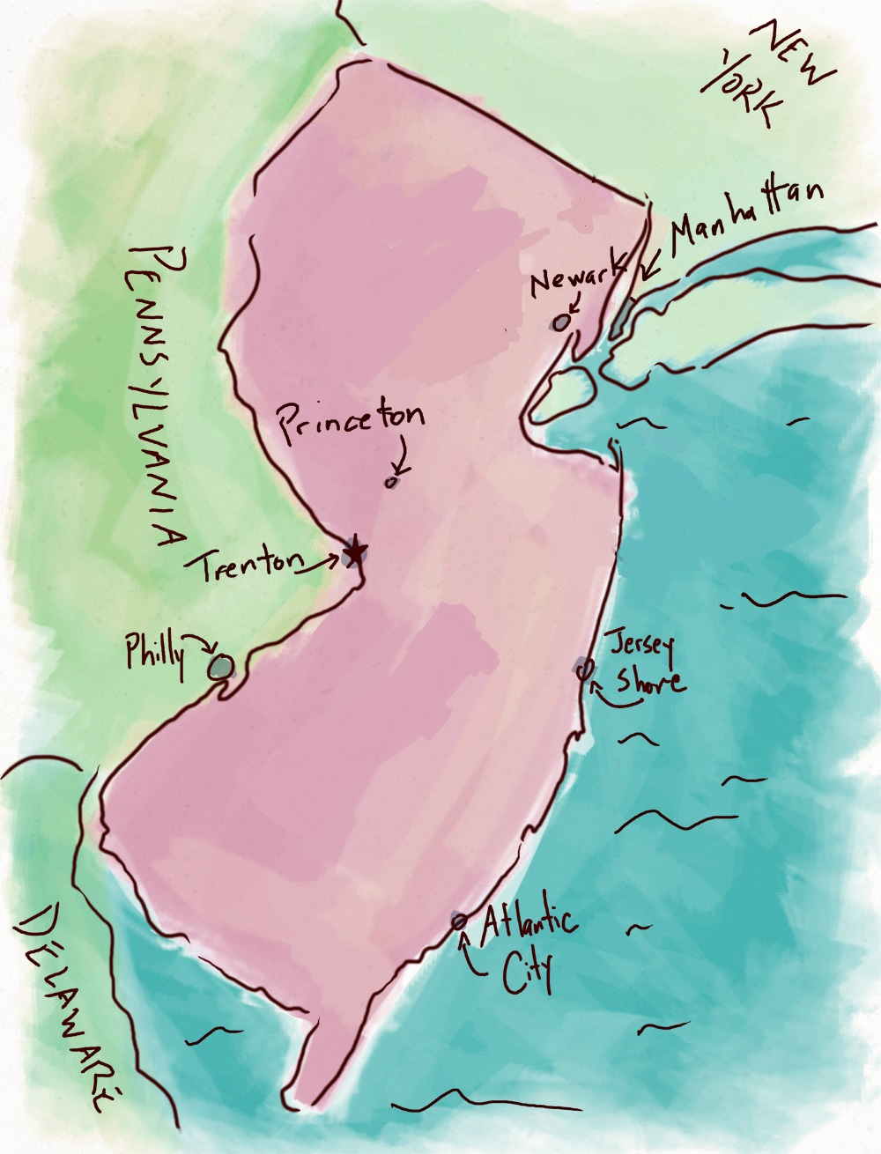
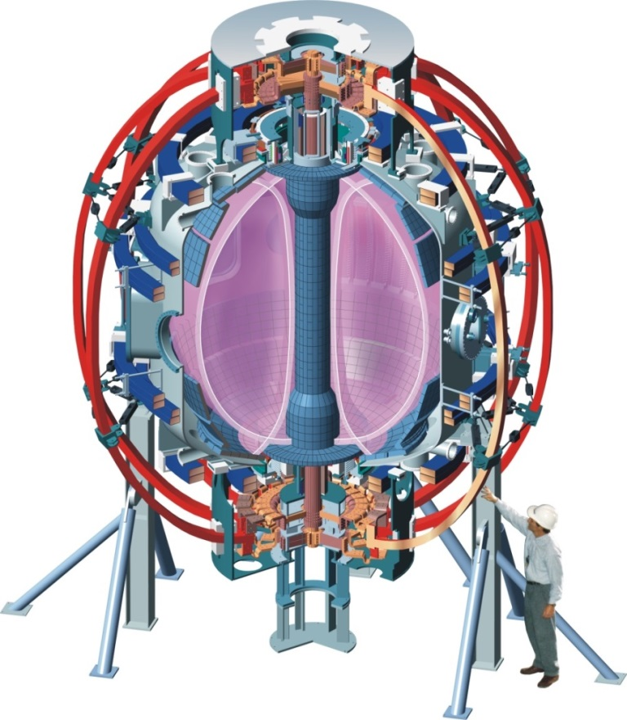
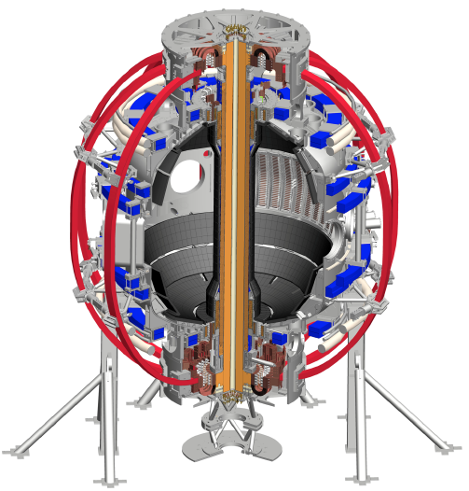
The National Spherical Torus Experiment Upgrade (NSTX-U) at the Princeton Plasma Physics Lab
NSTX (1999-2011)
NSTX-U (2015-)

Slide 8

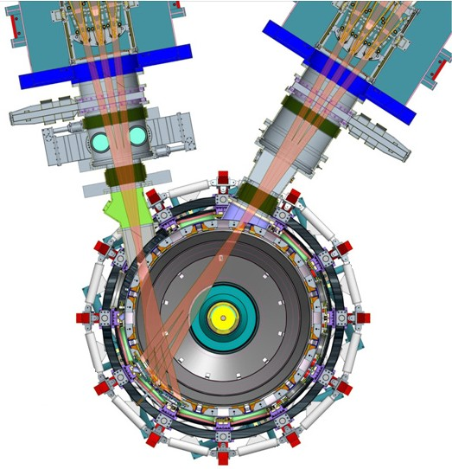
NSTX-U will access new physics with 2 major new tools:
1. New Central Magnet
2. Tangential 2nd Neutral Beam
Higher T, low ν* from low to high β
→ Unique regime, study new transport and stability physics
Full non-inductive current drive
→ Not demonstrated in ST at high-β_{T}
Essential for any future steady-state ST

Slide 9
NSTX-U will have major boost in performance
1. New Central Magnet
2. Tangential 2nd Neutral Beam
2017-2018 goals:
➢2× heating power (5 → 10MW)
Tangential NBI → 2× current drive efficiency
➢4× divertor heat flux
➢Up to 10× higher nTτ_{E} (~MJ plasmas)
➢2× toroidal field (0.5 → 1T)
➢2× plasma current (1 → 2MA)
➢5× longer pulse (1 → 5s)

Slide 10
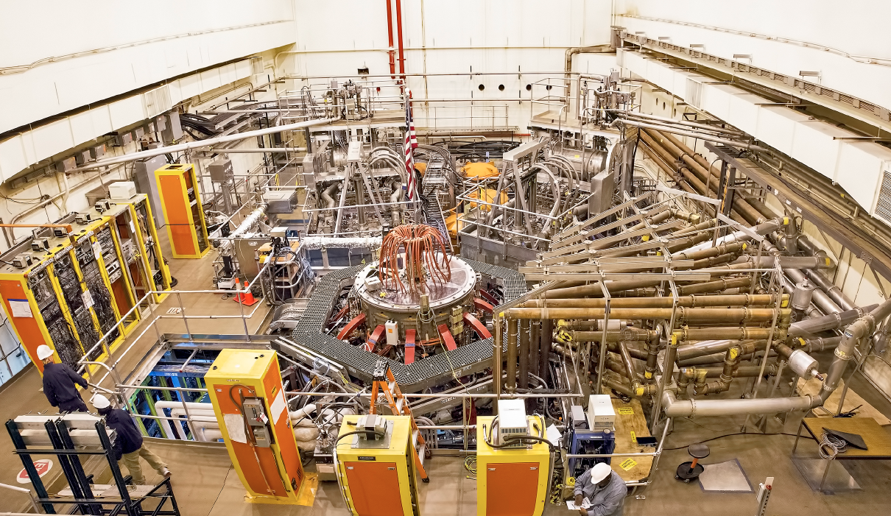
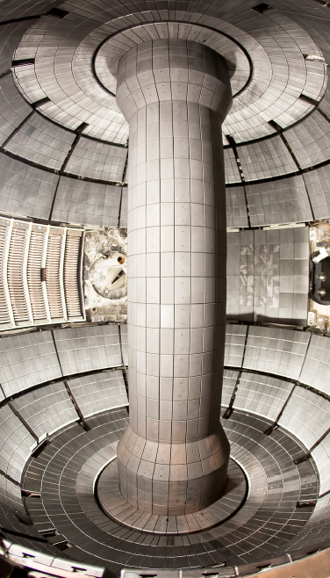
NSTX-U Facility Is Now Operational
Upgrade Project Completed on Schedule and Cost
2nd NBI
1st NBI
HHFW System
NSTX-U
All six NBI sources are now operational, supporting high performance experiments

Slide 11
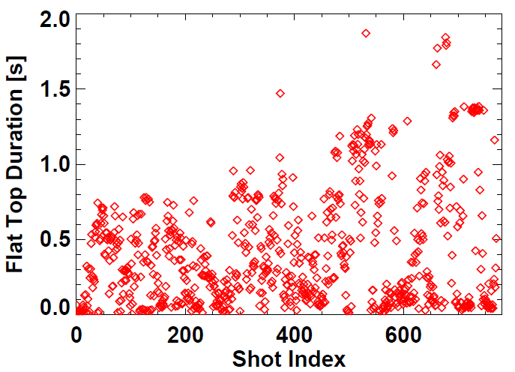
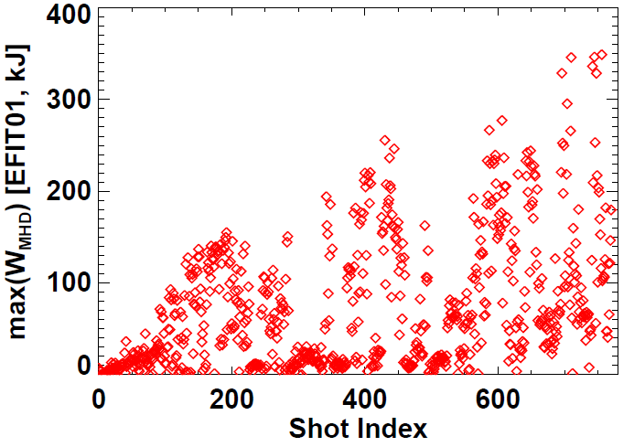
NSTX-U plasma commissioning status
~7 run weeks of operations, I_{P} = 0.5–1MA
Nearly all shots at B_{T} = 0.6-0.65T > NSTX max = 0.55T
All 6 NBI injected into plasmas, 4-6MW routinely available
Exceeded NSTX L & H-mode pulse-lengths
using 1MW L-modes (0.65, 0.8MA)
Approaching NSTX W_{TOT} record ~ 430kJ
NSTX record
NSTX record

Slide 12
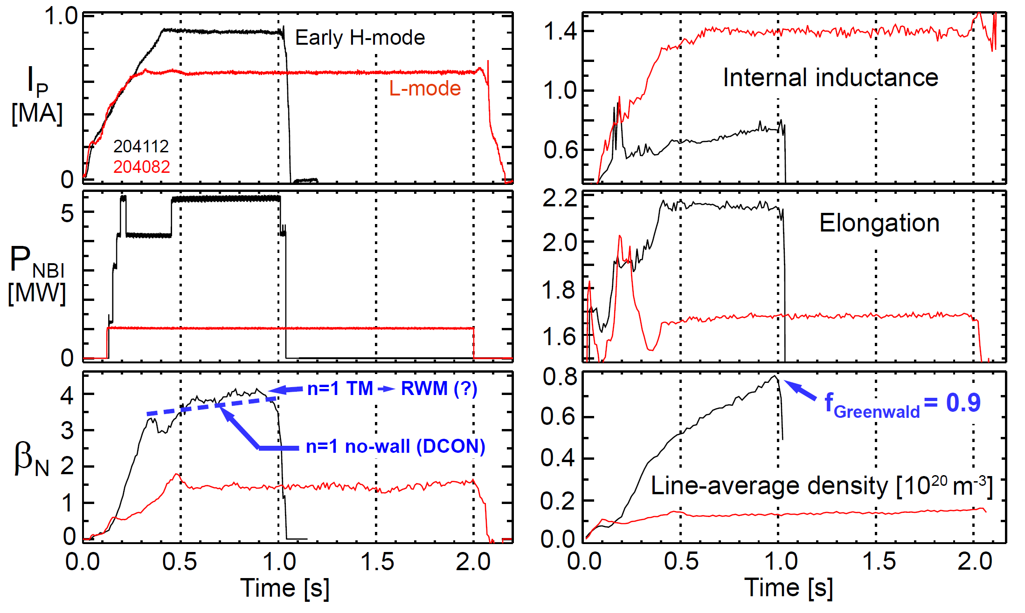
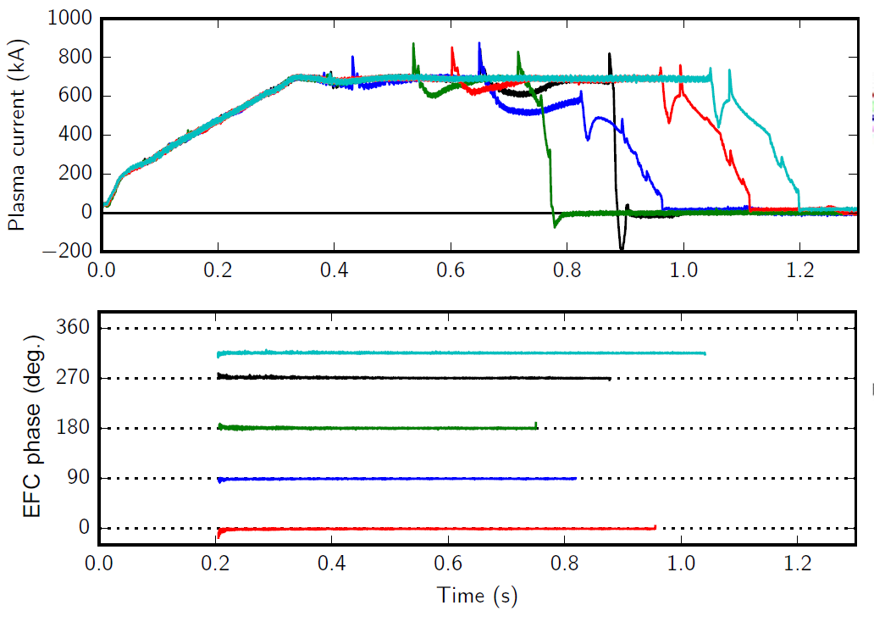
Examples of high-performance
L and H-modes achieved thus far
Optimal n=1 error field correction amplitude and phase identified to maximize pulse length, discharge performance

Slide 13
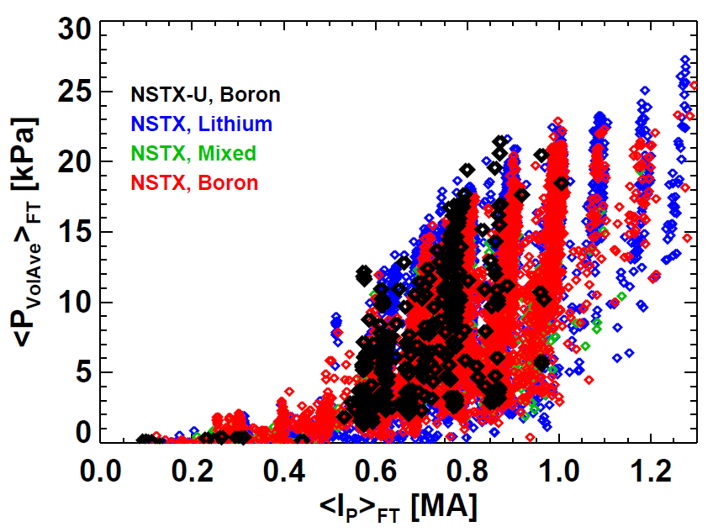
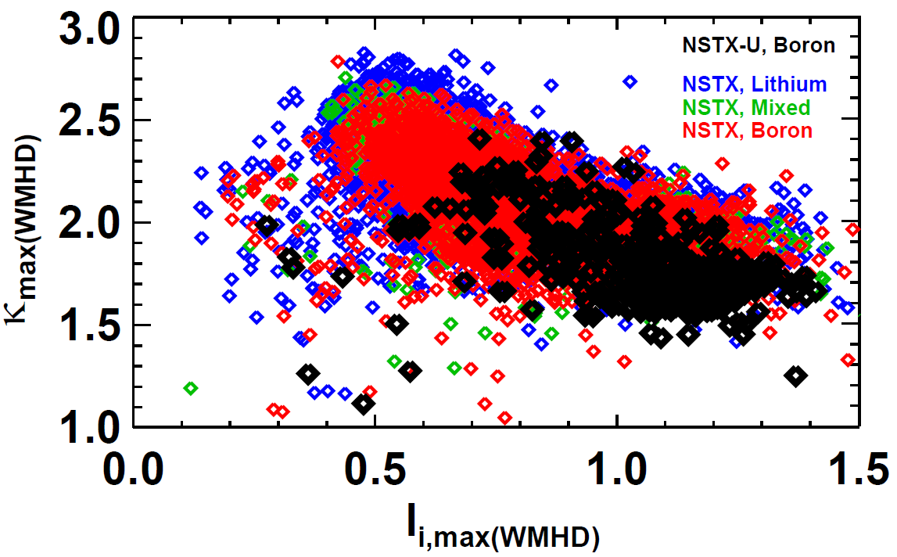
NSTX-U has matched NSTX highest flat-top pressures for plasma currents up to 0.9MA
(Current profile peakedness)
Utilizing real-time equilibrium reconstruction and vertical motion detection for stability
Near-term: l_{i} = 0.5-0.6, κ = 2.5 – 2.7, I_{P} = 1.1 – 1.3MA

Slide 14
Outline
National Spherical Torus Experiment – Upgrade
  ST Overview and Motivation, NSTX-U Mission
  NSTX-U Upgrades, Status
  NSTX-U Research Focus
Modifications to Ideal Stability by Kinetic Effects
  Includes rotation, collisionality, and energetic particle effects
  Benchmarked MISK code calculations can explain experimental stability
Summary

Slide 15
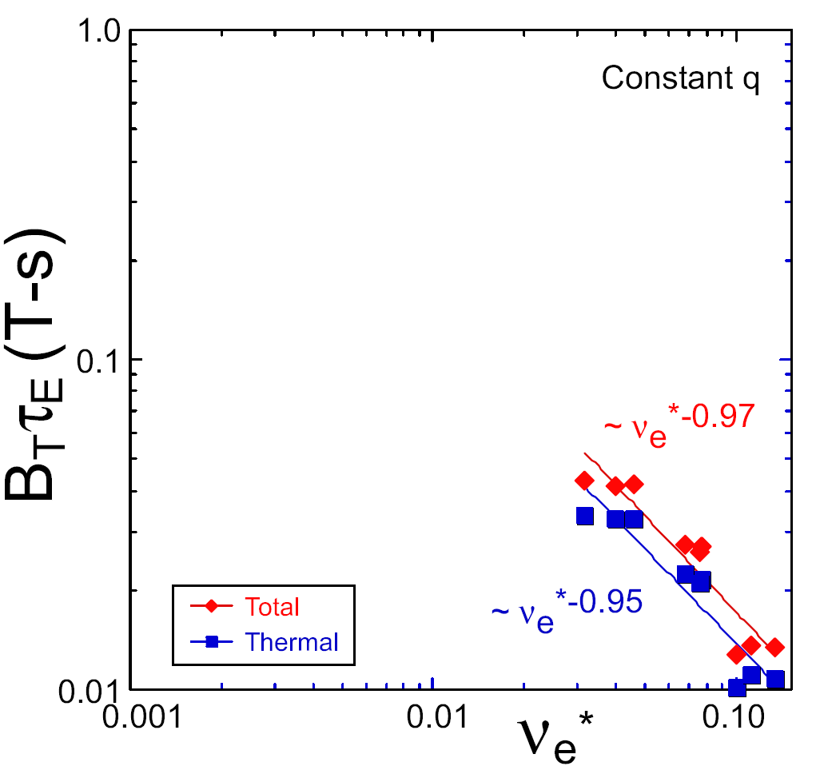
NSTX achieved favorable confinement and current drive results; Will trends continue in NSTX-U?
ST-FNSF
TRANSP Contours of Non-Inductive Fraction
constant q, β, ρ∗
NSTX Upgrade
?
H_{98y2} confinement
parameter
NSTX
ITER-like scaling
I_{P}=1 MA, B_{T}=1.0 T, P_{NBI}=12.6 MW
Normalized electron collisionality ν_{e}* ∝ n_{e} / T_{e}²
NSTX observed confinement increase at higher T_{e}!
Will trend continue, or look like conventional A?
NSTX achieved 70% “transformer-less” current drive Will NSTX-U achieve 100% as predicted?
Favorable confinement results could lead to more compact ST reactors
Steady-state operation required for FNSF

Slide 16
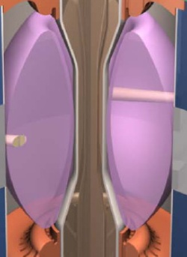
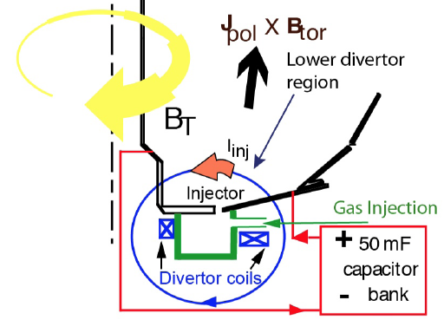
Plasma current start-up/ramp-up critical issue for FNSF
Compact ST-FNSF has no/small central solenoid
I_{P} [MA]
ST-FNSF Scenarios
Current ramp-up and profile control
NBI
Solenoid-free
Start-up
HHFW
RF and/or HI
Time
• Two novel techniques for solenoid-free start-up and ramp-up will be investigated
  Radio-frequency power
  Helicity Injection
~ 1-2 MA of solenoid-free start-up current needed for FNSF

Slide 17
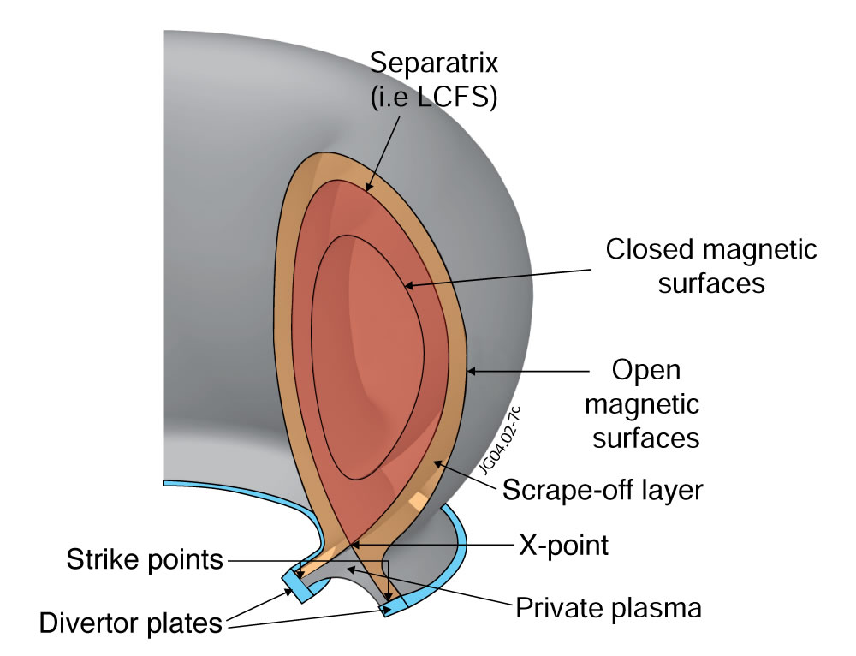
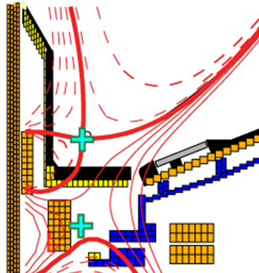
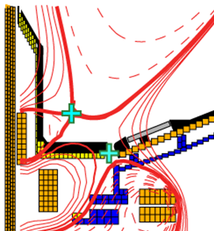
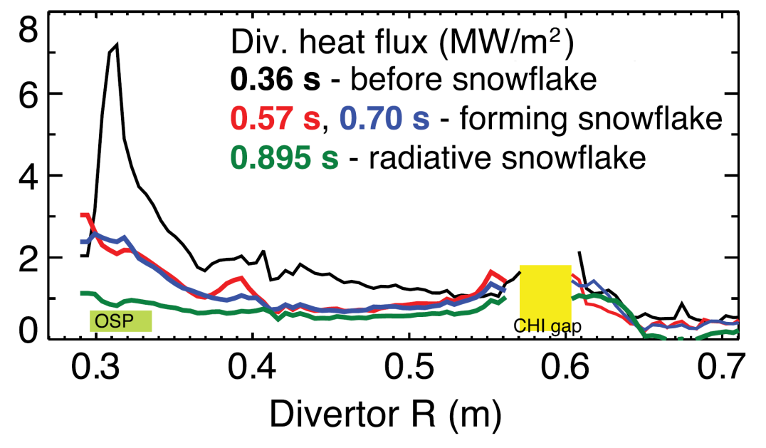
NSTX-U will test ability of advanced divertors to mitigate very high heat-fluxes
Power exhaust width outside main plasma can be very narrow (few mm)
NSTX-U has additional coils for improved control of snowflake
Standard Divertor
Snowflake Divertor
Power / particles contact target plates here
NSTX-U peak heat fluxes will be up to 4-8× higher than in NSTX

Slide 18
Outline
National Spherical Torus Experiment – Upgrade
  ST Overview and Motivation, NSTX-U Mission
  NSTX-U Upgrades, Status
  NSTX-U Research Focus
Modifications to Ideal Stability by Kinetic Effects
  Includes rotation, collisionality, and energetic particle effects
  Benchmarked MISK code calculations can explain experimental stability
Summary

Slide 19
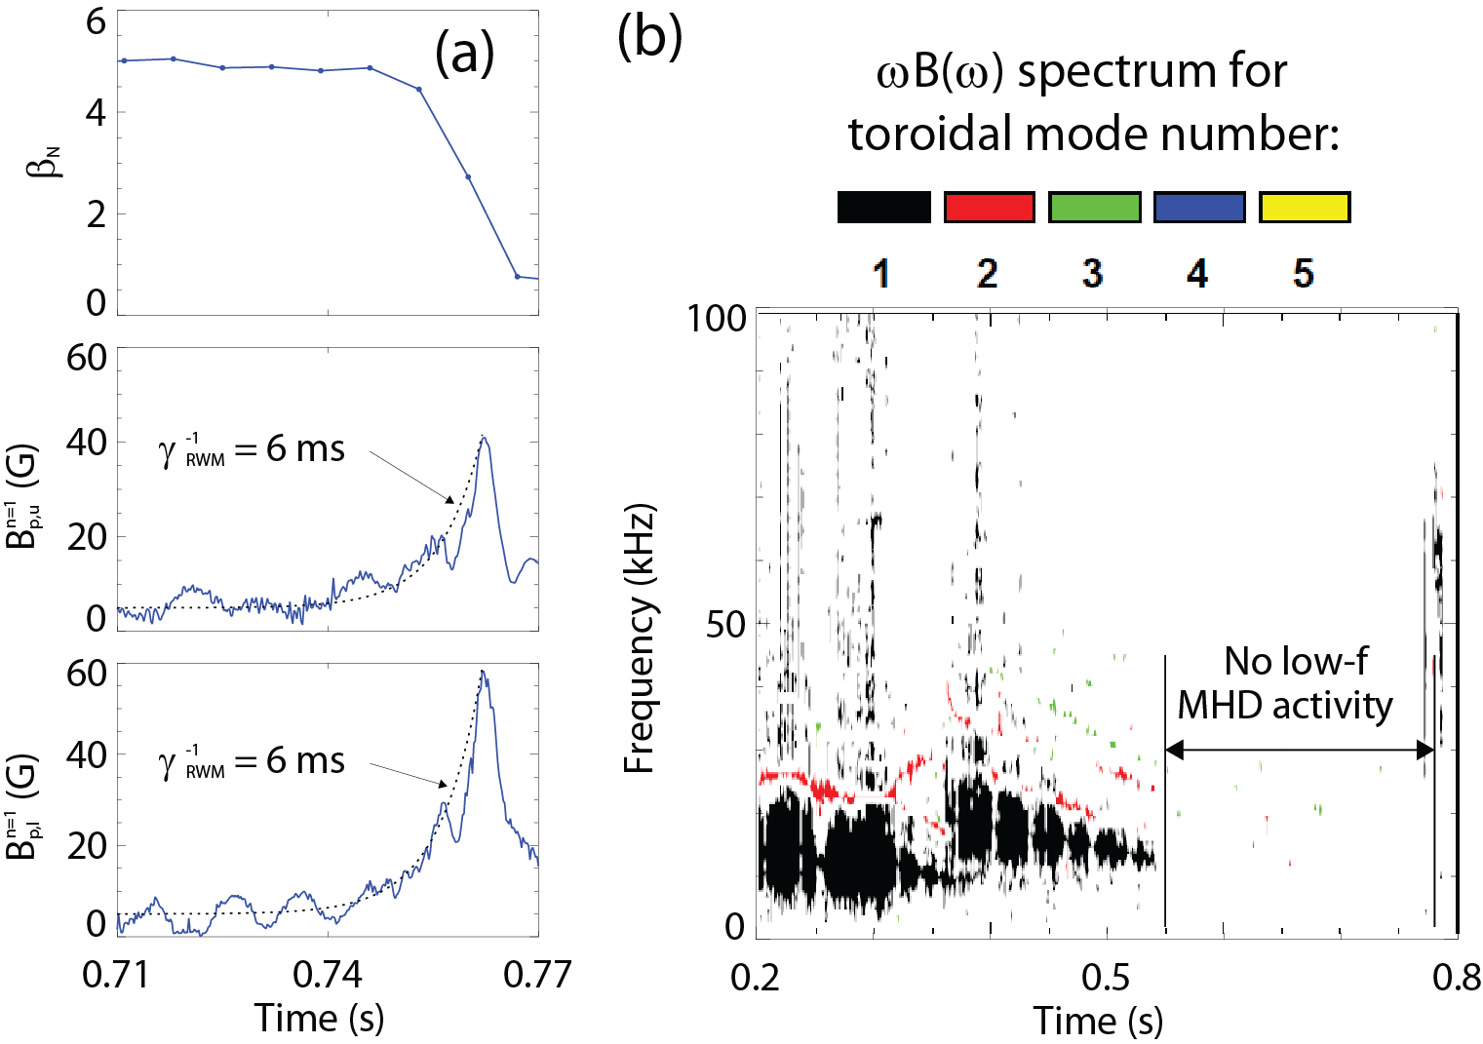
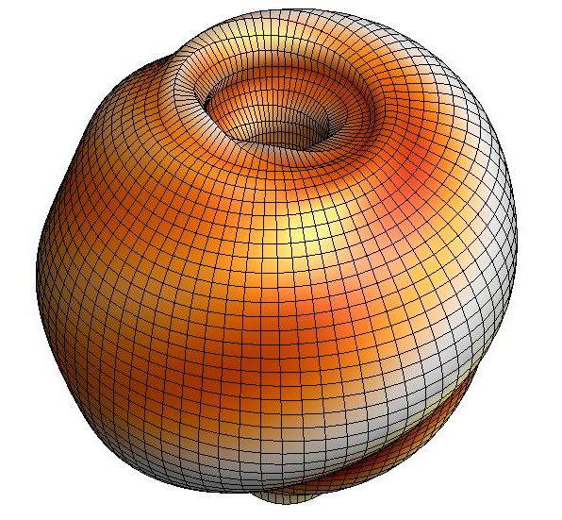



An unstable RWM is an exponential growth of magnetic field line kinking that can cause disruptions
The resistive wall mode (RWM) is a kinking of magnetic field lines slowed by penetration through vessel structures
B_{p}
NSTX 130235
where
[S. Sabbagh et al., Nucl. Fusion 46, 635 (2006)]
RWMs can cause a collapse in β, disruption, and termination of the plasma

Slide 20
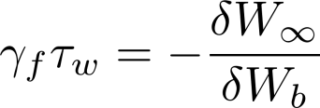
RWM dispersion relation evaluated with ideal and kinetic components allows for passive stabilization of the RWM
Resistive Wall Mode (RWM) fluid dispersion relation:
Ideal Kink Mode
Resistive Wall Mode
γ
~τ_{w}⁻¹
unstable
0
τ_{w}⁻¹ is slow enough for active stabilization (feedback)
stable
However, experiments operate above the no-wall limit without active control!
β_{N}^{no-wall}
β_{N}^{with-wall}
Ideal Stability

Slide 21
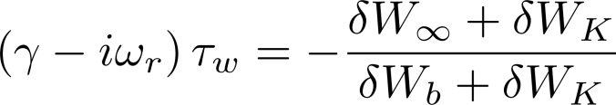
RWM dispersion relation evaluated with ideal and kinetic components allows for passive stabilization of the RWM
Resistive Wall Mode (RWM) fluid dispersion relation:
Ideal Kink Mode
Resistive Wall Mode
γ
~τ_{w}⁻¹
unstable
0
τ_{w}⁻¹ is slow enough for active stabilization (feedback)
stable
However, experiments operate above the no-wall limit without active control!
β_{N}^{no-wall}
β_{N}^{with-wall}
Ideal Stability
Kinetic Effects
Passive stabilization
  Collisional dissipation
  Rotational stabilization
    Models with scalar “critical rotation” for stability could not explain experiments
[B. Hu et al., Phys. Rev. Lett. 93, 105002 (2004)]
[S. Sabbagh et al., Nucl. Fusion 50, 025020 (2010)]

Slide 22
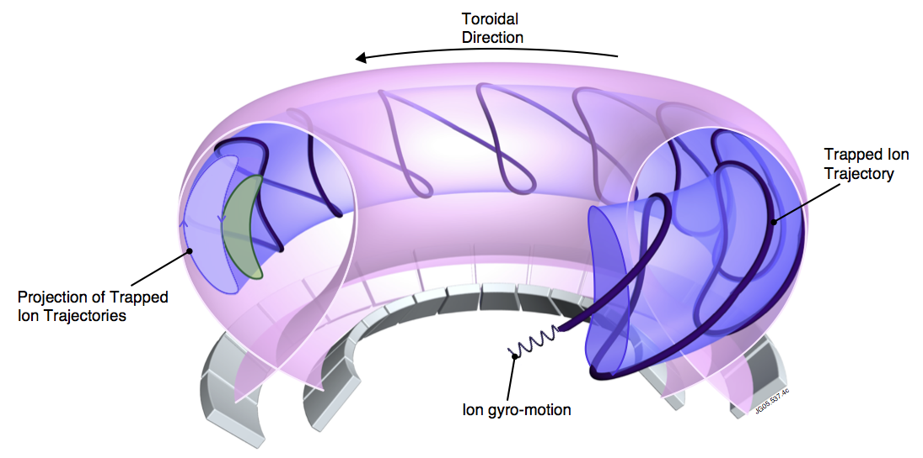
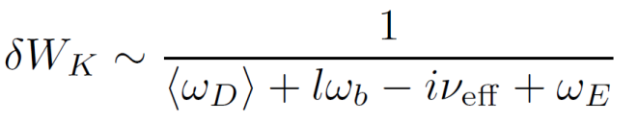
“Kinetic effects” means taking into account complicated particle motion rather than treating the plasma as a fluid
[D. Pace et al., Physics Today 68, 34 (2015)]
Precession Drift
Bounce
~ Plasma Rotation
Rotational resonance effect
[J. Berkery et al., Phys. Rev. Lett. 104, 035003 (2010)]

Slide 23
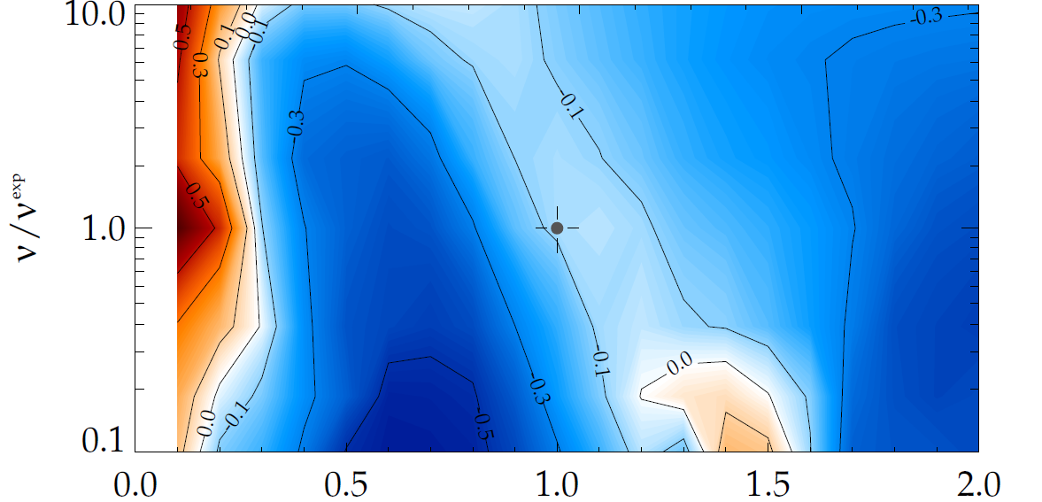
Kinetic theory consistent with RWM destabilization at intermediate plasma rotation
MISK code calculations for NSTX γτ_{w} contours vs. ν and ω_{φ}
Destabilization appears between:
precession resonance at low ω_{φ}
bounce resonance at high ω_{φ}
(marginal stability)
Plasma evolution
Precession drift resonance stabilization
Marginal stability
Bounce/transit resonance stabilization
ν_{eff}/ν^{exp (marginal stability)}
instability
(experiment)
NSTX 121083
unstable
ω_{φ}/ω_{φ}^{exp (marginal stability)}
unstable
Precession Drift
Bounce
~ Plasma Rotation
Rotational resonance effect
[J. Berkery et al., Phys. Rev. Lett. 104, 035003 (2010)]

Slide 24
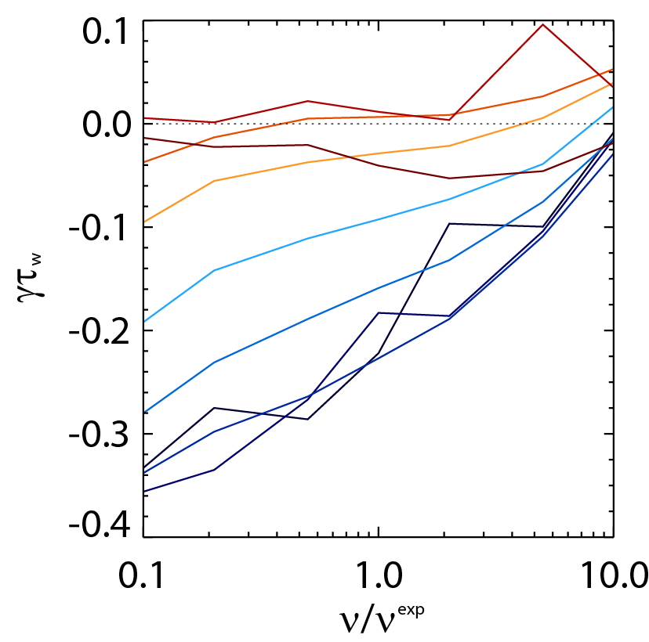

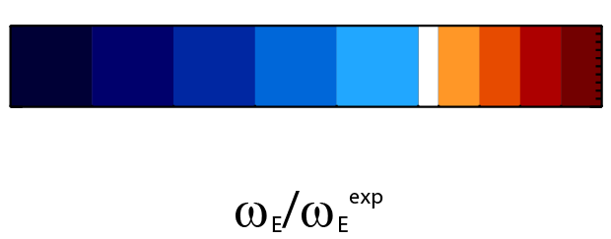
Collisionality affects the strength of kinetic resonances
unstable
off-resonance
less stable
γ ~ constant
1.4
Early theory predicted RWM stability should decrease at low ν
Kinetic RWM stability theory at low ν:
  Stabilizing resonant kinetic effects enhanced
1.2
1.0
on-resonance
more stable
γ ~ -1/ν
0.8
0.6
stable
0.4
0.2
MISK calculations
Collisionality
~ Plasma Rotation
Collisionality effect
[J. Berkery et al., Phys. Rev. Lett. 106, 075004 (2011)]

Slide 25
Outline
National Spherical Torus Experiment – Upgrade
  ST Overview and Motivation, NSTX-U Mission
  NSTX-U Upgrades, Status
  NSTX-U Research Focus
Modifications to Ideal Stability by Kinetic Effects
  Includes rotation, collisionality, and energetic particle effects
  Benchmarked MISK code calculations can explain experimental stability
Summary

Slide 26
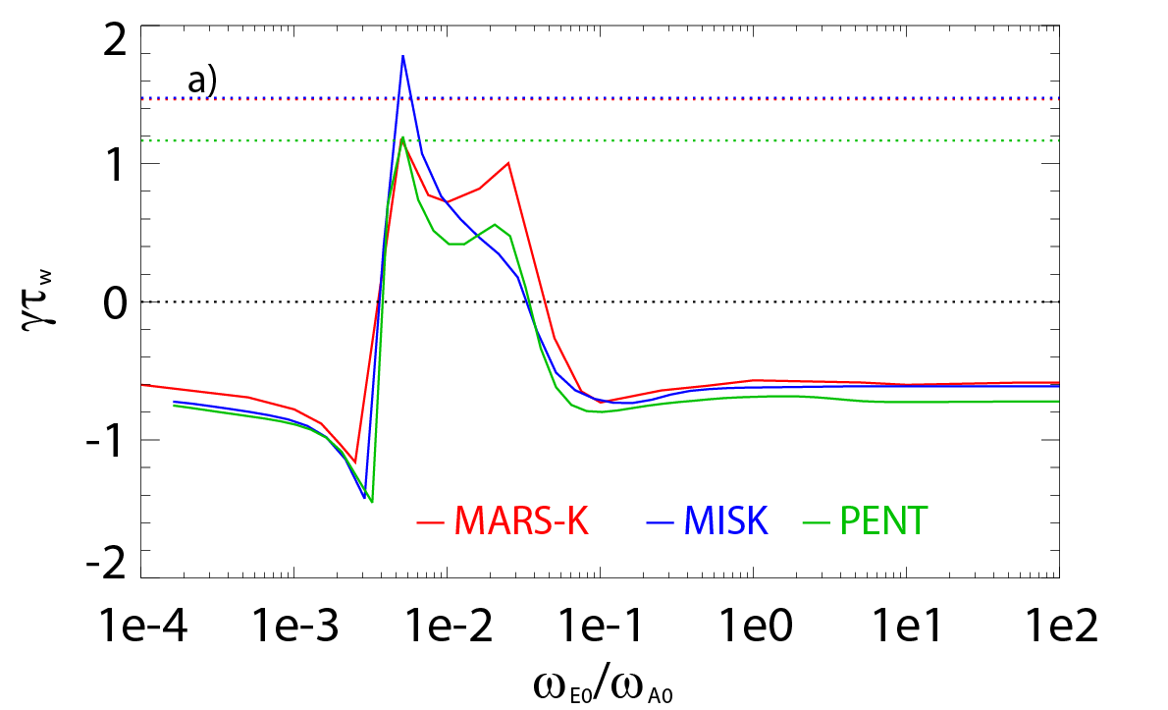
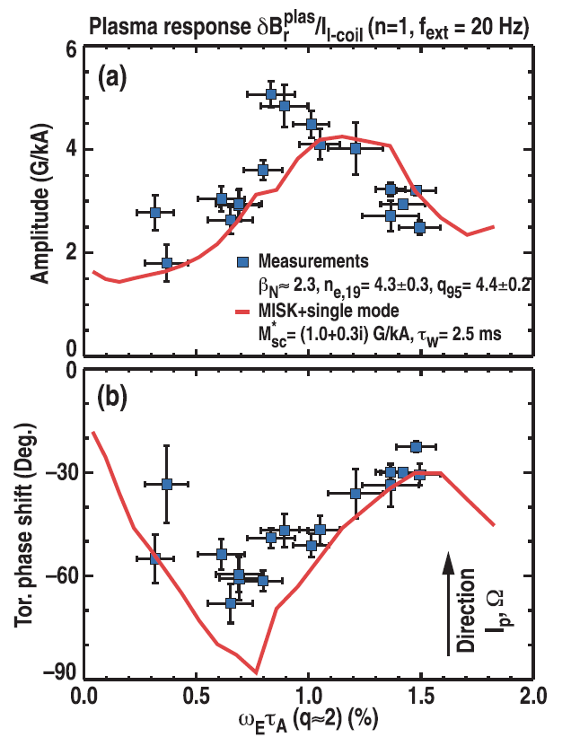
Kinetic RWM theory has been benchmarked between codes and applied to multiple devices
fluid growth rates
DIII-D
ITER test case
unstable
stable
fluid plus kinetic growth rates
low rotation
precession resonance
high rotation
bounce resonance
[J. Berkery et al., Phys. Plasmas 21, 052505 (2014)]
[H. Reimerdes et al., Phys. Rev. Lett. 106, 215002 (2011)]
Benchmarking with MARS-K (Yueqiang Liu) supports the understanding that RWM stability can be increased by kinetic effects
  At low rotation through precession drift resonance
  At high rotation by bounce resonance
Active measurements in DIII-D (Holger Reimerdes) support the importance of kinetic effects in stable plasma behavior as well
  Plasma response is enhanced where kinetic effects and RWM stability are weak
  MISK calculations match experiments

Slide 27
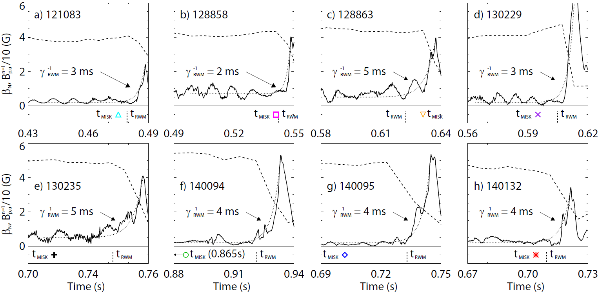
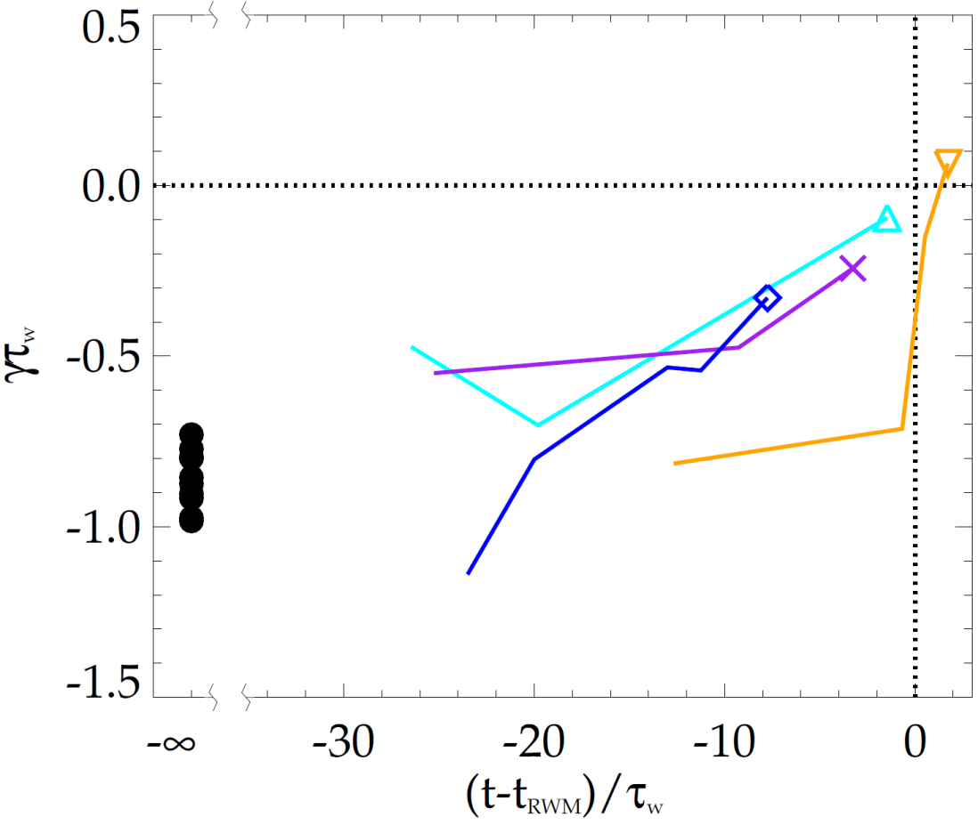
MISK calculations validated against unstable experimental plasmas; reproduce approach towards marginal stability
NSTX
NSTX
unstable
stable
The calculations trend towards instability (γτ_{w} = 0) approaching time of RWM instability growth
MISK calculations (at t_{MISK}) including kinetic effects, have been tested against many marginally stable NSTX experimental cases
[J. Berkery et al., Nucl. Fusion 55, 123007 (2015)]

Slide 28
Summary
NSTX-U project recently completed on cost and schedule
  Physics research began December 2015, making great progess
NSTX began, and NSTX-U will extend, opportunities to study toroidal confinement physics in novel regimes:
  Low aspect ratio, strong shaping, high β, low collisionality
  Advanced divertors, unique start-up solutions
  Will inform optimal configuration for next-step FNSF device
Kinetic RWM stability theory modifies ideal stability
  Includes rotation, collisionality, and energetic particle effects
  Benchmarked MISK calculations can explain experiments

Slide 29
Backup

Slide 30
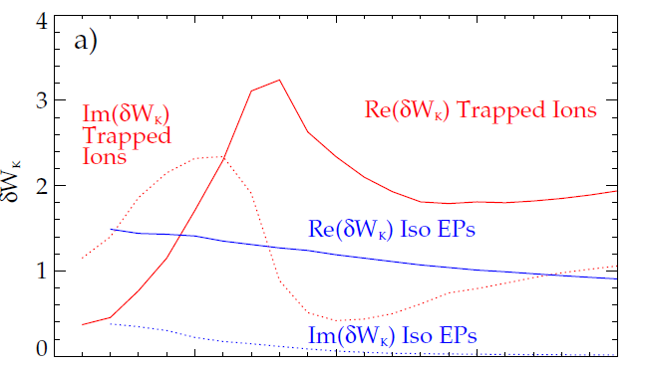
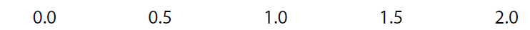
Energetic particles provide a stabilizing force that is nearly independent of rotation and collisionality
NSTX 121083 @ 0.475 s
Significant Re(δW_{K}), but nearly independent of ω_{φ}
Energetic particles are not in mode resonance
Effect is not energy dissipation, but rather a restoring force
δW_{K}
ω_{φ}/ω_{φ}^{exp}
Large for EPs
Small for EPs
Precession Drift
Bounce
Collisionality
~ Plasma Rotation
Energetic particle effect
[J. Berkery et al., Phys. Plasmas 17, 082504 (2010)]

Slide 31
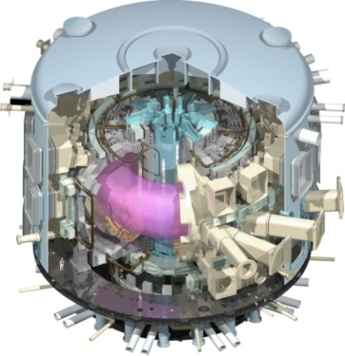
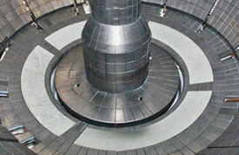
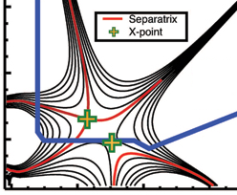
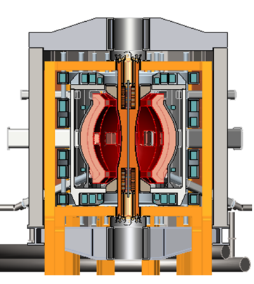
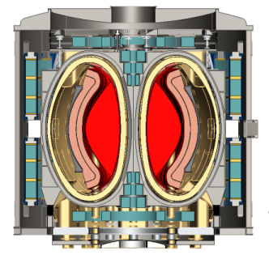
NSTX Upgrade mission elements
Explore unique ST parameter regimes to advance predictive capability - for ITER and beyond
Develop solutions for the plasma-material interface (PMI) challenge
Advance ST as candidate for Fusion Nuclear Science Facility (FNSF)
Develop ST as fusion energy system
ITER
Lithium
“Snowflake”
ST-FNSF / Pilot-Plant

Slide 32
Low collisionality operation achieved on NSTX using lithium wall coatings
Lithium coatings on carbon tiles reduced gas source from wall
  Lead to a larger H-mode pedestal, larger core temperature
  Confinement continued to improve with reduced collisionality
Longer discharges will address first wall solutions
  New diagnostics and campaigns with different wall materials will advance studies of plasma-wall interaction
R. Maingi, PRL 2011

Slide 33
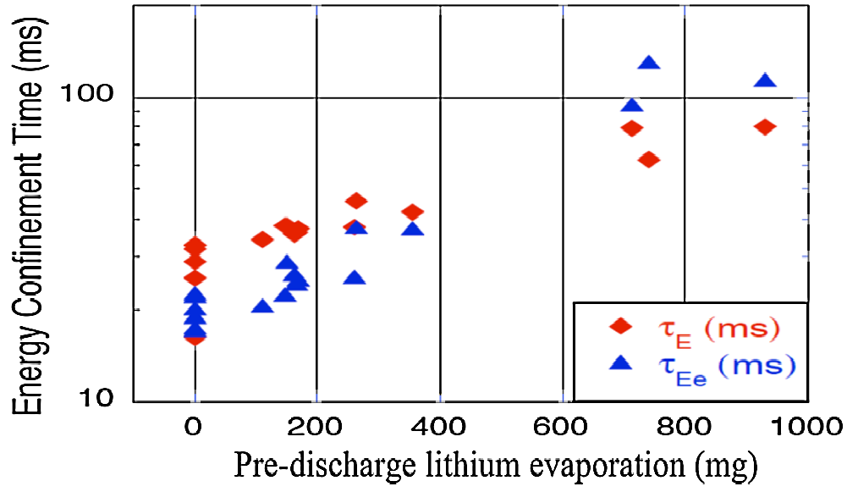
Plasma confinement increased continuously with increasing Li coatings in NSTX – what is limit?
Global parameters improve
  H_{98y2} increases ~0.9 → 1.4
  No core Li accumulation
High H critical for compact FNSF / Pilot Plants
Energy Confinement Time (ms)
Pre-discharge lithium evaporation (mg)
R. Maingi, et al., PRL 107 (2011) 145004
NSTX-U will double Li-wall coverage with upward evaporators
Will further assess contributors to confinement improvement:
  Lower-recycling / reduced neutral source / higher T_{e}
  Edge profile / turbulence changes
  Influence of (low-Z) impurities in pedestal region
Role of enhancements:
Compare Li-wall pumping to conventional pumping ↔ cryo

Slide 34
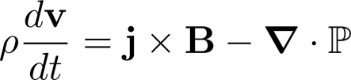
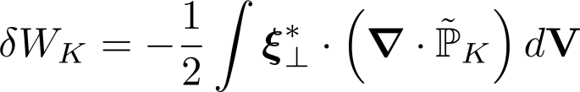


Kinetic effects arise from the perturbed pressure, are calculated in MISK from the perturbed distribution function
Force balance:
leads to an energy balance:
Kinetic Energy
Fluid terms
Change in potential energy due to perturbed kinetic pressure is:
is solved in MISK by using from the drift kinetic equation for

Slide 35
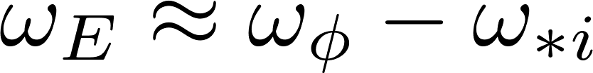
Kinetic effects arise from the perturbed pressure, are calculated in MISK from the perturbed distribution function
Force balance:
leads to an energy balance:
Kinetic Energy
Fluid terms
Change in potential energy due to perturbed kinetic pressure is:
is solved in MISK by using from the drift kinetic equation for
Precession Drift
Bounce
Collisionality
~ Plasma Rotation

Slide 36
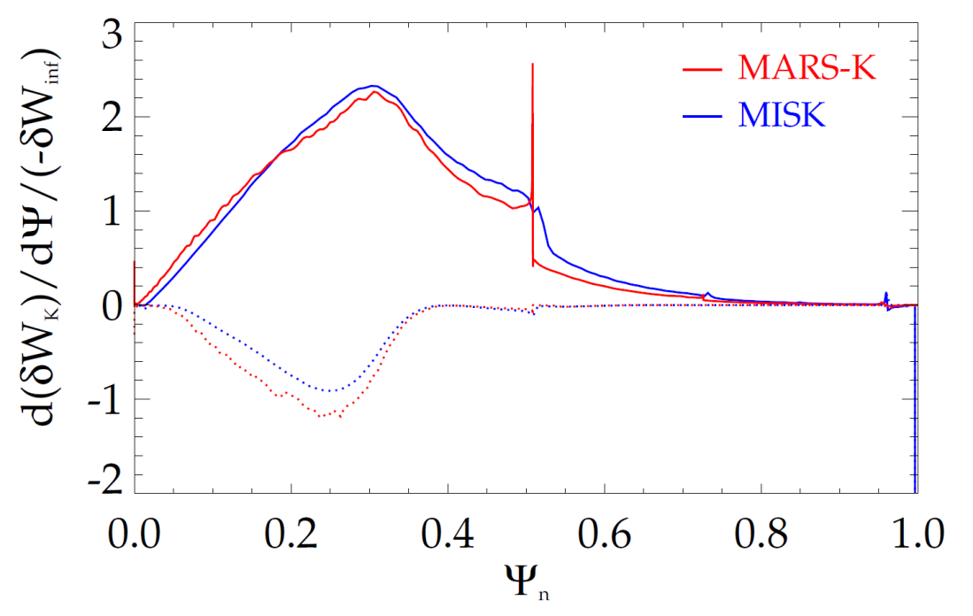
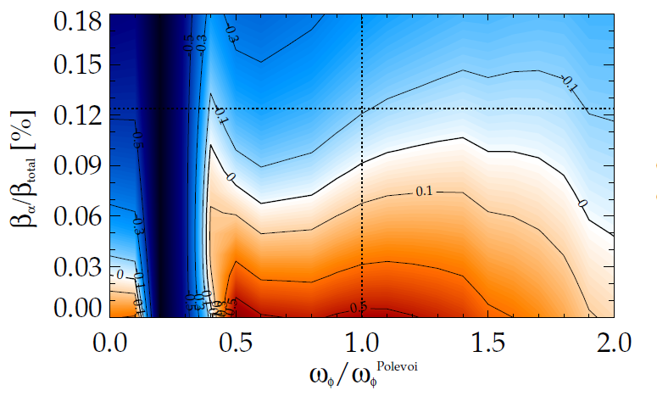
A realistic projection of ITER stability requires including all kinetic effects
precession resonance
stable
Real
expected
β_{α}
Comparing trapped alpha particle calculation
expected ω_{φ}
unstable
Imag
Collisionality and rotation will be low in ITER: strong precession resonance
Alpha particle calculations agree between MISK and MARS-K, are crucial to ITER stability
Rotational resonance effect
+
Collisionality effect
+
Energetic particle effect

Slide 37




NSTX-U developing a range of profile control actuators for physics studies, scenario optimization
q-Profile Actuators
Rotation Profile Actuators
Variations in Beam Sources
800 kA Partial Inductive, 87% < f_{NI} < 100%
Largest R_{tan}
Torque Profiles From 6 Different NB Sources
800 kA and 1 T
[50,60,70,130] cm
[50,60,120,130] cm
[60,70,110,120] cm
[70,110,120,130] cm
Neutral
Beams
(TRANSP)
Smallest R_{tan}
NSTX-U state-space ω_{φ} controller w/NTV as actuator
6
10⁴
t₁
Variations in Outer Gap
t₂
4
t₃
NTV
region
Plasma rotation (rad/s)
NTV torque density (N/m²)
2
desired ω_{φ}
0
S. Gerhardt,
NF 2012
27 22 17 12 7 2
Radial coordinate
Outer Gap
S. Sabbagh, IAEA 2014

Slide 38
Record β_{N} and β_{N} / l_{i} accessed in NSTX using passive + active resistive wall mode stabilization
  High β_{N} for fusion performance, high non-inductive fraction for continuous operation
    High bootstrap current fraction -> Broad current profile -> Low l_{i} = <B_{p}²>/<B_{p}>_{ψ}²
  Unfavorable for ideal stability since low l_{i} reduces the ideal n = 1 no-wall beta limit
The highest β_{N}/l_{i} is not the least stable in NSTX
  Passive stability of the resistive wall mode (RWM) must be explained
ST-FNSF
Unstable RWM
Stable / controlled RWM
S. Sabbagh, NF 2013; J. Berkery, POP 2014
Major NSTX-U mission is to achieve fully non-inductive operation at high β

Slide 39




Real-time models can be used for stability estimation
Modeled estimates for NSTX no-wall limit
Reduced RWM kinetic stability model
Internal inductance
Pressure peaking
Aspect ratio
Composite no-wall limit model
NSTX 138556
Above no-wall
limit
Rotation
Full MISK code too complex for real-time
Reduced model including: rotation, collisionality, EPs being implemented
Below
DCON
Growth rate
Fluid terms
Kinetic effects
RWM dispersion relation
[J.W. Berkery et al., Nucl. Fusion 55, 123007 (2015)]

Slide 40



State space rotation controller designed for NSTX-U can evolve plasma rotation profile toward global mode stability
NSTX-U (6 NBI sources and n = 3 NTV)
Recall:
NSTX (major disruption)
2.0
20
Marginally stable profile
unstable
stable
γτ_{wall}
Steady-state reached in ~ 3τ_{m}
1.5
15
MISK
1.0
NBI, -NTV torque density (N/m²)
Plasma rotation (kHz)
Broader stable
profile
Plasma rotation (krad/s)
10
5
NTV
0.5
stable
NBI
marginally
stable
0
0.0
0.0
0.2
0.4
0.6
0.8
1.0
Ψ_{N}
I. Goumiri (Princeton student), S.A. Sabbagh (Columbia U.), C. Rowley (P.U.), D.A. Gates, S.P. Gerhardt (PPPL)

Slide 41


DCON confirms NSTX-U above the no-wall limit;
NSTX-based model gives good estimate
NSTX-U H-mode discharges: 204112
204118 (April 2016)
Composite no-wall limit model
Composite no-wall limit model
DCON
DCON
Above no-wall limit
Above no-wall limit
Below
Below
J.W. Berkery, S.A. Sabbagh (Columbia University)
NSTX no-wall limit model ([J.W. Berkery et al., Nucl. Fusion 55, 123007 (2015)]) includes internal inductance, pressure peaking, and aspect ratio, predicts NSTX-U DCON no-wall limit

Slide 42
NSTX-U device performance progression
1st year: Limit forces to ½ way between NSTX and NSTX-U, and ½ of the design-point heating of any coil
  Presently operating at B_{T} ~ 0.65T
  Increase to B_{T} ~ 0.8T after completing engineering analysis
2nd year goal: Full field and current, coil heating to ¾ of limit
3rd year goal: Full capability
Parameter | NSTX (Max.) | Year 1 NSTX-U Operations | Year 2 NSTX-U Operations | Year 3 NSTX-U Operations | NSTX-U Ultimate Goal
I_{P} [MA] | 1.2 | ~1.6 | 2.0 | 2.0 | 2.0
B_{T} [T] | 0.55 | ~0.8 (0.65) | 1.0 | 1.0 | 1.0
Allowed TF I²t [MA²s] | 7.3 | 80 | 120 | 160 | 160
I_{P} Flat-Top at max. allowed I²t, I_{P}, and B_{T} [s] | ~0.4 | ~3.5 | ~3 | 5 | 5
42

Slide 43
Examples of high-performance
L and H-modes achieved thus far
(motivates cryo-pump)
NEXT: Increase κ to avoid tearing, active RWM control, trigger ELMs (ΔR_{sep}, granule injector)

