Slide 1







Supported by
Kinetic Resistive Wall Mode Stabilization in Tokamaks and Initial Results from NSTX-U*
S.A. Sabbagh¹, J.W. Berkery¹, Y. Liu², J.E. Menard³, H. Reimerdes⁴, and the NSTX-U Research Team
¹Dept. of Applied Physics and Applied Mathematics, Columbia U., New York, NY, USA
²CCFE, Culham Science Centre, Abingdon OX14 3DB, UK
³Princeton Plasma Physics Laboratory, Princeton, NJ, USA
⁴Ecole Polytechnique Fédérale de Lausanne (EPFL), Swiss Plasma Center (SPC), CH-1015 Lausanne, Switzerland
KTH Research Seminar
8 February 2017
Stockholm, Sweden
NSTX-U
V1.2
*This work supported by the US DOE contract DE-AC02-09CH11466, DE-FC02-04ER54698, and DE-FG02-99ER54524

Slide 2
Outline
Importance of global MHD stability and early RWM theory
Experimental inconsistencies provoking new understanding
Kinetic RWM stability physics summary
Corroborative experiments in stable and unstable plasmas in NSTX and DIII-D, and implications for ITER
NSTX-U: Plan aimed toward understanding confinement in ST, disruption avoidance, etc; initial device operation

Slide 3
The research shown here verified understanding of resistive wall mode (RWM) stability physics using kinetic MHD theory
Importance: Strongly growing RWMs cause disruptions
  Also cause large stored energy collapse (minor disruption) with ΔWtot ~ 60% (~ 200 MJ in ITER)
    For comparison, large ELMs have ΔWtot ~ 6% (20 MJ in ITER)
Experimental RWM reconstruction in NSTX
  RWM: a global kink/ballooning mode with growth rate, rotation slowed by conducting wall (~ 1/τ_{wall})
  RWM typically doesn’t occur when strong tearing modes (TM) appear
    But, what happens when TMs are avoided / controlled (as is planned for ITER)?
  RWM evolution is also dangerous as it can itself trigger TMs
RWM stability physics must be understood to best assess techniques for disruption avoidance
(S.A. Sabbagh, et al., Nucl. Fusion 46 (2006) 635)
NSTX

Slide 4
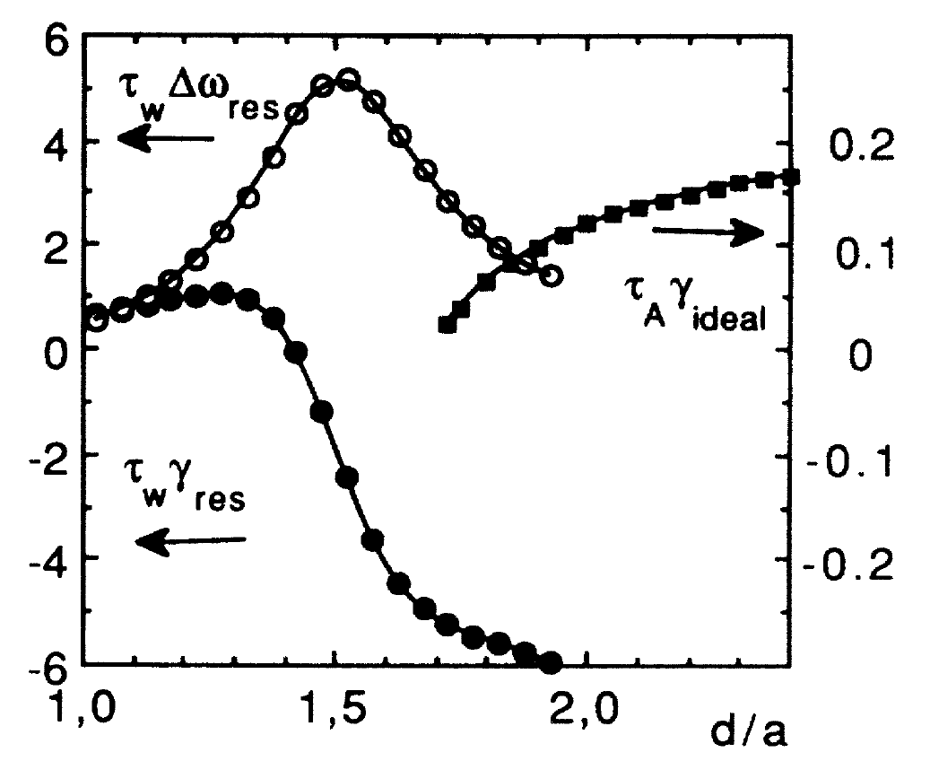
Early theoretical investigations provided initial hypotheses for global kink/ballooning/RWM mode stabilization physics
Conducting wall stabilizes global kink/ballooning mode
  Global kink growth rate ~ 1/τ_{Alfven} ~ μs
  Mode transforms into slower growing resistive wall mode (RWM)
RWM physical characteristics
  Growth rate γ_{RWM} ~ 1/τ_{wall} ~ ms
  RWM less stable when wall is closer
  RWM stabilized at plasma critical rotation of a few % of Alfven speed
➔ Bondeson and Ward, PRL 72 (1994) 2709
Global kink/ballooning
mode
Unstable
γτ_{w}
RWM
Stable
Wall / plasma radius
Early experiments looked to determine the plasma critical rotation speed
- Experiments initially found consistency with critical rotation at few % of V_{A}

Slide 5
Therefore, early global mode stabilization physics models related to plasma rotation were investigated
Ideal MHD stabilization physics
  Sound wave continuum damping
  Shear Alfven resonance damping
Non-ideal MHD stabilization physics
  Resistive layer damping
  Viscous boundary layer damping
Kinetic stabilization physics
  Parallel viscous force model for sound wave damping
  Semi-kinetic model: mode resonance with thermal ion bounce motion
- Bondeson, et al., PRL 72 (1994) 2709
- Betti, et al., PRL 74 (1995) 2949
- Y. Liu, et al., 45 (2005) 1131
- Bondeson, et al., PRL 72 (1994) 2709
- Zheng, et al., PRL 95 (2005) 255003
- Finn, Phys. Plasmas 2 (1995) 3782
- Gimblett & Hastie, Phys. Plasmas 7
(2000) 258
- Fitzpatrick & Aydemir NF 36 (1996) 11
- Chu, et al., Phys. Plasmas 2 (1995) 2236
- Bondeson & Chu (Phys. Plasmas 3 (1996) 3013
- Bondeson, Y. Liu, PPCF 45 (2003) A253

Slide 6
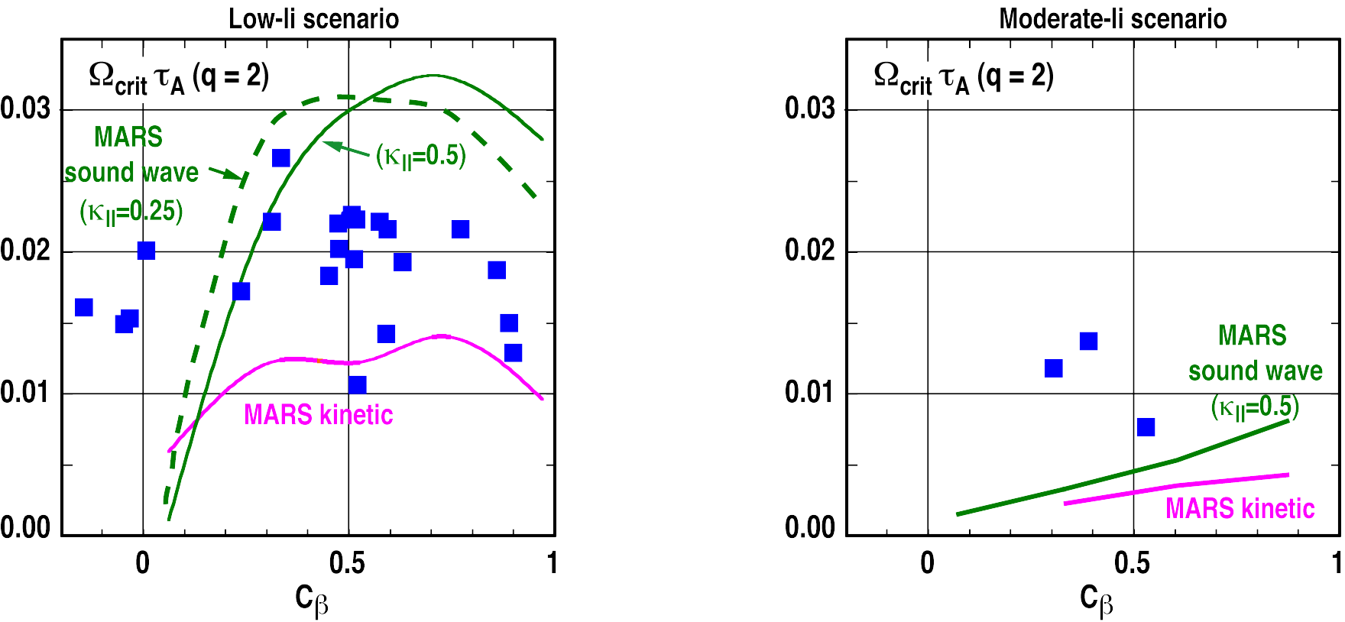
  Early theory did not find general quantitative agreement with experimental RWM marginal stability
Low internal inductance plasma
Moderate internal inductance plasma
Critical rotation
Critical rotation
(β − β_{no-wall})/(β_{ideal-wall}−β_{no-wall})
(β − β_{no-wall})/(β_{ideal-wall}−β_{no-wall})
Low-l_{i} plasma yields Ω_{crit} τ_{A} ~ 0.02 with weak β dependence
Moderate-l_{i} scenario yields significantly lower Ω_{crit}
  ➔ Kinetic damping generally underestimates Ω_{crit}
- R. LaHaye, …, Y. Liu, H. Reimerdes, et al., NF 44 (2004) 1197
- H. Reimerdes, J. Bialek, M.Chance, …, Y.Liu, et al., NF 45 (2005) 368
MARS code: Y. Liu

Slide 7
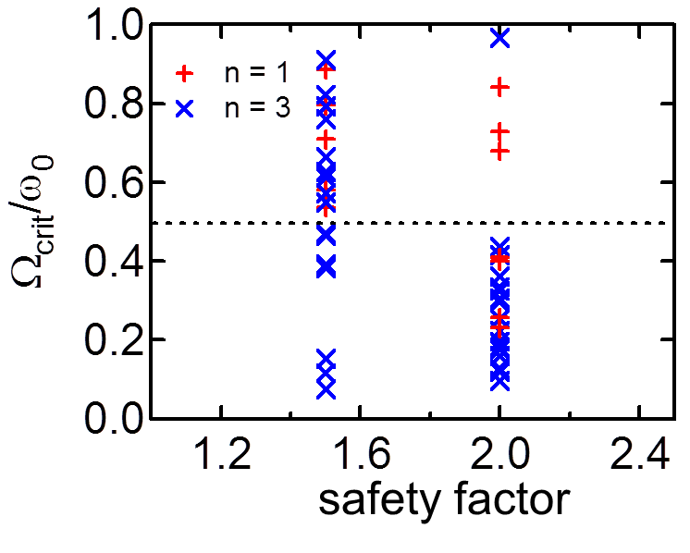
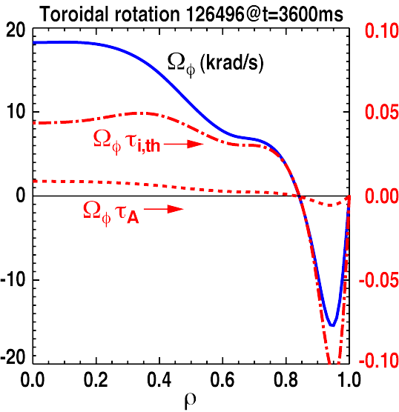
  Key transitional period 2006–08: Several experiments showed key inconsistencies with early stability physics models
Results from earlier critical rotation experiments using resonant magnetic braking (n = 1 field) rescinded – explained by torque bifurcation, not RWM (Garofalo, et al., IAEA Fusion Energy Conference (FEC) 2006, paper EX/7-1Ra)
New hypotheses were now needed to explain mode stabilization physics – that is where this story begins…
  NSTX using non-resonant (n = 3) magnetic braking by NTV yielded a growing RWM instability (Sabbagh, et al., PRL 97 (2006) 045004) and did not produce torque bifurcation (Sontag, Sabbagh, et al. NF 47 (2007) 1005)
  DIII-D with balanced NBI: RWM stable at plasma rotation less than 1% V_{A} (Reimerdes PPCF 49 (2007) B349)
  NSTX: Berkery/Sabbagh showed RWM instability at higher plasma rotation (Sabbagh IAEA FEC 2008 paper EX/5-1; Berkery, et al. PRL 104 (2010) 035003
NSTX
➔ Conclusion: simple critical rotation hypothesis is NOT sufficient to explain stability, new theory needed
NSTX

Slide 8
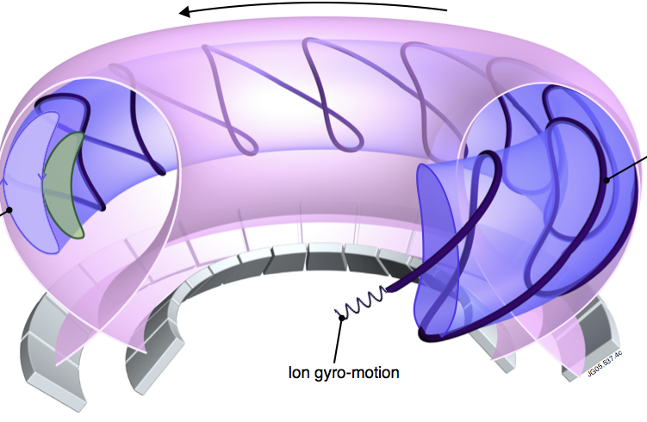
Drift kinetic theory energy functional (Hu/Betti) includes key precession drift resonance as stabilizing mechanism
Kinetic modification to ideal MHD
Stability depends on
  Trapped / circulating ions, trapped electrons
  Particle collisionality
  Energetic particle (EP) population
  Integrated ω_{φ} profile matters!!! : broad rotation resonances in δW_{K}
Trapped particle orbit precession drift
Trapped orbit 2D
projections
Trapped particle
orbit
ion gyro-orbit
and trajectory
(Fig. adapted from R. Pitts et al., Physics World (Mar 2006))
plasma integral over particle energy
(Hu, Betti, et al., PoP 12 (2005) 057301)
EP integral component is dominated by precession drift term
precession drift
bounce
collisionality
ω_{φ} profile (enters through ExB frequency)

Slide 9
Kinetic modifications show decrease in RWM stability at relatively high ω_{φ} – consistent with experiment (MISK code)
Theoretical variation of ω_{φ}
RWM stability vs. V_{φ} (contours of γτ_{w})
ω_{φ}/ω_{φ}^{exp}
Marginally stable
experimental
profile
ω_{φ}/ω_{φ}^{exp}
γτ_{w}
2.0
ω_{φ}/ω_{φ}^{exp}
ω_{φ}/2π (kHz)
1.0
2.0
0.2
121083
Im(δW_{K})
1.0
ψ/ψ_{a}
0.2
Marginal stable experimental plasma reconstruction, rotation profile ω_{φ}^{exp}
Variation of ω_{φ} away from marginal profile increases stability
Unstable region at low ω_{φ}
unstable
experiment
Re(δW_{K})
S.A. Sabbagh, J.W. Berkery, et al., IAEA Fusion Energy Conference (FEC) 2008 (paper EX/5-1)
NSTX

Slide 10
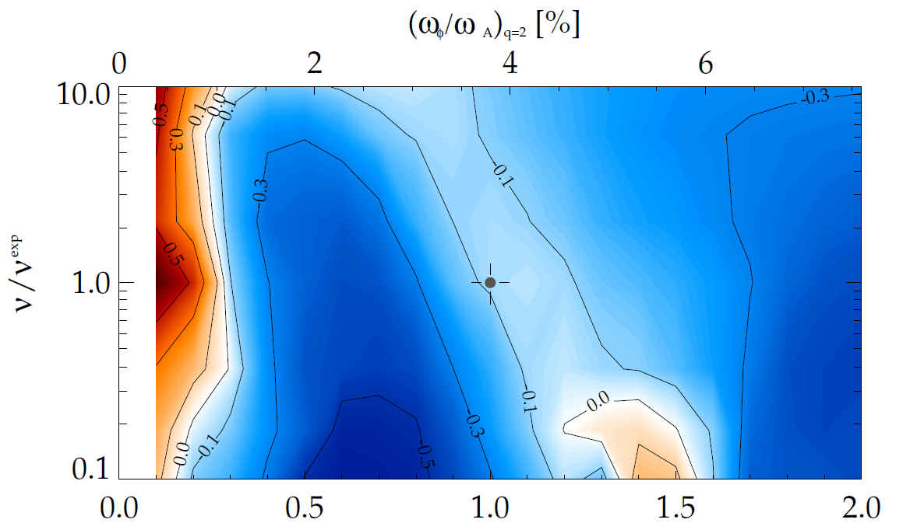
MISK calculations for NSTX consistent with RWM destabilization at intermediate plasma rotation; stability altered by collisionality
γτ_{w} contours vs. ν and ω_{φ}
(marginal stability)
Plasma evolution
Precession drift resonance stabilization
Marginal stability
Bounce/transit resonance stabilization
ν_{eff}/ν^{exp (marginal stability)}
instability
(experiment)
unstable
NSTX 121083
unstable
ω_{φ}/ω_{φ}^{exp (marginal stability)}
Destabilization appears between precession drift resonance at low ω_{φ}, bounce/transit resonance at high ω_{φ}
Destabilization moves to increased ω_{φ} as ν decreases
J.W. Berkery, et al., PRL 104 (2010) 035003 S.A. Sabbagh, et al., NF 50 (2010) 025020
NSTX

Slide 11
Kinetic modifications completely change the understanding and scaling of mode stability at reduced collisionality
Ion precession drift resonance
stabilization
Past models/ideas
  Collisions provide mode stabilization
  So, stability decreased with decreasing ν
  Unfavorable for ITER
Present model
  Collisions spoil broad stabilizing resonances
  Mode stabilization vs. ν depends on ω_{φ}
    At strong resonance: mode stability increases with decreasing ν
unstable
stable
stable
unstable
weak resonance
2.0
- J.W. Berkery, S.A. Sabbagh, et al., Phys. Rev. Lett. 106 (2011) 075004
- J.W. Berkery, S.A. Sabbagh, et al., Phys. Plasmas 21 (2014) 056112
NSTX

Slide 12
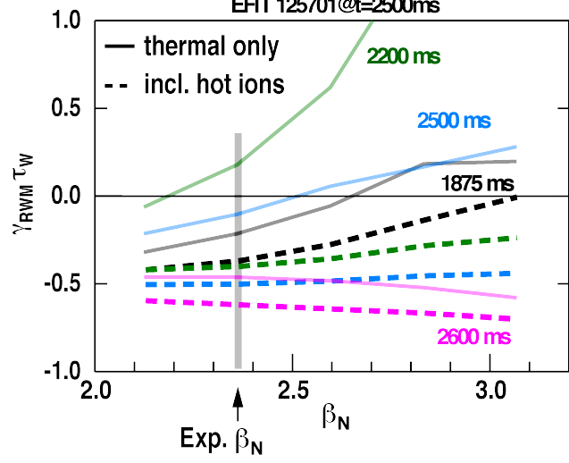
Further kinetic RWM analysis showed importance of fast particles to refine quantitative marginal stability evaluation
Stability vs. ω_{φ} (contours of γτ_{w}) - NSTX
Stable rotation profile scan - DIII-D
NSTX 140132, t = 0.704s
125701
w/fast particles
thermal
unstable
2.0
ω_{φ}/ω_{φ}^{exp}
stable
Marginal stability in experiment
1.0
unstable
Rotation profile scans in NSTX and DIII-D
Inclusion of fast particles more accurately determines mode stability
- Reimerdes, et al., APS 2008
- Sabbagh, Berkery, et al., APS DPP 2010 GI2.00001(invited talk)
- Berkery, Sabbagh, et al., PoP 21 (2014) 056112
NSTX

Slide 13
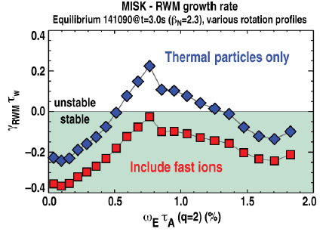
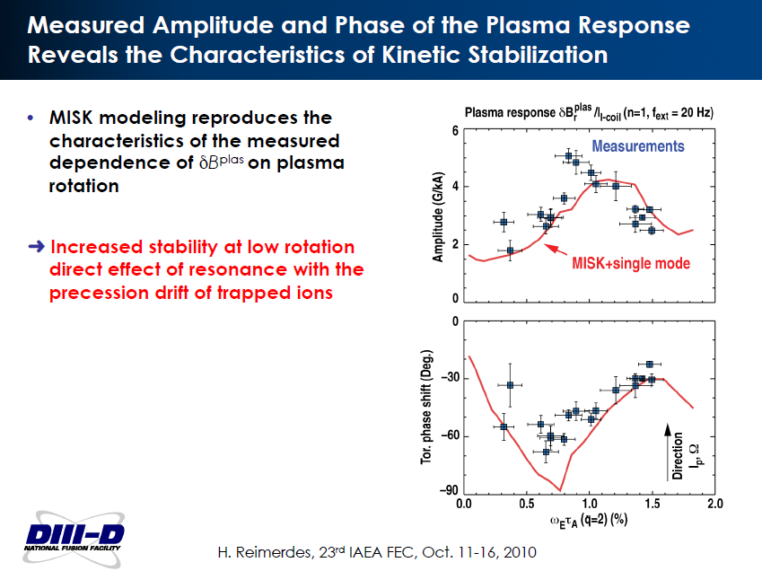
Kinetic RWM calculations for DIII-D are consistent with MHD spectroscopy results when energetic particles are included
Technique
  Low frequency MHD spectroscopy measures resonant field amplification (RFA) of applied n=1 field
  Yields RWM growth rate in a stable plasma
Results show
  Kinetic model requires fast ions to explain experimental stability
  Plasma rotation dependence of RFA matches kinetic RWM theory
    Similar finding in NSTX plasmas
    Recently re-confirmed in DIII-D
➔ H. Reimerdes, et al., PRL 93 (2004) 135002
Rotation
Less stable
(Wang, Lanctot, Liu, et al., PRL 114 (2015) 145005)
Reimerdes, Berkery, …, Sabbagh et al., PRL 106 (2011) 215002
Rotation

Slide 14
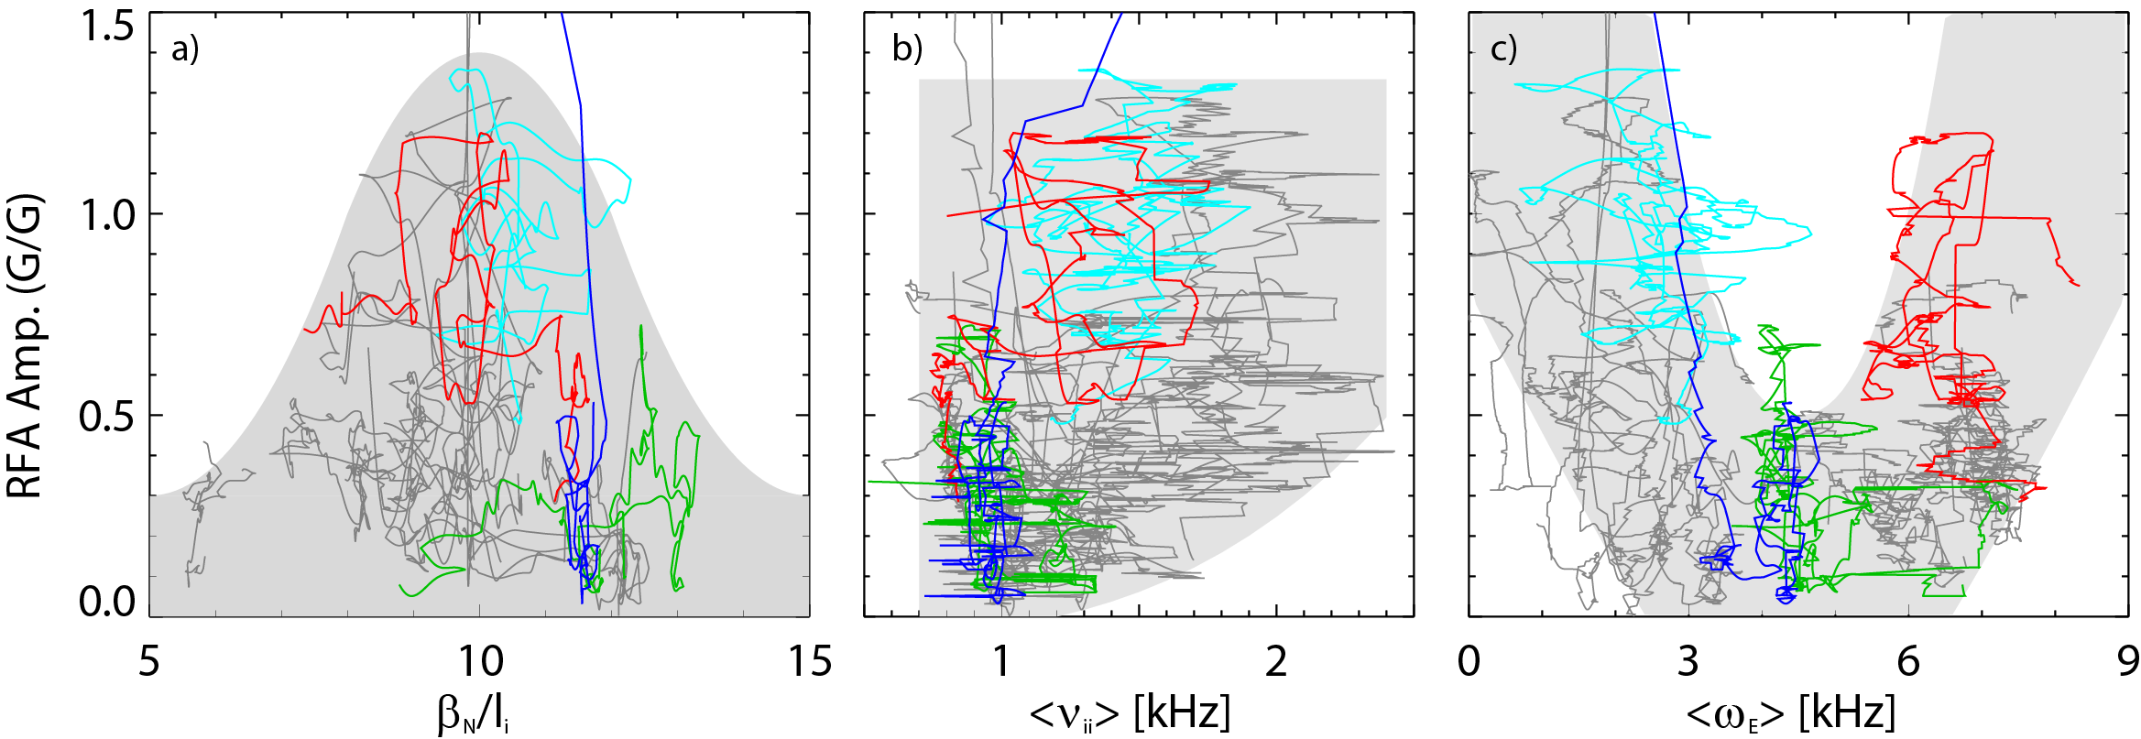
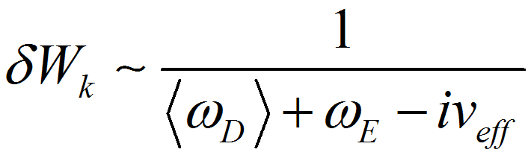
Experiments directly measuring global stability using MHD spectroscopy (RFA) understood by kinetic RWM theory
RFA vs. rotation (ω_{E})
Resonant Field Amplification vs. β_{N}/l_{i}
Most
stable
unstable
RWM
RFA Amp. (G/G)
RFA Amp. (G/G)
Less stable
Stability vs. rotation
  Largest stabilizing effect from ion precession drift resonance with ω_{φ}
Stability vs. β_{N}/l_{i}
  decreases up to β_{N}/l_{i} = 10, increases at higher β_{N}/l_{i}
  Consistent with kinetic resonance stabilization
Minimize |<ω_{D}> + ω_{E}|
(trajectories of 20 experimental plasmas)
S. Sabbagh, et al., NF 53 (2013) 104007
J. Berkery, et al., PoP 21 (2014) 056112
NSTX

Slide 15
2014: Dedicated DIII-D experiments directly probed RWM marginal stability boundary, compared to NSTX results
DIII-D High β_{N}, q_{min} plasmas
Candidates for steady-state, high β_{N} operation
Can have high probability of significant RWM activity with q_{min} > 2
  RWMs and TMs cause strong β collapses in 82% of a database of 50 shots examined, with an average of 3 collapses every 2 shots
  RWMs cause collapse 60% of the time, TMs 40% of the time
Employ high q_{min} > 2 to avoid 2/1 TM instability (TM precludes RWM)
  Used ECCD control of 3/1 TM to provide further control of strong n = 1 TMs
Unique 1 ms resolution of ω_{φ} and T_{i} measurement captures profile detail in timescale < RWM growth time
S.A. Sabbagh, J.W. Berkery, J. Hanson, et al. APS DPP Invited Talk VI2.0002 (2014)
NSTX
Strong RWM drive: Maximum β_{N} > 7, β_{N} /l_{i} > 13.5
Strong TMs eliminated by high elongation (> 2.6) or Li wall conditioning
NSTX

Slide 16
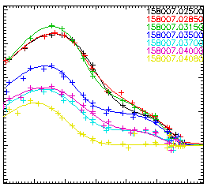
2014: Kinetic RWM marginal stability boundaries were directly probed over wide range of plasma rotation profiles
RWM marginal stability examined for major and minor disruptions
  Found at high β_{N} and high rotation
  Found at high β_{N} and low rotation
    Low rotation expected in ITER
  At moderate β_{N} and high rotation with increased profile peaking
    similar loss of profile broadness might easily occur in ITER
Wide range of DIII-D toroidal plasma
velocity profiles
1.
400
300
2.
200
Plasma toroidal rotation (km/s)
100
3.
0
-100
1.7
1.8
1.9
2.0
2.1
2.2
2.3
R (m)
S.A. Sabbagh, J.W. Berkery, J. Hanson, et al. APS DPP Invited Talk VI2.0002 (2014)

Slide 17
Comparison of RWM growth and dynamics in high β_{N} shots with high plasma rotation
1.
DIII-D (β_{N} = 3.5)
NSTX (β_{N} = 4.4)
Elements
  RWM rotation and mode growth observed
  No strong NTM activity
  Some weak bursting MHD in DIII-D plasma
    Alters RWM phase
  No bursting MHD in NSTX plasma
rotation
growth
rotation
growth
ΔB_{p}^{n=1}(G)
amplitude
amplitude
phase
phase
φ_{Bp}^{n=1}(deg)
toroidal magnetics
toroidal magnetics
Frequency (kHz)
D_{α}
D_{α}
(arb)
t (s)
t (s)
NSTX

Slide 18
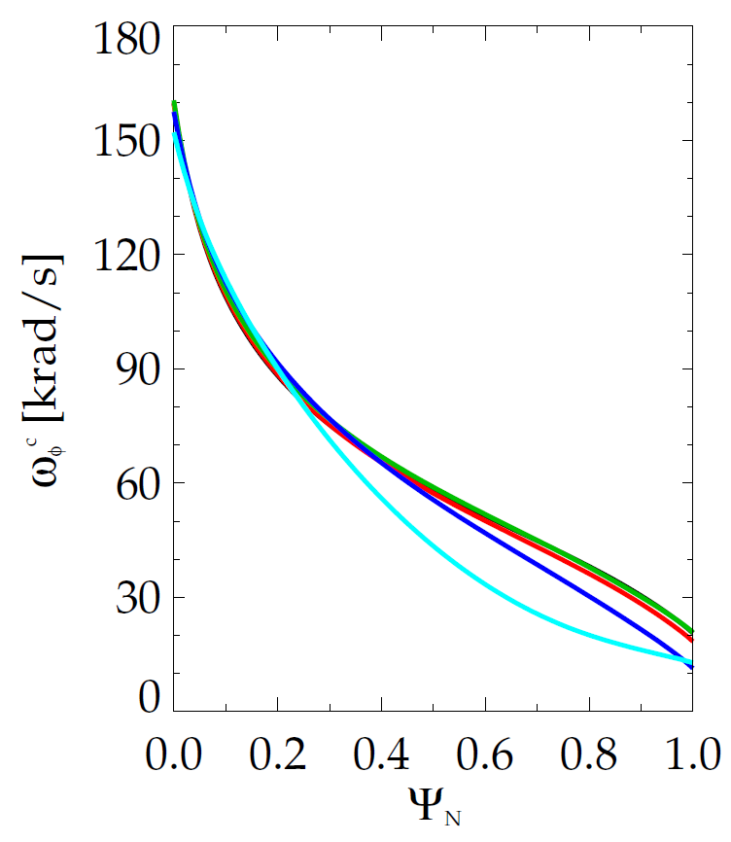
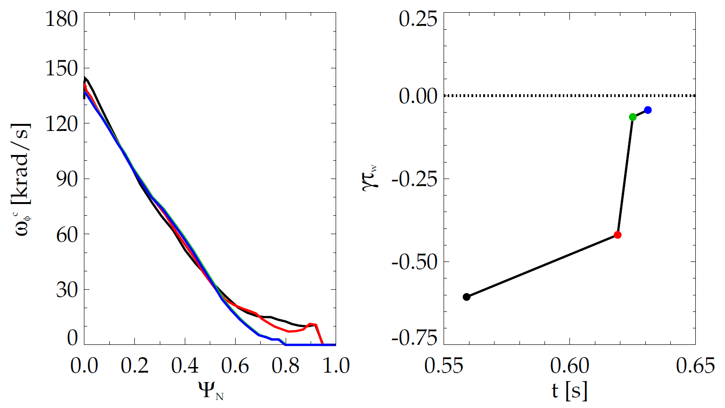
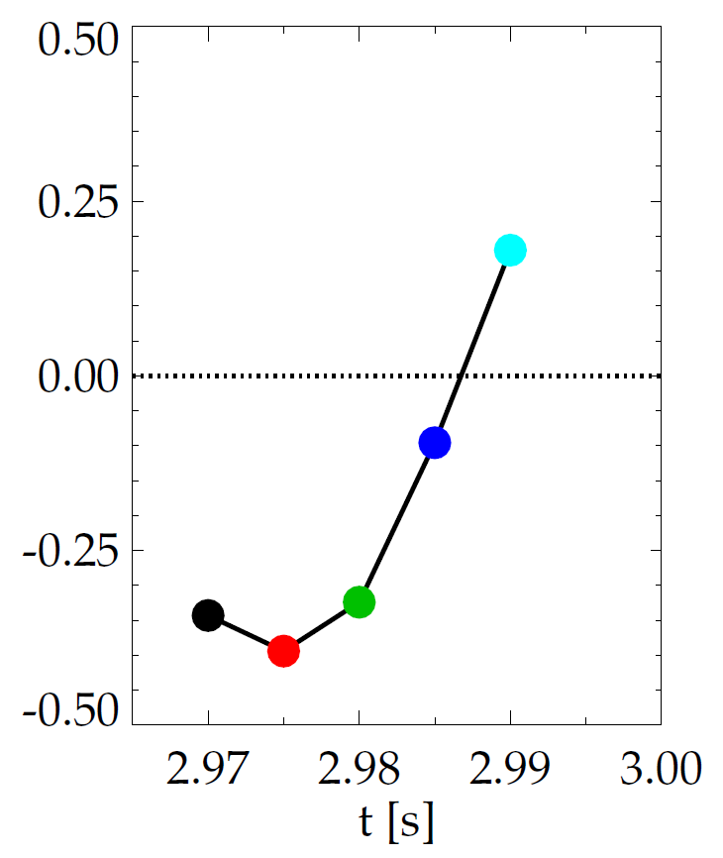
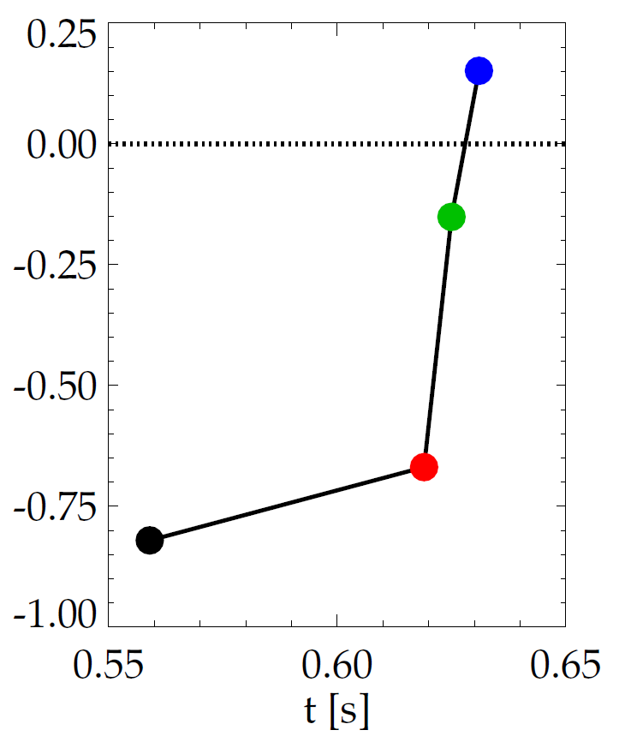
Evolution of plasma rotation profile leads to linear kinetic RWM instability as disruption is approached
DIII-D (minor disruption)
NSTX (major disruption)
unstable
stable
γτ_{wall}
unstable
γτ_{wall}
stable
MISK
MISK
increasing time
increasing time
NSTX

Slide 19
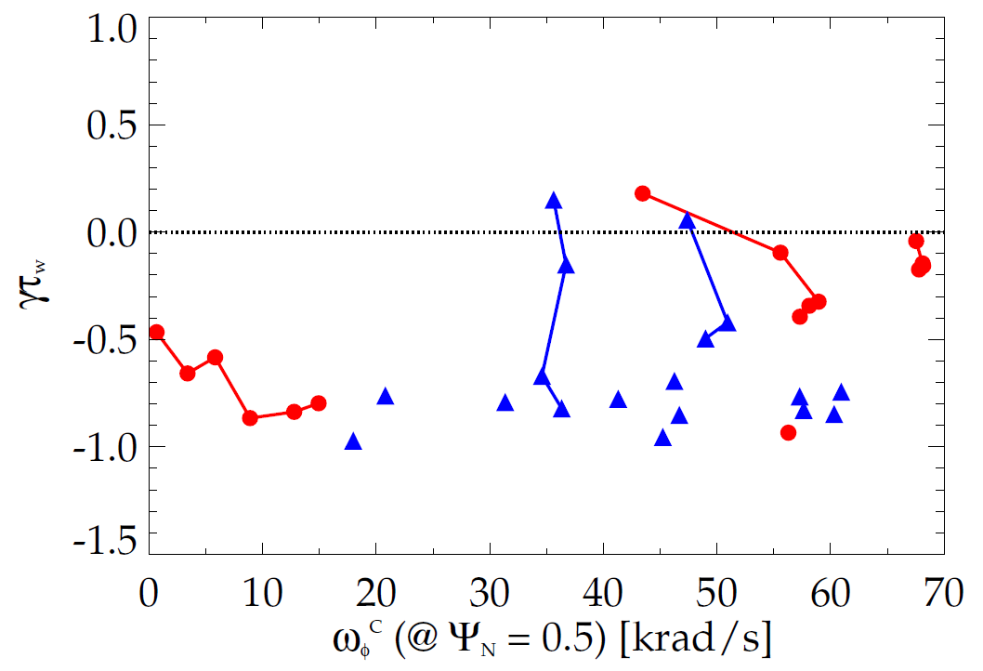
Kinetic RWM stability analysis evaluated for DIII-D and NSTX plasmas
Kinetic RWM stability analysis for experiments (MISK)
Summary of results
  Plasmas free of other MHD modes can reach or exceed linear kinetic RWM marginal stability
DIII-D
NSTX
1.
1.
unstable
Normalized growth rate (γτ_{w})
3.
2.
major disruption
minor disruption
stable
Plasma rotation [krad/s] (ψ_{N} = 0.5)
S.A. Sabbagh, J.W. Berkery, J. Hanson, et al. APS DPP Invited Talk VI2.0002 (2014)
NSTX

Slide 20
Kinetic RWM stability analysis evaluated for DIII-D and NSTX plasmas
Kinetic RWM stability analysis for experiments (MISK)
Summary of results
  Plasmas free of other MHD modes can reach or exceed linear kinetic RWM marginal stability
  Bursting MHD modes can lead to non-linear destabilization before linear stability limits are reached
DIII-D
NSTX
unstable
Normalized growth rate (γτ_{w})
“weak stability” region
- Present analysis can quantitatively define
a “weak stability” region below linear instability
major disruption
minor disruption
stable
Strait, et al., PoP 14 (2007) 056101
Plasma rotation [krad/s] (ψ_{N} = 0.5)
S.A. Sabbagh, J.W. Berkery, J. Hanson, et al. APS DPP Invited Talk VI2.0002 (2014)
NSTX

Slide 21
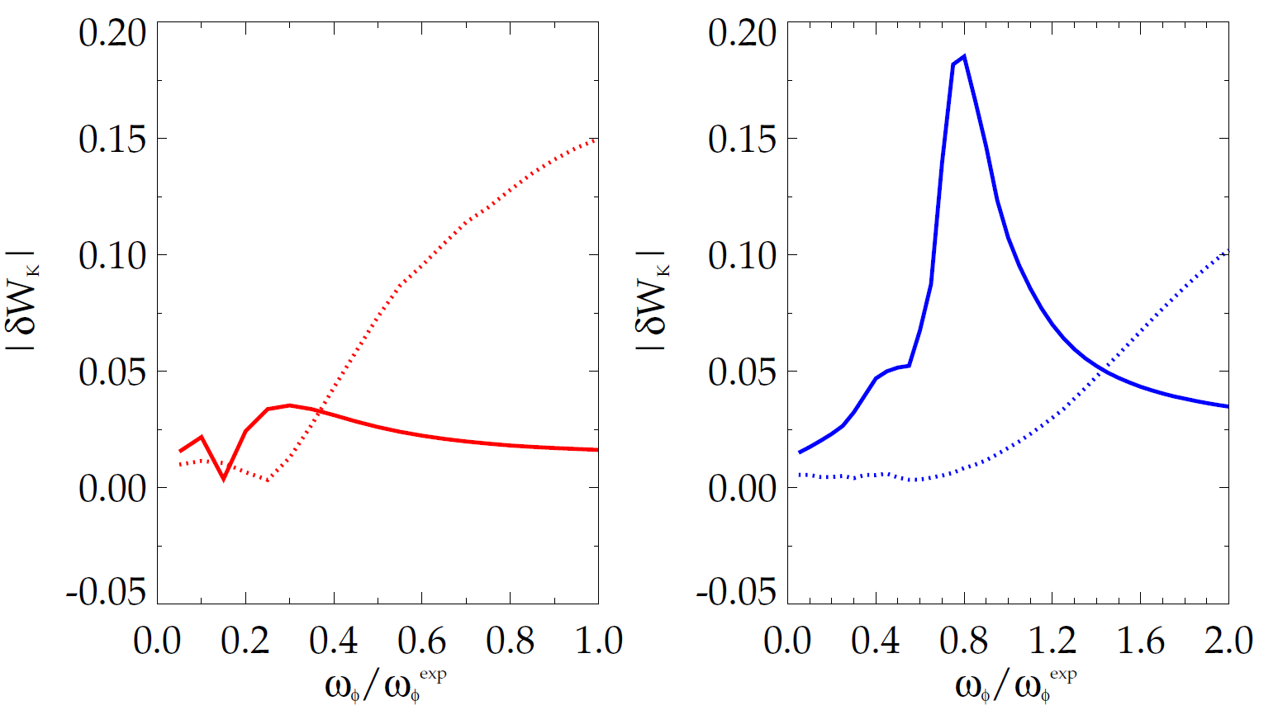
Bounce resonance stabilization dominates for DIII-D vs. precession drift resonance for NSTX at similar, high rotation
|δW_{K}| for trapped resonant ions vs. scaled experimental rotation (MISK)
DIII-D
precession
resonance
NSTX
bounce / circulating
resonance
bounce / circulating
resonance
precession
resonance
133103 @ 3.330 s
stable plasma
133776 @ 0.861 s
stable plasma
Rotation
DIII-D experimental rotation profile
NSTX experimental rotation profile
NSTX

Slide 22
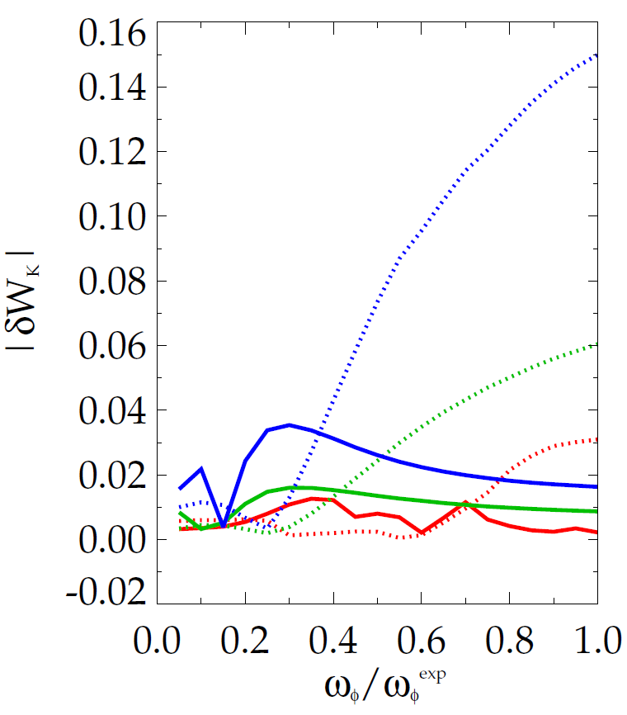
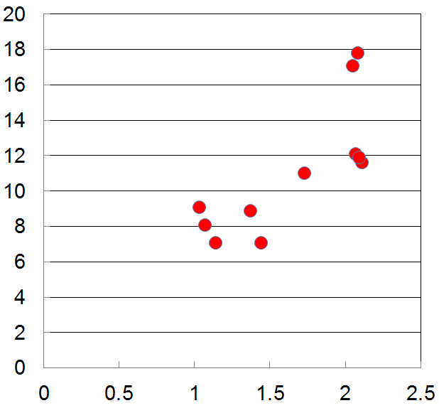
Reduced RWM stability measured in DIII-D plasmas as q_{min} is increased is consistent with kinetic RWM theory
|δW_{K}| for trapped resonant ions vs. scaled experimental rotation (MISK)
Measured plasma response to 20 Hz, n = 1 field vs q_{min}
DIII-D (q_{min} = 1.2)
DIII-D (q_{min} = 1.6)
DIII-D (q_{min} = 2.8)
less stable
bounce /
circulating
resonance
precession drift
resonance
n = 1 |δB_{p} | (G/kA)
q_{min}
Bounce resonance dominates precession drift resonance for all q_{min} examined at the experimental rotation
DIII-D experimental rotation profile

Slide 23
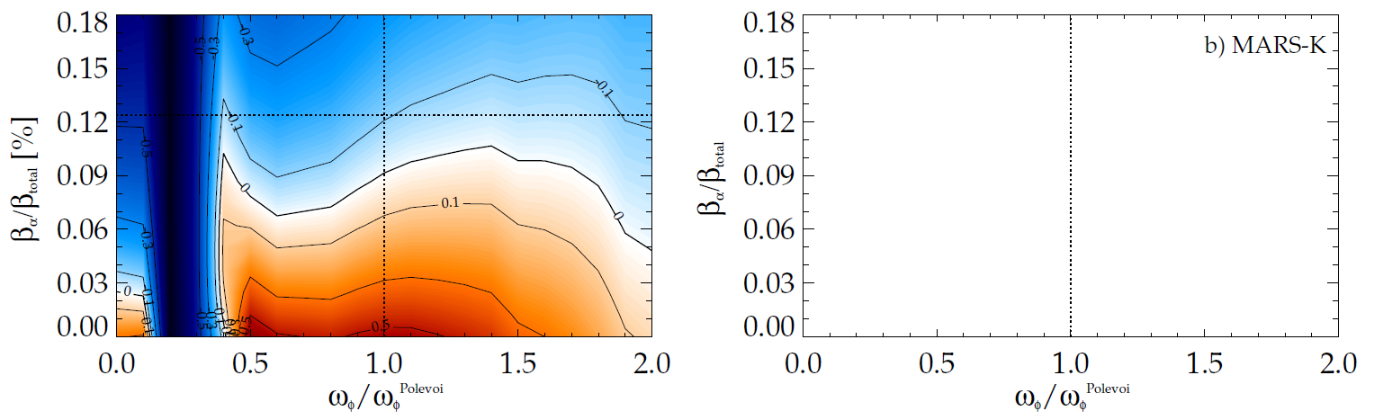
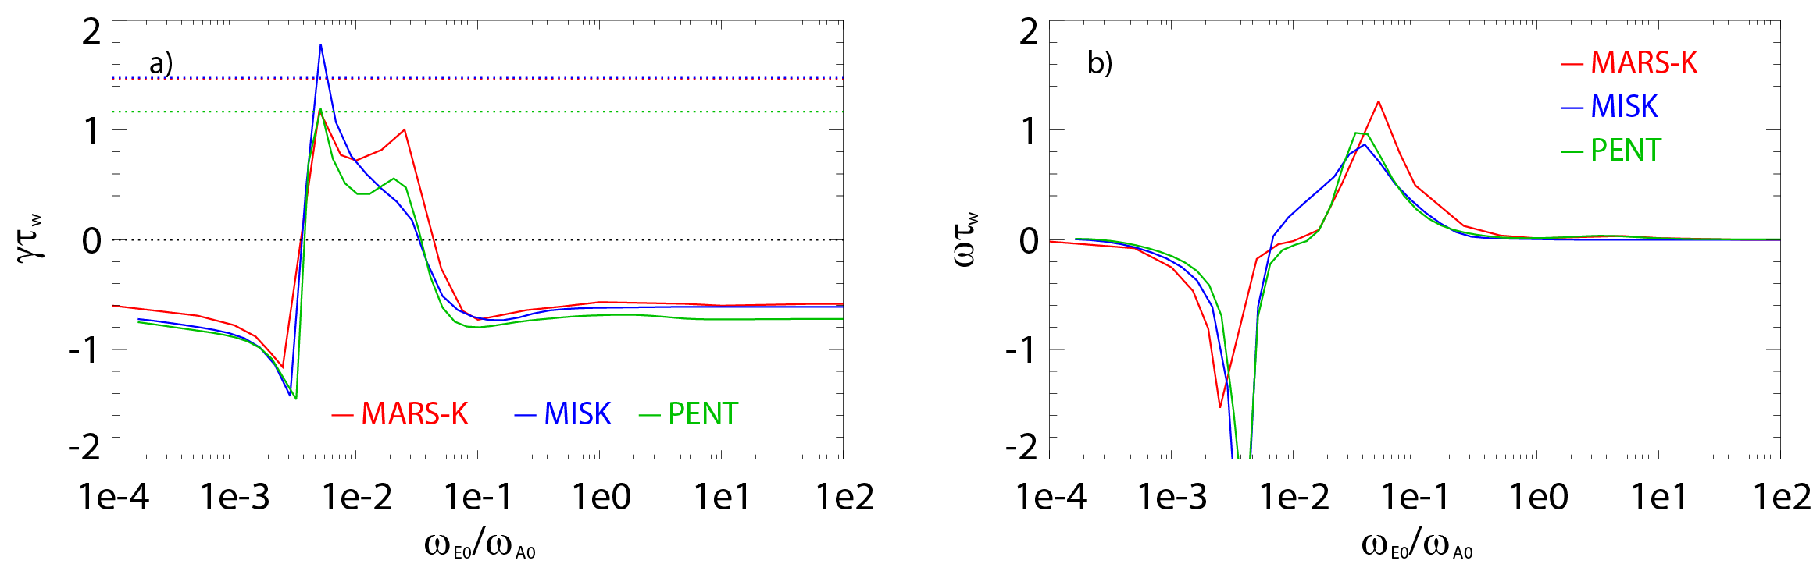
Key analysis codes MARS-K and MISK were brought into agreement in γτ_{w} vs ω_{E} for analysis of ITER
Code benchmarking (growth rate vs. rotation)
MISK calculation for ITER
stable
fluid growth rates
expected β_{α}
unstable
expected ω_{φ}
unstable
stable
stable
fluid plus kinetic growth rates
unstable
Rotation
  Case: β_{N} = 2.9 (20% > no-wall limit – advanced scenario)
  Alpha particles are required for RWM stabilization at all ω_{φ}
  Near RWM marginal stability at β_{α}/β_{total} = 0.1 at expected rotation
low rotation
precession
resonance
high rotation
bounce/transit
resonance
- J.W. Berkery, Y. Liu, … S.A. Sabbagh et al.
Phys. Plasmas 21 (2014) 052505
MARS-K code/analysis: Y. Liu, Z. Wang

Slide 24
NSTX-U is building on past strength, creating an arsenal of capabilities for disruption avoidance (available / future)
Predictor/Sensor (CY available) | Control/Actuator (CY available) | Modes | REFER TO
Rotating and low freq. MHD (n=1,2,3) 2003 | Dual-component RWM sensor control (closed loop 2008) | NTM RWM | - Menard NF 2001 - Sabbagh NF 2013
Low freq. MHD spectroscopy (open loop 2005); Kinetic RWM modeling (2008) | Control of β_{N} (closed loop 2007) | Kink/ball RWM | - Sontag NF 2007 - Berkery (2009–15) - Gerhardt FST 2012
r/t RWM state-space controller observer (2010) | Physics model-based RWM state-space control (2010) | NTM, RWM Kink/ball, VDE | - Sabbagh IAEA 2010 - Sabbagh NF 2013 - THIS TALK
Real-time V_{φ} measurement (2016) | Plasma V_{φ} control (NTV 2004) (NTV + NBI rotation control closed loop ~ 2018-19) | NTM Kink/ball RWM | - Podesta RSI 2012 - Zhu PRL 06 - THIS TALK
Reduced kinetic RWM stabilization (2016) (aimed at real-time) | Safety factor, l_{i} control (closed loop ~ 2018-19) | NTM, RWM Kink/ball, VDE | - Berkery, NF 2015 (+ THIS TALK) - D. Boyer, NF 2015
MHD spectroscopy (real-time) (in 5 Year Plan) | Upgraded 3D coils (NCC): improved V_{φ} and mode control (in 5 Year Plan) | NTM, RWM Kink/ball, VDE | - NSTX-U 5 Year Plan

Slide 25
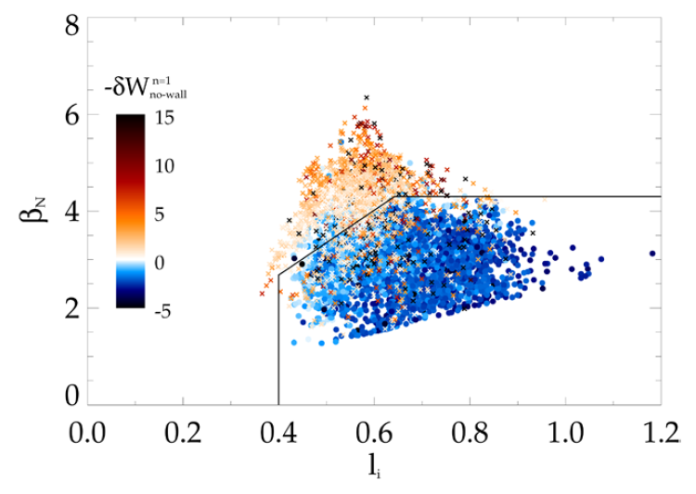
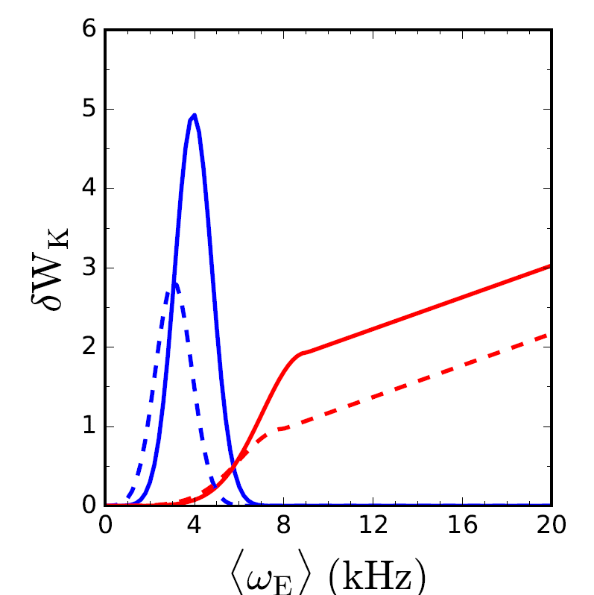
      A reduced kinetic RWM model in new Disruption Event Characterization And Forecasting (DECAF) code
Elements: mode growth rate calculation
DCON calculation of n=1 no-wall limit
Ideal component δW
  Equilibrium quantities including l_{i}, p₀/<p>, A, used in beta limit models for δW_{b}, δW_{inf}
Kinetic component δW_{k}
  Functional forms (mainly Gaussian) used to reproduce precession and bounce/transit resonances
  Height, width, position of peak depend on collisionality
J.W. Berkery, S.A. Sabbagh, R.E. Bell, et al., NF 55 (2015) 123007
Precession resonances
Bounce/transit resonances
<ν> = 1 kHz
NSTX

Slide 26
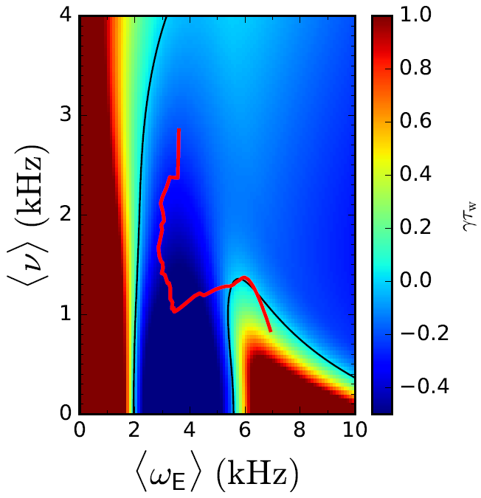
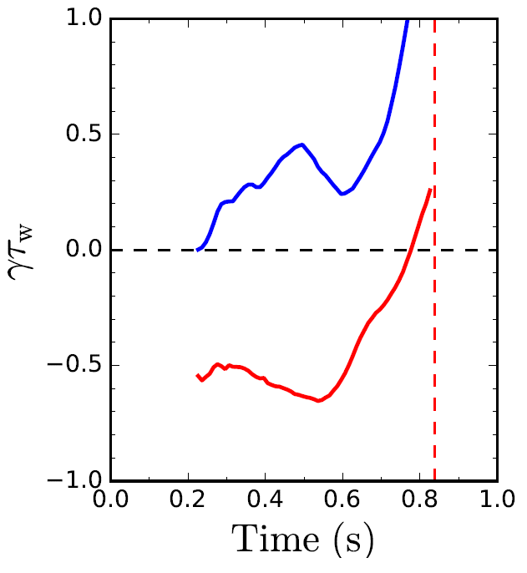
      Reduced kinetic RWM model in DECAF results in a calculation of γτ_{w} vs. time for each discharge
γτ_{w} contours vs. ν and ω_{φ}
Normalized growth rate vs. time
Increasing time
ideal
γτ_{w}
γτ_{w}
unstable
stable
Ideal + kinetic
disruption
139514
predicted instability
Favorable characteristics
  Stability contours CHANGE for each time point (last time point shown left frame)
  Possible to compute growth rate prediction in real time
J.W. Berkery, S.A. Sabbagh, R. Bell, et al., submitted to Phys. Plasmas (2017)
NSTX

Slide 27
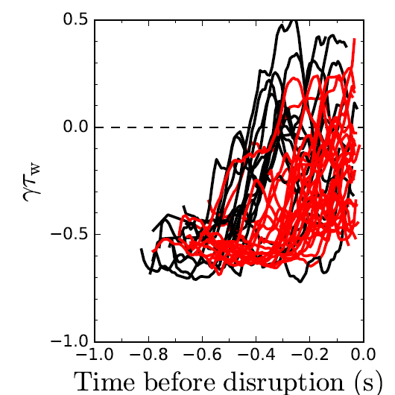
      DECAF reduced kinetic model results initially tested on a database of NSTX discharges with unstable RWMs
Normalized growth rate vs. time
Predicted instability statistics (44 shots)
Stable
(14%)
Instability < 450 ms
before disruption
(32%)
Instability < 300 ms
before disruption
(54%)
unstable
stable
86% of shots are predicted unstable
54% predicted unstable < 300 ms (approx. 60τ_{w}) before current quench
32% predicted unstable < 450 ms before current quench
  Mostly earlier cases are minor disruptions
NSTX

Slide 28
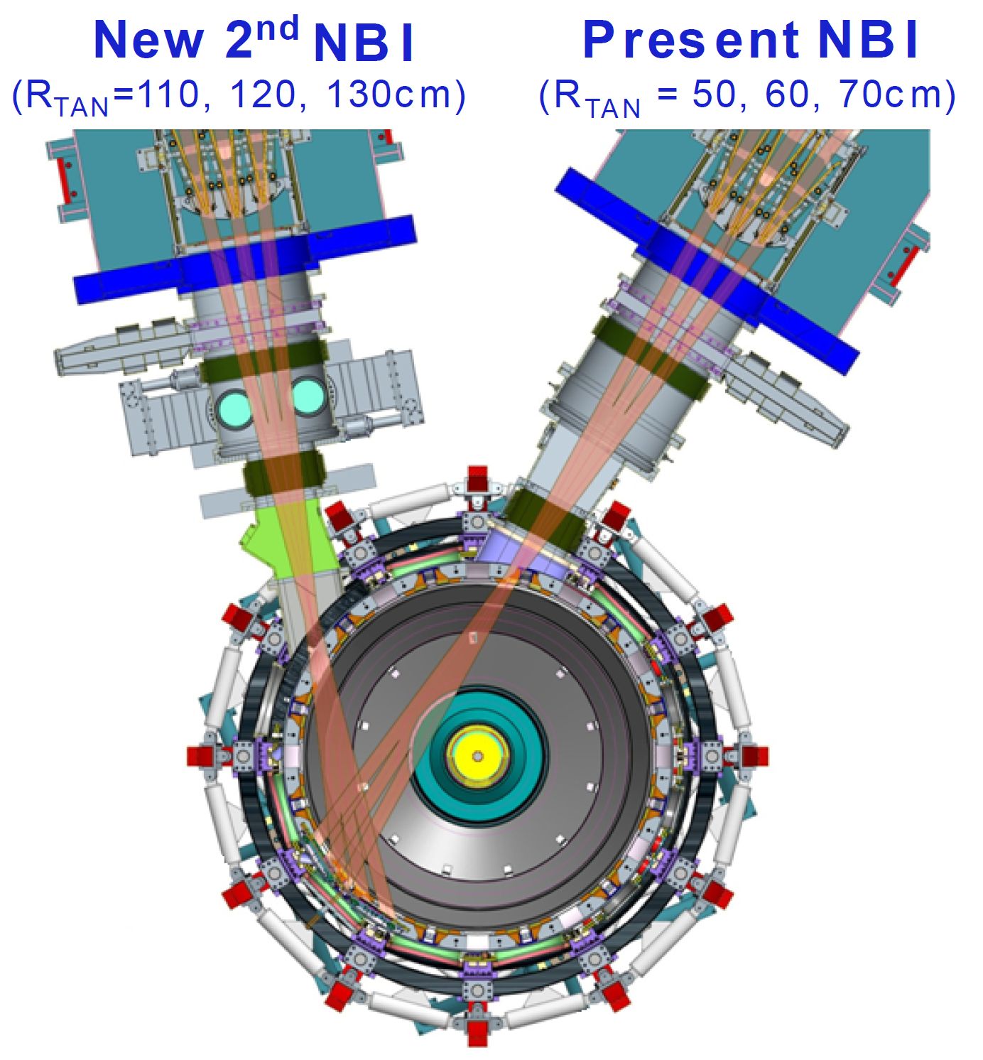
State space rotation controller designed for NSTX-U using non-resonant NTV and NBI to maintain stable profiles
Momentum force balance – ω_{φ} decomposed into Bessel function states
Neoclassical Toroidal Viscosity (NTV) torque:
Momentum Actuators
NBI and NTV torque profiles for NSTX-U
1.5
New NBI
(broaden rotation)
3D Field Coil
(shape ω_{φ} profile)
1.0
-NTV
Torque
NBI, -NTV torque density (N/m²)
0.5
NBI
Torque
(NSTX)
0.0
0.0
0.2
0.4
ψ_{N}
0.6
0.8
1.0
NSTX

Slide 29
State space rotation controller designed for NSTX-U using non-resonant NTV and NBI to maintain stable profiles
Momentum force balance – ω_{φ} decomposed into Bessel function states
Neoclassical Toroidal Viscosity (NTV) torque:
Momentum Actuators
NBI and NTV torque profiles for NSTX-U
1.5
New NBI
(broaden rotation)
3D Field Coil
(shape ω_{φ} profile)
NBI Torque
(NSTX-U)
1.0
-NTV
Torque
NBI, -NTV torque density (N/m²)
0.5
NBI
Torque
(NSTX)
0.0
0.0
0.2
0.4
ψ_{N}
0.6
0.8
1.0
NSTX

Slide 30
NTV physics studies for rotation control: measured NTV torque density profiles quantitatively compare well to theory
n = 3 coil configuration
n = 2 coil configuration
NSTX
NSTX
x1.7
x0.6
Experimental
-dL/dt
Experimental
-dL/dt
NTVTOK
NTVTOK
ψ_{N}
ψ_{N}
T_{NTV} (theory) scaled to match peak value of measured -dL/dt
  Scale factor ((dL/dt)/T_{NTV}) = 1.7 and 0.6 for cases shown above – O(1) agreement
For NTV experiment/theory see: W. Zhu, S.A. Sabbagh, R.E. Bell, et al., PRL 96 (2006) 225002
Also, see recent NTV review paper: K.C. Shaing, K. Ida, S.A. Sabbagh, et al., Nucl. Fusion 55 (2015) 125001
NSTX

Slide 31
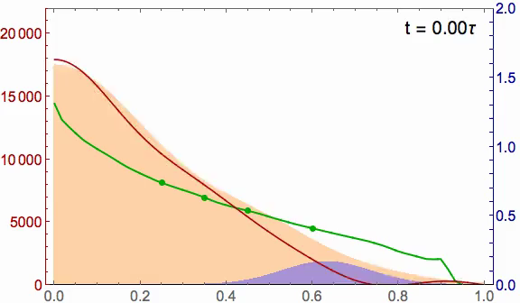
Application of kinetic RWM physics understanding from present research will now be used for disruption avoidance
Planned rotation control in NSTX-U
(actuators: 6 NBI sources, n = 3 NTV)
Recall:
NSTX (major disruption)
2.0
20
Marginally stable profile
unstable
stable
γτ_{wall}
Steady-state reached in ~ 3τ_{m}
1.5
15
MISK
1.0
NBI, -NTV torque density (N/m²)
Plasma rotation (kHz)
Broader stable
profile
Plasma rotation (krad/s)
10
5
-NTV
0.5
stable
NBI
marginally
stable
0
0.0
0.0
0.2
0.4
ψ_{N}
0.6
0.8
1.0
I. Goumiri, C. Rowley, S.A. Sabbagh, et al. Nucl. Fusion 56 (2016) 036023
NSTX

Slide 32
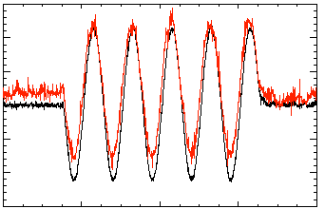
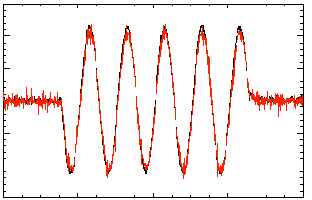
Model-based RWM state space controller including 3D model of plasma and wall currents used at high β_{N}
Full 3-D model
~3000+ states
State reduction (< 20 states)
RWM
eigenfunction(2 phases, 2 states)
Balanced
truncation
…
Controller reproduction of n = 1 field in NSTX
Controller model can compensate for wall currents
  Includes linear plasma mode-induced current model (DCON)
  Includes plasma response model
  Straightforward inclusion of multiple modes (n = 1, or n > 1)
Potential to allow control coils to be moved further from plasma, and be shielded (e.g. for ITER)
150
100
5 states
used
50
Sensor Difference (G)
0
Controller
(observer)
-50
A. Boozer, Phys. Plasmas 10 (2003) 1458
-100
-150
118298
Measurement
150
100
50
10 states
used
0
Sensor Difference (G)
-50
O. Katsuro-Hopkins, et al., NF 47 (2007) 1157
-100
118298
(only wall states used)
-150
0.2
0.4
0.6
0.8
1.0
t (s)
NSTX

Slide 33
NSTX RWM state space controller sustains otherwise disrupted plasma caused by DC n = 1 applied field
RWM state space feedback (12 states)
n = 1 DC applied field test
  Generate resonant field amplication, disruption
  Use of RWM state space controller sustains discharge
RWM state space controller sustains discharge at high β_{N}
  Best feedback phase produced long pulse, β_{N} = 6.4, β_{N}/l_{i} = 13
1.2
I_{p} (MA)
0.6
Control
applied
0.0
Control not applied
6
β_{N}
3
0
10
5
B_{p}^{n=1} (G)
0
0.5
I_{RWM-4} (kA)
n = 3 correction
0.0
n = 1 field on
12
ω_{φ}/2π_{~q=2}
(kHz)
8
140025
140026
4
0
0.0
0.2
0.4
t(s)
0.6
0.8
1.0
S. Sabbagh et al., IAEA FEC (2010) Paper EXS/5-5
S. Sabbagh et al., Nucl. Fusion 53 (2013) 104007
NSTX

Slide 34
NSTX RWM state space controller sustains high β_{N}, low l_{i} plasma – available for NSTX-U with independent coil control
RWM state space feedback (12 states)
NSTX Experiments
(from 2010)
I_{p} (MA)
n = 1 applied field suppression
  Suppressed disruption due to n = 1 field
Feedback phase scan
  Best feedback phase produced long pulse, β_{N} = 6.4, β_{N}/l_{i} = 13
(A)
S. Sabbagh et al., IAEA FEC (2010) Paper EXS/5-5
S. Sabbagh et al., Nucl. Fusion 53 (2013) 104007
NSTX

Slide 35
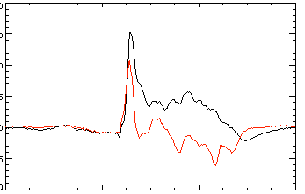
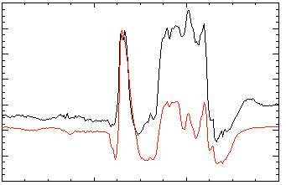
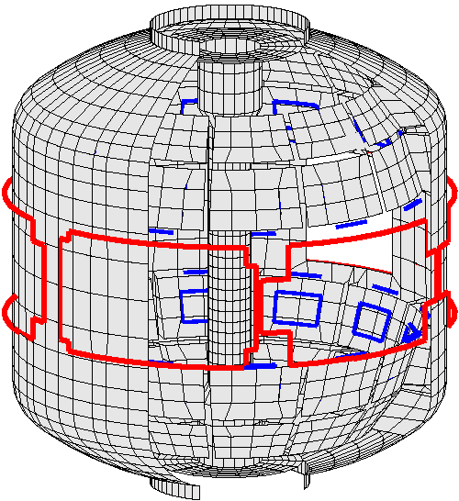
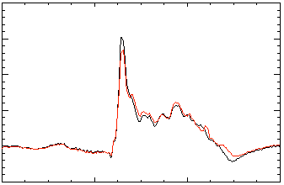
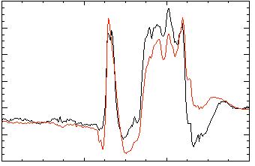
Open-loop comparisons between measurements and RWM state space controller show importance of states and model
A) Effect of Number of States Used
B) Effect of 3D Model Used
2 States
Sensor data
No NBI Port
200
δB_{p}¹⁸⁰
RWM
Controller (observer)
80
δB_{p}⁹⁰
Sensor
data
100
40
RWM
0
0
Controller
(observer)
-40
137722
-100
0.56
0.58
0.60
0.62
0.56
0.58
0.60
0.62
t (s)
t (s)
RWM Sensor Differences (G)
7 States
With NBI Port
200
δB_{p}¹⁸⁰
80
δB_{p}⁹⁰
100
40
0
0
RWM sensors
137722
-100
-40
0.56
0.58
0.60
0.62
0.56
0.58
0.60
0.62
t (s)
t (s)
Improved agreement with sufficient number of states (wall detail)
3D detail of model important to improve agreement
NSTX

Slide 36
In addition to active mode control, the NSTX-U RWM state space controller can be used for real-time disruption warning
Effect of 3D Model Used
The controller “observer” produces a physics model-based calculation of the expected sensor data – a synthetic diagnostic
If the real-time synthetic diagnostic doesn’t match the measured sensor data, a r/t disruption warning signal can be triggered
  Technique will be assessed using new Disruption Event Characterization and Forecasting (DECAF) code
No NBI Port
80
δB_{p}⁹⁰
Sensor
data
RWM Sensor Differences (G)
40
RWM
0
Controller
(observer)
-40
137722
0.56
0.58
0.60
0.62
t (s)
With NBI Port
80
δB_{p}⁹⁰
40
RWM Sensor Differences (G)
0
-40
137722
0.56
0.58
0.60
0.62
t (s)
NSTX

Slide 37
In addition to active mode control, the NSTX-U RWM state space controller can be used for real-time disruption warning
Effect of 3D Model Used
The controller “observer” produces a physics model-based calculation of the expected sensor data – a synthetic diagnostic
If the real-time synthetic diagnostic doesn’t match the measured sensor data, a r/t disruption warning signal can be triggered
  Technique will be assessed using new Disruption Event Characterization and Forecasting (DECAF) code
No NBI Port
80
δB_{p}⁹⁰
Sensor
data
RWM Sensor Differences (G)
40
RWM
0
Controller
(observer)
-40
137722
0.56
0.58
0.60
0.62
t (s)
With NBI Port
80
δB_{p}⁹⁰
40
RWM Sensor Differences (G)
0
-40
137722
0.56
0.58
0.60
0.62
t (s)
NSTX

Slide 38
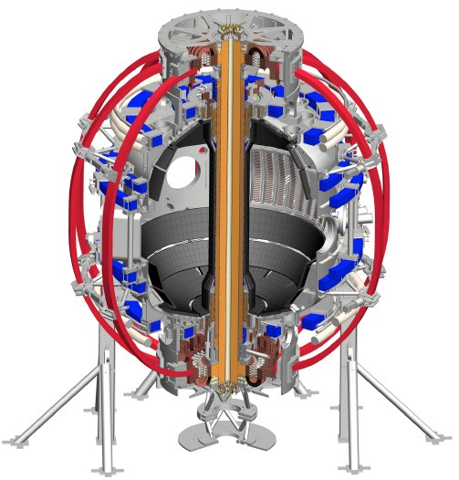
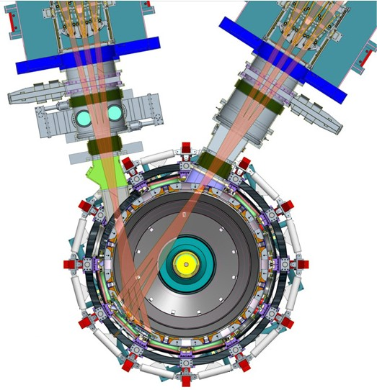
NSTX-U will access new physics
with 2 major new tools
1. New Central Magnet
2. Tangential 2nd Neutral Beam
Higher T, low ν* from low to high β
→ Unique regime, study new transport and stability physics
Full non-inductive current drive
→ Not demonstrated in ST at high-β_{T}
Essential for any future steady-state ST

Slide 39
NSTX-U designed for major performance boost
1. New Central Magnet
2. Tangential 2nd Neutral Beam
➢2× heating power (5 → 10MW)
Tangential NBI → 2× current drive efficiency
➢4× divertor heat flux (→ ITER levels)
➢Up to 10× higher nTτ_{E} (~MJ plasmas)
➢2× toroidal field (0.5 → 1T)
➢2× plasma current (1 → 2MA)
➢5× longer pulse (1 → 5s)

Slide 40
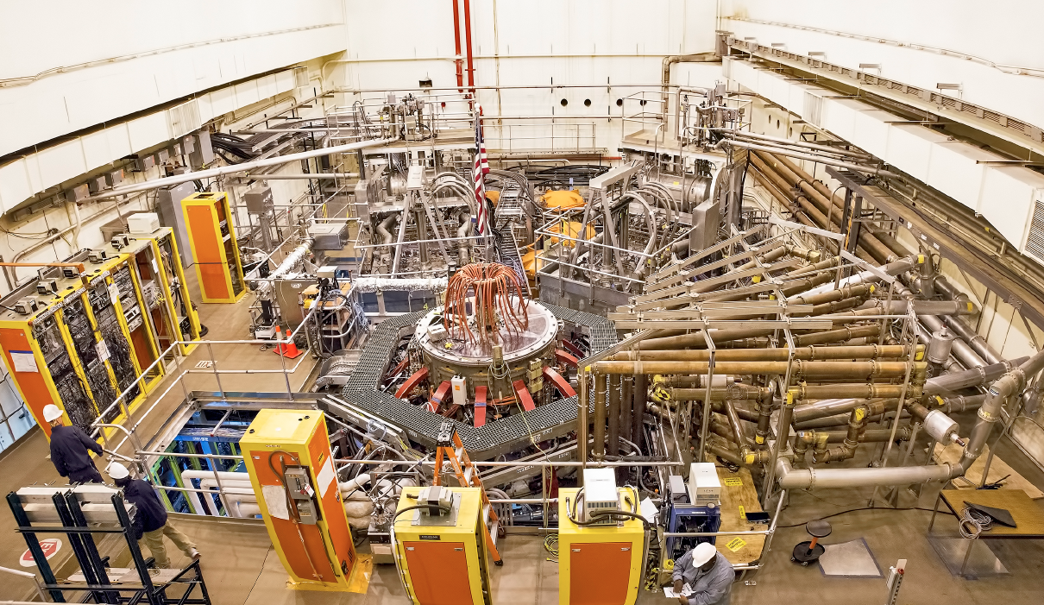
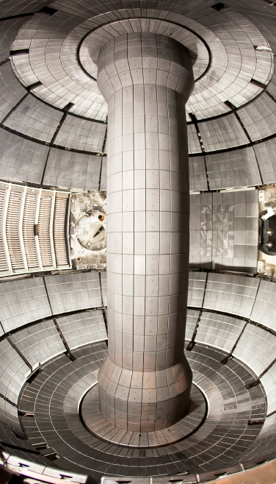
NSTX Upgrade Device and Test Cell – Interior (inset) and Aerial View
2nd NBI
1st NBI
HHFW System
NSTX-U

Slide 41
NSTX-U will address key physics questions
in first 3 years leveraging unique capabilities
What role do electromagnetic effects play in electron energy transport? (High β, lower ν*)
Can fast-ion instabilities be predicted and controlled for ITER and beyond? (Vary v_{f} /v_{A}, β_{f}, anisotropy)
Can ST operate disruption-free near with-wall limit, aiming to be 100% non-inductive?
  Only ST in world capable of this research critical for steady-state FNSF / Pilot Plant
What physics determines SOL heat flux width? (Low-A, 2× I_{P} , Li wall)
How do advanced divertors and Li impact edge transport, scenarios?
Establish ST physics / scenarios:
Confinement vs. β , collisionality
Sustain high β w/ advanced control
Non-inductive start-up, ramp-up
Mitigate high heat fluxes
Test high-Z divertor, Li vapor shielding

Slide 42
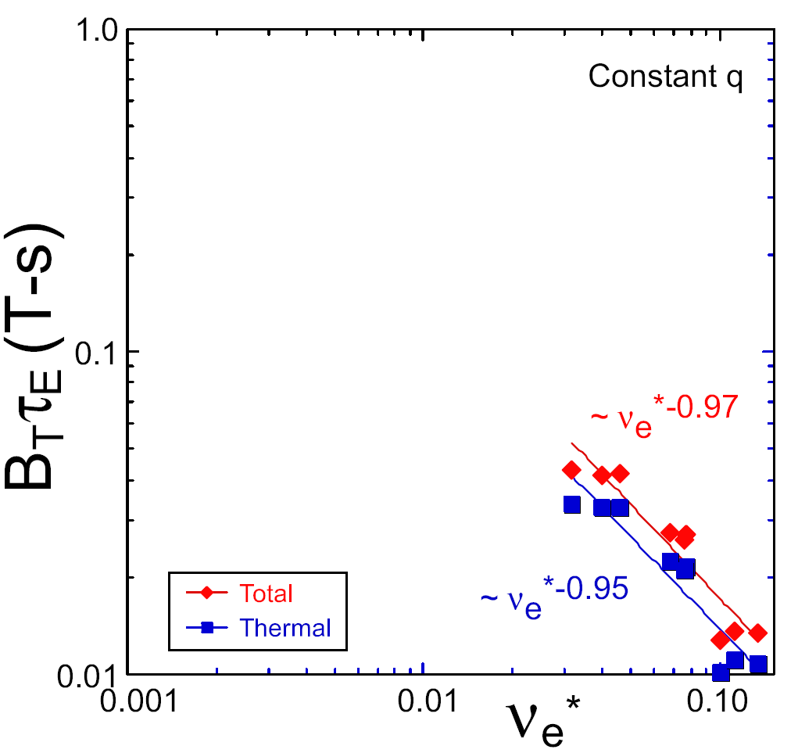
NSTX / MAST confinement increased at higher T_{e} (!)
Will confinement trend continue, or look like conventional A?
ST-FNSF
constant q, β, ρ∗
NSTX Upgrade
?
Favorable confinement results could lead to more compact ST reactors
NSTX
ITER-like scaling
Normalized electron collisionality ν_{e}* ∝ n_{e} / T_{e}²
Low ν* → need higher plasma current, toroidal field, heating power, density control

Slide 43
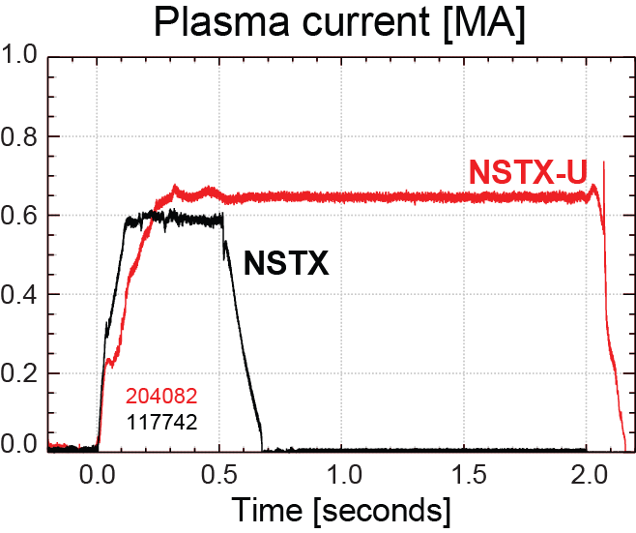
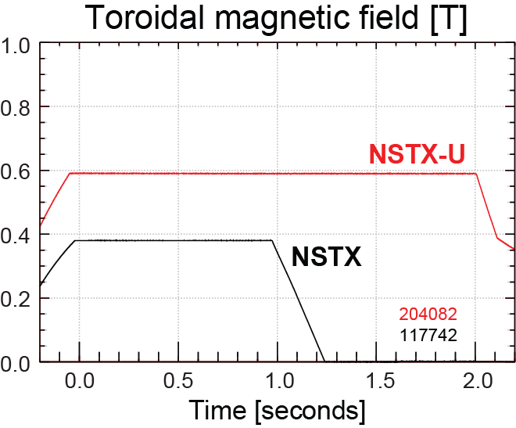
NSTX-U has surpassed maximum pulse duration and magnetic field of NSTX
Compare similar NSTX / NSTX-U Boronized L-modes, P_{NBI}=1MW
4x longer
NSTX-U L-mode duration
exceeds longest NSTX H-mode
NSTX-U B_{T} > highest NSTX B_{T}

Slide 44
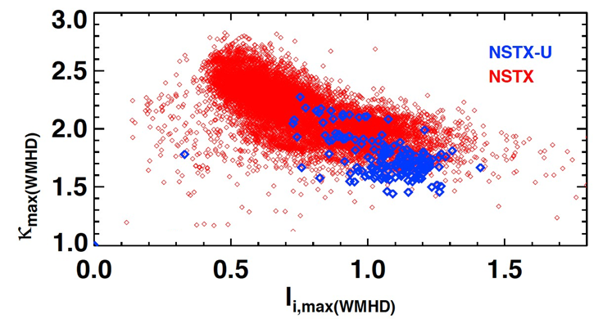
Accessed high elongation κ using progressively earlier H-mode and heating + optimized EFC
Future goal
NSTX-U (5 run weeks)
NSTX (10 years)
H-mode flattop
L-mode flattop
Goal: Internal inductance l_{i} = 0.5-0.7 → κ = 2.4-2.7

Slide 45
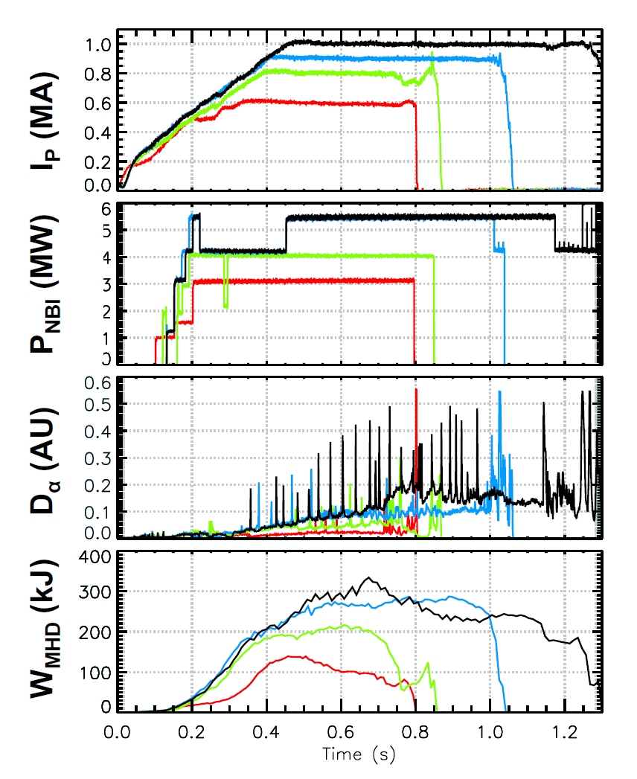
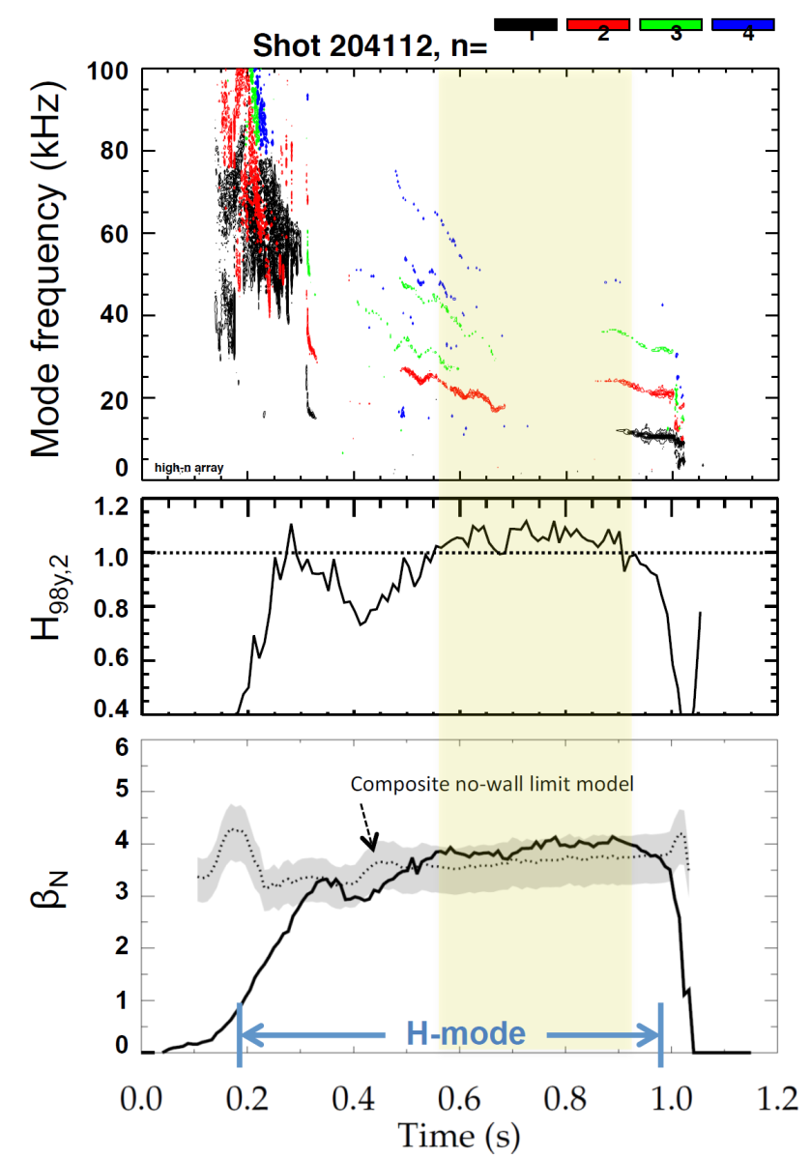

Recovered ~1MA H-modes that reached / exceeded the ideal n = 1 no-wall limit
202946 – no EFC 204112 – EFC v2
203679 – EFC v1 204118 – EFC v2
H₉₈ ≥ 1, β_{N} ~ 3.5-4 ≥ n=1 no-wall limit

Slide 46
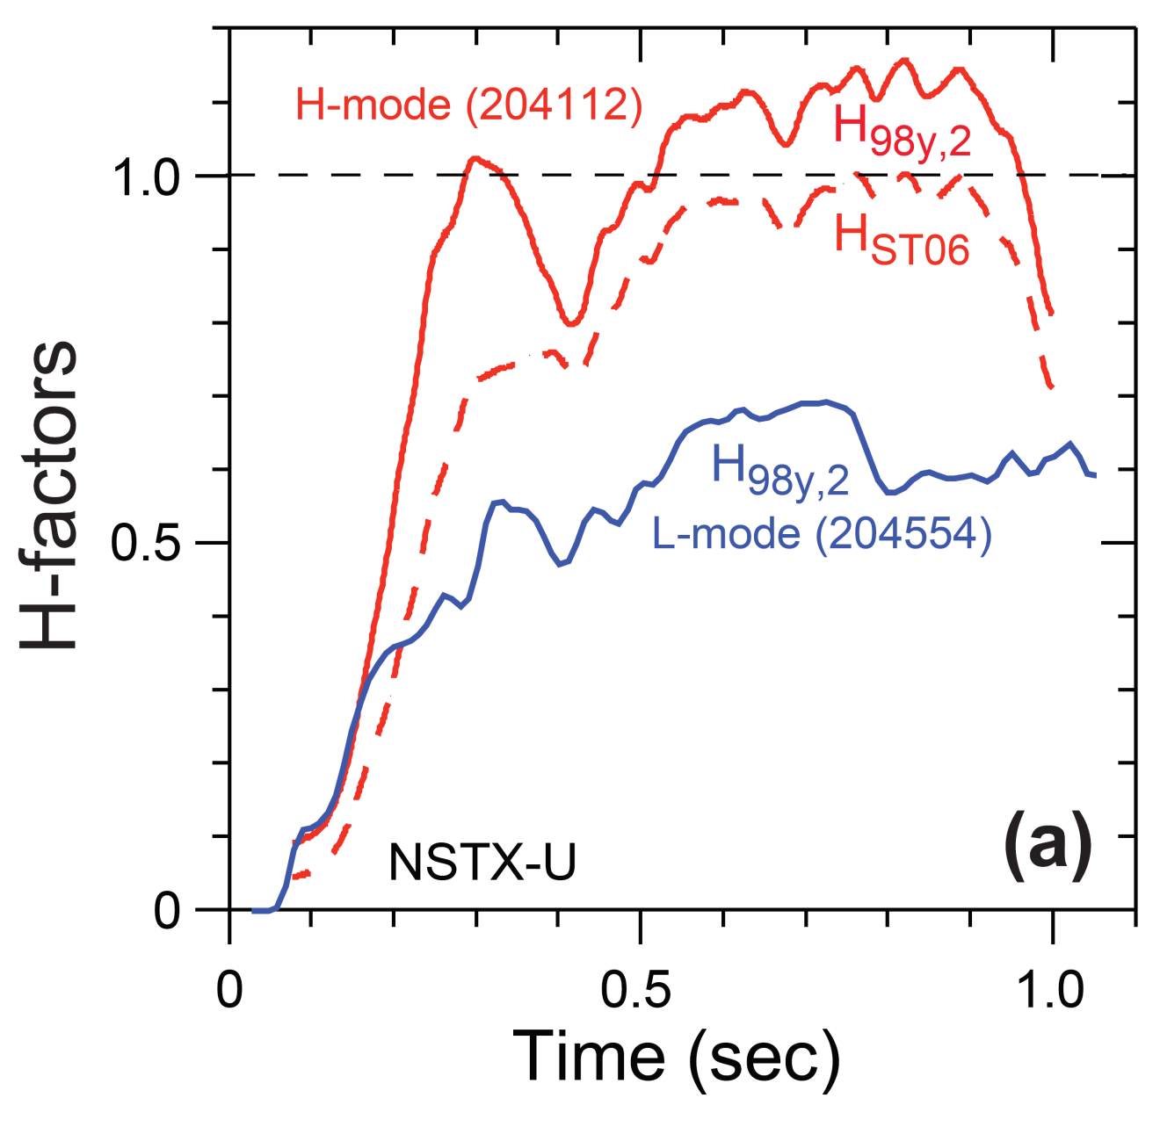
H-mode confinement > ITER scaling, consistent with ST scaling (so far) – need higher I_{P}, B_{T} to test

Slide 47
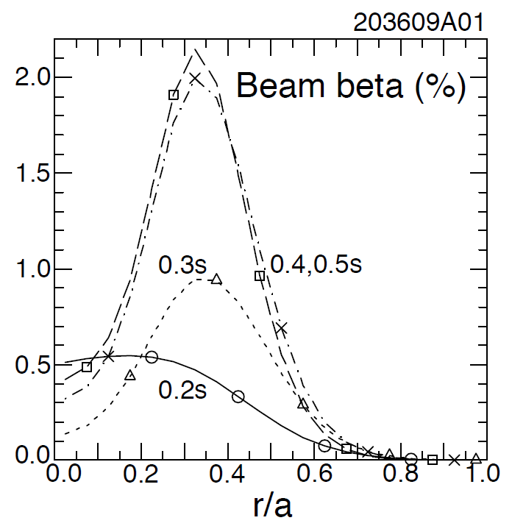
Most tangential NBI generates counter-propagating Toroidal Alfvén Eigenmodes (TAEs)
Counter-propagating TAE predicted for hollow fast-ion profiles
H.V. Wong, H. Berk, Phys. Lett. A 251 (1999) 126.
TRANSP: As current builds up beam fast-ion beta profile predicted to become hollow
1st evidence of off-axis NBI in NSTX-U

Slide 48
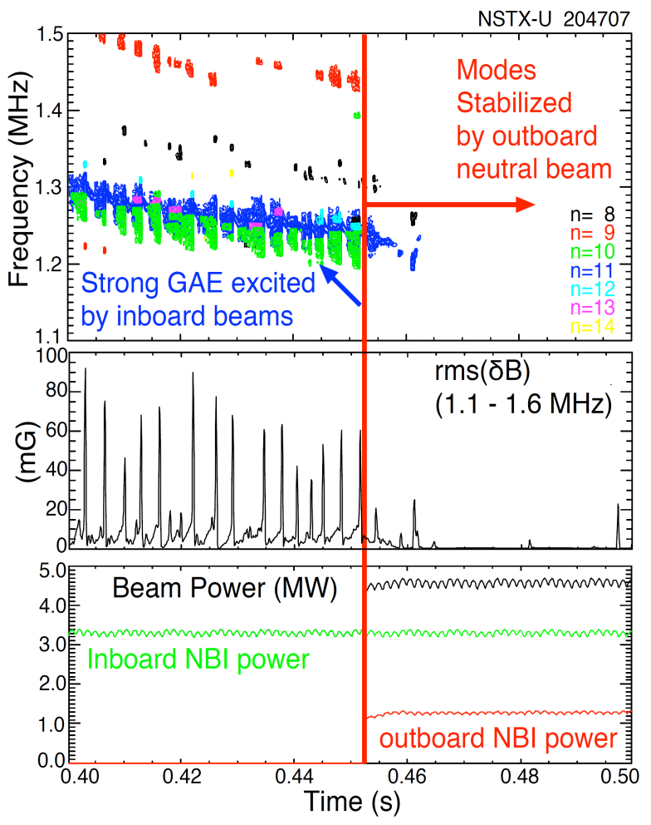
Tangential 2nd neutral beam suppresses Global Alfven Eigenmode (GAE) – consistent with simulation
HYM code simulation of #204707, n=10
|δB_{n} |²
t=0.44s
t=0.47s
t ω_{ci}
HYM code: growth of n=10 counter-GAE from 1st NBI
HYM: suppression of n=10 counter-GAE by 2nd NBI
Most unstable n-number, mode ω consistent with HYM
New 2nd NBI already powerful tool for fast-ion mode physics

Slide 49
NSTX-U had scientifically productive 1st year
Achieved H-mode on 8th day of 10 weeks of operation
Surpassed magnetic field and pulse-duration of NSTX
Matched best NSTX H-mode performance at ~1MA
Identified and corrected dominant error fields
Exceeded the n = 1 ideal MHD no-wall beta limit
Injected up to 12MW NBI power into armor by end of run
Discovered new 2nd NBI modifies several fast-ion modes
Implemented techniques for controlled plasma shut down, disruption detection, commissioned new tools for mitigation
2016 run ended prematurely due to fault in divertor PF coil
  Coil forensics, Extent of Condition → new coil fab, other repairs
  Aim to resume plasma operation during 2018 – but timing still TBD

Slide 50
Research established verified understanding of kinetic MHD theory to determine global mode stability in tokamaks
  Early theory did not find general agreement with experimental global mode (RWM) marginal stability; simple “critical rotation” hypothesis inadequate
  Drift kinetic theory modification to ideal stability criterion can explain mode stability results in experiments when precession drift physics is included
Computed kinetic RWM marginal stability limits can describe disruptive limits in plasmas free of other MHD modes
Stabilization physics complementarity found: at similar high rotation, kinetic RWM stabilization physics dominated by ion precession drift resonance in NSTX, and bounce orbit resonance in DIII-D
Unification of theoretical understanding and joint experimental verification allows stability research to progress to next step: disruption avoidance
  Expanded use of present theory for disruption prediction
  Disruption avoidance via plasma rotation profile control
- Berkery, Sabbagh, et al. submitted to PoP (2017)
- Goumiri, Rowley, Sabbagh, et al. NF 56 (2016) 036023

Slide 51
Goals for future NSTX-U operation
Increase field to 0.8-1T, current to 1.6-2MA, extend flat-top duration (H-mode) to 2-5s
Characterize 2nd beam: heating, current drive, torque / rotation profiles, fast-ion instabilities
Characterize and forecast events leading to disruptions; demonstrate disruption-free operation
Assess energy confinement, pedestal height/structure, edge heat-flux width
Push toward full non-inductive current drive
Test advanced divertor heat flux mitigation

Slide 52
Supporting Slides Follow

Slide 53


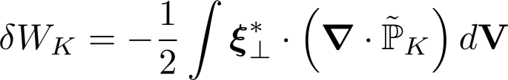

Modification of Ideal Stability by Kinetic theory (MISK code) has sufficiently broad physics to determine RWM stability
(Hu, Betti, et al., PoP 12 (2005) 057301)
Energy balance
Kinetic Energy
Fluid terms
Change in potential energy due to perturbed kinetic pressure is:
is solved numerically by using from the drift kinetic equation to solve for
Precession drift resonance
~ Plasma Rotation
Bounce orbit resonances
Collisionality

Slide 54

Plasma response to external n=1 field is determined by the RWM damping rate γ_{RWM} and mode rotation frequency ω_{RWM}
Dependence of the plasma response δB_{plas} on the frequency ω_{ext} of an externally applied n=1 field described by single mode model
  Perturbed field at wall:
  Plasma response at wall:
  with complex growth rate
  γ₀=γ_{RWM}+iω_{RWM}
  and coupling coefficient M_{sc} between coil c and sensor s
H. Reimerdes et al., PRL (2004)
*

Slide 55
A classic, simple RWM model illustrates basic mode dynamics
mode rotating
mode growth
Simulation with error field, and increasing mode drive
Stable RWM amplifies error field (resonant field amplification (RFA))
When RWM becomes unstable, it first unlocks, rotates in co-NBI direction
  Amplitude is not strongly growing during this period
Eventually unstable mode amplitude increase causes RWM to re-lock, mode grows strongly
RWM growth rate, rotation frequency is O(1/τ_{wall})
RWM stable, amplifies 3D field
RWM unstable
2
1
log₁₀(mode amplitude)
0
-1
-2
1
mode phase (arb)
0
-1
0.4
plasma velocity (arb)
0.2
0
0
10
20
30
40
50
60
time (normalized to τ_{wall})
R. Fitzpatrick, Phys. Plasmas 9 (2002) 3459

Slide 56

Kinetic RWM stability analysis evaluated for DIII-D and NSTX plasmas
Kinetic RWM stability analysis for experiments (MISK)
Summary of results
  Plasmas free of other MHD modes can reach or exceed linear kinetic RWM marginal stability
  Bursting MHD modes can lead to non-linear destabilization before linear stability limits are reached
  Extrapolations of DIII-D plasmas to different V_{φ} show marginal stability is bounded by 1.6 < q_{min} < 2.8
DIII-D
NSTX
q_{min} = 2.8
unstable
Normalized growth rate (γτ_{w})
“weak stability” region
q_{min} = 1.6
major disruption
minor disruption
extrapolation
stable
Plasma rotation [krad/s] (ψ_{N} = 0.5)
NSTX

Slide 57

The earliest potential indication of a locking island (from CER) comes after the n = 1 RWM has fully grown
1 ms CER indicates that an island may be forming and locking by 1.510s
Magnetics show that n = 1 RWM reaches full amplitude by 1.509s
Conclude that this dynamic is not caused by an island-induced loss of torque balance
RWM growth
starts
RWM growth
ends
Earliest indication of island

Slide 58
Due to benchmarking effort, alterations to both MARS-K and MISK codes produced agreement in all categories
INITIAL RESULT | r_{wall}/a | Ideal δW/-δW∞ | Re(δW_{k}) /δW∞ | Im(δW_{k})/ (δW∞) | γτ_{wall} | ωτ_{wall} | δW_{k}/-δW∞ (ω_{E} = ∞)
Solov’ev 1 (MARS-K) (MISK) | 1.15 | 1.187 1.122 | 0.0256 0.0243 | -0.0121 0.0280 | 0.804 0.850 | -0.0180 -0.0452
Solov’ev 3 (MARS-K) (MISK) | 1.10 | 1.830 2.337 | 0.208 0.371 | -0.343 0.0601 | 0.350 0.232 | -0.228 -0.0273
ITER (MARS-K) (MISK) | 1.50 | 0.682 0.677 | 141.5 0.665 | 2.286 -0.548 | -0.988 0.0709 | 0.00019 0.437
FINAL RESULT
Solov’ev 1 (MARS-K) (MISK) | 1.15 | 1.187 1.122 | 0.0218 0.0208 | -0.0121 -0.0068 | 0.803 0.861 | 0.0180 0.0189 | 0.157 0.154
Solov’ev 3 (MARS-K) (MISK) | 1.10 | 1.830 2.337 | 0.0794 0.0892 | -0.147 -0.090 | 0.471 0.374 | 0.114 0.051 | 1.98 1.09
ITER (MARS-K) (MISK) | 1.50 | 0.682 0.677 | 0.241 0.367 | -0.046 -0.133 | 0.817 0.581 | 0.090 0.202 | 6.11 6.72
Green = good

Slide 59
State Derivative Feedback Algorithm needed for Current Control
State equations to advance
Control vector, u; controller gain, K_{c}
Observer est., y; observer gain, K_{o}
K_{c} , K_{o} computed by standard methods
(e.g. Kalman filter used for observer)
Previously published approach found to be formally “uncontrollable” when applied to current control
State derivative feedback control approach
  new Ricatti equations to solve to derive control matrices – still “standard” solutions for this in control theory literature
e.g. T.H.S. Abdelaziz, M. Valasek., Proc. of 16th IFAC World Congress, 2005
Advance discrete state vector
Written into the PCS
General (portable) matrix output file for operator
(time update)
(measurement
update)
NSTX

Slide 60
The ITPA process greatly aided our unified EU and US effort
(example: code benchmarking and implications for ITER)
ITPA allowed a common basis and goals for research
  Reimerdes, Sabbagh, Liu were/are ITPA joint experiment leaders/co-leaders
Significant kinetic RWM analysis code benchmarking effort
  Two Solov’ev, and ITER Advanced Scenario case tested
  Leading codes tested: MARS-K, MISK (PENT code written during this process)
Key components of the analyses separately compared
  Ideal MHD stability functional δW (with and without stabilizing wall)
  Kinetic MHD stability functional δW_{k} (Real & Imaginary components)
Yielded a direct comparison of kinetic RWM growth rate and natural rotation rate (γτ_{wall}, ωτ_{wall})
ITPA joint experiments: MDC-2 Reimerdes, Liu, Sabbagh; and MDC-21: Sabbagh, Liu

Slide 61





The 2016 Landau-Spitzer Award recipients are greatly thankful for this fine honor
Landau
Spitzer
The awardees especially thank
  The 2016 Award committee
  The EPS and the APS
  Prof. Riccardo Betti (U. Rochester) for his enthusiastic, and selfless nomination
The awardees
  Appreciate the joint, collaborative, nature of this research between the EU and US, aided by the ITPA
  Acknowledge the experimental teams on NSTX and DIII-D; scientific exchanges with JET, JT-60U, RFX, HBT-EP
  Convey that the research meriting the award comprises an ~decade-long effort
S.A. Sabbagh
J.W. Berkery
Y.Q. Liu
H. Reimerdes

Slide 62
NSTX-U device performance progression
1st year: Limit forces to ½ way between NSTX and NSTX-U, and ½ of the design-point heating of any coil
  Presently operating at B_{T} ~ 0.63T
  Increase to B_{T} ~ 0.8T after completing engineering analysis
2nd year goal: Full field and current, coil heating to ¾ of limit
3rd year goal: Full capability
Parameter | NSTX (Max.) | Year 1 NSTX-U Operations | Year 2 NSTX-U Operations | Year 3 NSTX-U Operations | NSTX-U Ultimate Goal
I_{P} [MA] | 1.2 | ~1.6 | 2.0 | 2.0 | 2.0
B_{T} [T] | 0.55 | ~0.8 (0.65) | 1.0 | 1.0 | 1.0
Allowed TF I²t [MA²s] | 7.3 | 80 | 120 | 160 | 160
I_{P} Flat-Top at max. allowed I²t, I_{P}, and B_{T} [s] | ~0.4 | ~3.5 | ~3 | 5 | 5

Slide 63



Fast-ion confinement measured to be at / near predicted values at low total NBI power ~1-2MW
E_{NBI} = 85keV
E_{NBI} = 65keV
Neutron rate
Good agreement between neutron measurement and TRANSP prediction
Need small anomalous fast ion diffusivity (D_{af}=0.3m²/s) for agreement

