Slide 1


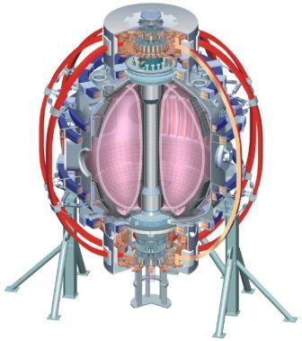

NSTX
Supported by
NSTX FY2011 Year-End Report
Facility and Diagnostic Upgrades, Research Highlights
Masayuki Ono and Jon Menard
for the NSTX Research Team
Columbia U
CompX
General Atomics
FIU
INL
Johns Hopkins U
LANL
LLNL
Lodestar
MIT
Nova Photonics
New York U
ORNL
PPPL
Princeton U
Purdue U
SNL
Think Tank, Inc.
UC Davis
UC Irvine
UCLA
UCSD
U Colorado
U Illinois
U Maryland
U Rochester
U Washington
U Wisconsin
Culham Sci Ctr
U St. Andrews
York U
Chubu U
Fukui U
Hiroshima U
Hyogo U
Kyoto U
Kyushu U
Kyushu Tokai U
NIFS
Niigata U
U Tokyo
JAEA
Hebrew U
Ioffe Inst
RRC Kurchatov Inst
TRINITI
NFRI
KAIST
POSTECH
ASIPP
ENEA, Frascati
CEA, Cadarache
IPP, Jülich
IPP, Garching
ASCR, Czech Rep
Videoconference with FES
PPPL - B205
October 27, 2011

Slide 2
Outline
Milestones
Facility and Diagnostic Overview
Research Results
Summary
Notes:
2
2

Slide 3
NSTX FY2011 Milestones
DOE Joint Research Target: “Improve the understanding of the physics mechanisms responsible for the structure of the pedestal and compare with the predictive models described in the companion theory milestone.“ (Completed)
R(11-1): Measure fluctuations responsible for turbulent electron, ion and impurity transport. (Completed)
(R11-2): Assess ST stability dependence on plasma aspect ratio and boundary shaping. (Completed)
R(11-3): Assess very high flux expansion divertor operation. (Completed)
R(11-4): H-mode pedestal transport, turbulence, and stability response to 3D fields. (Partially completed)
F(11-1): Operate NSTX Facility for 14 Experimental Run Weeks. (Not completed)
D(11-1): Complete the commissioning of a real-time plasma velocity (RTV) diagnostic system. (Completed)
AF(11-1): Complete commissioning of facility upgrades. (Completed)
AD(11-1): Complete commissioning of diagnostic upgrades. (Completed)
The final year-end reports submitted to DOE. Also reported at ISTW-2011
Notes:
3
3

Slide 4
NSTX Facility Overview
To Support NSTX Mission Elements and Upgrades
FY2009
FY2010
FY2011
FY2012
Run Weeks
16.8
15.4
4.2
Upgrade Outage
CHI Absorber Control Coil
CHI / HHFW / Energetic Particles
Start-up
Ramp-up
Sustainment
HHFW Antenna Upgrade
Reflectometry
16 ch
Tangential
FIDA
Perpendicular
FIDA
Liquid Lithium Divertor & Diagnostics
Boundary / Lithium
Moly-Tiles
High Power Long Pulse Divertor
Dual LITER and dropper
2ND Dual LITER
Dual-band
IR Camer
MAPP
Improved high-k
BES 16ch
BES 32 ch
Turbulence & Transport
Core /
Pedestal
Transport
MPTS 42 ch
MSE-LIF
RWM State Space Controller
2nd SPA
High Beta, Advanced
Scenarios
Macrostability
& ASC
β Control
Real time Rotation Diag
δ Control
Real time Rotation Control

Slide 5
Facility Milestone F(11-1): Operate NSTX Facility for 14 Experimental Run Weeks (Target – Sept. 2011, 4.21 run weeks completed – Oct. 2010)
Achieved 4.2 run weeks with 839 plasma shots on October 25, 2010 which represents a record ~ 200 plasma shots per run week.
Completed the 2011 outage including diagnostic installations and calibrations in June 2011 and prepared to resume operation.
During the recommissioning ISTP, an electrical failure in the toroidal field (TF) coil inner bundle occurred on July 20, 2011
Dissection of the bundle revealed that the fault was caused by a gradual deterioration of the insulation by residues of a flux containing zinc-chloride used during fabrication of the TF bundle in 2003.
A panel of external experts in magnet construction conducted an independent review of the TF failure on September 7, 2011 endorsing the findings.
After carefully assessing options, it was decided to proceed directly to the planned NSTX Upgrade Project outage as this would result in an acceleration of its upgrade schedule by about six months.
A number of improvements will be implemented in manufacturing the new TF bundle for the upgrade.
Notes:
5
5

Slide 6
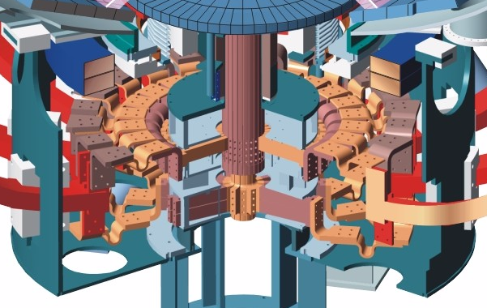
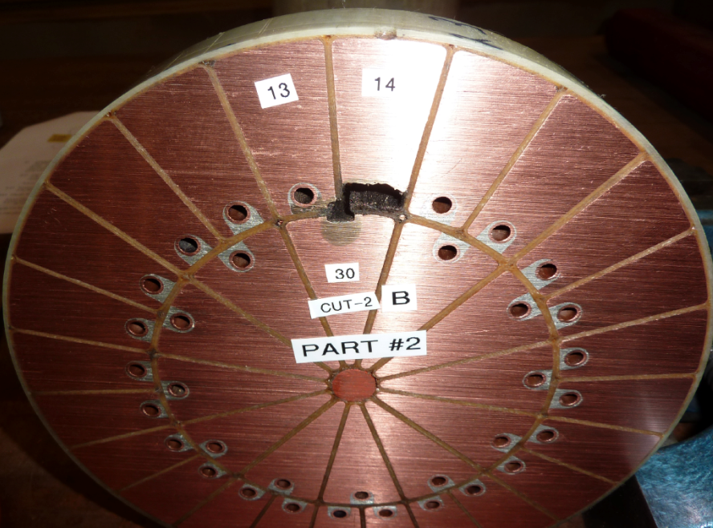

NSTX TF Fault Occurred on July 20, 2011
TF Bundle Operated for 7+ years for 20,000 shots
  TF bundle short occurred ~ 2 feet from the bottom in a relatively low mechanical stress area.
  TF bundle dissection and analyses showed no sign of fatigue.
  Zinc chloride based flux used for cooling water tube soldering was the cause of insulation failure.
Dissection of shorted region
Cooling tube
13
14
Soft solder
30
TF Upgrade will use rosin flux and change the procedures for removing the flux residues

Slide 7
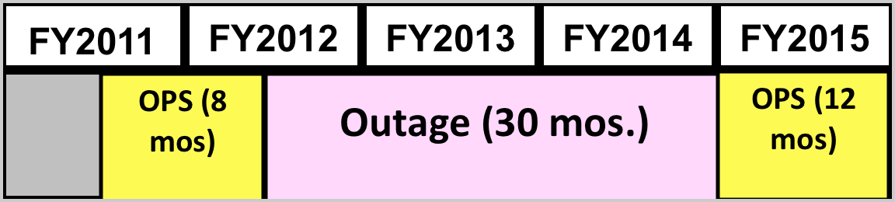
Upgrade acceleration maximizes NSTX run time
and scientific productivity over next 5 yr period (2011-15)
Option: | Pre-Upgrade Ops | Post-U pgrade Ops | Total Ops
Base plan | 8 months | 12 months | 20 months
Rebuild TF | 7 months | 2 months | 9 months
Upgrade | 0 | 19 months | 19 months
Base
OPS
Outage (30 mos.)
OPS
Rebuild
TF Rebuild
OPS
Outage (30 mos.)
Upgrade
Outage (30 mos.)
OPS
APS
APS / IAEA
APS
APS / IAEA
Next Five Year Plan Review
NSTX-U Ops Prep
Collaborations, data analysis / publications, next-step ST study
Next Five Year Period
FY 2014-2018

Slide 8
ARRA Funding Greatly Enhanced Research Capability
Planned ARRA Upgrades Completed on Schedule
Enhanced operation of Major Fusion Facilities in FY09 and FY10
- 5 extra run weeks in FY 09 and one extra in FY 10 enabled the NSTX researchers to conduct high priority fusion plasma experiments.
Diagnostics and Facility Upgrades in FY 09 - 11:
  - Extra 12 channels for the multi-pulse Thomson scattering system for improved H-mode pedestal and plasma edge spatial resolution to support the FY 11 joint research milestone.
  - Motional Stark Effect Laser Fluorescence advanced diagnostic system for internal magnetic and electric field measurements was installed.
  Enhancement to the liquid lithium divertor target capability for modifying edge collisionality, including two lithium evaporators, LLD diagnostics and molybdenum tiles on the inboard divertor.
  Post Doctoral Fellows to support the enhanced research capabilities.
  2nd switching power amplifier system for improved error field/resistive wall mode/resonant magnetic perturbation spectra to control the edge error field.

Slide 9
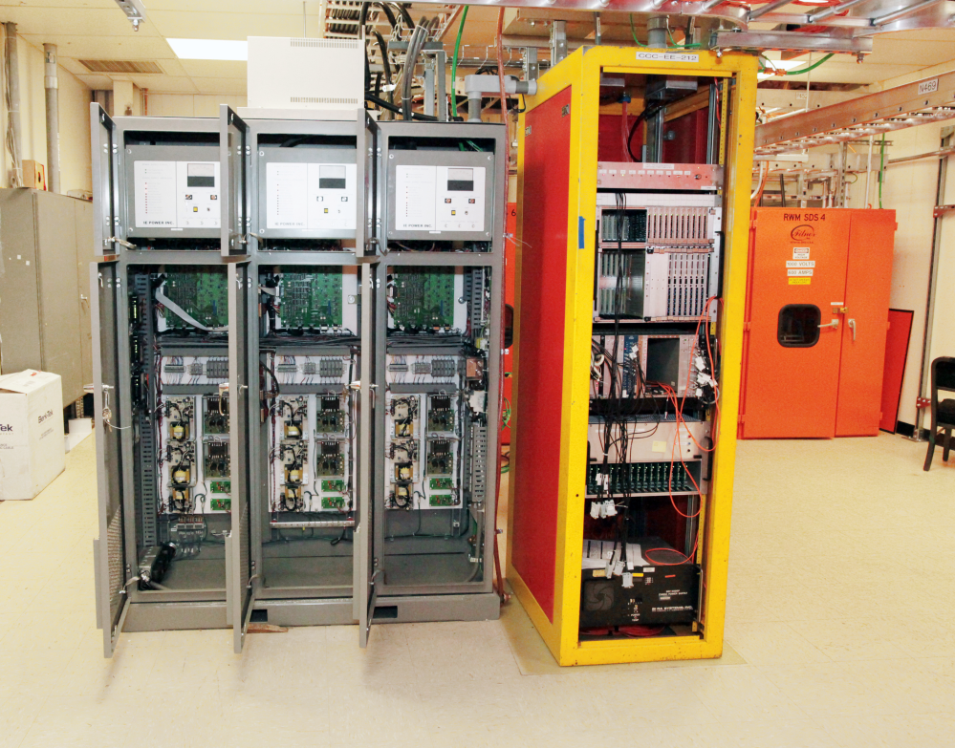
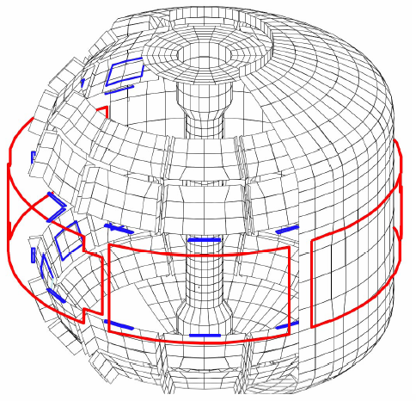
2nd SPA Successfully Installed and Commissioned
Sustain β_{N} and Understand MHD Behavior Near Ideal Limit
Copper passive
conductor plates
SS Vacuum
Vessel
B_{R}
B_{P} sensor
6 ex-vessel midplane control coils
2nd 3-channel Switching Power Amplifier (SPA) comissioned in July 2011 powers independent currents in six EFC/RWM coils for simultaneous control of n = 1, 2, 3 field harmonics
    RWM spectrum dependence
    Rotation and beta effects on NTMs
    Response to 3D fields for EFC, ELM and Neoclassical Toroidal Viscosity physics
    Disruption physics

Slide 10
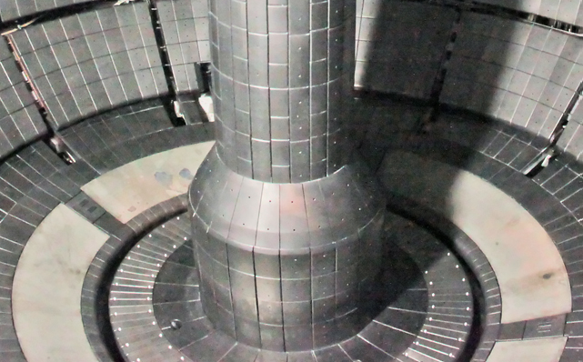
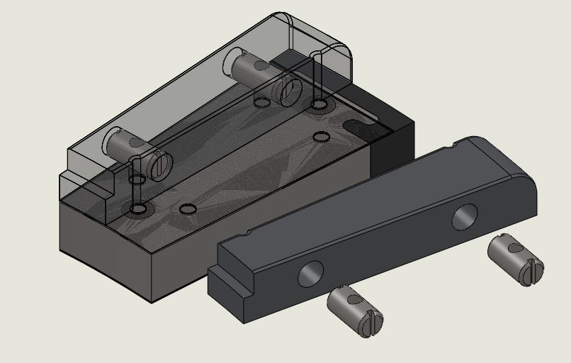
Molybdenum Tiles Installed for In-Board Divertor
Liquid Lithium Covered Molybdenum Surfaces Reduced Carbon Influx
Split-top Moly on SS tile satisfies design requirements
New moly tiles
~ 1” thick Moly (TZM) tiles
ATJ graphite “end cap”
LLD
~ 1” thick SS base
SS “barrel” nuts with ¼-20 screws
Molybdenum tiles manufactured and installed on inboard
divertor in April 2011
Supported by ARRA funding
Replace 48 second row tiles with 1” thick molybdenum tiles
Three tiles contain diagnostics
Lithium coating with LITER ~ 2 x outer LLD rate
Plasma heating can liquefy lithium on surface

Slide 11
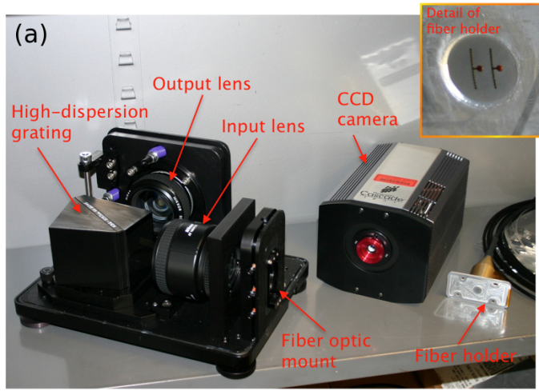
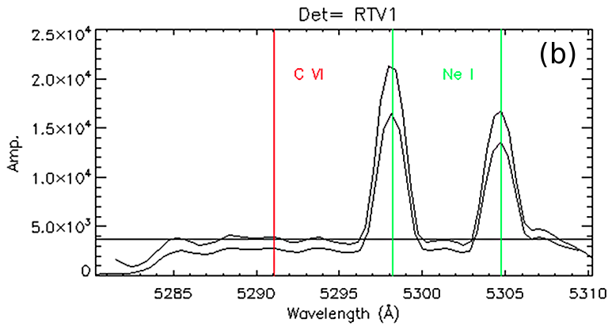
Real Time Velocity Diagnostics Developed
Important Tool for Advanced Plasma Control
A Real-Time Velocity (RTV) diagnostic will be incorporated into the plasma control system for feedback control of the plasma rotation profile using the NBI and non-resonant magnetic braking as the actuators
• Based on active charge-exchange recombination spectroscopy (CHERS)
• Measures at six radial locations and a sampling rate of 5 kHz.
• Uses two toroidally separated views to distinguish the heating NB view from the background (intrinsic) contribution.
• Installed and commissioned on NSTX in July 2011
RTV hardware including CCD camera & spectrometer
Example of spectra measured on two channels during a Ne glow.

Slide 12
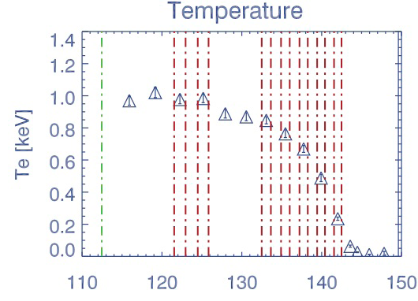
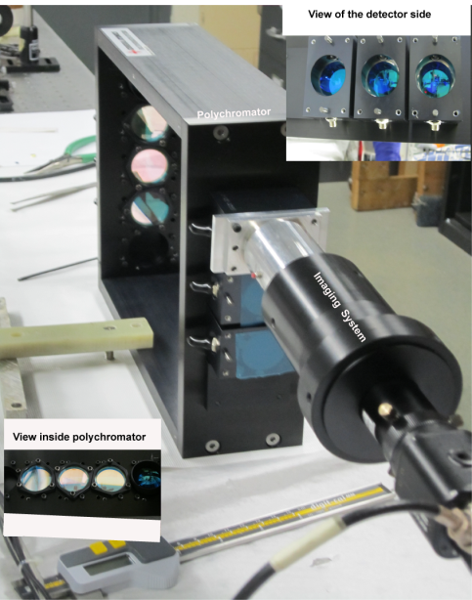
Enhanced Pedestal / Profile Diagnostics
for Pedestal and Core Transport Joint Research Targets
R(cm)
Additional 12 channels enhance resolution in pedestal to ~1 cm and improve diagnosis of ITB in plasma core
Polychromator assembly
• Twelve additional channels for the multi-pulse Thomson scattering (MPTS) system were installed and commissioned in July, 2011.
• Calibration was performed in situ by employing Rayleigh and Raman scattering of the light from the MPTS laser system by nitrogen and argon introduced into the vacuum vessel

Slide 13
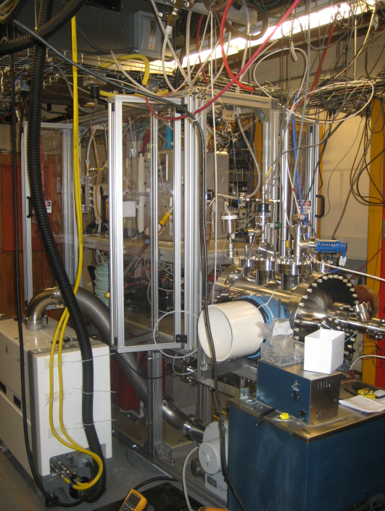
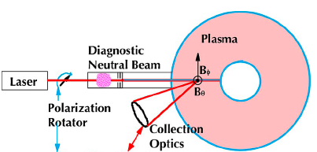
MSE-LIF Installed for Enhanced Pedestal / Profile Diagnostics
Installed and Commissioned on NSTX in August 2011
The Motional Stark Effect measurement based on Laser Induced Fluorescence (MSE-LIF) diagnostic will provide measurements of the field line pitch angle profile without requiring injection of the heating neutral beam.
Schematic of the MSE-LIF system
Nova Photonics
MSE-LIF system installed on NSTX
MSE-LIF provides unique capabilities
• Measure RF-driven current without the heating neutral beam.
• Measure total magnetic field in plasma to reconstruct total plasma pressure.
• Together with MSE-CIF, yield radial electric field profile

Slide 14
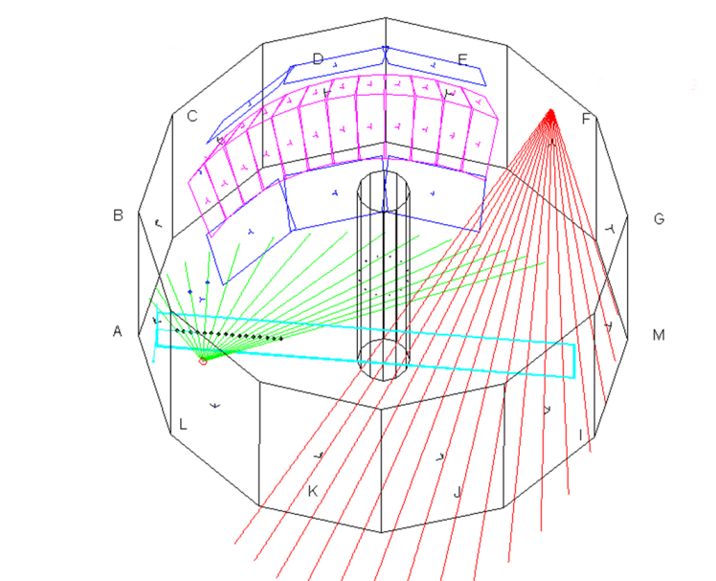
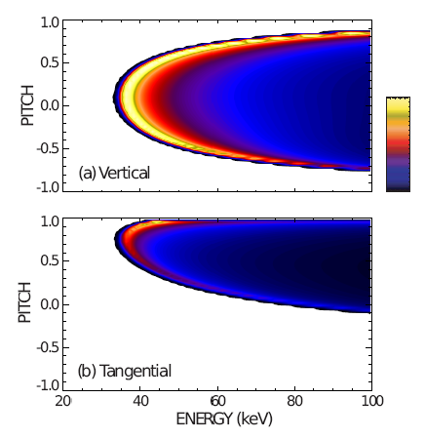
t-FIDA upgrade was implemented in 2011
Energetic Particle Capability for α-Physics and NBI CD
Fast Ion D-Alpha Diagnostic Providing Crucial Energetic Particle Data
Tangential FIDA Views
Vertical
UC Irvine
Tangential
• A new tangential Fast-Ion Deuterium-Alpha (t-FIDA) diagnostic, with a view mostly tangential to the B field, has been built, installed and commissioned in FY 2011.
• Complements the vertical FIDA, as it measured fast ions parallel to B, particularly valuable for non-inductive current drive research in the NSTX Upgrade.
• The observation geometry with both active and background views has been aligned to an accuracy < 5 mm at the measurement location.

Slide 15
Additional Facility and Diagnostic Capabilities Led by Collaborators Became Available in FY 2011
• Upgraded 32 channel Beam Emission Spectroscopy diagnostic system (U. Wisc.) for low-k turbulence and transport research.
• A high resolution tangential Multi-Energy SXR (ME-SXR) array (JHU) for an improved diagnostic of the edge / H-mode pedestal plasma.
• Real time density measurement by the FIReTIP system (UCD) to be utilized for density feedback control.
• A wide angle, 30 Hz infrared camera system, two tile-mounted eroding thermocouples (response time ~ 1 ms) near the PFC surface, and a set of 16 new filterscope chords (ORNL) were implemented.
• A new vacuum-ultraviolet divertor spectrometer (SPRED), a new near-infrared spectrometer, and a new optical Penning gauge (LLNL) for divertor-boundary research.
• Massive gas injector (MGI) at two different poloidal locations (U. Wash.) for disruption control optimization. NSTX can offer new insights by injecting gas into the private flux and lower x-point regions.
• A single-channel 288 GHz radial polarimeter/interferometer (UCLA) on a Bay G midplane port on NSTX for MHD driven magnetic fluctuations.

Slide 16
Strong Publications and Conference Participations
Growing Number of Highly Capable Young Researchers
Half of the publications and invited talks were led by collaborators
Publications:
• 58 papers published in 2011 with 15 additional manuscripts being reviewed.
• Six PRLs published in 2011 four of which were led by junior researchers
IAEA and invited talks:
• 25 papers presented at 2010 IAEA meeting, the most for NSTX.
• 10 invited papers presented at 2010 APS meeting, the most for NSTX.
• 12 invited talks given at other conferences.
Honors and Recognitions:
• S. Sabbagh (Columbia) was honored at IAEA for his Nuclear Fusion Paper Award.
• J. Menard (PPPL) and S. Sabbagh (Columbia) were elected APS-DPP Fellows.
• J-K Park (PPPL) received the Rosenbluth Outstanding Doctoral Thesis Award.
• J-K Park received the 2011 Outstanding Young Researcher Award (OYRA) from Association of Korean Physicists in America (AKPA)
• NSTX received the State of New Jersey Commissioner of Labor and Workforce Development’s 2010 Continued Excellence Award for working 10 consecutive years (2,011,666 hours) without an away from work lost time injury/illness case.

Slide 17
Research Results Outline
Joint Research Target contributions from NSTX
NSTX research milestone highlights
Additional research highlights
Summary
Notes:
17
17

Slide 18
NSTX FY2011 Research Milestone Overview
Joint Research Target: “Improve the understanding of the physics mechanisms responsible for the structure of the pedestal and compare with the predictive models described in the companion theory milestone.”
R(11-1): Measure fluctuations responsible for turbulent electron, ion, impurity transport
  Utilize new diagnostic capabilities, characterize turbulent fluctuations
R(11-2): Assess ST stability dependence on plasma aspect ratio, boundary shaping
  Prepare for Upgrade operating scenarios, explore ideal and RWM stability
R(11-3): Assess very high flux expansion divertor operation
  Combine with other heat flux mitigation techniques, optimize control
R(11-4): H-mode pedestal transport, turbulence, and stability response to 3D fields
  Utilize perturbative impurity transport experiments
Notes:
18
18

Slide 19
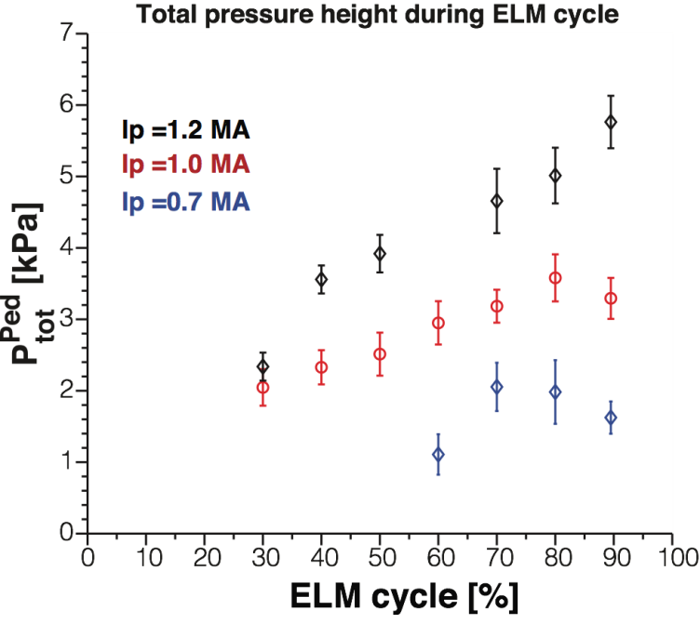
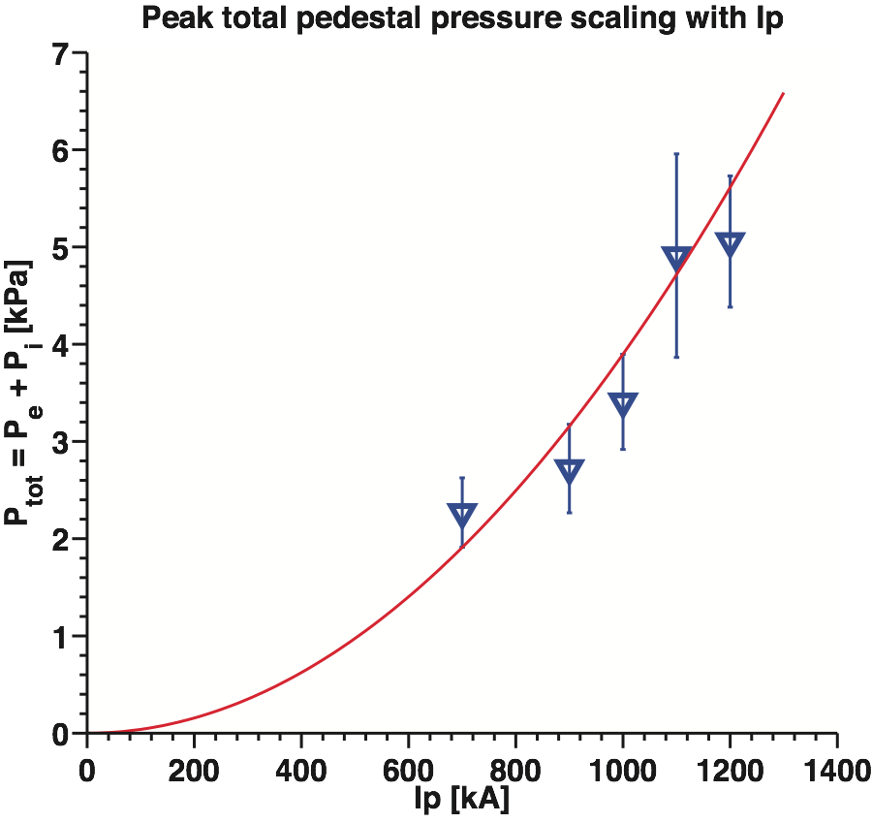
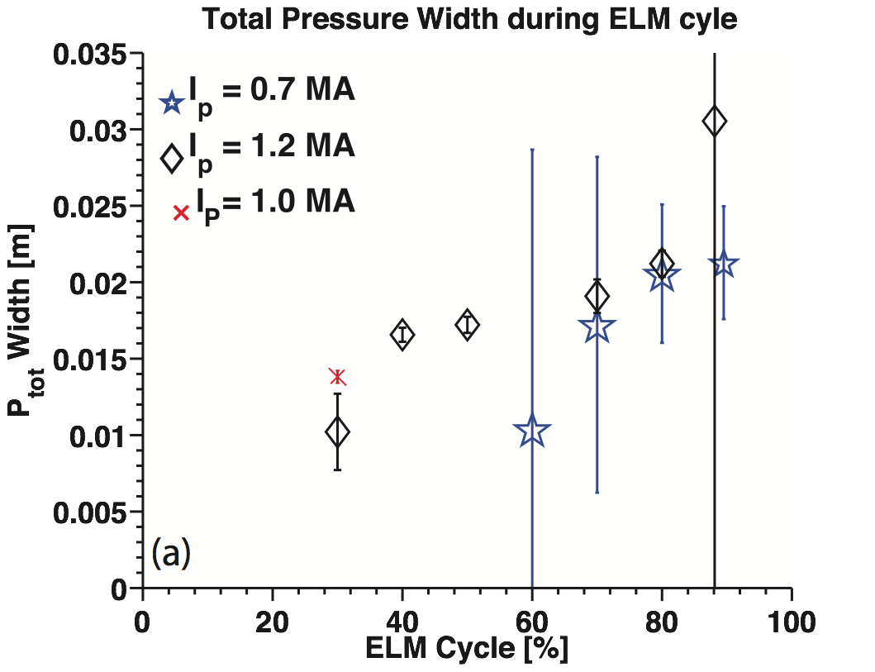
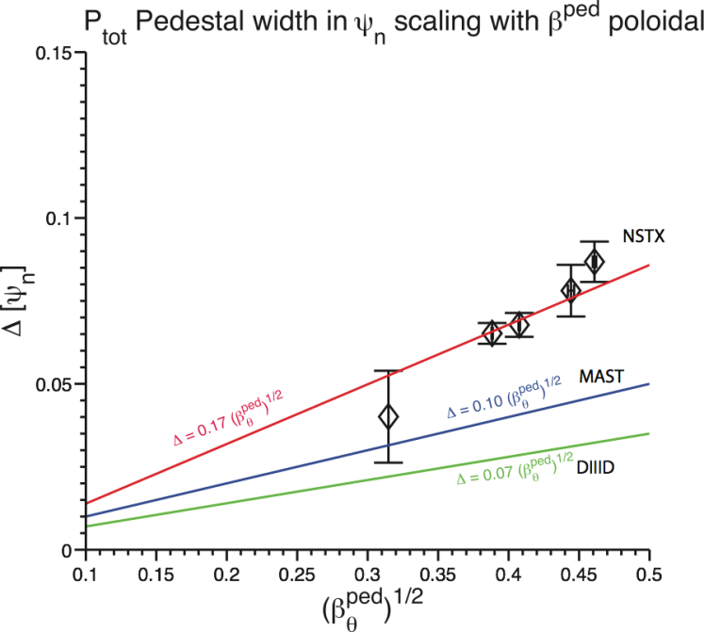
Inter-ELM pedestal structure and dynamics in NSTX depend strongly on I_{P}
JRT-11:
A. Diallo - NF 2011
19
19
Notes:
19
19

Slide 20
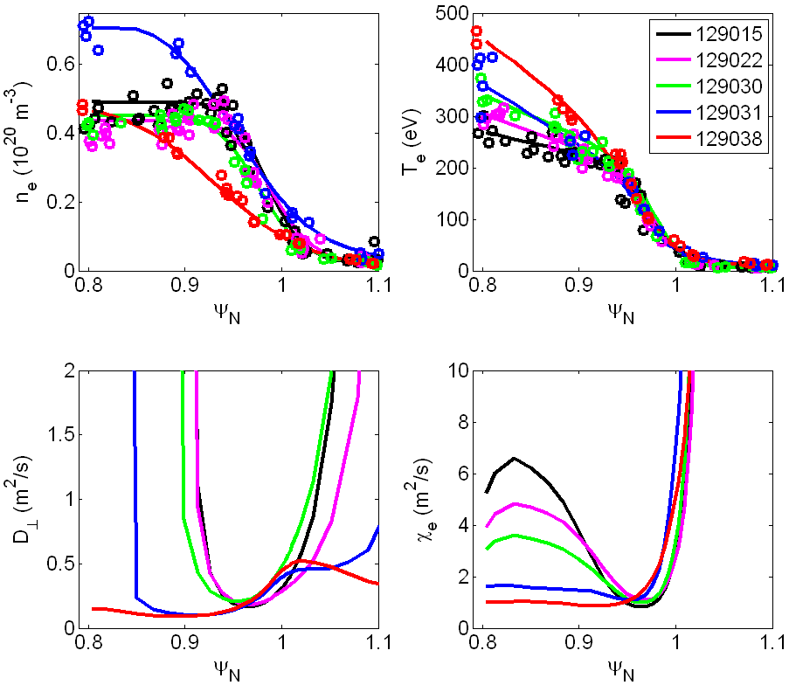
As lithium evaporation increases (direction of green arrow), edge barrier widens, pedestal-top χ_{e} reduced
JRT-11:
Several shots analyzed with increasing lithium thickness (direction of arrow)
ELMy to reduced frequency to ELM-free
T_{e} gradient clamped
J. Canik PoP 2011
20

Slide 21
ELMy discharges close to the kink/peeling stability boundary, ELM-free discharges are farther away
JRT-11:
ELMy
ELM-free
D. Boyle PPCF 2011
ELMy
ELM-free
21

Slide 22
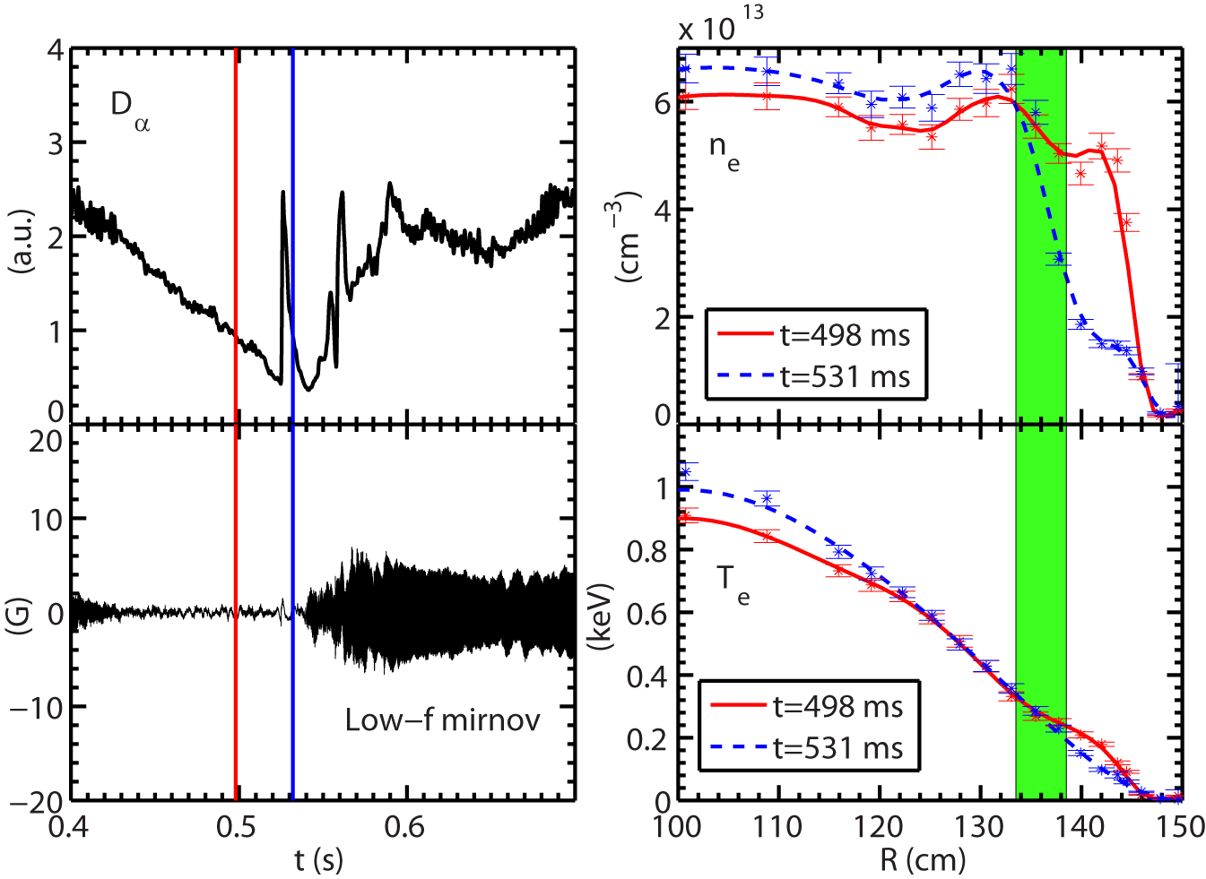
Large density gradient induced by ELM events used to probe high-k turbulence and electron transport
R11-1:
ELM event
High-k measurement region
After the ELM event:
  A factor of 4 increase in density gradient
  60% increase in electron temperature gradient
  60 % decrease in ion temperature gradient
  40% increase in T_{i}
  Less than 25% variation in all other equilibrium quantities
No large global MHD mode appears before and right after ELM
Shot=140620
Y. Ren, PRL 106, 165005 (2011)

Slide 23
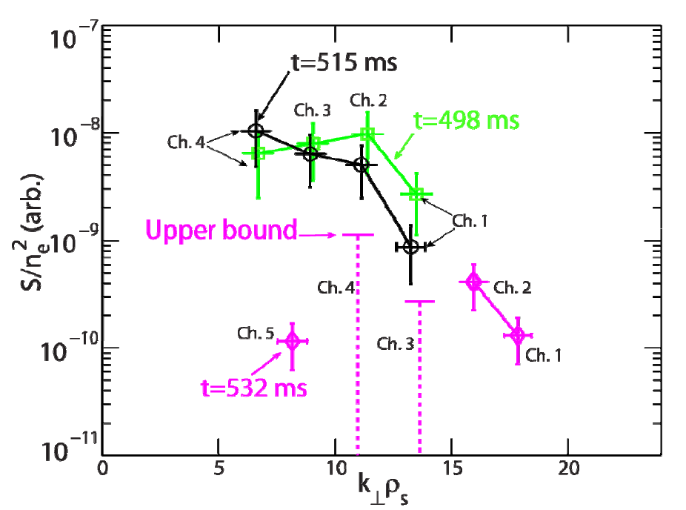
High-k turbulence in H-mode pedestal decreases post ELM crash
R11-1:
Y. Ren
Pre-ELM: black/green post-ELM: purple
Largest decrease in turbulence observed for lower k
Post-crash measured χ_{e} is reduced, ETG modes stabilized (GS2)

Slide 24
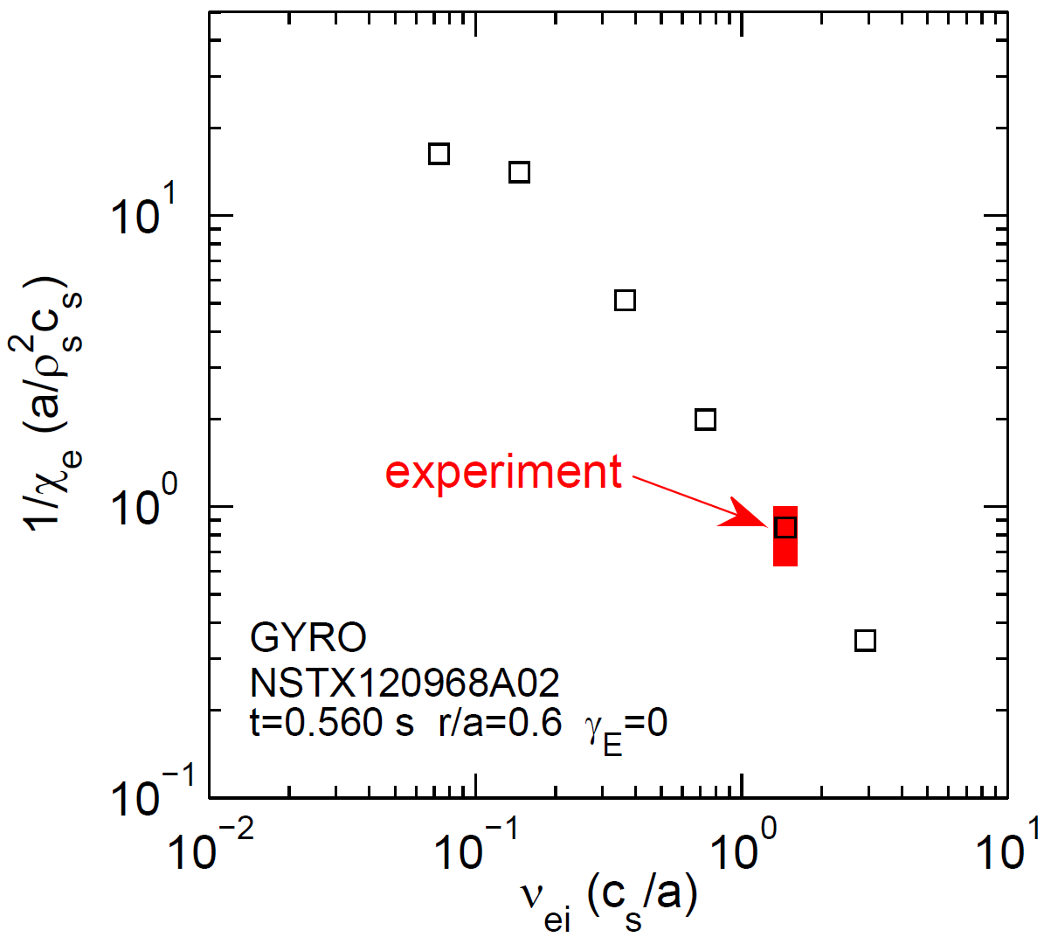
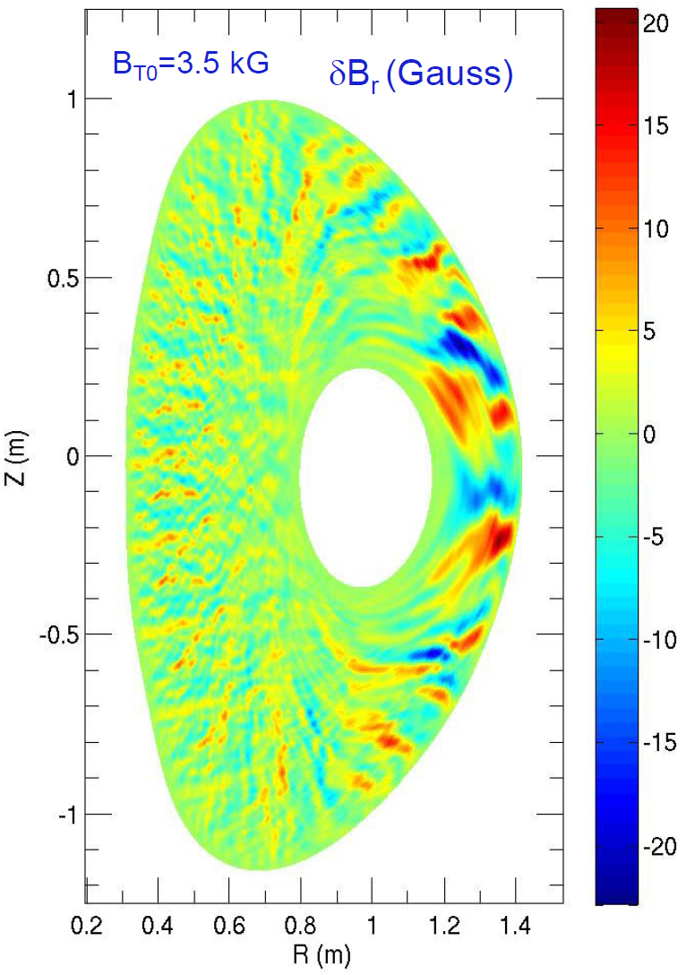
Extended non-linear GYRO calculations of micro-tearing turbulent electron transport
R11-1:
β_{e} ≈ 9%
NSTX
experiment
W. Guttenfelder, PRL 106, 155004 (2011)
μ-tearing produces experimentally relevant e-transport: τ_{E-e} ∝ 1/χ_{e} ∝ 1/ν_{e}*
E×B shear predicted to reduce transport from micro-tearing (ongoing research)
Simulations → 98% of transport caused by δB_{r}, projected to be detectable w/ polarimetry (UCLA)

Slide 25
Correlation analysis of BES data beginning to provide insight into ST ion-gyro-scale turbulence
R11-1:
Database of correlation lengths assembled in FY2011
  Broadband spectra extend to ~100 kHz
  R=140 cm (r/a~0.85) → poloidal correlation lengths y ~10-20 cm
Poloidal correlation length trends in stationary H-modes:
  Increase at higher n_{e}, ∇n_{e}, ∇T_{e}, q/ŝ
    (ŝ is normalized magnetic shear)
  Decrease at higher T_{i} and ∇T_{i}
  Scalings change from early to late H-mode phase → may indicate different turbulent modes active at different times
Preliminary: correlation lengths decrease at higher ion collisionality
  B_{T}=4.4kG, I_{P}=900kA, P_{NBI}=4 MW
D.R. Smith – UW Madison

Slide 26
New Doppler Backscattering diagnostic used to study turbulence dynamics of L→ H transition
R11-1:
S. Kubota - UCLA
Observe reduction in radial correlation length (top) over narrow radial region immediately after L→H transition, combined with suppression of turbulence over wide range of k_{r} (bottom) in same narrow radial region

Slide 27
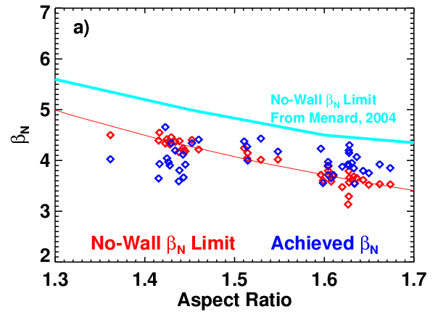
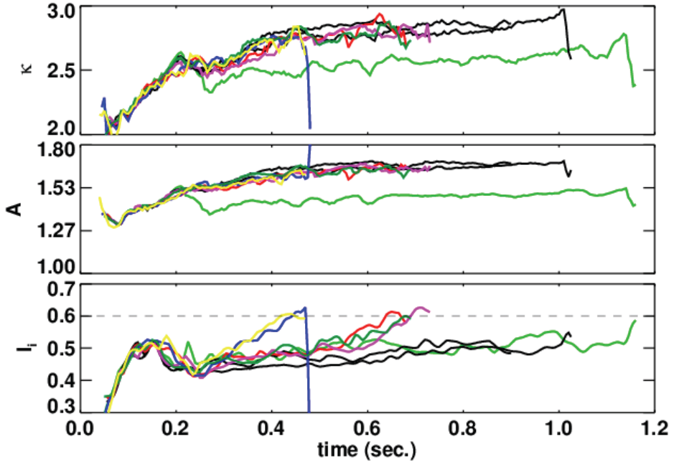
NSTX explored effects of aspect ratio, shaping, current profile on MHD stability
R11-2:
Successfully operated at β_{N} > 4 for several τ_{CR} at Upgrade A and κ
Optimized profile
Reduction of calculated n = 1 no-wall β_{N} limit observed in plasmas with increased A
Found l_{i} ≤ 0.6 required to avoid VDE at higher A with present n=0 control
S. Gerhardt – Nucl. Fusion 51 (2011) 073031

Slide 28
NSTX calculations explored effects of collisionality on RWM stability
R11-2:
Expect NSTX-U to have higher T_{i}, reduced ion collisionality
Ion precession drift resonance stabilization
0.1
ν
unstable
10.0*
2
0.0
stable
ν
wall
2.0*
2
γτ
-0.1
-0.2
ν
off
2
resonance
ν
0.5*
2
-0.3
ν
0.1*
2
-0.4
0.0
0.5
1.0
1.5
2.0
ω
/
ω
exp
φ
φ
J. Berkery – PRL 106, 075004 (2011)
MISK analysis indicates reduced collisionality could improve RWM stability

Slide 29
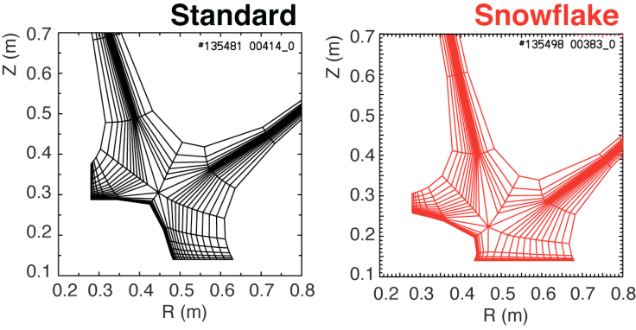
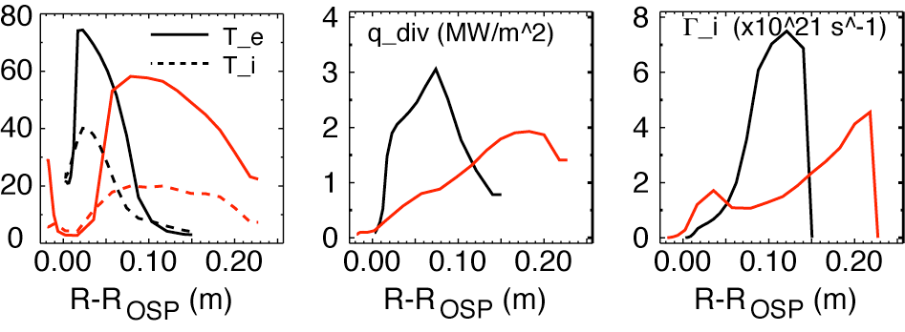
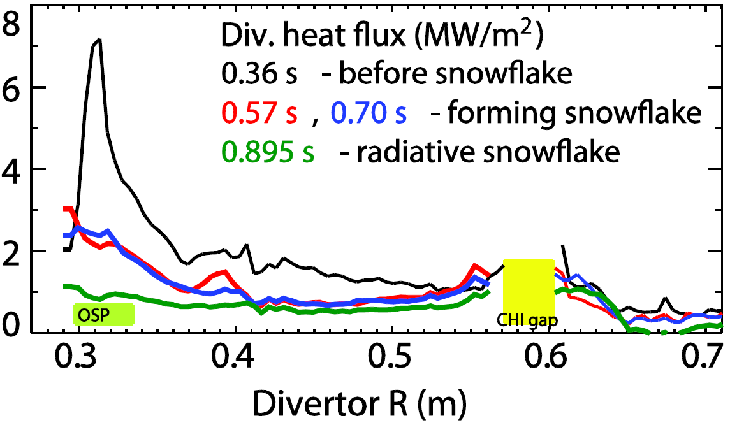
NSTX tested very high flux expansion + detachment for large heat-flux reduction
R11-3:
UEDGE modeling performed comparing conventional divertor to snowflake
V. Soukhanovskii (LLNL) – EPS 2011
Snowflake divertor synergistic with detachment/radiative divertor → large heat flux redution

Slide 30
Multi-energy SXR array used to measure neon impurity transport in edge region
R11-4:
Measured X-ray brightness
Radiated power density
Bolometry (solid)
STRAHL code (dashed)
Modeled X-ray brightness
Modeled neon diffusivity
D. Clayton - JHU

Slide 31
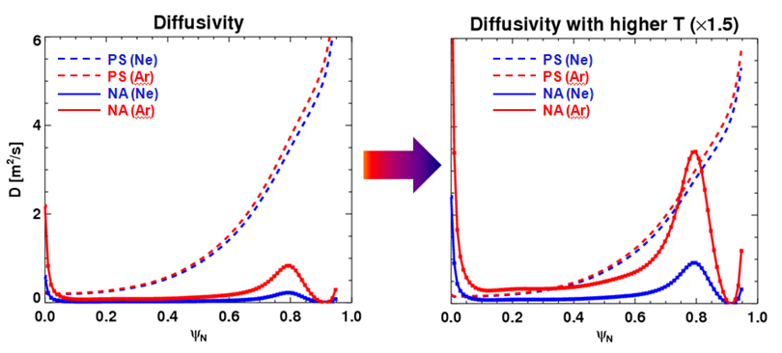
FY2011-12 plan was to test 3D field structure using measured and predicted impurity transport
R11-4:
J.-K. Park
Comparison of predicted particle diffusivity profiles by 3D (NA) and 2D (PS) neoclassical theory for: Ne and Ar ions, n=3 I_{EFC}=2kA, T_{e}(0) ~ 0.8keV
1.5 higher Ar ion temperature predicted increase 3D particle transport to 2D levels → plan: use higher current, enhanced-pedestal H-mode to test

Slide 32
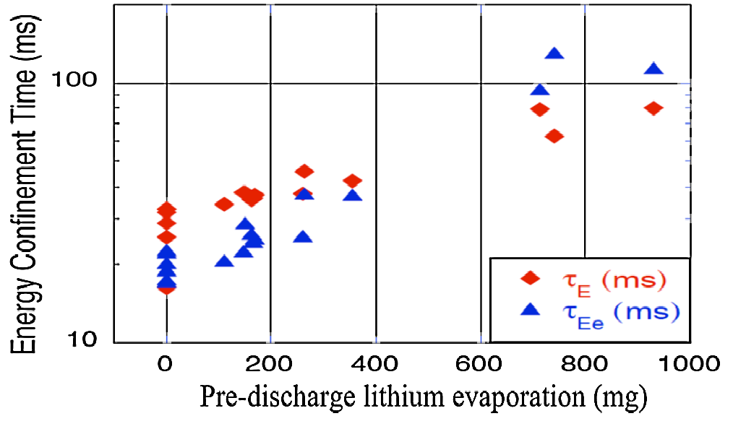
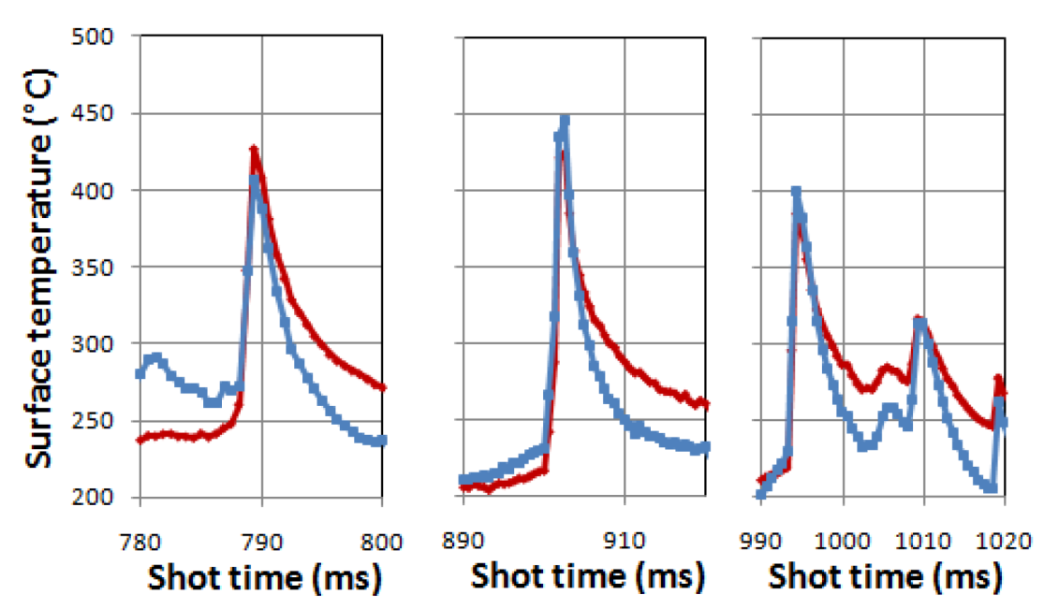
NSTX investigated effects of Li PFCs on plasma confinement and divertor thermal evolution
Lithium
R. Maingi – PRL 107, 145004 (2011)
A. McClean – preliminary analysis
Energy confinement increases continuously with increased Li evaporation in NSTX.
High confinement very important for FNSF and other next-steps - what is upper bound?
Peak surface temperature of LLD coated with Li apparently limited to < 450-500C during repeated ELM events.
Possible Li evaporative cooling as means to protect substrate?

Slide 33
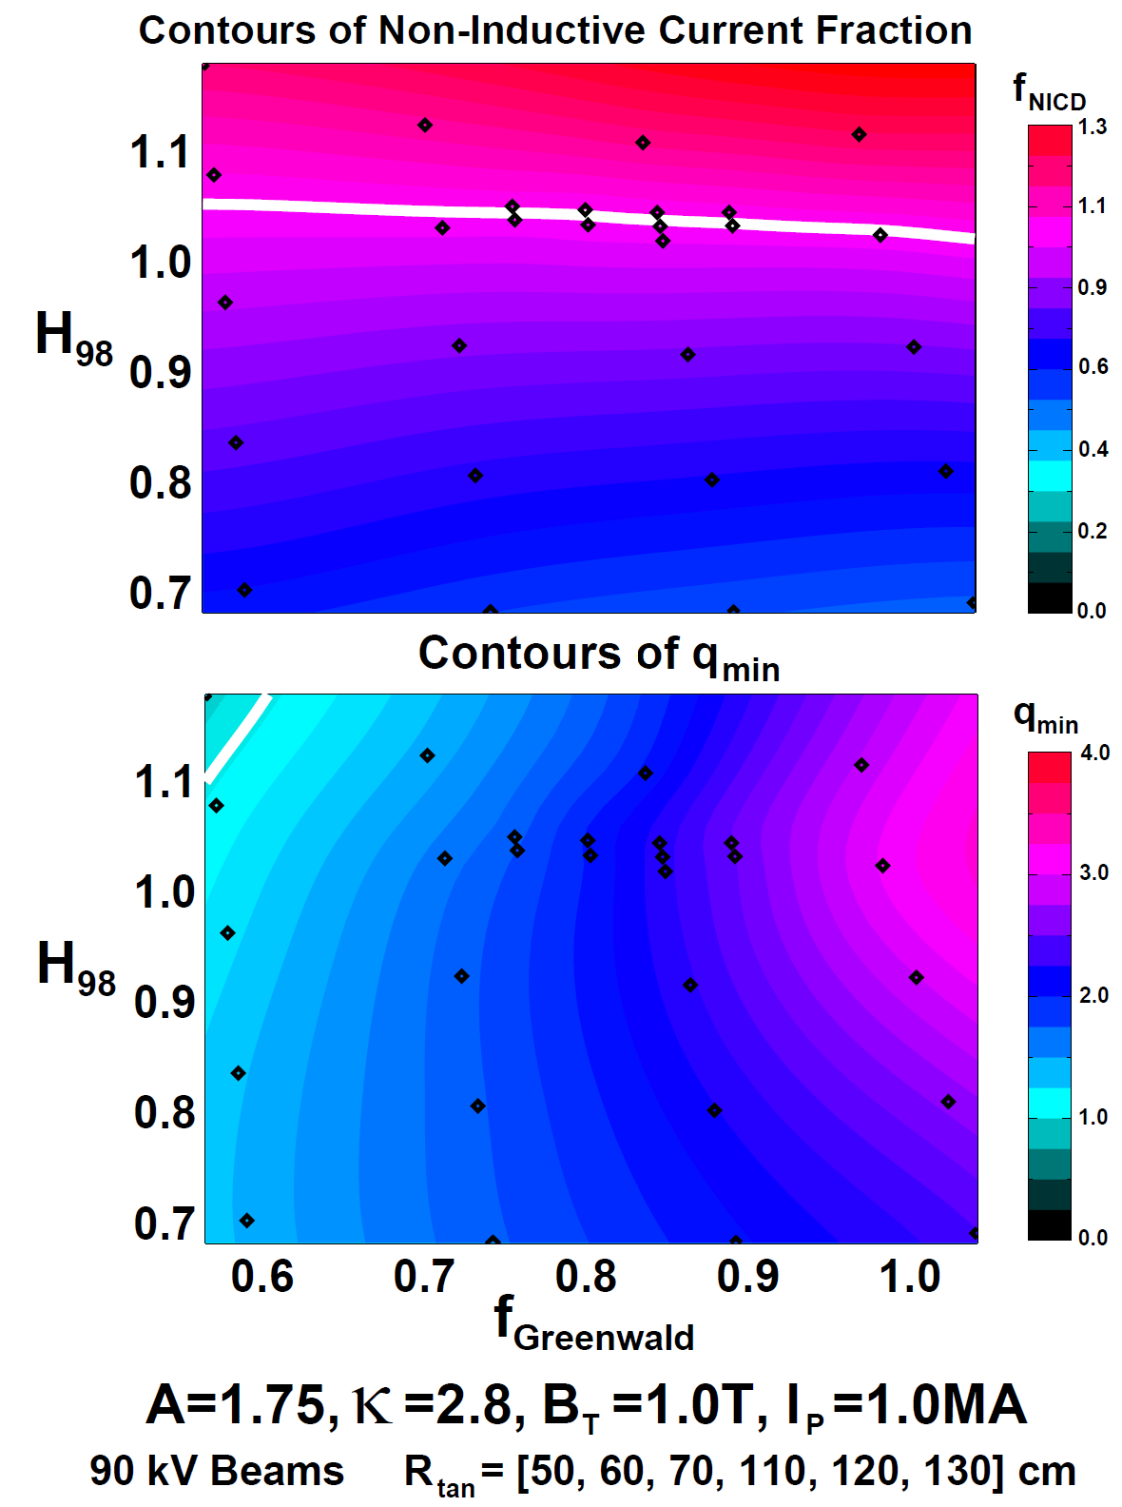
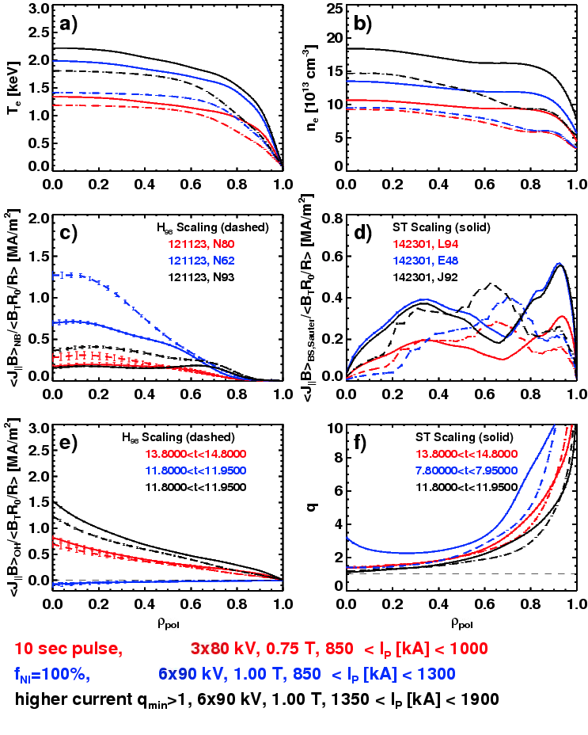
Free-boundary TRANSP modeling of range of
NSTX Upgrade scenarios extended in FY2011
Advanced Scenarios and Control
S. Gerhardt – NF in prep
J. Menard - NSTX-U overview – submitted to NF

Slide 34
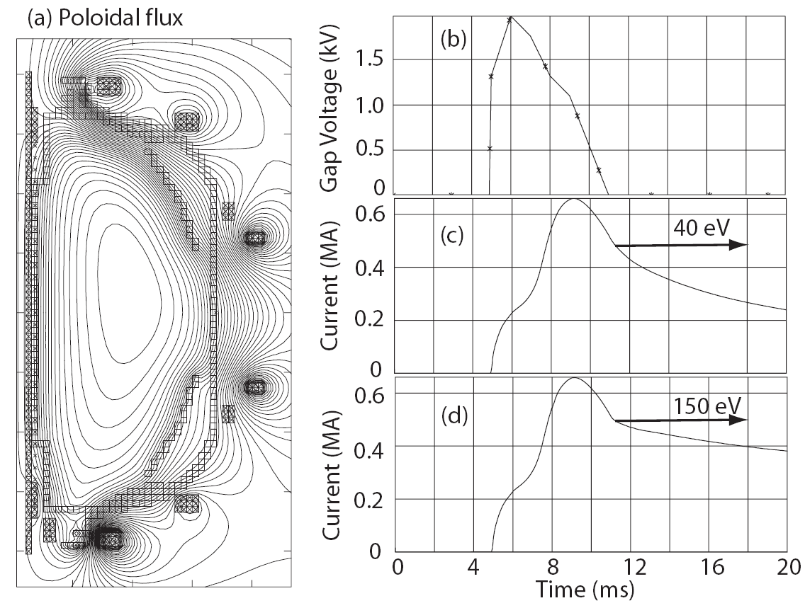
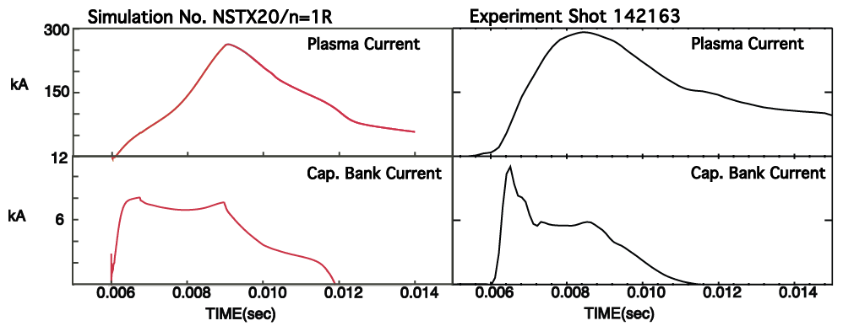
Simulations of CHI project to increased start-up current in NSTX Upgrade
CHI
TSC simulations of transient CHI start-up in NSTX-U have been performed
TF increased to 1 T and injector flux increased to about 80% of max allowed → can generate up to ~600kA of toroidal current
  Figs (a-c): T_{e} = 40 eV, Z_{eff} = 2.5
  Fig (d): T_{e} = 150 eV for t > 12 ms
R. Raman – U. Wash
NIMROD simulations of CHI have been initiated
Initial comparisons of simulated (left) with experimental (right) injector current and plasma current are favorable
B. Hooper

Slide 35
Research Results Summary
Joint Research Target:
  NSTX pedestal structure systematically assessed for first time
  Effects of lithium on edge transport and pedestal stability quantified
Milestone research highlights
  Investigated modes (ETG, μ-TM) responsible for anomalous transport
  Quantified vertical and kink stability vs A, RWM versus collisionality
  Snowflake-divertor: heat flux mitigation with detachment, control
  Calculate impurity ion transport from 3D fields measurable at higher T_{i}
    Consider testing impurity 3D transport physics in another device during outage
Additional research highlights
  Continuous increase in τ_{E} with Li, assessing Li PFC temperature clamping
  Extended scenario modeling for NSTX-U, CHI projects favorably to NSTX-U

Slide 36
Staff plans for FY2012-13 analysis and research
Complete analysis and publication of FY2011-12 data
Develop, write NSTX Upgrade 5 year plan for 2014-18
  Draft outline of research plan is provided in subsequent slides
Planning and design studies supporting post-Upgrade ops:
  Start-up: CHI upgrades, point helicity injection (plasma guns)
  Boundary: Divertor cryo-pumps, divertor diagnostics
  Lithium: Additional Mo tiles, upward Li evaporators, next-gen LLD
  Transport, EP: New high-k scattering, polarimetry, assess solid-state NPA
  MHD: 3D-coil physics design for RWM/RMP/TM/EFC/NTV/TAE + disruption force diagnostics, disruption precursor ID
  Control: Real-time-MSE for NBI J-profile control, rt-control of heat flux
Collaborate on domestic and international facilities
  Initial collaboration planning process described in subsequent viewgraph
Update/extend physics design of ST-FNSF
  LDRD to further develop design concepts, utilize NSTX team expertise
  Predictive modeling of start-up, sustainment, transport, stability, divertor

Slide 37
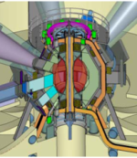
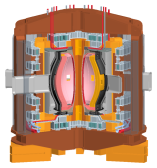
FY2012 LDRD proposal: NSTX/ST researchers will contribute to study of Mission and Configuration of an ST-FNSF
Overarching goal of studies:
  Determine optimal mission, performance, size
Review proposed ST devices: UK-CTF, FNSF, Pilot Plant, others
The goals of this study are:
  Put physics and engineering design basis on more uniform footing
  Review existing designs, identify advantageous features, utilize these features in an updated and potentially improved configuration
  Assess potential of designs to achieve T self-sufficiency
  Assess maintainability and upgradeability of internal components (divertors, shields, blankets), identify maintenance strategies
  Perform at least one self-consistent and detailed physics and engineering assessment for use by community
  Strong ST community input for definition, mission, design (STCC)
Partially fund 6 PPPL/non PPPL engineers, input from 13+ NSTX physicists, also encourage non-US collaboration

Slide 38
Held team-wide discussions on FY12-13 collaboration opportunities and expectations
Collaboration should aim to support NSTX-Upgrade mission
For all researchers, use Upgrade outage as opportunity to:
  Extend and improve your ongoing and future research on NSTX
  Learn about other facilities – bring back knowledge, best practices
  Try or learn something new – new physics, diagnostics, analysis, …
Aim to form small teams from NSTX (PPPL + non-PPPL)
  Coordinating research plans, analysis, travel, and participation
Expectations for researchers:
  Select 1 primary and 1 secondary/backup collaboration project
  Aim for first author paper (Nature, PRL, NF…), invited presentation
  At very least, be a co-author, extend/improve your NSTX research
  Present results periodically to NSTX, PPPL research seminars
Facilities: MAST, DIII-D, C-Mod, LHD, EAST, KSTAR, JET, small expts, PPPL, ITER diagn.
Funding: PPPL covers salaries of PPPL NSTX researchers by default
Challenge: no additional NSTX funding dedicated to collaboration

Slide 39
NSTX Made Excellent Progress in FY 2011
The NSTX team will remain productive throughout Upgrade outage
• All of the facility and diagnostic milestones including those for the ARRA funded upgrades were completed on schedule except for the run week milestone due to the TF fault
• All the research milestones were completed except for the 3D field milestone (R-4) which was partially completed
• NSTX research team was highly productive in terms of honors, publications and invited talks at major conferences
• NSTX team responded rapidly to the TF fault event:
  Identified the cause of the TF fault and incorporated necessary changes to the Upgrade TF bundle manufacturing process
  Decision was made to go into the upgrade outage immediately to accelerate the upgrade completion by ~ 6 months
• A detailed planning process has been initiated to utilize the researchers most productively through data analyses, publication / conference presentations, national and international collaborations, and planning for the post upgrade operation

Slide 40
Backup

Slide 41
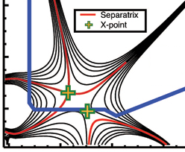
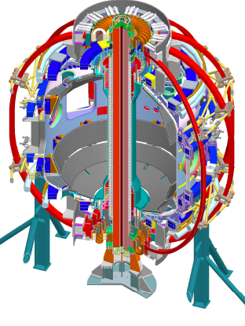
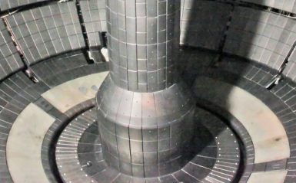
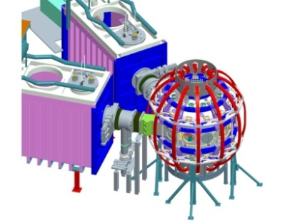
NSTX Upgrade + follow-on upgrades will enable access to broad range of new ST regimes
2009 | 2010 | 2011 | 2012 | 2013 | 2014 | 2015 | 2016 | 2017 | 2018
1 MA Plasma
Upgrade Outage
1.5 → 2 MA Plasma
HHFW Upgrade
New Center-Stack
1 MW ECH/EBW
NSTX Upgrade Research Goals
• Low collisionality plasma regimes
• 100% non-inductive operation
• Long-pulse, high power divertor
• Advanced high-β scenarios
2nd NBI
Moly-tile
LLD
Long–pulse
Divertor
CHI Control Coils
0.5 MA CHI
New Center-stack
1 MA CHI / Plasma Gun
0.5 MA Plasma Gun
NCC
Upgrade
“Snowflake”
Secondary
PP option
Primary
PP option
2nd NBI
Existing
coils
Lithium
Non-axisymmetric Control Coils (NCC)

