Slide 1




NSTX-U
Supported by
NSTX-U Project Status
Culham Sci Ctr
U St. Andrews
York U
Chubu U
Fukui U
Hiroshima U
Hyogo U
Kyoto U
Kyushu U
Kyushu Tokai U
NIFS
Niigata U
U Tokyo
JAEA
Tsukuba U
Hebrew U
Ioffe Inst
RRC Kurchatov Inst
TRINITI
NFRI
KAIST
POSTECH
SNU
ASIPP
ENEA, Frascati
CEA, Cadarache
IPP, Jülich
IPP, Garching
ASCR, Czech Rep
Columbia U
CompX
General Atomics
FIU
INL
Johns Hopkins U
LANL
LLNL
Lodestar
MIT
Nova Photonics
New York U
ORNL
PPPL
Princeton U
Purdue U
SNL
Think Tank, Inc.
UC Davis
UC Irvine
UCLA
UCSD
U Colorado
U Illinois
U Maryland
U Rochester
U Washington
U Wisconsin
Masa Ono
for the NSTX-U Team
NSTX-U FY 2013 Q4 Review Meeting
October 22, 2013

Slide 2
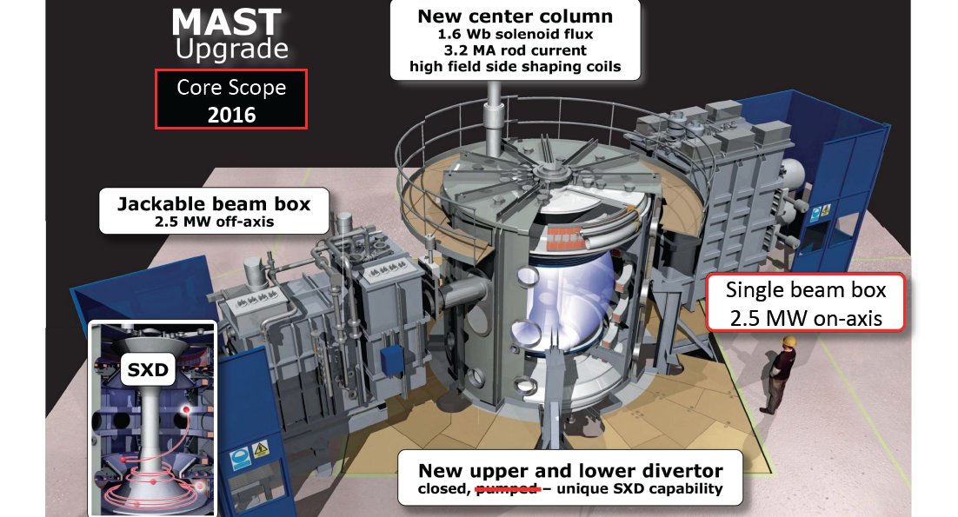
International ST Workshop in York UK
Sept 16 – 19, 2013, http://www.york.ac.uk/physics/ypi/istw2013/
• NSTX-U related presentations were NSTX Upgrade Project (M. Ono), NSTX Upgrade Program (J. Menard), FNSF Design (J. Menard), CHI (B. Nelson, UW), HHFW Theory/Modeling (M. Peng, ORNL)
• Many nice science talks particularly from the MAST team.
• MAST-U generated 70 kA with 70 kW of ECH at 28 GHz. QUEST also generated ~ 65 kA with ECH at 28 GHz.
• A. Sykes of Tokamak Solutions talked about very compact ST reactor concept with R₀ ~ 1 m using high temperature SC with minimal neutron shields.
• GLOBUS-M is now upgrading the machine for GLOBUS-M2. It aims to increase the toroidal field B_{T} and plasma current I_{p} by a factor of 2.5 to 1 T and 0.5 MA.
• MAST has concluded its operation and started its upgrade outage. Plan to be operational by 2016.

Slide 3
Third International Li Symposium in Rome, Italy
Oct. 7 - 11, 2013, http://www.isla2013.enea.it
• Over 50 presentations from US, China, Russia, Japan, Italy, and Spain, Israel, Latvia, Ukraine, Kazakhstan, Greece, and Netherlands. Fusion Devices: FT-U NSTX, HT-6, EAST, T-10, T-11M, RFX, TJ-2, Lithium Facilities: IFMIF, KTM, UI, MAGNUM-PSI, TJ-2.
• NSTX Invited: “RLLD/ARLLD” by M. Ono, “High-temperature, LL plasma-facing component research for NSTX-U” by M. A. Jaworski, and “Li sputtering from lithium-coated graphite plasma facing components in NSTX divertor” by F. Scotti (PU).
• NSTX Orals: “Divertor deuterium recycling and oxygen influxes in Li experiments on NSTX” by V. A. Soukhanovskii (LLNL), “Measurements and Interpretive 2D Edge Modeling of Lithiated NSTX Discharges” by T.K Gray (ORNL), “Erosion and re-deposition of Li coatings on TZM molybdenum and graphite during high-flux plasma bombardment” by T. Abrams (PU), “An apparatus for the repetitive injection of Li granules into fusion research devices” by D. K. Mansfield, “A LL dripper for fueling and ELM pacing in NSTX-U” by D. Andruczyk (UI), and “E-beam flash evaporator for NSTX-U” by A.L. Roquemore.
• NSTX Poster: “Effect of Charge Exchange on Lithium Cooling in the Tokamak Scrape-Off Layer near the Divertor Surface” by M. Constantin (PU).
• R. Nygren (SNL) led a special session on Lithium-Safety and Lithium Handling,
• R. Goldston (PPPL) led a Panel Discussion on lithium feasibility for fusion reactors.

Slide 4
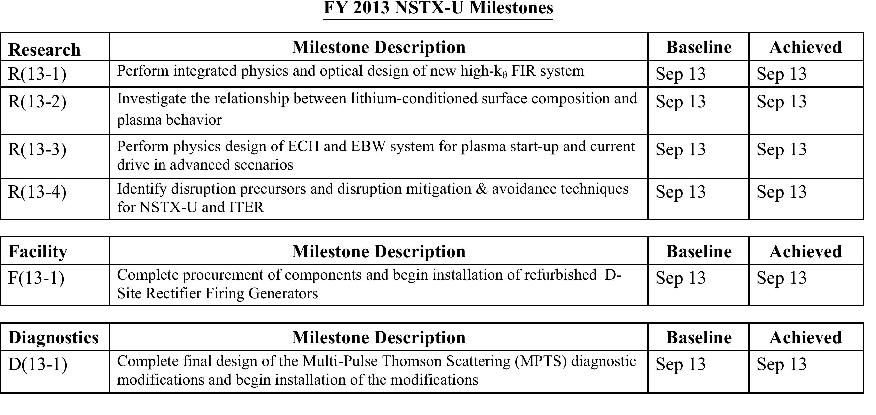
Successful Implementation of FY13 Milestones
Mainly Through Data Analyses, Theory/Modeling, and Collaborations
FY 2013 NSTX-U Facility Joint Research Milestone
Conduct experiments on major fusion facilities, to evaluate stationary enhanced confinement regimes without large Edge Localized Modes (ELMs), and to improve understanding of the underlying physical mechanisms that allow increased edge particle transport while maintaining a strong thermal transport barrier. … Candidate regimes and techniques have been pioneered by each of the three major US facilities (C-Mod, D3D and NSTX). … Exploiting the complementary parameters and tools of the devices, joint teams will aim to more closely approach key dimensionless parameters of ITER, and to identify correlations between edge fluctuations and transport. The role of rotation will be investigated. The research will strengthen the basis for extrapolation of stationary high confinement regimes to ITER and other future fusion facilities, for which avoidance of large ELMs is a critical issue. Stefan Gerhardt of NSTX-U coordinated the FY 2013 JRT and the final report has been submitted to DOE.
Notes:
4

Slide 5
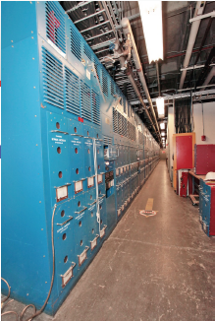
F(13-1) Complete procurement of components and begin installation of refurbished D-Site Rectifier Firing Generators
The D-site rectifiers (74 identical Transrex AC/DC Convertors of the NSTX Field Coil Power conversion System (FCPC) ) provide a pulsed power capability of 1800 MVA for 6 seconds every 300 seconds.
The new 34 Firing Generator (FG) delivers firing pulses to 68 convertors with far greater resolution, precision, and repeatability for NSTX-U. Becomes particularly critical for the new 8-parallel, 130kA TF system configuration.
Transrex AC/DC Convertors
Status:
All 34 Firing Generators have been completed and delivered to FCPC. More than half have been installed in rectifiers.
Fiber-optic control/communication links to be installed by end of November. Controls testing is expected to be complete by the end of the CY.
Open circuit rectifier testing will be in progress by the early spring. Multiple rectifier power testing is expected by June, 2014.

Slide 6
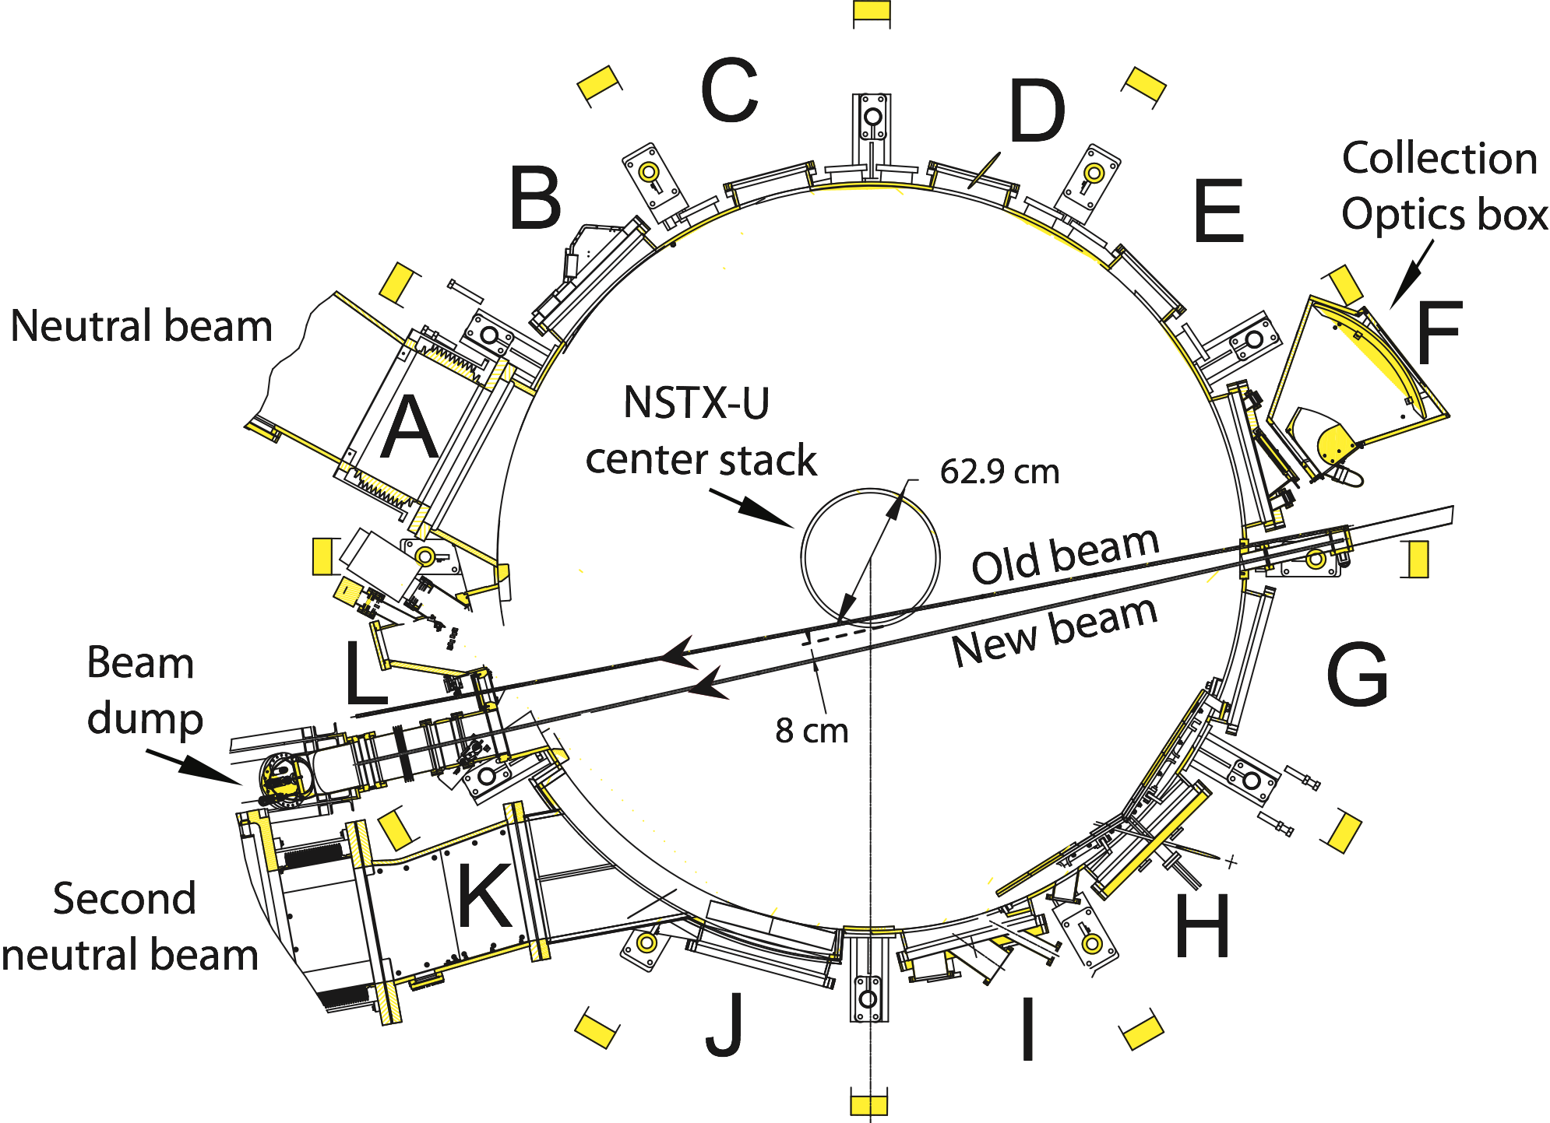
D(13-2) Complete final design of the Multi-Pulse Thomson Scattering (MPTS) diagnostic modifications and begin installation
Modification of the MPTS system is needed to accommodate the larger diameter NSTX-U Center Stack - Re-aim the laser beam, the light collection optics, redesign the beam dump, and calibration probe to be ready for the first plasma.
MPTS Midplane Cross Section
FY 13 Accomplishments:
Design of the reconfigured MPTS system to meet these requirements was completed in FY2013 and three final design reviews were held to validate the design of the ex-vessel components.
The new laser exit port and the new laser input port were installed on the vacuum vessel in FY2013.
Fabrication and procurement of many of the needed ex-vessel components is underway and fabrication drawings for the remaining ex-vessel components are being prepared.
The reconfigured MPTS diagnostic will be installed in FY2014 prior to NSTX-U first plasma and commissioned in early experimental operation following first plasma.
• Ahmed Diallo recently received an Early Career Research Program award - will install a fast rep rate (10-15 kHz) burst mode (5 ms) third laser for studies of ELMs and other fast phenomena in FY15.

Slide 7
Repair of the Motor Generator
(MG#1)
In 2004, Magnetic Particle Inspections identified cracking in the weld fillet of multiple joints between the radial arms of MG#1. Cracks were in primary load paths, taking that set out of service. MG#2 is in limited operations (run and monitor at reduced parameters) with cracks in “stiffener” welds intended to limit elastic deformation (not in primary load paths).
  Over 250” of welds in 19 rotor spider joints will be ground out and replaced to restore MG#1 to its original design configuration.
  A jacking system has been engineered to relieve all loads on the rotor assembly during the repair.
  PPPL and GE engineering collaborated on the detailed repair procedure (D/NSTX-RP-MG-07).
Status: Target completion date in Feb. 2014
A Statement of Work to perform the scope described in the repair procedure has been reviewed and approved.
Fixed-price proposals for the weld repairs have been received. A WAF capturing all project costs (PPPL and Sub-contractor) is being generated.
A draft Project Management Plan has been developed.

Slide 8
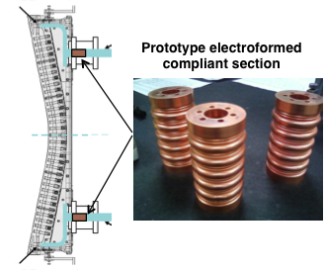
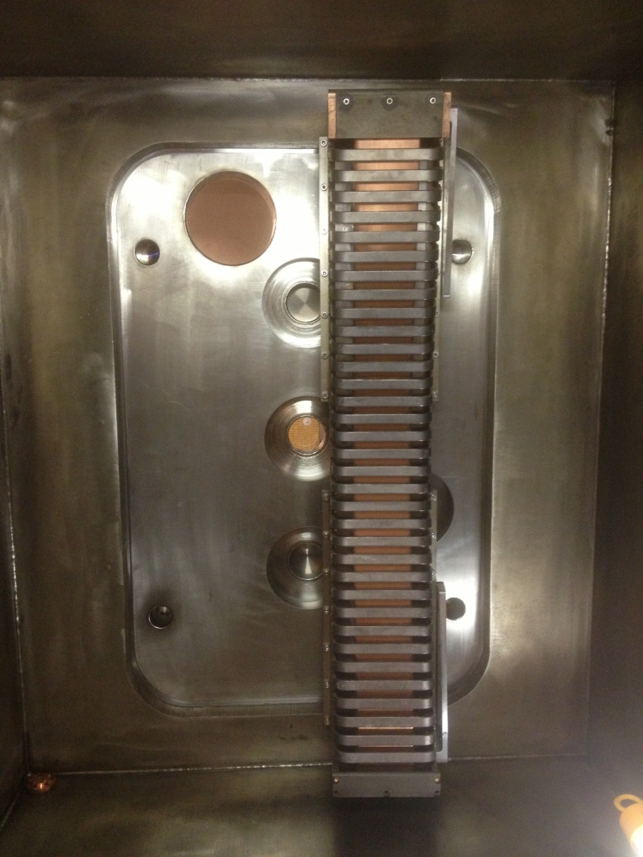
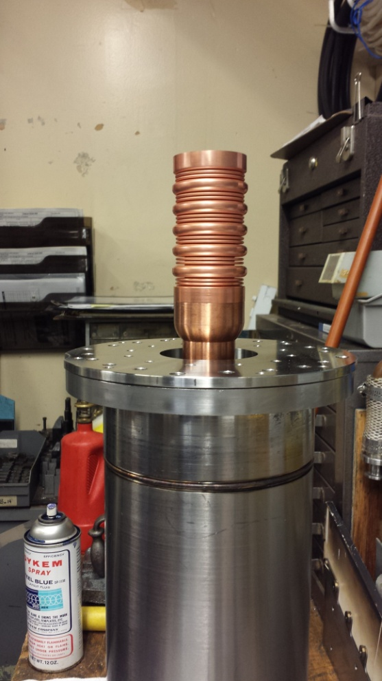
New Compliant HHFW Antenna Feeds
Will allow antenna feedthroughs to tolerate 2 MA disruptions
HHFW antenna tests planned in RFTF
Installation on feed-thru
Prototype feeds procured.
Feeds to be tested in the RF test-stand before FDR, installation in spring 2014.
Inside of RF Test Stand with one antenna assembly.

Slide 9
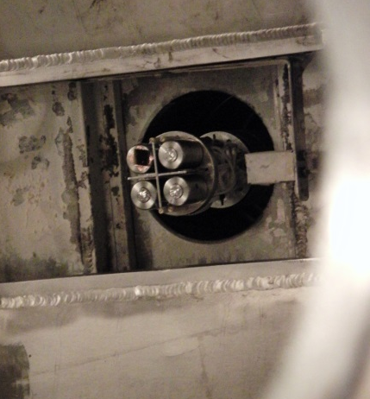
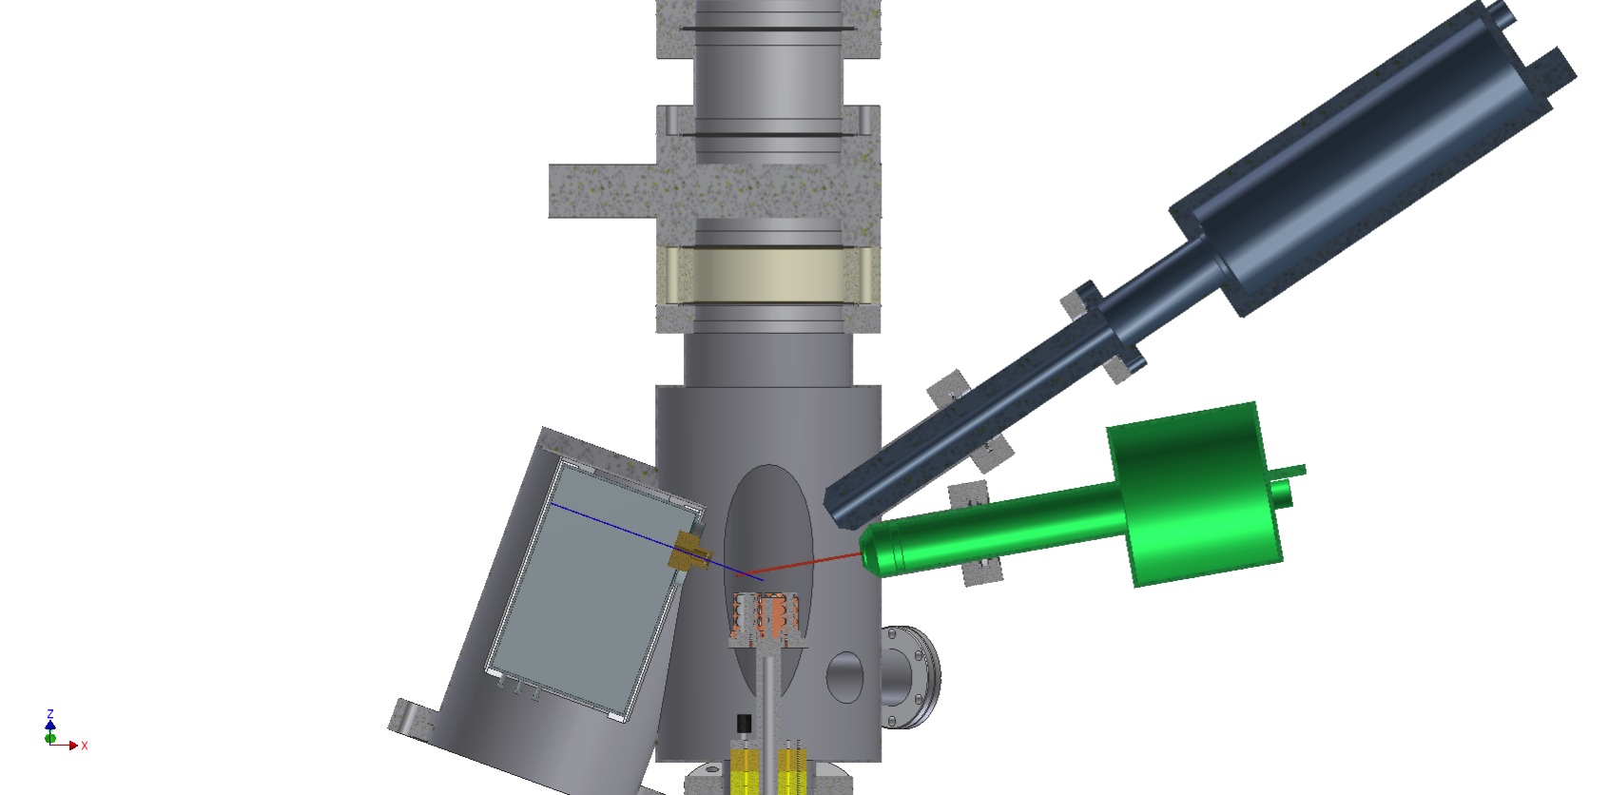
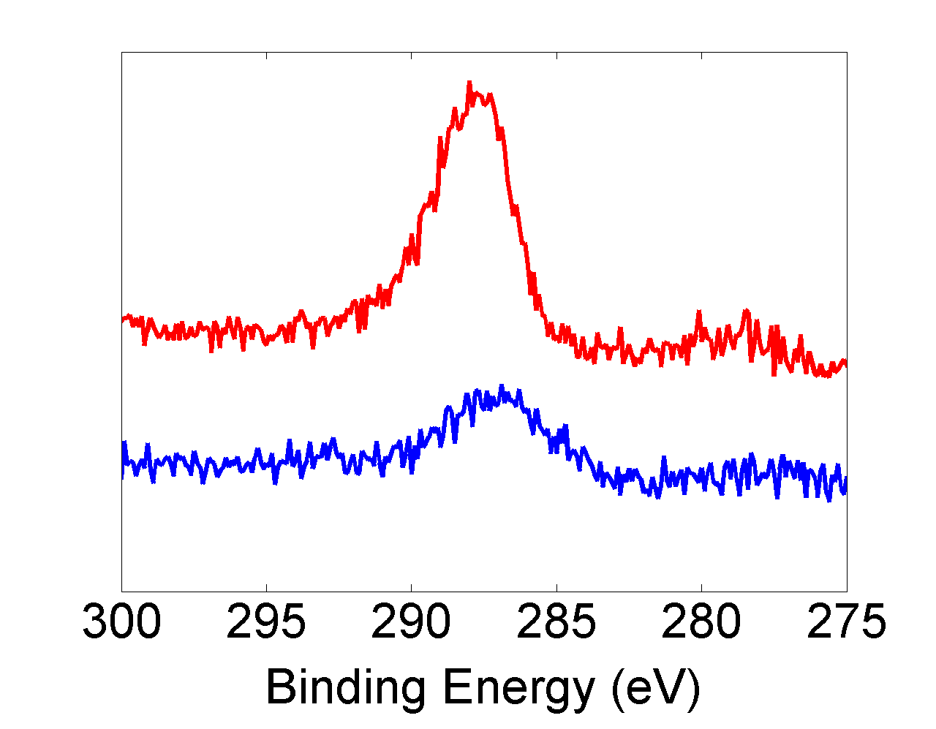
MAPP measurements of LTX surface after wall conditioning
Contributed to R13-2 Milestone
electron analyzer
The Materials Analysis Particle Probe (MAPP) enables the prompt analysis of components exposed to tokamak plasmas.
Lithium Tokamak Experiment is dedicated to the study of liquid lithium as a plasma-facing component (PFC).
Argon Glow Discharge Cleaning (GDC) on LTX:
  doubled the tokamak plasma current to > 20 kA
  extended the duration to 25 – 30 ms.
MAPP X-ray photo-electron spectroscopy showed reduction of surface carbon with GDC.
Direct measurements of effect of GDC on surface of tokamak plasma-facing components.
MAPP on LTX
samples
analysis chamber
ion gun
Carbon XPS spectra
x-ray
source
before argon GDC.
counts
after argon GDC.
R. Kaita, M. Lucia J.P. Allain, F. Bedoya
Notes:
LTX is a small tokamak at PPPL that you can see on the tour on Tuesday evening. It is dedicated….
During the NSTX-U upgrade we have used an upgraded sample probe called MAPP on LTX. First results show the effect of an argon GDC on carbon contamination of a plasma facing stainless steel surface.
NSTX-U_FY2013_year-end-report_v13.docx p. 31
Progress of MAPP: Materials Analysis Particle Probe
The Materials Analysis Particle Probe (MAPP) [R13-2-1] has been designed to allow the prompt analysis of plasma-facing components exposed to tokamak plasmas. During FY13, MAPP detector and software improvements were made at the Purdue University. The upgraded MAPP (MAPP-U) was returned to PPPL in June of 2013, and attached to a midplane port on the Lithium Tokamak Experiment (LTX) as shown in Fig. R13-2-1a.
Up to four different samples can be exposed to tokamak plasmas and analyzed individually with the MAPP-U diagnostics. In the present study, three samples were stainless steel, which matched the plasma-facing components (PFCs) of LTX, and the fourth was gold to use its well-characterized binding energy spectrum for calibration [R13-2-2]. When inserted into the LTX vessel, the MAPP-U samples were flush with the inner surface of the conducting shell (Fig. 13-2-1b). When the plasma was outboard-limited, MAPP-U samples also served as a limiting surface.
Plasmas in LTX with uncoated stainless steel PFCs lasted around 10 ms and had maximum currents of about 12 kA, even after argon glow discharge cleaning (GDC). Approximately 15 grams of lithium were introduced into the bottom of each shell half, with little effect on the achievable plasma current or pulse duration. Argon GDC was then performed, resulting in a doubling of the plasma current to over 20 kA and the pulse length extending to the 25 – 30 ms range. The need for the GDC may be due to the limited PFC coverage with lithium, since helium GDC had to be performed between shots when lower lithium evaporation rates were used on NSTX [R13-2-3].
X-ray photoelectron spectroscopy (XPS) was used to analyze the samples before and after exposure to LTX plasmas. The improvement in plasma performance correlates with clear changes in the XPS data. Figure R13-2-2a compares XPS measurements before and after the MAPP-U samples were exposed to argon GDC. In the pre-exposure data, there are significant peaks correspond to carbon slightly below 300 eV (C(1s)), and oxygen above 500 eV (O(1s)). The carbon peak in particular is substantially reduced after GDC, but more conspicuously, peaks that are identifiable with the stainless steel (i. e., iron, chromium, and nickel) become observable (Fig. R13-2-2b).
The MAPP-U data are the first that relate direct PFC measurements with the behavior of tokamak plasmas immediately after surface conditioning techniques are applied. The results are in general agreement with previous in situ XPS analysis of GDC on stainless steel [R13-2-4]. The change they suggest for the PFCs as an impurity source is consistent with earlier LTX observations of increased carbon and oxygen influx when plasma conditions degrade.

Slide 10
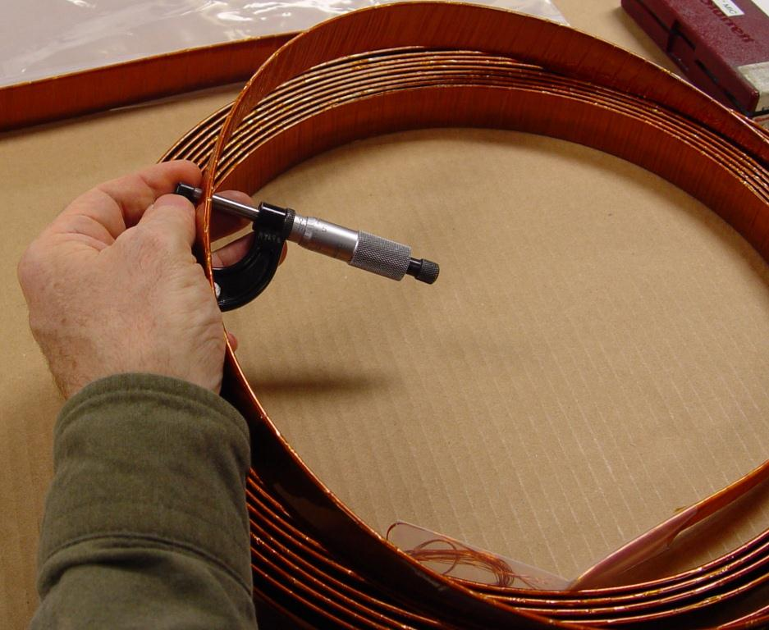
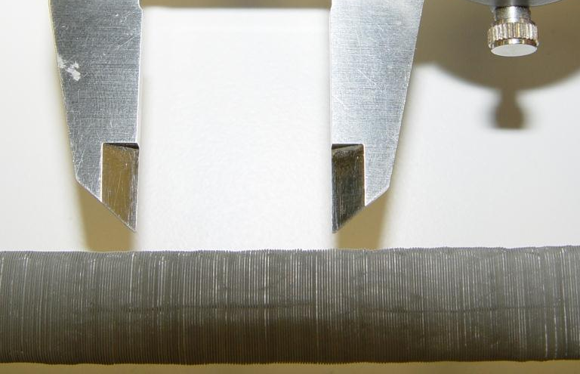
Most Center Stack Diagnostics Fabricated
Manufacture of Mirnov coils and Rogowski coils complete
  Includes extra Mirnov coils and “segmented” Rogowski coils for halo current measurements
All copper and thermocouple wires procured
  Satisfy specialized material and insulation requirements for installation under plasma-facing components
Graphite Langmuir probe tips complete
  Fabrication of all center stack diagnostic components will be finished when insulators for probes in tiles are machined
Procedures nearly complete for installation of diagnostics when center stack is ready
Plasma Current Rogowski Coil
Halo Current Rogowski Coil

Slide 11
NSTX-U diagnostics to be installed during first 2 years
Half of NSTX-U Diagnostics Are Led by Collaborators
MHD/Magnetics/Reconstruction
  Magnetics for equilibrium reconstruction
  Halo current detectors
  High-n and high-frequency Mirnov arrays
  Locked-mode detectors
  RWM sensors
Profile Diagnostics
  MPTS (42 ch, 60 Hz)
  T-CHERS: T_{i}(R), V_{φ}(r), n_{C}(R), n_{Li}(R), (51 ch)
  P-CHERS: V_{θ}(r) (71 ch)
  MSE-CIF (18 ch)
  MSE-LIF (20 ch)
  ME-SXR (40 ch)
  Midplane tangential bolometer array (16 ch)
Turbulence/Modes Diagnostics
  Poloidal Microwave high-k scattering
  Beam Emission Spectroscopy (48 ch)
  Microwave Reflectometer,
  Microwave Polarimeter
  Ultra-soft x-ray arrays – multi-color
Energetic Particle Diagnostics
  Fast Ion D_{α} profile measurement (perp + tang)
  Solid-State neutral particle analyzer
  Fast lost-ion probe (energy/pitch angle resolving)
  Neutron measurements
Edge Divertor Physics
  Gas-puff Imaging (500kHz)
  Langmuir probe array
  Edge Rotation Diagnostics (T_{i}, V_{φ}, V_{pol})
  1-D CCD H_{α} cameras (divertor, midplane)
  2-D divertor fast visible camera
  Metal foil divertor bolometer
  AXUV-based Divertor Bolometer
  IR cameras (30Hz) (3)
  Fast IR camera (two color)
  Tile temperature thermocouple array
  Divertor fast eroding thermocouple
  Dust detector
  Edge Deposition Monitors
  Scrape-off layer reflectometer
  Edge neutral pressure gauges
  Material Analysis and Particle Probe
  Divertor VUV Spectrometer
Plasma Monitoring
  FIReTIP interferometer
  Fast visible cameras
  Visible bremsstrahlung radiometer
  Visible and UV survey spectrometers
  VUV transmission grating spectrometer
  Visible filterscopes (hydrogen & impurity lines)
  Wall coupon analysis
New capability, Enhanced capability

Slide 12
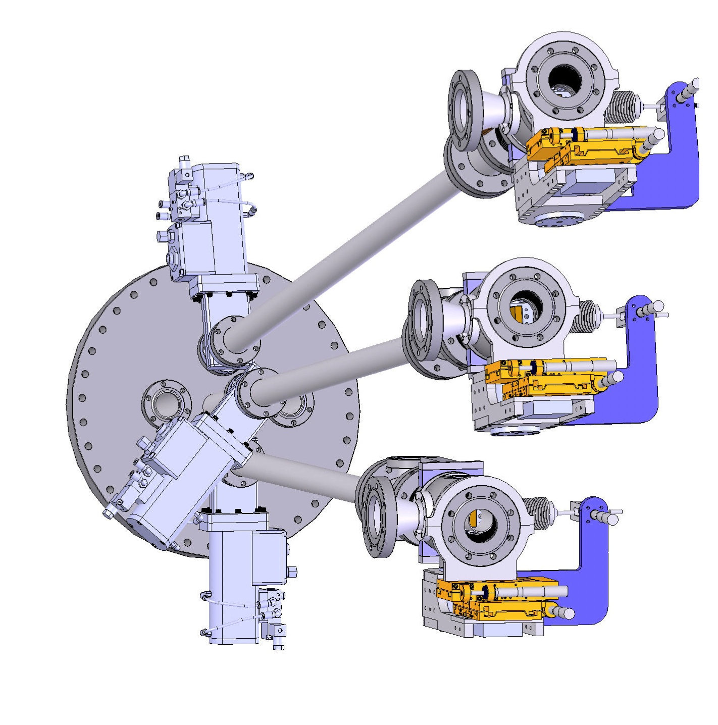
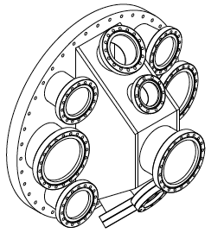
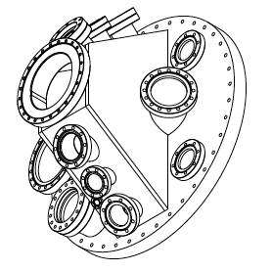
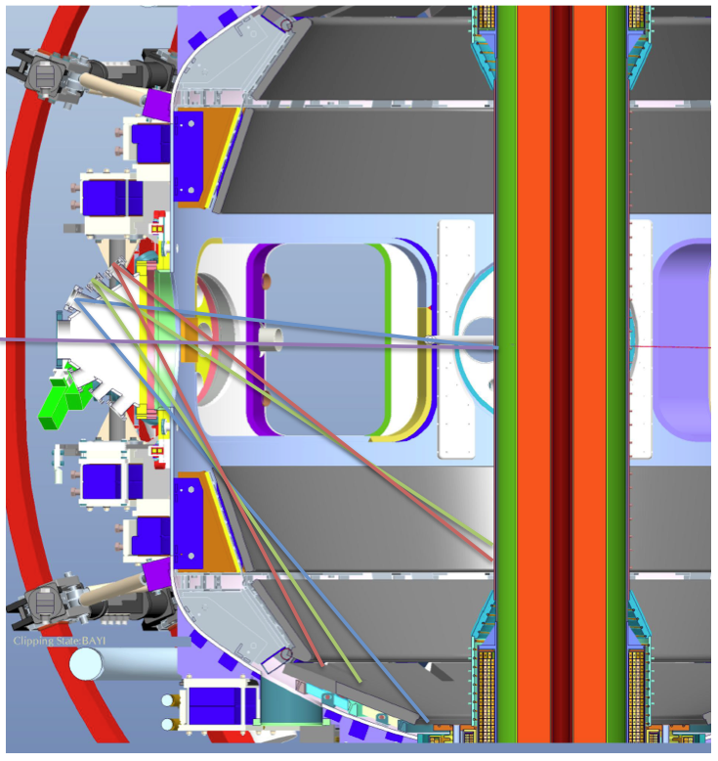
New Port Covers Have Been Designed For Bays E, I, J, and L
Detailed Design to Accommodate Enhanced NSTX-U Diagnostic Access Needs
Bay E Supports 3
UV Spectrometers (LoWEUS, XEUS, MonaLisa) and MIG1
Bay J Supports
IR and Visible Cameras, UT-K and Divertor Spectrometers, Upward LITER, UCLA Reflectometer and Polarimeter, LBO, RF Probe.
Bay I Supports
XCS, TGS, IR & Visible Cameras, SSNPA, SGI, 1D CCD & EIES, Microwave Imaging, QMB, Bolometers
Design is very close to done.
Bay-L Cap (not shown) Supports
MPTS exit window, High-k exit, plasma TV+GPI view, SSNPA, spectroscopy & CHERS view, GDC feedthroughs, magnetics feedthroughs.

Slide 13
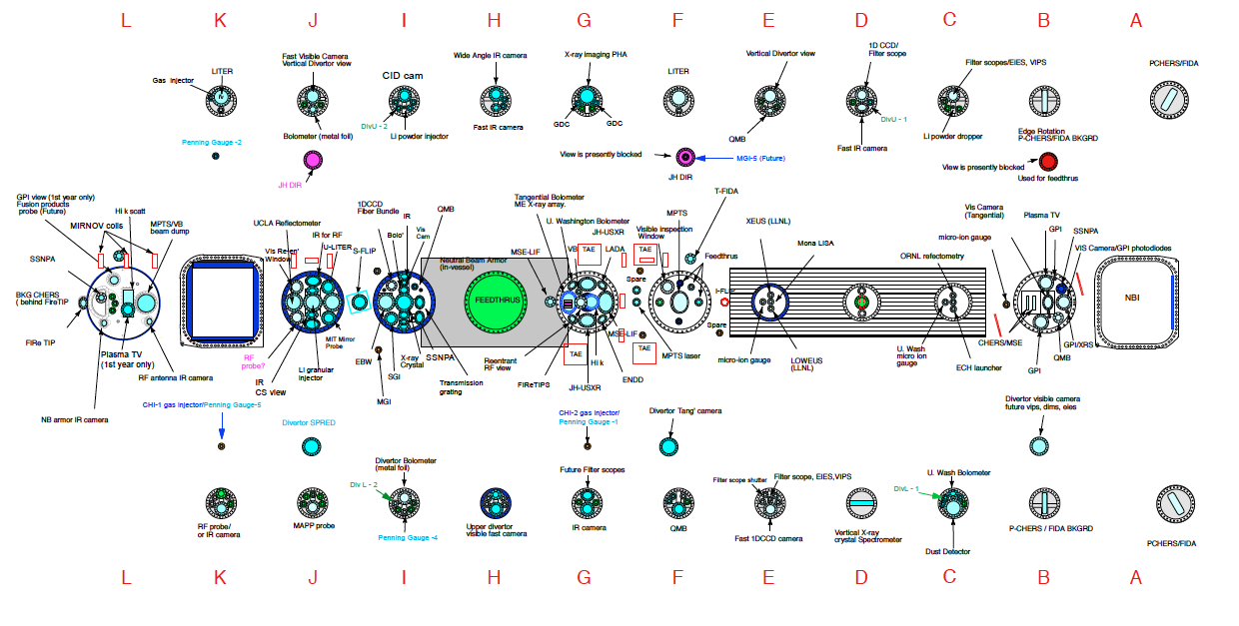
NSTX-U facility/diagnostics port assignment
Port flanges designed and being procured

Slide 14
Engineering and Diagnostic Development/Operations Supporting Numerous Diagnostic Upgrades
Oct. 1 - Dec. 13: Basic diagnostic interface installation, first calibrations.
Dec. 16 - Feb. 28: Test pump-down, leak checking and repair.
March 1 - April 15: Finish diagnostic installations and calibration.
Mid-plane Port Covers:
  Bay E port cover is finished and ready for installation.
    Supports suite of LLNL EUV instruments.
  Bay J port cover is nearly finished…needs some modifications at vendor.
    Supports LITER, Reflectometer & Polarimeter, RF Probe, various spectroscopy
  Bay I port cover design is at the vendor…working out final details of their fabrication plan.
    Supports SSNPA, TGIS, Bolometry,XICS, IR Cameras, QMB,…
Diagnostic systems that are unchanged will be installed as part of a generic procedure.
Diagnostic systems that are new or heavily modified will need dedicated installation procedures.
Key near term task: get as many diagnostic vacuum interfaces as possible on machine by December.

Slide 15
Transition into operations- planning underway
NSTX-U Start-up Process Similar to NSTX
NSTX-U ISTP, Commissioning, and Startup will follow the same process as NSTX initial commissioning and startup from February 1999.
Pre-operational test of subsystems (PTP’S)
Activity Certification Committee (ACC) review
DOE Readiness Assessments (RA)
Integrated system test procedure (ISTP) (per OP-NSTX-02 rev 14)
CD-4 Demonstrated
Performance
Commence Operations and run XP’s
Activity Certification Committee (ACC) comprised of representatives from PPPL Engineering, Research, Safety, and the DOE Princeton Area Office to review newly installed subsystems before commissioning. System reviews are performed at completion of construction activities.
Led by the DOE Princeton Site Office (PSO), a Operational Readiness Assessment (ORA) will be made based on ACC and QA Audit reports before the project moves to start-up.
Safety Certificates allowing Power and then Plasma Operation will be issued upon the recommendations of the ORA.
Shake-down
Notes:
ACC > ORA >
PTP’s >>>ISTP OP-NSTX-02

Slide 16
NSTX-U Coil Energization
A programmable Digital Coil Protection System (DCPS) with control algorithms appropriate for NSTX-U parameters is being developed to protect both coils and structures.
Includes data acquisition, user interfaces, auto-testing, and standalone codes for algorithm verification and scenario development.
Systems are currently being installed with plans to begin pre-operational testing in Feb. 2014, and full system commissioning in June 2014.
1st year operating space parameters will be established and control algorithms verified.
Same algorithms will be applied to the Power Supply real Time Control System (PSRTC).
DCPS/PSRTC systems will be configured to support limited FCPC rectifier dummy load testing in Mar. 2014.

Slide 17
Plans to Rapidly Recover Physics Operations Capabilities
Plasma Operations with:
I_{p}≤1.0 MA, B_{T}≤0.5
Develop:
Breakdown and current ramp scenarios
Shape & position control
Reliable H-mode
Diagnostic operations
Continue to add diagnostic & control capabilities while initiating physics experiments.
ISTP:
(Integrated Systems Test Procedure)
Establishes facility in state of readiness for operations.
I_{p}≤1.5-1.6 MA
B_{T}≤0.75-0.8
Aug-Nov. 2014
ISTP-1 & CD-4 Prep
MPTS Calibrations, Bake Out, CD-4
Operations
Commissioning
Phys. Ops
ISTP-2
Phys.
Ops
~ 2-3 Months
ISTP-2
Required to increase the field and current for later research phase
Attempt 50 kA CD-4 plasma before bake-out. If water in PFCs prevents success, then repeat after bake-out.

Slide 18
Formulating Strategy Toward Full NSTX-U Parameters
After CD-4, the plasma operation could enter quickly into new regimes
 | NSTX (Max.) | Year 1 NSTX-U Operations (2015) | Year 2 NSTX-U Operations (2016) | Year 3 NSTX-U Operations (2017) | Ultimate Goal
I_{P} [MA] | 1.2 | ~1.6 | 2.0 | 2.0 | 2.0
B_{T} [T] | 0.55 | ~0.8 | 1.0 | 1.0 | 1.0
Allowed TF I²t [MA²s] | 7.3 | 80 | 120 | 160 | 160
I_{P} Flat-Top at max. allowed I²t, I_{P}, and B_{T} [s] | ~0.4 | ~3.5 | ~3 | 5 | 5
1st year goal: operating points with forces up to ½ the way between NSTX and NSTX-U, ½ the design-point heating of any coil
  Will permit up to ~5 second operation at B_{T}~0.65
2nd year goal: Full field and current, but still limiting the coil heating
  Will revisit year 2 parameters once year 1 data has been accumulated
3rd year goal: Full capability

Slide 19
NSTX-U Operation Preparation Well Underway
Exciting Opportunities and Challenges Ahead
• NSTX-U Team has been quite productive in all areas.
• NSTX-U researchers participated strongly in ISTW-2013 (STs) and ISLA-2013 (Lithium) workshops.
• All of the NSTX-U FY 2013 milestones accomplished on schedule.
• NSTX upgrade outage activities are progressing well
  Diagnostics were stored and secured for the upgrade activities. Collaborator diagnostics are being refurbished and enhanced.
  Researchers are working productively on data analysis, collaboration, preparation for the NSTX-U operation.
  NSTX operations technical staff were shifted to the Upgrade Project tasks in FY 2012 – 13. They will be shifted back to the NSTX-U operational preparation in FY 2014 as the Upgrade Project scopes are completed.
  NSTX Upgrade Project is thus far progressing on budget and on schedule.
  NSTX-U operational preparation is well underway.
  Diagnostic reinstallation are starting.
  Various engineering operations tools are being refurbished / upgraded including CHI gap, rectifier control, motor generator, plasma control system, and PF control.

