Slide 1


Columbia U. Group - Collaborative Research on NSTX-U for Disruption Avoidance
S.A. Sabbagh – for the Columbia U. / NSTX-U Group
(J.W. Berkery, J.M. Bialek, Y.S. Park)
Report to DOE and NSTX-U Program
PPPL
7/23/15
V1.1

Slide 2
Near 100% disruption avoidance is a critical need for future tokamaks; Columbia Research on NSTX-U is focused on this
The new “grand challenge” in tokamak stability research
  Can be done! (JET: < 4% disruptions w/C wall, < 10% w/ITER-like wall)
    ITER disruption rate: < 1 - 2% (energy load, halo current); << 1% (runaways)
Strategic plan: utilize/expand stability/control research success
  Disruption prediction, avoidance, and mitigation (DPAM) is multi-faceted, best addressed by a focused, (inter)national effort (multiple devices/institutions)
FESAC 2014 Strategic Planning report defined “Control of Deleterious Transient Events” highest priority (Tier 1) initiative
NSTX-U is a world-leading laboratory for focused research on disruption avoidance with quantitative measures of progress
  Columbia U. group endorsed by NSTX-U Program in a leadership role for this research, building on past success in MHD stability and control research

Slide 3
Columbia Group Research at PPPL provides key disruption avoidance research, emphasis on global mode stabilization
Physics Elements
  Kinetic RWM stabilization physics - unification between NSTX / DIII-D
  NTV used in plasma rotation control (supports NSTX-U V_{φ} control)
  Physics model-based active RWM state-space controller
  Dual-component sensor RWM PID control
  RWM control analysis of upgraded 3D coils for NSTX-U
  NSTX-U equilibrium reconstruction – key basis for stability analysis
  Planned real-time MHD spectroscopy for NSTX-U (in 5 Year Plan)
  Related high normalized beta and NTV experiments on KSTAR
Research synergism
  These elements now being brought together as part of a disruption prediction/avoidance system; NSTX-U DPAM working group formed)
  New Disruption Characterization and Prediction code / initial results
Response to DOE call for enhanced university participation
  CU-PPPL group outreach to Columbia U. APAM department; new diagnostic proposal to be submitted (Volpe/Sabbagh)
Princeton
student

Slide 4
Joint NSTX / DIII-D experiments and analysis gives unified kinetic RWM physics understanding for disruption avoidance
RWM Dynamics
  RWM rotation and mode growth observed
  No strong NTM activity
  Some weak bursting MHD in DIII-D plasma
    Alters RWM phase
  No bursting MHD in NSTX plasma
DIII-D (β_{N} = 3.5)
NSTX (β_{N} = 4.4)
rotation
growth
rotation
growth
ΔB_{p}^{n=1}(G)
amplitude
amplitude
phase
phase
φ_{Bp}^{n=1}(deg)
toroidal magnetics
toroidal magnetics
Frequency (kHz)
D_{α}
D_{α}
(arb)
S. Sabbagh et al., DIII-D/NSTX experiments
S. Sabbagh et al., APS Invited talk 2014
t (s)
t (s)

Slide 5
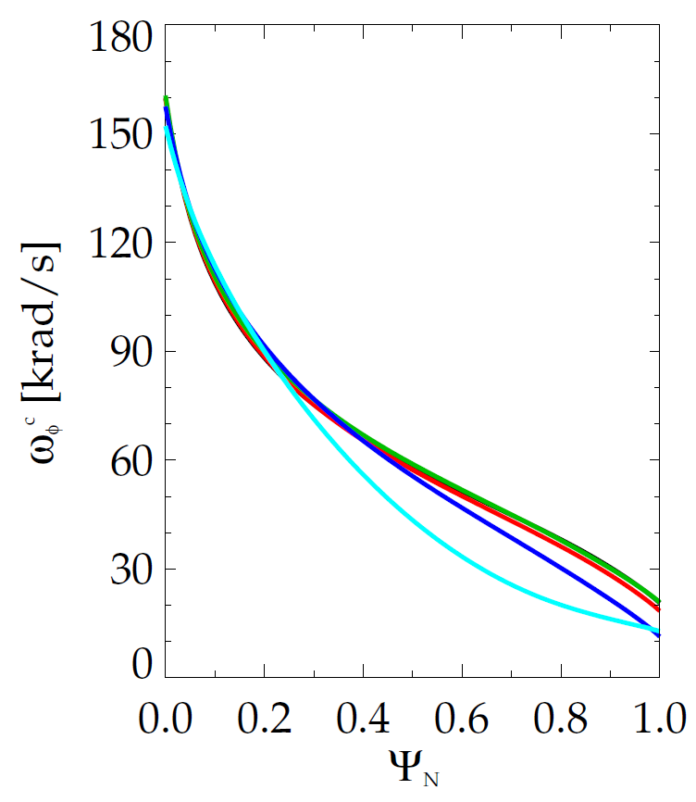
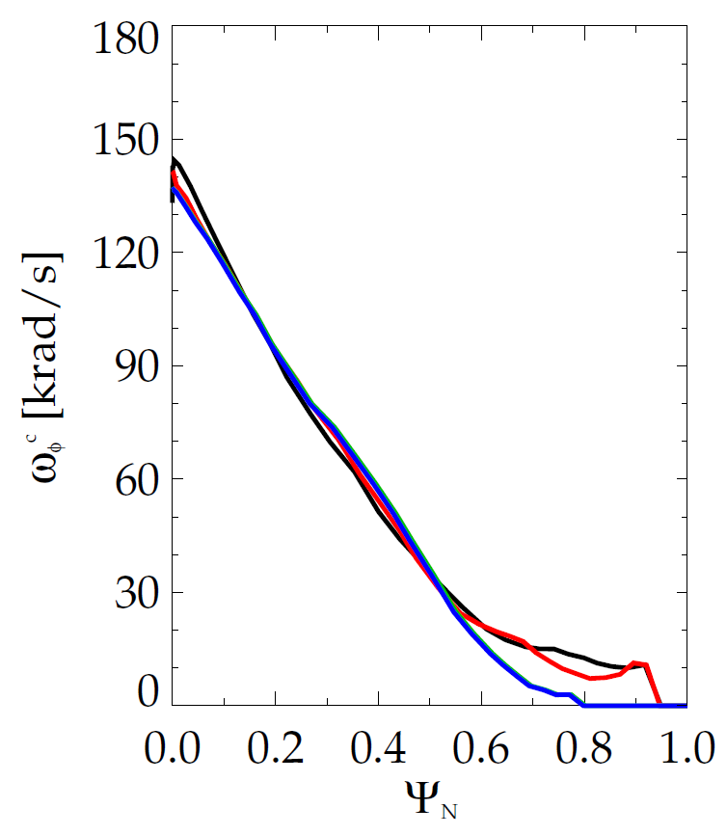
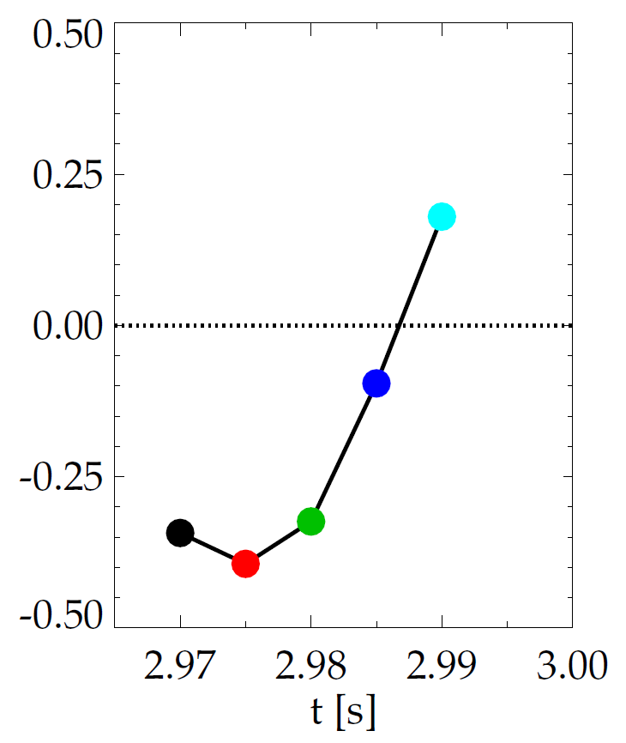
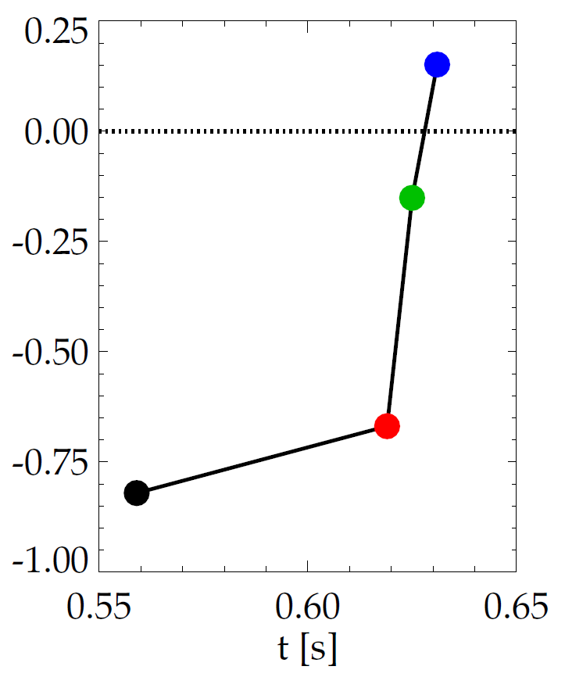
Evolution of plasma rotation profile leads to linear kinetic RWM instability as disruption is approached
DIII-D (minor disruption)
NSTX (major disruption)
unstable
stable
γτ_{wall}
unstable
γτ_{wall}
stable
MISK
MISK
increasing time
increasing time
S. Sabbagh et al., DIII-D/NSTX experiments; S. Sabbagh et al., APS Invited talk 2014

Slide 6
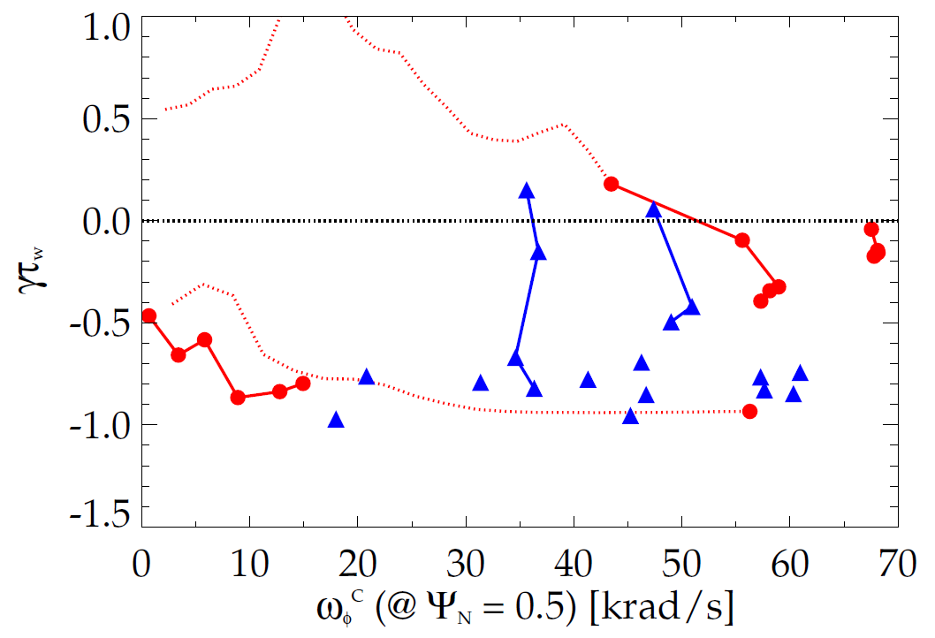
Kinetic RWM stability evaluated for DIII-D and NSTX plasmas, reproduces experiments over wide rotation range
Kinetic RWM stability analysis for experiments (MISK)
Summary of results
  Plasmas free of other MHD modes can reach or exceed linear kinetic RWM marginal stability
  Bursting MHD modes can lead to non-linear destabilization before linear stability limits are reached
  Extrapolations of DIII-D plasmas to different V_{φ} show marginal stability is bounded by 1.6 < q_{min} < 2.8
DIII-D
NSTX
q_{min} = 2.8
unstable
Normalized growth rate (γτ_{w})
“weak stability” region
q_{min} = 1.6
major disruption
minor disruption
extrapolation
stable
Plasma rotation [krad/s] (ψ_{N} = 0.5)
Reduced models of kinetic RWM stability now being investigated to support real-time disruption avoidance (e.g. by rotation profile control)
J.W. Berkery, J.M. Hanson, S.A. Sabbagh (Columbia U.)

Slide 7
Rotation feedback controller designed for NSTX-U using non-resonant NTV and NBI used as actuators
Momentum force balance – ω_{φ} decomposed into Bessel function states
NTV torque:
(non-linear)
Rotation evolution and NBI and NTV torque profiles
3D coil current and NBI power (actuators)
10
2.5
2
7
10⁴
desired ω_{φ}
t₁ = 0.00t
t₂ = 0.68t
t₃ = 1.99t
t₄ = 4.78t
6
8
t₄
2.0
5
6
t₁
1.5
4
1
NBI power (MW)
3D Coil Current (kA)
NBI, NTV torque density (N/m²)
3
Plasma rotation (rad/s)
NTV
torque
4
1.0
2
2
NBI
torque
0.5
feedback on
1
feedback on
0
0.0
0
0
0.0
0.2
0.4
ψ_{N}
0.6
0.8
1.0
0.5
0.6
0.7
0.8
0.5
0.6
0.7
0.8
t (s)
t (s)
I. Goumiri (P.U. student), S.A. Sabbagh (Columbia U.), C. Rowley (P.U.), D.A. Gates, S.P. Gerhardt (PPPL)

Slide 8
NTV physics studies for rotation control: measured NTV torque density profiles quantitatively compare well to theory
n = 3 coil configuration
n = 2 coil configuration
NSTX
NSTX
x1.7
x0.6
Experimental
-dL/dt
Experimental
-dL/dt
NTVTOK
NTVTOK
ψ_{N}
ψ_{N}
T_{NTV} (theory) scaled to match peak value of measured -dL/dt
  Scale factor ((dL/dt)/T_{NTV}) = 1.7 and 0.6 for cases shown above – O(1) agreement
S. Sabbagh et al., IAEA FEC 2014 (EX/1-4)

Slide 9
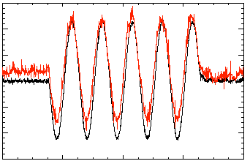
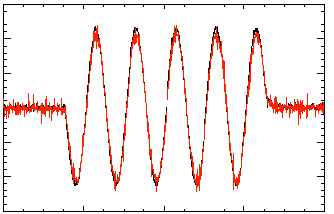
Model-based RWM state space controller including 3D model of plasma and wall currents used at high β_{N}
Full 3-D model
~3000+ states
State reduction (< 20 states)
RWM
eigenfunction(2 phases, 2 states)
Balancing
transformation
…
Controller reproduction of n = 1 field in NSTX
Controller model can compensate for wall currents
  Includes plasma mode-induced current
Potential to allow more flexible control coil positioning
  May allow control coils to be moved further from plasma, and be shielded (e.g. for ITER)
  Straightforward inclusion of multiple modes (with n = 1, or n > 1) in feedback
150
5 states
used
100
50
Sensor Difference (G)
0
Controller
(observer)
-50
-100
118298
-150
Measurement
150
100
50
10 states
used
Katsuro-Hopkins, et al., NF 47 (2007) 1157
0
Sensor Difference (G)
-50
-100
118298
(only wall states used)
-150
0.2
0.4
0.6
0.8
1.0
t (s)

Slide 10
NSTX RWM state space controller sustains high β_{N}, low l_{i} plasma
RWM state space feedback (12 states)
NSTX Experiments
I_{p} (MA)
n = 1 applied field suppression
  Suppressed disruption due to n = 1 field
Feedback phase scan
  Best feedback phase produced long pulse, β_{N} = 6.4, β_{N}/l_{i} = 13
(A)
Run time has been allocated for continued experiments on NSTX-U
S. Sabbagh et al., Nucl. Fusion 53 (2013) 104007

Slide 11
Active RWM control: dual B_{r} + B_{p} sensor feedback gain and phase scans produce significantly reduced n = 1 field
6
β_{N}
140124
140122
139516
β_{N}
Favorable B_{p} + B_{r} feedback (FB) settings found (low l_{i} plasmas)
Time-evolved theory simulation of B_{r}+B_{p} feedback follows experiment
4
2
0
B_{r} gain scan
0.8
0.6
0.4
l_{i}
l_{i}
No B_{r} feedback
B_{r} Gain = 1.0
0.2
0.0
B_{r}^{n = 1} (G)
S. Sabbagh et al., Nucl. Fusion 53 (2013) 104007
6
6
4
4
2
2
B_{r} Gain = 1.50
0
Simulation of B_{r} + B_{p} control (VALEN)
0.0
0.2
0.4
0.6
0.8
1.0
1.2
1.4
t (s)
Feedback on
0 deg FB phase
B_{r} FB phase scan
Radial field n = 1 (G)
90 deg FB phase
Vacuum error field
+ RFA
180 deg FB phase
Vacuum error field
Δt (s) (model)

Slide 12
Active RWM control design study for proposed NSTX-U 3D coil upgrade (NCC coils) shows superior capability
NCC 2x6 odd parity, with favorable sensors
NCC 2x12 with favorable sensors, optimal gain
NCC (plasma facing side)
Full NCC coil set allows control close to ideal wall limit
  NCC 2x6 odd parity coils: active control to β_{N}/β_{N}^{no-wall} = 1.58
  NCC 2x12 coils, optimal sensors: active control to β_{N}/β_{N}^{no-wall} = 1.67

Slide 13
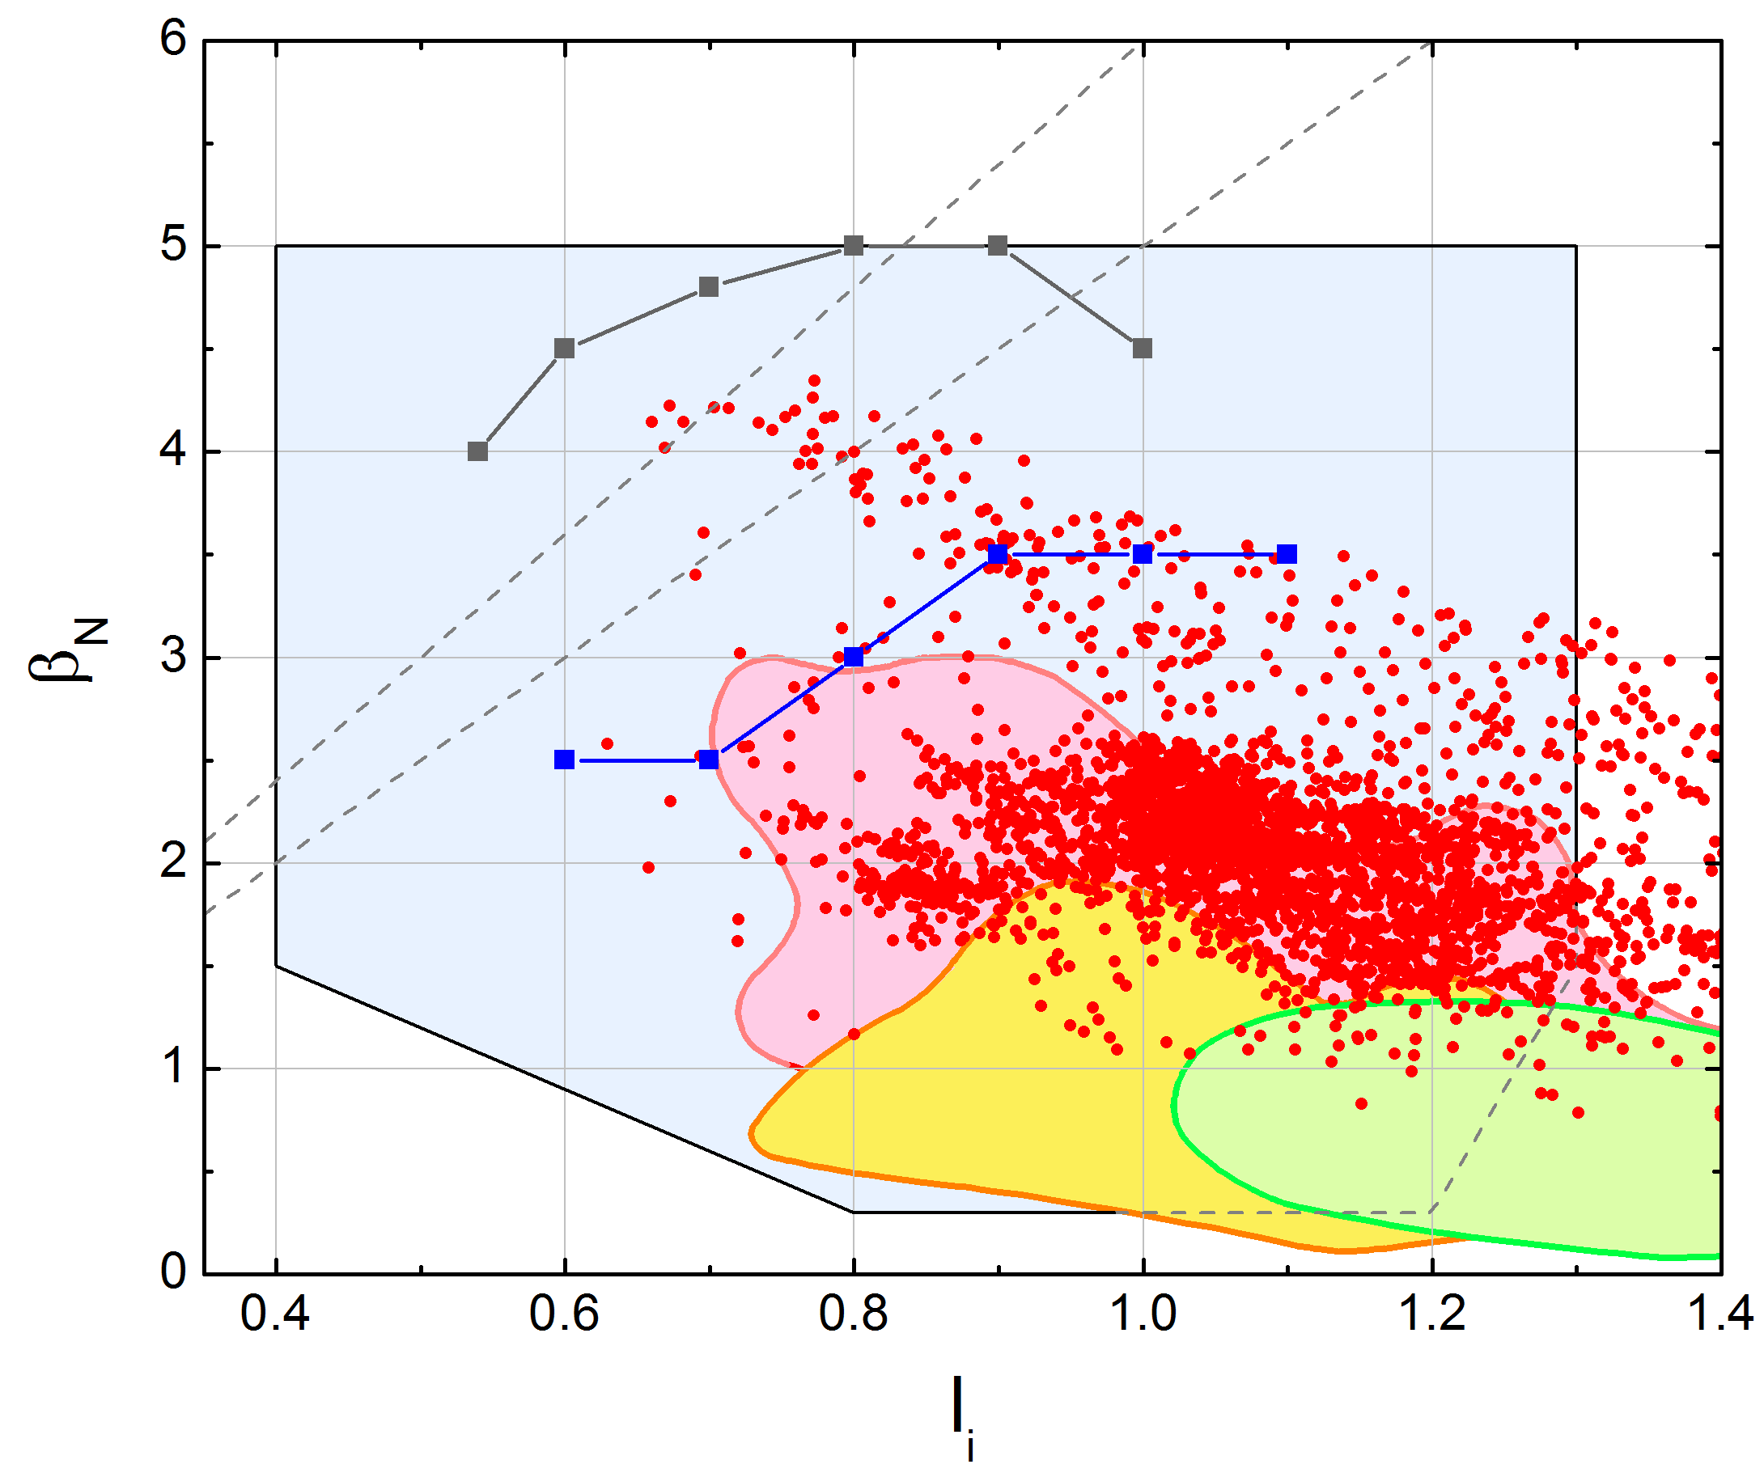
Columbia U. experiments yield record β_{N} for KSTAR, significantly surpassed the ideal MHD n = 1 stability limit
Recent operation
having β_{N} > β_{N}^{no-wall}
β_{N} /l_{i} = 6
β_{N} /l_{i} = 5
Plasma parameters
  q₉₅ ~4.5
  P_{NBI} = 2.7 - 4 MW (2 or 3 beam sources)
β_{N}/l_{i} > 6 (50% increase from the highest values in previous operations)
  A high value for advanced tokamaks
  β_{N} up to 4.3
  l_{i} ranging 0.66 - 0.87 with β_{N} > 4
  Discharge β_{N} was not limited by n > 0 events
n = 1 with-wall
limit
MP2014-05-02-007
by Sabbagh and Y.S. Park
n = 1 no-wall limit***
Previous
Operation*,**
KSTAR design target
operating space
First H-mode
Normalized beta vs. internal inductance from KSTAR EFIT
*Y.S. Park, et al., Nucl. Fusion 53 (2013) 083029
**Y.S. Park, et al., Phys. Plasmas 21 (2014) 012513
** O. Katsuro-Hopkins, et al., Nucl. Fusion 50 (2010) 025019
Y.S. Park, S.A. Sabbagh, et al., KSTAR Conference 2015

Slide 14
Disruption event chain characterization capability started for NSTX-U as next step in disruption avoidance plan
Approach to disruption prevention
  Identify disruption event chains and elements
  Predict events in disruption chains
    Attack events at several places
    Give priority to early events
  Provide cues to avoidance system to break the chain
  Provide cue to mitigation system if avoidance deemed untenable
t
General code written (Python) to address the first step – initial test runs started using NSTX data

Slide 15
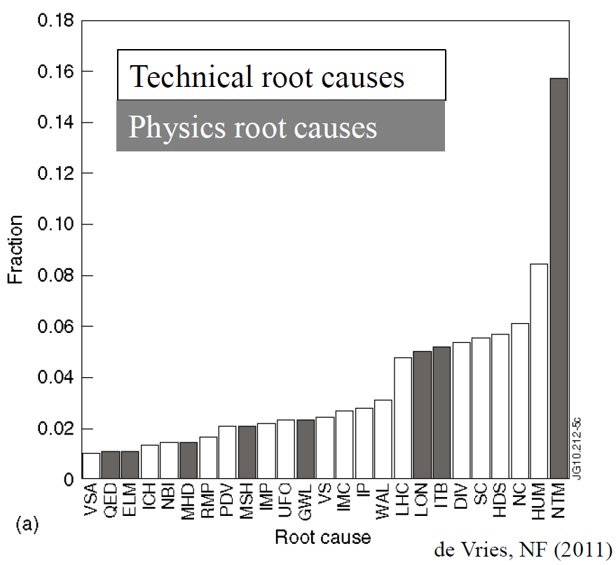
JET disruption event characterization provides framework to follow for understanding / quantifying DPAM progress
JET disruption event chains
Related disruption event statistics
P.C. de Vries et al., Nucl. Fusion 51 (2011) 053018
JET disruption event chain analysis performed by hand, need to automate
NSTX-U DPAM Working Group formed (w/ Columbia U. Group leadership): List of disruption chain events defined, interested individuals identified

Slide 16
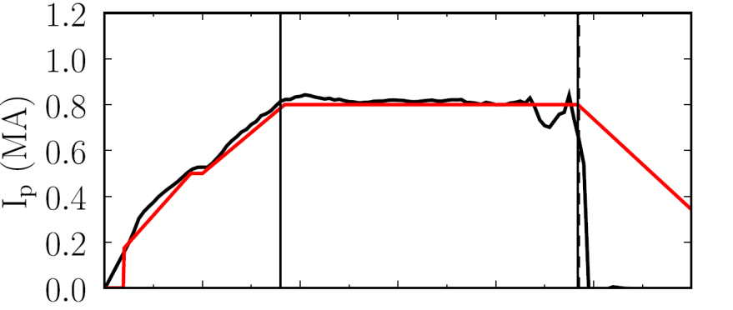
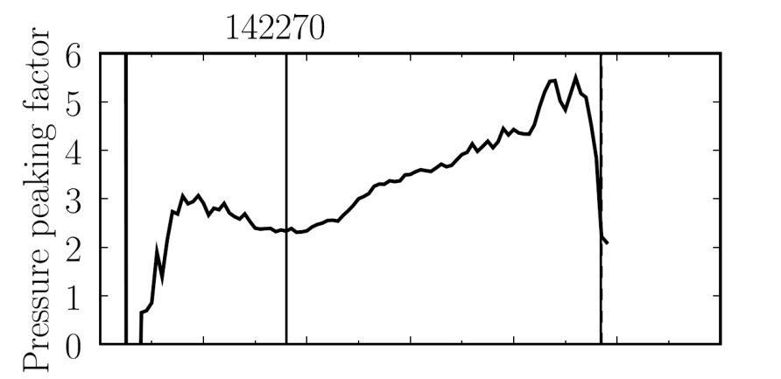

Disruption Characterization Code now yielding initial results: disruption event chains, with related quantitative warnings
10 physical disruption chain events and related quantitative warning points are presently defined in code
  Code is easily expandable, portable to other tokamaks
This example: Pressure peaking (PRP) disruption even chain identified by code
  (PRP) Pressure peaking warnings identified first
  (VDE) VDE condition subsequently found 20 ms after last PRP warning
  (SCL) Shape control warning issued
  (IPR) Plasma current request not met
NSTX
142270
Disruption
PRP warnings
PRP
VDE
SCL
IPR
0.420s
0.440s
0.475s
0.485s
J.W. Berkery, S.A. Sabbagh, Y.S. Park (Columbia U.)

Slide 17
NSTX-U is a world leading program on disruption avoidance, Columbia U. Group Research providing a leadership role
Physics Elements
  Kinetic RWM stabilization physics
  NTV physics for plasma rotation control (for instability avoidance)
  Active RWM control (physics-based RWM state-space controller)
  RWM control analysis of upgraded 3D coils for NSTX-U
  NSTX-U equilibrium reconstruction – key basis for stability analysis
  Planned real-time MHD spectroscopy for NSTX-U (in 5 Year Plan)
  Related high normalized beta and NTV experiments on KSTAR
Research synergism
  Elements now being brought together as part of a disruption prediction/avoidance system; NSTX-U DPAM working group leadership
  Disruption Characterization/Prediction code initiated
Action to enhance university / student / post-doc participation
  New diagnostic proposal to be submitted (Volpe/Sabbagh)

Slide 18
Supporting slides follow

Slide 19
Modification of Ideal Stability by Kinetic theory (MISK code) is used to determine proximity of plasmas to stability boundary
Initially used for NSTX since simple critical scalar ω_{φ} threshold stability models did not describe RWM stability
Kinetic modification to ideal MHD growth rate
  Trapped / circulating ions, trapped electrons, etc.
  Energetic particle (EP) stabilization
Stability depends on
  Integrated ω_{φ} profile: resonances in δW_{K} (e.g. ion precession drift)
  Particle collisionality, EP fraction
Sontag, et al., Nucl. Fusion 47 (2007) 1005
Hu and Betti, Phys. Rev. Lett 93 (2004) 105002
ω_{φ} profile (enters through ExB frequency)
Trapped ion component of δW_{K} (plasma integral over energy)
Some NSTX / MISK analysis references
J. Berkery et al., PRL 104, 035003 (2010)
S. Sabbagh, et al., NF 50, 025020 (2010)
J. Berkery et al., PRL 106, 075004 (2011)
J. Berkery et al., PoP 21, 056112 (2014)
J. Berkery et al., PoP 21, 052505 (2014)
(benchmarking paper)
precession drift
bounce
collisionality

Slide 20
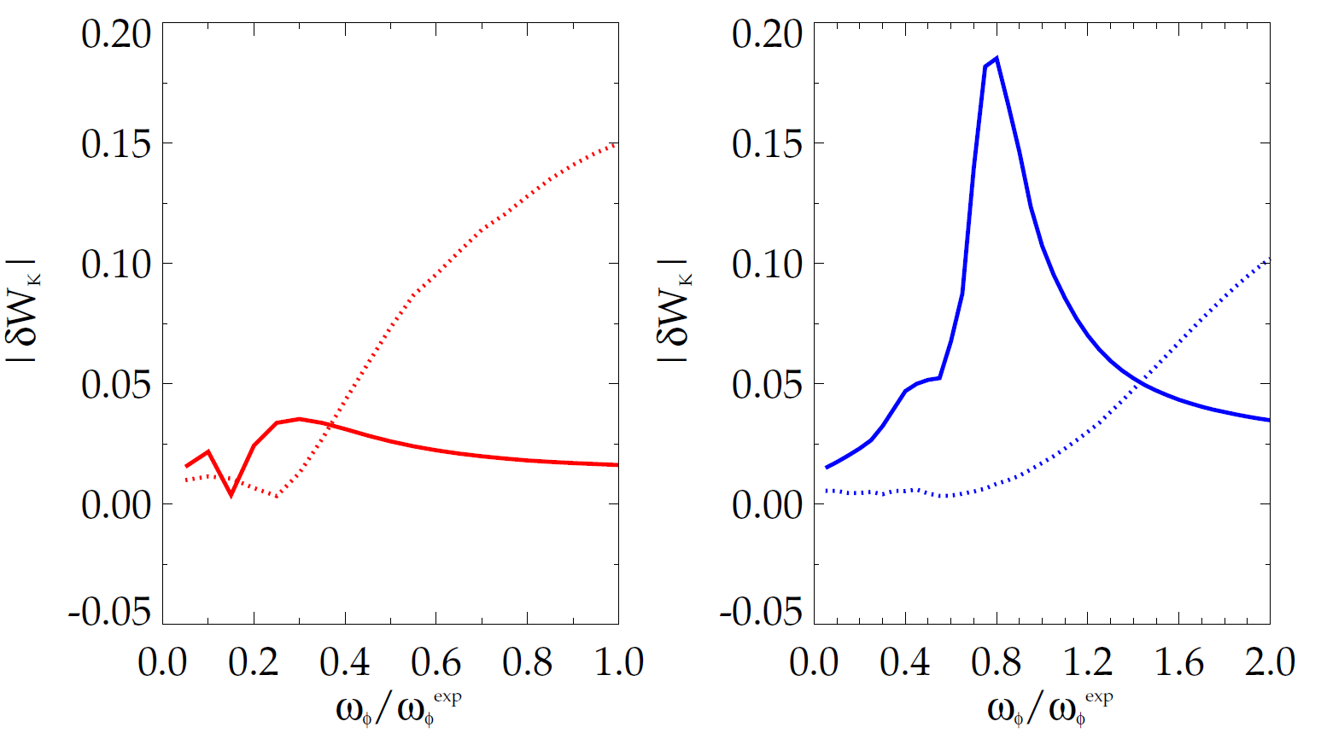
Bounce resonance stabilization dominates for DIII-D vs. precession drift resonance for NSTX at similar, high rotation
|δW_{K}| for trapped resonant ions vs. scaled experimental rotation (MISK)
DIII-D
precession
resonance
NSTX
bounce / circulating
resonance
bounce / circulating
resonance
precession
resonance
133103 @ 3.330 s
stable plasma
133776 @ 0.861 s
stable plasma
DIII-D experimental rotation profile
NSTX experimental rotation profile

Slide 21
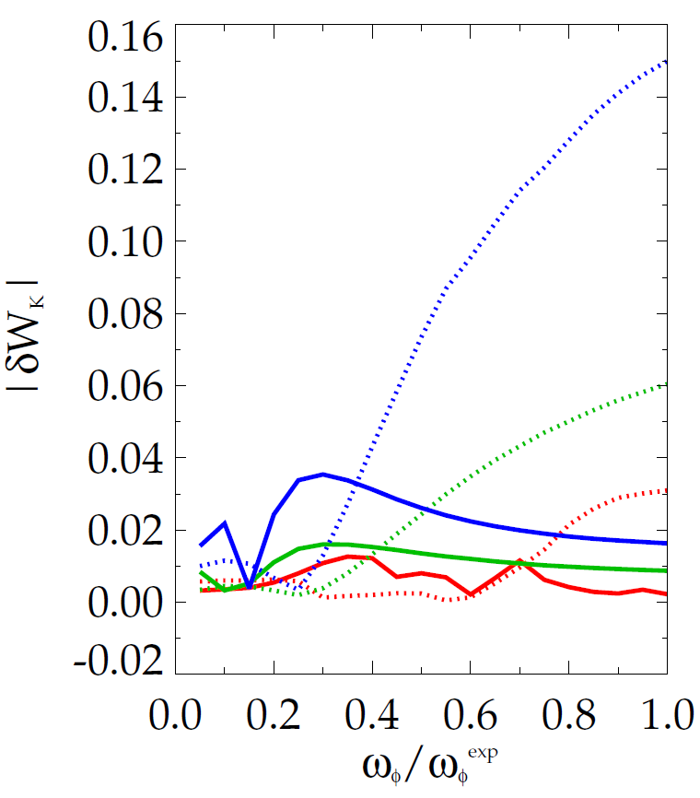
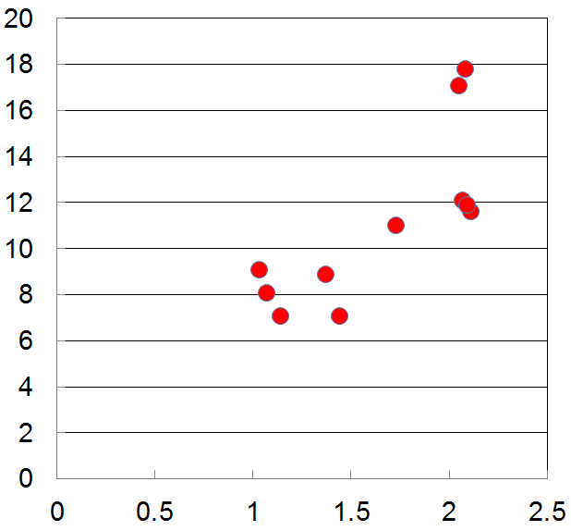
Increased RWM stability measured in DIII-D plasmas as q_{min} is reduced is consistent with kinetic RWM theory
|δW_{K}| for trapped resonant ions vs. scaled experimental rotation (MISK)
Measured plasma response to 20 Hz, n = 1 field vs q_{min}
DIII-D (q_{min} = 1.2)
DIII-D (q_{min} = 1.6)
DIII-D (q_{min} = 2.8)
less stable
bounce /
circulating
resonance
precession drift
resonance
n = 1 |δB_{p} | (G/kA)
q_{min}
Bounce resonance dominates precession drift resonance for all q_{min} examined at the experimental rotation
DIII-D experimental rotation profile

Slide 22
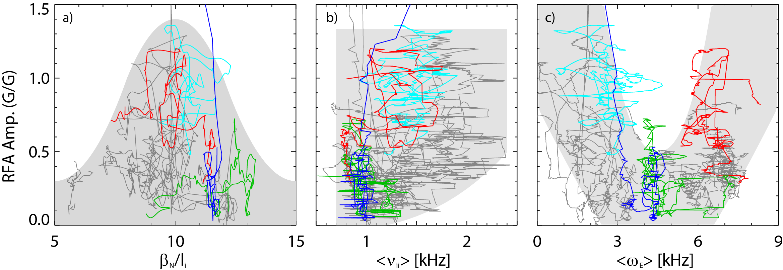
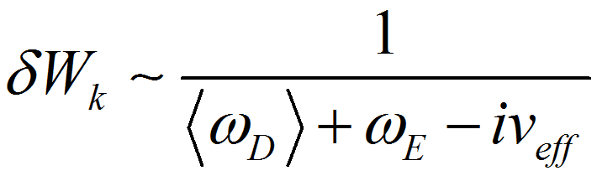
Experiments directly measuring global stability using MHD spectroscopy (RFA) support kinetic RWM stability theory
Resonant Field Amplification vs. β_{N}/l_{i}
RFA vs. rotation (ω_{E})
NSTX experiments
unstable
RWM
Most
stable
Stability at lower ν
  Collisional dissipation is reduced
  Stabilizing resonant kinetic effects are enhanced
  Stabilization when near broad ω_{φ} resonances; almost no effect off-resonance
(trajectories of 20 experimental plasmas)
Stability vs. rotation
  Largest stabilizing effect from ion precession drift resonance with ω_{φ}
Stability vs. β_{N}/l_{i}
  decreases up to β_{N}/l_{i} = 10, increases at higher β_{N}/l_{i}
  Consistent with kinetic resonance stabilization
Minimize |<ω_{D}> + ω_{E}|
S. Sabbagh, et al., NF 53 (2013) 104007
J. Berkery, et al., PoP 21 (2014) 056112

Slide 23
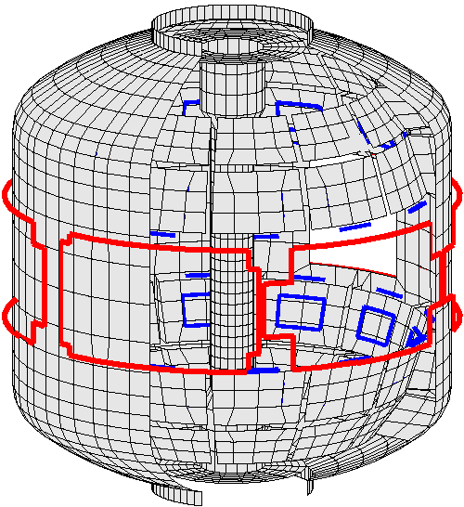
NSTX is a spherical torus equipped to study passive and active global MHD control
High beta, low aspect ratio
  R = 0.86 m, A > 1.27
  I_{p} < 1.5 MA, B_{t} = 5.5 kG
  β_{t} < 40%, β_{N} > 7
Copper stabilizer plates for kink mode stabilization
Midplane control coils
  n = 1 – 3 field correction, magnetic braking of ω_{φ} by NTV
  n = 1 RWM control
Combined sensor sets now used for RWM feedback
  48 upper/lower B_{p}, B_{r}
3D Structure Model
RWM poloidal
sensors (B_{p})
Stabilizer
plates
RWM radial sensors (B_{r})
RWM active stabilization coils

Slide 24
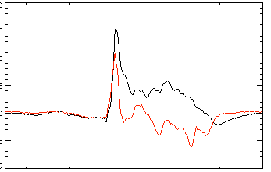
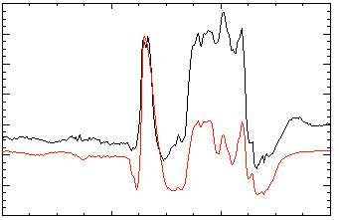
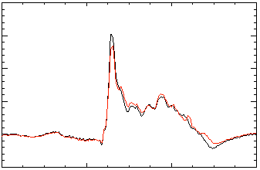
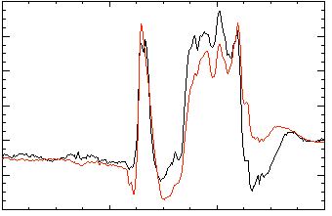
Open-loop comparisons between measurements and RWM state space controller show importance of states and model
A) Effect of Number of States Used
B) Effect of 3D Model Used
2 States
Measurement
No NBI Port
200
δB_{p}¹⁸⁰
RWM
Controller (observer)
80
δB_{p}⁹⁰
100
40
0
0
-100
-40
137722
0.56
0.58
0.60
0.62
0.56
0.58
0.60
0.62
t (s)
t (s)
RWM Sensor Differences (G)
7 States
With NBI Port
200
δB_{p}¹⁸⁰
80
δB_{p}⁹⁰
100
40
0
0
-100
-40
137722
0.56
0.58
0.60
0.62
0.56
0.58
0.60
0.62
t (s)
t (s)
Improved agreement with sufficient number of states (wall detail)
3D detail of model important to improve agreement

Slide 25
When T_{i} is included in NTV rotation controller model, 3D field current and NBI power can compensate for T_{i} variations
Rotation evolution and NBI and NTV torque profiles
3D coil current and NBI power (actuators)
10
2.0
7
2.5
10⁴
desired ω_{φ}
t₁ = 0.59s
t₂ = 0.69s
t₃ = 0.79s
1.8
6
8
2.0
5
t₃
1.6
6
1.5
4
t₂
NTV
torque
1.4
NBI power (MW)
3D Coil Current (kA)
NBI, NTV torque density (N/m²)
3
Plasma rotation (rad/s)
t₁
t₂
4
t₃
1.0
1.2
t₂
2
2
t₁
t₁
0.5
1.0
1
NBI
torque
t₃
0.8
0
0
0.0
0.5
0.7
0.9
0.5
0.7
0.9
0.0
0.2
0.4
0.6
0.8
1.0
t (s)
t (s)
ψ_{N}
1.8
1.2
T_{i} (keV)
K1 = 0, K2 = 2.5
0.6
NTV torque profile model for feedback dependent on ion temperature
t₁
t₂
t₃
t (s)
0.0
0.4
0.5
0.6
0.7
0.8
0.9

Slide 26
NSTX-U: RWM active control capability increases as proposed 3D coils upgrade (NCC coils) are added
Using present midplane RWM coils
Partial NCC 1x12 (upper), favorable sensors
NCC upper (1x12) (plasma facing side)
Partial 1x12 NCC coil set significantly enhances control
  Present RWM coils: active control to β_{N}/β_{N}^{no-wall} = 1.25
  NCC 1x12 coils: active control to β_{N}/β_{N}^{no-wall} = 1.52
Existing
RWM
coils

Slide 27
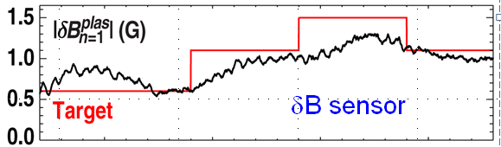
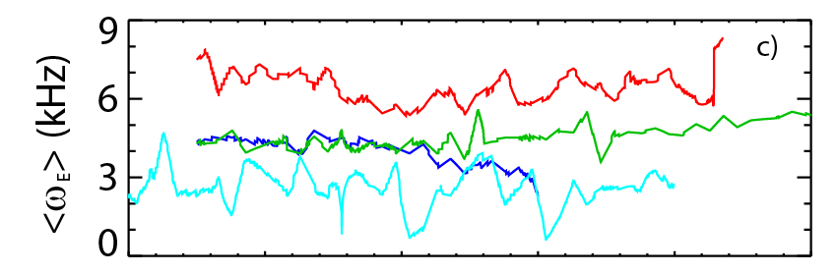
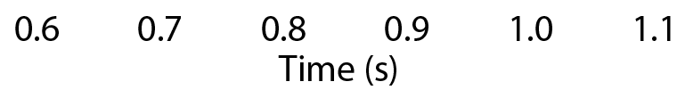
Real-time MHD spectroscopy, model-based active control, and kinetic physics will be used for disruption avoidance
MHD Spectroscopy
  Use real-time measurement of plasma global mode stability to “steer” toward increased stability
Advanced active control
  Combined Br + Bp feedback reduces n = 1 field amplitude, improves stability
  RWM state space controller sustains low l_{i}, high β_{N} plasma
Simplified kinetic physics models
  “steer” profiles (e.g. plasma toroidal rotation) toward increased stability in real-time
DIII-D
NSTX
I_{p} (MA)
too high
safe
NSTX
too low

Slide 28
NSTX-U DPAM Working Group meeting: List of disruption chain events defined, interested individuals identified
Impurity control (NC)
  bolometry-triggered shutdown (SPG); "tailoring” radiation-induced TM onset (LD, DG)
  change plasma operational state / excite ELMs, etc. (TBD – perhaps JC)
Greenwald limit (GWL)
  density/power feedback, etc. (DB)
Locked TM (LTM)
  TM onset and stabilization conditions, locking thresholds (JKP,RLH,ZW)
  TM entrainment (YSP)
Error Field Correction (EFC)
  NSTX-U EF assessment and correction optimization (CM,SPG)
  NSTX-U EF multi-mode correction (SAS, YSP, EK)
Current ramp-up (IPR)
  Active aux. power / CD alteration to change q (MDB, SPG)
Shape control issues (SC)
  Active alteration of squareness, triangularity, elongation – RFA sensor (SPG,MDB)
Transport barrier formation (ITB)
  Active global parameter, V_{φ}, etc. alteration techniques (SAS,JWB,EK)
H-L mode back-transition (HLB)
  Active global parameter, V_{φ}, etc. alteration techniques (SAS,JWB,EK)
Approaching vertical instability (VSC)
  Plasma shape change, etc. (SPG, MDB)
Resistive wall mode (RWM)
  Active global parameter, V_{φ}, etc. alteration techniques (SAS,JWB)
  Active multi-mode control (SAS,YSP,KT)
Ideal wall mode (IWM)
  Active global parameter, V_{φ}, etc. alteration techniques (JEM)
Internal kink/Ballooning mode (IKB)
  Active global parameter, V_{φ}, etc. alteration techniques (SAS,JWB)
  Active multi-mode control (SAS, YSP, KT)
Abbreviations:
JWB: Jack Berkery
AB: Amitava Bhattacharjee
DB: Devon Battaglia
MDB: Dan Boyer
JC: John Canik
LD: Luis Delgado-Aparicio
DG: Dave Gates
SPG: Stefan Gerhardt
MJ: Mike Jaworski
EK: Egemen Kolemen
RLH: Rob La Haye
JEM: Jon Menard
CM: Clayton Myers
JKP: Jong-Kyu Park
YSP: Young-Seok Park
RR: Roger Raman
SAS: Steve Sabbagh
KT: Kevin Tritz
ZW: Zhirui Wang
TBD: (To be decided)
Interest from Theory
  Amitava Bhattacharjee, Allen Boozer, Dylan Brennan, Bill Tang have requested involvement
Interested? contact:
sabbagh@pppl.gov
raman@pppl.gov

Slide 29
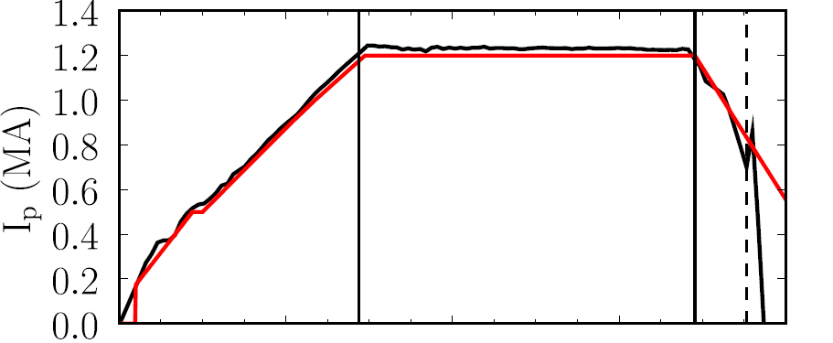
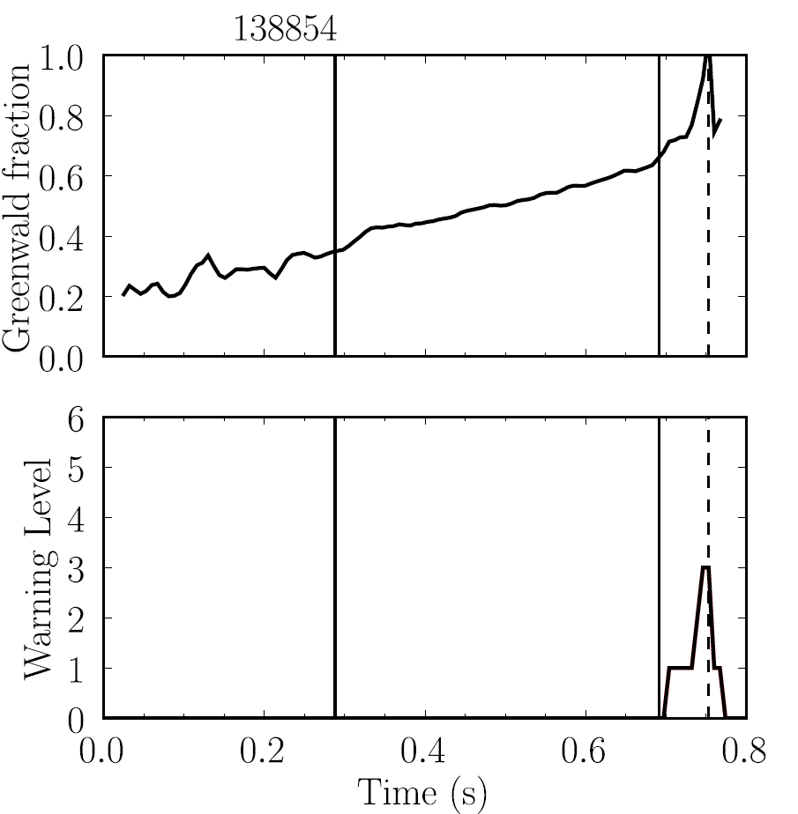
Disruption Characterization Code now yielding initial results: disruption event chains, with related quantitative warnings (2)
NSTX
138854
This example: Greenwald limit warning during I_{p} rampdown
  (GWL) Greenwald limit warning issued
  (VDE) VDE condition then found 7 ms after GWL warning
  (IPR) Plasma current request not met
Disruption during
I_{p} ramp-down
GWL warnings
GWL
VDE
IPR
0.746s
0.753s
0.753s
J.W. Berkery, S.A. Sabbagh, Y.S. Park

