Slide 1

NSTX-U Project / Facility Status
Masa Ono and Jon Menard
NSTX-U FY 2016 Q1 Review Meeting
February 8, 20156

Slide 2
Outline
Facility Operations Status and Plan
On-Going Facility Enhancement Status and Plan
Longer Term Facility Enhancement Status and Plan
Summary
Back-up: Explanation of Increments

Slide 3
FY 2016 plasma operations started
Expecting to run 18 run weeks in FY 2016
November 2015
December 2015
January 2016
February
Post bake
ISTP
Holiday
Plasma Operation
Maintenance
ISTW 2015
APS
Plasma Operations started on Dec. 18.
Boronizations
PAC 37
H-Mode!
• After CD-4, we vented briefly to install various items before the bake.
• Bakeout was completed with good vacuum pressure in October
• During ISTP, MGs experienced control problem during ISTP. The problem resolved and MG#1 is supporting the operations.
• Plasma operation started on Dec. 18 and ran for 2.5 days before the holiday.
• The first boronization performed on Jan. 4, 2016 and performed four times.
• NBI injection started and H-mode access achieved quickly.

Slide 4
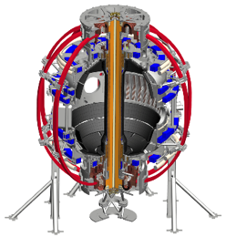
Digital System Provides Electromechanical Coil Protection
DCPS supporting the research operation very nicely
Protects the NSTX-U coils and mechanical structure against electromagnetic loads
Computes forces and stresses in realtime based on reduced models of the full mechanical structure
Redundant systems
Full commissioning of the system went very well; DCPS is now routinely supporting operations.
Power Supply Suppress and Bypass
Coil and Plasma Current Measurements
Realtime Acquisition #1
Realtime Acquisition #2
Stand Alone Digital Coil Protection Computer
Digital Coil Protection & Plasma Control Computer
Level-1 Fault Interface
Rectifier Hardware Controls
Discussions ongoing with ITER for collaboration
Notes:
A bunch of sensors give conditioned current inputs
Output is Go/NoGo… Fault/No Fault

Slide 5
Excellent Progress on Magnetic Diagnostics
Plasma current, loop voltage, poloidal flux and field measurements in good shape supporting EFIT.
  All integrators recalibrated
  Rogowski coils fully calibrated, and pickup compensations established
  All Mirnov sensors and flux loops have had their position determinations refined based on calibration shots.
New diamagnetic loop system is now operational also supporting EFIT.
  Based on using the Rogowski return loop as a diamagnetic loop.
  Successfully implemented and eliminated the old TF-coil diamagnetic system.
High-n and high-f array is taking data.
  Used for detecting rotating Kink/Tearing modes, *AE modes.
RWM sensors are writing mode fit data to the tree.
  Realtime RWM sensor codes have also been upgraded, now in testing.

Slide 6
Significant Progress in Plasma Control System
Now supporting the research operations
PCS has been supporting plasma operations.
  Pre-programmed PF control & simple radial and vertical position control, I_{P} control.
  Gas injection and pre-fill control
  Real-time magnetic sensor calibrations
  Beam control from PCS
  Automatic discharge shutdown following disruption detection.
  rtEFIT running in the background on the control machines
  RWM/EF coil current control from PCS has been restored.
Some older less-reliable real-time digitizers have been replaced, and a new every-shot latency measurement system has been implemented.
Near term PCS steps
  Finish testing rtEFIT and begin to use ISOFLUX shape control
  Finish the recommissioning of the RWM/EF control algorithms
  Then move on to profile control and snowflake divertor control.

Slide 7
NSTX-U diagnostics to be installed during first year
More than half are led by collaborators
Ready now/commissioning
  Magnetics for equilibrium reconstruction
  Halo current detectors
  High-n and high-frequency Mirnov arrays
  RWM / Locked-mode sensors
  MPTS (42 ch, 60 Hz)
  T-CHERS: T_{i}(R), V_{φ}(r), n_{C}(R), n_{Li}(R), (51 ch)
  P-CHERS: V_{θ}(r) (71 ch)
  Edge Rotation Diagnostics (T_{i}, V_{φ}, V_{pol})
  Midplane ME-SXR (200 ch)
  Midplane tangential AXUV bolometer array (40 ch)
  Ultra-soft x-ray arrays – multi-color
  Fast Ion D_{α} profile measurement (perp + tang)
  Solid-State neutral particle analyzer
  Neutron measurements
  Charged Fusion Product
  Fast IR camera (two color)
  Material Analysis and Particle Probe
  AXUV-based Divertor Bolometer
  Tile temperature thermocouple array
  Fast visible cameras
  Visible bremsstrahlung radiometer
  Visible and UV survey spectrometers
  VUV transmission grating spectrometer
  Visible filterscopes (hydrogen & impurity lines)
  Wall coupon analysis
  1-D CCD H_{α} cameras (divertor, midplane)
  2-D divertor fast visible cameras (4)
  Two-color intensified 2D cameras TWICE (2)
  Edge neutral density diagnostic ENDD
  IR cameras (30Hz) (3)
  Dust detector
  Edge Deposition Monitors
  Scrape-off layer reflectometer
  Edge neutral pressure gauges
Ready by mid-run
  Fast lost-ion probe (energy/pitch angle resolving)
  Microwave Reflectometer
  Beam Emission Spectroscopy (48 ch)
  MSE-CIF (18 ch)
  MSE-LIF (20 ch)
  SAMI edge field pitch diagnoistc
  Divertor VUV Spectrometer (SPRED)
  Gas-puff Imaging (500kHz)
  Langmuir probe array
  Divertor fast eroding thermocouple
Ready by end of run
  FIReTIP interferometer
Ready next run year
  Poloidal FIR high-k scattering
  Midplane metal foil bolometer
  Metal foil divertor bolometer
New capability,
Enhanced capability

Slide 8
Heating System Operations
Both Neutral Beams are still at LHe temperatures. Routine panel regens.
Neutral Beam #2
  N2A Source has operated to 60 kV. High voltage transmission line repairs completed.
  N2B Source has operated to 60 kV. High voltage transmission line repairs completed.
  N2C Source had operated and injected power up to 75 kV.
Neutral Beam #1
  N1A Source had operated and injected power up to 75 kV.
  N1B Source had operated and injected power up to 65 kV.
  N1C Source had operated and injected power up to 85 kV.
RF Systems
  RF HHFW #1-6 dummy load tested to 1 MW 0.5 seconds prior to Holidays.
  Plan to start antenna conditioning after arc fault recovery is completed.
  Still need some dedicated conditioning time needed on all systems.

Slide 9
Latest run plan schedule for 2016
Goal is to operate 18 run weeks
FY16 budgets are favorable enough to support 18 weeks
Want as much data as possible for IAEA synopses/meeting, APS-2016
December: 0.5 run weeks (XMP)
January: ~ 2 run weeks (XMP, XP), PAC-37
Two week maintenance: Neutral Beam T-line repair, Argon purge system, LITER, Diagnostics
• February: ~ 3 run weeks
March ~ 3 run weeks
  Mid-run assessment in March/April
April – June 9.5 run weeks, complete FY16 run
July: Start outage: install high-k, high-Z tiles, …
Resume operations winter 2017 for FY17: ~16 run weeks

Slide 10
NSTX-U device performance progression
1st year: Limit forces to ½ way between NSTX and NSTX-U, and ½ of the design-point heating of any coil
  Presently operating at B_{T} ~ 0.65T
  Increase to B_{T} ~ 0.8T after completing engineering analysis
2nd year goal: Full field and current, coil heating to ¾ of limit
3rd year goal: Full capability
Parameter | NSTX (Max.) | Year 1 NSTX-U Operations | Year 2 NSTX-U Operations | Year 3 NSTX-U Operations | NSTX-U Ultimate Goal
I_{P} [MA] | 1.2 | ~1.6 | 2.0 | 2.0 | 2.0
B_{T} [T] | 0.55 | ~0.8 (0.65) | 1.0 | 1.0 | 1.0
Allowed TF I²t [MA²s] | 7.3 | 80 | 120 | 160 | 160
I_{P} Flat-Top at max. allowed I²t, I_{P}, and B_{T} [s] | ~0.4 | ~3.5 | ~3 | 5 | 5

Slide 11
Outline
Facility Operations Status and Plan
On-Going Facility Enhancement Status and Plan
Longer Term Facility Enhancement Status and Plan
Summary
Back-up: Explanation of Increments

Slide 12
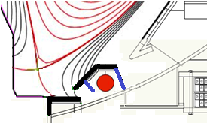
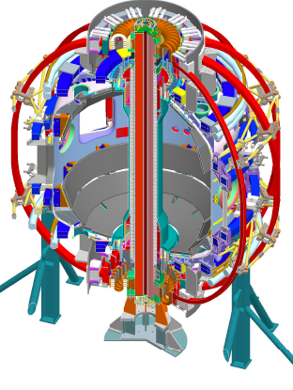
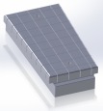
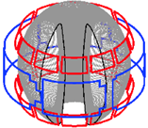
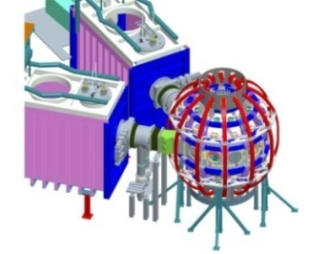
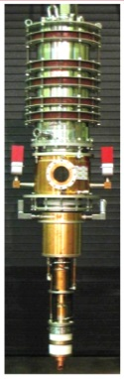
Five Year Facility Enhancement Plan (green – ongoing)
2015: Engineering design for high-Z tiles, Cryo-Pump, NCC, ECH
Fiscal Year:
2015 | 2016 | 2017 | 2018 | 2019
Major enhancements:
Base funding
+15% incremental
Upgrade Outage
1.5 → 2 MA, 1s → 5s
Run Weeks:
18
16
12-16
10-12
New
center-stack
Pulse-burst MPTS
Lower divertor cryo-pump
Boundary Science
+ Particle Control
Boronization
High-Z tile row on lower OBD
High-Z PFC diagnostics
Li granule injector
LiTER
Upward
LiTER
LLD using bakeable cryo-baffle
MAPP
MGI disruption mitigation
Upgraded halo sensors
Off-midplane 3D coils (NCC)
Core Science
δB diag. - incremental
Enhanced MHD sensors
Laser blow-off
42 ch MPTS
DBS, PCI, or other intermediate-k
48 ch BES
High k_{θ}
MSE/LIF
Charged fusion product
Neutron collimator
4 coil AE antenna
Establish control of:
Rotation
q_{min}
HHFW limiter upgrade
Snowflake
Integrated Scenarios
FIReTIP
n_{e}
Divertor P_{rad}
2nd NBI
1 MW ECH/EBW
Upgraded CHI for ~0.5MA
0.5-1 MA CHI
up to 1 MA plasma gun

Slide 13
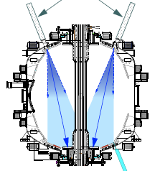
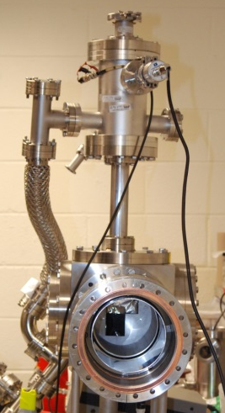
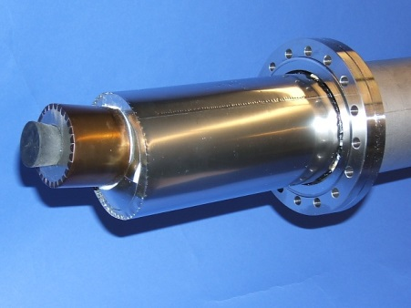
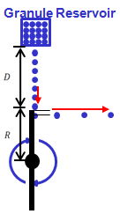
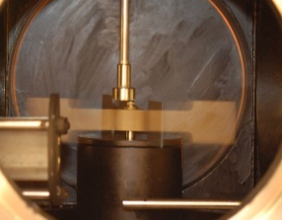
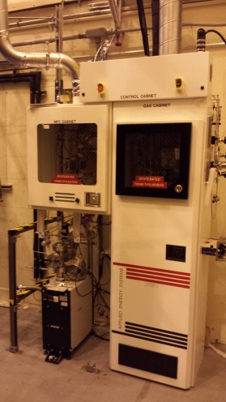
First Year Boundary Physics Tools
Boronization, Lithium Evaporators, Granule Injector
Lithium Evaporator (LITERs)
LITERs
Granule injector (GI) for ELM pacing
Successfully tested
on EAST and DIII-D
Granules: Li, B₄C, C
f ~ up to 500 Hz
Granular Reservoir
• LITERs filing set up in high bay south of NSTX-U Test Cell
• Argon purge system being implemented for safety
Rotating Impeller
• Remote control undergoing tests
• Stand complete
• Vacuum interlock requirements identified and implementation plan specified
Boronization System
dTMB Gas Cabinet
for safety
• Multiple injection and glow made more uniform boronization.
• System is working very well. Third boronization complete. Also being used for He glow discharges.

Slide 14
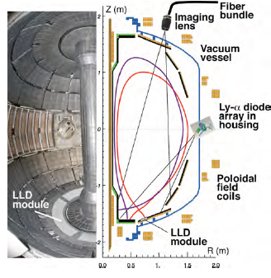
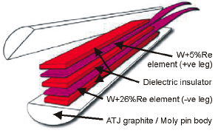
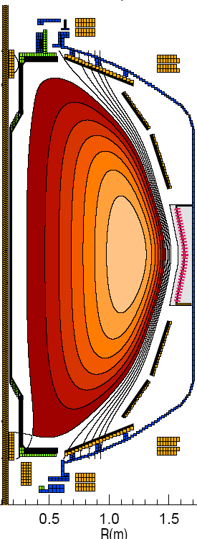
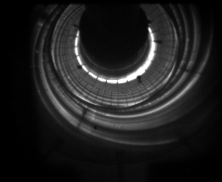
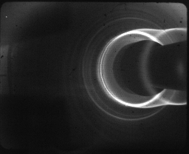
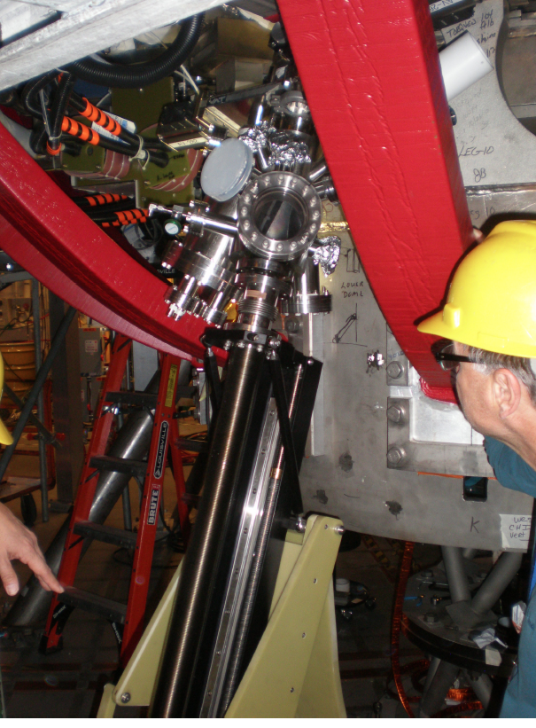
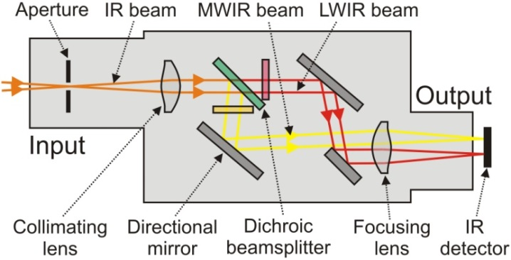
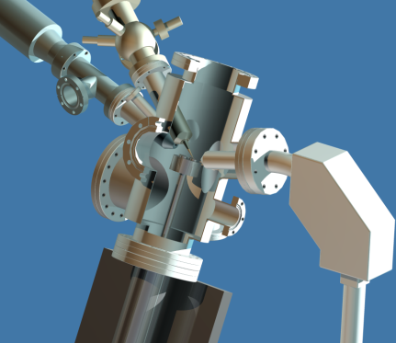
Enhanced Capability for PMI Research
Multi-Institutional Contributions
Divertor fast eroding thermocouples
Multiple fast 2D visible and IR cameras with full divertor coverage
Divertor Imaging
Spectrometer
ORNL
LLNL, ORNL, UT-K
LLNL
Li I
ORNL
C II
Dual-band fast IR Camera
MAPP probe for between-shots surface analysis – Now taking data
U. of Illinois, PPPL

Slide 15
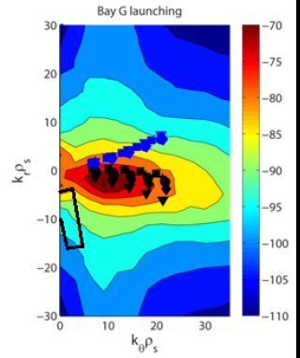
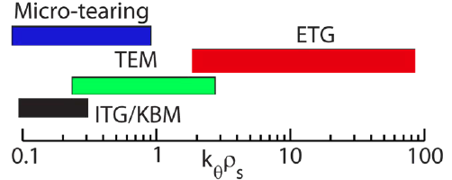
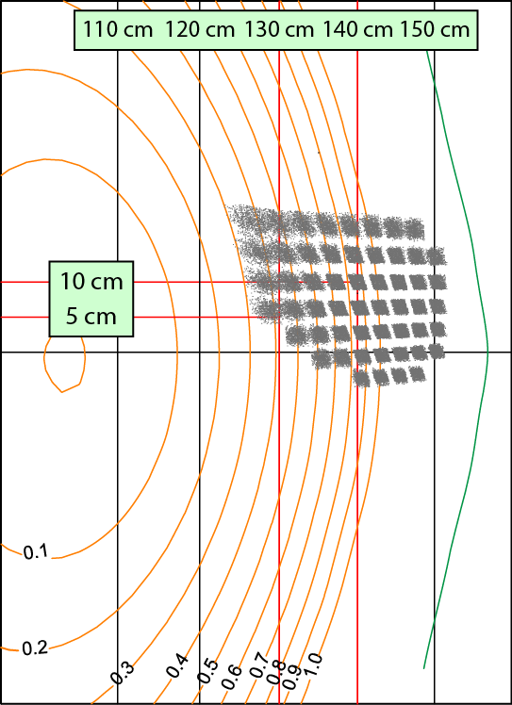
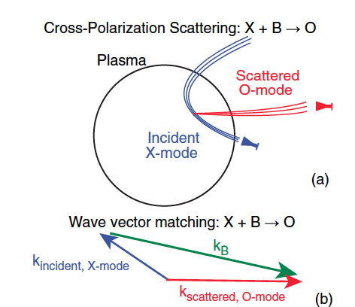
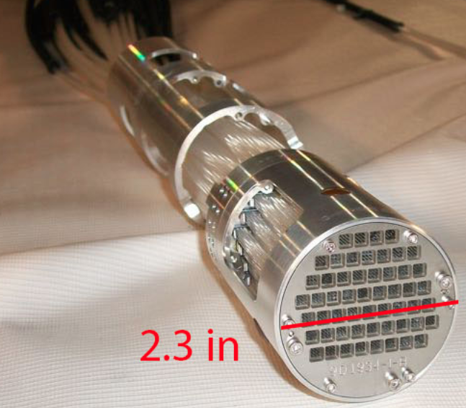
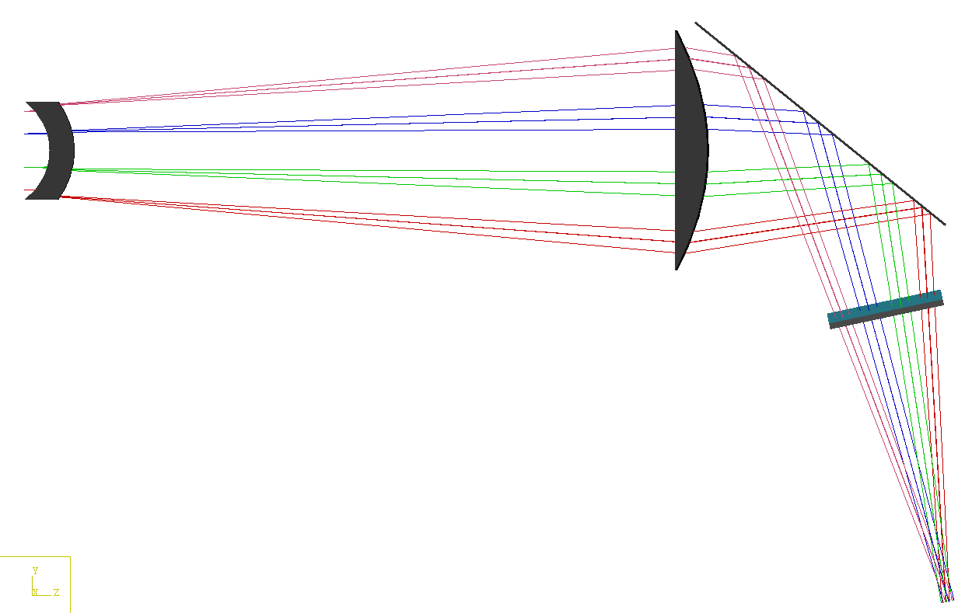
Microturbulence Diagnostics Being Enhanced
To measure ion to electron gyro-scale, magnetic fluctuations
Beam Emission Spectroscopy
for low k turbulence
48 chs being readied
Low k
High-k scattering for ETG
High k
Cross-Polarization Scattering for magnetic fluctuations being developed in collaboration with DIII-D and MAST
UC Davis
BES-2D-Fiber
Assembly
Collection optics (Bay L)
4x1 subharmonic mixer array
U Wisconsin
UCLA
Available for FY 17

Slide 16
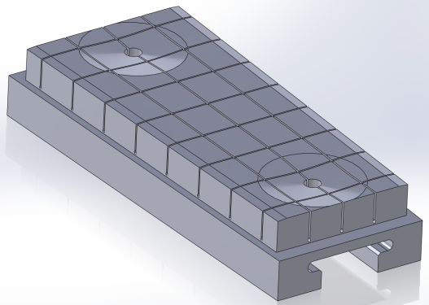
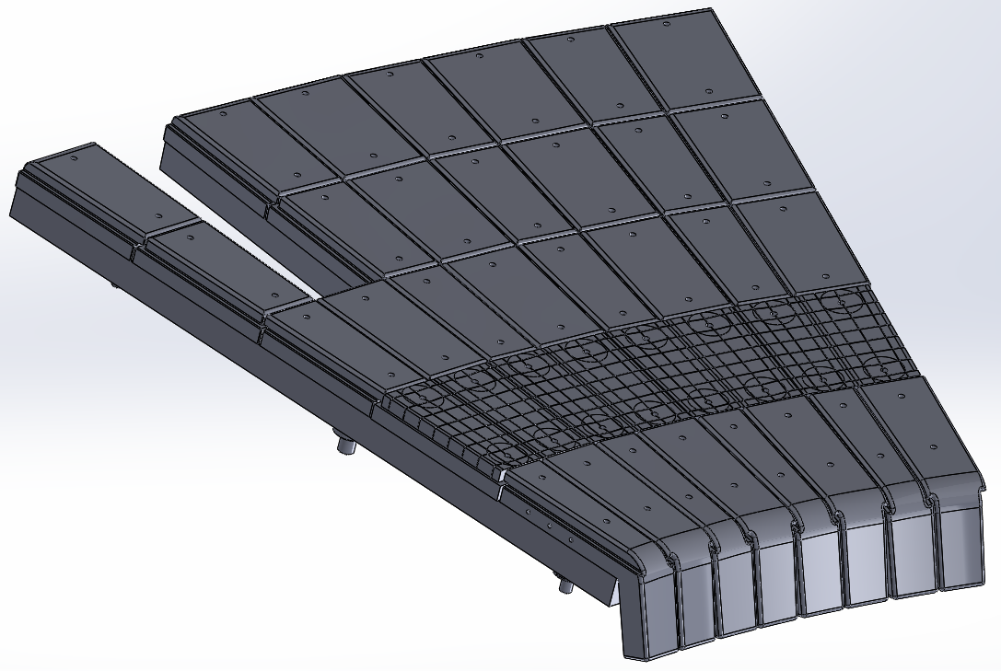
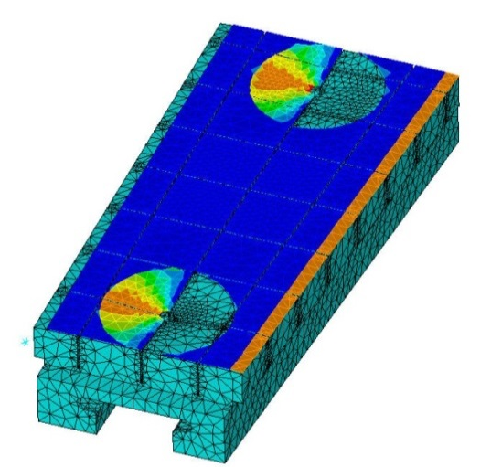
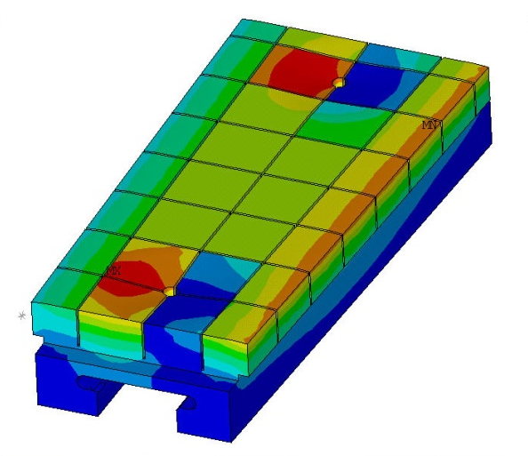
High-Z Tile Design Nearly Complete
(See M. Jaworski’s PAC talk for more detail - plan to be ready by the 2016 outage)
Successful PDR held in
December
  Final drawings and installation issues
  nearly complete (FDR mid-Feb.)
  82% of raw materials on-site
Final design rated to 10 MW/m² for 1s heat flux for 1000s of cycles
  Installation flexibility introduced to accommodate “as built” vessel tolerances
  Edge and access-way chamfers introduced to reduce heat-flux peaking
Design “lesson’s learned” already informing cryo-pump PFC design
  Geometric flexibility emphasized to avoid stress-limited design
  Tight tolerancing in sub-structure emphasized to avoid time-intensive installation tasks
Surface heat flux
Temperature

Slide 17
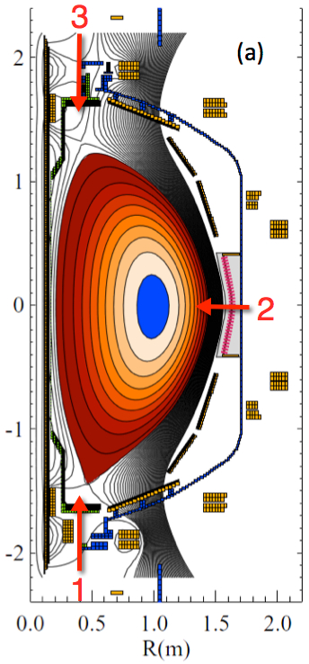
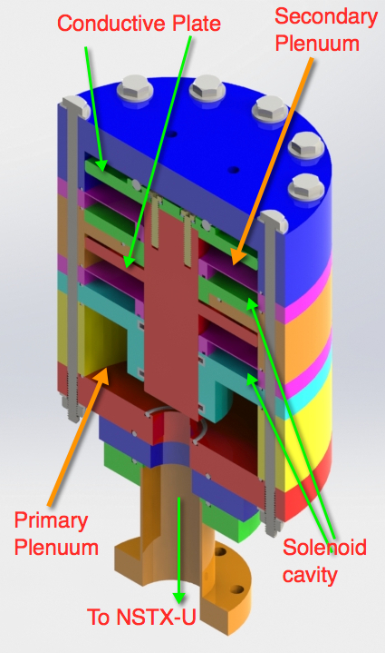
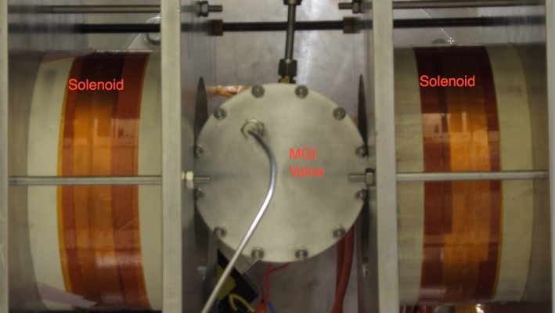
Disruption Mitigation System for NSTX-U
Massive gas injection system at multiple poloidal positions
NSTX-U MGI Valve
  - Massive gas injector system at multi
  poloidal location with identical injection set-up
  - Compact power supply proto-type tested at UW
  - A new double solenoid MGI design (zero net J x B
  torque) based on the ORNL ITER MGI design
  MGI also tested on the U. Washington test stand with magnetic field
Magnets
Magnets
MGI
Valve
U. Washington
• Conceptual Design Review of MGI system was held on October 16. Recommended changes were incorporated into the power system hardware.
• All the MGI components including MGI valves were delivered to PPPL from U. Washington.
• Preparation are being made to commission the MGI system on NSTX-U this year.

Slide 18
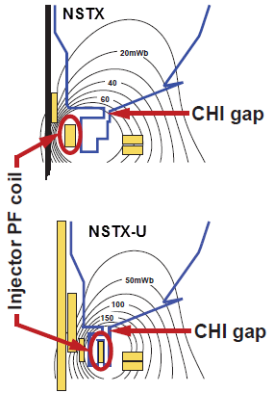
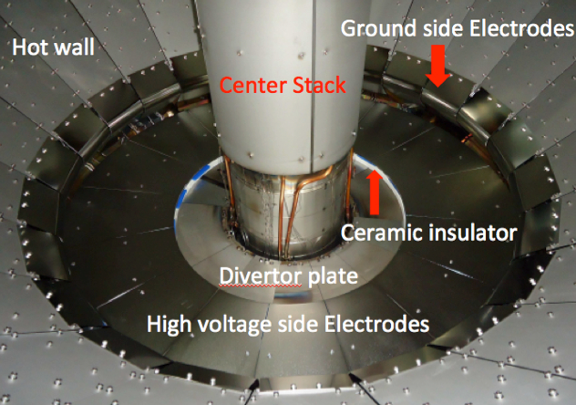
Solenoid-free start-up in support of ST-FNSF
NSTX-U CHI configuration permits ~ 400 kA level start-up
CHI Start-Up in NSTX-U
QUEST CHI Experiment to test high-Z electrode operation
• Inj. Flux in NSTX-U is about 2.5 times higher than in NSTX
• NSTX-U coil insulation greatly enhanced for higher voltage ~ 3 kV operation
U. Washington
• CHI will start with the present 2 kV capability then enhanced to higher voltage as needed.
• Control system updates for the CHI cap bank have been completed, and the system is ready for remote testing.
• The CHI control room procedure has been updated.
An ST-FNSF like CHI configuration will undergo plasma tests on QUEST after FY 2016 NSTX-U operation
CHI electrodes installed in QUEST, CHI power supply and gas injection system fabricated at U-Washington

Slide 19
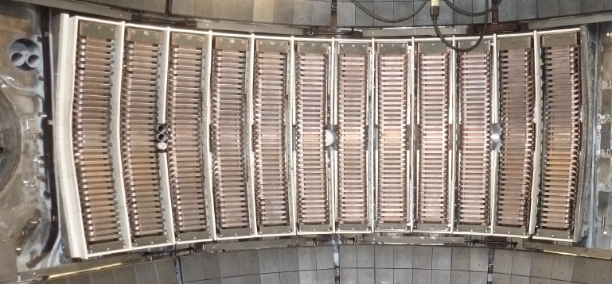
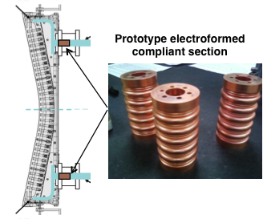
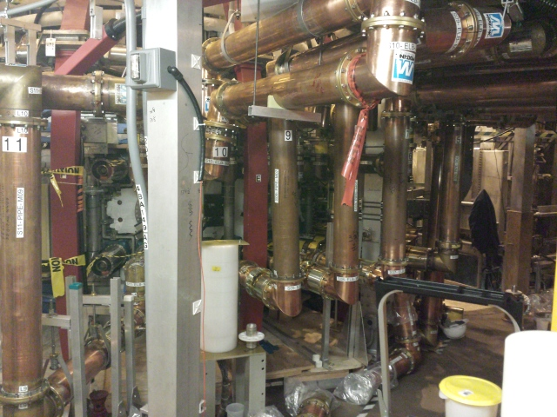
HHFW system will be ready for operation in March
All sources are ready to start antenna conditioning
New Compliant Antenna Feeds
Allow HHFW antenna feedthroughs to tolerate 2 MA disruptions
Antennas were re-installed with the new feeds and back-plate grounding
Transmission lines installed & tuned.
Additional ground installed
- Prototype compliant feeds tested to 46 kV in the RF test-stand. Benefit of back-plate grounding for arc prevention found.
- RF diagnostics also installed.
• All sources will be ready to support HHFW operation in March.

Slide 20
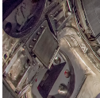
Enhanced FIDA will measure NBI distribution function
For NBI fast ion transport and current drive physics
Fast Ion D-Alpha Diagnostics
FIDA Views
• Both vertical (perpendicular) and new tangential (parallel) FIDA systems are ready.
• Both FIDA systems have 10 ms, 5 cm, ≈ 10 keV resolutions.
CHI Gap
Vertical
Center-Stack
Tangential
HHFW
Antennas
FY 2016 - 2017 Energetic Particle Conceptual Design and Diagnostic Upgrade
  SS-NPA installed but investigating pick-up problem.
  sFLIP is installed for lost ion measurements
  Active 2 X 2 TAE antennas installed. Initially passive spectroscopy then active excitation at few kW level.
  Proto-type charged fusion product (CFP) profile diagnostic to be installed this year.
  8+8 reflectometry array available for AEs.
TAE antennas
UCI
sFLIP
FIU
UCLA

Slide 21
Outline
Facility Operations Status and Plan
On-Going Facility Enhancement Status and Plan
Longer Term Facility Enhancement Status and Plan
Summary
Back-up: Explanation of Increments

Slide 22
Five Year Facility Enhancement Plan (green – ongoing)
2015: Engineering design for high-Z tiles, Cryo-Pump, NCC, ECH
Fiscal Year:
2015 | 2016 | 2017 | 2018 | 2019
Major enhancements:
Base funding
+15% incremental
Upgrade Outage
1.5 → 2 MA, 1s → 5s
Run Weeks:
18
16
12-16
10-12
New
center-stack
Pulse-burst MPTS
Lower divertor cryo-pump
Boundary Science
+ Particle Control
Boronization
High-Z tile row on lower OBD
High-Z PFC diagnostics
Li granule injector
LiTER
Upward
LiTER
LLD using bakeable cryo-baffle
MAPP
MGI disruption mitigation
Upgraded halo sensors
Off-midplane 3D coils (NCC)
Core Science
δB diag. - incremental
Enhanced MHD sensors
Laser blow-off
42 ch MPTS
DBS, PCI, or other intermediate-k
48 ch BES
High k_{θ}
MSE/LIF
Charged fusion product
Neutron collimator
4 coil AE antenna
Establish control of:
Rotation
q_{min}
HHFW limiter upgrade
Snowflake
Integrated Scenarios
FIReTIP
n_{e}
Divertor P_{rad}
2nd NBI
1 MW ECH/EBW
Upgraded CHI for ~0.5MA
0.5-1 MA CHI
up to 1 MA plasma gun

Slide 23
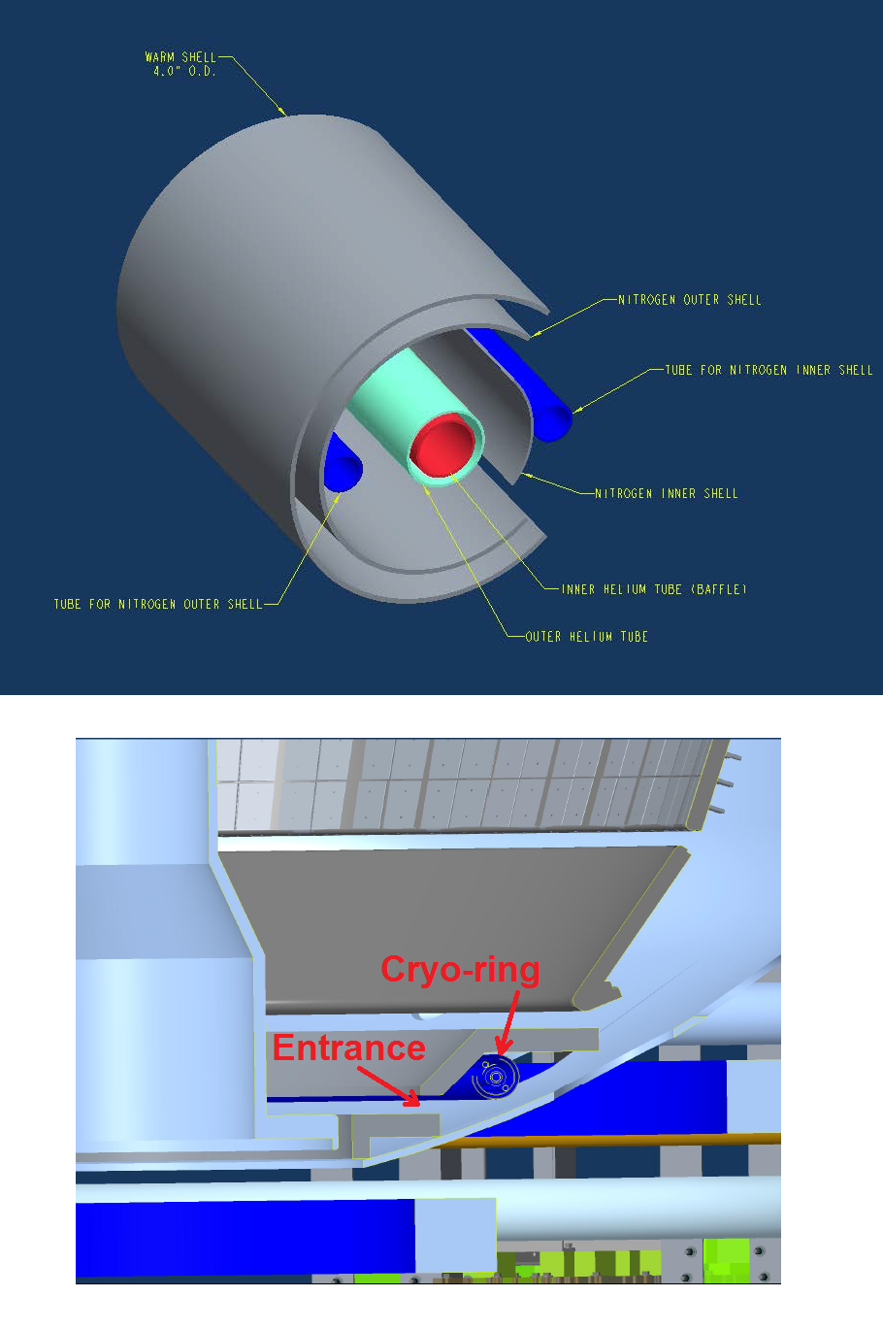

Divertor Cryo-pump Design Activities Started
Physics Design Described at PAC 33 by J. Canik, ORNL
Initial in-vessel geometry has been laid out. MIT will design cryo-ring.
  Pump radius, throat dimensions taken from the modeling.
  Is a significant perturbation, requiring a rebuild of basically the entire lower outer divertor.
  High-Z tile research will contribute to the choice of PFCs (see M. Jaworski’s talk)
Specification in progress for the Liquid He refrigerator.
  Likely suitable model found
  Location in room adjacent to NSTX-U has been identified.
Ex-vessel liquid He plumping and transfer Dewar is under design.
Cryo-ring
Transfer line layout

Slide 24
NSTX-U boundary / PFC plan: add divertor cryo-pump, transition to high-Z wall, study flowing liquid metal PFCs
5yr goal: Integrate high τ_{E} and β_{T} with 100% non-inductive
10yr goal: Assess compatibility with high-Z & liquid lithium PFCs
2016
2017-18
2018-19
2020-21
2022-23
High-Z tile row
All high-Z FW +
divertors
+ flowing LLD
module
Cryo + full lower outboard high-Z divertor
Cryo + high-Z FW
B+C BN
Li High-Z
Lower OBD
high-Z row of tiles
and OBD
+ liquid Li divertor (LLD)
Downward Li evaporator +
Li granule injector
High-Z tile row
Up + downward Li evaporator, possible pre-filled Li tiles (FY18)
Heatable high-Z PFCs for liquid Li (including pre-filled)
Cryo-pump
or
Flowing Li module (Concept, location, size TBD)

Slide 25
High Z, Liquid Lithium, and Cryo-Pump Enhancements
We are assessing the viability of supporting two separate enhancements: (1) Cryo-pump and (2) heatable high-Z PFC with liquid Li capabilty:
• Heatable high-Z PFCs with liquid lithium divertor capability ~ $ 6-7 M
• Cryo-pump system ~ $ 6- 7 M
Heatable high-Z PFCs for liquid Li (including pre-filled)
Cryo-pump
Also as a part of facility reliability enhancement, a cryo-plant (helium refrigerator) upgrade is envisioned (~ $2.5M). The existing helium refrigerator is 35 years old and it if fails may cause loss of NSTX-U plasma operation in a given year. It is also located far from NSTX-U which causes more than 50% heat loss. The existing system could become a back-up refrigerator and support other cryogenic needs at PPPL.

Slide 26
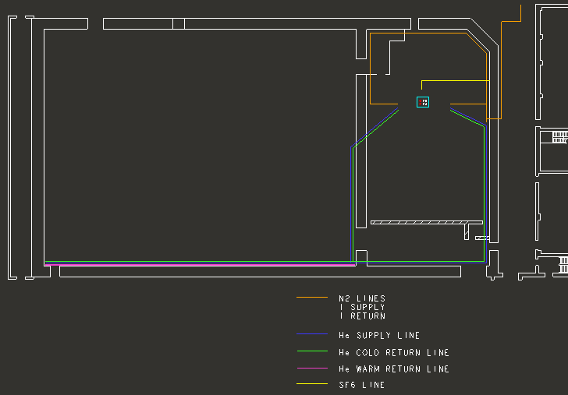
A new efficient 400 W liquid helium (L-He) refrigerator to minimize down time risk and reduce operating cost
Proposed 400 W L-He refrigerator ~ $2.5M
Former TFTR Test Cell
• Located near NSTX-U, accommodates all envisioned loads (NBIs and cryo-pump) by benefit of less piping and heat loss.
• The unit would reuse power and space previously used for a previous 225 Watt refrigerator.
• The existing NBI controls PLC and operations staff can operate this system with only minor adaptations.
• The existing NBI tank Farm and liquid Nitrogen systems would support this 400 Watt refrigerator.
NSTX-U
500 feet of supply and return piping
TFTR legacy liquid helium refrigerator
• 35 years old for NBI #1 and 2 operating at near capacity
• If a failure occurs, the risk is estimated to be 6 months to 1 year of down-time.
• Back up L-He on NSTX-U without causing down time or as a site credit for future projects if needed.

Slide 27
Flexible Mid-Plane Feedback Coils for MHD Studoes
NCC will greatly enhance MHD physics studies and control
Full toroidal NCC array (2 x 12)
Partial toroidal NCC array (2 x 6)
Partial NCC
Full NCC
Existing
RWM
coils
Columbia U
General Atomics
• 6-channel Switching Power Amplifier (SPA) powers independent currents in existing EFC/RWM Coils.
• NCC (a facility enhancement) can provide various NTV, RMP, RWM, and EF selectivity with flexibility of field spectrum (n ≤ 6 for full and n≤ 3 for partial)
Base – Engineering design work on NCC to be performed in 2016 – 2017 to develop reliable cost and schedule.

Slide 28
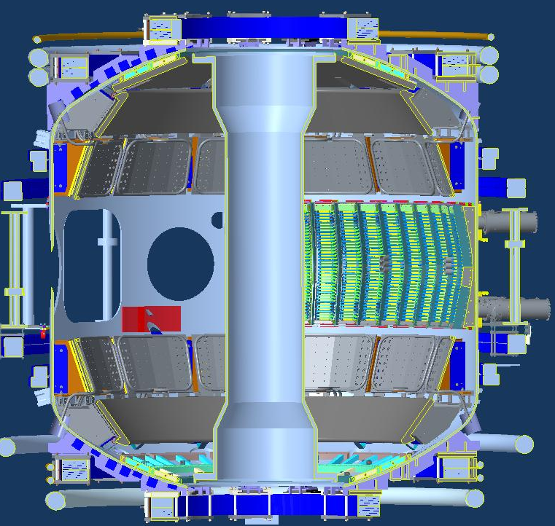
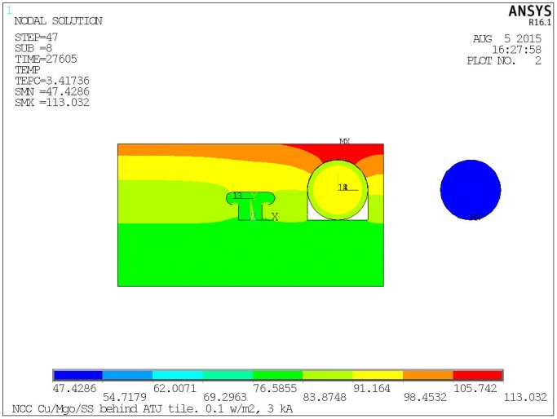
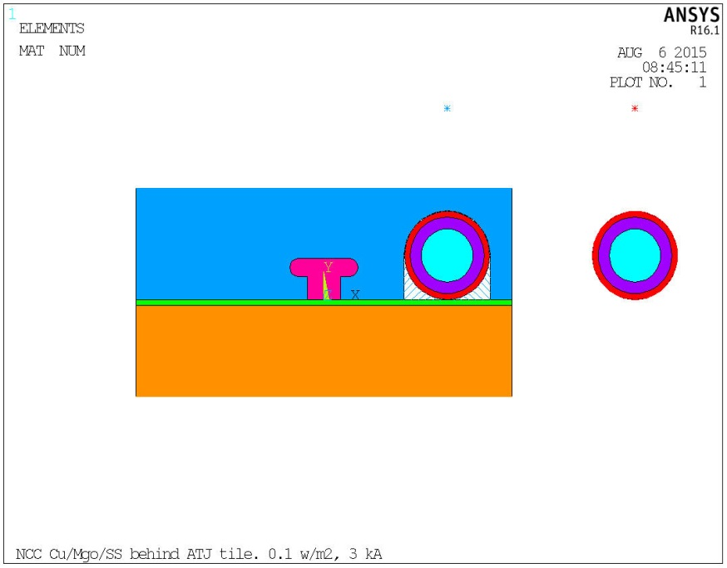
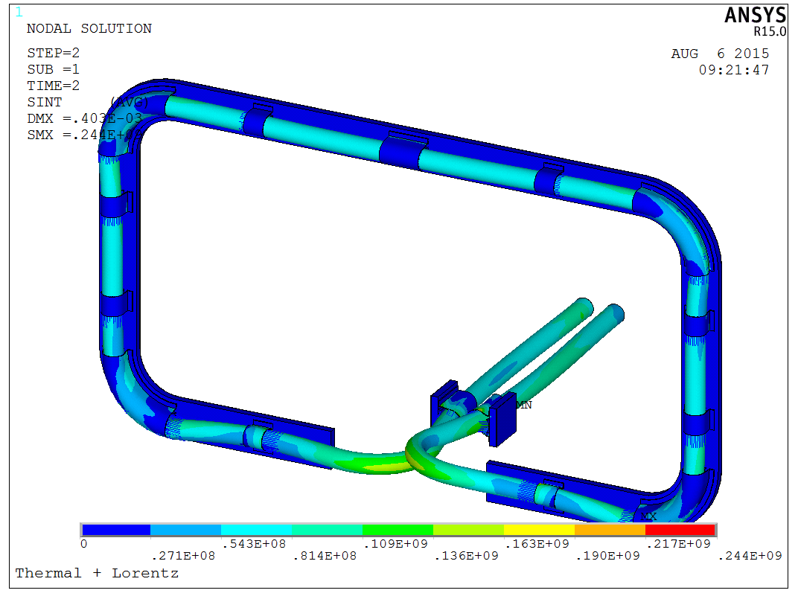
NCC Lorentz and Thermal
Stress Analysis
NCC Coils Design Activity Made Significant Progress
NCC Physics Design Presented by J-K Park at PAC 33
NCC = Non-axisymmetric Control Coil
2 x 12
Coil
Thermal Analysis
Tile
End of Last Pulse Temp (8 hours)
PP
Lead
3 kA,0.1 MW/m2 Plasma Heating,5s pulse,1200 s reprate
• Selected candidate conductors and test sample received for R&D.
• The R&D selection criteria include thermal capability, manufacturability, impact on interfacing objects, fabrication lead time and cost.
• Helium cooling system or no direct cooling options will be quantified.
• Cost and schedule will be prepared as part of the CDR which is targeted for May, 2016.
With Lead Clamp, 50 C Heat-up, 3kA+ Background Field

Slide 29
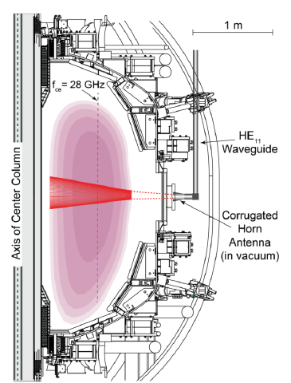

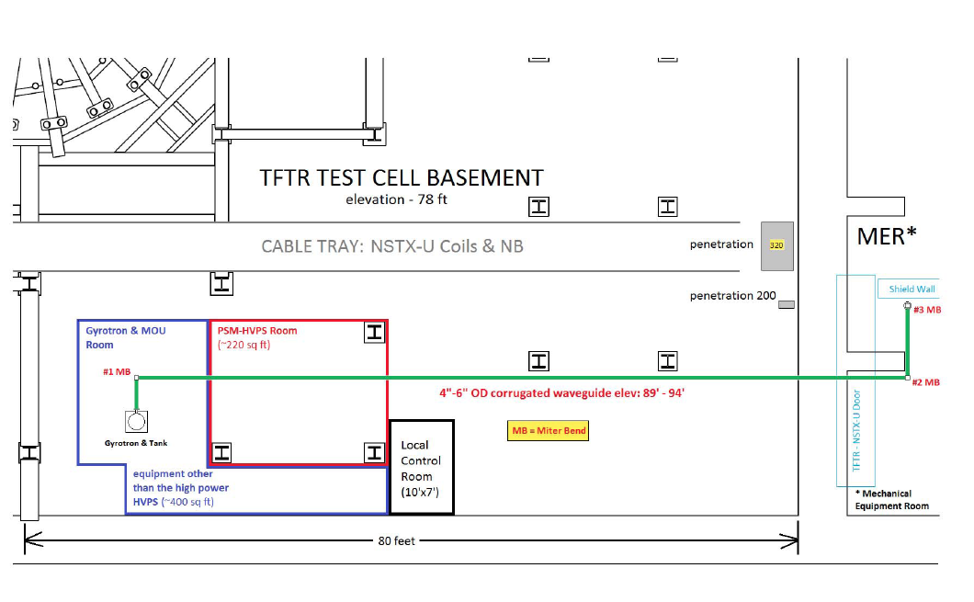
28 GHz ECH System Design Progressing Well
Develop engineering design and cost/schedule this year
CHI can form a 200-400 kA seed plasma, but it is too cold for HHFW absorption.
Use of ECH can “bridge the T_{e} gap” to where HHFW and then NB current drive can support the ramp and sustain the current – crucial for OH solenoid-free compact STs - Talk by F. Poli at this PAC.
  Good first pass absorption predicted.
Goal of first ECH power in 2019 run with 15% incremental funding.
28 GHz 1 MW Tube by Tsukuba
28 GHz Gyrotron Room
NSTX-U
Test Cell
28 GHz Gyrotron Development
• 2nd generation 1.5 MW 28/35 GHz gyroton being developed at Tsukuba University. (See back-up slide)
• The gyrotron is being constructed. Will be tested this summer.
Gyroton room
Power Supply Room
Gyrotron will be located in the TFTR basement. Stray magnetic fields was measured to be negligible

Slide 30
Highest Priority for Incremental Funding
See back-up slide for more detail
1) Supporting our 18 run-week milestone
2) Improving reliability of critical systems that support operation
3) Supporting our collaborator needs to install their hardware
4) Any additional funds available will be used to support the major enhancements (Divertor Cryo-Pump and High-Z)

Slide 31
Summary of Facility and Diagnostics
Research operations successfully started
• Research preparation progressing well. Team is vigorously preparing diagnostics and research tools for the first year of plasma operations.
• Research operation started on December 18, 2015. Very good progress on the plasma control system. Routine H-mode obtained shortly after the second boronization.
• After two week maintenance period, the plasma operation is restarting this week with all NBI and new capabilities and diagnostics.
• Engineering design work continuing for the major facility enhancements: divertor cryo-pump, high-Z tiles, ECH, and NCC.
• Considering two enhancements: the divertor cryo-pump in parallel with the heatable high-Z PFCs with LL divertor capability.
• 400 W L-He refrigerator is also being considered for risk reduction.

Slide 32
Back-up Slides

Slide 33
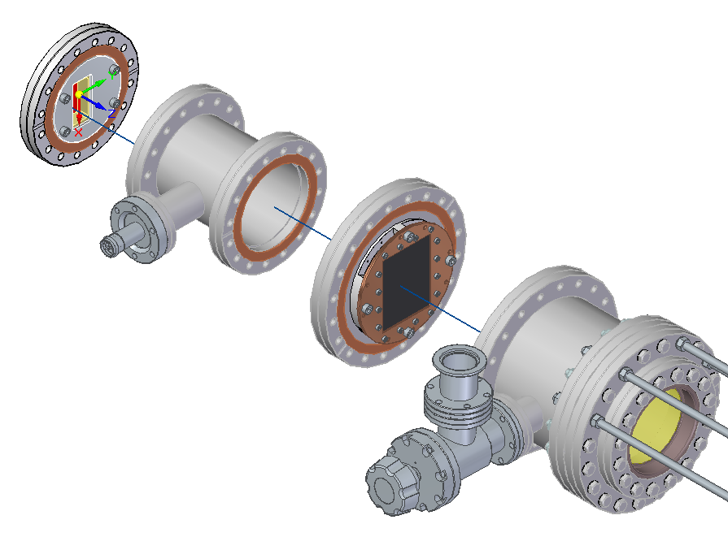
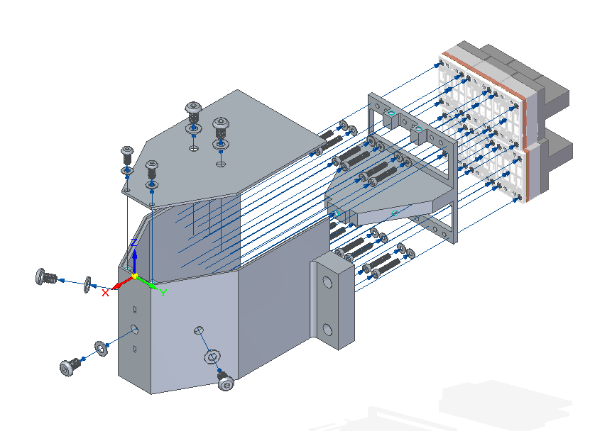
NSTX-U Developing Tools for Measuring
Core and Boundary Radiation
Prototype IR video bolometer (IRVB) with NIFS and DIFFER
Redesign and expand bolometer diagnostics to support FY17 operations
  16 ch of lower divertor viewing for boundary radation
  24 ch tangential midplane core radiation
plasma
thin Pt foil, heated by radiation, imaged by IR camera
testing 32-ch system for viewing lower x-pt late in FY16 campaign
Midplane Bolometer
CDR Nov. 2015
M. Reinke, ORNL

