Slide 1

NSTX-U Project / Facility Status
Masa Ono and Jon Menard
NSTX-U FY 2016 Q2 Review Meeting
May 3, 2016

Slide 2
Outline
Facility Operations Status and Plan
On-Going Facility Enhancement Status and Plan
Summary

Slide 3
Latest run plan schedule for 2016
~ 7.2 run week to date, goal is to operate 18 run weeks
Outage
Completed Plasma Operations
Planned Plasma Operations
Want as much data as possible for IAEA synopses/meeting, APS-2016
December 2015: 0.4 run weeks (XMP)
January 2016 (3 weeks): 2 run weeks (H-mode), PAC-37
Two week maintenance: NBI T-line repair, Argon purge system, LITER, Diagnostics
• February – March (4 weeks): 2.4 run weeks (routine H-mode)
Two week maintenance: BN piece recovery, NBI Auto/transformer/T-line repair, LGI, MGI, Diagnostics
March – April: (3 weeks) 2.4 run weeks (high power H-mode)
Three week maintenance: BPM, NBI LHe refrigeration regeneration & leak repair, LGI, MGI, Diagnostics
May – August - 10.8 run weeks to complete FY16 run with extended run days
August: Start outage

Slide 4
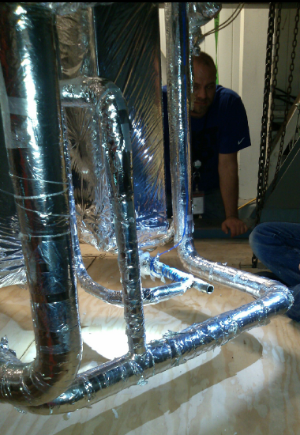
LHe Refrigerator Cold Box Leak
Leaks were found and repaired along with a similar piece
The LHe Refrigerator Cold Box leak was determined to be in a piece of pipe used as a thermocouple diode well. The temperature measurement at this location was no longer in service because those types of diodes are obsolete. The pipe was cut off and capped. The cap was seal welded and QC inspected.
A second similar well was also cut out and capped and welded as a precaution.
Another very small leak in another location was discovered and likewise capped and welded.
After leak checking, the Cold Box shell was replaced and vacuum restored. The LHe refrigerator was put back into service and initial operations indicate that the unit is back to full capacity. BL 1 & 2 cool down complete and operations started.
Thermocouple diode well
Interior of the LHe Refrigerator Cold Box

Slide 5
Heating System Operations
NBI system should be approaching full performance
Cryogenics repairs completed. Restart of LHe refrigerator complete. Cooldown of BLs in progress for operations yesterday (Monday, May 2, 2016) and starting up NBI operation today.
Neutral Beam #2
  N2A Source had operated to 86 kV. (Hipot to 90 kV completed.)
  N2B Source had operated to 80 kV. (High voltage investigation completed.)
  N2C Source had operated to 80 kV.
Neutral Beam #1
  N1A Source had operated to 76 kV. (New source conditioning still in progress)
  N1B Source had operated to 70 kV.
  N1C Source had operated to 90 kV.
RF Systems
  HHFW #1-4 Recovery CAP completed. Ready to start antenna conditioning.
  HHFW #5-6 CAP completed. Awaiting protective relay installation (imminent)
  RF awaiting AC Power repairs in switchyard (completion imminent)

Slide 6
We are using dTMB now for PFC Conditioning, and Will Switch to Lithium in a Few Weeks
We have been boronizing the ATJ graphite PFC at a rate of 1 bottle per week.
  1 bottle = 10 grams dTMB in a Helium background was the standard quanta of boronization in NSTX.
  Started NSTX-U run with a full bottle boronization each Sunday, found conditions were degrading by the end of the week.
  Switched to 1/5 bottle boronization late 2nd shift each evening.
    Provides more consistent conditions day-to-day.
We are working towards using lithium evaporators during this run.
  Cables for motor control drives are among pacing items.
  Still need to complete procedure revisions, do ACC reviews.
  Installing an Ar Purge System (APS) to fill the vessel with Ar in the event of a catastrophic vent during lithium evaporation.
  Target date for lithium use is early June.

Slide 7
We are Working to Deploy/Commission Additional Systems in the Remaining Duration of the Run
Langmuir probe electronics
Massive Gas Injector (UW) – disruption mitigation
Lithium Granule Injector – ELM pacing
SAMI (Univ. York) – EBW physics, field pitch at edge (next slide)
High Harmonic Fast Wave Heating & Current Drive
  AC power problem on sources delayed operation.
  Sources 1-4 are nearing operation, 5 & 6 are ~1-1.5 months out.
Infrared Video Bolometer (ORNL, NIFS)
Divertor SPRED (LLNL)
Fusion Products Detector (FIU)
CHI Instrumentation & Gas Feeds (UW)
TF Coil Bending Stress Instrumentation for 0.8 T Operation
  Use existing instrumentation chassis to confirm that the outer leg bending is consistent with predictions from the mechanical analysis branch.

Slide 8
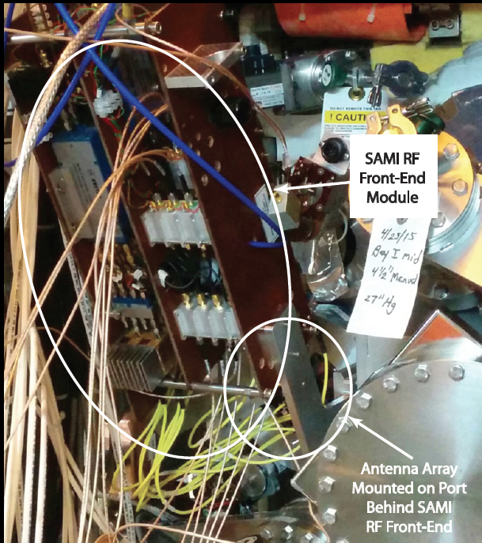
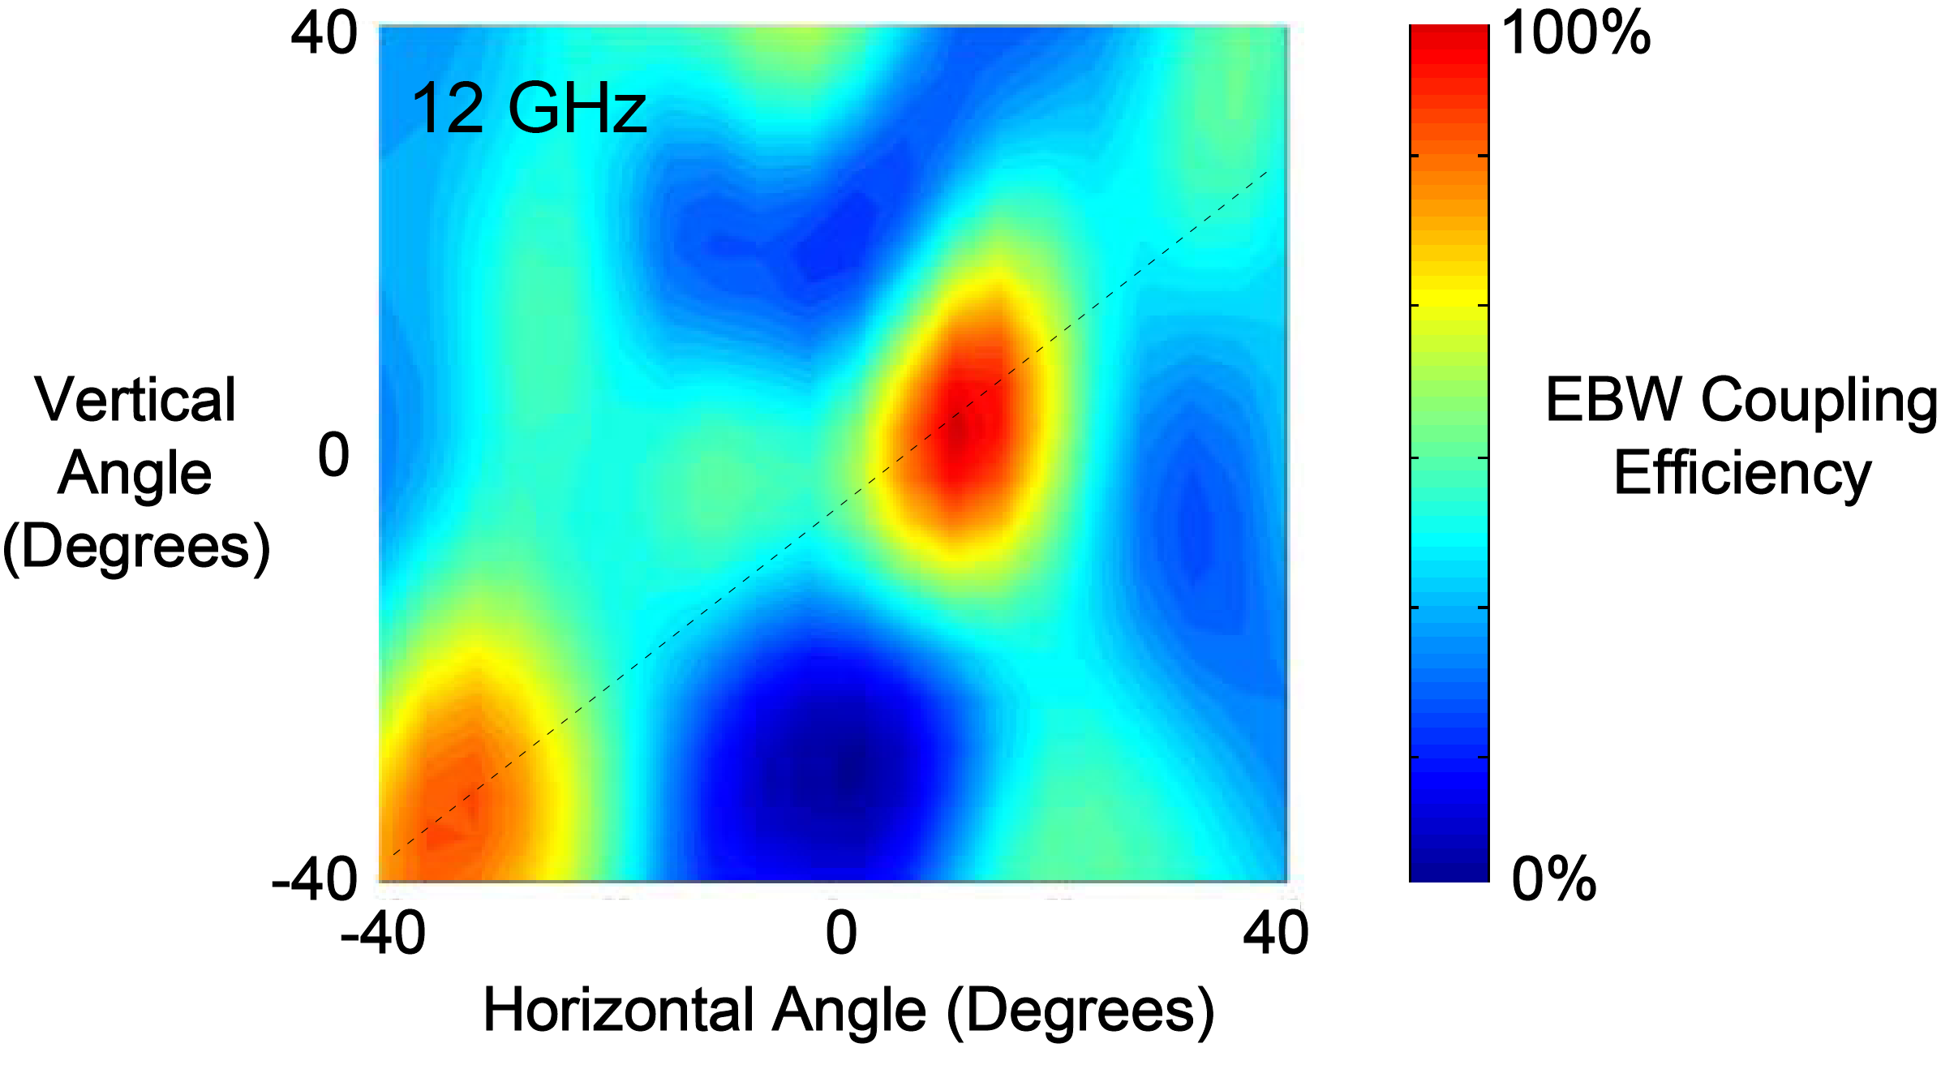
Synthetic Aperture Microwave Imaging (SAMI) diagnostic now calibrated and operating on NSTX-U
SAMI* measures 10-35.5 GHz emission using 16 local oscillators and an array of antennas to image over a large field of view
[Collaboration with Univ of York, Durham Univ & CCFE in UK]
Two probing beams used for 2-D Doppler Back Scattering
Emission data digitized at 250 mega samples/sec
SAMI RF front-end and antenna array installed on NSTX-U
First used successfully on MAST
Image can be focused post shot
Measures EBW coupling efficiency, plasma turbulence, and pitch angle of magnetic field in the plasma edge with high radial resolution
SAMI EBW Emission Data from MAST

Slide 9
NSTX-U device performance progression
1st year: Limit forces to ½ way between NSTX and NSTX-U, and ½ of the design-point heating of any coil
  Presently operating at B_{T} ~ 0.65T
  Increase to B_{T} ~ 0.8T after completing engineering analysis
2nd year goal: Full field and current, coil heating to ¾ of limit
3rd year goal: Full capability
Parameter | NSTX (Max.) | Year 1 NSTX-U Operations | Year 2 NSTX-U Operations | Year 3 NSTX-U Operations | NSTX-U Ultimate Goal
I_{P} [MA] | 1.2 | ~1.6 | 2.0 | 2.0 | 2.0
B_{T} [T] | 0.55 | ~0.8 (0.65) | 1.0 | 1.0 | 1.0
Allowed TF I²t [MA²s] | 7.3 | 80 | 120 | 160 | 160
I_{P} Flat-Top at max. allowed I²t, I_{P}, and B_{T} [s] | ~0.4 | ~3.5 | ~3 | 5 | 5

Slide 10
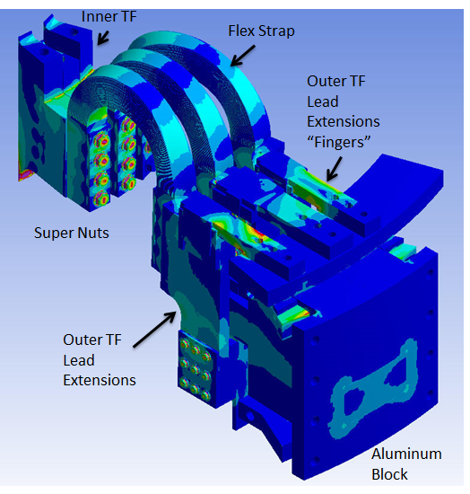
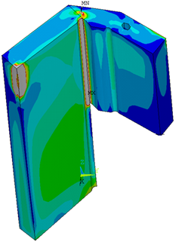
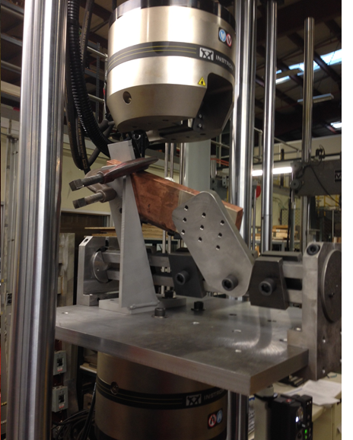
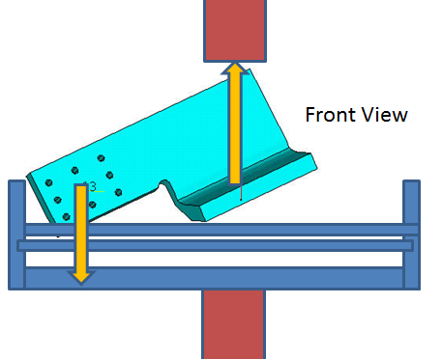
NSTX Upgrade Lead Extension Qualifications
Confirmed by Calculations and Cyclic Fatigue Test
TF Inner to Outer Connection Details
• The CuCrZr TF lead extensions and all the related parts associated with the connections between the inner and outer TF conductors are qualified to be acceptable for up to 300 pulses at B_{T} = 0.8 Tesla.
• It successfully passed the cyclic fatigue test to the .8 T level for 6000 cycles (20 * 300 cycles expected in this run period at 0.8T).
• The full 1.0Tesla level to 400,000 cycles is being conducted this week.
• Components are being inspected, analyzed tested and replaced as needed to qualify operation at full performance after the shut-down starting in August of 2016.
INSTRON Cyclic Tester and Test Fixture

Slide 11
Longer Term Plan Supports Operations in FY-17
TF Lead Extensions
Diag Cal.
Bakeout
FY-16 Run
Vent & Purge
Diag Cal.
High-Z Tiles
Pump
ISTP
FY-17 Run
Passive Plate
Diag. Install
OH Water Heater
Present run projected to run through mid-August
Maintenance period shown mid-August thru December 2016
  OH Water Heater
  Passive Plate Replacement
  TF Coil Maintenance and Partial Parts Replacement
  High-Z tiles
  Diagnostic work including high-k, FIReTIP, bolometer, laser blow-off
Diagnostic calibrations, bakeout, leak checking and coil testing through March 2017
Operations April thru September: 5.5 months for 16 run weeks.

Slide 12
Outline
Facility Operations Status and Plan
On-Going Facility Enhancement Status and Plan
Summary

Slide 13
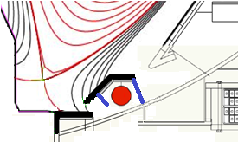
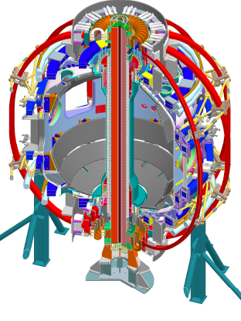
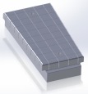
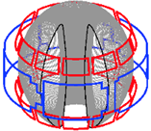
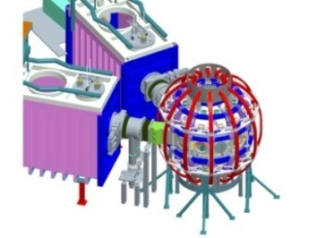
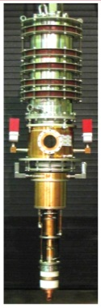
Five Year Facility Enhancement Plan (green – ongoing)
Incremental enables 5 year plan enhancements including NCC, ECH
Fiscal Year:
2015 | 2016 | 2017 | 2018 | 2019
Major enhancements:
Base funding
incremental funding
Upgrade Outage
1.5 → 2 MA, 1s → 5s
Run Weeks:
18
16
12-16
10-12
New
center-stack
Pulse-burst MPTS
Lower divertor cryo-pump
Boundary Science
+ Particle Control
High-Z tile row on lower OBD
Boronization
High-Z PFC diagnostics
Li granule injector
Scanning MLP
Upward
LiTER
Graphite CHI/Lower Bullnose
LiTER
APD-based GPI
MAPP
Resistive
Bolometer
MGI disruption mitigation
XICS
Off-midplane 3D coils (NCC)
Upgraded halo sensors
Core Science
sß
Enhanced MHD sensors
42 ch MPTS
Laser blow-off
CPS δB diag.
DBS, PCI, or other intermediate-k
48 ch BES
High k_{θ}
MSE/LIF
Charged fusion product
Neutron collimator
4 coil AE antenna
Establish control of:
Rotation
q_{min}
HHFW limiter upgrade
Snowflake
Integrated Scenarios
FIReTIP
n_{e}
Divertor P_{rad}
2nd NBI
1 MW ECH/EBW
Upgraded CHI for ~0.5MA
0.5-1 MA CHI
up to 1 MA plasma gun

Slide 14
Five Year Facility Enhancement Plan (green – ongoing)
Incremental enables 5 year plan enhancements including NCC, ECH
Fiscal Year:
2015 | 2016 | 2017 | 2018 | 2019
Major enhancements:
Base funding
incremental funding
Upgrade Outage
1.5 → 2 MA, 1s → 5s
Run Weeks:
18
16
12-16
10-12
New
center-stack
Pulse-burst MPTS
Lower divertor cryo-pump
Boundary Science
+ Particle Control
High-Z tile row on lower OBD
Boronization
High-Z PFC diagnostics
Li granule injector
Scanning MLP
Upward
LiTER
Graphite CHI/Lower Bullnose
LiTER
APD-based GPI
MAPP
Resistive
Bolometer
MGI disruption mitigation
XICS
Off-midplane 3D coils (NCC)
Upgraded halo sensors
Core Science
sß
Enhanced MHD sensors
42 ch MPTS
Laser blow-off
CPS δB diag.
DBS, PCI, or other intermediate-k
48 ch BES
High k_{θ}
MSE/LIF
Charged fusion product
Neutron collimator
4 coil AE antenna
Establish control of:
Rotation
q_{min}
HHFW limiter upgrade
Snowflake
Integrated Scenarios
FIReTIP
n_{e}
Divertor P_{rad}
2nd NBI
1 MW ECH/EBW
Upgraded CHI for ~0.5MA
0.5-1 MA CHI
up to 1 MA plasma gun

Slide 15
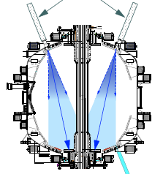
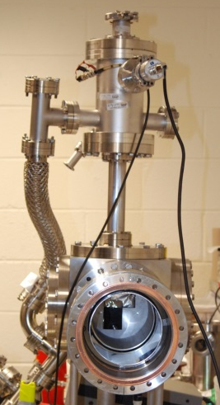
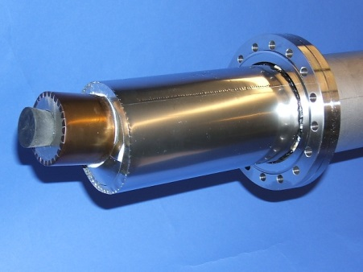
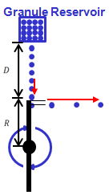
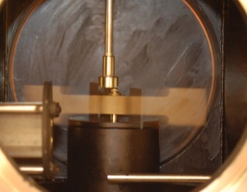
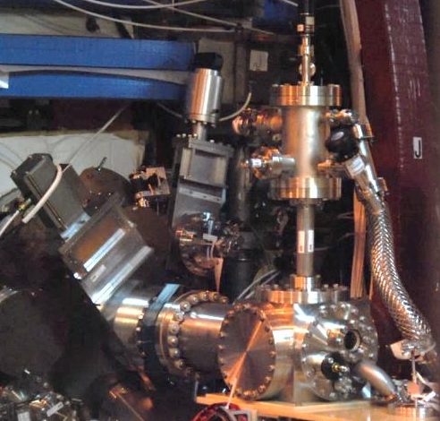
First Year Boundary Physics Tools
Boronization, Lithium Evaporators, Granule Injector
Lithium Evaporator (LITERs)
LITERs
Granule injector (GI) for ELM pacing
Successfully tested
on EAST and DIII-D
Granules: Li, B₄C, C
f ~ up to 500 Hz
Granular Reservoir
• LITERs filing set up in high bay south of NSTX-U Test Cell.
• Argon purge system implemented for Li safety, used for the quick argon vent.
• Expected to be operational in June.
Rotating Impeller
Boronization System
• Multiple injection and glow made more uniform boronization.
• System is working very well. Multiple # of boronization including daily ones performed. Also being used for He glow discharges.
• Undergoing commissioning and initial injection during the next plasma operation.
GI installed on NSTX-U

Slide 16
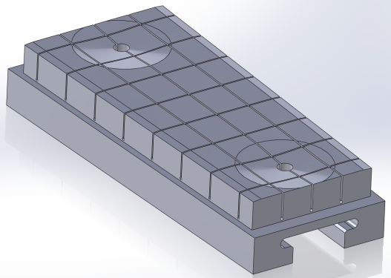
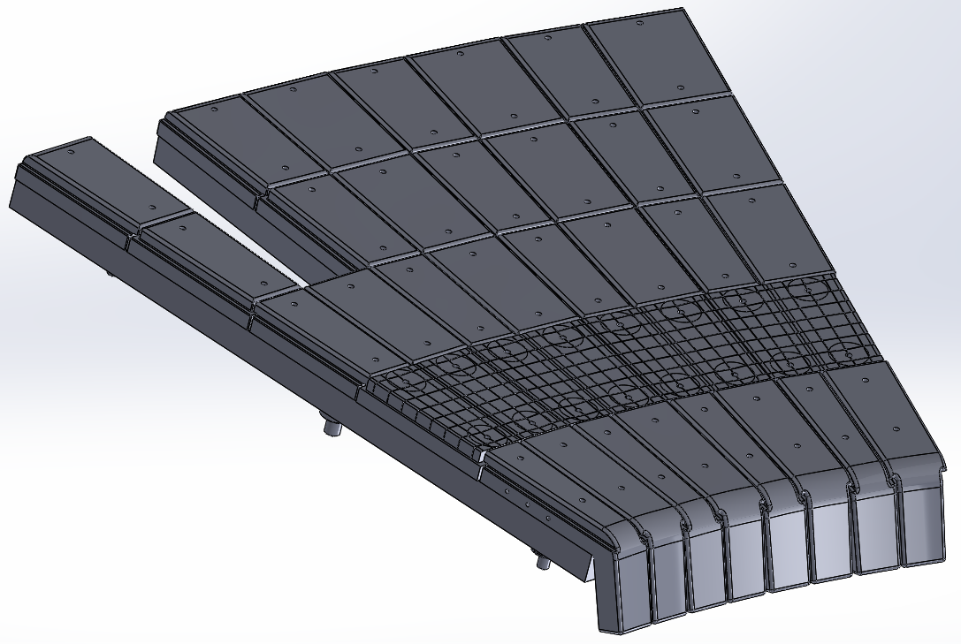
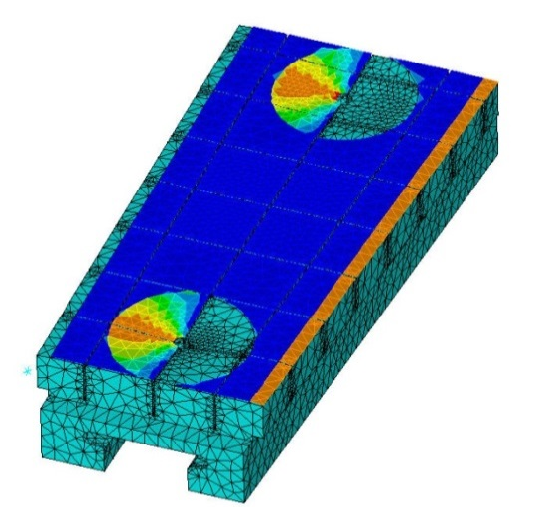
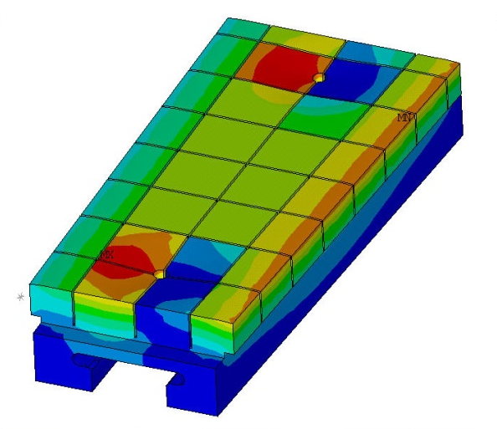
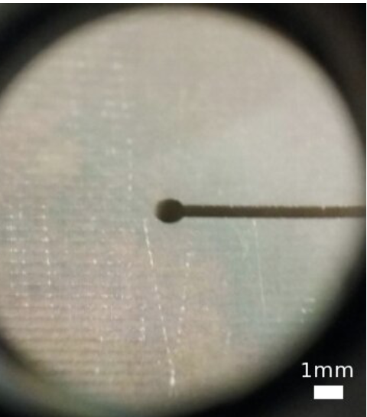
High-Z Tile to be installed for FY 2017 run
Design to replace a row of the graphite tiles in lower outer divertor
Successful FDR held in
February
  82% of raw materials on-site
  Fabrication RFQ being prepared
  Schedule to be delivered in September in time for the installation in NSTX-U
Final design rated to 10 MW/m² for 1s heat flux for 1000s of cycles
  Installation flexibility introduced to accommodate “as built” vessel tolerances
Surface heat flux
Temperature
  Edge and access-way chamfers introduced to reduce heat-flux peaking
Test cut from one of the castellations performed

Slide 17
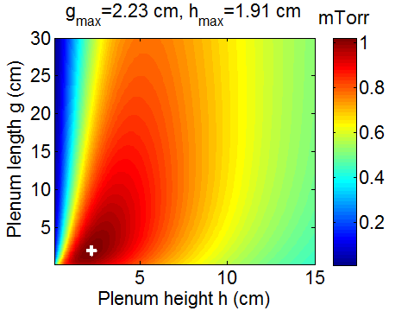
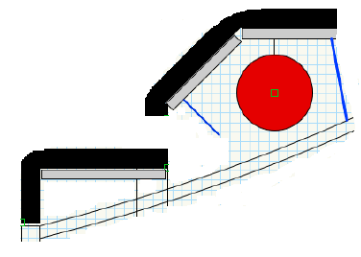
Lower Divertor Cryo-pump to Provide Pumping over a Wide Range of Divertor Geometries and Core Densities
Physics design completed in collaboration with ORNL.
  Defined the geometry, plenum sizes, ability to pump various geometries.
Conceptual design process has been initiated:
  Draft GRD has been formulated.
  Initial designer sketches of in-vessel implementation completed.
  Two types of PFCs being investigated.
  CHI/lower bullnose section may be pursued as separate job as it may be enhanced for high Z and flowing Li in the future.
  Goal is to to have the system ready for installation in the 2018-2019 outage under base funding.
Need 0.8 mTorr or better
Two PFC Options for CDR
350C
bake
350C
bake
Passive
bake
Or
A
B
PFC type:
Graphite
CHI/ lower bullnose
Baffle diagonal / upper bullnose
Baffle top / horizontal
tiles
High-Z, high q⊥
High-Z, low q⊥

Slide 18
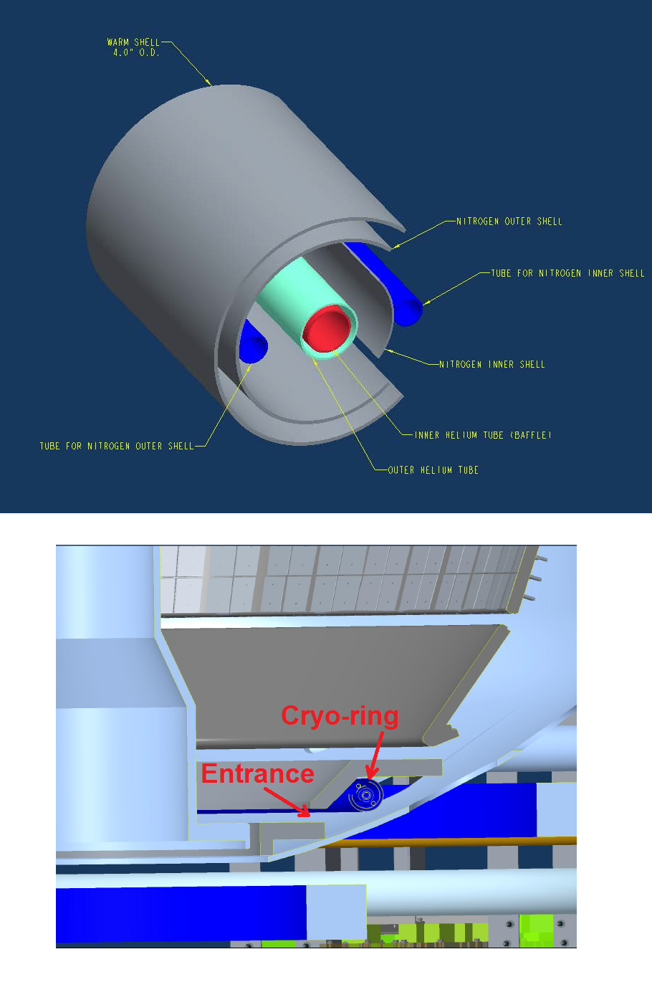

Divertor Cryo-pump Design Activities Started
Design also includes appropriate PFCs and L-He refrigerator
Cryo-ring
Initial in-vessel geometry has been laid out. MIT will design cryo-ring.
  Pump radius, throat dimensions taken from the modeling.
  The entire lower outer divertor region to be reduild.
• Cryo-baffle design to be finalized at CDR.
  Diagnostic access and cryo-ring maintainability are major design consideration.
  Two PFC options (Graphite or high Z) are pursued for CDR.
• A 400W liquid He refrigerator considered to reduce NBI operational risk and operational cost savings.
  A room adjacent to NSTX-U has been identified for energy efficient location with utilities already available.
  Replaces the outdated TFTR-era L-He refrigerator reducing risks to the NBI operations.
Transfer line layout

Slide 19
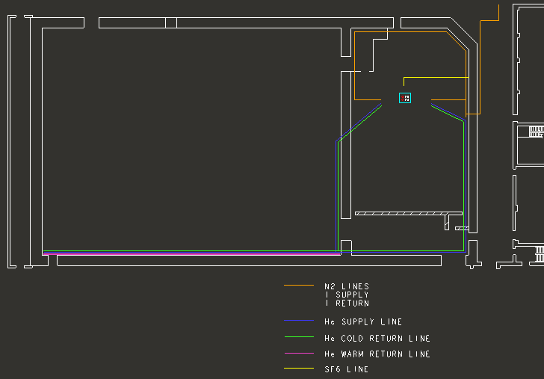
A new efficient 400 W liquid helium (L-He) refrigerator to minimize down time risk and reduce operating cost
Proposed 400 W L-He refrigerator ~ $2.5M
Former TFTR Test Cell
• To be located in the Cryogenics Compressor Room near NSTX-U, accommodates all envisioned loads by benefit of greatly reduced piping and heat loss (x 3-4).
• The unit would reuse power and space previously used for a 225 Watt refrigerator with all the utilities and compressors available.
• Benefit:
  Remove down time risk
  Increase available L-He for NSTX-U including NBI and Divertor Cryo-pump.
  Reduced operating and maintenance cost
NSTX-U
500 feet of supply and return piping
TFTR legacy liquid helium refrigerator
• 36 years old 800 W refrigerator for NBI #1 and 2 operating at near capacity due to long piping causes significant heat loss – also quite expensive to operate and maintain.
• If a cold box failure occurs, the repair will require reverse engineering and loss of several months will severely impact NSTX-U operations.

Slide 20
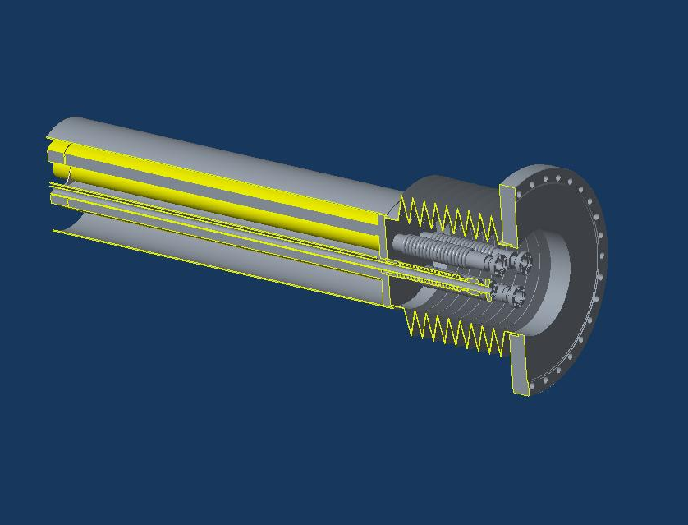
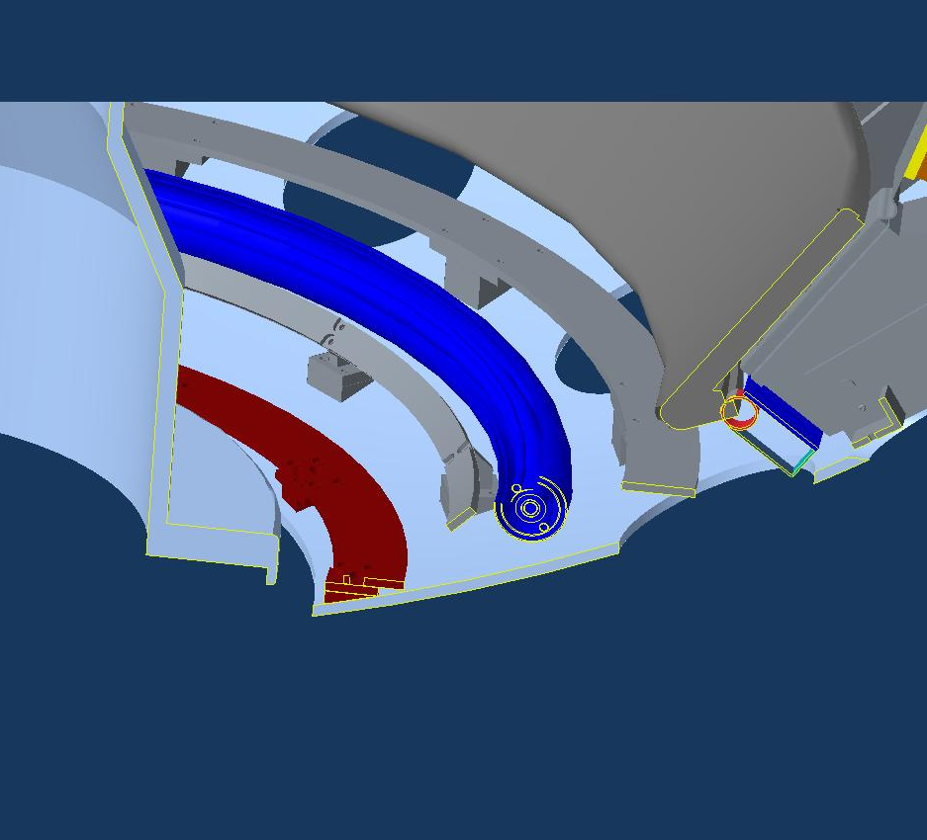
Implement Divertor Cryo-Pump with base funding
Exploring various options to minimize cost for timely completion
Schedule for Cryo-pump and PFCs:
  Start formal design collaboration with MIT in Feb 2016.
  CDR – planned in July 2016 with cost and schedule developed (Notable Outcome)
  PDR – planned in Nov. 2016
  FDR – planned in March 2017
  Complete fabrication of in-vessel components – May 2018
  Complete installation of in-vessel and ex-vessel components – Feb. 2019
Cryogenic vacuum feedthrough concept.
Schedule for L-He refrigerator:
  PDR in June 2016 with external reviewers
  Start procurement – Sep. 2016.
  Start installation – June 2017
  Commission – Oct. 2017
Cryopump with redesigned divertor support structures
Transfer line layout

Slide 21
Five Year Facility Enhancement Plan (green – ongoing)
Incremental enables 5 year plan enhancements including NCC, ECH
Fiscal Year:
2015 | 2016 | 2017 | 2018 | 2019
Major enhancements:
Base funding
incremental funding
Upgrade Outage
1.5 → 2 MA, 1s → 5s
Run Weeks:
18
16
12-16
10-12
New
center-stack
Pulse-burst MPTS
Lower divertor cryo-pump
Boundary Science
+ Particle Control
High-Z tile row on lower OBD
Boronization
High-Z PFC diagnostics
Li granule injector
Scanning MLP
Upward
LiTER
Graphite CHI/Lower Bullnose
LiTER
APD-based GPI
MAPP
Resistive
Bolometer
MGI disruption mitigation
XICS
Off-midplane 3D coils (NCC)
Upgraded halo sensors
Core Science
sß
Enhanced MHD sensors
42 ch MPTS
Laser blow-off
CPS δB diag.
DBS, PCI, or other intermediate-k
48 ch BES
High k_{θ}
MSE/LIF
Charged fusion product
Neutron collimator
4 coil AE antenna
Establish control of:
Rotation
q_{min}
HHFW limiter upgrade
Snowflake
Integrated Scenarios
FIReTIP
n_{e}
Divertor P_{rad}
2nd NBI
1 MW ECH/EBW
Upgraded CHI for ~0.5MA
0.5-1 MA CHI
up to 1 MA plasma gun

Slide 22
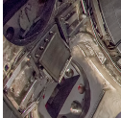
Enhanced FIDA will measure NBI distribution function
For NBI fast ion transport and current drive physics
Fast Ion D-Alpha Diagnostics
Taking data on NSTX-U
FIDA Views
CHI Gap
• Both vertical (perpendicular) and new tangential (parallel) FIDA systems are ready.
• Both FIDA systems have 10 ms, 5 cm, ≈ 10 keV resolutions.
Vertical
Center-Stack
Tangential
HHFW
Antennas
FY 2016 - 2017 Energetic Particle Conceptual Design and Diagnostic Upgrade
  SS-NPA installed and taking data.
  sFLIP installed for lost ion measurements
  Active 2 X 2 TAE antennas installed. Initially passive spectroscopy then active excitation at few kW level.
  Proto-type charged fusion product (CFP) profile diagnostic is being prepared to be installed.
  8+8 reflectometry array available for AEs.
TAE antennas
UCI
sFLIP
FIU
UCLA

Slide 23
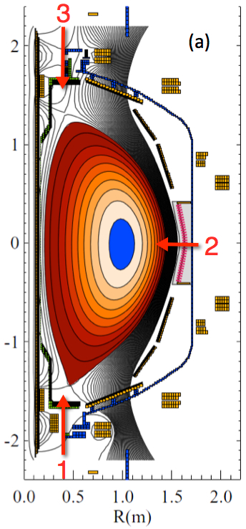
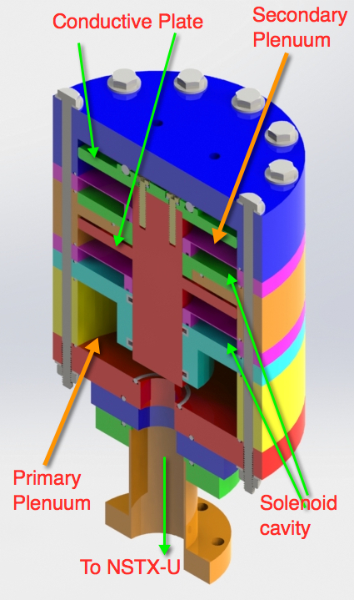
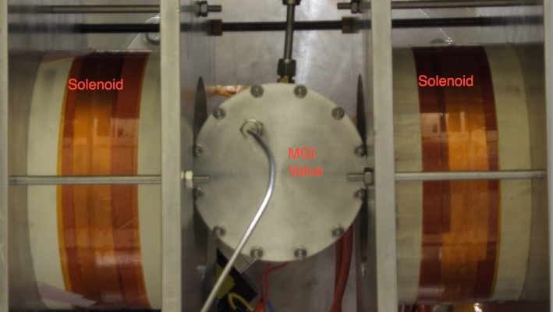
Disruption Mitigation System for NSTX-U
Massive gas injection system at multiple poloidal positions
NSTX-U MGI Valve
  - Massive gas injector system at multi
  poloidal location with identical injection set-up
  - Compact power supply proto-type tested at UW
  - A new double solenoid MGI design (zero net J x B
  torque) based on the ORNL ITER MGI design
  MGI also tested on the U. Washington test stand with magnetic field
Magnets
Magnets
MGI
Valve
U. Washington
• Successful final Design Review of MGI system was held on February 18, 2016.
• All the MGI components were installed on NSTX-U and the control is being installed.
• Preliminary MGI test is planned in May, 2016 for the initial gas pulses into NSTX-U.

Slide 24
Summary of Facility and Diagnostics
We are at 40% of the 18 run weeks
• The commissioning phase is nearly complete and the plasma operation is now becoming routine and the availability increasing to ~ 90 % range.
• NBI and boronization are now supporting operations with routine H-mode access. NBI is approaching the full capability. HHFW is starting up. Will switch to lithium in June.
• Very good progress on the plasma control system, quickly achieving H-mode and high performance discharges comparable to the best NSTX plasma parameters.
• Plan to achieve parameters well beyond NSTX in the near future. In preparation for the 0.8 T operation later this year, a cyclic fatigue test was successfully conducted on the TF lead extension e-beam weld joint.
• A number of enhancements are being implemented to support the NSTX-U research plan. installation of high-Z tiles and complete conceptual engineering design for divertor cryo-pump, NCC, and ECH this year.
• Divertor cryo-pump, outer lower divertor PFCs will be implemented in the base plan.

Slide 25
Back-up Slides

Slide 26
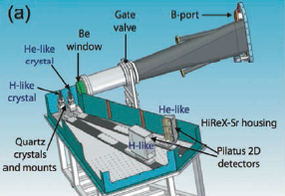
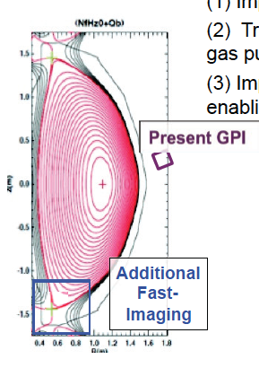
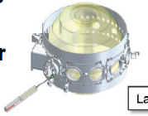
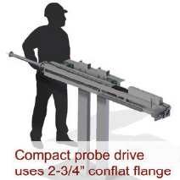
MIT PSFC Complements Well Existing NSTX-U Capabilities
Discussions Started on Various Diagnostic Implementations
MIT will enhance NSTX-U GPI systems
X-ray Imaging Crystal Spectroscopy
Avalanche-PhotoDiode (APD)-based GPI
MIT is developing a next generation, servo-driven, compact scanning MLP system

Slide 27
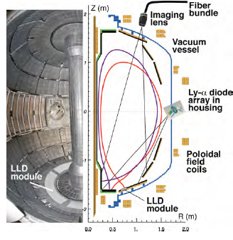
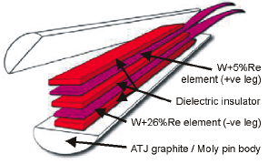
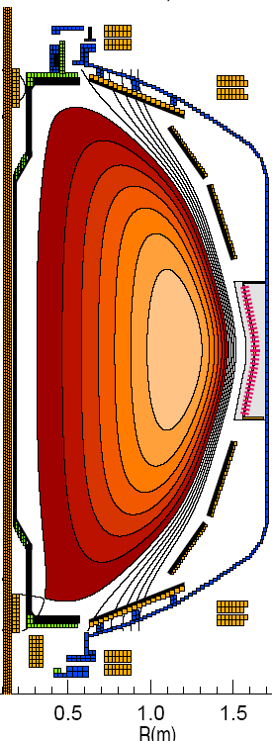
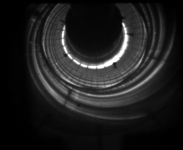
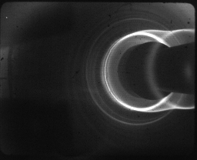
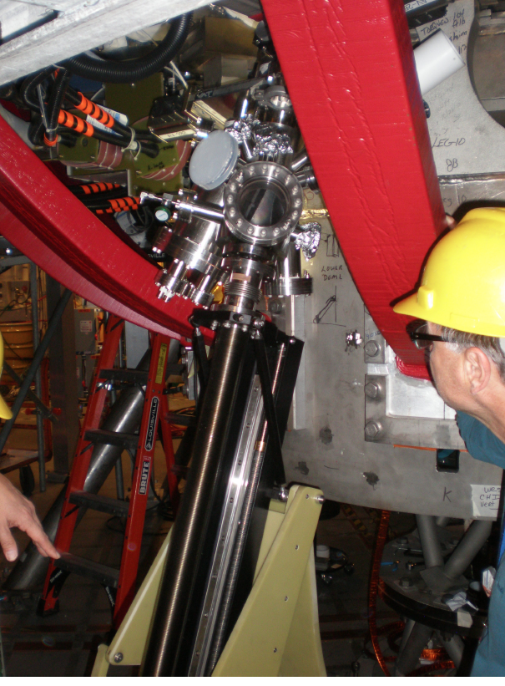
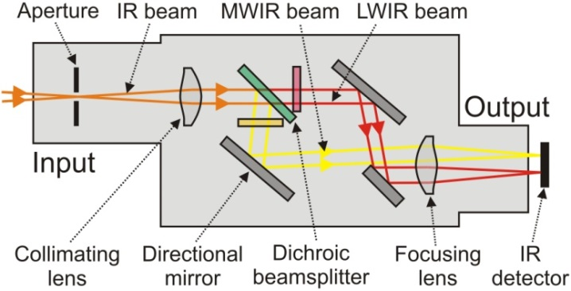
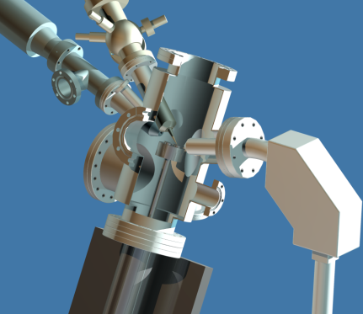
Enhanced Capability for PMI Research
Multi-Institutional Contributions
Divertor fast eroding thermocouples
Multiple fast 2D visible and IR cameras with full divertor coverage
Divertor Imaging
Spectrometer
ORNL
LLNL, ORNL, UT-K
LLNL
Li I
ORNL
C II
Dual-band fast IR Camera
MAPP probe for between-shots surface analysis – Now taking data
U. of Illinois, PPPL

Slide 28
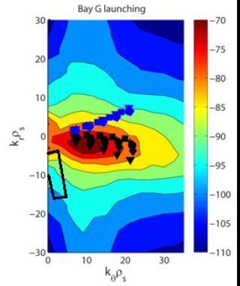
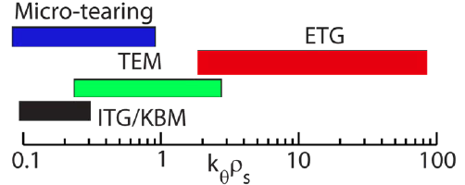
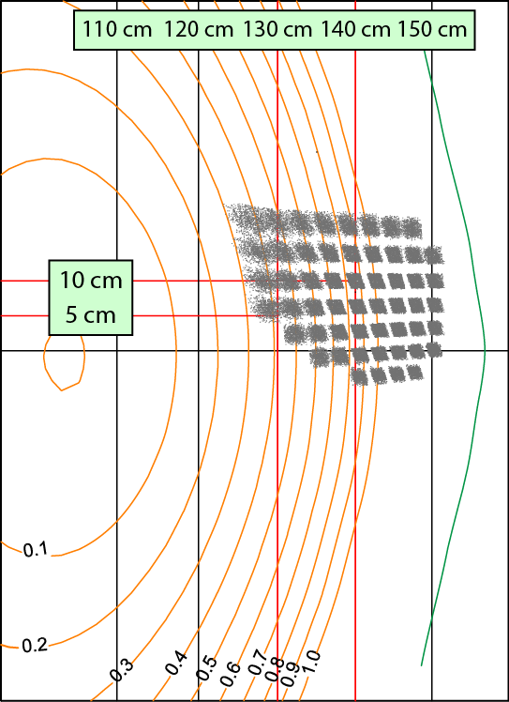
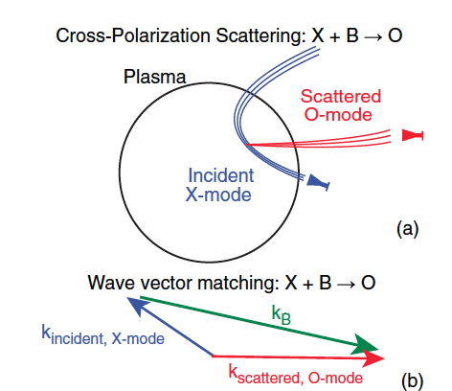


Microturbulence Diagnostics Being Enhanced
To measure ion to electron gyro-scale, magnetic fluctuations
Beam Emission Spectroscopy
for low k turbulence
48 chs being readied
Low k
High-k scattering for ETG
High k
Cross-Polarization Scattering for magnetic fluctuations being developed in collaboration with DIII-D and MAST
UC Davis
BES-2D-Fiber
Assembly
Collection optics (Bay L)
4x1 subharmonic mixer array
U Wisconsin
4–channel CPS system in 2017
UCLA
Available for FY 17

Slide 29
Flexible Mid-Plane Feedback Coils for MHD Studies
NCC will greatly enhance MHD physics studies and control
Full toroidal NCC array (2 x 12)
Partial toroidal NCC array (2 x 6)
Partial NCC
Full NCC
Existing
RWM
coils
Columbia U
General Atomics
• 6-channel Switching Power Amplifier (SPA) powers independent currents in existing EFC/RWM Coils supporting experiments
• NCC (a facility enhancement) can provide various NTV, RMP, RWM, and EF selectivity with flexibility of field spectrum (n ≤ 6 for full and n≤ 3 for partial)
Base Budget – NCC engineering conceptual design work to develop reliable cost and schedule is being concluded to focus engineering resources to divertor cryo-pump design. CDR in May 2016.
Incremental Budget – Enables continued design, development, and installation of NCC.

Slide 30




NCC Lorentz and Thermal
Stress Analysis
NCC Coils Design Activity Made Significant Progress
Test area prepared to perform conductor sample R&D
NCC = Non-axisymmetric Control Coil
2 x 12
Coil
Thermal Analysis
Tile
End of Last Pulse Temp (8 hours)
PP
Lead
3 kA,0.1 MW/m2 Plasma Heating,5s pulse,1200 s reprate
• Candidate conductor for test sample received for R&D.
• R&D facility prepared and test being conducted.
• The R&D selection criteria include thermal capability, manufacturability, impact on interfacing objects, fabrication lead time and cost.
• Cost and schedule will be prepared as part of the CDR which is targeted for May, 2016.
With Lead Clamp, 50 C Heat-up, 3kA+ Background Field

Slide 31
Five Year Facility Enhancement Plan (green – ongoing)
Incremental enables 5 year plan enhancements including NCC, ECH
Fiscal Year:
2015 | 2016 | 2017 | 2018 | 2019
Major enhancements:
Base funding
incremental funding
Upgrade Outage
1.5 → 2 MA, 1s → 5s
Run Weeks:
18
16
12-16
10-12
New
center-stack
Pulse-burst MPTS
Lower divertor cryo-pump
Boundary Science
+ Particle Control
High-Z tile row on lower OBD
Boronization
High-Z PFC diagnostics
Li granule injector
Scanning MLP
Upward
LiTER
Graphite CHI/Lower Bullnose
LiTER
APD-based GPI
MAPP
Resistive
Bolometer
MGI disruption mitigation
XICS
Off-midplane 3D coils (NCC)
Upgraded halo sensors
Core Science
sß
Enhanced MHD sensors
42 ch MPTS
Laser blow-off
CPS δB diag.
DBS, PCI, or other intermediate-k
48 ch BES
High k_{θ}
MSE/LIF
Charged fusion product
Neutron collimator
4 coil AE antenna
Establish control of:
Rotation
q_{min}
HHFW limiter upgrade
Snowflake
Integrated Scenarios
FIReTIP
n_{e}
Divertor P_{rad}
2nd NBI
1 MW ECH/EBW
Upgraded CHI for ~0.5MA
0.5-1 MA CHI
up to 1 MA plasma gun

Slide 32


Solenoid-free start-up in support of ST-FNSF
NSTX-U CHI configuration permits ~ 400 kA level start-up
CHI Start-Up in NSTX-U
QUEST CHI Experiment to test high-Z electrode operation
• Inj. Flux in NSTX-U is about 2.5 times higher than in NSTX
• NSTX-U coil insulation greatly enhanced for higher voltage ~ 3 kV operation
U. Washington
• The resistive voltage divider network was made functional, and many of the components related to a fast voltage monitoring system were installed.
• All of the connections of the gas lines to the CHI gas injection systems have been completed.
• Initial testing of the CHI system into a plasma load will begin in the near future.
U. Washington
An ST-FNSF like CHI configuration will undergo plasma tests on QUEST after FY 2016 NSTX-U operation (after July 2016).
All metal (high-Z) CHI electrodes provide valuable information for NSTX-U (presently graphite electrodes)

Slide 33



HHFW system will be ready for operation
Antenna plasma conditioning to start in May
New Compliant Antenna Feeds
Allow HHFW antenna feedthroughs to tolerate 2 MA disruptions
Antennas were re-installed with the new feeds and back-plate grounding
Transmission lines installed & tuned.
Additional ground installed
- Prototype compliant feeds tested to 46 kV in the RF test-stand. Benefit of back-plate grounding for arc prevention found.
- RF diagnostics also installed.
• All sources will be ready to support HHFW operation in May.

Slide 34



28 GHz ECH System Design Progressing Well
Complete conceptual design and cost/schedule this year
CHI can form a 200-400 kA seed plasma, but it is too cold for HHFW absorption.
Use of ECH can “bridge the T_{e} gap” to where HHFW and then NB current drive can support the ramp and sustain the current – crucial for OH solenoid-free compact STs
  Good first pass absorption predicted.
Goal of first ECH power in 2019 run with 15% incremental funding.
28 GHz 1 MW Tube by Tsukuba
28 GHz Gyrotron Room
NSTX-U
Test Cell
28 GHz Gyrotron Development
• 2nd generation 1.5 MW 28/35 GHz gyroton being developed at Tsukuba University. (See back-up slide). Power test to start in May.
• Incremental budget enables continued design and procurement of the ECH system.
Gyroton room
Power Supply Room
Gyrotron will be located in the TFTR basement. Stray magnetic fields was measured to be negligible

