Slide 1



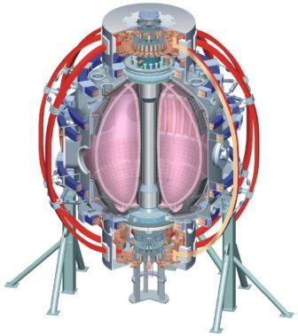
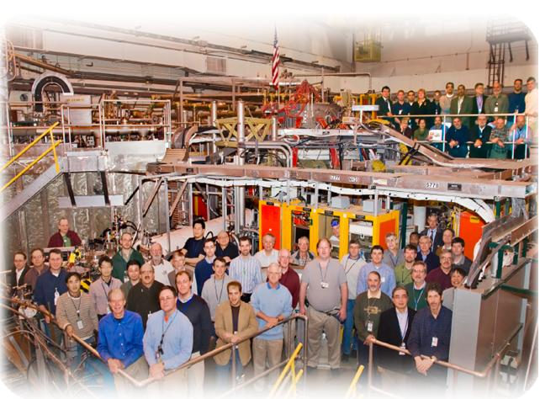

Supported by
Radiative divertor with impurity seeding and with LLD
College W&M
Colorado Sch Mines
Columbia U
CompX
General Atomics
INEL
Johns Hopkins U
LANL
LLNL
Lodestar
MIT
Nova Photonics
New York U
Old Dominion U
ORNL
PPPL
PSI
Princeton U
Purdue U
SNL
Think Tank, Inc.
UC Davis
UC Irvine
UCLA
UCSD
U Colorado
U Illinois
U Maryland
U Rochester
U Washington
U Wisconsin
Culham Sci Ctr
U St. Andrews
York U
Chubu U
Fukui U
Hiroshima U
Hyogo U
Kyoto U
Kyushu U
Kyushu Tokai U
NIFS
Niigata U
U Tokyo
JAEA
Hebrew U
Ioffe Inst
RRC Kurchatov Inst
TRINITI
KBSI
KAIST
POSTECH
ASIPP
ENEA, Frascati
CEA, Cadarache
IPP, Jülich
IPP, Garching
ASCR, Czech Rep
U Quebec
V. A. Soukhanovskii, LLNL
and NSTX Team
Boundary Physics TSG Meeting
Princeton, NJ
16 July 2010

Slide 2
Use of impurity seeding will provide an opportunity to study reactor-relevant radiative divertor
Radiative divertor experiments used D₂ injection to demonstrate peak heat flux reduction in NSXT with carbon radiation
A significant divertor peak heat flux reduction will be needed in NSTX-U, probably not possible with low Z impurities
Reduced density LLD / LITER operation will reduce radiated power due to extrinsic impurity seeding – is radiative divertor possible at all?
Need to learn control aspects of radiative divertor
  Identify divertor quantities that can be monitored and used as actuators for feeding into PCS to regulate impurity injection
Additional emphasis – consider joining ITPA DSOL-20 “Transient divertor re-attachment”
  ITER will run with partially detached divertor (PDD)
  Study possible fault conditions – loss of PDD regime
  Dynamic / transient experiment – how intrinsic carbon can replace extrinsic impurity radiated power due to loss of impurity seeding

Slide 3
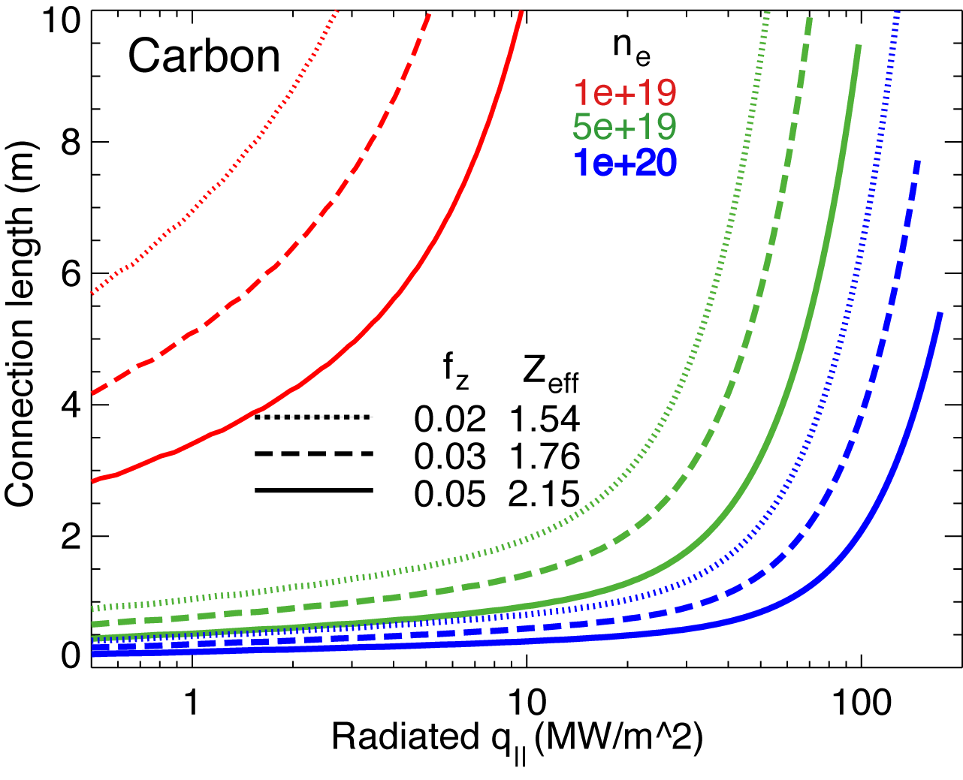
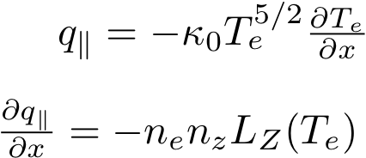
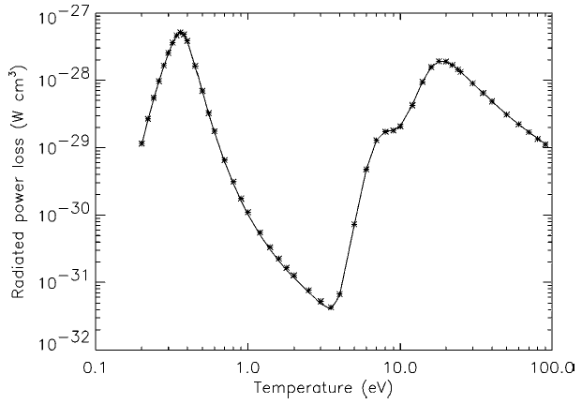
Impurity radiation role is to be clarified in radiative divertor experiments
It is marginally possible to radiate the necessary fraction of q|| with intrinsic carbon in NSTX
Lithium and helium can play an important role in divertor power balance
  Helium - energy expensive (first I.P. 24.6 eV), radiates at 1-10 eV
  Lithium – highly radiative at T_{e} < 1-3 eV
In PDD experiments in FY 2006-2008
  Radiated power was due to D, He, Li, C
  He and C were main contributors

Slide 4
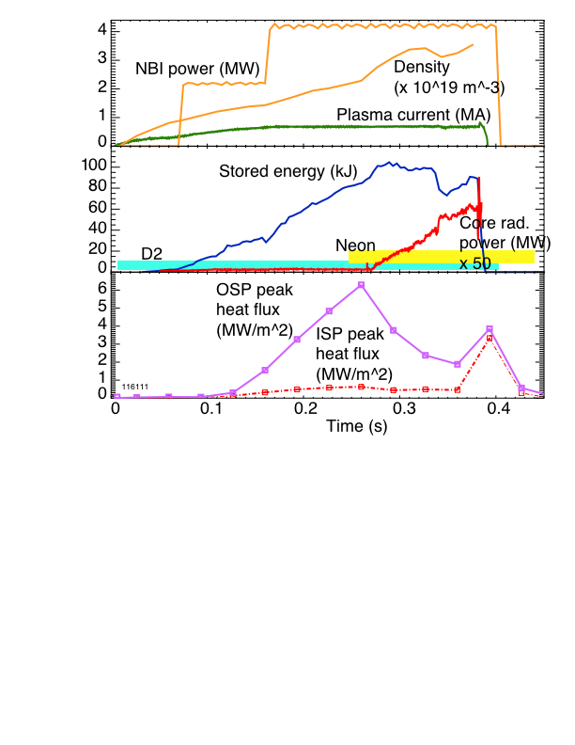
Previous NSTX radiative divertor experiments with neon demonstrated that the divertor was too cold for efficient neon radiation

Slide 5
Radiative divertor with impurity seeding – complete XP605, XP708, XP814 (1 run day)
  High κ, δ LSN plasmas with I_{p} = 0.8 - 1.2 MA, P_{NBI} = 4-5 MW (β-limit permitting)
  LITER to be used in part I, warm LLD to be used in part II, to study compatibility of radiative divertor with LLD pumping
  He, Ne, or CD₄ to be injected in the divertor region
    Neon may be a good candidate in the LLD with higher T_{e}
  Study divertor conditions as a function of impurity injection rate
  Measurements of pedestal profiles and pedestal stability calculations to understand impact of radiative divertor on core and pedestal plasma

Slide 6
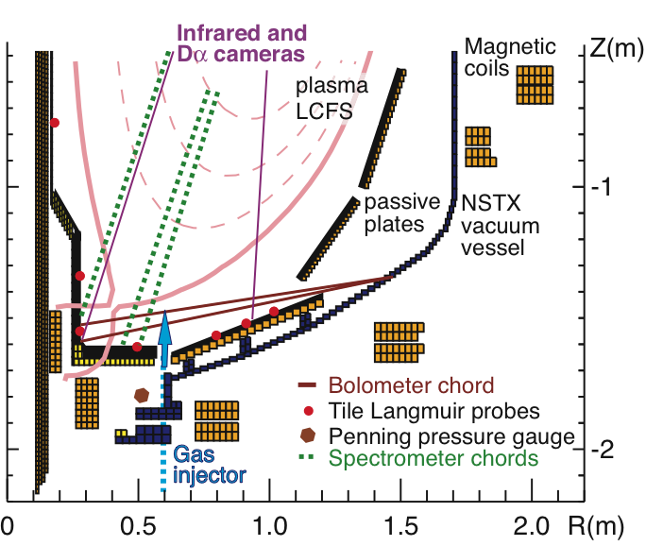
Multiple diagnostic measurements will be needed to elucidate on radiative divertor physics in NSTX
Machine capabilities:
  Low Z_{eff}, low H/D
  Reliable H-mode access
  B_{t} up to 5.5 kG
  Divertor gas injector (Bay E)
Needed diagnostics:
  Two-color IR camera
  Bolometers (core plasma and new divertor bolometers)
  Dα, Dγ, C III, C IV cameras
  Neutral pressure gauges (incl. 3 lower div. Penning gauges)
  Divertor Langmuir probes
  MPTS, CHERS, ERD (n_{e}, T_{e}, n_{c})
  Spectroscopy (D I Balmer series, impurities)
  Gas puff imaging

