Slide 1


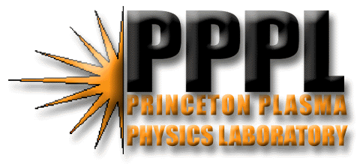
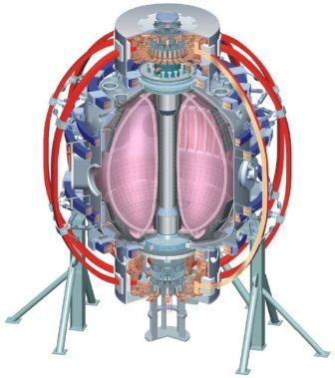
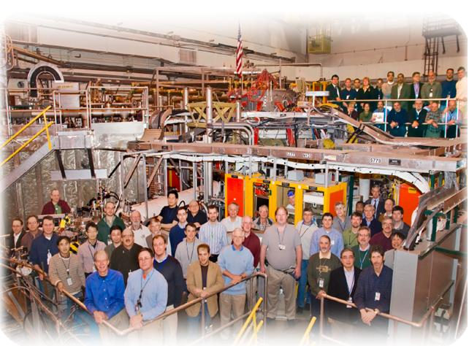

Supported by
XP 1045: “Snowflake” divertor
characterization in NSTX
College W&M
Colorado Sch Mines
Columbia U
CompX
General Atomics
INEL
Johns Hopkins U
LANL
LLNL
Lodestar
MIT
Nova Photonics
New York U
Old Dominion U
ORNL
PPPL
PSI
Princeton U
Purdue U
SNL
Think Tank, Inc.
UC Davis
UC Irvine
UCLA
UCSD
U Colorado
U Illinois
U Maryland
U Rochester
U Washington
U Wisconsin
Culham Sci Ctr
U St. Andrews
York U
Chubu U
Fukui U
Hiroshima U
Hyogo U
Kyoto U
Kyushu U
Kyushu Tokai U
NIFS
Niigata U
U Tokyo
JAEA
Hebrew U
Ioffe Inst
RRC Kurchatov Inst
TRINITI
KBSI
KAIST
POSTECH
ASIPP
ENEA, Frascati
CEA, Cadarache
IPP, Jülich
IPP, Garching
ASCR, Czech Rep
U Quebec
V. A. Soukhanovskii, LLNL
and NSTX Team
Boundary Physics TSG Meeting
Princeton, NJ
30 July 2010

Slide 2
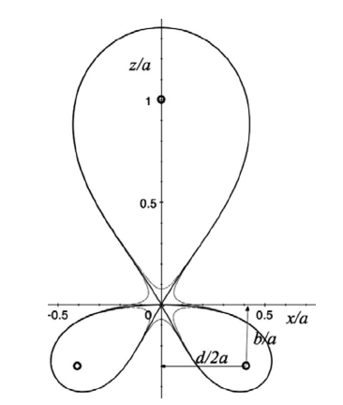
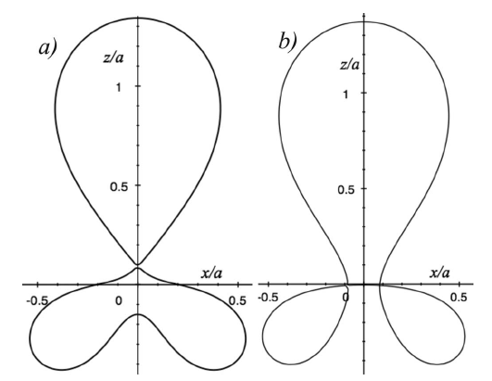
“Snowflake” divertor configuration may be a game changer for divertor tokamaks
“Snowflake” divertor (SFD) configuration proposed and studied theoretically by D. D. Ryutov (LLNL)
  Phys. Plasmas 14, 064502 (2007)
  Phys. Plasmas, 15, 092501 (2008)
  34th EPS Conference on Plasma Phys. Warsaw, 2 - 6 July 2007 ECA Vol.31F, D-1.002 (2007)
  Paper IC/P4-8 at IAEA FEC 2008
SFD is obtained by creating a second-order poloidal null in the (lower) divertor with existing divertor coils
Two cases – SFD-plus and SFD-minus
Predicted properties
  Large flux expansion (B_{p}/B small) and long parallel connection length
  Null-pt flux tube squeezing – barrier for turbulence
  Possibility of ELM control (increased edge magn. shear)
  Enhanced null-point grad B drift (C. S. Chang’s X-pt transport)
Ideal SFD
SFD-plus and SFD-minus

Slide 3
NSTX is making a contribution to the novel divertor geometry development for future devices
XP 924 (2009) - Initial “snowflake” divertor studies in NSTX (0.5 day)
  Obtained “snowflake”-like configurations for 100’s ms
  Magnetic configuration – very large flux expansion, longest connection length, largest divertor volume
  Detachment of divertor OSP
    Large heat flux reduction
    Increased divertor P_{rad} and recombination
    Reduced core P_{rad} and carbon density
  No core confinement degradation
NSTX is making a unique contribution to divertor studies among medium and large high-power tokamaks
  TCV has been experimenting with “snowflake” divertor
  “Snowflake” configuration is a candidate for heat flux mitigation in NSTX-U

Slide 4
XP 1045 to continue “snowflake” divertor studies
“Snowflake” divertor configuration will be obtained as in 2009 by using PCS OSP control and two div. coils (PF1A and PF2L)
  Candidate FY2010 shot 137983 (suggested by E. Kolemen)
  Separately, will also attempt to obtain SFD-minus using PF1B
Goals for XP1045 this year:
  SOL and divertor transport and turbulence
    Measure heat flux profiles in abs. units w / two-color IR camera
    Obtain data in a range of P_{SOL} (P_{NBI} = 2-5 MW, I_{p} = 0.8-1.2 MA)
    Synergy with LLD pumping (scan LITER rate?)
    Comparison of midplane and divertor turbulence (GPI + fast vis. cam.)
    Detachment characteristics (probes, new spectroscopy)
    Impurity sources and core density, P_{rad}
  Pedestal stability

Slide 5
Backup

Slide 6
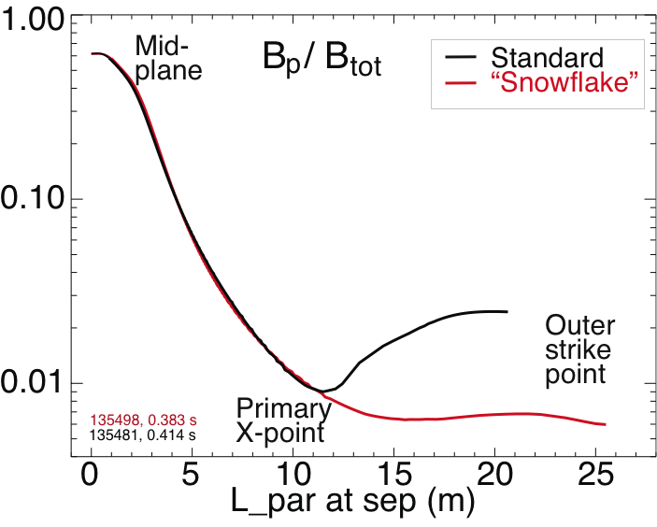
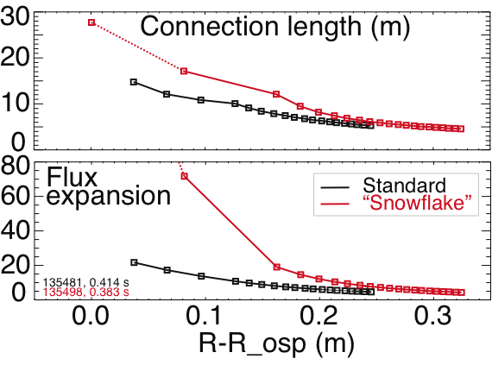
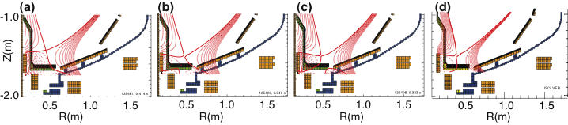
Results from XP 924

Slide 7
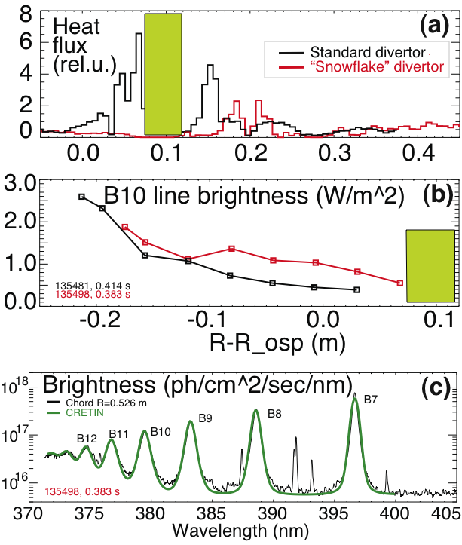
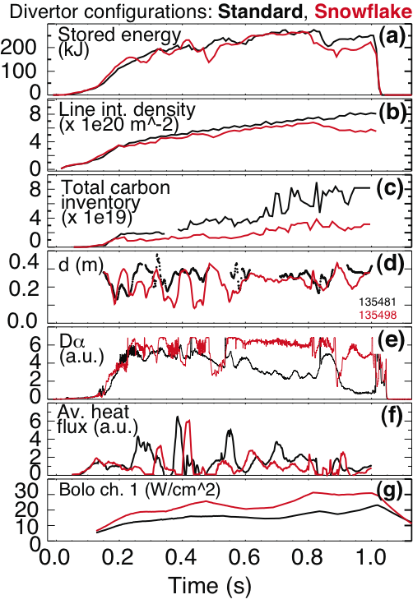
Results from XP 924

