Slide 1

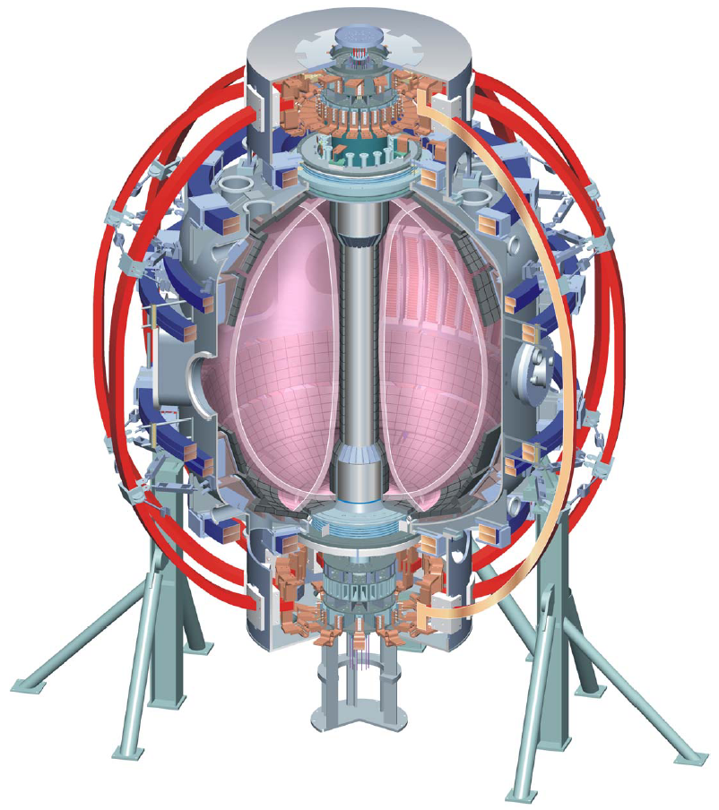
Supported by
Boundary Physics Topical Science Group
FY 2011 - FY 2012 discussion
College W&M
Colorado Sch Mines
Columbia U
Comp-X
General Atomics
INEL
Johns Hopkins U
LANL
LLNL
Lodestar
MIT
Nova Photonics
New York U
Old Dominion U
ORNL
PPPL
PSI
Princeton U
SNL
Think Tank, Inc.
UC Davis
UC Irvine
UCLA
UCSD
U Colorado
U Maryland
U Rochester
U Washington
U Wisconsin
V. A. Soukhanovskii, TSG Leader
Lawrence Livermore National Laboratory, Livermore, CA
R. Maingi, TSG Deputy
Oak Ridge National Laboratory, Oak Ridge, TN
D. P. Stotler, Theory & Modeling
Princeton Plasma Physics Laboratory, Princeton, NJ
NSTX BP TSG discussion
3 December 2010
Princeton, NJ
Culham Sci Ctr
U St. Andrews
York U
Chubu U
Fukui U
Hiroshima U
Hyogo U
Kyoto U
Kyushu U
Kyushu Tokai U
NIFS
Niigata U
U Tokyo
JAEA
Hebrew U
Ioffe Inst
RRC Kurchatov Inst
TRINITI
KBSI
KAIST
POSTECH
ASIPP
ENEA, Frascati
CEA, Cadarache
IPP, Jülich
IPP, Garching
ASCR, Czech Rep
U Quebec

Slide 2
In FY 2011-FY 2012, Boundary Physics TSG priorities will be defined by
DOE and NSTX Milestones
  FY2011 DOE Joint Research Target: Conduct experiments on major fusion facilities to improve the understanding of the physics mechanisms responsible for the structure of the pedestal and compare with the predictive models described in the companion theory milestone.
  IR(11-2) Assess pedestal and SOL response to externally applied 3D fields.
  R(12-2): Assess very high flux expansion divertor operation
NSTX-U planning needs and ST development path needs
ITPA participation, ITER needs

Slide 3
  IR(11-2) Assess pedestal and SOL response to externally applied 3D fields
Three-dimensional (3D) fields are proposed in ITER to suppress ELMs and reduce time averaged heat flux.
This research aims to improve understanding of the underlying physics of the pedestal and SOL transport and stability response to 3D fields, and use this understanding to optimize boundary plasma control.
On NSTX, 3D fields are used to trigger ELMs in ELM-free discharges to reduce impurity and radiated power buildup, but the mechanisms for this triggering are not well understood.
Experiments will be conducted to test transport and stability code predictions (e.g. XGC-0, EMC3-EIRENE, IPEC, and M3D).
The divertor heat and particle flux profiles, as well as midplane profiles and fluctuations, will be measured during a variety of applied 3D fields.
Trends from the calculations will be used to aid understanding and guide optimization of heat flux and ELM control in NSTX-U and ITER.

Slide 4
  R(12-2): Assess very high flux expansion divertor operation
The exploration of high flux expansion divertors for mitigation of high power exhaust is important for proposed ST and AT-based fusion nuclear science facilities and for Demo.
In this milestone, the controllability and plasma response to advanced divertor concepts including the “snowflake” and “x-divertor” configuration will be assessed.
Divertor heat flux handling, pumping with the liquid lithium divertor, impurity production, SOL turbulence and their trends with engineering parameters will be studied.
Edge pedestal stability, ELM characterization, core transport and confinement, as well as edge transport and turbulence will also be studied.
Measurements will be compared to analytic and numerical code predictions.
This research will provide a significant impact on the present PMI concept development for both the ST and tokamak.

