Slide 1
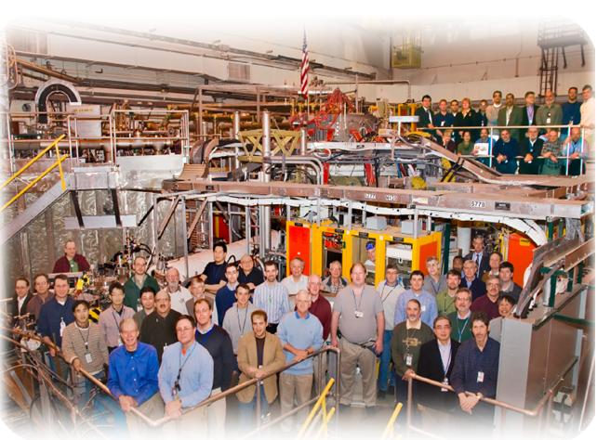
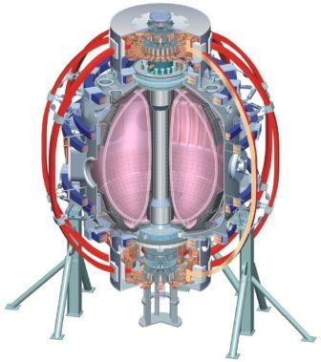
NSTX
Supported by
Thermography analysis of transient events in NSTX
College W&M
Colorado Sch Mines
Columbia U
CompX
General Atomics
INEL
Johns Hopkins U
LANL
LLNL
Lodestar
MIT
Nova Photonics
New York U
Old Dominion U
ORNL
PPPL
PSI
Princeton U
Purdue U
SNL
Think Tank, Inc.
UC Davis
UC Irvine
UCLA
UCSD
U Colorado
U Illinois
U Maryland
U Rochester
U Washington
U Wisconsin
Culham Sci Ctr
U St. Andrews
York U
Chubu U
Fukui U
Hiroshima U
Hyogo U
Kyoto U
Kyushu U
Kyushu Tokai U
NIFS
Niigata U
U Tokyo
JAEA
Hebrew U
Ioffe Inst
RRC Kurchatov Inst
TRINITI
KBSI
KAIST
POSTECH
ASIPP
ENEA, Frascati
CEA, Cadarache
IPP, Jülich
IPP, Garching
ASCR, Czech Rep
U Quebec
K.Gan(ASIPP)
R.Maingi, J-W.Ahn, T.K.Gray(ORNL), A.G.McLean(LLNL)

Slide 2


Outline
Calculate the 2D heat flux distribution with TACO code
  How to choose the α parameter
  Comparison of the Taco and Theodor results
The characteristics of ELM divertor heat flux
  Type III ELM
  Type V ELM
  Type I ELM
  Different situation ELM heat flux
Survery the power load with 2D heat flux distribution
  Toroidal asymmetry on divertor heat flux
  Strange edge transport during L-H transition
  Different 2D heat flux between type V and type III ELM
2

Slide 3
Outline
Calculate the 2D heat flux distribution with TACO code
  How to choose the α parameter
  Comparison of the Taco and Theodor results
The characteristics of ELM divertor heat flux
  Type III ELM
  Type V ELM
  Type I ELM
  Different situation ELM heat flux
Survery the power load with 2D heat flux distribution
  Toroidal asymmetry on divertor heat flux
  Strange edge transport during L-H transition
  Different 2D heat flux between type V and type III ELM
3

Slide 4
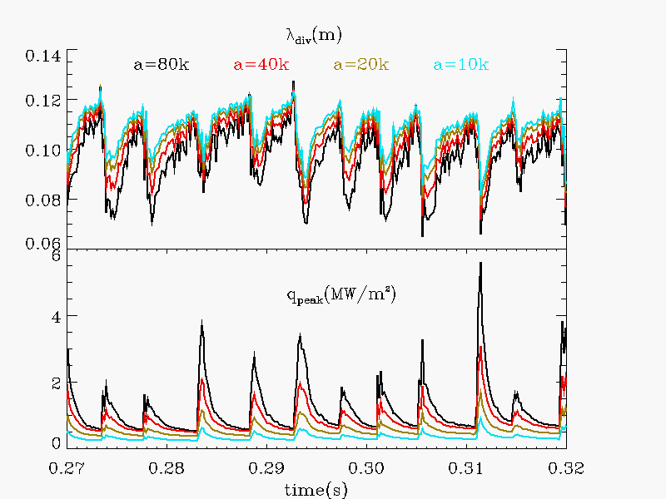
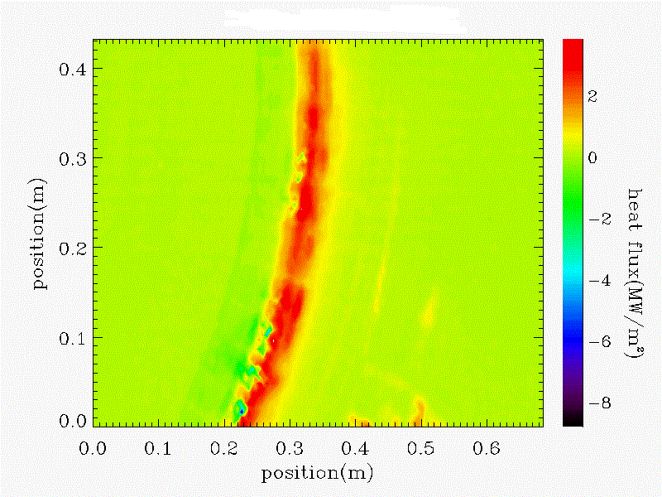
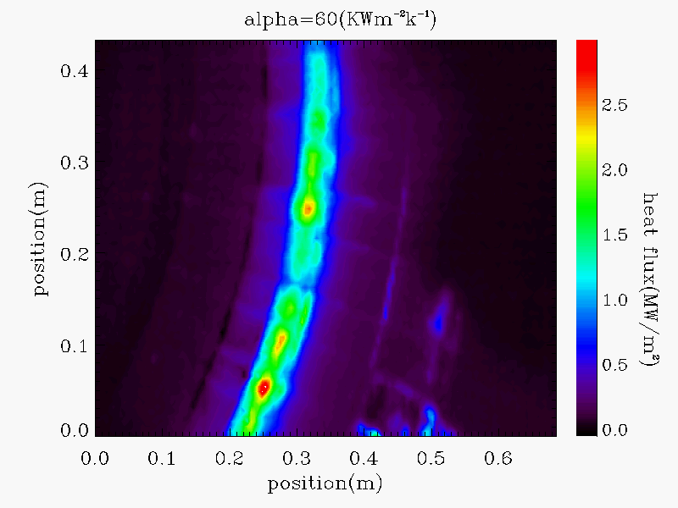
Taco code
Physical LLD model for numerical temperature calculation
Taco is a inversion algorithm on a 3D Fourier method which solve the heat transfer equation and get 2D heat flux data.
previous Taco did not consider the heat transmission coefficient, α parameter (Herrmann)
Negative heat flux was often calculated after transient event
Negative heat flux can be removed with α parameter
α parameter has large impact on the calculation of peak heat fluxes
Without α
Physical LLD model for numerical temperature calculation
4

Slide 5
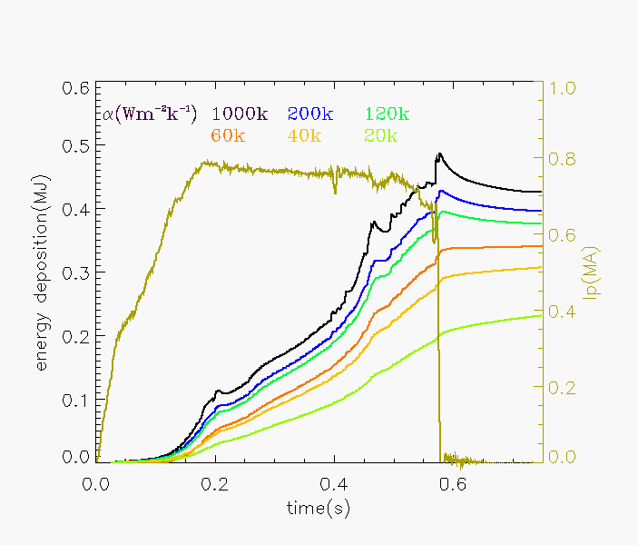
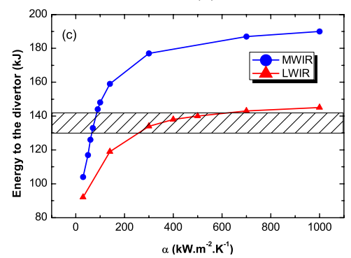
Choose the α value
MAST
NSTX
G De Temmerman, PPCF, 52 (2010) 095005 (14pp)
IN MAST, the optimum value of α for the LWIR case sits at the knee of the curve while in the MWIR case, it sits in the steepest part of the curve
IN NSTX, Choose the α value to keep the energy deposition constant after discharge
5

Slide 6
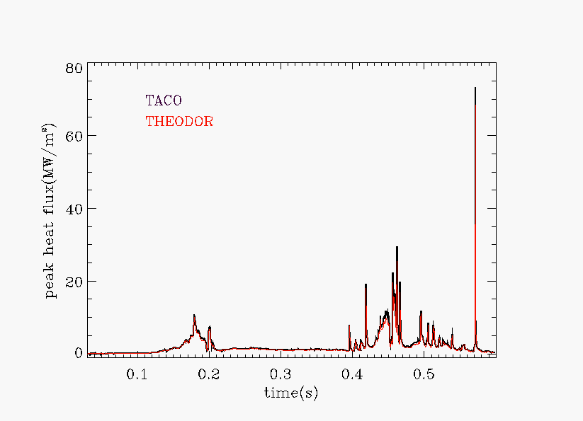
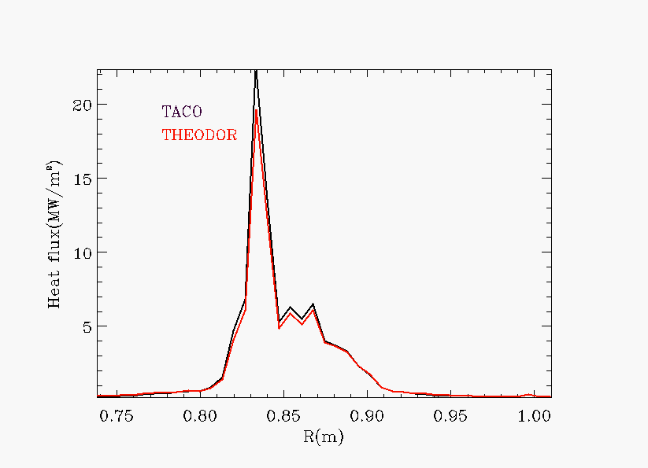
Comparison of TACO and THEODOR results
Good consistent q on a single radial line between TACO and THEODOR
The heat flux distribution almost the same between TACO and THERDOR on a single radial line
6

Slide 7
Outline
Calculate the 2D heat flux distribution with TACO code
  How to choose the α parameter
  Comparison of the Taco and Theodor results
The characteristics of ELM divertor heat flux
  Type III ELM
  Type V ELM
  Type I ELM
  Different situation ELM heat flux
Survery the power load with 2D heat flux distribution
  Toroidal asymmetry on divertor heat flux
  Strange edge transport during L-H transition
  Different 2D heat flux between type V and type III ELM
7

Slide 8
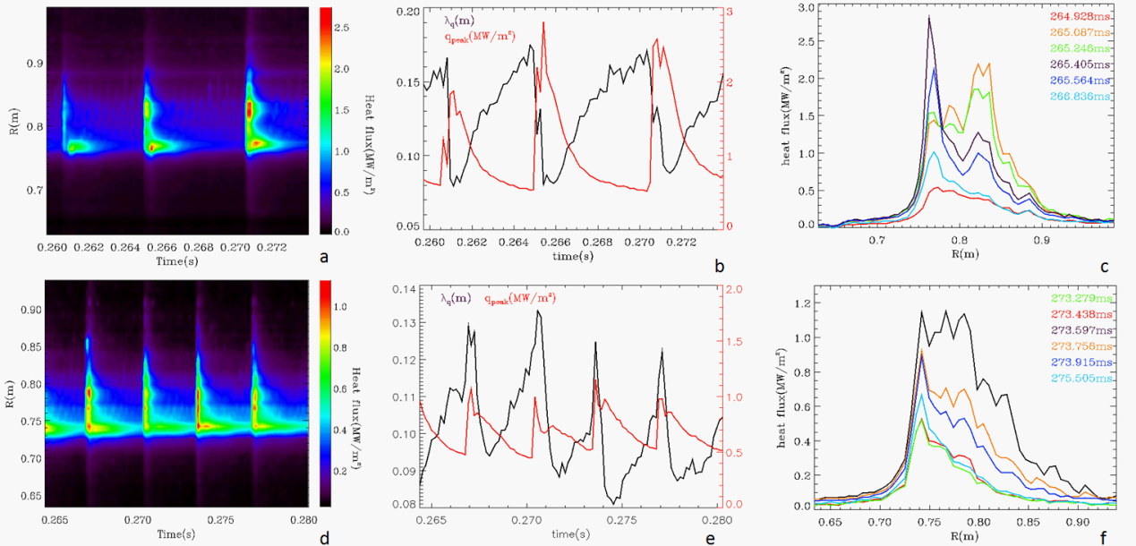
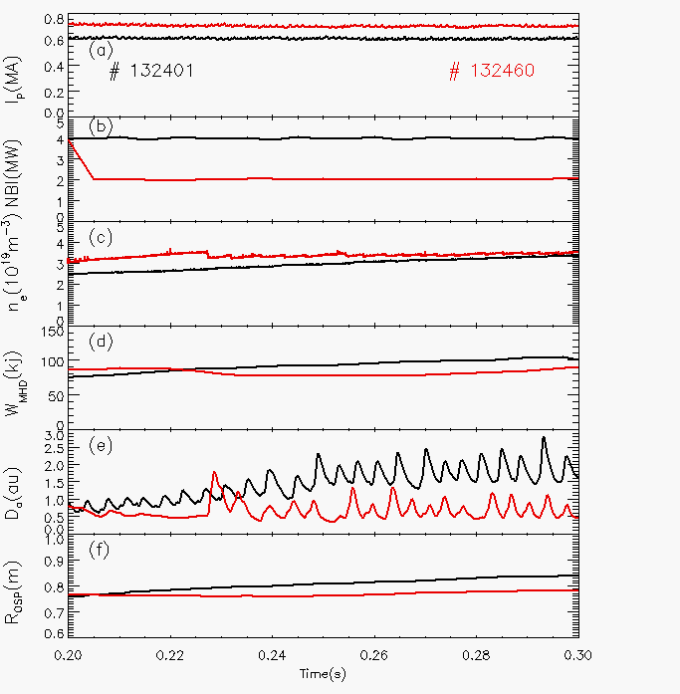
Divertor heat flux during type III ELM
132401
132460
Intermittent (2KHZ) type V ELM existed between type III ELM
ELM filament happened during ELM, λ_{q} will be smaller after ELM filament
λ_{q} increase (decrease) with ELM for shot 132460 (132401).
8

Slide 9
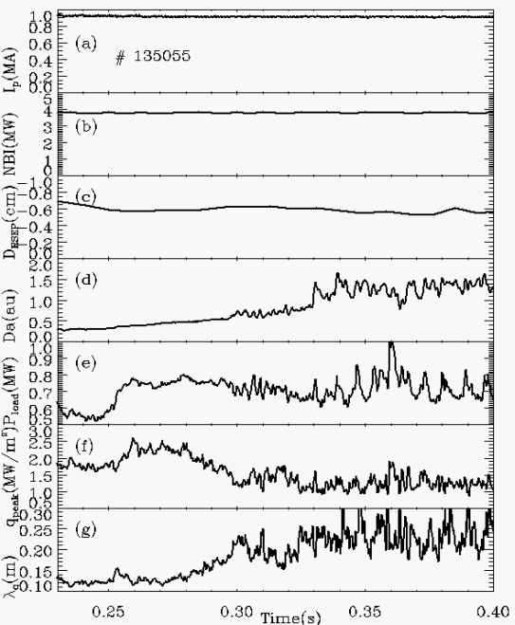
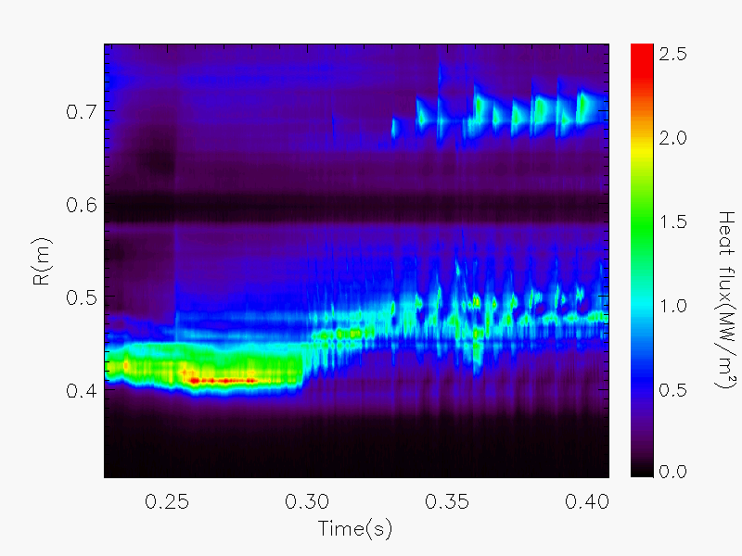
Divertor heat flux during type V ELM with high δ
Type V ELM will Increase the transport and reduce the peak heat flux with large λ_{q}
A strange heat flux region existed between 0.25-0.30s
Fx_osp~18
9

Slide 10
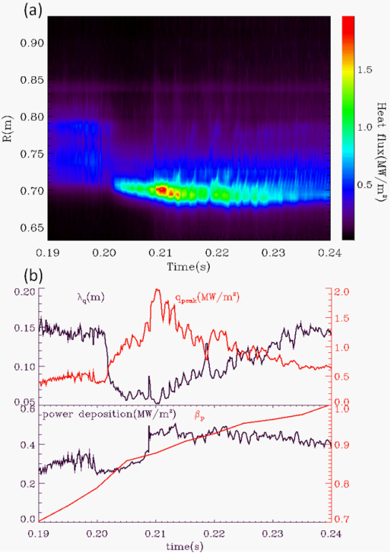
Divertor heat flux during type V ELM with low δ
132406
During 0.201-0.208s, the q_{peak} increased and λ_{q} decreased and power deposition seems constant
the q_{peak} is 0.62MW/m² at 0.24s, 1.93MW/m² at 0.21s. It almost decreased 70% q_{peak}
During type V ELM, the q_{peak} decreased and increased with almost constant power deposition
Type v ELMs(0.24s) reduced the 40% q_{peak} compare to ELM free phase
10

Slide 11
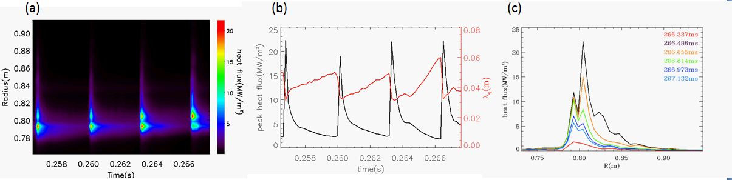
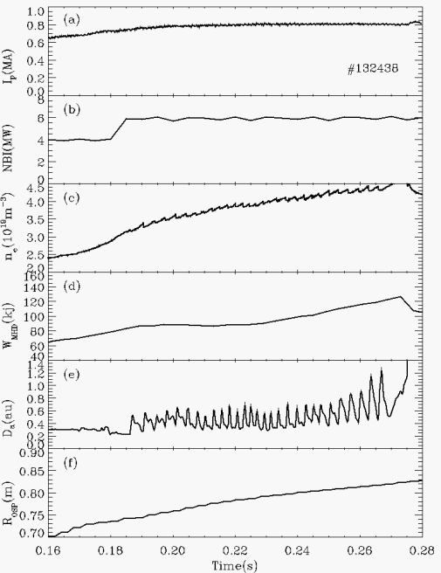
Divertor heat flux during type I ELM
Shot # | Time (s) | λ_{q} (m) | fx_osp | λ_{qn} (m)
132403 | 264.928ms, type v ELM | 0.175m | 5.3 | 0.033
132406 | 204.809ms,ELM-free phase | 0.056m | 5.4 | 0.01
132438 | 266.337ms, inter-type I ELM | 0.06m | 1.85 | 0.032
λ_{q} decrease ~40% during type I ELM filament
6KHZ energy transport between type I
ELM (GPI)
λ_{qn} is similar between type v ELM
(# 132403) and inter type I ELM.
11

Slide 12
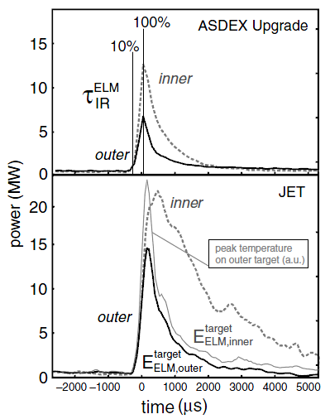
Heat flux research in JET and ASDEX
was defined as ELM rise time
In the first phase,( )the target temperature and the power increase up to a peak value
In the second phase,( )the target temperature decays back to the Inter-ELM value
T. Eich, JNM, 337–339 (2005) 669–676
12

Slide 13
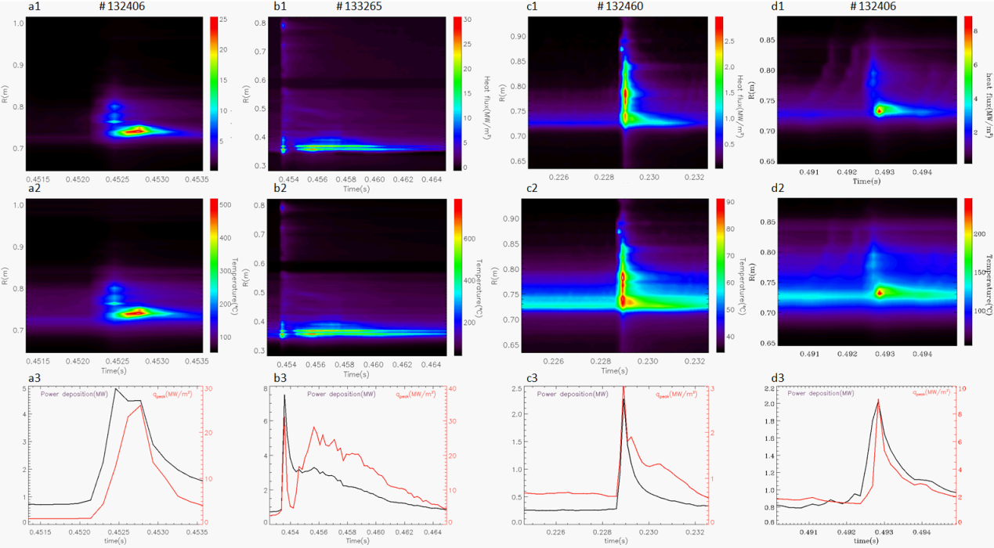
Different situation ELM heat flux
Maximum power load in ELM filament, Maximum q_{peak} after ELM filament
(situation II ELM)
Triggered ELM
Maximum power load and q_{peak} appeared at
ELM filament
Maximum power and q_{peak}
Appeared after ELM filament
(situation I ELM)
(situation III ELM)
13

Slide 14
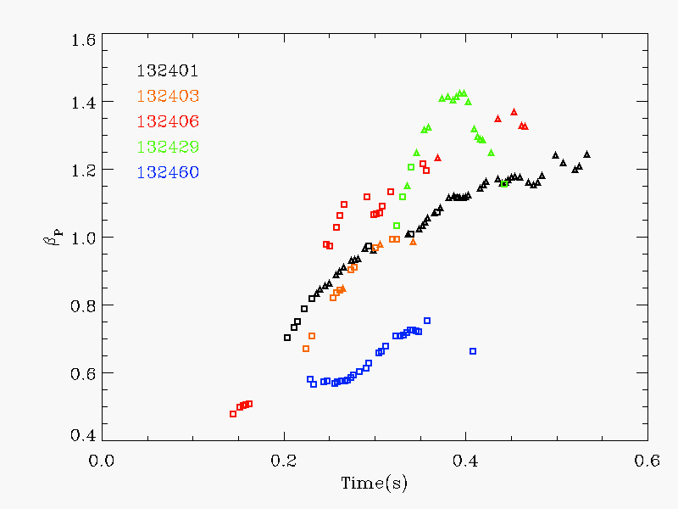
The relationship between situation I,II ELM and β_{p}
The maximum q_{peak} will appeared at ELM filament with a low β
With β_{p} increase, the number of situation I ELM begun to decrease, and the situation II ELM appeared.
The real physical mechanism is still unknown
square represent the situation I ELM heat flux, triangle represent the situation II ELM heat flux
14

Slide 15
Outline
Calculate the 2D heat flux distribution with TACO code
  How to choose the α parameter
  Comparison of the Taco and Theodor results
The characteristics of ELM divertor heat flux
  Type III ELM
  Type V ELM
  Type I ELM
  Different situation ELM heat flux
Survery the power load with 2D heat flux distribution
  Toroidal asymmetry on divertor heat flux
  Strange edge transport during L-H transition
  Different 2D heat flux between type V and type III ELM
15

Slide 16
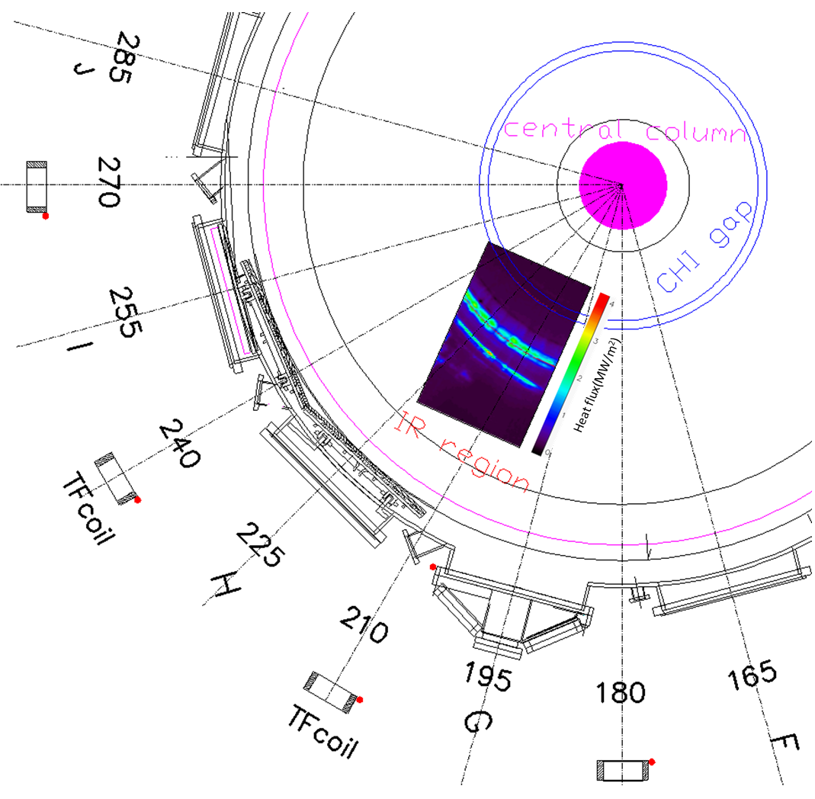
2D divertor heat flux distribution on NSTX
16

Slide 17
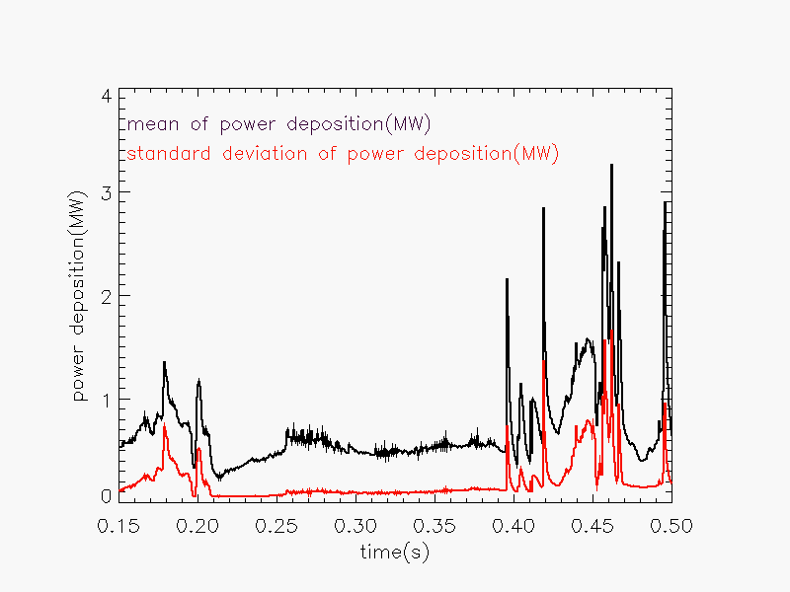
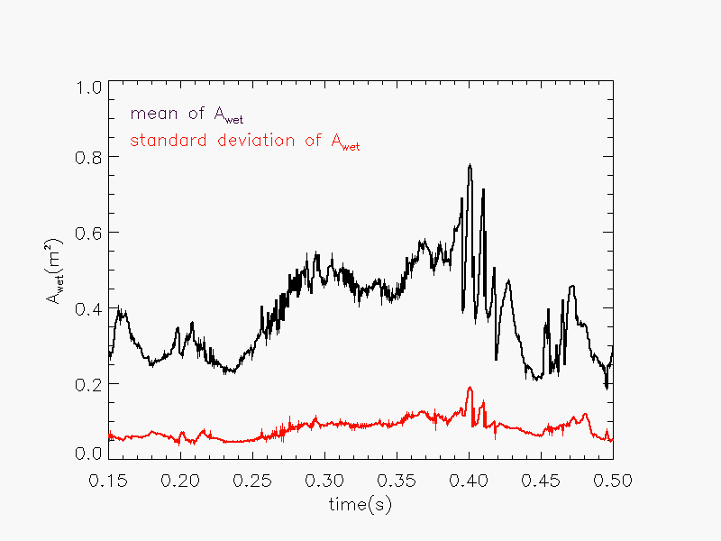
Toroidal asymmtry on divertor heat flux
According to the toroidal asymmetry
The reason of toroidal asymmetry is still unclear, toroidal ripple, 3D structure of filaments, misalign divertor tile or inconsistent surface property (α value)
17

Slide 18
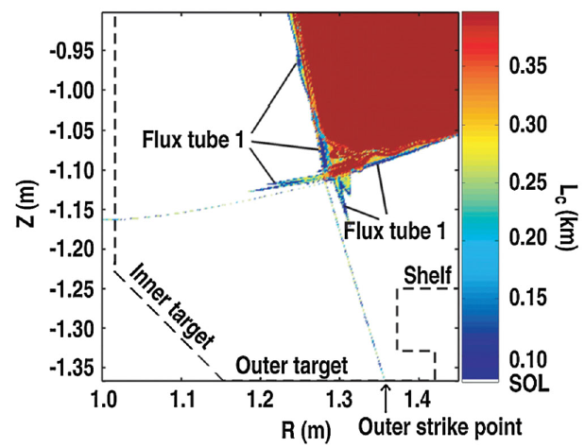
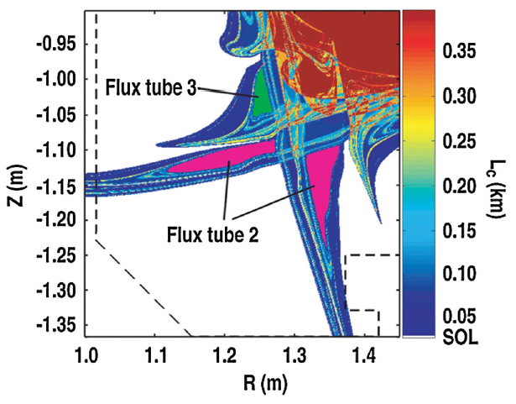
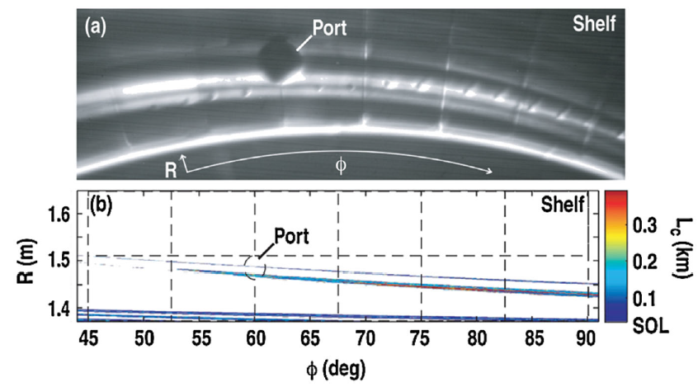
Numerical Modeling of ELM Filaments on Divertor Plates
The initial heat pulse during an ELM generate thermoelectric current between two divertor plate
typical ELM stripe structures can be correctly modeled
Add 300A on Flux tube 1
A. Wingen, PRL, 104, 175001 (2010)
18

Slide 19
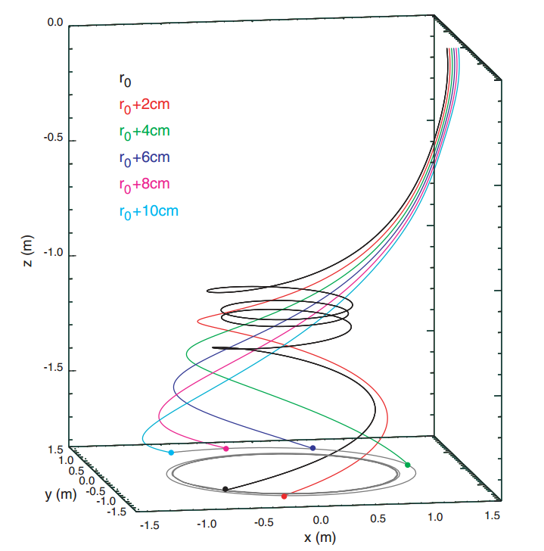
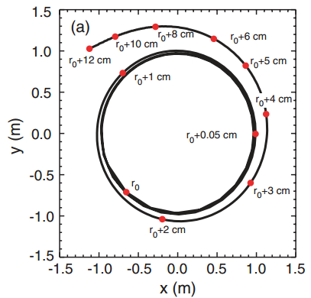
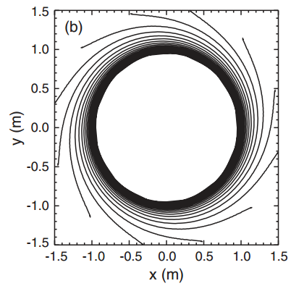
ELM power load in MAST
α was set to 100k, the T_{s} is closer to the LLD
temperature measured by dual-band IR camera
A Kirk, PPCF, 49 (2007) 1259–1275
Filament at different radial position and different toroidal angle generate the striated divertor heat flux
19

Slide 20
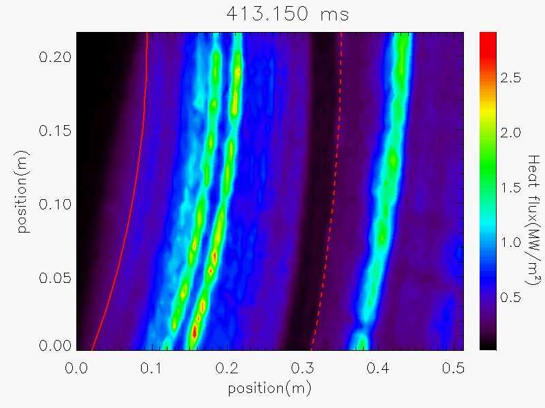
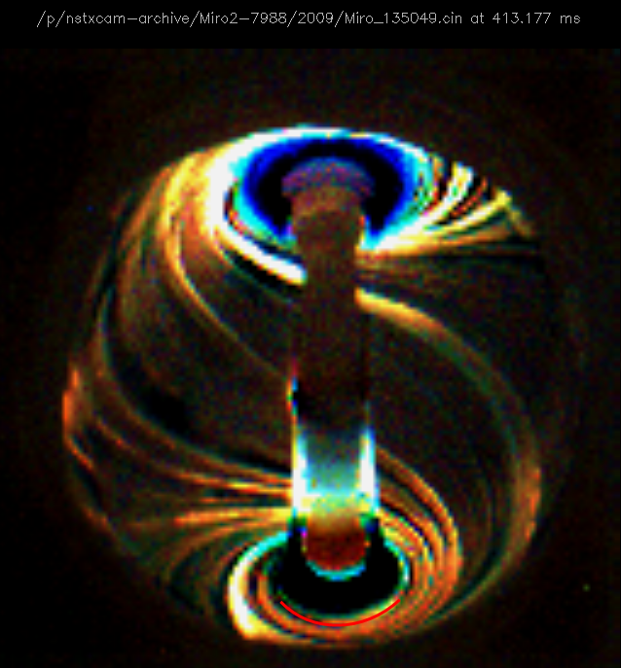
Striated heat flux in NSTX
α was set to 100k, the T_{s} is closer to the LLD
temperature measured by dual-band IR camera
The striated heat flux (R>0.61m) was generated by filaments
It’s unclear the reason which cause the striated divertor heat flux
(R<0.57m)
Question: Did the filaments and magnetic topology generate the striated divertor heat fluxes together?
20

Slide 21
Outline
Calculate the 2D heat flux distribution with TACO code
  How to choose the α parameter
  Comparison the Taco and Theodor results
The characteristics of ELM divertor heat flux
  Type III ELM
  Type V ELM
  Type I ELM
  Different situation ELM heat flux
Survery the power load with 2D heat flux distribution
  Toroidal asymmetry on divertor heat flux
  Strange edge transport during L-H transition
  Different 2D heat flux between type V and type III ELM
21

Slide 22
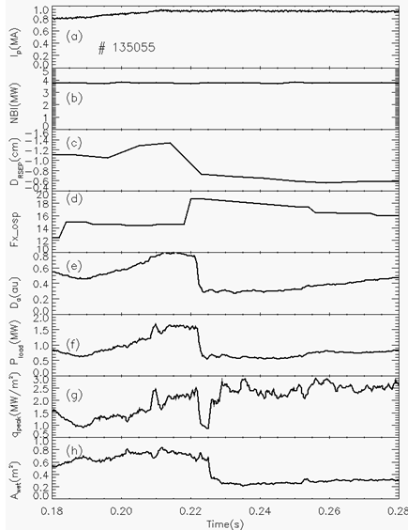
Strange edge transport during L-H transition
α was set to 100k, the T_{s} is closer to the LLD
temperature measured by dual-band IR camera
Increasing P_{load} before L-H transition was caused by decreased Drsep
During L-H transition , the q_{peak} first decrease then increase
A delayed time existed between q_{peak} and Awet during L-H transition
22

Slide 23
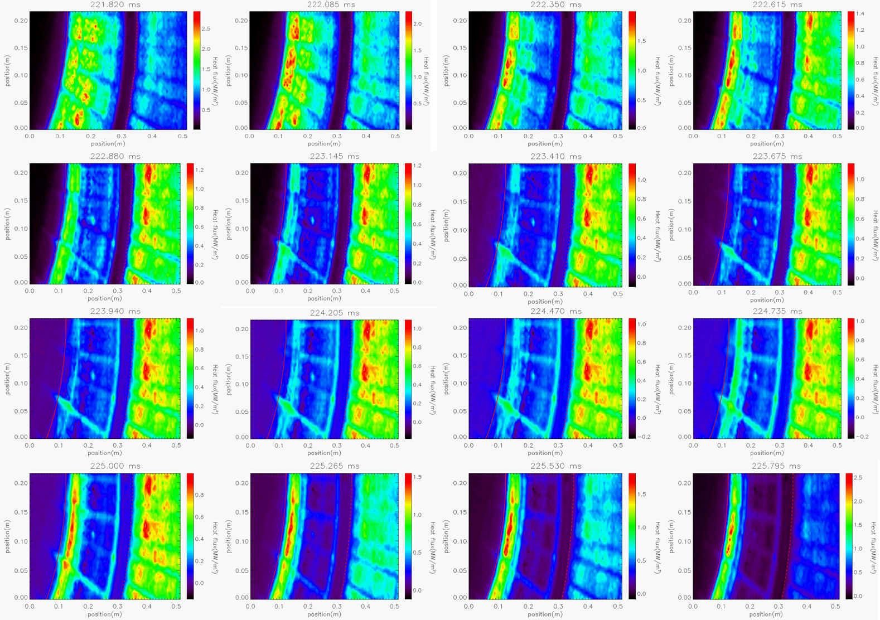
2D heat flux distribution during L-H transition
α was set to 100k, the T_{s} is closer to the LLD
temperature measured by dual-band IR camera
During L-H transition, the heat flux around the out strike point first become very small, then increase to ELM-free phase
23

Slide 24
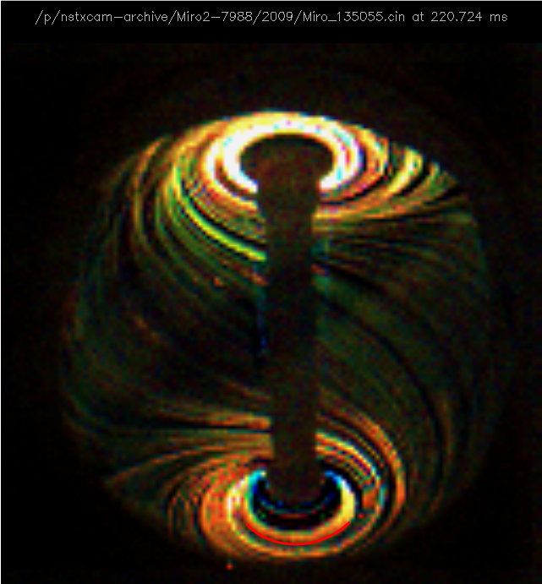
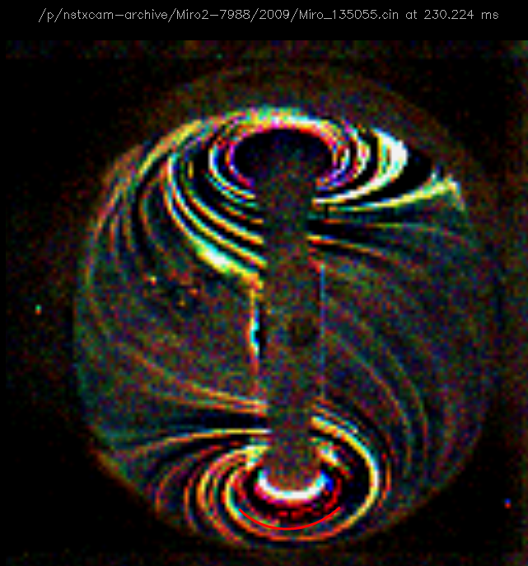
Filaments during L-H transition
α was set to 100k, the T_{s} is closer to the LLD
temperature measured by dual-band IR camera
Filaments generated the striated heat flux(R>0/61m)
Separate the power deposition with two parts:
(filaments)
24

Slide 25
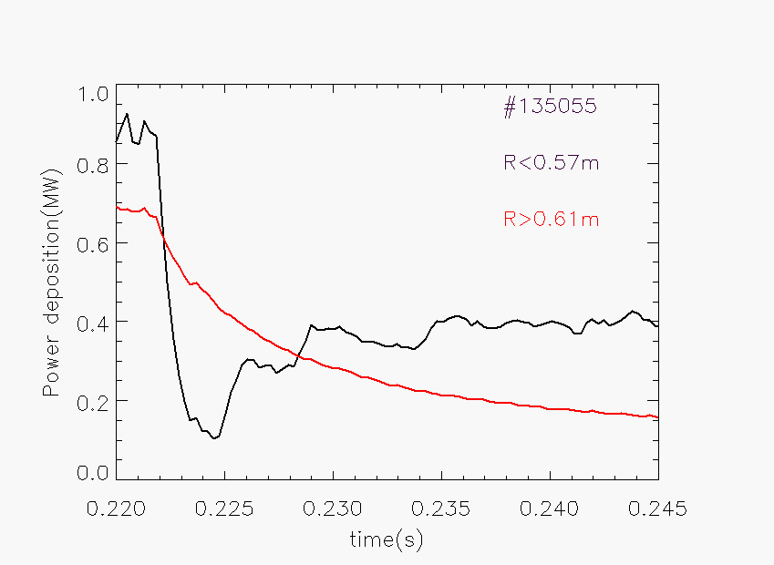
The power load during L-H transition
α was set to 100k, the T_{s} is closer to the LLD
temperature measured by dual-band IR camera
During L-H transition
P_{in} decrease fast to a low value then increase
P_{out} decrease slower than P_{in}
P_{out} can be several times bigger than P_{in}
25

Slide 26
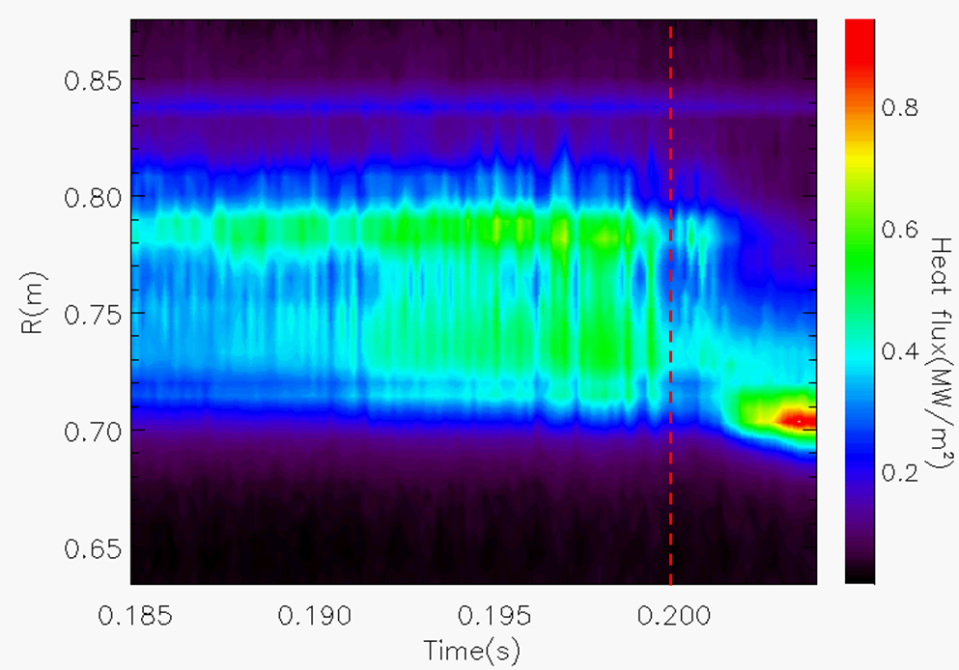
Heat flux evolution during L-H transition
α was set to 100k, the T_{s} is closer to the LLD
temperature measured by dual-band IR camera
132406 (6.3khz)
The intermittent filaments still happen during L-H transition
~3KHZ heat flux oscillation appeared before L-H transition
During L-H transition, the heat flux near the OSP first decrease then increase
26

Slide 27
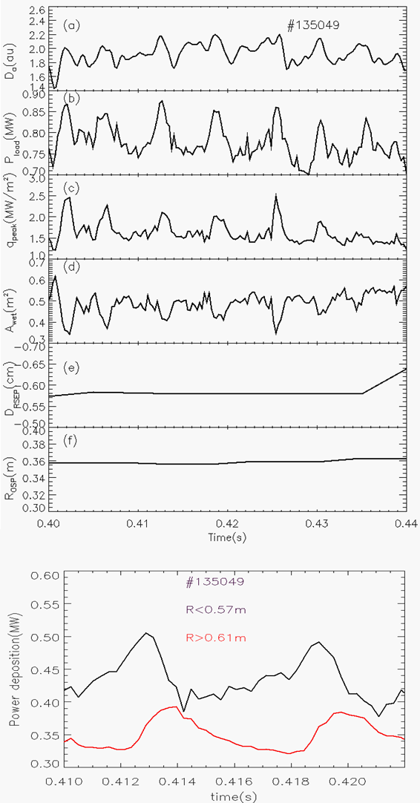
2D heat flux distribution during ELM
α was set to 100k, the T_{s} is closer to the LLD
temperature measured by dual-band IR camera
The Power deposition seems just increase ~13% during Type V ELM peak than between ELMs
The plasma wetting area decrease with type v ELM
There is a delay time between Pin and Pout during type V ELM
27

Slide 28
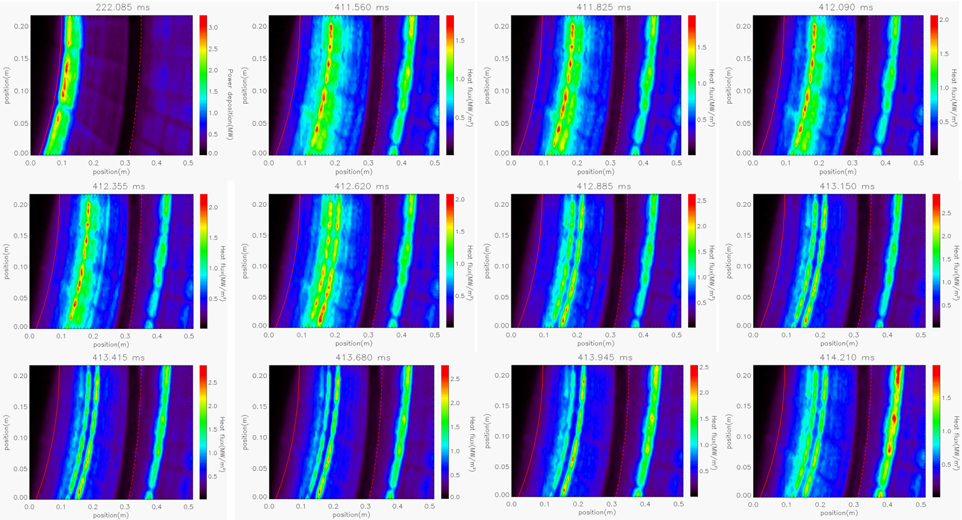
2D heat flux distribution during type V ELM
α was set to 100k, the T_{s} is closer to the LLD
temperature measured by dual-band IR camera
During ELM-free , the heat flux region is close to the OSP
During type V ELM, the heat flux region is far from the OSP
The heat flux inside the CHI gap increase first
28

Slide 29
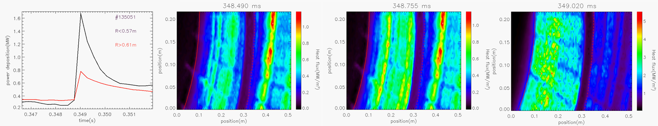
2D heat flux during type III ELM
α was set to 100k, the T_{s} is closer to the LLD
temperature measured by dual-band IR camera
The position of qpeak can be 34cm far from the OSP at pre-ELM
The Pin and Pout increase together during type III ELM
29

Slide 30
Summary
TACO has been applied successful on heat flux calculation in NSTX
A criteria to choose the α value: Modify α until the energy deposition is kept constant after discharge
The width of power deposition on divertor (λ_{q}) will decrease with type III ELM due to the obvious type v ELM during inter-type III ELM.
Type v ELM will increase the transport and decrease the peak heat flux
Compare to ELM phase phase
Situation II ELM will appeared under high β_{p}
It was first time to analyze the power load with 2D heat flux distribution in NSTX
  Divertor heat flux is toroidal asymmetry
  Strange edge transport has been reported during L-H transition
  There is a delay time between Pin and Pout during type V ELM, Pin and Pout increase together during type III ELM
30

