Slide 1
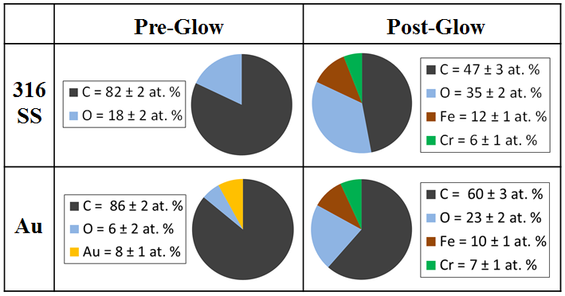
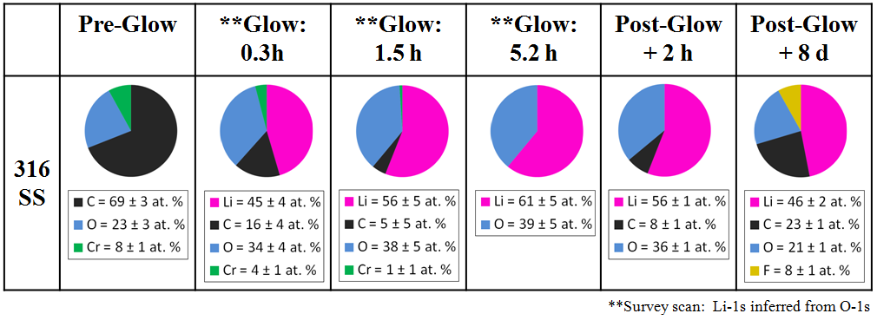
MAPP XPS capable of monitoring surface elemental composition (except H, He) during wall conditioning
Samples held “flush” with LTX shell surface during argon GDC wall conditioning
Reveal extensive “adventitious” carbon on surface of non-carbon PFCs
Brief retraction and analysis (< 10 min) provides intermediate surface composition

Slide 2
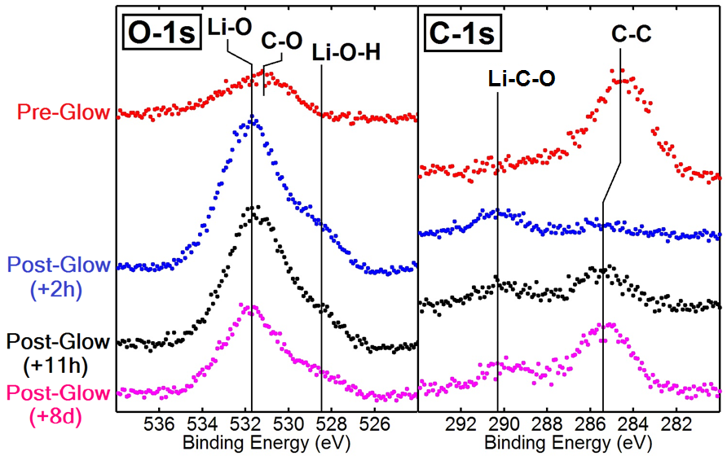
Chemical identification possible also possible with XPS, provided sufficient resolution in binding energy
Elemental bonding in given oxidation state causes chemical shifts ~ 1-2 eV
MAPP designed with analyzer resolution to distinguish 1 eV shifts
Current analyzer resolution ~ 3 eV, so (partially) unavailable until FY16

