Slide 1
Boundary Physics TSG priorities for 2010 and LLD timing are in conflict
FY2010 Joint Research Milestone: Compare divertor heat flux widths to midplane density and temperature widths and edge turbulence characteristics, and determine the scaling of SOL and divertor heat transport
LLD impact: compromise IR camera calibrations
NSTX Milestone R10-3: Determine the relationship of ELM properties to discharge boundary shape, lithium conditioning, and 3D resonant magnetic perturbations (RMPs), and compare stability of pedestal/ELMs with model calculations
FY2011 Joint Research Milestone: Understand and develop a predictive capability for the physics mechanisms responsible for the structure of the H-mode pedestal
Concern: LLD / lithium changes pedestal MHD stability and ELMs

Slide 2
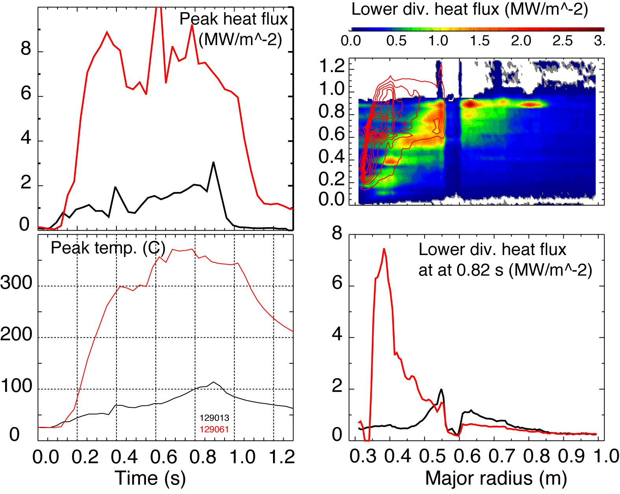
Divertor heat flux measurements are complicated by lithium coatings
Instrumental effects:
Thermal contact between lithium coating and bulk graphite tile
Surface emissivity reduction
Plasma effects:
Much lower P_{SOL}
Higher divertor heat flux?
Lithium melting T= 186º C
No lithium (129013)
190 mg Lithium (129061)

Slide 3
Thoughts on start-up planning…
Boundary Physics TSG would greatly benefit from a no-lithium period
NSTX 10-year experience: poor plasma performance without boronization (or lithium)
GDC alone cannot mitigate the issue
Questions to NSTX and LLD Managers:
If LLD is success, we will be prepared to take advantage of LLD as a tool
Planning for LLD failures is important - are we prepared to
Identify failure modes and their impact on NSTX operations
Plan for specific problems and ways to resolve them
Proposed start-up plan
Run without lithium until the no-lithium research agenda is exhausted (~1 week)
Run with LLD until the critical LLD experiments are completed (~ 2 weeks)
Assess options to continue
An administrative decision may move # 2 to # 1 to benefit LLD research

Slide 4
Plan for LLD start-up experiments
Focus on four main thrusts
LLD pumping capability
Effect on pedestal and core performance
Effect on SOL / divertor transport
Divertor heat flux handling
Start LLD experiments in an as much controlled manner as possible
High-triangularity (δ~0.7-0.8, R_{OSP} ~ 0.4-0.5 m) fiducial 2-4 MW NBI
little heating / heat flux on LLD
Use LLD at controlled temperature using heaters
scan temperature between 150 and 350 C
Obtain data to address the four point above
Then proceed to medium triangularity shape (δ~0.5-0.6, R_{OSP} ~ 0.5-0.65 m) but start with cold LLD

