Slide 1

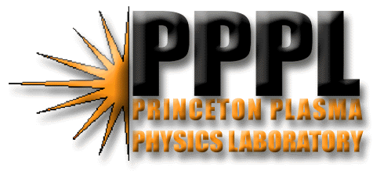

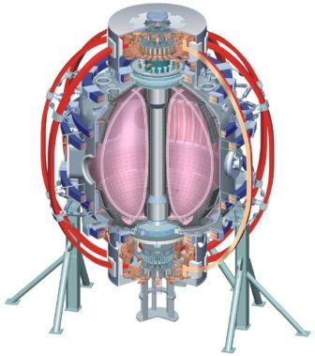
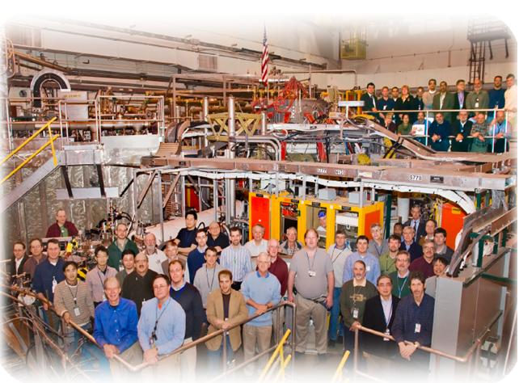

Supported by
XP 1002: Core impurity density and P_{rad} reduction using divertor condition modifications
College W&M
Colorado Sch Mines
Columbia U
CompX
General Atomics
INEL
Johns Hopkins U
LANL
LLNL
Lodestar
MIT
Nova Photonics
New York U
Old Dominion U
ORNL
PPPL
PSI
Princeton U
Purdue U
SNL
Think Tank, Inc.
UC Davis
UC Irvine
UCLA
UCSD
U Colorado
U Illinois
U Maryland
U Rochester
U Washington
U Wisconsin
Culham Sci Ctr
U St. Andrews
York U
Chubu U
Fukui U
Hiroshima U
Hyogo U
Kyoto U
Kyushu U
Kyushu Tokai U
NIFS
Niigata U
U Tokyo
JAEA
Hebrew U
Ioffe Inst
RRC Kurchatov Inst
TRINITI
KBSI
KAIST
POSTECH
ASIPP
ENEA, Frascati
CEA, Cadarache
IPP, Jülich
IPP, Garching
ASCR, Czech Rep
U Quebec
V. A. Soukhanovskii, LLNL
and NSTX Team
Lithium Research TSG Meeting
Princeton, NJ
10 June 2010

Slide 2
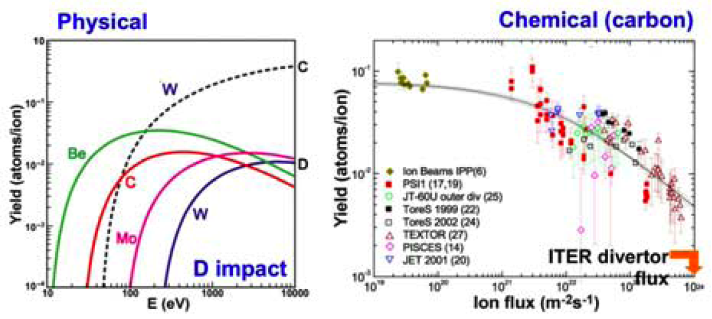
Impurity sources are due mainly to physical and chemical sputtering from deuterons and impurities
  Where is the dominant influx – divertor or main chamber?
  Sputtering due to ELMs is highly non-linear

Slide 3
SOL transport carries ionized impurities to the confined plasma
Balance between anomalous (turbulent) cross-field transport and classical parallel transport
Parallel transport dominated by collisional processes: frictional drag and ion temperature gradient forces
(Stangeby 2000)
Target: ← ← ← → →
2D fluid codes include most of the physics
  Classical Braginskii parallel transport, anomalous radial transport
  E x B and grad B drifts
  sputtering models

Slide 4
SOL and divertor conditions are significantly modified due to lithium coatings
Evaporative lithium coatings on carbon PFCs modify divertor and SOL sources
  Lower divertor, upper divertor and inner wall recycling was reduced by up to 50 %
  Local recycling coefficients reduced on inner wall and far SOL, remained similar in the outer strike point region
  Lower divertor carbon source from physical sputtering did not increase
  Divertor lithium influx increased, however, lithium was retained in divertor
SOL transport regime changes from high-recycling to sheath-limited
  Apparently small parallel T_{e} gradient
  Detached inner divertor re-attached, X-point MARFEs disappeared
Pedestal and core confinement improvement leads to
  Reduction of ion inventory (density) by up to 50 % due to surface pumping
  Effective screening of lithium from core plasma
  Carbon and high-Z impurity accumulation
    P_{rad} increases in the core while P_{SOL} reduced

Slide 5
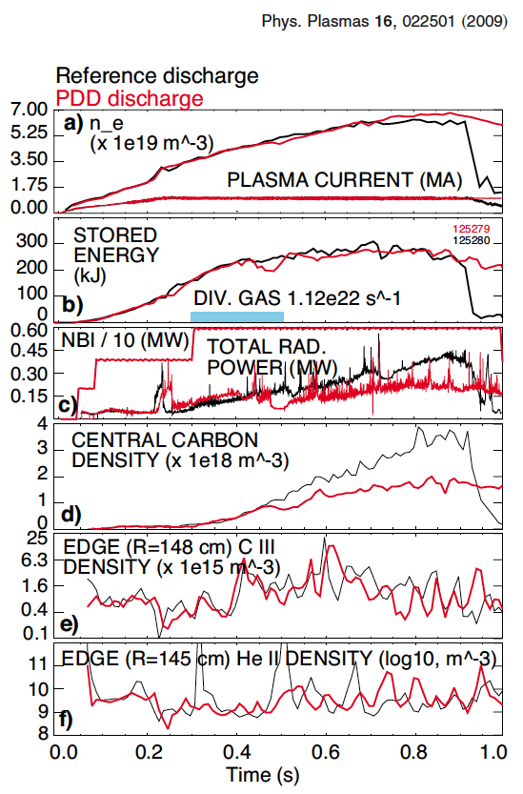
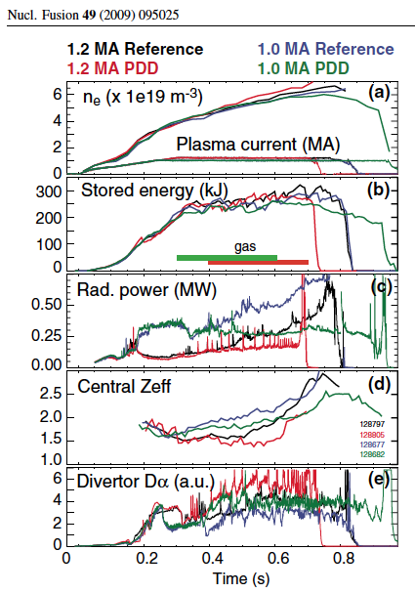
Significant core n_{C} and P_{rad} reduction observed in divertor heat flux mitigation experiments (w/o lithium)
Due to more frequent ELMs? or source reduction?

Slide 6
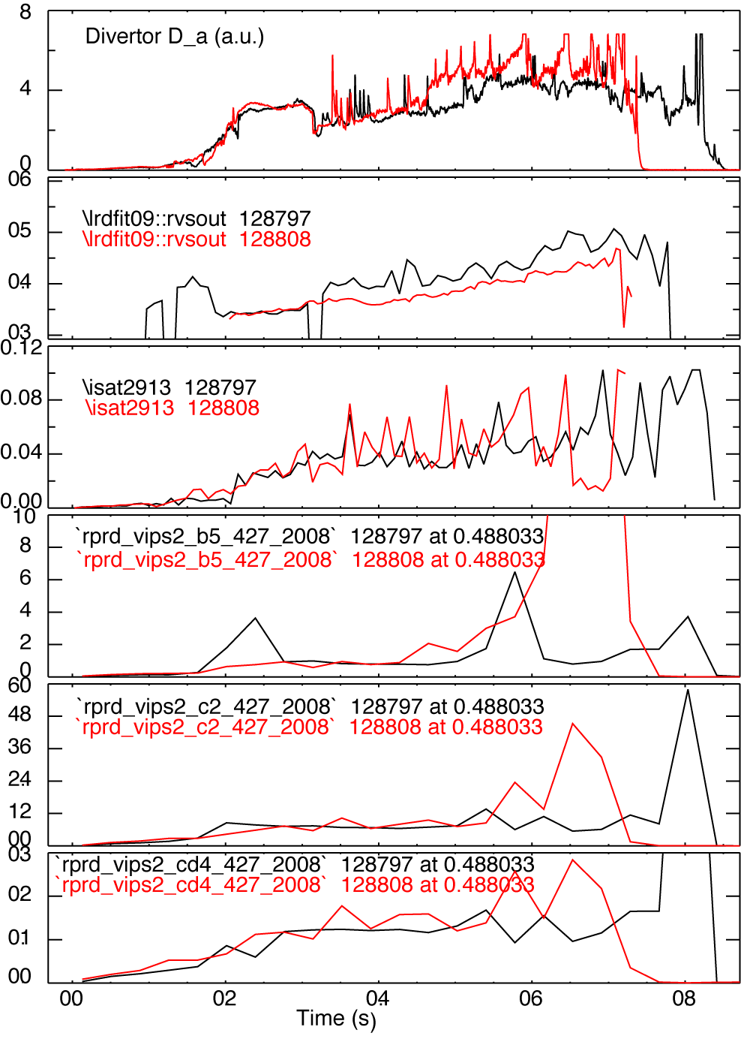
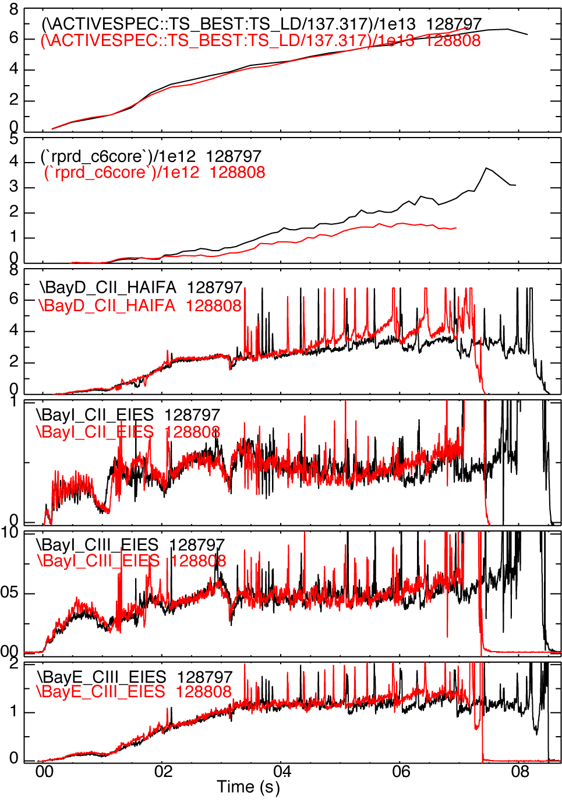
Divertor carbon source evaluation in PDD discharges was inconclusive
Dα
R_{OSP}
LP
Dδ
C II
CD₄
red-PDD, black - reference

Slide 7
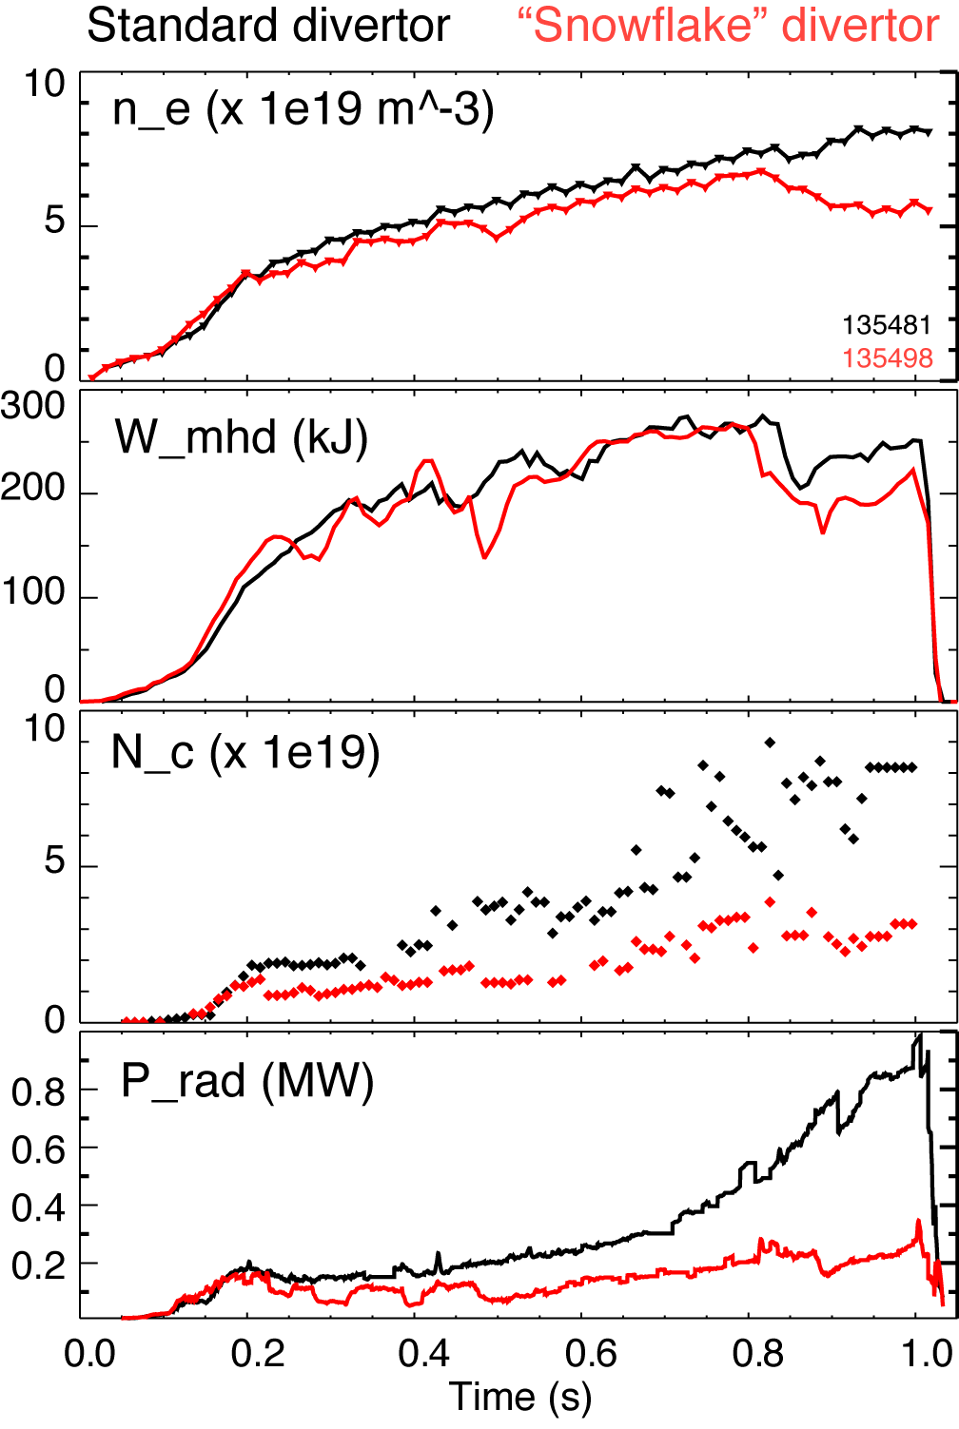
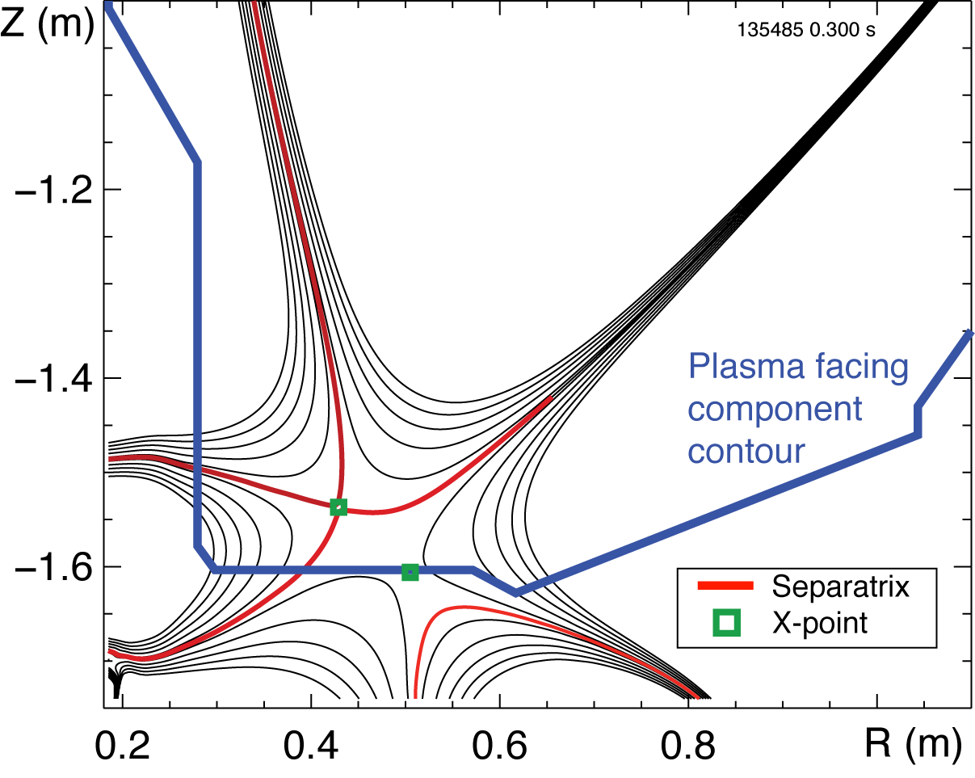
Significant core n_{C} and P_{rad} reduction observed in snowflake divertor experiments
Medium-δ 0.9 MA 4-6 MW NBI discharge (standard divertor, black)
“Snowflake” divertor with detached outer strike point region (red)
Used lithium at ~ 8-10 mg/min
First detachment observation in NSTX without gas puffing

Slide 8
Use deuterium divertor injection to study effects on core impurity density
In a discharge with gas puffing
  T_{e}-dependent physical and chemical carbon sputtering rates are reduced
    reduced impurity source ?
  neutral pressure increased in SOL and divertor
    preferentially decreased wall impurity source?
    increased impurity compression in divertor due to D flow?
    parallel momentum balance (viscosity), E_{r}, SOL flows (both drift and source) changed → change SOL radial impurity transport ?
    n₀-dependent neoclassical convention in confined edge plasma?
    collisional thermalization of fast ions?
In lithium discharges inner divertor is attached (while it is detached in no-lithium discharges)
  Inner divertor a significant carbon source?
Generally ELM-free H-modes present a unique opportunity to study impurity sources and SOL impurity transport

Slide 9
Run plan focuses on developing a scenario with minimum divertor gas rate and no core impurity accumulation
Use 8-12 mg/min LITER rate
Use high-δ ELM-free 1 MA, 3-5 MW NBI fiducial with high P_{rad} and Z_{eff}
Inject D₂ from Bay E divertor injector
  Vary rate 30-150 Torr l /s (detachment observed at 150-200 Torr l /s)
  Vary injection duration between 50-200 ms
  Inject during flat-top, I_{p} ramp-up
Measure carbon and P_{rad} profiles as function of gas injection
  in core plasma, in lower / upper divertors, outer midplane and inner wall
  infer carbon influx from inner, outer divertor, main chamber
Connect with impurity transport and edge 2D modeling
Connect with pedestal stability analysis
  Reduced “ear” n_{C} and n_{e} may change edge pressure gradient and affect ELMs

