Slide 1
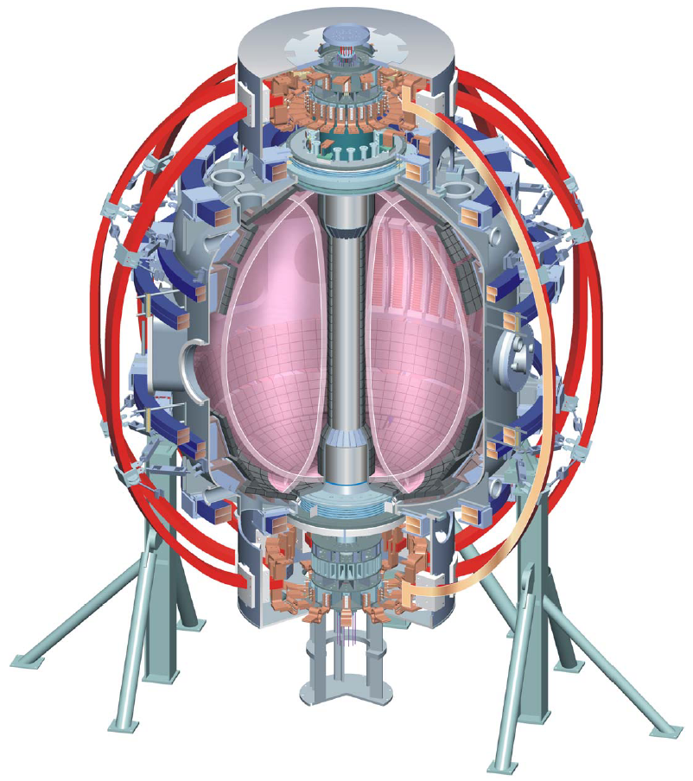
NSTX
Supported by
XP1111: RWM PID control optimization based on theory and experiment
College W&M
Colorado Sch Mines
Columbia U
Comp-X
General Atomics
INEL
Johns Hopkins U
LANL
LLNL
Lodestar
MIT
Nova Photonics
New York U
Old Dominion U
ORNL
PPPL
PSI
Princeton U
Purdue U
Sandia NL
Think Tank, Inc.
UC Davis
UC Irvine
UCLA
UCSD
U Colorado
U Maryland
U Rochester
U Washington
U Wisconsin
S.A. Sabbagh, J.W. Berkery, J.M. Bialek, S.P. Gerhardt, Y.S. Park, B. LeBlanc, et al.
Department of Applied Physics, Columbia University, NY, NY
Plasma Physics Laboratory, Princeton University, Princeton, NJ
Advanced Scenarios & Control TSG Meeting
Friday June 3rd, 2011
PPPL
Culham Sci Ctr
U St. Andrews
York U
Chubu U
Fukui U
Hiroshima U
Hyogo U
Kyoto U
Kyushu U
Kyushu Tokai U
NIFS
Niigata U
U Tokyo
JAEA
Hebrew U
Ioffe Inst
RRC Kurchatov Inst
TRINITI
KBSI
KAIST
POSTECH
ASIPP
ENEA, Frascati
CEA, Cadarache
IPP, Jülich
IPP, Garching
ASCR, Czech Rep
U Quebec
V1.0

Slide 2
XP1111: Aims to optimize n = 1 RWM PID control for general NSTX experimental use, and comparison to theory
Motivation
  Experiments using n = 1 RWM control in 2010, and subsequent analysis using the VALEN code show that some settings for control using B_{R} and B_{p} sensors are optimal, while others can be improved
  Support NSTX experiments in general by optimizing RWM PID control
Goals / Approach
  Optimize n = 1 RWM PID control focusing on scans of key parameters not presently optimized in theory
    Vary B_{p} feedback phase, B_{R} feedback gain presently differ in the most in the analysis from the experimental settings. B_{p} sensor gain will also be examined in this experiment (never scanned with r/t/ AC compensation).
    Use two different high performance target plasmas (fiducial; low l_{i} targets)
Addresses
  General support for NSTX high beta experiments
  ITPA joint experiment MDC-17, MHD Working Group 7

Slide 3
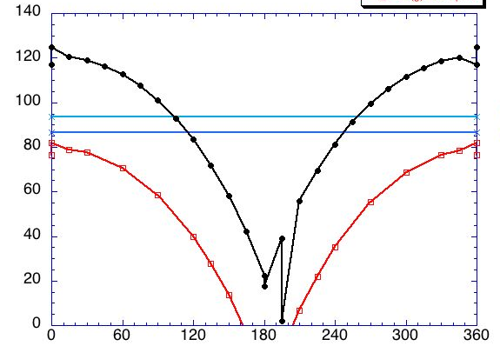
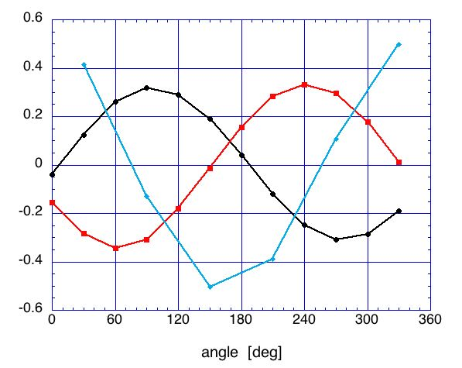
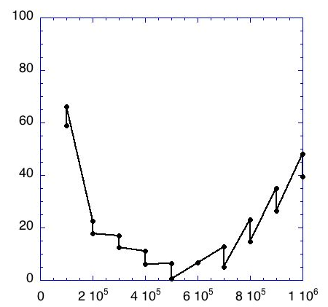
RWM feedback using upper/lower B_{p} and B_{R} sensors shows good agreement with B_{R} feedback phase; gain not optimized
Modeled B_{r} field at sensors and midplane
B_{r} sensors alone
250 degrees
Passive growth
Growth rate (1/s)
Radial field (G)
B_{r} and B_{p}
sensors
gain 2e5
bottom sensors
midplane
top sensors
DCON, VALEN
codes
B_{r} feedback phase (deg)
Toroidal angle (deg)
VALEN eqv. gain 2e5
Both B_{r}, B_{p} feedback contribute to active control
  B_{r} mode structure and optimal feedback phase agrees with parameters used in experiment
  B_{r} feedback alone provides stabilization for growth times down to ~ 10 ms with optimal gain
  Physics of best feedback phase for B_{p} sensors in low l_{i} plasmas under investigation
Growth rate (1/s)
optimal gain
B_{r} gain (arb)

Slide 4
RWM B_{r} sensor n = 1 feedback phase variation shows superior settings when combined w/B_{p} sensors; good agreement w/theory so far
NSTX Experiments: B_{p} + B_{R} feedback
n = 1 B_{R} + B_{p} feedback
(B_{p} gain = 1, B_{R} gain = 1.5)
VALEN calculation of NSTX B_{r} + B_{p} control
Feedback on
0 deg FB phase
Radial field n = 1 (G)
90 deg FB phase
Vacuum EF + RFA
180 deg FB phase
Vacuum error field
Δt (s)
VALEN calculation of B_{r}+B_{p} feedback follows XP
  stable plasma (negative “s”)
  Now examining plasma response model variation
    impact of “s”, and diff. rotation (“α”) on results
Favorable (experimental) B_{p} feedback settings, varied B_{R} settings
  Positive/negative feedback produced at theoretically expected phase values

Slide 5
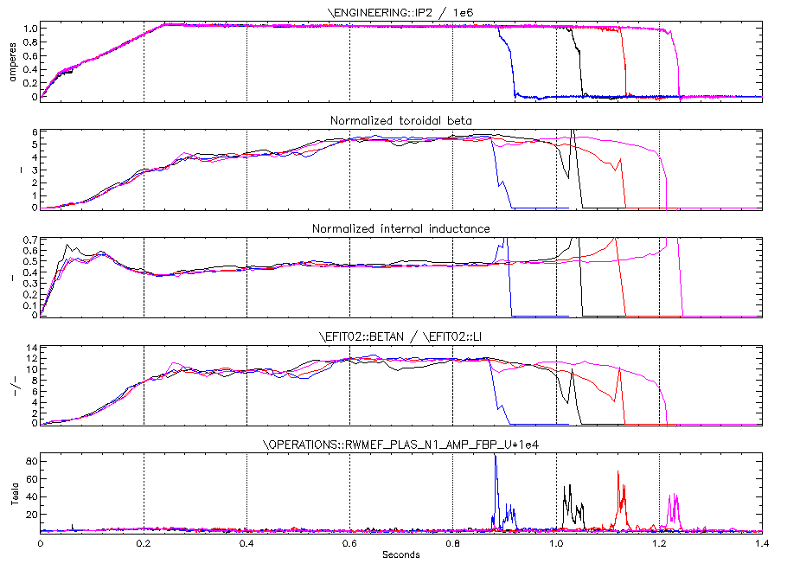
Tweaking B_{p} sensor feedback phase around 180 degrees led to long-pulse, low l_{i}, high β_{N}/l_{i}
202.5 deg
157.5 deg
180 deg
Steady, high β_{N}/l_{i}
  Between 12 – 12.5
Not in agreement with theory
  VALEN indicates a value near 270 deg is optimal
  Analysis ongoing
I_{p} (MA)
β_{N}
l_{i}
β_{N}/l_{i}
B_{p}^{n = 1} (G)
139347
139515
139516
139517

Slide 6
XP1111: RWM PID control optimization based on theory and experiment – shot plan
Task Number of Shots
0) Control shots
A) Generate Fidicial target (long pulse ~ 1s, I_{p} ~ 0.9 MA) 1
B) Generate low l_{i} target (long pulse ~ 1s, I_{p} ~ 0.9 MA) - NOTE: run this AFTER fiducial scans done 1
C) Generate RWM using n > 1 magnetic braking if RWM is not generated 2
1) RWM n = 1 PID feedback control variable scans (at optimal B_{R} feedback phase)
A) Vary RWM B_{p} sensor feedback phase for first target plasma 6
B) Vary RWM B_{R} sensor feedback gain for first target plasma 3
C) Repeat scans (A) for second target plasma 6
D) Vary RWM B_{p} sensor feedback gain for one of the two plasma targets 3
_____________________________________________________________________________________________
Total: 22
½ run day originally slated for RWM state space controller XMP would be used for this XP
(RWM state space controller work can be run in transparent piggyback)
V1.0

Slide 7
XP1111: RWM PID control optimization based on theory and experiment – Diagnostics, etc.
Required diagnostics / capabilities
  n = 1 RWM PID feedback control using B_{p} and B_{r} sensors
  CHERS toroidal rotation measurement
  Thomson scattering
  MSE
  Toroidal Mirnov array / between-shots spectrogram with toroidal mode number analysis
  Diamagnetic loop
Desired diagnostics
  USXR, ME-SXR, BES
  FIDA variants
  FIReTip
  Fast camera

