Slide 1
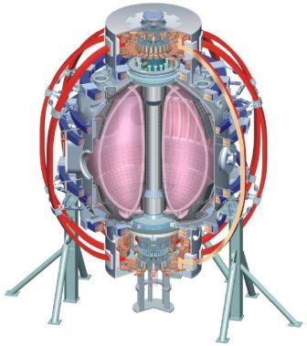
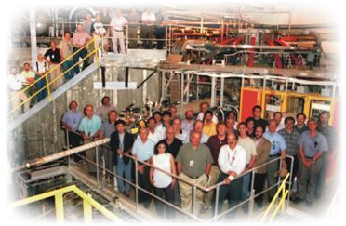
NSTX
Supported by
Suppression of turbulent transport in NSTX internal transport barriers
College W&M
Colorado Sch Mines
Columbia U
Comp-X
General Atomics
INEL
Johns Hopkins U
LANL
LLNL
Lodestar
MIT
Nova Photonics
New York U
Old Dominion U
ORNL
PPPL
PSI
Princeton U
Purdue U
SNL
Think Tank, Inc.
UC Davis
UC Irvine
UCLA
UCSD
U Colorado
U Maryland
U Rochester
U Washington
U Wisconsin
Howard Yuh, Nova Photonics
F.M. Levinton¹, R.E. Bell², J.C.Hosea², S.M. Kaye², B.P.LeBlanc², E.Mazzucato², D.R. Smith², J. Luc Peterson²,
H.K. Park³, W.Lee³, C.W. Domier⁴, N.C.Luhmann⁴, Jr.
and the NSTX Research Team
¹Nova Photonics Inc., Princeton, NJ, ² PPPL, Princeton Univ., Princeton, NJ
³POSTECH, Pohang, Korea, ⁴UC Davis, Davis, CA
Culham Sci Ctr
U St. Andrews
York U
Chubu U
Fukui U
Hiroshima U
Hyogo U
Kyoto U
Kyushu U
Kyushu Tokai U
NIFS
Niigata U
U Tokyo
JAEA
Hebrew U
Ioffe Inst
RRC Kurchatov Inst
TRINITI
KBSI
KAIST
POSTECH
ASIPP
ENEA, Frascati
CEA, Cadarache
IPP, Jülich
IPP, Garching
ASCR, Czech Rep
U Quebec
50th APS DPP Conference
Dallas, Texas
November 20th, 2008

Slide 2
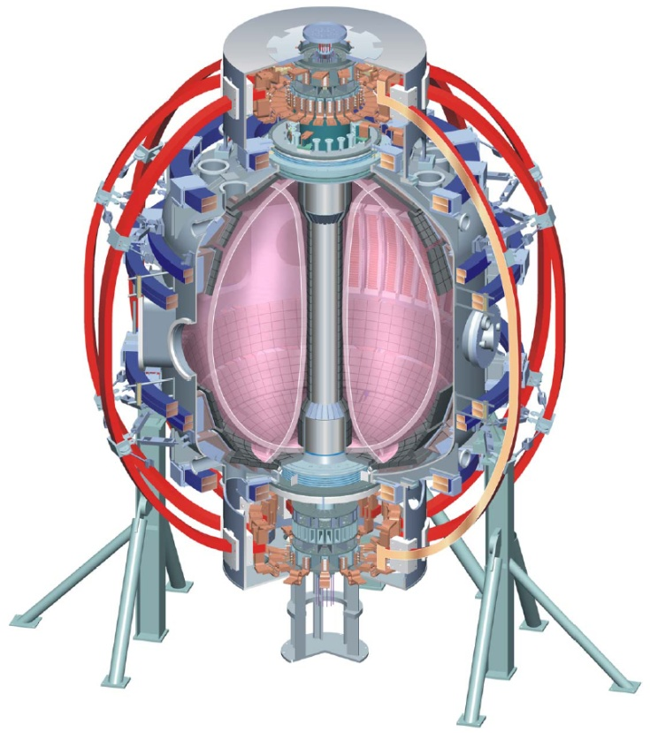
Motivation to understand confinement
NSTX is a high performance spherical torus that has achieved very high β
Ion transport is typically neoclassical in H-modes
Major radius | 0.85 m
Aspect ratio | 1.3
Plasma current | 1 MA
Toroidal field | 0.55 T
Neutral Beams | 6 MW
High Harmonic Fast Wave | 3 MW
Elongation | 2.7
Triangularity | 0.8

Slide 3
Motivation to understand confinement
NSTX is a high performance spherical torus that has achieved very high β
Ion transport is typically neoclassical in H-modes
Anomalous electron transport dominates heat loss
ST fusion reactors must achieve improvements in core electron confinement
NSTX is well equiped to study electron confinement

Slide 4
Motivation to understand confinement
NSTX is a high performance spherical torus that has achieved very high β
Ion transport is typically neoclassical in H-modes
Anomalous electron transport dominates heat loss
ST fusion reactors must achieve improvements in core electron confinement
NSTX is well equiped to study electron confinement
Internal Transport Barriers (ITBs) lead to dramatic improvements in core electron confinement

Slide 5
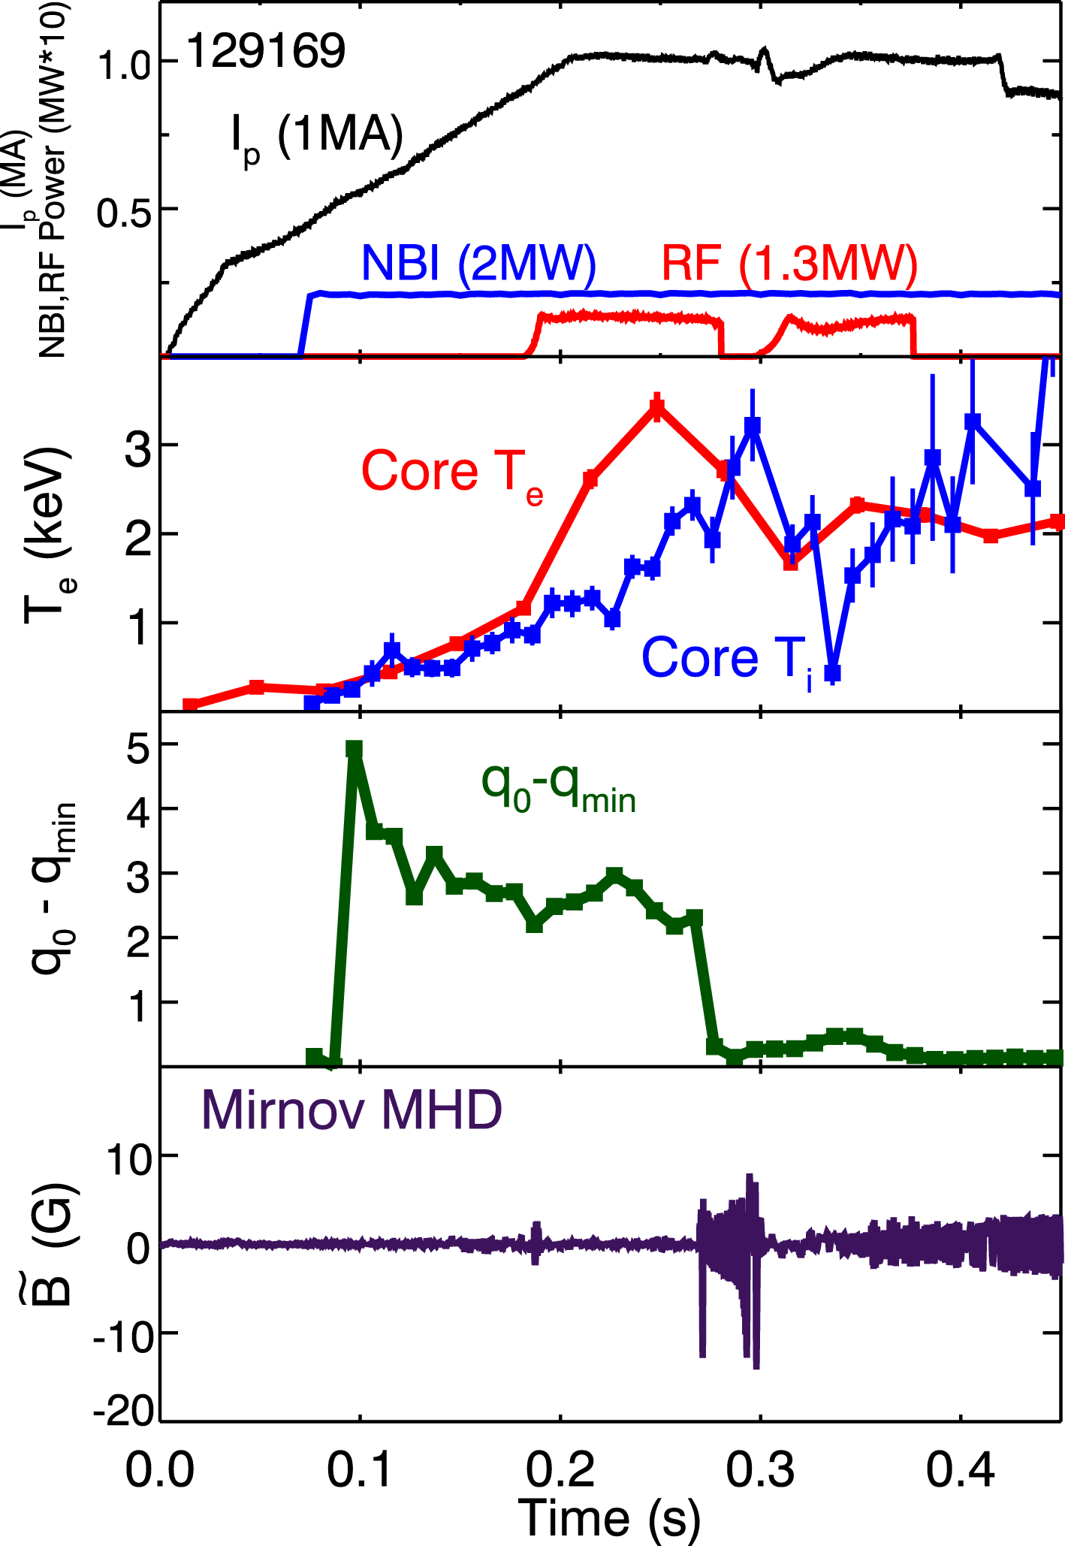
Reversed (negative) magnetic shear plasmas show dramatic confinement improvements
NSTX L-mode plasmas can display an early period of enhanced confinement
Core electron and ion temperatures, as well as core toroidal velocity increase rapidly during periods of enhanced confinement
Loss of high confinement phase coincident with MHD activity redistributing current and loss of reverse shear

Slide 6
Negative magnetic shear twists radial eddies away from curvature drive
ŝ=r/q (dq/dr)
Antonsen [PoP 3,2221,(1996)] showed pictorially how negative magnetic shear stabilizes ballooning type modes and simulation results showing the breaking up of radially extended streamer structures
Negative shear rotates radially extended streamers such that they are no longer aligned with the curvature drive

Slide 7
Outline
Experimental profiles of ITBs
Statistical analysis of the kinetic profile database
High-k fluctuation data in the ITB at the electron scale
Comparison between experimental and simulation results
Conclusion

Slide 8
16 channel Motional Stark Effect (MSE) diagnostic measures internal magnetic pitch angles
Lyot filter based MSE system provides 10ms resolution at ≤0.3T
Provides full coverage from edge to well past magnetic axis
Diagnoses nearly all NSTX plasmas with beam heating or beam blips

Slide 9
MSE accurately constrains q and j profiles of reversed shear discharges
The minimization of flux consumption on NSTX plasma startup frequently results in early reversed shear q-profiles
Reconstructions performed using LRDFIT (J. Menard)
  Free boundary, Grad-Shafranov solver using magnetics, E_{r} corrected MSE, T_{e} isothermal flux surfaces, and rotation

Slide 10
Internal transport barriers form when magnetic shear is negative
Peaked core gradients in electron and ion temperatures, and toroidal velocity
Electron density gradient does not show much change with ITB
NSTX profile diagnostics
  51 channel toroidal CHarge Exchange Recombination Spectroscopy (CHERS) measures T_{i},v_{φ}
  30 channel Thomson scattering measures T_{e}, n_{e}
  16 channel MSE

Slide 11
Definitions of profile quantities for statistical analysis
q_{min} and location
s_{min} and location
maximum R/L_{Te} and location (e-ITB)
maximum R/L_{Ti} and location (i-ITB)
maximum R/L_{vφ} and location
Profiles from over 80 ITB discharges with over 500 timeslices
Tanh or spline fitted

Slide 12
ITB locations do not coincide with q_{min} or rational q
Peak gradient locations well separated from q_{min}
ITBs occurs over a range of q values

Slide 13
T_{i} gradient increases with increasing flow shear
E×B shearing rate can quench ITG
Toroidal velocity shear is the largest component of E×B
Simulations results show ITG linearly stable in many cases for NSTX

Slide 14
i-ITB location is closely correlated to peak E×B shearing rate location
i-ITB occurs most frequently just outside peak E×B location

Slide 15
e-ITB coincides minimum magnetic shear location
e-ITB occurs most frequently just inside s_{min,} only very rarely outside
i-ITB occurs well outside s_{min}

Slide 16
How does negative magnetic shear correlate with T_{e} gradients?
Long pulse, high power, high β_{N} discharges provides baseline electron confinement performance

Slide 17
Gradients in weakly reversed shear L-mode plasmas are similar to baseline
Long pulse, high power, high β_{N} discharges provides baseline electron confinement performance

Slide 18
Strongly negative magnetic shear improves
T_{e} gradient performance
Long pulse, high power, high β_{N} discharges provides baseline electron confinement performance
Gradients in weakly reversed shear L-mode plasmas
are similar to baseline

Slide 19
Increasing power increases T_{e} gradients...
Long pulse, high power, high β_{N} discharges provides baseline electron confinement performance
Gradients in weakly reversed shear L-mode plasmas
are similar to baseline
Strongly negative magnetic shear improves T_{e} gradient performance

Slide 20
...but only for profiles exhibiting strong negative magnetic shear
Long pulse, high power, high β_{N} discharges provides baseline electron confinement performance
Gradients in weakly reversed shear L-mode plasmas
are similar to baseline
Strongly negative magnetic shear improves T_{e} gradient performance
Increasing power increases T_{e} gradients...

Slide 21
Is the profile stiff at zero and weakly negative shear?
Long pulse, high power, high β_{N} discharges provides baseline electron confinement performance
Gradients in weakly reversed shear L-mode plasmas
are similar to baseline
Strongly negative magnetic shear improves T_{e} gradient performance
Increasing power increases T_{e} gradients...
...but only for profiles exhibiting strong negative magnetic shear
Are there changes in electron-scale turbulence that accompany the change in the electron temperature gradient?
Critical
gradient?
Stiff T_{e} profile?

Slide 22
High-k microwave scattering diagnostic measures n_{e} fluctuations at electron scale wavenumbers
k⊥ρ_{e} ≤ 0.6 can be measured
Multiple detection channels can measure fluctuations at multiples k values simultaneously
Localized scattering volume, radial resolution ~2.5cm
Plan View
2.5cm
D.R. Smith
YI2.005

Slide 23
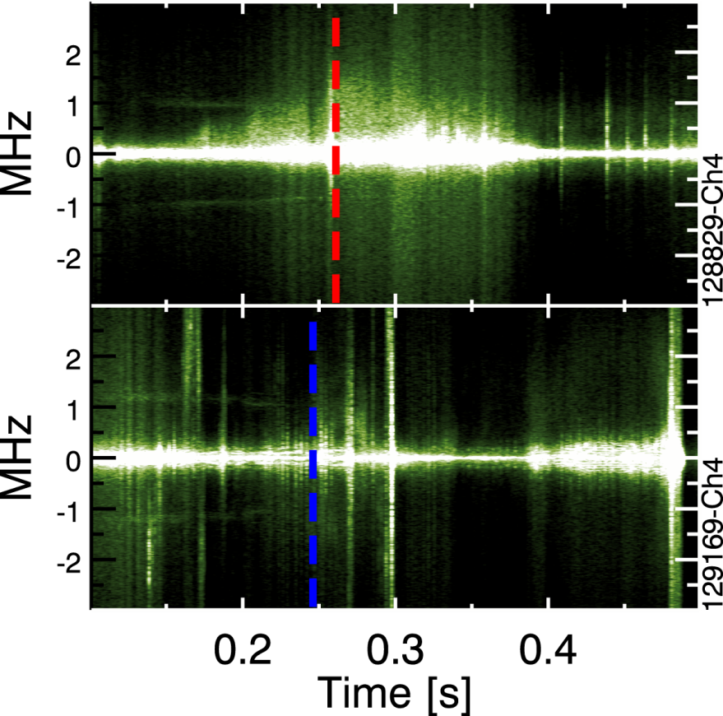
High-k scattering fluctuations are reduced inside e-ITB
k┴ρ_{e} ≈ 0.2
Reduced high-k fluctuation amplitude seen in strongly reversed shear e-ITB
Weak negative shear shows greater amplitude high-k fluctuations despite lower T_{e} gradients

Slide 24
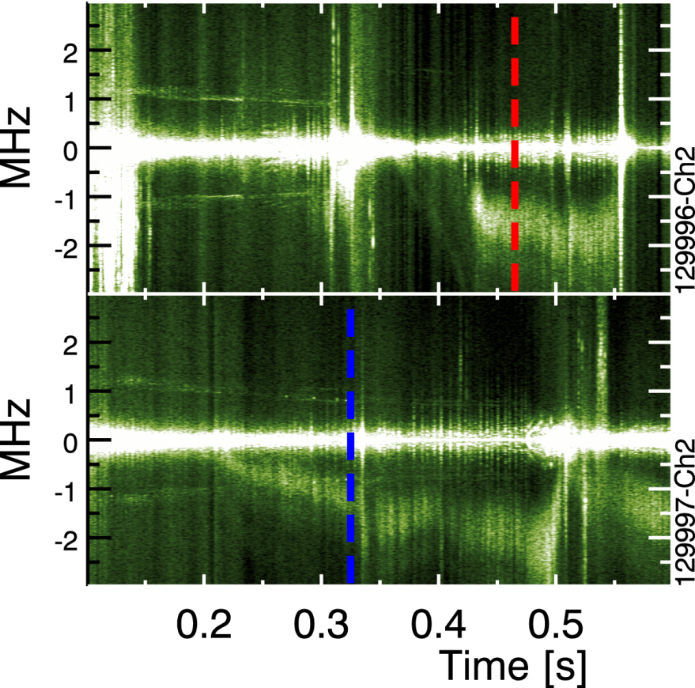
High-k scattering fluctuations persist just outside e-ITB
k┴ρ_{e} ≈ 0.2
Fluctuations depend on local value of magnetic shear
High-k fluctuation are in the electron diamagnetic drift direction but Doppler shifted by toroidal rotation

Slide 25
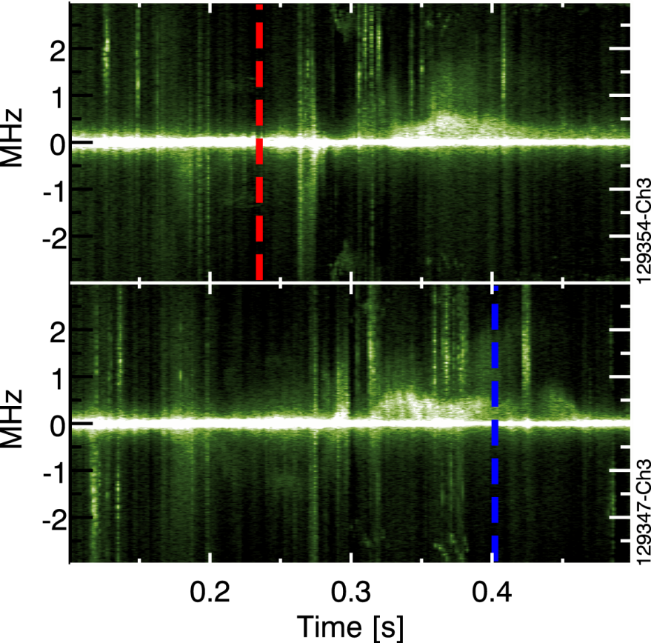
Negative magnetic shear can suppress electron thermal turbulence without flow shear
k┴ρ_{e} ≈ 0.2
HHFW only with beam blips
Minimal ExB shearing rate due to cold ions with low toroidal rotation
Magnetic shear alone can suppress electron turbulence

Slide 26
Zero/weakly reverse shear establish a range for high-k fluctuations at low R/L_{Te}
Slight trend of increasing high-k fluctuation power with increased gradients
Additional power not able to increase local gradients

Slide 27
Strongly reversed shear e-ITBs show low high-k fluctuation power despite strong ∇T_{e} gradient drive
Do measurements of increased T_{e} gradient and reduced fluctuations agree with theory and simulation?

Slide 28
Measured gradients well above predicted
ETG critical gradient
GS2 and GYRO linear simulations performed across profile range
Critical gradients for ETG instability greatly exceeded in e-ITBs
Low high-k fluctuation power measured in ITB
Can negative magnetic shear suppressing transport caused by ETG ?
Is there a limit?
Stiff
T_{e} profile
GS2 critical gradients
J. Luc Peterson
NP6.094
GYRO critical gradients:
single profile, s & Zeff(T_{e}/T_{i}) variation

Slide 29
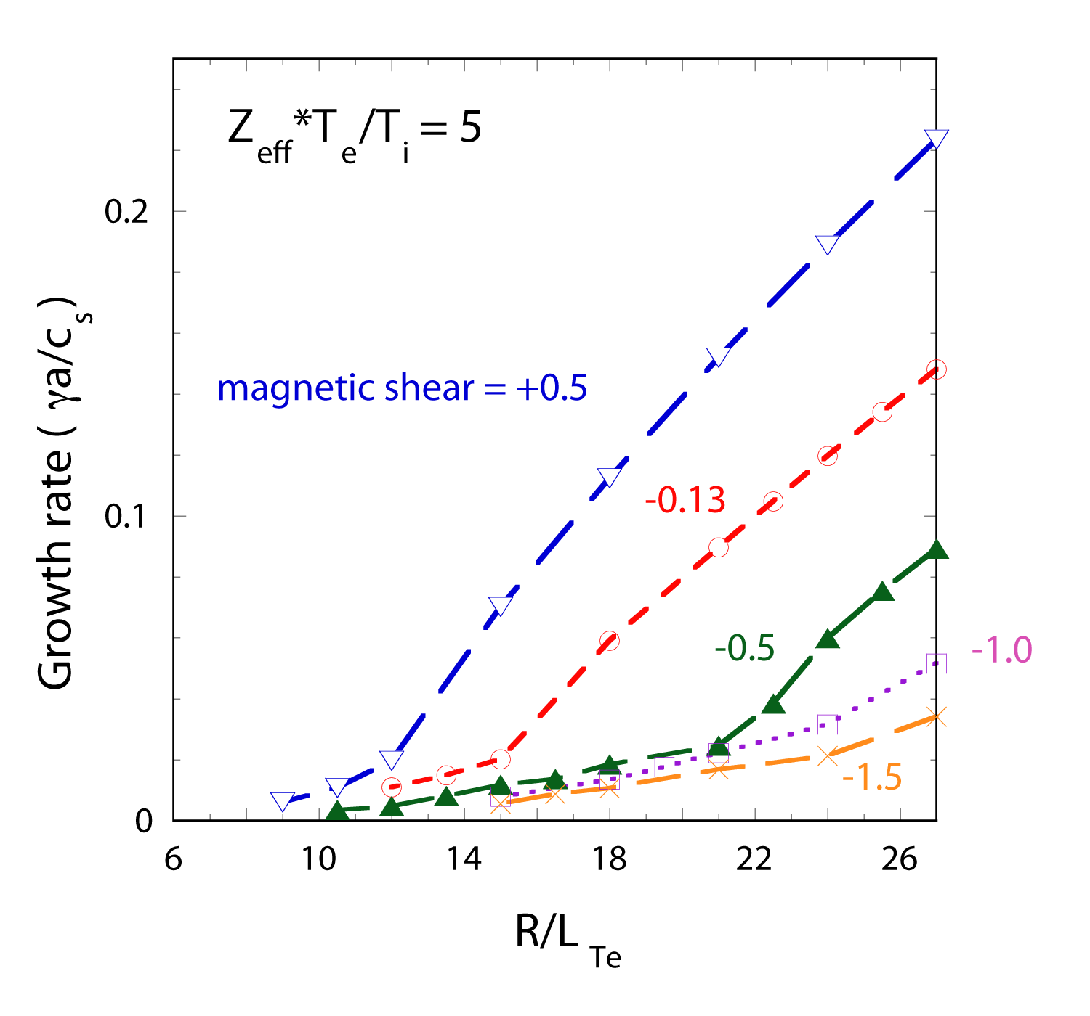
Previous non-linear simulations has shown negative magnetic shear can reduce transport by ETG
Negative magnetic shear suppression of ETG transport has been predicted by Jenko, Dorland [PRL 89, 225001 (2002)]
Secondary instability better able to compete with primary mode at negative magnetic shear
D. Mikkelsen
NP6.093

Slide 30
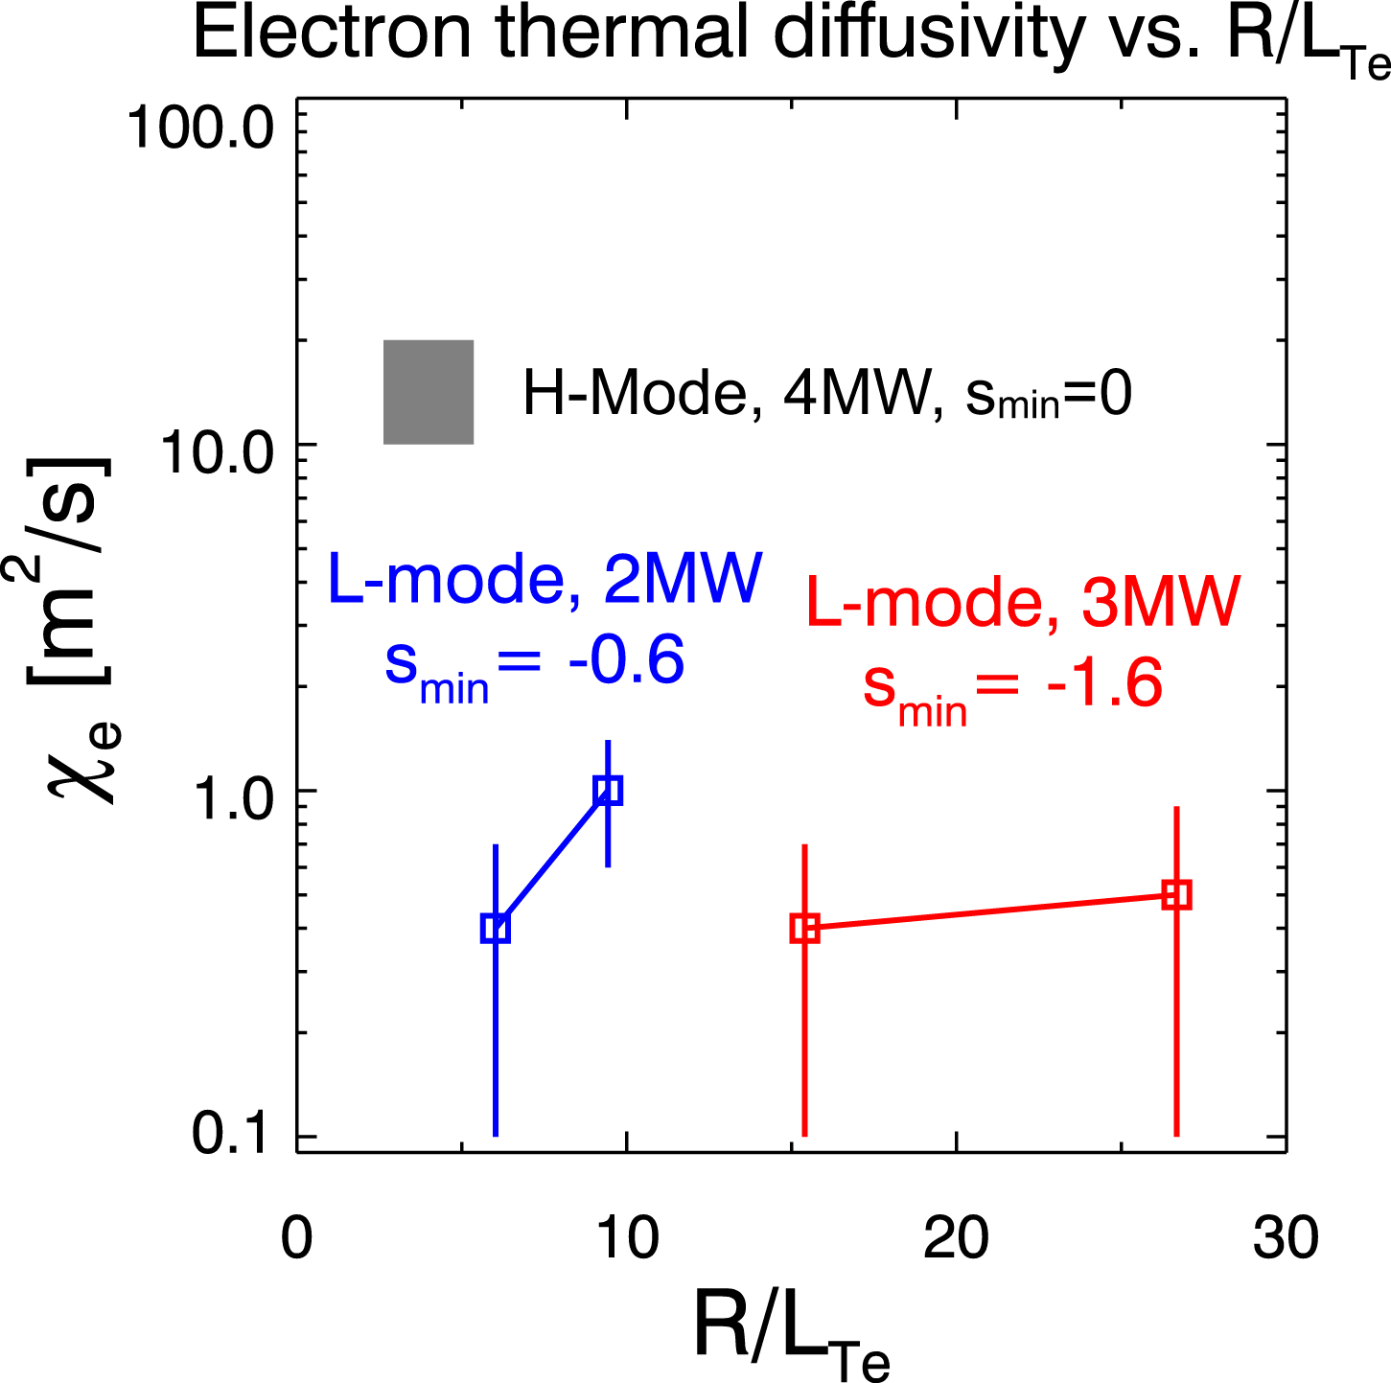
Previous non-linear simulations has shown negative magnetic shear can reduce transport by ETG
Negative magnetic shear suppression of ETG transport has been predicted by Jenko, Dorland [PRL 89, 225001 (2002)]
Secondary instability better able to compete with primary mode at negative magnetic shear
Experimental data shows a similar reduction in χ_{e} with low sensitivity to increasing temperature gradients

Slide 31
Conclusions
Electron ITB location strongly correlated with minimum of negative magnetic shear
Ion ITB does not occur at s minimum, but closer to maximum E×B shear location
T_{e} profiles appear to be stiff for zero and weak negative magnetic shear
Strong negative magnetic shear reduces electron scale turbulence in ITB regions despite high gradients
Reduced transport is observed in negative magnetic shear regions

Slide 32
Thank You for listening
Questions?

Slide 33
Ti2.05 – Landmark b
Thursday, nov 20, 2008
11:30AM – 12:00PM
Suppression of turbulent transport in NSTX internal transport barriers
Howard Yuh, Nova Photonics
F.M. Levinton¹, R.E. Bell², J.C.Hosea², S.M. Kaye², B.P.LeBlanc², E.Mazzucato², D.R. Smith², J. Luc Peterson²,
H.K. Park³, W.Lee³, C.W. Domier⁴, N.C.Luhmann⁴, Jr.
and the NSTX Research Team

Slide 34
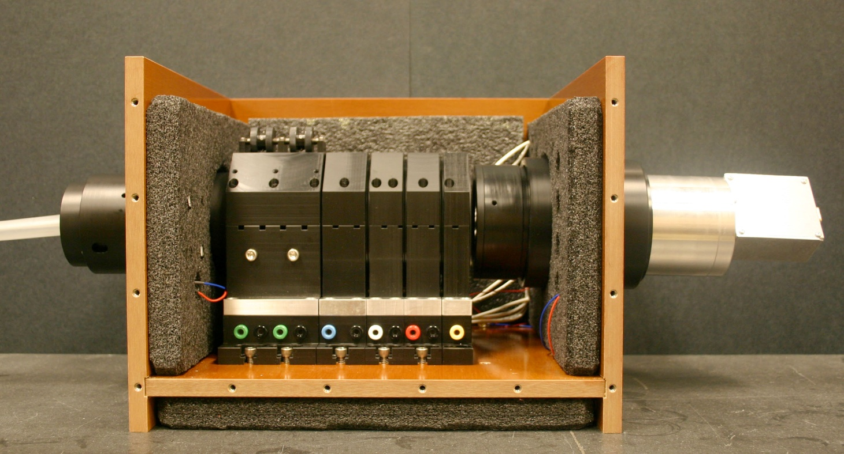
Low field on NSTX requires use of Lyot filters
Lyot filter, collimating and focusing optics, APD detector, HV for wavelength tuning, and temperature control are built into compact modules
Achieved a spectral FWHM of 0.062 nm

Slide 35
Lyot filter properties suitable for ITER MSE
Filter Bandpass
High Bremsstrahlung to signal ratio favors viewing only the highest intensity Stark multiplet (σ₀)
High throughput, low bandpass filters allow the ITER MSE system enough etendue viewing σ₀ only
Would require interference filter in a large size not available commercially
ITER simulated Stark Spectrum

Slide 36
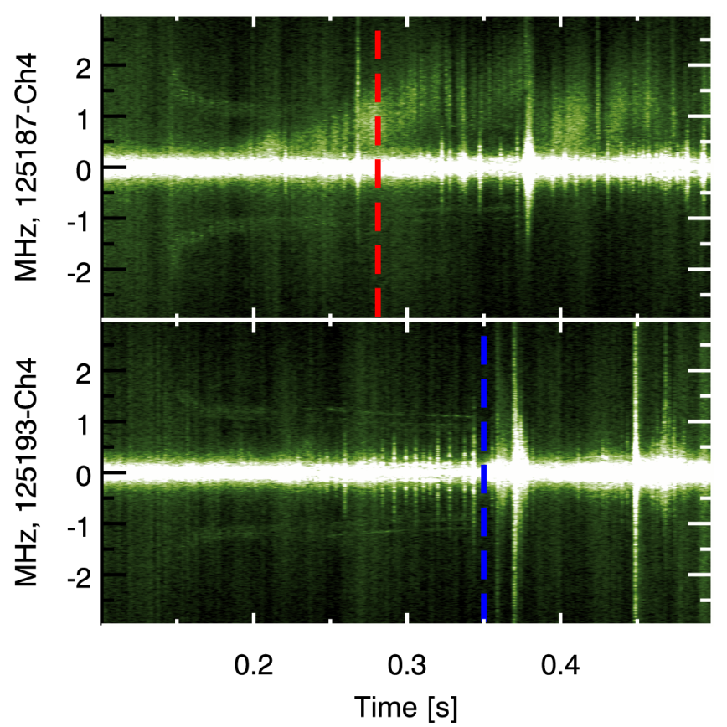
High-k scattering comparison, top of electron-ITB (R=114cm)
Strong negative
magnetic shear
Zero magnetic shear
k┴ρ_{e} ≈ 0.2
High-k scattering measures reduced local n_{e} fluctuations in the ETG k range for ITB discharges.
Compare measurements in ITB vs. non-ITG cases
Shows strong activity for non-ITB case despite weak gradients
Beam heated discharge, flow shear and T_{i}-ITB also present

Slide 37
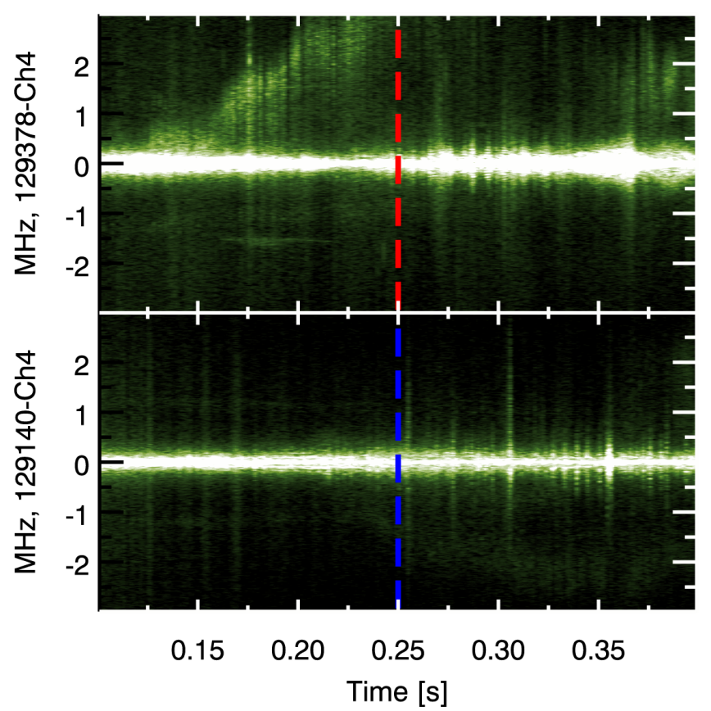
High-k scattering comparison, peak R/L_{te} electron-ITB (R=120cm)
Strong negative
magnetic shear
Zero magnetic shear
k┴ρ_{e} ≈ 0.2
Measured frequency is in electron diamagnetic direction but strongly Doppler shifted by toroidal rotation
High-k fluctuations strongly suppressed in reversed shear ITB case, despite strong gradients (R/L_{Te}=10)

Slide 38
q values at ITB peak gradient does not show favored rational surfaces

Slide 39
Peak R/L_{Te} location highly correlated with ŝ minima
Statistical analysis of profiles using data from ~90 shots with over 500 profiles
Radial location of minima in magnetic shear (ŝ) compared with locations of maximum gradients, but only for high R/L_{Te} (ITB) profiles
Standard deviation of the separation for electron ITB cases (4 cm) is significantly below the convolution width of the radial locations of min(ŝ) and max(R/L_{Te}) (7.5cm)
minimum magnetic shear (ŝ) location is highly correlated with peak gradient location
Location of ion-ITB shows mean offset from minimum shear location

Slide 40
Ion ITB occurs at maximum E×B shear
Ion ITB coincides with peak E×B shearing rate but electron ITB does not
Result shown is for beam heated only ITB discharge
TORIC HHFW power deposition profile has very recently been incorporated into TRANSP
RF heated ITB discharges show increased T_{e} gradients
Ongoing analysis will show dependence of χ_{e} on input power for ITB discharges
χ_{i} _{ITB}→χ_{i} _{neo}
χ_{e}<1 m²/s inside ITB

Slide 41
Peak R/L_{Vφ} location tends to be between peak R/L_{Te} and R/L_{Ti}
The radial locations for ITBs in T_{e}, T_{i}, and V_{φ} are offset
The T_{i}-ITB is tends to be furthest out, followed by V_{φ}-ITB, and T_{e}- ITB closest to the magnetic axis
Separation between T_{i}-ITB location and minima in magnetic shear suggests magnetic shear is not the dominant suppression
Analysis shows peak E×B location to be at foot of V_{φ} pedestal, close to the location of the T_{i}-ITB
Consistent with hypothesis that:
  E×B shear quenches ITG
  Negative magnetic shear quenches ETG

Slide 42
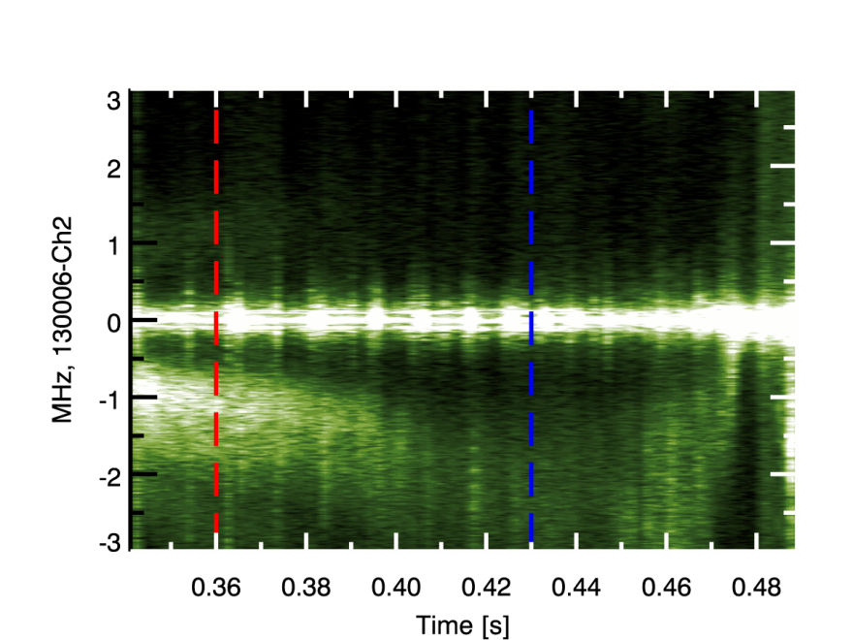
...but flow shear can also affect electron turbulence
k┴ρ_{e} ≈ 0.2
Comparing two profiles from single discharge, beam heating only for both times
Rotation profile is increasing E×B shearing rate at high-k measurement location
q-profile is stationary throughout time period, and measurement is at q_{min}
Frequency evolves due to increase in Doppler shift
The observed amplitude of high-k fluctuations decrease with increasing v_{φ} shear rate

Slide 43
Negative magnetic shear reduces high-k fluctuations simultaneous with increasing T_{e} gradient
Strong negative shear, low gradient, low high-k power points lie inside ITB
Flat profile inside ITB likely not due to ETG turbulence
Another transport mechanism or is lack of current reducing confinement
D. Stutman
CO3.004

