Slide 1
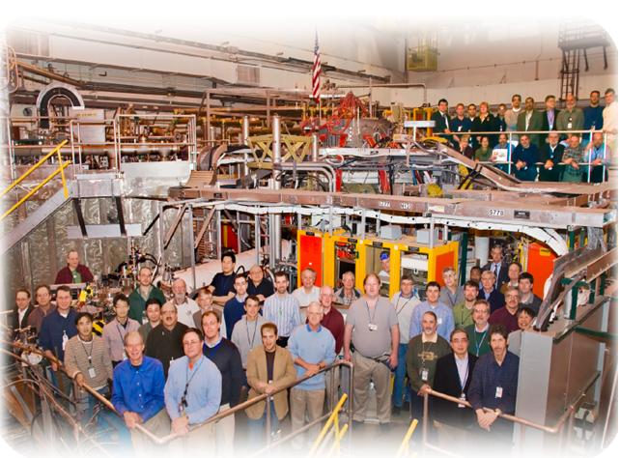
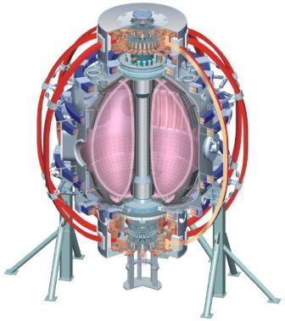
NSTX
Supported by
Modifications in divertor and scrape-off layer conditions with lithium coatings in NSTX
College W&M
Colorado Sch Mines
Columbia U
CompX
General Atomics
INEL
Johns Hopkins U
LANL
LLNL
Lodestar
MIT
Nova Photonics
New York U
Old Dominion U
ORNL
PPPL
PSI
Princeton U
Purdue U
SNL
Think Tank, Inc.
UC Davis
UC Irvine
UCLA
UCSD
U Colorado
U Illinois
U Maryland
U Rochester
U Washington
U Wisconsin
V. A. Soukhanovskii, LLNL
H. W. Kugel, R. Kaita, R. Bell, D. A. Gates, J. E. Menard, D. Mueller, B. P. LeBlanc, S. F. Paul, A. L. Roquemore, D. P. Stotler (PPPL), R. Maingi (ORNL), R. Raman (U W), A. Pigarov, R. Smirnov (UCSD)
Culham Sci Ctr
U St. Andrews
York U
Chubu U
Fukui U
Hiroshima U
Hyogo U
Kyoto U
Kyushu U
Kyushu Tokai U
NIFS
Niigata U
U Tokyo
JAEA
Hebrew U
Ioffe Inst
RRC Kurchatov Inst
TRINITI
KBSI
KAIST
POSTECH
ASIPP
ENEA, Frascati
CEA, Cadarache
IPP, Jülich
IPP, Garching
ASCR, Czech Rep
U Quebec
Poster PP8.00037
51st Annual Meeting of the APS Division of Plasma Physics
Atlanta, Georgia
November 2-6, 2009

Slide 2
Abstract & Acknowlegments
Two lithium evaporators were used in NSTX to deposit lithium coatings on graphite plasma-facing tiles in the lower divertor, enabling neutral deuterium pumping and resulting in reduced recycling. This was evident from the reduction by 50 % - 80 % in Dα poloidal and divertor brightnesses, as well as the ion outfluxes, edge neutral pressure, core and divertor n_{e}. The two point and multi-fluid UEDGE code modeling suggested a shift of the outer divertor operating space toward the sheath-limited transport regime with lithium. Particle balance calculation showed that the deuteron inventory was well controlled and remained nearly constant in the long 1.2-1.4 s ELM-free H-mode discharges with lithium coatings. However, n_{e} rose due to the increasing carbon inventory. The carbon source, estimated from C II and C III intensities and atomic S/XB factors, was reduced, suggesting that impurity accumulation was due to the improved particle confinement.
Supported by the U.S. DOE under Contracts DE-AC52-07NA27344, DE AC02-09CH11466, DE-AC05-00OR22725, DE-FG02-08ER54989, and W-7405-ENG-36.

Slide 3
Summary and Conclusions
Evaporative lithium coatings on carbon PFCs modify divertor and SOL sources
  Lower divertor, upper divertor and inner wall recycling was reduced by up to 50 %
  Local recycling coefficients reduced on inner wall and far SOL, remained similar in the outer strike point region
  Lower divertor carbon source from physical sputtering also reduced
  Divertor lithium influx increased, however, lithium was retained in divertor
SOL transport regime changes from high-recycling to low-recycling (sheath-limited)
  Apparently small parallel T_{e} gradient
  Detached inner divertor re-attaches, X-point MARFEs disappear
Pedestal and core confinement improvement leads to
  Surface pumping reduces ion inventory (density) by up to 50 %
  Lithium is effectively screened from plasma
  Carbon accumulation observed

Slide 4
Lithium research program on NSTX focuses on solid and liquid lithium plasma facing components
Primary motivation for lithium coating studies – ion and impurity density control in H-mode plasmas
Multi-phase lithium research plan on NSTX
  Lithium pellet injection (2005-2009)
  Lithium evaporation (2006-2009)
  Liquid lithium divertor module (2009-2012)
Recent NSTX experiments with lithium have shown
  Reduced plasma density early in discharge
  ELM suppression and longer pulse length
  Improved energy confinement
  Reduced flux consumption
  Broader electron temperature profile

Slide 5
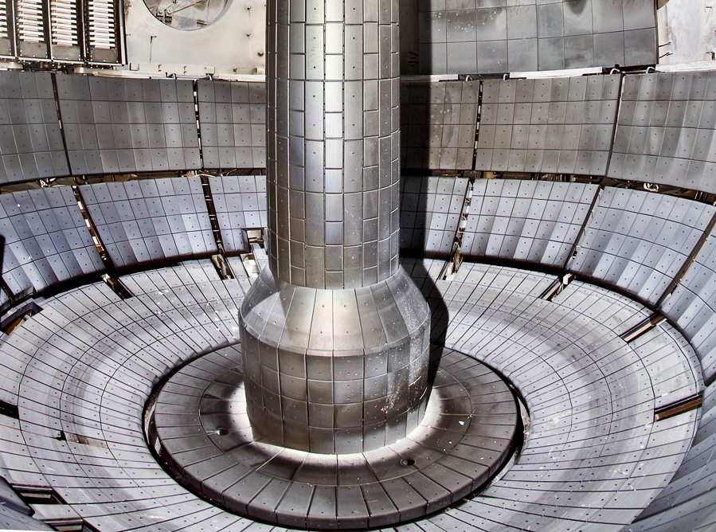
Plasma-surface interaction with lithium-coated graphite plasma-facing components
NSTX plasma facing components
  ATJ and CFC graphite tiles
  Typical divertor tile
  temperature in 1 s pulses
  T < 500 C (q_{peak} ≤ 10 MW/m²)
Lithium pumping
  Through formation of LiD
  Coating can bind D with a full 200-400 nm thickness
Impurity (Li, C) generation
  Sputtering by D ions
  Self-sputtering
  Evaporation

Slide 6
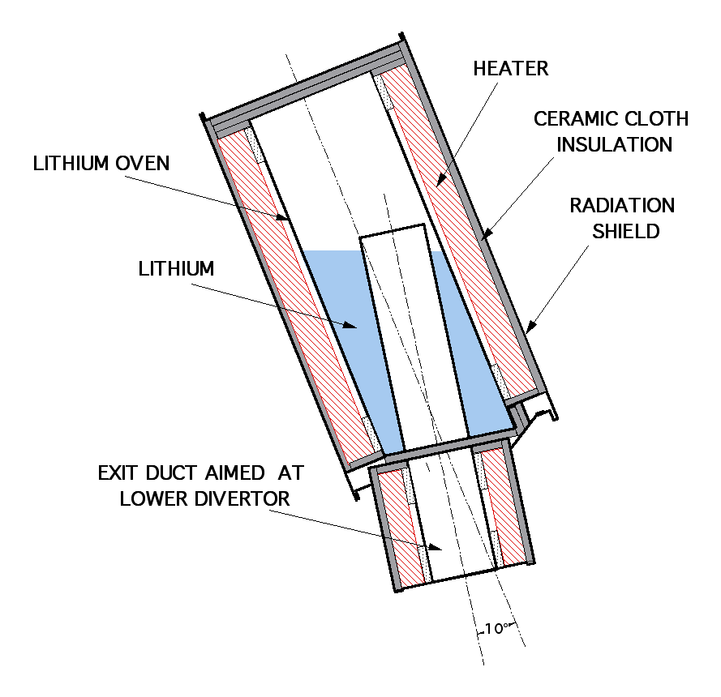
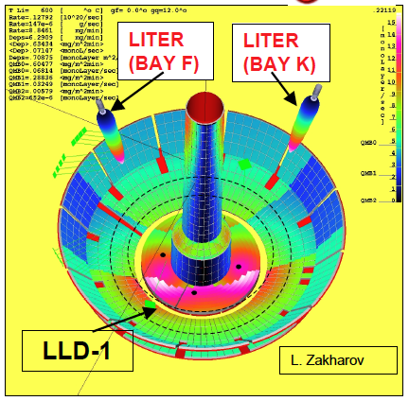
Two lithium evaporators (LITERs) were used in 2008 and 2009 experiments in NSTX
Two LITERs
  fuller coverage of lower divertor region
  higher deposition rate
Typical Operating Conditions
  Capacity: 90 g Li
  Oven Temp: 600-680°C
  Rate: 1mg/min - 80mg/min

Slide 7
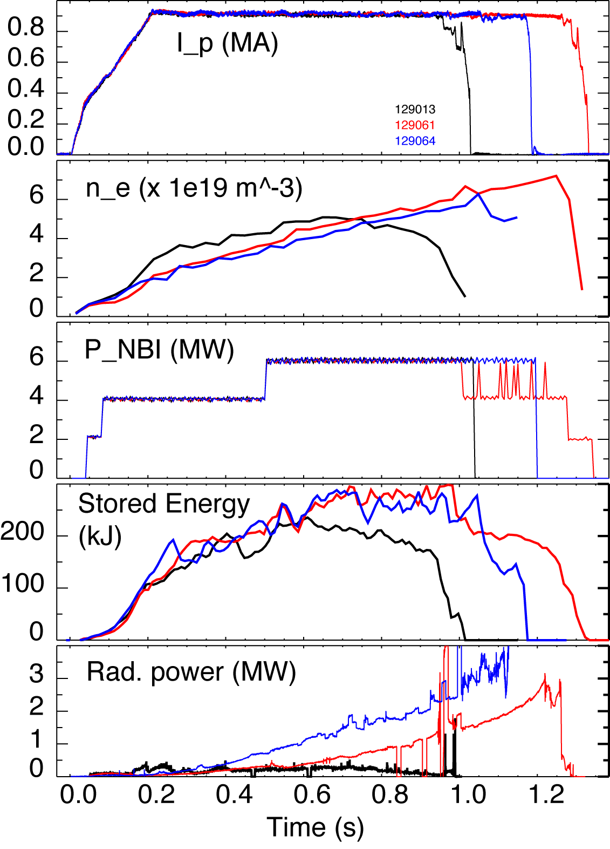
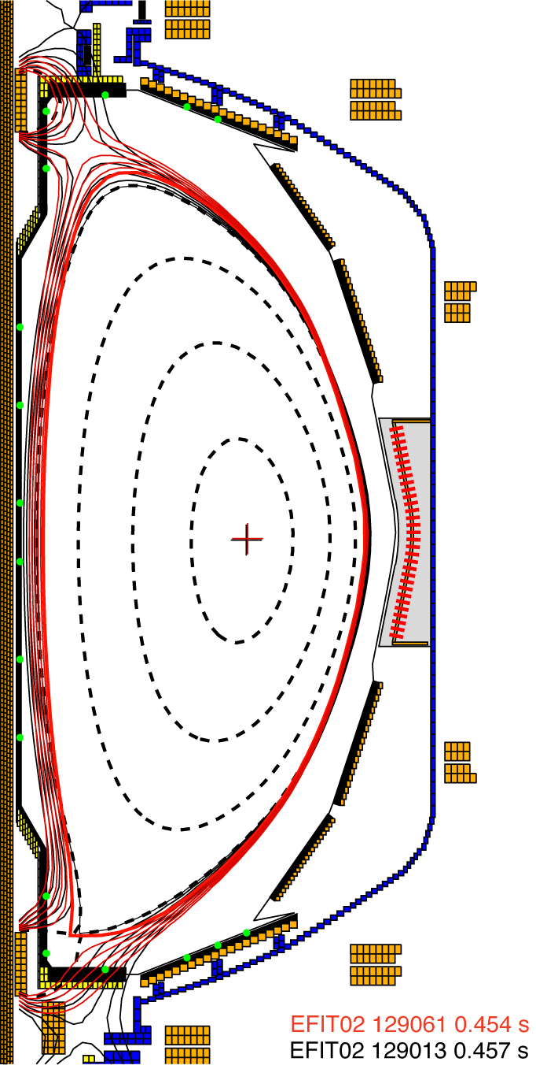
Impact of lithium conditioning was investigated in 4-6 MW H-mode discharges
0.9 MA, 4.5 kG, 4-6 MW NBI
High κ~2.3, δ~0.6 shape
Biased DN with δr_{sep}=6-8 mm
No lithium (129013)
190 mg Lithium (129061)
600 mg lithium (129064)

Slide 8
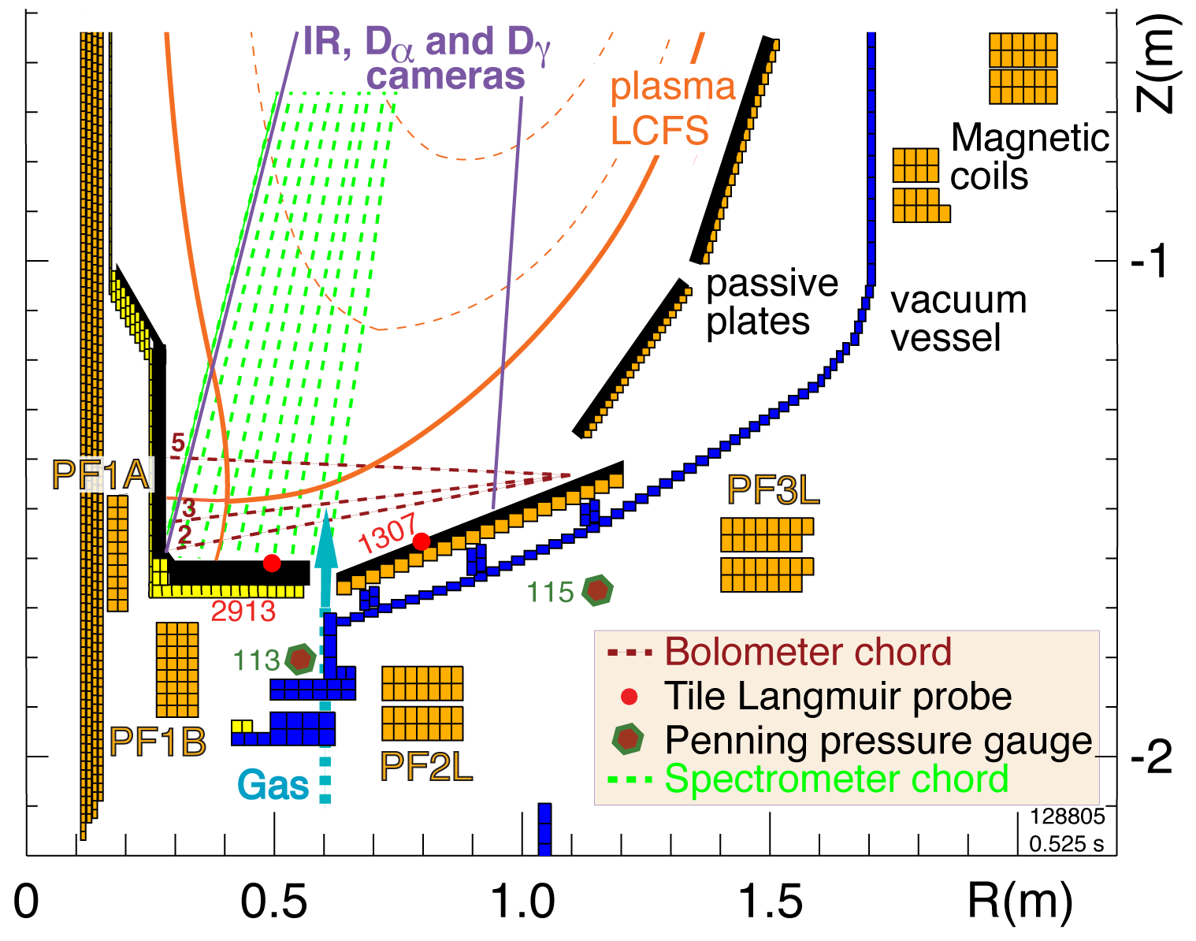
Multiple diagnostic measurements are analyzed to elucidate on divertor and SOL physics in NSTX
Diagnostic set for divertor
studies:
  IR cameras
  Bolometers
  Neutral pressure gauges
  Tile Langmuir probes
  Dα, Li I filtered CCD arrays
  Filterscopes
  UV-VIS spectrometer
  (10 divertor chords)
Midplane Thomson scattering and CHERS systems

Slide 9
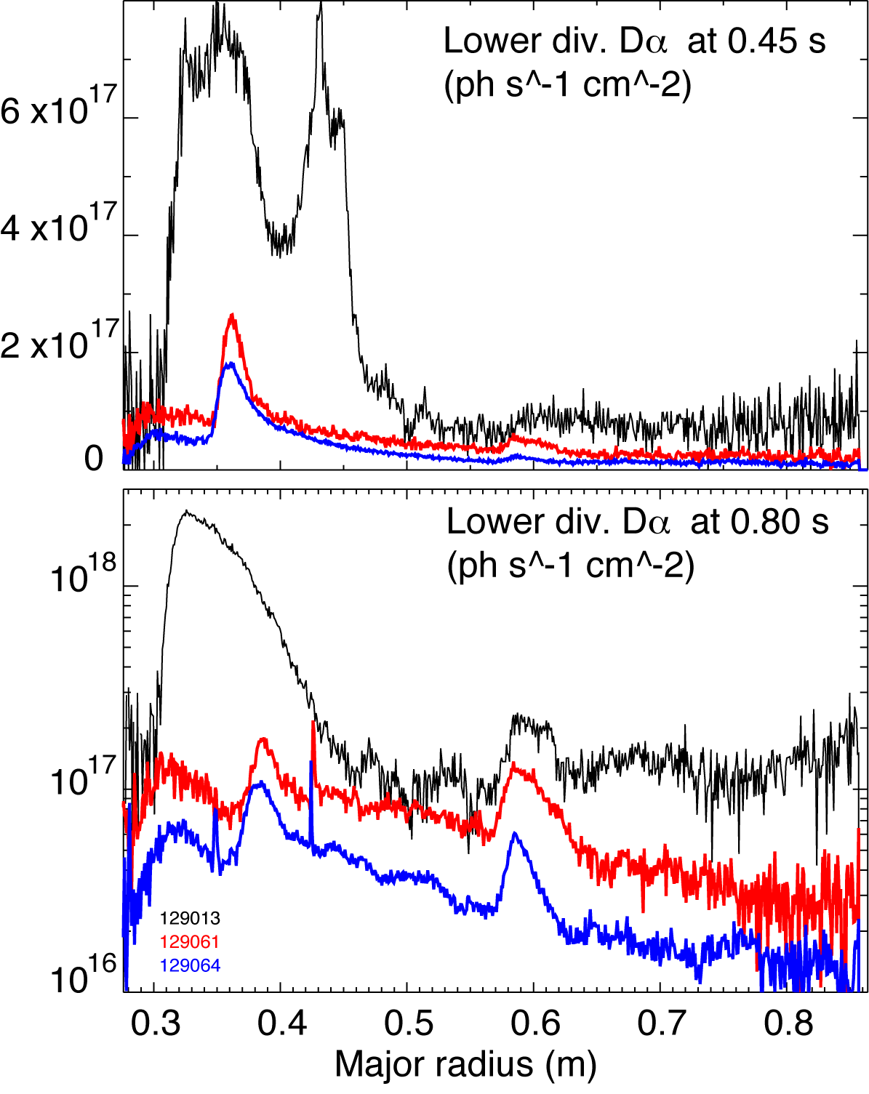
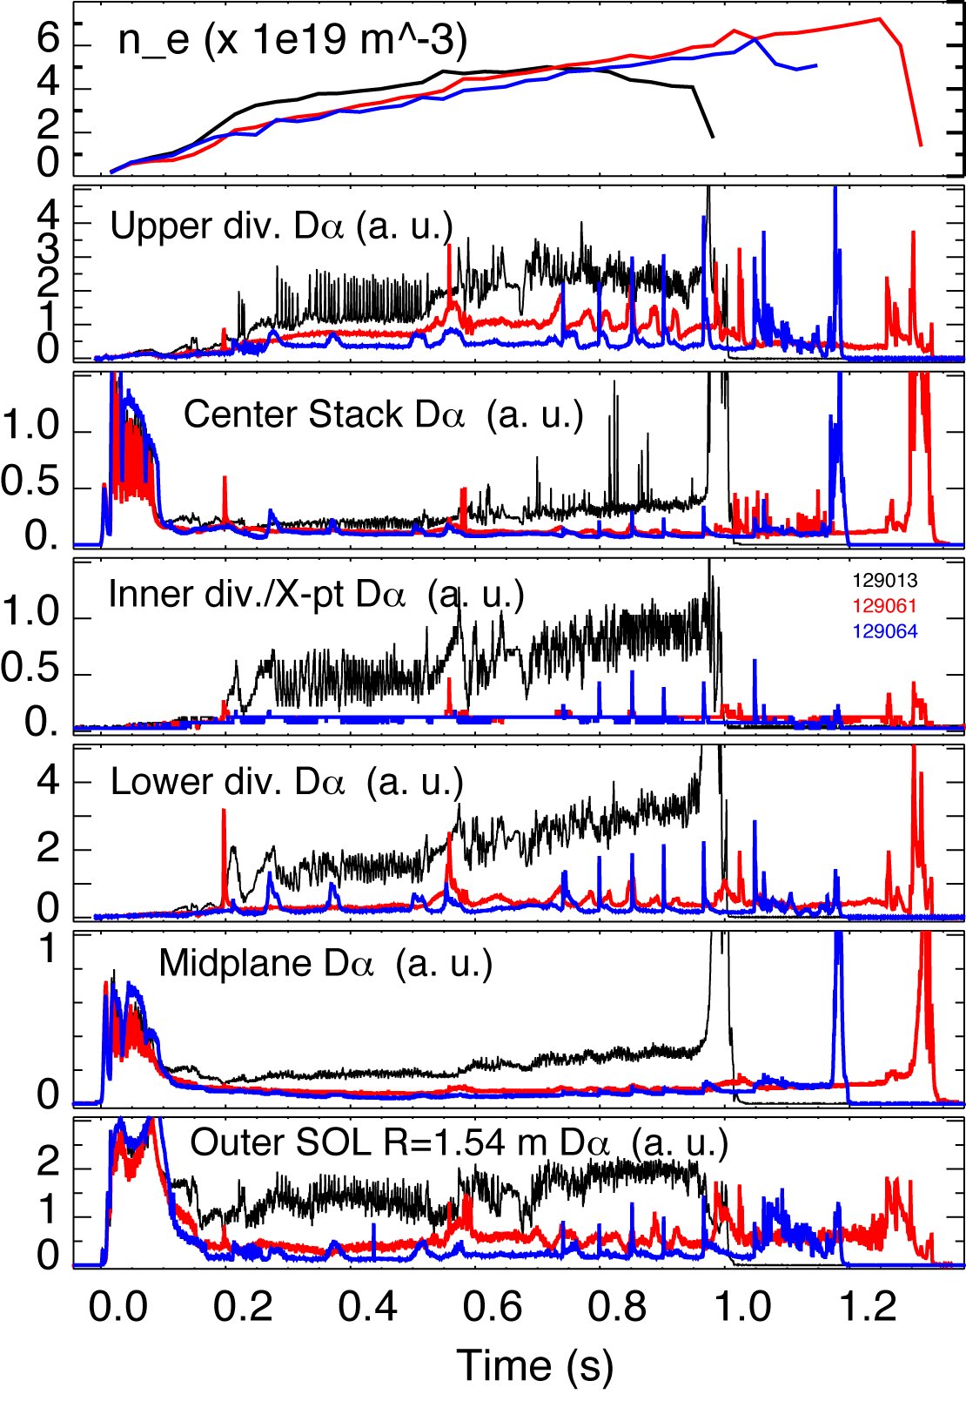
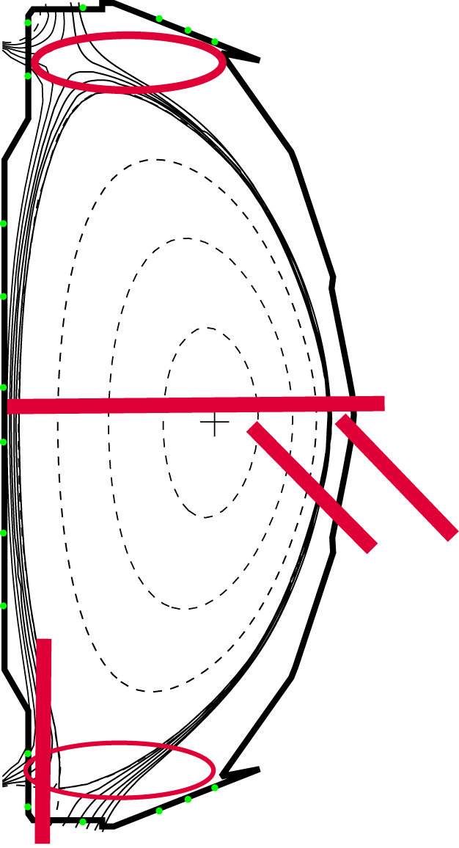
Lithium had a profound and cumulative effect on poloidal recycling flux profile
No lithium (129013)
190 mg Lithium (129061)
600 mg lithium (129064)

Slide 10
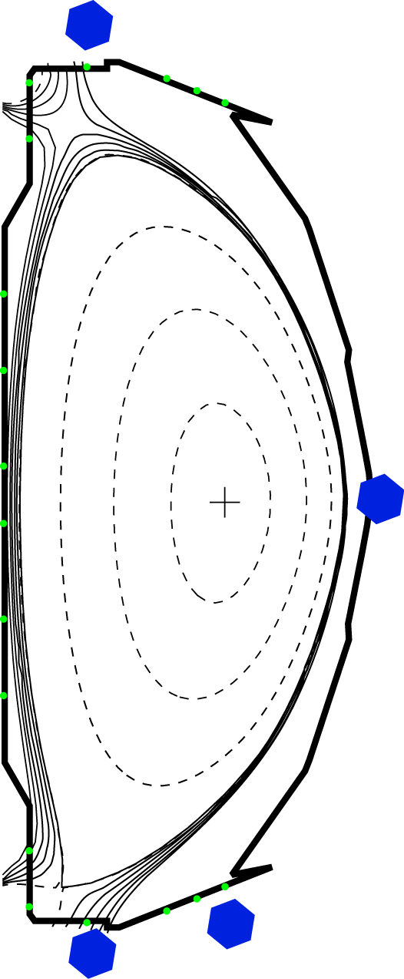
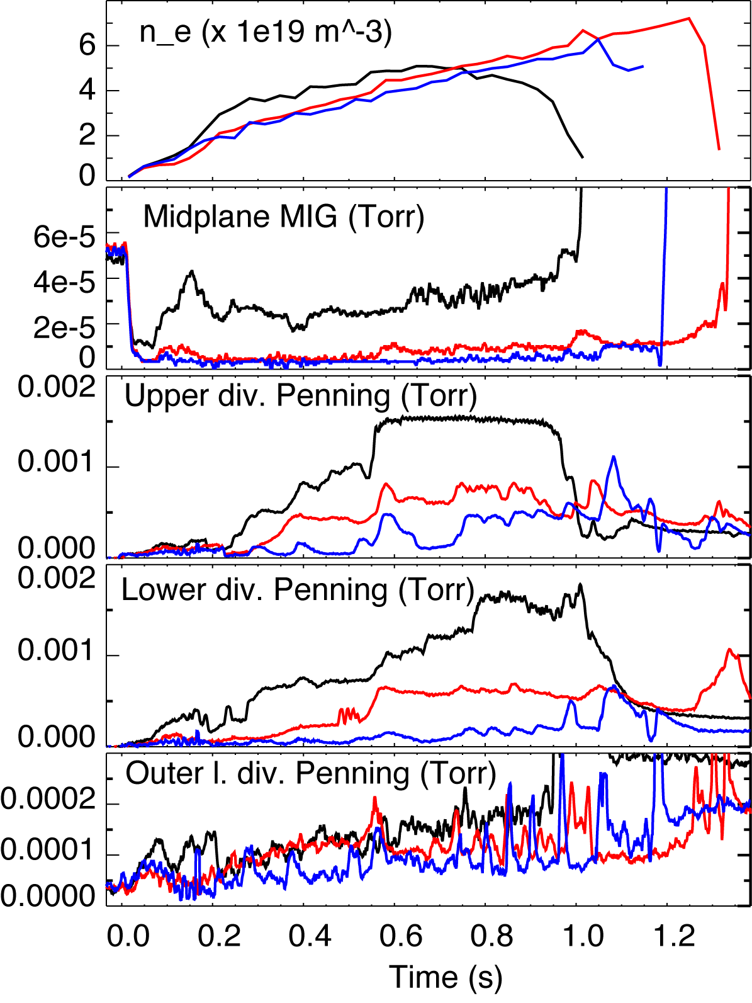



Neutral pressures in SOL and divertor were reduced after lithium application
No lithium (129013)
190 mg Lithium (129061)
600 mg lithium (129064)
“Standard” way to estimate
molecular / atomic fluxes from pressure neutral measurements
Might be about factor of 2-3 overestimated (from MC simulations and / or kinetic simulations)

Slide 11
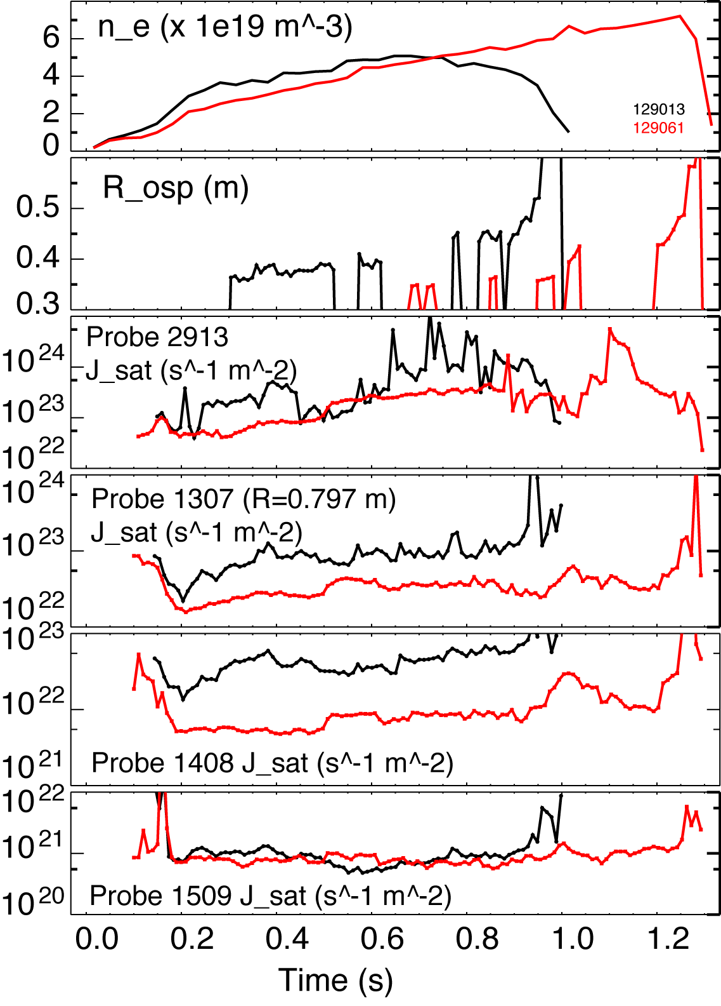


Ion outflux is measured by Langmuir probes
No lithium (129013)
190 mg Lithium (129061)
Tile Langmuir probes are flush-mounted
Main computational effort is to calculate α’s accurately for shallow angles
(α < 1−2^{ο})
On center stack, apparently large error bars in α’s

Slide 12
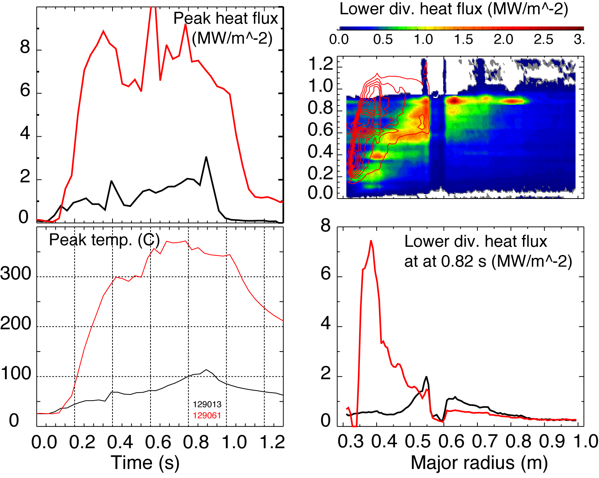
Divertor heat flux measurements are complicated by lithium coatings
Instrumental effects:
  Thermal contact between lithium coating and bulk tile
  Surface emissivity reduction
Plasma effects:
  Higher heat flux?
Lithium melting T= 186º C
No lithium (129013)
190 mg Lithium (129061)

Slide 13
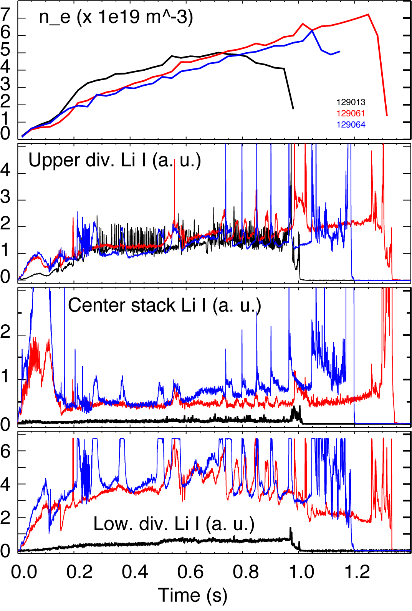
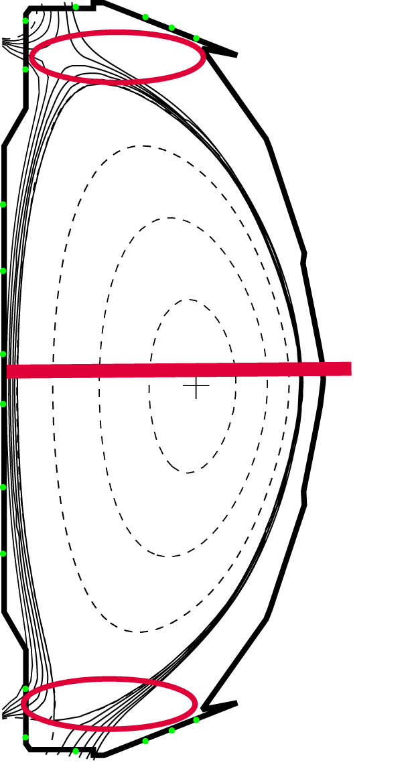
Lithium spectroscopy indicates higher lithium deposition on lower divertor and center stack
Li I λ670 nm emission increase
  x 10 in lower divertor
  x 2-3 on center stack
  little increase in upper divertor
No systematic signs of accumulative effects
No lithium (129013)
190 mg Lithium (129061)
600 mg lithium (129064)

Slide 14
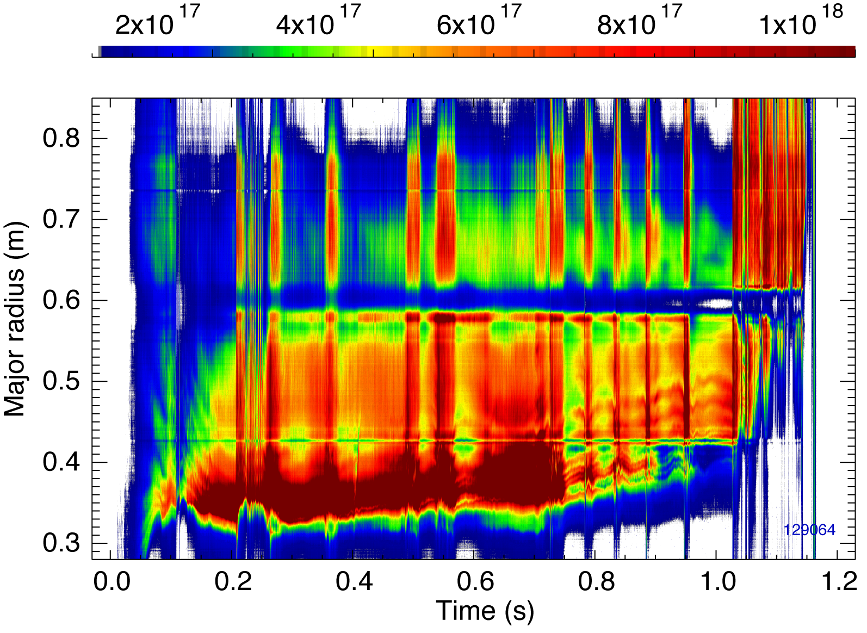
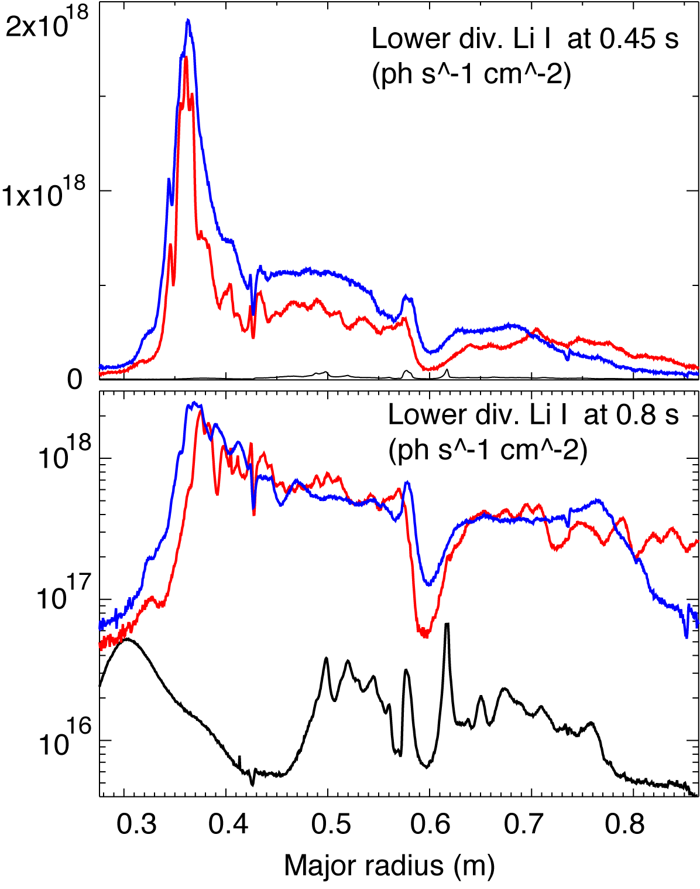
Li I emission profiles are highly peaked suggesting lithium melting in strike point region
No lithium (129013)
190 mg Lithium (129061)
600 mg lithium (129064)

Slide 15
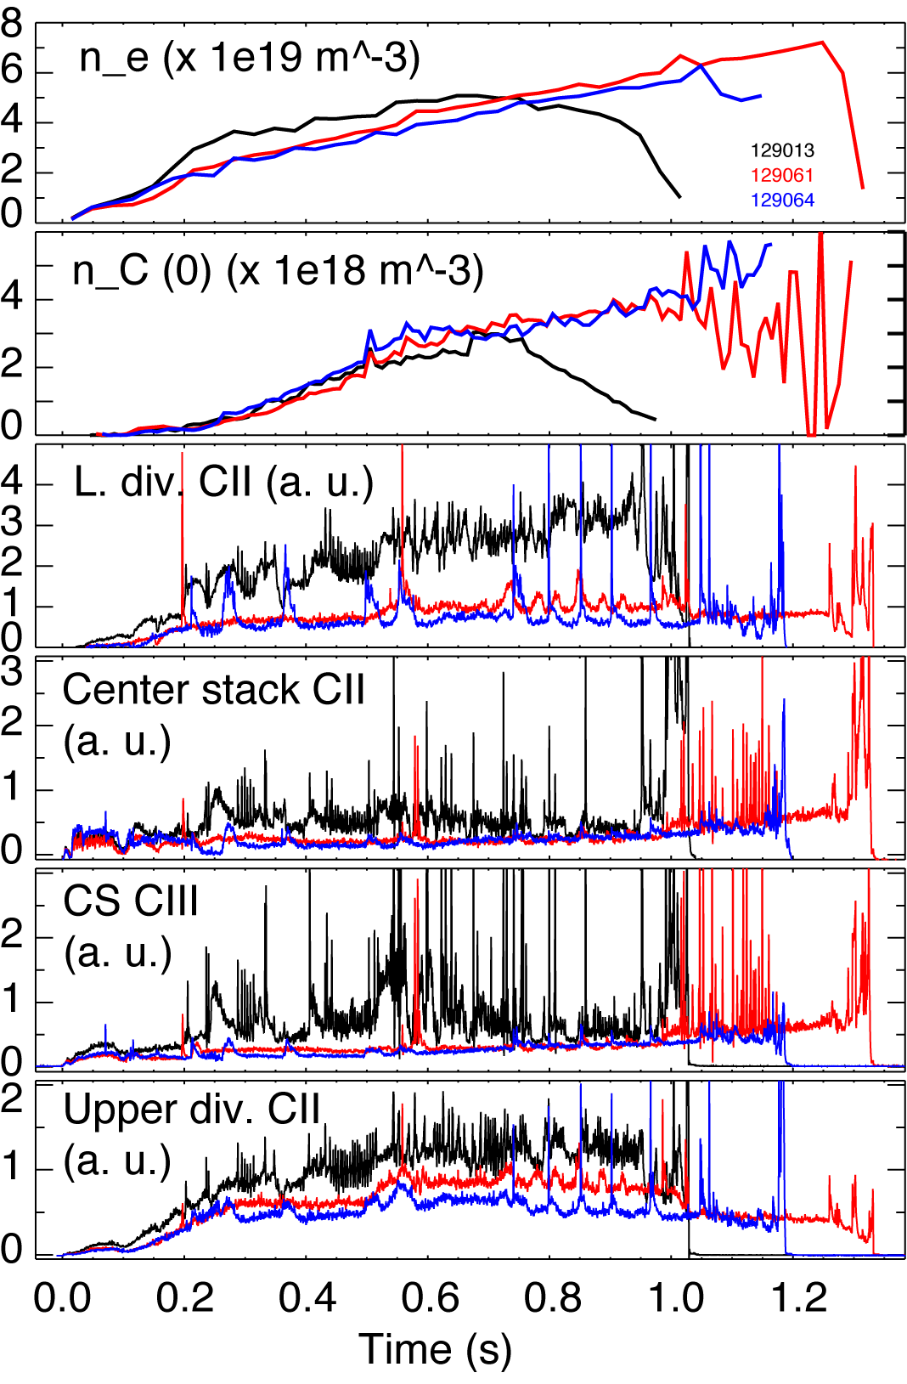
Reduction of carbon emission may suggest carbon source reduction w/ lithium
C II emission reduction
  x 2-3 in lower divertor
  x 2 on center stack
  x 1.5-2 in upper divertor
C II anticorrelated with core C density
Appears to be accumulative effect
No lithium (129013)
190 mg Lithium (129061)
600 mg lithium (129064)

Slide 16
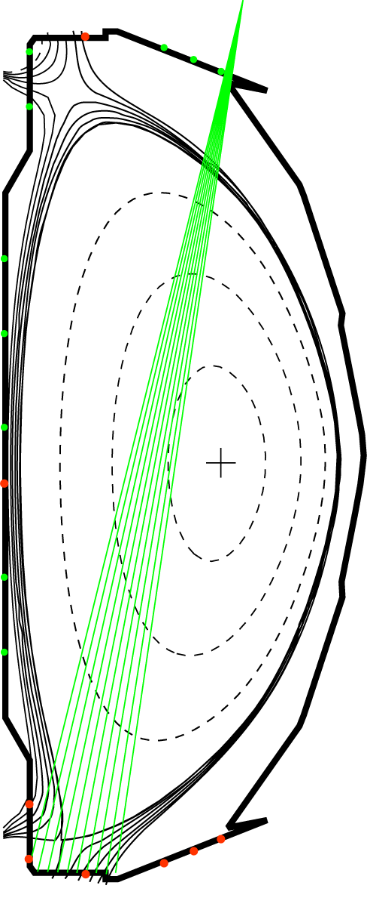
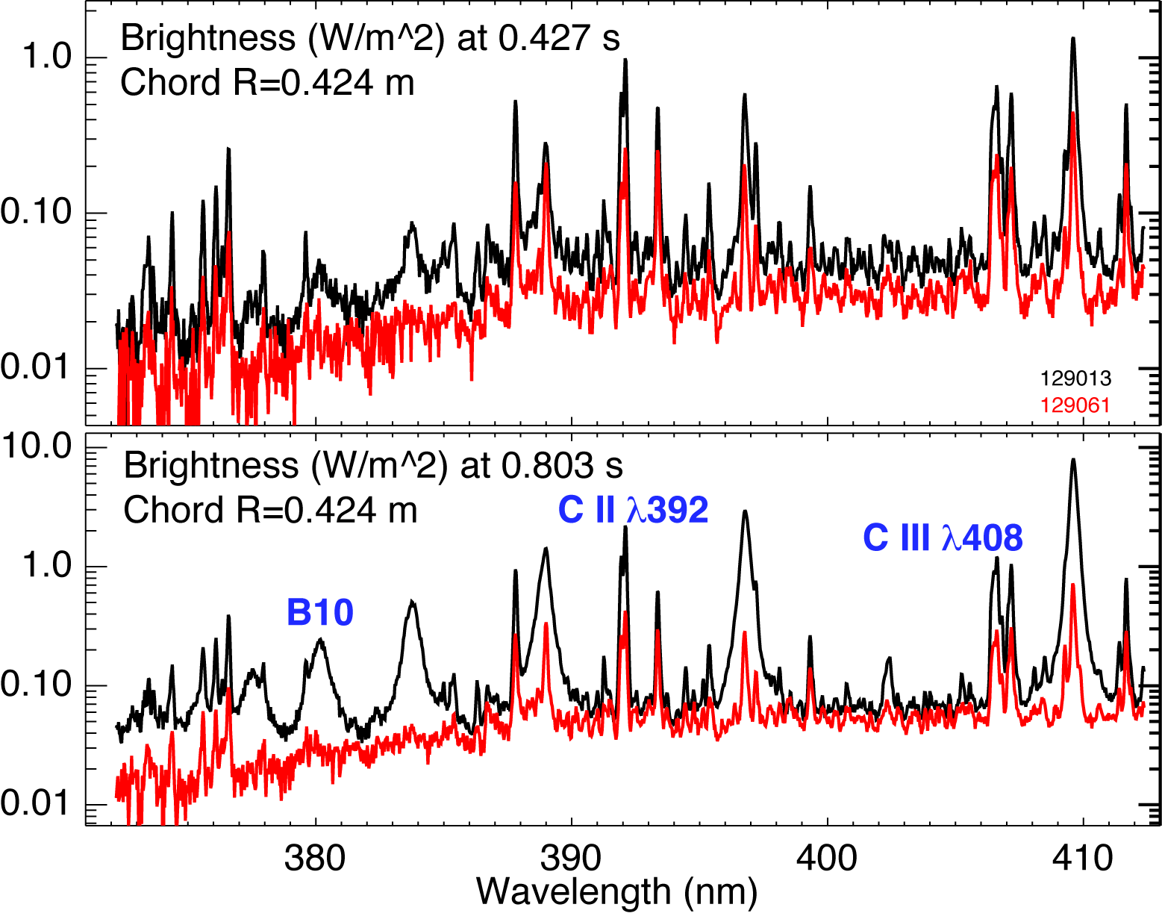
Divertor spectroscopy shows reduction in impurity emission and reduction in n_{e}
No lithium (129013)
190 mg Lithium (129061)
Lines in spectra
  C III λ408 nm
  DI Balmer series n=2 - 6…12
  C II λ392 nm (3p ²P - 4s ²S)
  O I, O II, O III lines
  LiD molecular band emission in the region 330-470 nm (A¹Σ⁺ - X¹Σ⁺)

Slide 17
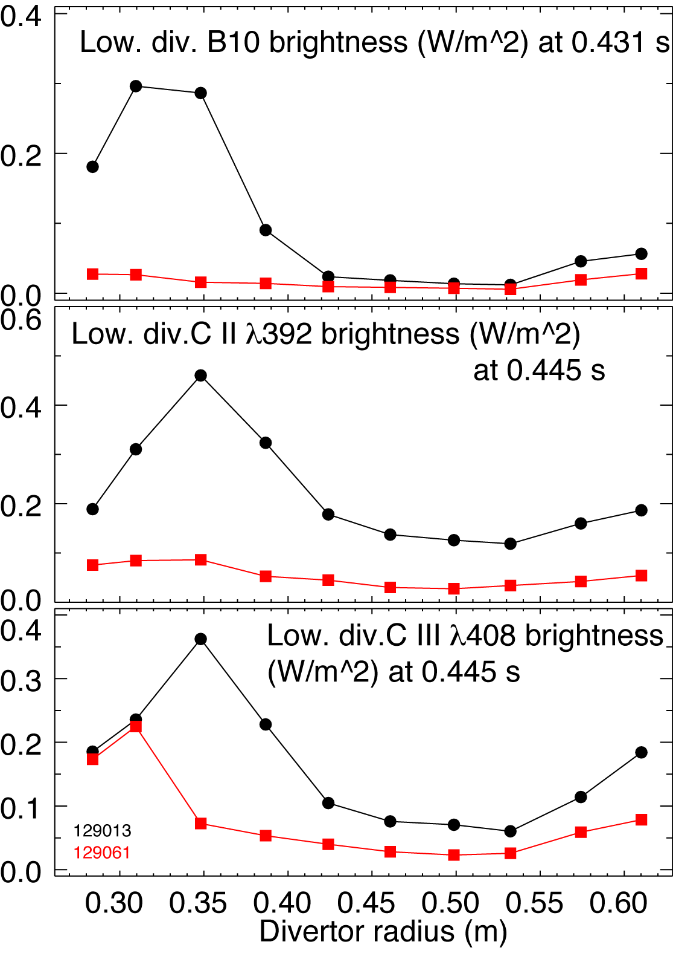
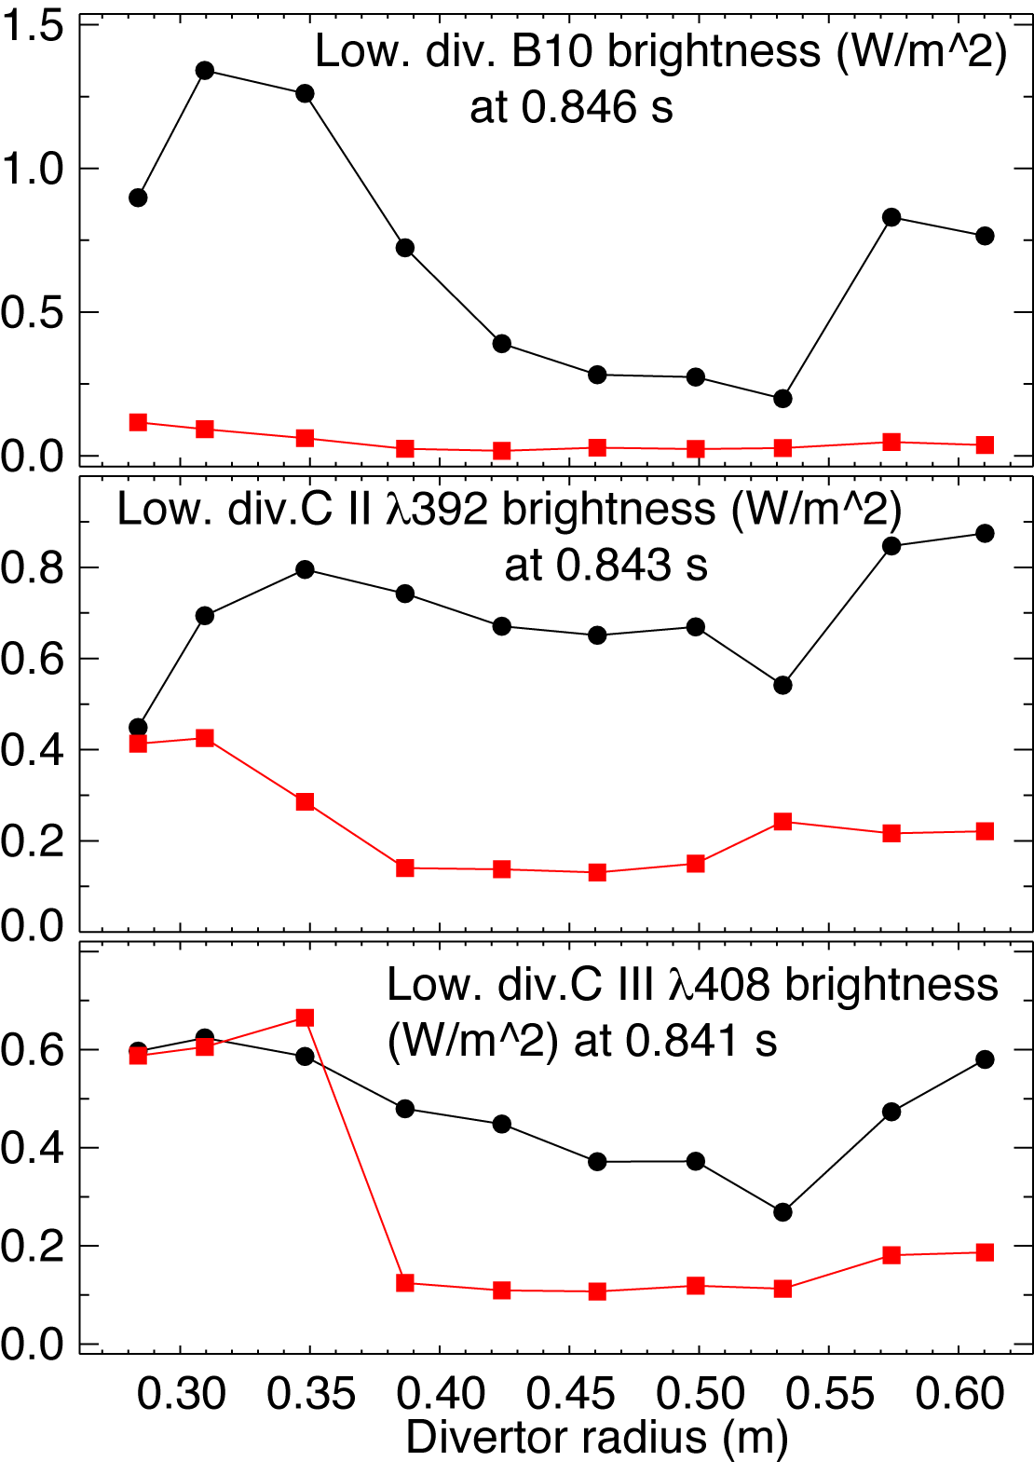
Divertor profiles suggest significant reduction in n_{e} and an increase in T_{e}
No lithium (129013)
190 mg Lithium (129061)

Slide 18
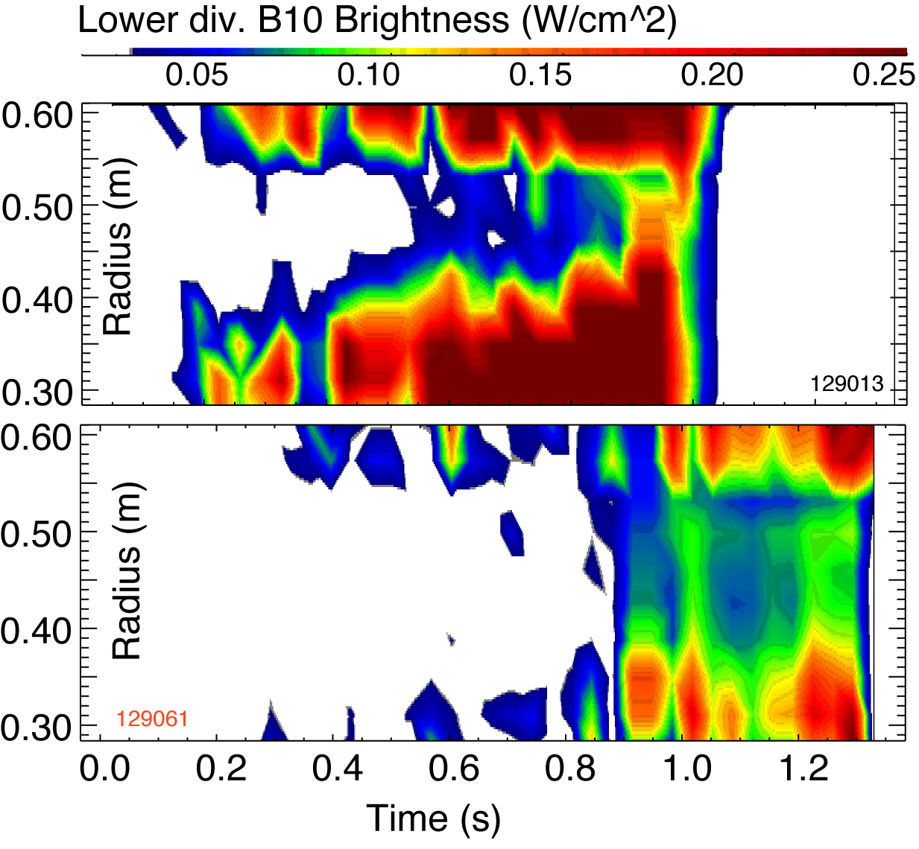
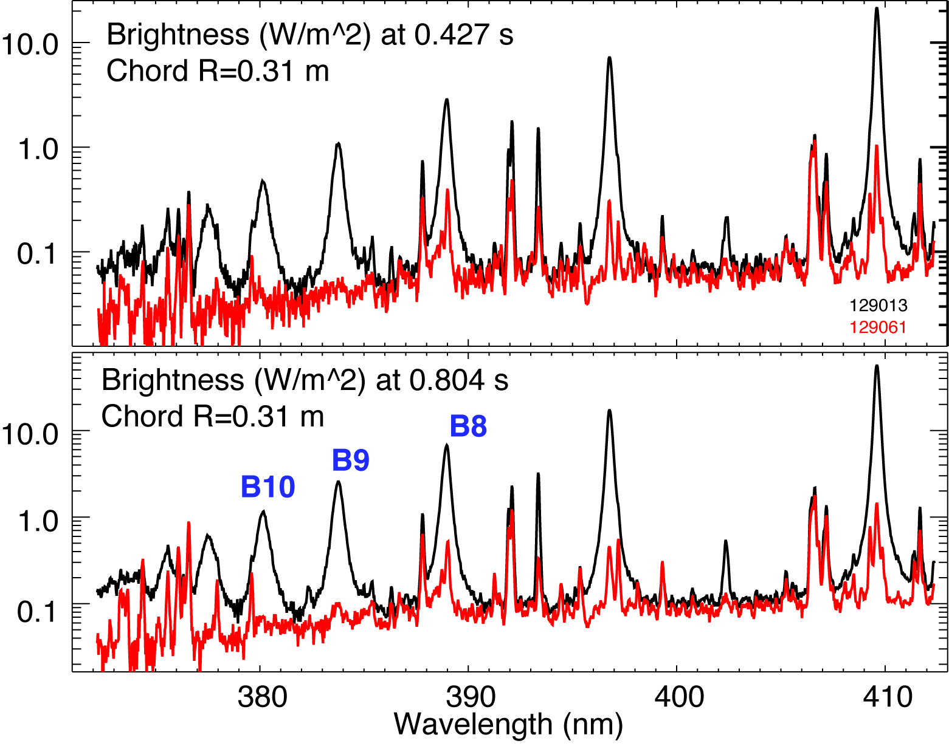
Lithium coatings reduced divertor density, eliminated X-point MARFEs and re-attached inner divertor SP
Poster PP8.00042: Modeling of Balmer series deuterium spectra with the CRETIN code for diagnosing the inner divertor re-attachment threshold in NSTX discharges with lithium coatings, F. Scotti et. al
No lithium (129013)
190 mg Lithium (129061)
600 mg lithium (129064)

Slide 19
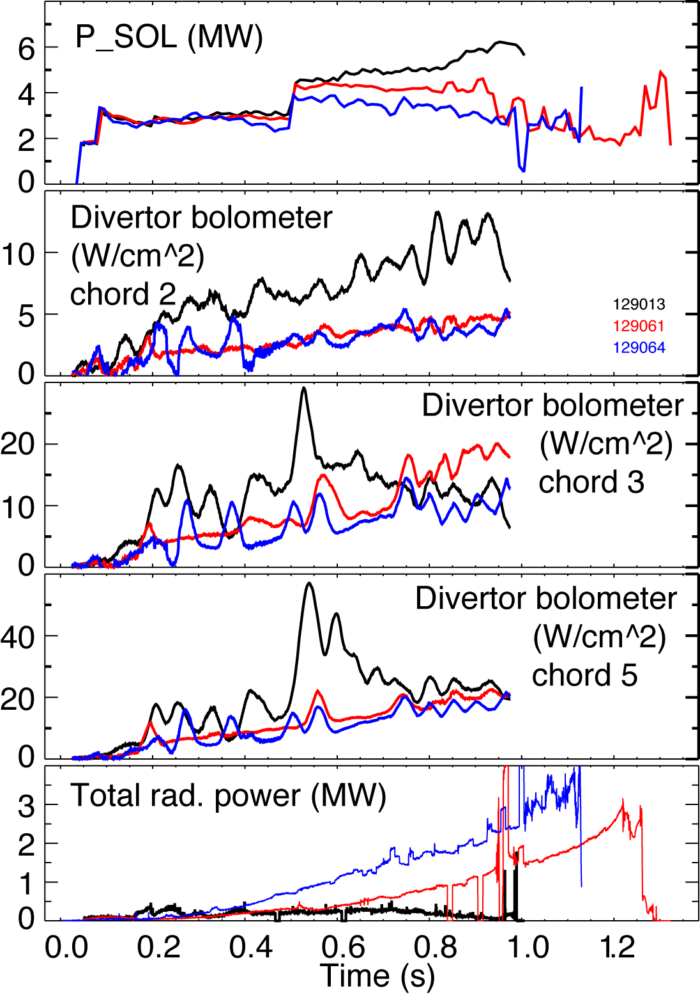
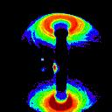
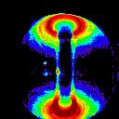
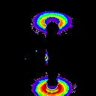
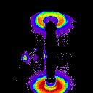
Divertor radiation was significantly reduced in discharges with lithium coatings
No lithium (129013)
190 mg Lithium (129061)
600 mg lithium (129064)
Unfiltered camera images at 0.450 s and 0.800 s

Slide 20
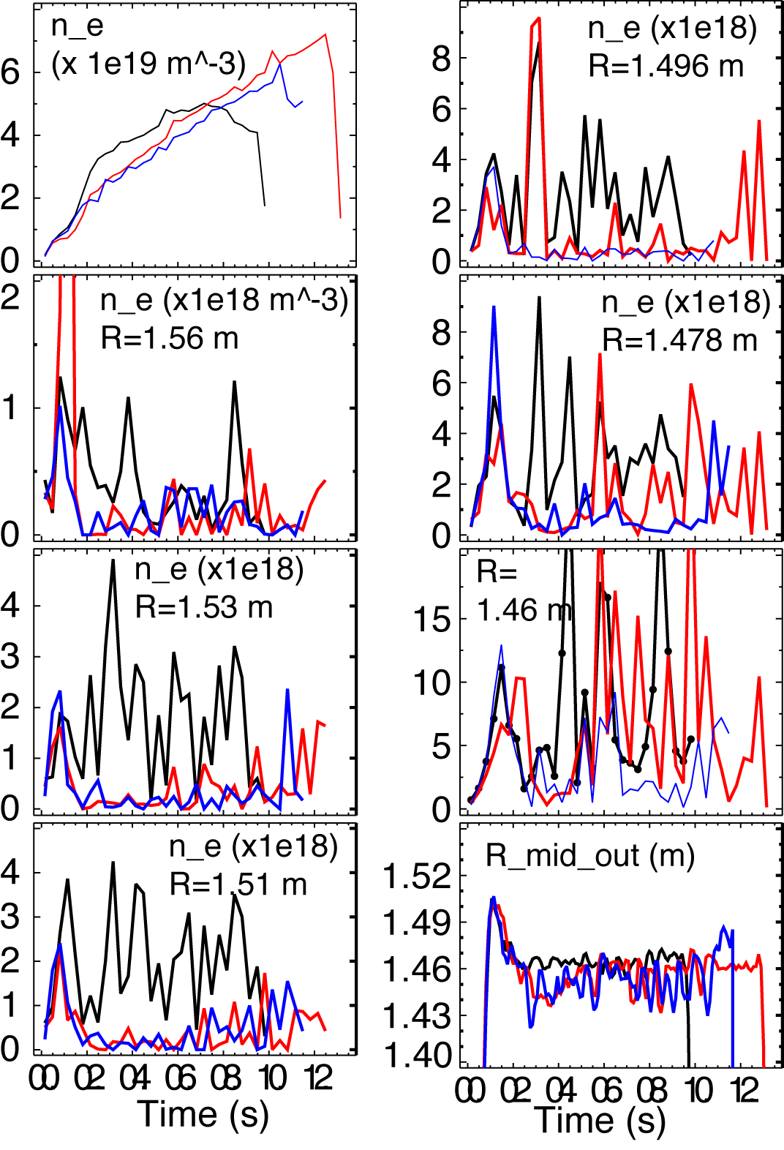
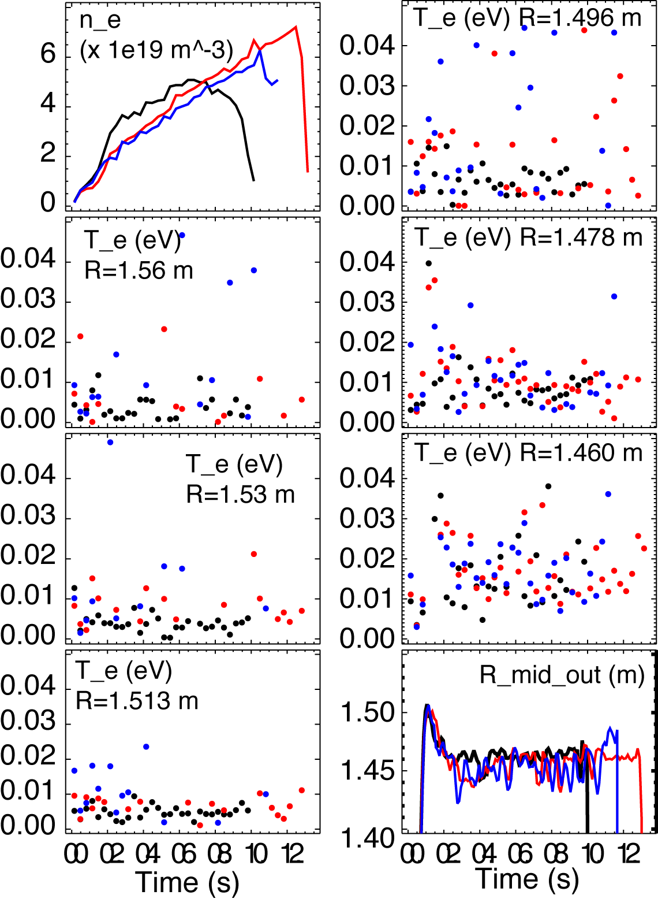
Midplane SOL T_{e} increased and n_{e} decreased with lithium coatings
No lithium (129013)
190 mg Lithium (129061)
600 mg lithium (129064)

Slide 21
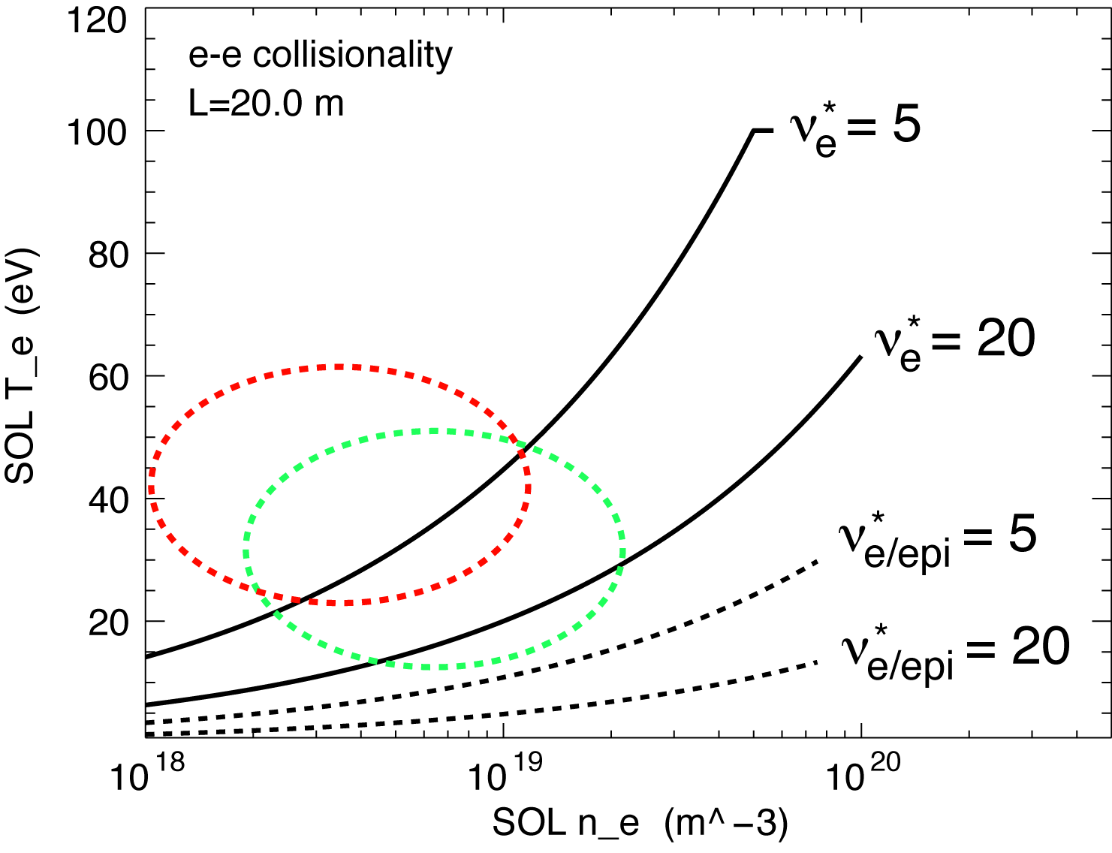
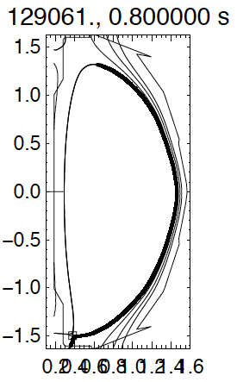
SOL collisionality decreased with lithium
with Lithium
no Li
Transition from conduction-limited (high recycling) regime to low-recycling (sheath-limited)

Slide 22




S/XB technique is used to estimate particle influx from spectroscopic measurements
Technique originally developed by L. C. Johnson & E. Hinnov, and further by A. Kallenbach
Used for deuterium and impurities
1D viewing geometry
x1- recycling / erosion boundary, x2 - detector location
Recombination neglected
Excitation and ionization occur in the same volume
Steady-state condition

Slide 23
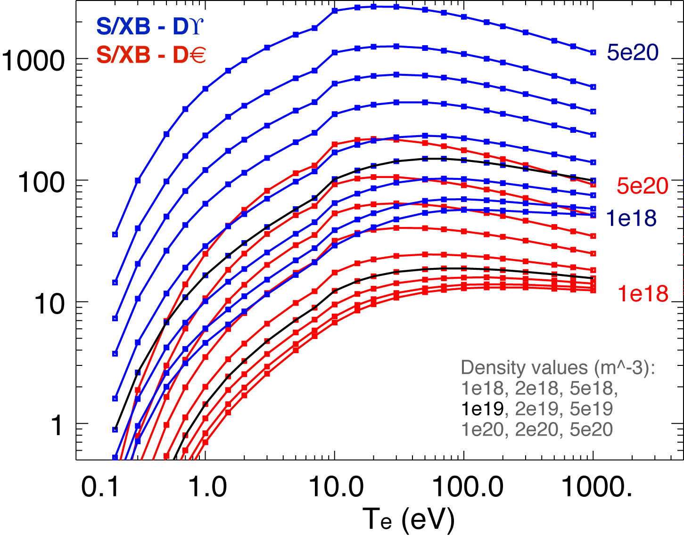
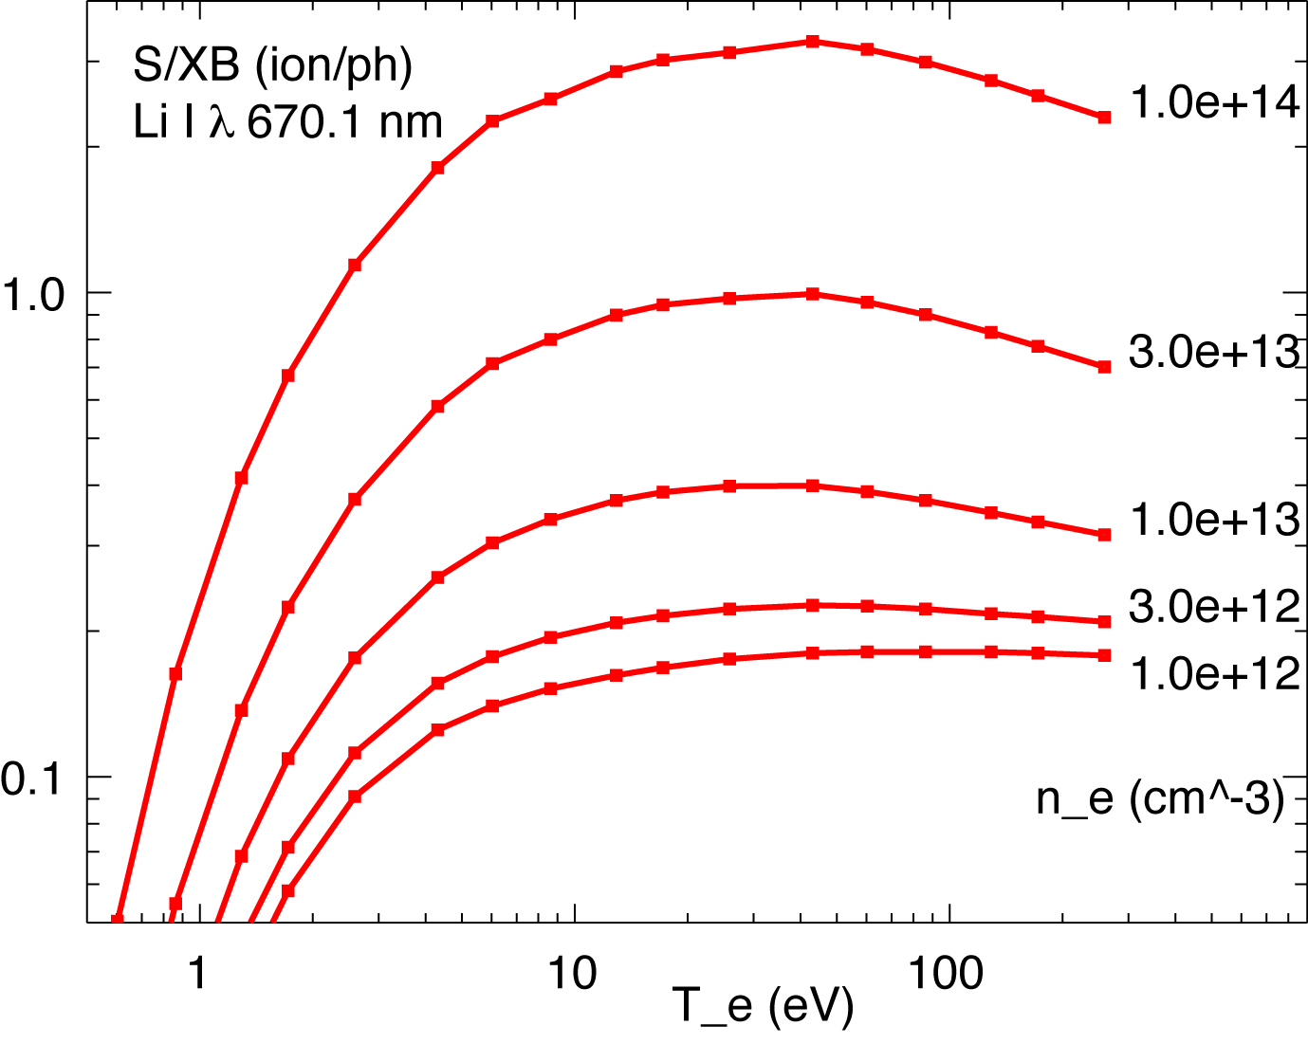
ADAS S/XB factors are used
ADAS database use courtesy of ORNL Controlled Fusion Atomic Data Center (CFADC)
D_{β}
D_{α}
Li I S/XB factors
  - very weak T_{e} dependence
  - strong n_{e} dependence
D_{α}, D_{β} S/XB – weak T_{e} and n_{e} dependence

Slide 24
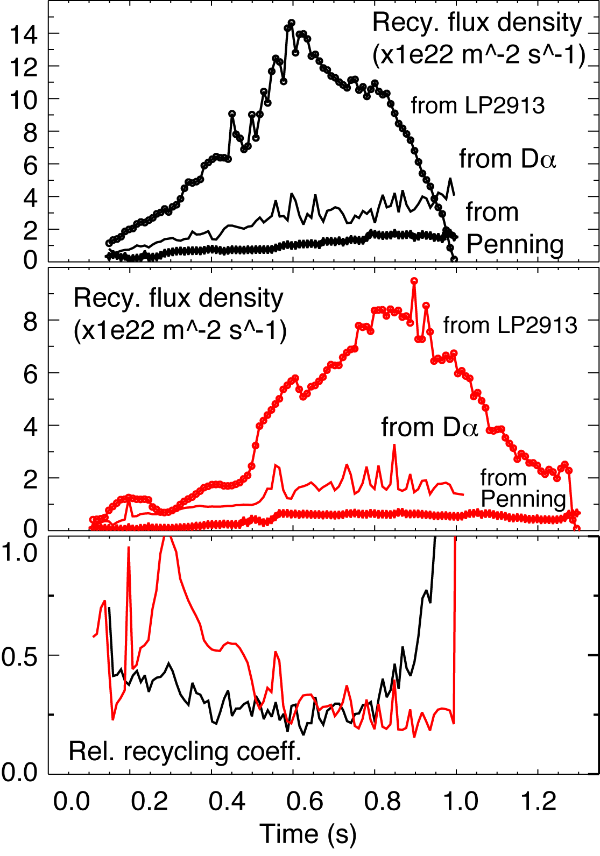
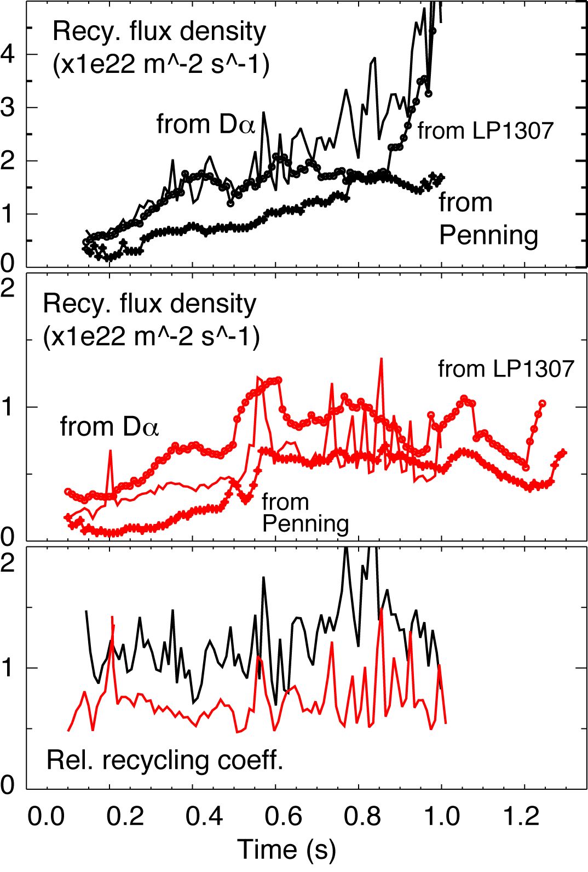
Estimates of particle fluxes suggest local recycling coefficient reduction in SOL but not at strike point
No lithium (129013)
190 mg Lithium (129061)

Slide 25
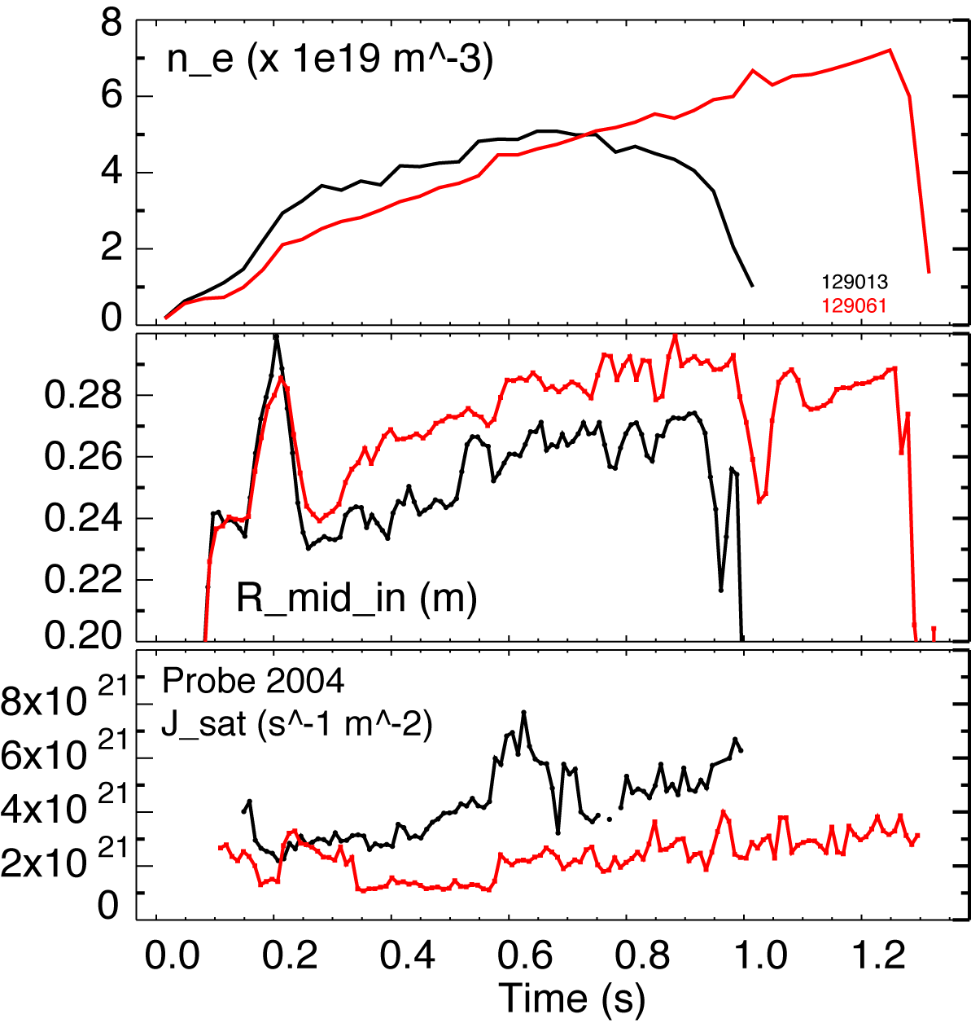
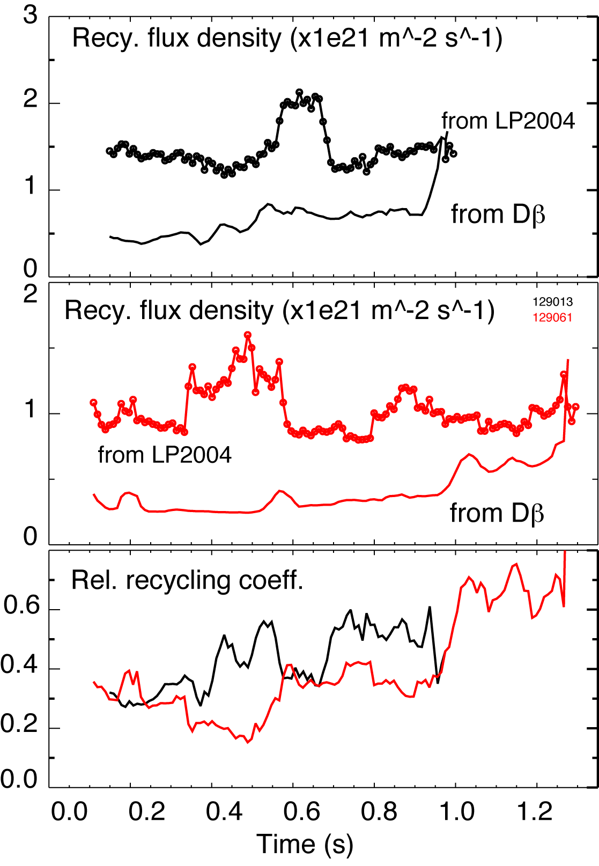
Estimates of particle fluxes suggest local recycling coefficient reduction on center stack
No lithium (129013)
190 mg Lithium (129061)

Slide 26
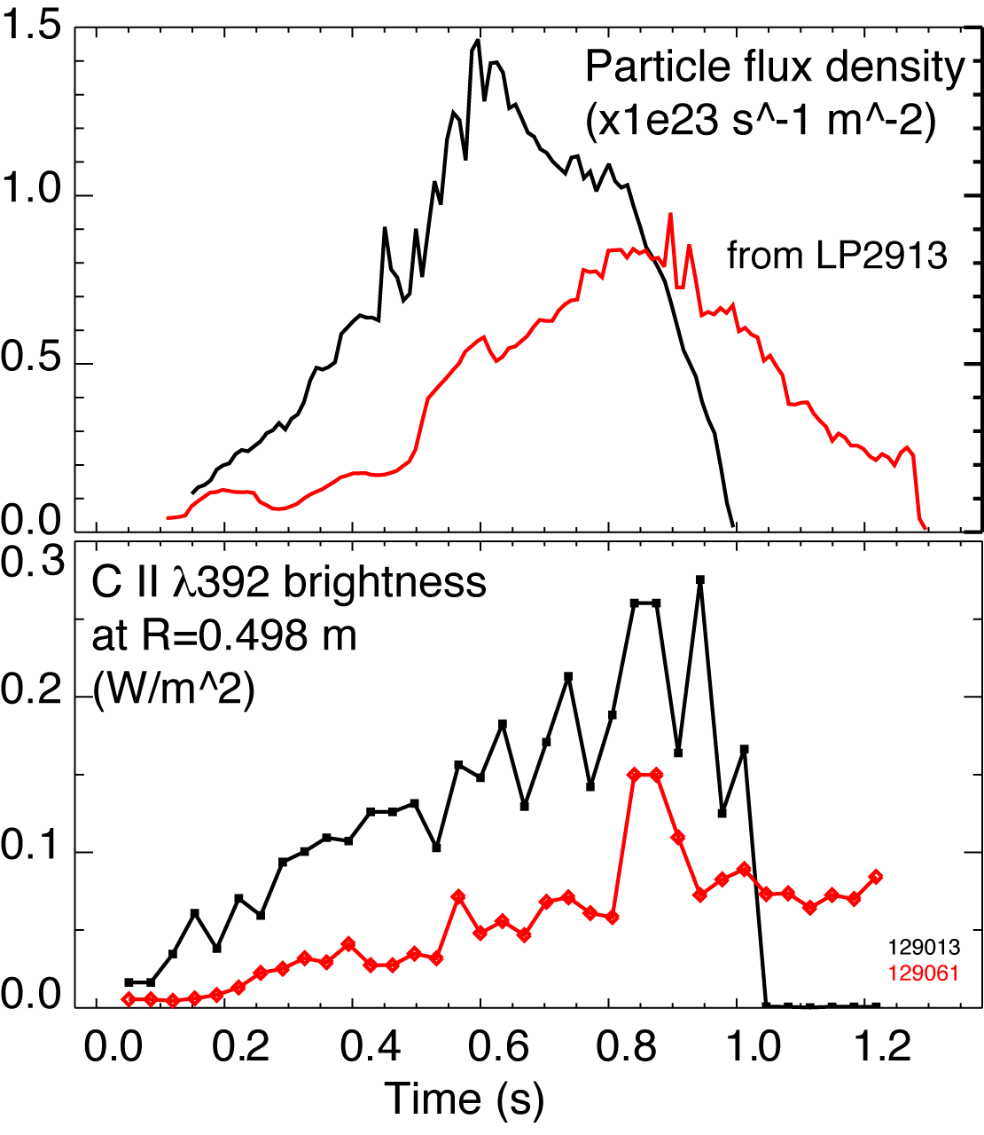
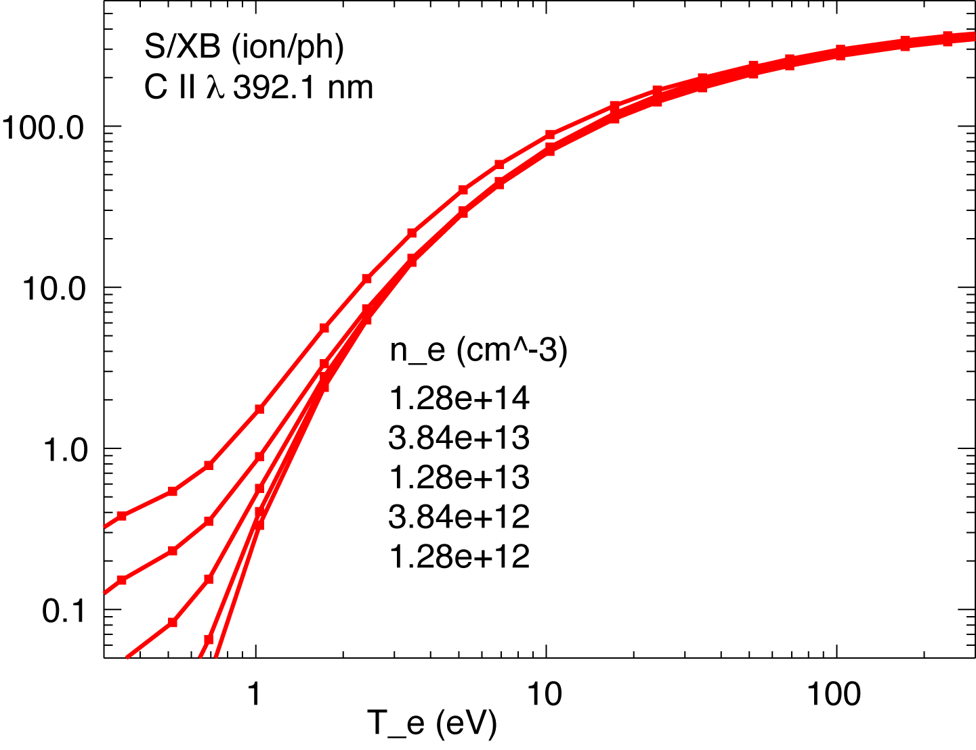
Spectroscopic measurements suggest that divertor physical sputtering yield for carbon does not increase
No lithium (129013)
190 mg Lithium (129061)

Slide 27
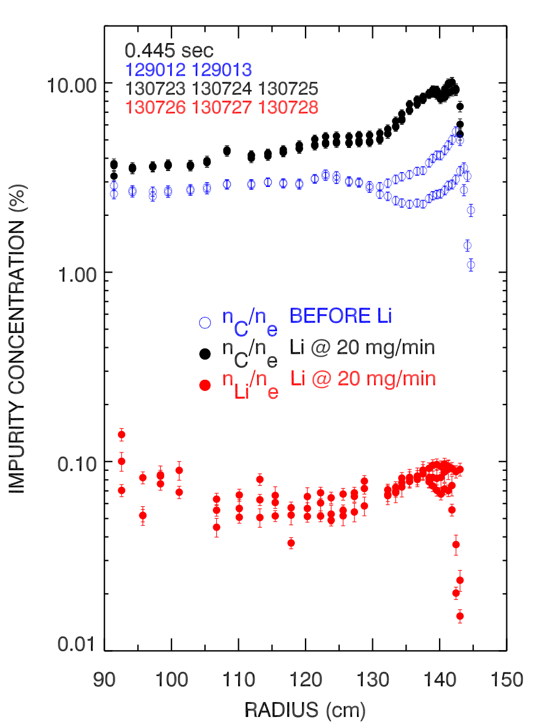
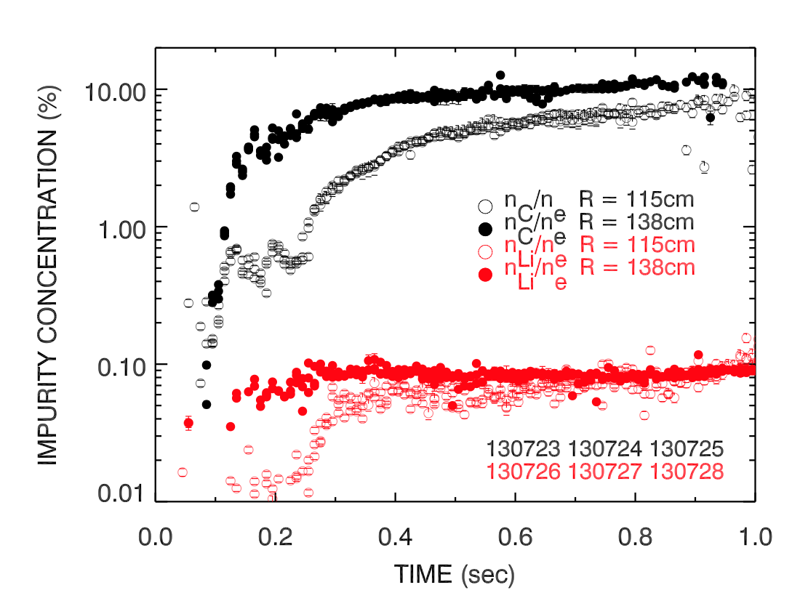
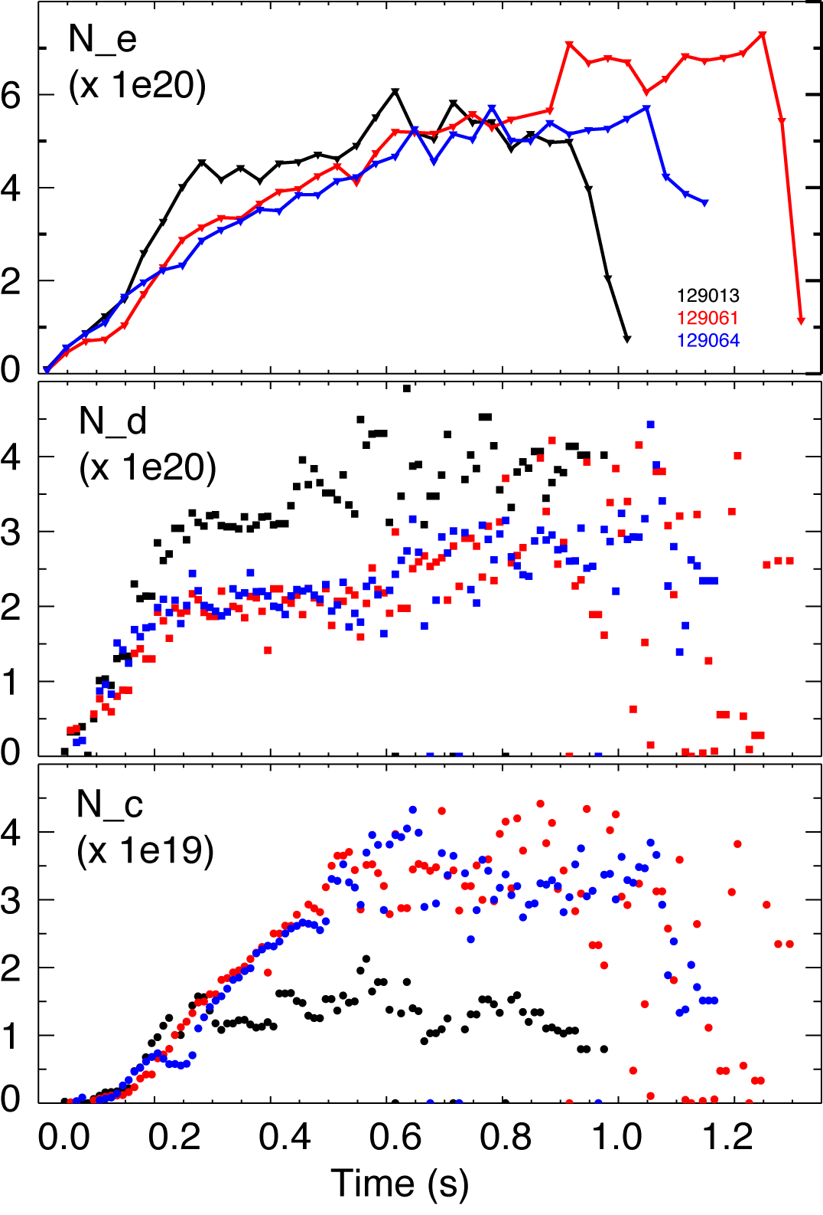
Ion inventory is well controlled in discharges with lithium, core carbon accumulates, lithium is screened out
ion
Impurity density profiles from CHERS
  C VI, n = 8-7 transition, 529.1 nm
  Li III, n = 7-5 transition, 516.7 nm
Lithium concentration much lower than carbon concentration
  n_{C}/n_{Li} ~ 100
Carbon increases with Li evaporation
No lithium (129013)
190 mg Lithium (129061)
600 mg lithium (129064)

Slide 28
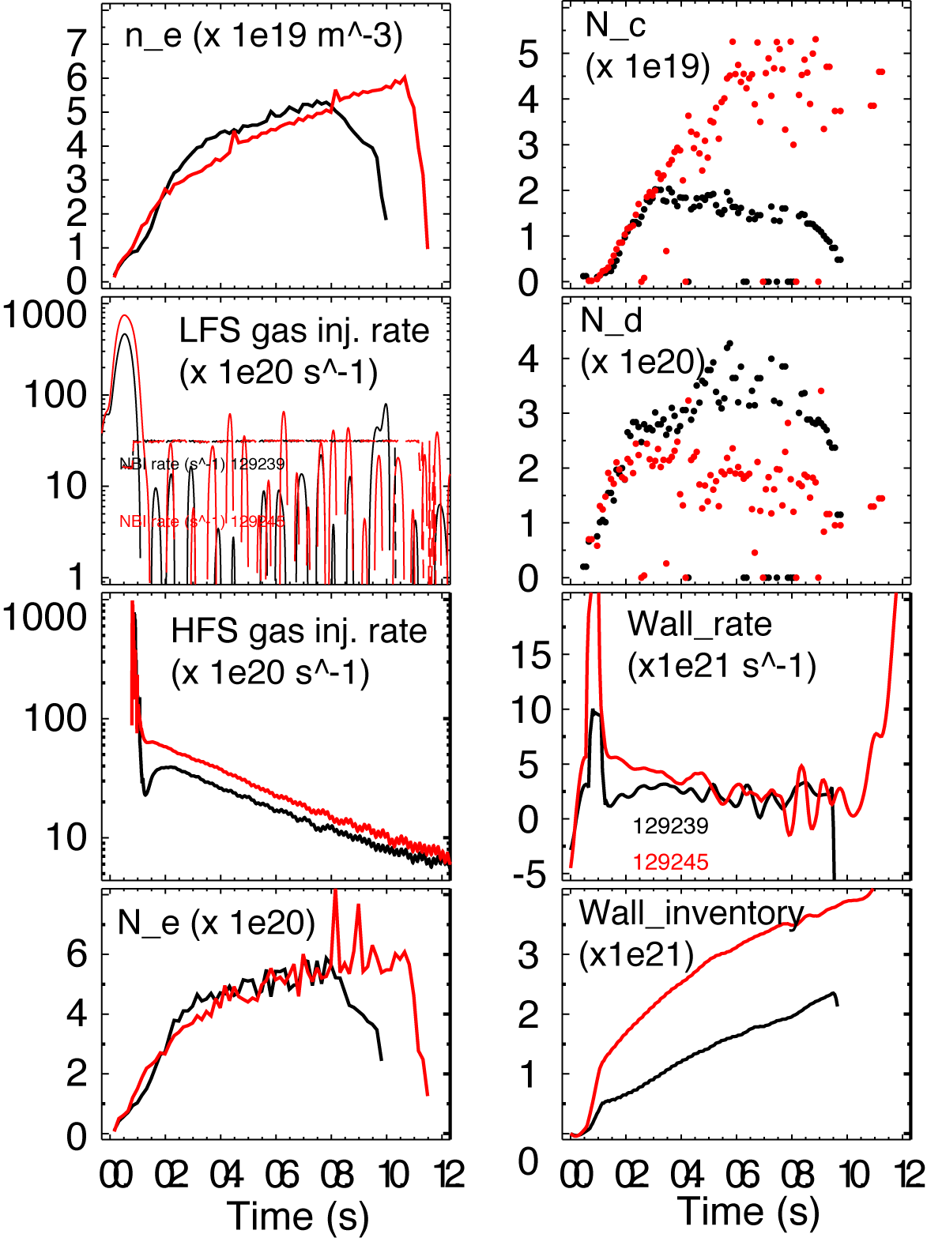
Dynamic particle balance model indicates strong pumping by lithium
Change of
particle
inventory
Gas feed rate
NBI fueling
rate
NBI cryopump
rate
Wall fueling or pumping rate
TM pump rate
Neutral gas buildup rate
Ion density
No lithium (129013)
190 mg Lithium (129061)
Fueling efficiency
Rewrite global particle balance equation as:

Slide 29
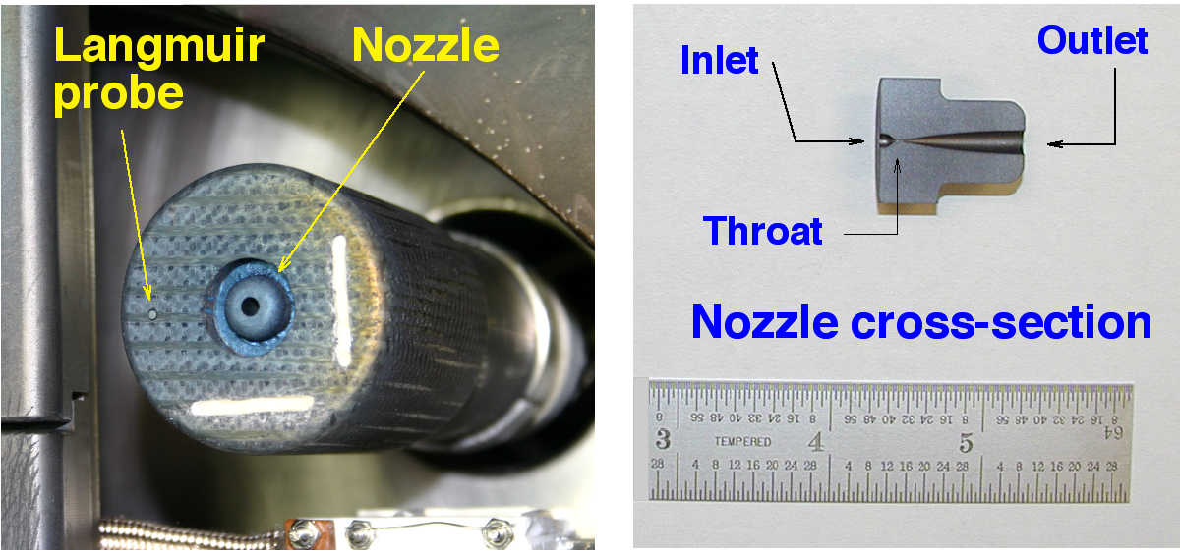
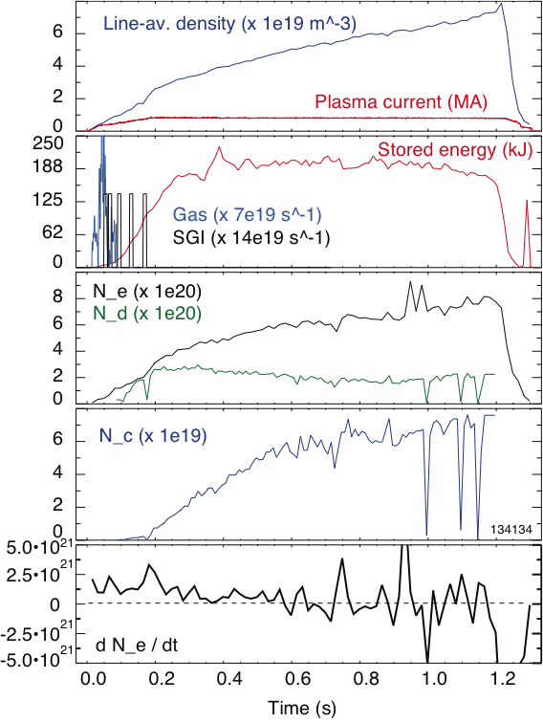
A long pulse H-mode discharge scenario with SGI fueling and controlled N_{i} was developed
Used SGI-only fueling
LITER rate 6-9 mg/min
Ion density control
N_{i} constant, while N_{e} is rising due to carbon
SGI=Supersonic gas injector
Constant N_{i}

Slide 30
UEDGE modeling reproduces many features of the observed low-recycling divertor regime
Poster PP8.00041: Modeling of low-recycling divertor with lithium coating in NSTX, by R.D. Smirnov, A.Yu. Pigarov et. al
In the UEDGE model of low-recycling regime
  Small parallel T_{e} gradients
  Relatively high divertor T_{e} and low n_{e}
  Small particle (ion) flux to divertor plates, i.e., external fueling dominates
  Lithium sputtered and evaporated in the divertor is retained in the divertor region
Parallel profiles of electron
temperature along separatrix
OMP
OSP

Slide 31
UEDGE model of low-recycling divertor with lithium predicts high divertor heat flux
Radial profiles of the heat load
to the outer divertor plate
Heat in the SOL is carried by the electron conduction
The profile narrows in the low-recycling regimes due to faster parallel transport
In the low-recycling regime, the peak heat flux to outer plate can be high enough to melt Li around the strike point
Input plasma power 3MW

Slide 32
Comparison with cryo-pumps
Cryo-pumping (e.g., DIII-D experience)
  Significant in-vessel hardware modifications
  Inflexibility in plasma shaping due to the need of proximity to strike point
  Calibrated pumping rate
  Demonstrated density control
  Compatibility with radiative divertor
Lithium coatings on graphite PFCs (NSTX LITER experience)
  Flexibility in plasma shaping
  Need for operational scenario development for each pumping and fueling rate
  Multiple side effects (good and bad) on plasma core and edge

