Slide 1
Correlation between Electron Transport and Shear Alfvén Activity in NSTX
D. Stutman, N. Gorelenkov, L. Delgado, S. Kaye, E. Mazzucatto, K. Tritz
and the NSTX Team

Slide 2
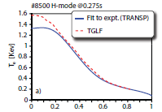
Talk outline
Puzzle: T_{e} flattens, central χ_{e} increases in NSTX H-mode
as P_{NB} increases
Effect possibly apparent also in MAST (Akers 08)
Low frequency MHD not the cause for T_{e} flattening:
- Negligible NTM-TAEs after t > 0.4-0.5 s
- No internal reconnections or large ELMs
Flattening of the fast ion profile not the cause either:
- Assuming flat FI profile neutrons decrease strongly, χ_{e} changes little
- Fast ion data support peaked FI profile, no anomalies in NPA spectra
- Electron/ion heating partition dominantly classical (at high n_{e} T_{i}≈T_{e}, χ_{i} ≈ χ^{neo})
Perturbative experiments also confirm rapid central electron transport at high P_{NB}
T_{e} flattening is genuine electron transport effect
NSTX
MAST

Slide 3
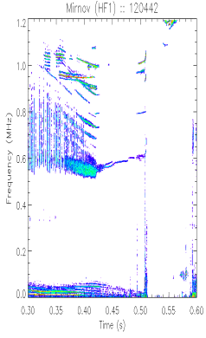
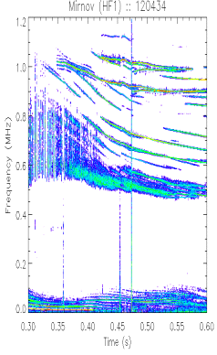
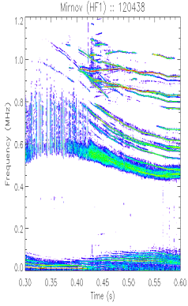
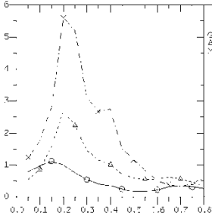
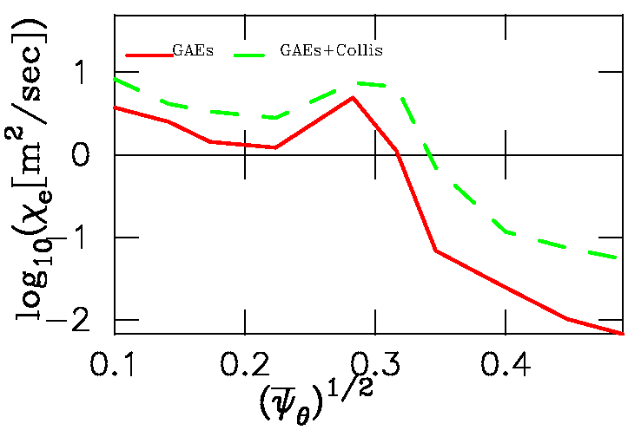
What drives rapid central electron transport?
- D_{neon}, χ_{i} ≈ neoclassical -> no low-k turbulence
- µ-wave scattering shows also no high-k turbulence
- GS2 shows central gradients too low for any instability
- Fast ion gradients only free energy source
- Broadband, central GAEs in high P_{b} NSTX H-modes
Experiments on GAE/electron transport connection
- P_{NB} changes at fixed q, n_{e}, ω_{ExB}
- V_{NB} changes (+µ-wave interferometry for GAE amplitude)
Flat T_{e}, large central χ_{e} consistently correlate with GAE level
Correlation seen also in in L-modes
Interplay between GAE and gradient driven (ETG) transport
Theoretical support (N. Gorelenkov):
GAEs can resonantly perturb electron trajectories
to form phase space "islands"
- Multiple islands can overlap and produce stochastic transport
GAE amplitude seems sufficient for observed transport
More detailed GAE characterization in 2009 XP (K. Tritz)
One possible explanation for flat T_{e} inside tokamak ITBs
Likely impact for ST-CTF, burning plasma
f (MHz)
2 MW
4 MW
6 MW
1.0
0.8
n=3
-
GAEs
5
0.6
0.4
pre
n=7
0.2
heat
0.4
0.5
0.4
t (s)
0.5
0.4
0.5
60
χ
(
m
2
/s)
e
40
20
0.0
0.2
0.4
0.6
0.8
r/a
ORBIT χ_{e}

