Slide 1




NSTX-U
Supported by
Overview of Results and Analysis from the National Spherical Torus Experiment
S. A. Sabbagh
Columbia University
for the NSTX-U Research Team
Coll of Wm & Mary
Columbia U
CompX
General Atomics
FIU
INL
Johns Hopkins U
LANL
LLNL
Lodestar
MIT
Lehigh U
Nova Photonics
ORNL
PPPL
Princeton U
Purdue U
SNL
Think Tank, Inc.
UC Davis
UC Irvine
UCLA
UCSD
U Colorado
U Illinois
U Maryland
U Rochester
U Tennessee
U Tulsa
U Washington
U Wisconsin
X Science LLC
Culham Sci Ctr
York U
Chubu U
Fukui U
Hiroshima U
Hyogo U
Kyoto U
Kyushu U
Kyushu Tokai U
NIFS
Niigata U
U Tokyo
JAEA
Inst for Nucl Res, Kiev
Ioffe Inst
TRINITI
Chonbuk Natl U
NFRI
KAIST
POSTECH
Seoul Natl U
ASIPP
CIEMAT
FOM Inst DIFFER
ENEA, Frascati
CEA, Cadarache
IPP, Jülich
IPP, Garching
ASCR, Czech Rep
54th Meeting of the APS Division of Plasma Physics
October 30th, 2012
Providence, Rhode Island
V1.4s

Slide 2
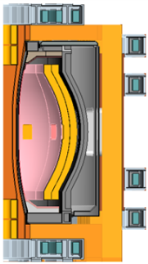
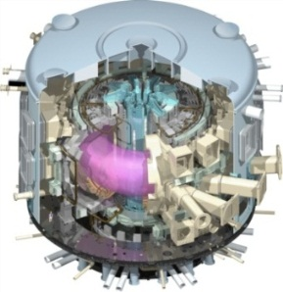
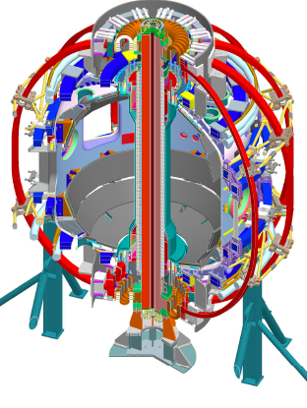
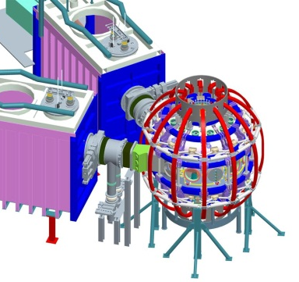
NSTX research targets predictive physics understanding needed for fusion energy development facilities
Enable devices: ST-FNSF, ST-Pilot/DEMO, ITER
  Leveraging unique ST plasmas provides new understanding for tokamaks, challenges theory
Fusion Nuclear Science Facility (FNSF)
ST Pilot Plant
Outline
ITER
Develop key physics understanding to be tested in unexplored, hotter ST plasmas
  Study high beta plasma transport and stability at reduced collisionality, for extended pulse
  Prototype methods to mitigate very high heat/particle flux
  Move toward fully non-inductive operation
NSTX-U
New center-stack
2nd neutral beam
B_{T}
I_{p}
0.5
1 T
P_{NBI}
pulse
6
12 MW
1
2 MA
1
5 s

Slide 3
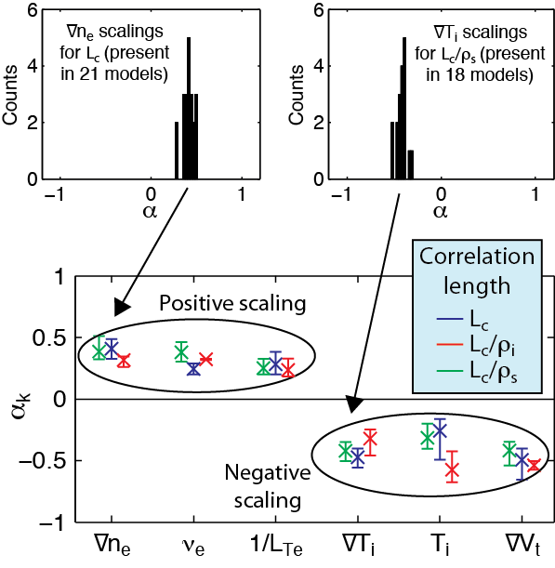
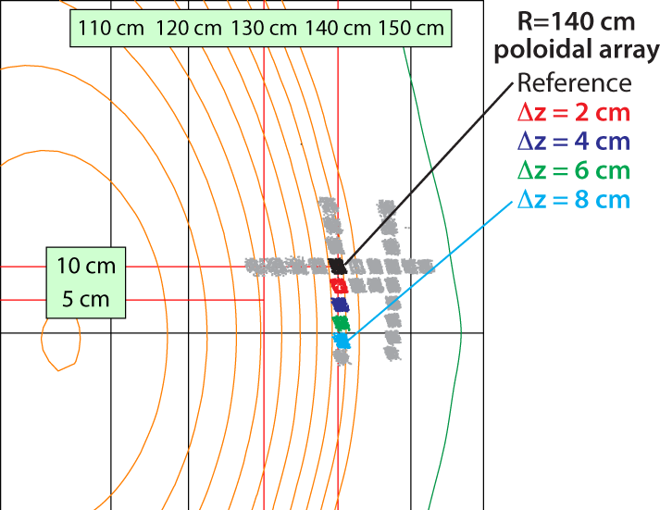
BES measured low-k turbulence in ELM-free H-mode pedestal steep gradient region is most consistent with TEMs
Beam emission spectroscopy (BES) array
Poloidal Correlation Length vs. Parameters
Z
R
Measurements during MHD quiet periods, in steep gradient region
  k_{θ} ≈ 0.2-0.4 cm⁻¹ and k_{θ}ρ_{i} ≈ 0.2
Large poloidal correlation lengths
  L_{c} ≈ 10 ρ_{i}
Multivariate linear scaling coefficients α_{k}
  Fitting results are robust
  Scalings are most consistent with Trapped Electron Modes
Smith YI3.04 (Invited – Friday)

Slide 4
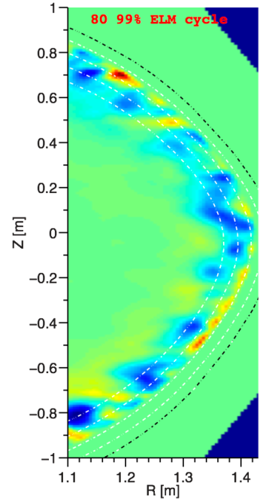

Pedestal width scaling differs from other devices; turbulence correlation measurements consistent with theory
Pedestal width scaling
Turbulence correlation lengths
0.16
  (During inter-ELM period, at pedestal top)
Theory
(non-linear XGC1 code)
0.4 (β_{θ}^{ped})
^{1.05}
NSTX
3 cm | 2 – 4 cm (reflecto-metery)
11 cm | 10 – 14 cm (BES)
0.12
Experiment
Pedestal width (ψ_{N})
C-Mod
0.08
radial
DIII-D
0.04
poloidal
~ 0.08 (β_{θ}^{ped})
^{0.5}
0.00
R = 1.38m
80% - 99% ELM cycle
0.1
0.3
0.5
0.7
0.9
139047
Pedestal width scaling β_{θ}^{α} applies to multiple machines
In NSTX, observed ped. width is larger
  Data indicates stronger scaling: β_{θ} vs. β_{θ}^{0.5}
  Initial ballooning critical pedestal analysis indicates scaling ~ β_{θ}^{0.8} for NSTX
Measured correlation lengths at pedestal top are consistent with theory
  spatial structure exhibits ion-scale microturbulence (k⊥ρ_{i} ~ 0.2 - 0.7)
  Compatible with ITG modes and/or KBM
P. Snyder, IAEA 2012
Diallo PP8.010 (We)
4
4
Notes:
4
4

Slide 5
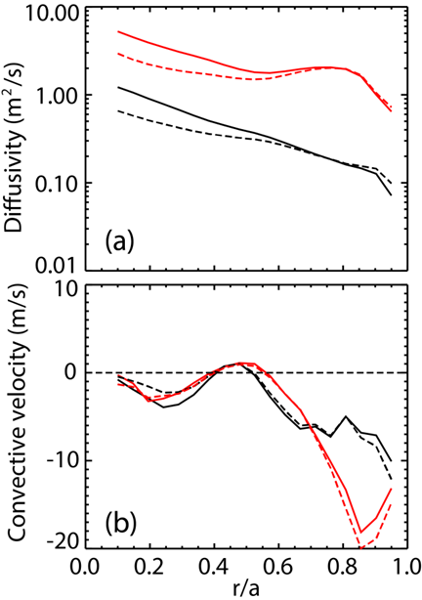
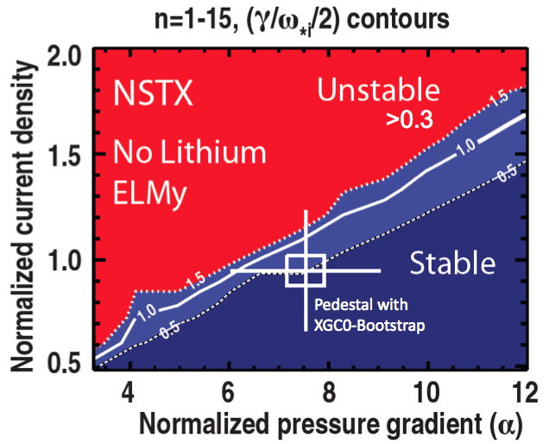
Investigations underway to understand positive aspects of lithium wall coating; plasmas reach kink/peeling limit
Energy confinement improves, ELMs stabilize - with no core Li accumulation
  Partially due to high neoclassical particle diffusivity
1.0
Bootstrap current profile
0.8
0.6
XGC0 model
0.4
Norm. surface avg. current
0.2
Sauter model
Lithium
0.0
0.5
0.6
0.7
0.8
0.9
1.0
ψ_{N}
Particle diffusivity (m²/s)
Carbon
NEO (solid)
NCLASS (dash)
130725
r/a
Scotti GI2.05 (Invited – Tu 11:30 AM)
Surface analysis experiments show oxide coverage of Li plasma facing components (PFCs) expected in 20 – 200s
  Short reaction times motivate flowing Li PFCs
  Oxygen plays important role in D retention
New bootstrap current calculation (XGC0 code) agrees with profile reaching kink/peeling limit before ELM
Jaworski PP8.032 (We)
Capece GO6.08 (Tu)
Chang PO7.07 (We)
Maingi PP8.007 (We)

Slide 6
Experiments measuring global stability further support kinetic RWM stability theory, provide guidance for NSTX-U
Resonant Field Amplification (RFA) vs. β_{N}/l_{i}
Resonant Field Amplification (RFA) vs ν
off resonance
unstable
mode
on resonance
B_{plasma}
RFA =
B_{applied}
(trajectories of 20 experimental plasmas)
Mode stability directly measured in experiments using MHD spectroscopy
  Stability decreases up to β_{N}/l_{i} = 10, increases at higher β_{N}/l_{i}
  Consistent with kinetic resonance stabilization
Two competing effects at lower ν
  Collisional dissipation reduced
  Stabilizing resonant kinetic effects enhanced (contrasts early theory)
Expectations at lower ν
  More stabilization near ω_{φ} resonances; almost no effect off-resonance
Berkery GO6.09 (Tu)
Bialek PP8.013 (We)

Slide 7
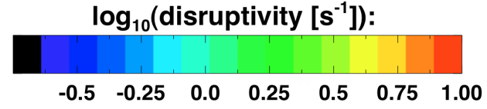

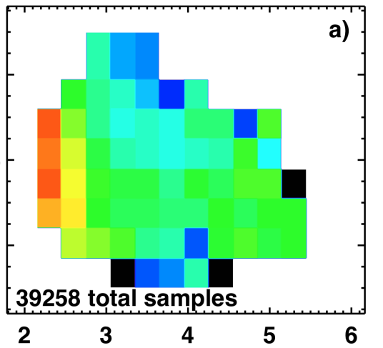
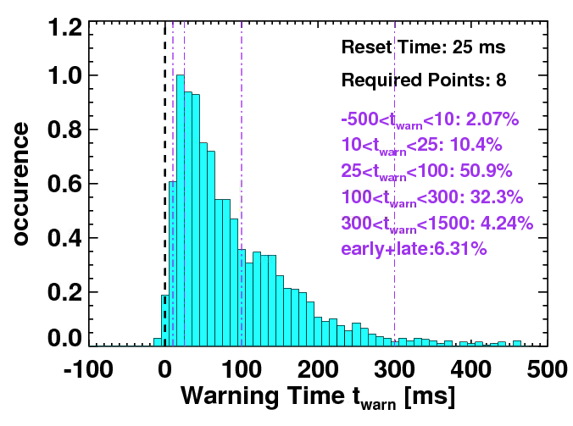
Disruptivity studies and warning analysis of NSTX database are being conducted for disruption avoidance in NSTX-U
Disruptivity
Warning Algorithms
Disruption warning algorithm shows high probability of success
  Based on combinations of single threshold based tests
β_{N}
l_{i}
q*
All discharges since 2006
Physics results
  Low disruptivity at relatively high β_{N} ~ 6; β_{N} / β_{N}^{no-wall(n=1)} ~ 1.3-1.5
    Consistent with specific disruption control experiments, RFA analysis
  Strong disruptivity increase for q* < 2.5, and at very low rotation
Results
  ~ 98% disruptions flagged with at least 10ms warning, ~ 4% false positives
  False positive count dominated by near-disruptive events
S.P. Gerhardt

Slide 8
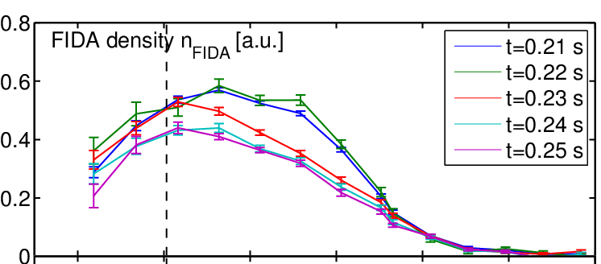
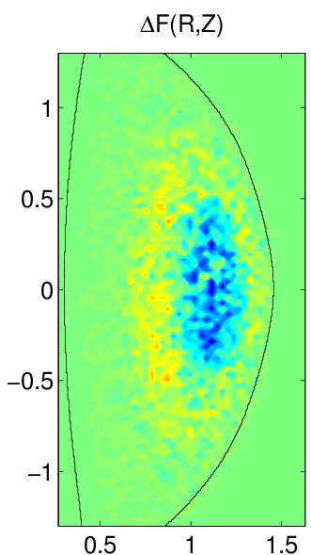
Fast ion redistribution associated with low frequency MHD measured by fast ion D_{α} (FIDA) diagnostic
Caused by n = 1 global kink instabilities
Redistribution can affect stability of *AE, RWMs, other MHD
Full-orbit code (SPIRAL) shows redistribution in real and velocity space
  Radial redistribution from core plasma
  Particles shift towards V||/V = 1
Fast ion density reduction during kink
0.9
1.0
1.1
1.2
1.3
1.4
1.5
R(m)
Change in distribution due to kink mode
SPIRAL code
Core localized CAE/GAEs measured in H-mode plasmas
CAE/GAE-simulated core electron thermal transport matches experiment
Simulations of NBI-driven CAEs show coupling to KAWs
Crocker GO6.03 (Tu)
Z [m]
V||\V
CAE resonances
Tritz GO6.04 (Tu)
R [m]
Energy [keV]
Belova PP8.022 (We)
Bortolon JI2.02 (Invited – Tuesday PM)

Slide 9
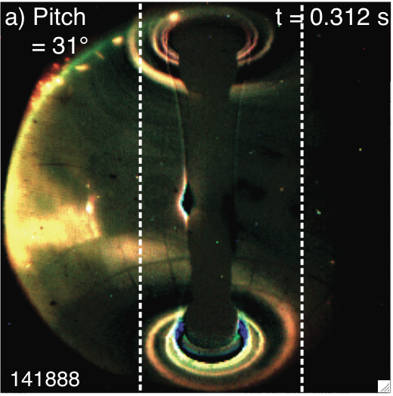
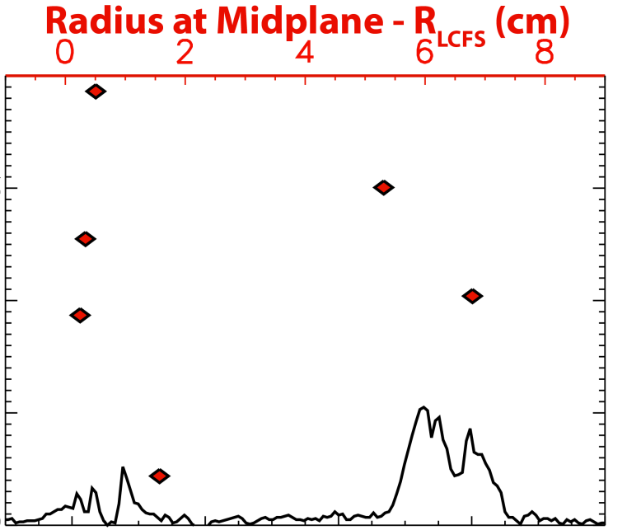
Significant HHFW power deposited in the SOL in front of the antenna flows to divertor region
Visible camera image of edge RF power flow to divertor
RF power loss profile (divertor, and mapped to midplane)
LCFS
Antenna
4
HHFW
Antenna
Data mapped to midplane
3
Power flux (MW/m²)
2
Divertor
Divertor
1
0
0.4
0.6
0.8
1.0
1.2
R (m)
RF power couples to field lines across entire scrape-off layer (SOL) width, not just to field lines connected to antenna components
  Midplane mapping shows strong losses close to antenna and separatrix
Shows importance of quantitatively understanding RF power coupling to the SOL for prediction to future devices
R. Perkins, et al., PRL 109 (2012) 045001
Perkins GO6.012 (Tu)

Slide 10
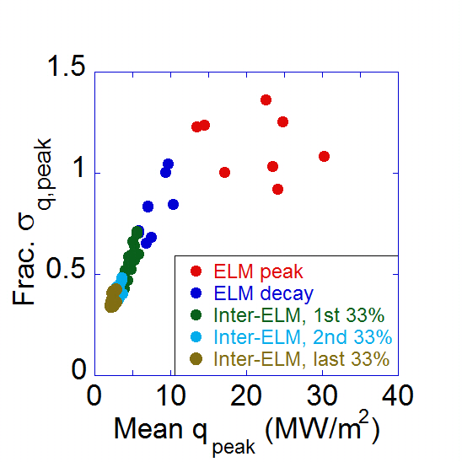
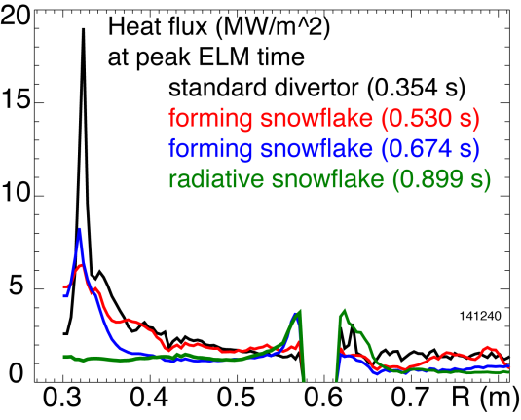
Radiative snowflake divertor greatly reduces heat flux during ELMs; toroidal asymmetry of 2D heat flux studied
Snowflake divertor in NSTX
Toroidal asymmetry of 2D heat flux
Heat flux at peak ELM time
ε_{DA}(q_{peak})
Divertor heat flux (MW/m²)
Toroidal asymmetry
CHI gap
R (m)
Divertor heat flux significantly reduced both during and between ELMs
  during ELMs: 19 to ~ 1.5 MW/m²
  steady-state: 5-7 to ~ 1 MW/m²
Achieved by a synergistic combination of detachment + radiative snowflake
,2D
2D fast IR camera measurement (6.3kHz)
Toroidal asymmetry becomes largest at the peak heat flux for usual Type-I ELMs
Soukhanovskii PP8.027 (We)
Meier PP8.028 (We)
Ahn GO6.06 (Tu)

Slide 11

100% non-inductive scenarios projected over wide range of NSTX-U operation; coaxial helicity injection (CHI) scales well
NSTX-U projected scenarios
TSC simulation of CHI startup
1.0 ms
1.6 ms
2.7 ms
2
1
Z (m)
0
-1
-2
0
1
2
0
1
2
0
1
2
R (m)
R (m)
R (m)
In NSTX, I_{p} ramp to 1 MA requires 35% less inductive flux when CHI is used
  Plasmas with favorable high κ, low l_{i}, n_{e}
TSC modeling predicts a doubling of closed flux current > 400kA in NSTX-U
  Suitable for hand-off to NBI heating/current drive
In NSTX
  Sustained non-inductive fraction of 65% with NBI at I_{P} = 0.7 MA
  70 - 100% non-inductive reached using HHFW current drive (I_{P} = 0.3 MA)
Ono PP8.06 (We)
S. Gerhardt, et al., Nucl. Fusion 52 (2012) 083020
Raman GO6.011 (Tu)

Slide 12
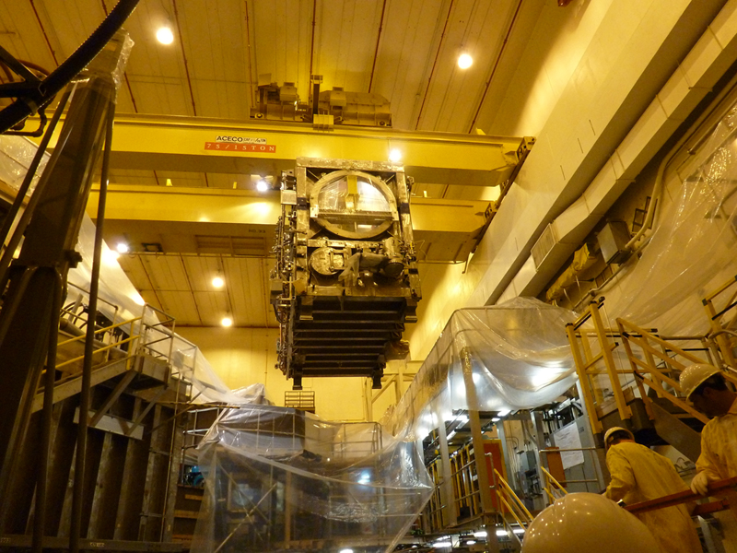
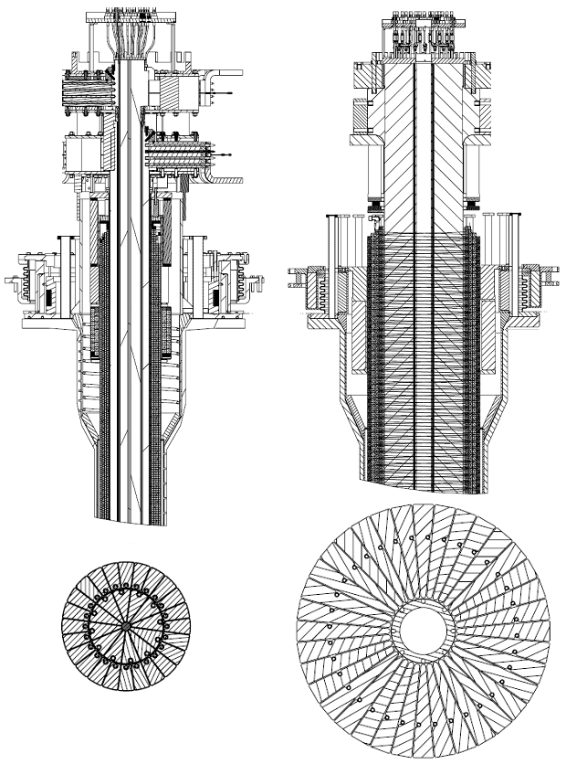
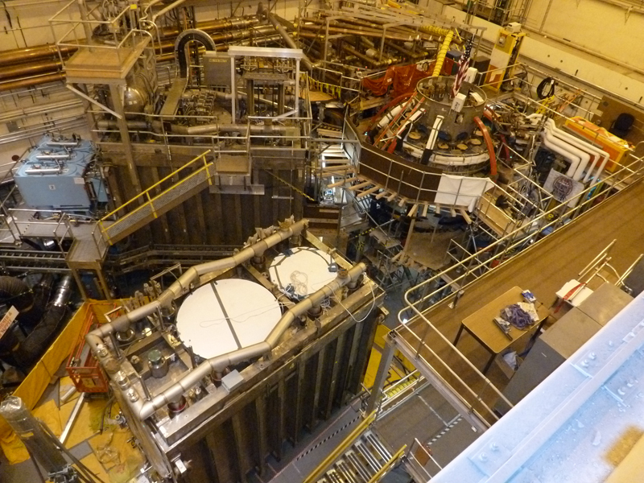
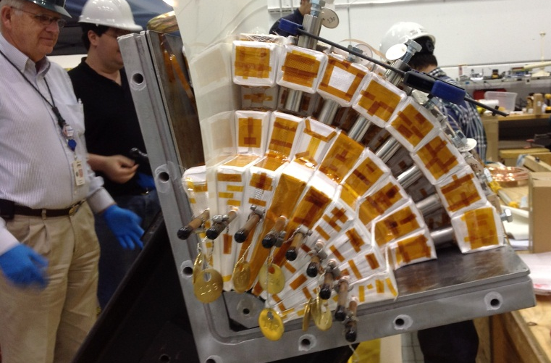
Rapid Progress is Being Made on NSTX Upgrade
Old center stack
NEW Center Stack
TF OD = 20cm
TF OD = 40cm
2nd neutral beam moved into place
TF quadrant assembled
(first plasma anticipated Summer 2014)
Ono PP8.06 (We)

Slide 13
NSTX Presentations at the 54th APS DPP Meeting
Invited / Tutorial Talks
Contributed Talks
Tuesday
Modifications of impurity transport and divertor sources with lithium wall conditioning in NSTX | Scotti | GI2.005
Interplay between coexisting MHD instabilities mediated by energetic ions in NSTX H-mode plasmas | Bortolon | JI2.002
Thursday
Physics of tokamak plasma start-up | Mueller | UT3.001
Friday
Assessing low wavenumber pedestal turbulence in NSTX with measurements and simulations | Smith | YI3.004
Tuesday
NSTX Overview | Sabbagh | GO6.001
Ohmic H-mode intrinsic rotation | J-K. Park | GO6.002
CAE/GAE structure and ID | Crocker | GO6.003
CAE/GAE-induced transport | Tritz | GO6.004
Divertor heat asymmetry | Ahn | GO6.006
Impurity effects on lithium wall | Capece | GO6.008
RWM control / physics | Berkery | GO6.009
Co-axial helicity injection | Raman | GO6.011
RF power flow in SOL | Perkins | GO6.012
2D ELM precursor studies | Sechrest | GO6.013
Wednesday
Bootstrap current model | Chang | PO7.007
(11:30 AM – 12:00 PM)
(2:30 PM – 3:00 PM)
(2:00 PM – 3:00 PM)
Poster Session
(11:00 AM – 11:30 AM)
Session PP8: Wednesday Afternoon (Room: Hall BC)

