Slide 1
Supported by
Physics of tokamak plasma start-up
D. Mueller
APS-DPP Meeting, Providence, RI Meeting
October 29 - November 2, 2012

Slide 2
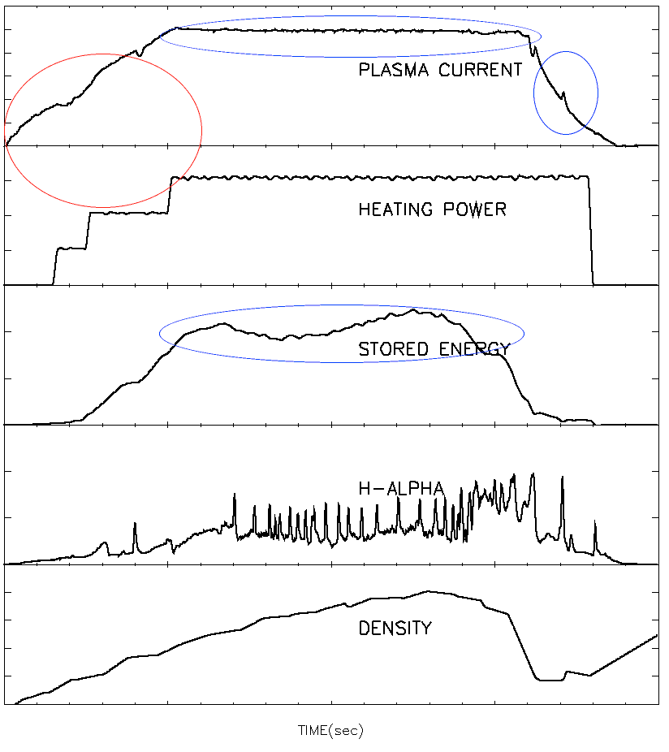
Normal aspect ratio tokamaks have inner coils for inductive start-up, spherical tokamaks have limited space
Now is the time to plan for start-up in
NSTX-U
JT60-SA
ITER
Most of the planning revolves around what will happen during the flattop
Recent start-up experience from
EAST and KSTAR, the first fully super-conducting tokamaks
JET ITER-like wall
Long-pulse STs require non central solenoid start-up
Generally focus is on the plasma current flattop, MHD events ELMs and disruptions
Start-up gets attention when it fails

Slide 3
Physics of tokamak plasma start-up
Central solenoid inductive start-up and current ramp
Breakdown/avalanche
Impurity burn-through
Electron cyclotron radio-frequency assist
Examples from EAST and KSTAR
Early stage of plasma current ramp-up
Start-up techniques without a central solenoid
Outer PF coil start-up
Electron Bernstein Wave start-up
Helicity injection
Coaxial helicity injection (CHI)
Plasma Guns

Slide 4
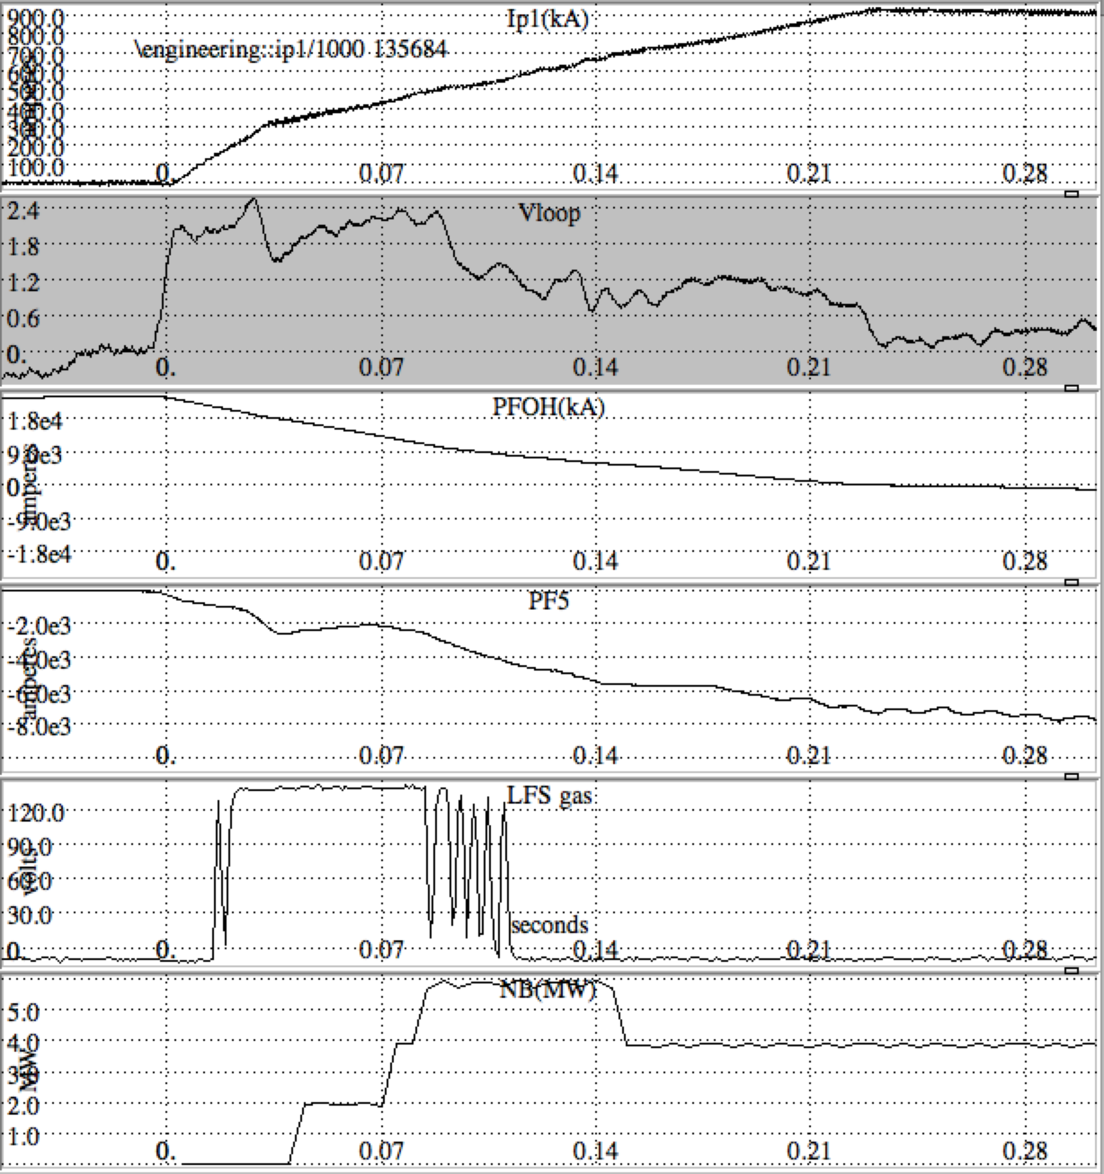
Inductive start-up can be divided into three phases, break-down/avalanche, burn-through and controlled ramp-up
NSTX
Break-down, T_{e} < 10 eV, j < 35 kA/m² I_{p(NSTX)}< 35 kA
Burn-through, 10 eV < T_{e} < 100 eV, 30 kA/m² < j < 300 kA/m²
Controlled ramp-up I_{p} > 100 kA
Central solenoid provides voltage
Resistive heating or auxiliary power to heat and ionize low Z impurities
Vertical field to control plasma radius
Other Poloidal Field coils - shaping
Gas puffing for fueling
Time (s)

Slide 5
Inductive start-up
The central solenoid is supplied with a current in the desired direction of the plasma current before t₀
At t₀, the current is reduced towards zero by action of power supplies (assisted by IR drop)
Resistance of coil or for superconducting coils by a resistor inserted into the circuit
Leakage field
Free electrons are always present, but can be supplemented by ECH, radiation, heated filaments, etc.

Slide 6
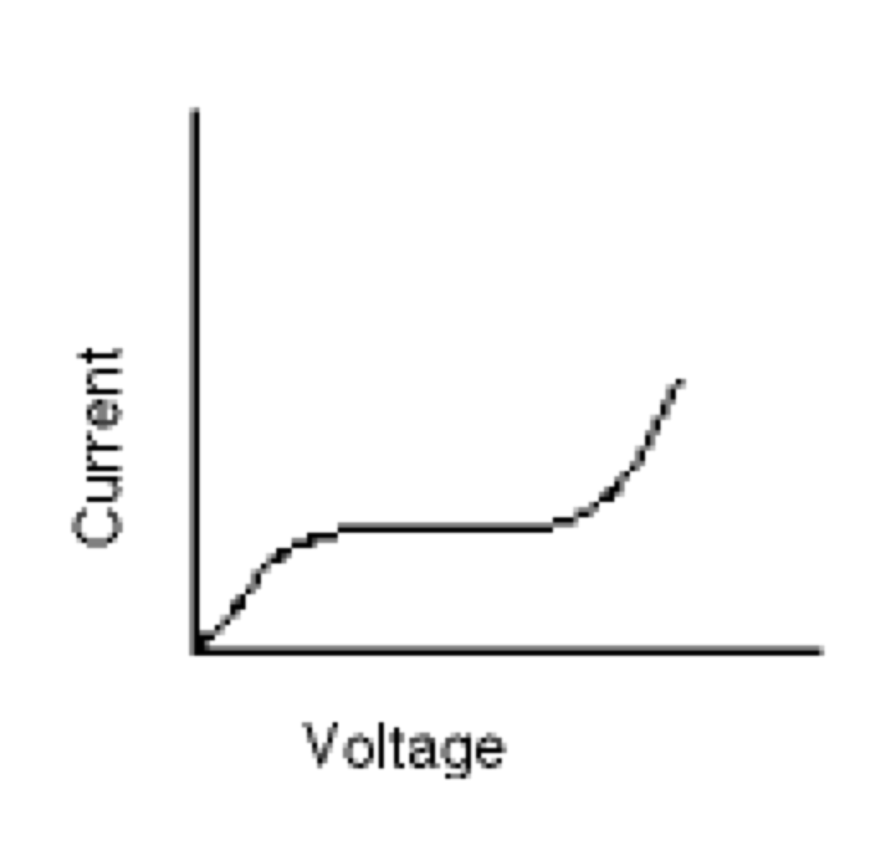
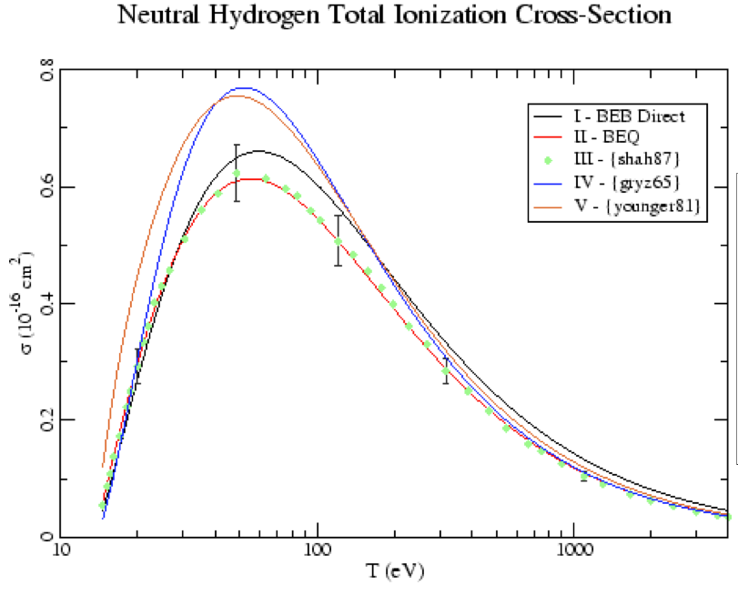
Breakdown in a gas, the Townsend avalanche
For parallel plate electrodes
If an electron produces α new electrons per meter then
dn_{e} = α n_{e} dx
n_{e} = n_{e} (0) e^{αx}
α is called the first Townsend coefficient
0.8
0.6
σ(10⁻¹⁶cm²)
0.4
0.2
0
100
1000
10
T_{e}(eV)
From S.C. Brown, Intro. To Electrical Discharges in Gases, John Wiley and Sons, 1966.
Ionization cross-section peaks at about 50 eV and falls at high energy
From http://physics.nist.gov/cgi-bin/Ionization/ion_data.php?id=HI&ision=I&initial=&total=Y

Slide 7
The voltage required for an avalanche depends upon the pressure distance product
The Paschen curve
(from http://ja.wikipedia.org/wiki/ファイル:Paschen_Curves.PNG
10⁶
10⁵
H₂
N₂
Ar
10⁴
V(volts)
avalanche
10³
Ne
He
10²
10⁻¹
10⁰
10¹
10²
10³
Pd(Torr•cm)
For NSTX, p ~ 5x 10⁻⁵ Torr and V_{l} ~ 2 V/turn
For NSTX then α ~ 10⁻² /m
Connection length must be > 100 m, many toroidal transits
For E/p > 5X10³ V m⁻¹ Torr⁻¹, T_{e} is high enough that thermal ionization is important
This limits T_{e} to about 10 eV until ionization of the initial gas is nearly complete
R. Papoular, Nuclear Fusion 16 (1976) 37.

Slide 8
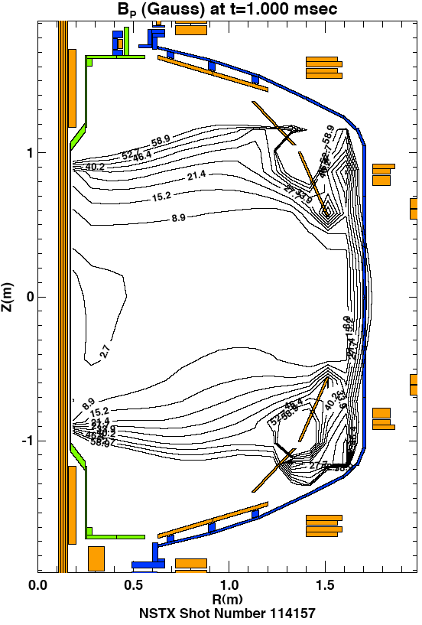
Electrons must travel many ionization lengths before being lost if an avalanche is to occur
Parallel losses
The stray field connection length, L ~ h B_{T}/<δB_{z}> h is the height of the machine <δB_{z}> is the average transverse field
For NSTX B_{T} ~ 4 kG, h ~ 2 m
<δB_{z}> ~ 2.5 to 5.0 G
L ~ 3000 m
The electron drift velocity, v_{de} parallel to the field lines is approximately 35 E/p (m/s)
Time to drift to wall ~ 6 ms
For ions, v_{di} = 0.9E/p, the time to drift to the wall ~ 150 ms
Secondary emission is unimportant
Lloyd estimates the time to complete the avalanche process as 41/v_{de}(α - L⁻¹)
~ 7 ms
58.9
15.2
8.9
2.7
8.9
15.2
58.9
Field null at start-up in NSTX, includes eddy currents
Similar plots can be made for every tokamak
Lloyd et al., Nuclear Fusion, Vol.31. No.ll (1991)

Slide 9
Other losses that might stop avalanche from proceeding
If pressure is too low the density of neutrals will not be sufficient to provide electrons for the avalanche to continue
Guiding center drift velocity
v_{D} = (1/2v⊥² + v||²)/Rω_{ce} ; v⊥² ~ v||² ~ 3KT_{e}/2m
v_{D} ~ 4 to 40 m/s
Loss time ~ 25 -250 ms > avalanche time
Taken together for a wide range of devices
V_{L} = 2 to 30 V/turn, E = 0.3 to 2 V/m, with stray fields B_{z}/B_{T} ~ 10⁻³ over much of the vessel
p = 1-10 x 10⁻⁵ Torr
E/p = .4 to 3 X 10⁴ V m⁻¹ Torr⁻¹
Time for avalanche to occur ~ 2 - 50 ms
JET found E • B_{T}/dB_{z} > 10³ V/m
A. Tanga, et al.in “Tokamak Start-up” H. Knoepfel. Plenum Press, NY (1985)
Consistent with NSTX and DIII-D
I.H.Hutchinson, J.D.Strachan Nucl. Fusion 14 649(1974)

Slide 10
Avalanche proceeds until electron-ion collisions are the dominate process compared to electron-neutral collisions
Electron-neutral and electron-ion collision rates equal when n_{e} ~ 0.1 n₀
Current density is j = γ n₀ e v_{d} where γ is the H or D ionization fraction
j ~ 15-40 kA m⁻²
I_{p} ~ 5 - 10 kA for NSTX, ~ 20 kA for JET
For I_{p}= 10 kA a = 0.5 m, poloidal field μ₀I_{p}/2πa ~ 40 G
Comparable to stray fields
At end of avalanche phase, γ ~ 0.5, Coulomb collisions dominate j ~ 160 kA m⁻² this agrees with I_{p} ~ 200-400 kA at end of avalanche for JET
Until ionization is nearly complete, T_{e} is limited below 10 eV
Later T_{e} can be limited by low Z impurity radiation to < 100 eV until the impurities are ionized (latter phase is called burn-through)
Burn-through can be a sticking point when either the influx of impurities liberated from the wall or the density is too high
For NSTX this can happen at I_{p} = 100 to 300 kA and limit the current ramp-rate during start-up so discharge fails

Slide 11
Database from JET show good agreement between Lloyd’s estimate of the avalanche time and the peak time of H_{α}
The JET ITER-like wall is comprised of Tungsten and berrylium
Time of peak H_{α}(s)
τ^{Lloyd} = 41/(v_{de}(α - L⁻¹))
Using the best estimate of L
Failed discharges do not deviate from others during the avalanche
→ failure is generally not in the avalanche process
P. deVries, 25th IAEA,SanDiego, EXD4-2(2012)

Slide 12
Physics of tokamak plasma start-up
Central solenoid inductive start-up and current ramp
Breakdown/avalanche
Impurity burn-through
Electron cyclotron radio-frequency assist
Examples from EAST and KSTAR
Early stage of plasma current ramp-up
Start-up techniques without a central solenoid
Outer PF coil start-up
Electron Bernstein Wave start-up
Helicity injection
Coaxial helicity injection (CHI)
Plasma Guns

Slide 13
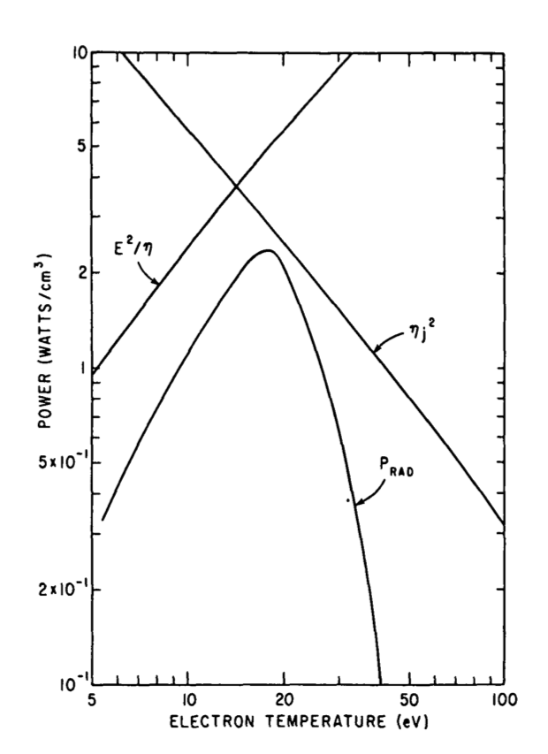
It has been known for a long time that Low Z impurity radiation can cause excessive energy losses at low T_{e}
f(Z,T_{e})(ergs•cm⁻³•s⁻¹)
10⁻²
10⁻¹
1
10
10²
10⁻²
10⁻¹
1
10
10²
10⁻²
10⁻¹
1
10
10²
10.
Radiated power P_{rad} ~ n_{e}Σn_{Z}f(Z,T_{e})
Power supply
E^{2/}η
Coronal equilibrium 3% O with n_{e} of 3 X 10¹⁹ m⁻³ V_{L} (150V)
Radiation Barrier: The radiated power must be less than the input power or the discharge will cool and collapse
High Z materials have lower sputtering yields at low T so are less important at start-up
q-limit
Power(W/cm³)
j²η
1.0
P_{RAD}
From Hawryluk and Schmidt, 1976 Nucl. Fusion 16 775
0.1
5
10
20
50
100
From D.E. Post et al., At. Data Nucl. Data Tables 2, 400, 1977
T_{e}(eV)

Slide 14
Impurity burn through has presented difficulties to most tokamaks, particularly early in the machine’s operation
Solutions employed to minimize impurity influx include
High temperature vacuum bake (to 350° to remove water and complex hydrocarbons)
Glow discharge cleaning (removes oils and He GDC removes H/D)
Boronization (various application techniques, reduces O)
Lithium coatings (Reduces C, O and H/D)
Ti gettering (coats surfaces reduces O, H/D and C)
Use of metal walls can limit the source of low Z impurities (ITER plans include Be which radiates significantly less than C or O)
Alternatively auxiliary heating can be employed to burn through the low Z impurities and heat the plasma

Slide 15
Recently H-T Kim developed a model (DYON) that uses a dynamic recycling and sputtering model for JET start-up
Deuterium confinement time τ_{D}
1/τ_{D} = 1/τ_{D},|| + 1/τ_{D},⊥
The rotational transform will increase the effective distance to the wall as Ip increases so
L(t) ~ (0.25 a(t) B_{T}/B_{z}(t) exp(I_{p}(t)/I_{ref}))
I_{ref} is chosen so the plasma’s poloidal field exceeds the stray field
The deuterium confinement time due to parallel particle loss is
τ_{D},|| = L(t)/C_{s} where C_{s} is the sound speed (T_{e} + T_{i})^{1/2}/m_{D}
For Perpendicular transport use Bohm diffusion
A dynamic recycling coefficient is used for deuterium
Physical sputtering and a simple chemical sputtering model is used: O→ C+O and C + 4D→ CD₄
Hyun-Tae Kim, W. Fundamenski, A.C.C. Sips et al.Nucl. Fusion 52 (2012) 103016

Slide 16
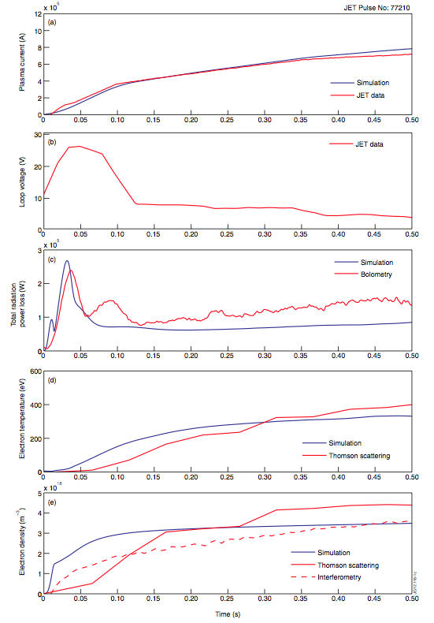
Model results agree well with experiment and demonstrate the importance of including the parallel loss
Blue lines indicate simulation results
Red curves on the plots are JET data
C-II
1 MA
I_{p}
The temporal agreement for the C-II emission gives confidence that impurities are being well-modeled
The time evolution of the C charge states in the model indicates from 0.15 s on C is fully ionized
The early density discrepancies may be due to geometrical effects
This recent start-up model is self-consistent and includes the important time evolution of impurities from the wall due to sputtering by plasma ions
V_{Loop}
20 V
P_{Rad}
2 MW
400 eV
T_{e}
4 X 10¹⁸/m²
n_{e}
0
Time(s)
0.5
Hyun-Tae Kim, W. Fundamenski, A.C.C. Sips et al.Nucl. Fusion 52 (2012) 103016

Slide 17
The density at the time of burn-through depends on fill pressure, and the radiated power depends on the wall
For discharges with similar start-up conditions V_{loop} =12 V, E = 0.8 V/m
At t_{BURN} the density is prefill pressure + some extra for C-Wall
At t_{BURN} radiated power is a steep function of density for C-Wall
No non-sustained breakdowns with ILW due to deconditioning
P. deVries, 25th IAEA, SanDiego, EXD4-2(2012)

Slide 18
Physics of tokamak plasma start-up
Central solenoid inductive start-up and current ramp
Breakdown/avalanche
Impurity burn-through
Electron cyclotron radio-frequency assist
Early stage of plasma current ramp-up
Examples from EAST and KSTAR
Start-up techniques without a central solenoid
Outer PF coil start-up
Electron Bernstein Wave start-up
Helicity injection
Coaxial helicity injection (CHI)
Plasma Guns

Slide 19
Superconducting tokamaks have low loop voltage which can be marginal on ITER for breakdown and burn-through
Power supply cost, eddy current heating in the superconducting coils, vacuum vessel and cryo-stat combine to place limits on the applied electric field
For ITER, E ~ 0.3V/m, the low end of successful breakdown
EAST and KSTAR insert resistors into the coil circuits to produce higher voltage for breakdown
All 3 have less ohmic power to heat the plasma and ramp the plasma current than conventional tokamaks
Electron Cyclotron Radiofrequency Heating (ECRH) can lower the voltage required for breakdown by a factor of about two
ECRH can provide power to heat the plasma
This is especially important during burn-through when I_{p} is low and ohmic power is limited

Slide 20
Lloyd used a 0-D model of power balance during the start-up on ITER to assess the need for additional power
Electron power balance
Ion power balance
Particle balance
This 0-D model handles impurities by assuming they are a fixed fraction of the deuterium density
It uses deuterium recycling coefficient R=1.01
B Lloyd, P G Carolan and C D Warric, Plasma Phys. Control. Fusion 38 (1996) 1627–1643.

Slide 21
Conclusions for the 0-D model for start-up is that start-up on ITER will be more robust with additional power
Zero-dimensional modeling of ITER start-up scenarios indicates that for inductive only start-up:
Burn-through with 2% Be impurity is possible for low fill pressure 1.5X10¹⁷/m³ (2X10⁻⁶ Torr), post avalanche density < 1.5 X10¹⁸/m³
However for 5% Be or a higher fill pressure failure is likely
Addition of auxiliary power in the form of Electron Cyclotron Resonant Heating (ECRH) improves power margin
With 2 MW of absorbed ECRH 5% Be impurity is allowable with a post avalanche density of 5 X10¹⁸/m³
but not for 2% C
For 5% C and the same density 5 MW of absorbed ECRH is required for robust start-up
ITER plans now include several MW of ECRH
Now we will move on to experience with ECRH and start-up on JET with ITER-like wall which provide useful data for further insight
B Lloyd, P G Carolan and C D Warric, Plasma Phys. Control. Fusion 38 (1996) 1627–1643.

Slide 22
ECRH has been used on many devices to provide pre-ionization and electron heating during start-up
2nd Harmonic X-Mode (E⊥B) and fundamental O-Mode (E||B) launched from the low field side can access the plasma
Use of ECH lowers the required field for breakdown below 0.3 V/m
2ω_{ce}
Fast-framing camera of C^{III} emission during 2nd harmonic ECH in DIII-D
G. L. Jackson PhysPlasmas_17_056116 (2010)

Slide 23
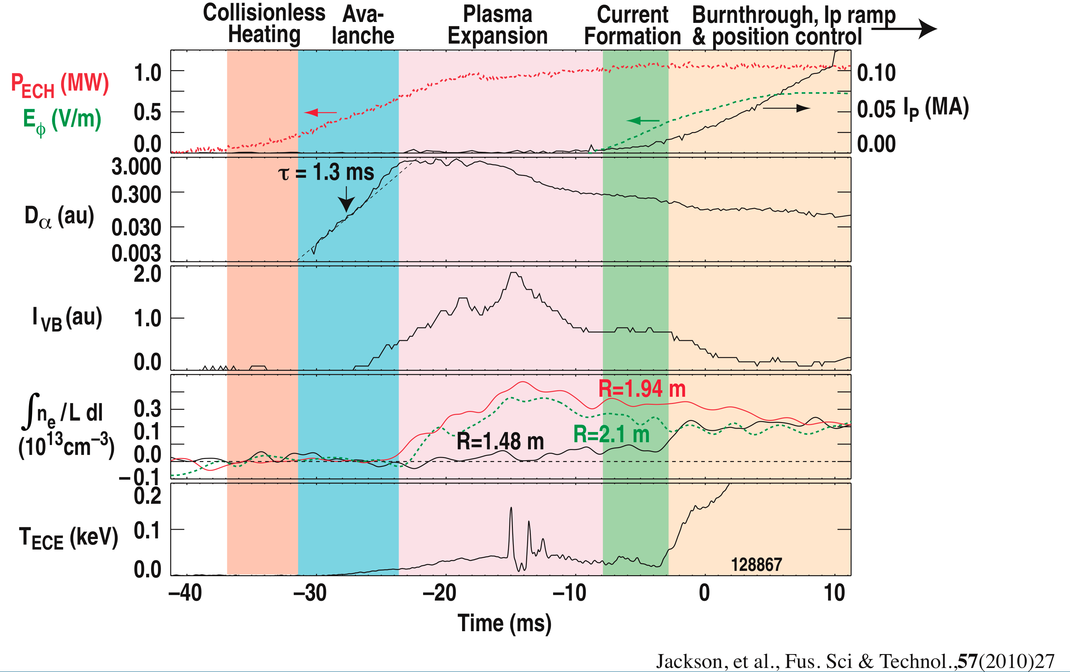
Progression of discharge phases during ECRH start-up in DIII-D
Avalanche and expansion phases have low I_{p}
Current channel forms at 20-60 kA evidenced by increase it T_{e}
Burn-through follows with additional heat from ECH

Slide 24
Physics of tokamak plasma start-up
Central solenoid inductive start-up and current ramp
Breakdown/avalanche
Impurity burn-through
Electron cyclotron radio-frequency assist
Examples from EAST and KSTAR
Early stage of plasma current ramp-up
Start-up techniques without a central solenoid
Outer PF coil start-up
Electron Bernstein Wave start-up
Helicity injection
Coaxial helicity injection (CHI)
Plasma Guns

Slide 25
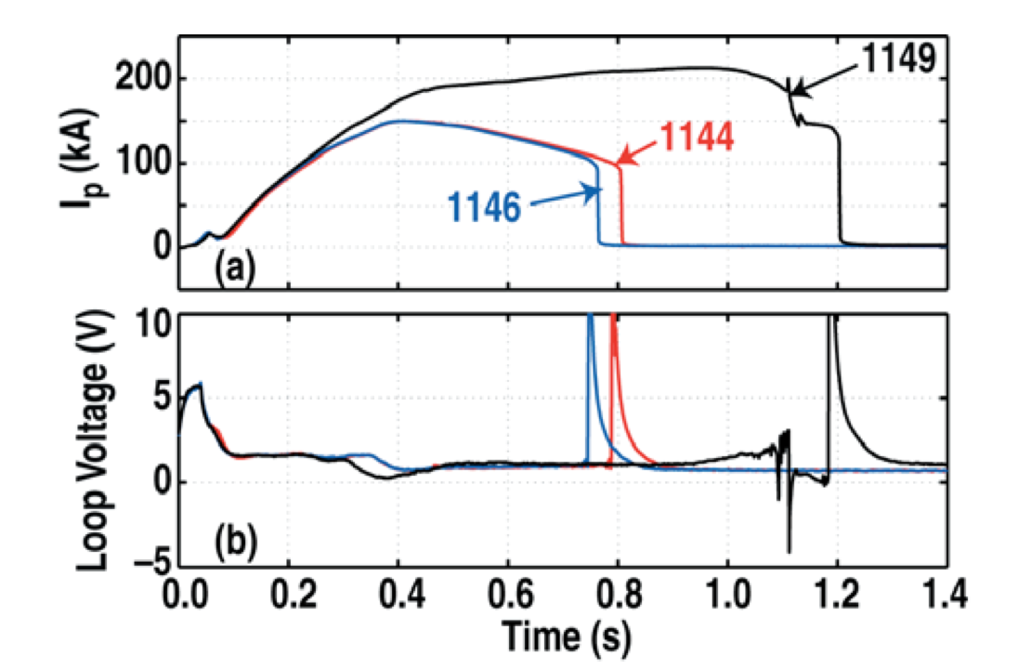
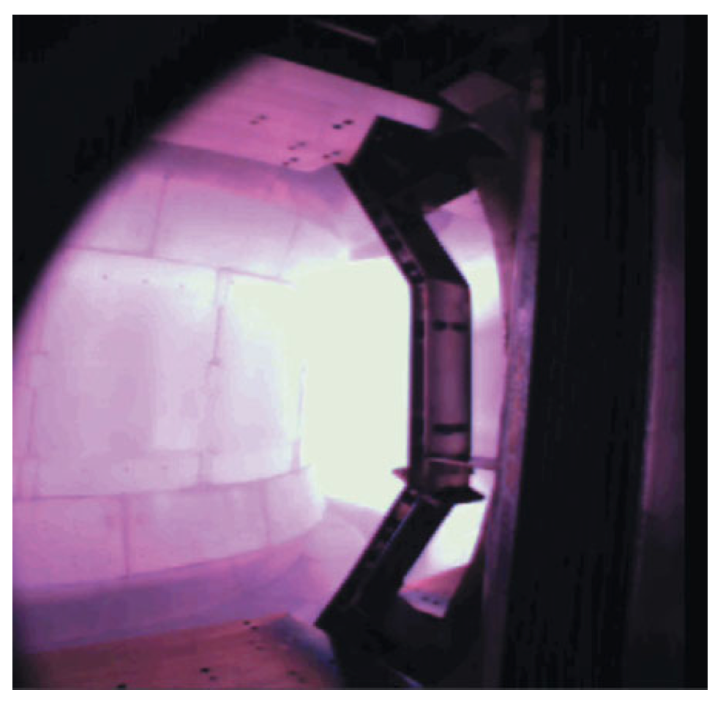
Causes of discharge failure are not always obvious
EAST First Plasma
CCD image just after break-down suggests failure to burn-through
The start-up of the first plasma on EAST
Early attempts disrupted at I_{p} ~ 35 kA at 70-100 ms, unclear why
The breakdown resistors were in the circuit for 100 ms
Mutual from central coils exceeded vertical field power supply capability (which have since been upgraded)
Model predicted more negative vertical field than achieved
Camera images indicate plasma was at large R
Failure was due to too small vertical field
Shortened the breakdown resistor time to 50 ms
From J. Leuer, et al., Fusion Science and Tech.. 57 2010

Slide 26
For all tokamaks it is essential to apply the proper vertical field and to have a vertically and radially stable field pattern
Vertical field
(circular plasma)
Radial Field
Field index n
KSTAR has ferromagnetic material in the coil jackets
Higher vertical field at small R which increases field index
Important effect for field null and low B_{z}
Plasma start-up variability, particularly smaller R, sometimes resulted in radial instability before the effect of magnetic material was considered
Modifying the start-up field pattern to account for ferromagnetic effects produced a stable configuration
Greatly improved reliability when implemented in 2010 and allowed ohmic start-up without ECH for the first time in KSTAR
J. Kim, Nucl. Fusion 51 (2011) 083034

Slide 27
Physics of tokamak plasma start-up
Central solenoid inductive start-up and current ramp
Breakdown/avalanche
Impurity burn-through
Electron cyclotron radio-frequency assist
Examples from EAST and KSTAR
Early stage of plasma current ramp-up
Start-up techniques without a central solenoid
Outer PF coil start-up
Electron Bernstein Wave start-up
Helicity injection
Coaxial helicity injection (CHI)
Plasma Guns

Slide 28
So far neglected a discussion of plasma density except when discussing Kim’s and Lloyd’s modelling
With graphite wall generally the density rises with Ip, even with no additional fueling (Blue trace)
With JET-ILW and no additional fueling the density falls (Green trace)
Lower n_{e} → higher T_{e} broader current profiles that result in instability
Gas puffing is effective to fuel the plasma and target plasmas can be achieved(Black trace)
P. deVries, 25th IAEA, SanDiego, EXD4-2(2012)

Slide 29
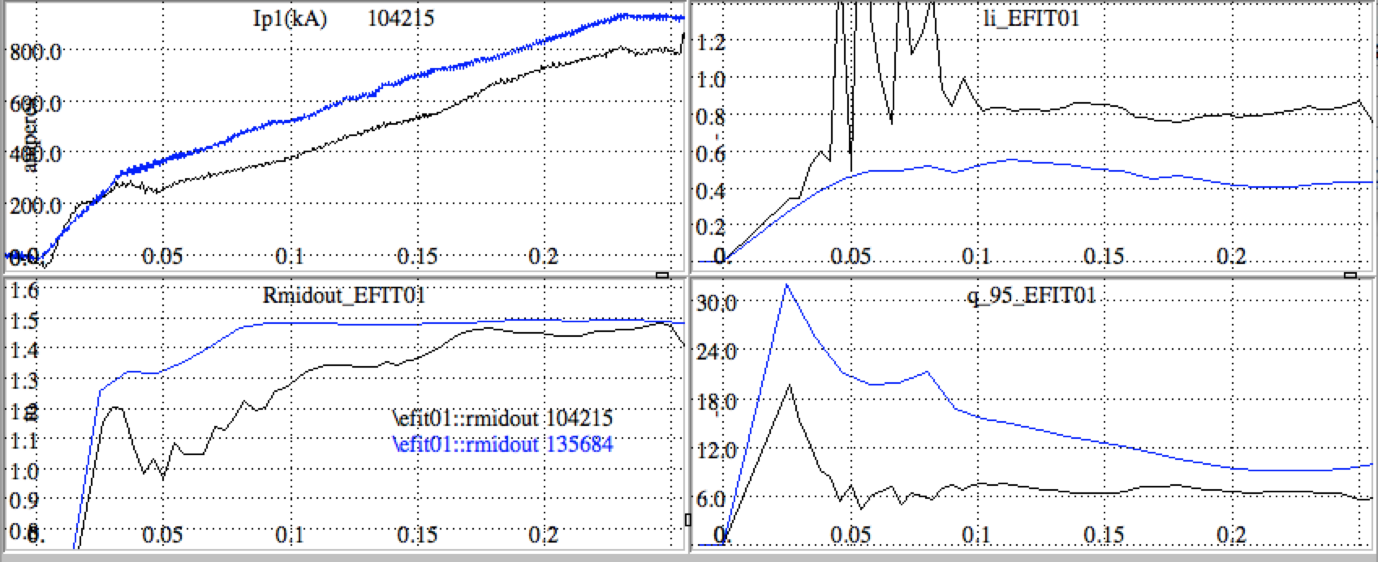
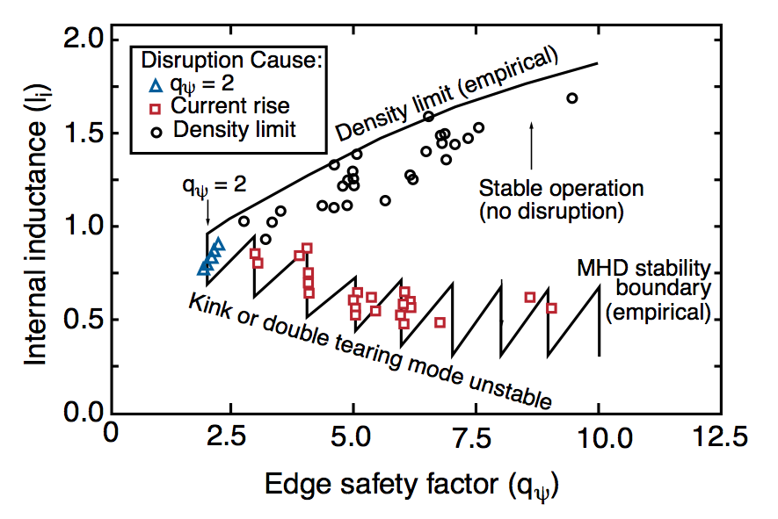
The choice of plasma growth strategy determines the current density profile evolution which influences stability
I_{p}
JET
Internal inductance
R_{out}
q-95
Constant q growth realizes fully evolved j(r) profiles earlier and has higher internal inductance, l_{i}
Full aperture scenario has broader j(r) and minimizes l_{i}
Each strategy is affected by ramp-rate, impurities and heating power and timing typically, dI_{p}/dt < 0.5 MA/s
Wesson, J., et al., Nucl. Fusion 29 (1989) 641.

Slide 30
ITER strategy for plasma growth has evolved from small aperture growth to a large-bore start-up that diverts earlier
Small aperture growth
Small bore start-up scenario; q ~ constant growth, diverts at high current
Long Ip ramp-up time due to low loop voltage
Limited on outboard surface – heating issue
Facilitates current penetration – early sawteeth
Large bore plasma that diverts at lower I_{p} reduces heating of limiter
Large-bore start-up studies on DIII-D indicate less heating of limiter and l_{i} closer to ITER target and has now been adopted by ITER
G. Jackson, Nucl. Fusion 48 (2008) 125002

Slide 31
Physics of tokamak plasma start-up
Central solenoid inductive start-up and current ramp
Breakdown/avalanche
Impurity burn-through
Electron cyclotron radio-frequency assist
Examples from EAST and KSTAR
Early stage of plasma current ramp-up
Start-up techniques without a central solenoid
Outer PF coil start-up
Electron Bernstein Wave start-up
Helicity injection
Coaxial helicity injection (CHI)
Plasma Guns

Slide 32
Central solenoid is well understood and works well, but there are reasons to consider other start-up techniques
Elimination of a conventional solenoid is required to achieve low aspect ratio at small device size for fusion nuclear applications
If non-inductive current drive could support a steady state reactor, an alternative start-up technique could support elimination of the solenoid
Having small or no solenoid could also help reduce conventional tokamak reactor size and cost
With an iron core the plasma physics is similar, but engineering issues remain
D.A. Gates et al. Fusion Engineering and Design 86 (2011) 41–44

Slide 33
All inductive start-up strategies face the same issues as using a central solenoid, but the emphasis may differ
DIII-D, JT60, MAST, NSTX and others have demonstrated inductive start-up without use of the central coils
A good field null with a stabilizing poloidal field pattern must be provided while at the same time ramping the outer coils to produce flux
Example from DIII-D
Coil currents and plasma current for outer PF start-up
Used ECRH for plasma initiation and burn-through
Only the labeled coils participate
Diverting plasma requires positive current in divertor coils
From J. Leuer, Nucl. Fusion 51 (2011) 063038

Slide 34
Physics of tokamak plasma start-up
Central solenoid inductive start-up and current ramp
Breakdown/avalanche
Impurity burn-through
Electron cyclotron radio-frequency assist
Examples from EAST and KSTAR
Early stage of plasma current ramp-up
Start-up techniques without a central solenoid
Outer PF coil start-up
Electron Bernstein Wave start-up
Helicity injection
Coaxial helicity injection (CHI)
Plasma Guns

Slide 35
Of the candidate RF start-up strategies for the ST, so far Electron-Bernstein Wave (EBW) is the most promising
The acceleration of electrons in a preferential direction by RF waves can be used for start-up
Lower Hybrid Current Drive start-up to 100 kA was demonstrated on PLT in the early 80s.
Start-up by ECH on DIII-D, TS2 and LATE
EBW has been used on MAST to start-up the plasma current to 33 kA using 100 KW
EBW is an electrostatic wave that can exist only in a plasma
It can be produced by mode-conversion of X-Mode electron-cyclotron frequency waves at the upper hybrid resonance (UHR)

Slide 36
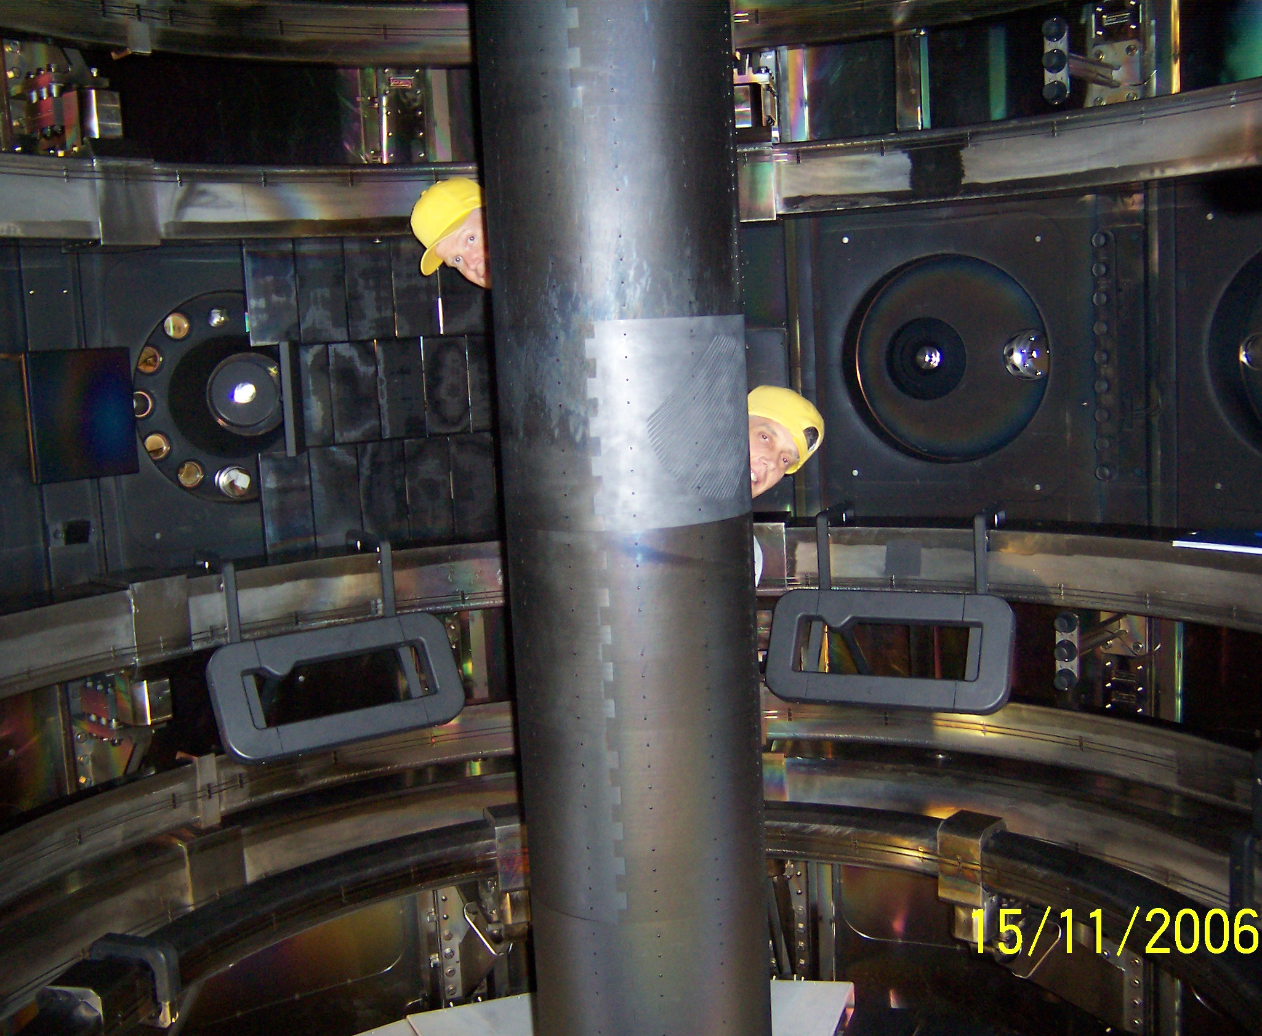
EBW can be produced by mode conversion of X-Mode waves in ECRF launched from the high field side
MAST solution is to launch O-Mode from the low field side (LFS)
O-Mode wave at 28 Ghz is not strongly damped (<2% absorption) below the cut off density of about 1X10¹⁹/m³
A grooved reflector (polarizing mirror) cut into the central column converts the O-Mode to X-Mode wave.
From V. Shevchenko, EC-15 Joint Workshop, 2008, Yosemite, CA, USA

Slide 37
28 GHz breakdown with O-Mode launch with toroidal field and 1mT vertical field in MAST, and ray tracing of EBW
Sketch of ray-tracing modelling of EBW CD plasma initiation
Gas puff
ω_{ce}
O-mode, I_{p} ≈ 5 kA
EBW ⊥ UHR
Sign of n|| from projection of k along poloidal field (B_{p})
B_{p} changes sign when closed flux forms
V. Shevchenko, EC-15 Joint Workshop, 2008, Yosemite, CA, USA
See Laqua, Plasma Phys. Control. Fusion 49 (2007) R1–R42

Slide 38
MAST EBW start-up to 33 kA with 100 kW ECRF using vertical shifts to provide co-current in both open- and closed-fields
V.F. Shevchenko et al. Nucl. Fusion 50 (2010) 022004 (5pp)
#18240, 98ms
I_{p} = 32kA, non-solenoid
Proportion co/counter EBW CD depends on fraction above/below the midplane
Plasma shifted up during open field line period
Plasma shifted at the time closed field lines appear to maintain co-current drive

Slide 39
Physics of tokamak plasma start-up
Central solenoid inductive start-up and current ramp
Breakdown/avalanche
Impurity burn-through
Electron cyclotron radio-frequency assist
Examples from EAST and KSTAR
Early stage of plasma current ramp-up
Start-up techniques without a central solenoid
Outer PF coil start-up
Electron Bernstein Wave start-up
Helicity injection
Coaxial helicity injection (CHI)
Plasma Guns

Slide 40
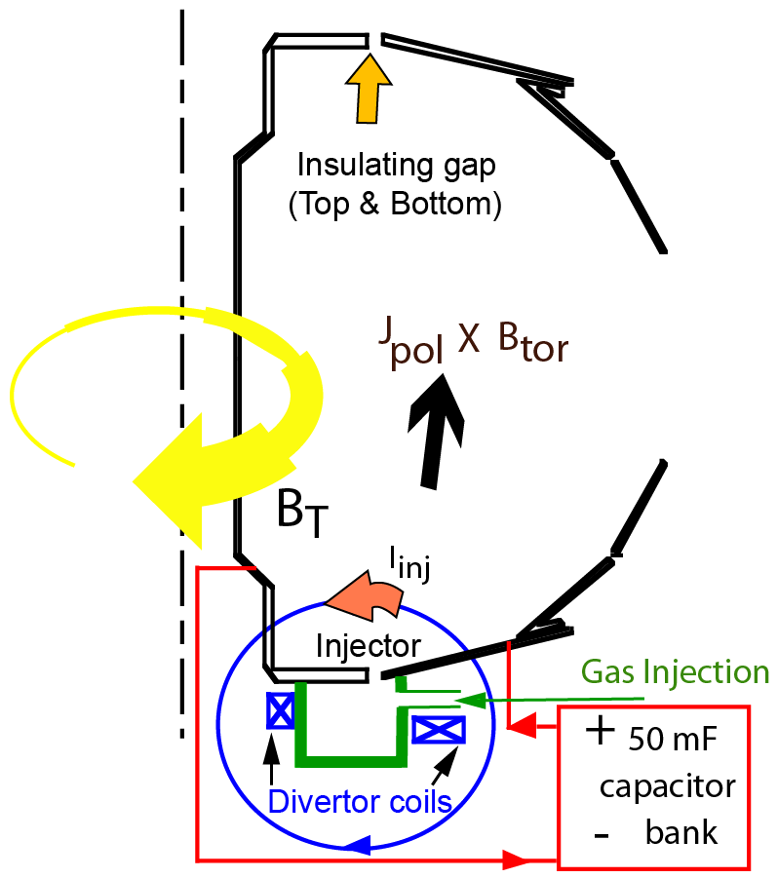
Transient CHI current formation achieved by biasing inner vs. outer vessel to drive expanding helical current channel
Gas injected at bottom of device, breakdown proceeds via Townsend avalanche along helical field connecting inner and outer vessel with many wraps the toroidal current can be 100 times injector current
Bubble burst condition: When
I_{inj} > 2 ψ_{inj}²/(μ₀²d²I_{TF}) Plasma fills vessel
Reconnection occurs when injector current is reduced to zero → closed flux surfaces
R. Raman, Nucl. Fusion 51 (2011) 113018 (8pp)
D. Mueller. Fusion Science and Technol. 52 2007

Slide 41
Transient CHI start-up must be followed by another means of current drive - so far only inductive drive has been available
Comparison of CHI initiated discharge ( in red) with only inductive current drive (in blue)
Neutral beam heated L-Mode discharges initiated with CHI use about 40% less inductive flux to reach 1 MA.
Discharges with high T_{e} early ramp to higher currents
From Nelson, Nucl. Fusion 51 (2011) 063008

Slide 42
Physics of tokamak plasma start-up
Central solenoid inductive start-up and current ramp
Breakdown/avalanche
Impurity burn-through
Electron cyclotron radio-frequency assist
Examples from EAST and KSTAR
Early stage of plasma current ramp-up
Start-up techniques without a central solenoid
Outer PF coil start-up
Electron Bernstein Wave start-up
Helicity injection
Coaxial helicity injection (CHI)
Plasma Guns

Slide 43
Plasma guns have been employed on PEGASUS to inject helicity and provide start-up plasmas
Relaxation Limit → High I_{inj}, low w
From Eidietis, J. Fusion Energy (2007)26:43-46
Helicity input rate → High V_{inj}, A_{inj}
From Battaglia, Nucl. Fusion 51 (2011) 073029
Images of plasma gun startup with gun located near the center (top) and outside (lower) of the Pegasus
a) filaments
b) Merging
c) Relaxation
Gun location is flexible
Could be withdrawn after start-up
From Battaglia, J Fusion Energy (2009) 28:140–143
Notes:
If Ip ~ V … practical limit on V ~5 kV

Slide 44
Plasmas initiated with plasma guns on PEGASUS have been ramped to over 100 kA with < 4 kA of gun current
44
Plasma initiated with plasma guns can be ramped to higher current by induction.
150 kA in this example was achieved with half the inductive flux required for a purely inductively driven plasma
Demonstrated initiation and ramp-up I_{p} > 100 kA
Current multiplication >25
Battaglia, PRL 102, 225003 (2009)

Slide 45
Inductive start-up with ECH is well understood and promising non-inductive start-up techniques exist for STs
Townsend avalanche and burn-through have been modeled self-consistently
ECRH to both assist the avalanche and heat to burn through low Z impurities
Low aspect ratio tokamaks have little space for a central solenoid so the usual inductive technique is problematic
Possible alternatives to solenoidal start-up
Outer PF start-up
Electron Bernstein Wave
Coaxial helicity injection
Plasma guns to inject helicity
Demonstrated start-up from zero to significant current
Well-positioned for start-up of ITER

Slide 46
Acknowledgements
Thanks to
Gary Jackson – General Atomics
Peter deVries - JET
Victor Schevchenko - MAST
Gary Taylor - PPPL
Michael Bell – PPPL
Roger Raman – Univ. of Washington
Ray Fonck – Univ. of Wisconsin
Devon Battaglia – PPPL
Walter Guttenfelder – PPPL
David Gates - PPPL
and Jon Menard – PPPL
for providing me with material, for valuable insights, and for useful discussions.
Work supported by U.S. DOE Contract No. DE-AC02-09CH11466

Slide 47
References to illustrative work
Inductive start-up
S.C. Brown, Intro. To Electrical Discharges in Gases, John Wiley and Sons, 1966.
R. Papoular, Nucl. Fusion 16 (1976) 37
B. Lloyd et al., Nucl. Fusion, Vol.31. No.ll (1991)
A. Tanga, et al. in “Tokamak Start-up” H. Knoepfel. Plenum Press, NY (1985)
I.H.Hutchinson and J.D.Strachan Nucl. Fusion 14 649(1974)
E.A. Lazarus et al. Nucl. Fusion 38 1083 (1998)
P. deVries, 25th IAEA,SanDiego, EXD4-2(2012)
R. Hawryluk and J. Schmidt, 1976 Nucl. Fusion 16 775
From D.E. Post et al., At. Data Nucl. Data Tables 2, 400, 1977
Hyun-Tae Kim et al. Nucl. Fusion 52 (2012) 103016
J. Kim, Nucl. Fusion 51 (2011) 083034
J. Leuer, et al., Fusion Science and Tech.. 57 2010
J. Leuer, Nucl. Fusion 51 (2011) 063038
ECRH
B Lloyd, P G Carolan and C D Warric, Plasma Phys. Control. Fusion 38 (1996) 1627–1643.
G. L. Jackson et al. Phys. Plasmas_17_056116 (2010)
G.L. Jackson et al. Fus. Sci. & Technology 50 (2010) 27
T. Yoshinaga et al. PRL 96, 125005 (2006)
A. Ejiri et al. Nucl. Fusion 46 (2006) 709–713
EBW
V. Shevchenko, EC-15 Joint Workshop, 2008, Yosemite, CA, USA
Laqua, Plasma Phys. Control. Fusion 49 (2007) R1–R42
V.F. Shevchenko et al. Nucl. Fusion 50 (2010) 022004 (5pp)
C.B. Forrest et al. Phys. Plasma 7, 1352 (2000)
CHI
R. Raman et al. Nucl. Fusion 51 (2011) 113018 (8pp)
D. Mueller et al. Fusion Science and Technol. 52 2007
B.A. Nelson et al. Nucl. Fusion 51 (2011) 063008
Plasma guns
Battaglia, J Fusion Energy (2009) 28:140–143
Battaglia, Nucl. Fusion 51 (2011) 073029
Eidietis, J. Fusion Energy (2007)26:43-46
Battaglia, PRL 102, 225003 (2009)
Other
F.C. Jobes PRL 52 12, 1005 (1984)
F.C. Jobes et al. in , et al. in “Tokamak Start-up” H. Knoepfel. Plenum Press, NY (1985)
D.A. Gates et al. Fusion Engineering and Design 86 (2011) 41–44

