Slide 1

Why Magnetically Confined Plasmas Rotate, and Why it is Important
Stanley M. Kaye
Princeton Plasma Physics Laboratory
Princeton University, Princeton NJ 08543
American Physical Society Meeting
Atlanta, GA
31 March-2 April 2012

Slide 2
I would like to acknowledge the direct and indirect contributions of:
C. Angioni¹, P. Diamond², S.-H. Ku³, R. McDermott¹, J.-K. Park³, J. Rice⁴, F. Ryter¹ W. Solomon³, T. Tala⁵, W. Wang³, M. Yoshida⁶
¹ Max-Planck Institut fur Plasmaphsik, Garching, Germany
² UCSD, San Diego CA, USA
³ PPPL, Princeton University, Princeton NJ, USA
⁴ PSFC, MIT, Cambridge MA, USA
⁵ Association Euratom-Tekes, VTT, Finland
⁶ JAEA, Japan
This work was supported in part by U.S. DOE Contract # DE-AC02-09CH11466

Slide 3
In this talk, I will explore aspects of rotation and momentum confinement in magnetically-confined plasmas
Background
  Magnetically confined plasmas in tokamaks/spherical tokamaks
  Rotation observed in other configurations (stellarator, RFP, linear devices), but will focus on tokamak/ST
Why is rotation important
  Stabilization of micro-, macro-turbulence leads to higher performance
How do rotation profiles develop and evolve – how can we understand rotation?
  Rotation generation (driven, self-generated)
  Transport of momentum
    Find tokamak/ST results similar gives glimpse into underlying common physics
  Predictions for fusion power devices (ITER)
Future work and summary
  What else do we need to understand
Rotation/momentum transport strongly coupled primarily to ion-gyroradius scale turbulence

Slide 4
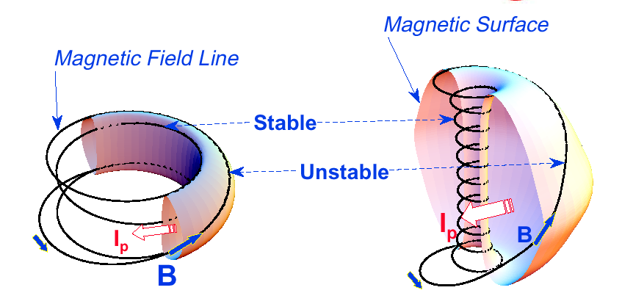
Fusion-grade plasmas are magnetically confined in toroidal devices
Most of tokamak research historically and presently conducted at conventional aspect ratio
Only a decade of research on Spherical Tokamaks (STs)
Strong toroidicity at low aspect ratio benefits
both stability and confinement
(poloidal)
(toroidal)
(radial)
a~ 0.65 m, R~0.85 m
I_{p} ~ 1 MA, B_{T}~ 0.5 T
R/a~4, κ=2, q_{a}=4
R/a~1.3, κ=2, q_{a}=12
a~ 0.65 m, R~1.7 m
I_{p} ~ 1 MA, B_{T}~ few T
V_{φ}(center) up to 300 km/s
Rotation profiles measured by Doppler shift of spectroscopic lines

Slide 5
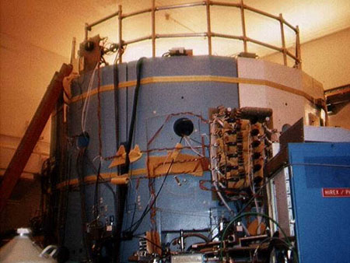


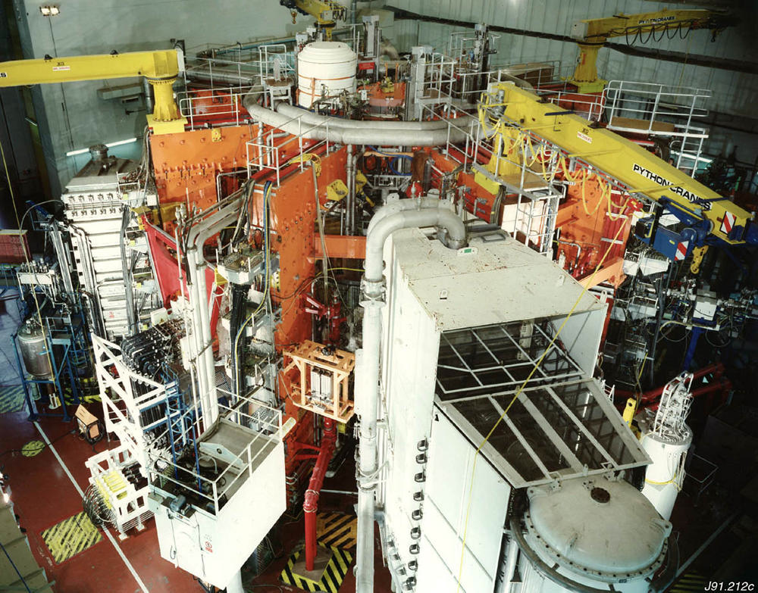



Results from tokamaks/STs from around the world contribute to this talk
ASDEX-Upgrade (EU)
Alcator C-Mod (US)
DIII-D (US)
JET (UK/EU)
NSTX (US, ST)
MAST (UK, ST)
JT-60U (Japan)

Slide 6
Evolution of key parameters during a plasma discharge
Plasma undergoes abrupt
transition from a lower to a
higher energy state at ~ 0.2 s
Low (L-) ➔ High (H-) confinement
mode (observed on all devices)
NSTX
M_{s}∼0.75
L -> H

Slide 7
In this talk, I will explore aspects of rotation and momentum confinement in magnetically-confined plasmas
Background
  Magnetically confined plasmas in tokamaks/spherical tokamaks
  Rotation observed in other configurations (stellarator, RFP, linear devices), but will focus on tokamak/ST
Why is rotation important
  Stabilization of micro-, macro-turbulence leads to higher performance
How do rotation profiles develop and evolve – how can we understand rotation?
  Rotation generation (driven, self-generated)
  Transport of momentum
    Find tokamak/ST results similar gives glimpse into underlying common physics
  Predictions for fusion power devices (ITER)
Future work and summary
  What else do we need to understand
7

Slide 8
There are two main sources of radial transport in tokamaks/STs
  Neoclassical – collisional processes in toroidal systems
            ➔ sets minimum transport level
  Anomalous– turbulent microinstabilities: scale lengths from the ion to the electron gyroradius
Most of the transport in tokamaks/STs is anomalous
Rotation plays an important role in the suppression of microturbulence
E_{radial} determined by p,v
E_{r}xB shear can stretch and break up turbulent eddies
ExB Shear
Turbulent
Eddies
t₁
t₂
t₃
Usually dominant
Radial Direction
Rule of thumb: turbulence suppression when ω_{ExB}>γ_{mode}

Slide 9
Larger ExB shear is correlated with reduced turbulence and reduced transport
TFTR
Reduced ion-scale
turbulence when ω_{ExB} > γ
Ion thermal diffusivity (a measure of
radial transport of heat) is lower when
turbulence is lower
γ
ω_{ExB}
Enhanced turbulence
(ω_{ExB} ≤ γ)
Reduced turbulence
(ω_{ExB} > γ)
Mazzucato et al., PRL (1996)

Slide 10
Rotation important for the suppression of macro-scale MHD modes that can lead to sudden plasma termination
MHD mode growth follows damping
of rotation – disruption follows
Higher rate of disruptivity with lower rotation
NSTX
Disruption
S. Gerhardt (2012)
Sabbagh et al, Nuc. Fusion (2010)
also on DIII-D: Garafalo et al, Nuc. Fusion (2001)

Slide 11
In this talk, I will explore aspects of rotation and momentum confinement in magnetically-confined plasmas
Background
  Magnetically confined plasmas in tokamaks/spherical tokamaks
  Rotation observed in other configurations (stellarator, RFP, linear devices), but will focus on tokamak/ST
Why is rotation important
  Stabilization of micro-, macro-turbulence leads to higher performance
How do rotation profiles develop and evolve – how can we understand rotation?
  Rotation generation (driven, self-generated)
  Transport of momentum
    Find tokamak/ST results similar gives glimpse into underlying common physics
  Predictions for fusion power devices (ITER)
Future work and summary
  What else do we need to understand

Slide 12
Momentum balance is the basis for addressing the sources and transport of rotation and momentum
Time rate of change
of angular momentum
Input torques
Momentum
transport
Viscous torque
(c-x, i-i, etc)
Neutral beam injection provides torque
through classical collisions to drive rotation
DIII-D Neutral
Beam Injectors

Slide 13
Magnetic field asymmetries are a source of viscous torque
3D toroidal magnetic field asymmetries can result from
  Magnetic field ripple (finite # TF coils) – studied in JET
  Intrinsic error fields (coil misalignments or motion during discharge due to JxB forces)
  Applied non-axisymmetric B-field perturbations at edge
Sabbagh et al. (2010)
2-4 mm deflection
NSTX
NSTX
B.
~5 m
DIII-D
C.
T_{NBI}~ T_{ΔB}
Magnetic field (ctr) torque increases at low rotation; consistent with theory:
Park et al. PRL (2009), Cole et al. PRL (2011)

Slide 14
There is evidence that some “intrinsic drive” exists in tokamak/ST plasmas
Momentum evolution given by
Can also measure intrinsic torque via evolution of angular momentum
Solve for two unknowns from time evolution of angular momentum, L
Co-, ctr-NBI on DIII-D allows for flexibility to produce non-rotating plasmas across profile
For steady-state, can produce non-rotating plasmas when:
T_{NBI} = -T_{intrinsic}
Solomon et al. PoP (2010)

Slide 15
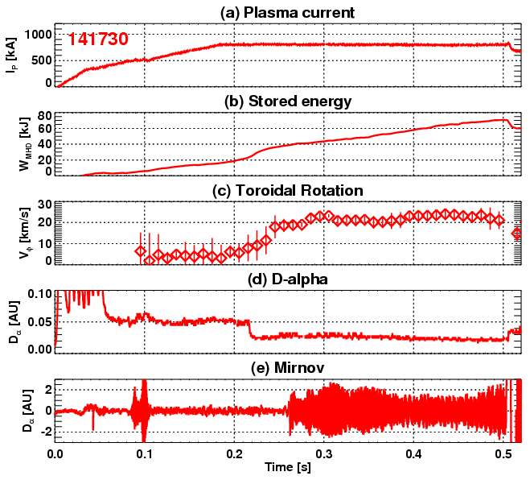
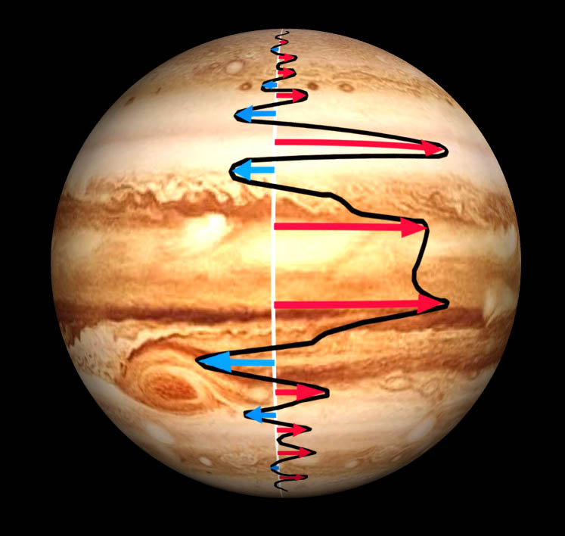
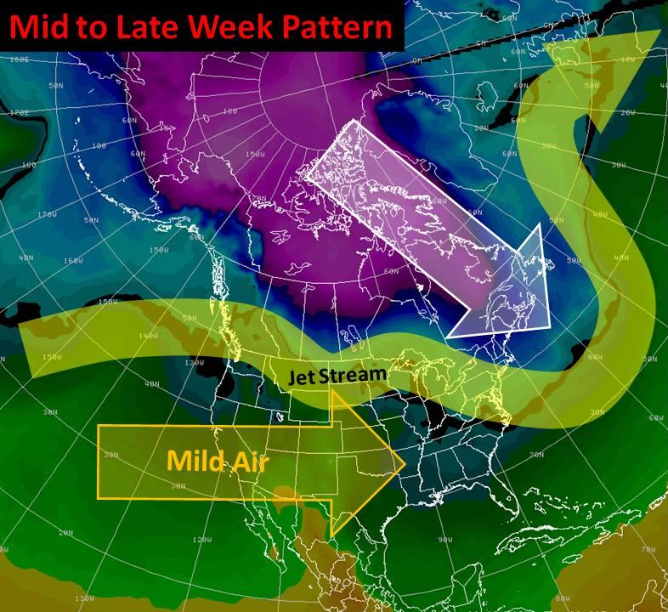
Edge intrinsic torques lead to edge intrinsic rotation
Typically use L-H transitions in OH or RF-heated (torque-free) plasmas to study change in intrinsic rotation
Self-generated flow is seen in a
number of physical systems
NSTX
Intrinsic drive
H-mode
Park (2011)

Slide 16
Intrinsic drive and rotation appears to be controlled strongly by respectively
Intrinsic torque scales with p
Intrinsic rotation scales with T
Δ
Δ
DIII-D
C-Mod
Solomon et al. NF (2011)
Rice et al. PRL (2011)
Dependences consistent with ion-scale turbulence theory:
Gurcan et al. PoP (2007), Wang et al. PoP (2010),
Kosuga et al. PoP (2010), Gurcan et al. PoP (2010)

Slide 17
In this talk, I will explore aspects of rotation and momentum confinement in magnetically-confined plasmas
Background
  Magnetically confined plasmas in tokamaks/spherical tokamaks
  Rotation observed in other configurations (stellarator, RFP, linear devices), but will focus on tokamak/ST
Why is rotation important
  Stabilization of micro-, macro-turbulence leads to higher performance
How do rotation profiles develop and evolve – how can we understand rotation?
  Rotation generation (driven, self-generated)
  Transport of momentum
    Find tokamak/ST results similar gives glimpse into underlying common physics
  Predictions for fusion power devices (ITER)
Future work and summary
  What else do we need to understand

Slide 18
Now that sources of rotation are established, need to understand what controls momentum transport & development of rotation profile
Momentum
transport
A theorist’s approach
Reynold’s stress
Particle flux
Langmuir probes can measure Reynold’s stress and particle flux near the edge in lower
temperature devices (Prager, PPCF 1999); these measurements are challenging on
high temperature tokamaks/STs

Slide 19
Momentum transport characteristics can be inferred from experimental data
Momentum
transport
Steady-state momentum balance with known torques (diffusion paradigm)
Perturbation analysis allows separation of diffusive and pinch terms
Conduction
Convection

Slide 20
Steady-state analysis shows that momentum transport is always anomalous
Ion-scale turbulence theory predicts χ_{φ}∼χ_{i}
χ_{φ}∼ 0.1-0.4 χ_{i} from experiment
χ_{φ} neoclassical ≈ 0
χ_{φ} >> χ_{φ,neo}(turbulence impt!)
NSTX
Pr = χ_{φ}/χ_{i} <1
JET
Kaye et al. Nuc. Fusion (2009)
Tala et al. PPCF (2009)

Slide 21
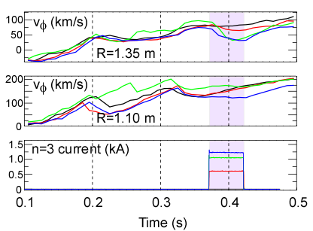
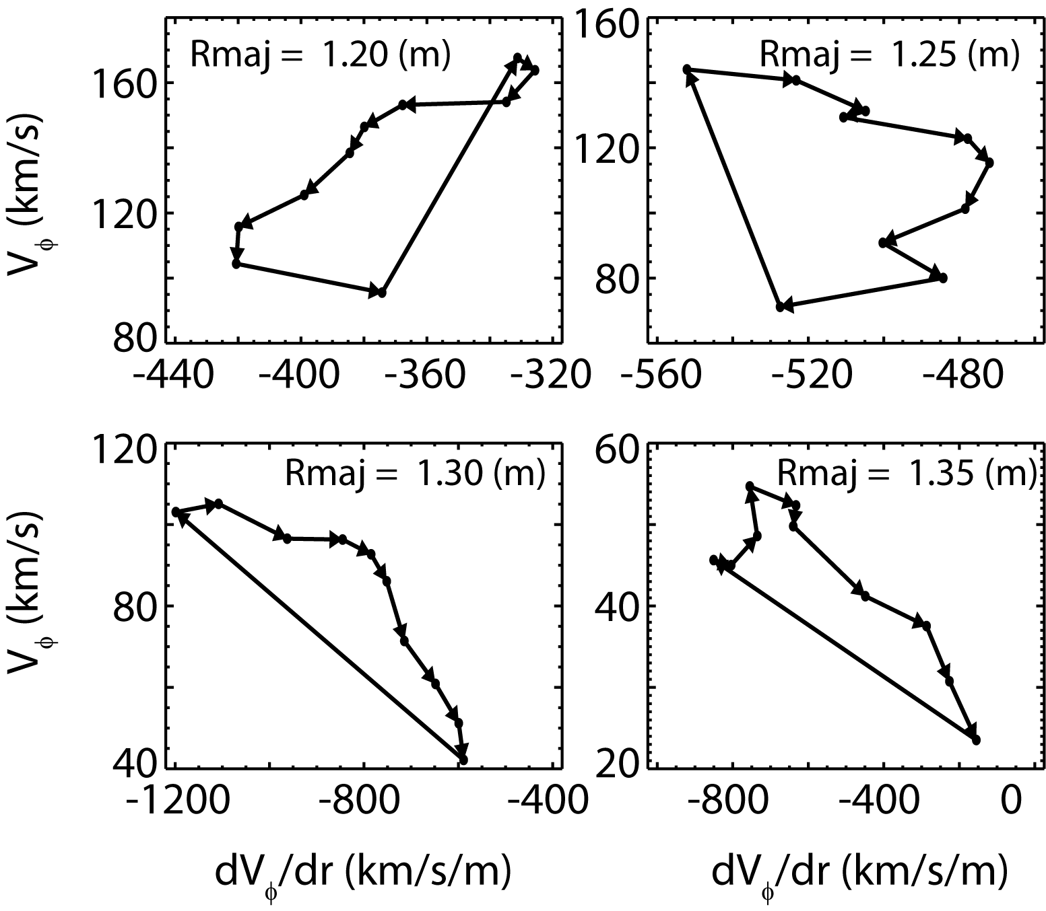
Perturbation techniques used to isolate χ_{φ} , v_{pinch}
ΔB pulse modifies rotation near edge
NB modulation
Edge
Center
JET
NSTX
NB pulse preferentially modifies
rotation near core
Use forward modeling to determine χ_{φ}, V_{pinch} by matching phase, amplitude of response
Separation of v_{φ},
v_{φ} essential to
determining χ_{φ},
v_{pinch}
Δ
Tala et al. PRL (2009)

Slide 22
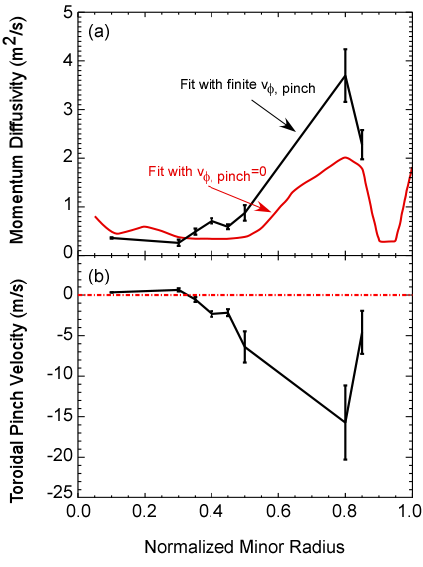
Perturbative momentum transport analysis reveals significant inward pinch in outer region of plasma
ΔB pulse
NB modulation
JET
Fit with finite v_{pinch}
χ_{φ}/χ_{i}
Fit with v_{pinch}=0
Tala et al. PRL (2009)
NSTX
χ_{φ} (finite v_{pinch})∼ 2χ_{φ}^{eff} (v_{pinch}=0)
Including v_{pinch} brings Pr closer to ion-scale turbulence theory prediction (~1)

Slide 23
Developing a comprehensive theoretical model of momentum transport is challenging
Need to know
  Realistic boundary conditions
  Importance of off-diagonal terms in turbulence generation
  Nature of turbulence (strongly turbulent or near marginality)
Fluid treatment of plasma can capture much physics, but almost always need to include kinetic effects
Validation of theoretical model through comparisons with experimental data
Are there any dominant parametric dependence (or lack thereof)
predicted by theory that can be tested?
Some insight, but questions remain

Slide 24
Ion-scale turbulence theory predicts virtually NO dependence of pinch number (Rv_{pinch}/χ_{φ}) on collisionality (ν)
Theory
Experiment
v_{pinch}
Rv_{pinch}/χ_{φ} vs ν
χ_{φ}
Peeters et al. PoP (2009)
Rv_{pinch}/χ_{φ}
JET
ν
Tala et al. Nucl. Fusion (2011)
Solomon et al. PoP (2011)

Slide 25
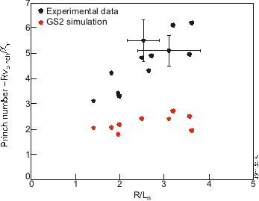
Ion-scale turbulence theory predicts dependence of pinch number (Rv_{pinch}/χ_{φ}) on density gradient (R/L_{n})
Theory
Experiment
Representative discharge
Gyrokinetics
vs R/L_{n}
Pinch Number (Rv_{pinch}/χ_{φ})
Peeters et al. Nucl. Fusion (2011)
JET
Reduced fluid models also indicate
linear dependence on R/L_{n}
Peeters et al. PoP (2009)
Yoon and Hahm (2011)
Tala et al. Nucl. Fusion (2011)
Also, ASDEX-Upgrade, DIII-D, JT-60U, NSTX

Slide 26
ITG theory predicts dependence of pinch number
(Rv_{pinch}/χ_{φ}) on density gradient (R/L_{n})
Theory
Experiment
Representative discharge
Gyrokinetics
vs R/L_{n}
Pinch Number (Rv_{pinch}/χ_{φ})
Peeters et al. Nucl. Fusion (2011)
JET
Reduced fluid models also indicate
linear dependence on R/L_{n}
Peeters et al. PoP (2009)
Yoon and Hahm (2011)
Tala et al. Nucl. Fusion (2011)
Theory calculations predicts weaker
dependence than is observed in experiment

Slide 27




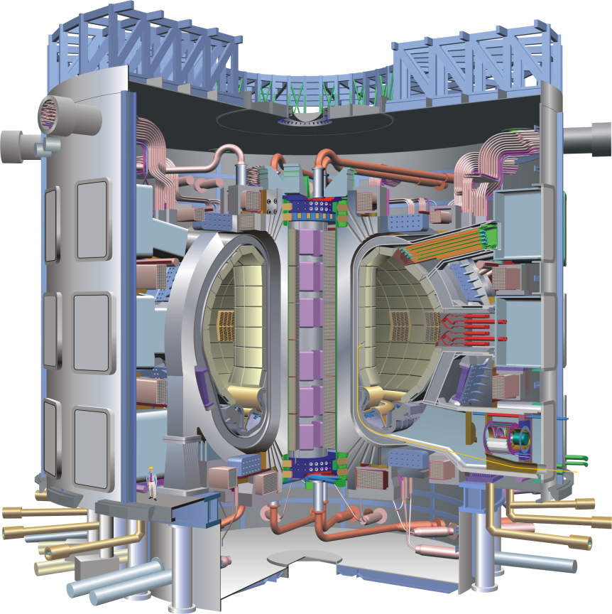

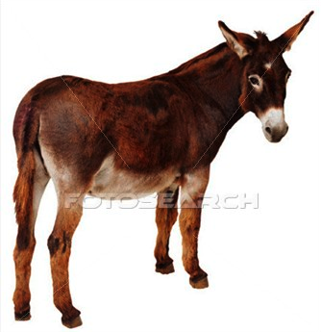



A fusion power production device is presently under construction
(ITER)
Operating Parameters
a = 2.0 m
R = 6.2 m (R/a= 3.1)
I_{p} = 15 MA
B_{T} ⁼ 5.3 T
24 m
Performance Parameters
Fusion Power ~ 0.5 GW
Power Amplification ~ 10
Burn Flattop > 400 s
27

Slide 28
Do we know enough to extrapolate to ITER?
Making progress in developing a theory-based predictive capability, but not there yet
Predictive simulations based
JET values of Pr, Rv_{pinch}/χ_{φ}
T_{NBI}=35 N-m
Fixed NB torque simulations indicate
importance of boundary conditions
Little change of v_{φ} profile with
different torque profiles with
fixed boundary condition
ω_{bound}=7 krad/s
Rotation boundary condition, inward pinch
most critical in determining core rotation
Tala et al. Nucl. Fusion (2011)

Slide 29
Many open questions for “comprehensive” understanding
A strong coupling between turbulence/transport and ExB shear exists
  Can we establish causality (is it possible)?
Boundary conditions: typically no slip has been assumed by theory (BC critical)
  Edge flows observed, however
Effect of core MHD, energetic particle modes on rotation
Understand and quantify RF “torques”
Influence of high-k (electron mode) turbulence on rotation generation/momentum transport
C-Mod
LaBombard et al. Nucl. Fusion (2004)

Slide 30
Summary
Rotation in tokamaks and STs can be large and can have a profound effect on discharge performance (transport and stability)
Intrinsic rotation generation and momentum transport strongly coupled to ion-scale microturbulence
A comprehensive theoretical understanding is at its early stages
  Boundary conditions critical – theory must apply across full plasma
  Requires detailed validation with existing data

Slide 31
Backup

Slide 32
Fusion-grade plasmas are magnetically confined in toroidal devices
Tokamak
(also, stellarators, RFPs)
Present day tokamaks have elongated cross-sections
b
R
a
Elongation
Aspect Ratio
Helical magnetic field line topology described by safety factor
(Helicity critical for confining plasmas)
Describes magnetic field “pitch”

Slide 33
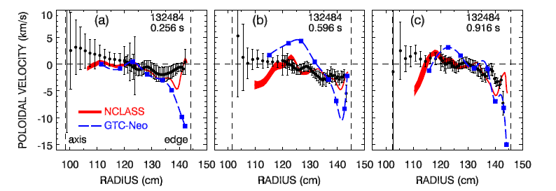
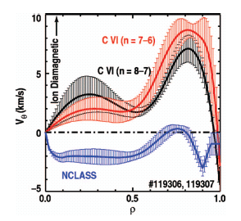
Poloidal rotation << toroidal rotation in tokamak/STs
Discrepancy between STs and higher aspect ratio tokamaks seen
V_{θ} in STs consistent with predictions
from neoclassical theory*
Difference of V_{θ} with neoclassical
predictions can be large in tokamaks
Data
Data
Theory
Theory
NSTX (from Bell et al., PoP 2010)
DIII-D (from Solomon et al., PoP 2005)
* Neoclassical transport ~ Enhanced collisional transport due to connection length,
            particle trapping effects in toroidal geometries

Slide 34
ExB shear facilitates transitions to enhanced confinement regimes
Large E_{r} shear leads to lower power needed for L- to H-mode transition
Strong ExB shear leads to “Internal Transport Barriers”
Bell et al, PPCF (1999)
McKee et al, Nuc. Fusion (2009)
ITB
DIII-D
∼ Zero torque
non-ITB
TFTR
Large >0 torque
ITB
Synakowski et al, Nuc. Fusion (1999)

Slide 35
Large E_{r} shear leads to lower power needed for L- to H-mode transition
DIII-D
McKee et al, Nuc. Fusion (2009)

Slide 36
Electrode biasing in TEXTOR drives ExB shear and associated reduction in turbulence levels
Boedo et al, PPCF(2002)

Slide 37
Higher E_{r} shear facilitates the
transition from L- to H-mode
Xu et al, Phys. Rev. Lett. (2000)
HT-6M
L->H

Slide 38
Radio-frequency heating of plasma also provides torque
- Ubiquitous, but not well understood -
C-Mod
(Fast wave ICW)
C-Mod
Lin et al, Nuc. Fusion (2011)
Ince-Cushman et al, PRL (2011)
High Harmonic Fast Waves
RF can reduce
co-rotation
and/or lead to
counter-rotation
ASDEX-U
McDermott et al, PPCF (2011)
Taylor et al, PoP (2010)

Slide 39
Magnetic field asymmetries are a source of viscous torque
3D toroidal magnetic field asymmetries can result from
  Magnetic field ripple (finite # TF coils)
  Intrinsic error fields (coil misalignments or motion during discharge due to JxB forces)
  Applied non-axisymmetric B-field perturbations at edge
Non-resonant magnetic field (ctr) torque increases at low rotation; consistent with theory:
Cole et al. PRL (2011)
Park et al. PRL (2009)
NSTX
NSTX
B.
DIII-D
C.
Solomon et al. PoP (2010)

Slide 40
There is evidence that some “intrinsic drive” exists in tokamak/ST plasmas (T_{self-driven})
Co-, ctr-NBI on DIII-D allows for flexibility to produce non-rotating plasmas across profile
- Counter torque required to offset intrinsic drive
Can also measure intrinsic torque via evolution of angular momentum
Solve for two unknowns from time evolution of angular momentum, L
DIII-D
Solomon et al. PoP (2010)

Slide 41
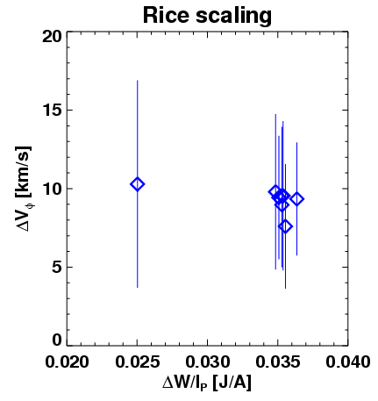
Edge intrinsic torques lead to edge intrinsic rotation
Typically use L-H transitions in OH or RF-heated plasmas to study change in intrinsic rotation
NSTX OH L-H-mode
Rice scaling not universal
Intrinsic drive
J.-K. Park, 2011
H-mode
Rice et al. Nucl. Fusion (2007)

Slide 42
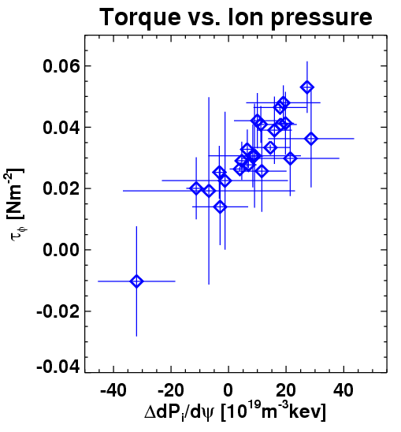
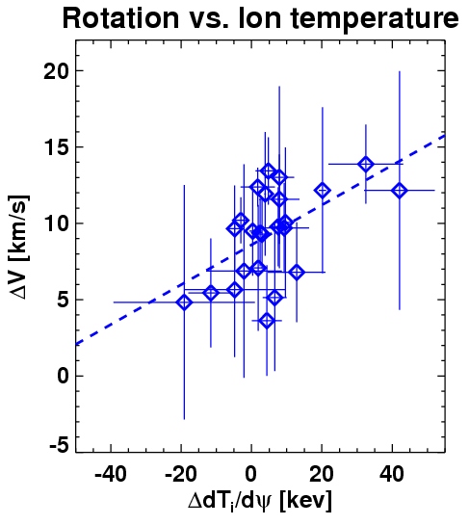
Intrinsic drive and rotation appears to be controlled strongly by respectively
Intrinsic torque scales strongly with
p, consistent with low-k turbulence
theory, Gurcan et al. PoP (2007)
Correlation found between intrinsic rotation and T_{i} in C-Mod and NSTX (also JT-60U)
Δ
Δ
DIII-D
C-Mod
Solomon et al. NF (2011)
Wang et al. PoP (2010)
Kosuga et al. PoP (2010)
Gurcan et al. PoP (2010)
theory ---
Rice et al. PRL (2011)
NSTX
NSTX
J.K. Park (PPPL)
J.K. Park (PPPL)

Slide 43
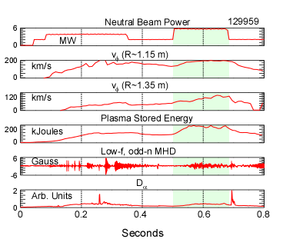
Perturbation techniques used to isolate χ_{φ} , v_{pinch}
NB step
NB modulation
Separation of v_{φ},
v_{φ} essential to
determining χ_{φ},
v_{pinch}
Center
Δ
Edge
JET
NSTX
Tala et al. PRL (2009)
Applied ΔB step
Can solve for χ_{φ}, V_{pinch} in source-free region from amplitude & phase of response
Usually find source region broad – technique not valid
Use forward modeling to determine χ_{φ}, V_{pinch}
Edge
Center

Slide 44
Perturbative momentum transport analysis reveals significant inward pinch in outer region of plasma
Including v_{pinch} brings Pr closer to 1 (0.5 – 0.8)
χ_{φ} ∼ 2χ_{φ}^{eff}
NB modulation
JET
MP step
Tala et al. PRL (2009)
JT-60U
NSTX
Yoshida et al. Nucl. Fusion (2007)

Slide 45
Not all theory predictions are seen in the data
Theory
Theory indicates inward pinch should increase with increasing inverse aspect ratio (ε)
Peeters et al, PoP (2009)
vs q
Gyrokinetics
Experiments do not show this from device-to-device
Peeters et al. Nucl. Fusion (2011)
Experiment
Not definitive

Slide 46
Drift wave turbulence is basis for understanding dependences of intrinsic rotation/torque (stress)
Conversion of turbulent energy to directed flow (leading theory)
Driven by gradients in T, p, n; requires “symmetry breaking” (rotation imbalance in Φ)
ExB shear
Fluctuation intensity gradient
Symmetry breaking
accomplished in
several ways
Gurcan et al. PoP (2007)
Ku et al. submitted to PoP (2011)
ExB shearing can come from generation of
Zonal Flows/GAMS (Geodesic Acoustic Modes)
Flow in poloidal direction with m=0/n=0
Associated with radial zones of varying E_{r}
ω∼0 (ZFs) or few kHz (GAMs)

Slide 47
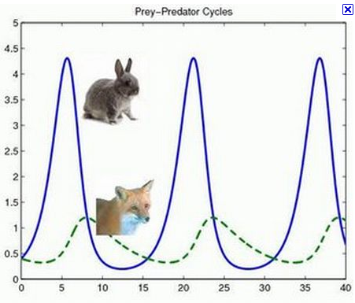
Turbulence/flow energy coupled strongly through energy conservation (and predator-prey paradigm)
ZF is like predator (eats turbulence)
Turbulence is like prey (eats gradients)
Transport and turbulence reduced by ZFs
Gurcan et al. PoP (2007)
Predator-Prey relation observed in toroidal devices
ASDEX-U
TJ-II stellarator
Estrada et al. PRL (2011)
Conway et al. PRL (2011)

Slide 48
Intrinsic rotation reversals may give insight into which specific drift wave modes are dominant
Alcator C-Mod finds confinement regimes/rotation directions depend strongly on density
Rice et al. to appear in Phys. Plasmas (2012)
Rice et al. PRL (2011)
Low n_{e}
High n_{e}
Turbulence measurements indicate likely transition from TEM (low n_{e}, T_{e}>T_{i}) to ITG (high n_{e}, T_{e}∼T_{i}) –dominated regime

Slide 49
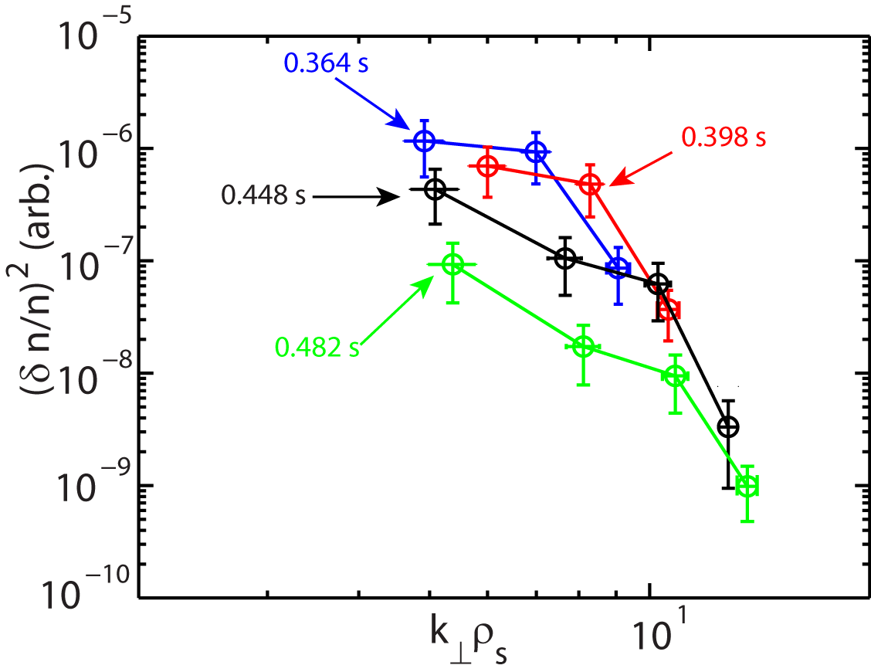
High-k scattering shows drop in turbulence across k-spectrum with increasing ExB shear

