Slide 1
Thermoelectric-Driven Flow of Liquid Lithium in Solid Metal Trenches: a New Plasma-Facing Component for Fusion Devices
David N. Ruzic, D. Andruczyk¹, M. Christenson, D. Curreli, P. Fiflis, S. Jung, K. Lindquist and W. Xu
¹assigned to PPPL

Slide 2
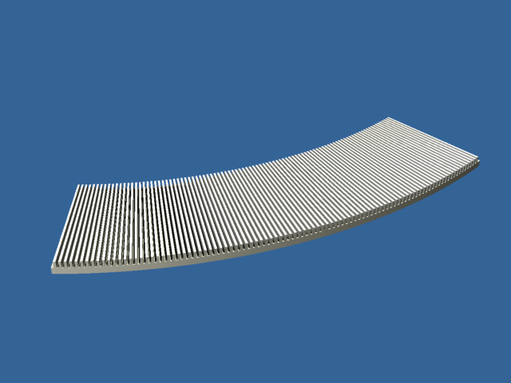
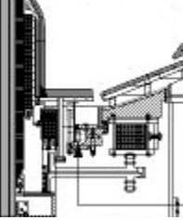
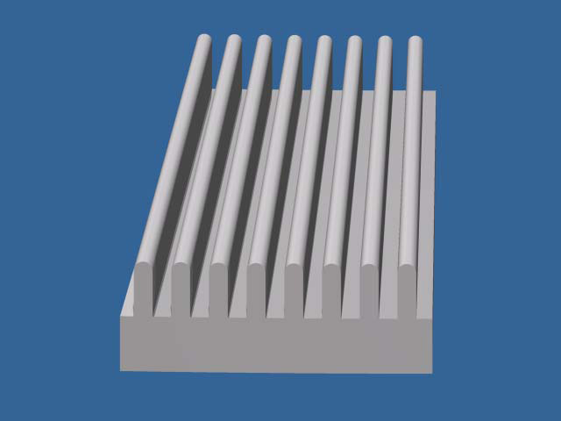
The Idea: “LiMIT” as a Divertor Plate
Edge-on view of a full toroidal divertor plate
Divertor Strikepoint Heat Stripe
LiMIT stands for “Liquid-Metal Infused Trenches” and works via TEMHD
Left is a cross-section of NSTX showing the “shelf-like” inner divertor plates.
Right is the LiMIT concept: metal tiles with radial trenches containing lithium or other liquid metal. The trenches run in the radial (pollodial) direction such that they lie primarily perpendicular to the toroidal magnetic field.

Slide 3
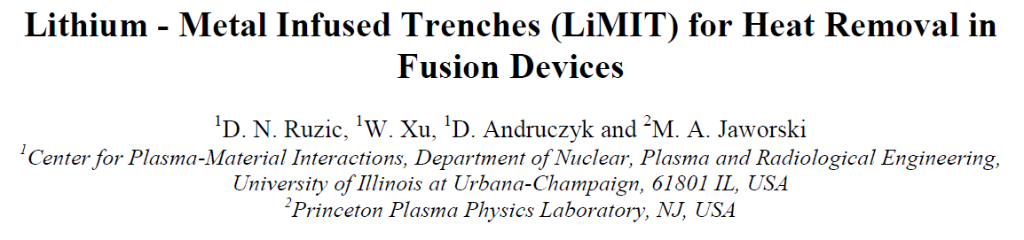
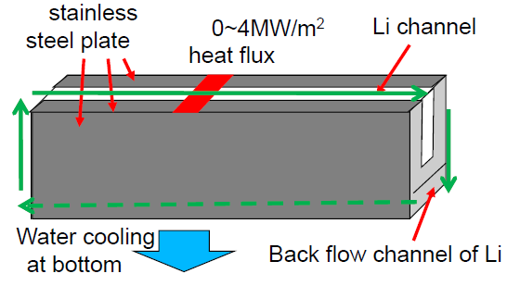

Self-Driven Lithium Flow
The top surface of the Li is hotter than the surface that is deeper. Therefore there is a VERTICAL temperature gradient
D.N. Ruzic, et al. Nucl. Fusion Lett. 51 (2011) 102002
Heat flux
F
Hot
Li flow
J
B
Cooling channels
Outlet
Inlet
Passive Li replenishment
Concept for heat removal using TEMHD. The Li flows in the slots of the metal plate powered by the vertical temperature gradient. This vertical temperature gradient generates vertical current, which when “crossed” by the toroidal magnetic field, will create a radial force on the Li driving it along the slot. This flow will transfer the heat from the strike point to other portions of the divertor plate. The bulk of the metal plate could be actively cooled for a long-pulsed device or passively. Under the plate the Li flows back. The Li is not under Pressure – very important safety consideration!

Slide 4
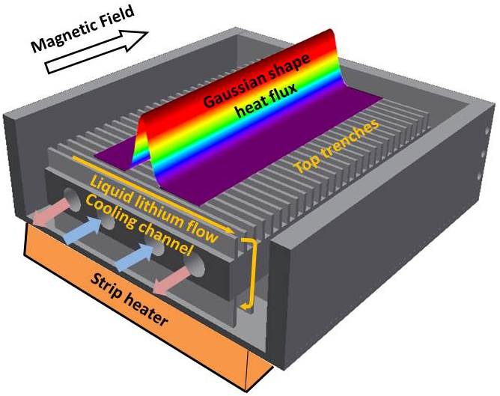
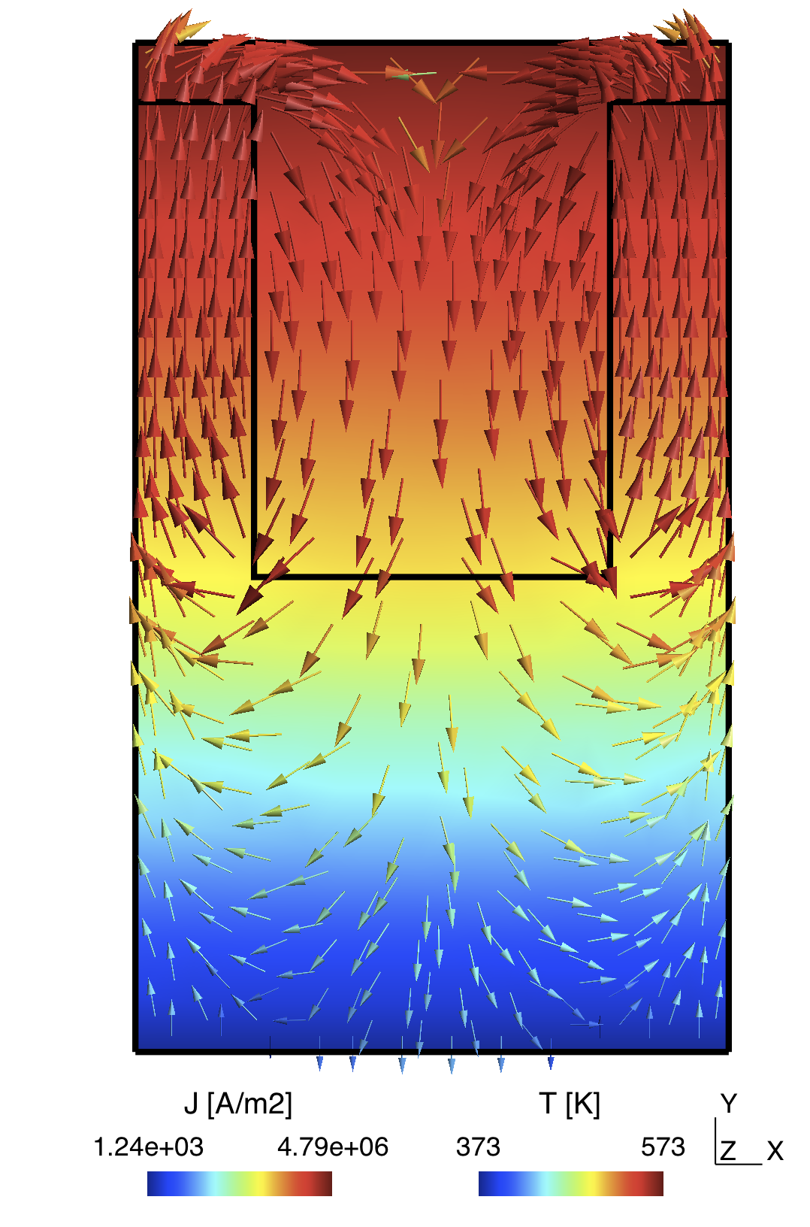
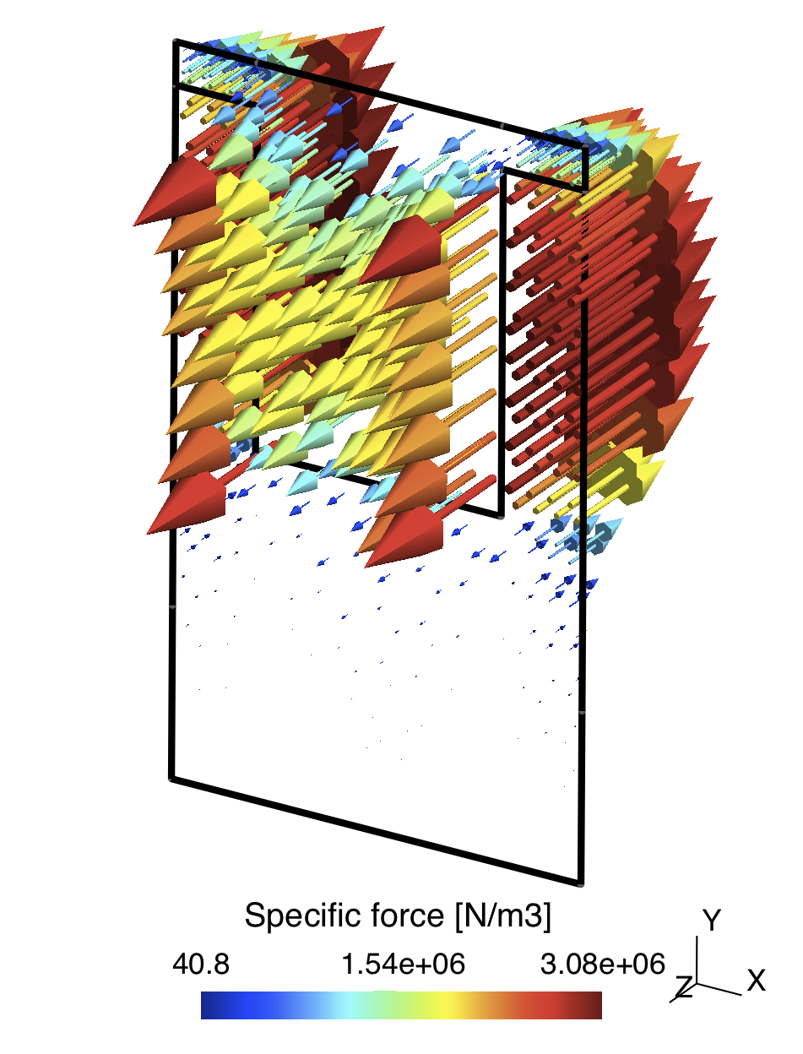
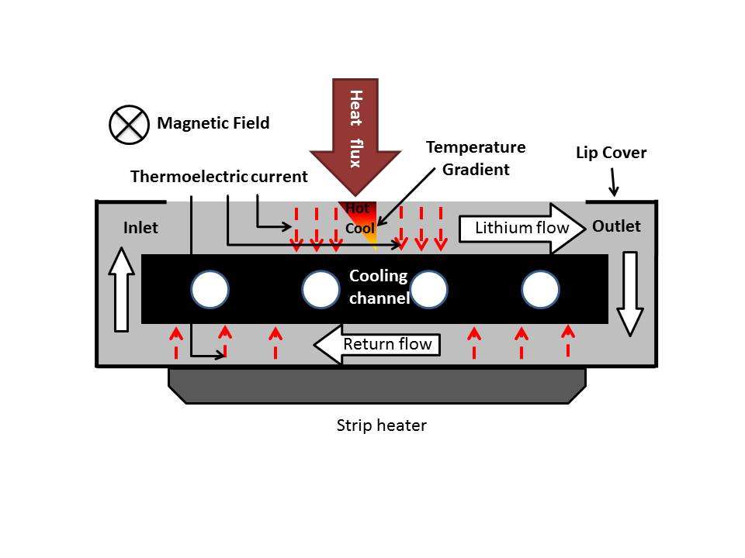
LiMIT: “Lithium/Metal Infused Trenches”
4
Magnetic Field
F

Slide 5
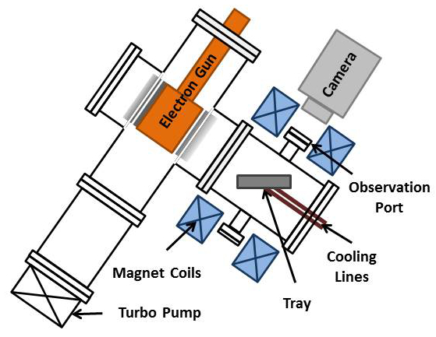
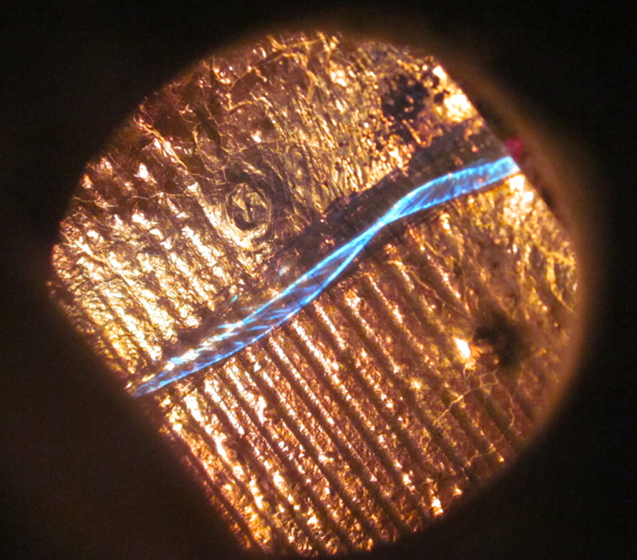
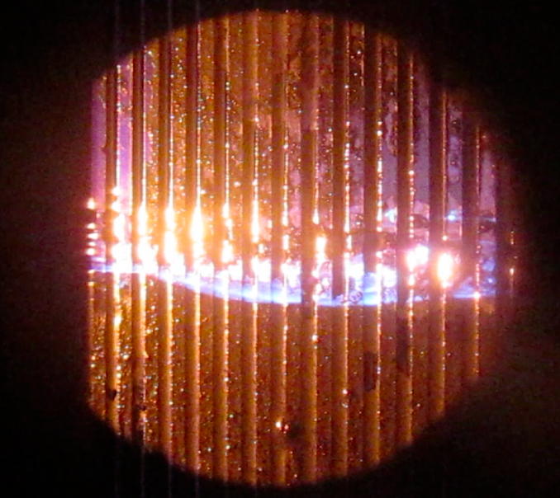
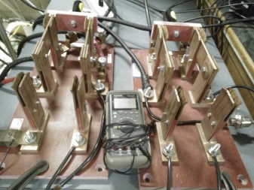
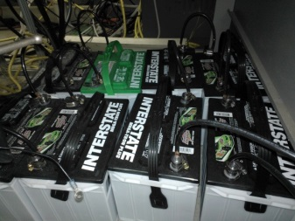
Solid/Liquid Divertor Experiment (SLiDE)
SLIDE
M.A. Jaworski, D.N. Ruzic, et al. Phys. Rev. Lett., 104, 094503 (2010)
LiMIT
10cm
Electron Gun
Gaussian
Current density
profile
25cm
10cm
LiMIT
10cm
UP8.134 Thursday pm

Slide 6
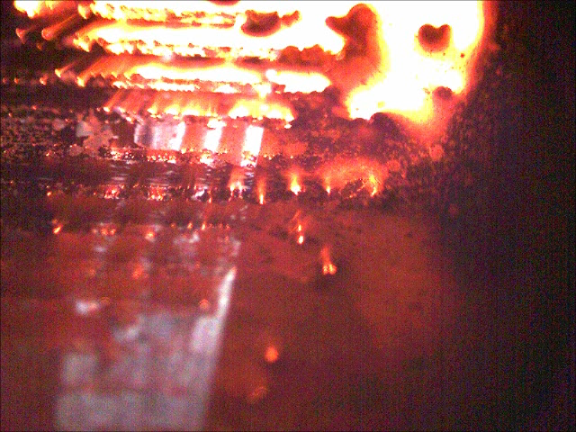
Fast-Framing Camera Showing Flow

Slide 7
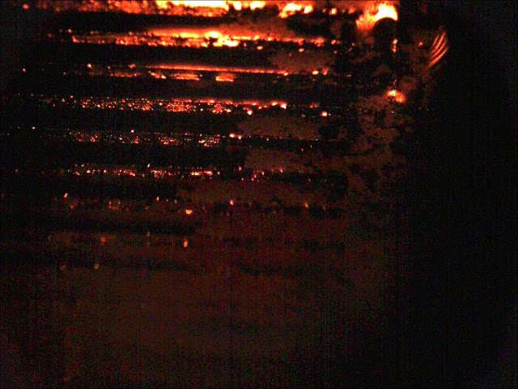
Flow at Higher Magnetic Field

Slide 8
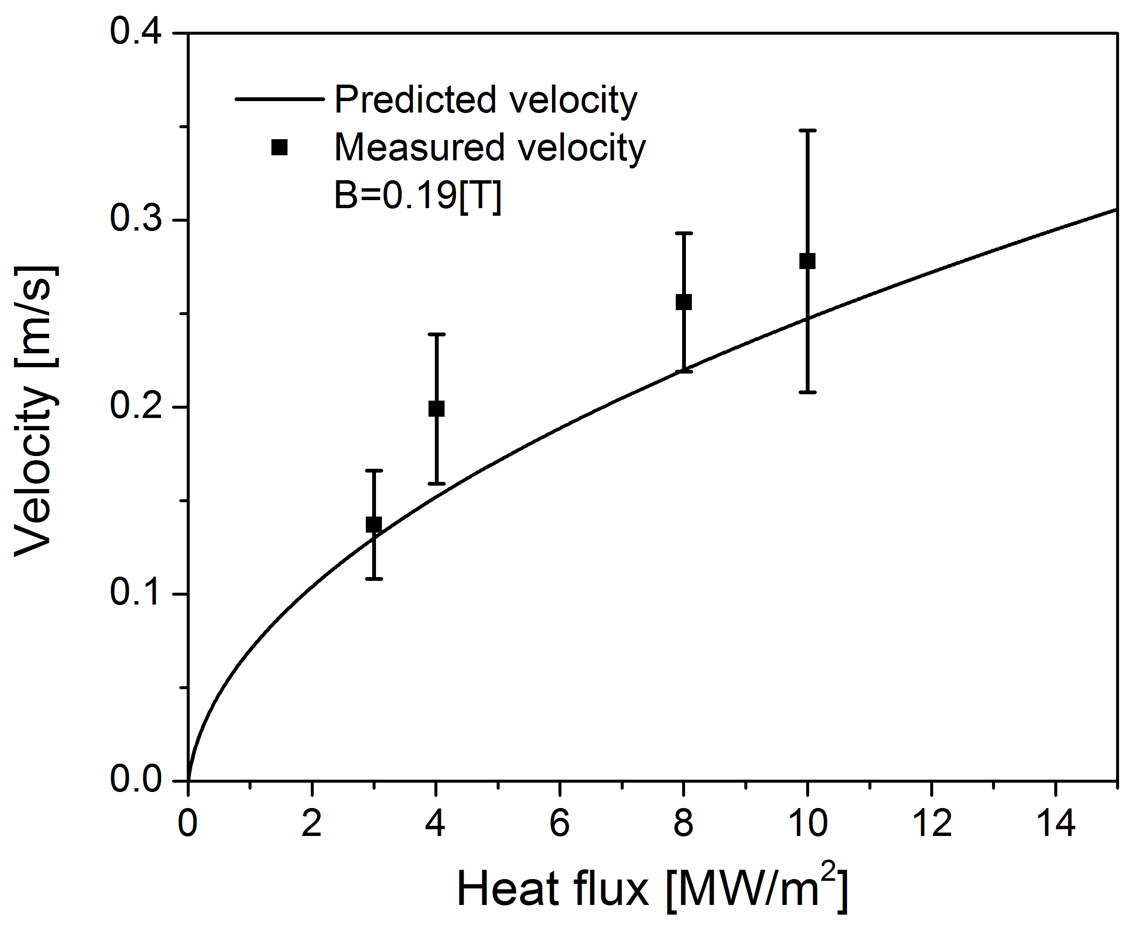
Flow Velocity Compared to Theory vs Power
The plot shows velocities at higher heat fluxes (up to 10 MW/m² ) done in SLiDE at Illinois
The measured velocity is compared with the 1D model of [1] for the B=0.19 T case.
[1] D.N. Ruzic, W. Xu, D. Andruczyk and M.A. Jaworski, Nuclear Fusion, 51 (2011) 102002
But, what about higher “real” nagnetic fields?

Slide 9
First Tokamak Shot with a Lithium/Metal Infused Trenches (LiMIT) Plasma-Facing Component on HT-7 in China. B= 2 Tesla

Slide 10
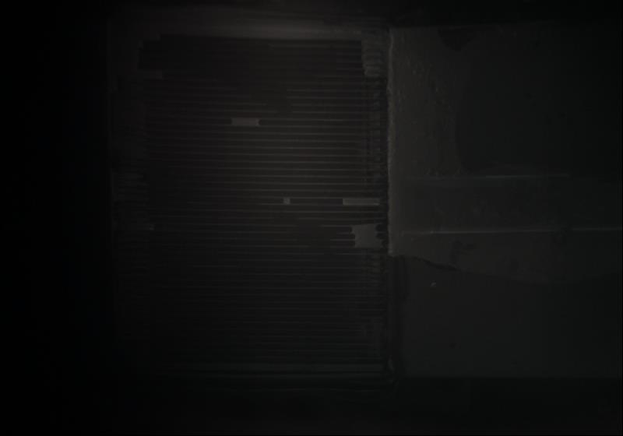

Slide 11
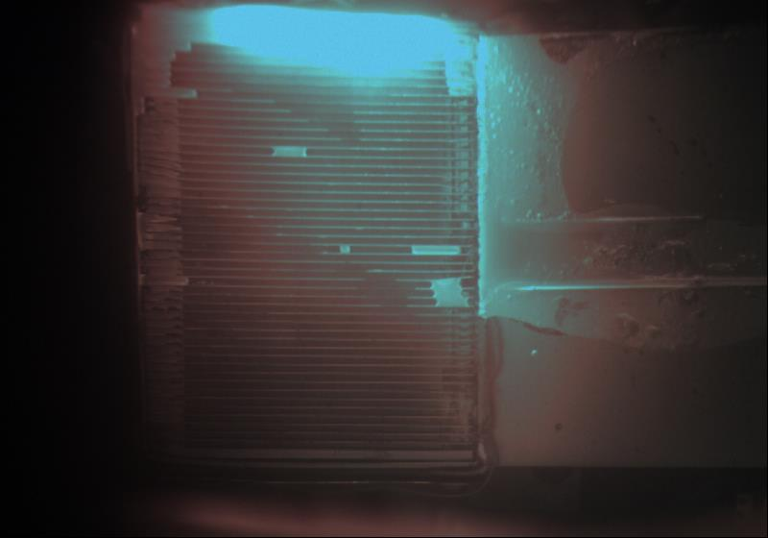

Slide 12
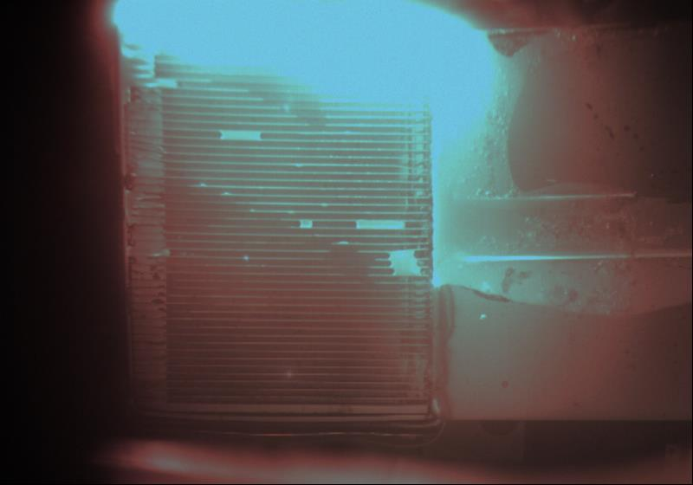

Slide 13
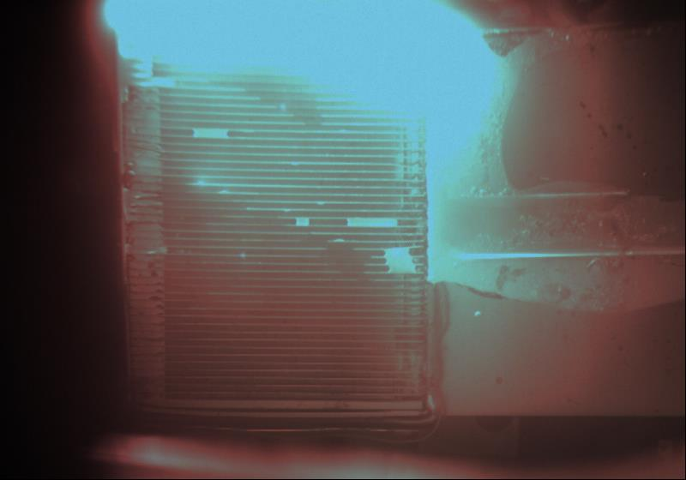

Slide 14
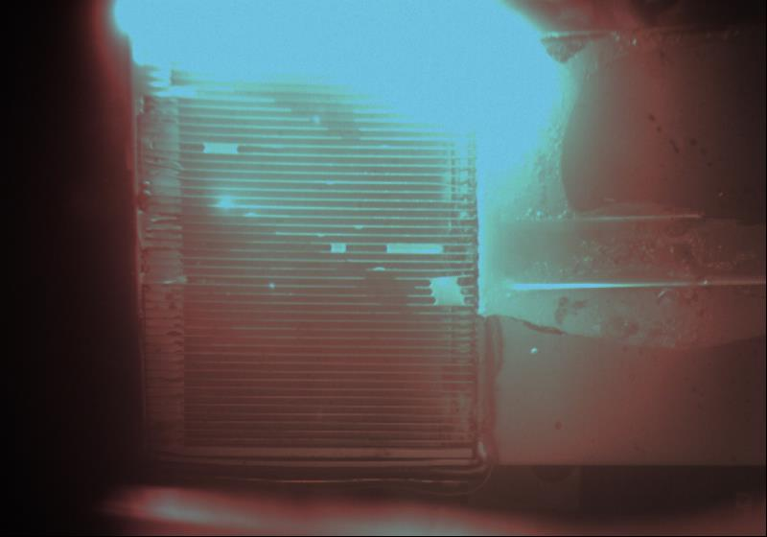

Slide 15
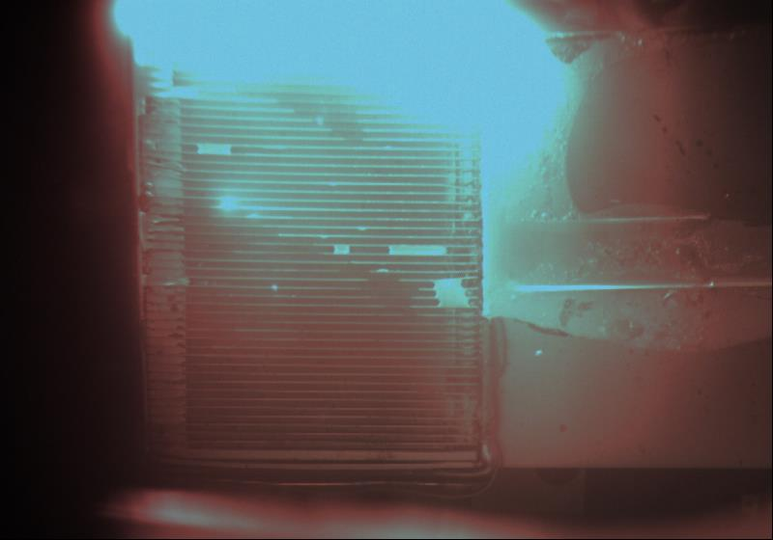

Slide 16


Slide 17


Slide 18
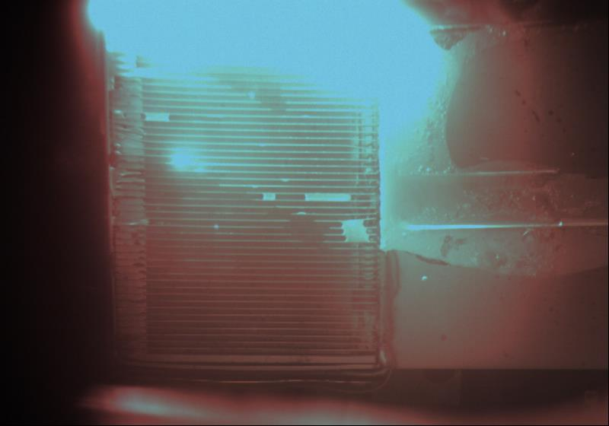

Slide 19
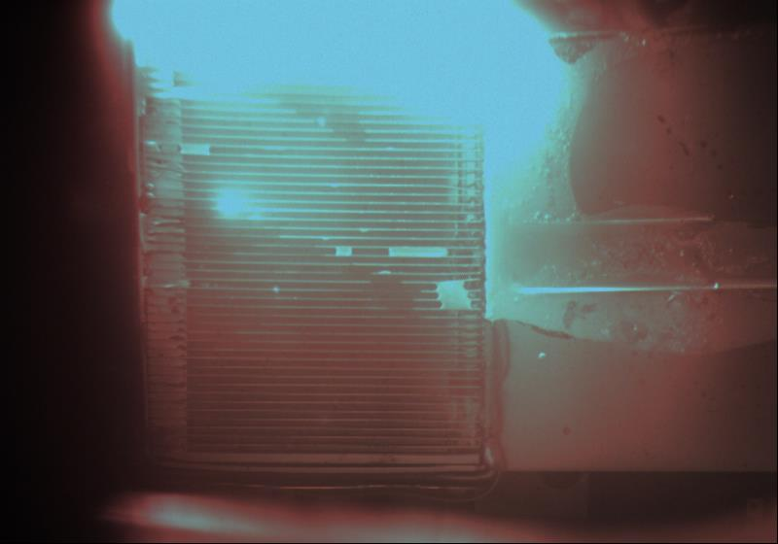

Slide 20


Slide 21
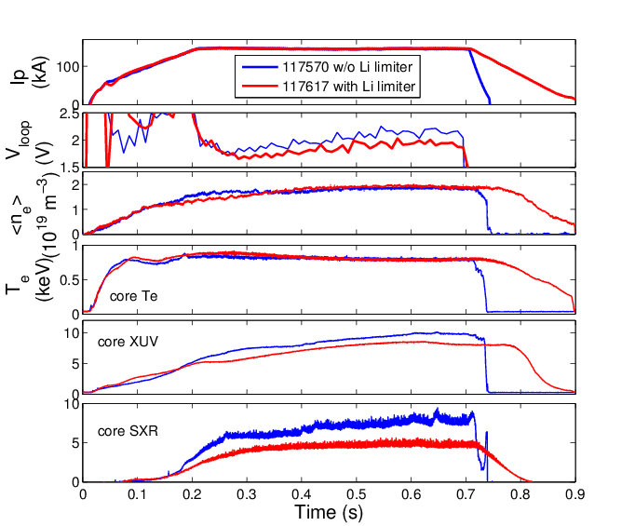
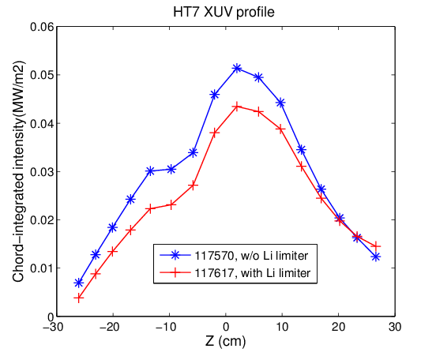
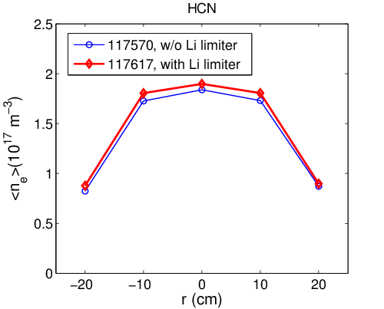
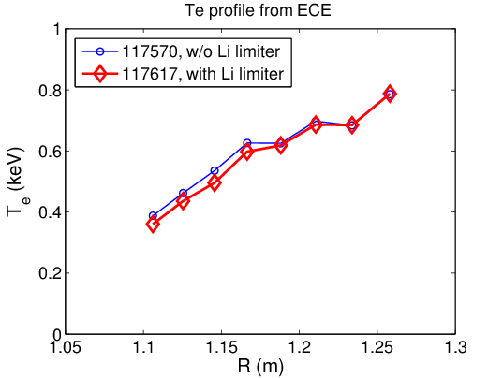
Comparison with and without the UIUC LiMIT limiter
-- n_{e} and T_{e} profiles are similar. The confinement increase ~10% with Illinois LiMIT limiter due to the decrease in radiation.
-- This result is for LiMIT positioned 2 cm outside the last closed flux surface. Greater improvement expected if more of the device was filled.

Slide 22
Velocity and Other Calculations
Field was 1.76 Tesla
Theoretical prediction from model: 4.4 cm/sec
Maximum velocity measured by video: 3.7 +/- 0.5 cm/sec
The key results is that even at realistic high (~2 Tesla) fields, the lithium still flows and therefore still keeps its ability to provide a zero-recycling clean surface,
The lithium did not leap out. It did not cause a disruption. In fact, it improved the confinement time by 10% even just by being deep in the scrape off layer and not having all the trenches filled.

Slide 23
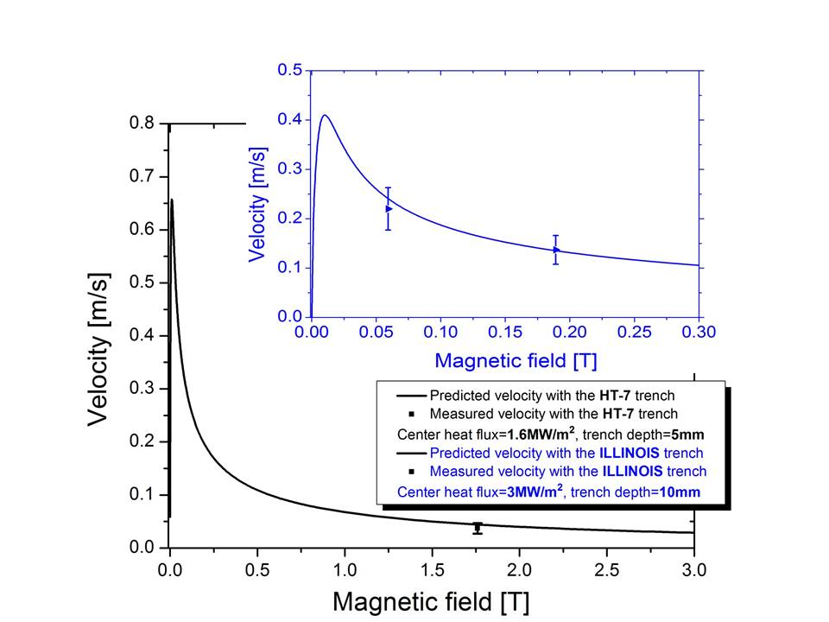
Comparison to Theory
The inset (blue) shows the velocity at B=0.059 T and B=0.19T for the same heat flux of 3MW/m²
The velocity at high field is smaller (0.13 m/s) than the velocity at lower magnetic field (0.22 m/s)
The second plot shows velocities at higher fields found in HT-7. It predicts 0.044 m/s.
The measured velocity is compared with the 1D model of Ruzic et. al. Nucl. Fusion Let., 2011

Slide 24
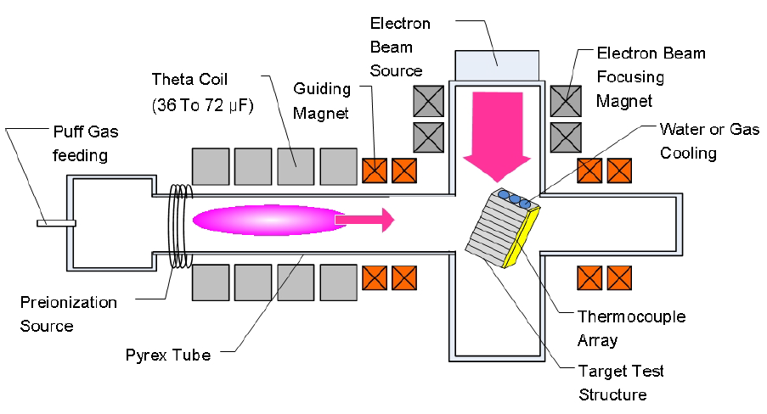
  Thermoelectric-Driven Liquid-Metal Plasma-Facing Structures (TELS)
What is next at Illinois ?
n
DEVEX
(Divertor Erosion and Vapor Sheilding Experiment)
SLIDE (Solid/Liquid Divertor Experiment)
TELS
TP8.060 Thursday morning

Slide 25
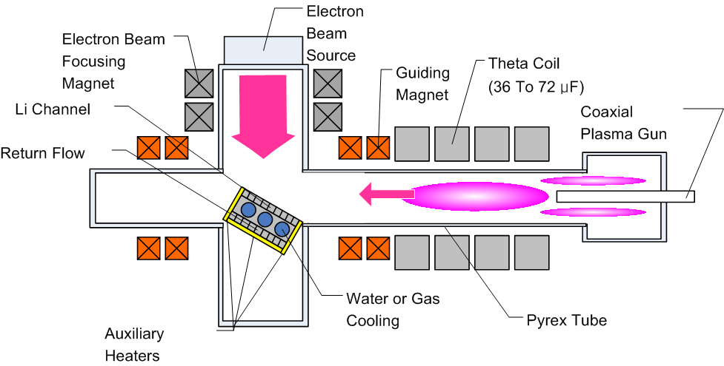
Motivation for TELS
Goal: Build a test facility to study the interactions between a liquid-metal divertor structure (LiMITS) and high pulsed plasma heat load (E > 1 MJ/m²) ie, an ELM
Previous device (DEVEX) had insufficient plasma density and temperature to simulate off-normal events in a tokamak.
Approach:
utilization of a
coaxial plasma
gun in the
existing theta
pinch device.
Desired Level:
0.1 - 1 MJ/m² (100MW/m²)

Slide 26
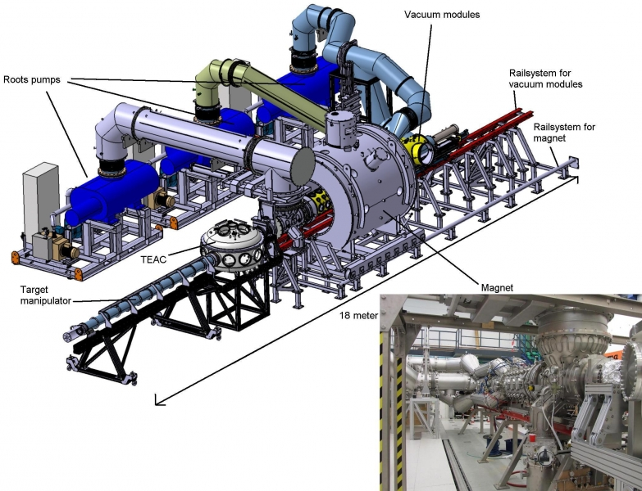
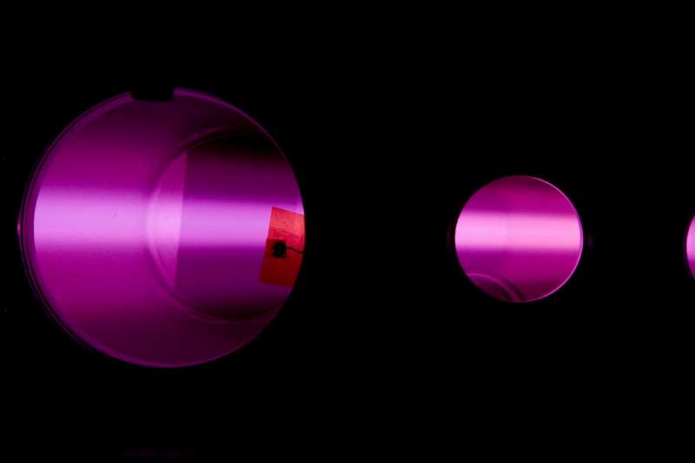
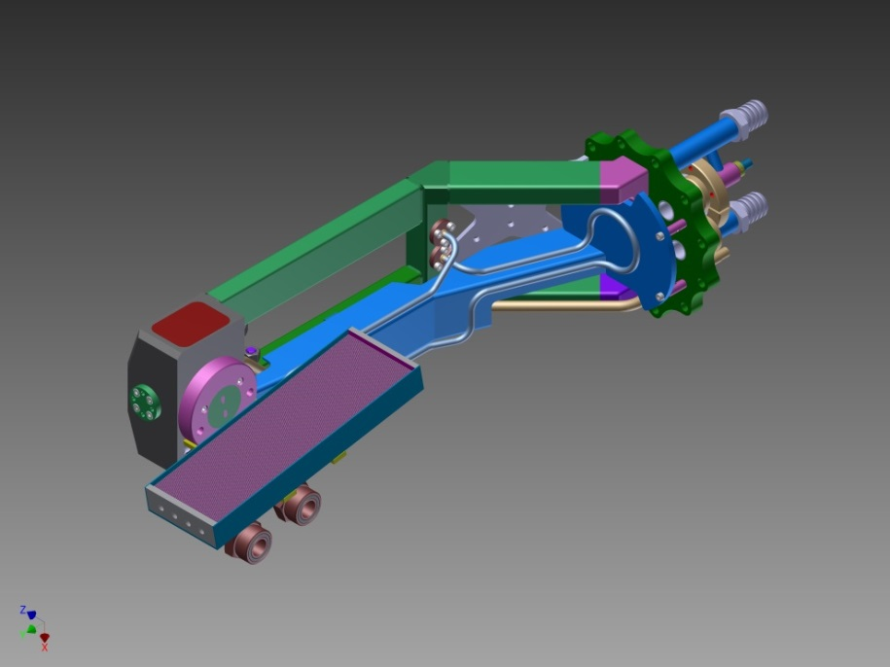
Magnum-PSI
Magnum-PSI is a linear plasma device capable <25 MW/m² parallel to the beam, B-field of 0.5 T
Construct trenches out of TZM (0.5% titanium, 0.08% zirconium, the rest is molybdenum)
TZM is chemically compatible with Li
Li-TZM junction has a thermopower of about 2/3 that of Li-SS, but better thermal properties
Cooling system using liquid water will be used only if safety requirements will be met, otherwise gas cooling
Design iterations on:
  Failure Mode and Effects Analysis
  Thermo-Mechanical Analysis (Ansys)
  Cooling channel analysis (Ansys)
Interface of LiMIT with the sample arm of Magnum-PSI

Slide 27
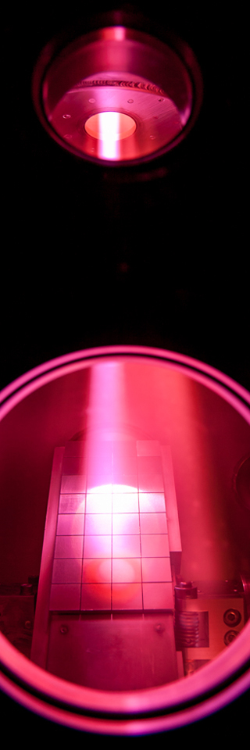
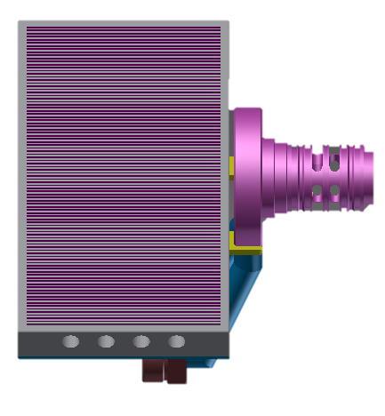
LiMIT on Magnum PSI
Plasma Flow Direction
Opportunity to test LiMIT under high-heat flux, “high” field conditions
Potential to further confirm theoretical predictions of lithium velocities under different magnetic fields
Will be able to study lithium vapor shielding in steady state
Filling and wetting demonstrated at Illinois
Magnetic Field
Linear plasma device capable of 25 MW/m² parallel to the beam with a magnetic field of about 0.5 T
TO.007 Thursday morning

Slide 28
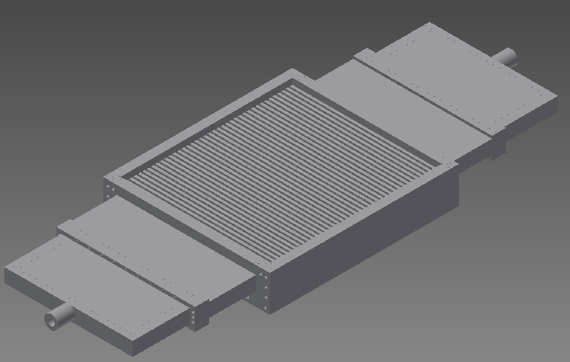
LiMIT Design: Assembly
New Design Motivated by Difficulty of Welding TZM
Magnetic Field
Anticipated Plasma Strike Point
TE Current (In Lithium)
Lithium Flow
LiMIT Trenches
Coolant Flow

Slide 29
Conclusions
LIMIT can maintain a fresh hydrogen-absorbing surface in contact with the plasma
The technology of liquid metal PFC engineering is being studied in all of its aspects, including materials compatibility, wetting, Seebeck effect, and lithium delivery.
Experiments are underway in all important categories:
  TELS --- a pulsed plasma device to simulate ELMS
  Magnum PSI – a high-heat flux facility which can duplicate DEMO environments
  (planned) EAST -- a full fledged large-scale tokamak

Slide 30
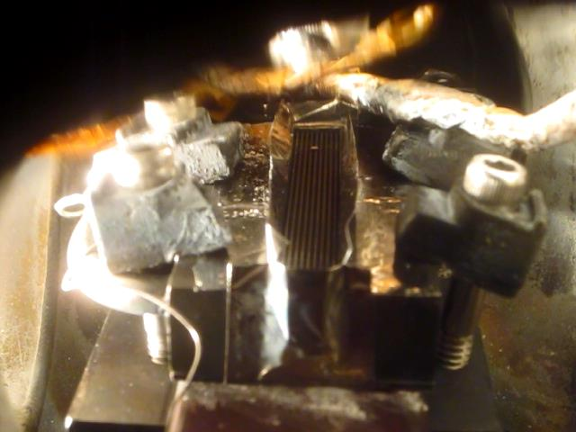
Latest at Illinois

Slide 31
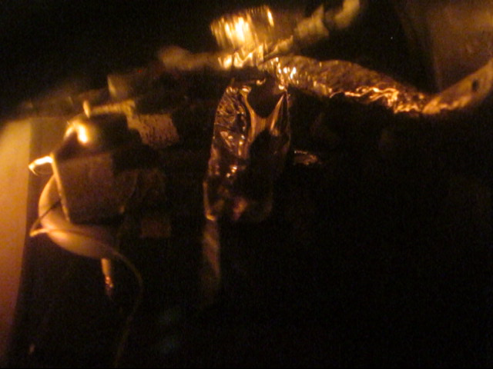
Over-filled trenches still flow

