Slide 1
Advanced divertor magnetic configurations for tokamaks: concepts, status, future.
Vlad Soukhanovskii
Edge Coordinating Committee Fall 2014 Technical Meeting
29 October 2014
New Orleans, Louisiana

Slide 2
Acknowledgements
Dmitri Ryutov, LLNL
Dale Meade, Princeton, NJ

Slide 3
This talk to discuss poloidal magnetic divertor configurations for tokamaks
Outline
Introduction
  Poloidal magnetic divertor configuration
  Perspectives on advanced magnetic divertor configurations: physics, engineering, history
Status of experiments
Research plans

Slide 4
Other Plasma-Material Interface areas are as important, however, not discussed in this talk
Core and pedestal integration
Plasma facing components
  Divertor target geometry
  Continuously moving divertor plates
  Liquid metal divertors
  Pebble divertors
  Solid divertor targets with active cooling
Operating scenarios
  Particle control with cryo
  Radiative regimes
  Ergodic divertors
  3D fields
Numerical plasma and material models

Slide 5
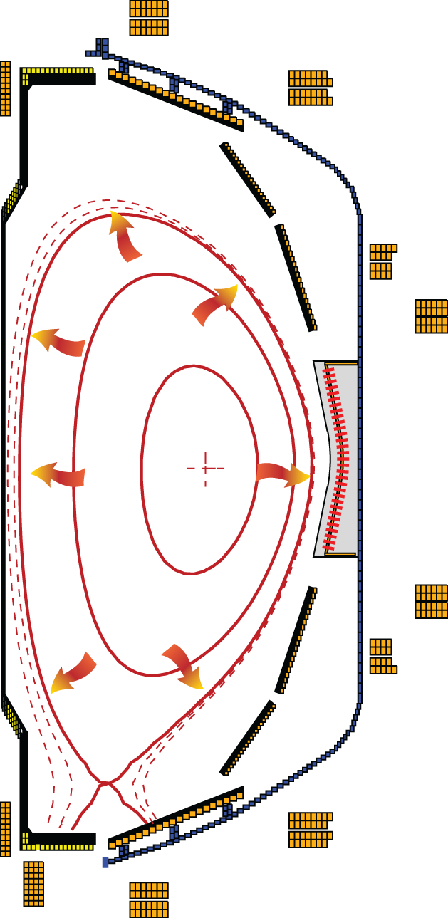
Poloidal X-point divertor enabled progress in tokamak physics studies in the last 30 years
Critical divertor tasks
  Power exhaust
  D/T and He pumping
  Impurity source reduction
  Impurity screening
Advanced magnetic configurations: potential to perform the divertor tasks better than the standard X-point divertor
National Spherical Torus Experiment,
Princeton Plasma Physics Lab
C. S. Pitcher and P. Stangeby, PPCF 39, 779 (1997)

Slide 6
Significant gaps exist between present divertor solutions and future device requirements
P_{heat}/R
  Present experiments: ≤ 14 MW/m
  ITER: ≤ 20 MW/m DEMO: 80-100 MW/m
  Proposed solution: radiate up to 80-90%
Steady-state heat flux
  Technological limit q_{peak} ≤ 5-15 MW/m²
  ITER: q_{peak} ≤ 10 MW/m² (Mitigated)
  DEMO: q_{peak} ≤ 150 MW/m² (Unmitigated)
ELM energy, target peak temperature
  Melting limit 0.1-0.5 MJ/m²
  DEMO: Unmitigated, ≥ 10 MJ/m²
Impurity erosion (divertor target plasma temperature)
Greenwald report, Toroidal Alternate Panel Report, ReNeW
IAEA DEMO Workshops

Slide 7
Advanced magnetic divertor configurations can improve standard divertor properties and performance
Radiated power loss
Increase via V_{div}, L_{II}
Poloidal Target
Inclination, etc
N
Increase plasma-wetted area
Increase divertor area at large R_{SP}
Increase λ_{q} via
increased
radial transport, L_{II}
Number of
Divertors / legs
Divertor physics is inherently 2D or even 3D
  Parallel / cross-field transport and turbulence
  Radiation front (detachment) stability
  Neutral pressure / density distribution
Increase plasma-wetted area via increasing f_{exp}

Slide 8
Engineering and technology aspects define divertor configuration options
Plasma equilibria, shaping and control
  Magnetic coils – inside or outside TF magnet
  Neutron shielding
  Cooling
  Electromagnetic forces
  Maintenance and remote handling

Slide 9
Advanced divertor magnetic configurations (classified by appearance)
Multiple divertors, each with one X-point
Higher order (2nd, 3rd) null divertors
Divertor with multiple X-points
Long-legged divertors with multiple X-points
Note on early concepts
  Envisioned before H-mode discovery (1982)
  Some concepts envisioned divertor for particle and impurity control only

Slide 10
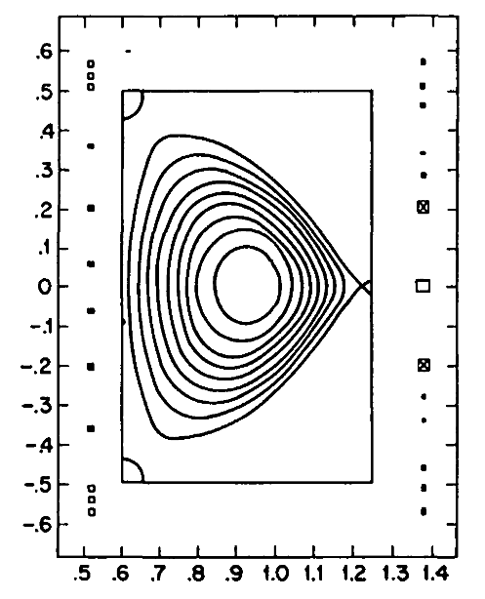
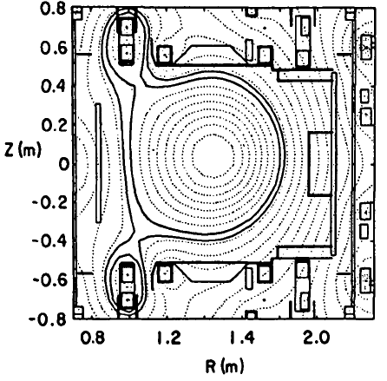
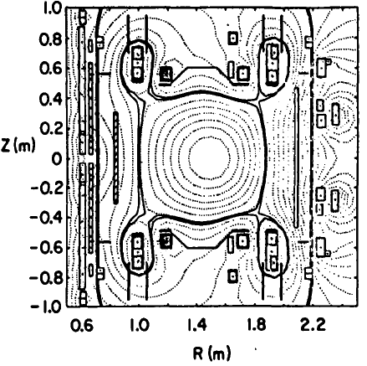
1. Multiple divertors: triple-null, quadruple-null to share heat and particle fluxes
Poloidal Divertor Experiment tokamak at PPPL (1979 – 1983)
Significant contribution to divertor physics with double-null configuration
D-shaped plasma, high triangularity
Increased local shear
Enhanced kink stbility
K. Bol et.al, Nucl. Fusion 25, 1149 (1985)
J. Kesner, Nucl. Fusion 30, 548 (1990)

Slide 11
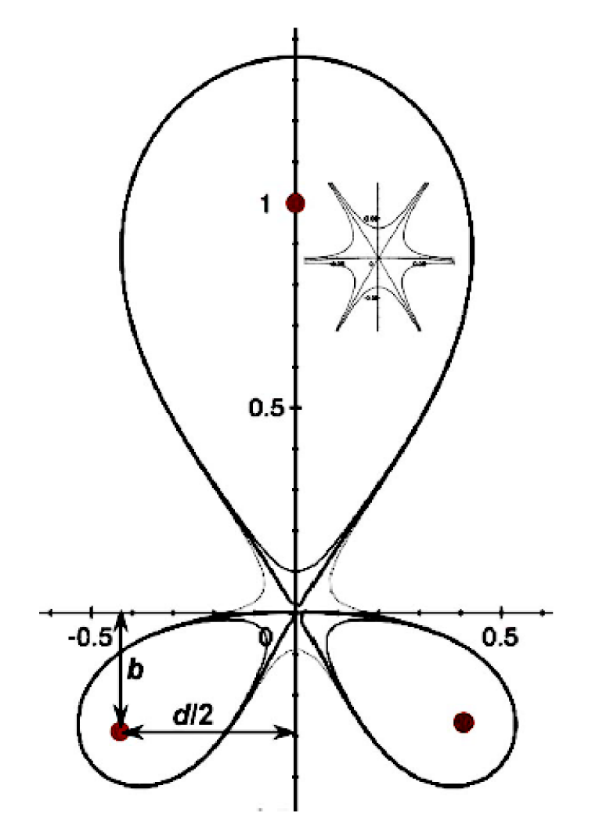
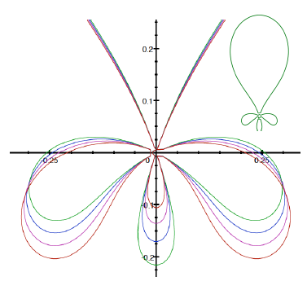
2. Higher order null divertors : larger region of very low B_{p} to affect geometry and transport
Snowflake, 2nd order null
  B_{p} ~ 0, grad B_{p} ~ 0 (Cf. first-order null: B_{p} ~ 0)
  B_{p}(r)~r² (Cf. first-order null: B_{p} ~ r )
  Four divertor legs
Cloverleaf, 3rd order null
  B_{p}(r)~r³
  Six divertor legs
Strong plasma convection
D. D. Ryutov, Phys. Plasmas 14 (2007), 064502
D. D. Ryutov et. al, Phys. Plasmas 20 (2013), 092509

Slide 12
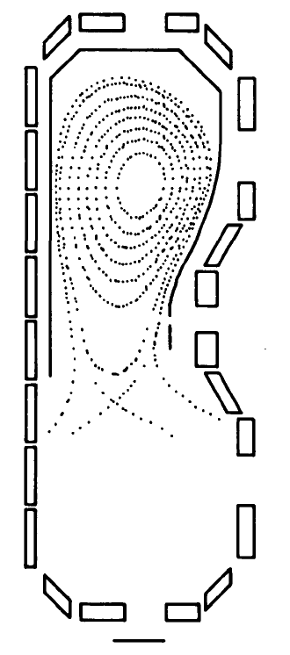
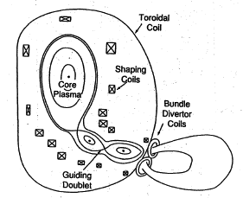
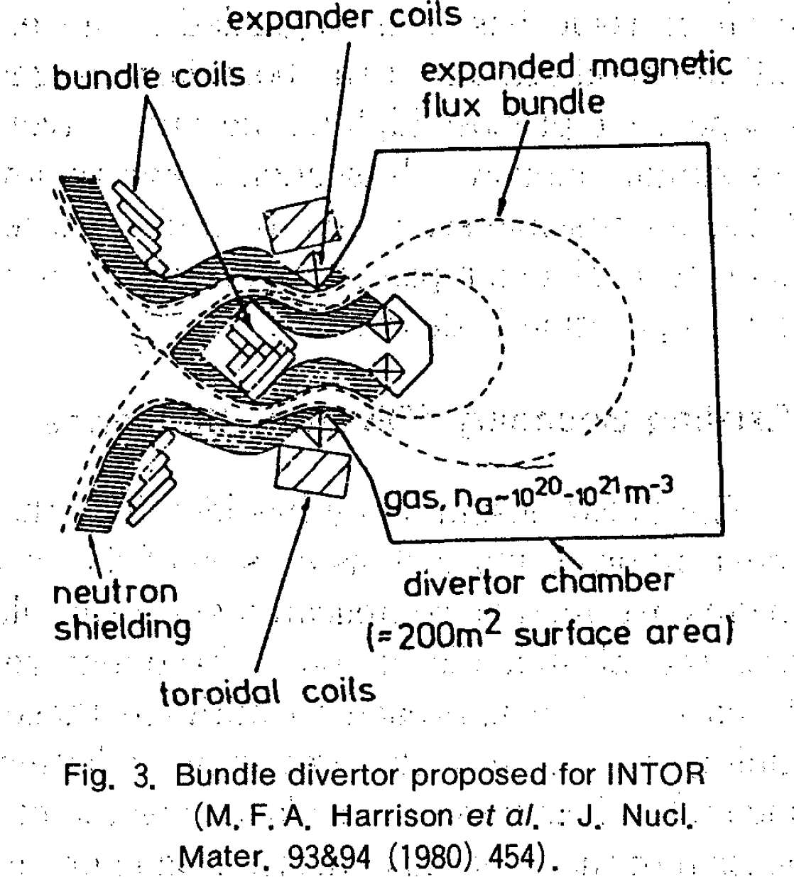
3. Divertor with multiple X-points: expand SOL in the divertor region
N. Ohyabu et. al, Nucl. Fusion 5 519 (1981)
N. Ohyabu, J. Plasma Fus. Res. 5 525 (1991)
Doublet III Expanded Boundary
Poloidal Bundle + Expanded Boundary
Analysis of radiation, H-mode compatibility, neutron shielding, coil currents

Slide 13
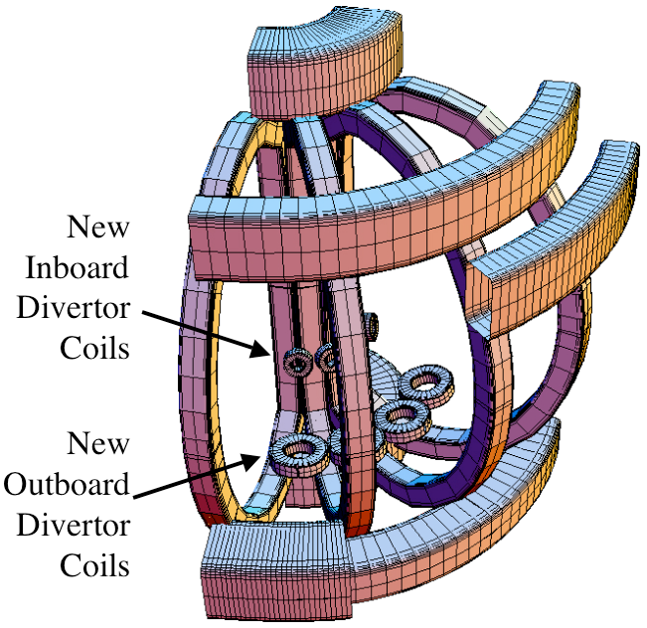
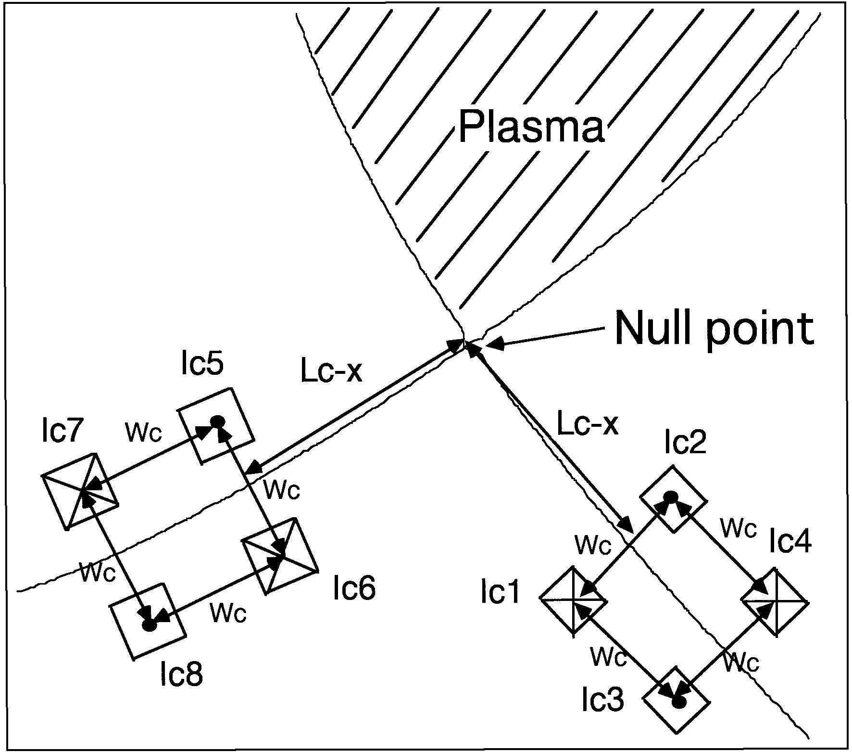
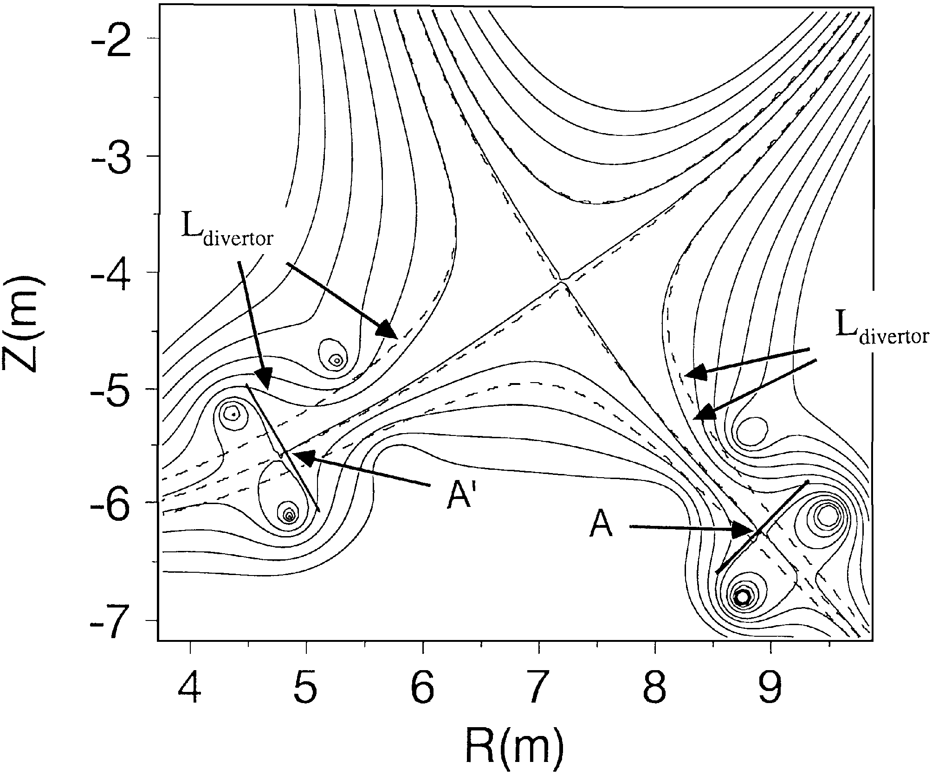
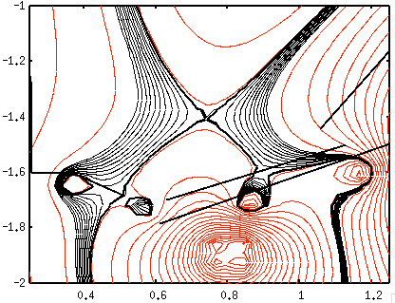
3. Divertor with multiple X-points: expand SOL in the divertor region
H. Takase, J. Phys. Soc. J. 70, 609, 2001
M. Kotschenreuther et. al, IAEA FEC 2004;
Phys. Plasmas 14, 072502 (2007)
Cusp-like divertor configuration
  Coil currents acceptable for ITER-like parameters
X-Divertor
  Small dipole coils under each divertor leg, inside the TF
  Potential to stabilize rad. front

Slide 14
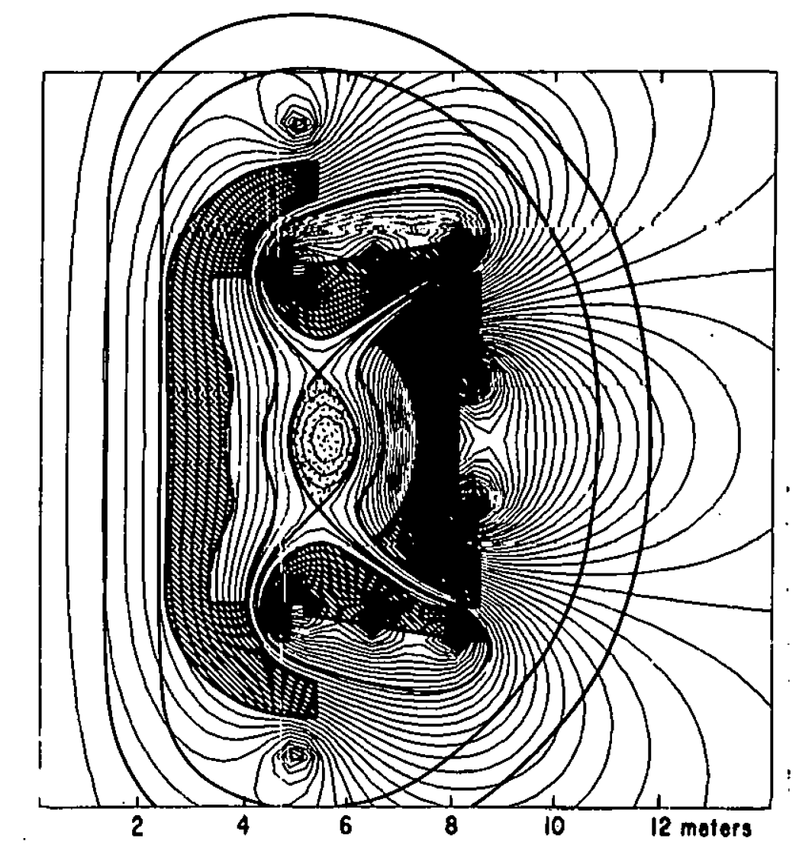
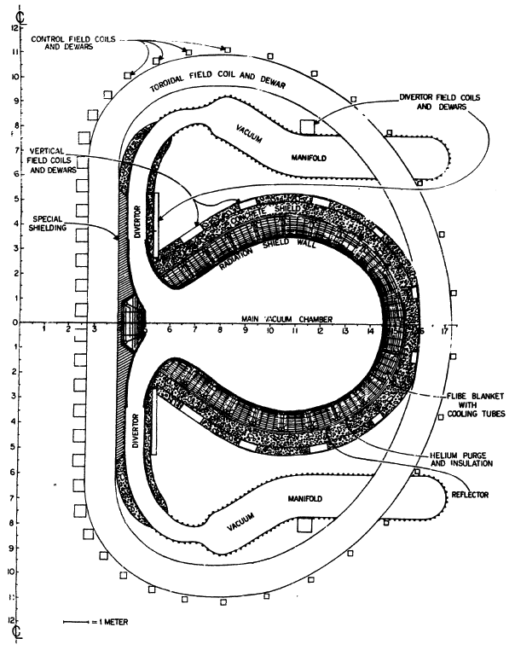
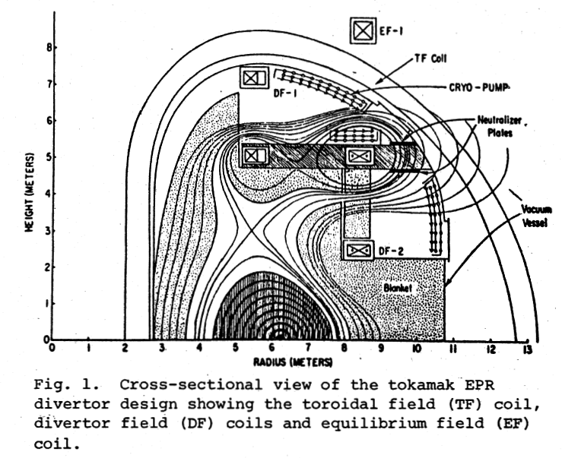
4. Long-legged divertors with multiple X-points: increase connection length, expand SOL
F. H. Tenney et.al,
J. Nucl. Mater. 53 43 (1974)
A.V. Georgievsky et.al, 6th Symp Eng Prob of Fus Energy, p 583, 1975, IEEE 75CH1097-5-NPS, Copyright 1976
F. H. Tenney,
PPPL Report 1284, 1976
Conceptual divertor design for Princeton Reference Design Reactor.
Long-legged high flux expansion poloidal divertor
Long-legged double null poloidal divertor

Slide 15
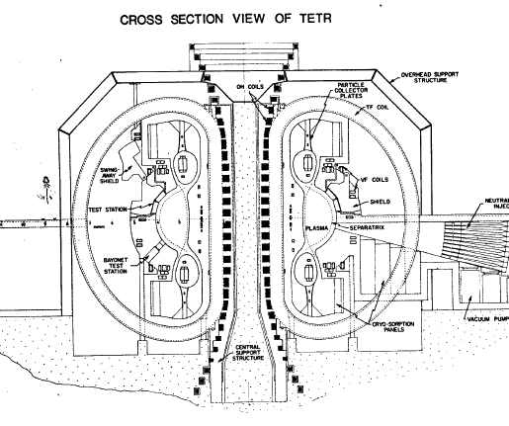
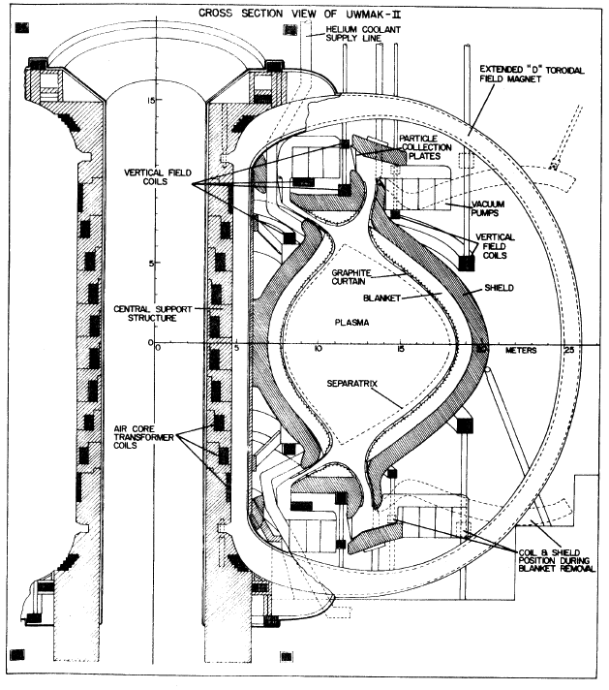
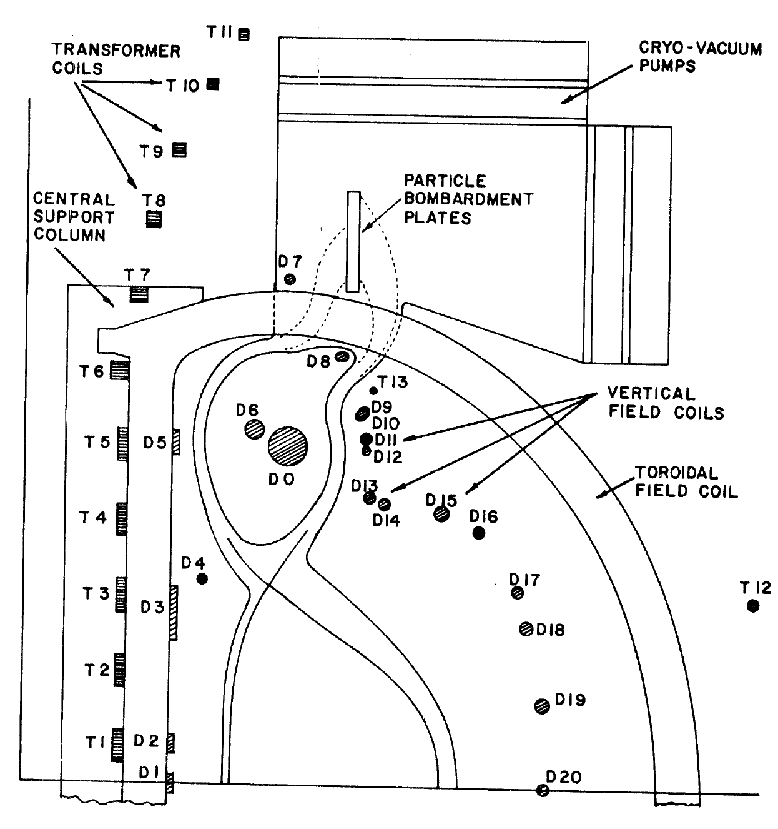
Long-legged divertors with multiple X-points
R. W. Conn et.al, U. Wisc. Report UWFDM-114, 1974
B. Badger et.al, U. Wisc. Report UWFDM-150, 1975
G. L. Kulcinski et.al, U. Wisc. Report UWFDM-173, 1976
UWMAK-II
UWMAK-III
Tokamak Enginering Test Reactor
UW Fusion Technology Institute conceptual reactor systems studies

Slide 16
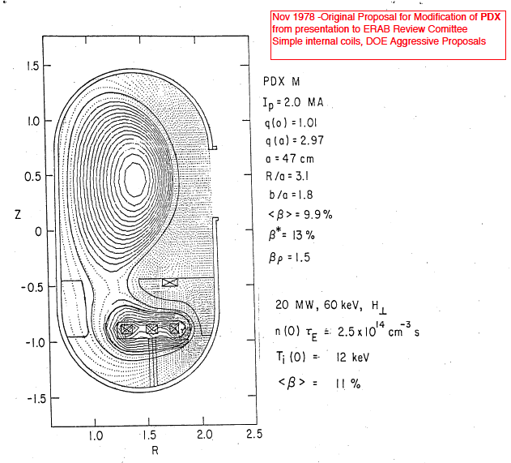
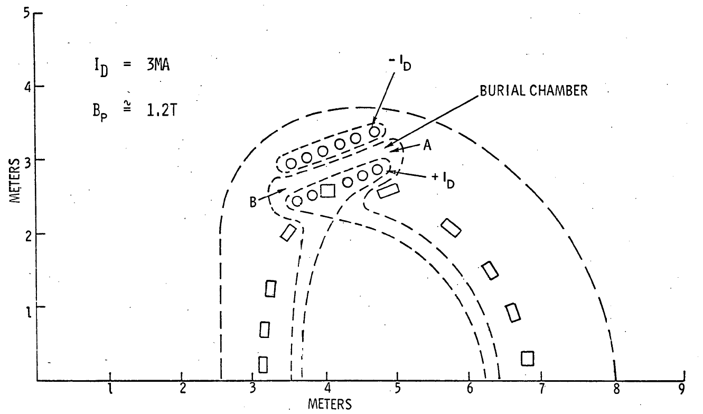
4. Long-legged divertors with multiple X-points
T. F. Yang et.al, Westinghouse Corp. WFPS-TME-055 1977
TNS reactor (w/ ORNL)
Divertor heat flux 1-3 MW/m²
Flowing liquid lithium targets for heat and particle removal
D. Meade, Private Communication
PDX Modification proposal

Slide 17
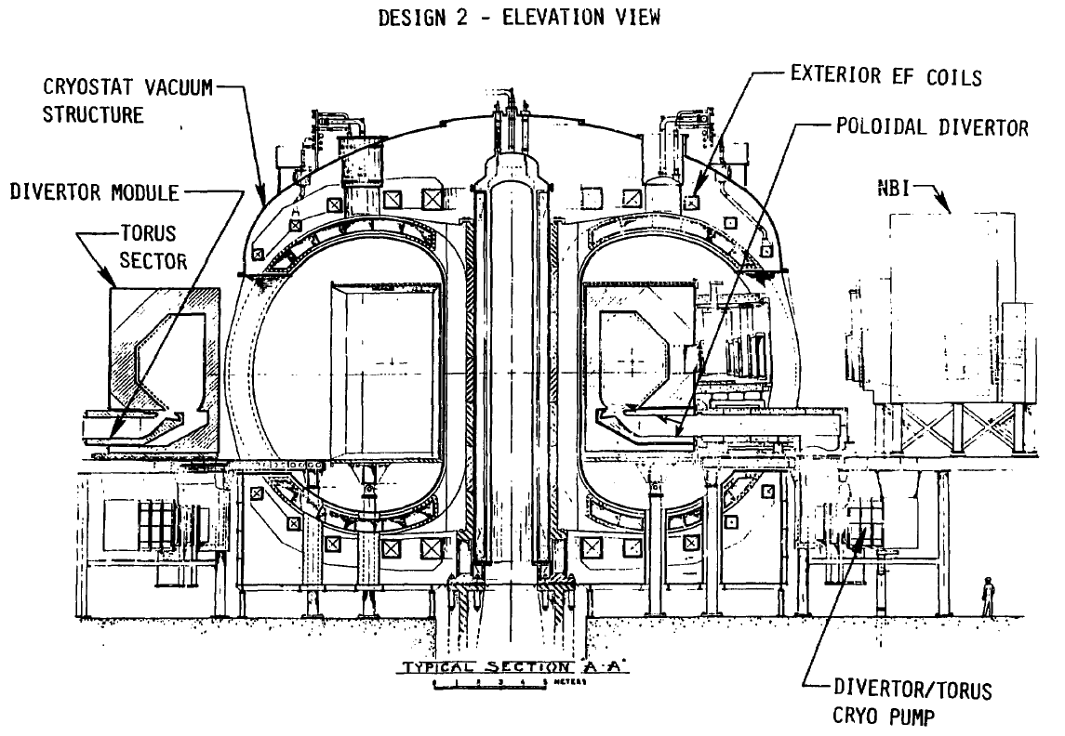
4. Long-legged divertors remove interaction zone away from plasma
Conceptual design Engineering Test Facility
R=5.6 m
a=1.3 m
B_{t}=5.5 T
I_{p}=6.1 MA
P_{NBI}=60 MW
Poloidal divertor
  W target plates
  Cryo-panels for particle control
P. H. Sager et. al, J. Vac. Sci. Tech. 18, 1081 (1981)

Slide 18
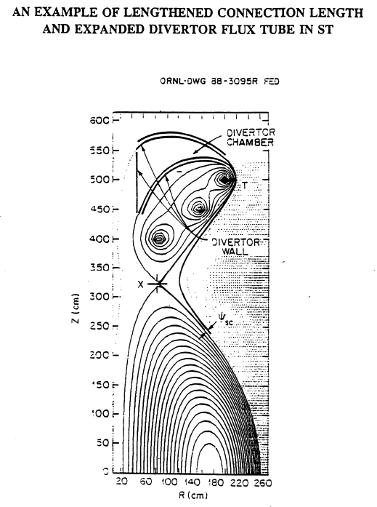
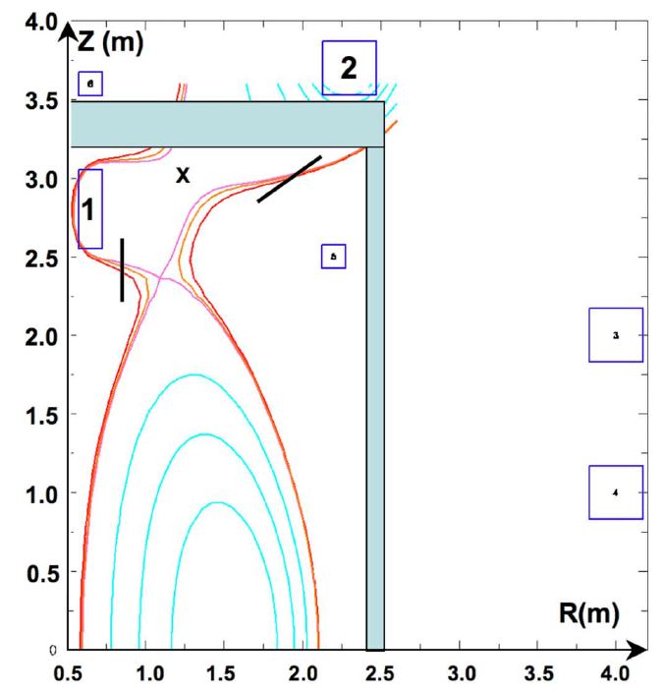
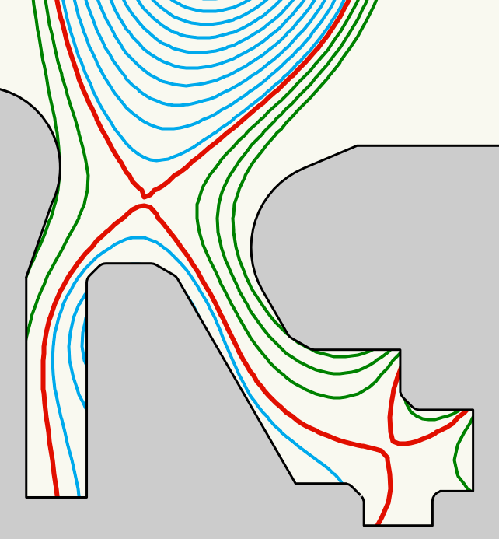
4. Long-legged divertors with multiple X-points
P. M. Valanju et.al, Phys.
Plasmas 16, 056110 (2009)
B. LaBombard et.al, APS 2013,
IAEA 2014
M. Peng, Steady-state Spherical tokamak TST,
Workshop on Edge Plasma for BPX and ITER, 1991
X-point target divertor
ADX tokamak proposal
Super-X divertor

Slide 19
Advanced magnetic divertor configurations: status of experiments
Dedicated experimental devices (1979-1986)
    PDX
    Doublet III Expanded boundary
Snowflake divertor configuration (existing devices with existing coils, 2008-present)
    TCV, 2008
    NSTX, 2009
    DIII-D, 2012
    EAST, 2014
Long leg divertor physics (2010-present)

Slide 20
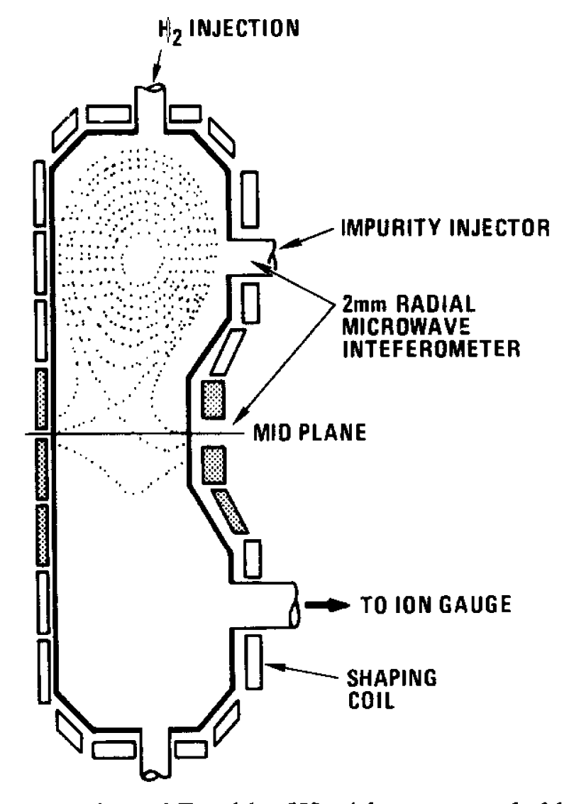
1. Doublet III Expanded Boundary was the first advanced magnetic divertor configuration experiment
Stability of divertor configuration with outside PF coils
Integrated power and particle exhaust
  Reduction of intrinsic impurities in the core
  Radiative divertor plasma cooling with seeded argon
  Argon screening from main plasma
Compatibility with core confinement
N. Ohyabu et. al, Nucl. Fusion 5 519 (1981)
A. Mahdavi et. al, J. Nuc. Mater. 111 (1982) 355

Slide 21
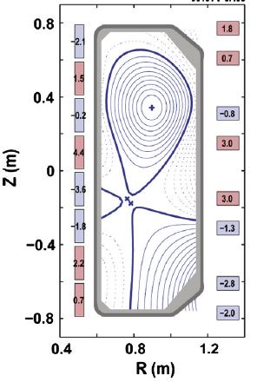
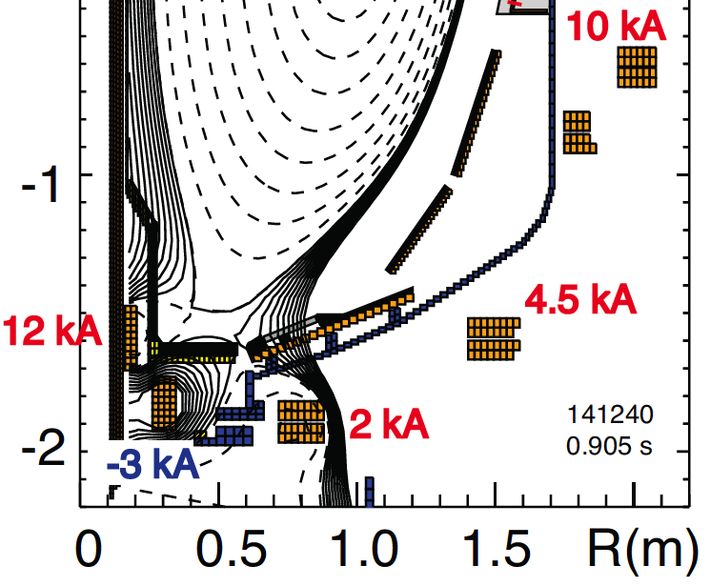
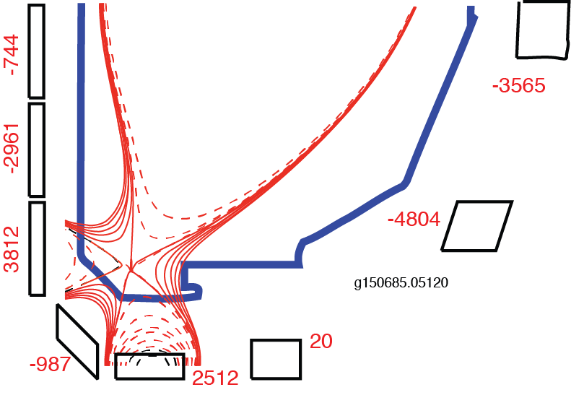
2. Snowflake configuration has been realized in several devices using existing PF coils
TCV
  Ip≤1 MA
  B_{t}≤1.5 T
  16 PF coils, Pre-programmed currents
NSTX
  I_{p}=0.8-1.0 MA
  B_{t}≤0.45 T
  3 divertor coils, pre-programmed currents
DIII-D
  I_{p}=0.8-1.0 MA
  B_{t}=2 T
  3 divertor coils w/control

Slide 22
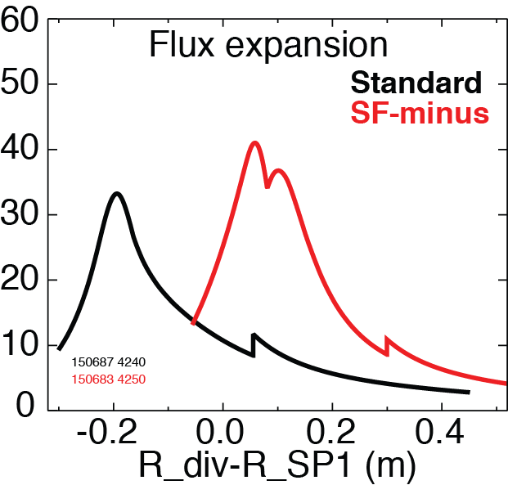
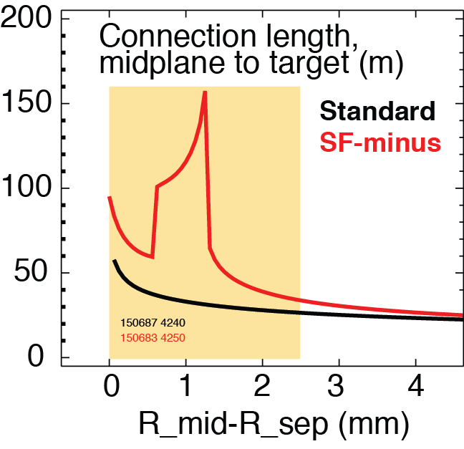
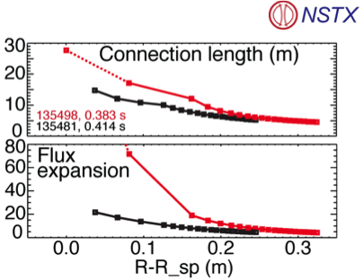

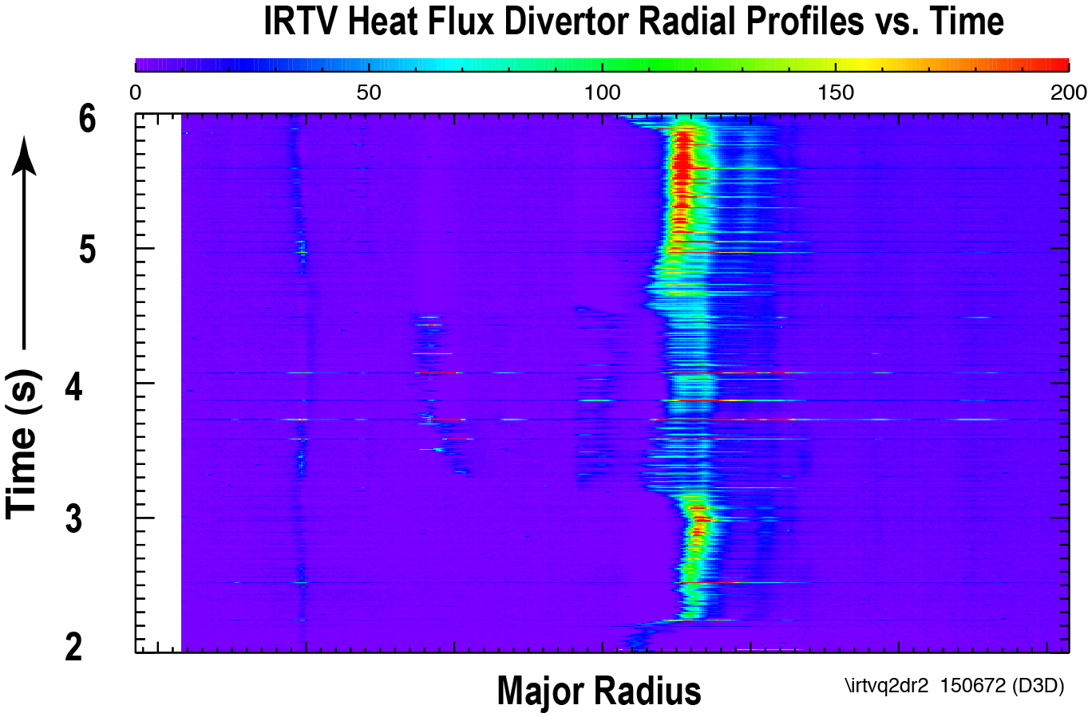
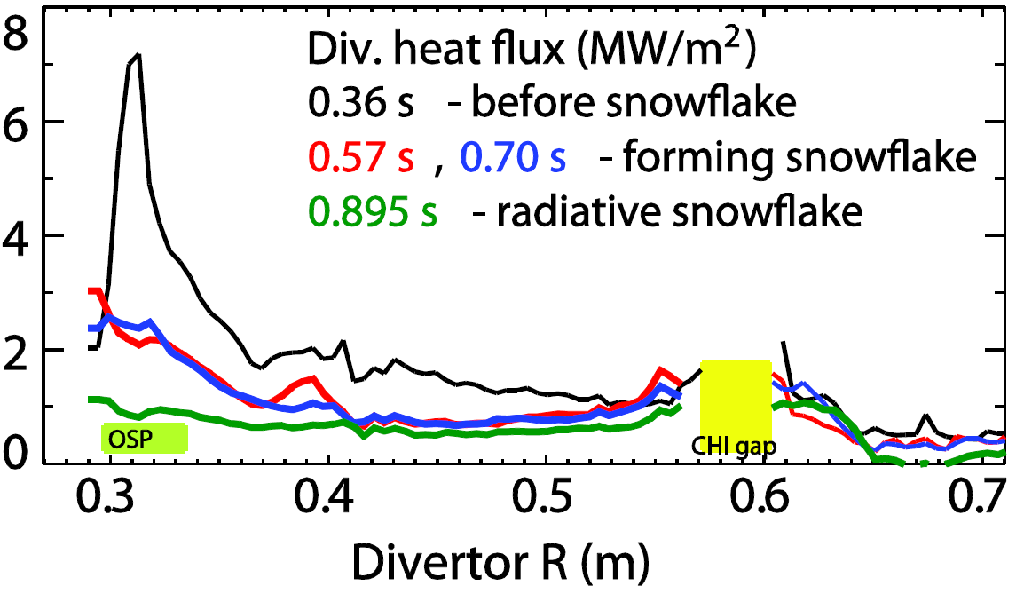
Divertor heat flux significantly reduced due to snowflake divertor geometry effects
Standard Snowflake
Standard Snowflake
SOL
snowflake
NSTX
DIII-D

Slide 23
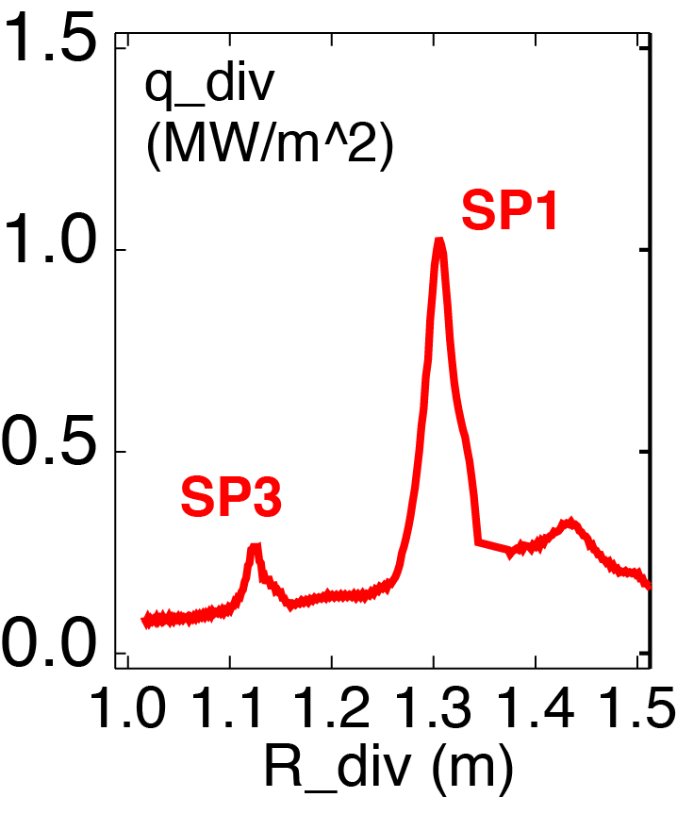
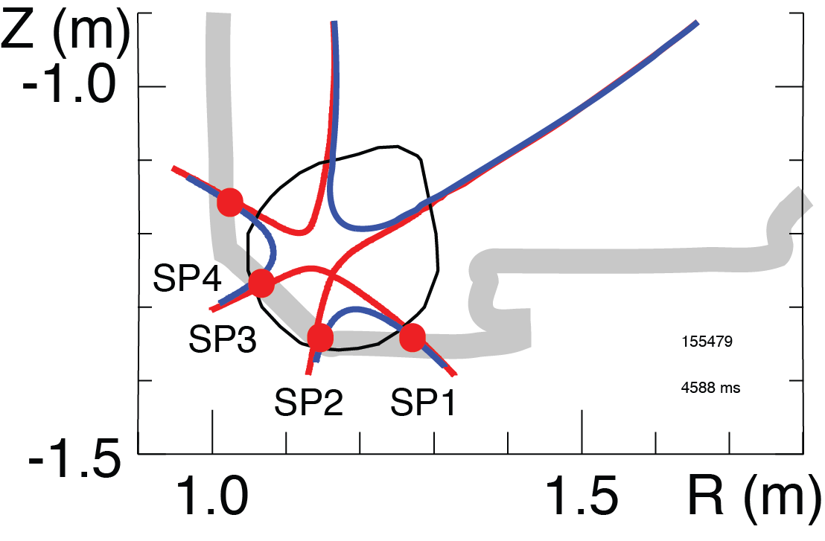
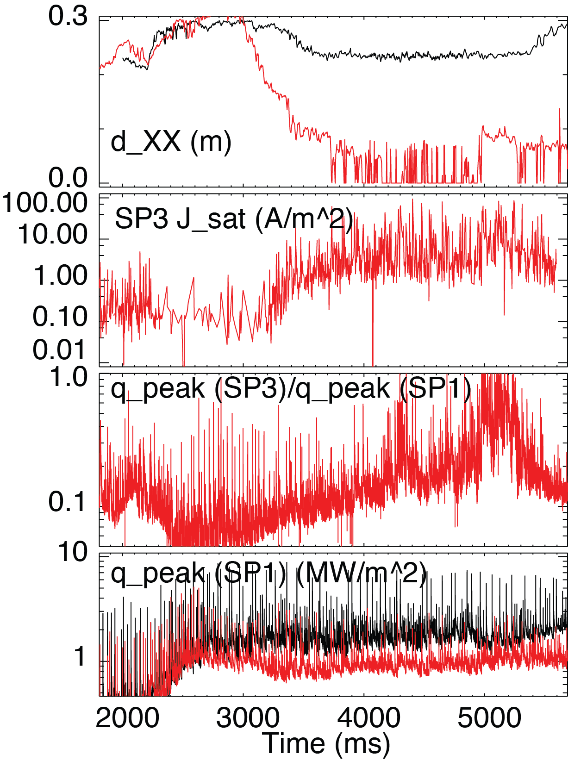

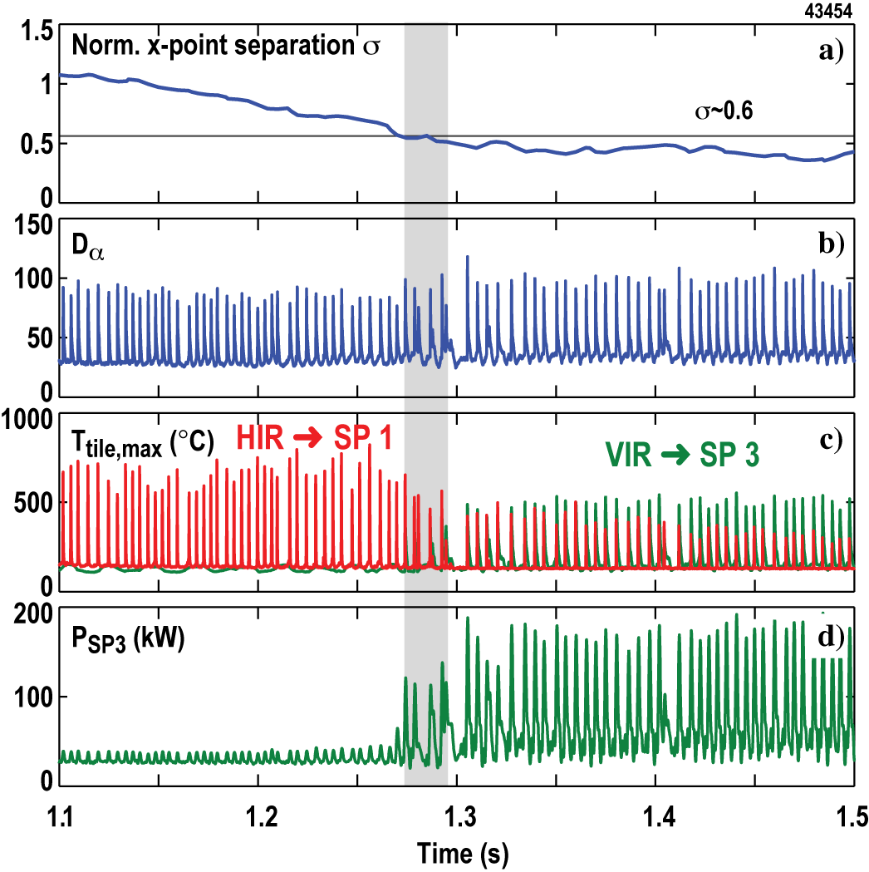
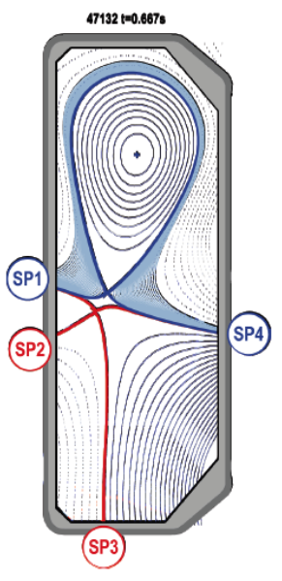
Snowflake divertor enables power and particle sharing over multiple strike points
Standard Snowflake
Γ_{SP3}
q_{SP3}
q_{SP1}
V. A. Soukhanovskii et.al, IAEA FEC 2014
W. Vijvers et.al, IAEA FEC 2012

Slide 24
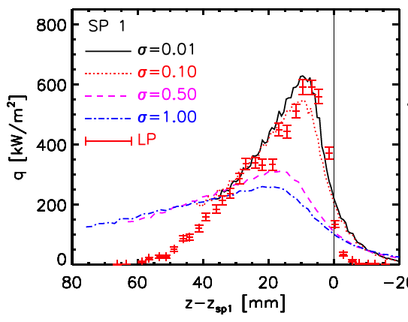
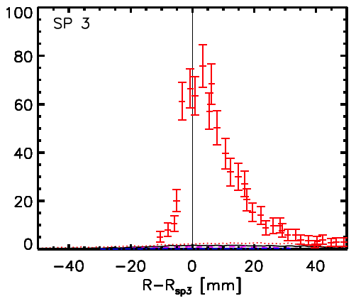
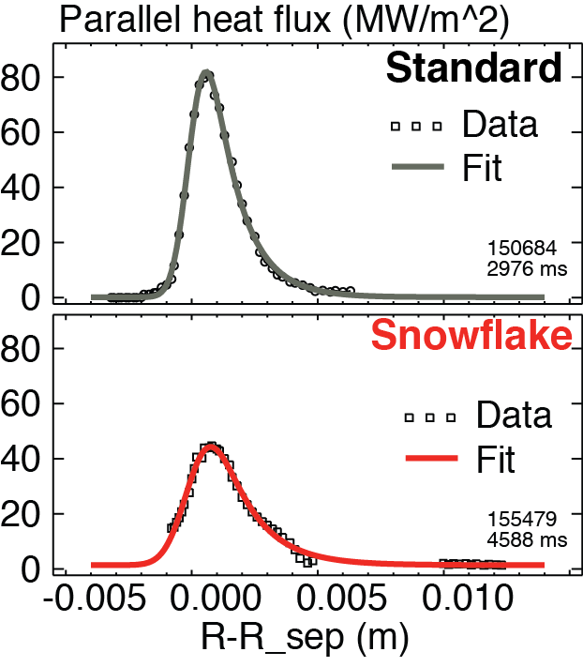
Divertor heat transport affected by snowflake geometry
Parallel heat flux (MW/m²)
λ_{q} = 2.40 mm
λ_{q} = 3.20 mm
EMC3-IRENE modeling under-predicts power in additional strike points
Suggests additional transport channel in the null region
Increased λ_{q} may imply increased transport
  Increased radial spreading due to L||
  SOL transport affected by null-region mixing
H. Reimerdes et al. PPCF 2013, T. Lunt et al. PPCF 2014
V. A. Soukhanovskii et.al, IAEA FEC 2014

Slide 25

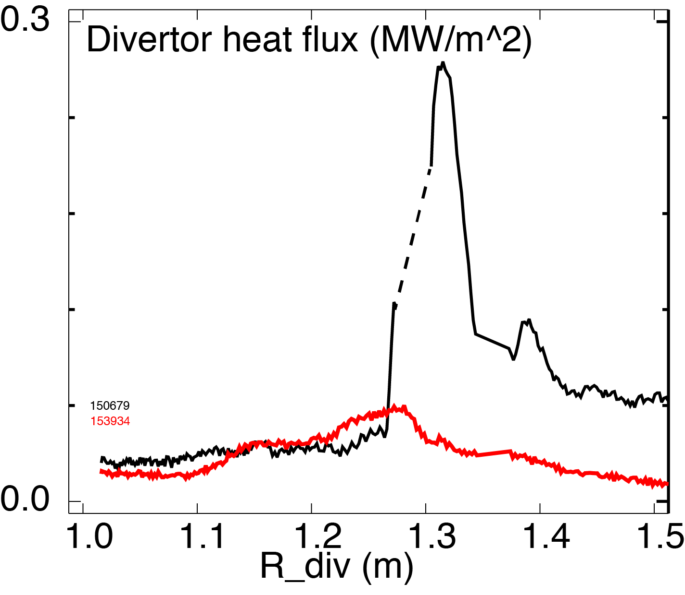
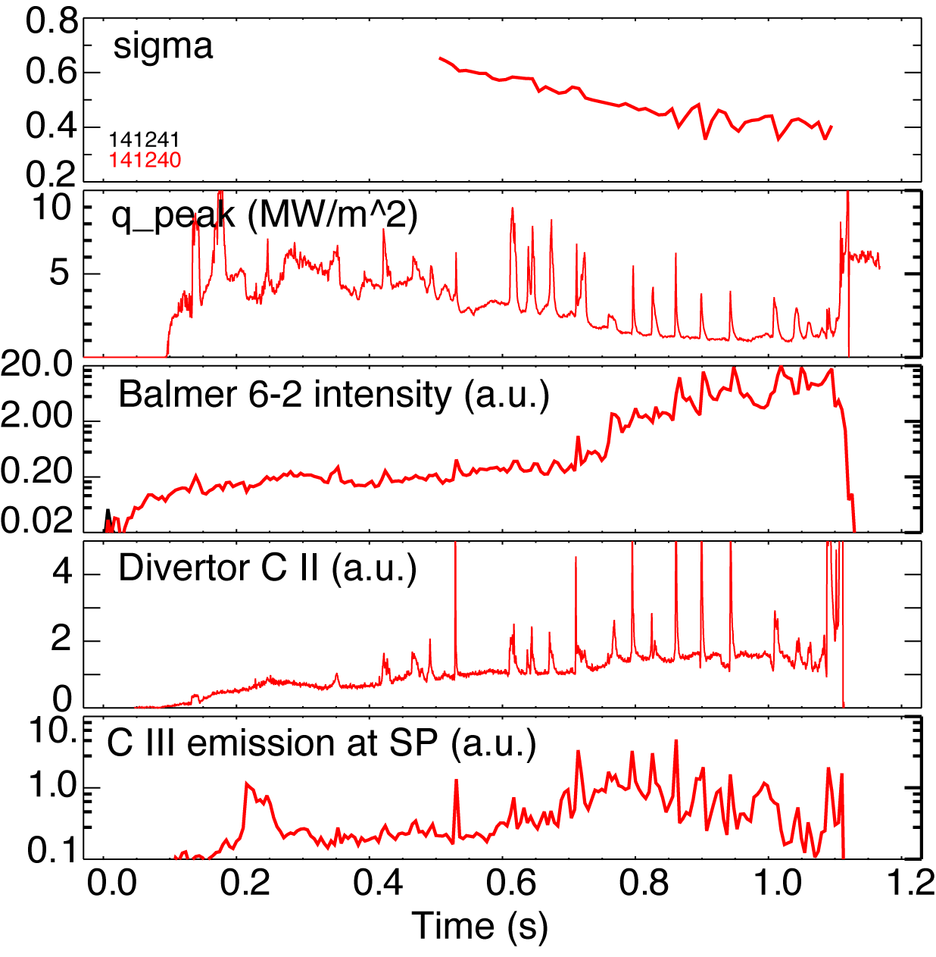
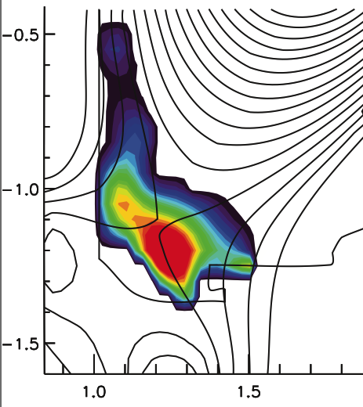
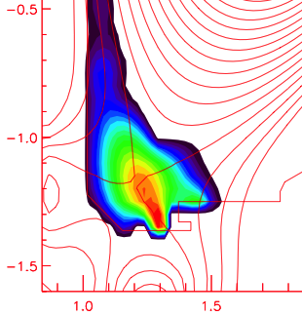
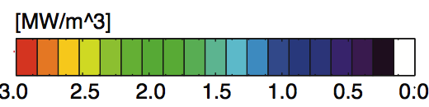
Snowflake configuration favorably affects radiative divertor and detachment
Standard Snowflake
P_{SOL} = 3-4 MW
Standard Snowflake
Natural partial detachment in NSTX snowflake otherwise inaccessible with standard divertor
Broader radiated power distribution, nearly complete power detachment in DIII-D
V. A. Soukhanovskii et.al, NF 2011; POP 2011
V. A. Soukhanovskii et.al, IAEA FEC 2014

Slide 26
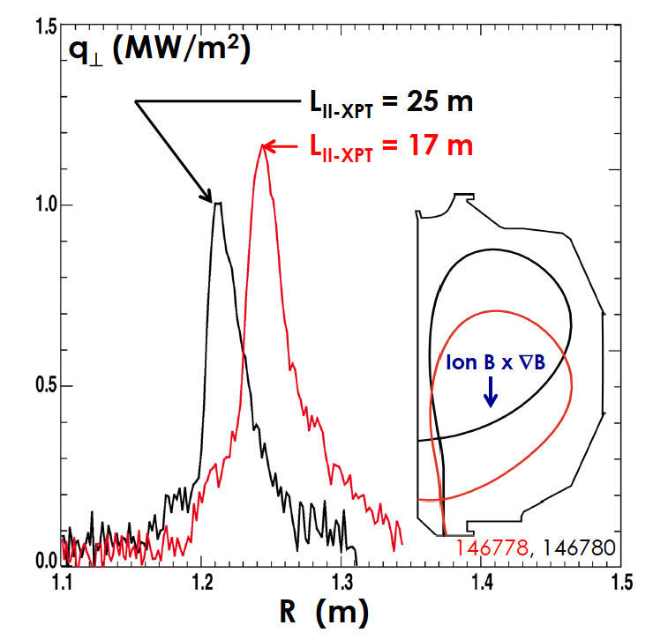
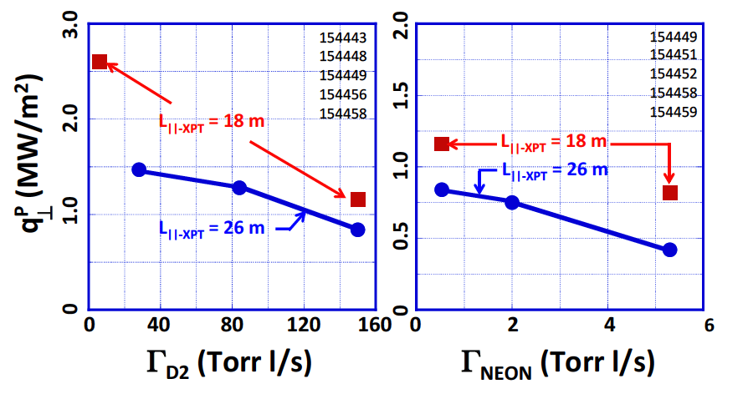
3. Recent DIII-D experiments demonstrated benefits of the increased connection length
Longer connection length vs shorter connection length
  Divertor peak heat flux reduced
  Divertor T_{e} reduced
  Divertor radiation increased
T. Petrie et.al, APS 2013, PSI2014, IAEA FEC 2014, APS 2014

Slide 27
Advanced magnetic divertor configuration development
Near-term plans (5 years)
  Clarify effects of 2nd order null, extra X-points and long legs on
    Pedestal stability
    Steady-state and transient transport (heat, ion, impurity)
    Impurity radiation limits
Tokamaks
  Upgraded: TCV, NSTX-U, HL-2M, MAST-U
  Existing: DIII-D, EAST
Long-term plans (5-15 years) ?

Slide 28
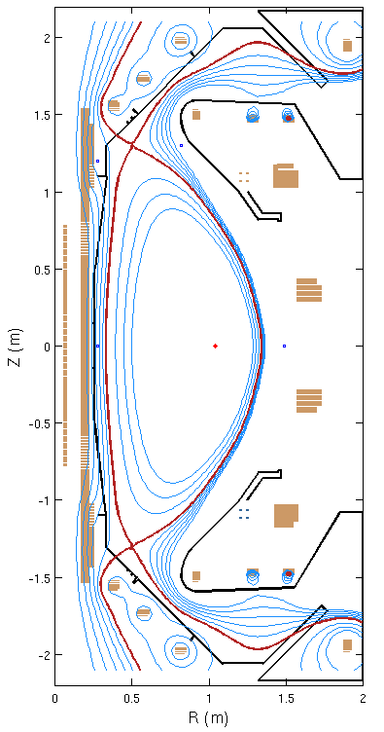

MAST Upgrade to test advanced divertor configurations
Super-X Snowflake
B_{t}=0.8 T
I_{p} ≤ 2 MA
P_{NBI} ≤ 7.5 MW
8 divertor PF coils
Extensive diagnostic set
Radial and parallel transport, stability of detachment
Pedestal formation, structure, 3D fields
G. Fishpool et.al, J. Nucl. Mater. 2013

Slide 29




Snowflake divertor is a leading heat flux mitigation candidate for NSTX-Upgrade
New center-stack
2nd neutral beam
B_{T}
I_{p}
1 T
P_{NBI}
pulse
12 MW
2 MA
5 s
NSTX-U Mission elements:
  Advance ST as candidate for Fusion Nuclear Science Facility
  Develop solutions for the plasma-material interface challenge
  Explore unique ST parameter regimes to advance predictive capability for ITER
  Develop ST as fusion energy system
J. E. Menard et. al, Nucl. Fusion 52 (2012) 083015

Slide 30


HL-2M tokamak enables a number of advanced magnetic configurations
jj
Snowflake Snowflake-plus Snowflake-minus Tripod
Major radius R = 1.78 m
Minor radius a = 0.65 m
Toroidal field B_{t} = 2.2 T
Plasma current I_{P} = 2.5 MA
P_{in}=32 MW (Design)
G.Y. Zheng et.al, Fus. Eng. Design 89 (2014) 2621

Slide 31





Many pre-DEMO and DEMO designs include snowflake and Super-X configurations
Super-X for Aries Slim CS
Snowflake for DEMO
M. Kotschenreuther et. al, ARIES Workshop 2010
R Albanese et. al,
PPCF, 56 (2014) 035008
China Fusion Experimental Reactor
Y. Wan, SOFE 2013
Z. Luo et.al, IEEE TRANSACTIONS ON PLASMA SCIENCE, V42, 2014, 1021
Super-X and Snowflake for DEMO
N. Asakura et.al, Trans. Fus. Sci. Tech. 63, 2013, 70.

Slide 32
Everything New Is Actually Well-Forgotten Old (Новое – это хорошо забытое старое, the Russian saying).
A number of potentially attractive magnetic divertor configurations exist
Much research remains to be done to qualify them as
  Advanced magnetic divertor configurations
  Divertor candidates for a fusion reactor

Slide 33
Backup

Slide 34
Abstract
The present vision for controlling the plasma–material interface of a tokamak is an axisymmetric poloidal magnetic X-point divertor. The divertor must enable access to high core and pedestal plasma performance metrics while keeping target plate heat loads and erosion within the operating limits of plasma-facing component cooling technology and target plate materials. The proposed ITER divertor is based on standard X-point geometry designs tested in large tokamak experiments and uses tilted vertical targets to generate partial radiative detachment of the strike points. However, the standard divertor approach is likely to be insufficient for next step advanced tokamak and spherical tokamak devices such as the proposed fusion nuclear science facilities and for the DEMO reactor.
Novel magnetic divertor configuration development and optimization has always been an active area in fusion plasma research. In this talk, advanced poloidal divertor concepts and experimental performance will be reviewed. Advanced divertors have the capability to modify steady-state and transient power exhaust via modifications to parallel and perpendicular transport and dissipative loss channels. The basic physics principles of these concepts will be summarized, from the first divertor for impurity control proposed by L. Spitzer for the stellarator, to long legged divertors, expanded boundaries, multiple X-point divertors, and multipole divertors for tokamaks. Many of the these divertor configurations face practical limitations on magnetic coil layout and construction. In recent years, two advanced divertor concepts have been pursued experimentally: snowflake (2nd order null) divertors, implemented in the TCV, NSTX, DIII-D and EAST tokamaks with existing magnetic coils, and the (long-legged) Super-X divertor, which is presently being implemented in MAST Upgrade using specially designed additional coils. The status and plans for research in these areas will be summarized.
Several outstanding physics and engineering problems need to be addressed in order to qualify an advanced divertor concept for a next step tokamak reactor. This talk will discuss the general issues and motivations, including coil design and placement, equilibria design and plasma real-time control, plasma-facing component design, compatibility with highly radiative scenarios, and integration with high-performance core and pedestal plasma.
This work is supported by the US Department of Energy under DE-AC5207NA27344.

Slide 35

Conventional divertor history…
Poloidal bundle divertor
First proposal of a magnetic divertor
  L. Spitzer, Phys. Fluids 1 (1958) 253 (for impurity control in a stellarator)
First use of a poloidal divertor
  JFT-2a (DIVA), Japan, 1975 (approx.)
First demonstration of impurity control using a divertor
  JFT-2a, Japan, 1975 (approx.)
First demonstration of H-mode with a poloidal divertor
  ASDEX, Germany 1982
A. D. Sanderson et.al, J. Nucl. Mater. 76 530 (1978)

