Slide 1


Global MHD Mode Stabilization and Control for Tokamak Disruption Avoidance
S.A. Sabbagh¹, J.W. Berkery¹, J.M. Bialek¹, J.M. Hanson¹, C. Holcomb²,
M. Austin³, D. Battaglia⁴, R.E. Bell⁴, K. Burrell³, R. Buttery³, N. Eidietis³,D.A. Gates⁴, S.P. Gerhardt⁴, B. Grierson⁴, I. Goumiri⁵, G. Jackson³, R. La Haye³, J. King³, E. Kolemen⁴, M.J. Lanctot², M. Okabayashi⁴, T. Osborne³, Y.S. Park¹, C. Rowley⁵, E. Strait³
¹Department of Applied Physics, Columbia University, New York, NY, ²Lawrence Livermore National Laboratory, Livermore, CA, ³General, Atomics, San Diego, CA, ⁴Princeton Plasma Physics Laboratory, Princeton, NJ, ⁵Princeton University, Princeton, NJ
57th Annual Meeting of the APS Division of Plasma Physics, Savannah, Georgia
11/18/15
V1.5

Slide 2
Disruption avoidance is a critical need for future tokamaks; NSTX-U is focusing stability research on this
The new “grand challenge” in tokamak stability research
  Can be done! (JET: < 4% disruptions w/C wall, < 10% w/ITER-like wall)
    ITER disruption rate: < 1 - 2% (energy load, halo current); << 1% (runaways)
Strategic plan: utilize/expand stability/control research success
  Synergize and build upon disruption prediction and avoidance successes attained in present tokamaks
FESAC 2014 Strategic Planning report defined “Control of Deleterious Transient Events” highest priority (Tier 1) initiative
NSTX-U will allow focused research on disruption prediction and avoidance with quantitative measures of progress

Slide 3
Research in today’s presentation is part of NSTX-U’s evolving capabilities for disruption prediction/avoidance
Sensor/predictor (CY available) | Control/Actuator (CY available)
Low frequency MHD (n=1,2,3): 2003 | Dual-component RWM sensor control (closed loop: 2008)
Low frequency MHD spectroscopy (open loop: 2005) | Control of β_{N} (closed loop: 2007)
r/t RWM state-space controller observer (2010) | Physics model-based RWM state-space control (2010)
Real-time rotation measurement (2016) | Plasma rotation control (NTV rotation control open loop: 2003) (+NBI closed loop ~ 2017)
Kinetic RWM stabilization initial real-time model (2016-17) | Safety factor control (closed loop ~ 2016-17)
MHD spectroscopy (real-time) (in NSTX-U 5 Year Plan) | Upgraded 3D coils (NCC) (in NSTX-U 5 Year Plan)
  +New Disruption Event Characterization and Forecasting code, initial results

Slide 4
Joint NSTX / DIII-D experiments and analysis gives unified kinetic RWM physics understanding for disruption avoidance
DIII-D (β_{N} = 3.5)
NSTX (β_{N} = 4.4)
RWM Dynamics
  RWM rotation and mode growth observed
  No strong NTM activity
  Some weak bursting MHD in DIII-D plasma
    Alters RWM phase
  No bursting MHD in NSTX plasma
rotation
growth
rotation
growth
ΔB_{p}^{n=1}(G)
amplitude
amplitude
phase
phase
φ_{Bp}^{n=1}(deg)
toroidal magnetics
toroidal magnetics
Frequency (kHz)
D_{α}
D_{α}
(arb)
t (s)
t (s)
S. Sabbagh et al., APS Invited talk 2014

Slide 5
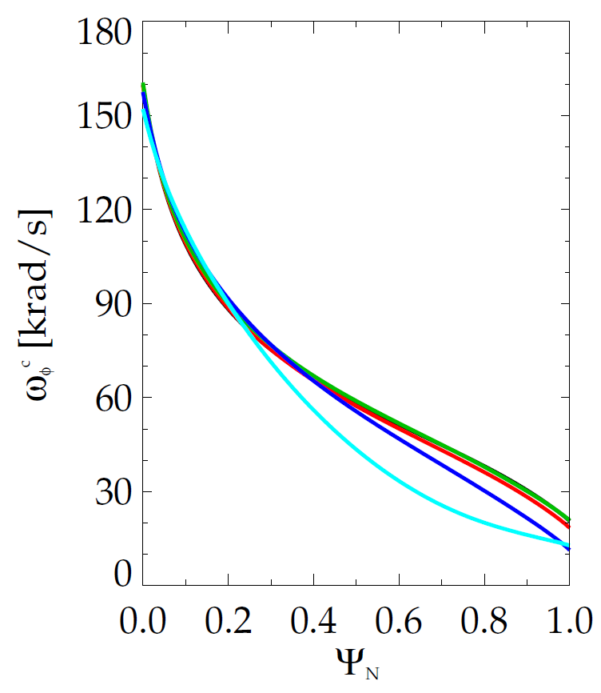
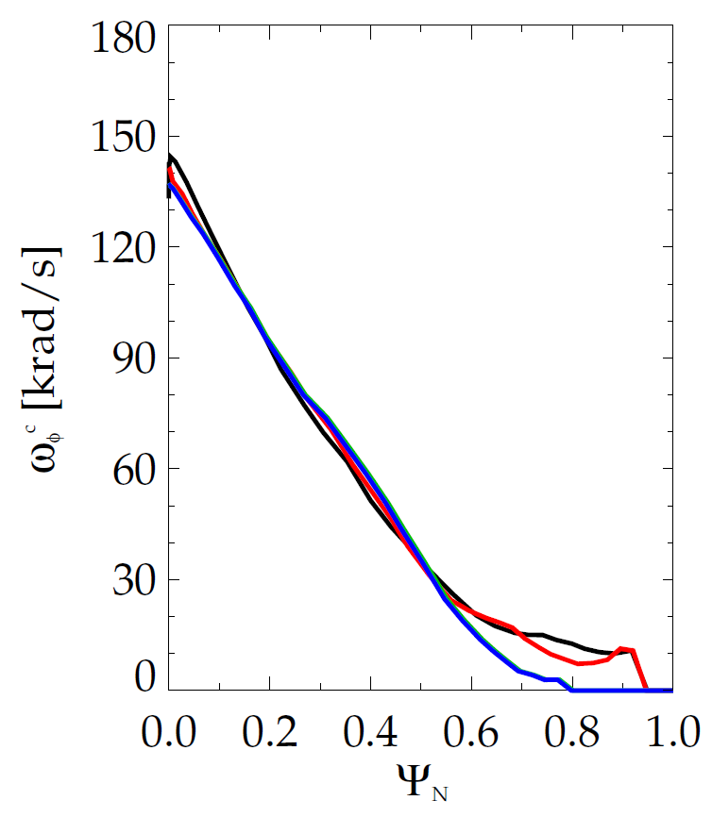
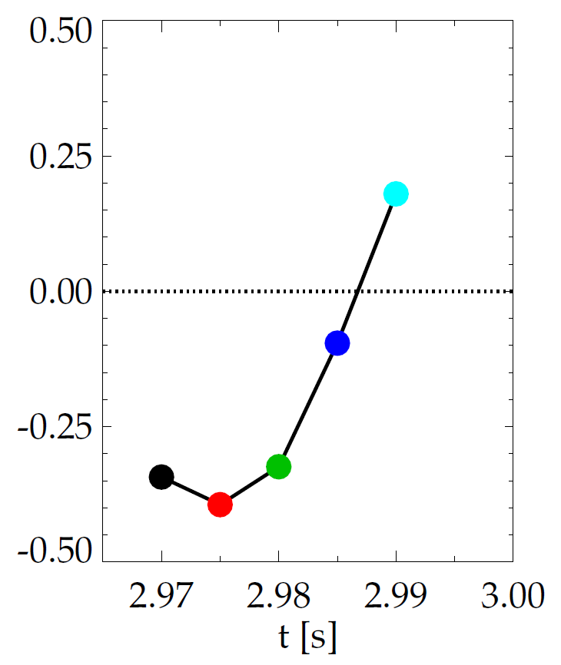
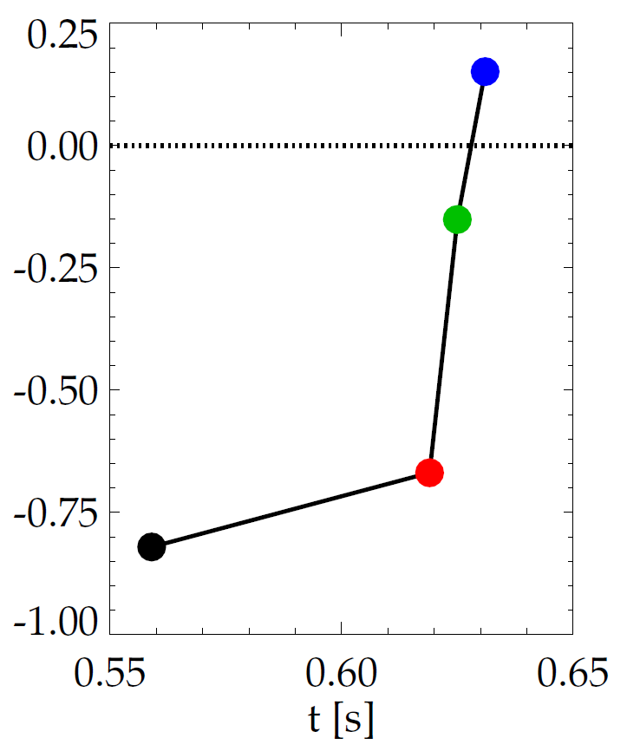
Evolution of plasma rotation profile leads to linear kinetic RWM instability as disruption is approached
DIII-D (minor disruption)
NSTX (major disruption)
Kinetic RWM stabilization occurs from broad resonances between plasma rotation and particle precession drift, bounce/circulating and collision frequencies
unstable
unstable
stable
γτ_{wall}
γτ_{wall}
stable
MISK
MISK
increasing time
increasing time
S. Sabbagh et al., APS Invited talk 2014

Slide 6
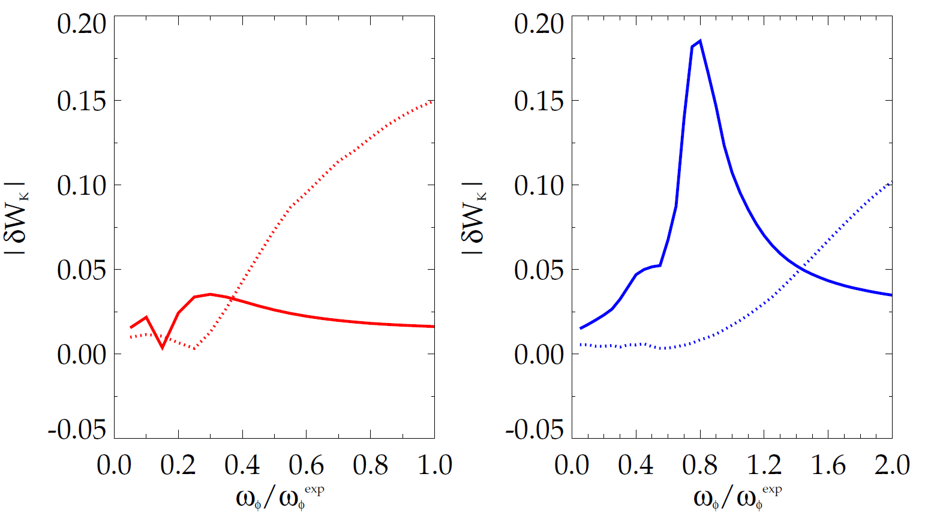
Bounce resonance stabilization dominates for DIII-D vs. precession drift resonance for NSTX at similar, high rotation
|δW_{K}| for trapped resonant ions vs. scaled experimental rotation (MISK)
DIII-D
precession
resonance
NSTX
bounce / circulating
resonance
bounce / circulating
resonance
Some NSTX / MISK analysis references
precession
resonance
- J. Berkery et al., PRL 104, 035003 (2010)
- S. Sabbagh, et al., NF 50, 025020 (2010)
- J. Berkery et al., PRL 106, 075004 (2011)
- S. Sabbagh et al., NF 53, 104007 (2013)
- J. Berkery et al., PoP 21, 056112 (2014)
- J. Berkery et al., PoP 21, 052505 (2014)
- J. Berkery et al., NF 55, 123007 (2015)
133103 @ 3.330 s
stable plasma
133776 @ 0.861 s
stable plasma
DIII-D experimental rotation profile
NSTX experimental rotation profile

Slide 7
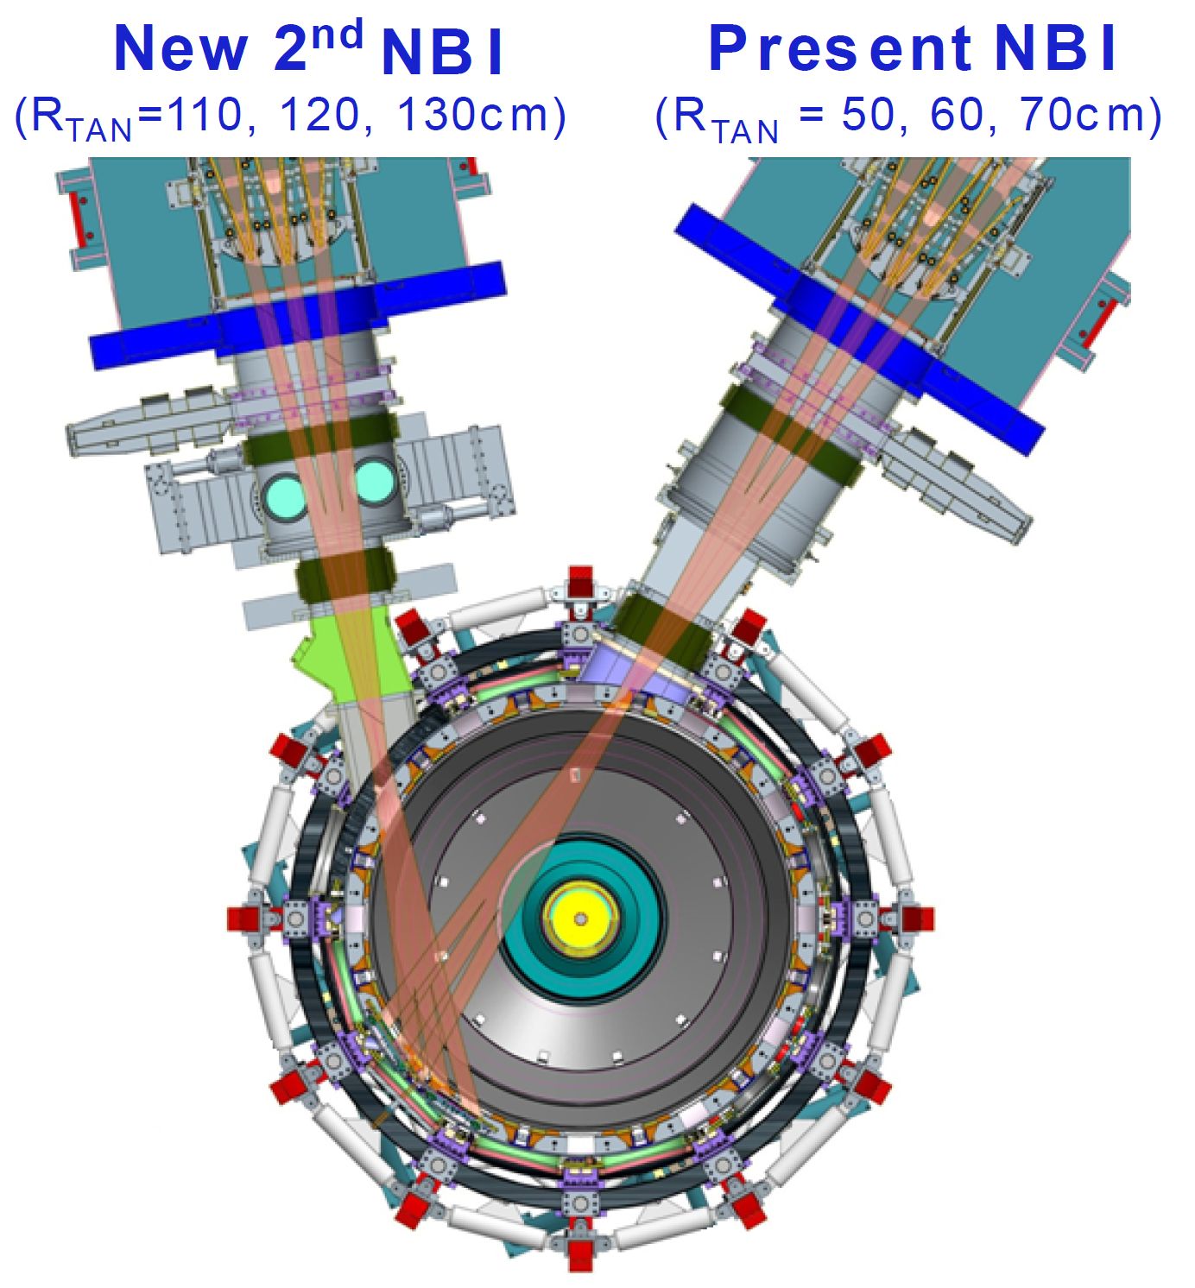
State space rotation controller designed for NSTX-U using non-resonant NTV and NBI to maintain stable profiles
Momentum force balance – ω_{φ} decomposed into Bessel function states
NTV torque:
(non-linear)
Momentum Actuators
NBI and NTV torque profiles for NSTX-U
1.5
New NBI
(broaden rotation)
3D Field Coil
(shape ω_{φ} profile)
1.0
-NTV
Torque
NBI, -NTV torque density (N/m²)
0.5
NBI
Torque
(NSTX)
0.0
0.0
0.2
0.4
ψ_{N}
0.6
0.8
1.0

Slide 8
State space rotation controller designed for NSTX-U using non-resonant NTV and NBI to maintain stable profiles
Momentum force balance – ω_{φ} decomposed into Bessel function states
NTV torque:
(non-linear)
Momentum Actuators
NBI and NTV torque profiles for NSTX-U
1.5
New NBI
(broaden rotation)
3D Field Coil
(shape ω_{φ} profile)
NBI Torque
(NSTX-U)
1.0
-NTV
Torque
NBI, -NTV torque density (N/m²)
0.5
NBI
Torque
(NSTX)
0.0
0.0
0.2
0.4
ψ_{N}
0.6
0.8
1.0

Slide 9
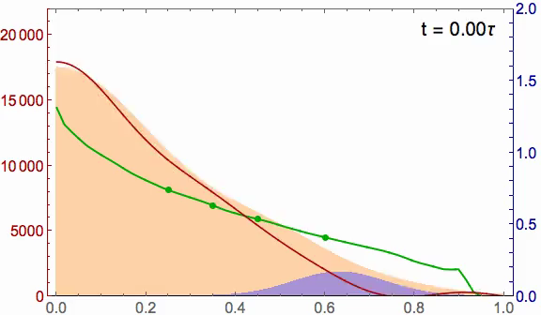
State space rotation controller designed for NSTX-U can evolve plasma rotation profile toward global mode stability
NSTX-U (6 NBI sources and n = 3 NTV)
Recall: NSTX (major disruption)
2.0
Marginally stable profile
unstable
20
stable
Steady-state reached in ~ 3τ_{m}
1.5
γτ_{wall}
15
NBI, -NTV torque density (N/m²)
Plasma rotation (kHz)
Broader stable
profile
1.0
MISK
10
5
NTV
0.5
increasing time
NBI
0
0.0
0.0
0.2
0.4
ψ_{N}
0.6
0.8
1.0
I. Goumiri (Princeton student), S.A. Sabbagh (Columbia U.), C. Rowley (P.U.), D.A. Gates, S.P. Gerhardt (PPPL)

Slide 10
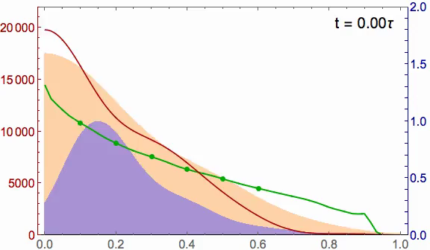
With planned NCC coil upgrade, rotation controller can reach desired rotation profile faster, with greater fidelity
NSTX-U ω_{φ} control with
  6 NBI sources
  Greater core NTV from planned NCC upgrade
Better performance
  Faster to target t ~ 0.5τ_{m}
  Matches target ω_{φ} better
2.0
20
Marginally stable profile
1.5
15
NBI
NBI, -NTV torque density (N/m²)
Plasma rotation (kHz)
Broader stable
profile
1.0
10
5
0.5
Planned NCC upgrade
NTV
0
0.0
0.0
0.2
0.4
ψ_{N}
0.6
0.8
1.0
Also, calculations show that NCC can allow RWM control up to ideal MHD wall limit

Slide 11
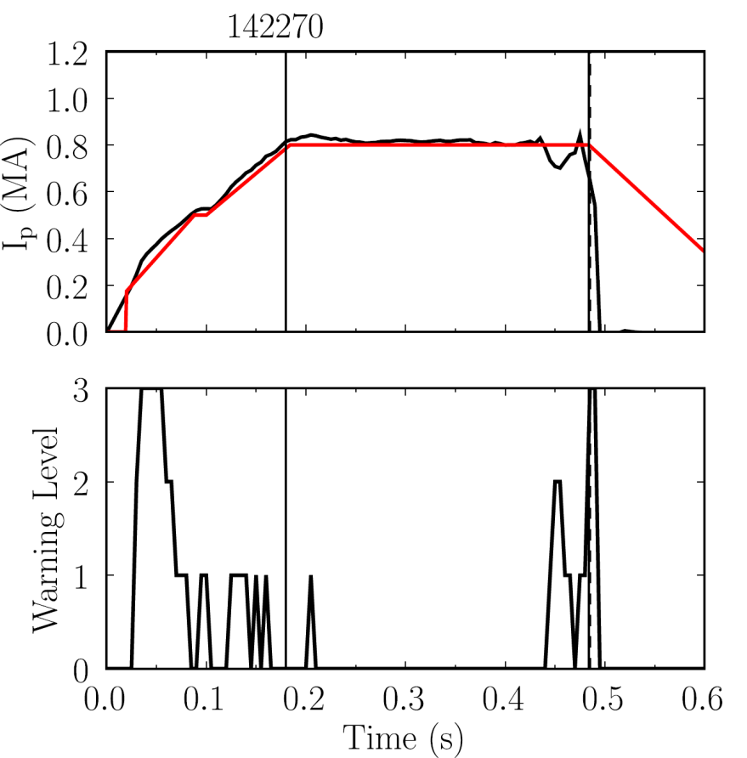
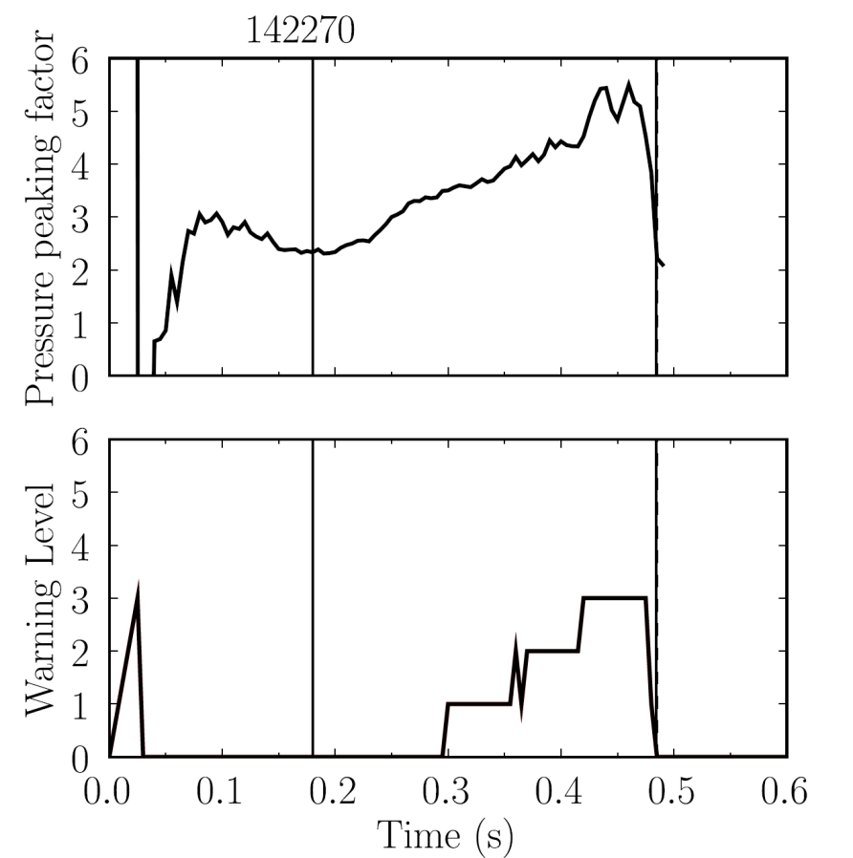

Disruption Event Characterization And Forecasting Code (DECAF) yielding initial results (pressure peaking example)
10 physical events presently defined in code with quantitative warning points
  Builds on characterization work of de Vries
  Builds on warning algorithm of Gerhardt
  New code written (in Python) to be easily expandable, portable to other tokamaks
Example: Pressure peaking (PRP) disruption event chain identified by code
  (PRP) Pressure peaking warnings identified first
  (VDE) VDE condition subsequently found 19 ms after last PRP warning
  (IPR) Plasma current request not met
  (SCL) Shape control warning issued
NSTX
142270
P.C. de Vries et al., Nucl. Fusion 51 (2011) 053018
Disruption
S.P. Gerhardt et al., Nucl. Fusion 53 (2013) 063021
PRP warnings
Event chain
PRP
VDE
IPR
SCL
Detected at: 0.4194s
0.4380s
0.4522s
0.4732s

Slide 12
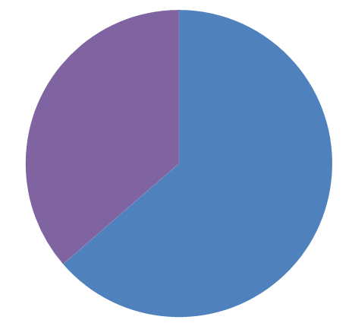
Initial DECAF results detect RWM events when applied to dedicated 44 shot NSTX disruption database
Several events were detected for all shots
  DIS: Disruption occurred
  RWM: RWM event warning
  VDE: VDE warning (42 shots)
  IPR: Plasma current request not met
  LOQ: Low edge q warning
Very simple RWM event criteria
  RWM B_{P}^{n=1} lower sensor amplitude used
  Simple criterion + no threshold optimization yet ➔ “false positive” rate is high; adjust criteria to reduce it
Code already sees common disruption event chains
  (event)➔VDE➔SCL➔IPR occurs in 52% of the shots
RWM event warning timing
(simple criterion, not optimized)
Before 100 ms of DIS
(36%)
Within 100 ms of DIS
(64%)
Common event chain
(event)
VDE
SCL
IPR
Also see poster by M. Parsons PP12.00118 (Wed 2 pm) for related work on supervised machine learning for disruption prediction

Slide 13
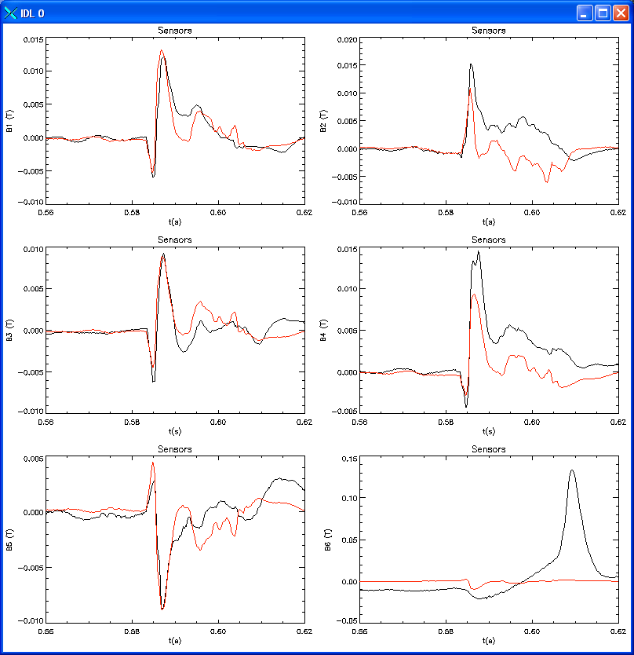
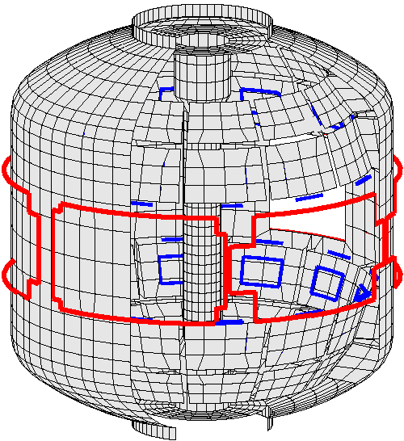
In addition to active mode control, the NSTX-U RWM state space controller will be used for real-time disruption warning
RWM state space controller used for RWM control in NSTX - long pulse plasmas reached high stability parameters β_{N} = 6.4, β_{N} /l_{i} = 13
S. Sabbagh et al., Nucl. Fusion 53 (2013) 104007
Measurement
200
δB_{p}¹⁸⁰
RWM
Controller
(observer)
The controller “observer” produces a physics model-based calculation of the expected sensor measurements – a real-time synthetic diagnostic
If the real-time synthetic diagnostic poorly matches the measured sensor data, a real-time disruption warning signal can be triggered
  Technique will be assessed using the DECAF code
100
RWM Sensor Differences (G)
0
-100
0.56
0.58
0.60
0.62
t (s)
RWM sensors

Slide 14
Global MHD mode stabilization understanding and control will synergize in NSTX-U for disruption avoidance
Physics Understanding
  Unification of DIII-D / NSTX experiments and analysis gives improved RWM understanding for disruption avoidance
  Complementarity found: at similar high rotation, kinetic RWM stabilization physics is dominated by bounce orbit resonance in DIII-D, and by ion precession drift resonance in NSTX
  Disruption Event Characterization and Forecasting code initial results identify RWM events and disruption event chains
Stability Control
  Rotation profile control has potential to steer away from unstable profiles
  Model-based active RWM state-space controller can also be used as synthetic diagnostic for disruption warning
  Further improvements to rotation profile control, active mode control possible with planned NCC 3D coil upgrade

Slide 15
Supporting slides follow

Slide 16
Active RWM control design study for proposed NSTX-U 3D coil upgrade (NCC coils) shows superior capability up to ideal wall limit
NCC 2x6 odd parity, with favorable sensors
NCC 2x12 with favorable sensors, optimal gain
Full NCC coil set allows control close to ideal wall limit
  NCC 2x6 odd parity coils: active control to β_{N}/β_{N}^{no-wall} = 1.58
  NCC 2x12 coils, optimal sensors: active control to β_{N}/β_{N}^{no-wall} = 1.67
NCC (plasma facing side)

