Slide 1




Disruption Event Characterization and Forecasting in NSTX-U
S.A. Sabbagh¹, J.W. Berkery¹, J.M. Bialek¹, Y.S. Park¹, R.E. Bell², M.D. Boyer², S.P. Gerhardt², C. Myers² , J.D. Riquezes³
¹Department of Applied Physics, Columbia University, New York, NY, ²Princeton Plasma Physics Laboratory, Princeton, NJ, ³University of Michigan, Ann Arbor, MI
58th Annual Meeting of the APS Division of Plasma Physics, San Jose, California
11/1/16
V1.6
*This work supported by the US DOE contracts DE-AC02-09CH11466 and DE-FG02-99ER54524

Slide 2
Disruption event chain characterization capability started for NSTX-U as next step in disruption avoidance plan
Disruption prediction/avoidance framework
Approach to disruption prevention
  Identify disruption event elements and chains
  Predict events in disruption chains
  Cue disruption avoidance systems to break event chains
    Attack events at several places with active control
  Synergizes and builds upon both physics understanding, control successes of NSTX
t
(from DOE Report on Transients in Tokamak Plasmas (2015))

Slide 3
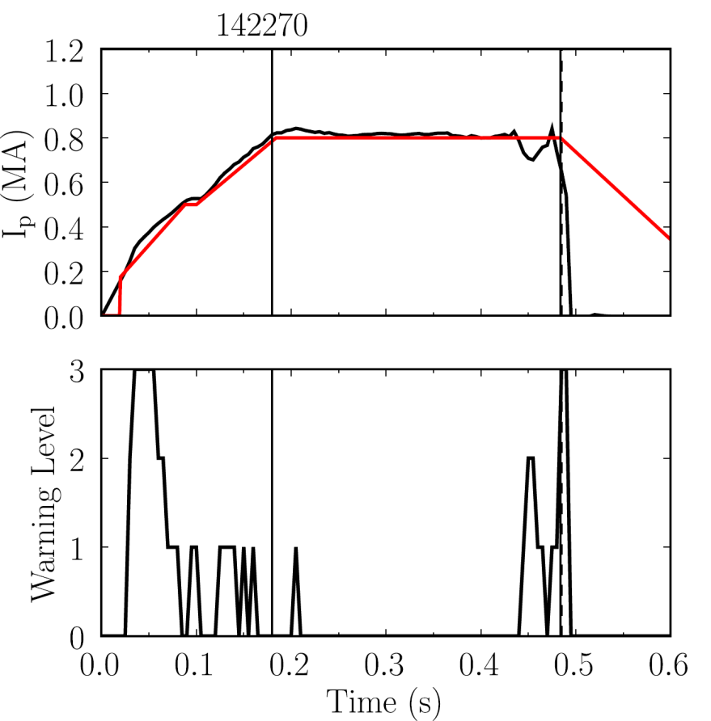
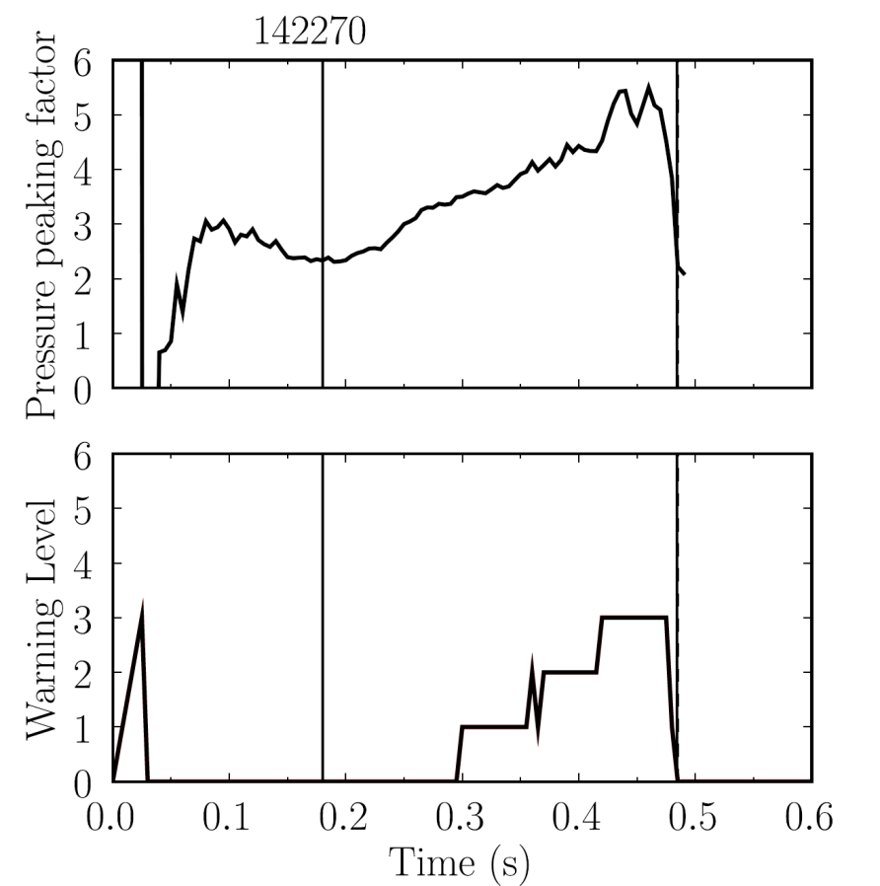

Disruption Event Characterization And Forecasting Code (DECAF) yielding initial results
10 physical events presently defined in code with quantitative warning points
  Builds on characterization work of de Vries
  Builds on warning algorithm of Gerhardt
  New code written (in Python) to be easily expandable, portable to other tokamaks (reads NSTX, NSTX-U, DIII-D data)
Example: Pressure peaking (PRP) disruption event chain identified by code
  (PRP) Pressure peaking warnings identified first
  (VDE) VDE condition subsequently found 19 ms after last PRP warning
  (IPR) Plasma current request not met
  (SCL) Shape control warning issued
NSTX
142270
P.C. de Vries et al., Nucl. Fusion 51 (2011) 053018
Disruption
S.P. Gerhardt et al., Nucl. Fusion 53 (2013) 063021
PRP event
Event chain
PRP
VDE
IPR
SCL
Detected at: 0.4194s
0.4380s
0.4522s
0.4732s

Slide 4
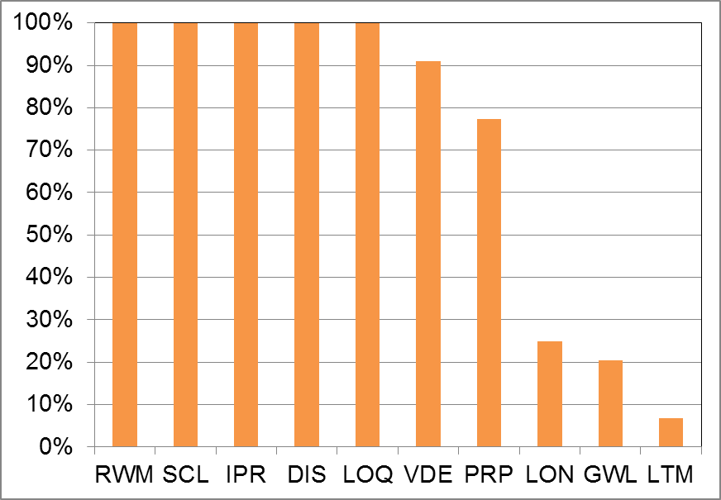
DECAF results detect disruption chain events when applied to dedicated 44 shot NSTX RWM disruption database
Several events detected for all shots
  RWM: Resistive wall mode
  SCL: Loss of shape control
  IPR: Plasma current request not met
  DIS: Disruption occurred
  LOQ: Low edge q warning
  VDE: VDE warning (40 shots)
Other Events
  PRP: Pressure peaking warning
  LON: Low density warning
  GWL: Greenwald limit
  LTM: Locked tearing mode
Many occur after RWM

Slide 5
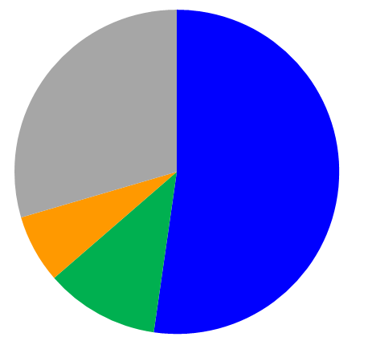
DECAF analysis is finding common disruption event chains
Event chains with RWM and VDE (52.3%)
  Related chains
    RWM ➔ VDE ➔ SCL ➔ IPR ➔ DIS
    RWM ➔ SCL ➔ VDE ➔ IPR ➔ DIS
    VDE ➔ RWM ➔ SCL ➔ IPR ➔ DIS
    VDE ➔ RWM ➔ IPR ➔ DIS ➔ SCL
    RWM ➔ SCL ➔ VDE ➔ GWL ➔ IPR ➔ DIS
Disruption event chains w/o VDE (11.4%)
New insights being gained
  Chains starting with GWL are found that show rotation and β_{N} rollover before RWM (6.8%)
    GWL ➔ VDE ➔ RWM ➔ SCL ➔ IPR ➔ DIS
    GWL ➔ SCL ➔ RWM ➔ IPR ➔ DIS
Disruption event chains with RWM (44 shot database)
Other
(29.5%)
Event chains with RWM and VDE
(52.3%)
GWL start
(6.8%)
No
VDE
(11.4%)
NSTX

Slide 6
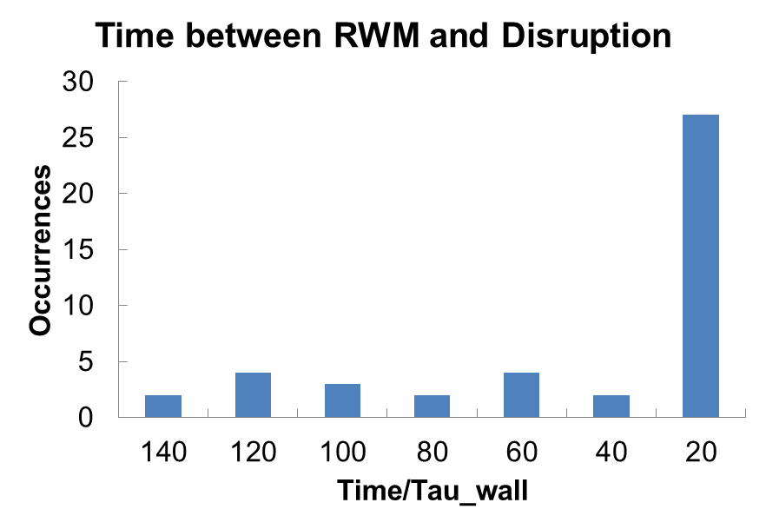
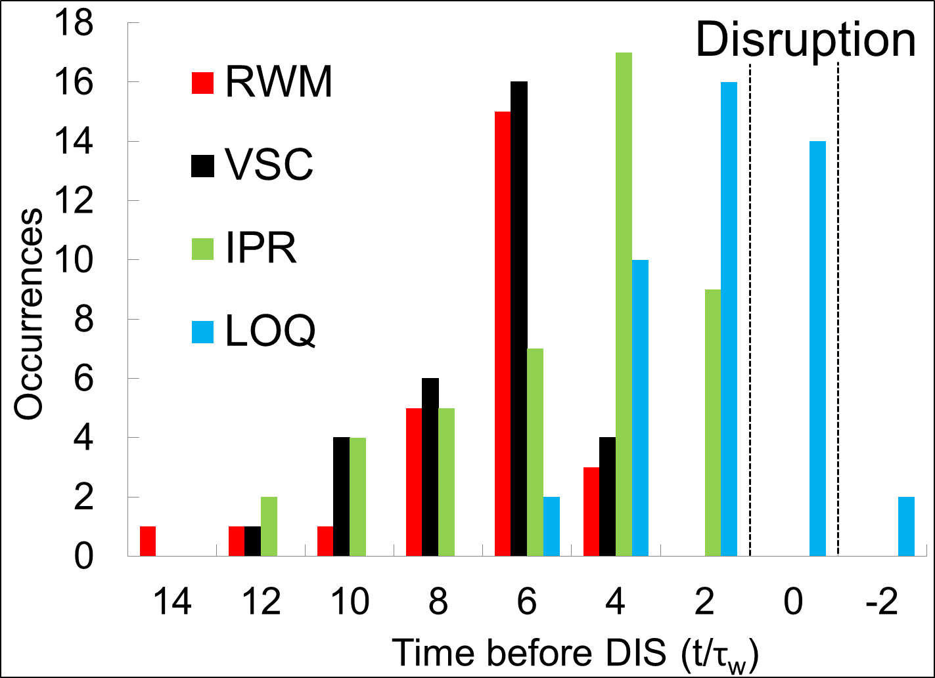
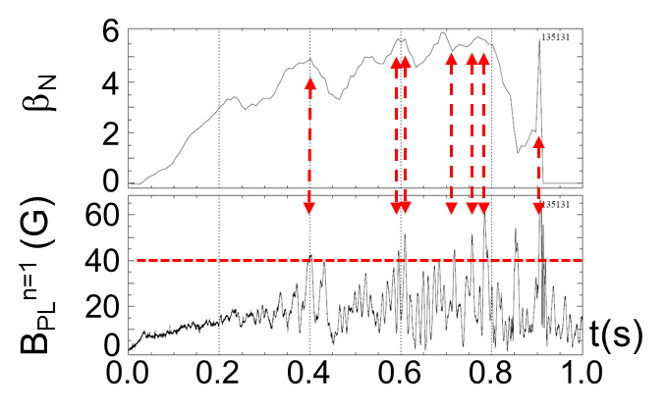
DECAF analysis yields time relation of chain events when applied to NSTX RWM disruption database
VDE
Most RWM events near major disruption
  61% of RWM occur within 20 τ_{w} of disruption time (τ_{w} = 5 ms)
  Earlier RWM events NOT false positives – cause large decreases in β_{N} with recovery (minor disruptions)

Slide 7
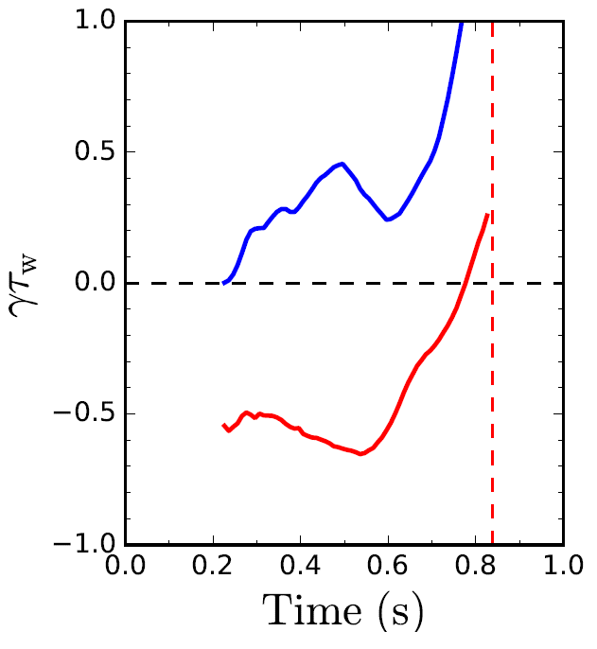
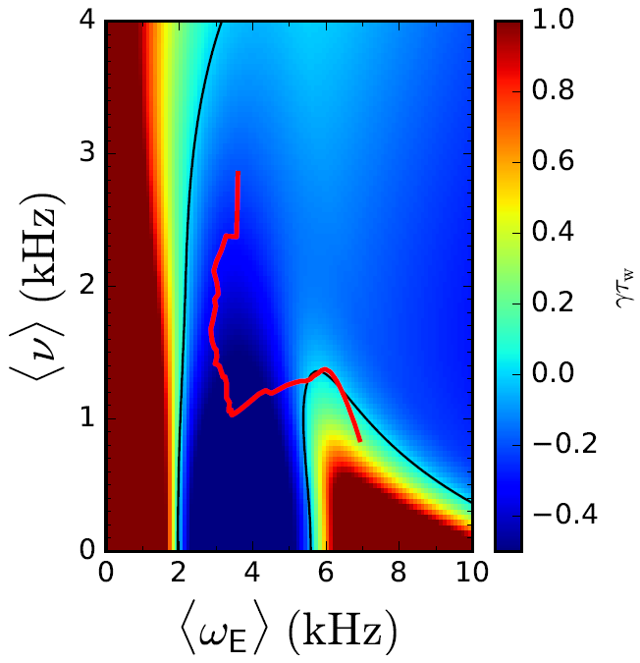
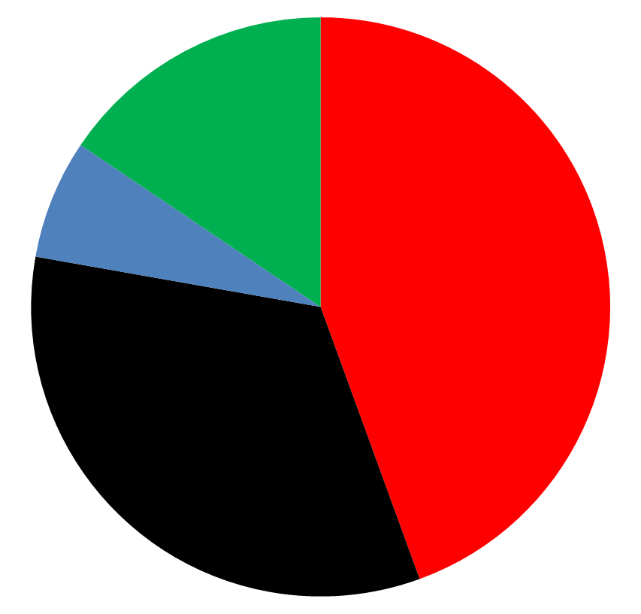
Global mode stability forecasting: DECAF initial reduced kinetic MHD model tests well on unstable RWM database
Norm. growth rate vs. time
γτ_{w} contours vs. ν and ω_{E}
Predicted instability statistics
Increasing time
γτ_{w}
Stable
(16%)
ideal
unstable
disruption
Instability < 320 ms
before disruption
(44%)
(7%) False
positives
γτ_{w}
ideal + kinetic
Instability within 100 ms of minor
disruption
(33%)
stable
139514
84% predicted unstable (unoptimized)
7% false positives
predicted instability
Reduced model guided by full kinetic RWM stability model
See J. Berkery invited talk YI2.00005 (Fri 11:30 AM)

Slide 8
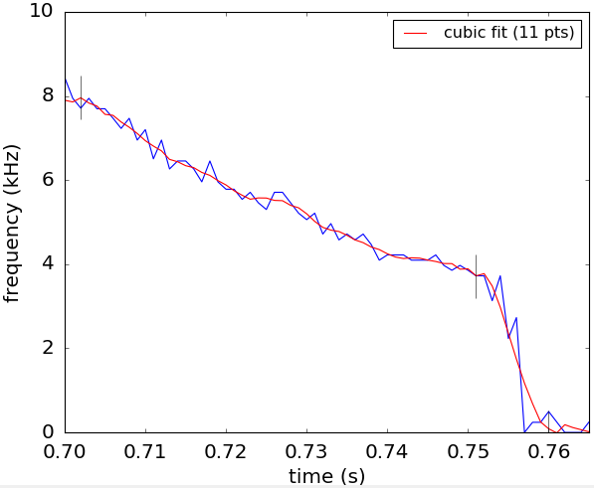
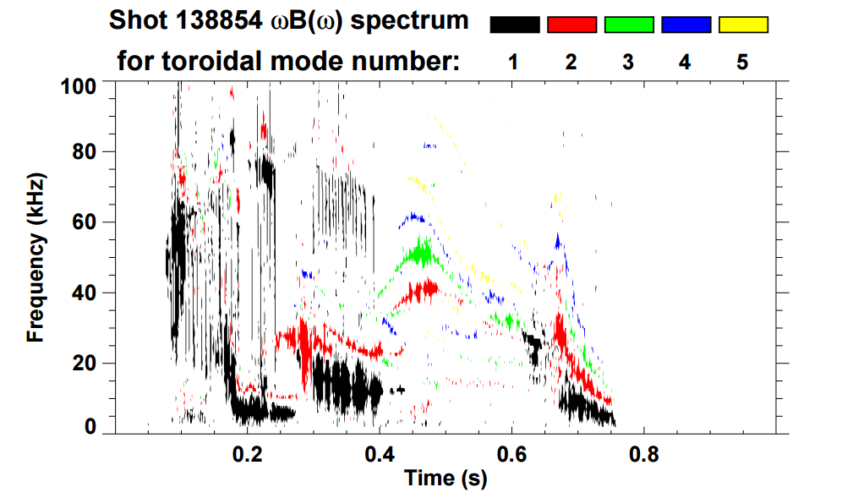
Essential new step for DECAF analysis of general tokamak data: Identification of rotating MHD (e.g. NTMs)
Mode frequency vs. time (zoomed in)
Magnetic spectrogram of rotating MHD
Mode frequency
bifurcation
frequency (kHz)
138854
lock
DECAF FFT analysis determines mode frequency, bifurcation, and mode locking
Initial mode locking prediction model developed
See JP10.00057 J. Riquezes (Tue PM)

Slide 9
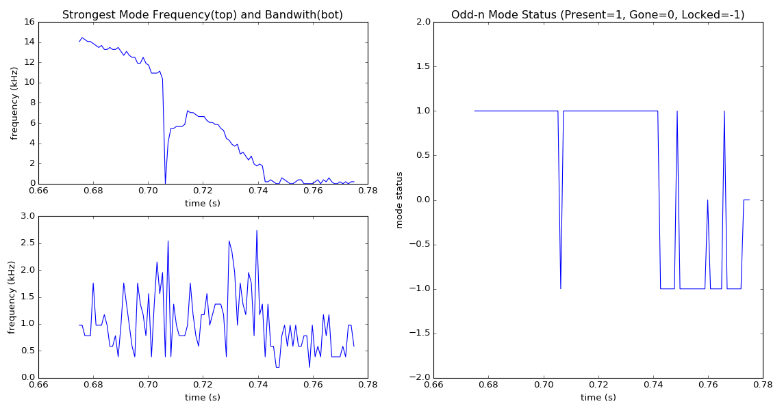
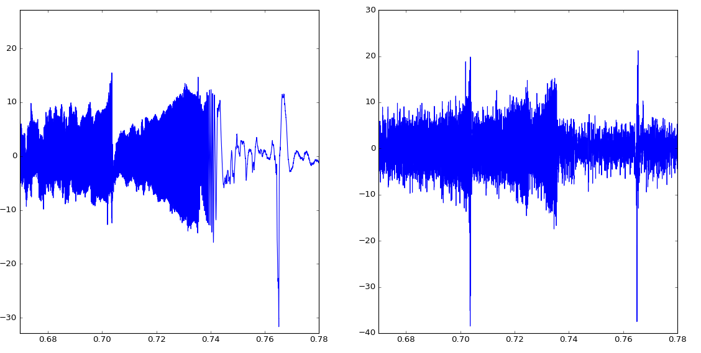
DECAF rotating MHD analysis identifies the state of the modes found
Magnetic signal / analysis (mode locking / unlocking)
Frequency vs. time
DECAF mode status
16
2
n = 1 mode
12
1 = mode rotating
frequency (kHz)
8
1
4
0
0 = No mode
0
20
10
B (G)
0
-1
-10
-20
204202
mode lock
-1 = mode locked
-30
t (s)
-2
t (s)
NSTX-U
0.68
0.70
0.72
0.74
0.76
0.78
0.66
0.70
0.74
0.78

Slide 10
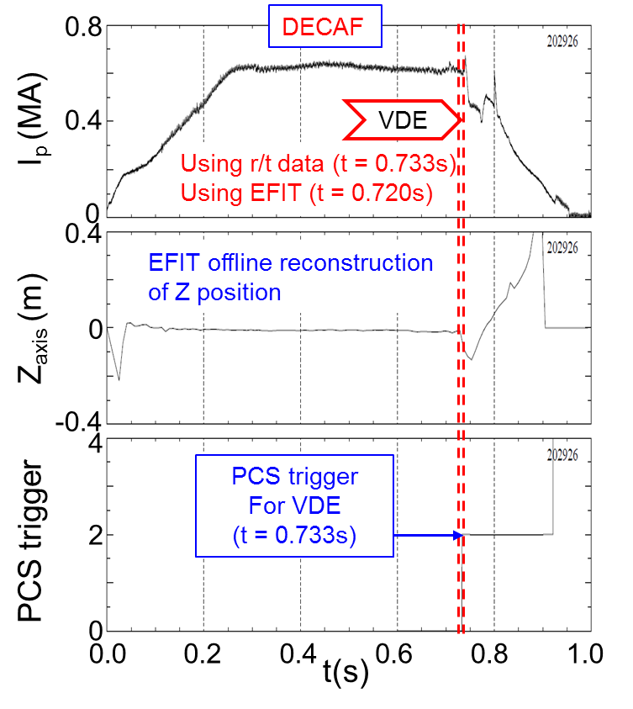
DECAF replicates the triggers found in new real-time plasma shutdown capability of NSTX-U
Important capability of DECAF: compare analysis using offline vs. real-time data
Plasma Shutdown Handler conditions are analogous to DECAF events
  Control system loss of vertical control ➔ DECAF
DECAF comparison: VDE event
  Matches Plasma Control System when r/t signal is used (1 criterion)
  VDE event 13 ms earlier using offline EFIT signals (3 criteria: Z₀, dZ₀/dt, Z₀ x dZ₀/dt)
I_{p} (MA)
VDE
Z₀ (m)
PCS state
(for shutdown handler: see NP10.00005 S. Gerhardt (Wed AM)

Slide 11
Disruption event characterization, forecasting, and control are synergizing in NSTX-U for disruption avoidance
Physics Understanding
  Disruption Event Characterization and Forecasting code (DECAF) development continues: defining / forecasting disruption event chains
  Recent DECAF development includes initial kinetic RWM forecasting, and initial identification of rotating MHD modes, bifurcation, and locking
Stability Control
  An arsenal of control tools will be available on NSTX-U for disruption avoidance (e.g. rotation, q profile control; RWM state-space controller)

Slide 12
Supporting Slides Follow

Slide 13
Disruption avoidance is a critical need for future tokamaks; NSTX-U is focusing stability research on this
The present “grand challenge” in tokamak stability research
  Can be done! (JET: < 4% disruptions w/C wall, < 10% w/ITER-like wall)
    ITER disruption rate: < 1 - 2% (energy load, halo current); << 1% (runaways)
Strategic plan: utilize/expand stability/control research success
  Synergize and build upon past MHD stability/control success (don’t just repeat!)
  Utilize this knowledge / evolve into disruption prediction and avoidance research
FESAC 2015 DOE Transient Events report: Disruption Predicition, Avoidance, Mitigation a Tier 1 (highest priority) initiative
Research at NSTX-U producing focused approach on disruption prediction and avoidance with quantitative measures of progress
s

Slide 14
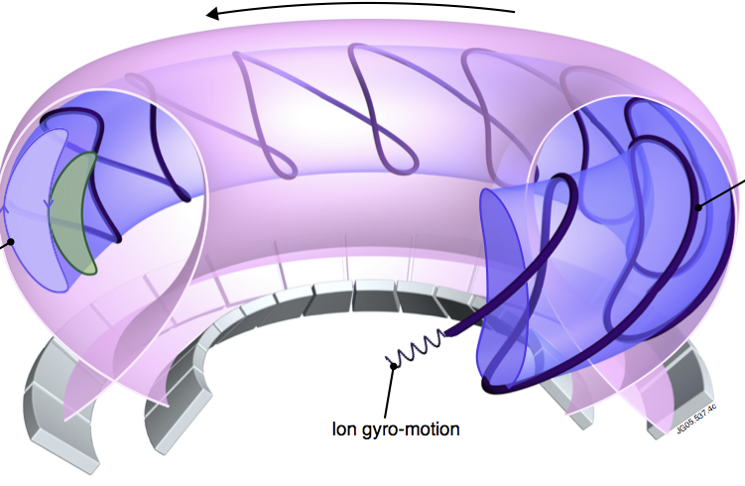
Global mode stability forecasting: build from success of drift kinetic theory modification to MHD as a model
Kinetic modification to ideal MHD
Stability depends on
  Trapped / circulating ions, electrons
  Collisionality; Energetic particles
  Integrated ω_{φ} profile matters!!! : broad rotation resonances in δW_{K}
Trapped orbit 2D
projections
Trapped particle orbit precession drift
Trapped particle
orbit
ion gyro-orbit
and trajectory
plasma integral over particle energy
(Fig. adapted from R. Pitts et al., Physics World (Mar 2006))
Just some references:
B. Hu, R. Betti, et al., PoP 12 (2005) 057301
J. Berkery et al., PRL 104 (2010) 035003
S. Sabbagh, et al., NF 50 (2010) 025020
J. Berkery et al., PRL 106 (2011) 075004
J. Berkery et al., NF 55 (2015) 123007
precession drift
bounce
collisionality
ω_{φ} profile (enters in ω_{Ε})

