Slide 1



Advances in boronization in NSTX-U
C.H. Skinner, F. Bedoya, F. Scotti, J.P. Allain,
W. Blanchard, D. Cai, M. Jaworski, B.E. Koel
58th Annual Meeting of the APS Division of Plasma Physics
San Jose California
Oct 31 – Nov 4, 2016,
Notes:
Source text and plots from 2016 NSTX-U results review ‘Skinner Boronization RR2016.pptx’
Before that from ‘Skinner PSI-2016 poster / Skinner PSI-22 FINAL A0.pptx’
Piggyback results, did not get to run XP1550 Boronization XP.
Like to thank co-authors and acknowledge whole NSTX team without which this would not be possible.

Slide 2
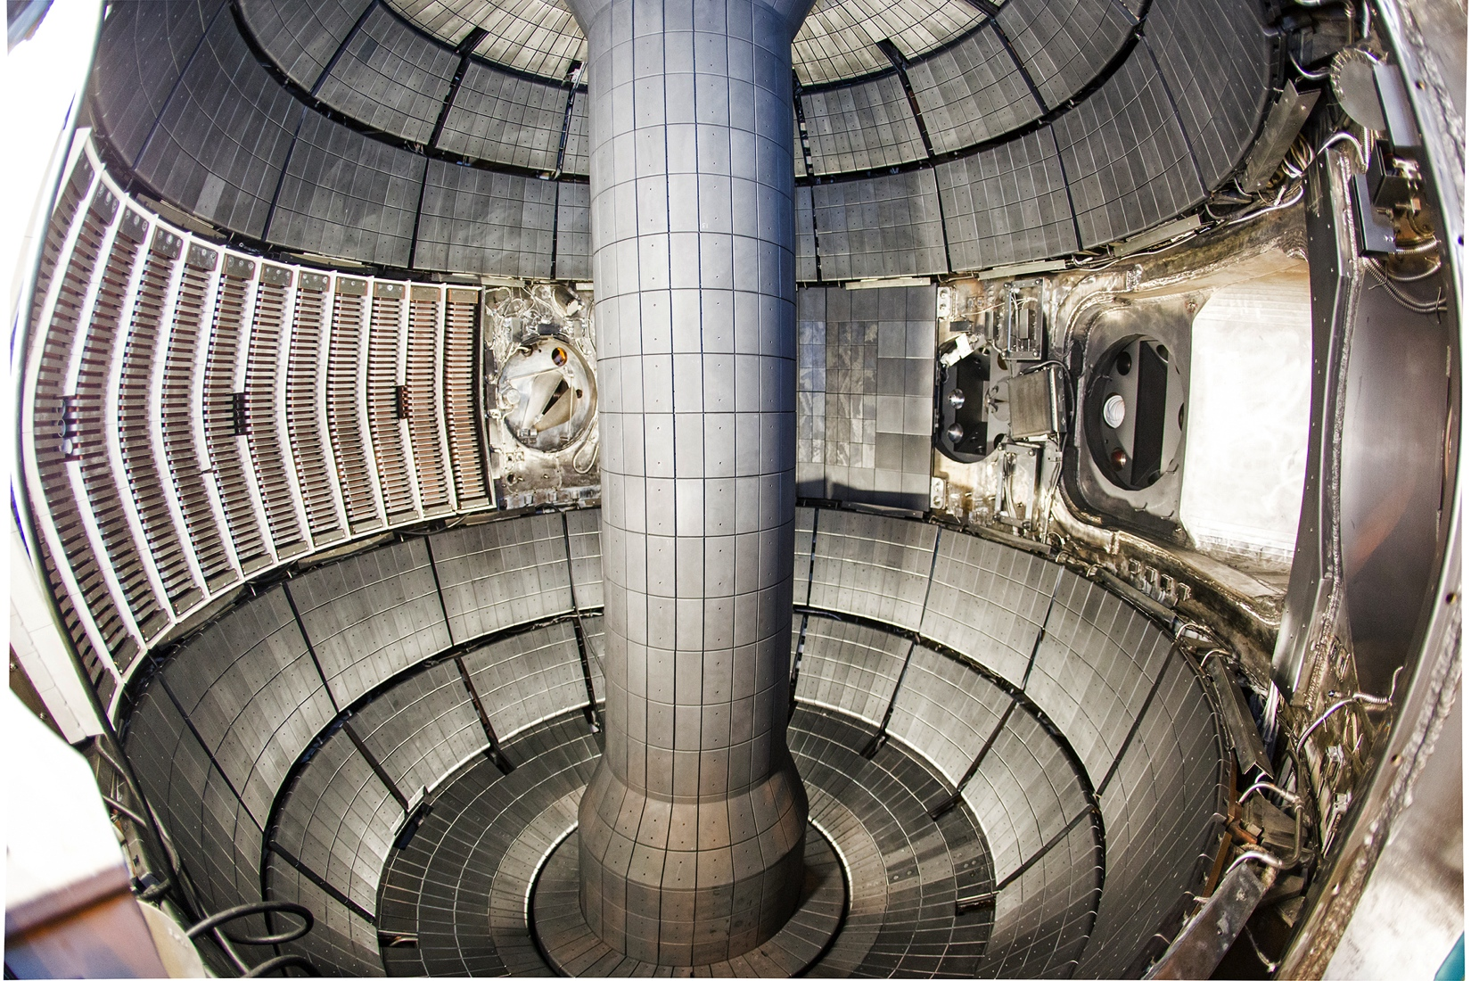







NSTX-U Boronization
Boronization was main wall conditioning technique in 2016
Trimethylboron was dissociated in a helium glow discharge. Forms a hard, sputter resistant coating on PFCs.
2 Electrodes: 30°, 180° toroidally
3 Gas inlets:
60° lower, 90° upper, 150° midplane
4 Quartz Microbalances:
30° mid, 120° top, 150° lower 240° mid
D Cai et al., TOFE proceedings (2016)
Notes:
Photos from: Photo Survey before 2015 campaign / Fisheye_3.jpg, Photo Survey after 2015 campaign
Boron/carbon coatings applied onto PFCs through plasma-enhanced chemical vapor deposition
Trimethylboron is dissociated in a helium glow discharge and ionized boron containing radicals then impinge onto the PFC cathode to form a hard, reactive and corrosion resistant coating.
Complex 3D geometry, I will label components as top, mid plane, bottom, and toroidal angle w.r.to NB duct #1.

Slide 3
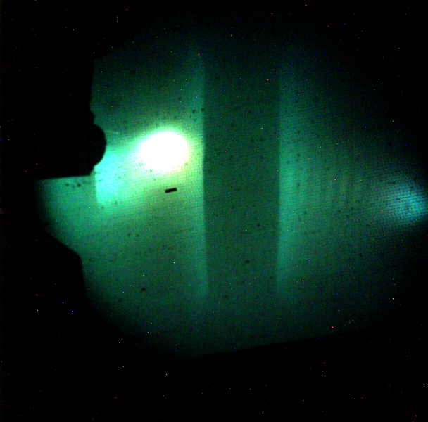
NSTX-U Glow Discharge
Glow Discharge Physics:
A hollow-cathode discharge,
sustained mainly by ionization by secondary electrons emitted from the vessel wall (cathode),
accelerated ballistically through a thin cathode sheath, penetrating the plasma as a fast electron beam,
trapped by the cathode fall surrounding the plasma on all sides.
The electric field distribution inside the plasma is controlled by low-energy plasma bulk electrons.
The anode has a much lower surface area compared to the cathode (vessel wall)
- leads to the formation of an anode glow and an order-of-magnitude higher ion flux near the anode.
Bay B anode glow
RF
antenna
Sheath ionization in pump duct
Hagelaar Plasma Phys Contr F 57 (2015) 025008
Notes:
Physics explored for ITER – see backup slide and references:
HagelaarPlasma Phys Contr F 2015 Modelling of tokamak glow discharge cleaning I physical principles.pdf
KogutPlasma Phys Contr F 2015 Modelling of tokamak glow discharge cleaning II comparison with experiment and application to ITER.pdf
19th century plasma physics, but now without interesting aspects. Glow discharges came under renewed scrutiny recently as they are one of the pincipal wall conditioning techniques for ITER and there was some modern modeling of GDs coupled to benchmarking against experiment at JET and RFX. The broad conclusion was that

Slide 4
Most deposition at midplane
Deposition at midplane during boronization
Deposition at top and bottom
‘Full-bottle’ procedure: 30 s of He-GDC followed by 6 h of 5% (9 g) dTMB, 95% He GDC
Followed by 2h He-GDC to deplete co-deposited D from tiles.
Bay C lower gas injector used for above data.
Note the difference in Y-axis scales (Å based on ρ=1.6 g cm⁻³)
D₃C
D₃C
B
Tri-methyl boron
D₃C
Notes:
These are the results from the quartz microbalances.
The GD was 95% He with 5% of TMB.
Showing deposition at the midplane and top and bottom.
NSTX 25 – 47x less boron deposited on the lower and upper divertor than on the midplane.
NSTX-U about factor 15

Slide 5
More divertor deposition @ lower pressure
GDC pressure 2 mtorr 4 mtorr
Deposition at top and bottom of vessel increased at lower pressure
(longer mfp).
Subsequent boronizations
used 1.7 mtorr.

Slide 6
More deposition near gas injector, most deposition near electrode
QMB
120° top
QMB
150°
bottom
Deposition on the QMBs using only one GD electrode, plotted as a function of distance to the electrode in use.
The high point at 1,515Å is deposition on the 30° QMB when the nearby 30° GD electrode is in use.
Top injector enhances top deposition by 30%.
Lower injector enhances bottom deposition by 21%
Notes:
Can also change injejecton location.
Similar situation on lower divertor.
Can run GD from one electrode and plot the deposition vs. distance from electrode to QMB.
Reallly not much deposition in lower divertor and ¾ of that is carbon.
LH fig = Fig.4 submitted NME
RH fig. Updated with measured distances.
NSTX-U / QMB data 2016 / ersec16_20160326 8th boronization / persec16.20160326 no TC4 correction.xlsx / analysis2 worksheet /

Slide 7
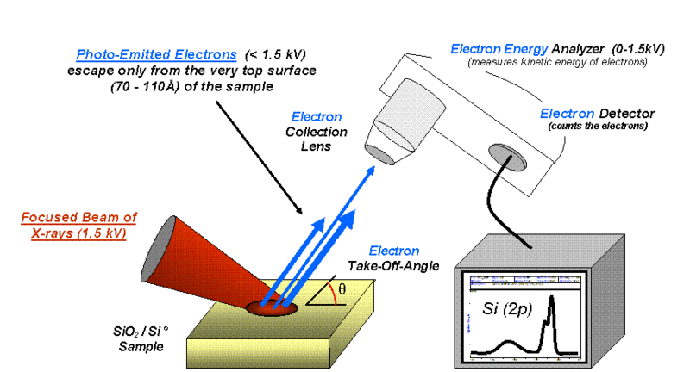
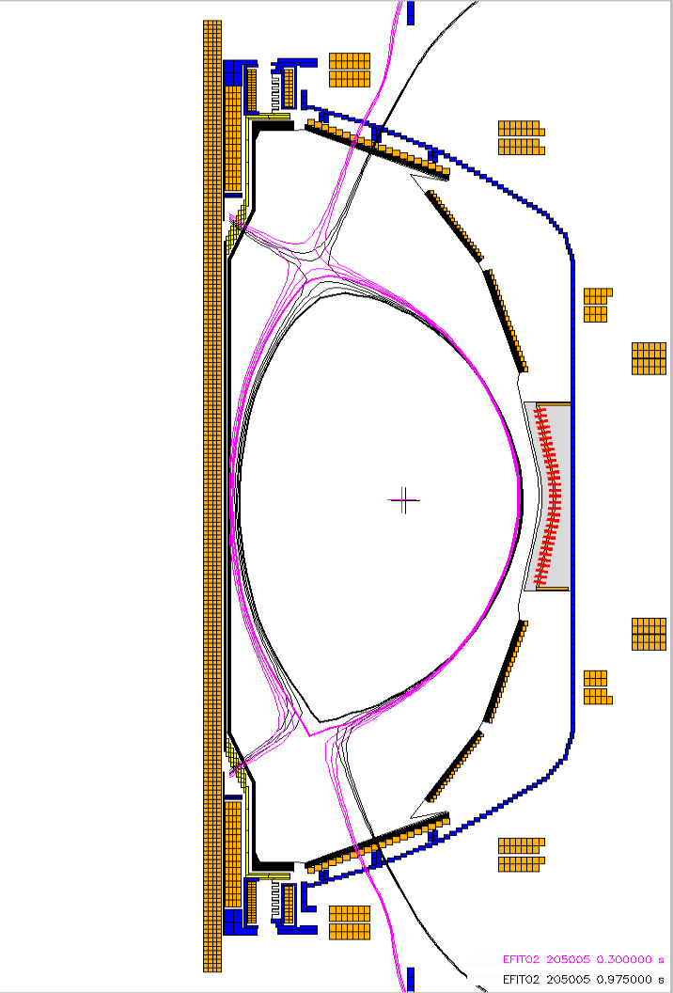
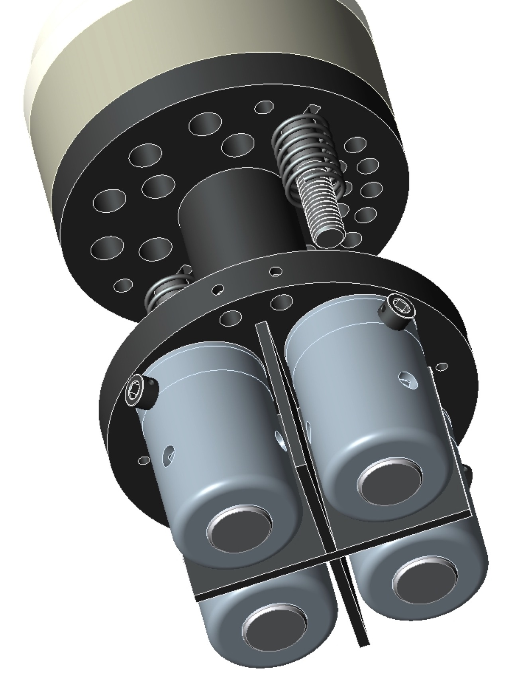
Surface chemistry monitored with MAPP
Materials Analysis Particle Probe (MAPP)
X-ray Photoelectron Spectroscopy
  JP Allain, B Heim, F Bedoya, R Kaita et al…
photoelectrons
electron energy analyser
X-ray beam
sample
XPS spectrum shows elemental composition and chemical shifts.
Sample holder with 4 samples
https://commons.wikimedia.org/wiki/File:System2.gif
See next talk: GO6.00009: C Bedoya et al.,
EFIT02 142512 @ 547 ms
Notes:
From ‘NSTX_PAC29_Lithium_Skinner.ppt’ and
https://commons.wikimedia.org/wiki/File:System2.gif
Battaglia_Strike point summary.pptx

Slide 8
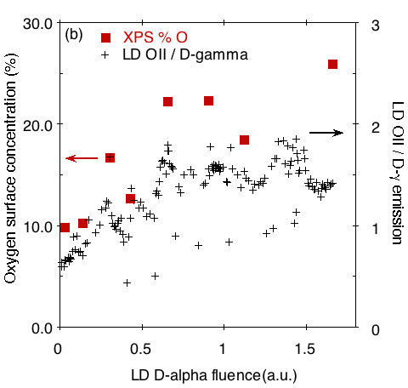
MAPP probe revealed OII emission correlated with surface O rise after boronization
Boronization reduced surface oxygen concentration to 4% - 9%
Surface oxygen then increased with plasma exposure by 0.14%/sec from 7.6% up to 26%.
This increase in surface oxygen concentration was correlated with a rise in lower divertor OII plasma emission.
(plasma exposure)
boronization #5
Notes:
Explain Axes
Fig. 6b
Skinner PSI-2016 paper / Fig.6 MAPP vs OII emission / Fig6b OII plots from Filippo Scotti / Fig6b Poster.qpc

Slide 9
Surface %O and OII emission rose faster after ‘mini-boronization’
‘Mini-boronizations’ used 1.8 g dTMB compared to full-bottle 9 g.
Both surface %O and OII emission rose faster after ‘mini-boronization’,
as expected from shorter erosion
lifetime of thinner boronized layer
(plasma exposure)
Notes:
Fig. 7 NME
Explain axes
No there is not a buried mB point at 0 fluence. No test cell access to take measurement.

Slide 10
Conclusions:
After boronization, surface oxygen, as measured by XPS, and OII 441 nm emission from plasma both increased with plasma exposure. H-mode achieved after full bottle boronization.
- nice correlation of surface composition and plasma performance !
Deposition uniformity was improved by operating the glow discharge at low pressure.
The deposition was enhanced by 20 – 30% in the region local to the gas injection port.
But boron deposition in divertors relatively low (10s of monolayers).
Considering to increase fraction of d-TMB/He from 5% to 10% - 20% next year.
Extensive program of surface analysis of samples retrieved from NSTX-U is underway
Notes:
10% d-TMB used in NSTX prior to 2004.

Slide 11
Backups

Slide 12
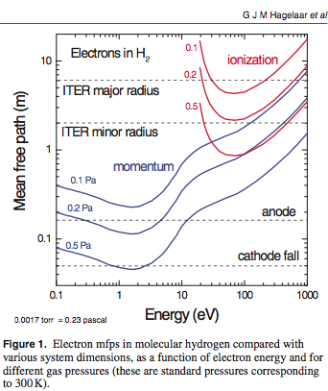
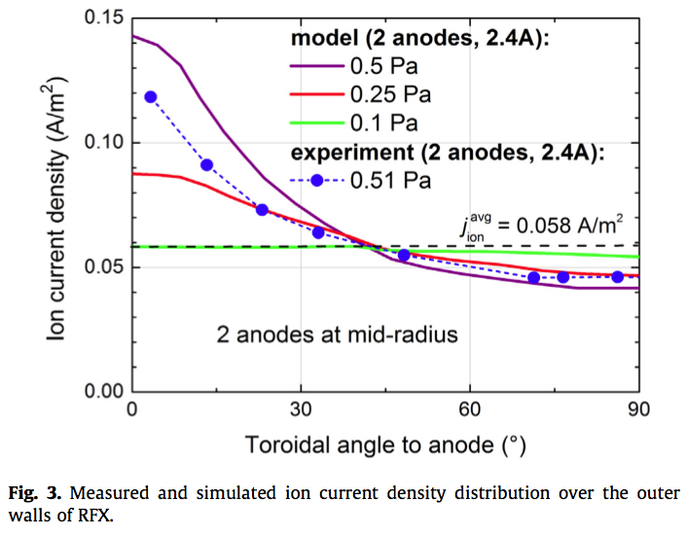
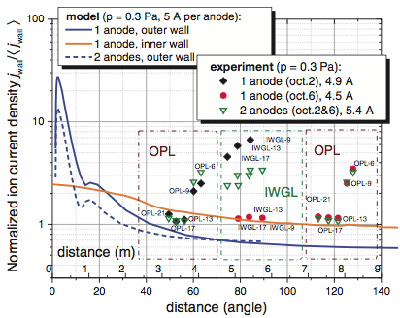
GDC Modeling; RFX, JET benchmarks
RFX: R=2m, a=0.43m
JET

Slide 13
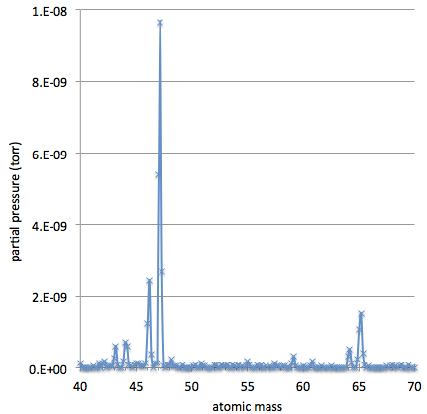
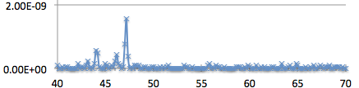
Boronization conditions:
Typically Bay B electrode 540 V, 2.3 A
Bay G electrode 530 V, 1.8 A
One 9-g bottle d-TMB / per full boronization
Gas mix: 5% d-TMB 95% He
75% carbonization 25% boronization
Ion fluence = current x time, is close to
total d-TMB + He atoms/mol used
Vessel pressure set at 1.7 mtorr
Nominal vessel area: 40 m²
Average coverage would be ~ 1400Å
but is not uniform
Expected erosion rate: 1 – 10+ Å/s
Di-methyl boron
RGA during He/d-TMB pumpout
D₃C
B
D₃C
Tri-methyl boron
RGA during He/d-TMB GDC
¹⁰B¹¹B
amu

Slide 14
Other machines, Options for more boron coverage:
C-mod uses ECDC sweep in He/diborane (B₂H₆) ( Lipschultz)
Thickness: ‘1500-2000 Å assuming uniform deposition over 10m^{2’}
DIII-D uses GD 90% He/ 10% diborane (B₂H₆) (Jackson)
‘average 1000 Å thickness 90% B, 10% C film (AES)’
JT60 GDC He/decaborane - 70-g B₁₀D₁₄ lasted 50 shots (Nakano)
Carborane: C₂B₁₀H₁₂ @ 180 C (solid at room temp) EAST, KSTAR; (Wu, Hong)
Conclude more boron needed in NSTX-U divertor:
Increase fraction of d-TMB from 5% to 10% ?
Relocate GDC electrodes to divertor ?
- need toroidal coverage - convert select divertor tiles to anodes ?
More boron rich gas e.g. B₂D₆ - but toxic & explosive;
Mega boronization ! - just use more d-TMB ?

