Slide 1
Advancing Non-Solenoidal Startup on the Pegasus ST
Joshua A. Reusch
J.L. Barr, G.M. Bodner, M.W. Bongard, M.G. Burke, R.J. Fonck, J.L. Pachicano, J.M. Perry, N.J. Richner, C. Rodriguez Sanchez, D.J. Schlossberg
58th Annual Meeting of the APS Division of Plasma Physics
Nov. 1, 2016
Notes:
To do:
Pegasus poster session: NP10, Wed. Morning.

Slide 2
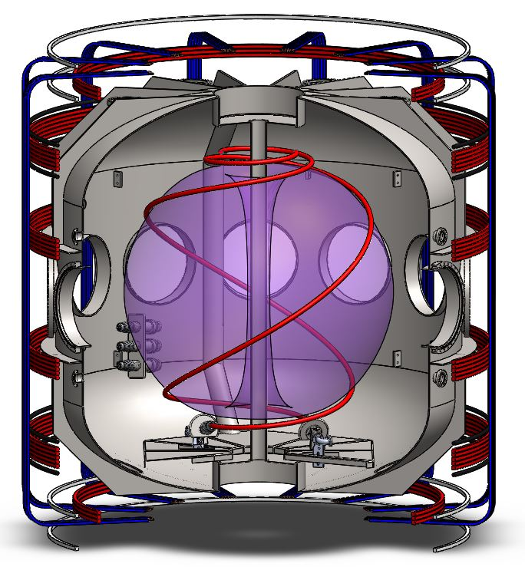
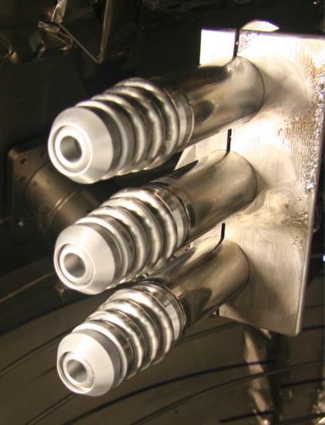
Local Helicity Injection (LHI) is a Promising
Non-Solenoidal Startup Technique
I_{p} ≤ 0.18 MA (I_{inj} = 5 kA)
Injected Current Stream
Local Helicity Injectors
Compact, modular washer-stack arc sources inject edge current
Unstable current streams form tokamak-like state via magnetic reconnection, Taylor relaxation
Physics and engineering tradeoffs strongly coupled to injector location
J.A. Reusch, APS-DPP 2016
Notes:
Replace with cad that has div injectors, replace Ip trace with overplot of two

Slide 3
0-D Power Balance Model Used to Explore Projections for NSTX-U Startup
I_{p}(t) from 0-D power balance model:
Shape evolution for
LFS LHI on NSTX-U
NSTX-U: Projected
Helicity dissipation (V_{IR}) dependent on T_{e}
Importance of V_{LHI}, V_{IND} depends on injector geometry, plasma growth scenario
  Final plasma depends strongly on full time evolution
LFS mid-plane injection: V_{LHI} early, V_{IND} late
HFS divertor injection mainly V_{LHI}
<T_{e}>=150eV
Need to explore plasma evolution with different dominant drive terms
Notes:
This needs a new title…

Slide 4
On Pegasus: Utilize Different Injector Geometry to Emphasize Different Drive Mechanisms
I_{p}(t) from 0-D power balance model:
Outboard Mid-plane (LFS)
High I_{p} LFS
Lower Divertor (HFS)
-V_{IR}
-V_{IR}
V_{LHI}
V_{IND}
V_{IND}
-V_{IR}
V_{LHI}
V_{LHI}
V_{IND}
V_{IND} dominant
V_{LHI} dominant
Vary relative drive ratios to inform predictive model
Future: Test scaling to high I_{p} in both LFS and HFS injection
Notes:
Get rid of V_IR?
Scale of LHI system depends strongly on V_{IR} → T_{e} scaling
See next talk for details on this

Slide 5
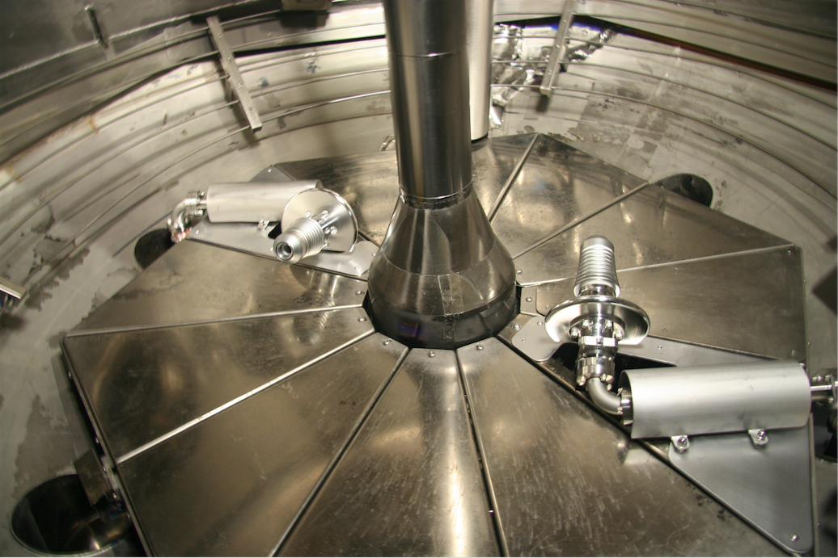
New Helicity Injectors in the Divertor Region of Pegasus are Installed and Operating
HFS → 3-4x increased helicity input
  Access to higher I_{p} startup
Static geometry → low V_{IND}
Injector operation at longer pulse, high-B_{TF}
Divertor Injectors after Installation
Centerstack
Lower div
Strike Plate
HFS injectors

Slide 6
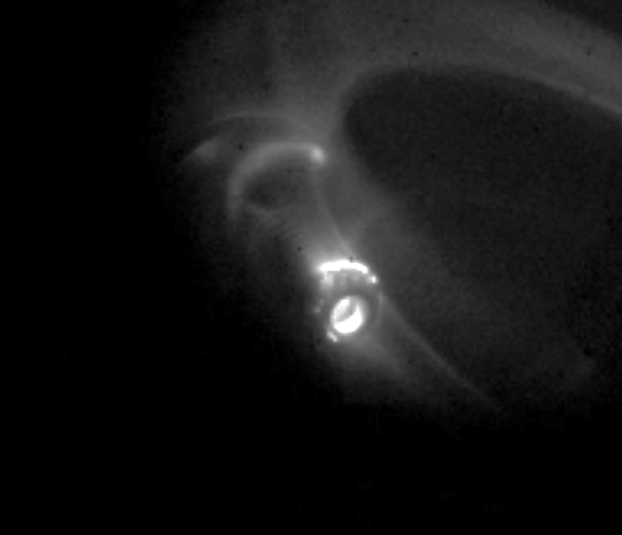
In the Process of Optimizing PMI Mitigation Measures in the HFS Injector Geometry
PMI on injector surfaces
PMI on lower divertor plate
PMI: Cathode spots, arc-back, divertor plate interaction
Consequence: Impurity injection, reduced drive, loss of reproducibility
PMI mitigated: Operation at low B_{TF}, improved alignment and local limiters
PMI is much reduced, but still optimizing
Notes:
Work on the title

Slide 7
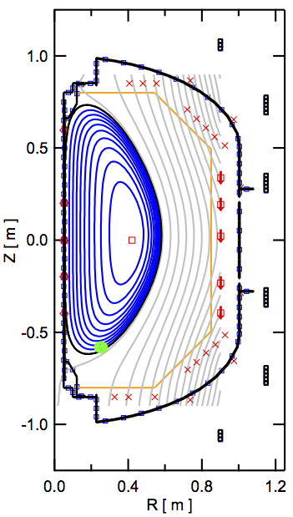
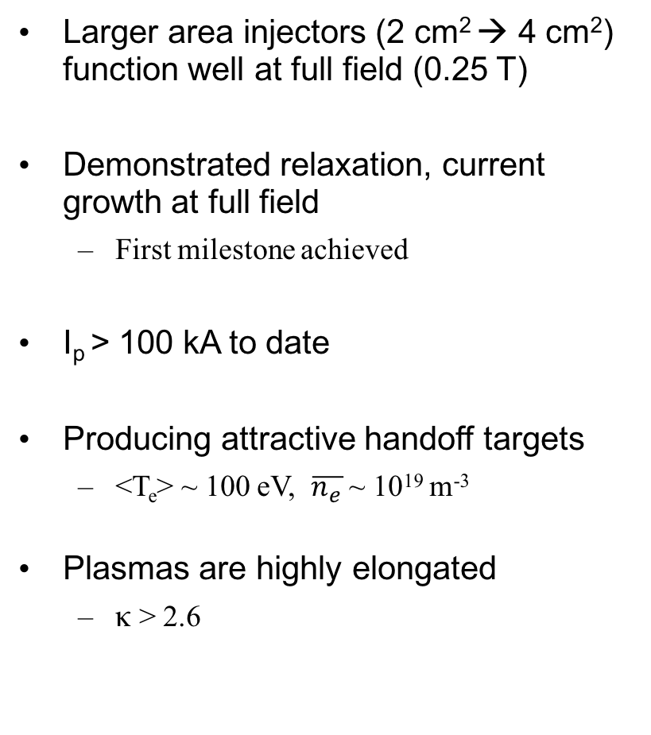
Initial Results from HFS Injector Campaign are Promising
Larger area injectors (2 cm² → 4 cm²) function well at full field (0.25 T)
Demonstrated relaxation, current growth at full field
  First milestone achieved
I_{p} > 100 kA to date
Producing attractive handoff targets
  <T_{e}> ~ 100 eV, $\overline{n_{e}}$ ~ 10¹⁹ m⁻³
Plasmas are highly elongated
  κ > 2.6
100kA at 100% B_{TF}
High κ
155kA at 30% B_{TF}
Notes:
Clean up Ip plots

Slide 8
Fully V_{LHI} Driven Discharges at Low B_{TF} Exhibit Unexpected MHD Phenomenology
HFS LHI
LFS LHI
0-D model indicates full growth and sustainment by LHI drive
MHD markedly different from LFS LHI
  Initial phase: current drive from large scale reconnection of helical streams
  MHD abruptly drops by an order of magnitude
V_{LHI}
-V_{IR}
-V_{IR}
V_{IND}
V_{IND}
V_{LHI}
Notes:
Clean up all of these

Slide 9
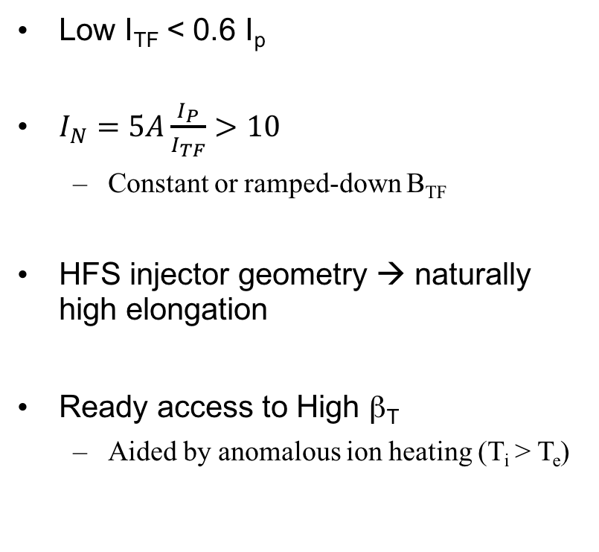
Interim Operation at Low B_{TF} Allowed Observation of Sustained High I_{N}, High κ Discharge
Access to I_{N} > 14, n_{e} > 10¹⁹ m⁻³ with HFS Injection, B_{TF} Ramp-down
Low I_{TF} < 0.6 I_{p}
$I_{N}=5A\frac{I_{P}}{I_{TF}}>10$
  Constant or ramped-down B_{TF}
HFS injector geometry → naturally high elongation
Ready access to High β_{T}
  Aided by anomalous ion heating (T_{i} > T_{e})
I_{p} (kA)
I_{N}
n_{e} (10¹⁹ m⁻³)
Notes:
MHD observations from new discharges compared to old discharges
Compare TI to IV vs. I root(V). Could be more like KAW (Kinetic alfven wave)
Fully non-sol sustained, high elongation, aux Ti

Slide 10
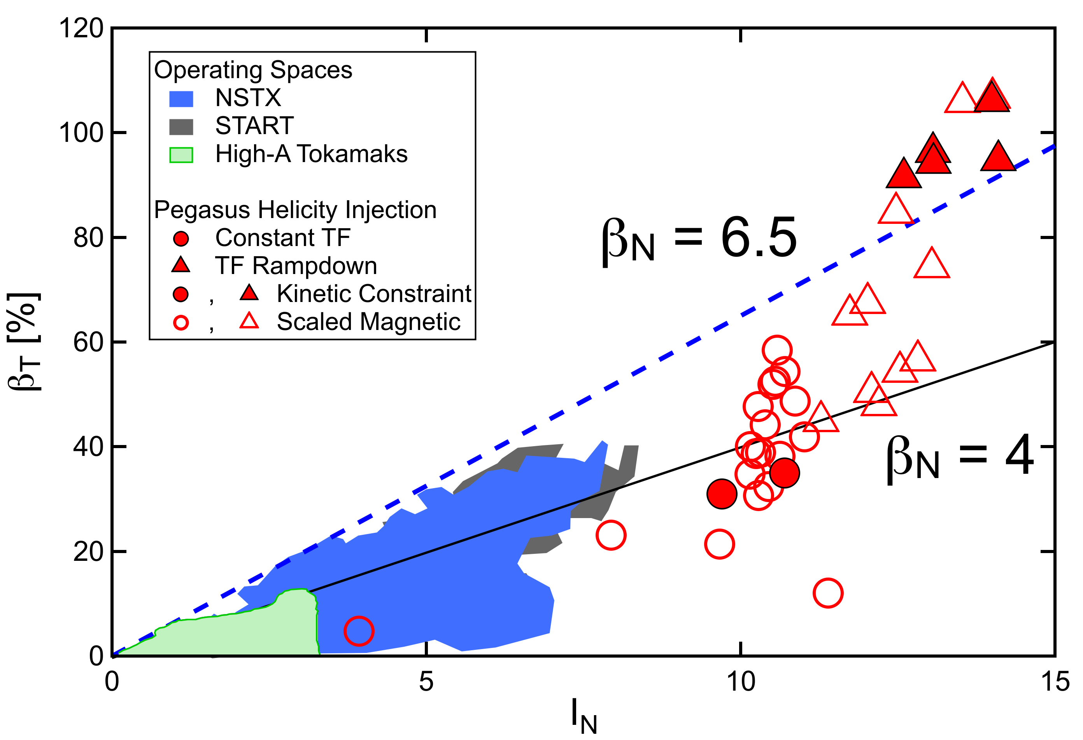
LHI Provides Access to High-β_{T} at A ~ 1 with Non-Solenoidal Sustainment and Anomalous Ion Heating
Equilibrium reconstructions indicate high β_{T} (~<P>/B_{T0}²)
High β_{T} plasmas often terminated by disruption
  n = 1, low-m precursors
Expands I_{N}, β_{T} space for stability studies at extreme toroidicity
Initial Exploration of High-β_{T} Space
Notes:
MHD observations from new discharges compared to old discharges
Compare TI to IV vs. I root(V). Could be more like KAW (Kinetic alfven wave)
Fully non-sol sustained, high elongation, aux Ti

Slide 11
HFS Injection Enables Exploring Varied Drive Mechanisms.
Coincidentally: Unique Access to High I_{N}, β_{T} Space
HFS injector operation and relaxation to a tokamak demonstrated at full TF (B_{TF_inj}~0.25T)
Completely V_{LHI} driven startup and sustainment realized
Sharp drop in MHD during I_{p} ramp suggests change in current drive mechanism
HFS injection at low B_{TF} enables sustained non-inductive operation at high κ, high I_{N}, and high β_{T}
Present campaign:
  Optimize HFS injector implementation to mitigate PMI at high B_{TF}
  Develop high I_{p} scenarios to test scaling
  Design CHI system for comparison studies (with PPPL, U. Wash)
Notes:
Divertor Injection Enabling Critical Tests of LHI Confinement and Access to Stability Test at Extreme Toridicity

