Slide 1
Impurity Contamination Effects on the Interaction of Li and Sn Films on W(poly)
Oluseyi O. Fasoranti, and B.E. Koel
Department of Chemistry, and Department of Chemical and Biological Engineering,
Princeton University, Princeton, NJ, USA
58th Annual Meeting of the APS Division of Plasma Physics.
San Jose, CA
1-4 November 2016

Slide 2
Motivation
Liquid metal plasma facing components (LM PFCs) such as lithium (Li) and tin (Sn) can potentially perform better than solid PFCs
The positive effects of Li coatings on plasma performance has led to an interest in Li chemistry on high Z metals such as tungsten (W)
Liquid Sn is attractive because it has lower vapor pressures and thus lower evaporative flux and higher operating temperature limits in tokamaks.
Impurity contamination of these LM PFCs can alter surface composition and affect parameters such as wetting and hydrogen retention
We report in this talk ultrahigh vacuum (UHV) studies of the impact of O-contamination on thermal stability of Li and Sn films on polycrystalline tungsten (W)
Notes:
Need Quantitative Data and Clear Conclusion each
Primarily mention that the focus of this talk will be on O-contamination

Slide 3
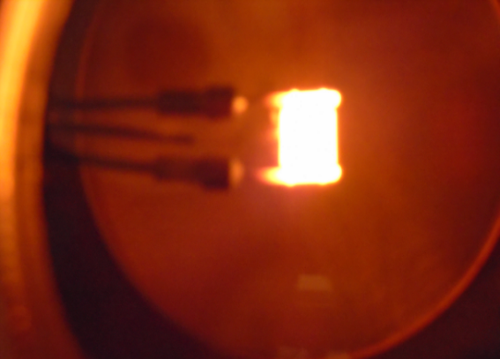
Overview of Surface Science Methods
4-axis sample manipulator
Energy
analyzer
Li evaporator
port
Sn evaporator
port
Ion Pump
Surface analysis toolbox:
Auger Electron Spectroscopy (AES)
X-ray Photo-electron Spectroscopy (XPS)
Low Energy Ion Scattering (LEIS)
Temperature Programmed Desorption (TPD)
Clean Li and Sn film deposition through evaporation sources
Clean” W(poly) surface: ~3% O, No C
W(poly)
Sample resistive heating to 1900 K

Slide 4
Li-Li bond weaker than Li-W bond
Li atoms
QMS
Li Multilayer
Li Monolayer
560 K
Li Monolayer
1500 K
W(poly)
W(poly)
W(poly)
TPD measures desorption energy, rate constants, & amount desorbed
TPD of Li on W(poly), show weak Li-Li bond compared to strong Li-W bond
Submonolayer Li film on W(poly) stable up to 1500 K
Bonding | Desorption Energy (eV)
Li-Li | 1.4 eV
Li-W | 3.3 eV
TPD: Temperature Programmed Desorption
Notes:
- Estimated amounts of Li on the surface to understand what is going on
Submonolayer coverage and Monolayer
Explain how to get coverage from the TPD data and the Ea
Explain increase in Li LEIS signal and this could be due to O being dissolved in the substrate

Slide 5
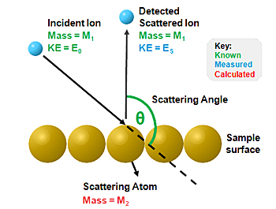
LEIS shows dynamic Li stability up to 1500 K
Low Energy Ion Scattering (LEIS)
Top atomic surface layer information
∆E of elastically backscattered ions to obtain surface information
Li LEIS shows:
O dissolution into Li film at 450 K
Submonolayer Li stability up to 1500 K
No major loss of Li due to bulk diffusion
LEIS: Low Energy Ion Scattering
Notes:
- Estimated amounts of Li on the surface to understand what is going on
Submonolayer coverage and Monolayer
Variations in signal intensity can be used to follow surface processes

Slide 6
Complex decomposition of LiO_{x} films on W(poly)
Li oxidation from submonolayer to multilayer coverages to elucidate oxide formation and growth
Four Li oxide peaks identified
Separate peaks by annealing
Species identification underway with XPS
TPD: Temperature Programmed Desorption
Notes:
After Characterization of the thermal stability of Clean Li Films
2 figures not explained how connected. Discuss how they are connected
(Li₂O, LiO₂ or Li-W-O species)

Slide 7
Formation of LiOx on pre-oxidized W(poly)
20 L O₂
O(a)
Li
LiOx
W(poly)
W(poly)
W(poly)
Exposed W surface to 20 L O₂ to form chemisorbed O
LiOx species formed after deposition of Li on O/W
TPD: Temperature Programmed Desorption
LEIS: Low Energy Ion Scattering

Slide 8
Sn submonolayer stable up to 1800 K
QMS
TPD shows:
On W(poly), small surface O impurity leads to SnO formation
SnO desorbs at 1000 K before multilayer desorption
O-contamination leads to 100 K decrease in desorption onset
Sn-Sn bonds weaker than Sn-W bonds
AES annealing studies indicate:
Surface redistribution or clustering of Sn at 450 K
Sn atoms
Sn Multilayer
Sn Monolayer
1150 K
Sn Monolayer
1800 K
W(poly)
W(poly)
W(poly)
Bonding | Desorption Energy (eV)
Sn-Sn | 3.1
Sn-W | 4.2
QMS: Quadrupole Mass Spectrometer
AES: Auger Electron Spectroscopy
TPD: Temperature Programmed Desorption
Notes:
QMS (Quadrupole Mass Spectrometer Define)
Indicate that you have seen this on TZM surface
- Large bulk films on W

Slide 9
Conversion of Sn to SnO on pre-oxidized W(poly)
20 L O₂
O(a)
Sn
SnO and Sn
W(poly)
W(poly)
W(poly)
Sn deposition on O/W forms SnO_{x}
Complete conversion of Sn to SnO_{x} at low coverages
Notes:
Better Explain Results

Slide 10
LiO_{x} decomposition more complex than SnO_{x}
LiO_{x} compounds show complex oxide decomposition
Peaks at 850 K, 1000 K and 1300 K
In the case of Sn, SnO_{x} compound decomposes with a single peak
Peaks at 1000 K
TPD: Temperature Programmed Desorption
Notes:
Better Explain Results, Implications to Fusion as well as bonding data

Slide 11
Conclusions
Li multilayers initially desorb at 560 K, monolayer films do not fully desorb until 1500 K
Sn multilayers desorb at 1170 K, monolayer films are stable up to 1800 K
LiO_{x} species formed through Li post-oxidation or Li deposition on oxidized W
Complete conversion of Sn to SnO on oxidized W(poly)
Oxygen increases Li thermal stability but decreases that of Sn
LiO_{x} species decomposition is complex, SnO_{x} species decomposition occurs at a single temperature
Funding: We acknowledge support by DOE FES grant no. DE-SC0012890
Notes:
- What does diffusion mean?

Slide 12
Back up slides

Slide 13
Annealing studies with AES and LEIS
Ultrathin Sn Films (10 ML and 5 ML) deposited at 300 K
Sn signal from AES and LEISS proportional to concentration.
On AES, Sn signal starts to drop after annealing to 450 K due to clustering or surface redistribution of Sn
Notes:
Explain Difference between LEIS and AES (Include in presentation)

