Slide 1
Initial operation of the NSTX-U Real-Time Velocity diagnostic
M. Podestà and R. E. Bell
58th APS-DPP Meeting
October 31 – November 4, 2016
San Jose, CA
Work supported by US DoE – FES grant no. DE-AC02-09CH11466

Slide 2
Abstract
A Real-Time Velocity (RTV) diagnostic based on active charge-exchange recombination spectroscopy is now operational on the National Spherical Torus Experiment-Upgrade (NSTX-U) spherical torus. The system has been designed to supply plasma velocity data in real time to the NSTX-U Plasma Control System, as required for the implementation of toroidal rotation control. Measurements are available from four radii, spanning from the core to the plasma edge, at a maximum sampling frequency of 5 kHz. Post-discharge analysis of RTV data provides additional information on ion temperature, toroidal velocity and density of carbon impurities. Initial results from RTV measurements are presented and compared with those from the main NSTX-U charge-exchange recombination spectroscopy system. Examples of physics studies enabled by RTV measurements from initial operations of NSTX-U are then discussed, with emphasis on the effects of plasma disturbances such as sawteeth and MHD instabilities on toroidal velocity and its temporal evolution.

Slide 3
Outline
The RTV system
Analysis of RTV data
Example of physics studies
Summary & outlook

Slide 4
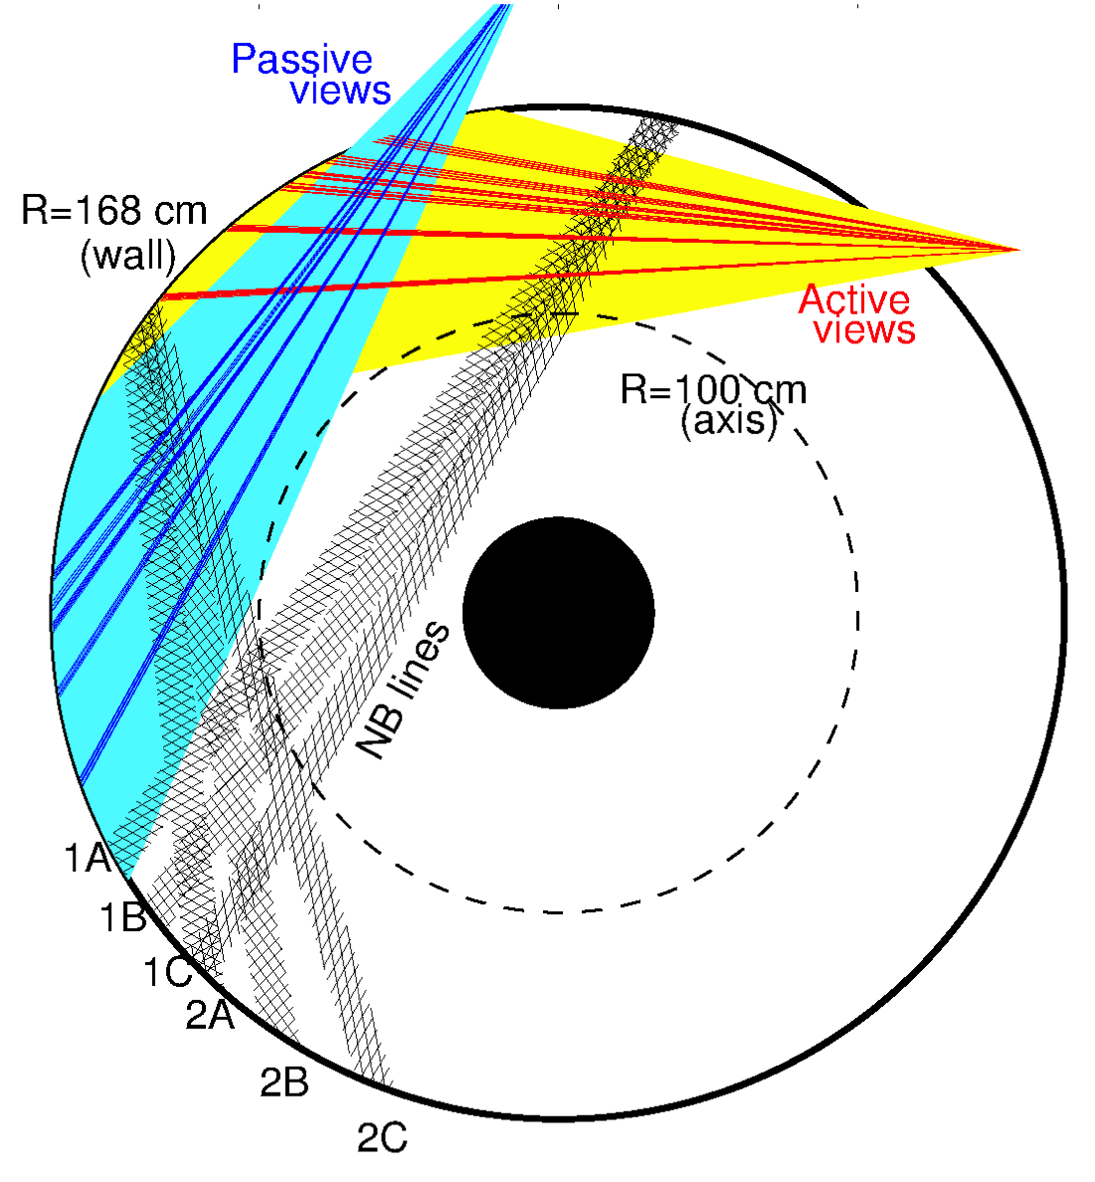
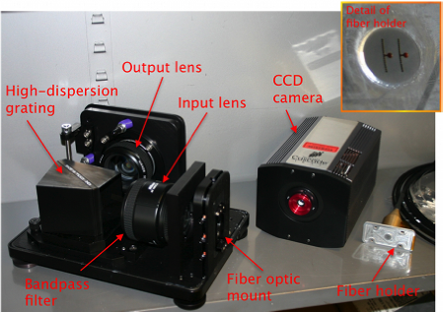
Real-Time Velocity (RTV) is a fast system based on active spectroscopy
System based on active charge-exchange spectroscopy (NB1 line)
Monitor C VI, n=8-7 line @ 5291nm
RTV views interleaved with CHERS views at midplane
4 views available
R=112, 125, 132, 140cm

Slide 5
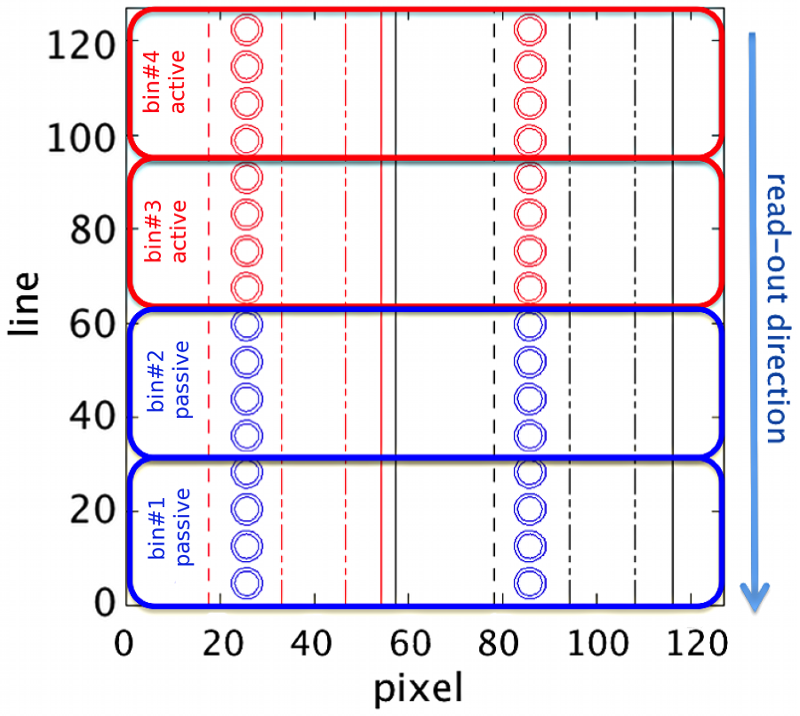
Fiber arrangement on detectors is optimized for real-time operation
Fiber arrangement on each of two (identical) systems:
7-8 fibers aiming at same radial location
Each “channel” is composed by pairs of active and background views
Simplified system for higher sampling rate
no chopper (flexible timing)
no entrance slit (collect more light)

Slide 6
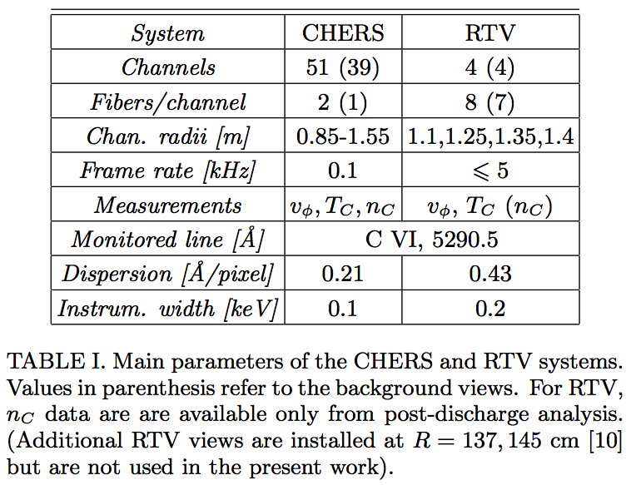
RTV complements CHERS information with high temporal but low spatial resolution data
*
*
*
*
*Achieved performance meets or exceeds requirements for real-time v_{φ} control
[M. Podestà, PPCF 2016 (in press)]

Slide 7
Diagnostic was first tested in FY11; Up & running since first NSTX-U plasma
RTV systems assembled in 2011
Tested with Ne lamps, He glow; calibrated
Acquisition and analysis software improved after first data from NSTX-U plasmas
Demonstrated RT analysis for v_{φ}, possibly T_{i} (limited to T_{i}>150eV)
Developed post-discharge analysis tools
v_{φ} from real time analysis available right after shot
Quick analysis (v_{φ}, T_{i}) available ~1 minute after shot
Full analysis (CHERS-like: v_{φ}, T_{i}, n_{C}) available ~5 minutes after shot
Implemented & tested data transfer to PCS
Thanks to PCS Group!
Data now routinely available to develop & test v_{φ} control algorithm(s) in PCS
[M. Podestà, RSI 83 033503 (2012)]

Slide 8
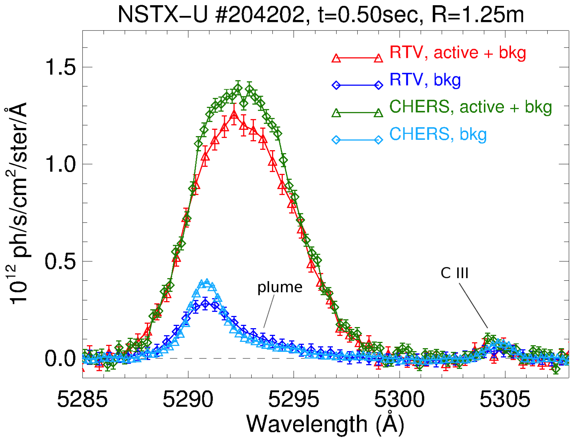
Measured spectrum features good S/N ratio for P_{NB}>2MW; P_{NB}~1MW marginal but measurable
brightness
Shown here is CHERS @100Hz vs RTV @2kHz for P_{NB}~4.2MW
All typical feature appear in RTV spectra
Active CX component, background, plume, C III
Plume contribution removed during RT analysis for core channels

Slide 9
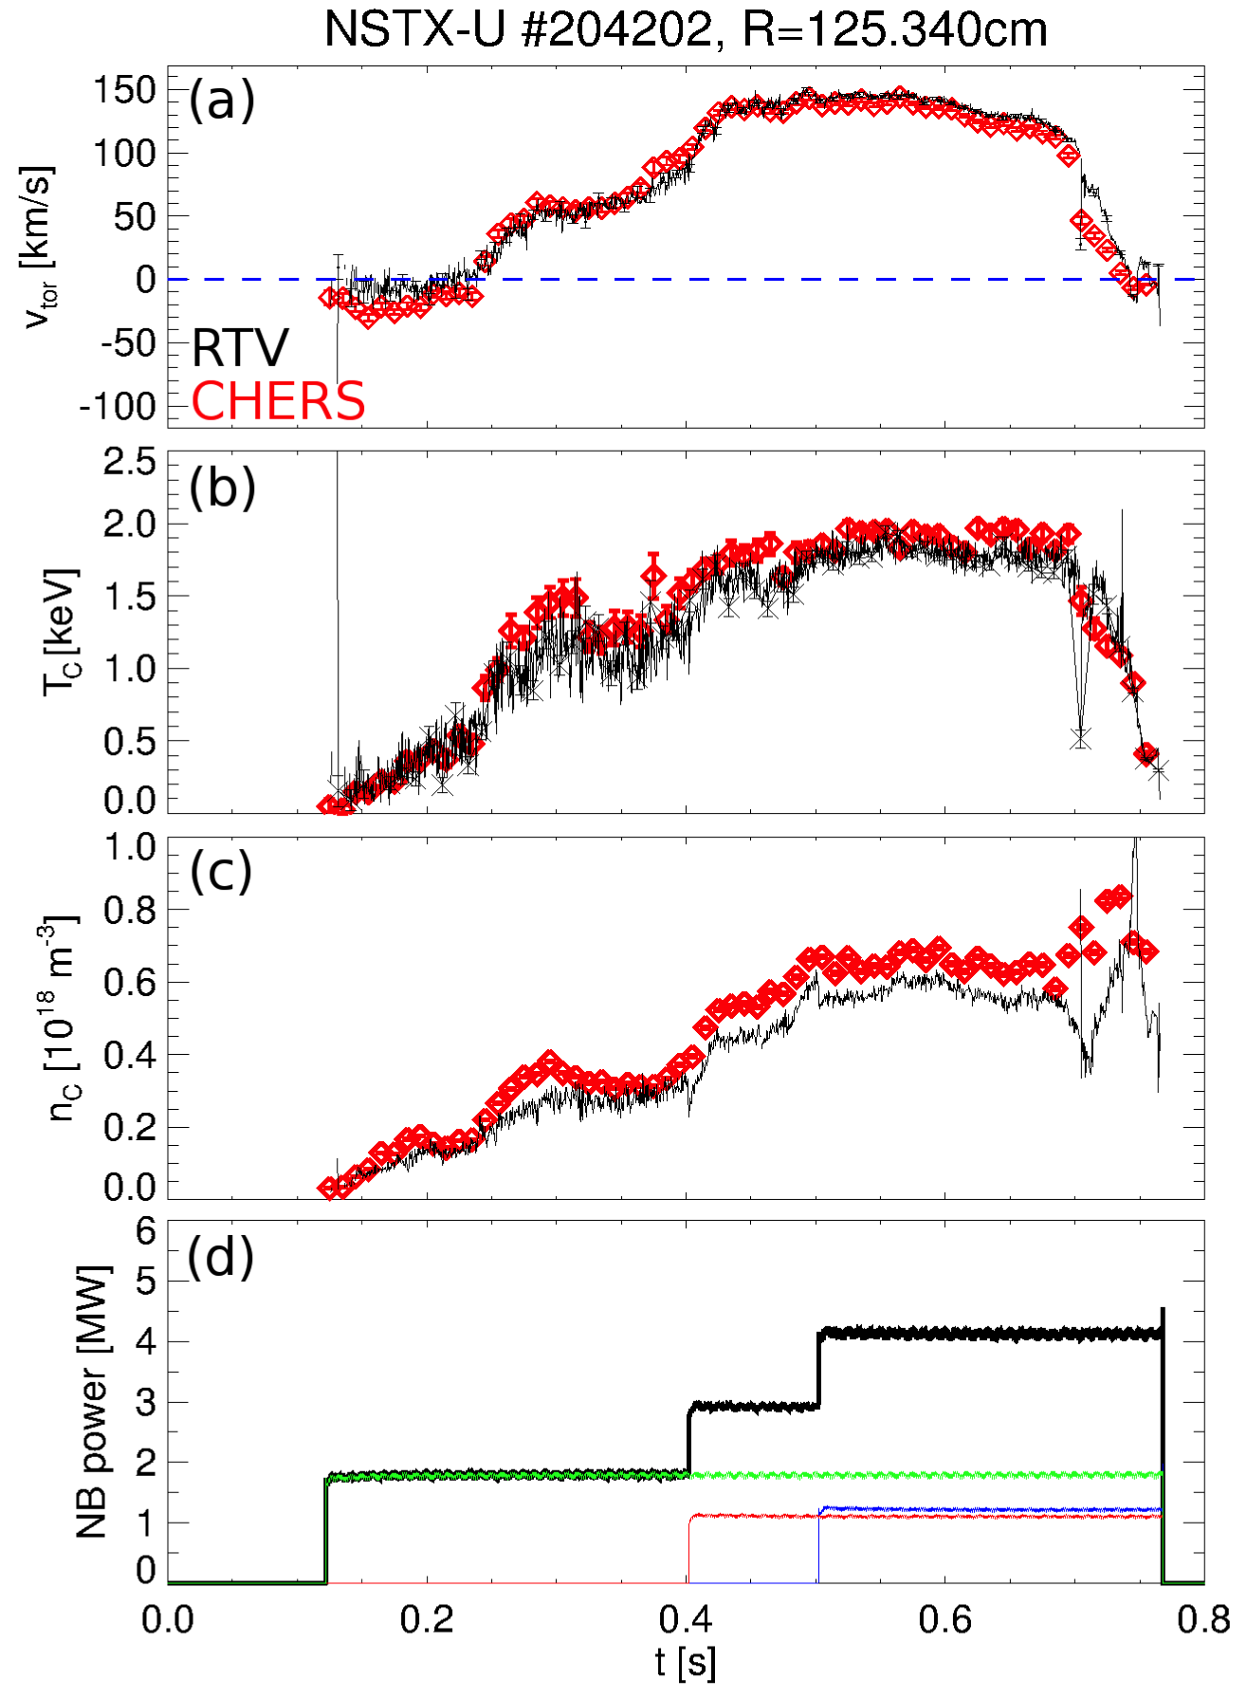
Post-discharge analysis compares well with CHERS results
NSTX-U #204202
P_{NB} increases from 1.7MW up to 4.2MW
Mid-radius channel, R~125cm
Low carbon content
Z_{eff}~1.2-1-5 from CHERS
Good match for v_{φ}, T_{i} at all four RTV radii
Larger discrepancies >20% for carbon density
Suspect uncertainties in RTV vs. CHERS absolute calibration (performed summer 2014!)
Spot size is different (larger for RTV)
Also: window coating at Bay B-mid?
Analysis relies on MPTS for n_{C} analysis: lower “effective” time resolution

Slide 10
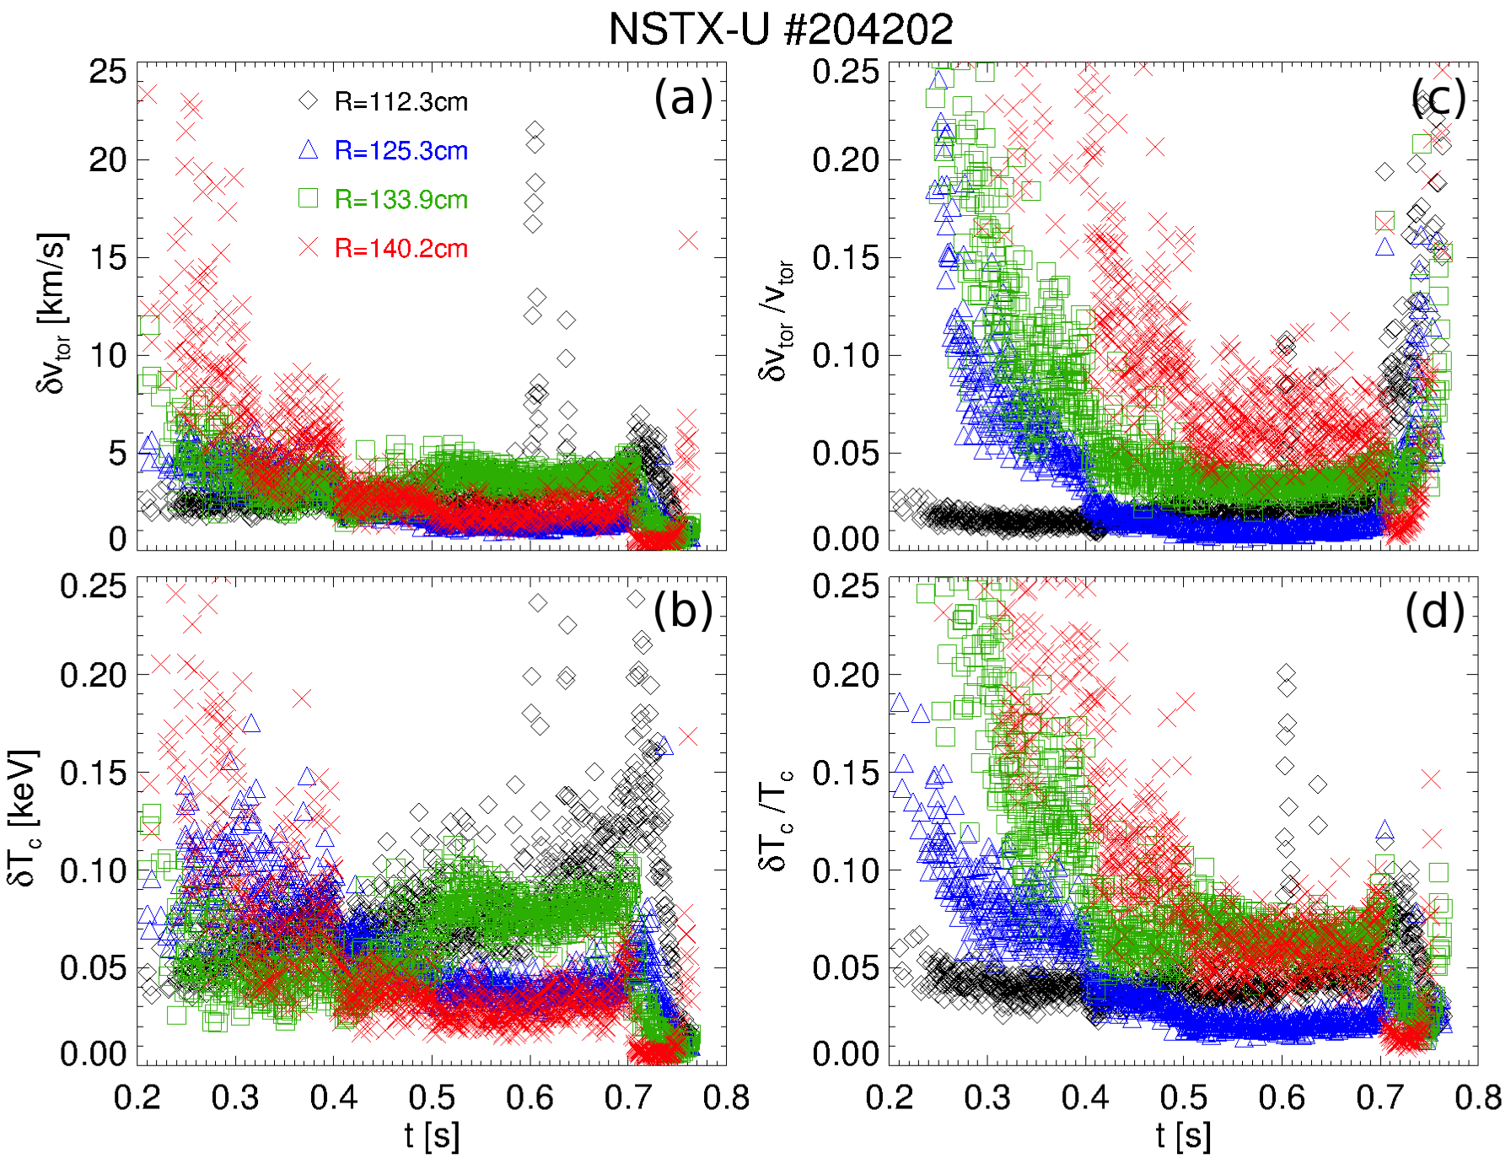
Uncertainties on velocity, temperature are <10% when P_{NB}>2MW
Absolute & relative uncertainties within expected range
Relative uncertainties <10% for sufficiently high P_{NB}

Slide 11
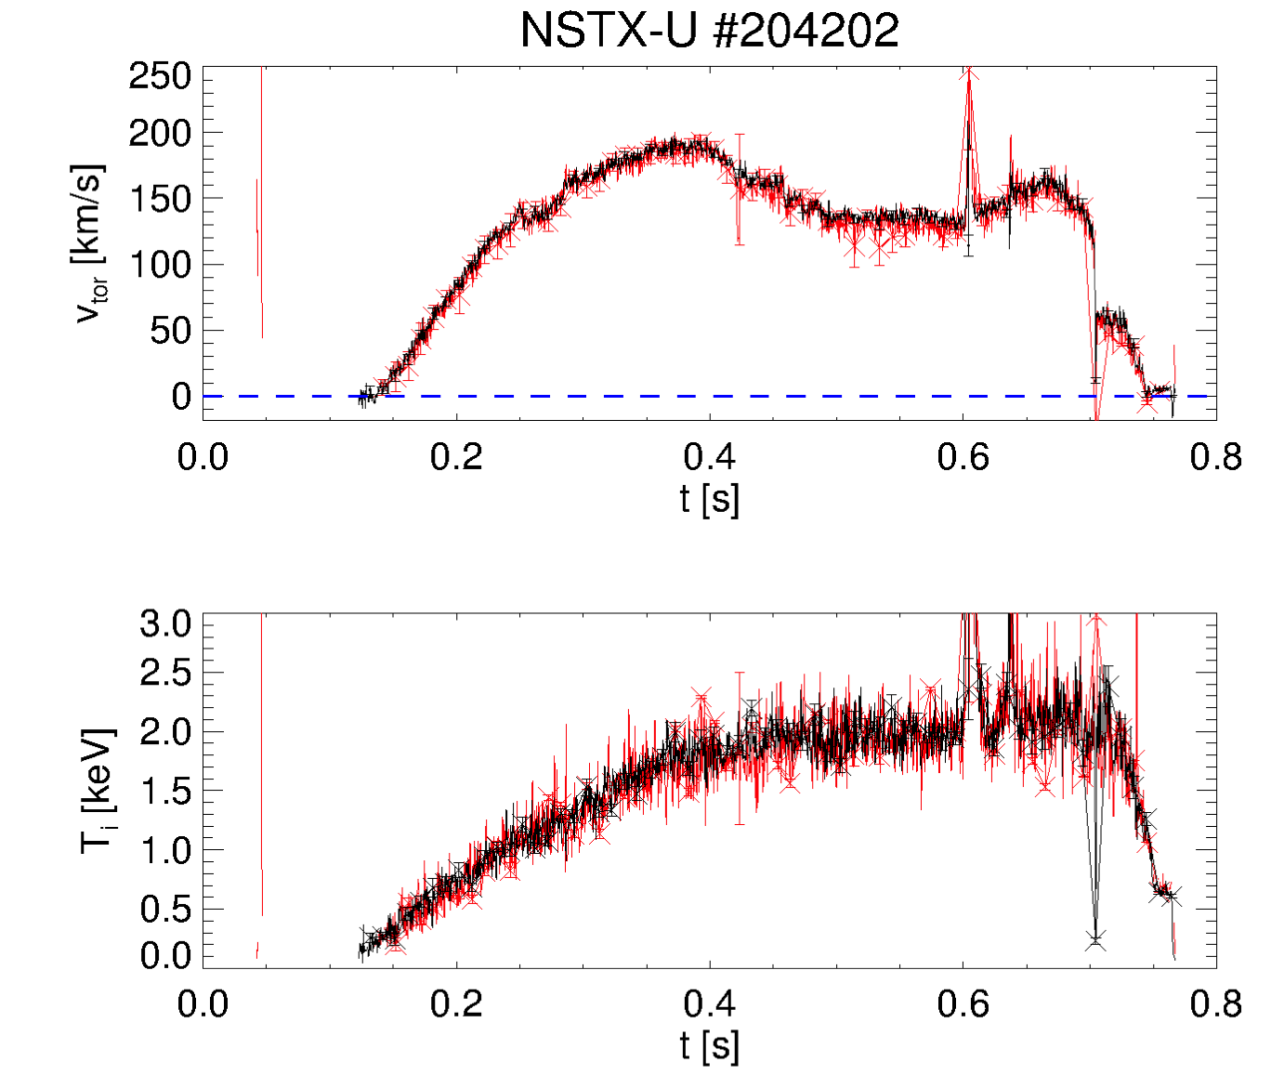
Real-time analysis provides accurate data for rotation feedback (and more) /1
Good match for both v_{φ} and T_{i} between real-time and post-discharge analysis
Larger uncertainties for RT analysis (as expected)
Simplified analysis
E.g. to account for instrumental function, plume contribution, background baseline
Reduced number of fit iterations
R~112cm
post-discharge
real-time

Slide 12
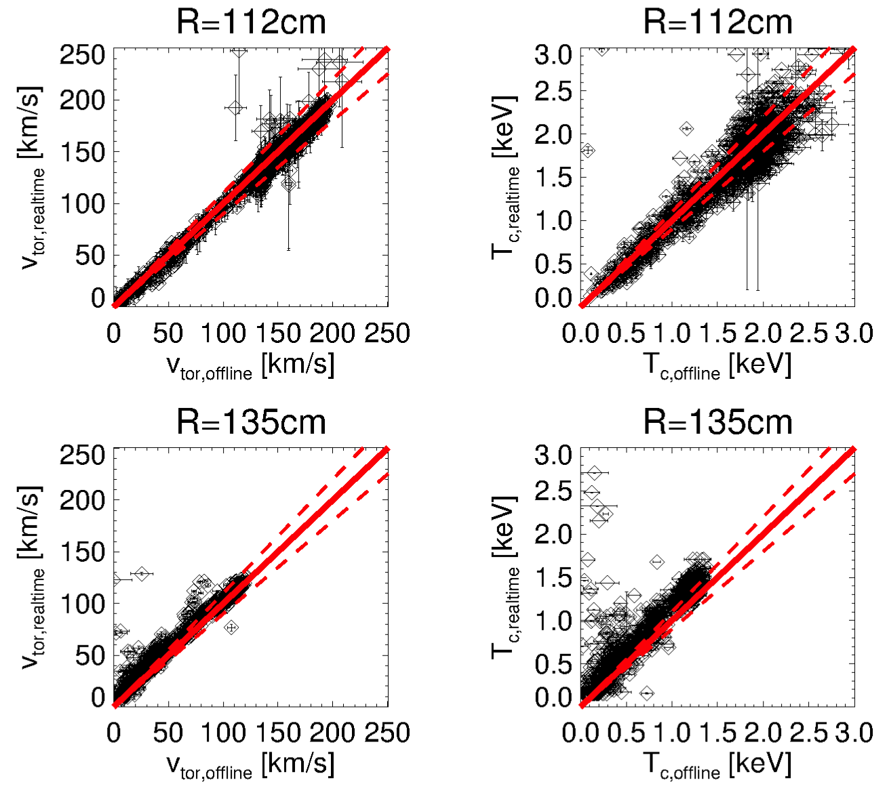
Real-time analysis provides accurate data for rotation feedback (and more) /2
Agreement with post-discharge analysis is typically better than 20%

Slide 13
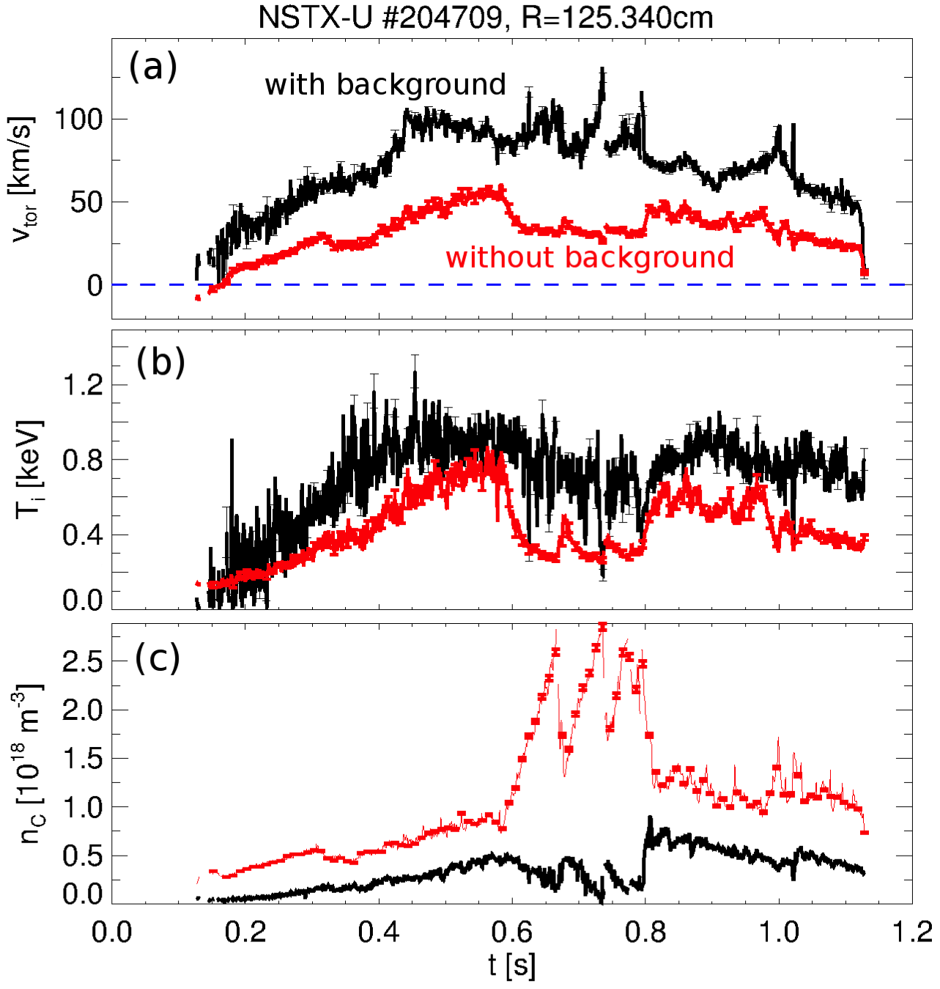
Background measurements are critical for reliable RTV results
Paired active/background views are key for successful background removal in real time
Results off by 2x or more if no/negligible background is assumed
Drawback: background views intercept second NBI line
No RT results if 2nd NB lines are injecting
H-L transition
L-H transition

Slide 14
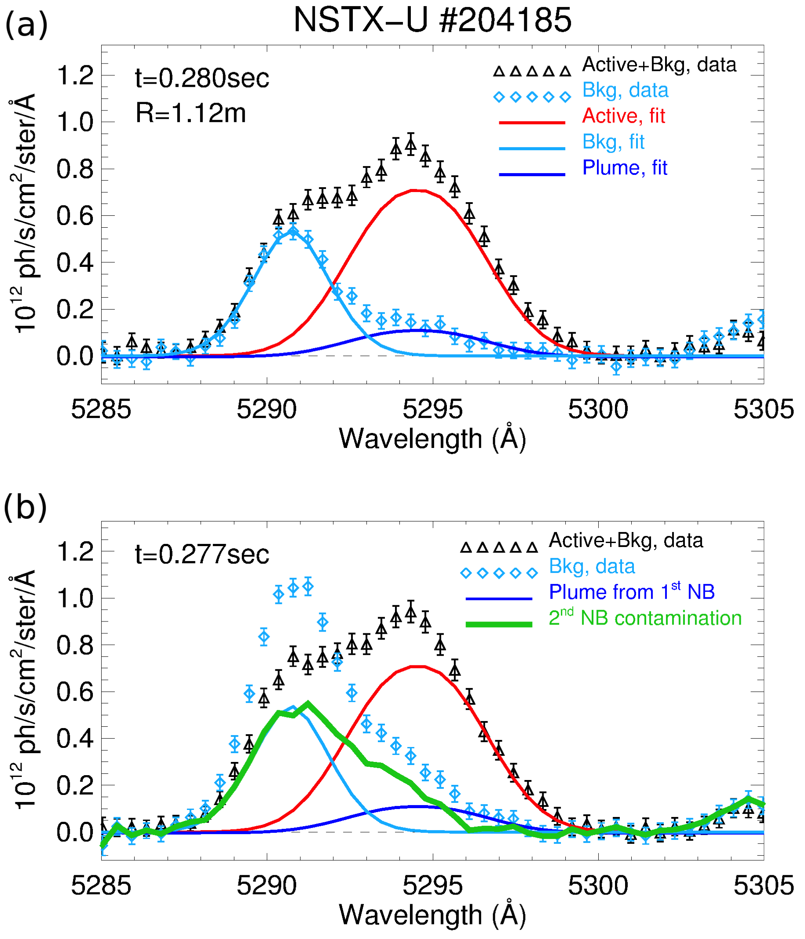
Injection from second NB line compromises RTV (and CHERS) measurements
Beam turn-off provides estimate of 2nd NBI contamination
(a) only NB1 sources ON
(b) NB1 + NB2 ON
Assume NB1 emission is unchanged from (a)
Subtract Active, Bkg from (a) to infer contamination from NB2
Signal from NB2 comparable to Active, Bkg
Spectrum is distorted
Superposition of active, background & plume from both NB lines
Cannot resolve lines (especially in real time)

Slide 15
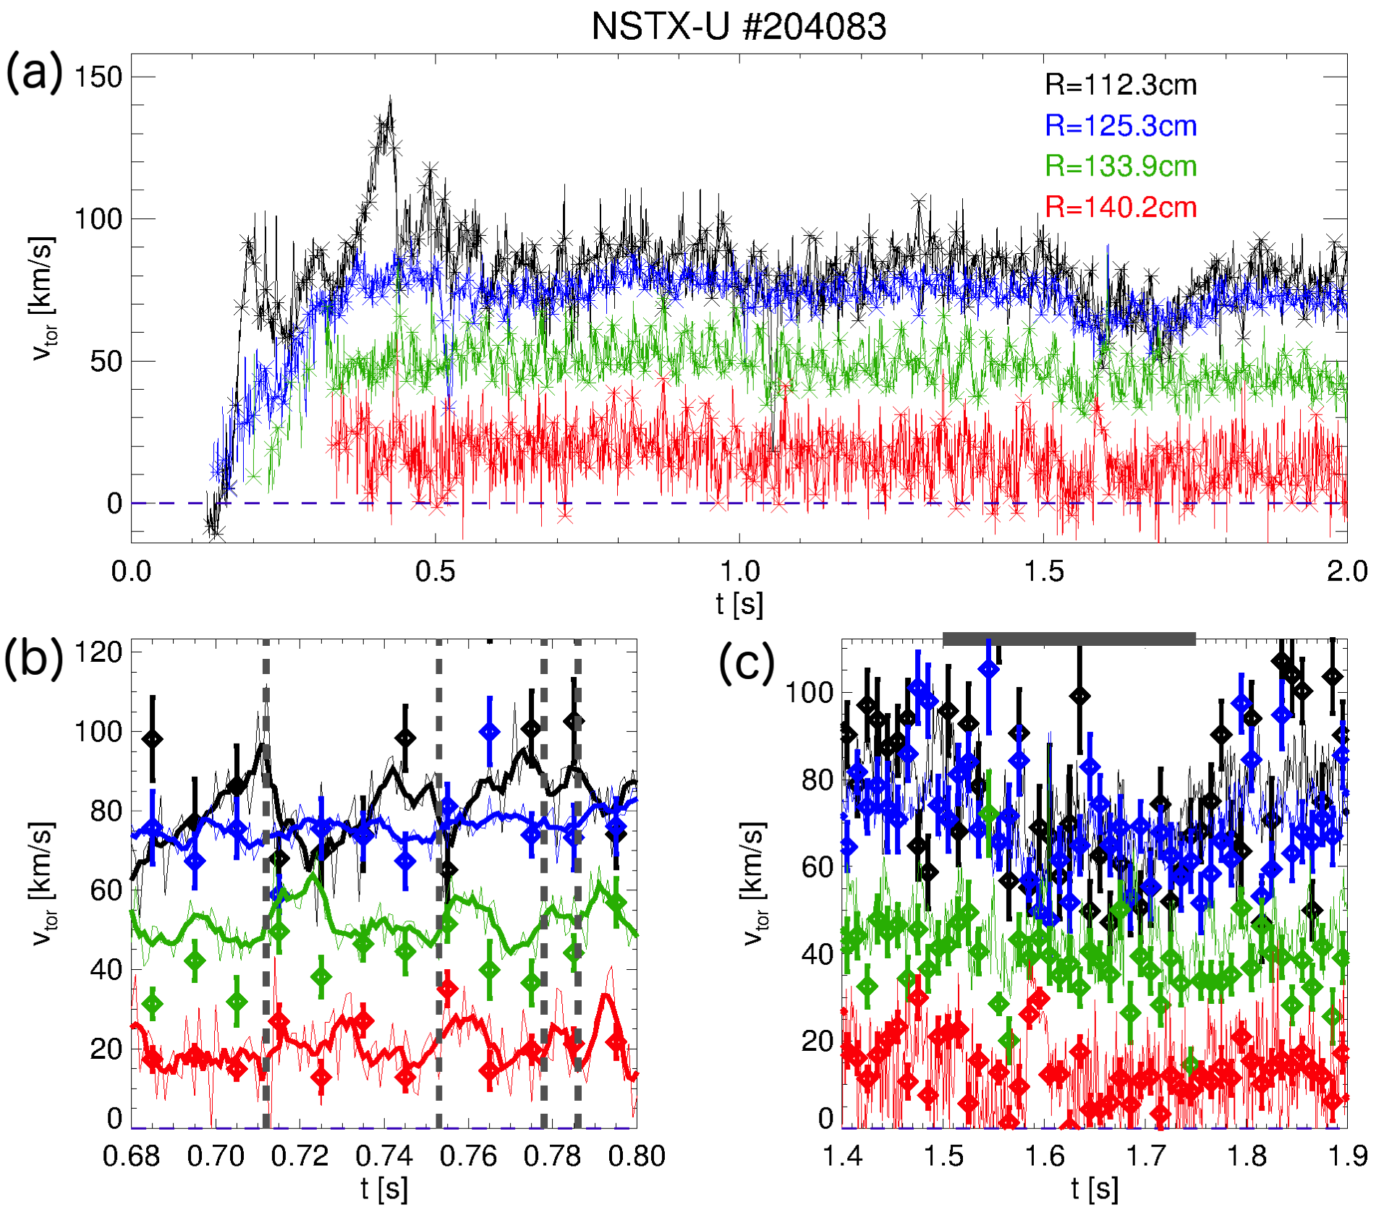
Sawteeth redistribute momentum, core v_{φ} decreases by ~20%
L-mode, P_{NB}~1MW
Sawteeth seen after t=0.5s
Crashes visible on v_{φ}(0), anti-correlate with increased v_{φ} at R>130cm
Large RMP pulse at 1.5s captured by RTV, CHERS

Slide 16
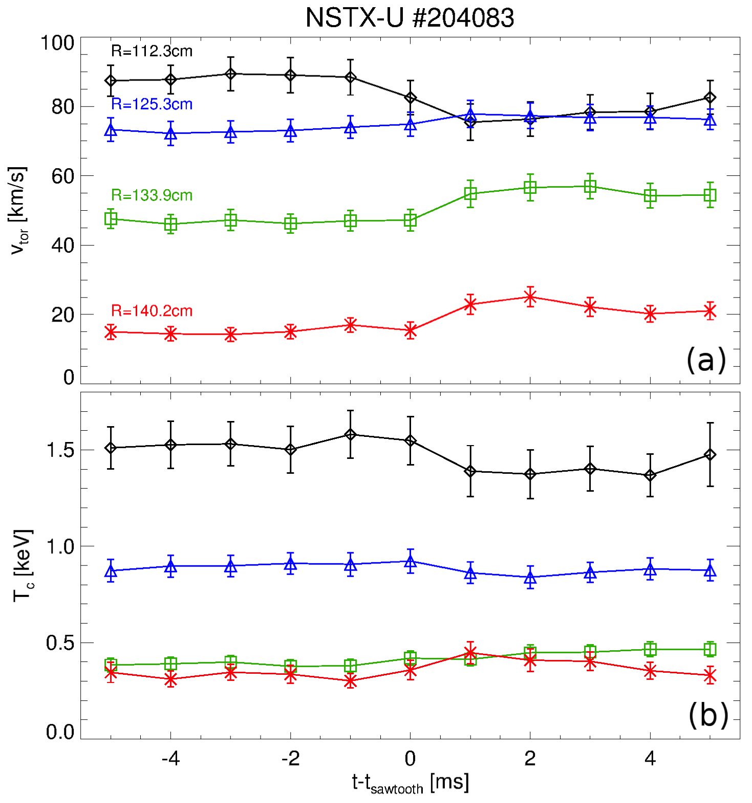
High sampling rate enables Conditional Averaging of sawteeth effects
Conditional sampling of data at f_{samp}=1kHz
Clear drop in core rotation, T_{i}
Core v_{φ} drops by ~20% over 2ms
Estimated inv. radius is R~125cm
Data suggest different dynamics for v_{φ}, T_{i}

Slide 17
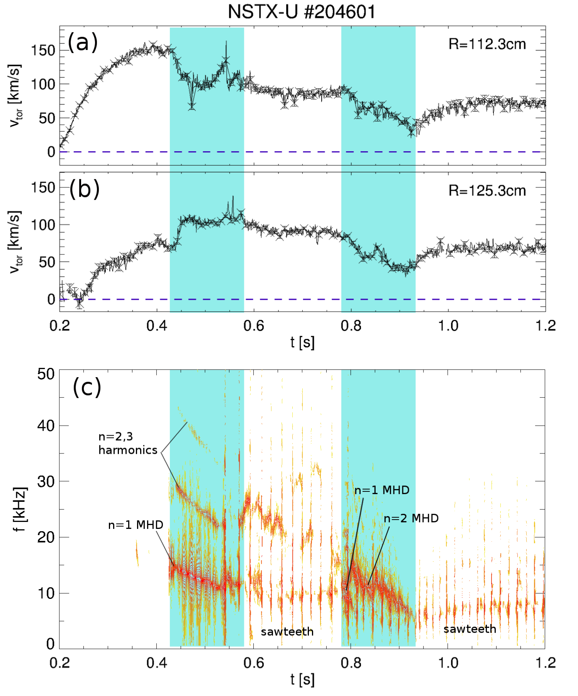
MHD, sawteeth can compete in v_{φ} redistribution; different time scales, high f_{samp} enables separation
Complex scenario
MHD n=1,2 modes act on ~10ms time scale
Sawteeth act on ~1ms time scale
High f_{samp} of RTV allows to differentiate time scales
Complements high spatial resolution CHERS profiles

Slide 18
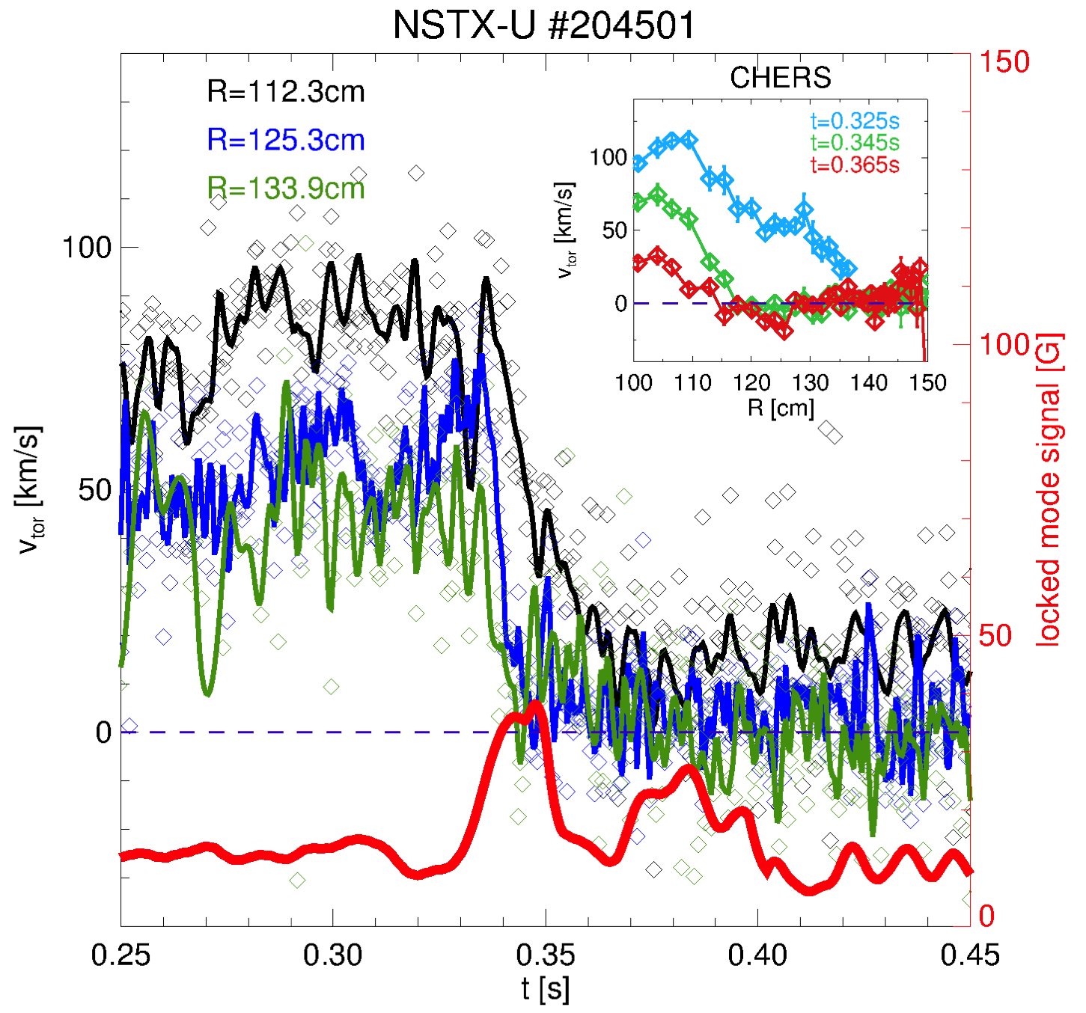
Mode locking and associated fast dynamic clearly observed on RTV data
L-mode, P_{NB}~1.1MW
Mode grows after t~0.33s, then locks over 10ms
First, fast response observed outside mid-radius
Then propagates to the core
CHERS provides full profiles pre/post locking (inset)

Slide 19
Summary & outlook
First RTV data from NSTX-U confirm achievement of design goals
System is ready to support development & testing of real-time v_{φ} control on NSTX-U
Much more physics insight can be gathered from post-discharge analysis
E.g. effects of RMPs, MHD, ELMs, pellets/granules on v_{φ}, T_{i}, n_{C}
Complements high spatial resolution of CHERS with sub-millisecond time resolution (at 4 radii)
Post-discharge automatic analysis tools implemented for routine operations
Under way: combine info from RTV and CHERS for high spatial & temporal profile data

