Slide 1


58th APS DPP Meeting, San Jose CA, October 31- November 4, 2016
Coupling of Neutral-beam-driven Compressional Alfvén Eigenmodes to Kinetic Alfvén Waves in NSTX and Energy Channeling
E. V. Belova¹, N. N. Gorelenkov¹, N. A. Crocker², J. B. Lestz¹,
E. D. Fredrickson¹, K. Tritz³
1) Princeton Plasma Physics Laboratory, Princeton NJ, USA
2) University of California, Los Angeles, California 90095, USA
3) Johns Hopkins University, Baltimore MD, USA

Slide 2
Abstract
An energy channelling mechanism is proposed to explain flattening of the electron temperature profiles at high beam power in beam-heated National Spherical Torus Experiment (NSTX). High-frequency Alfvén eigenmodes are frequently observed in beam-heated NSTX plasmas, and have been linked to enhanced thermal electron transport and flattening of the electron temperature profiles. Results of 3D nonlinear self-consistent simulations of neutral-beam-driven compressional Alfvén eigenmodes (CAEs) in NSTX are presented that demonstrate strong coupling of CAE to kinetic Alfvén wave at the Alfvén resonance location. It is shown that CAE can channel significant fraction of the beam energy to the location of the resonant mode conversion at the edge of the beam density profile, modifying the energy deposition profile.

Slide 3
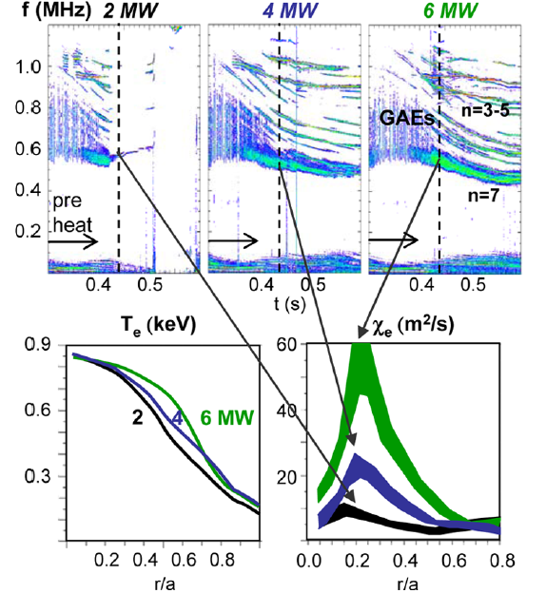
Correlation between strong GAE/CAE activity and flattening of the electron temperature profile has been observed in NSTX [Stutman, PRL 2009]
Intense GAE/CAE activity (0.5-1.1MHz).
Flattening of T_{e} profile with
- increased beam power;
- beam energy scanned between 60 and 90 keV
[Stutman, PRL 2009].
Was attributed to enhanced electron transport.
- Test particle simulations predict thermal electron
transport due to orbit stochasticity in the
presence of multiple GAEs [Gorelenkov, NF 2010].
Different mechanism is considered here:
Energy channeling due to coupling to KAW.
Anomalously low T_{e} potentially can have
significant implications for future fusion devices, especially low aspect ratio tokamaks.
Correlation between GAE activity, T_{e} flattening, and central electron heat diffusivity χ_{e} in NSTX H modes with 2, 4, and 6MW neutral beam.

Slide 4
HYM – Parallel Hybrid/MHD Code
HYM code developed at PPPL and used to investigate kinetic effects on MHD modes in toroidal geometry (FRCs and NSTX)
3-D nonlinear, parallel.
Several different physical models:
- Resistive MHD & Hall-MHD.
- Hybrid (fluid electrons, particle ions).
- MHD/particle (one-fluid thermal plasma, + energetic
particle ions).
Full-orbit kinetic ions.
Delta-f numerical scheme.
Production size run: 5-20 wall clock hours.

Slide 5
Self-consistent MHD + fast ions coupling scheme
Background plasma - fluid:
Fast ions – delta-F scheme:
- particle weight
ρ, V and p are thermal plasma density, velocity and pressure, n_{b} and j_{b} are beam ion density and current, and n_{b} << n_{e} – is assumed.

Slide 6
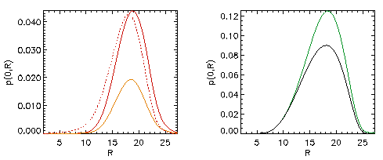
Self-consistent anisotropic equilibrium including the NBI ions
Grad-Shafranov equation for two-component plasma:
MHD plasma (thermal) and fast ions [Belova et al, Phys. Plasmas 2003].
, G – poloidal stream
function
Beam effects
Beam
Modifications of equilibrium due to beam ions:
more peaked current profile,
anisotropic pressure,
increase in Shafranov shift
might have indirect effect on stability.

Slide 7
Fast ions – delta-f scheme: F₀=F₀(ε,μ,p_{φ})
Equilibrium distribution function F₀ = F₁(v) F₂(λ) F₃(p_{φ},v)
where v₀ = 2-5v_{A}, v*= v₀ /2, λ= μB₀/ε – pitch angle parameter, λ₀= 0.5-0.7,
and μ= μ₀ + μ₁ includes first-order corrections [Littlejohn’81]:
Parameters are chosen to match TRANSP beam profiles.

Slide 8
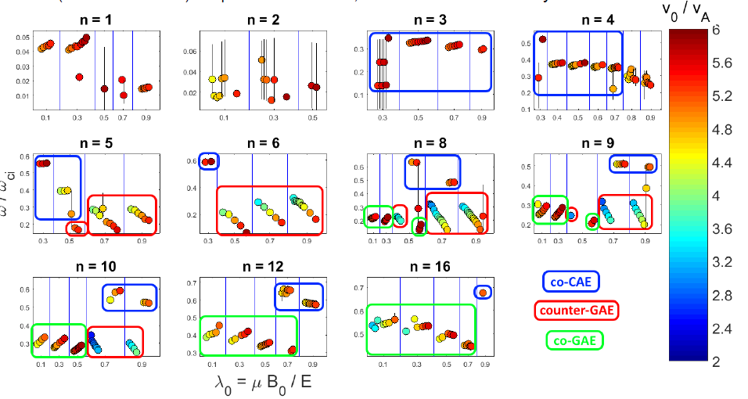
NSTX: Beam ion distribution parameter scan shows that
many modes can be excited for v/v_{A} ≥ 4
[J. Lestz, APS 2016]

Slide 9
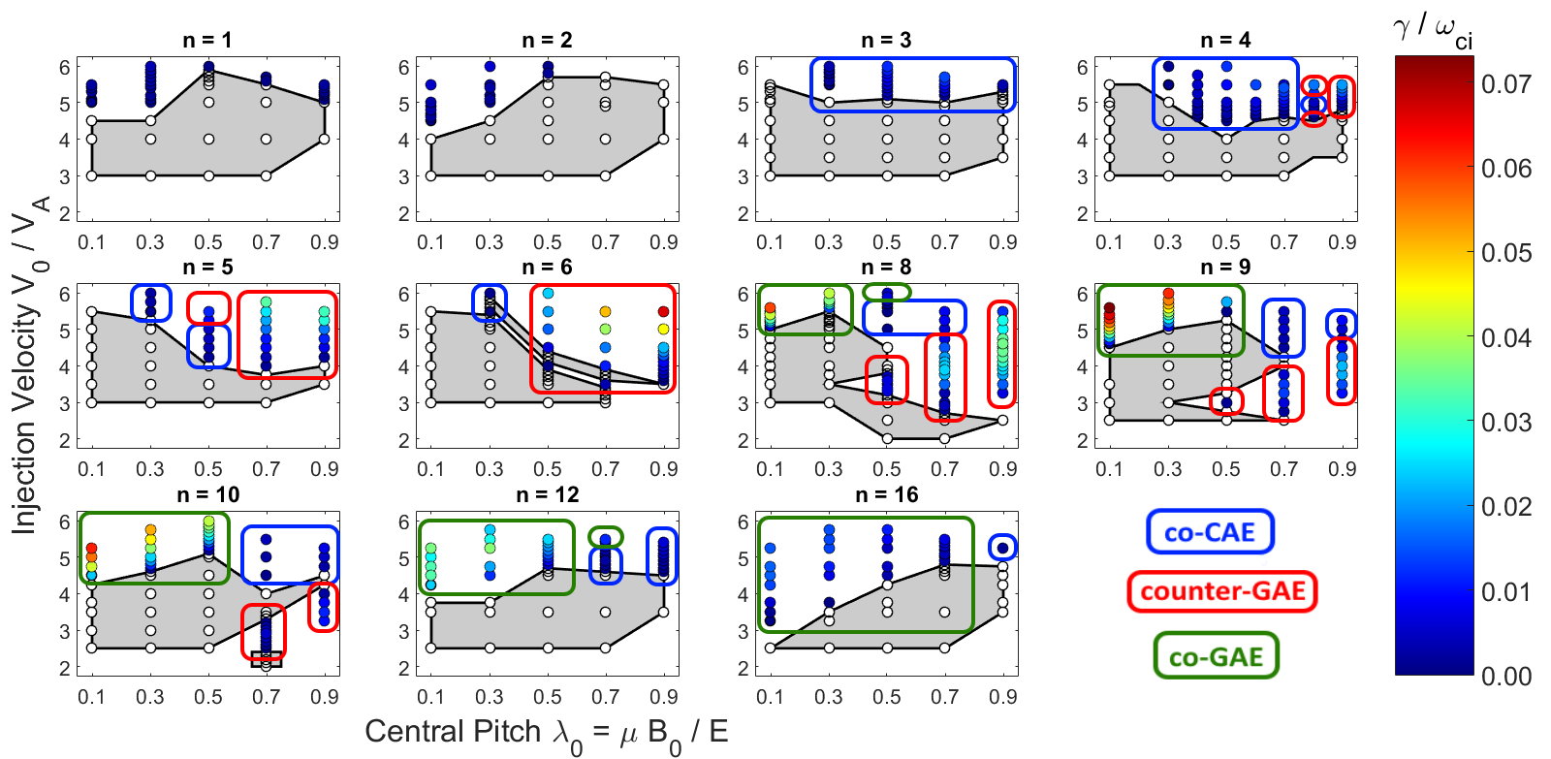
NSTX: Beam ion distribution parameter scan shows that
many modes can be excited for v/v_{A} ≥ 4
[J. Lestz, APS 2016]
New findings:
  dependence of number of unstable CAE/GAEs on v₀/v_{A}
  strong dependence on most unstable ω on beam parameters for GAEs
  predicted unstable co-GAEs

Slide 10
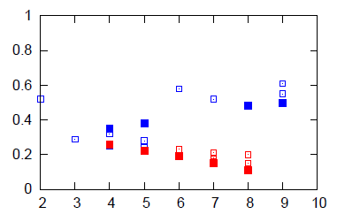
HYM simulations reproduce frequency range of unstable GAE and CAE modes observed in NSTX
Experimental analysis:
Detailed measurements of GAE and CAE amplitudes and mode structure for H-mode plasma in NSTX shot 141398 [N. Crocker, NF 2013].
CAEs: f>600 kHz, and |n|≤5.
GAEs: f<600 kHz, and |n|~6-8.
Co- and counter-rotating CAEs with f~1.2-1.8 MHz, and n=6-14 also observed in the same shot [E. Fredrickson, PoP 2013].
■ - HYM
- Experiment
CAE
GAE
|n|
Frequency versus toroidal mode number for unstable GAEs (red) and CAEs (blue), from HYM simulations and experiment, f_{ci}=2.5MHz.
HYM simulations:
For n=5-7 most unstable are counter-rotating GAEs, with f= 380-550 kHz.
For n=4 and n=8, 9 most unstable are co-rotating CAEs with f= 870-1200 kHz.

Slide 11
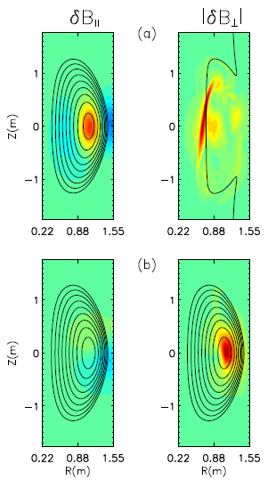
CAE has large compressional component in the core and couples to KAW
n=4, CAE
n=6, GAE
δB||
|δB⊥| (KAW)
δB||
|δB⊥|
δB|| is significantly larger than δB⊥ at the axis.
δB|| is comparable to δB⊥ only at the edge.
CAE/KAW coupling seen for all unstable CAEs.
KAW has large amplitude on HFS.

Slide 12
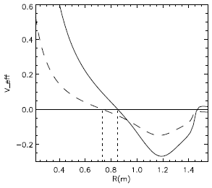
CAE/KAW coupling is universal
V_{eff}
Approximate equation for CAE mode, assuming circular cross-section, and neglecting beam effects and coupling to SAW:
V_{eff} < 0
n=8
n=4
Z
HYM simulations show unstable n=8 mode with ω=0.48ω_{ci0} and γ=0.004ω_{ci0}.
Effective potential well for n=8 mode is narrower and deeper than V_{eff} for n=4 resulting in more localized CAE mode with larger frequency.
R
R (m)
R_{axis}
Contour plot and radial profile of the effective potential V_{eff} for n=8 CAE mode with ω=0.48ω_{ci0} (solid) and n=4 CAE with ω=0.34ω_{ci0} (dashed). Mode can exist for V_{eff} < 0 with radial extent: 0.85(0.73)m<R<1.45m.
Edge of CAE well coincides with resonance location → CAE/KAW coupling.

Slide 13
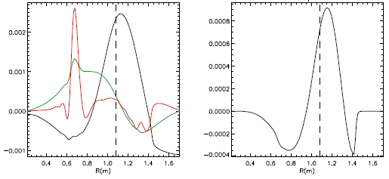
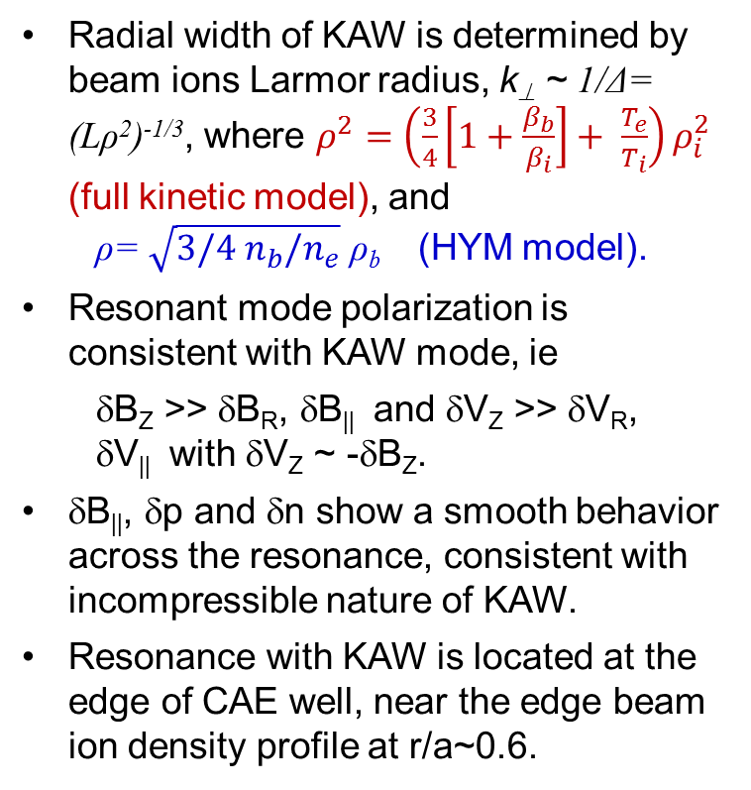
On-axis CAE couples to off-axis KAW
δB_{Rxb}
Radial width of KAW is determined by beam ions Larmor radius, k⊥ ~ 1/Δ= (Lρ²)^{-1/3}, where $ρ^{2}=\left(\frac{3}{4}\left[1+\frac{β_{b}}{β_{i}}\right]+ \frac{T_{e}}{T_{i}}\right)ρ_{i}^{2}$ (full kinetic model), and
  ρ= $\sqrt{3/4{ n}_{b}/n_{e}}$ ρ_{b} (HYM model).
Resonant mode polarization is consistent with KAW mode, ie
  δB_{Z} >> δB_{R}, δB|| and δV_{Z} >> δV_{R},
  δV|| with δV_{Z} ~ -δB_{Z}.
δB||, δp and δn show a smooth behavior across the resonance, consistent with incompressible nature of KAW.
Resonance with KAW is located at the edge of CAE well, near the edge beam ion density profile at r/a~0.6.
δB||
δB/B₀
δB_{R}
δp
Profiles of (a) magnetic field perturbation; and (b) normalized thermal δp for the n=4 CAE versus major radius. The CAE peaks near the magnetic axis R=1.07m.

Slide 14
KAW can have strong effect on electron transport due to finite δE||
Radial width of KAWs is relatively large on HFS in NSTX. Therefore, the KAWs will overlap radially.
In addition to the energy channelling mechanism, several overlapping KAWs with relatively large δE|| can also have a direct effect on both the electron transport and the beam ion re-distribution.
Need to include 2-fluid effects in CAE/KAW simulations.
(a) Radial profiles of δE|| from CAE/KAW simulations for n=4(black) and n=8 (red); (b) contour plot of δE|| for the n=8 CAE/KAW.

Slide 15
Simulations: main drive for CAE comes from resonant particles with v||~ ω/k||
CAE
(cyclotron resonance)
CAE
(regular resonance)
Two groups of resonant particles:
- regular resonance: ω - k||v|| =0,
- Doppler-shifted cyclotron resonance:
|ω| + ω_{ci} - k||v|| =0
(higher energy particles).
Main contribution comes from the beam ions with v|| ~ ω/k||.
“Turning off” high-energy resonant particles does not change the growth rate → contribution from the cyclotron resonances is negligible.
V|| /V_{A}
GAE
Orbit-averaged cyclotron frequency vs orbit-averaged parallel velocity for resonant particles. From simulations for n=8 CAE (ω=0.48ω_{ci0}, γ=0.004ω_{ci0}).
Particle color corresponds to different energies: from E=0 (purple) to E= 90keV (red).

Slide 16
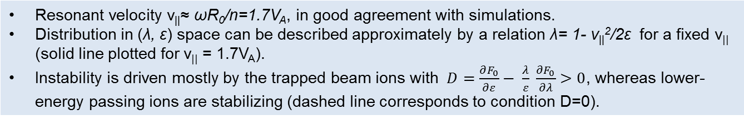
Location of resonant particles in phase-space
CAE (regular resonance)
CAE (l=-1 cyclotron
resonance)
δF/F
λ
0 20 40 60 80 keV
V|| /V_{A}
ε
GAE
Location of resonant particles in phase space: λ=μB₀/ε vs energy. From HYM simulations for n=8 CAE. Particle color corresponds to different energies: from E=0 (purple) to E=90keV (red).
Particle weight w ~ δF/F vs orbit-averaged parallel velocity for all simulations particles.
Resonant velocity v||≈ ωR₀/n=1.7V_{A}, in good agreement with simulations.
Distribution in (λ, ε) space can be described approximately by a relation λ= 1- v||²/2ε for a fixed v|| (solid line plotted for v|| = 1.7V_{A}).
Instability is driven mostly by the trapped beam ions with $D=\frac{∂F_{0}}{∂ε}− \frac{λ}{ε} \frac{∂F_{0}}{∂λ}>0$, whereas lower-energy passing ions are stabilizing (dashed line corresponds to condition D=0).

Slide 17
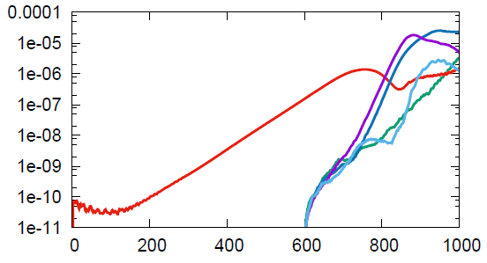
Nonlinear CAE simulations
Fully nonlinear simulations including 32 toroidal harmonics show saturation of the n=4 CAE mode.
Initial conditions for nonlinear run were obtained by running the n=4 linearized simulations (from t=0-550) to obtain a converged linear mode structure of CAE.
Nonlinear run starts at t=550, and also shows growth of n=5,6,7 GAEs and n=8 CAE modes.
n=6 and 7 GAEs have larger linear growth rates than the n=4 CAE mode.
n=4 CAE ⎯⎯
n=5 GAE ⎯⎯
n=6 GAE ⎯⎯
n=7 GAE ⎯⎯
n=8 CAE ⎯⎯
|dB_{n} |²
(au)
tω_{ci}
Time evolution of amplitudes of different toroidal harmonics from fully nonlinear simulations for NSTX shot 141398.

Slide 18
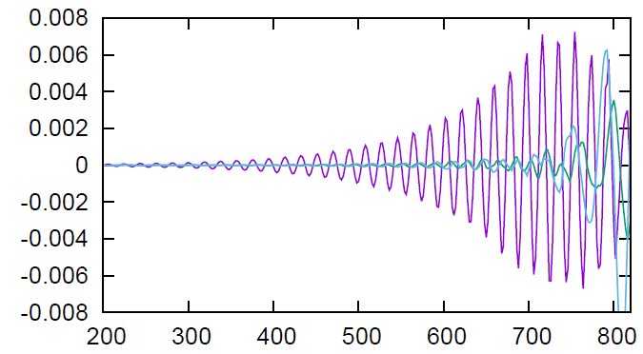
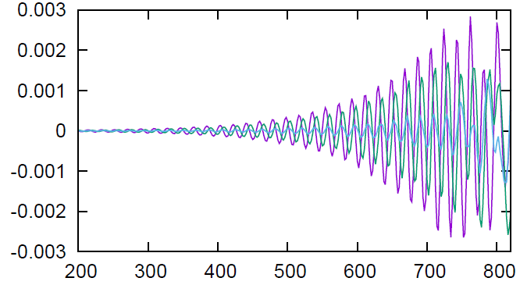
Nonlinear simulations show CAE saturation amplitudes higher but comparable to experimentally observed
δB||
δB_{R}
δB┴
In the core, the compressional perturbation is 3-4 times larger than the shear perturbation.
Mixed compressional/shear polarization near the plasma edge on LFS .
δB/B₀
core
δB||
δB_{R}
δB┴
δB/B₀
edge
tω_{ci}
Time evolution of dB|| and two components of δB⊥ in the core, and close to the plasma edge on LFS.
Saturation amplitude of the n=4 CAE: δB||/B₀= 6.6×10⁻³.
Measured plasma displacement |ξ|= 0.1-0.4 mm [Crocker,2013] corresponds to δB/B₀= (0.9-3.4)×10⁻³ (based on HYM-calculated mode structure for n=4 CAE).

Slide 19
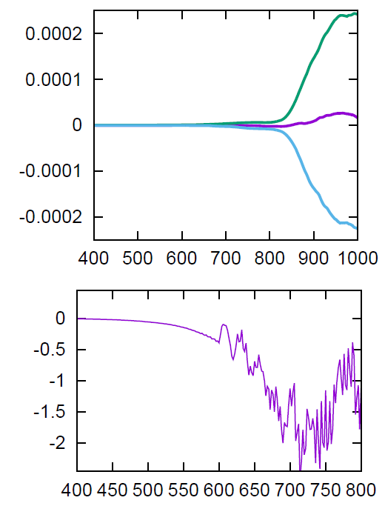
Significant fraction of the total beam power can transferred to a single CAE of relatively large amplitude
δE_{M}+ δK+ δE_{P}
δE_{tot}
δE(au)
(a) Time evolution of the fluid energy (green), the beam ion energy (light blue), and the total energy of the system (purple);
(b) Time evolution of rate of change of beam ion energy, calculated as ∫ (J_{beam}E) d³x.
δK_{Beam}
dK_{Beam}/dt
(MW)
tω_{ci}
Rate of change of the beam ion energy is ~1.5MW for calculated the n=4 CAE saturation amplitude δB||/B₀= 6.6×10⁻³.

Slide 20
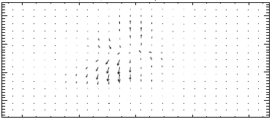
Energy flux is directed away from magnetic axis
Vector plot of energy flux
S= ExB/4π + pVγ/(γ-1).
Energy flux is directed away from magnetic axis, towards both high- and low-field side. LFS resonance is more diffuse compared to HFS.
From the self-consistent nonlinear simulations of the n=4 CAE mode near saturation.
Z
R (m)
Change of energy flux across resonant layer at R~0.7m is S_{R} ~ 0.8×10⁵ W/m²,which corresponds to power absorption at the high-field-side resonance of P~ 0.2 MW for δB||/B₀~ 3×10⁻³.

Slide 21
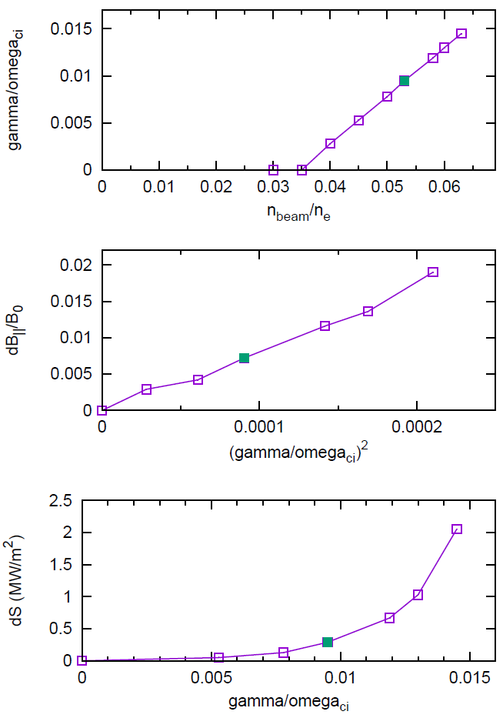
CAE-to-KAW energy channeling shows strong scaling with the beam power
γ/ω_{ci}
From density threshold – damping rate due to CAE/KAW coupling is large γ_{damp}= 0.66 γ_{dr.}
Threshold value of the beam power needed for the excitation of the n=4 CAE can be estimated as P~4MW.
Instability saturates nonlinearly due to particle trapping, and δB||/B₀~ (γ/ω_{ci})².
Absorption rate shows a very strong scaling with growth rate: ΔS ~ (γ/ω_{ci})⁵, implying that the energy loss at the resonance scales as a fifth power of the beam ion density (beam power).
δB||/B₀
(γ/ω_{ci})²
ΔS
(MW/m²)
γ/ω_{ci}
(a) Growth rate of the n=4 CAE vs beam ion density (b) Saturation amplitude vs γ²
(c) Calculated change of the energy flux at the resonance location vs γ

Slide 22
  CAE/KAW coupling can provide an efficient energy channeling mechanism, and can have direct effect on the T_{e} profiles.
Simulations show unstable CAE modes for toroidal mode numbers n=4-9 in H-mode NSTX discharges.
Unstable CAE modes couple with KAW on the HFS. Resonance with KAW is located at the edge of CAE well, and just inside beam ion density profile. Radial width of KAW is determined by beam ion Larmor radius.
A significant fraction of NBI energy can be transferred to several unstable CAEs: up to P~0.4MW for one mode with δB/B₀ ~3x10⁻³ .
  Energy flux is shown to be directed away from the magnetic axis (CAE) toward the resonance location (KAW); power absorption at the high-field-side resonance of P~ 0.2 MW for δB||/B₀~ 3×10⁻³.
Strong CAE/KAW coupling follows from dispersion relation, therefore, this mechanism applies to any device with unstable CAEs.
Absorption rate shows a very strong scaling with growth rate: ΔS ~ (γ/ω_{ci})⁵, implying that the energy loss at the resonance scales as a fifth power of the beam power.

Slide 23
Future Plans
Code development
Improve the fast ion distribution function model.
Include thermal ions kinetic effects (Hall, FLR) and bulk plasma rotation.
Physics
Understanding conditions for preferential excitation of GAEs and CAEs.
Comparison of the relative importance of the energy channeling vs anomalous electron transport mechanisms.
Comparison with experimental results including mode structure, saturation amplitudes and etc for several shots.
Continue NSTX-U simulations – GAEs stabilization.

