Slide 1

Comparison of simulations, experiments, and theory of sub-cyclotron Alfvén eigenmodes in NSTX
Jeff Lestz, Elena Belova, Nikolai Gorelenkov (PPPL)
Shawn Tang, Neal Crocker (UCLA)
APS DPP 58
San Jose, CA
November 2, 2016

Slide 2
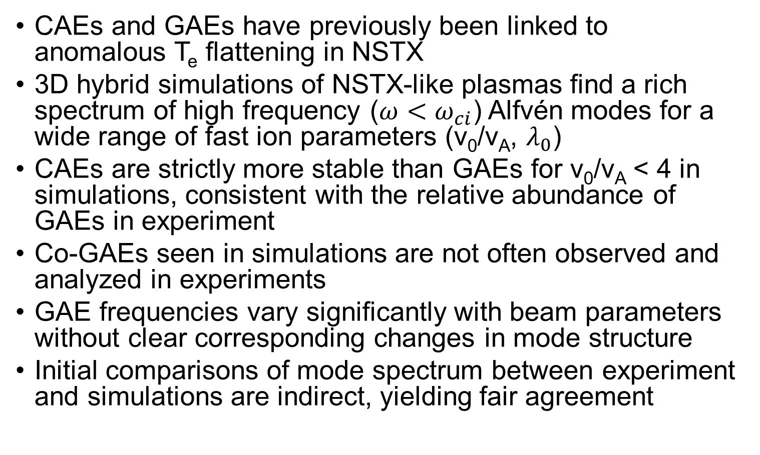
Overview
CAEs and GAEs have previously been linked to anomalous T_{e} flattening in NSTX
3D hybrid simulations of NSTX-like plasmas find a rich spectrum of high frequency ($ω<ω_{ci}$) Alfvén modes for a wide range of fast ion parameters (v₀/v_{A}, $λ_{0}$)
CAEs are strictly more stable than GAEs for v₀/v_{A} < 4 in simulations, consistent with the relative abundance of GAEs in experiment
Co-GAEs seen in simulations are not often observed and analyzed in experiments
GAE frequencies vary significantly with beam parameters without clear corresponding changes in mode structure
Initial comparisons of mode spectrum between experiment and simulations are indirect, yielding fair agreement

Slide 3
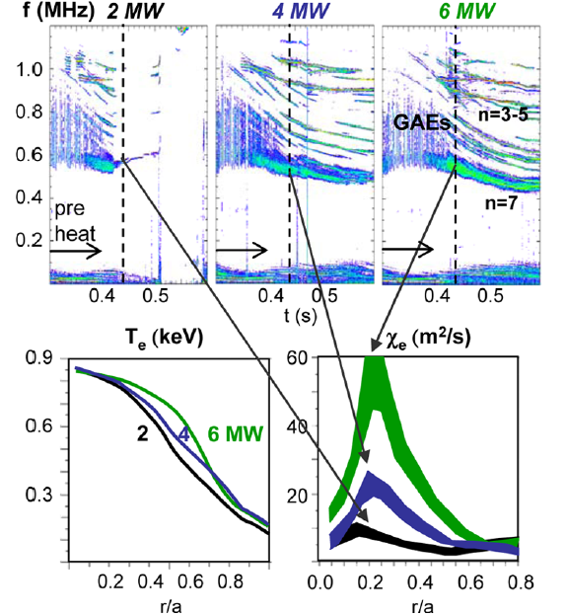
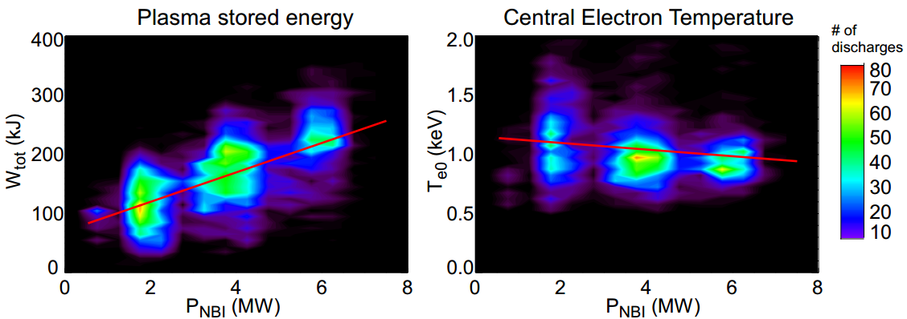
CAE/GAE May Limit ST Performance
High beam power NSTX discharges exhibit anomalously flat T_{e} profiles
  Correlates with increased beam power, strong CAE/GAE activity
Vital to understand how properties of fast ion distribution affect excitation of these modes
  Anomalously low T_{e} imperils future ST development
[Stutman, PRL 2009]
[Tritz, APS DPP 2012]

Slide 4
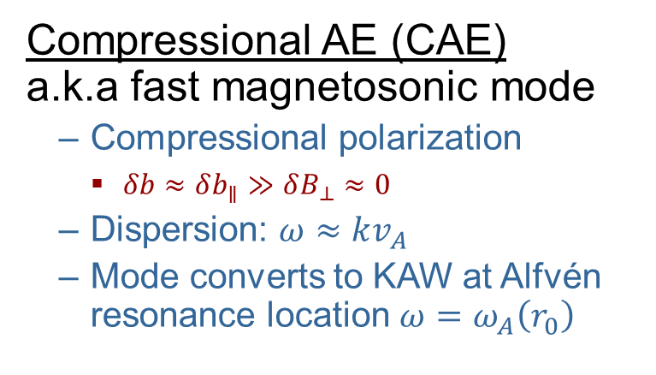
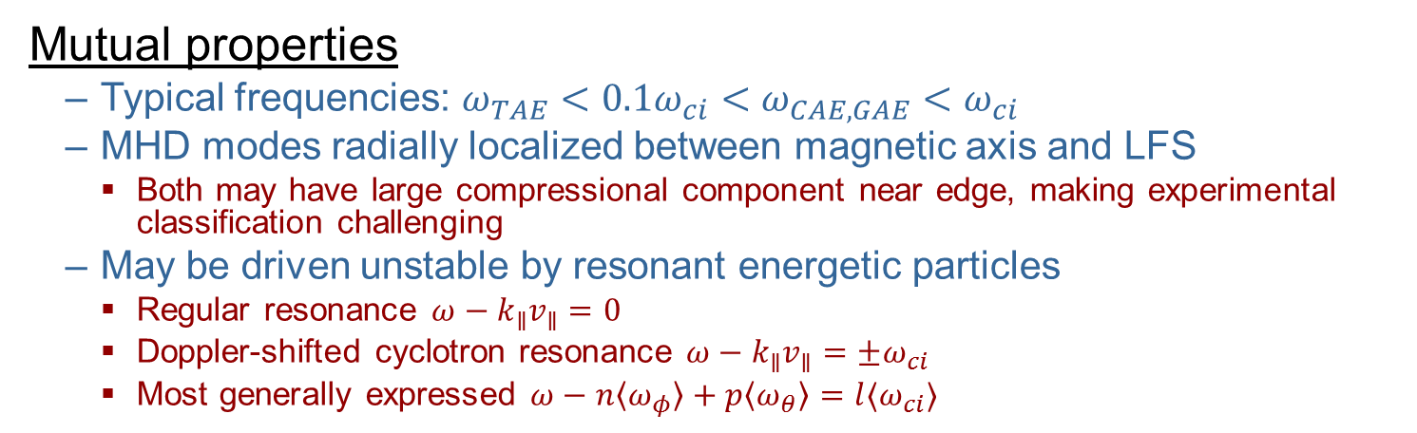
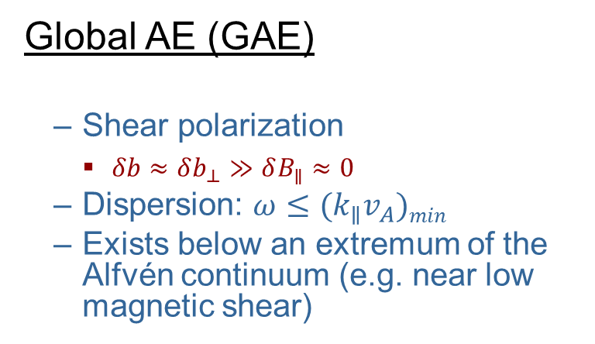
CAE/GAEs for the Uninitiated
Mutual properties
  Typical frequencies: $ω_{TAE}<0.1ω_{ci}<ω_{CAE,GAE}<ω_{ci}$
  MHD modes radially localized between magnetic axis and LFS
    Both may have large compressional component near edge, making experimental classification challenging
  May be driven unstable by resonant energetic particles
    Regular resonance $ω−k_{∥}v_{∥}=0$
    Doppler-shifted cyclotron resonance $ω−k_{∥}v_{∥}=±ω_{ci}$
    Most generally expressed $ω−n〈ω_{φ}〉+p〈ω_{θ}〉=l〈ω_{ci}〉$
Compressional AE (CAE)
a.k.a fast magnetosonic mode
  Compressional polarization
    $δb≈δb_{∥}≫δB_{⊥}≈0$
  Dispersion: $ω≈kv_{A}$
  Mode converts to KAW at Alfvén resonance location $ω=ω_{A}\left(r_{0}\right)$
Global AE (GAE)
  Shear polarization
    $δb≈δb_{⊥}≫δB_{∥}≈0$
  Dispersion: $ω≤{(k}_{∥}v_{A})min$
  Exists below an extremum of the Alfvén continuum (e.g. near low magnetic shear)

Slide 5
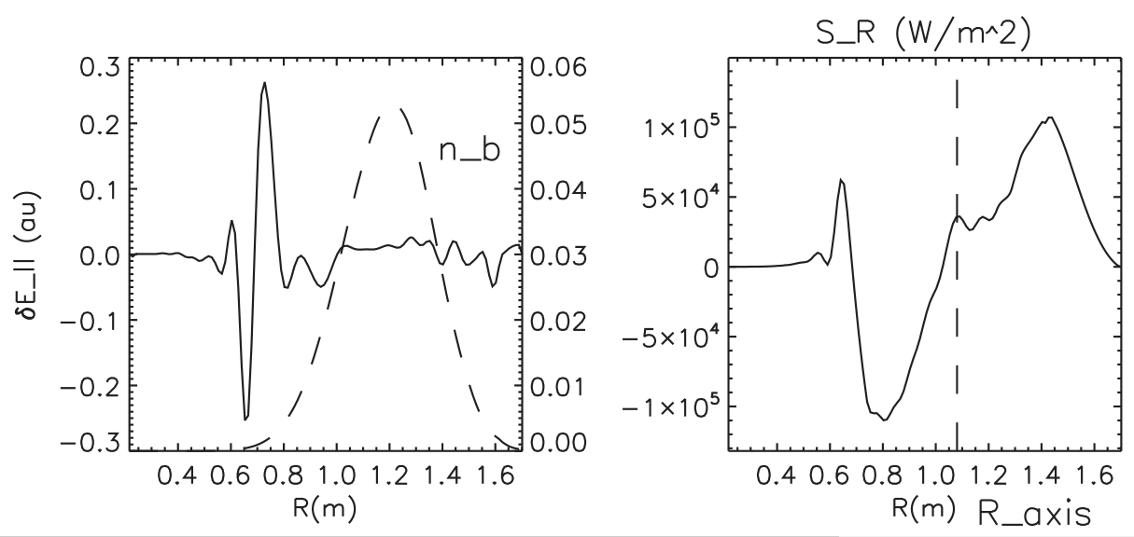
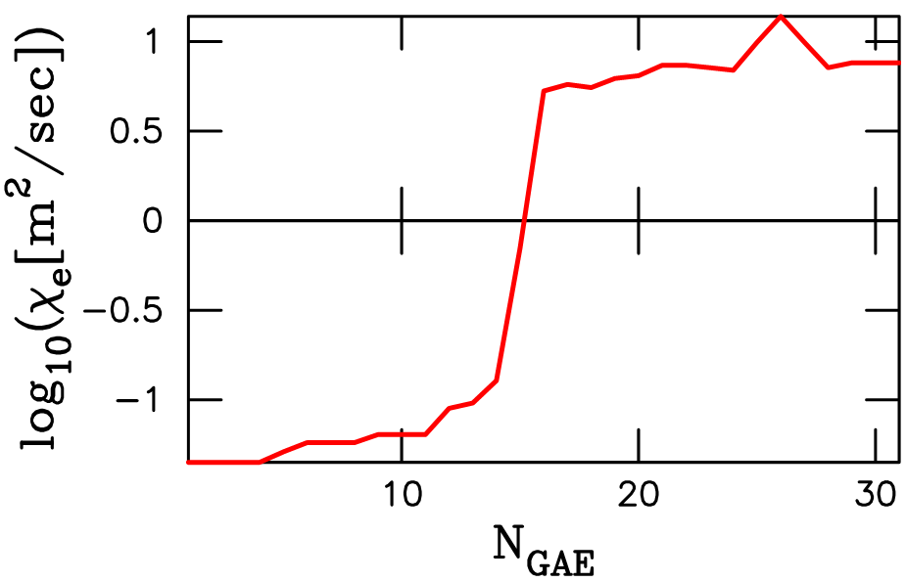
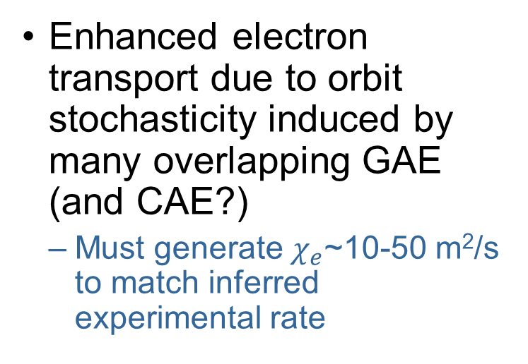
Theoretical Explanations for T_{e} Flattening
Enhanced electron transport due to orbit stochasticity induced by many overlapping GAE (and CAE?)
  Must generate $χ_{e}$~10-50 m²/s to match inferred experimental rate
Energy channeling via mode conversion from core CAE (and GAE?) to edge KAW
  Predicts up to ~0.5MW power deposition per eigenmode
[Gorelenkov, NF 2010]
[Belova, PRL 2015]

Slide 6
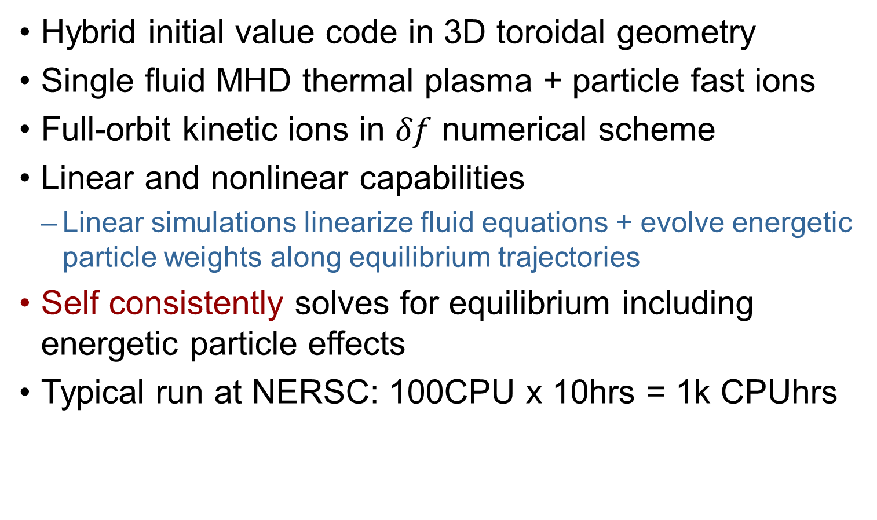
HYbrid MHD/Particle Code (HYM)
Hybrid initial value code in 3D toroidal geometry
Single fluid MHD thermal plasma + particle fast ions
Full-orbit kinetic ions in $δf$ numerical scheme
Linear and nonlinear capabilities
  Linear simulations linearize fluid equations + evolve energetic particle weights along equilibrium trajectories
Self consistently solves for equilibrium including energetic particle effects
Typical run at NERSC: 100CPU x 10hrs = 1k CPUhrs

Slide 7
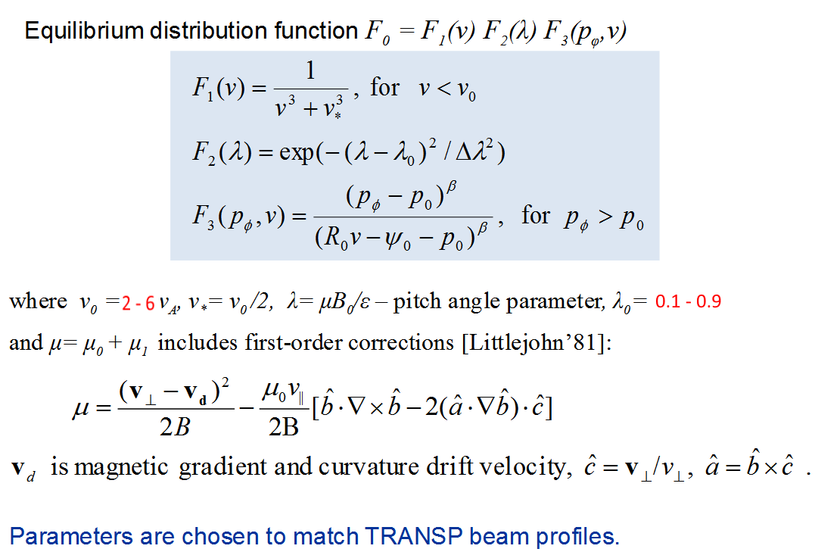
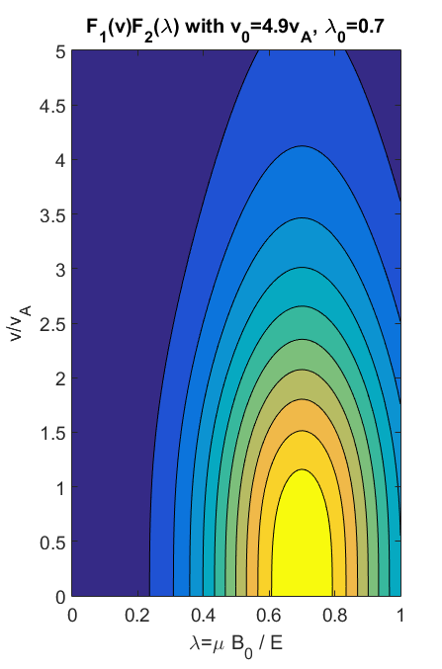
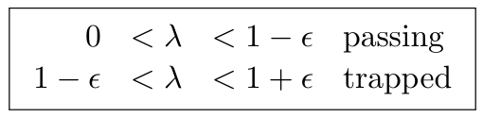
Fast Ion Distribution Model

Slide 8
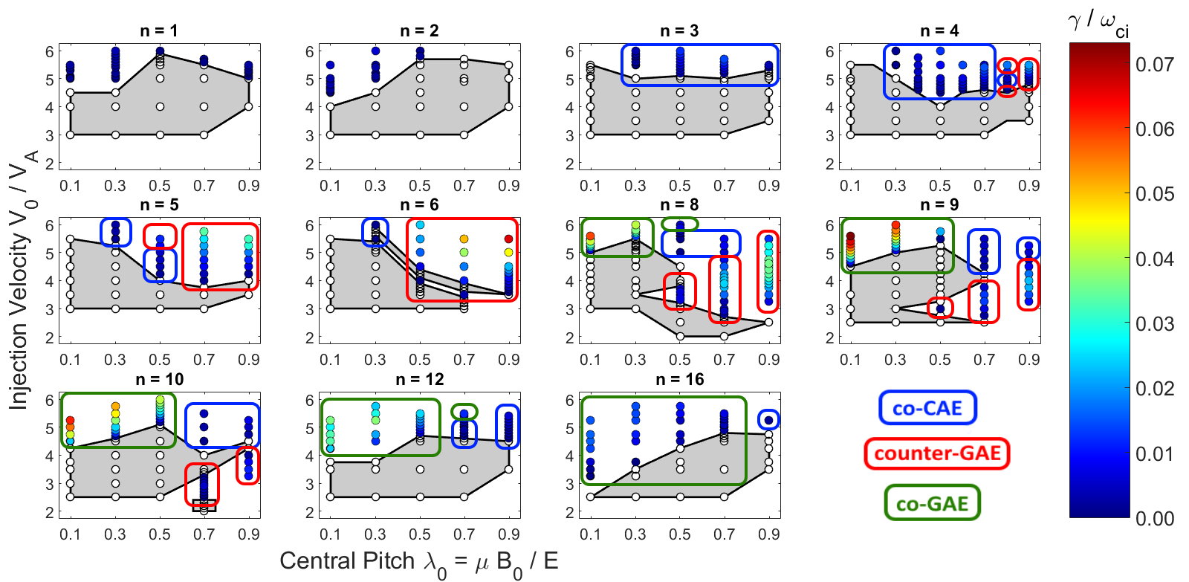
Variety of Unstable Modes Found
Most unstable: n=8-10 co-GAE, then n=5-8 cntr-GAE, then n=3-4 co-CAE
  Colored circles: linear growth rate of most unstable mode
  White circles: no unstable mode of any type
n = 1,2 modes are much different from CAE/GAE
  Much lower frequency, higher poloidal mode number

Slide 9

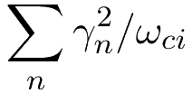
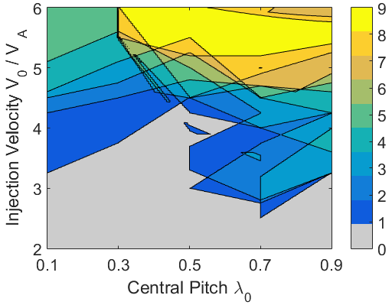
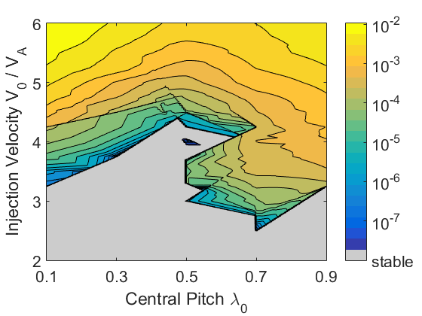
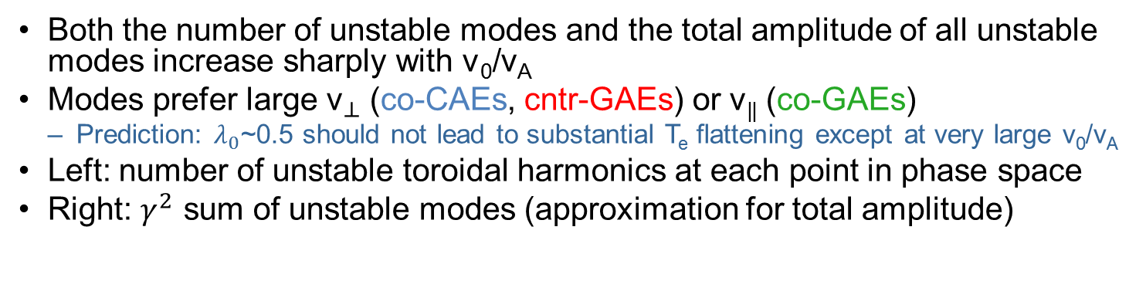
Number of Excited Modes in Phase Space
Both the number of unstable modes and the total amplitude of all unstable modes increase sharply with v₀/v_{A}
Modes prefer large ${\text{v}}_{⊥}$ (co-CAEs, cntr-GAEs) or v|| (co-GAEs)
  Prediction: $λ_{0}$~0.5 should not lead to substantial T_{e} flattening except at very large v₀/v_{A}
Left: number of unstable toroidal harmonics at each point in phase space
Right: $γ^{2}$ sum of unstable modes (approximation for total amplitude)

Slide 10
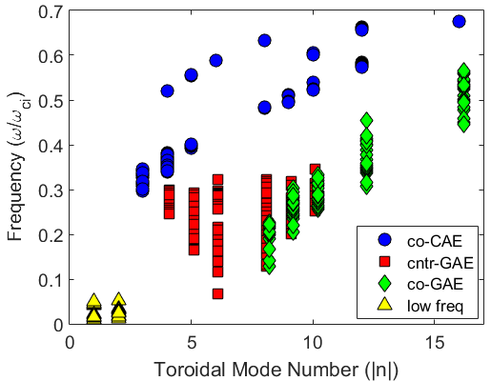
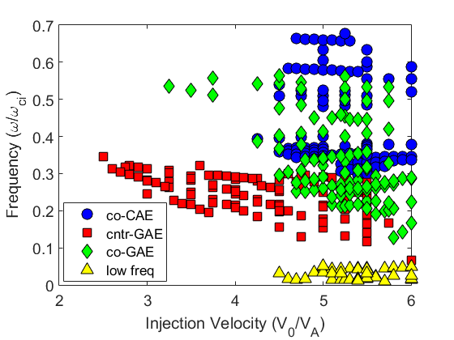
Mode Spectrum Depends Strongly on n & v₀
At each n, CAE and GAE modes appear at distinct frequencies
Co-GAE seen in simulations at large |n| (>7) are yet to be thoroughly investigated experimentally
  Weakly unstable near the boundary of realistic NSTX beam geometry
Spectrum becomes much more rich as v₀/v_{A} increases past 4.5
1680 kHz
1440 kHz
1200 kHz
960 kHz
720 kHz
480 kHz
240 kHz

Slide 11
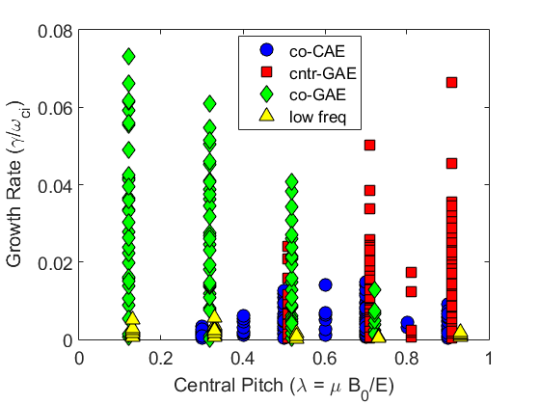
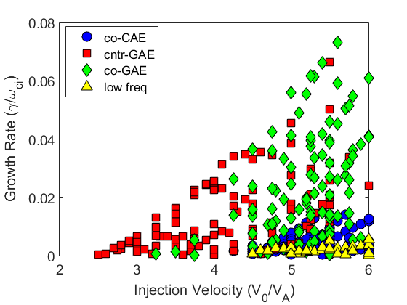
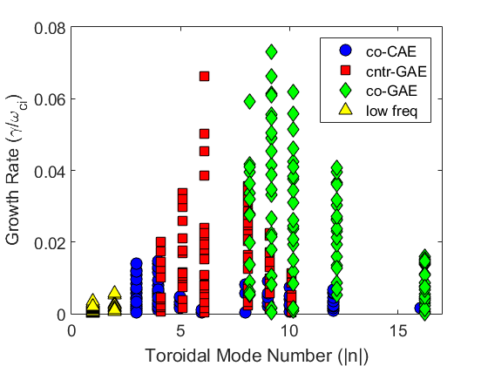
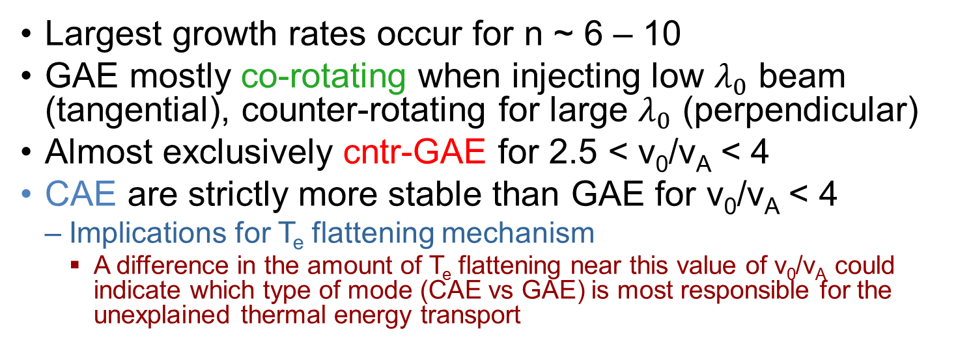
GAE Typically More Unstable than CAE
Largest growth rates occur for n ~ 6 – 10
GAE mostly co-rotating when injecting low $λ_{0}$ beam (tangential), counter-rotating for large $λ_{0}$ (perpendicular)
Almost exclusively cntr-GAE for 2.5 < v₀/v_{A} < 4
CAE are strictly more stable than GAE for v₀/v_{A} < 4
  Implications for T_{e} flattening mechanism
    A difference in the amount of T_{e} flattening near this value of v₀/v_{A} could indicate which type of mode (CAE vs GAE) is most responsible for the unexplained thermal energy transport

Slide 12
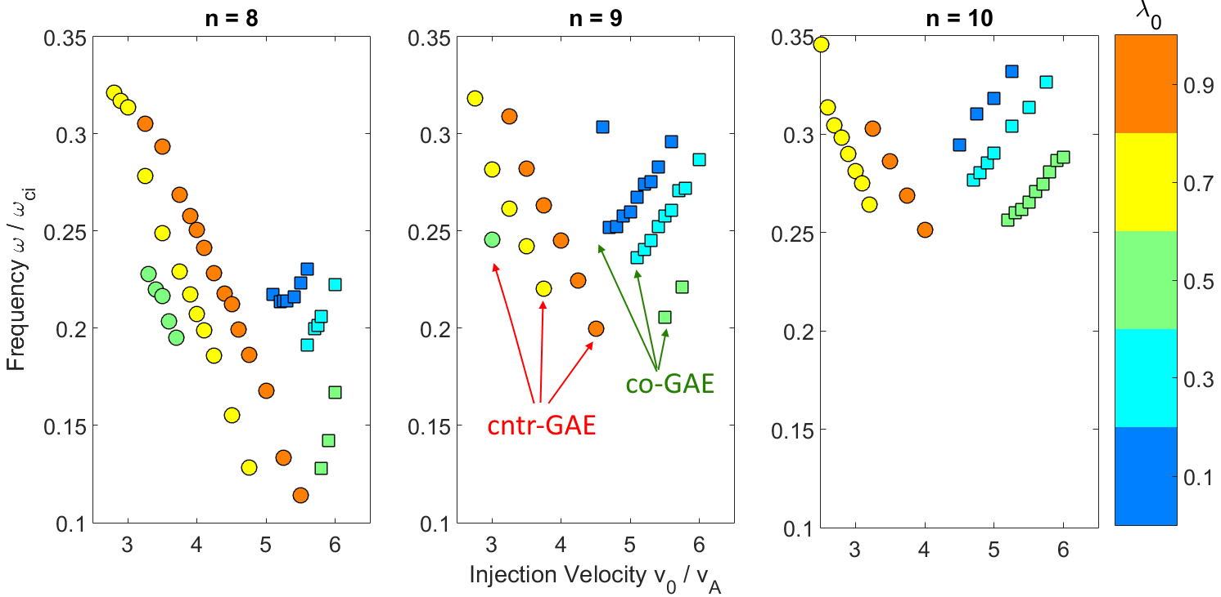
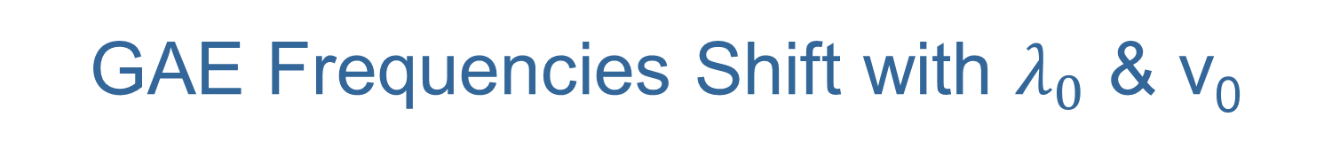
GAE Frequencies Shift with $λ_{0}$ & v₀
Opposite trends for cntr-GAEs (circles) and co-GAEs (squares)
Are these true MHD modes or high frequency EPM?
In contrast, CAE frequencies change only slightly

Slide 13
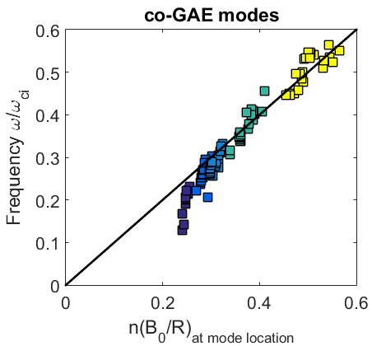
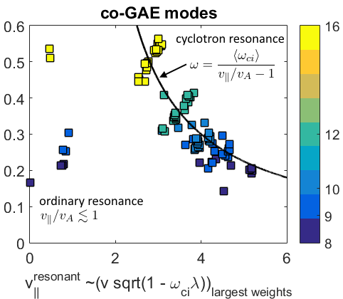
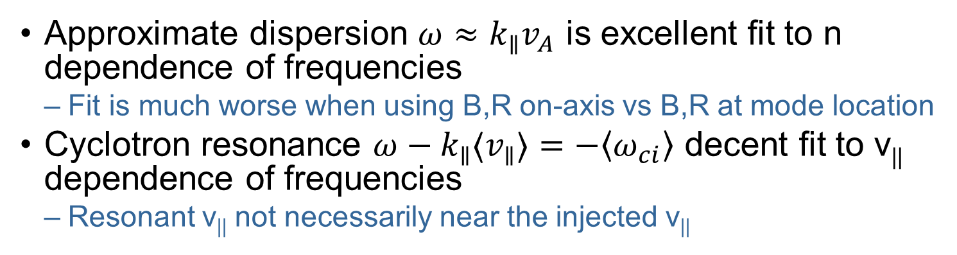
Co-GAE Dispersion and Resonance
Approximate dispersion $ω≈k_{∥}v_{A}$ is excellent fit to n dependence of frequencies
  Fit is much worse when using B,R on-axis vs B,R at mode location
Cyclotron resonance $ω−k_{∥}{〈v}_{∥}〉=−〈ω_{ci}〉$ decent fit to v|| dependence of frequencies
  Resonant v|| not necessarily near the injected v||
n

Slide 14
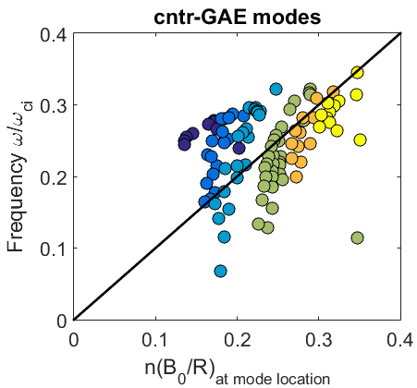
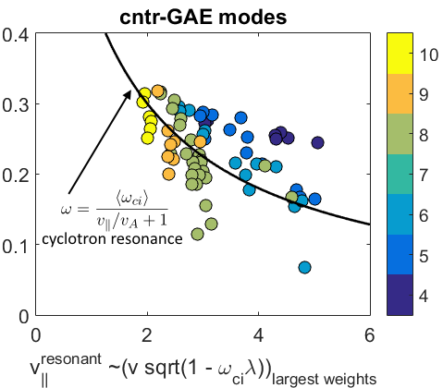
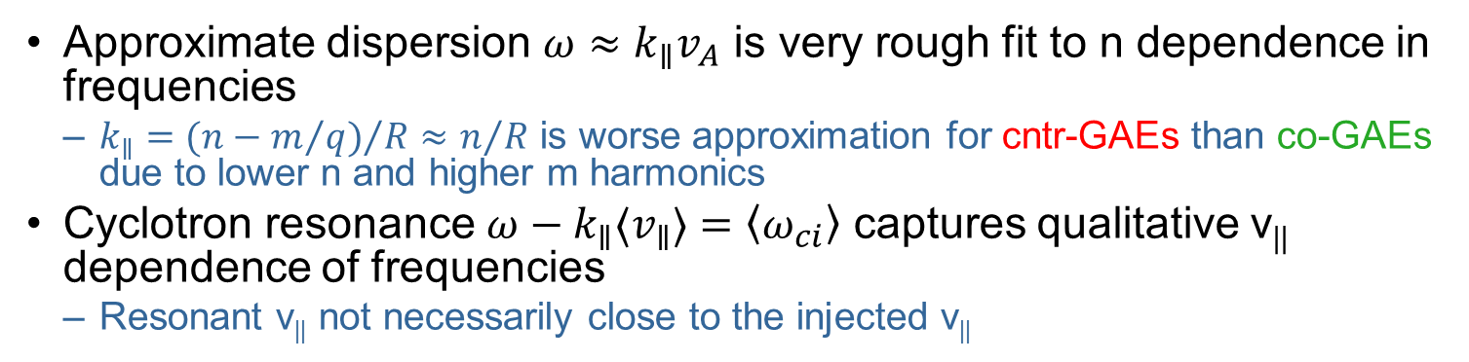
Counter-GAE Dispersion and Resonance
Approximate dispersion $ω≈k_{∥}v_{A}$ is very rough fit to n dependence in frequencies
  $k_{∥}={(n−m/q)}/{R≈n/R}$ is worse approximation for cntr-GAEs than co-GAEs due to lower n and higher m harmonics
Cyclotron resonance $ω−k_{∥}{〈v}_{∥}〉=〈ω_{ci}〉$ captures qualitative v|| dependence of frequencies
  Resonant v|| not necessarily close to the injected v||
n

Slide 15
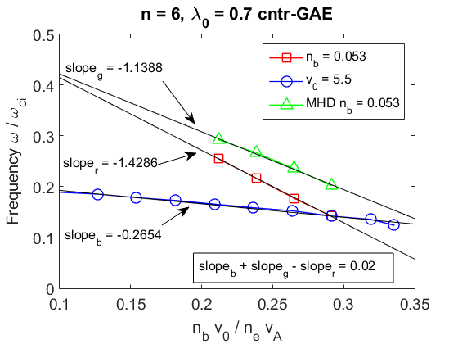
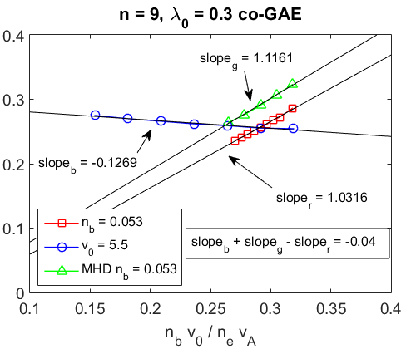

$ω_{GAE}$ also Changes with Fixed Equilibrium
Equilibrium solver is self-consistent → increasing v₀/v_{A} increases J_{beam}/J_{plasma}, modifying the equilibrium. Must disentangle “equilibrium effects” from “EP phase space effects” on frequencies
  Method 1: Fix beam energy and vary beam density to make the equilibrium more MHD-like without changing the energetic particle phase space
  Method 2: Remove energetic particles from equilibrium equations (no longer self consistent), fix beam density and vary beam energy to manipulate the EP phase space
Large frequency changes are still observed when varying v₀/v_{A} with identical equilibria
LEGEND
Self-consistent equilibrium, varying v₀ with constant n_{b}
Self-consistent equilibrium, varying n_{b} with constant v₀
NON self-consistent, “MHD-like” equilibrium, varying v₀ with constant n_{b}

Slide 16
EPMs in Disguise?
Large and unexpected changes in frequency with changes in EP distribution is uncharacteristic of MHD modes
Even when excluding EP effects on equilibrium, different EP distributions with the same equilibrium lead to large changes in frequency
  Quantitatively described by resonance condition
Frequencies are usually near expected GAE freq.
Yet there are not always (or even typically?) clear and substantial modifications to the mode structure corresponding to these large changes in frequency
Are these modes more accurately regarded as high frequency energetic particle modes (EPM)?

Slide 17
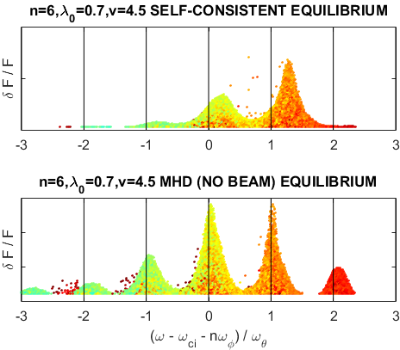
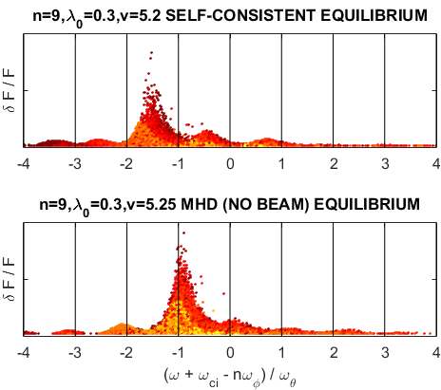
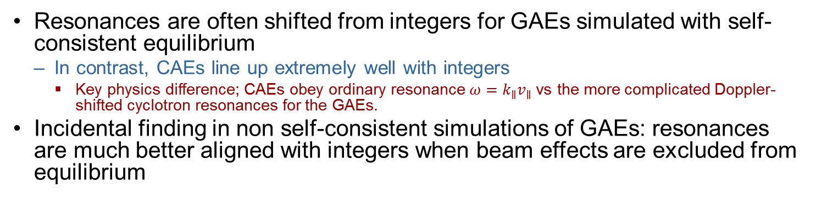
GAE resonances nicer in MHD equilibrium
Resonances are often shifted from integers for GAEs simulated with self-consistent equilibrium
  In contrast, CAEs line up extremely well with integers
    Key physics difference; CAEs obey ordinary resonance $ω=k_{∥}v_{∥}$ vs the more complicated Doppler-shifted cyclotron resonances for the GAEs.
Incidental finding in non self-consistent simulations of GAEs: resonances are much better aligned with integers when beam effects are excluded from equilibrium

Slide 18
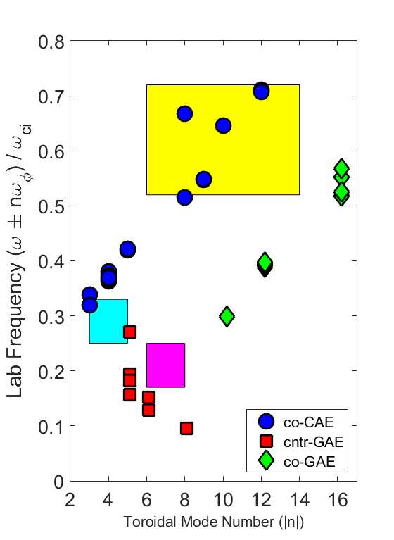
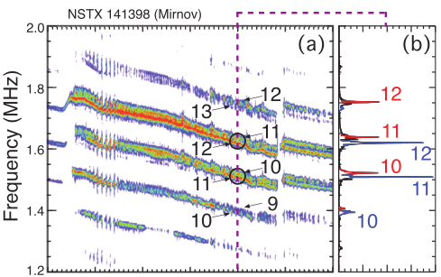
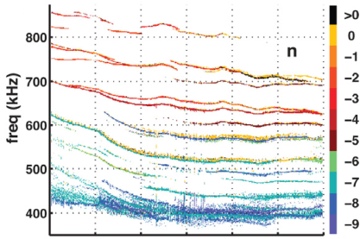
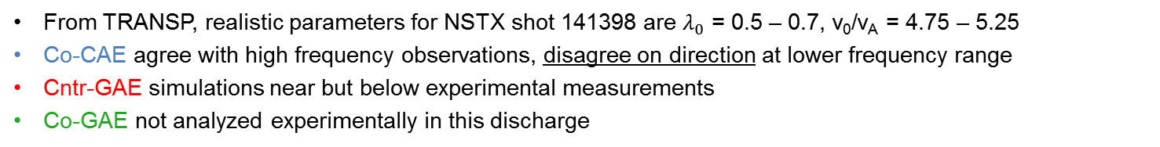
Experimental vs Simulated Mode Spectrum
From TRANSP, realistic parameters for NSTX shot 141398 are $λ_{0}$ = 0.5 – 0.7, v₀/v_{A} = 4.75 – 5.25
Co-CAE agree with high frequency observations, disagree on direction at lower frequency range
Cntr-GAE simulations near but below experimental measurements
Co-GAE not analyzed experimentally in this discharge
1920 kHz
co-CAE
1680 kHz
1440 kHz
1200 kHz
[Fredrickson, PoP 2013]
960 kHz
720 kHz
cntr-CAE
480 kHz
240 kHz
cntr-GAE
[Crocker, NF 2013]

Slide 19
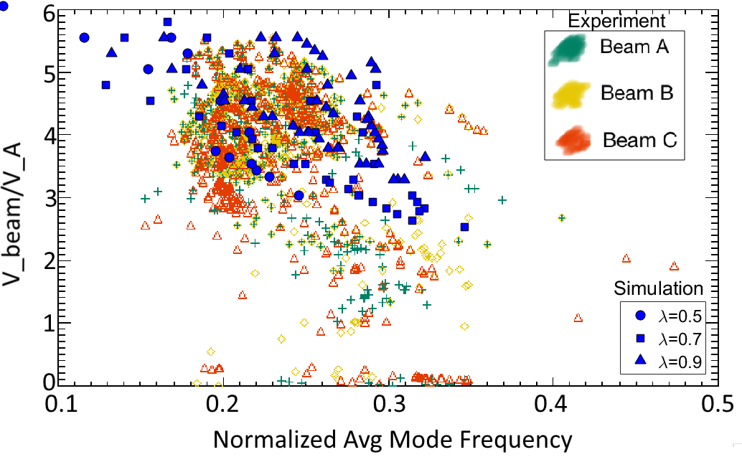
Mode Spectrum Dependence on v₀/v_{A}
Red/yellow/green points from experimental survey of 50ms intervals in NSTX discharges satisfying:
  (1) T_{e} > 500 eV, (2) <f> > 200 kHz, (3) -10 < <n> < -4
Blue marks: individual cntr-GAE modes from simulations
Some qualitative agreement, but very preliminary – requires more direct comparison
  Individual mode comparison can test simulation predicted stability boundaries in v₀/v_{A}
[Tang & Crocker, 2016]

Slide 20
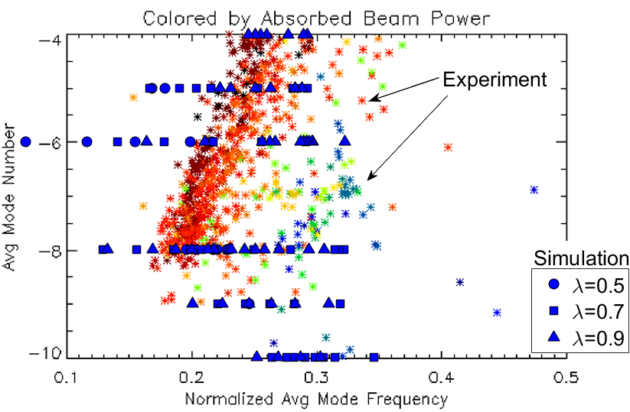
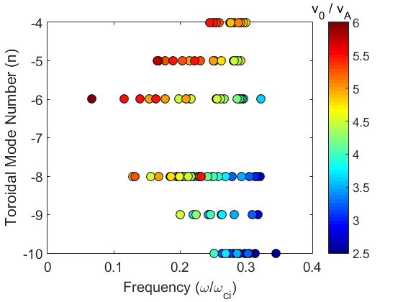
Mode Spectrum Dependence on n
Red/yellow/green points from experimental survey of 50ms intervals in NSTX discharges satisfying:
  (1) T_{e} > 500 eV, (2) <f> > 200 kHz, (3) -10 < <n> < -4
Blue marks: individual cntr-GAE modes from simulations
Reasonable agreement for |n| > 7, and correct trends along v₀/v_{A} contours
Also requires more direct comparison
[Tang & Crocker, 2016]

Slide 21
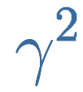



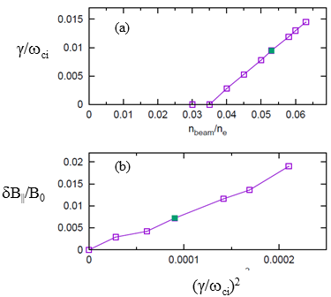
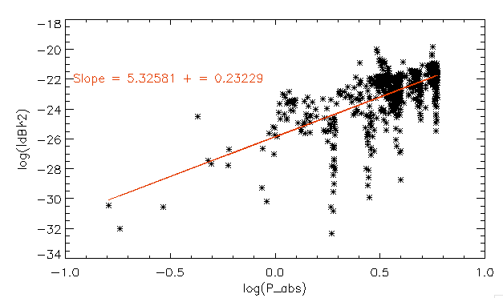
Modes Saturate with
Nonlinear simulations of n = 4 CAE reveal
  Consistent with saturation via particle trapping
Experimental database shows when fitting all CAE/GAE modes
Hence power transferred to KAW scales
  Very strong beam power dependence implies energy channeling should be strong effect in high power NSTX-U discharges
    Though CAE could be more stable in general due to larger nominal B₀
[Tang & Crocker, 2016]

Slide 22
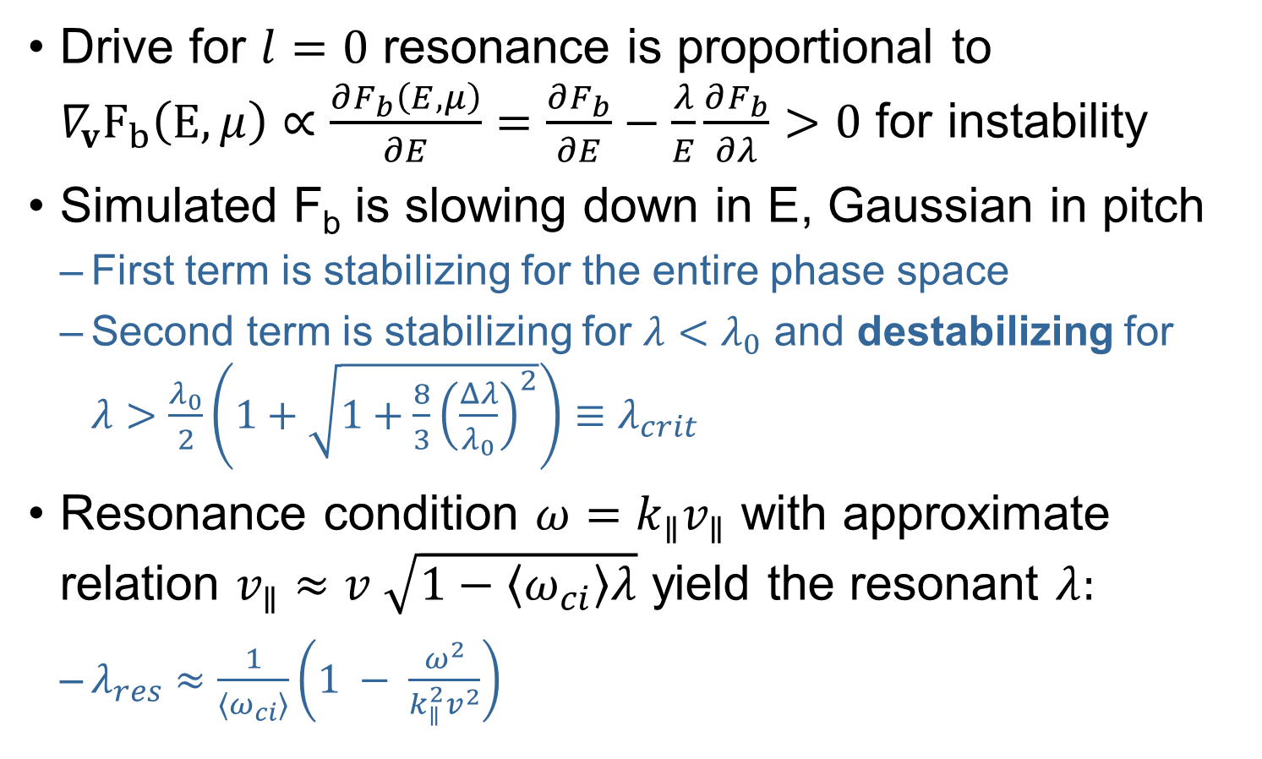
Qualitative Co-CAE Stability Theory
Drive for $l=0$ resonance is proportional to $∇_{v}F_{b}\left(E,μ\right)∝\frac{∂F_{b}\left(E,μ\right)}{∂E}=\frac{∂F_{b}}{∂E}−\frac{λ}{E}\frac{∂F_{b}}{∂λ}>0$ for instability
Simulated F_{b} is slowing down in E, Gaussian in pitch
  First term is stabilizing for the entire phase space
  Second term is stabilizing for $λ<λ_{0}$ and destabilizing for $λ>\frac{λ_{0}}{2}\left(1+\sqrt{1+\frac{8}{3}{\left(\frac{Δλ}{λ_{0}}\right)}^{2}}\right)≡λ_{crit}$
Resonance condition $ω=k_{∥}v_{∥}$ with approximate relation $v_{∥}≈v \sqrt{1−〈ω_{ci}〉λ}$ yield the resonant $λ:$
  $λ_{res}≈\frac{1}{〈ω_{ci}〉}\left(1 − \frac{ω^{2}}{k_{∥}^{2}v^{2}}\right)$
[Belikov, PoP 2003]

Slide 23
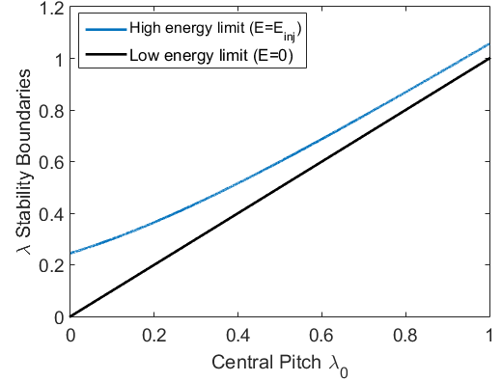
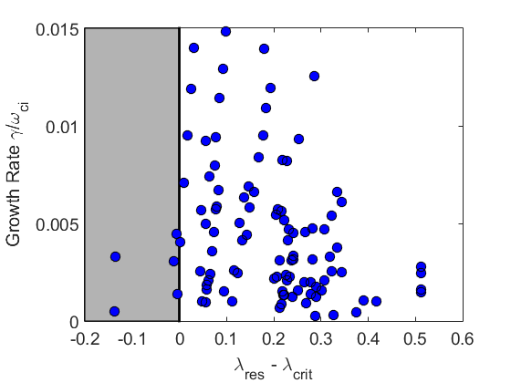

Unstable CAE Modes vs Theory
$λ_{res}>λ_{crit}$ is a necessary condition for instability
Check against simulations with assumptions:
  $〈ω_{ci}〉≈0.9ω_{ci0}$ (good), $k_{∥}≈\frac{n}{R}$ (okay), $v_{res}≈v_{0}$ (unreliable)
CAEs in simulation usually satisfy this instability condition (predicts unshaded region to be unstable)
Beilkov et. al. also claim v₀/v_{A} > 4 is necessary for co-CAEs to be preferentially driven by trapped particles – remarkably similar to the stability boundary demonstrated in these simulations (earlier slide)
[Belikov, PoP 2004]

Slide 24



Cntr-GAE Stability Theory
According to theory, ${2<k}_{⊥}ρ_{b}<4$ required for cntr-GAE instability with NSTX-like EP distributions
From dispersion, $k_{⊥}≈\frac{ω}{v_{A}}\left(\frac{k_{⊥}}{k_{∥}}\right)$, hence $k_{⊥}ρ_{b}=\frac{ω}{ω_{ci}}\frac{v_{⊥}}{v_{A}}\left(\frac{k_{⊥}}{k_{∥}}\right)≈\frac{ω}{ω_{ci}}\frac{v_{0}\sqrt{〈ω_{ci}〉λ_{0}}}{v_{A}}\left(\frac{k_{⊥}}{k_{∥}}\right)$
Unfortunately, ${k_{⊥}}/{k_{∥}}$is not known for each mode, though it is expected to be much larger than 1 (usual tokamak limit)
Encouragingly, the other factors in $k_{⊥}ρ_{b}$ show a clustering in growth rates (left plot)
The inferred values of ${k_{⊥}}/{k_{∥}}$ necessary for the unstable modes to obey the theoretical instability conditions are generally ${k_{⊥}}/{k_{∥}}$ = 2 – 6 (right plot)
  Challenging to verify because mode structure is not usually well-aligned with $ψ$ contours → obfuscates poloidal mode number and thus expressions for $k_{∥}$ and $k_{⊥}$
[Gorelenkov, NF 2003]

Slide 25
Summary and Conclusions
3D hybrid simulations were performed for a wide range of beam parameters to investigate CAEs/GAEs in NSTX plasmas
Cntr-GAEs have best overall agreement between simulations and experimental observations
Co-GAEs are observed in simulations to be quite unstable for very tangential beam distributions, but little experimental or analytic work exists on these modes
CAEs in simulation disagree with direction of propagation observed in experiment in moderate frequency band
CAEs are more stable than GAEs for v₀/v_{A} < 4
  Implications for dominant mechanism of anomalous T_{e} flattening
GAE frequencies depend strongly on beam parameters without clearly corresponding changes in mode strucure
  Quantitatively explained by GAE dispersion + resonance, but may be better described as a new, high frequency EPM?

Slide 26
Ongoing and Future Work
Direct single mode simulation/experiment comparison
Continued investigation of GAE vs EPM question
What causes the GAE resonances to be shifted, and why are the shifts so diminished when neglecting the (often large) EP contributions to the equilibrium?
Analytic descriptions of stability boundaries
Compare relative importance of enhanced electron diffusion and energy channeling in various regimes
Predictions for ITER and other devices which may routinely access the EP parameter space necessary to excite these modes

Slide 27
Request for Electronic Copy

Slide 28
Backup Slides

Slide 29




HYM Physical Equations
Single fluid thermal plasma
Delta-f energetic ions

Slide 30



Co-CAE Mode Converts to KAW
CAE typically m = 0.5 – 2, peaking on axis
KAW structure visible in $δB_{⊥}$ fluctuation on HFS
n=4
$λ_{0}$=0.7
v₀=5.0

Slide 31


Counter-GAE are Core-Localized
Typically m = 1.5 – 2.5
Often has large compressional component near edge
n=6
$λ_{0}$=0.7
v₀=4.5

Slide 32


Co-GAE are also Core-Localized
Typically very low m = 0.5 – 1
Not commonly observed in experiment?
n=9
$λ_{0}$=0.3
v₀=5.2

Slide 33


Low Frequency Modes are Qualitatively Different
Typically m ≥ 3 (as large as m~6)
What are they? TAE/fishbone/EPM/???
n=2
$λ_{0}$=0.3
v₀=5.4

Slide 34

Unexpected Low-Frequency Modes
Frequencies : ω ~ 0.01 – 0.05ω_{ci} = 2π(25 – 125) kHz
Growth rates : γ/ω = 0.013 – 0.37, γ_{max} = 0.073ω_{ci} = 90 kHz
Require large v₀ and either very high or low λ₀
Colored circles: low n mode is most unstable mode
Gray circles: Different mode has larger growth rate
White circles: No unstable modes of any type

Slide 35



NSTX H-mode Shot 141398
n_{e} = 6 x 10¹⁹ m⁻³
B_{tor,0}=0.325 T
I_{p} = 0.8 MA
f_{ci,0}=2.4 MHz
90 keV NBI
at 6 MW
v₀ = 4.9 v_{A}
$λ_{0}$ = 0.7
n_{b}/n_{e} ~ 5%
[Figures from Fredrickson, PoP 2013]

Slide 36


CAE & GAE Observed in Experiment
[Fredrickson, PoP. 2013]
Fredrickson observes 3 groups of modes
  Co-propagating CAE
    n=6-14, 0.5ω_{ci} < ω < 0.75ω_{ci}
  Counter-propagating CAE & GAE
    0.15ω_{ci} < ω < 0.35ω_{ci}
  Kinks correlated with high frequency co-CAE
    ω ~ .005ω_{ci}
Crocker studies moderate frequency modes
  ω > 0.25ω_{ci} CAE
    Mostly -3 < n < -5, more core-localized
  ω < 0.25ω_{ci} GAE
    Mostly -6 < n < -8, broad mode structure
[Crocker, NF 2013]

Slide 37


Co-GAE structure mostly unchanged
Below: $δb_{⊥}$ for n=9, $λ_{0}$=0.3 co-GAE with v₀/v_{A}=5.2-6.0
$ω/ω_{ci}$ increases linearly from 0.24 to 0.29
Mode structure does not change qualitatively
  Same eigenmode or different in subtle way?

Slide 38

Resonant Quantities
To do: if time permits, would be nice to comment on the sometimes large variance between injection quantities and beam quantities
  E.g. for CAEs, resonant lambda is typically opposite injected lambda (inject passing particles → modes driven by trapped particles, and the converse)

