Slide 1
Gas Puff Imaging Diagnostic on NSTX-U
S.J. Zweben¹, F. Scotti², D.P. Stotler¹,
A. Diallo¹, N. Mandell¹, J.L. Terry³, W. Han³
PPPL, Princeton NJ USA
LLNL, Livermore CA USA
MIT, Cambridge MA USA
Abstract NP10-00027
Wednesday morning, Nov. 2, 2016
This work was supported by USDOE Contracts #DE-AC02-09CH11466, DE-SC0014264, and DE-AC52-07NA27344.

Slide 2
Abstract
The first results and plans for the gas puff imaging (GPI) diagnostic on NSTX-U will be described. The GPI optical efficiency has been improved by about x10 using a new fiber bundle and interference filter, and the new optics has a zoom lens which can potentially resolve turbulence below the ion-gyroradius scale. Experiments are planned to study high-k edge turbulence, correlations of edge turbulence with the SOL heat flux width, and the trigger mechanism of the L-H transition. A second fast camera is planned to view the GPI gas cloud from across the machine, which can potentially measure the field line pitch by simultaneously viewing individual field-aligned blob filaments in the radial vs. poloidal (GPI) and toroidal vs. poloidal (second camera) directions. An incoming collaboration from MIT will bring a 9x10 pixel APD-based detector array from Alcator C-Mod to NSTX-U, initially for faster and more sensitive imaging of the existing GPI gas puff. New results and further diagnostic plans will be described.

Slide 3
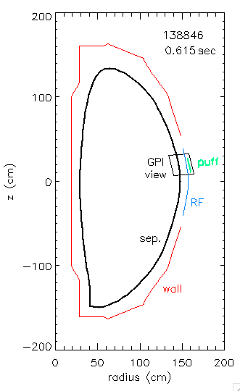
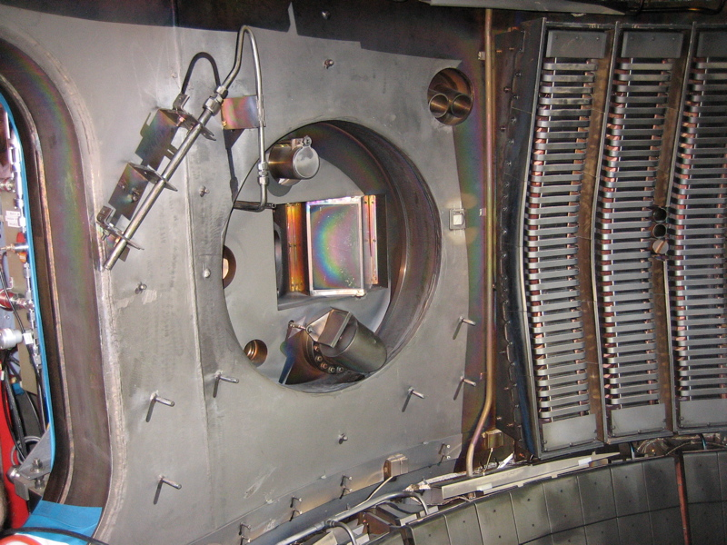
Gas Puff Imaging (GPI) Diagnostic on NSTX
• D₂ gas puffed from GPI manifold on outer wall above midplane
• Dα light emission from gas puff viewed from along local B field
• Fluctuations in Dα light emission interpreted as edge turbulence
GPI gas
puffer
Dα emission
from puff
RF limiter
B field
GPI optical
viewport

Slide 4
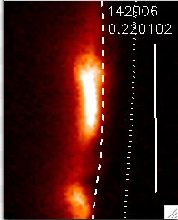
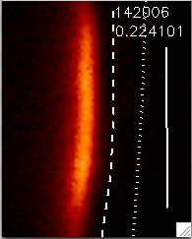
Typical GPI Images from NSTX (2010 data)
• Exposure time/frame = 2.1 µsec/frame @ 400,000 frames/sec
L-mode
H-mode
poloidal
80 pixels
30 cm
GPI gas
injector
radial
64 pixels
24 cm
separatrix
RF antenna
shadow

Slide 5
GPI Optics Improvements for NSTX-U
These upgrades were implemented for the 2016 run:
• New Schott coherent fiber bundle, 8x10 mm and 9 ft. long
(improves signal x4 due to browning of prior bundle)
• New Dα interference filter with wider bandwidth 9 nm FWHM
(~80% transmission vs. prior ~35%)
• New optical zoom lenses to improve GPI spatial resolution
(manual zoom from ~0.5 cm to ~0.1 cm at gas cloud)
=> ~10x larger GPI signal should allow reduced GPI gas puff
rate and better space and/or time resolution

Slide 6
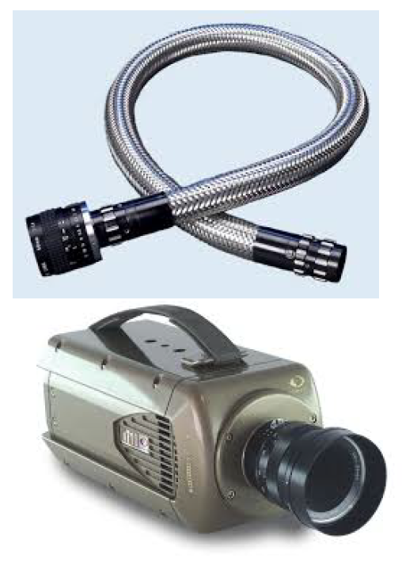
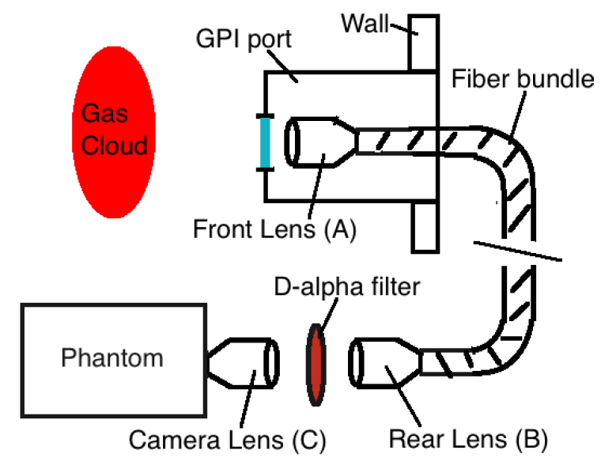
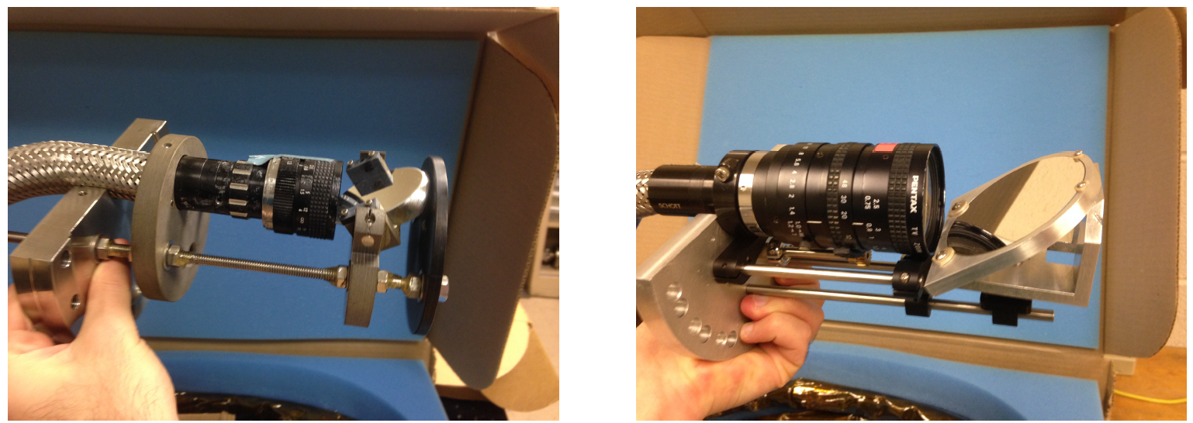
Zoom Lens for Improved Spatial Resolution
Front lens changed from
25 mm to 8-48 mm zoom
Camera lens changed from
25 mm to 8-48 mm zoom
2010
front
end
lens
2016
front
end
lens

Slide 7
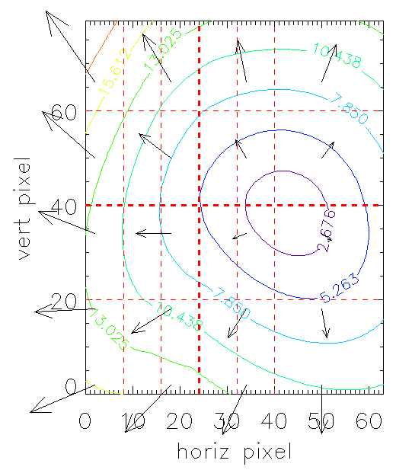
Limitation due to B Field Angle Alignment
• Maximum GPI optical zoom has ~ 1 mm spatial resolution
• Could resolve structure k_{pol} ρ_{i} ~ 1 at edge (T_{i}=100 eV, B=1 T)
• But misalignment of GPI view with B can “smear” resolution
Typical misalignment
angles to local B field
smearing due to parallel length of
GPI cloud: Δ_{smear} ~ L_{II,cloud} tan θ_{B}
e.g. for θ ~ 1º, L_{II,cloud} ~ 15 cm,
Δ_{smear} ~ 0.3 cm
Arrows are misalignment
angles to the local B field
24x30 cm
GPI field
of view
.
.
θ_{Β} ~ 0º perfect alignment (no smearing)
θ_{Β} ~ 2.7º slight misalignment (0.7 cm smearing)
139501
0.515 sec
θ_{Β} ~ 8º large misalignment (2.0 cm smearing)

Slide 8
Present GPI Configuration for 2016 Run
• Started with same GPI view as NSTX but with improved optics
• No gas puff available in 2016 run due to engineering delays
• Used Dα filter to view background edge light at 100 kHz
• Zoom lens had vigneting in 24x30 cm view (as expected)
good data on edge turbulence in background Dα light for
whole duration of ~ 100 shots (but with no GPI puff)
good data on radial Dα profile for edge neutral density
measurement (for comparison with ENDD)

Slide 9
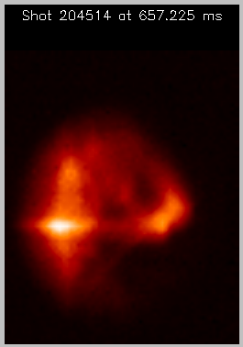
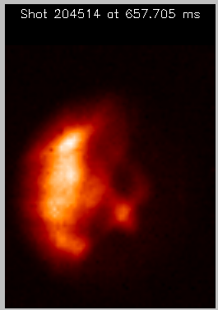
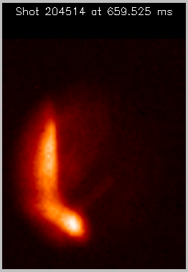
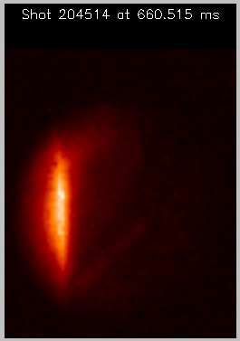
Present GPI Results from 2016 Run
• Edge turbulence in background Dα looked about as expected
large fluctuation levels at ~5 cm scale length in L-mode
quiet band of Dα emission during H-mode periods
• But difficult to analyze due to lack of GPI spatial localization
L-mode
L-mode
L-mode
H-mode

Slide 10
Planned and Possible GPI Upgrades
Planned
• APD array from C-Mod to improve signal/noise and bandwidth
• Second Phantom 710 camera to view GPI cloud from the side
• Helium line ratio measurement of edge T_{e} and n_{e} profiles
Possible
• Additional GPI view(s) for measuring 3-D filament structure
• Better collimated gas manifold for higher spatial resolution
• Remote control of GPI pan/zoom for small-scale structure

Slide 11
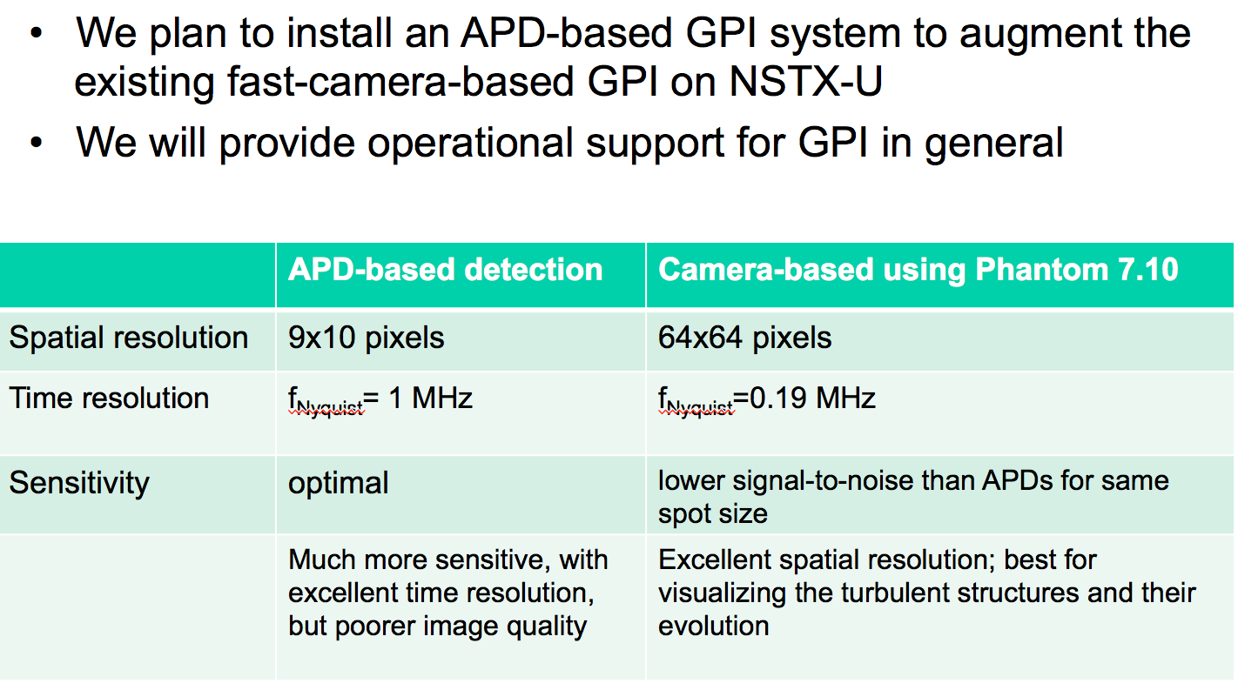
Incoming GPI Collaboration from MIT

Slide 12
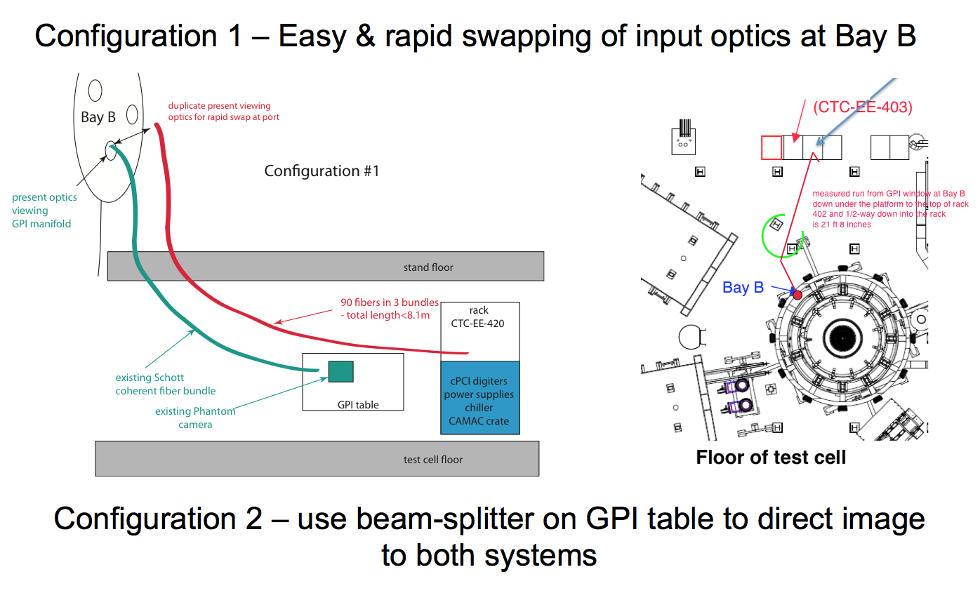
Configuration of MIT APD Array for GPI

Slide 13
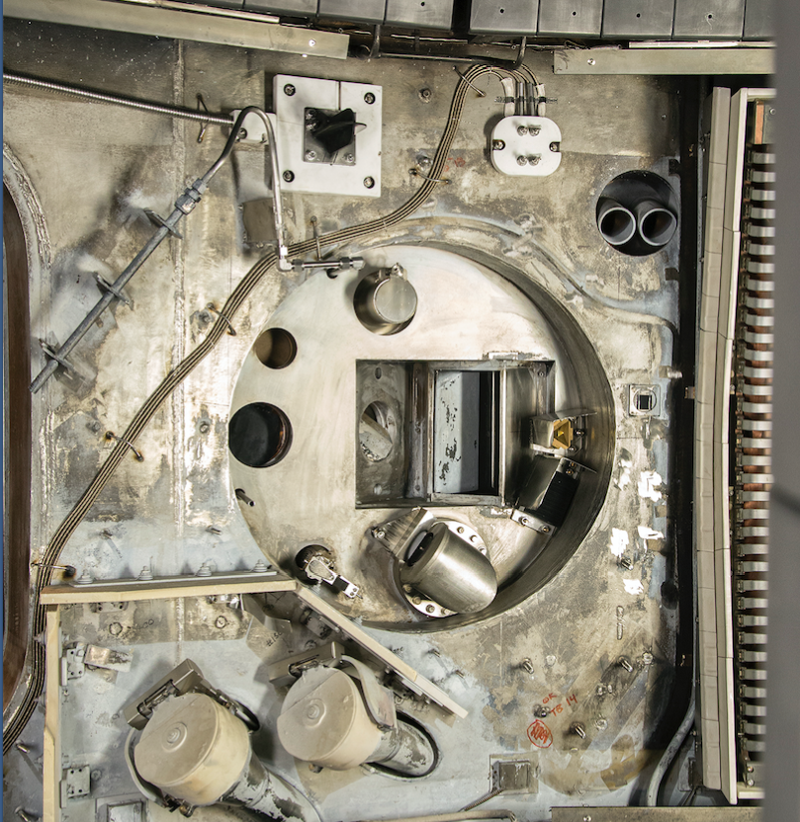
Planned Side View of GPI Gas Puff Cloud
Using the Phantom 710 camera previously used for GPI at C-Mod
Edge filaments
in GPI cloud
• Compare cloud shape with DEGAS 2
• Correlate filaments with GPI images
• Find local B field line angle => q(r)
assuming filaments aligned with B
• Add another gas puffer in field of
view to check B-field alignment
B
GPI optical
viewport

Slide 14
Planned Helium Line Ratio Measurement
• The GPI view can be used to measure neutral helium line ratios
to determine radial profiles of T_{e} and n_{e} in edge (proposed
by RFX-mod/Padova and Wisconsin)
• Initial evaluation of expected helium line signals looks good for measurements at > 1 kHz (Burgos et al, Phys. Plasmas 2016)
• These profiles will be useful for the interpretation of GPI signals,
and increasing frequency range up to ~100 kHz may be possible with large helium gas puffs (Agostini et al, RSI 2015)
• Main issues are possible perturbation effect of helium gas puff,
and self-absorption of helium lines in a large gas puff

Slide 15
Possible Additional GPI Views
• Needed to evaluate parallel structure/dynamics of turbulence
• Each new view will need a new gas puffer a new fast camera
divertor plate surface
X-point region
inner wall
4) ~ 2 m along B from GPI
5) ~ 5 m along B from (4)
4
3
5
2
1

Slide 16
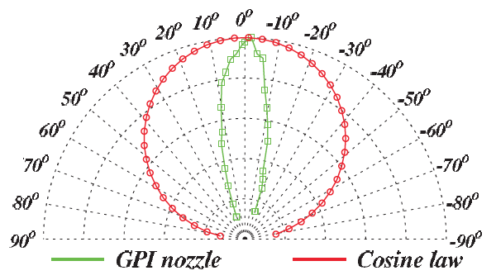
Possible Improvement to Gas Manifold
• Present GPI gas manifold has holes 1 mm diam. x 1 mm deep,
which should emit gas with a wide ~ cosine dependence
• TEXTOR GPI manifold has holes 0.5 mm diam. x 15 mm deep,
which emits gas with ~20º FWHM angular dependence
• New manifold could significantly improve spatial resolution of
GPI, due to shorted parallel length along cloud (see p. 7)
TEXTOR manifold (measured)
NSTX manifold (estimated)
(Shesterikov et al, RSI 2013)

Slide 17
Remote Control of GPI Zoom and Pan
• Present GPI zoom must be adjusted by hand in test cell, and the front-end optics removed to adjust the tilt angle (pan)
• This makes alignment with local B field for measuring small-
scale turbulence structure very difficult (can try to adjust
plasma to match pre-set zoom and pan)
• Zoom lenses and front-end mirror could be remotely controlled
between shots for more efficient measurements
• Main issues are exposure of stepper motors to magnetic fields
(air motors ?), and accuracy/reproducibility of the settings

Slide 18
Planned GPI Experiments on NSTX-U
=> these can be done with existing GPI hardware:
• Search for small-scale edge turbulence structure at k_{pol}ρ_{i} ~ 1
(w/Ren, Guttenfelder)
• Correlation of edge turbulence with heat flux SOL width and
XGC-1 results (w/ Gray, Chang)
• Continue study of L-H transition (w/Stoltfus-Dueck)
• Continue correlation of GPI with divertor plate turbulence
(w/Soukhanovskii)
18

Slide 19
Planned GPI Studies on NSTX-U
=> these require upgraded GPI hardware:
• Measure turbulence up to ~ 1 MHz with APDs
• Measure turbulence far inside separatrix with APDs
• Measure edge q(r) from GPI + side view filaments
• Compare GPI gas cloud side view with DEGAS 2
• Measure edge T_{e} and n_{e} profiles with helium line ratios
also:
- Continue study of blobs, GAMs, zonal flows
- Search for RF-SOL interaction dynamics
Search for effects of application of 3-D fields
Study effects of divertor geometry and detachment
Study coherent edge modes (QCM, EHO, KBM, etc)

Slide 20
Please ask Filippo Scotti (next poster) for further information,
or sign up for a copy of this poster:

