Slide 1

Generation of Non-Inductive H-Mode Plasmas with 30 MHz Fast Wave Heating in NSTX-U*
G. Taylor¹, N. Bertelli¹, S. P. Gerhardt¹, J. C. Hosea¹,
D. Mueller¹, R. J. Perkins¹, F. M. Poli¹, R. Raman², J. R. Wilson¹
¹Princeton Plasma Physics Laboratory, Princeton, NJ 08543, USA
²University of Washington, Seattle, WA 98195, USA
Paper NP10.00035
APS-DPP Meeting
San Jose, California
November 2, 2016
* This work is supported by USDOE Contract No. DE-AC02-09CH11466

Slide 2
Introduction

Slide 3
Developing fully non-inductive (NI) plasmas is a
NSTX-U 10-year research goal
In a Fusion Nuclear Science Facility based on a spherical tokamak the plasma current (I_{p}) needs to be initiated, ramped-up and sustained with little or no central solenoid field
30 MHz fast wave (FW) heating can play a critical role in NSTX-U supporting non-inductive (NI) I_{p} ramp-up to 300 kA:
  FW heating effectively heats low density plasmas with I_{p} ≤ 300 kA, whereas neutral beam injection (NBI) requires I_{p} ≥ 300 kA to ensure fast ion confinement and to maintain shine through below 50%
Experiments on NSTX-U aim to couple ~ 3 MW of FW power into I_{p} ~ 300 kA plasmas, achieving NI current fraction, f_{NI} ≥ I
This poster presents the first results from time-dependent transport simulations of these FW-heated I_{p} ~ 300 kA plasmas

Slide 4
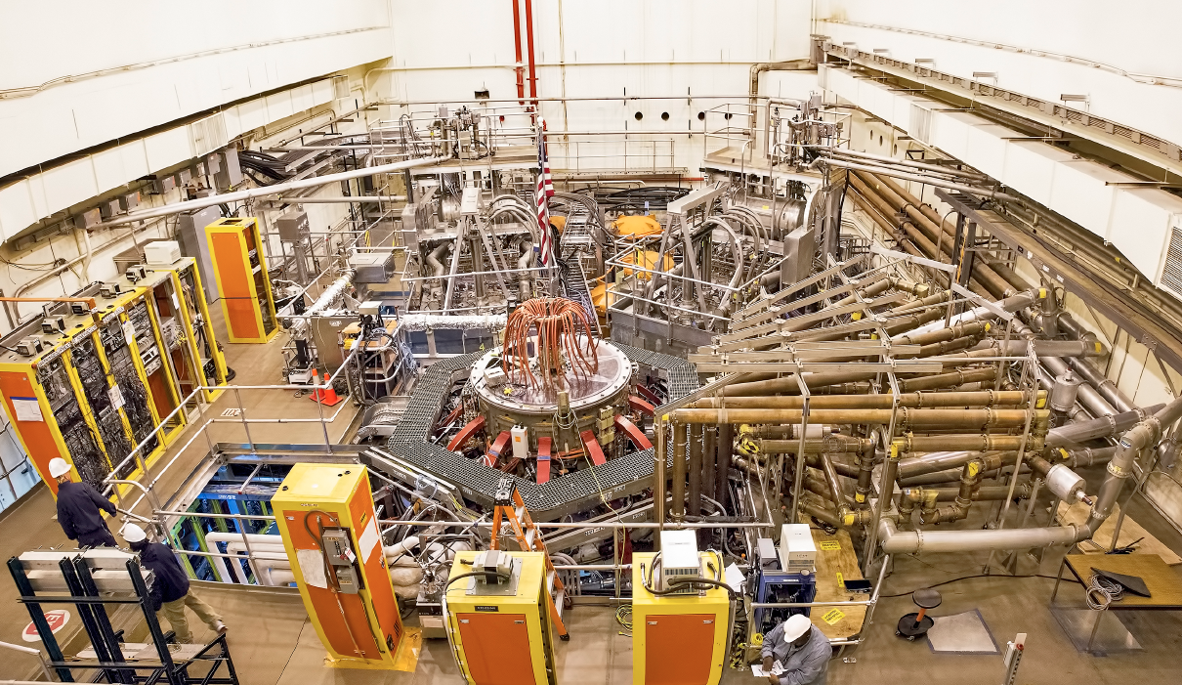
NSTX-U facility includes a 6 MW, 30 MHz FW heating system previously used on NSTX
2nd NBI
1st NBI
NSTX-U
30 MHz FW System

Slide 5
NSTX-U performance will far exceed NSTX with regard to maximum I_{p}, B_{T} and I²t*
Parameter | NSTX (Max.) | FY2016 NSTX-U Operations Achieved | FY2017 NSTX-U Repair PF | FY2018 NSTX-U Operations | NSTX-U Ultimate Goal
I_{P} (MA) | 1.2 | ~1.1 | - | 2.0 | 2.0
B_{T} (T) | 0.55 | ~ 0.65 | - | 1.0 | 1.0
Allowed TF I²t (MA²s) | 7.3 | 80 | - | 160 | 160
NSTX 30 MHz FW heating was operated in the high harmonic FW (HHFW) regime, with RF damping on up to 11ω_{ci} at B_{T}(0) = 0.55 T
NSTX-U 30 MHz FW heating will operate in the Medium Harmonic FW (MHFW) regime, with RF damping on up to 5ω_{ci} at B_{T}(0) = 1 T
* J. E. Menard et al., Nucl. Fusion 52 (2012) 083015

Slide 6
Development of NI Plasmas
Heated by 30 MHz FW Power

Slide 7
Experiments in NSTX-U will develop NI start-up, ramp-up and plasma sustainment separately
NSTX-U NI Plasma Strategy
I_{P} Target [kA]
~ 750
~ 300
~ 150
H-mode
Time
30 MHz FW heating
NBI and FW heating &
Bootstrap current ramp-up
CHI, 28 GHz
EC/EBW and/or plasma gun startup
NBI and Bootstrap current sustainment

Slide 8
Time-dependent modeling of NSTX-U NI I_{p} ramp-up predict that NBI is not suitable for I_{p} ≤ 300 kA
TRANSP modeling of NI plasma started with NBI predicts very high shine-through during the first 100 ms when I_{p} ≤ 300 kA
Simulations suggest that an additional source of current is needed in the first 200 ms of a NI plasma*
FW power can effectively heat plasma at low density
FW heating can be through both the electron and ion channels, depending on the antenna phasing**
Plan to use ~3 MW of 30 MHz FW power to ramp I_{p} to 300 kA
* F. M. Poli et al., Nuclear Fusion 55 (2015) 123011
** N. Bertelli et al., AIP Conf. Proc. 1580 (2014) 310

Slide 9
To support development of FW-heated I_{p} ramp-up in NSTX-U first demonstrate fully NI I_{p} ~ 300 kA discharges
Couple 30 MHz FW heating as early as possible into the I_{p} flattop
Ramp FW power as fast as possible to maximum FW power, preferably in < 50 ms to generate early H-mode transition
Use k// = - 8 m⁻¹ current drive phasing
NI current drive via both direct FW current drive and bootstrap current generated through FW heating
First experiment was run in NSTX during 2010 campaign:
  Achieved f_{NI} ~ 0.7 in an I_{p} = 300 kA H-mode plasma sustained for several
  100 ms using only P_{rf} ~ 1.4 MW (next slide)
Extend scenario to higher P_{rf} at higher B_{T}(0) in NSTX-U to achieve sustained I_{p} = 300 kA H-mode plasma with f_{NI} ≥ 1

Slide 10
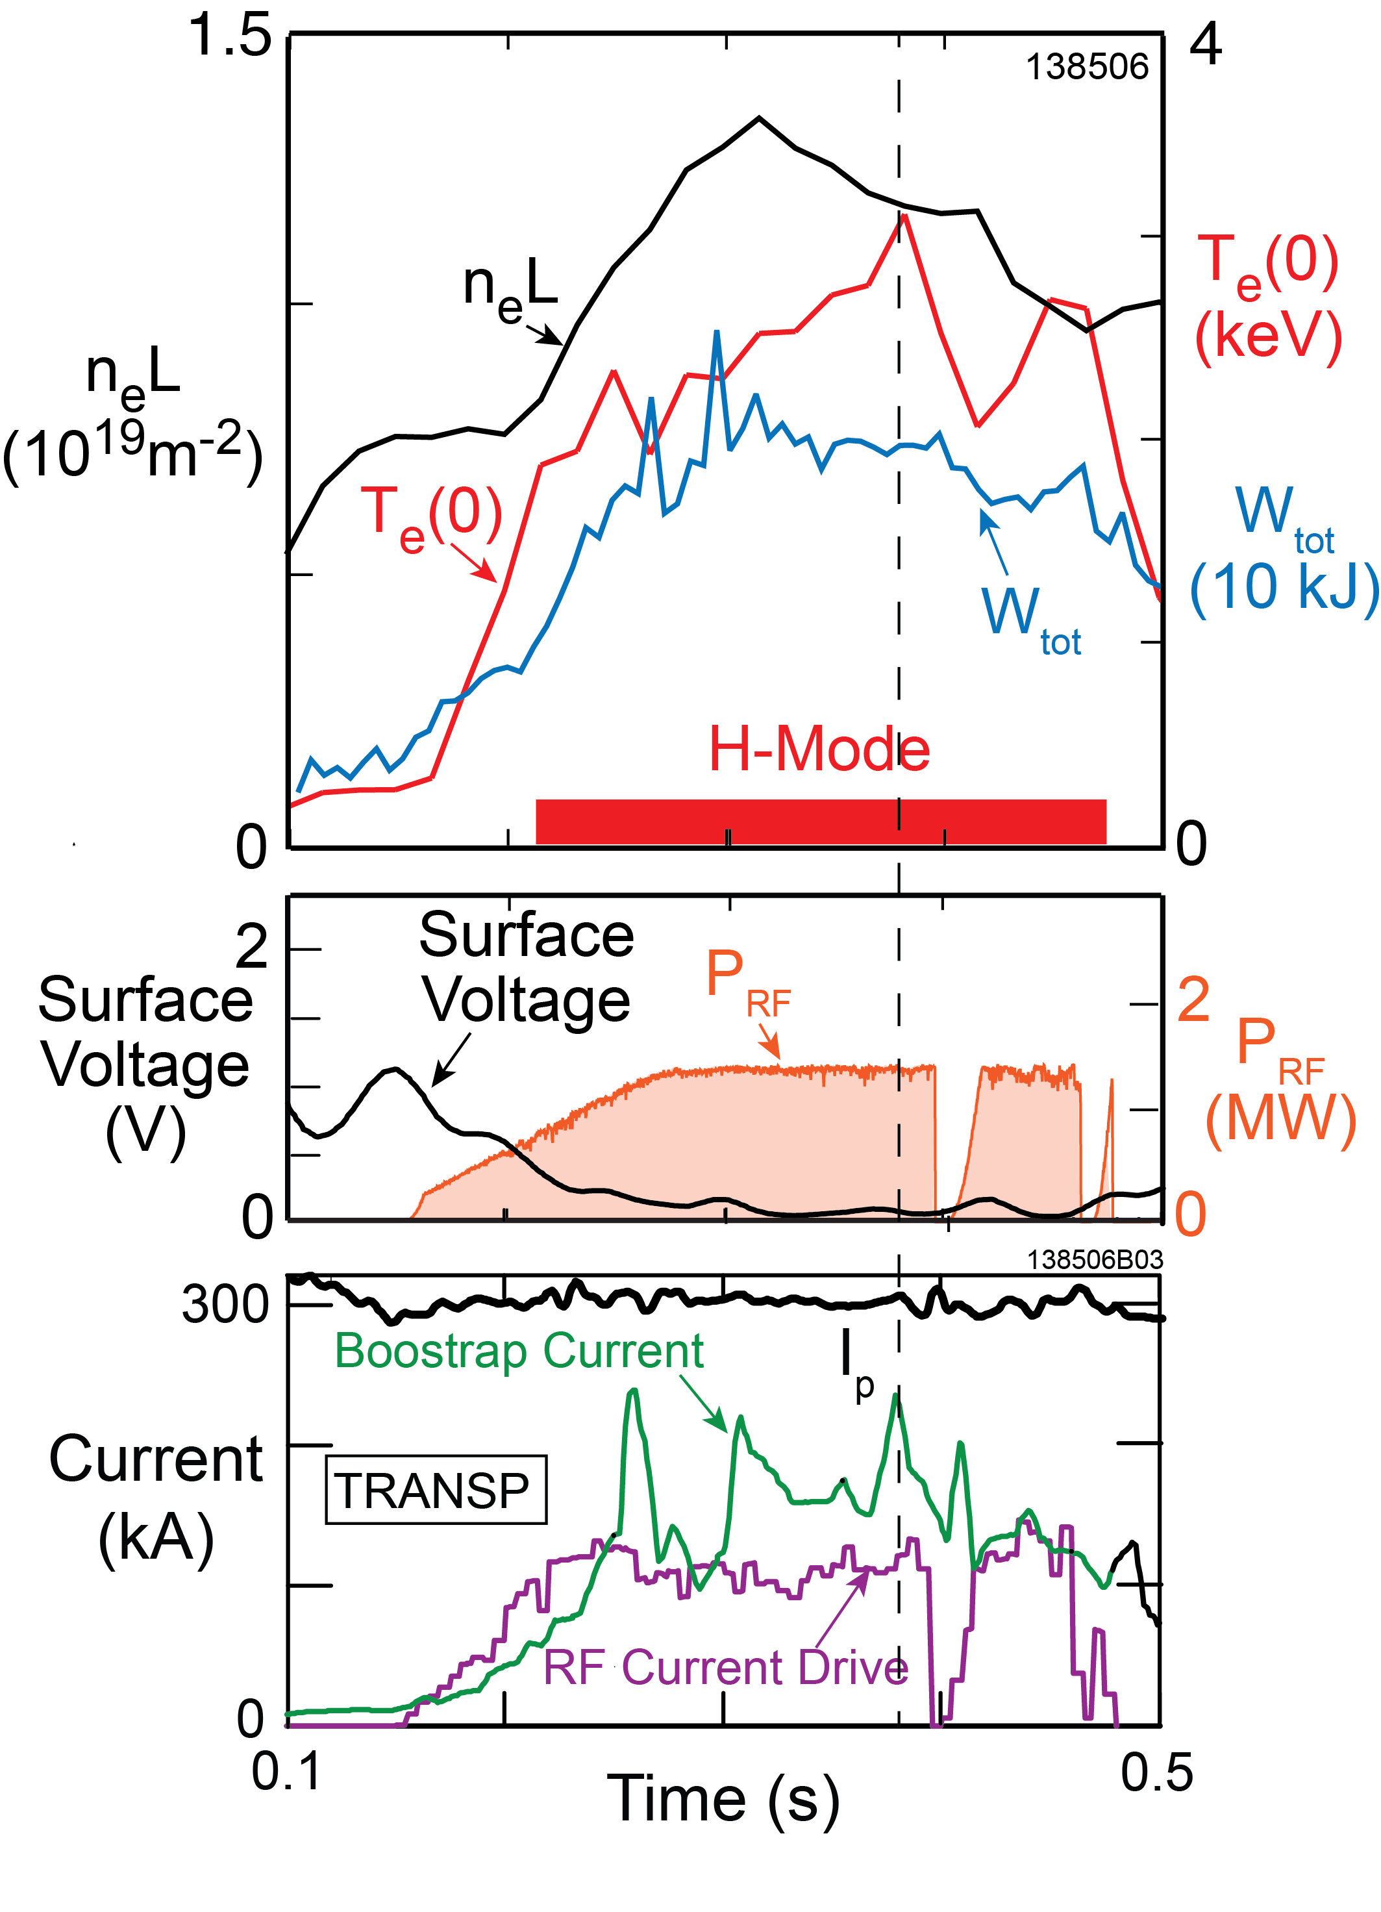
FW heating of an I_{p} = 300 kA plasma in NSTX resulted in rapid increase of T_{e}(0) and f_{NI} > 70% H-mode*
  1.4 MW of 30 MHz, k// = 8 m⁻¹ HHFW power rapidly increased T_{e}(0) from 250 eV to 2 keV and triggered an H-mode transition
  (NSTX shot 138506)
Notably the Bootstrap current contribution was greater than that from direct RF current drive
50% fluctuations in bootstrap current during H-mode phase due to fluctuations in pressure profile
* G. Taylor et al., Phys. Plasmas 19 (2012) 042501

Slide 11
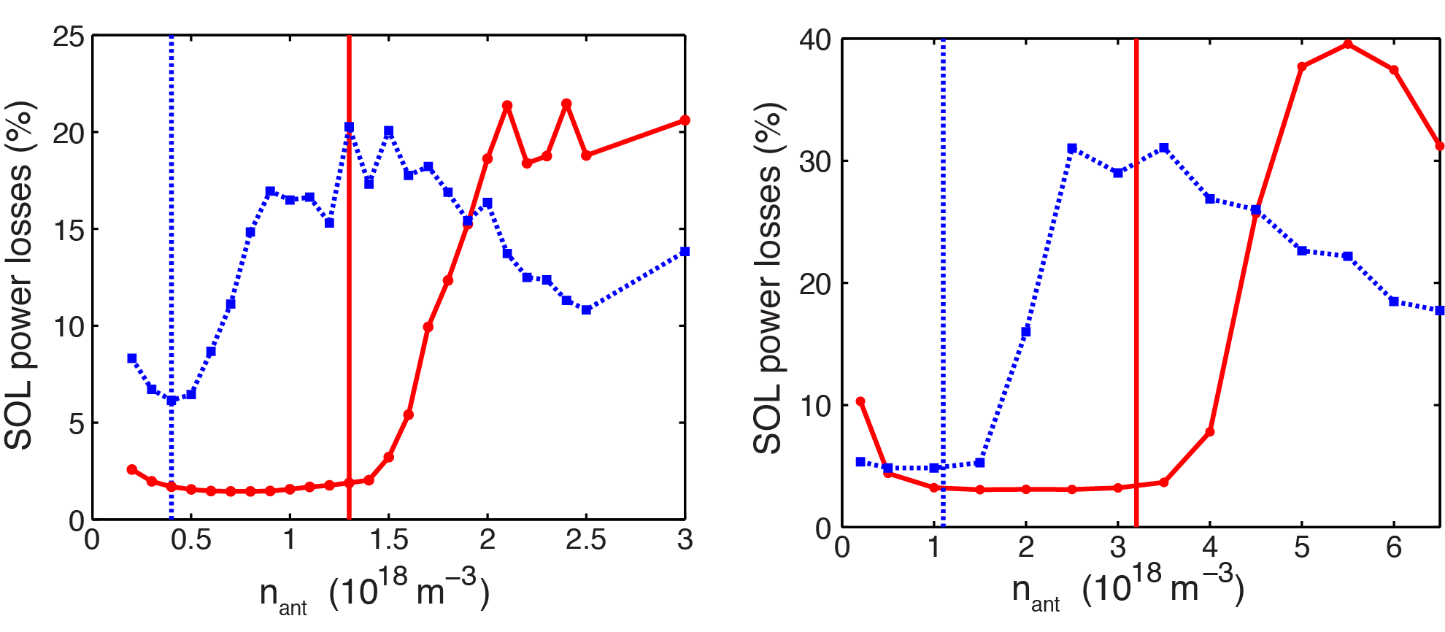
Modeling predicts low 30 MHz power losses over a wider range of SOL densities at higher B_{T}(0) in NSTX-U
NSTX B_{T}(0) = 0.55 T NSTX-U B_{T}(0) = 1 T
n_{φ} = -12
n_{φ} = -12
n_{φ} = -21
n_{φ} = -21
SOL power losses versus SOL density in front of antenna. Vertical lines represent values of density for which the FW cutoff starts to “open” in front of the antenna
AORSA modeling predicts RF power losses to SOL increase substantially above the FW cutoff density, consistent with experimental trends*
* N. Bertelli et al., Nuclear Fusion 54 (2014) 083004

Slide 12
TRANSP Modeling of
I_{p} = 300 kA Plasmas Heated by 30 MHz FW Power

Slide 13
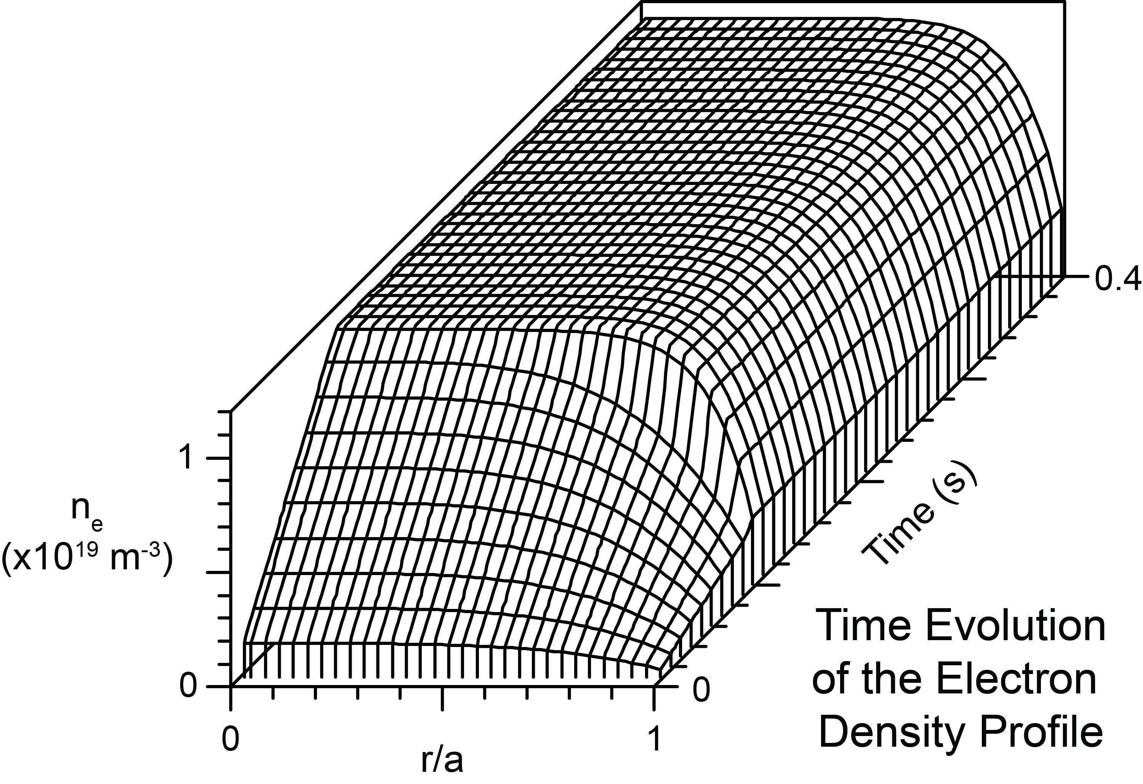
TRANSP time-dependent transport simulation being used to model FW heated NI NSTX-U plasmas
Simulations ramped n_{e}(0) to 1.15x10¹³ m⁻³, between 0 and 100 ms
n_{e}(0) is similar to NSTX shot 138506, but
didn’t attempt to reproduce the density
profile of that shot
An H-mode transition was
imposed at 100 ms by
transitioning to a more
flat density profile

Slide 14
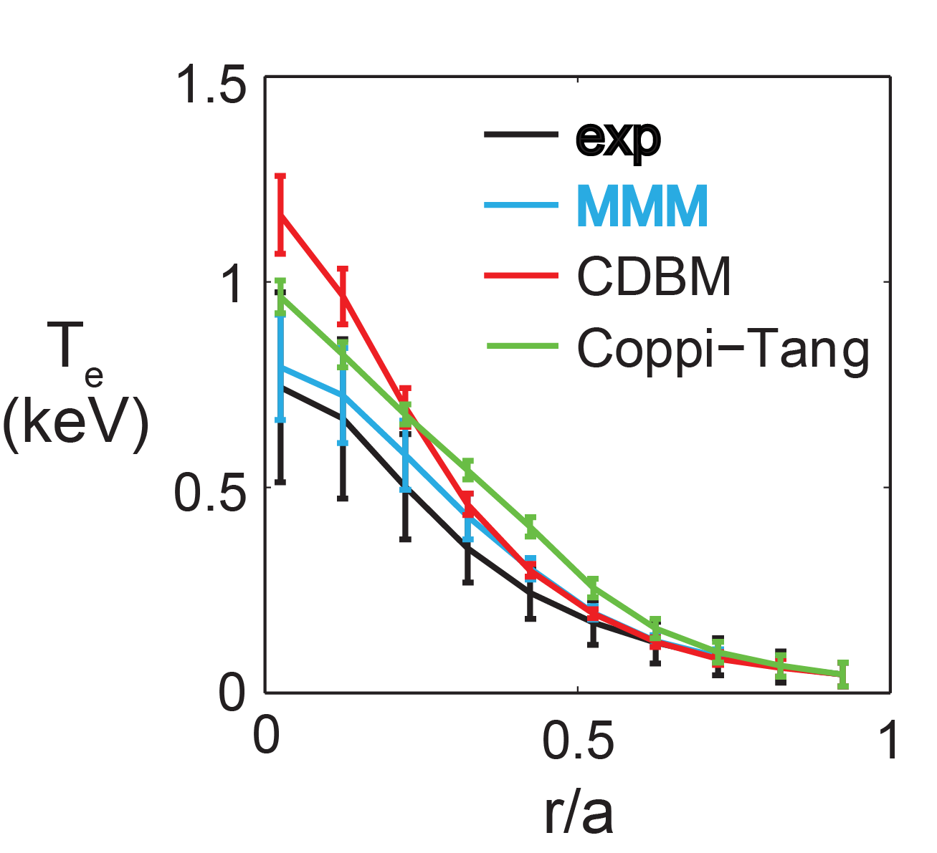
TRANSP simulated FW heating of an I_{p} = 300 kA plasma with B_{T}(0) between 0.5 and 1 T and P_{rf} up to 4 MW
MultiMode MMM7.1* transport model used for ions and electrons:
  MMM7.1 gave the best fit to experimental electron temperature profile for NBI-heated I_{p} = 300 kA NSTX plasmas, compared to Coppi-Tang or current diffusive ballooning mode model (CDBM)**
I_{p} flat top started at 100 ms, FW power
turned on at 100 ms and ramped to full
power in 40 ms
  FW heating and current drive calculated
  with TORIC full wave spectral code⁺
  Used k// = 8 m⁻¹ current drive antenna phasing
Simulations for B_{T}(0) = 0.5, 0.75 and 1.0 T and P_{rf} = 2, 3 and 4 MW
I_{p} = 300 kA NBI-heated NSTX plasma
* T. Rafiq et al., Phys. Plasmas 20 (2013) 032506
+ M. Brambilla, Plasma Phys. Control. Fusion 44 (2002) 2423
** F. M. Poli et al., Nucl. Fus. 55 (2015) 123011

Slide 15
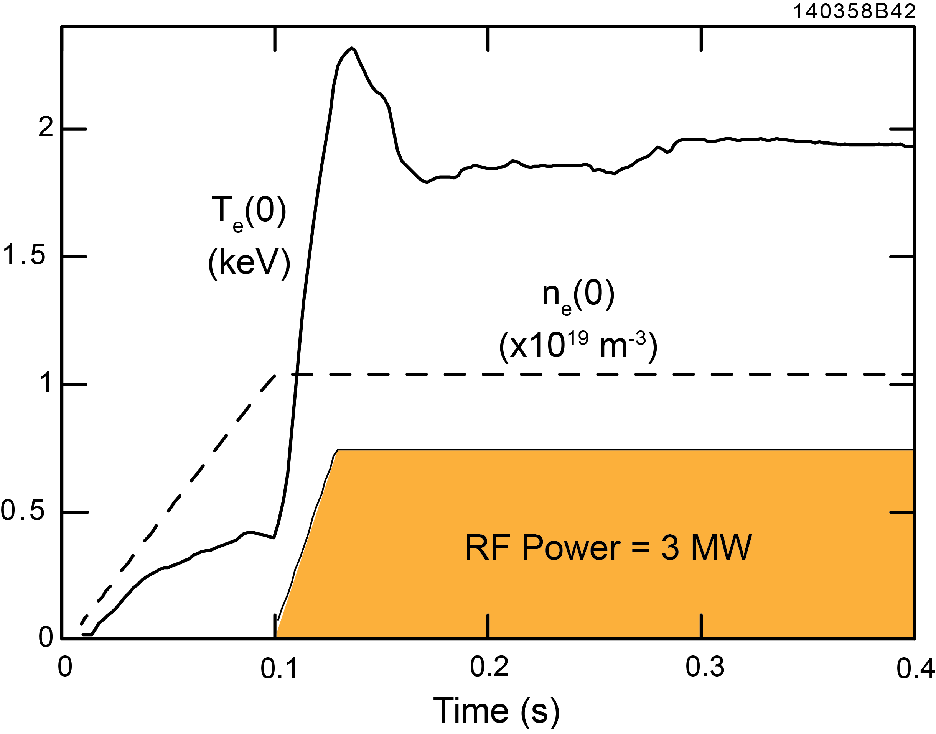
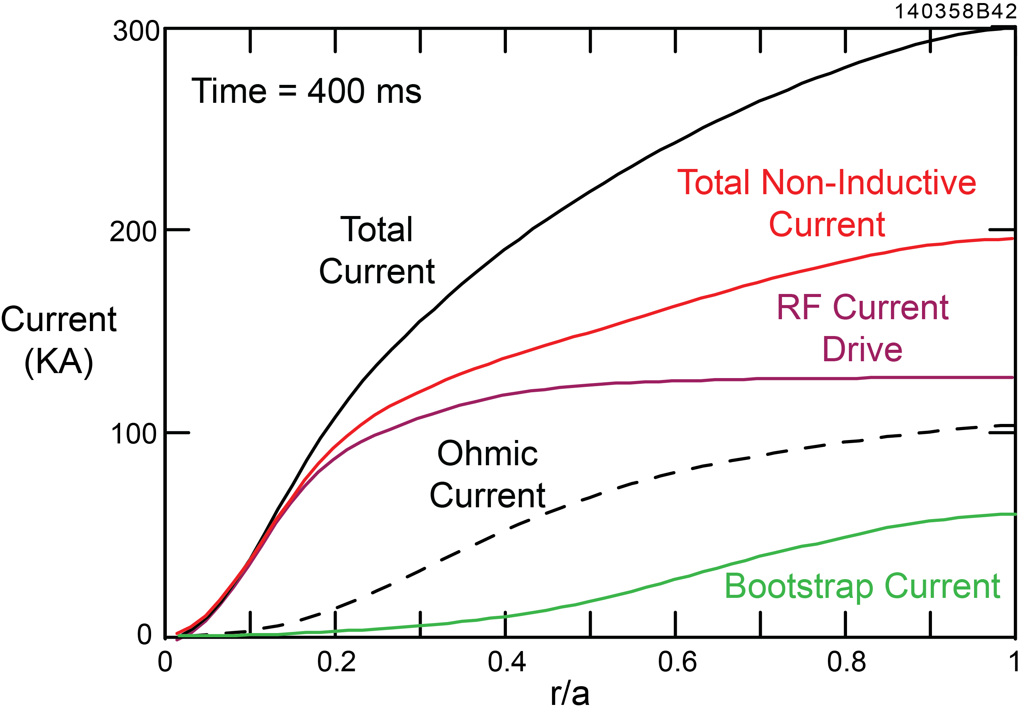
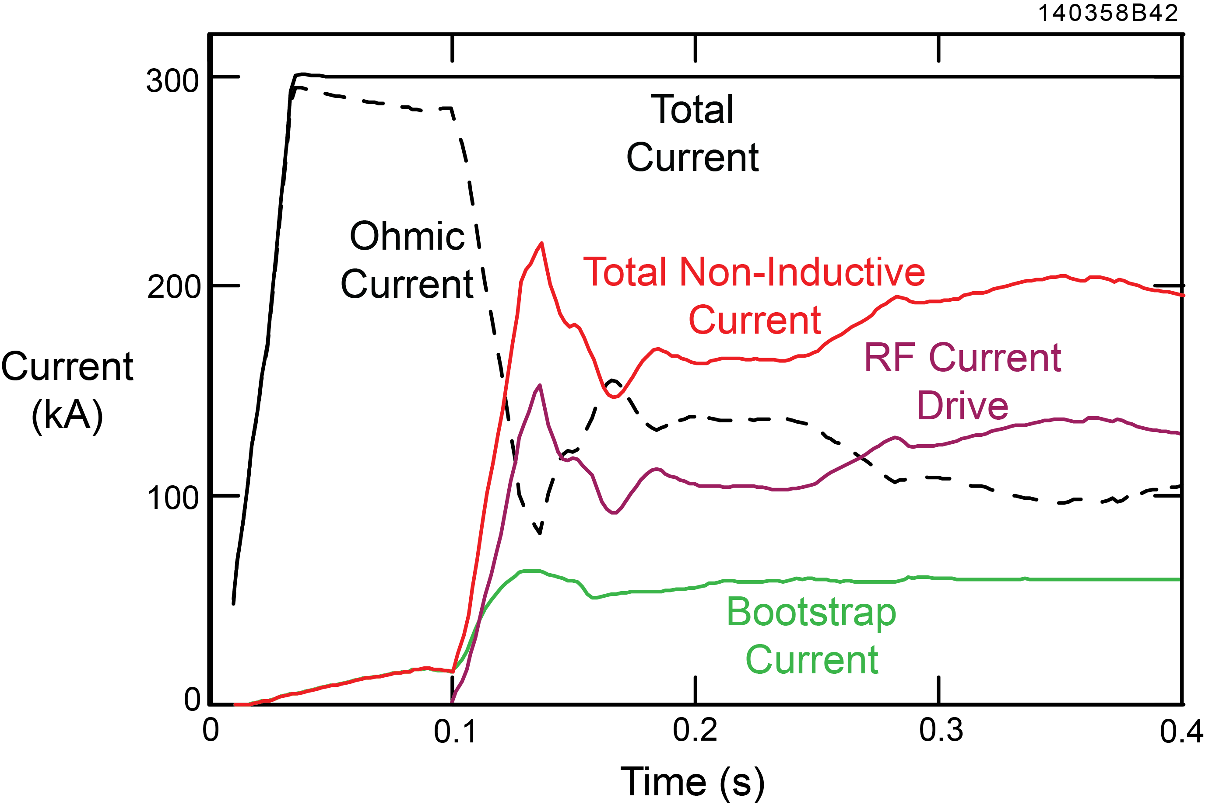
Simulation for B_{T}(0) = 0.5 T NSTX-U plasma predicts
f_{NI} ≥ 1 is only achievable with P_{rf} ~ 4 MW
At 400 ms:
RF current drive = 130 kA
Bootstrap current = 60 kA
Increasing P_{rf} to 4 MW yields a NI current of 280 kA

Slide 16
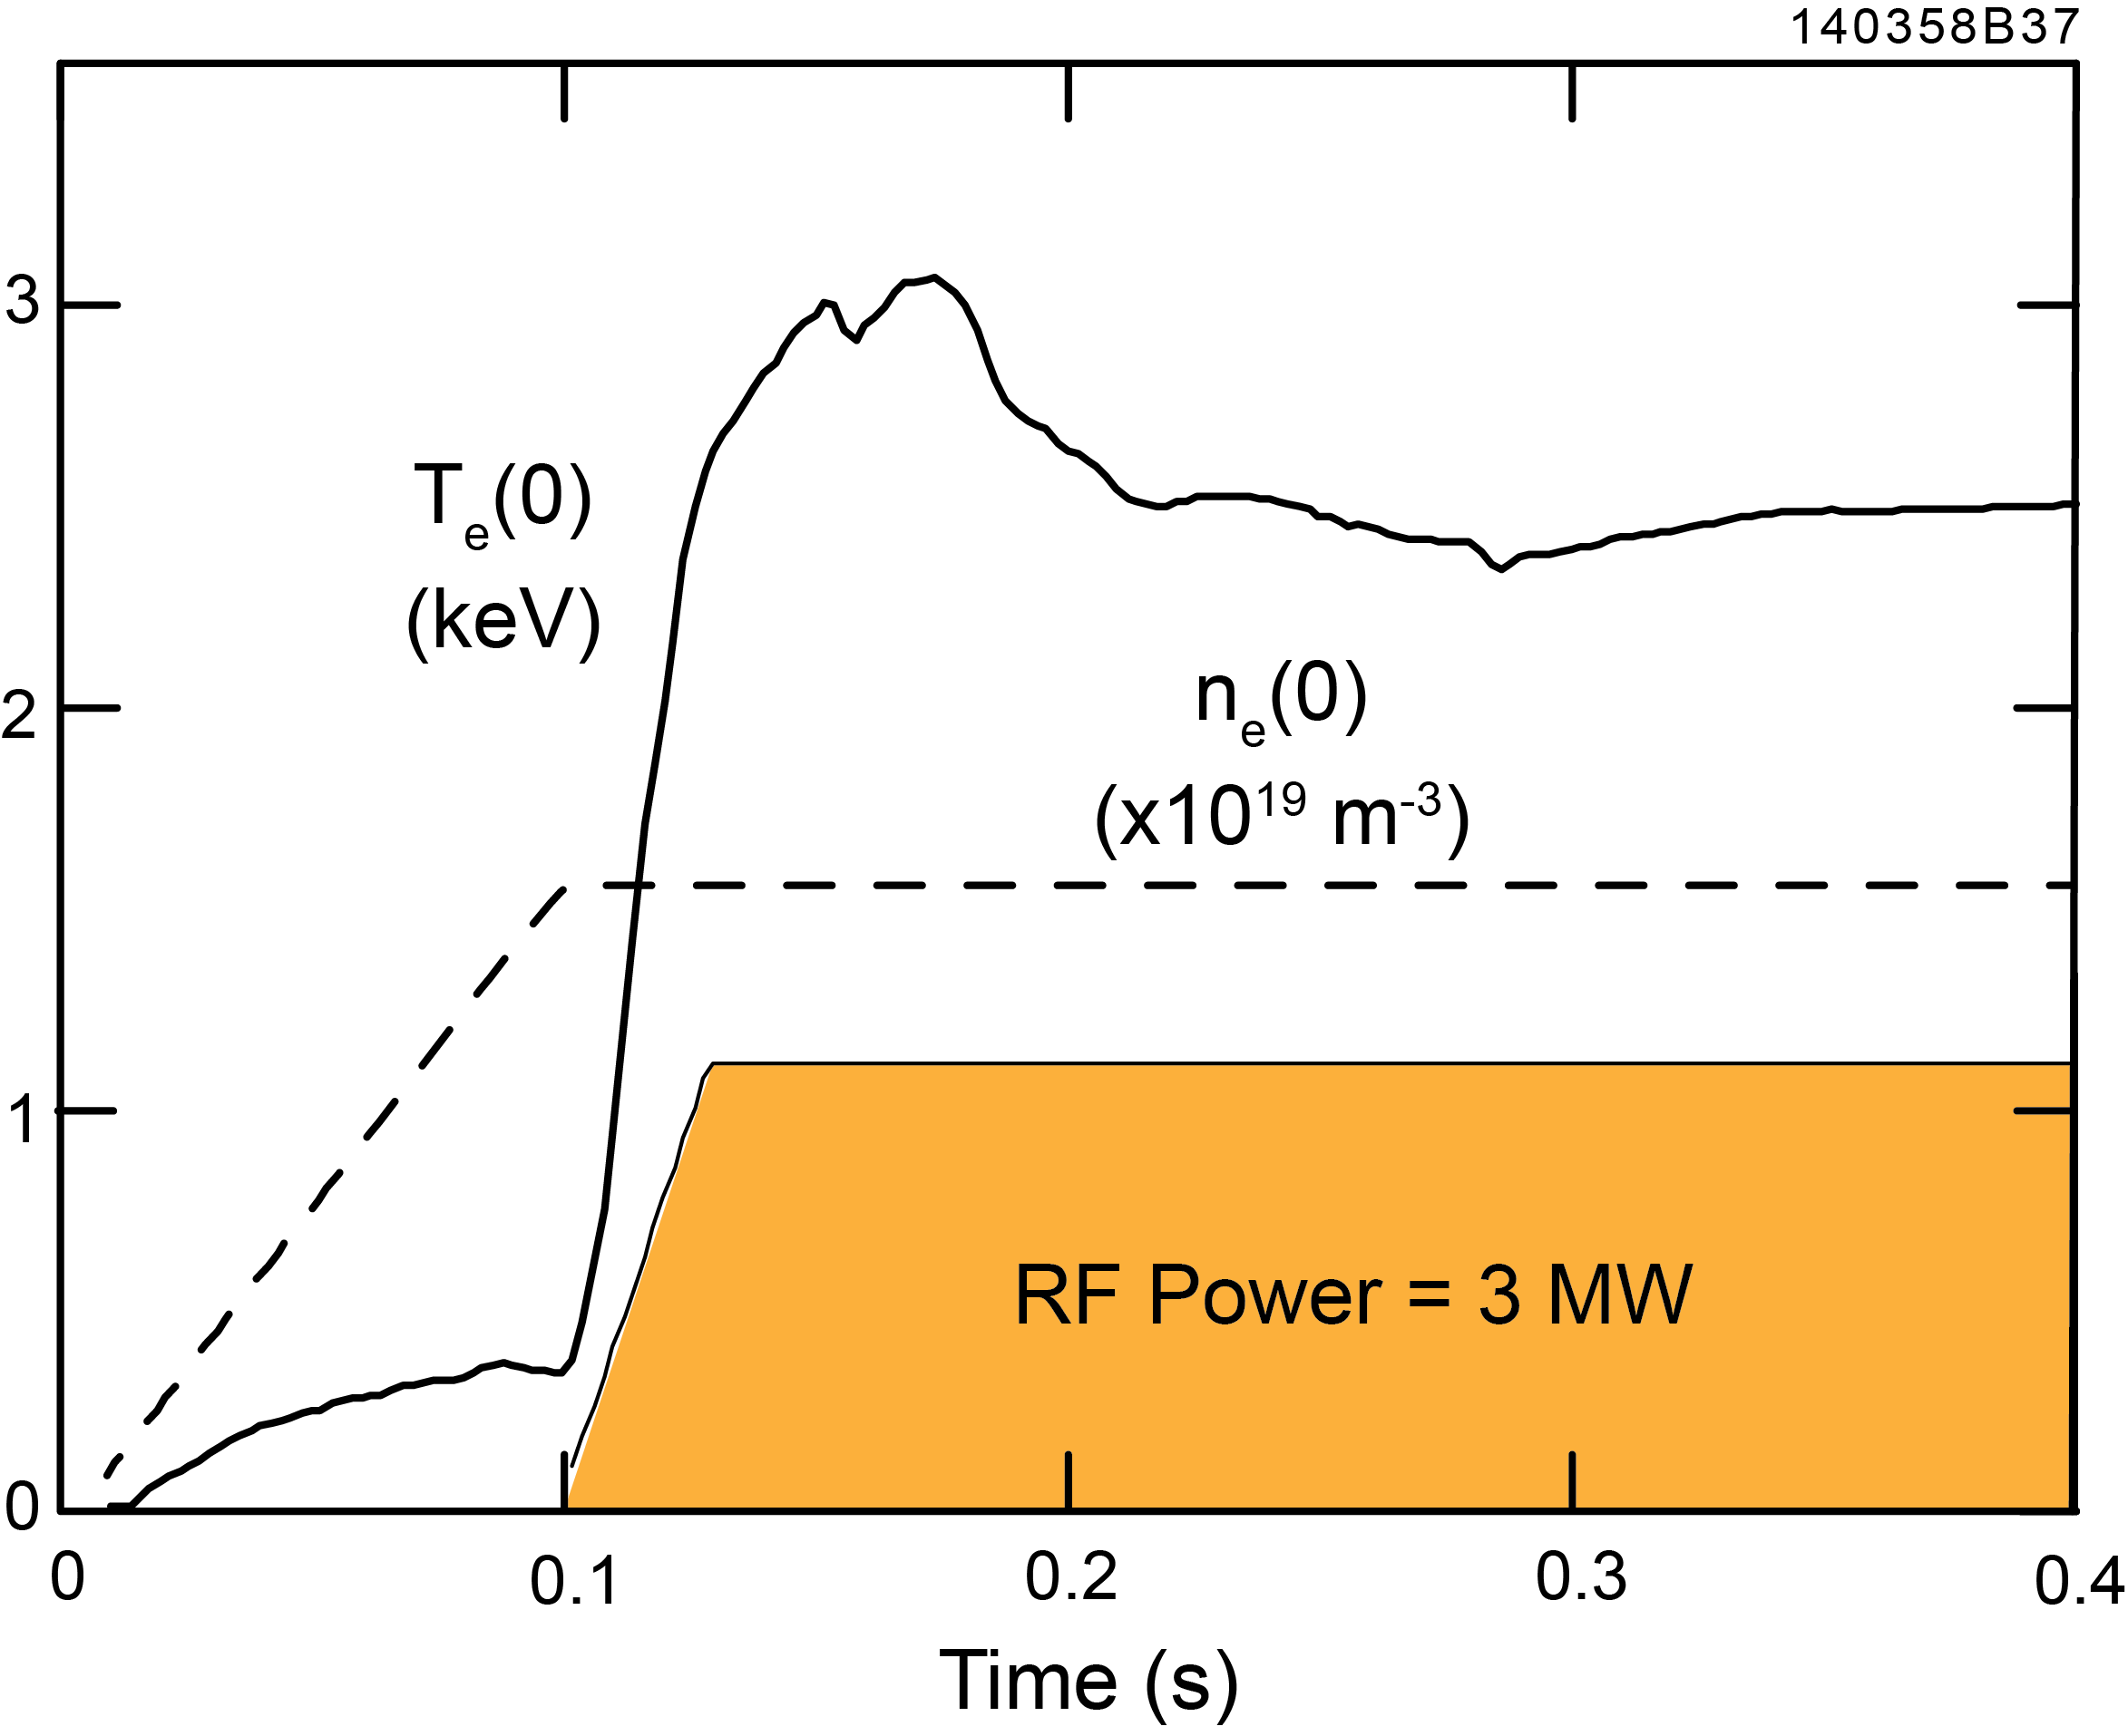
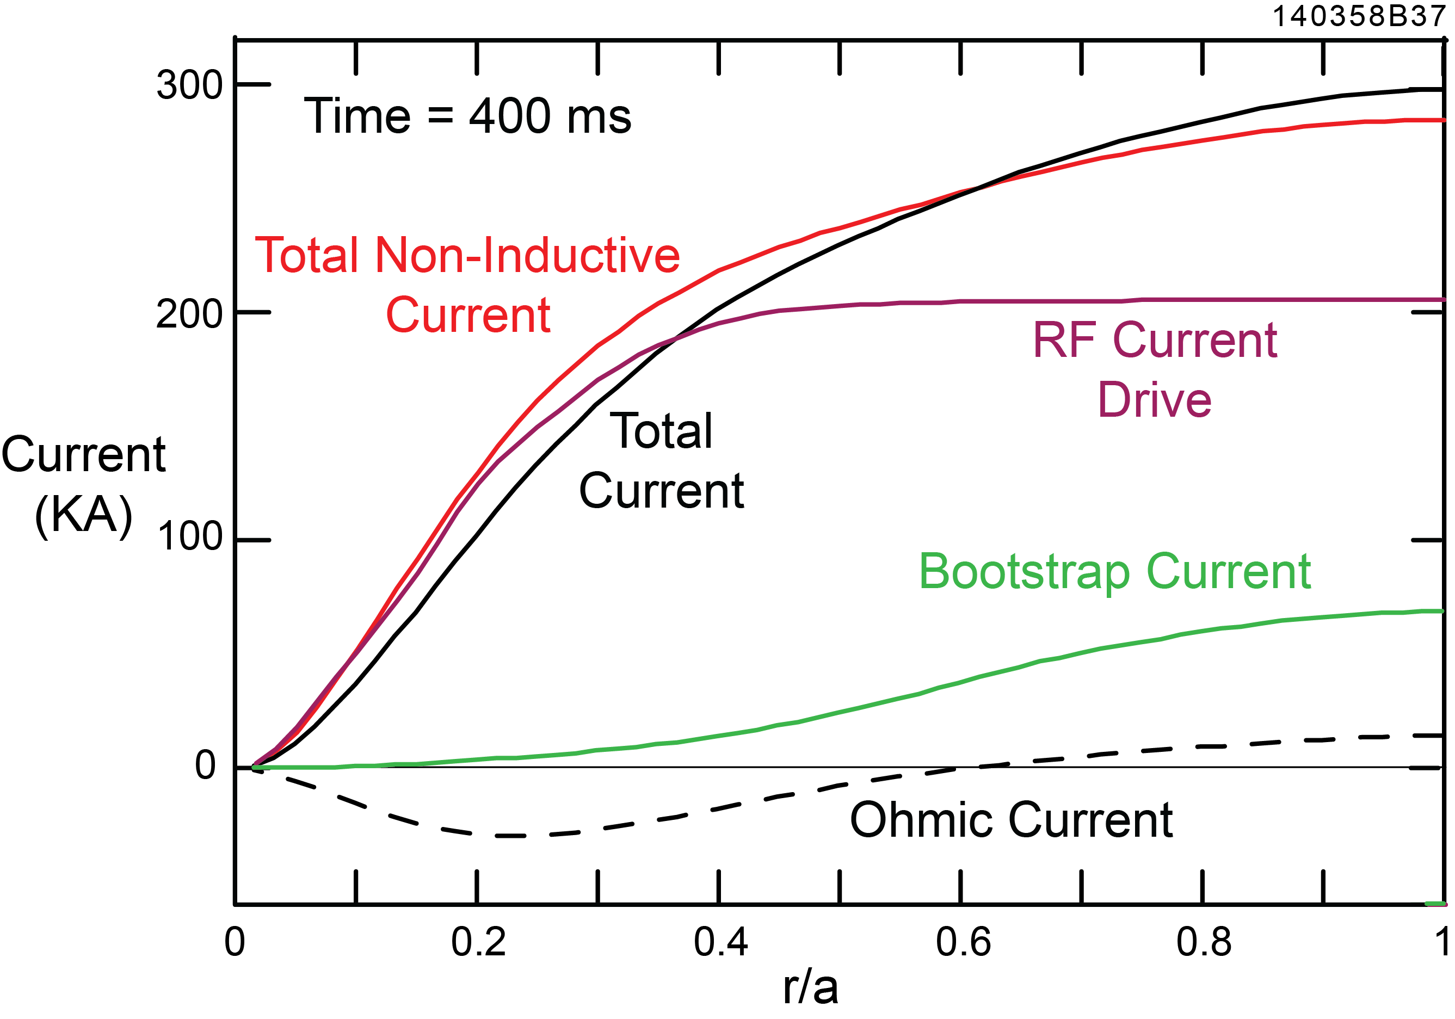
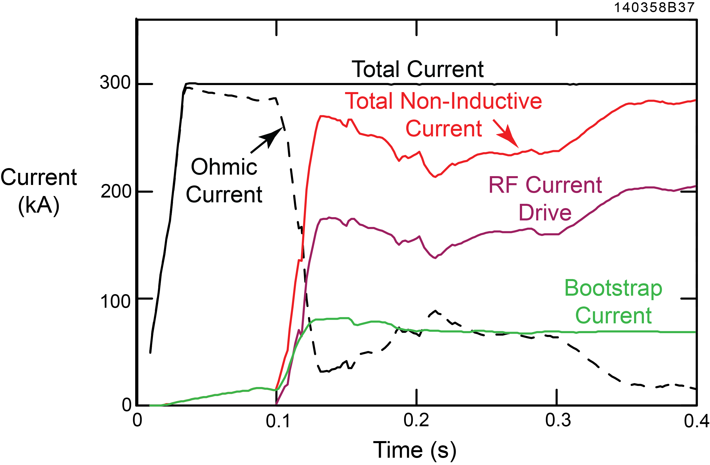
Simulation for B_{T}(0) = 0.75 T NSTX-U plasma predicts
f_{NI} ≥ 1 probably achievable with P_{rf} ~ 3 MW
At 400 ms:
RF current drive = 205 kA
Bootstrap current = 70 kA
Increasing P_{rf} to 4 MW yields a NI current of 400 kA

Slide 17
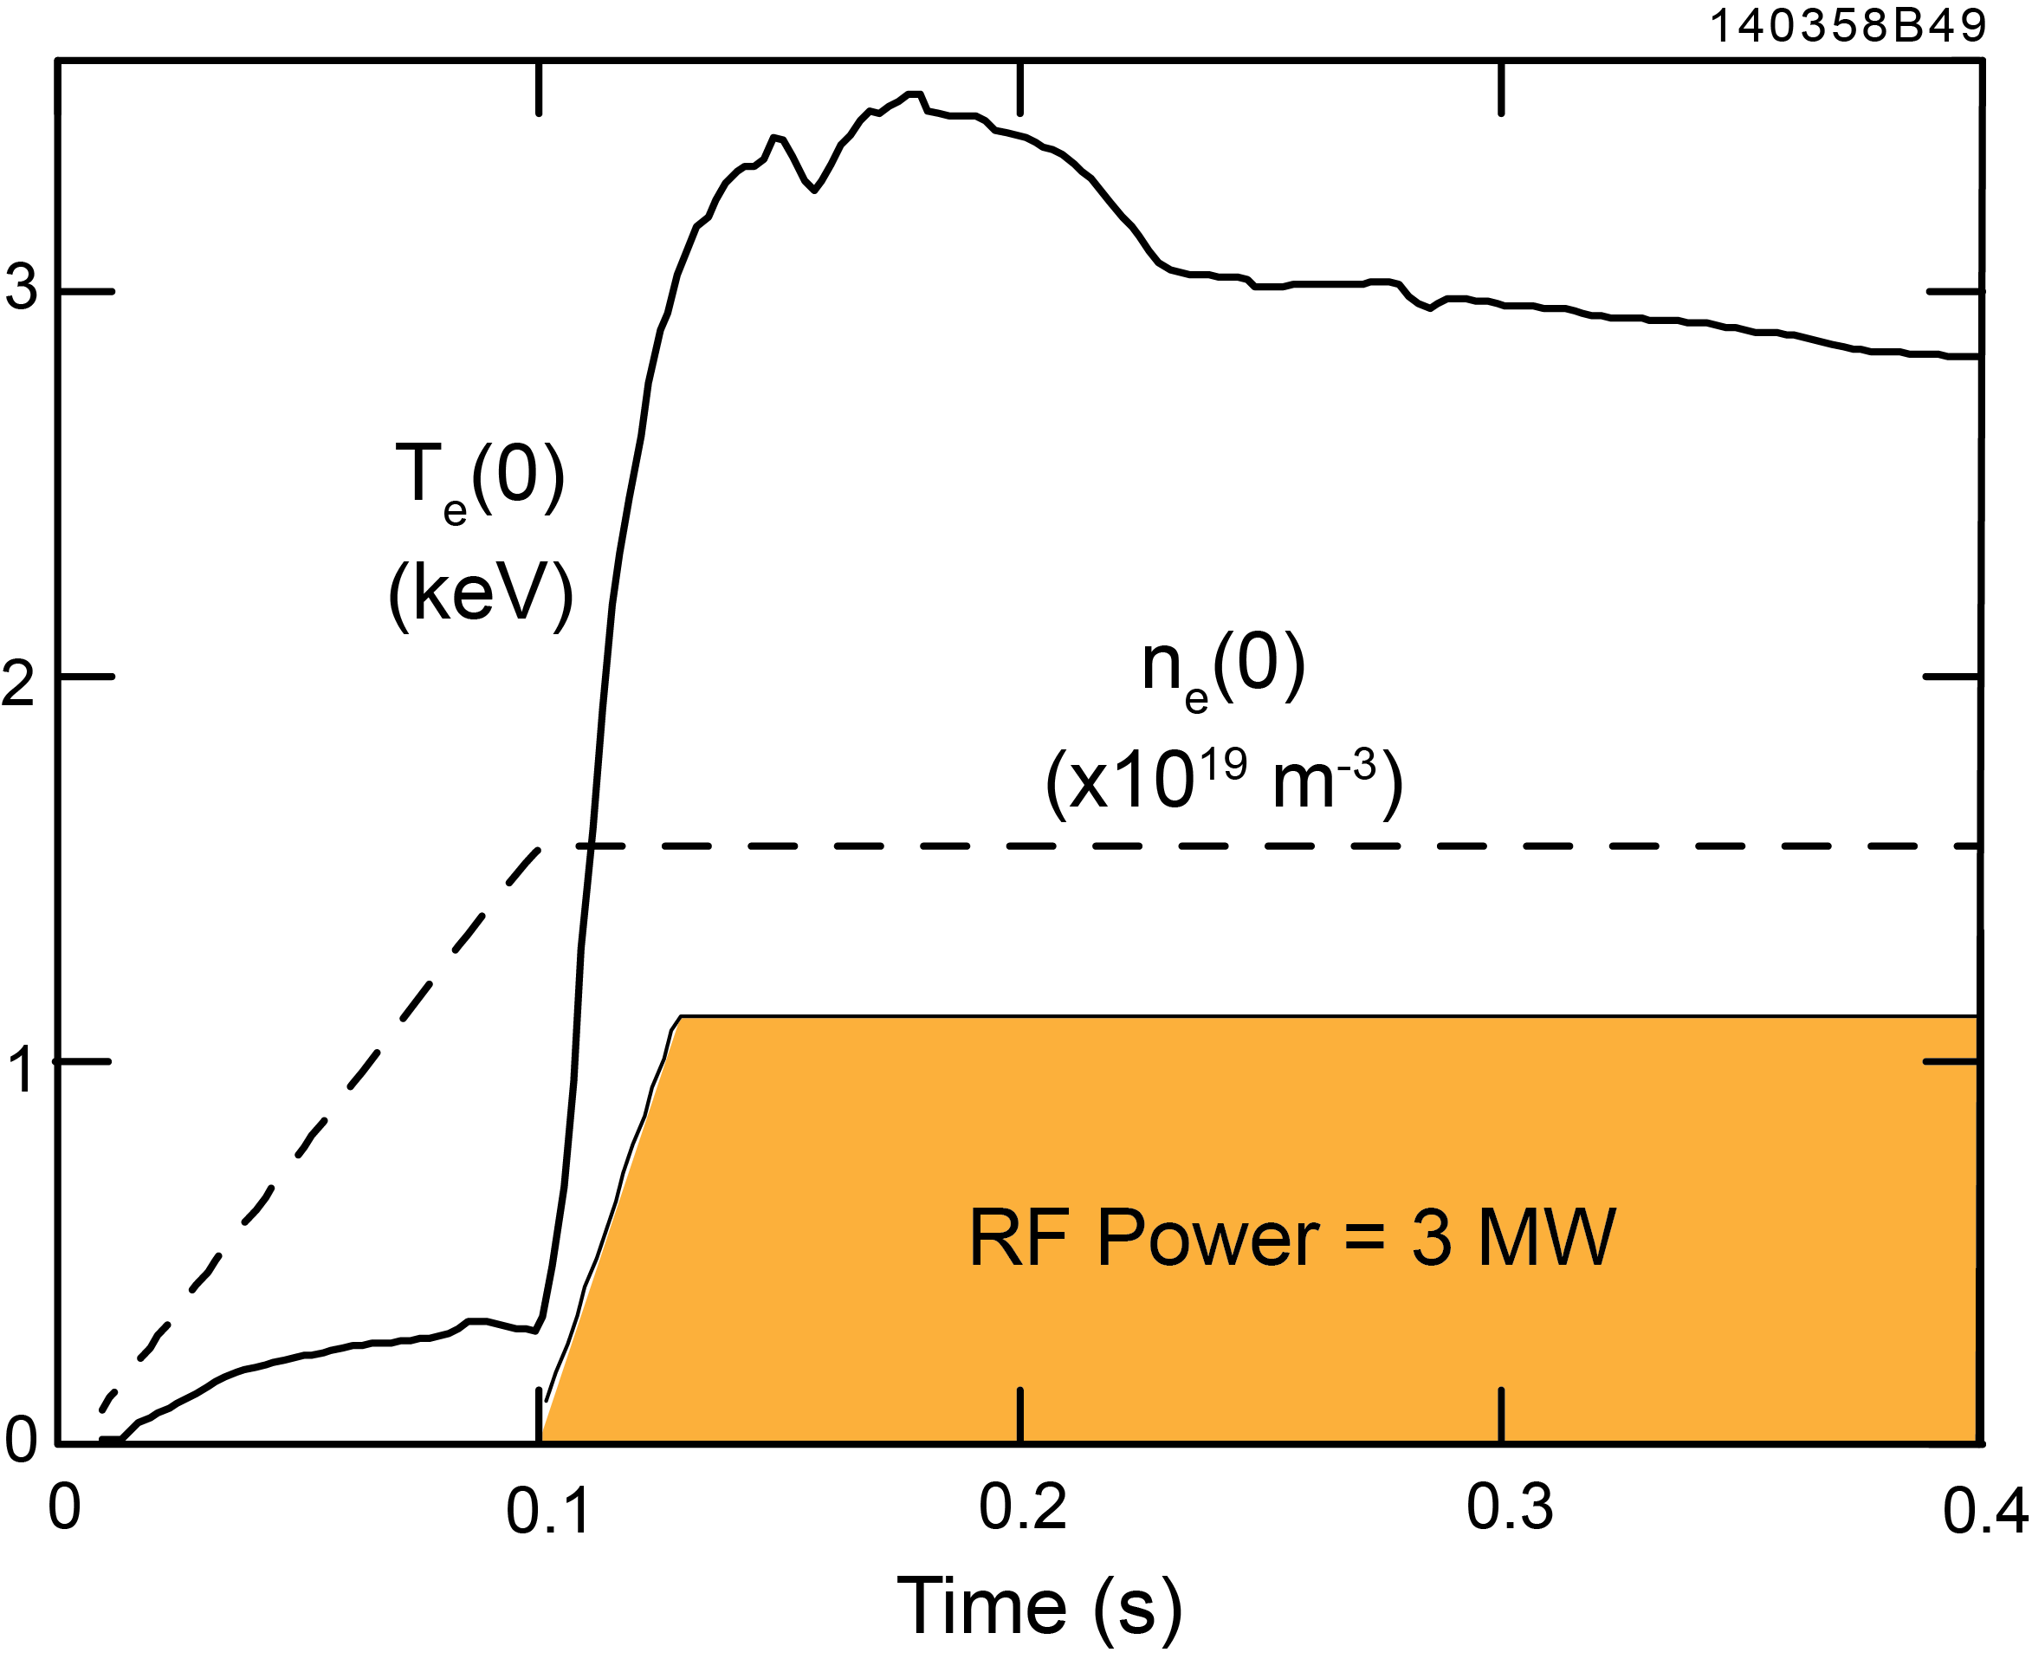
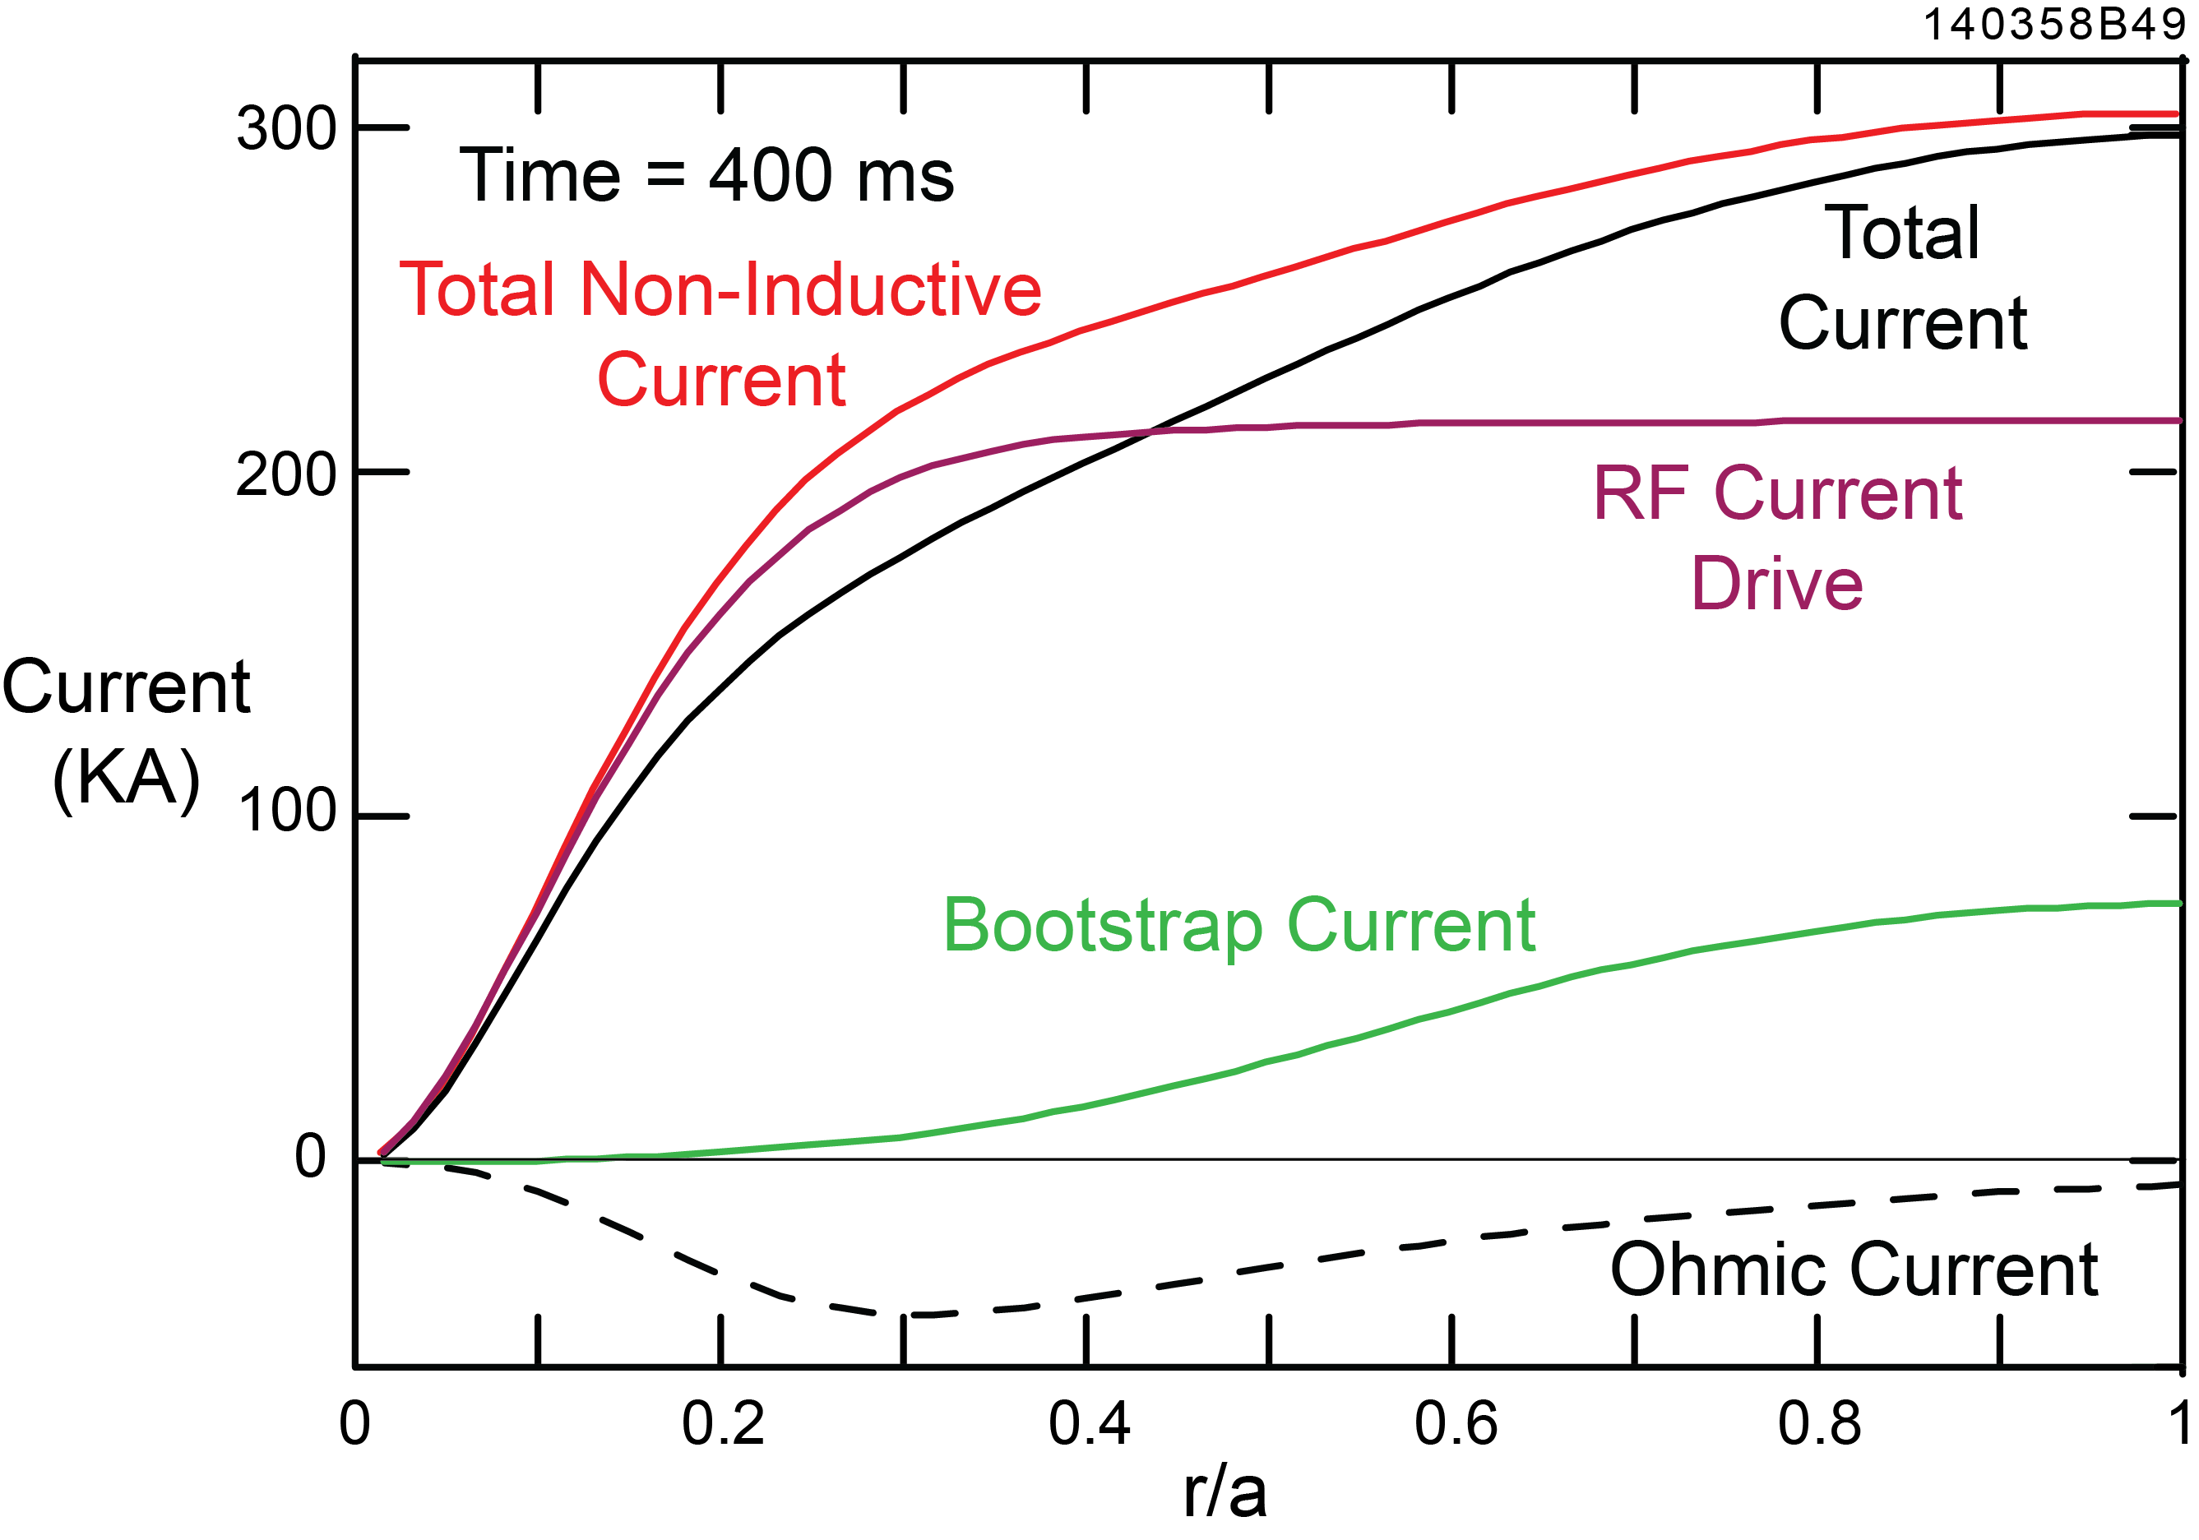
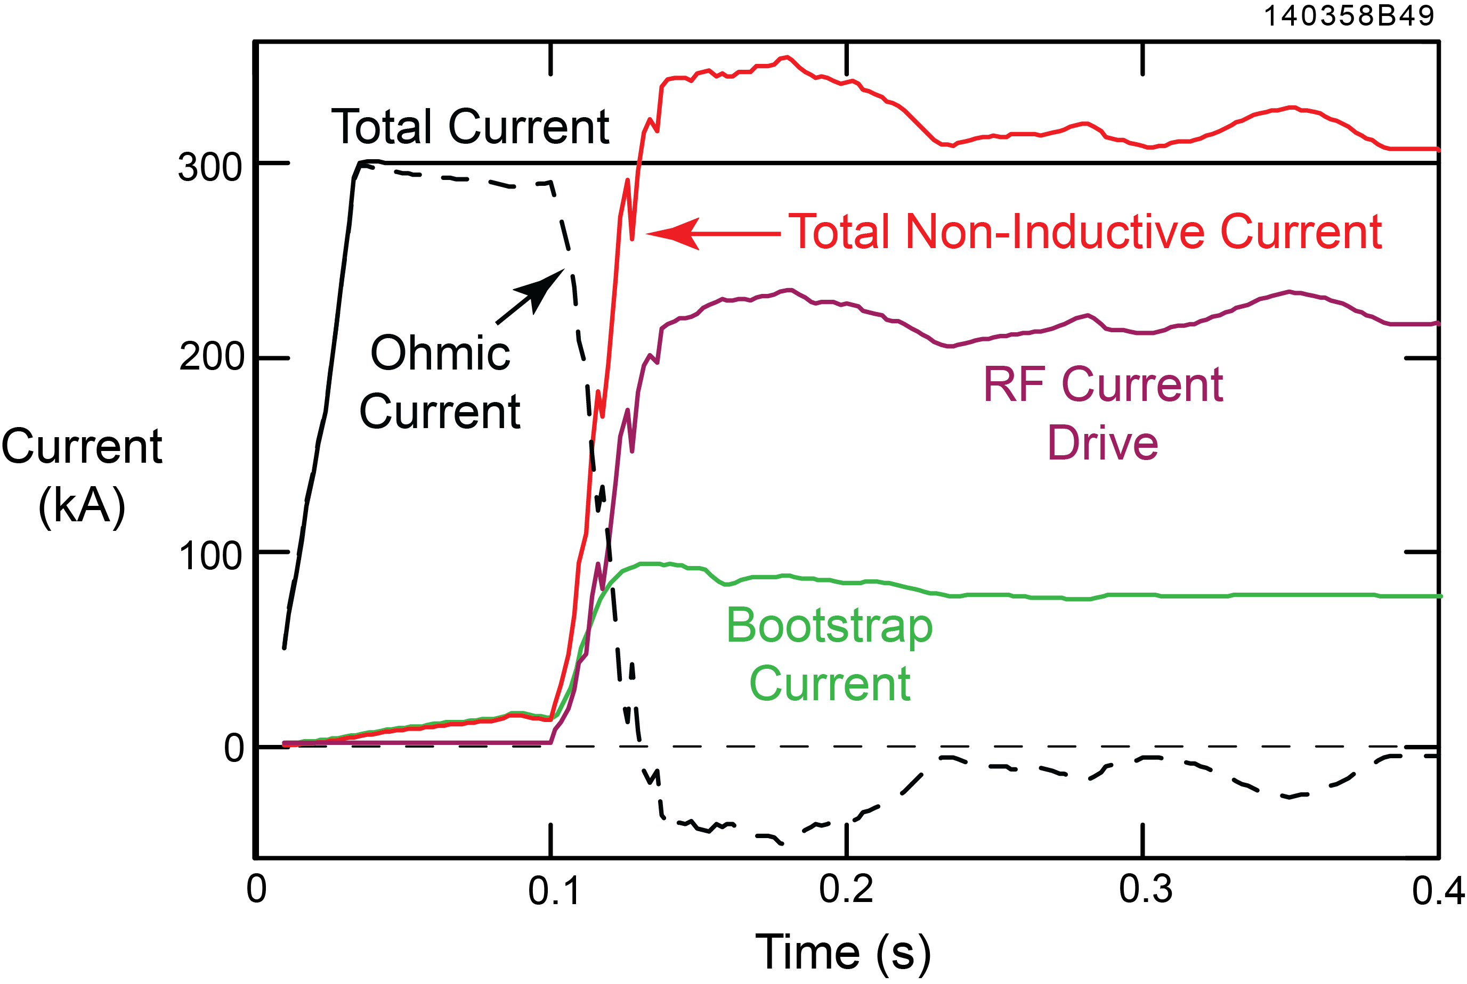
Simulation for B_{T}(0) = 1.0 T NSTX-U plasma predicts
f_{NI} ≥ 1 is achievable with P_{rf} ~ 3 MW
At 400 ms:
RF current drive = 220 kA
Bootstrap current = 80 kA
Increasing P_{rf} to 4 MW yields a NI current of 410 kA

Slide 18
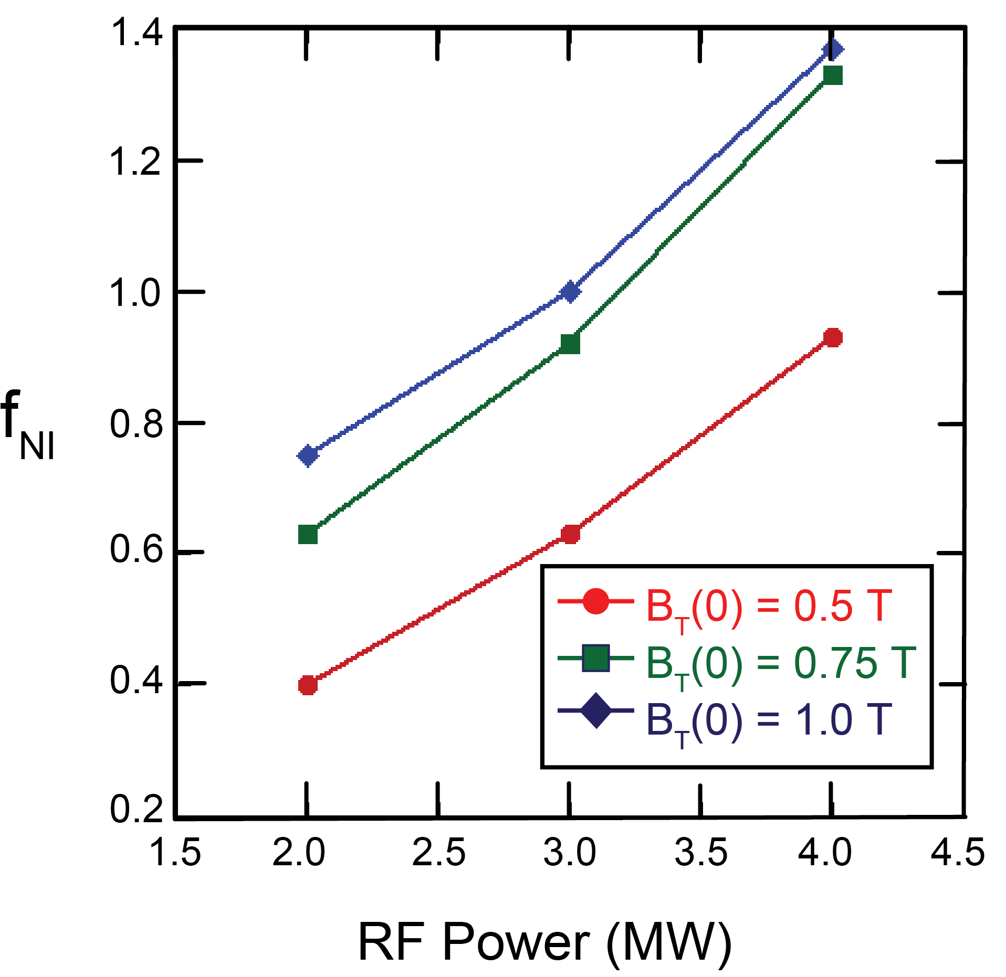
For the same P_{rf}, f_{NI} improved significantly when B_{T}(0) was increased from 0.5 to 0.75 T
Much smaller improvement in f_{NI} when B_{T}(0) was increased from 0.75 T to 1 T, compared to f_{NI} increase when B_{T}(0) was increased froim 0.5 to 0.75T
When P_{rf} was increased from
2 to 4 MW, the relative improvement in f_{NI} became smaller when B_{T}(0) was increased from 0.75 T to 1 T

Slide 19
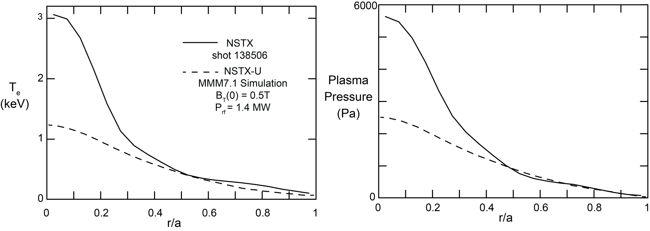
Simulations using MMM7.1 transport model show significant disagreement with NSTX shot 138506
Simulation of an I_{p} = 300 kA plasma using MMM7.1 transport model with similar B_{T}(0) and P_{rf} to NSTX shot 138506 predicts much lower T_{e}(0) and central plasma pressure than was obtained in experiment
Simulation using MMM7.1 transport model also predicts much lower FW current drive and bootstrap current than attained in shot 138506

Slide 20
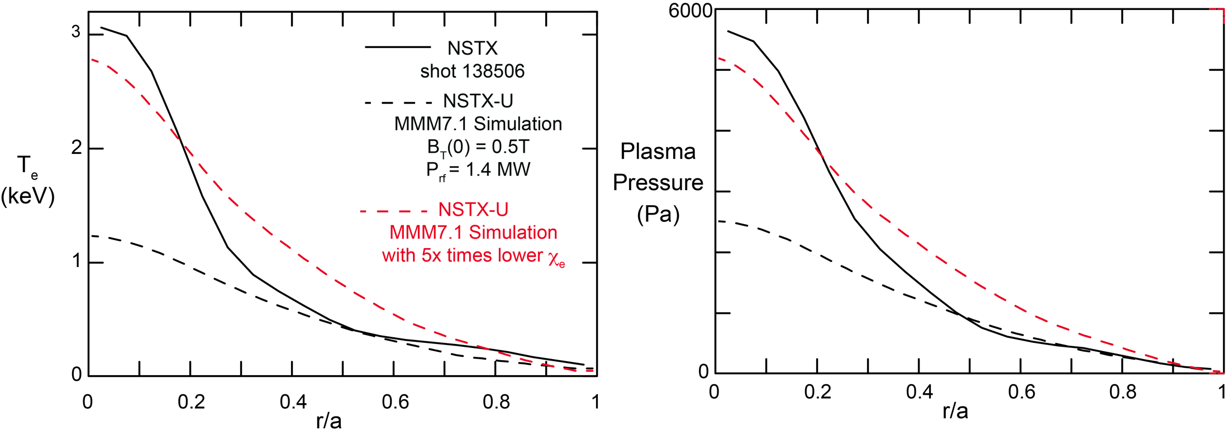
Simulation with 5 times lower electron diffusivity gives better match to T_{e}(0) in NSTX shot 138506
Simulation with 5 times lower electron diffusivity better matches T_{e}(0) and central pressure on NSTX shot 138506, but poorer match at r/a ~ 0.5
Appears core transport in the FW-heated I_{p} = 300 kA discharge is much lower than in the NBI-heated I_{p} = 300 kA discharge

Slide 21
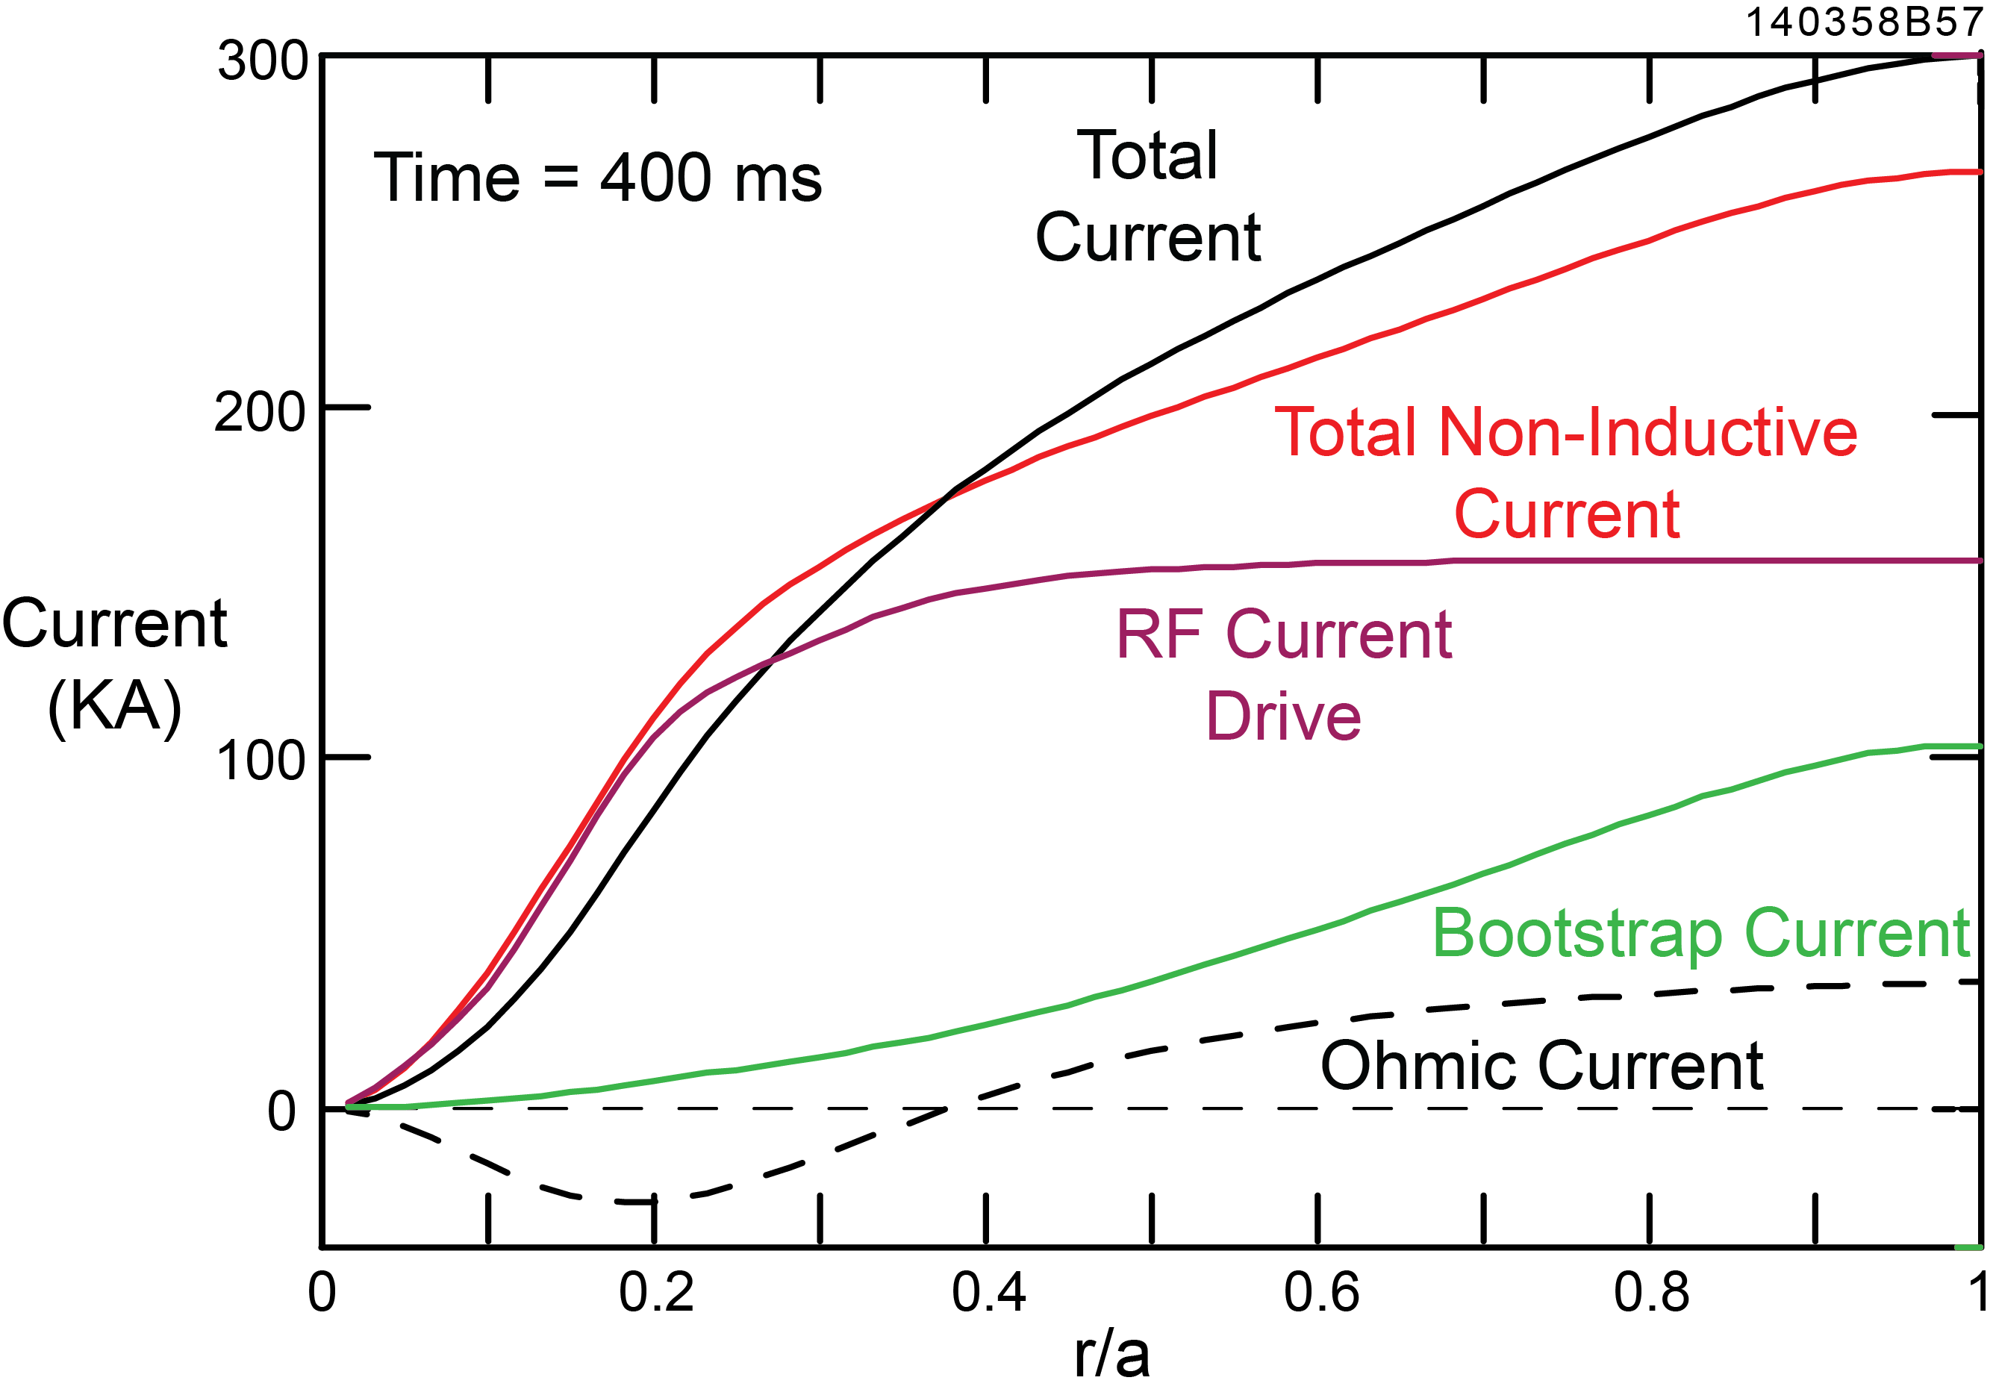
Simulation with B_{T}(0) = 0.5 T, P_{rf} = 3 MW and 5 times lower electron diffusivity predicts f_{NI} ~ 1
At 400 ms:
RF current drive = 160 kA
Bootstrap current = 105 kA

Slide 22
Summary
TRANSP simulations, using MMM7.1 transport model, were run for
FW-heated I_{p} = 300 kA NSTX-U plasmas with B_{T}(0) = 0.5, 0.75
and 1.0 T and P_{rf} = 2, 3 and 4 MW
For the same P_{rf}, f_{NI} improved significantly when B_{T}(0) was
increased from 0.5 to 0.75 T
f_{NI}=1 should be achievable with P_{rf} ~ 3 MW in B_{T}(0) =1 plasma and
possibly in B_{T}(0) = 0.75 T plasma
Simulation using the MMM7.1 model under conditions similar to
FW-heated NSTX shot 138506 predicts much lower T_{e}(0) than was
achieved experimentally:
  Suggests core transport lower in FW-heated plasma than in NBI-heated plasma,
  where MMM7.1 model predictions agree better with experiment
  Decreasing χ_{e} by 5x gave better agreement between predicted and measured
  T_{e}(0) in 138506 → possible that f_{NI} ~ 1 is achievable in a B_{T}(0) = 0.5 T NSTX-U
  plasma with P_{rf} ~ 3 MW

Slide 23
Future Work
Need transport model that gives better agreement to T_{e}(R) profile
obtained in NSTX shot 138506 in order to project performance of FW heating and current drive in NSTX-U
Simulations will be run with a density profile that better matches NSTX shot 138506
Study the effect of the timing and ramp rate of P_{rf} on f_{NI}

