Slide 1
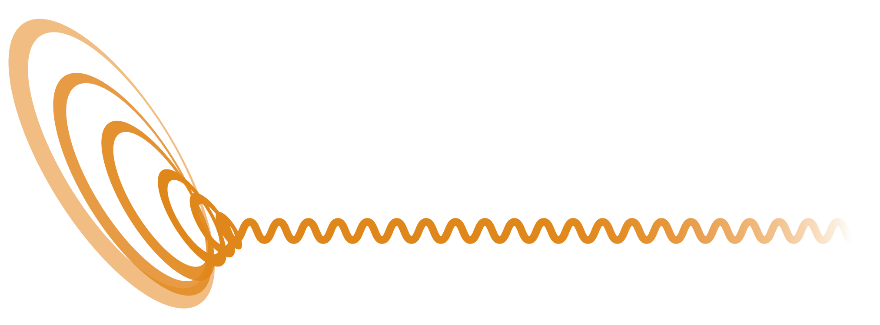
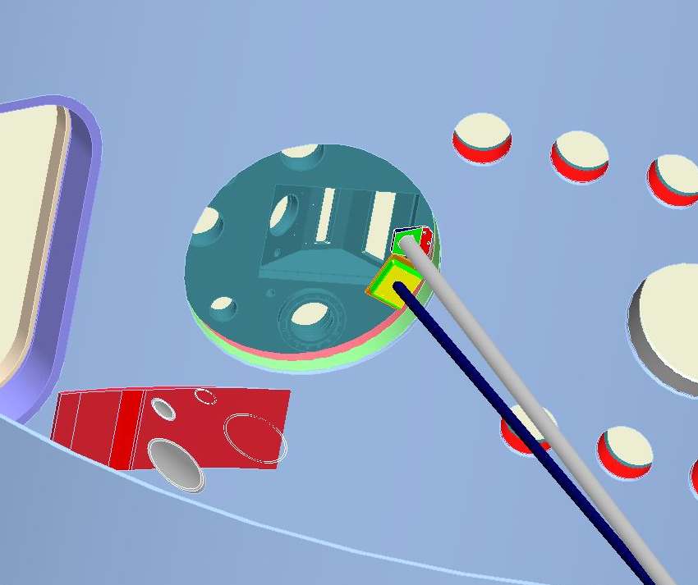
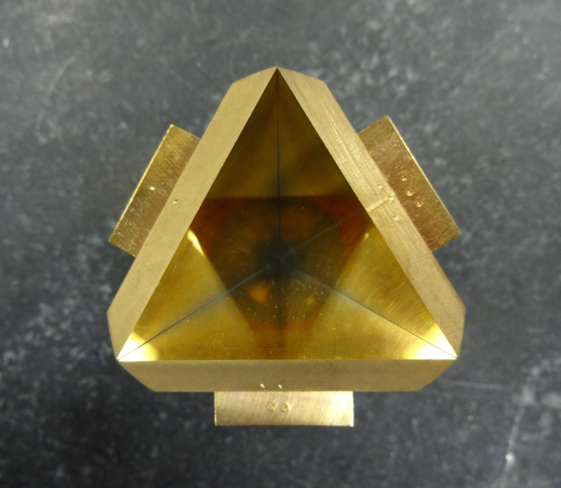
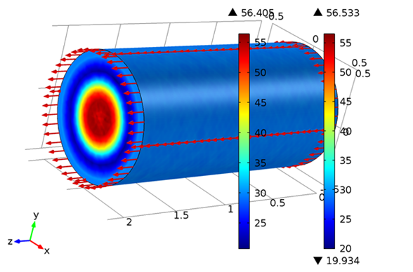
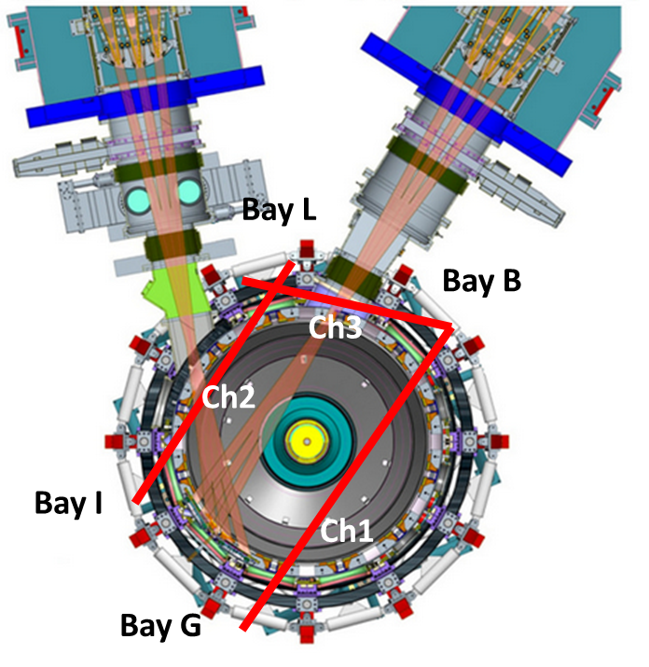
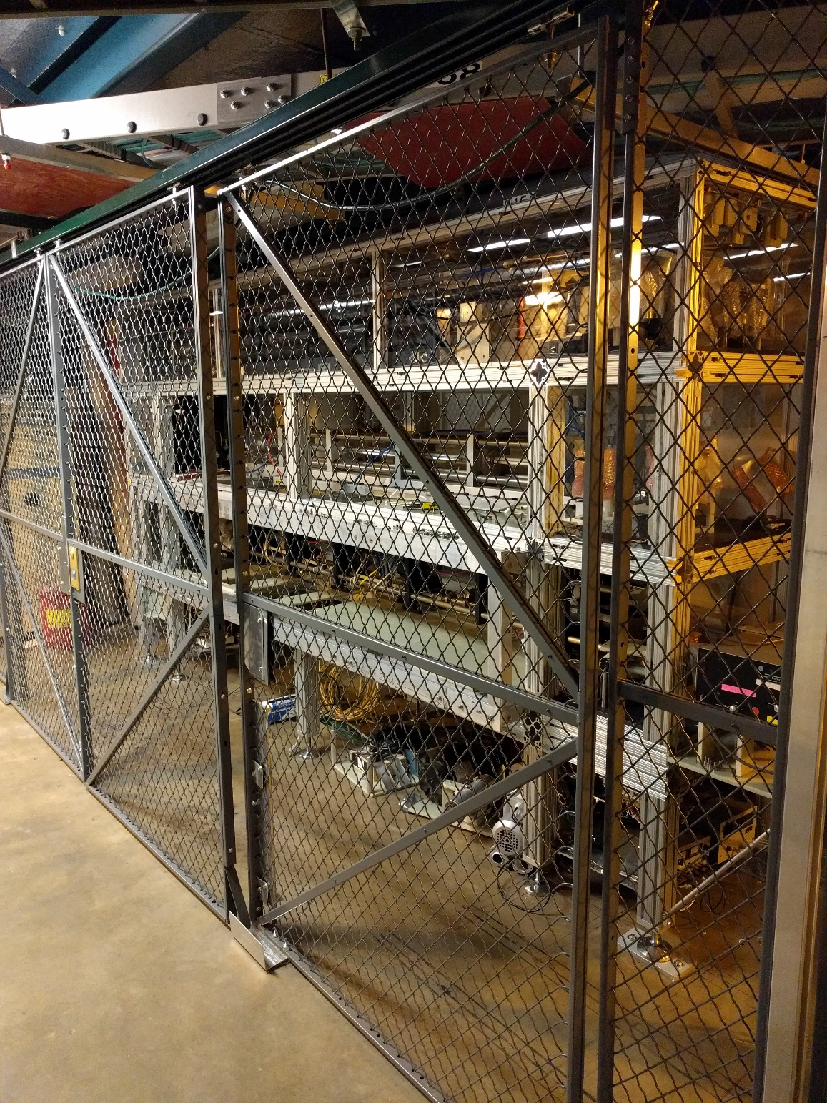
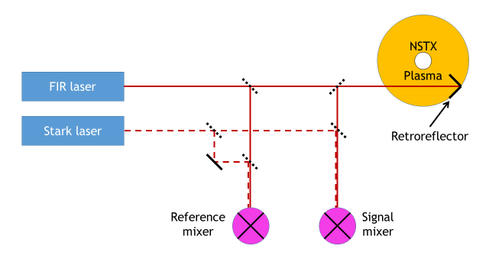
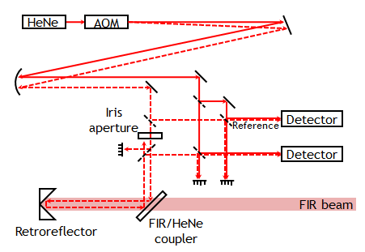
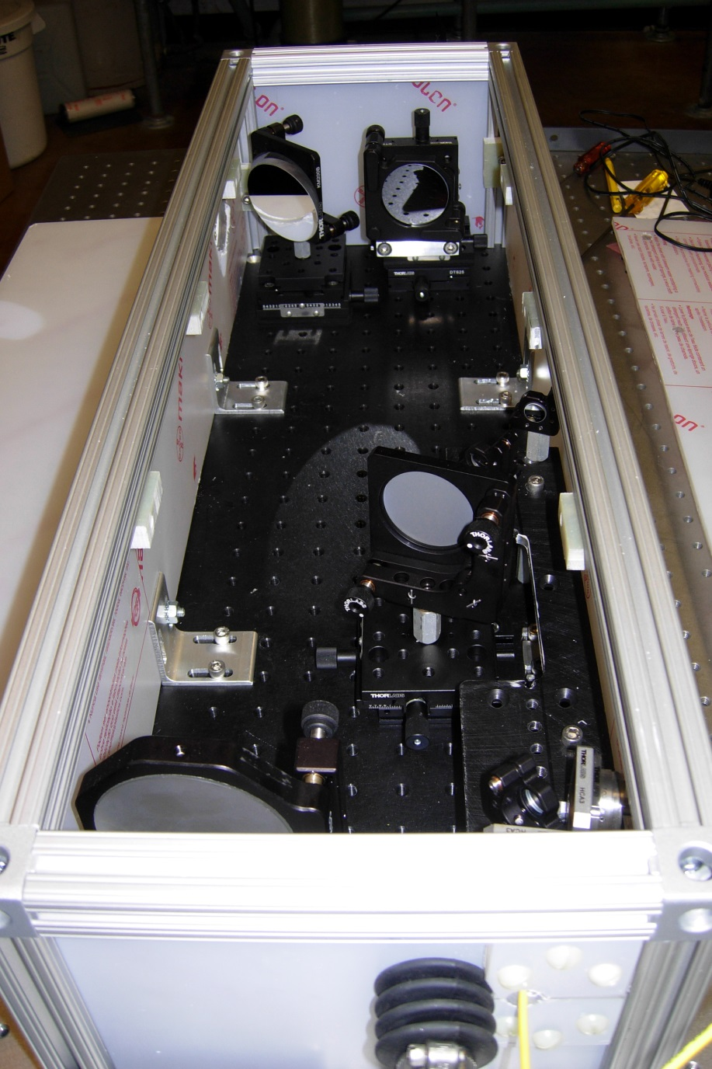
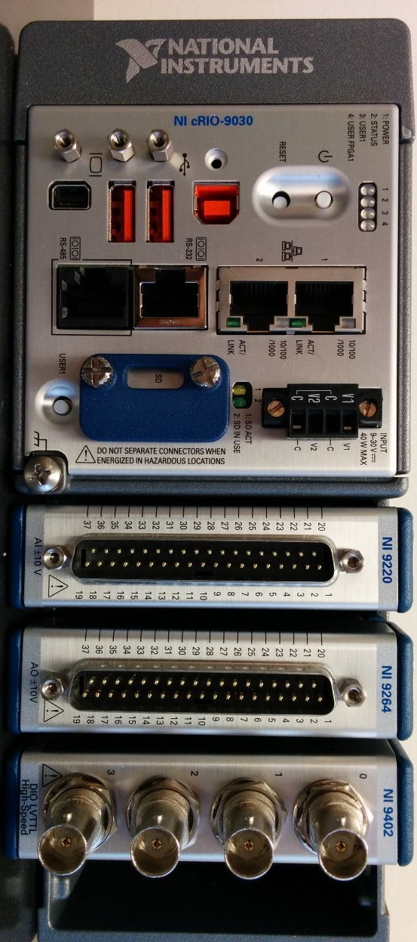
Progress on the FIReTIP diagnostic on NSTX-U
E.R. Scott¹, R. Barchfeld¹, P. Riemenschneider¹, C.M. Muscatello², M. Sohrabi¹, C.W. Domier¹, Y. Ren³, R. Kaita³,
N.C. Luhmann, Jr¹
¹University of California, Davis, ²General Atomics, ³Princeton Plasma Physics Laboratory
Work supported in part by U.S. DOE Grant DE-FG02-99ER54518 and DE-AC02-09CH1146
Introduction
Vibration compensation
Far-infrared Tangential Interferometer/Polarimeter (FIReTIP) system on NSTX-U is intended to provide robust, line-averaged electron density measurements
FIReTIP consists of three optically-pumped 119 µm methanol lasers; one can be tuned via Stark broadening for uniquely high intermediate frequencies and time resolutions
One major goal is to be incorporated into NSTX-U Plasma Control System (PCS) for real-time plasma density feedback control
Front-end optics mounted to Bay G shape and position the beam going into the plasma
An internal retroreflector located near Bay B facilitates double-pass measurements
Both front-end optics and internal retroreflector are hard-mounted to the NSTX-U vacuum vessel
Sensitivity to vibrational effects are mitigated with a 633 nm interferometer; due to the short wavelength, only the movement of the retroreflector and front-end optics are measured
An FPGA is used to subtract vibrational effects from the FIReTIP signal in real-time.
Second Neutral Beam Injector (NBI) required relocation of original FIReTIP system
Space requirements are further reduced with the retroreflector internally mounted to interior of Bay B port cover
Retroreflector made from polished 316 stainless steel and gold coated to increase HeNe reflectivity
Waveguide
Location of laser table outside NSTX-U test cell requires low-loss transport of FIReTIP probe beam
Atmospheric attenuation of -3.0 dB/m caused by water vapor over the 20+ meter waveguide run means significant power loss in probe, reference, and LO beams
Dielectric-coated waveguide (PTFE-coated aluminum) developed by UC Davis limits attenuation to -0.15 dB/m when filled with dry nitrogen
Bay B port cover
FIReTIP Ch1 beam path
Retroreflector
HeNe interferometer will measure magnitude and direction of any vibrations to be subtracted from the FIR signal in real-time using FPGA
Resulting vibration compensated signal to be used with plasma control system for real-time density feedback control
Beam paths
Waveguide simulation demonstrating low-loss HE₁₁ mode
FIR lasers
Front-end optics
Stark-effect FIR laser
Front-end optics focus a FIReTIP probe beam onto retroreflector while passing through a Bay G launch tube without clipping
Optics also shape 633 nm HeNe laser beam to allow the beam to pass back through optics box and recouple into fiber optics
High resistivity silicon wafer coated with alternating layers of ZnSe and ThF₄ reflects 99+% of HeNe beam with transmitting 80+% of FIR beam, allowing for collinear propagation through optics box to retroreflector
Launching mirror
CO₂ laser
FIR/HeNe coupler
I/Q mixer
I/Q mixer
CO₂ laser power supply
Main interferometer channel (Ch 1) between Bay G and Bay B for core plasma density will also be used for real-time density feedback control of the NSTX-U plasma
Two additional channels to measure edge and core density fluctuations in future upgrades
Lasers are housed in an enclosure external to NSTX-U test cell.
Laser paths are fully enclosed in dry air or nitrogen to reduce losses due to absorption by water vapor
Waveguide entrance
Corrected density
Presented as part of the proceedings of the 58th Annual Meeting of the APS Division of Plasma Physics in San Jose, CA, Oct 31st - Nov 4th, 2016

