Slide 1



Identification of multi-mode plasma response and extraction of plasma transfer function in tokamaks
Z.R. Wang¹
Y.Q. Liu², J.-K. Park¹, M.J. Lanctot³, C. Paz-Soldan³,
N. Logan¹,Y.W. Sun⁴, J. Menard¹, L. Cui¹ and R. Nazikian¹
        1) Princeton Plasma Physics Laboratory, Princeton, NJ 08543, USA
        2) CCFE Culham Science Centre, OX14 3DB, UK
        3) General Atomics, San Diego, CA 92186-5608, USA
        4) Institute of Plasma Physics, Chinese Academy of Science, Hefei, China
58th APS DPP Conference
San Jose, CA
Oct 31- Nov 4, 2016

Slide 2
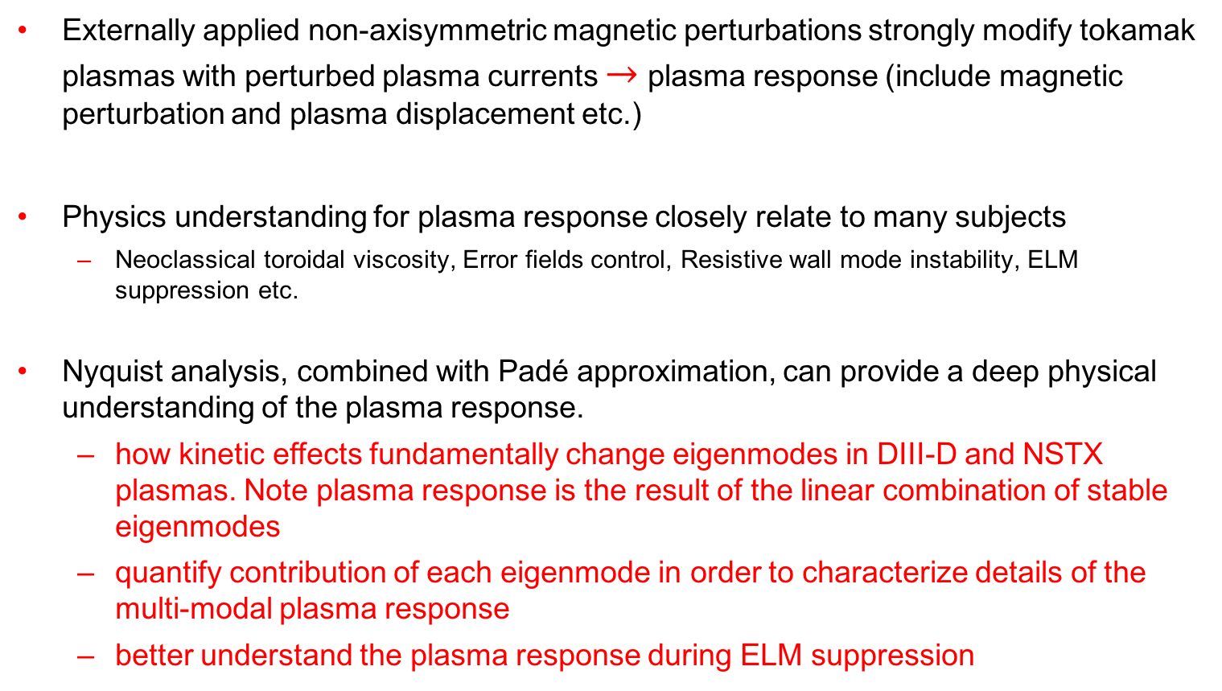
Motivation
Externally applied non-axisymmetric magnetic perturbations strongly modify tokamak plasmas with perturbed plasma currents $→$ plasma response (include magnetic perturbation and plasma displacement etc.)
Physics understanding for plasma response closely relate to many subjects
  Neoclassical toroidal viscosity, Error fields control, Resistive wall mode instability, ELM suppression etc.
Nyquist analysis, combined with Padé approximation, can provide a deep physical understanding of the plasma response.
  how kinetic effects fundamentally change eigenmodes in DIII-D and NSTX plasmas. Note plasma response is the result of the linear combination of stable eigenmodes
  quantify contribution of each eigenmode in order to characterize details of the multi-modal plasma response
  better understand the plasma response during ELM suppression
Z. R. Wang, M. J. Lanctot et al PRL 2015

Slide 3





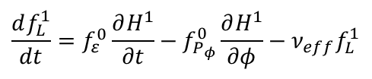


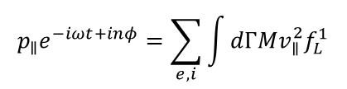
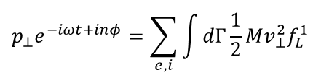



Linear Simulation of Plasma Response:
Hybrid Drift-Kinetic MHD Formulation (MARS-K)
MARS-K extends MARS-F and solves linearized MHD equations with perturbed kinetic pressure.
Fluid Part (MHD equations):
$$i\left(ω+nΩ\right)\vec{ξ}=\vec{v}+\left(\vec{ξ}⋅\vec{∇}Ω\right)R^{2}\vec{∇}ϕ$$
$$iρ\left(ω+nΩ\right)\vec{v}=−\vec{∇}⋅\vec{p}+\vec{j}×{\vec{B}}_{0}+{\vec{J}}_{0}×\vec{b}+ρ\left[2Ω\hat{Z}×\vec{v} −\left(\vec{v}⋅\vec{∇}Ω \right)R^{2}\vec{∇}ϕ\right]−\vec{∇}⋅\left(ρ\vec{ξ}\right)Ω\hat{Z}×{\vec{V}}_{0}$$
$$i\left(ω+nΩ\right)\vec{b}=\vec{∇}×\left(\vec{v}×{\vec{B}}_{0}\right)+\left(\vec{b}⋅\vec{∇}Ω\right)R^{2}\vec{∇}ϕ$$
Kinetic Model
Y.Q. Liu et al, PoP 2008
$$i\left(ω+nΩ\right)p=−\vec{v}⋅\vec{∇}P_{0}−ΓP_{0}\vec{∇}⋅\vec{v}$$
$$\vec{p}=p\overset{⃡}{I}+p_{∥}\vec{b}\vec{b}+p_{⊥}\left(\overset{⃡}{I}−\vec{b}\vec{b}\right)$$
$$\vec{j}=\vec{∇}×\vec{b}$$
replaced by kinetic pressure
Kinetic pressure $p_{∥}$ and $p_{⊥}$ couple with MHD equations
Applied field frequency
$$p_{∥}e^{−iωt+inφ}=\sum_{e,i}{\int{dΓMv_{∥}^{2}f_{L}^{1}}}$$
Coil equations:
$$\vec{∇}×\vec{b}={\vec{j}}_{coil}$$
$$\vec{∇}⋅{\vec{j}}_{coil}=0$$
$$p_{⊥}e^{−iωt+inφ}=\sum_{e,i}{\int{dΓ\frac{1}{2}Mv_{⊥}^{2}f_{L}^{1}}}$$
Resonant operator in $f_{L}^{1}$:
Applied field
frequency
Drift-kinetic equation:
Diamagnetic drift
$$\frac{df_{L}^{1}}{dt}=f_{ε}^{0}\frac{∂H^{1}}{∂t}−f_{P_{φ}}^{0}\frac{∂H^{1}}{∂φ}−ν_{eff}f_{L}^{1}$$
$$λ_{ml}=\frac{n\left[ω_{∗N}+\left({\hat{ε}}_{k}−3/2\right)ω_{∗T}+ω_{E}\right]−ω}{nω_{d}+\left[α\left(m+nq\right)+l\right]ω_{b}+nω_{E}−ω−iν_{eff}}$$
$H^{1}$: perturbed Lagrangian
Precession
drift
Bounce/Transit
EXB
Crook
Collisions
Ignore finite orbit width effect.
Drift kinetic effects can modify plasma response.

Slide 4

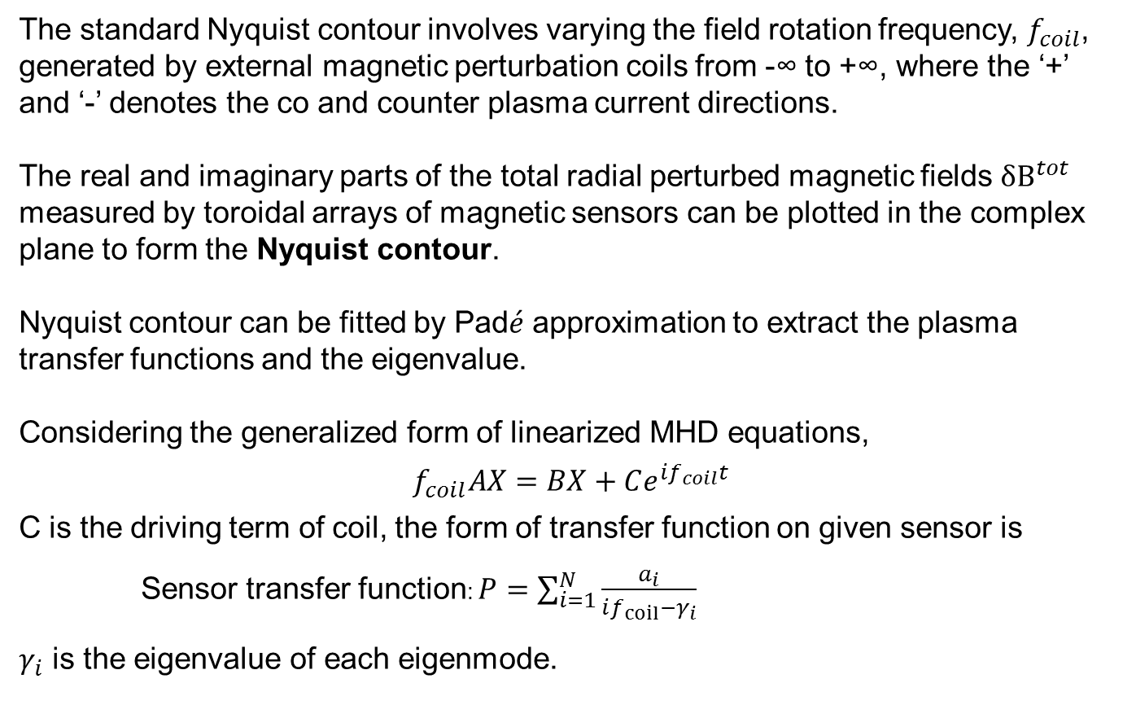
Nyquist Analysis and Pad$\acute{e}$ Approximation
The standard Nyquist contour involves varying the field rotation frequency, $f_{coil}$, generated by external magnetic perturbation coils from -∞ to +∞, where the ‘+’ and ‘-’ denotes the co and counter plasma current directions.
The real and imaginary parts of the total radial perturbed magnetic fields $δB^{tot}$ measured by toroidal arrays of magnetic sensors can be plotted in the complex plane to form the Nyquist contour.
Nyquist contour can be fitted by Pad$\acute{e}$ approximation to extract the plasma transfer functions and the eigenvalue.
Considering the generalized form of linearized MHD equations,
$$f_{coil}AX=BX+Ce^{if_{coil}t}$$
C is the driving term of coil, the form of transfer function on given sensor is
Sensor transfer function: $P=\sum_{i=1}^{N}{\frac{a_{i}}{if_{coil}−γ_{i}}}$
$γ_{i}$ is the eigenvalue of each eigenmode.

Slide 5
Nyquist Analysis of Kinetic Plasma Response

Slide 6
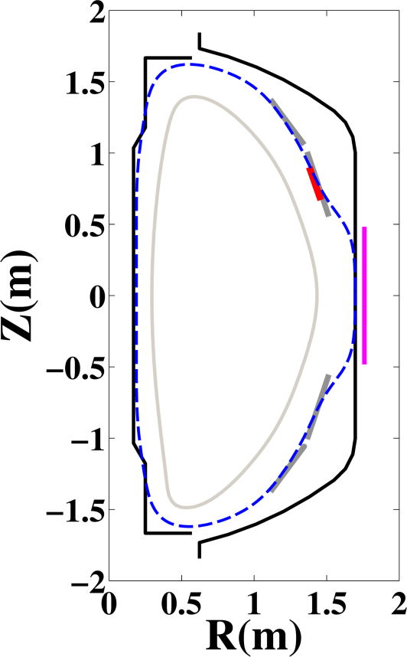
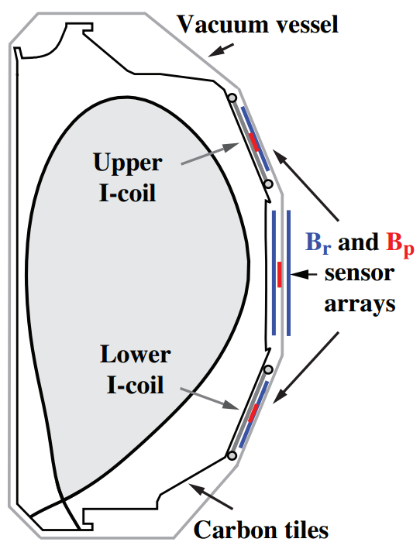


Frequency Scan of Plasma Response in DIII-D and NSTX with Different Coil Configurations
NSTX configuration
DIII-D configuration
Resistive
Wall (MARS)
Magnetic
sensor
Passive
plate
External
coil
MPID1A
MPID1B
Center stack casing
Resistive
Wall (MARS)
Vacuum vessel
Magnetic perturbation can be generated by I-coils in DIII-D and the external coil in NSTX.
By scanning the rotating frequency of external field, Nyquist contour can be formed by plotting the magnetic sensor measurement in complex plane.
NSTX-U

Slide 7
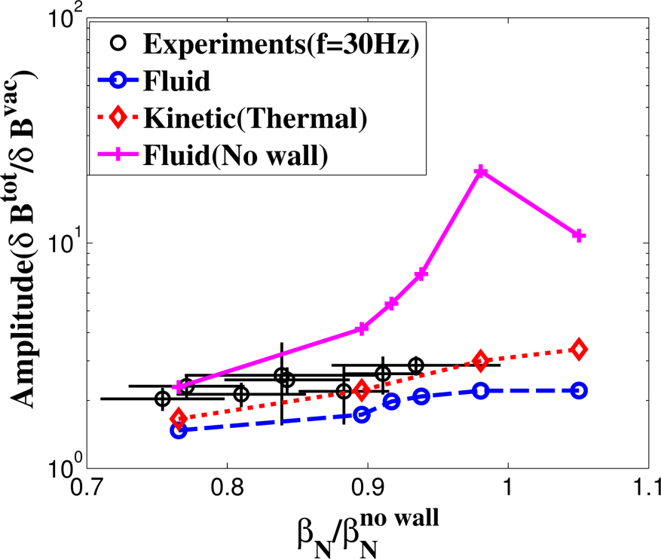
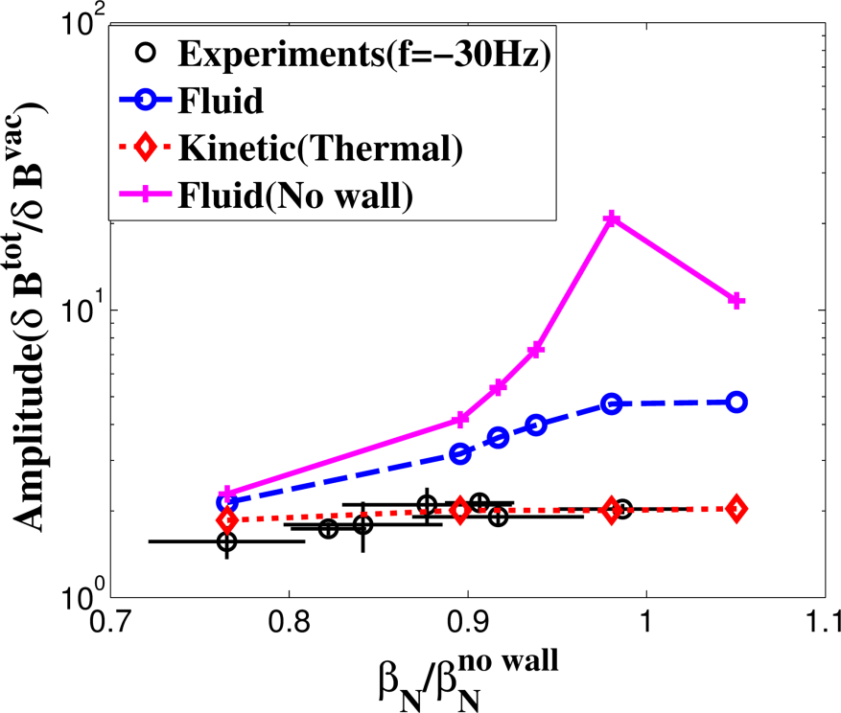
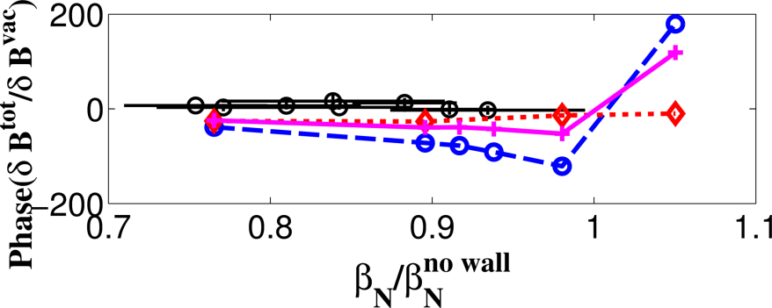
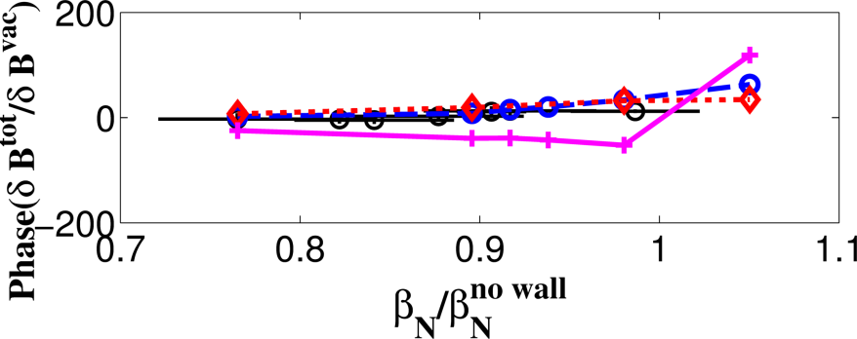


NSTX: Kinetic Plasma Response With Thermal Particles Shows Quantitative Agreement with Magnetic Sensor Measurements
The simulated plasma response is compared with experiments at upper radial magnetic sensor.
1) Fluid plasma response is solved by MARS-F
2) Kinetic plasma response is solved by MARS-K (include thermal ions and electrons).
3) Fluid plasma response is solved without resistive wall
$β_{N}^{no wall}$ ~ 4.75
$β_{N}^{no wall}$ ~ 4.75
Fluid
no wall
Fluid
no wall
NSTX f=30Hz
NSTX f= - 30Hz
Fluid
with wall
Kinetic
Fluid
with wall
Kinetic
NSTX-U

Slide 8
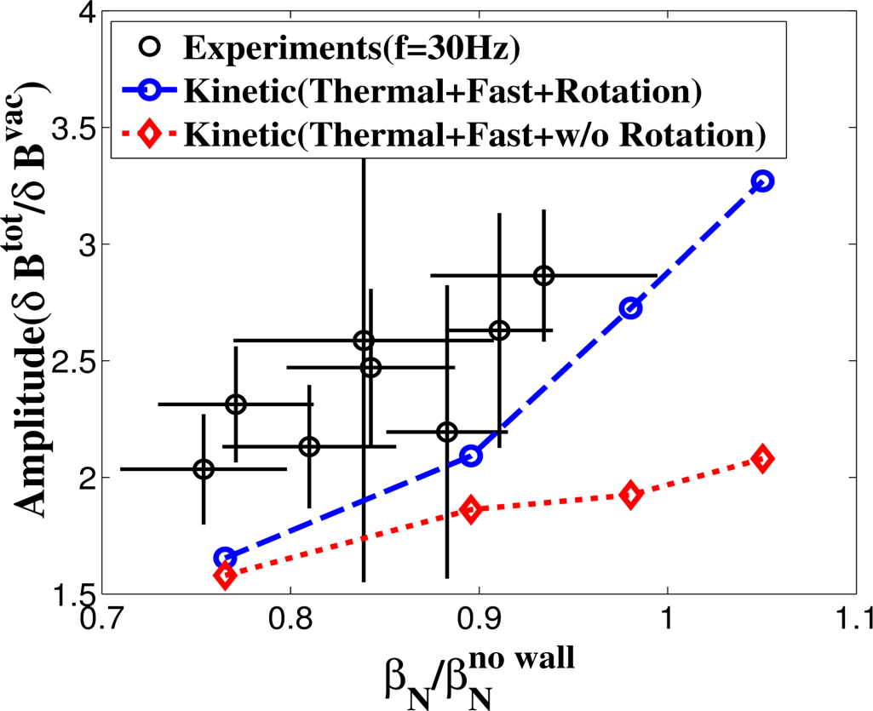
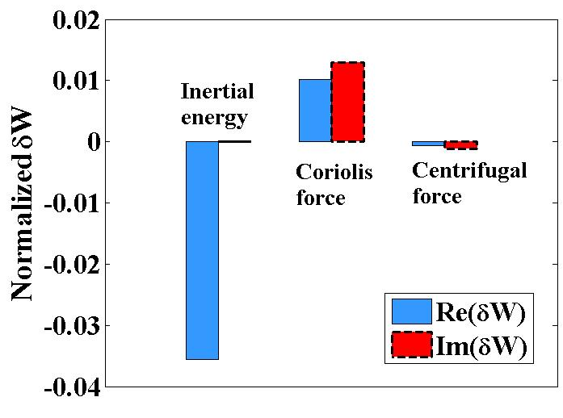
NSTX: Inertial Energy Plays a Destabilizing Role in NSTX Plasmas Response
Momentum equation:
$$iρ\left(ω+nΩ\right)\vec{v}=−\vec{∇}⋅\vec{p}+\vec{j}×{\vec{B}}_{0}+{\vec{J}}_{0}×\vec{b}+ρ\left[2Ω\hat{Z}×\vec{v} −\left(\vec{v}⋅\vec{∇}Ω \right)R^{2}\vec{∇}ϕ\right]−\vec{∇}⋅\left(ρ\vec{ξ}\right)Ω\hat{Z}×{\vec{V}}_{0}$$
Inertial
$β_{N}^{no wall}$ ~ 4.75
Coriolis force
Centrifugal force
(a.u.)
NSTX f=30Hz
With fluid flow
Without fluid flow
Inertial energy is negative and destabilizes the plasma which leads to larger amplification of plasma response.
NSTX-U

Slide 9


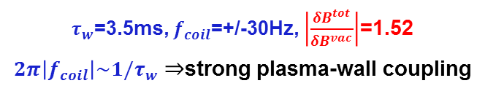

NSTX Shows Strong Plasma-Wall Coupling Effect in n=1 Plasma Response
$β_{N}^{no wall}$ ~ 4.75
Fluid
no wall
NSTX f=30Hz
Kinetic
Fluid
with wall
A simple analysis based on (s, $α$) model in the approximation with a single dominant mode:
Park, Boozer et al, PoP 2009
At marginal stability:
$$\left|\frac{δB^{tot}}{δB^{vac}}\right|=\left|\frac{1}{2πnτ_{w}f_{coil}} \right|$$
No wall: $τ_{w}→0 ⇒ \left|\frac{δB^{tot}}{δB^{vac}}\right|→+∞$
NSTX experiments
$τ_{w}$=3.5ms, $f_{coil}$=+/-30Hz, $\left|\frac{δB^{tot}}{δB^{vac}}\right|$=1.52
$2π\left|f_{coil}\right|\sim 1/τ_{w}⇒$strong plasma-wall coupling
NSTX-U

Slide 10
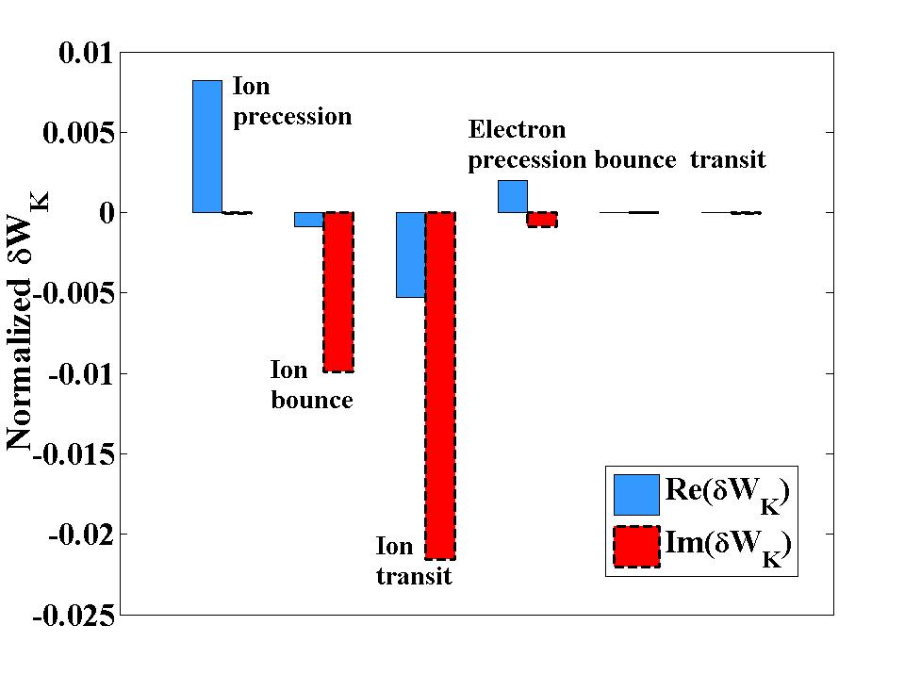
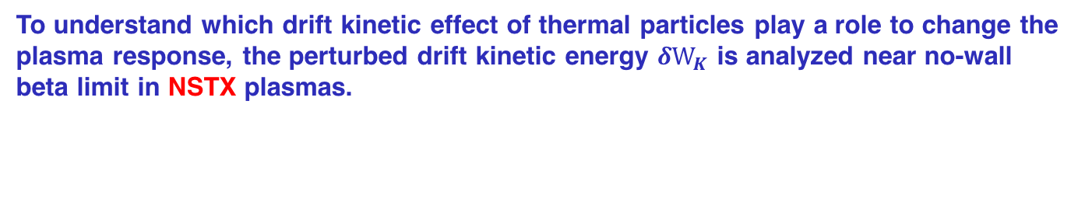
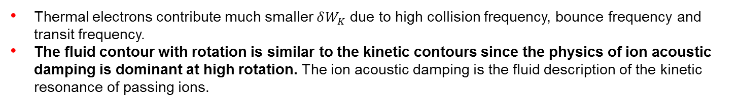
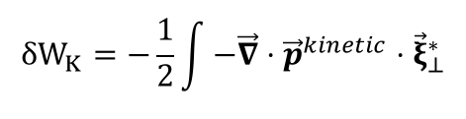
NSTX: Bounce and Transit Resonances of Thermal Ions Contributes Dominant Kinetic Energy to Kinetic Response
To understand which drift kinetic effect of thermal particles play a role to change the plasma response, the perturbed drift kinetic energy $δW_{K}$ is analyzed near no-wall beta limit in NSTX plasmas.
$$δW_{K}=−\frac{1}{2}\int{−\vec{∇}}⋅{\vec{p}}^{kinetic}⋅{\vec{ξ}}_{⊥}^{∗}$$
NSTX discharge 124801 at 560ms
(a.u.)
NSTX f=30Hz
Thermal electrons contribute much smaller $δW_{K}$ due to high collision frequency, bounce frequency and transit frequency.
The fluid contour with rotation is similar to the kinetic contours since the physics of ion acoustic damping is dominant at high rotation. The ion acoustic damping is the fluid description of the kinetic resonance of passing ions.
NSTX-U

Slide 11
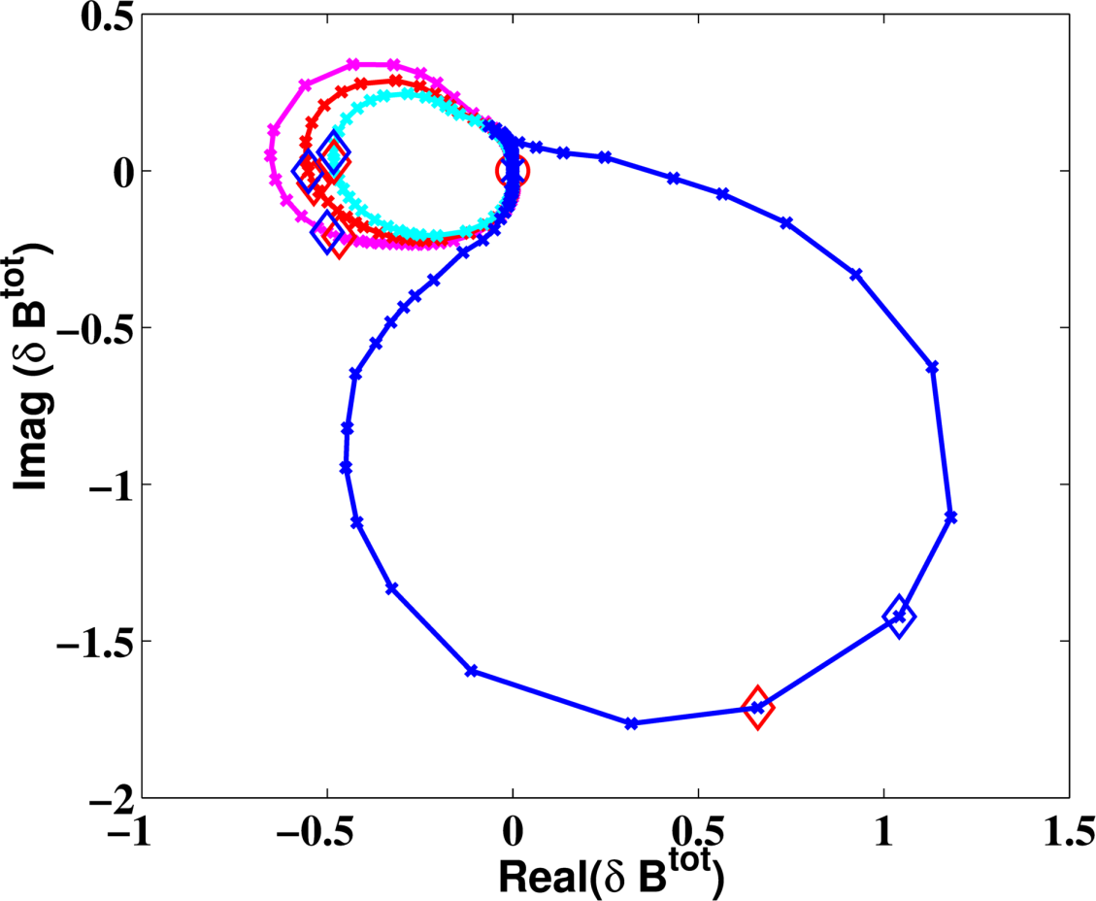
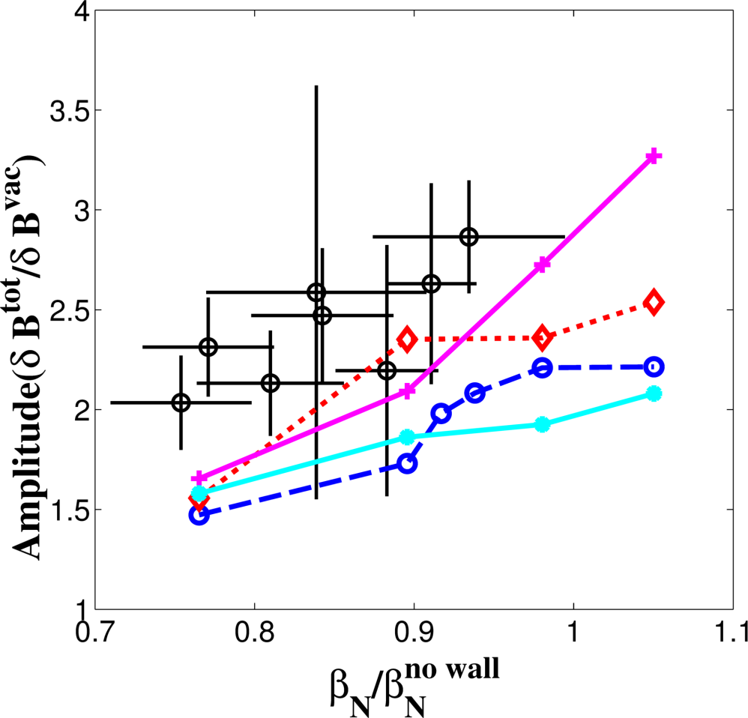





NSTX: Nyquist Contour Directly Identifies Kinetic Stabilization of Least Stable Mode in Plasma Response
Nyquist plot with highest beta above $β_{N}^{no wall}$
$β_{N}^{no wall}$ ~ 4.75
Kinetic + Rotation
Kinetic w/o Rotation
Fluid + Rotation
f_{coil} = 10Hz
f_{coil} = 0Hz
Fluid w/o Rotation
Padé approximation: $P=\frac{c_{1}}{s−γ_{1}}+\frac{c_{2}}{s−γ_{2}}$
Fluid w/o Rotation: $γ_{max}$= 13.66 Hz Unstable
Kinetic w/o Rotation: $γ_{max}$= -34.3 Hz Stable
$∨$ Fluid ion acoustic damping
$∨$ Inertial energy
Fluid + Rotation: $γ_{max}$= -28.97 Hz Stable
Kinetic + Rotation: $γ_{max}$= -13.22 Hz Stable
NSTX-U

Slide 12
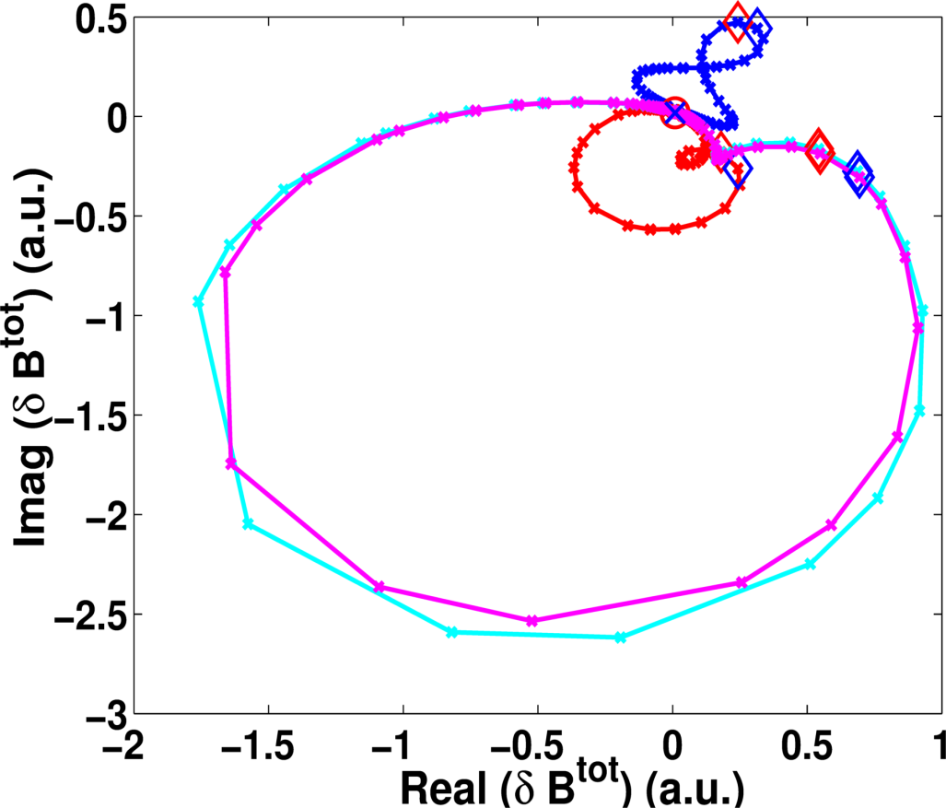
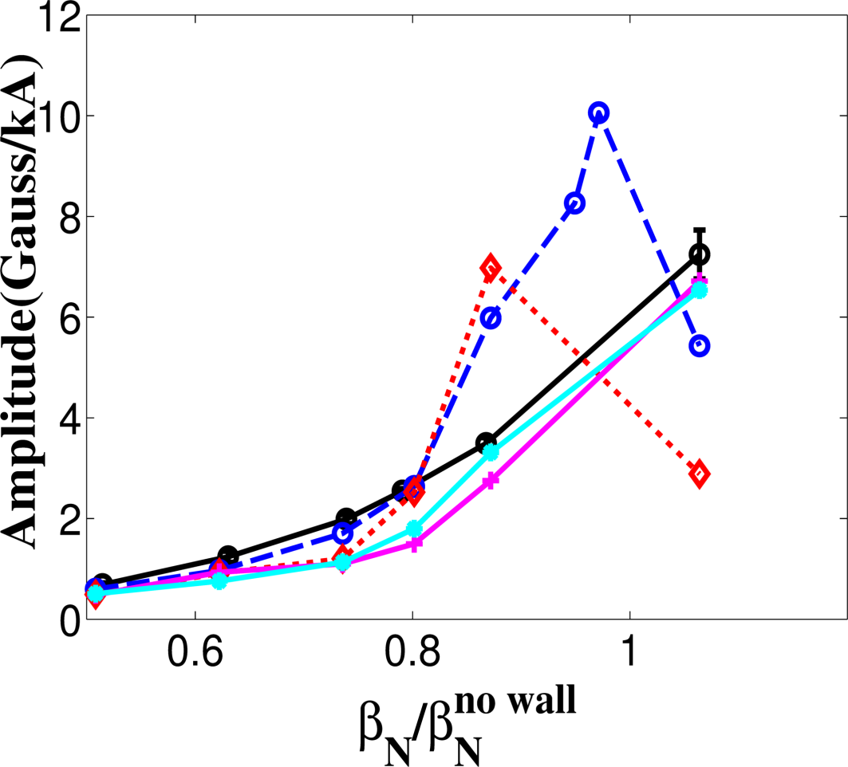
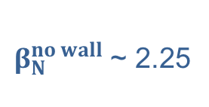
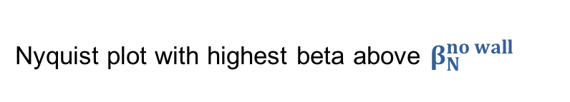
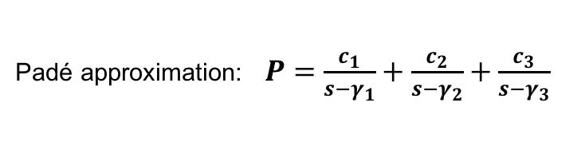



DIII-D: Different Response Physics Form Different Nyquist Contour
Nyquist plot with highest beta above $β_{N}^{no wall}$
$β_{N}^{no wall}$ ~ 2.25
Fluid w/o Rotation
Fluid + Rotation
Kinetic w/o Rotation
Kinetic + Rotation
f_{coil} = 0Hz
f_{coil} = 10Hz
Padé approximation: $P=\frac{c_{1}}{s−γ_{1}}+\frac{c_{2}}{s−γ_{2}}+\frac{c_{3}}{s−γ_{3}}$
Z. R. Wang, M. J. Lanctot et al PRL 2015
Fluid w/o Rotation: $γ_{max}$= 79.24 Hz Unstable
Kinetic w/o Rotation: $γ_{max}$= -9.19 Hz Stable
$∨$ Fluid ion acoustic damping
Fluid + Rotation: $γ_{max}$= -20.44 Hz Stable
Kinetic + Rotation: $γ_{max}$= -8.69 Hz Stable

Slide 13
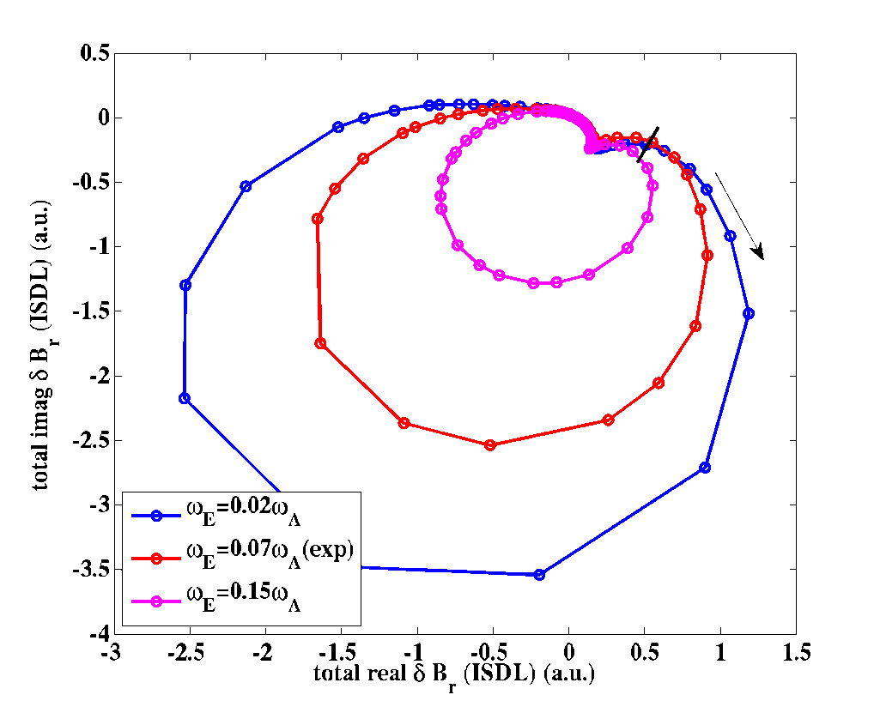
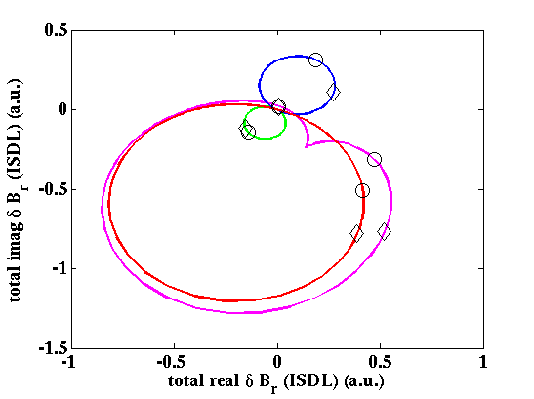
DIII-D: Multi-Mode Plasma Response in Kinetic-MHD Simulation (MARS-K) Quantified using Nyquist Contour Analysis
f_{coil} = 0Hz
3rd mode
γ = -77.7-12.24i (Hz)
1st mode(stable)
γ = -13.34-0.28i (Hz)
increasing plasma rotation
f_{coil} = 0Hz
decreasing plasma stability
f_{coil} = 10Hz
2nd mode
γ= -16.85+26.9i (Hz)
135759
Scan rotation & calculate radial magnetic field at low field side of the wall
Low rotation => Single-mode response
High rotation => Multi-mode response
Use Padé approximation to extract eigenmodes
Yields damping rate for each stable mode
Quantifies contribution of each eigenmode to the total sensor signal
Instead of first least stable mode, contribution from second least stable mode can dominate the kinetic plasma response when largest response observed (~10Hz).
Choose the coil frequency to amplify the preferred eigenmode’s response.

Slide 14
Modified Nyquist Analysis
(3D MHD Spectroscopy)

Slide 15

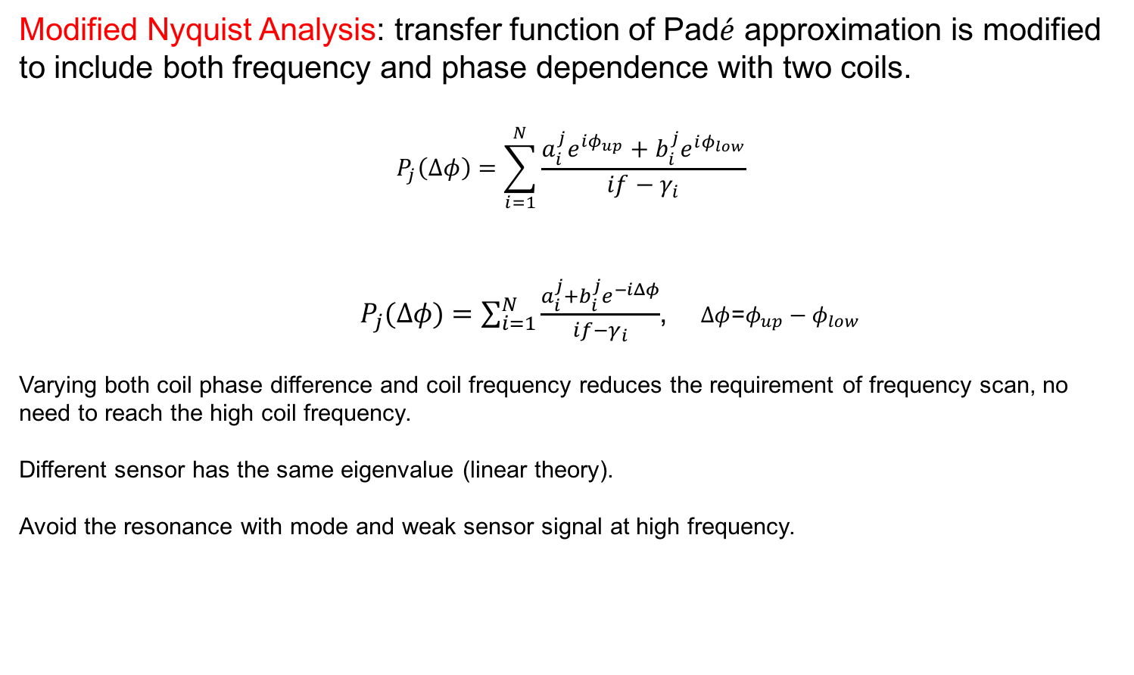

Modified Pad$\acute{e}$ Approximation Include Both Coil Phasing and Frequency Dependence
Standard Nyquist analysis requires a frequency scan $f∈(−∞,+∞)$.
Measurements at high frequency can be weak and noisy due to ELM etc.
Modified Nyquist Analysis: transfer function of Pad$\acute{e}$ approximation is modified to include both frequency and phase dependence with two coils.
$$P_{j}\left(Δφ\right)=\sum_{i=1}^{N}{\frac{a_{i}^{j}e^{iφ_{up}}+b_{i}^{j}e^{iφ_{low}}}{if−γ_{i}}}$$
$P_{j}(Δφ)=\sum_{i=1}^{N}{\frac{a_{i}^{j}+b_{i}^{j}e^{−iΔφ}}{if−γ_{i}}}$, $Δφ$=$φ_{up}−φ_{low}$
Varying both coil phase difference and coil frequency reduces the requirement of frequency scan, no need to reach the high coil frequency.
Different sensor has the same eigenvalue (linear theory).
Avoid the resonance with mode and weak sensor signal at high frequency.

Slide 16
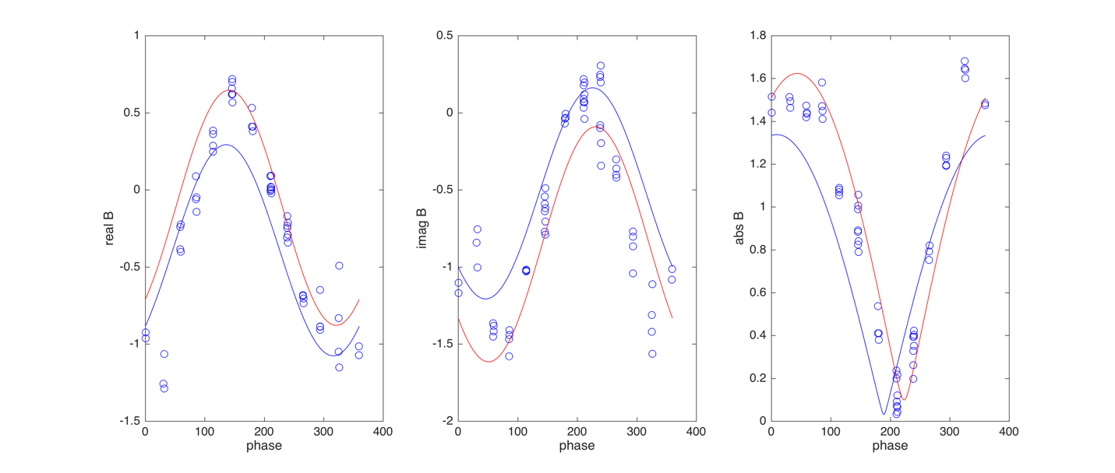
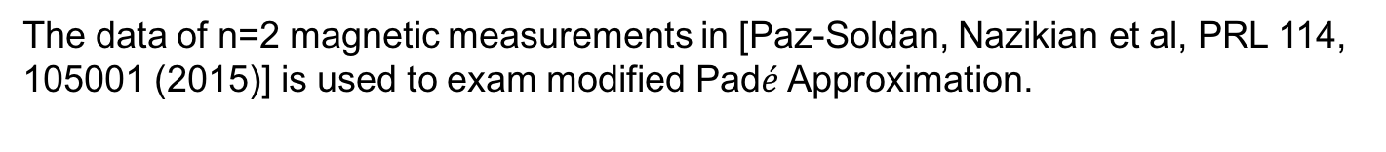



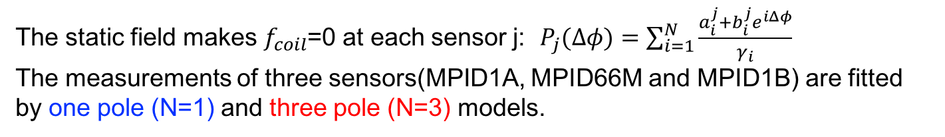
DIII-D: Application of Modified Nyquist Method in n=2 plasma response experiments
The data of n=2 magnetic measurements in [Paz-Soldan, Nazikian et al, PRL 114, 105001 (2015)] is used to exam modified Pad$\acute{e}$ Approximation.
The static field makes $f_{coil}$=0 at each sensor j: $P_{j}(Δφ)=\sum_{i=1}^{N}{\frac{a_{i}^{j}+b_{i}^{j}e^{iΔφ}}{γ_{i}}}$
The measurements of three sensors(MPID1A, MPID66M and MPID1B) are fitted by one pole (N=1) and three pole (N=3) models.
MPID1A sensor
Real $δB_{p}$ (G)
Imag $δB_{p}$ (G)
Abs $δB_{p}$ (G)
Phase
Phase
Phase

Slide 17
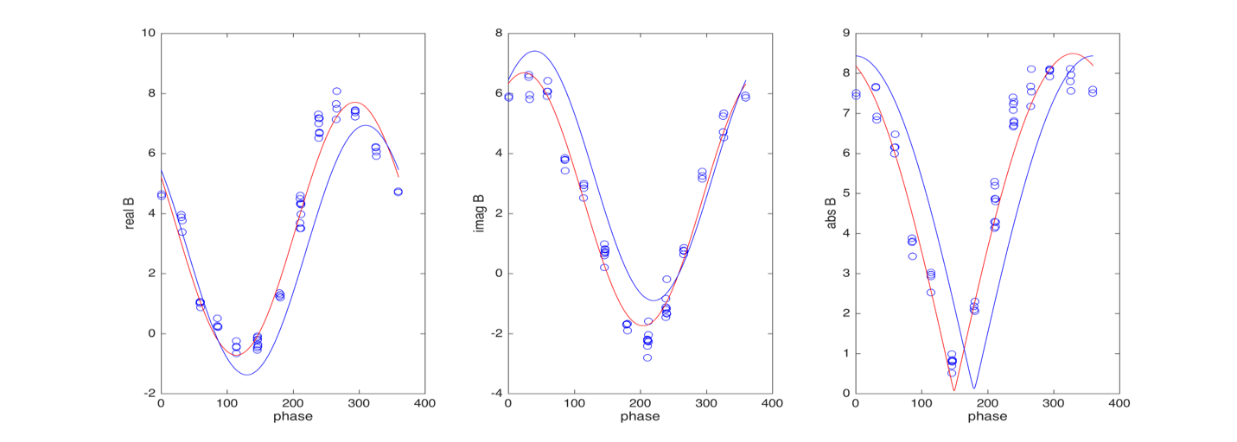
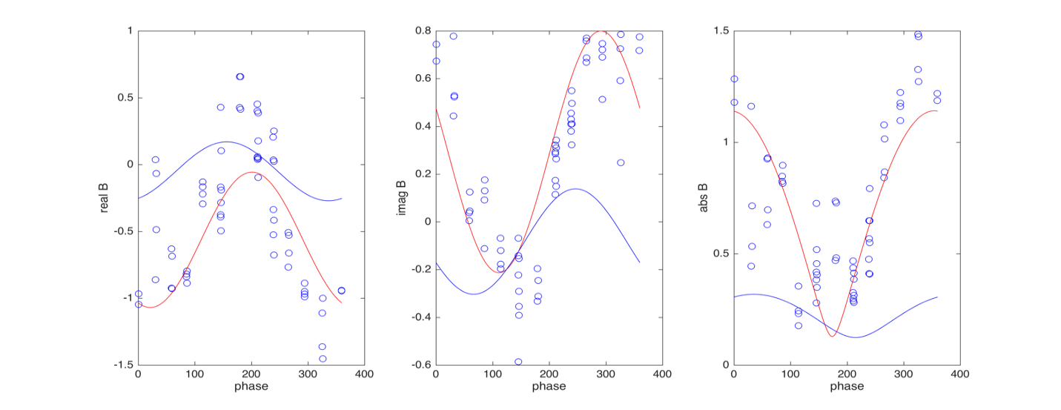

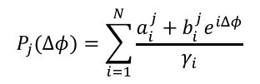





DIII-D: Application of Modified Nyquist Method in n=2 plasma response experiments
The measurements of three sensors(MPID1A, MPID66M and MPID1B) are fitted by one pole (N=1) and three pole (N=3) models.
MPID66M sensor
Three poles model fits three sensors and confirms the multi-mode response.
Three eigenvalue can be found but not be able to determine the dimension since f=0.
$γ_{1}$=1.8696e+00 + 1.6963e+00i
$γ_{2}=$ 8.5712e+00 - 1.9080e+00i
$γ_{3}$= 1.4569e-01 - 2.7639e-01i
Real $δB_{p}$ (G)
Imag $δB_{p}$ (G)
Abs $δB_{p}$ (G)
Phase
Phase
Phase
No physical meaning
MPID1B sensor
Real $δB_{p}$ (G)
Imag $δB_{p}$ (G)
Abs $δB_{p}$ (G)
$$P_{j}(Δφ)=\sum_{i=1}^{N}{\frac{a_{i}^{j}+b_{i}^{j}e^{iΔφ}}{γ_{i}}}$$
Phase
Phase
Phase

Slide 18
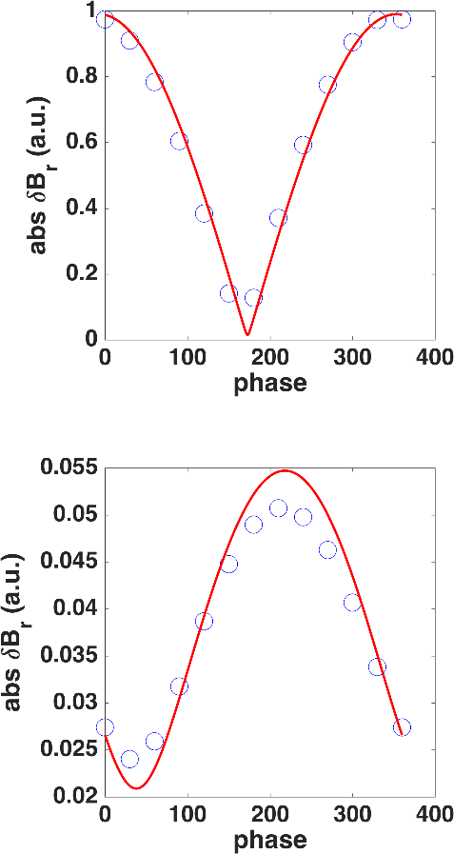
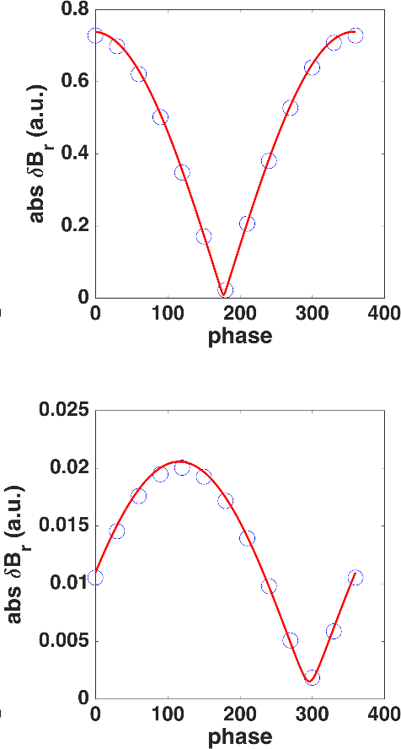


DIII-D: Modified Transfer Function Fits Simulated n=2 Resistive Response at Different Phasing and Frequency
n=2 plasma response in DIII-D discharge 158103 at 3796ms is simulated by MARS-F.
Five pole transfer function fits the LFS and HFS sensor measurements simultaneously.
$f_{coil}$=10Hz
$f_{coil}$=90Hz
Radial perturbed fields at LFS (ISL)
O MARS-F
— Fitted
five pole
transfer
function
Radial perturbed fields at HFS (Radial MPID1B)

Slide 19
DIII-D: Extracted Transfer Functions Identify Modification of n=2 Plasma Stability Due to Rotation and Resistivity
Nyquist method can investigate how the damping rates of these stable eigenmodes in both simulation and experiments.
The extracted damping rates of least stable mode for ideal response with/without rotation and resistive response are compared.
DIII-D discharge 158103 at 3796ms
Case | Eigenvalue of Least Stable Mode
Ideal Response + no Rotation | -3.017 - 9.92E-03i Hz
Ideal Response + Rotation | -2.03 - 1.85E-03i Hz
Resistive Response + Rotation | -6.53 + 1.075E-02i Hz
More negative real part more stable plasma
In the simulated DIII-D equilibrium, rotation slightly destabilize the plasma.
Resistivity plays a stabilizing effect on least stable mode.

Slide 20
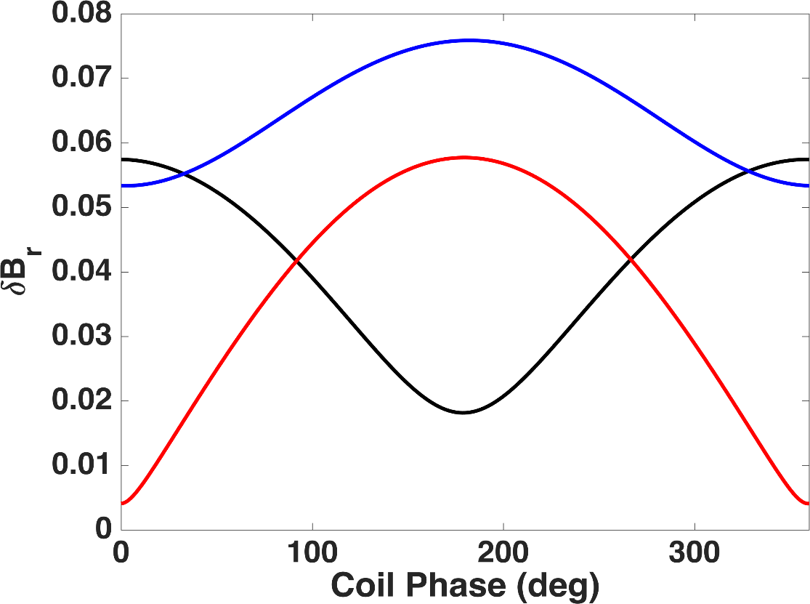



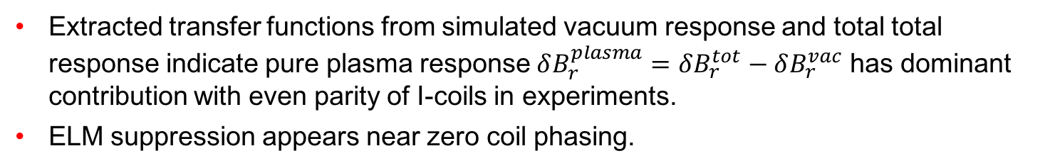
DIII-D: n=2 Response at HFS Purely Contributed by Plasma with Zero Degree Coil Phasing (Even Parity)
Extracted transfer functions from simulated vacuum response and total total response indicate pure plasma response $δB_{r}^{plasma}=δB_{r}^{tot}−δB_{r}^{vac}$ has dominant contribution with even parity of I-coils in experiments.
ELM suppression appears near zero coil phasing.
Resistive response based on
DIII-D discharge 158103 at 3796ms
HFS (MPID1B)
Radial field
$$δB_{r}^{tot}$$
(a.u.)
$$δB_{r}^{vac}$$
$$δB_{r}^{tot}−δB_{r}^{vac}$$

Slide 21
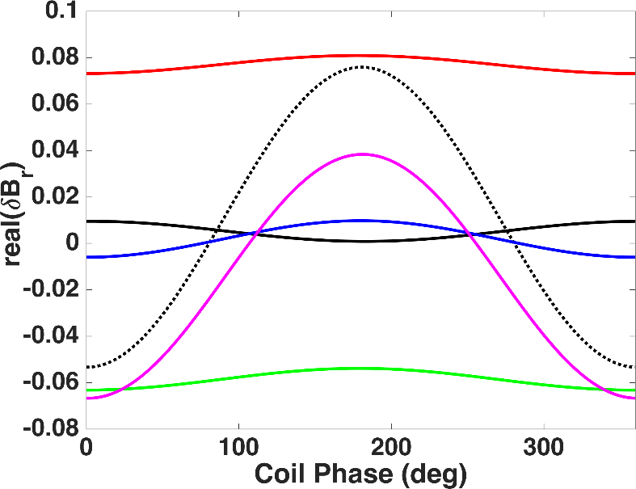
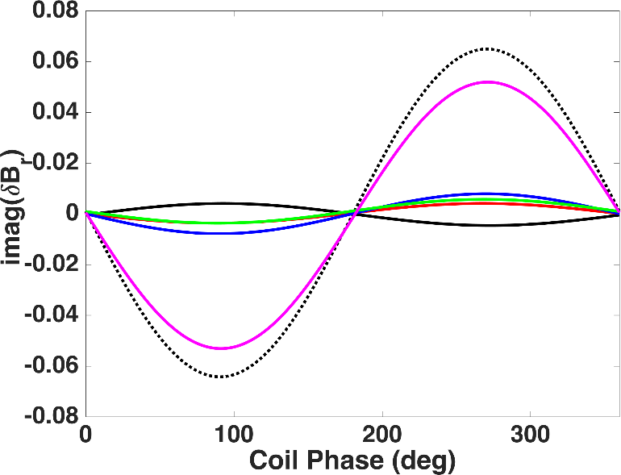
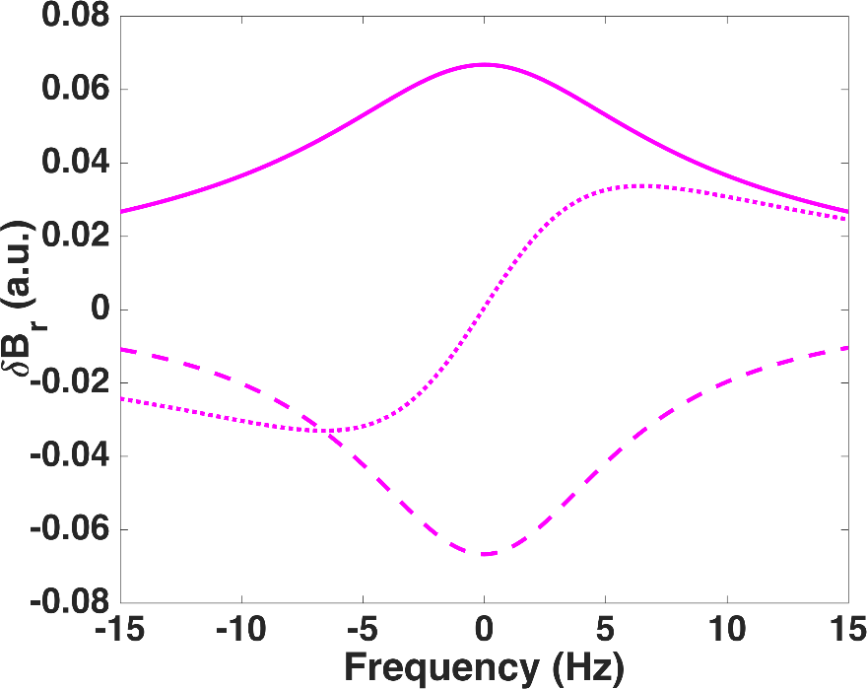

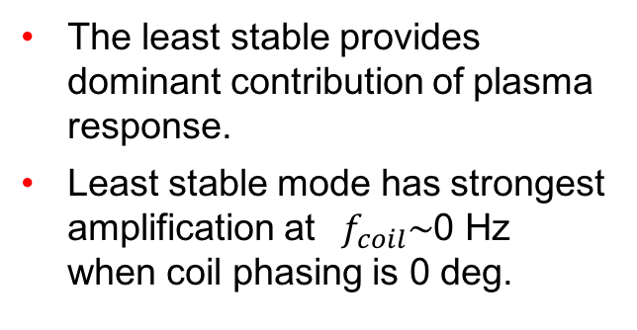









DIII-D: Least Stable Mode is Dominant in n=2 Resistive Plasma Response with Zero Degree Coil Phasing (Even Parity)
DIII-D discharge 158103 at 3796ms
1st mode
$γ$=-6.5+0.01i Hz
The least stable provides dominant contribution of plasma response.
Least stable mode has strongest amplification at $f_{coil}\sim$0 Hz when coil phasing is 0 deg.
$$δB_{r}^{tot}$$
2nd mode
$γ$=-61.9-0.0067i Hz
3rd mode
$γ$=-101.3+0.0045i Hz
Least stable
mode
4rd mode
$γ$=-113.8-3.07 Hz
5rd mode
$γ$=-822.5-0.014Hz
$$δB_{r}^{tot}$$
|$δB_{r}$|
Least stable
mode
I$mag δB_{r}$
Least stable
mode
R$eal δB_{r}$

Slide 22
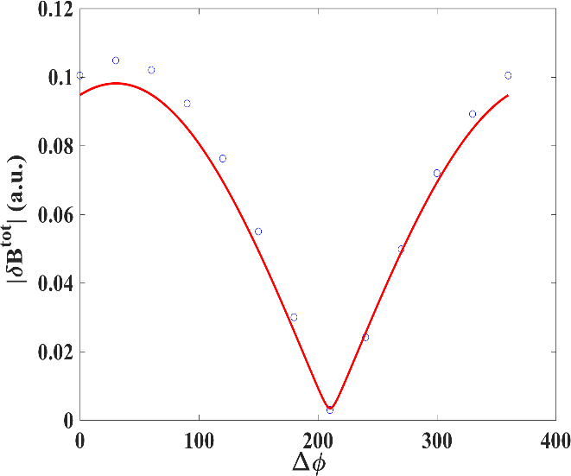
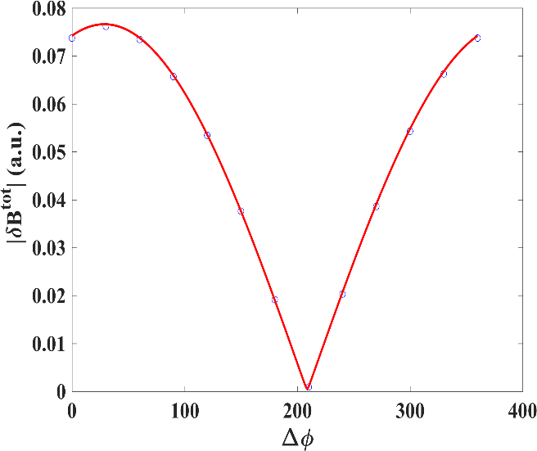
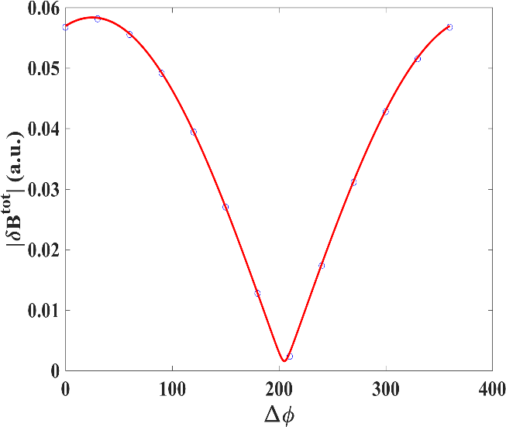

MARS-F Simulation of Response for Modified Pad$\acute{e}$ Approximation
EAST equilibrium (shot No. 52340) is used in the MARS-F simulation.
Phase scan of n=1 ideal response is simulated and measured by the assumed radial sensor at mid-plane of HFS.
Three contours with different coil frequencies (10Hz, 30Hz, 60Hz) are fitted at the same time.
f=10Hz
f=30Hz
f=60Hz
Three poles model well fit the sensor signals to extract plasma transfer function.
NSTX-U

Slide 23
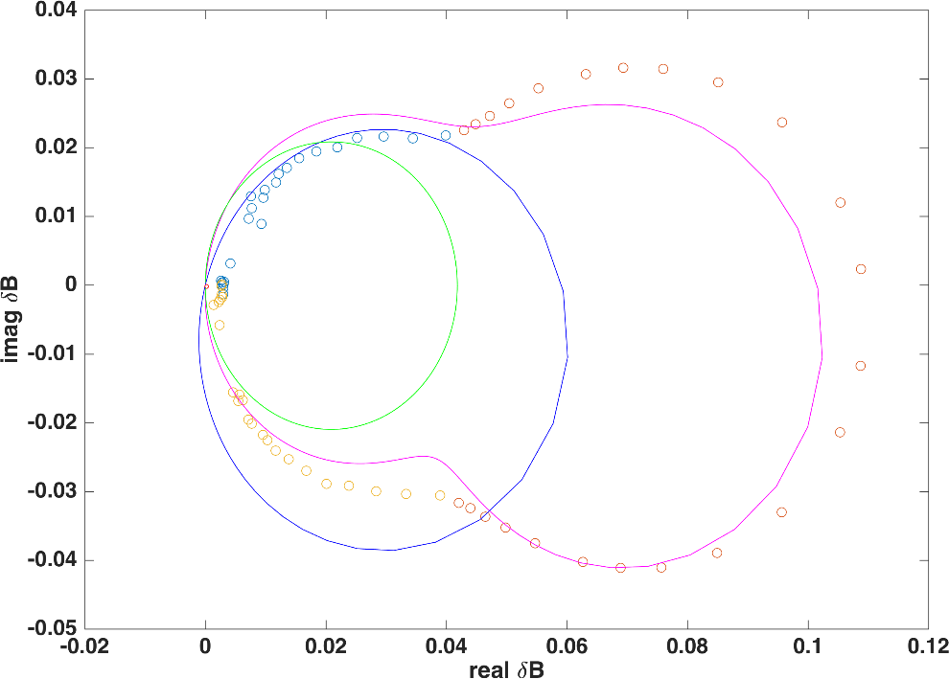
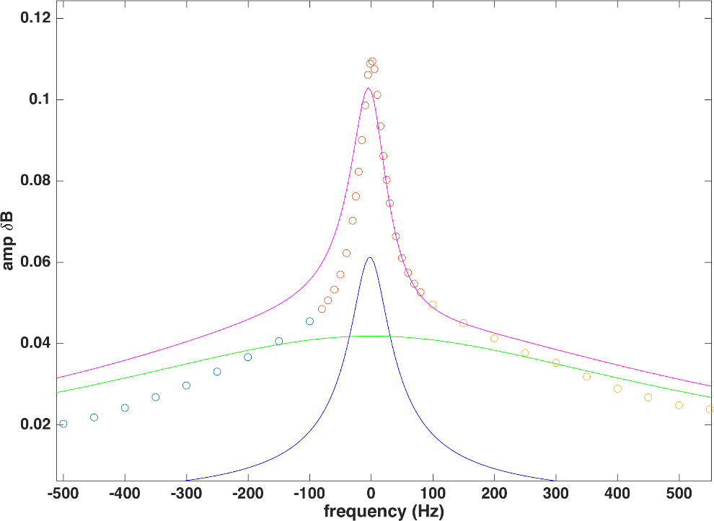



Two Modes Are Dominant on HFS with Zero Phase Degree
The eigenvalues of three poles：
  $γ_{1}$=-30.714 - 2.2163i Hz $γ_{2}$=-458.71 + 0.2993i Hz $γ_{3}$=-1624.8 + 3.02i Hz
The transfer function extracted from the low frequency and coil phase scan, can recover the simulated Nyquist contour at all frequency range.
Two modes are dominant (first and secondary modes)
MARS-F
simulation
Imag $δB_{r}$
Abs $δB_{r}$
Real $δB_{r}$
Extracted transfer
function
Frequency (Hz)
NSTX-U

Slide 24
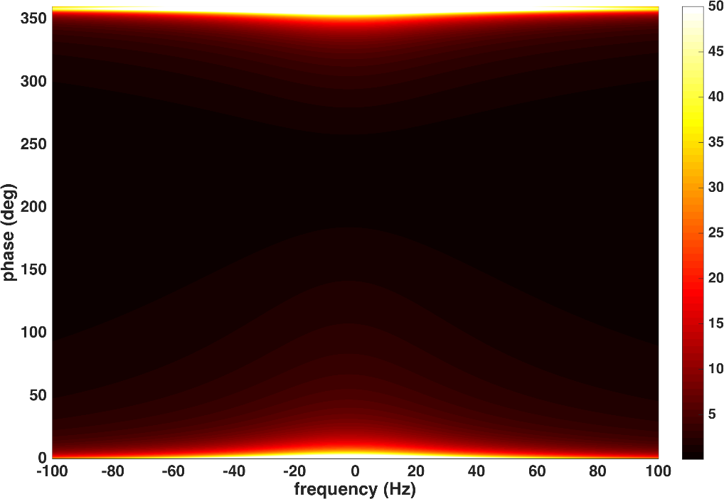
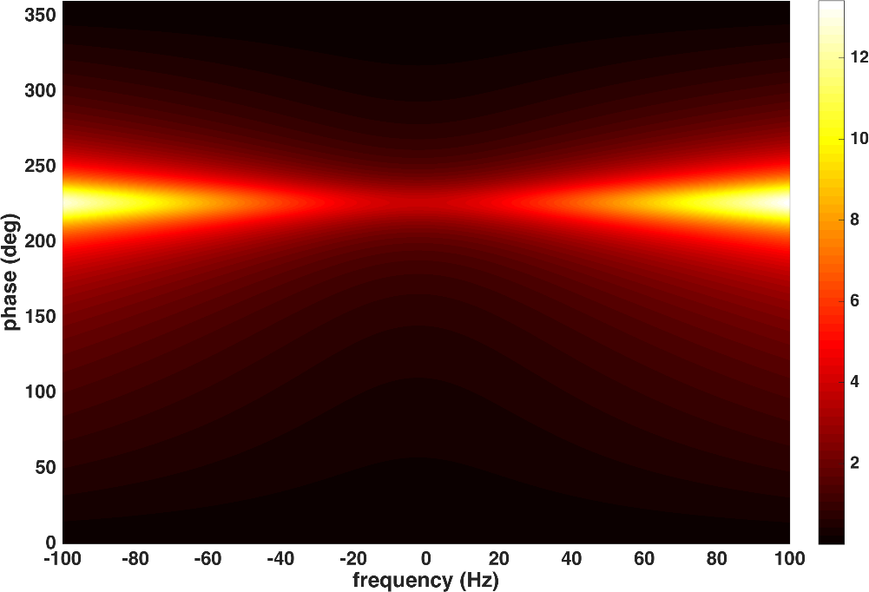







Use Transfer Functions to Optimize Coil Phase and Frequency for amplifying preferred eigenmode
Response transfer function: $P(Δφ)=\sum_{i=1}^{N}{\frac{a_{i}^{j}+b_{i}^{j}e^{−iΔφ}}{if−γ_{i}}}$
Two dominant modes in fitted $P$ :
$$P_{1}=\frac{0.9+0.17i+\left(0.92−0.66i\right)e^{iΔφ}}{if−(−30.71−2.216i)}$$
$$P_{2}=\frac{2.27−0.094i+\left(16.9+0.027i\right)e^{iΔφ}}{if−(−458.7+0.299i)}$$
$$Ratio =\left|\frac{P_{1}}{P_{2}}\right|$$
$$Ratio =\left|\frac{P_{2}}{P_{1}}\right|$$
$P_{1}$ is amplified at 0 deg coil phasing. $P_{2}$ is amplified at 240 deg coil phasing.
Increasing coil frequency further enhances the amplification of mode which can be important during ELM suppression.
NSTX-U

Slide 25
Nyquist Analysis Reveals Fundamental Contribution of Eigenmodes on Kinetic Plasma Response and Multi-Mode Response
Nyquist analysis is a powerful tool that can help to reveal a range of underlying physics associated with 3D fields. It finds
  dissipation of kinetic effects makes plasma more stable through stabilization of the eigenmodes.
  plasma in NSTX is destabilized by flow rotation and stabilized by eddy current in the wall.
  increasing EXB rotation can decrease the plasma stability in kinetic-MHD approach and make kinetic plasma response multi-modal.
  secondary mode can be dominant in n=1 kinetic response.
Modified Nyquist method including both coil phase and frequency dependences can
  indicate least stable mode plays a dominant role with zero degree coil phase in DIII-D n=2 ELM suppression experiments.
  give the capability to optimize coil phase and frequency for amplifying the preferred eigenmode during ELM control experiments e.g. amplify secondary mode with 240 degree coil phasing and finite coil frequency.
  be a candidate for 3D MHD spectroscopy and real-time monitoring of the plasma stability in long-pulse fusion reactors (new need high frequency scan to form Nyquist contour).
NSTX-U

Slide 26



DIII-D: n=2 Plasma Response Results Show Multi-Mode Structure with Nyquist Analysis in Ideal MHD simulation (MARS-F)
ISL sensor
135759
ESL sensor
1st mode(stable)
γ ~ -18.4+1.92i (Hz)
Multi-mode
pattern
f_{coil} = 10Hz
Nyquist
Contour
f_{coil} = 10Hz
2nd mode(stable)
γ ~ -53.4+ 2.5i (Hz)
UISL sensor
Padé approximation indicates plasma is stable to n=2 modes in ideal MHD simulation.
Two mode contribute to fluid response.
Second least stable mode also dominates n=2 fluid plasma response.
Nyquist contour measured by different sensor can have different pattern.
f_{coil} = 10Hz

Slide 27

Frequency Scan of Each Eigenmode (n=2), no full cancellation among different modes

