Slide 1

Impact of physics and technology innovations on compact tokamak fusion pilot plants
Jonathan Menard (PPPL)
T. Brown, S. Gerhardt, R. Maingi, R. Majeski, Y. Zhai,
L. El-Guebaly (UW Madison), and the NSTX-U team
58th Annual Meeting of the APS Division of Plasma Physics
San Jose, California
October 31 - November 4, 2016

Slide 2
Possible missions for fusion next-steps
Integrate high-performance, steady-state, exhaust
  Divertor test-tokamak - DTT
Fusion-relevant neutron wall loading
  Γ_{n} ~ 1-2MW/m², fluence: ≥ 6MW-yr/m²
Tritium self-sufficiency
  Tritium breeding ratio TBR ≥ 1
Electrical self-sufficiency
  Q_{eng} = P_{electric} / P_{consumed} ~ 1
Large net electricity generation
  Q_{eng} >> 1, P_{electric} = 0.5-1 GWe

Slide 3
Possible missions for fusion next-steps
Integrate high-performance, steady-state, exhaust
  Divertor test-tokamak - DTT
Fusion-relevant neutron wall loading
  Γ_{n} ~ 1-2MW/m², fluence: ≥ 6MW-yr/m²
Tritium self-sufficiency
  Tritium breeding ratio TBR ≥ 1
Electrical self-sufficiency
  Q_{eng} = P_{electric} / P_{consumed} ~ 1
Large net electricity generation
  Q_{eng} >> 1, P_{electric} = 0.5-1 GWe
This talk: assess possible innovations to achieve these missions in a single and more compact tokamak device

Slide 4
Outline
Scalings for electricity gain
Scalings for DT fusion gain
Possible innovations for higher gain
Example low-A pilot plant concept
Summary

Slide 5
Electricity gain Q_{eng} determined primarily by engineering efficiencies and fusion gain
Electricity produced
Electricity consumed
Q_{eng} ≡
=
Q_{eng} = η_{th} η_{aux} Q ×
η_{th} ≡ thermal power conversion efficiency
η_{aux} ≡ injected power wall plug efficiency
Q ≡ P_{fus} / P_{aux} = fusion power / auxiliary power
  Parameter Assumptions:
    M_{n} = 1.1, P_{pump} = 0.03×P_{th}
    P_{sub} + P_{control} = 0.04×P_{th}
    η_{aux} = 0.3
    η_{CD} = I_{CD}R₀n_{e}/P_{CD} ≈ 0.3×10²⁰A/W/m²
For more details see J. Menard, et al., Nucl. Fusion 51 (2011) 103014

Slide 6
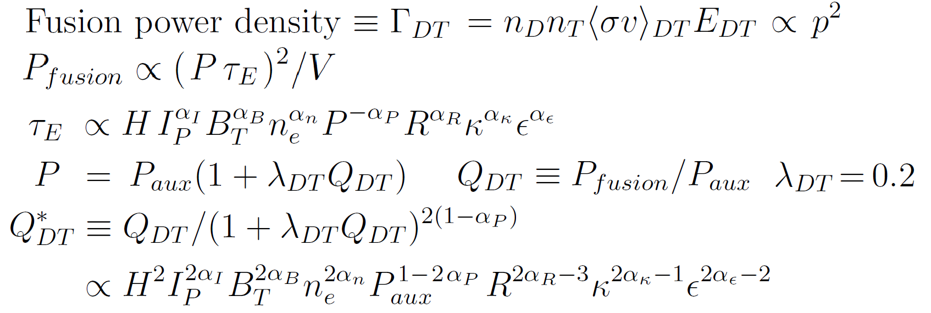
Fusion gain Q_{DT} ∝ H^{2→5} from low → high gain
Fix current, field, density, geometry, auxiliary power, α_{P} = 0.7:
Q_{DT} ≤1 → Q_{DT} ≈ Q*_{DT} ∝ H² Q_{DT} >>1 → Q_{DT} ∝ Q*_{DT}^{2.5} ∝ H⁵

Slide 7
Stability limits and other operating constraints
n = 0 stability limit: elongation κ ≤ κ_{max}(l_{i}, ε, β_{P}, wall)
n > 0 stability limits:
  Pressure: β_{N} ≡ β_{T} aB_{T0} / I_{P} [%mT/MA] < β_{N-max}(ε, κ, δ, profiles)
  Current: q* ≡ πa²B_{T0}(1+κ²)/μ₀R₀I_{P} > 2
Density limit: n_{e} < n_{Greenwald} = 10²⁰m⁻³ I_{P} [MA] / πa[m]²
Steady-state: I_{Plasma} = I_{bootstrap (BS)} + I_{external current drive (CD)}
  f_{BS} = C_{BS} ε^{1/2} β_{P} β_{P} β_{T} ∝ β_{N}² G(κ) G(κ) ∝ κ or (1+κ²)/2 ~ κ²
  Fraction of external current drive = f_{CD} = 1 - f_{BS}

Slide 8
Gain vs. physics and engineering constraints
For steady-state, current limit is weaker constraint than high f_{BS} → no q* dependence → relevant variables are β_{N} / f_{BS} and f_{gw}:
Choose electrostatic gyro-Bohm Petty-08 with no β degradation (JET, DIII-D, NSTX)
Optimize: confinement, current drive vs density aspect ratio
C. Petty, et al., Phys. Plasmas 15 (2008) 080501

Slide 9
Potential Innovation Areas for Compact Pilot
Aspect Ratio – Reduced A → higher β_{N} and κ
Magnet Technology – HTS for higher B_{T}, J_{winding-pack}
Confinement – Optimize edge transport barrier
Current Drive – Negative NBI, new RF techniques
Divertors – Long-leg, liquid metals
Blankets – Liquid metal, high efficiency

Slide 10
Potential Innovation Areas for Compact Pilot
Aspect Ratio
Magnet Technology
Confinement
Current Drive
Divertors
Blankets
Optimize this
combination first
Assess R₀ = 3m → smallest size for Q_{eng} > 1, high fluence

Slide 11
Optimization Approach
Fix plasma major radius, heating power (P_{NNBI}=50MW)
  R₀ = 3m – smallest size for Q_{eng} > 1 + high fluence ~ 6MWy/m²
Vary aspect ratio from A = 1.6 to 4
Include blanket/shield model to achieve TBR~1 for all A
Apply magnet (see backup) and plasma constraints
  HTS strain: 0.3%, β_{N}(ε) n=1 no-wall, κ(ε): 0.95×limit, f_{GW} = 0.8
  Vary HTS current density, peak field
  Also scan inboard shielding thickness
Compute Q_{DT}, Q_{eng}, and required H₉₈ (unconstrained)

Slide 12
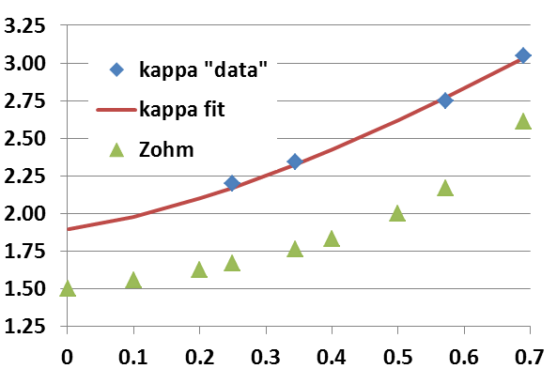
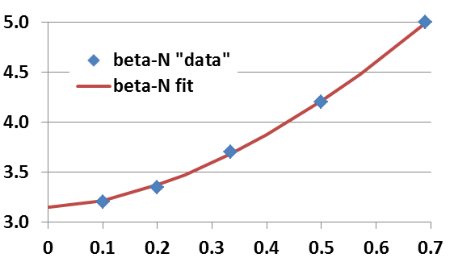
Aspect ratio dependence of limits: κ(ε), β_{N}(ε)
NSTX data (+ST-FNSF models) at low-A, DIII-D, ARIES-AT for high A
  κ → 1.9 for A → ∞
Profile-optimized no-wall stability limit at f_{BS} ≈ 50% (Menard PoP 2004)
  β_{N} → 3.1 for A → ∞
Pilot study uses 0.95 × κ values here:
Pilot study uses 1.0 × β_{N} values here:
κ
β_{N}
ε = A⁻¹
ε = A⁻¹
J. Menard, et al., Nucl. Fusion 56 (2016) 106023
H. Zohm, et al., Nucl. Fusion 53 (2013) 073019

Slide 13
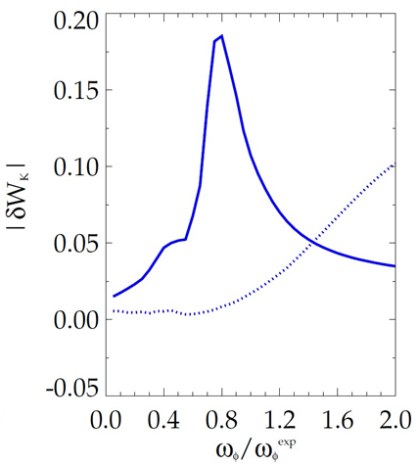
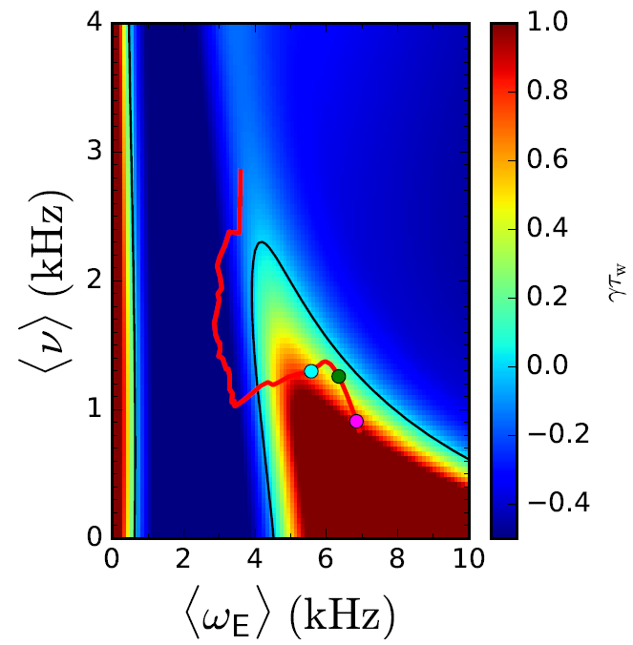
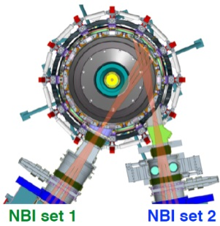
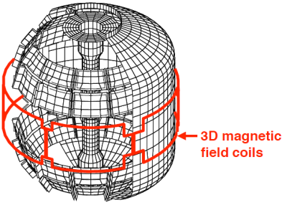
Rotation profile control may provide stable operation near and above n=1 no-wall limit
NSTX, DIII-D show resonant damping can stabilize resistive wall mode (RWM)
Expt. rotation for RWM-stable plasma
Reduced drift-kinetic MHD
RWM stability map
YI2.00005 - J. Berkery (Columbia University)
NSTX
precession resonance
bounce / circulating resonance
γτ_{wall}
Use neutral beams, rotation damping from 3D fields, other actuators to control rotation for RWM stability
133776, t=0.861 s
S. Sabbagh (Columbia University) – APS-DPP 2014
BI2.00005 - I. Goumiri (Princeton University)

Slide 14
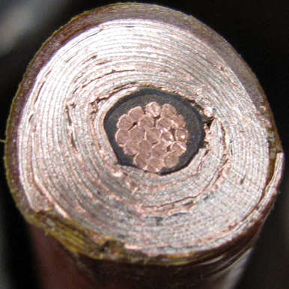
HTS cables using REBCO tapes achieving high winding pack current density at high B_{T}
10 mm
Conductor on Round Core Cables (CORC)
J_{WP} ~ 70MA/m² at 19T
6 mm
10 mm
7 kA CORC (4.2K, 19 T) cable
Base cable: 50 tapes YBCO Tapes with 38 μm substrate (Van Der Laan, HTS4Fusion, 2015)
7 mm
Higher J_{cable} HTS cable concepts under development:
Base Conductor
He Gas Cooled
8kA, J_{WP} ~ 160MA/m²
Copper
7 mm
SS conductor jacket for strength

Slide 15
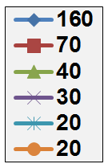
At lower A, high TF winding-pack current density enables access to maximum allowed B_{T} at coil
J_{WP} [MA/m²]
19T: Present CORC HTS limit
12T: ITER-like TF coil limit
(Nb₃Sn, 11.8T)
(12T)
Coil structure sized to maintain ≤ 0.3% strain on winding pack
Effective inboard tungsten carbide (WC) neutron shield thickness = 60cm

Slide 16
High current density HTS cable motivates consideration of lower-A tokamak pilot plants
ITER-like TF constraints:
  J_{WP}=20MA/m², B_{max} ≤ 12T
  P_{fusion} ≤ 130MW, P_{net} < -90MW
J_{WP} ~ 30MA/m², B_{max} ≤ 19T
  P_{fusion} ~ 400MW
  Small P_{net} at A=2.2-3.5
J_{WP} ≥ 70MA/m²,B_{max} ≤ 19T
  P_{fusion} ~500-600MW
  P_{net} = 80-100MW at A=1.9-2.3
J_{WP} [MA/m²]
(12T)
A ~ 2 attractive at high J_{WP}

Slide 17
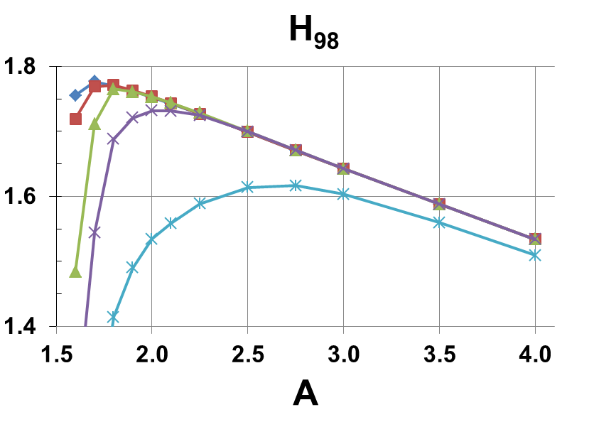
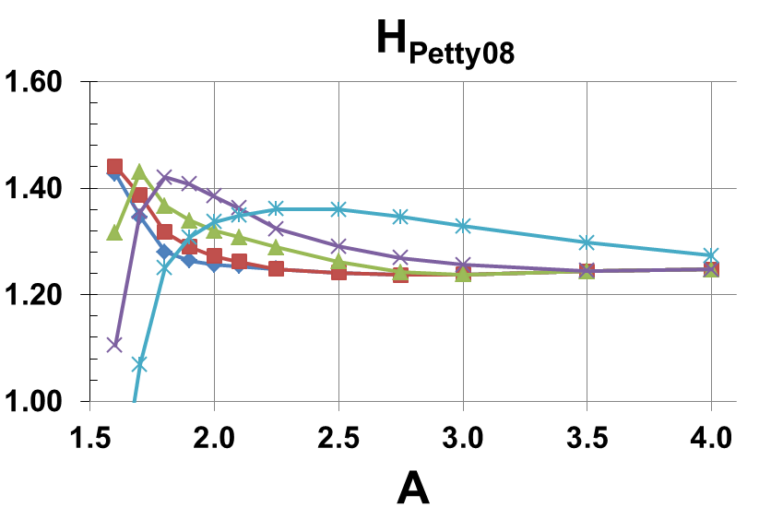
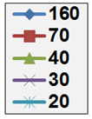
R=3m Pilot Plants require elevated H values
H_{98y2} = 1.5-1.8
H_{Petty-08} = 1.25-1.4
J_{WP} [MA/m²]
Effective inboard WC n-shield thickness = 60cm

Slide 18
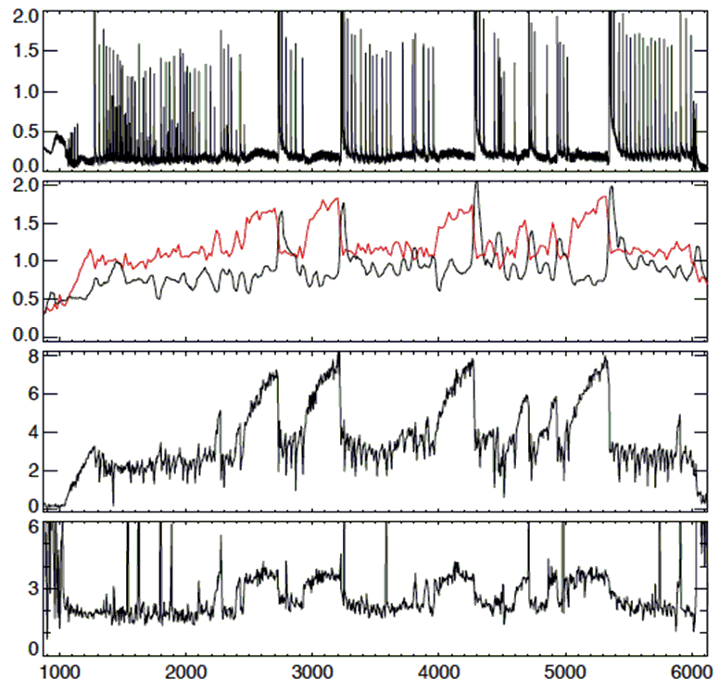
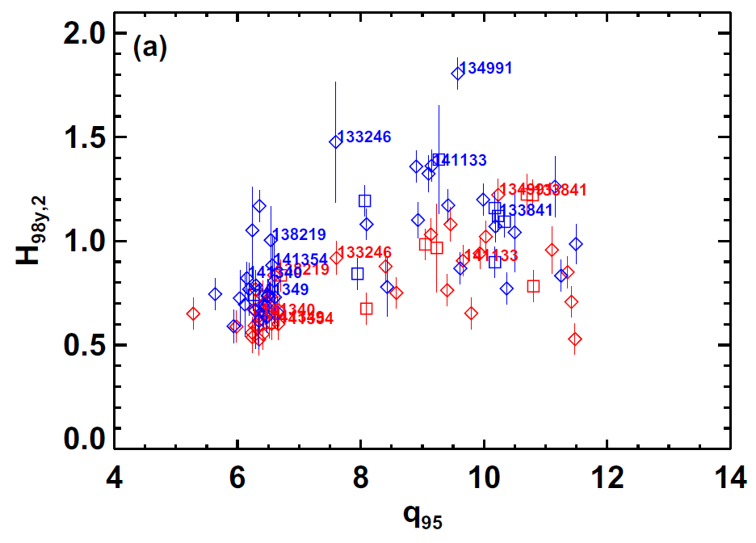
Increased edge rotation shear, wider and higher pedestal can increase normalized confinement ~1.5×
NSTX: Enhanced Pedestal H-mode
Higher edge v_{φ} shear (+Li) → H₉₈=1.3-1.8
Lithium injection on DIII-D
Li injection phases
EPH
H
D_{α}
H₉₈→1.5-1.8
2× wider,
2-3× higher pedestal
(BCM: Bursty chirping mode)
H₉₈
P_{rad} [MW]
P_{e}^{ped} [kPa]
#159643
P_{e}^{width} [cm]
S. Gerhardt, et al., Nucl. Fusion 54 (2014) 083021
T. Osborne, et al., Nucl. Fusion 55 (2015) 063018
Time [ms]

Slide 19
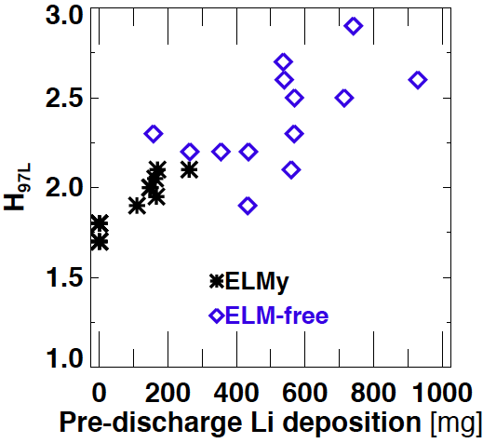
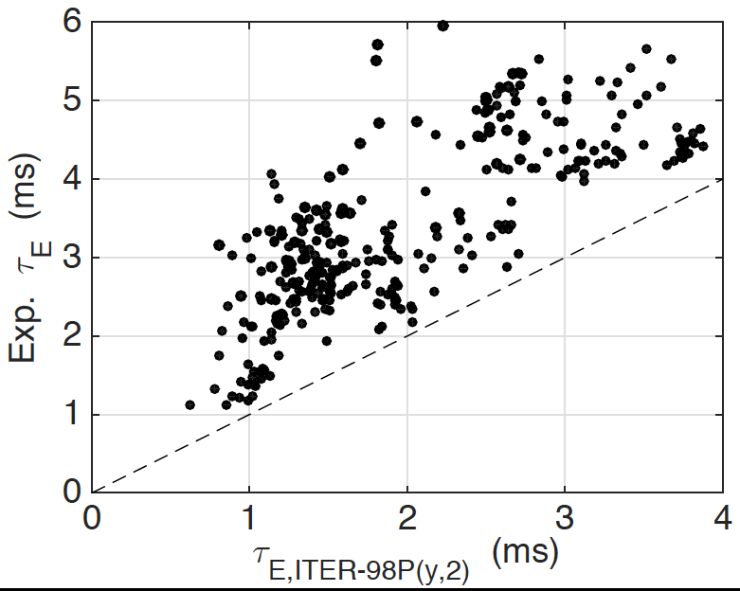
Li (solid and liquid) PFCs can increase confinement
NSTX (wider → higher pedestals)
LTX (flatter → higher T profiles)
H_{98y2} increased from 0.8 → 1.4
2-4x improvement over ITER98P(y,2)
H₉₈~1
D.P. Boyle, et al., J. Nucl. Mater. 438 (2013) S979
J.C. Schmitt, et al., Phys. Plasmas 22 (2015) 056112

Slide 20
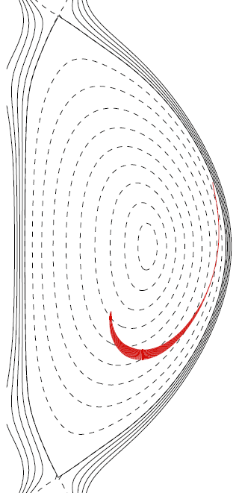
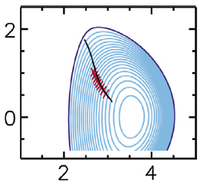
High-efficiency current drive options exist but need additional R&D and demonstration (1)
ARC (MIT)
Inboard Launch Lower Hybrid
η_{CD} ~ 3.6×10¹⁹ A/W/m²
HFS LHCD needs expt test
FNSF-AT (GA)
Helicon Wave
η_{CD} ~ 2.1×10¹⁹ A/W/m²
Helicon tests: DIII-D, KSTAR
Current drive (CD) efficiency target
for Pilot Plant:
η_{CD} ≡ n_{e} I_{CD} R / P
At least 2×10¹⁹ A/W/m²
Prefer > 3×10¹⁹ A/W/m² to keep f_{BS} ≤ ~80%
High-field side
25MW 8GHz
LH wave ray path
Z [m]
Helicon wave ray paths
Low-field side
40-80MW 1.2GHz
R [m]
B. Sorbom, et al., Fus. Eng. Design, 100, (2015) 378
R. Prater, et al., Nucl. Fusion 54 (2014) 083024

Slide 21
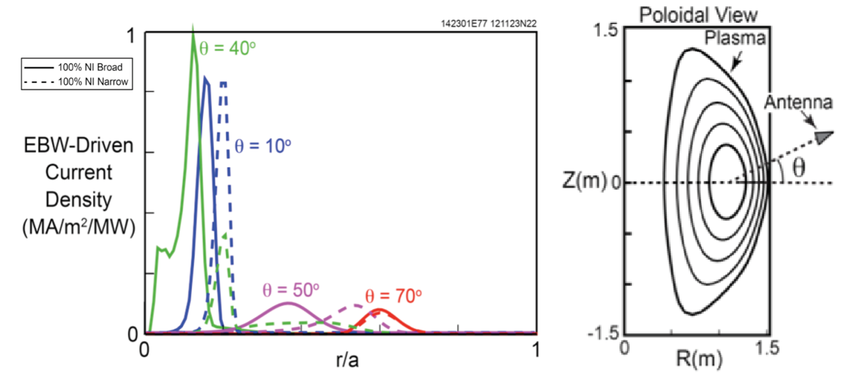
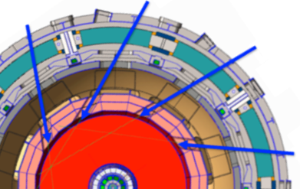
High-efficiency current drive options exist but need additional R&D and demonstration (2)
HTS ST-FNSF/Pilot
Electron Bernstein Wave (EBW)
η_{CD} ~ 3×10¹⁹ A/W/m²
Ongoing / future tests: QUEST / NSTX-U, MAST-U
Negative Neutral Beam Injection (NNBI)
η_{CD} ~ 3.5×10¹⁹ A/W/m²
Test on JT-60SA, leverage ITER NNBI
NNBI
R_{TAN} = 3.9m
Mid-plane tangential
50MW 0.5MeV
NSTX-U simulations at 28GHz scaled to R=3m, T_{e}=13keV, 110GHz
NNBI
R_{TAN} = 3.6m
NNBI
R_{TAN} = 3.0m
NNBI
R_{TAN} = 3.3m
G. Taylor, et al., EPJ Web of Conferences 87, 02013 (2015)
L. El-Guebaly, et al., Energies, 9 (2016) 632

Slide 22
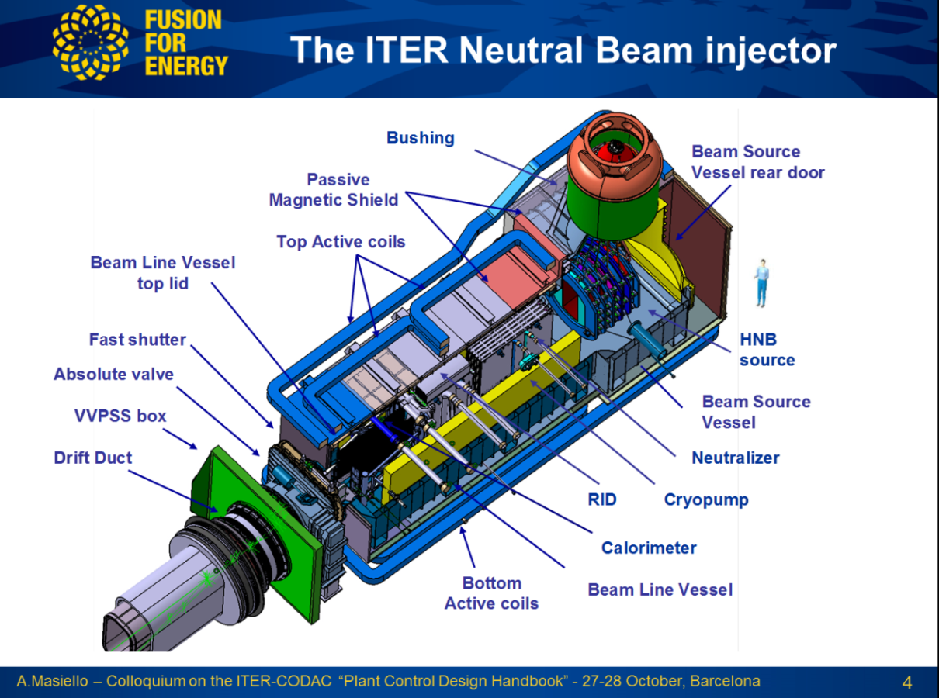
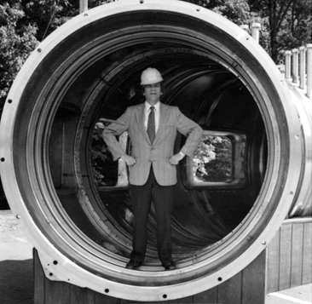
Despite ITER’s beam ions being “too light”,
Ron was impressed by the scale of ITER NBI
Ron Davidson inside mock-up of TFTR vacuum vessel
Plasma neutralization (≈80% efficient), laser photo-detachment (≈95% efficient) could improve η_{aux} from 30 → 40-50%

Slide 23
Potential Innovation Areas for Compact Pilot
Aspect Ratio
Magnet Technology
Confinement
Current Drive
Divertors
Blankets

Slide 24
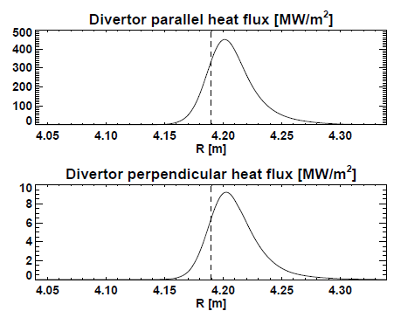
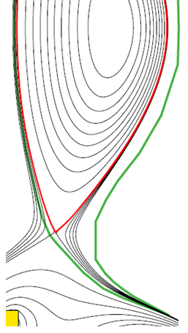
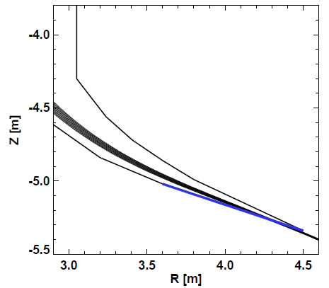
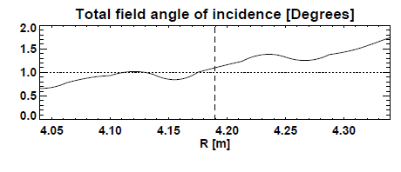
Long-leg / Super-X aids heat flux reduction
A=2 HTS TF FNSF/Pilot
f_{rad}=0.8, f_{obd}=0.8, N_{div} = 2
(Partial) detachment reduces peak q⊥ by further factor of 2-4
λ_{q} ~ 1mm, assume S ≈ λ_{q} (closed divertor)
T. Eich, et al., Nucl. Fusion 53 (2013) 093031

Slide 25
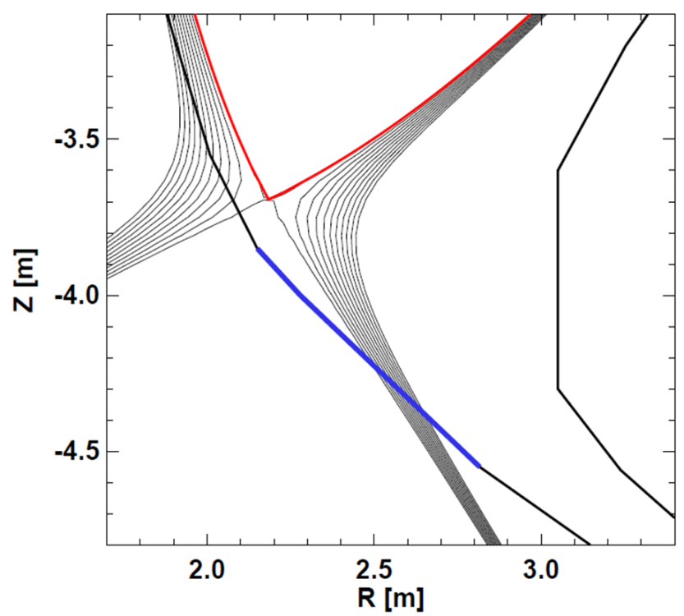
Another option: use fast-flowing Liquid Metal
(LM) divertor for high heat-flux mitigation
Long-leg / Super-X divertor
Shorter leg LM divertor
Geometry also compatible with
“vapor box” concepts (Ono / Goldston)
9 MW/m²
21 MW/m²

Slide 26
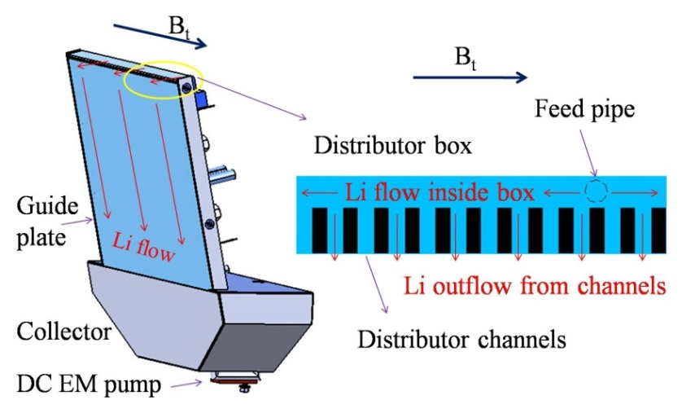
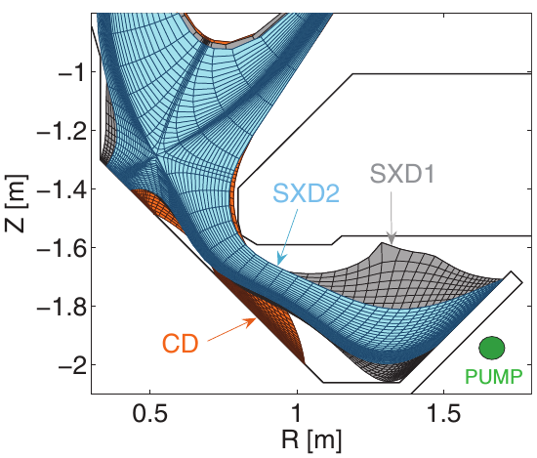
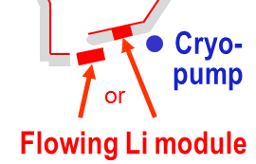
Advanced divertors under active development
MAST-U will test range of divertors:
  Conventional, snowflake (not shown)
  Long-leg “Super-X” with variable flaring
EAST testing flowing liquid Li limiter:
J.S. Hu, et al., Nucl. Fusion 56 (2016) 046011
EAST results will inform possible NSTX-U LM divertor
E. Havlickova, et al., Plasma Phys. Control. Fusion 56 (2014) 075008

Slide 27
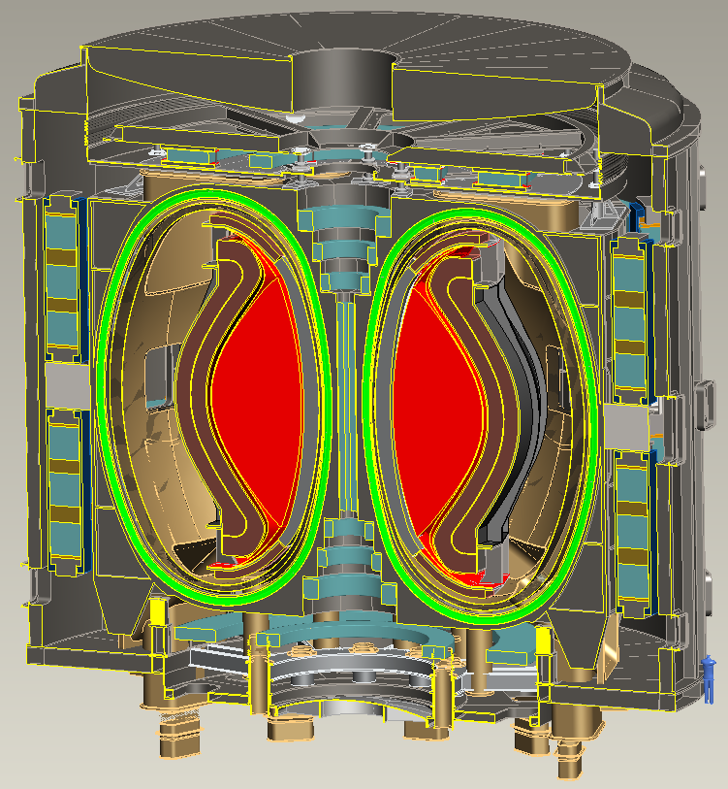
Example: A=2, R₀ = 3m HTS-TF Pilot Plant
B_{T} = 4T, I_{P} = 12.5MA
κ = 2.5, δ = 0.55
β_{N} = 4.2, β_{T} = 9%
H₉₈ = 1.75, H_{Petty-08} = 1.3
f_{gw} = 0.80, f_{BS} = 0.76
Startup I_{P} (OH)~2MA
J_{WP} = 70MA/m²
B_{T-max} = 17.5T
No joints in TF
Vertical maintenance
P_{fusion} = 520 MW
P_{NBI} = 50 MW
E_{NBI}=0.5MeV
Q_{DT} = 10.4
Q_{eng} = 1.35
P_{net} = 73 MW
⟨W_{n}⟩ = 1.3 MW/m²
Peak n-flux = 2.4 MW/m²
Peak n-fluence: 7MWy/m²
Cryostat volume ~ 1/3 of ITER
J. Menard, et al., Nucl. Fusion 56 (2016) 106023

Slide 28
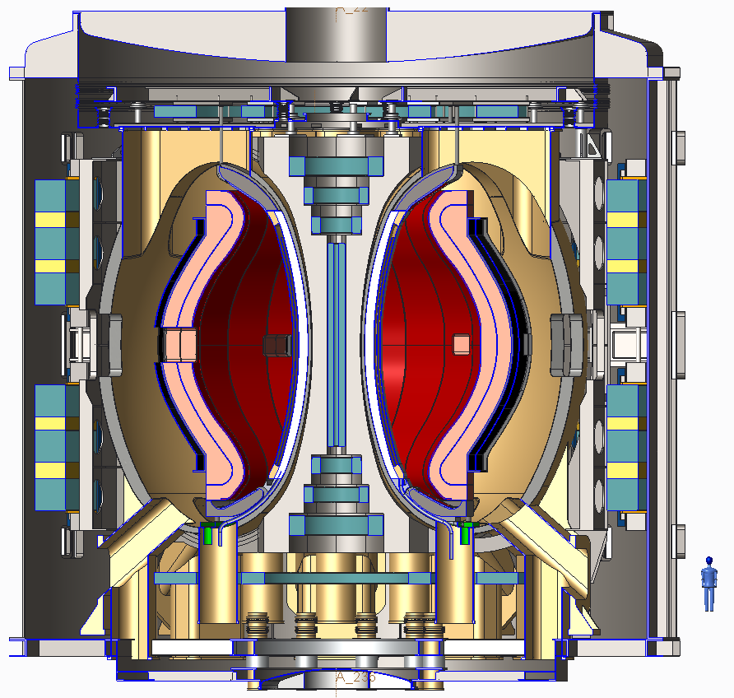
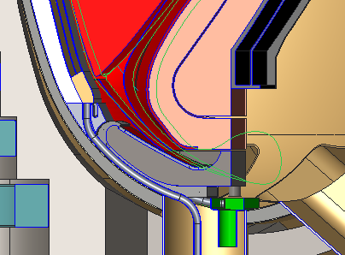
Low-A HTS design with Li flow on divertor and inboard surfaces
Double null liquid metal divertor system
Li flows from upper divertor down the inboard wall, exiting just after the lower inboard divertor.
Separate Li cooling of lower divertor
LM thickness = 5-10 mm, flow speed ~5-10 m/s
T. Brown, et al., submitted to Nuclear Fusion

Slide 29
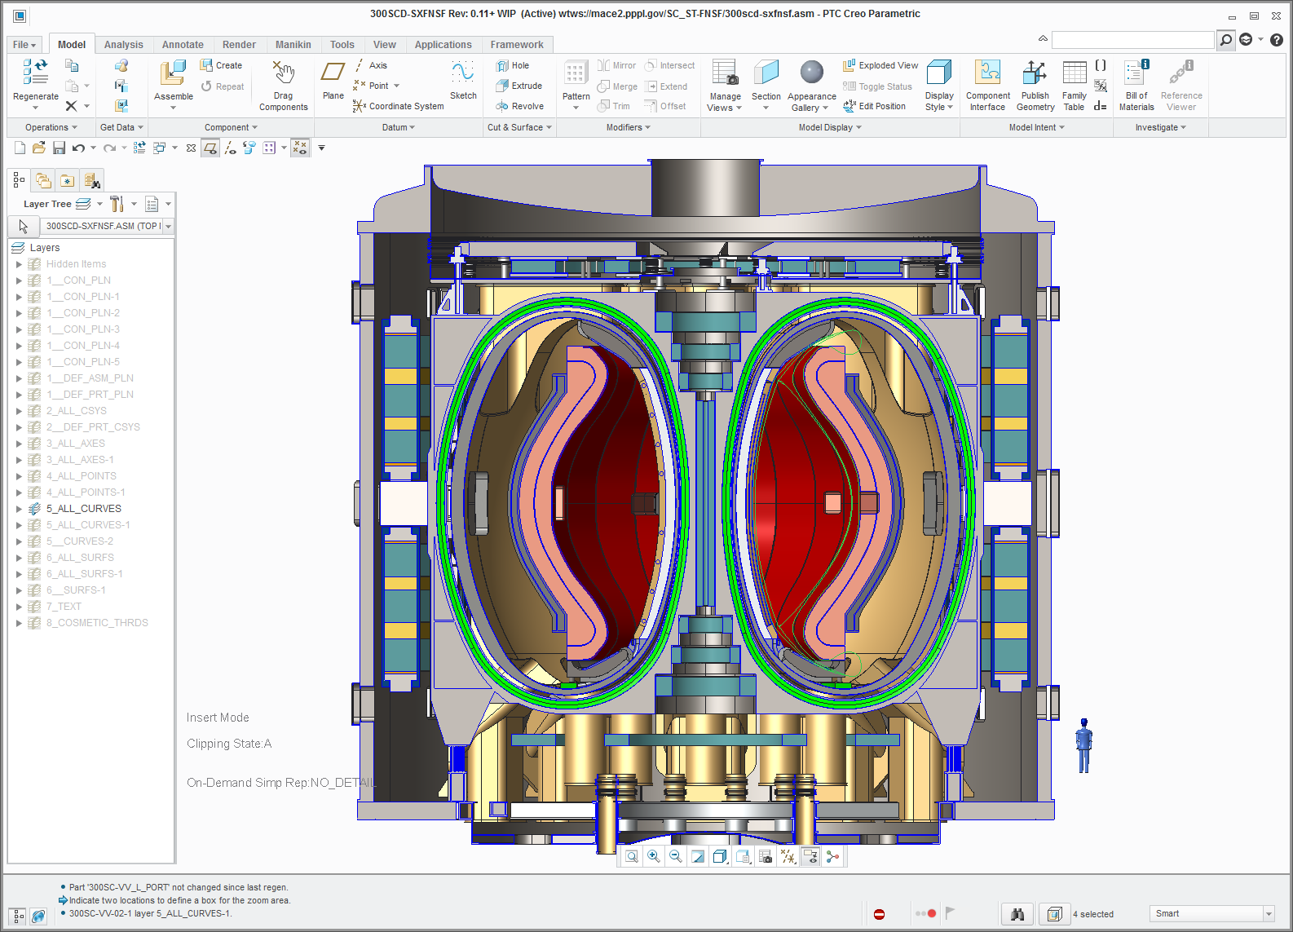
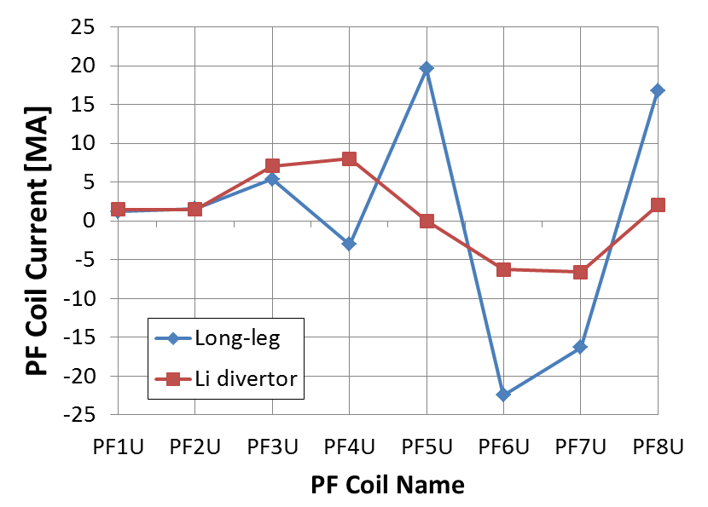
Benefits of shorter-leg liquid metal divertor:
No top PF coil or separate cryo-stat → simplified maintenance
4
5
3
2
6
1
7
8
Significantly reduce outboard PF coil current, force, structure
If liquid lithium, wall pumping could help increase H-factor

Slide 30
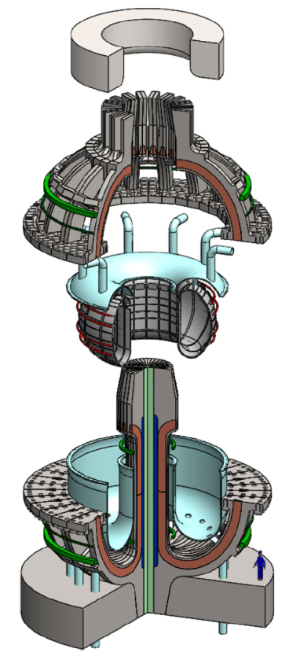
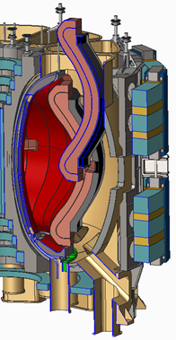
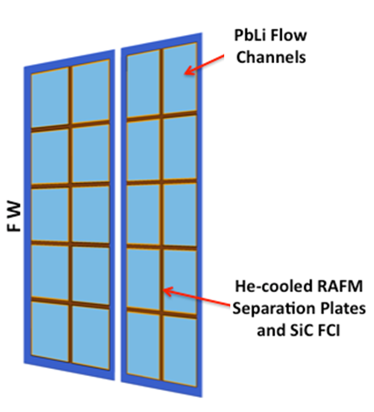
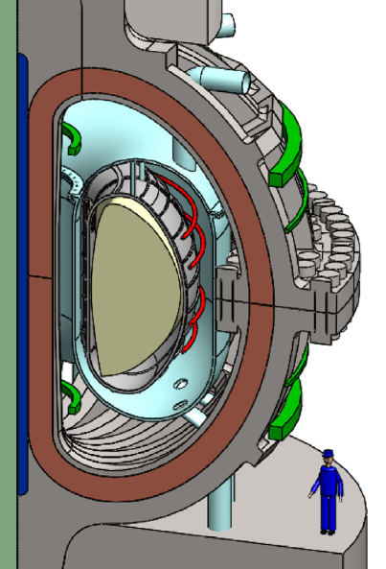
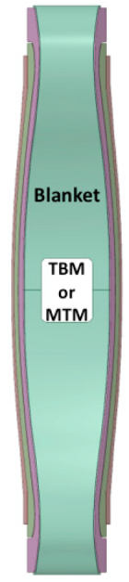
Liquid metal blankets offer potential for high thermal efficiency, modular design
HTS ST-FNSF/Pilot
ARC (MIT)
Jointed TF
FLiBe:
600-900ºC
PbLi
450-750ºC
SiC / PbLi
1000ºC
L. El-Guebaly, et al., Energies, 9 (2016) 632
Dual-coolant Lead-Lithium (DCLL) blankets, 20 vertical sectors: η_{th} = 30-45% (55% SiC/SiC)
FLiBe liquid immersion blanket, single component/removable: η_{th} = 40-50%

Slide 31
Summary: Compact fusion Pilot Plants possible with improved technology and physics operating regimes
Rare Earth BCO (REBCO) HTS TF magnet development
Lower A to improve stability – informed by NSTX-U/MAST-U
Pedestal confinement control via optimized velocity-shear, width
  Li wall pumping to provide pedestal width control, flatter T profiles
More efficient bulk current drive to facilitate steady-state
Long-leg / Super-X for heat-flux mitigation for narrow SOL
Liquid metals to exhaust heat, particles, eroded materials
  Simplify PF coil layout and vertical maintenance strategy
High-temp, efficiency modular or pool liquid-metal blankets

Slide 32
Backup slides

Slide 33
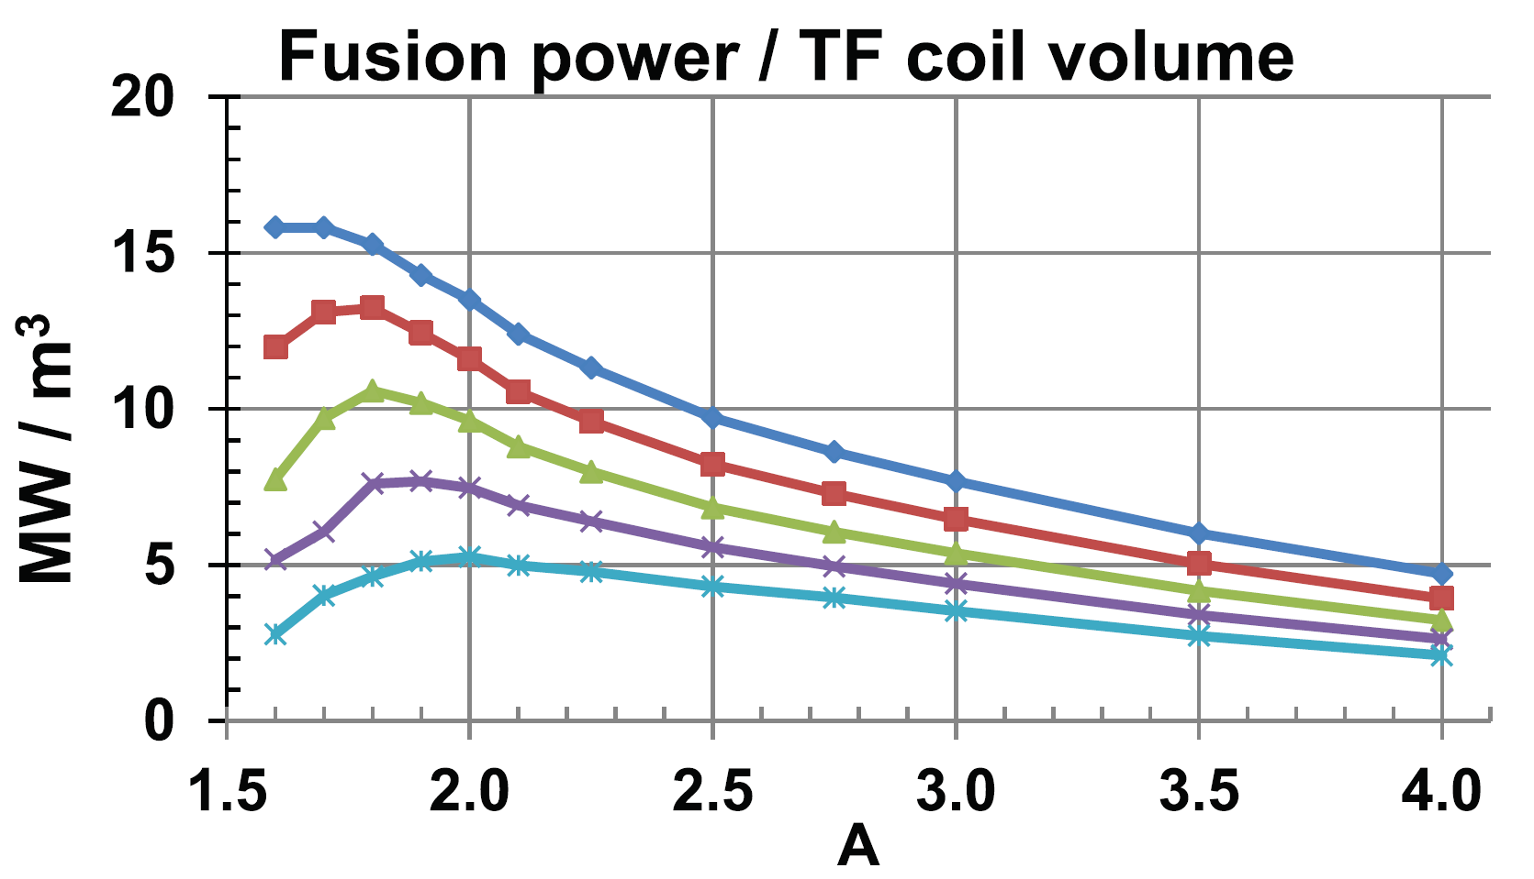
A = 1.8-2.3 maximizes TF magnet utilization, and TF will be significant fraction of core cost
Eff. shield
thickness:
J_{WP} = 70MA/m²
0.3m
0.4m
0.5m
0.6m
0.7m
A=4 utilization ~1/3-1/2 of maximum at low A
Optimal range

Slide 34
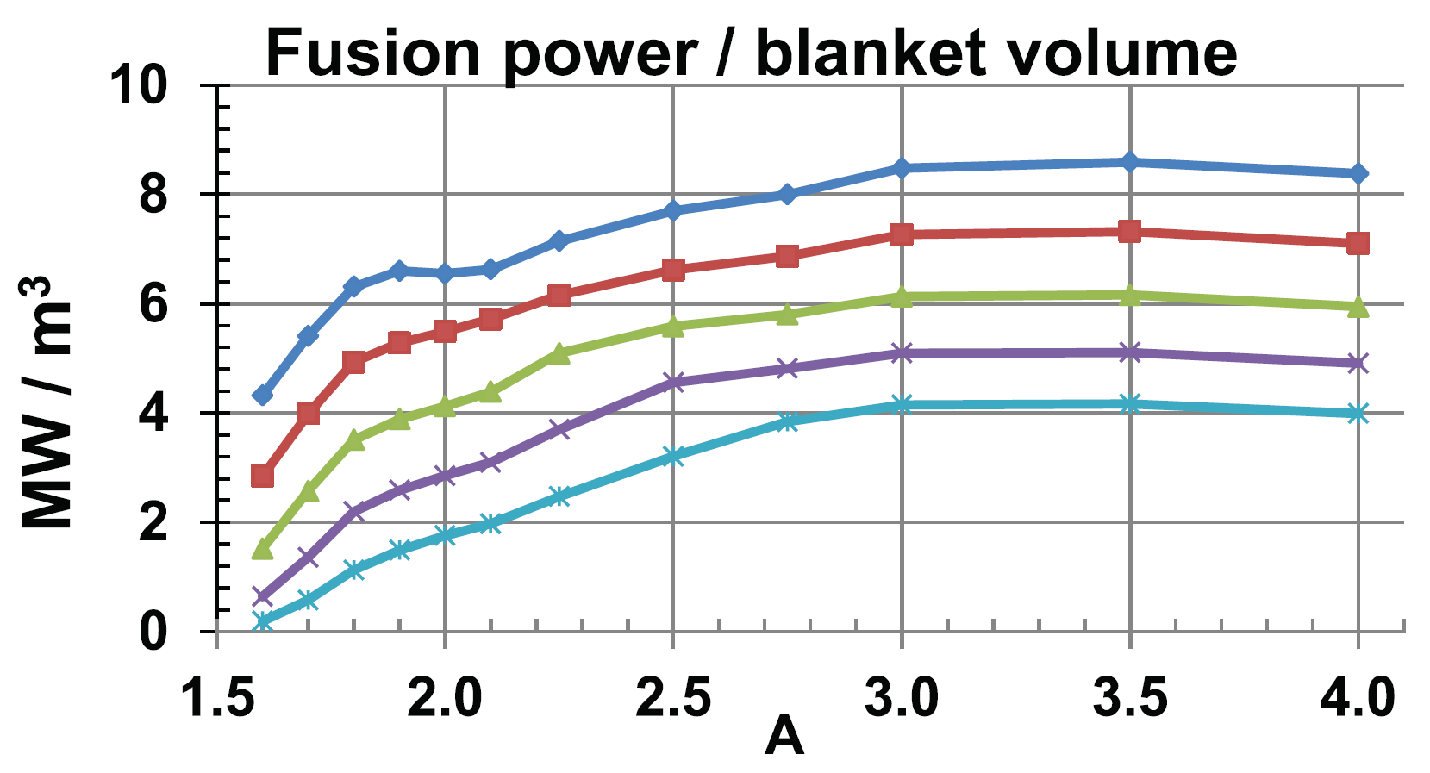
A ≥ 3 maximizes blanket volume utilization
Eff. shield
thickness:
0.3m
0.4m
0.5m
0.6m
0.7m
J_{WP} = 70MA/m²

Slide 35
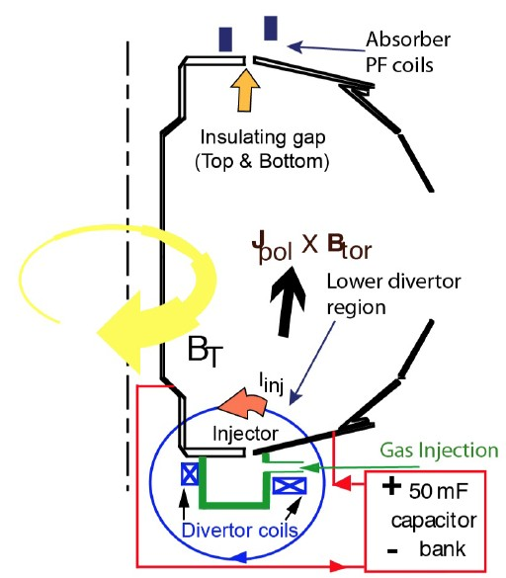
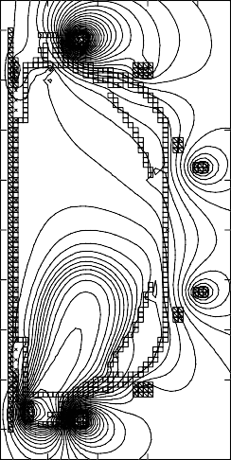
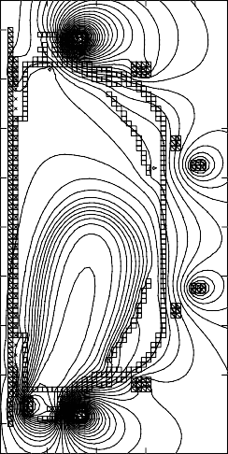
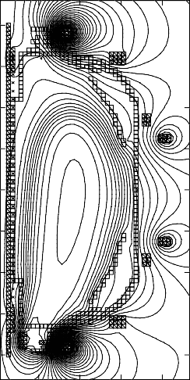

ST-FNSF may need solenoidless current start-up method
Coaxial Helicity Injection (CHI) effective for current initiation
CHI developed on HIT, HIT-II
Transferred to NSTX / NSTX-U
NSTX: 150-200kA closed flux current
NSTX-U: CHI projects to 300-400kA
TSC axisymmetric
simulation of CHI startup
1.0 ms 1.6 ms 2.7 ms
2
Z (m)
0
-2
R. Raman et al., PRL 2006
0
R (m)
2
0
R (m)
2
0
R (m)
2

Slide 36
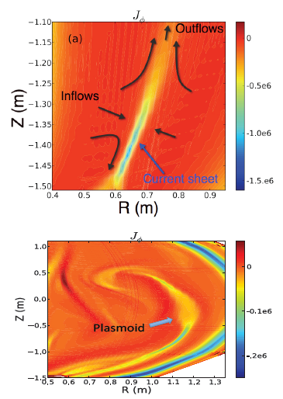
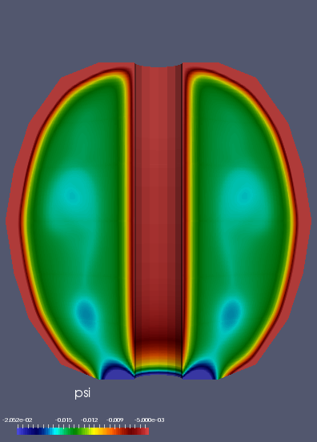
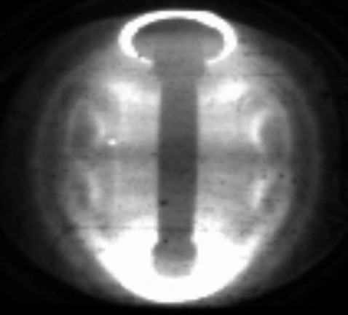

NIMROD simulations of CHI at high Lundquist number → plasmoid-mediated reconnection assists in flux closure
NIMROD Simulations
Sweet Parker (S-P) reconnection in the injector region at low Lundquist number
NIMROD simulation
Experiment
Plasmoids
Plasmoids seen in NSTX CHI
Plasmoids potentially important for extrapolating CHI to FNSF
F. Ebrahimi, et al., PRL (2015), NF (2016)

Slide 37
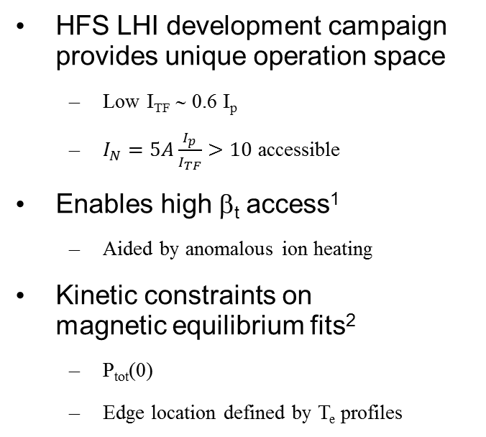
HFS Injection at low TF Provides Non-Solenoidal Sustainment at High I_{N}
I_{N} = 15
HFS LHI development campaign provides unique operation space
  Low I_{TF} ∼ 0.6 I_{p}
  $I_{N}=5A\frac{I_{p}}{I_{TF}}>10$ accessible
Enables high β_{t} access¹
  Aided by anomalous ion heating
Kinetic constraints on
magnetic equilibrium fits²
  P_{tot}(0)
  Edge location defined by T_{e} profiles
120
80
I_{p} (kA)
40
0
60
30
I_{TF} (kA)
0
18
22
26
Time (ms)
150
T_{i}
1.5
100
1.0
T_{e} (eV)
n_{e} (10¹⁹ m⁻³)
T_{e} (eV)
n_{e}(10¹⁹ m⁻³)
0.5
50
0.0
0
0
0.4
0.8
0
0.4
0.8
R_{maj} (m)
R_{maj} (m)
¹ M.W. Bongard, et al. NP10.52 Poster Wed morning
² G.M. Bodner, et al. NP10.54, Poster Wed. morning
Notes:
As it turns out, HFS injection at low toroidal field provides a unique operating space for non-solenoidal sustainment at High normalized current.
You heard previously that Plasma Material Interactions in our HFS injection campaign limited the magnitude of toroidal field we could apply.
When we pushed this space to its limits, ultimately here a toroidal field current only 60% our plasma current (shown here on the second trace), we were able to access and sustain plasmas in an operating space with very high normalized currents, at times with values 10-15.
Coupled with high densities and temperatures, shown here on the bottom right versus major radius, this enables access to very high beta toroidal values. A key feature I don’t have time to go into detail on, and that we’re still actively investigating, is the role of anomalous ion heating due to reconnection in the edge during LHI. I’m showing here the electron temperature profile in red, which interestingly shows a sharp gradient region in the edge. Regarding the ion temperatures, at this time point we measure the core ion temperature to be ~1.5 times the core electron temperature. This provides a significant contribution to the total plasma pressure.
Now, in order to accurately calculate toroidal beta, we’ve done kinetically-constrained magnetic equilibrium fits using the Thomson profiles. Specifically, we’ve constrained the total core pressure as measured by Thomson and our ion temperature diagnostic, and we’ve constrained the edge location as defined by the electron temperature profiles.

Slide 38



LHI-Produced Plasmas at low B_{t} Provide High β_{t}
Sample magnetic reconstruction at
t = 24.5 ms, using kinetic constraints
β_{T} for sustained, low-ℓ_{i}, high-κ,
LHI-driven plasmas
120
100
80
β_{t} (%)
60
40
20
0
0
5
I_{N}
10
15
¹ M.W. Bongard, et al. NP10.52 Poster Wed morning
Notes:
TO SAY:
I’m showing a sample magnetic reconstruction here on the left hand side which uses these kinetic constraints, here for a plasma current of 0.1 MA and toroidal field of 25 mT.
These plasmas are highly elongated, and have an extremely low li. For this case, we obtain a toroidal beta of 95%.
On the right hand side I’m showing a Troyon plot, a scatter plot of toroidal beta versus normalized plasma current. Operating spaces of several other tokamaks are shown as shaded regions, and updated Pegasus discharges are highlight as individual points. I should mention that the filled-in symbols represent beta-values obtained directly from kinetically-constrained equilibrium reconstructions. The empty symbols are magnetics-only reconstructions that have been calibrated based on the constrained results.
We note that some of the highest beta values come directly from kinetically-constrained equilibria.
I should also point out, too, that all of these discharges used zero Ohmic drive. Every Pegasus plasma on this plot was produced using solely Local Helicity Injection.
TO DO:
- Get list / have list on hand of caveats from Ray’s IAEA talk…

Slide 39
Engineering constraints
Magnet constraints
  Maximum stress in TF magnet structure = 0.66 GPa
  HTS tape/cable strain limit 0.3% (equivalent to 0.4 GPa)
  Winding pack current density (CORC 2015) 70 MA/m²
  OH at small R → higher solenoid flux swing for higher A
Shielding / blankets
  HTS fluence limit: 3.5-5 x 10²² n/m²
  Shield:10x n-shielding factor per 15-16cm WC for HTS TF
  Include inboard & outboard breeder thickness for TBR ~ 1
    “Effective shield thickness” includes shield + DCLL blanket
Electrical system efficiency assumptions:
  30% wall plug efficiency for H&CD - typical of NNBI
  ≥ 45% thermal conversion efficiency - typical of DCLL
    Also include pumping, controls, other sub-systems - see Pilot Plant NF 2011 paper

Slide 40



Simplified TF magnet design equations
From J. Schwartz, Journal of Fusion Energy, Vol. 11, No. 1, 1992

Slide 41


HTS performance vs. field and fast neutron fluence

Slide 42
Increased TF winding-pack current density can increase B_{T} in plasma 2-3× at low A
J_{WP} [MA/m²]
1.2× increase
(12T)
2× increase
3× increase

Slide 43
High current density HTS toroidal field coils could enable access to high fusion power in R~3m device
J_{WP} [MA/m²]
ITER-like TF constraints:
  J_{WP}=20MA/m², B_{max} ≤ 12T
  P_{fusion} ≤ 130MW
J_{WP} ~ 30MA/m², B_{max} ≤ 19T
  P_{fusion} ~ 400MW
J_{WP} ≥ 70MA/m²,B_{max} ≤ 19T
  P_{fusion} ~500-600MW
(12T)

Slide 44

A=2, R₀ = 3m device TF inboard leg
Current per coil: 6 MA
Winding Cd: 35.9 MA/m²
0.167 m² winding area

Slide 45






CAD Geometry of OB Blanket with Ports
Detailed Blanket Internals
MTM
Stabilizing
Shells
4 NBIs
TBM

Slide 46

Model blanket and shield thickness vs. A

Slide 47



Neutronics analysis for HTS TF shielding

Slide 48


Need inboard breeding for TBR > 1 at A=2
TBR
Required TBR = 1.04
(4% margin)
Outboard TBR ~ 0.92
IB blanket thickness [cm]
10cm IB blanket sufficient for TBR > 1.04

Slide 49


HTS TF lifetime is very strong function of inboard shielding thickness
Inboard shield + blanket equivalent to 60cm WC →
3FPY → 6-7MWy/m² → fulfill FNSF requirement

Slide 50

Detailed breeding calculations completed for A=2
Step 1- Infinite media of LiPb
Step 2- LiPb confined to OB FW/blanket
Step 3- Assembly gaps added
Step 4- Homogeneous mixture of blanket in upper and lower ends of OB blanket
Step 5- FW material added
Step 6- Side, back, and front walls added
Step 7- Cooling channels added
Step 8- SiC FCI added
Step 9- Stabilizing shells added
Step 10- MTM only inserted (TBR relative to Step #9)
Step 11- 4 TBMs only inserted (TBR relative to Step #9)
Step 12- 4 NBIs only inserted (TBR relative to Step #9)
Step 13- all MTM, 4 TBMs, and 4 NBIs inserted
Step 14 – include inboard breeding blanket

Slide 51


Outboard / inboard blanket vertical maintenance
Inboard blanket removed after outboard blanket sectors removed
Outboard blanket removed

Slide 52

Long-leg / deep-V slot divertor
PF coils outside TF
Increase strike-point radius ~2× to reduce q|| and peak heat flux
Divertor PFCs in region of reduced neutron flux
Narrow divertor aperture for increased TBR
More space for breeding at top and bottom of device

Slide 53


Pilot Plant study exploring liquid metal divertor design similar to flowing water curtain systems
LM injector system can be assembled in a single or double unit
LM containment structure
Shield block
Ferritic steel backing plate

Slide 54


Comparison of long vs. shorter-leg divertor Pilots:
Simplify vertical maintenance
Reduce outboard PF currents → can use LTS PF coils
Long-leg/Super-X divertor
Liquid Metal divertor

Slide 55


Lower Li containment system
Base Li return trough
Li flows over inboard surface to a continuous trough that feeds ten Li drain lines.
One of ten 100 mm ID Li inboard drain lines

Slide 56


Local details of Li divertor / inboard FW
Inboard shield
Upper Li feed
Li flow on girdle shell
Li and inboard component piping
Inboard DCLL blanket
Li drain plenum
Lower divertor

