Slide 1


Characterization and Forecasting of Unstable Resistive Wall Modes in NSTX and NSTX-U
Jack Berkery, Columbia University
S.A. Sabbagh¹, Y.S. Park¹, R.E. Bell², S.P. Gerhardt², C.E. Meyers²
¹Columbia University, ²Princeton Plasma Physics Laboratory
58th Annual Meeting of the APS Division of Plasma Physics
San Jose, CA, October 31 – November 4, 2016

Slide 2
Outline
Disruption Event Characterization and Forecasting
  New DECAF code developed and used to analyze NSTX disruptions
Characterization
  Example: Resistive wall modes (RWM)
  Analysis of a database of RWM unstable discharges in NSTX
Forecasting
  Modification of ideal stability by kinetic effects explains experimental instability
  Reduced kinetic model implemented in DECAF, successfully used on database
Can real-time reduced model be used in NSTX-U to avoid disruptions?

Slide 3
Disruption event chain characterization capability started for NSTX-U as next step in disruption avoidance plan
Approach to disruption prevention
  Identify disruption event chains and elements
  Predict events in disruption chains
  Cues disruption avoidance systems to break event chains
    Attack events at several places with active control
  Builds upon both physics and control successes of NSTX
t
[DOE report on Transient events (2015)]

Slide 4
Disruption Event Characterization And Forecasting (DECAF) code is structured to ease parallel development
Physical event modules
Physical event modules
  Present grouping follows work of deVries [P.C. de Vries et al., Nucl. Fusion 51, 053018 (2011)]
  – BUT, easily appended or altered
Warning algorithm
  Present approach follows [S.P. Gerhardt et al., Nucl. Fusion 53, 063021 (2013)]
  More flexible: arbitrary number of tests, thresholds, and user-defined levels and warning points
Code control workbooks
Density Limits
Confinement
Main data structure
Technical issues
Tokamak dynamics
Output processing
Power/current handling
Mode stability
Kinetic RWM analysis will be used in DECAF as a reduced stability model

Slide 5
Outline
Disruption Event Characterization and Forecasting
  New DECAF code developed and used to analyze NSTX disruptions
Characterization
  Example: Resistive wall modes (RWM)
  Analysis of a database of RWM unstable discharges in NSTX
Forecasting
  Modification of ideal stability by kinetic effects explains experimental instability
  Reduced kinetic model implemented in DECAF, successfully used on database
Can real-time reduced model be used in NSTX-U to avoid disruptions?

Slide 6
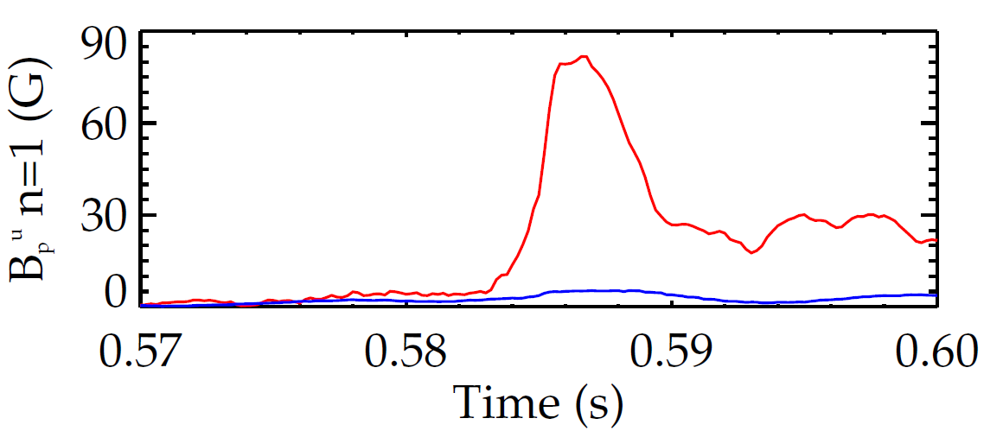
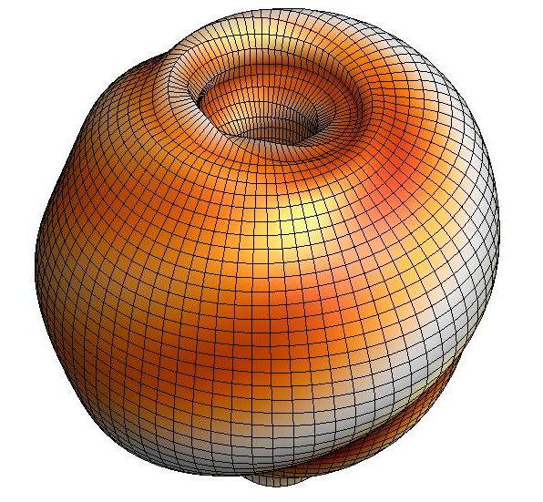

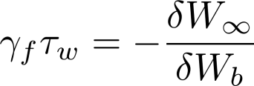
An unstable RWM is a plasma-induced exponential growth of magnetic field line kinking that can cause disruptions
Copper plate
unstable RWM
NSTX
137722
140102
B_{p}
Resistive Wall Mode
Ideal Kink
Mode
γ
~τ_{w}⁻¹
unstable
0
stable
[S. Sabbagh et al., Nucl. Fusion 46, 635 (2006)]
β_{N}^{no-wall}
β_{N}^{with-wall}

Slide 7
An unstable RWM is a plasma-induced exponential growth of magnetic field line kinking that can cause disruptions
Copper plate
unstable RWM
NSTX
137722
140102
B_{p}
Resistive Wall Mode
Ideal Kink
Mode
γ
~τ_{w}⁻¹
unstable
0
stable
[S. Sabbagh et al., Nucl. Fusion 46, 635 (2006)]
β_{N}^{no-wall}
β_{N}^{with-wall}

Slide 8
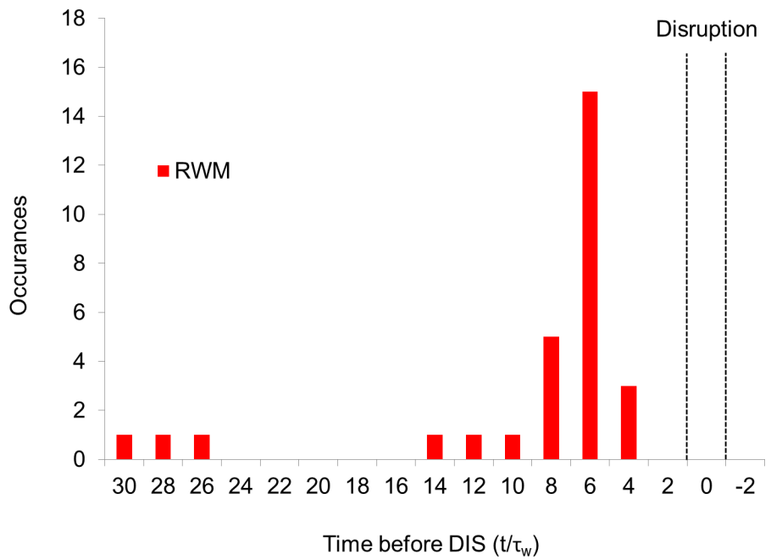
Initial DECAF results detects disruption chain events when applied to dedicated 44 shot NSTX RWM disruption database
RWM B_{P}^{n=1} threshold 30G (δB/B₀ ~ 0.67%)
~60% within 14 τ_{w} of disruption time (τ_{w} = 5 ms)
unstable RWM
NSTX
137722
140102
RWM events in DECAF
Disruption

Slide 9
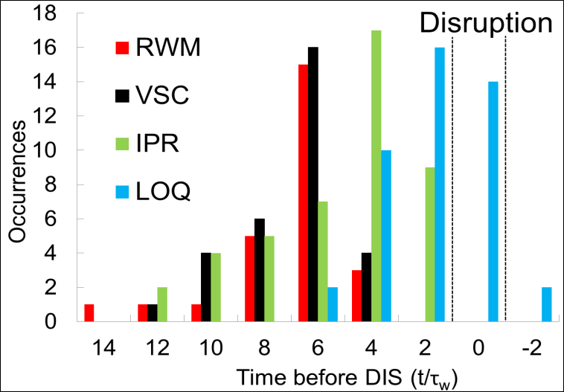
Initial DECAF results detects disruption chain events when applied to dedicated 44 shot NSTX RWM disruption database
RWM B_{P}^{n=1} threshold 30G (δB/B₀ ~ 0.67%)
~60% within 14 τ_{w} of disruption time (τ_{w} = 5 ms)
unstable RWM
NSTX
137722
140102
RWM events in DECAF
  RWM: RWM event warning
  VSC: Vertical stability control
  IPR: Plasma current request not met
  LOQ: Low edge q warning
Disruption

Slide 10
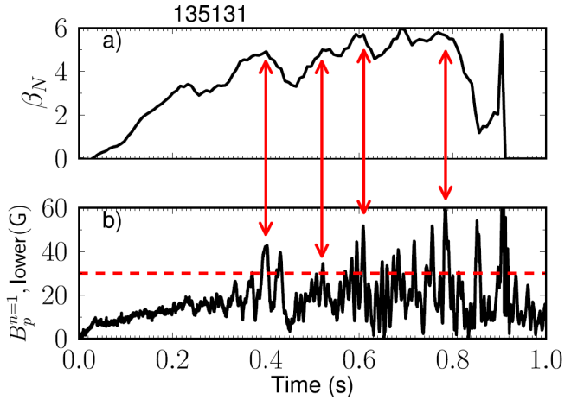
Initial DECAF results detects disruption chain events when applied to dedicated 44 shot NSTX RWM disruption database
RWM B_{P}^{n=1} threshold 30G (δB/B₀ ~ 0.67%)
~60% within 14 τ_{w} of disruption time (τ_{w} = 5 ms)
unstable RWM
NSTX
137722
140102
Earlier RWM events not false positives!
  Minor disruptions cause large decreases in β_{N} and stored energy with subsequent recovery
Disruption

Slide 11
Outline
Disruption Event Characterization and Forecasting
  New DECAF code developed and used to analyze NSTX disruptions
Characterization
  Example: Resistive wall modes (RWM)
  Analysis of a database of RWM unstable discharges in NSTX
Forecasting
  Modification of ideal stability by kinetic effects explains experimental instability
  Reduced kinetic model implemented in DECAF, successfully used on database
Can real-time reduced model be used in NSTX-U to avoid disruptions?

Slide 12
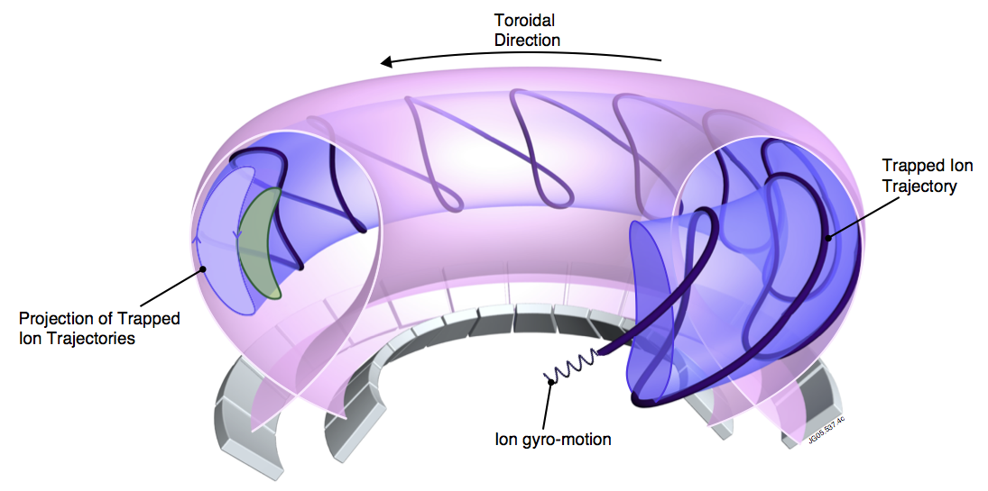

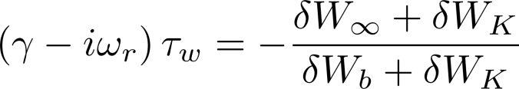
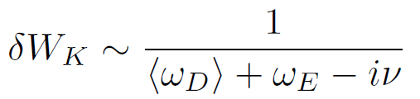
A full description of RWM stability includes both fluid and “kinetic effects”: taking into account complex particle motion
MISK code
Solves for RWM growth rate
is solved by using from the drift kinetic equation
Precession Drift
~Plasma Rotation
[R. Pitts et al., Physics World, March 2006]
[J. Berkery et al., Phys. Rev. Lett. 104, 035003 (2010)]

Slide 13
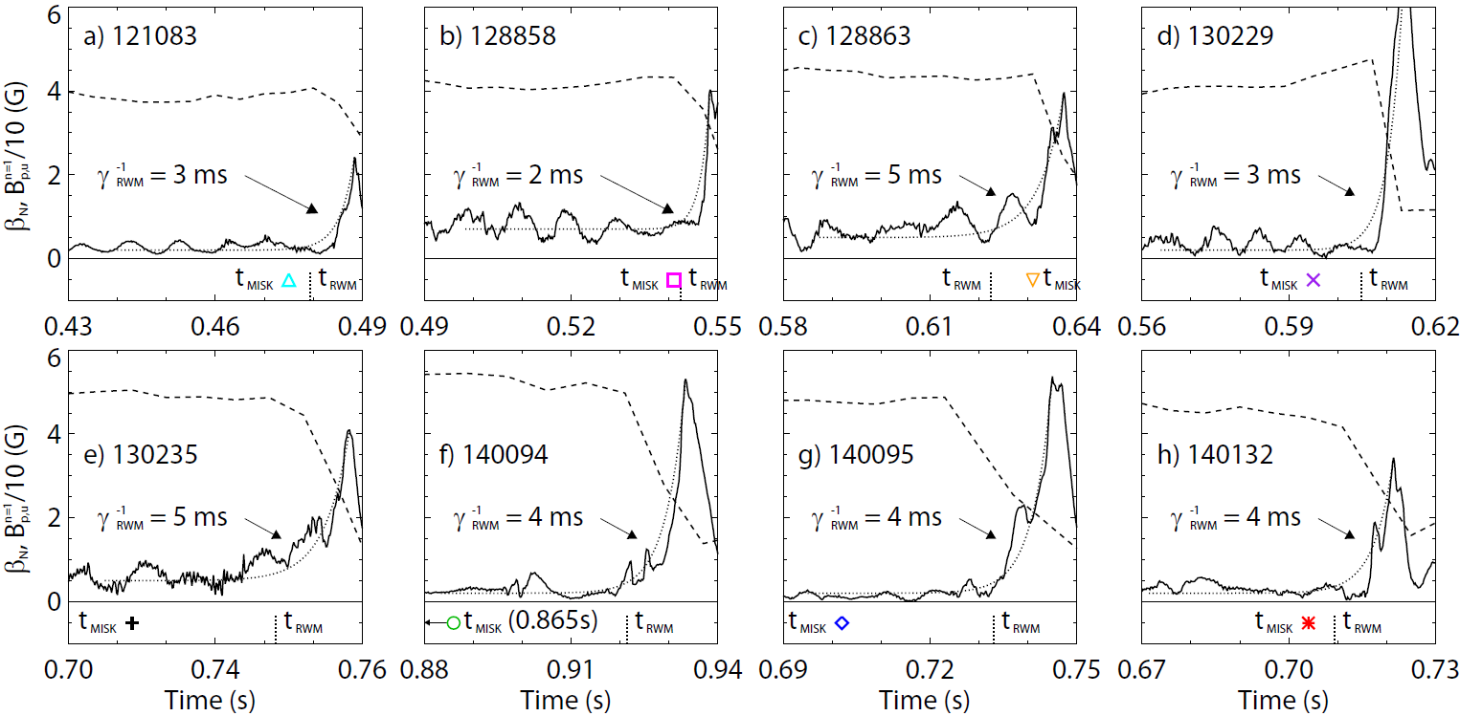
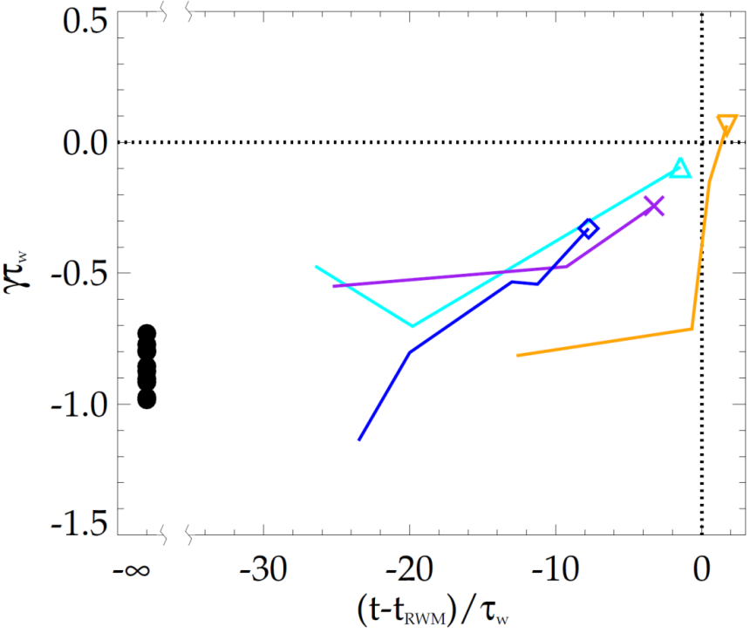
MISK calculations validated against unstable experimental plasmas; reproduce approach towards marginal stability
NSTX
NSTX
MISK Calculations
unstable
β_{N}
stable
B_{p}
[J. Berkery et al., Nucl. Fusion 55, 123007 (2015)]
MISK Calculations

Slide 14
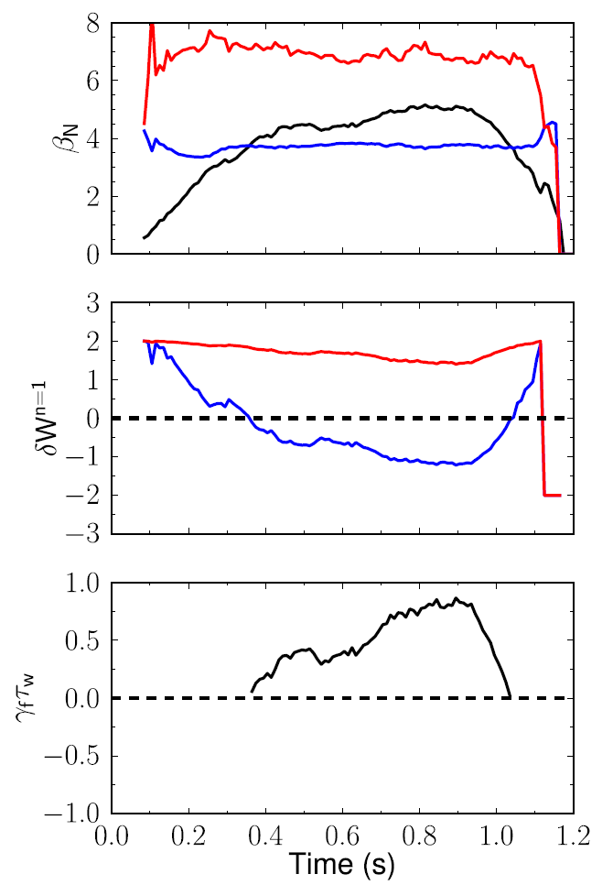
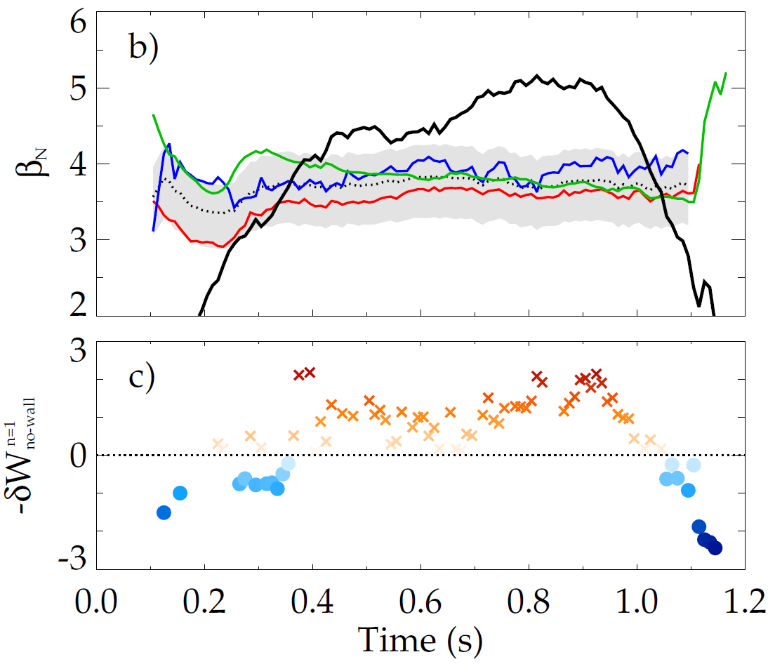
Goal is to forecast mode growth rate in real-time using parameterized reduced models for δW terms
Modeled estimates for NSTX no-wall limit
with-wall limit
Internal inductance
Pressure peaking
Aspect ratio
Composite no-wall limit model
β limits
no-wall limit
with-wall limit
NSTX 138556
δW
no-wall limit
Fluid Terms
fluid RWM growth rate
growth
rate
(γτ_{w})
RWM dispersion relation
stabilized by kinetic effects

Slide 15
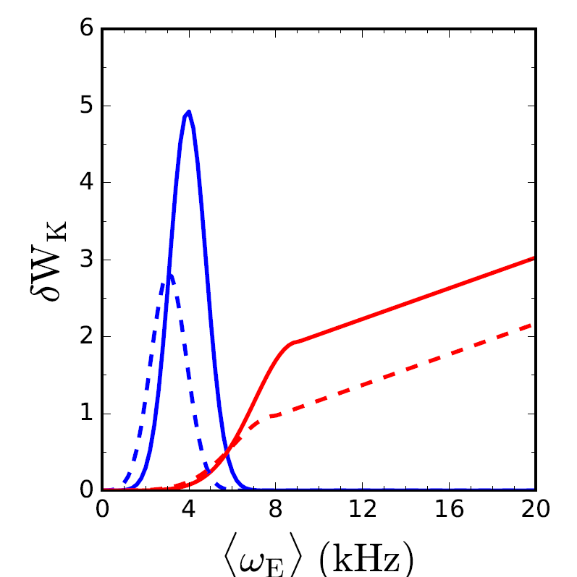
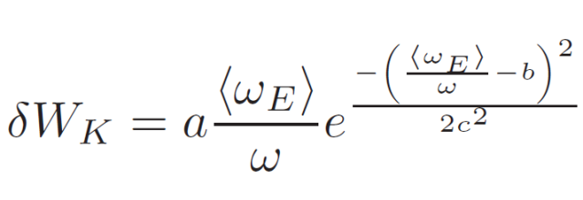
Physics understanding from previous RWM research used to construct a reduced kinetic model
Gaussian functions are used for resonances
  Positions in <ω_{E}> determined by ω_{D} and ω_{b}
  Height (a), width (b), and position (c) dependent on ν/ω_{D} or ν/ω_{b}
  Coefficients selected to reflect NSTX experience
Precession resonance
Bounce resonances
real
imaginary
<ν> = 1 kHz
RWM dispersion relation
Kinetic Effects

Slide 16
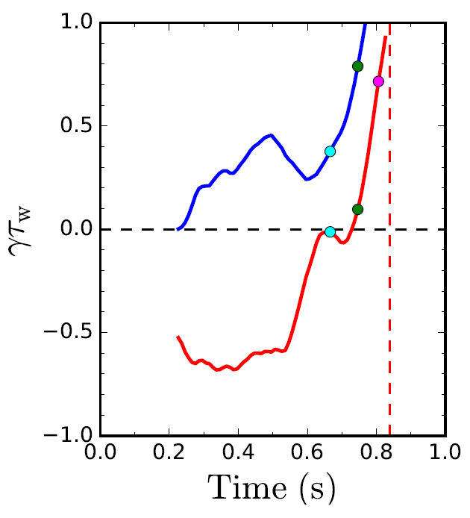
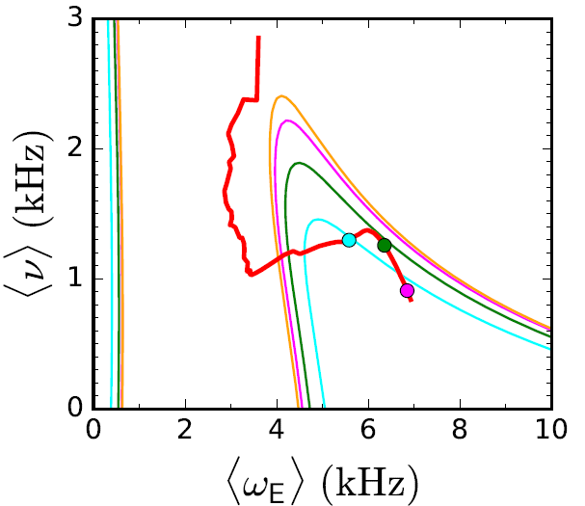

DECAF contains modeled kinetic quantities for generation of stability maps
Normalized growth rate vs. time
Stability diagram shows trajectory of a discharge towards unstable regions
Fluid
C_{β}
unstable
C_{β} = (β_{N} – β_{N}^{no-wall})/
(β_{N}^{with-wall} – β_{N}^{no-wall})
stable
Fluid + Kinetic
unstable
region

Slide 17
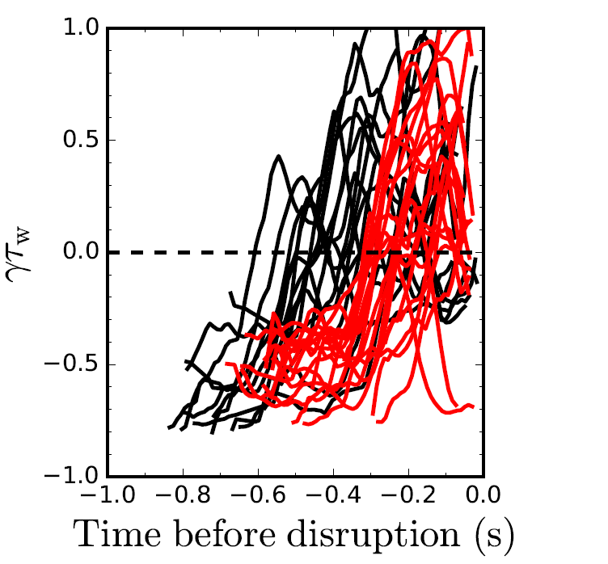
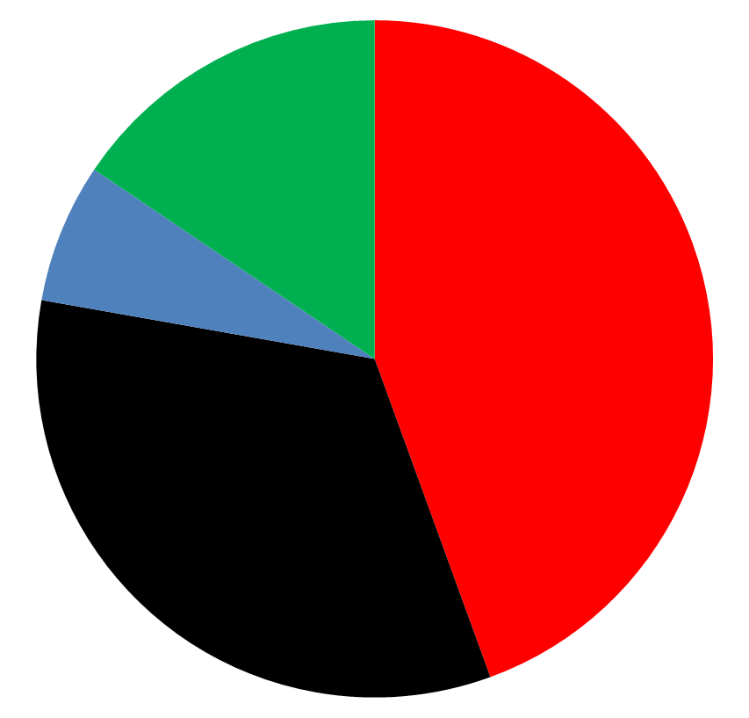
DECAF reduced kinetic model results initially tested on a database of NSTX discharges with unstable RWMs
Normalized growth rate vs. time
Predicted instability statistics (45 shots)
84% of shots are predicted unstable
44% predicted unstable < 320 ms before disruption
33% predicted unstable within 100 ms of a minor disruption
Stable
(16%)
Instability < 320 ms
before disruption
(44%)
(7%) False
positives
unstable
Instability within 100 ms of minor
disruption
(33%)
stable
Tradeoff: missed vs. early warnings

Slide 18
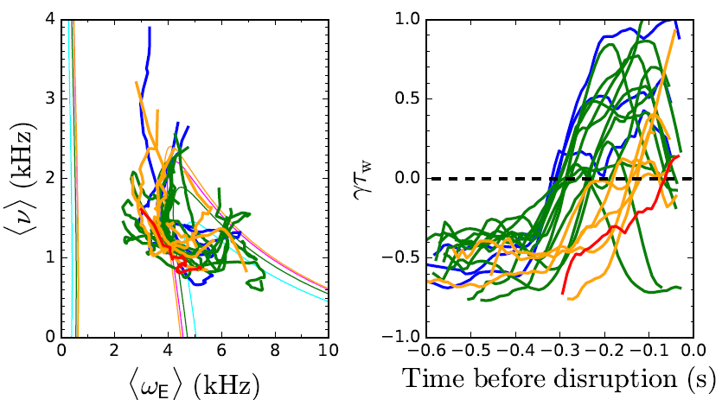
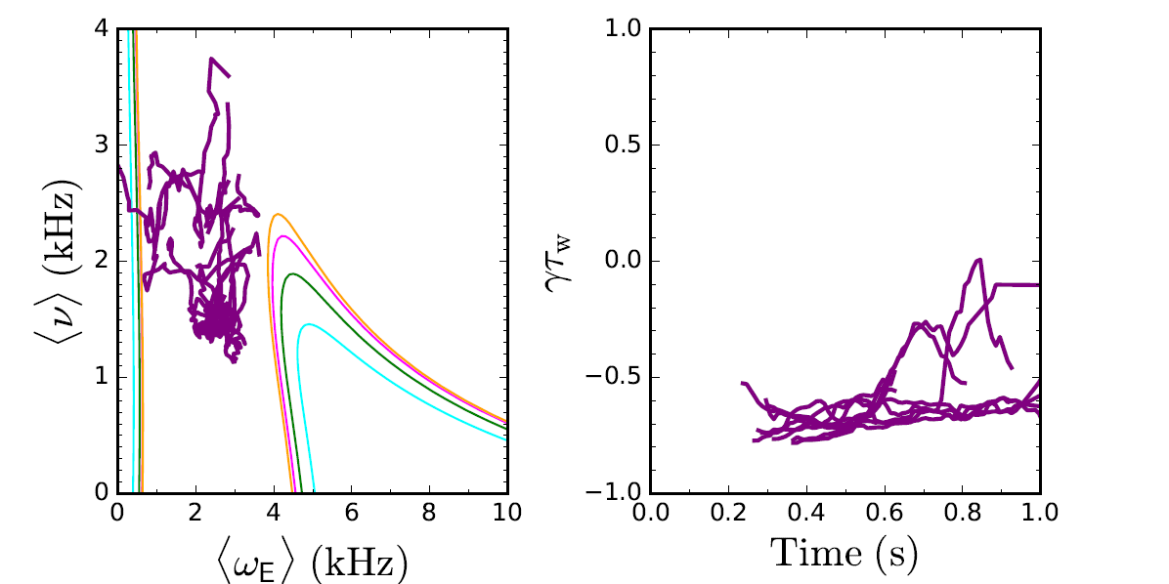
Reduced kinetic model distinguishes between stable and unstable NSTX discharges
Unstable cases
Stable cases
If <ω_{E}> ~ 0 warnings are eliminated, 10/13, or 77%, of stable cases are stable in the model
Model is successful in first incarnation - development continues to improve forecasting performance

Slide 19
Outline
Disruption Event Characterization and Forecasting
  New DECAF code developed and used to analyze NSTX disruptions
Characterization
  Example: Resistive wall modes (RWM)
  Analysis of a database of RWM unstable discharges in NSTX
Forecasting
  Modification of ideal stability by kinetic effects explains experimental instability
  Reduced kinetic model implemented in DECAF, successfully used on database
Can real-time reduced model be used in NSTX-U to avoid disruptions?

Slide 20
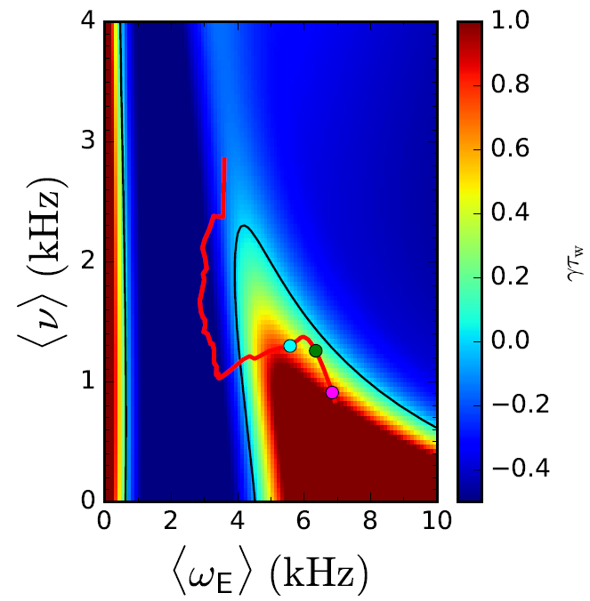
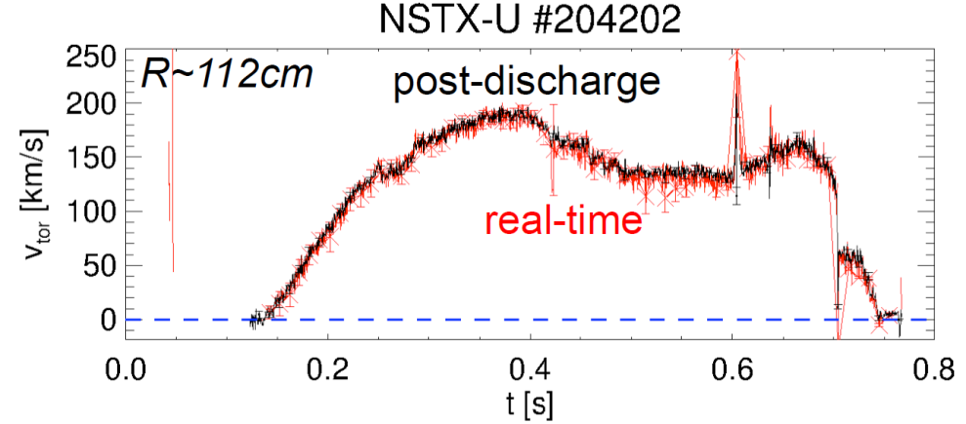
Next step: Can this reduced model be used in real-time to steer clear of RWM instability regions?
Real-time velocity data now available on NSTX-U
Steer plasma back into stable region
204202
[M. Podesta and R.E. Bell, submitted to Rev. Sci. Inst. (2016)]
(and poster, this conference)
State space rotation control designed for NSTX-U
  New 6-source NBI provides broader profile, more flexibility
[I.R. Goumiri et al., Nucl. Fusion 56, 036023 (2016)]
(and invited talk, this conference)

Slide 21
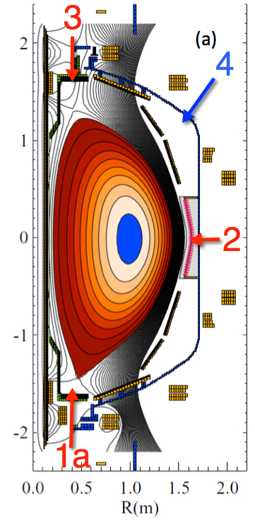
Next step: Can this reduced model be integrated into a larger disruption avoidance and mitigation scheme?
I_{P}
Plasma control system detects loss of control
  Ex: vertical oscillations exceeding a threshold
  Switches to new states that gently end the discharge
New MGI will study variation of poloidal injection location
  MGI valves 1 and 2 fully functional on NSTX-U
I_{P} Request
(including transition to rampdown)
  Z_{P}(dZ_{P}/dt) threshold
  Z_{P}(dZ_{P}/dt)
(D. Boyer talk, and S. Gerhardt poster, this conference)
[R. Raman et al., IEEE Trans. on Plasma Sci., (2016)]

Slide 22
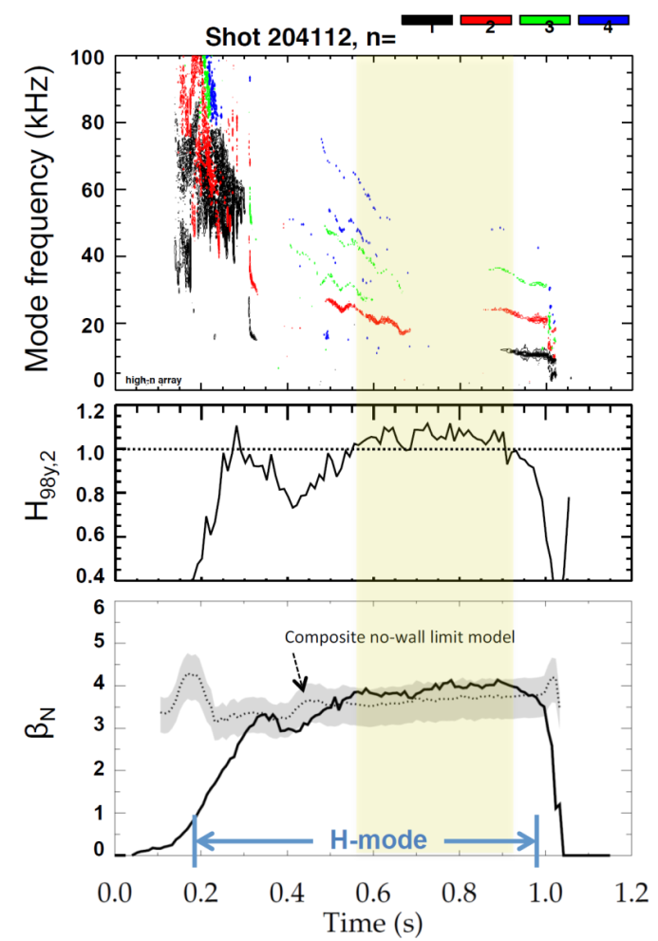
NSTX-U had scientifically productive first year, is poised to perform disruption avoidance experiments
1 2 3 4
Achieved H-mode on 8th day of 10 weeks of operation
Surpassed magnetic field and pulse-duration of NSTX
NSTX-U scenario achieved with H₉₈ ≥ 1, β_{N} ≥ no-wall limit
  Matches best NSTX performance at I_{p} = 0.9MA
Identified and corrected dominant error fields
Implemented techniques for controlled plasma shut down, commissioned new tools for mitigation
Aim to resume plasma operations end of 2017 / early 2018

Slide 23
Summary
DECAF code developed for disruption characterization and forecasting
Kinetic theory modifies ideal stability, includes rotation, collisionality
  MISK code calculations can explain experimental RWM stability
  Full MISK code calculations of δW_{K} can not be performed in real time, but physics insight used to create a reduced model
Reduced kinetic model for disruption avoidance is implemented, ready to be tested in NSTX-U
  Success rate is surprisingly high given its initial state and relative simplicity
  Will enable unstable growing RWM to be anticipated, rather than reacted to

Slide 24
Backup

Slide 25
Physics understanding from previous research used to construct a reduced kinetic model
Goal is to forecast γ in real-time using parameterized reduced models for δW terms
Need δW_{K} as a function of the most important, real-time measurable quantities
Reduced Kinetic Model
References
[1] B. Hu et al., Phys. Rev. Lett. 93, 105002 (2004)
[2] B. Hu et al., Phys. Plasmas 12, 057301 (2005)
[3] J. Berkery et al., Phys. Rev. Lett. 104, 035003 (2010)
[4] J. Berkery et al., Phys. Plasmas 17, 082504 (2010)
[5] J. Berkery et al., Phys. Rev. Lett. 106, 075004 (2011)
[6] H. Reimerdes et al., Phys. Rev. Lett. 106, 215002 (2011)
[7] J. Berkery et al., Phys. Plasmas 21, 056112 (2014)
[8] J. Berkery et al., Phys. Plasmas 21, 052505 (2014)
[9] S. Sabbagh APS invited (2014)
[10] J. Berkery et al., Nucl. Fusion 55, 123007 (2015)
… more
Rotation³,
Collisionality⁵
Fluid Terms¹⁰
Kinetic Effects¹
MISK² Calculations
Benchmarked⁸, Comp. to Expts^{3,4,6,7,9}

Slide 26
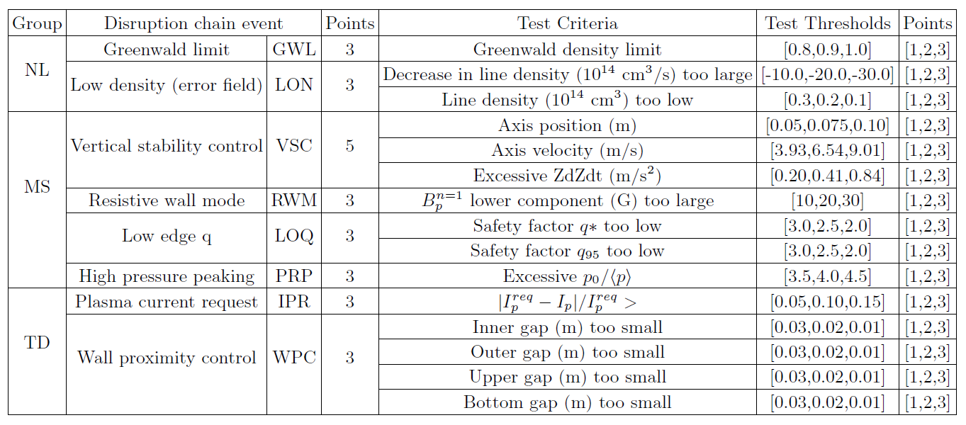
Several threshold tests are currently included in DECAF

Slide 27
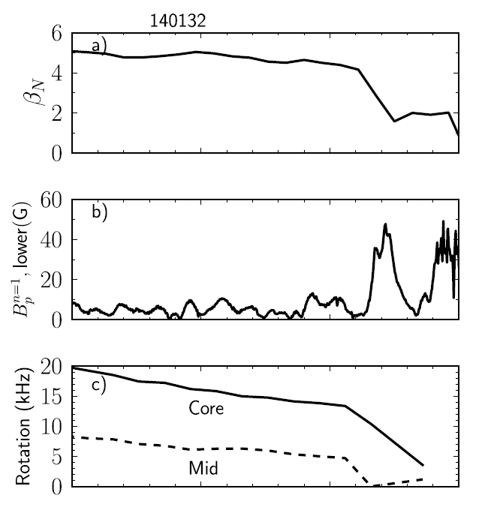
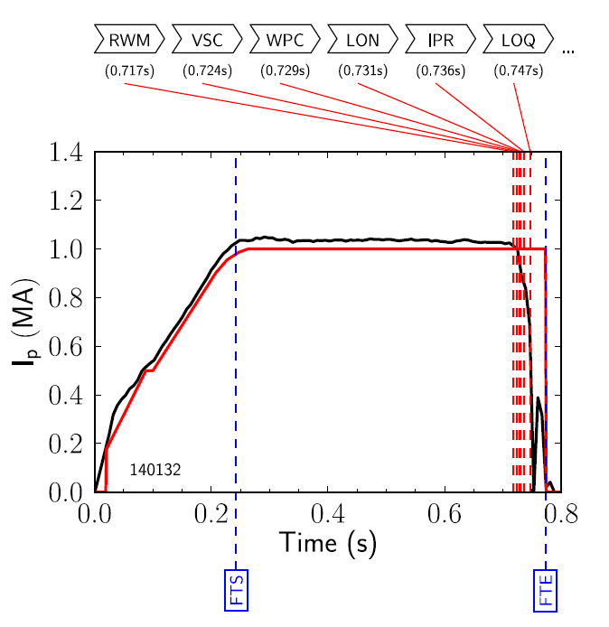

The DECAF code is being used to characterize disruption event chains on NSTX, including RWMs
Disruption event chain
  Resistive wall mode (RWM)
  Vertical stability control (VSC)
  Wall proximity control (WPC)
  Low density (LON)
  Plasma current not meeting request (IPR)
  Low q (LOQ)
  Excessive pressure peaking (PRP)
  Disruption
Also, flags:
  Flattop start (FTS)
  Flattop end (FTE)
  Etc…

Slide 28
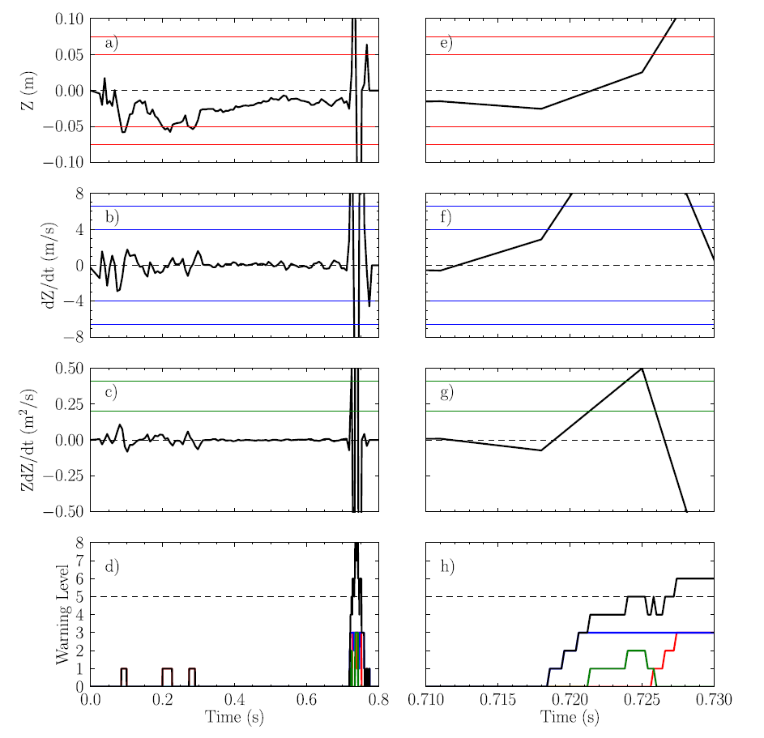
More detailed example of DECAF threshold testing:
Vertical Stability Control
Warning algorithm
  Present approach follows [S.P. Gerhardt et al., Nucl. Fusion 53, 063021 (2013)]
  More flexible: arbitrary number of tests, thresholds, and user-defined levels and warning points
Vertical stability tests
  Axis position
  Axis velocity
  Excessive Z*dZ/dt
NSTX 140132

Slide 29
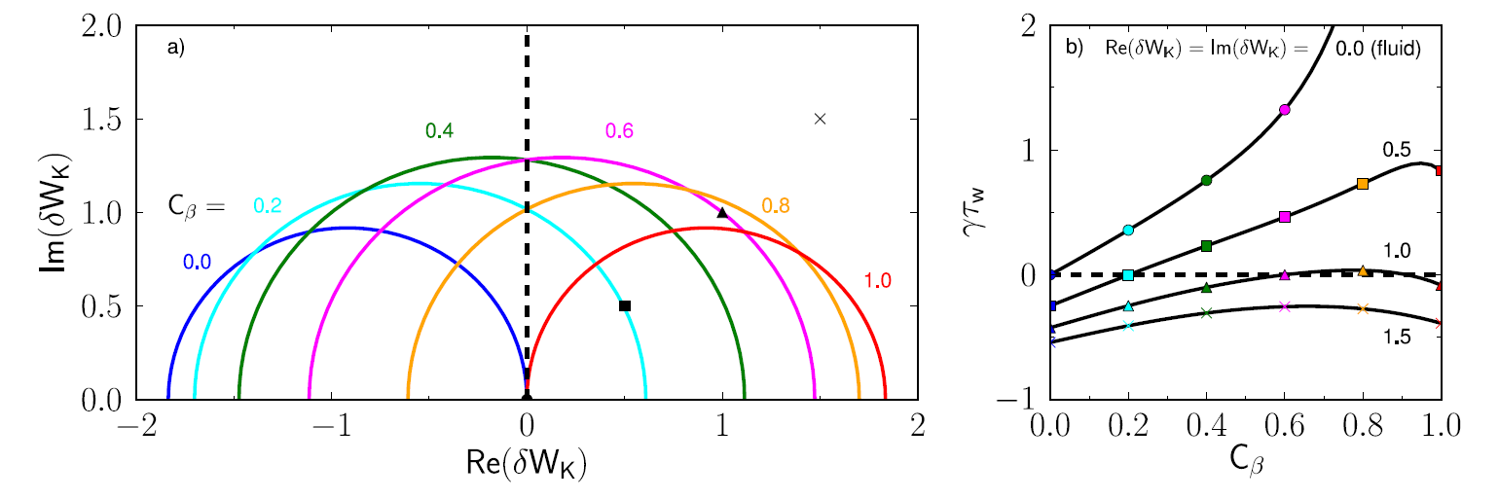
The unstable region of the stability diagram is determined by the fluid δW terms; Kinetic effects can stabilize the RWM
Stability diagram in kinetic stability space
Large kinetic effects – robustly stable
The unstable region, inside the circle, moves when β changes
Size and position of the circle determined by fluid δW terms
Moderate levels of kinetic effects stabilize the RWM at certain beta values

Slide 30
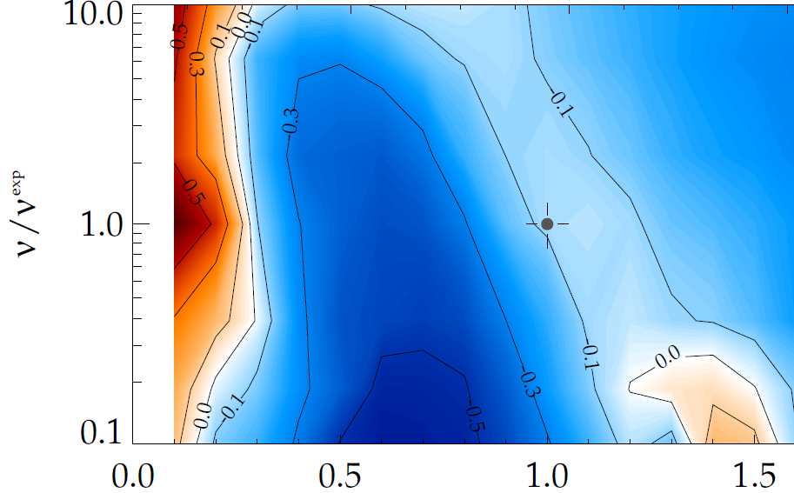
Kinetic theory consistent with RWM destabilization at intermediate plasma rotation and collisionality affects the strength of resonances
MISK calculations of γτ_{w} contours vs. ν and ω_{φ}
Destabilization appears between:
  precession resonance at low ω_{φ}
  bounce resonance at high ω_{φ}
Stabilizing resonant kinetic effects enhanced at low ν
(marginal stability)
instability
(NSTX
experiment)
ν/ν^{exp (marginal stability)}
Precession drift resonance stabilization
unstable
ω_{φ}/ω_{φ}^{exp (marginal stability)}

Slide 31
Initial DECAF analysis already finding common disruption event chains, giving new insight
Several events detected for all shots
  RWM: RWM event warning
  WPC: Wall proximity control
  IPR: Plasma current request not met
  LOQ: Low edge q warning
  Others:
    PRP: Pressure peaking warning (34/44)
    VSC: Vertical stability control (31/44)
VSC
PRP
15.9%
WPC
PRP
13.6%
IPR
WPC
11.4%
RWM
PRP
IPR
11.4%
WPC
VSC
9.1%
VSC
WPC
9.1%
Identifying common chains of events can provide insight on how to cue avoidance systems
  6 (out of theoretically 42) two-event combinations following RWM accounted for 70% of the cases in the database
Other
29.5%

Slide 32
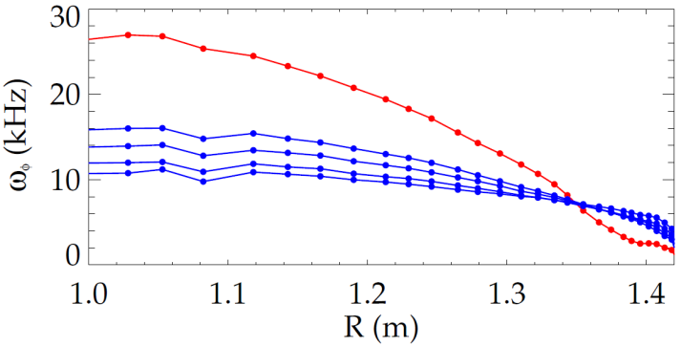
A scalar critical plasma rotation model can not explain RWM stability; it depends on the ω_{φ} profile
Early theories with scalar “critical rotation” for stability could not explain experiments
New theory: consider kinetic effects
unstable RWM
NSTX
137722
140102
Plasma rotation
Ideal Stability
Kinetic Effects
unstable
slowed by n=3 braking
[B. Hu et al., Phys. Rev. Lett. 93, 105002 (2004)]

