Slide 1


Internal instability driven by centrifugal force on spherical tokamak
G.Z. Hao, W.W. Heidbrink, D. Liu,(UCI), Y.Q.Liu (GA), N. Crocker (UCLA), E.D.Fredrickson, M.Podesta, Y.Ren, R.Bell (PPPL), K.Tritz(JHU)
59th Annual Meeting of APS Division of Plasma Physics
Milwaukee, Wisconsin
Oct. 23-Oct.27, 2017

Slide 2
Low-frequency (<50kHz) modes commonly induce fast-ion redistribution/loss on spherical tokamak
Low-frequency modes commonly occur at the early-phase of NSTX discharge. Some cases are associated with certain internal MHD instability.
  At the onset, the mode frequency generally matches the plasma rotation
  Low-f mode can cause beta saturation, rotation damping, and fast-ion redistribution/loss.
This work investigates the mechanism for the onset of the internal low-f mode
Key message of this work: internal mode driven by centrifugal force
Centrifugal force is expected to be important for MHD instabilities in fast rotating plasmas in both present spherical tokamak (ST) and future facilities based on ST
TRANSP classical

Slide 3
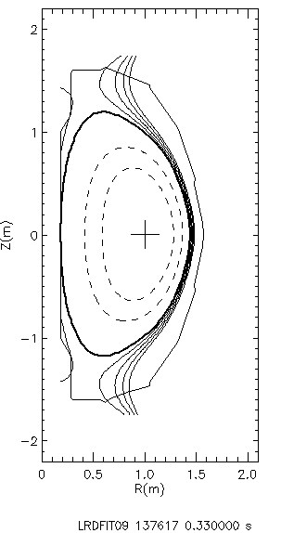
Introduction to centrifugal force (CF)
NSTX#137617,LRDFIT09
Perturbed momentum equation:
Centrifugal force direction
Centrifugal force (CF).
Always along major radius
Coriolis force
[Zheng1999POP]

Slide 4
Low-frequency mode is generally localized in the core region
Identified mode position, based on the mode frequency, is generally localized in the inside region (113-119 cm for the chosen shots)
Low-f mode strongly damps the plasma rotation in the core region
Mode is localized in the region with relatively large ‘CF’
Mode position
for 92 shots in database
Mode position
Rotation change kHz)

Slide 5
MARS-F is applied to study the effect of centrifugal force on MHD instability
pressure
Equilibria constructed by LRDFIT09. (Magnetics, Er-correction, iso-flux-Te, MSE, and rotation)
MARS-F is a full toroidal eigenvalue code, including toroidal rotation and plasma resistivity.
Safety factor
density
rotation

Slide 6
Centrifugal force drives an internal instability
Mode frequency
Growth rate
Growth rate
  Centrifugal force drives an internal instability. Here, resistive interchange mode is stable (D_{R}<0).
  Turning off both Coriolis and Centrifugal forces, no instability is found in computation.
  At the marginal point, plasma resistivity slightly enhances the instability

Slide 7
Centrifugal force drives an internal instability (cont’d)
  Driving of internal instability is robust, and insensitive to the uncertainty of the reconstructed q-profiles.
    Predicted critical value of rotation is close to the experimental value (0.24) with the discrepancy <18%.
    Mode frequency (0.24) agrees well with the experiment (0.22) with the discrepancy ~8%.
Exp.

Slide 8
Density gradient plays an important role in centrifugal force in the studied case
Exp. rotation
Radial position of the mode sensitively depends on the density profile
Critical rotation for driving mode decreases as density gradient increases. Experimental 1/Ln has a big uncertainty and, the possible value of 1/Ln is in the region [-3.5, 1.4].

Slide 9
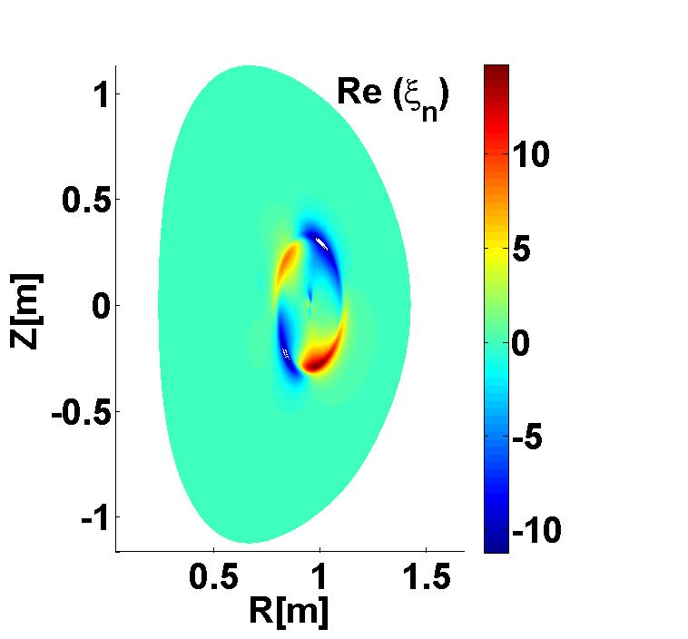
Simulated displacement agrees with experiment
(a.u.)
    Shape of the displacement in the outer region (sqrt(\psi_p) >0.5) agrees with the reflectometer measurement.

Slide 10
Simulated displacement agrees with experiment (cont’d)
  Soft x-ray (SXR) data is used to check the consistency with simulated mode structure in the core region.
  (i) Inverse layer position of S1 in computation agrees with experiment. The inverse layer position has a strong dependence on the mode position.
  (ii) In chords 1-4, simulation agrees well with experiment. Simulated S1 at chord 6 has a poor agreement with experiment.
  (iii) Discrepancy between the simulated and measured USXR is probably caused by uncertainty in the USXR weight function in the modelling.
S₀: equilibrium SXR emission
Simulated SXR fluctuation in (R,Z) domain
S₁: integrated SXR fluctuation

Slide 11
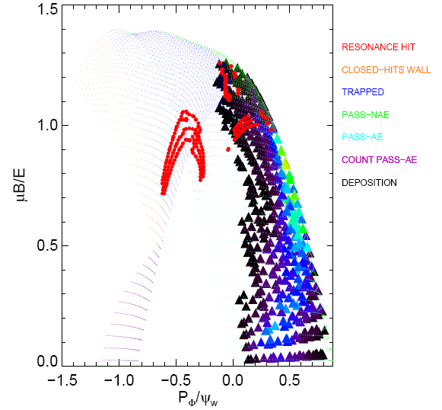
Resonance between the mode and fast ions is NOT important for the studied case
E_fast_ion=75 keV
Both the toroidal and poloidal frequencies of fast ions are computed
Spatial region for computing orbit is limited in the mode extension region (100-120cm). The corresponding deposition of fast-ion distribution is extracted from TRANSP
For the mode frequency, three cases are considered: 0, -5 and 5 kHz in plasma frame
Direct MARS-K computations also confirm minor role played by fast-ion resonances

Slide 12
Summary
  Some low-f modes in NSTX are internal instabilities driven by the centrifugal force.
    Simulated characteristics of internal instability consistent with experiment.
      Predicted critical rotation amplitude for driving mode is close to the experimental value.
      Mode frequency agrees well with the experiment value
      Shape of the normal displacement basically agrees with the measurements.
      At the onset of the mode, resonance between the mode and fast ions is NOT important.
    Mechanism for driving internal mode insensitive to the uncertainty of reconstructed q-profiles
    Density gradient plays an dominant role in centrifugal force for the studied case
  Next step: Combine MARS-F with tracking particle code, such as SPIRAL and ORBIT, to study the effect of the mode on the fast-ion redistribution.

Slide 13
Back-up slides

Slide 14
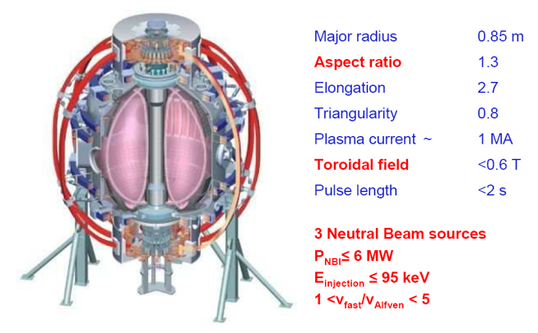
What’s NSTX?
National Spherical Torus Experiment (NSTX) is a magnetically confined fusion device with low aspect ratio (spherical tokamak)
One benefit: reach higher normalized pressure (beta_N), compared with the conventional tokamak
One mission : Advance the Spherical tokamak (ST) as a candidate for a Fusion Nuclear Science Facility

Slide 15
Formula for USXR modelling

Slide 16
Resistive interchange index DR<0 in the whole spatial region

Slide 17
Simulated S₁ is insensitive to a slight variation of S₀
Symbol: exp. S₀
curve: sim. S₀
S₁
S₁

Slide 18
More information for different q-profiles
Different q-profiles are generated by LRDFIT09, but with slightly different P-prime setting, such as :
Cases as label in slide 7 | P-prime | MSE absolute error(degree)
QP1 | 0.0, 0.25, 0.75, 0.875 | 0.3847
QP2 | 0.0, 0.25, 0.7, 0.875 | 0.4126
QP3 | 0.0, 0.25, 0.705, 0.89 | 0.4579
QP4 | 0.0, 0.2, 0.4, 0.6, 0.8 | 0.316

Slide 19
Discussion about the equilibrium rotation
g-file generated by LRDFIT → CHEASE → MARS-F
LRDFIT reconstruction of the equilibrium includes the measured q-profile for the rotating plasma. Safety factor is the key equilibrium quantity affecting MHD stability.
CHEASE is a static equilibrium code, which supplies the numerical equilibrium for MARS-F .
We neglect the effect of rotation on equilibrium, which leads to the below concerns.
  Magnetic axis positon from CHEASE is about 4cm smaller than that from LRDFIT. During the comparison between simulated and measured USXR, the above axis shift is compensated by horizontally shifting the whole plasma.
  The density gradient in poloidal direction is neglected, which slightly affect the mode growth rate in theory though the second GAM. However, this kind of GAM is not reported in both conventional and spherical tokamaks as we know.
  Given the good agreement between MARS-F simulation and experiments, it is reasonable to believe that the effect of rotation on equilibrium will NOT qualitatively change our key conclusions.

Slide 20
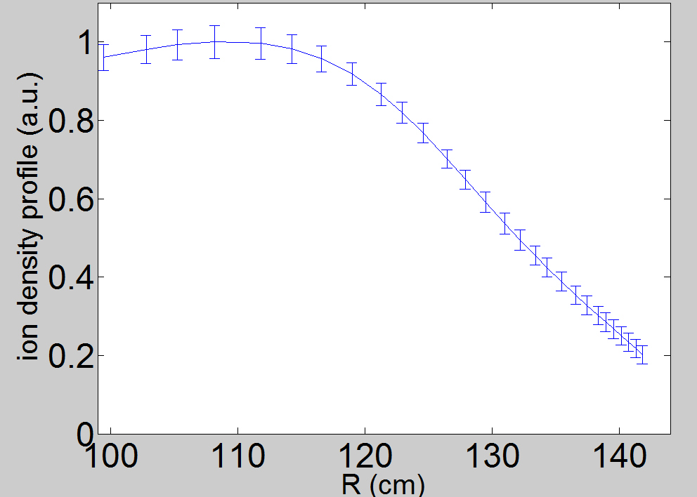
More information about density scale length
We vary density values in uncertain region at three channels, to estimate the density scale length ( Ln ) at 115 cm.
115cm

