Slide 1

Electron Scale Turbulence and Transport in an NSTX H-mode Plasma Using a Synthetic Diagnostic for High-k Scattering Measurements
J. Ruiz Ruiz¹
W. Guttenfelder², N. Howard¹, N. F. Loureiro¹, A. E. White¹, Y. Ren², S.M. Kaye², J. Candy⁷, B. P. LeBlanc², F. Poli², E. Mazzucato², K.C. Lee³, C.W. Domier⁴, D. R. Smith⁵, H. Yuh⁶
1. MIT 2. PPPL 3. NFRI 4. UC Davis 5. U Wisconsin 6. Nova Photonics, Inc. 7. General Atomics
59th Annual Meeting of the APS Division of Plasma Physics
October 23-27, 2017, Milwaukee, Wisconsin

Slide 2
Electron Scale Turbulence and Anomalous Electron Thermal Transport in STs
NSTX H-mode plasmas that are driven by neutral beams exhibit ion thermal transport close to neoclassical (collisional) levels, due to suppression of ion scale turbulence by ExB shear and strong plasma shaping [cf. Kaye NF 2007].
Electron thermal transport is always anomalous ( >> neoclassical).
Goal: Study electron thermal transport caused by electron-scale turbulence in NSTX and NSTX-U.
k⟘𝝆_{i} < 1
k⟘𝝆_{i} > 1
𝝆_{i} ion gyro radius
Ion scale
Electron Scale
k⟘𝝆_{i}
0.1
1
10
High-k scattering: k⟘𝝆_{e} ~ 0.2-0.4

Slide 3
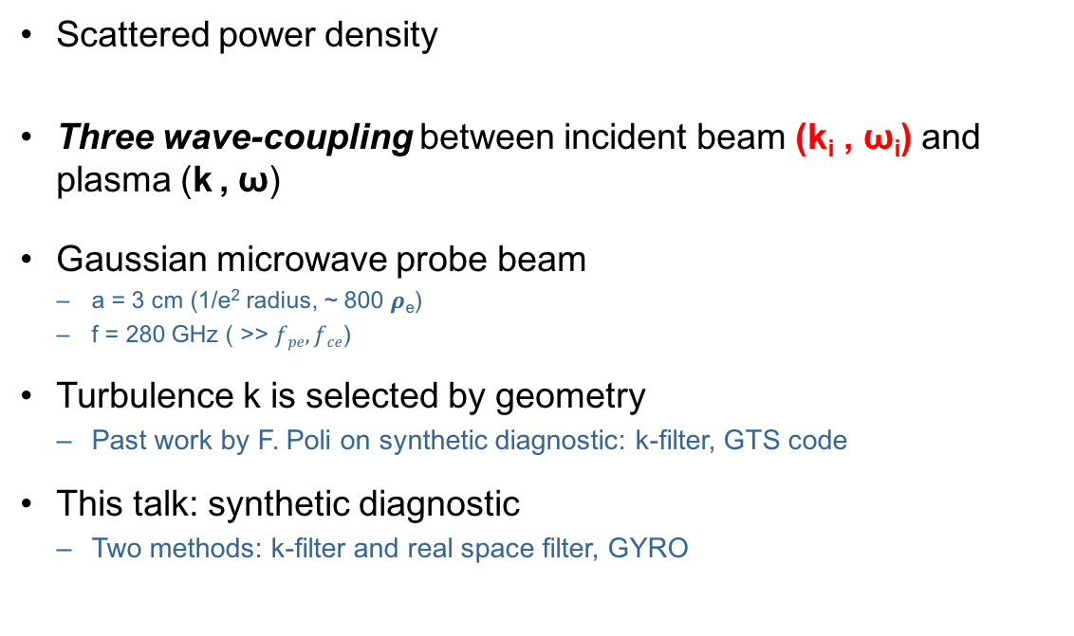

Use a High-k Scattering Diagnostic to Probe Electron Scale Turbulence in NSTX and NSTX-U
Scattered power density
Three wave-coupling between incident beam (k_{i} , ω_{i}) and plasma (k , ω)
Gaussian microwave probe beam
  a = 3 cm (1/e² radius, ~ 800 𝝆_{e})
  f = 280 GHz ( >> $fpe, fce$)
Turbulence k is selected by geometry
  Past work by F. Poli on synthetic diagnostic: k-filter, GTS code
This talk: synthetic diagnostic
  Two methods: k-filter and real space filter, GYRO
$$ks$$
k
k_{i}
ω_{s} = ω + ω_{i}
=
+
View from top of NSTX

Slide 4
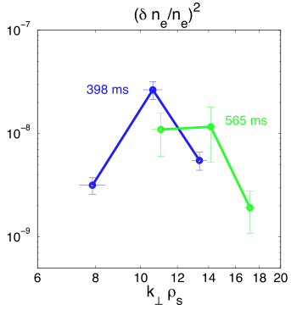
High-k Scattering Diagnostic Provides the Frequency and Wavenumber Spectrum of Electron Scale Turbulence
Frequency Spectrum of density fluctuations
k-spectrum of density fluctuations
P (a.u.)
ch. 1,2,3
Channel 1
NSTX 141767
turbulence
diagnostic artifact
Frequency analysis of scattered power → frequency spectrum.
Different channels → different k → wavenumber spectrum of turbulence
Notes:
Goal: A quantitative comparison between experiment and simulation of electron scale turbulence (e.g. frequency and k-spectrum below).

Slide 5
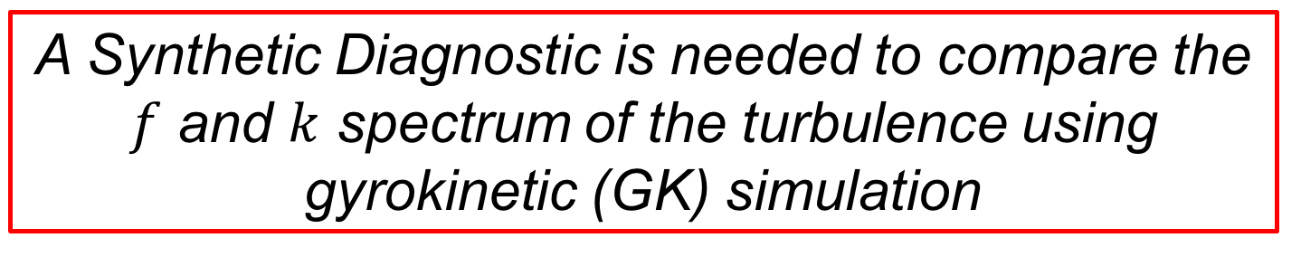
High-k Scattering Diagnostic Provides the Frequency and Wavenumber Spectrum of Electron Scale Turbulence
Frequency Spectrum of density fluctuations
k-spectrum of density fluctuations
P (a.u.)
ch. 1,2,3
Channel 1
NSTX 141767
A Synthetic Diagnostic is needed to compare the $f$ and $k$ spectrum of the turbulence using gyrokinetic (GK) simulation
turbulence
diagnostic artifact
Frequency analysis of scattered power → frequency spectrum.
Different channels → different k → wavenumber spectrum of turbulence
Notes:
Goal: A quantitative comparison between experiment and simulation of electron scale turbulence (e.g. frequency and k-spectrum below).

Slide 6
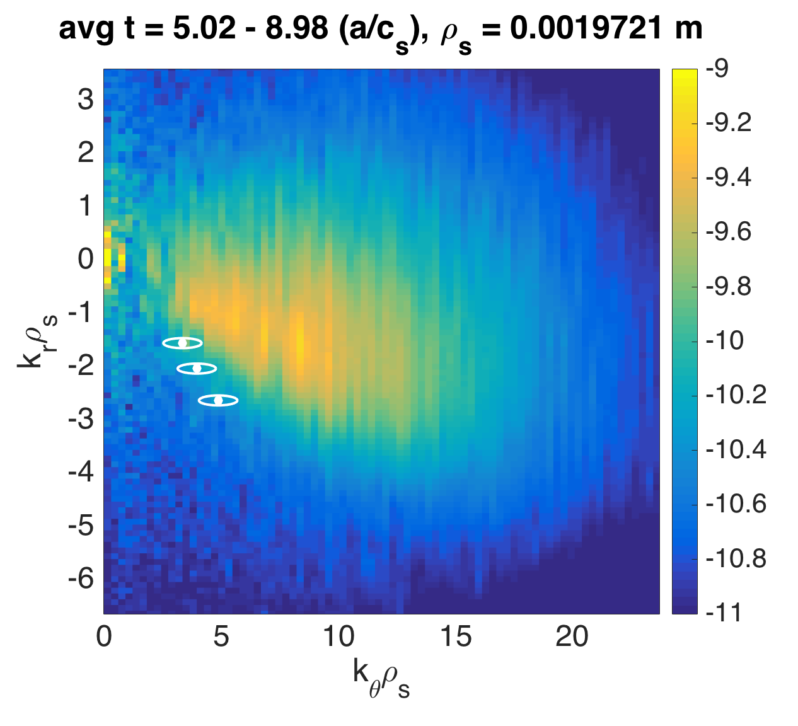
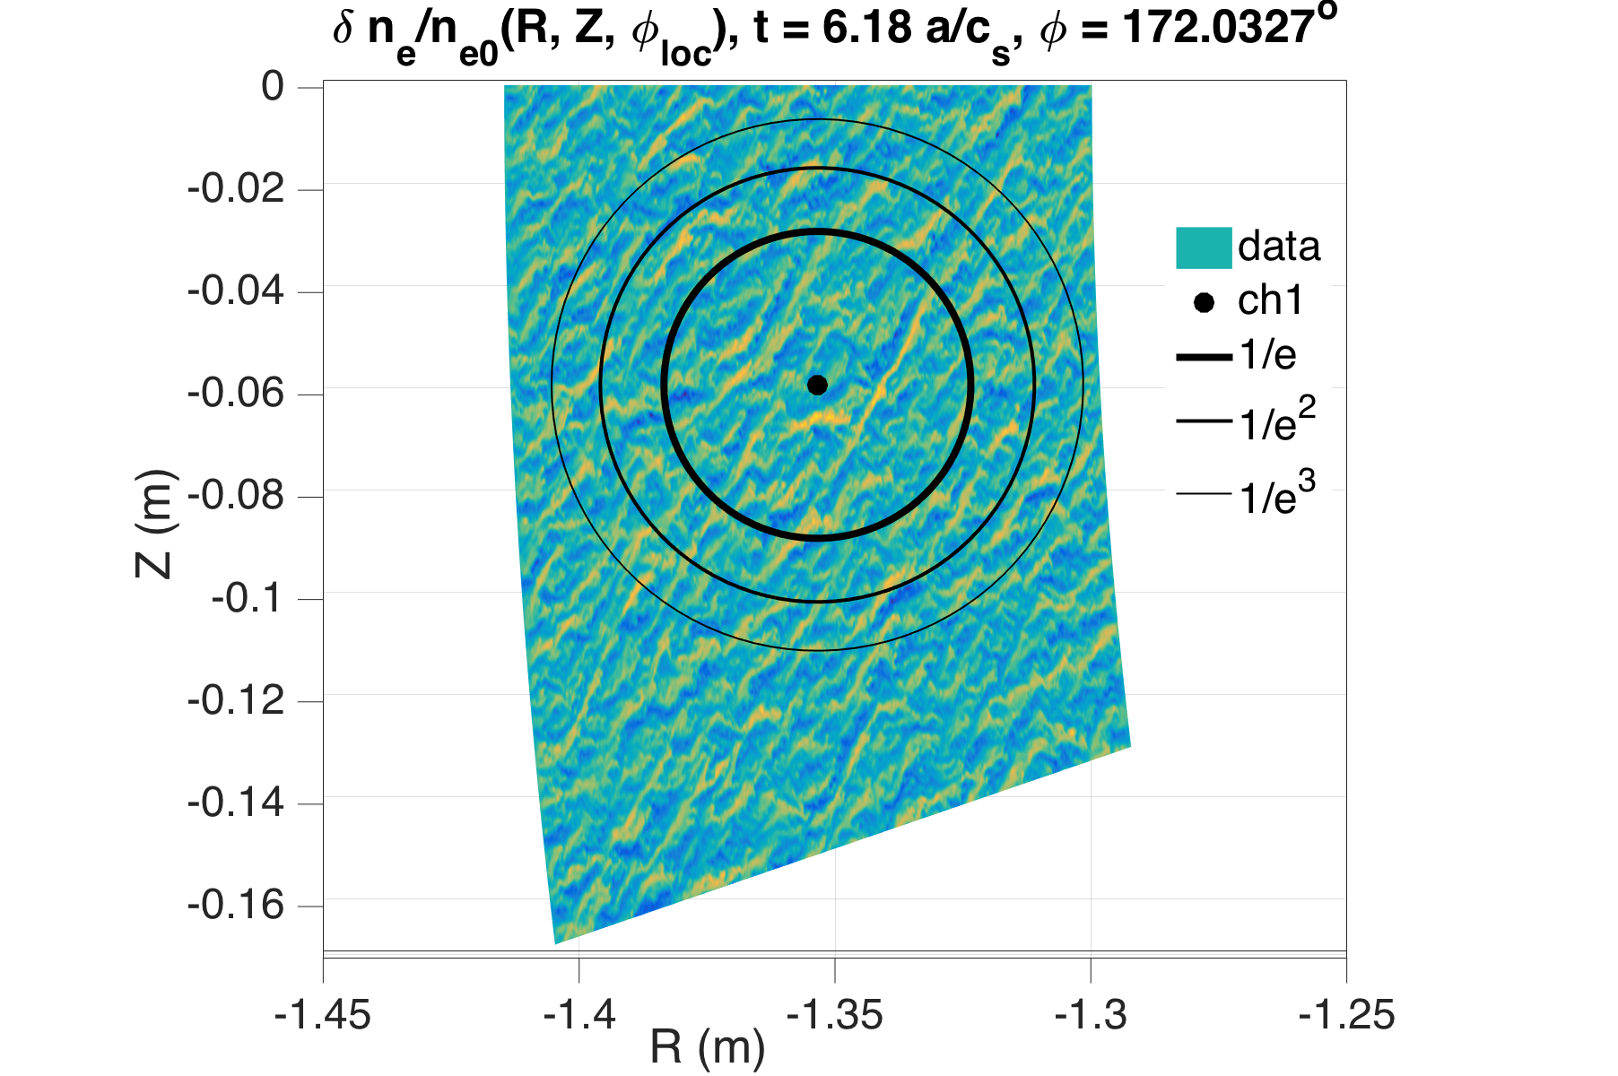
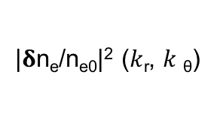
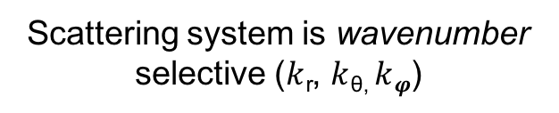
Two Equivalent Ways to Perform a Synthetic Diagnostic for Turbulence Scattering Measurements
Filter fluctuations in k-space
Filter fluctuations in real space
|𝛅n_{e}/n_{e0}|² ($k$_{r}, $k$_{θ})
δn_{e} (R, Z, 𝛟_{loc})
GYRO
GYRO
ch 3
ch 2
ch 1
ch1 (R_{loc}, Z_{loc})
Scattering system is wavenumber selective ($k$_{r}, $k$_{θ,} $k$_{𝝋})
Scattering system is spatially
localized (R, Z, 𝝋)
Notes:
Format 16:9

Slide 7
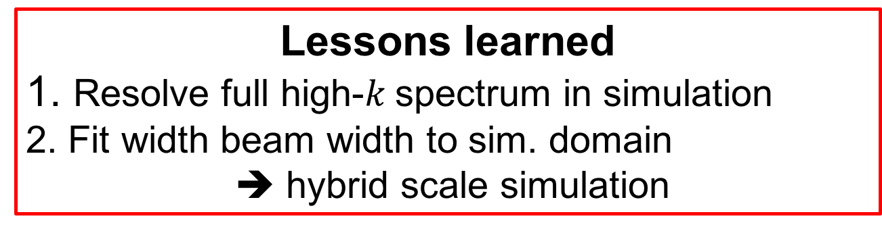
Two Equivalent Ways to Perform a Synthetic Diagnostic for Turbulence Scattering Measurements
Filter fluctuations in k-space
Filter fluctuations in real space
|𝛅n_{e}/n_{e0}|² ($k$_{r}, $k$_{θ})
δn_{e} (R, Z, 𝛟_{loc})
GYRO
Lessons learned
1. Resolve full high-$k$spectrum in simulation
2. Fit width beam width to sim. domain
➔ hybrid scale simulation
GYRO
ch 3
ch 2
ch 1
ch1 (R_{loc}, Z_{loc})
Scattering system is wavenumber selective ($k$_{r}, $k$_{θ,} $k$_{𝝋})
Scattering system is spatially
localized (R, Z, 𝝋)
Notes:
Format 16:9

Slide 8
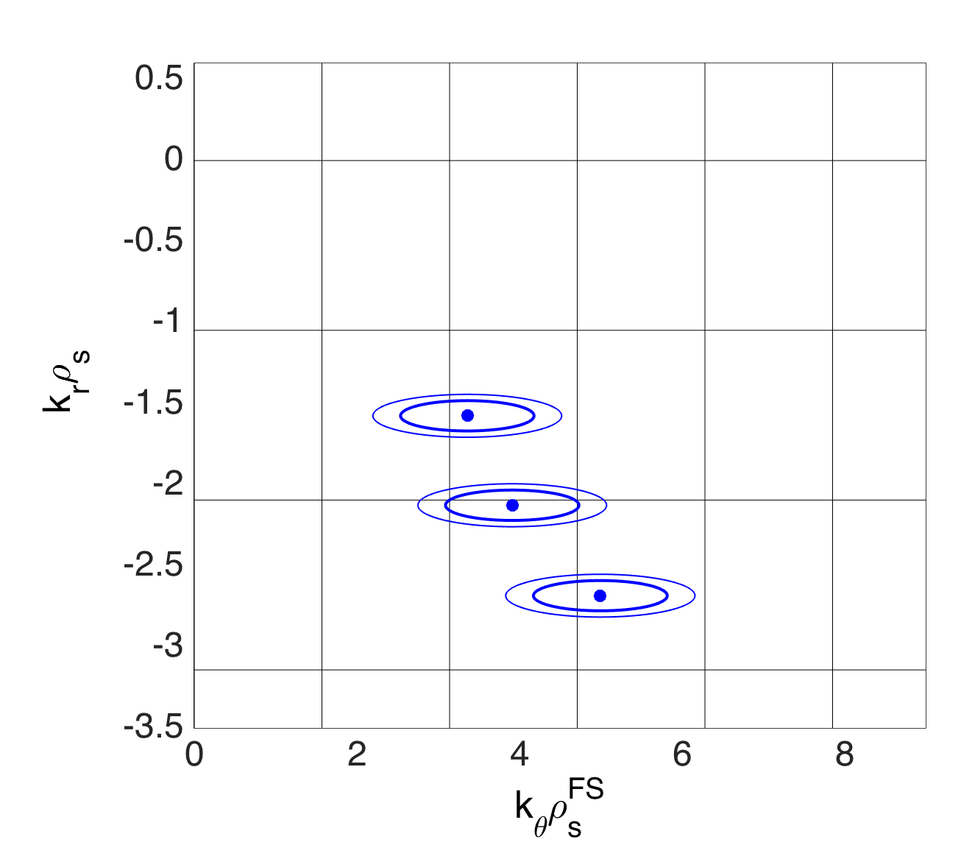
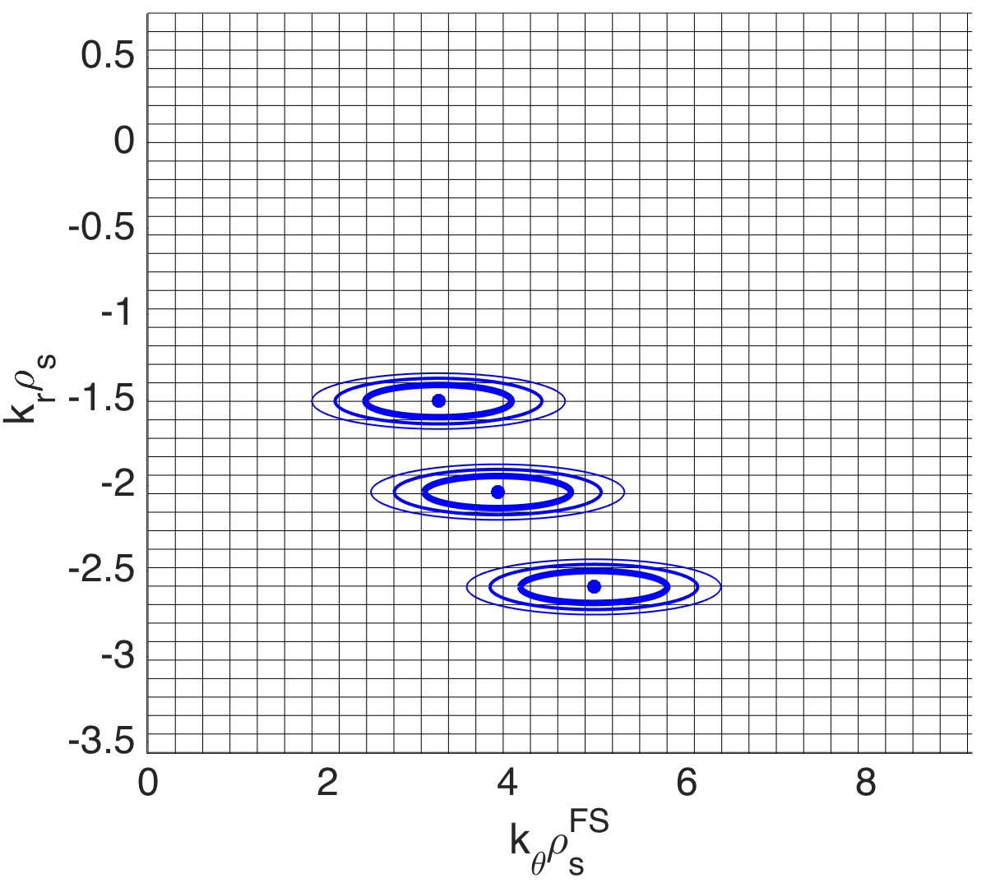
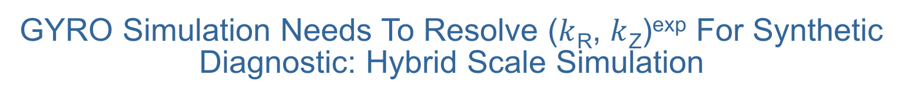
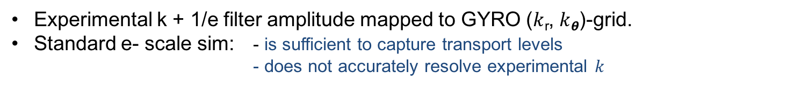
GYRO Simulation Needs To Resolve ($k$_{R}, $k$_{Z})^{exp} For Synthetic Diagnostic: Hybrid Scale Simulation
Standard e-scale sim
Hybrid-scale e-scale sim
ch 3
ch 2
ch 1
Experimental k + 1/e filter amplitude mapped to GYRO ($k$_{r}, $k$_{𝞱})-grid.
Standard e- scale sim: - is sufficient to capture transport levels
            - does not accurately resolve experimental $k$
Notes:
Hybrid sim is much more expensive simulation

Slide 9
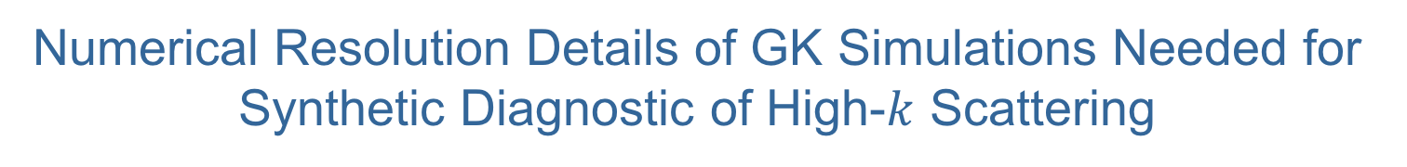
Numerical Resolution Details of GK Simulations Needed for Synthetic Diagnostic of High-$k$ Scattering
Experimental profiles used as input
Local simulations performed at scattering location (r/a~0.7, R~136 cm).
  Only electron scale turbulence included.
  3 kinetic species, D, C, e (Z_{eff}~1.85-1.95)
  Electromagnetic: A||+B||, β_{e}~ 0.3 %.
  Collisions (ν_{ei} ~ 1 c_{s}/a).
  ExB shear (γ_{E}~0.13-0.16 c_{s}/a) + parallel flow shear (γ_{p} ~ 1-1.2 c_{s}/a)
  Fixed boundary conditions with Δ^{b} ~ 2 ρ_{s} buffer widths (e- scale).
Resolution parameters
Full Box Hybrid Sim Goal
  L_{r} x L_{y} = 50 x 21 ρ_{s} (L/a~0.2)
  n_{r} x n = 900/1024 x 140/220
Reduced box Hybrid simulation
  L_{r} x L_{y} = 18 x 21 ρ_{s} (L/a~0.15)
  n_{r} x n = 512 x 140
Simulation cost ~ 1 M CPU h
Simulation cost ~ 0.5 M CPU h
Hybrid-scale, NOT multiscale simulation (ions not fully resolved)
Notes:
Change to smaller sim box
Two boxes for resolution parameters

Slide 10
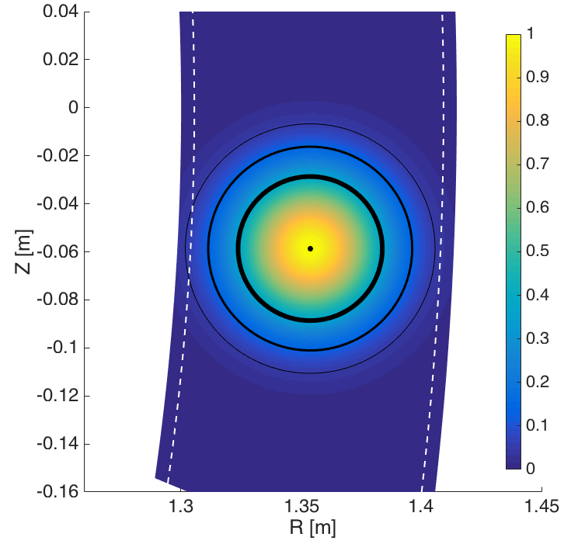
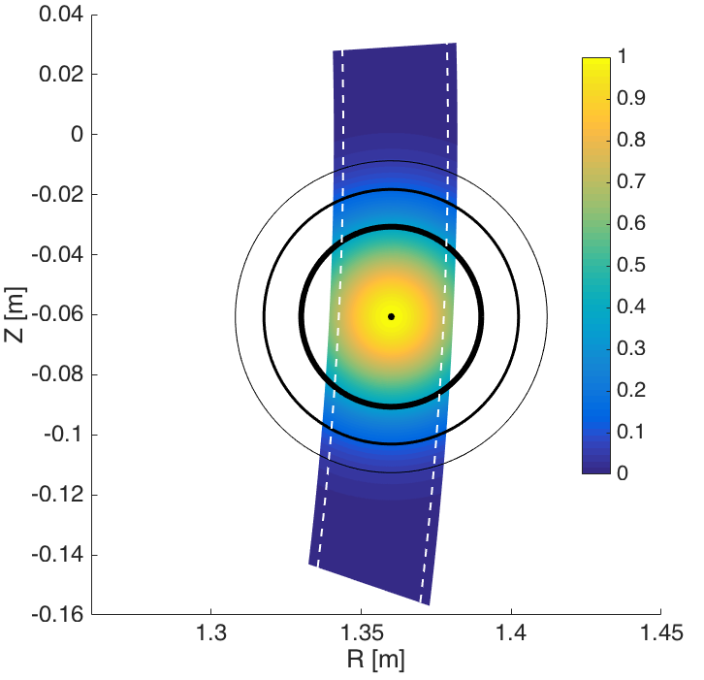
Numerical Resolution Details of GK Simulations Needed for Synthetic Diagnostic of High-$k$ Scattering
Experimental profiles used as input
Local simulations performed at scattering location (r/a~0.7, R~136 cm).
  Only electron scale turbulence included.
  3 kinetic species, D, C, e (Z_{eff}~1.85-1.95)
  Electromagnetic: A||+B||, β_{e}~ 0.3 %.
  Collisions (ν_{ei} ~ 1 c_{s}/a).
  ExB shear (γ_{E}~0.13-0.16 c_{s}/a) + parallel flow shear (γ_{p} ~ 1-1.2 c_{s}/a)
  Fixed boundary conditions with Δ^{b} ~ 2 ρ_{s} buffer widths (e- scale).
Goal
Reduced Box
Resolution parameters
Full Box Hybrid Sim Goal
  L_{r} x L_{y} = 50 x 21 ρ_{s} (L/a~0.2)
  n_{r} x n = 900/1024 x 140/220
Reduced box Hybrid simulation
  L_{r} x L_{y} = 18 x 21 ρ_{s} (L/a~0.15)
  n_{r} x n = 512 x 140
Simulation cost ~ 1 M CPU h
Simulation cost ~ 0.5 M CPU h
Hybrid-scale, NOT multiscale simulation (ions not fully resolved)
Notes:
Change to smaller sim box
Two boxes for resolution parameters

Slide 11


Spectral Peak and width are Recovered Applying Synthetic Diagnostic to Reduced Box Simulation
|δn_{e}|²($f$)
P [a.u.] ∝ |δn_{e}|²($f$)
turbulent
spectral
peak
Synthetic
Diagnostic
Experiment
turbulent
spectral
peak
k-filter
Exp.noise
at f = 0
Doppler shift (~ 1 MHz) must be included to match spectral shape + width
Quantitative comparison must use a Full Box, Hybrid sim. Correct experimental units determining the amplitude not included in Reduced Box Sim
Notes:
Show figure of beam going over
Started smaller sim
Cannot do a quantitative comparison
Clipping effect, need bigger sim

Slide 12
Next Steps and Conclusions
Conclusions
Two syn. diagnostic methods (k-space + real space) are proposed for quantitative comparison with experimental density fluctuations from high-k scattering
Computationally intensive hybrid-scale GK simulations are needed to capture experimental k + full ETG spectrum for synthetic diagnostic
Next steps
Run Full Box Hybrid Scale simulation
Ion-scale route to synthetic diagnostic
3D synthetic diagnostic

Slide 13
Questions
&
Discussion

Slide 14
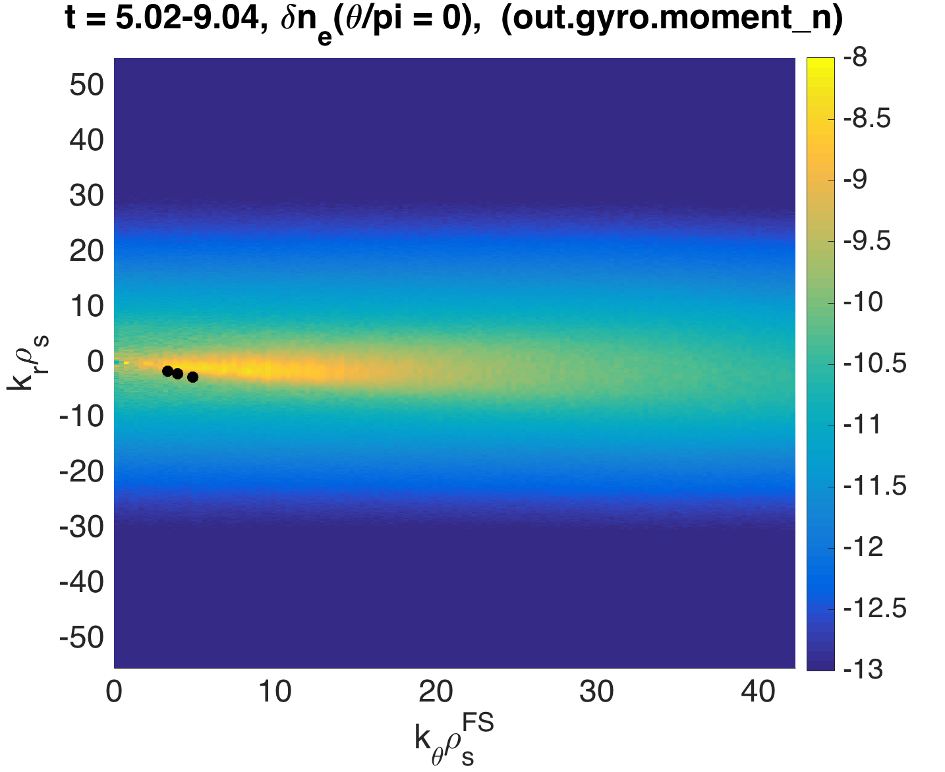
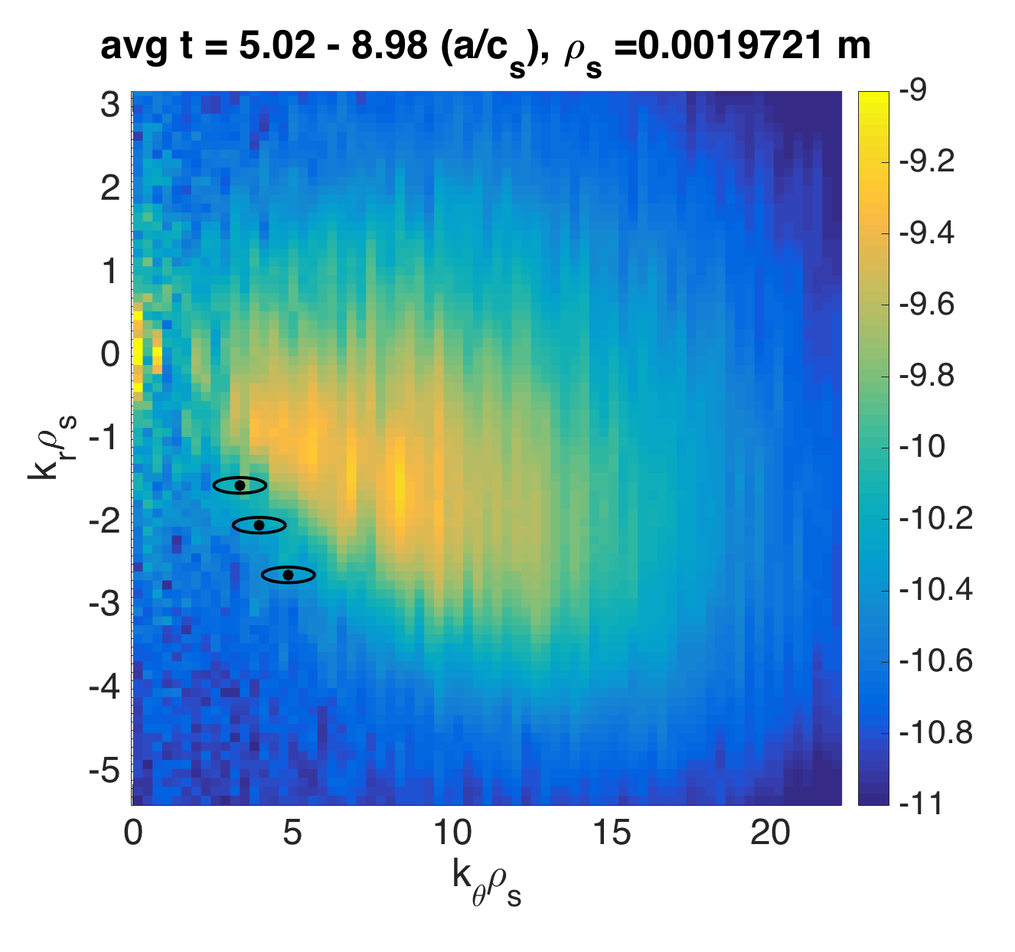
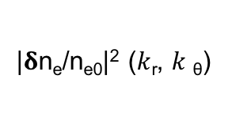
Experimental $k$ are Close to the Spectral Peak of Fluctuations
|𝛅n_{e}/n_{e0}|² ($k$_{r}, $k$_{θ})
|𝛅n_{e}/n_{e0}|² ($k$_{r}, $k$_{θ})
GYRO
ZOOM
Measured $k$ is close to the peak of the electron heat flux $Qe$
Notes:
Take white box out
Back up slide

Slide 15
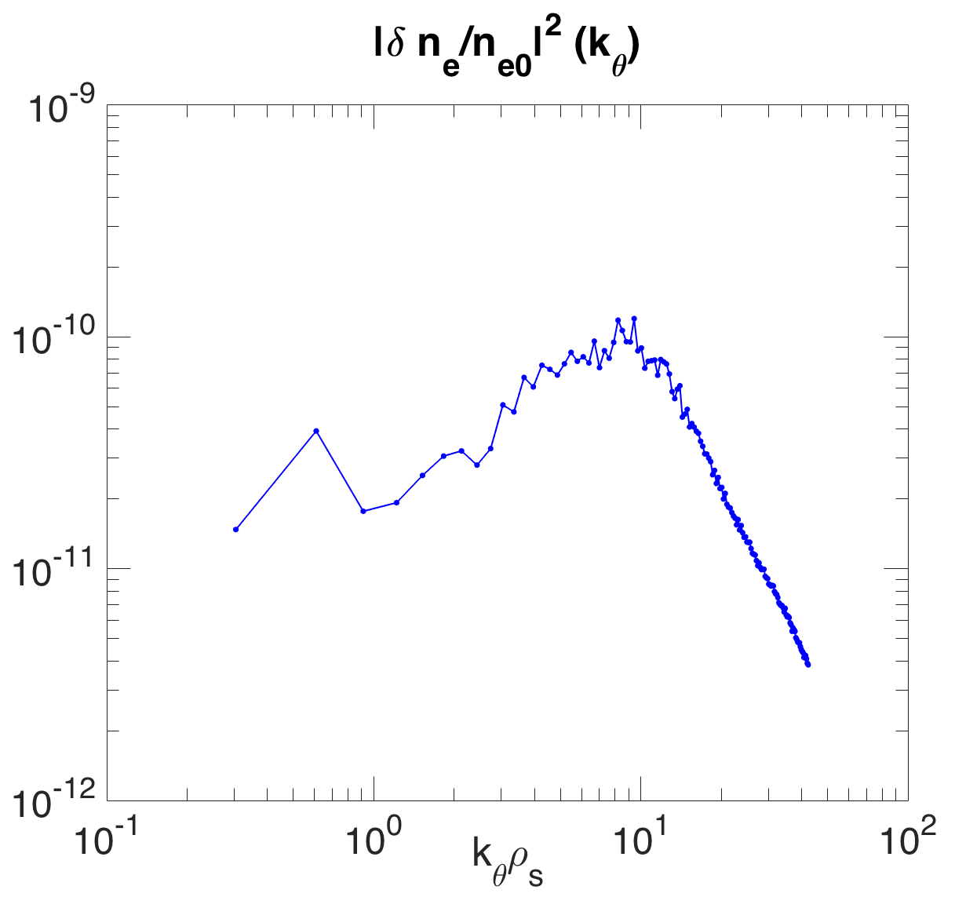
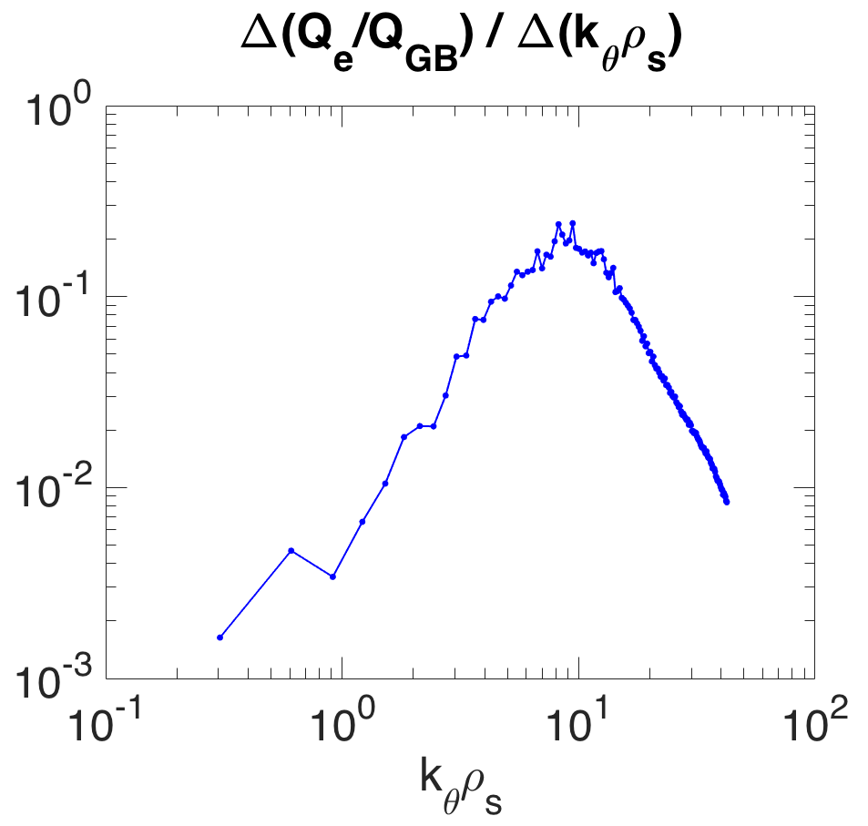
Experimental Wavenumbers Produce non-negligible transport
Q_{e}^{tot} ~ 0.3-0.4 MW
Scattering measurements
t = 398 ms
  Low density gradient case
  Unstable ETG
k^{exp} close to density and Q_{e} spectral peak.
Q_{e} consistent with previous standard e- scale sim results(Q_{e}~0.4 MW)
Notes:
Update S with dn2

Slide 16
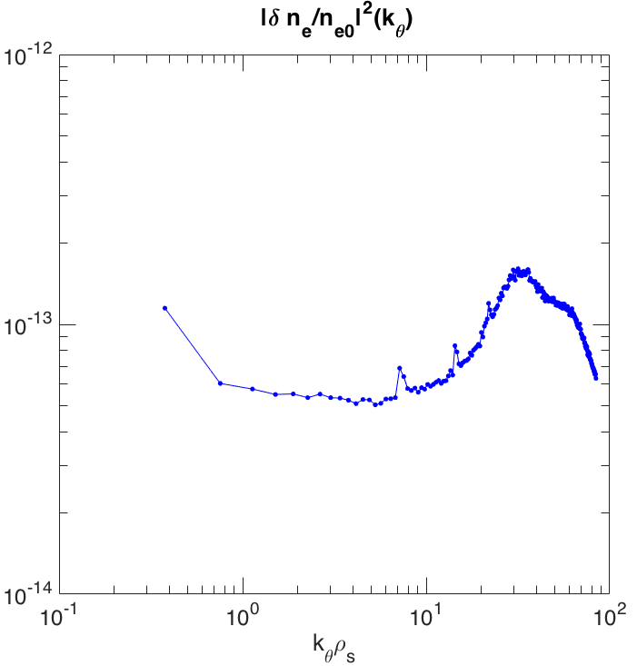
Experimental Wavenumbers Produce non-negligible transport
t = 565 ms.
  High density gradient case
  Stabilized ETG
Low fluctuation levels
Q_{e} expected to be very low
Scattering measurements
Notes:
t565 show Qe_k !!!!

Slide 17
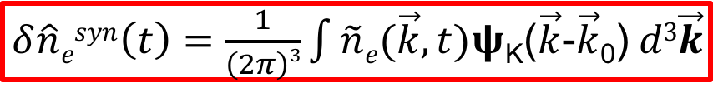
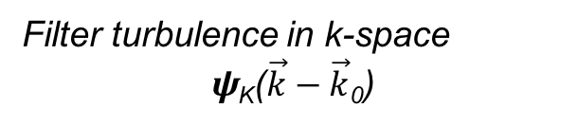
Traditional Implementation: filtering in k-space
A scattering system is wavenumber selective ($k$_{r}, $k$_{θ,} $k$_{𝝋})^{exp}
Analyze turbulence in k-space +
Filter turbulence in k-space
𝛙_{K}($\vec{k}−\vec{k}$₀)
|𝛅n_{e}/n_{e0}|² (k_{r}, k_{θ})
GYRO
k_{r}𝝆_{s}
(k_{r}, k_{θ})^{exp}
k_{r}𝝆_{s}
k_{θ}𝝆_{s}
k_{θ}𝝆_{s}
$δ\hat{n}esyn\left(t\right)=\frac{1}{\left(2π\right)3}\int{\tilde{n}e(\vec{k},t)}$𝛙_{K}($\vec{k}$-$\vec{k}$₀)$d3\vec{k}$
Obtain a time series of turbulent density fluctuations $δ\hat{n}esyn\left(t\right)$

Slide 18
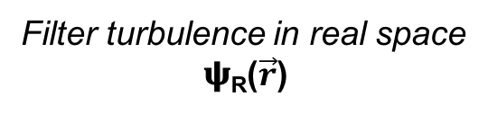
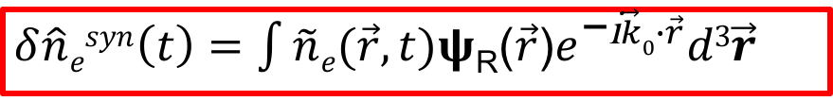
New Proposed Implementation: filtering in real space
Scattering system is spatially localized (R, Z, 𝝋)_{loc}
Analyze turbulence in real space +
Filter turbulence in real space
𝛙_{R}($\vec{r}$)
GYRO
(R_{loc}, Z_{loc})
$δ\hat{n}esyn\left(t\right)=\int{\tilde{n}e(\vec{r},t)}$𝛙_{R}($\vec{r}$)$e^{\text{−}\text{i}\vec{k}0∙\vec{r}}d3\vec{r}$
Obtain a time series of turbulent density fluctuations $δ\hat{n}esyn\left(t\right)$

Slide 19

Discussion of r & k filtering methods
k-space mapping - Selection of k
Traditional way to interpret filtered scattering spectra.
Delicate to compute, take into account correct wavenumber amplitudes.
Code-dependent.
Need to adequately complete k-mapping → painful, but useful!
New: Real space filtering
Common principle to all codes.
Easier to implement and understand (no k-mapping).
Need to resolve fine-scale structures (e- scale eddies) → much more computationally intensive (x5) but negligible wrt. turbulence simulations.
Two equivalent ways of interpreting scattering process
Useful to compute both methods to gain confidence in simulated synthetic spectra.
($k$_{R}, $k$_{Z}, $k$_{𝝋}) ➔ ($k$_{r}, $k$_{𝞱}, $k$_{𝝋})
Notes:
remove

Slide 20
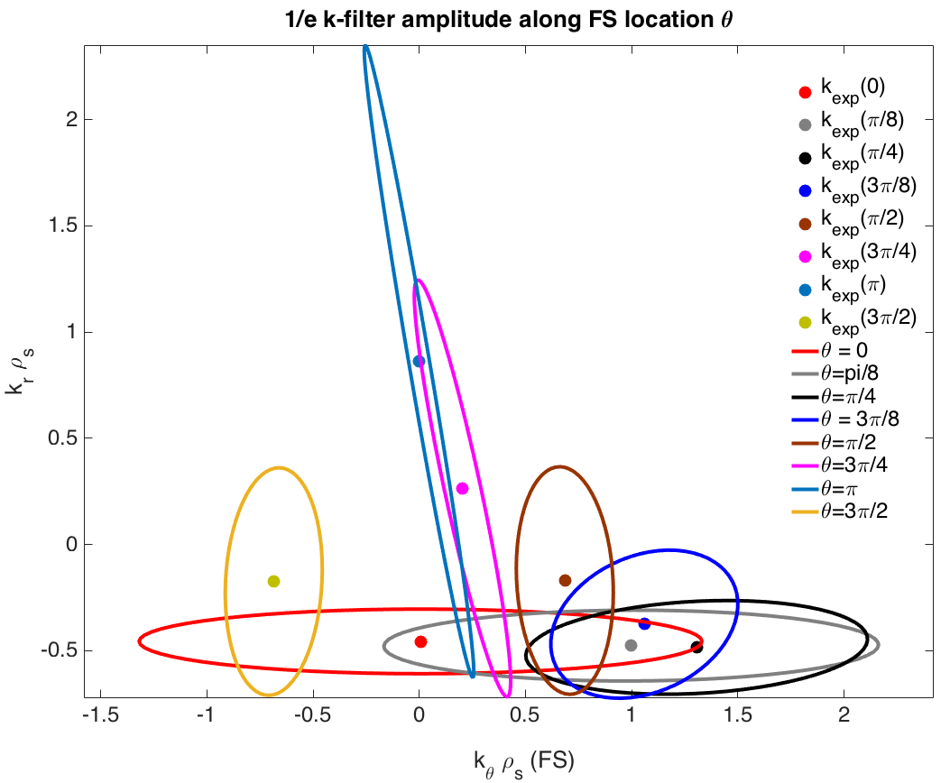
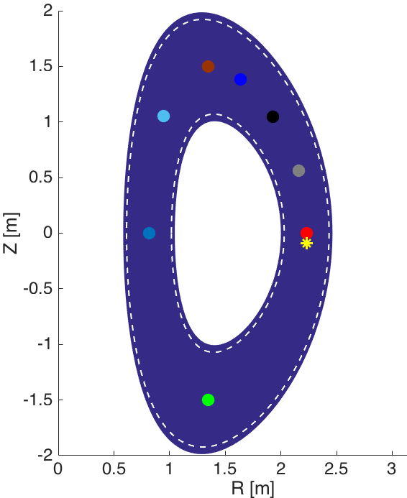

Shape of $k$-filter along Flux Surface
Notes:
Divide into two slides
Rotation
turbulence

Slide 21
Synthetic Diagnostic is an a posteriori analysis tool
Implementation of the synthetic diagnostic
Goal: A quantitative comparison between experiment and simulation of electron scale turbulence (e.g. frequency and k-spectrum).
Notes:
Divide into two slides
Rotation
turbulence

Slide 22
Synthetic Diagnostic applied to Cyclone Base Case
(not experiment! yet …)
Numerical resolution parameters
∆k_{x}𝝆_{s} = 0.049 | ∆k_{y}𝝆_{s} = 0.049
k_{x}𝝆_{s}^{max} = 3.14 | k_{y}𝝆_{s}^{max} = 3.093
L_{x}/𝝆_{s} = 128 | L_{y}/𝝆_{s} = 128
dn = 8 | Bm = 4.94
∆x/𝝆_{s} = 0.5 | Lx/a = 0.28
n_{x} = 256 | n_{n} = 64
Experimental beam width: ∆x = 5, 10, 20 cm
∆k_{x}𝝆_{s}^{beam} = | ∆k_{y}𝝆_{s}^{beam} =
Cyclone base case physical parameters:
2 kinetic species (DK e-)
ES
Periodic BC
Flat profiles
S-alpha, non-shifted geometry circular geometry
Doppler shift M = 0.1
a₀

Slide 23
Real Space Filters – 2D
Goal: establish sensitivity of synthetic signal to beam width
To what extent do we need a simulation domain that covers the full microwave beam?
a₀ = 5 cm
a₀ = 10 cm
a₀ = 20 cm
a₀
a₀ is the beam width

Slide 24
Cyclone Base Case: Wavenumber Space Filters – 2D
Measurement Wavenumbers
k_{r}𝝆_{s}^{exp}= 0.27 k_{𝞱}𝝆_{s}^{exp}= 0.42
a₀ = 5 cm
a₀ = 10 cm
a₀ = 20 cm

Slide 25
Cyclone Base Case: Wavenumber Space Filters – 1D
a₀ = 5 cm
a₀ = 10 cm
a₀ = 20 cm

Slide 26
Cyclone Base Case: Wavenumber measurement region
|𝝳n_{e}|²(k_{x})
Measurement Wavenumbers
k_{r}𝝆_{s}^{exp}= 0.27 k_{𝞱}𝝆_{s}^{exp}= 0.42
|𝝳n_{e}|²(k_{y})

Slide 27
Synthetic signal: a₀ = 5 cm
k_{r}𝝆_{s}^{exp}= 0.27
k_{𝞱}𝝆_{s}^{exp}= 0.42
GOOD AGREEMENT BETWEEN R & K FILTERS

Slide 28
Synthetic signal: a₀ = 10 cm
k_{r}𝝆_{s}^{exp}= 0.27
k_{𝞱}𝝆_{s}^{exp}= 0.42
GOOD AGREEMENT BETWEEN R & K FILTERS

Slide 29
Synthetic signal: a₀ = 20 cm
k_{r}𝝆_{s}^{exp}= 0.27
k_{𝞱}𝝆_{s}^{exp}= 0.42
FACTOR x2-3 AMPLITUDE DISCREPANCY

Slide 30
Conclusions from Cyclone Base Case Tests
We have shown good agreement between two alternate ways to approach a scattering synthetic diagnostic
  filtering in real space (r-filter)
  filtering in wevenumber space (k-filter)
The beam width was included in the full simulation domain at a₀ = 5 cm, and completely exceeded sim domain at a₀ = 20 cm.
Agreement between r & k filters was best at a₀ = 5 & 10 cm.
At a₀ = 20 cm, the r-filter was a factor 2-3 smaller amplitude than the k-filter method (possibly due to beam exceeding sim domain at a₀ = 20 cm)

Slide 31
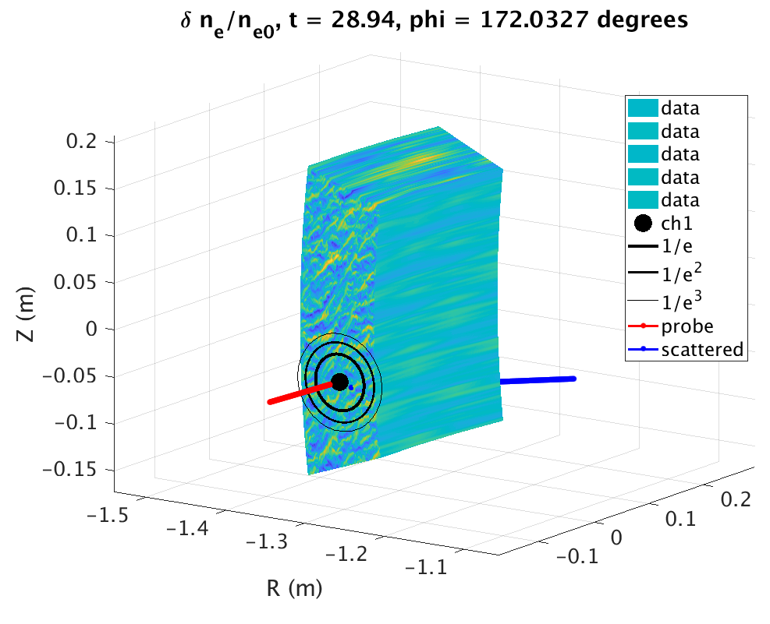
Immediate Next Steps
Apply synthetic diagnostic to realistic NSTX plasma conditions
  Run expensive GYRO simulations that overlap with scattering beam (~ 2 M CPU h) – coming in next week
  Compare frequency and k-spectrum with experiment
Implement a 3D synthetic diagnostic for higher fidelity modeling

Slide 32
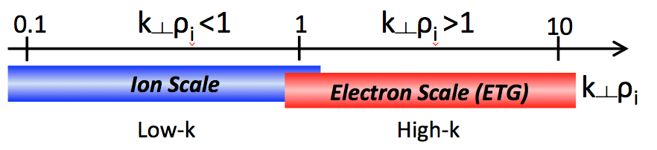
Ion–scale route to a synthetic diagnostic comparison
1
3-5
40-50
k_{𝞱}𝝆_{i}
1
Simulation resolution in k-space
2
(k_{r,} k_{𝞱})^{exp}
Standard ion scale simulation k∈[0.03,1]
Standard e- scale
sim grid
Standard e- scale simulation k∈[1, 40]
High-k scattering: (k_{r,} k_{𝞱})^{exp}
Big-box e- scale simulation k∈[0.3, 40]
High-k ion scale simulation k∈[0.03, 6]
40-50
k_{r}𝝆_{i}
e- scale sim. covers k^{exp}, but grid is too coarse
→ need big box e- scale sim, finer k-grid (expensive!)
Ion scale sim. has good grid space, but does not cover k^{exp}
→ need to extend sim from k = 1 to k^{exp} (expensive!)
𝝆_{i} ion gyro radius

Slide 33
Synthetic Diagnostic for the High-k Scattering System
Preliminary Steps:
High-k scattering diagnostic → experimental density fluctuation spectra |δn_{e}|²_{kR,kZ}(ω)
Ray tracing code:
  Scattering location + resolution (R_{loc}, Z_{loc}) + (ΔR_{loc}, ΔZ_{loc})
  Turbulence wavenumber + resolution (k_{R}^{exp}, k_{Z}^{exp}) + (Δk_{R}^{exp}, Δk_{Z}^{exp})
Run a nonlinear gyrokinetic simulation (used GYRO here) capturing scattering location + resolving the experimentally measured wavenumber.

Slide 34
2. Ray Tracing
Solve Ray tracing equations, Appleton-Hartree approximation (propagation of high freq. EM waves in plasma)
Cold plasma dispersion tensor + Appleton-Hartree dispersion relation (D = det(𝚲) = 0)
Solve the ray-tracing equations, (D = det(𝚲) = 0)
Obtain:
  Scattering location + resolution (R_{loc}, Z_{loc}) + (ΔR_{loc}, ΔZ_{loc})
  Turbulence wavenumber + resolution (k_{R}^{exp}, k_{Z}^{exp}) + (Δk_{R}^{exp}, Δk_{Z}^{exp})
Notes:
Divide into two slides
Rotation
turbulence

Slide 35
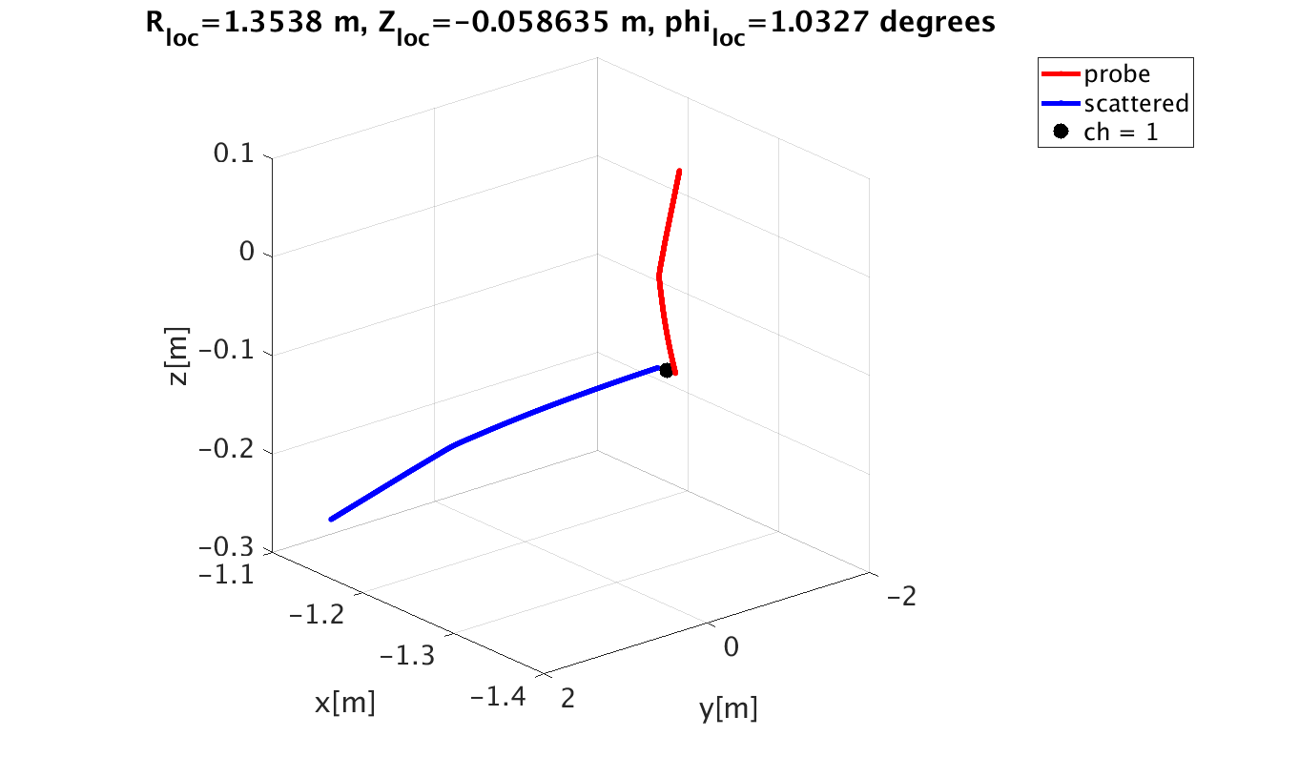
2. Ray Tracing
Solve Ray tracing equations, Appleton-Hartree approximation (propagation of high freq. EM
waves in plasma)
View from top of NSTX
(D.R. Smith PhD thesis 2009)
Obtain:
  Scattering location + resolution (R_{loc}, Z_{loc}) + (ΔR_{loc}, ΔZ_{loc})
  Turbulence wavenumber + resolution (k_{R}^{exp}, k_{Z}^{exp}) + (Δk_{R}^{exp}, Δk_{Z}^{exp})
Notes:
Divide into two slides
Rotation
turbulence

Slide 36
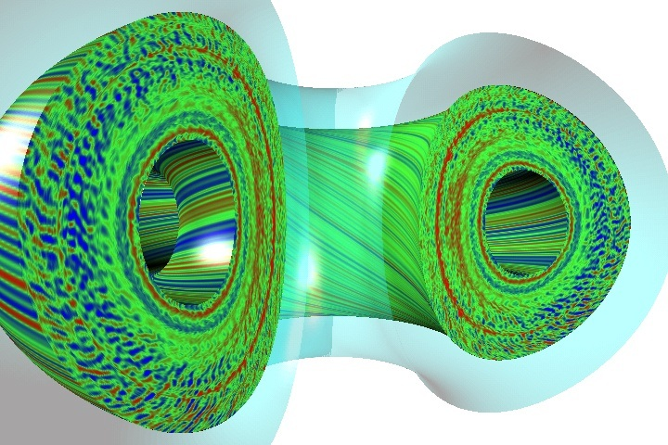

3. The GYRO code Numerically solves the Gyrokinetic-Maxwell System
The gyrokinetic-Maxwwell system cannot be
solved analytically except in simple limits
→ needs to be solved numerically (GYRO)
Inputs: experimental plasma parameters
  plasma shape, equilibrium geometry, profiles, …
Outputs: moments and fields
  Moments of the distribution function h_{s} 𝛅n_{s}, 𝛅v_{s}, 𝛅E_{s}
  Perturbed electromagnetic field components 𝛅𝛟, 𝛅A||, 𝛅B||
Turbulent fluxes (particle 𝚪_{s}, heat Q_{s}, … ) can be reconstructed from outputs, and compared with experimental values.
Notes:
Same figure

Slide 37
Numerical Resolution Details of Ion and Electron Scale Simulations Presented
Experimental profiles used as input
Local, flux tube simulations performed at scattering location (r/a~0.7, R~136 cm).
  Only electron scale turbulence included.
  Experimental T_{e}, n_{e}, T_{i}, rotation, etc.
  3 kinetic species, D, C, e (Z_{eff}~1.85-1.95)
  Electromagnetic: A||+B||, β_{e}~ 0.3 %.
  Collisions (ν_{ei} ~ 1 c_{s}/a).
  ExB shear (γ_{E}~0.13-0.16 c_{s}/a) + parallel flow shear (γ_{p} ~ 1-1.2 c_{s}/a)
  Fixed boundary conditions with Δ^{b} ~ 2 ρ_{s} buffer widths (e- scale).
Big-box e- scale resolution parameters (hybrid-scale) ~ 1 M CPU h
  L_{r} x L_{y} = 50 x 21 ρ_{s} (L/a~0.2).
  n_{r} x n = 900/1024 x 140.
  k_{θ}ρ_{s}^{FS} [min, max] = [0.3, 42]
  k_{r}ρ_{s} [min, max] = [0.3, 28]
  [n||, n_{λ}, n_{e}] = [14, 12, 12]
Large domain electron scale runs are hybrid-scale, NOT multiscale:
  Ions are barely correctly resolved Δk_{θ}ρ_{s}~0.3, L_{r} x L_{y} = 50 x 21 ρ_{s}.
  Simulation ran only for electron time scales (~20a/c_{s}), ions are not fully developed.

Slide 38
Numerical Resolution Details of the Scale Simulations Presented
Experimental profiles used as input
Local, flux-tube simulations performed at scattering location (r/a~0.7, R~136 cm).
  Only electron scale turbulence included.
  3 kinetic species, D, C, e (Z_{eff}~1.85-1.95)
  Electromagnetic: A||+B||, β_{e}~ 0.3 %.
  Collisions (ν_{ei} ~ 1 c_{s}/a).
  ExB shear (γ_{E}~0.13 c_{s}/a) + parallel flow shear (γ_{p} ~ 1 c_{s}/a)
  Fixed boundary conditions with Δ^{b} ~ 1.5 ρ_{s} buffer widths.
Standard e- scale resolution parameters
  L_{r} x L_{y} = 6 x 4 ρ_{s}.
  n_{r} x n = 192 x 48.
  k_{θ}ρ_{s} [min, max] = [1.5, 74]
  k_{r}ρ_{s} [min, max] = [1, 50]
  [n||, n_{λ}, n_{e}] = [14, 12, 12]
Big-box e- scale resolution parameters
  L_{r} x L_{y} = 50 x 21 ρ_{s}.
  n_{r} x n = 900/1024 x 142.
  k_{θ}ρ_{s}[min, max] = [0.3, 42]
  k_{r}ρ_{s} [min, max] = [0.3, 28]
  [n||, n_{λ}, n_{e}] = [10, 8, 8]

Slide 39
Operating Space of New High-k Scattering Diagnostic
A new high-k scattering system is being designed to detect streamers based on previous predictions:
  Old high-k system: high-k_{r}, intermediate k_{θ}
  New high-k system: high-k_{θ}, intermediate k_{r} → streamers
My goal: project the operating space of the new high-k scattering diagnostic using the mapping I implemented.
Disclaimer: k-mapping of new high-k scattering system is based on:
  1. Experimental turbulence wavenumbers from previous studies (Barchfeld APS 2015, UC-Davis/NSTX-U Review of Fluct. Diagnostics May 2016).
k_{Z} = 7-40 cm⁻¹
k_{R} = 0 cm⁻¹
→ High-k_{θ} scattering diagnostic.
  2. Current plasma conditions (B ~ 0.5 T, T_{e} ~ 0.4 keV).

Slide 40
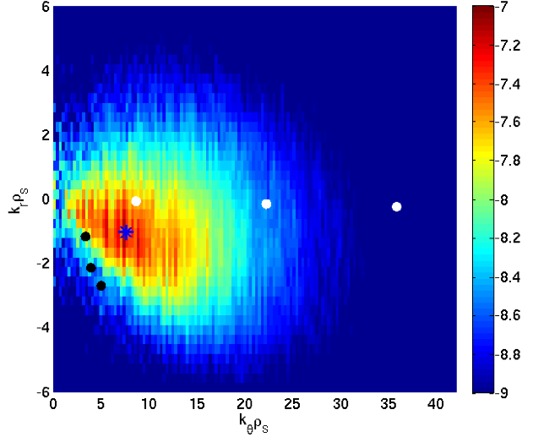
Mapped Wavenumbers of New High-k to GYRO 2D Fluctuation Spectrum
Re(𝛅n_{e}/n_{e0}) (k_{r}, k_{θ})
Black dots: old hk
White dots: new hk
Picked k‘s in predicted measurement range
k_{Z} = 7, 18, 29, 40 cm⁻¹
k_{R} = 0 cm⁻¹
Blue star: streamers

Slide 41
Mapped Wavenumbers of New High-k to GYRO 2D Fluctuation Spectrum
Black dots: old hk
White dots: new hk
Blue star: streamers
Re(𝛅n_{e}/n_{e0}) (k_{r}, k_{θ})
k_{R}=0
k_{Z}=7 cm⁻¹
k_{R}=0
k_{Z}=18 cm⁻¹
k_{R}=0
k_{Z}=29 cm⁻¹
Picked k’s in predicted measurement range
k_{Z} = 7, 18, 29, 40 cm⁻¹
k_{R} = 0 cm⁻¹
Lowest-k channel closest to streamers
k_{Z}=7 cm⁻¹
Highest-k not captured in simulation
k_{Z} = 40 cm⁻¹
Streamers: finite k_{R}
|k_{R}| ~ |k_{Z}|
k_{R}=-7 cm⁻¹
k_{Z}=6.5 cm⁻¹

Slide 42
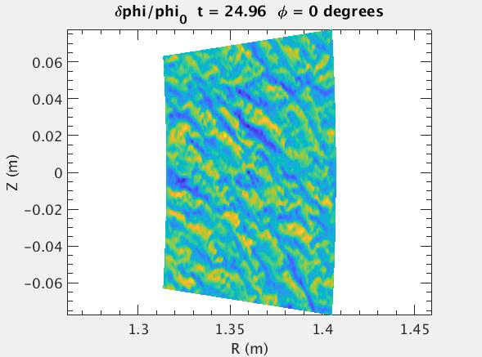
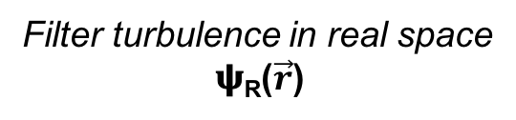
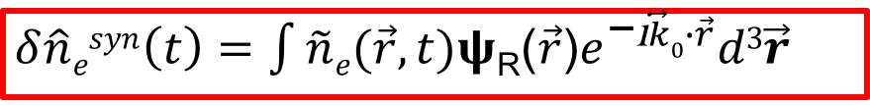
New Proposed Implementation: real space filtering
Scattering system is spatially localized (R, Z, 𝝋)_{loc}
Analyze turbulence in real space +
Filter turbulence in real space
𝛙_{R}($\vec{r}$)
$δ\hat{n}esyn\left(t\right)=\int{\tilde{n}e(\vec{r},t)}$𝛙_{R}($\vec{r}$)$e^{\text{−}\text{i}\vec{k}0∙\vec{r}}d3\vec{r}$
Obtain a time series of turbulent density fluctuations $δ\hat{n}esyn\left(t\right)$

Slide 43
Past Work on NSTX H-mode Plasma Showed Stabilization of e- scale Turbulence by Density Gradient
Ip [MA]
NSTX NBI heated H-mode featured a controlled current ramp-down. Shot 141767.
An increase in the equilibrium density gradient was correlated to a decrease in high-k density fluctuation amplitude (measured by a high-k scattering system). cf. Ruiz Ruiz PoP 2015.
  Low ∇n
  (t=398ms)
  High ∇n
  (t=565ms)
0.1
0.2
0.3
0.4
0.5
0.6
t [s]
Scattering
Region
r/a~0.7

Slide 44
Results of wavenumber mapping
Experiment GYRO
(shot 141767, ch1)
Cylindrical geometry (R,Z, 𝝋) Field aligned (r, θ,𝝋)
Ray Tracing: New mapping:
k_{R} = - 18.57 cm⁻¹ ➔ k_{r}ρ_{s} = - 2.68
k_{Z} = 4.93 cm⁻¹ ➔ k_{θ}ρ_{s} = 4.99
ρ_{s}^{exp} = 0.7 cm ρ_{s}^{GYRO} = 0.2 cm
Next step is to run a GYRO simulation that resolves the experimental wavenumbers and the high-k ETG spectrum.
Old high-k system is sensitive to k that are closer to the spectral peak of fluctuations than previously thought → more transport relevant!
Notes:
remove

Slide 45
Resolving (k_{R},k_{Z})^{exp} + Complete electron Scale Spectrum Requires a Big-Simulation-Domain e- Scale Simulation
Big-box e-scale sim. grid
S(k_{θ}) = |𝛅n_{e}/n_{e0}|²
Scattering measurements
Big-box simulation spectra show well resolved (k_{R},k_{Z})^{exp} and electron scale spectrum.

Slide 46
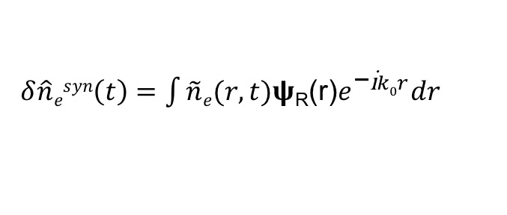
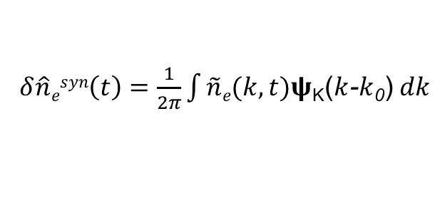
1D synthetic turbulence: proof of principle of equivalence between k & r filtering
Filter in real space
Filter in k-space
1D synthetic turbulence toy model shows proof of principle of equivalence between r & k filtering techniques.
$δ\hat{n}esyn\left(t\right)=\int{\tilde{n}e(r,t)}$𝛙_{R}(r)$e^{\text{−}\text{i}k0r}dr$
$δ\hat{n}esyn\left(t\right)=\frac{1}{2π}\int{\tilde{n}e(k,t)}$𝛙_{K}($k$-$k$₀)$dk$

Slide 47
Mapped Wavenumbers of New High-k Diagnostic to GYRO k_{θ} Fluctuation Spectrum
S(k_{θ}) = |𝛅n_{e}/n_{e0}|²
Spectrum is integrated in k_{r}.
Lowest-k channel will be closest to peak of fluctuation spectrum (streamers)
k_{R}=0, k_{Z}=7 cm⁻¹
Need to resolve very high-k (k_{θ}ρ_{s} ~ 50) to capture highest-k channel.
Red band: measurement range of old system.
Gray bands: measurement range of new system.
Old system
k_{θ}ρ_{s}
New system
Notes:
Remove standard e- scale
Include sim details in back up

Slide 48
Towards a Quantitative Comparison of Plasma Turbulent Frequency Spectrum
P [dB] ∝ |δn_{e}|²(f)
Similar spectral shape: spectral peak, spectral width.
NOTE: a quantitative comparison is not yet available: correct experimental units are not included in Synthetic diagnostic.
Experiment
Synthetic
diagnostic
f [kHz]

Slide 49
Resolving (k_{R},k_{Z})^{exp} + Complete ETG Spectrum Requires a Big-Simulation-Domain e- Scale Simulation
Resolution constrains: - Resolve (k_{R},k_{Z})^{exp} → Δk_{θ}ρ_{s}^{FS} ~ 0.3.
- Resolve full ETG spectrum → (k_{θ}ρ_{s}^{FS})^{max} ~43.
- Radial overlap with scattering beam width → L_{r}~8 cm (L_{r}~21 ρ_{s})
- Resolve e- scale turbulence eddies → Δr ~ 2ρ_{e}.
Spectra show well resolved (k_{R},k_{Z})^{exp} and ETG spectrum (cf. slide 22).
Experimental wavenumbers produce non-negligible δn_{e} and Q_{e} consistent with previous e- scale simulation results (Q_{e} ~ 0.4 MW).
Scattering measurements
Resolution parameters
 | Standard e- scale | Big-box e- scale
L_{r} [ρ_{s}] | 6 | 21
L_{y} [ρ_{s}] | 6 | 21
Δr [ρ_{e}] | ~ 2 | 2.5
n_{r} (radial grid) | ~ 200 | 512
Δk_{θ}ρ_{s} | 1-1.5 | 0.3
k_{θ}ρ_{s}^{max} | 40-50 | 43
n (tor. modes) | ~50 | 142
Q_{e} ~ 0.4 MW
k_{θ}ρ_{s} here means k_{θ}ρ_{s}^{FS}

Slide 50
Numerical Resolution Comparison with Traditional Ion Scale, Electron Scale and Multiscale Simulation
Poloidal wavenumber resolution (k_{θ}ρ_{s} here means k_{θ}ρ_{s}^{FS})
 | Δk_{θ}ρ_{s} | k_{θ}ρ_{s}^{max} | n #tor. modes
Ion scale | ~0.05 | ~1 | ~20-30
e- scale | ~1-1.5 | ~50 | ~50
Multi-scale | ~0.1 | ~40 | ~500
Hybrid e- scale | 0.3 | 43 | 142
Radial resolution Δr– radial box size L_{r}
 | Δr | L_{r} | n_{r} radial grid
Ion scale | ~ 0.5 ρ_{s} | ~80-100 ρ_{s} | ~ 200
e- scale | ~ 2 ρ_{e} | ~ 6-8 ρ_{s} | ~ 200
Multi-scale | ~ 3 ρ_{e} | ~ 40-60 ρ_{s} | ~ 1500
Hybrid e- scale | 3.5 ρ_{e} | 50 ρ_{s} | 1000

Slide 51
Prerequisites to Coordinate Mapping
We want to perform:
coordinate mapping GYRO (r,θ,φ) ⬅➔ physical (R, Z, φ)
wavenumber mapping (k_{r}ρ_{s},k_{θ}ρ_{s})_{GYRO} ⬅➔ (k_{R}, k_{Z})
Prerequisites
Units: r[m], R[m], Z[m], θ, φ ∈[0,2π]
GYRO definition of k_{θ}^{loc} and k_{θ}^{FS}
Wavenumber mapping under simplifying assumptions
Consistent with GYRO definition of flux-surface averaged k_{θ}^{FS}=nq/r (cf. backup)
Miller-like parametrization
ζ=0, dζ/dr=0 (squareness)
Z₀=0, dZ₀/dr=0 (elevation)
UD symmetric (up-down symmetry)
→(θ=0)

Slide 52
Calculated (k_{r},k_{θ})^{exp} in GYRO Geometry
Given from experiment (ray tracing)
  k_{R} = -1857 m⁻¹, k_{Z}=493 m⁻¹ (channel 1 of high-k diagnostic)
Get from GYRO (internally calculated)
  - (ρ_{s})_{GYRO} ~ 0.002 m (B_unit ~ 1.44)
  |∇r| ~ 1.43, κ ~ 2
Apply mapping (simplified approx.)
Obtain experimental wavenumbers mapped to GYRO
(k_{r}ρ_{s})_{GYRO}~ -2.6
(k_{θ}ρ_{s})_{GYRO}~ 2.0
cf. slide 15

Slide 53
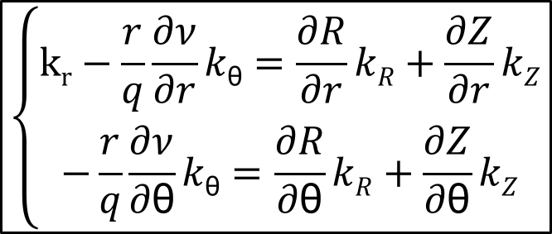
Wavenumber Mapping: (k_{R}, k_{Z}) ➔ (k_{r}, k_{θ})
Mapping (k_{R}, k_{Z}) → (k_{r}, k_{θ}) is done using the GYRO definitions of k + transformation of coordinate systems.
Result is:
$$\left\{\begin{aligned}kr−\frac{r}{q}\frac{∂ν}{∂r}k\text{θ}=\frac{∂R}{∂r}kR+\frac{∂Z}{∂r}kZ \\ −\frac{r}{q}\frac{∂ν}{∂\text{θ}}k\text{θ}=\frac{∂R}{∂\text{θ}}kR+\frac{∂Z}{∂\text{θ}}kZ\end{aligned}\right.$$
Need to compute ∂R/∂r, ∂R/∂θ, ∂Z/∂r, ∂Z/∂θ @ (r_{loc}, θ_{loc})
Given (k_{R}, k_{Z})^{exp} (ray-tracing), will obtain (k_{r},k_{θ})^{exp} in GYRO coordinates!
 | Previous studies | New k-mapping
k_{r}𝝆_{s}^{exp} | -4/-15 | -1.5/-3
k_{𝞱}𝝆_{s}^{exp} | 3-6 | 3-5
Notes:
remove

Slide 54
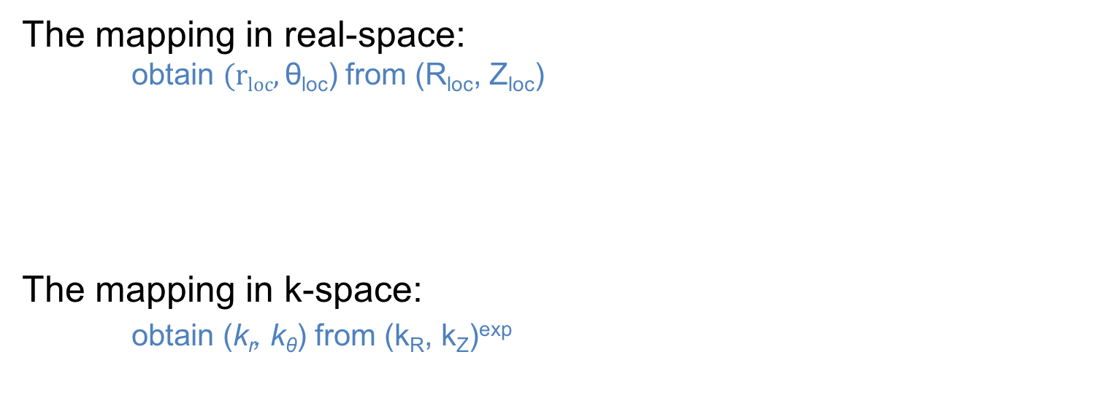
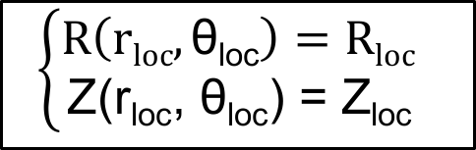

Summary of Coordinate Mapping
The mapping in real-space:
obtain $(rloc,\text{θ}\text{loc}\text{) }$from (R_{loc}, Z_{loc})
The mapping in k-space:
obtain (k_{r}, k$\text{θ}$) from (k_{R}, k_{Z})^{exp}
$$\left\{\begin{aligned}R\left(rloc,\text{θ}\text{loc}\right)=Rloc \\ \text{Z}\text{(}\text{r}\text{loc}\text{, }\text{θ}\text{loc}\text{) = }\text{Z}\text{loc} \end{aligned}\right.$$
$$\left\{\begin{aligned}kr−\frac{r}{q}\frac{∂ν}{∂r}k\text{θ}=\frac{∂R}{∂r}kR+\frac{∂Z}{∂r}kZ \\ −\frac{r}{q}\frac{∂ν}{∂\text{θ}}k\text{θ}=\frac{∂R}{∂\text{θ}}kR+\frac{∂Z}{∂\text{θ}}kZ\end{aligned}\right.$$
Notes:
Lay out procedures

Slide 55
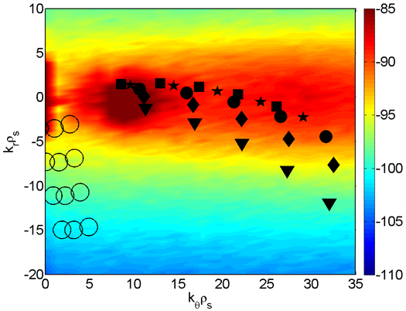
New High-k Scattering System was Designed to Detect Streamers based on Previous Predictions
Old high-k system: high-k_{r}, intermediate k_{θ}
New high-k system: high-k_{θ}, intermediate k_{r} → streamers
y-axis scales are different, x-axis scales are similar
Barchfeld APS 2015
My mapping

Slide 56
New High-k Scattering System was Designed to Detect Peak in Fluctuation Amplitude: streamers
Old high-k system: high-k_{r}, intermediate k_{θ}
New high-k system: high-k_{θ}, intermediate k_{r} → streamers
Poloidal cross section
View from top

Slide 57
Standard Electron Scale Simulation Captures Correctly Wavenumbers Detected by New High-k System
Big-box e-scale sim. grid
Standard e-scale sim. grid
k_{θ} values are restricted to [-5,5]
k_{r} shown are full simulated spectrum.
A big-box e- scale simulation is not needed to resolve spectrum of new high-k system.

Slide 58
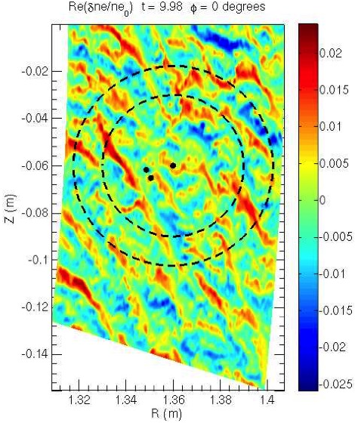
A Big-Simulation-Domain Electron Scale Simulation Was Performed to Apply New Synthetic Diagnostic
Outboard mid-plane δn_{e}(R, Z) in high resolution e- scale GYRO simulation of real NSTX plasma discharge.
Shot 141767, time t = 398 ms
(cf. Ruiz Ruiz PoP 2015).
Scattering location and scattering volume extent are within GYRO simulation domain.
Dots are scattering location for channels 1, 2, and 3 of high-k diagnostic.
Dashed circles are 3cm and √2*3 cm microwave beam radii (for channel 1).

Slide 59
Input Parameters into Nonlinear Gyrokinetic Simulations Presented
 | t=398 | t = 565
r/a | 0.71 | 0.68
a [m] | 0.6012 | 0.596
B_{unit} [T] | 1.44 | 1.27
n_{e} [10^19 m-3] | 4.27 | 3.43
T_{e}[keV] | 0.39 | 0.401
RHOSTAR | 0.00328 | 0.003823
a/L_{ne} | 1.005 | 4.06
a/L_{Te} | 3.36 | 4.51
β_{e}^{unit} | 0.0027 | 0.003
a/L_{nD} | 1.497 | 4.08
a/L_{Ti} | 2.96 | 3.09
T_{i}/T_{e} | 1.13 | 1.39
n_{D}/n_{e} | 0.785030 | 0.80371
n_{c}/n_{e} | 0.035828 | 0.032715
a/L_{nC} | -0.87 | 4.08
a/L_{TC} | 2.96 | 3.09
Z_{eff} | 1.95 | 1.84
nu_{ei} (a/c_{s}) | 1.38 | 1.03
q | 3.79 | 3.07
s | 1.8 | 2.346
R₀/a | 1.52 | 1.59
SHIFT =dR₀/dr | -0.3 | -0.355
KAPPA = κ | 2.11 | 1.979
s_{k}=rdln(κ)/dr | 0.15 | 0.19
DELTA = δ | 0.25 | 168
s_{δ}=rd(δ)/dr | 0.32 | 0.32
M | 0.2965 | 0.407
γ_{E} | 0.126 | 0.1646
γ_{p} | 1.036 | 1.1558
λ_{D}/a | 0.000037 | 0.0000426
c_{s}/a (10⁵ s-1) | 4.4 | 2.35
Qe (gB) | 3.82 | 0.0436
Qi (gB) | 0.018 | 0.0003

Slide 60
Mapping (k_{r}ρ_{s},k_{θ}ρ_{s})_{GYRO} ➔ (k_{R}, k_{Z})^{exp}
We want to perform:
coordinate mapping GYRO (r,θ,φ) ⬅➔ physical (R, Z, φ)
wavenumber mapping (k_{r}ρ_{s},k_{θ}ρ_{s})_{GYRO} ⬅➔ (k_{R}, k_{Z})
Preamble 1
Units: r[m], R[m], Z[m] θ, φ ∈[0,2π]
GYRO definition of k_{θ}^{loc} and k_{θ}^{FS}
Consistent with GYRO definition of flux-surface averaged k_{θ}^{FS}=nq/r
(cf. out.gyro.run)
(To be shown in slide 17)

Slide 61
Mapping (k_{r}ρ_{s},k_{θ}ρ_{s})_{GYRO} ➔ (k_{R}, k_{Z})^{exp}
Preamble 2 why is ??
GYRO decomposition of fields
Set φ=0 and ω₀ = 0. Focus on transformation of one toroidal mode n. By definition of k_{θ}^{loc}
Conclusion: we assume definition of k_{θ}^{loc} is correct.
There is a one-to-one relation between n and k_{θ}^{loc} .

Slide 62
Mapping (k_{r}ρ_{s},k_{θ}ρ_{s})_{GYRO} ➔ (k_{R}, k_{Z})^{exp}
Preamble 3 Wavenumber mapping under simplifying assumptions
Assumptions
  ζ=0, dζ/dr=0 (squareness + radial derivative)
  Z₀=0, dZ₀/dr=0 (elevation + radial derivative)
  UD symmetric (up-down asymmetry of flux surface)
In the following slides, develop mapping when assumptions are not satisfied, invert
(R(r,θ),Z(r,θ))=(R_{exp}, Z_{exp}) ➔(r_{exp},θ_{exp}) .

Slide 63
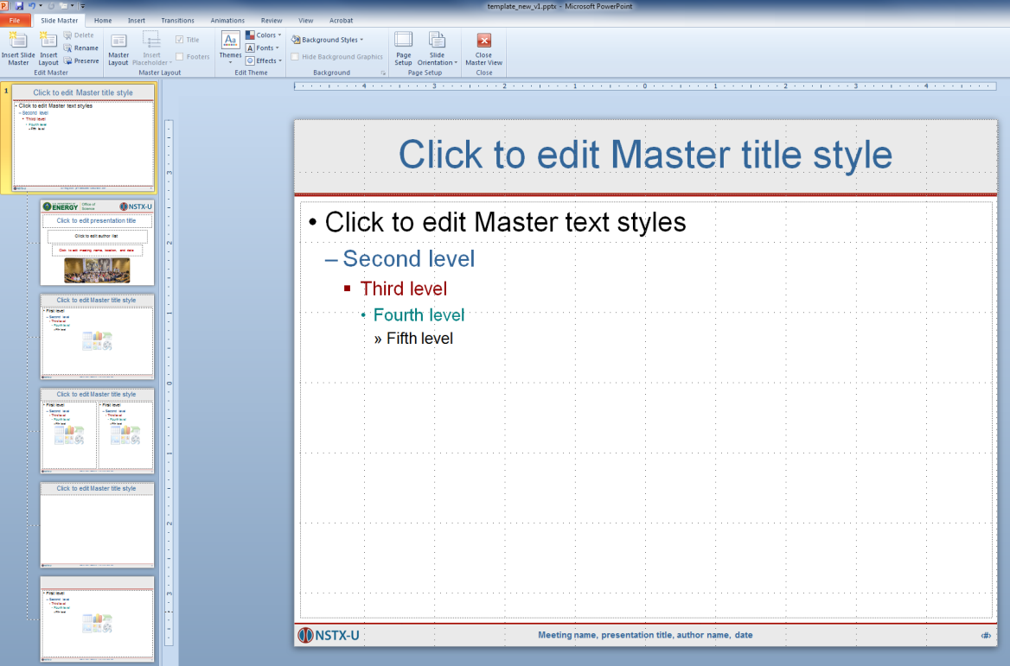
Instructions for editing bottom text banner
Go to View, Slide Master, then select top-most slide
  Edit the text box (meeting, title, author, date) at the bottom of the page
    Then Close Master View

Slide 64
Slide title
First level
  Second level
    Third level
      You really shouldn’t use this level – the font is probably too small

Slide 65
Slide title
Column 1
Column 2

Slide 66






Here are the official NSTX-U icons / logos

