Slide 1



Characterization of boronized graphite in NSTX-U and its effect on plasma performance
F. Bedoya, J.P. Allain, R. Kaita and C.H. Skinner
59th Annual APS DPP Meeting
Milwaukee, WI
Oct 23rd – Oct 27th 2017

Slide 2
Motivation – Oxygen retention
I_{P} (kA)
Low oxygen concentration following boronization
MAPP XPS data obtained at NSTX-U
NBI (MW)
Improved plasma performance on similar scenarios
Oxygen concentration reduction in PFCs with boronization improves performance.
Further studies in the laboratory (post-mortem and control) to test this hypothesis

Slide 3
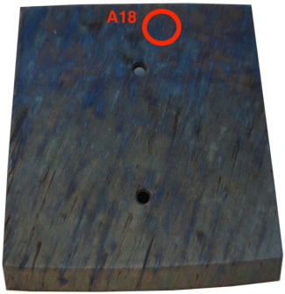
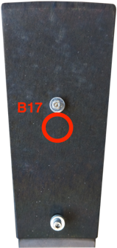
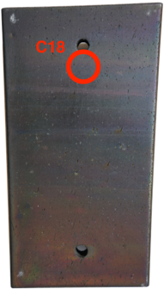
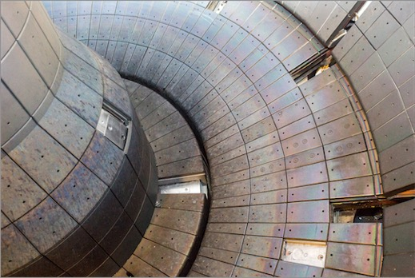
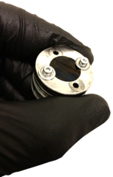
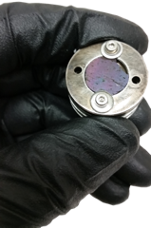
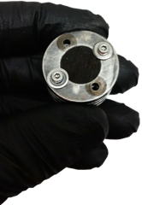
Samples made from NSTX-U tiles (post-mortem)
Core samples
CS -Shoulder
Inner LD
Outer LD
Tiles location
A18, Center Stack (CS) Shoulder
B17, Inner Lower Divertor (ILD)
C18, Outer Lower Divertor (OLD)

Slide 4
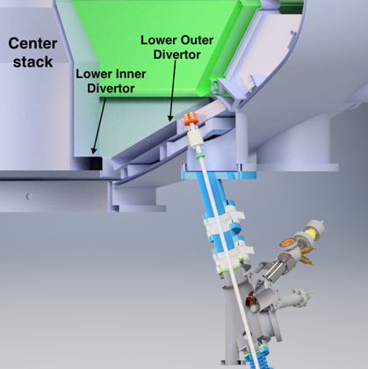
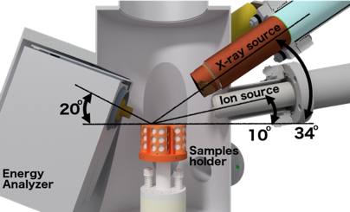
Experimental methods
Materials analysis in NSTX-U
Post-mortem and Controlled experiments at University of Illinois
IGNIS Facility
MAPP Facility
Ar⁺,D⁺
Analysis
Chamber

Slide 5
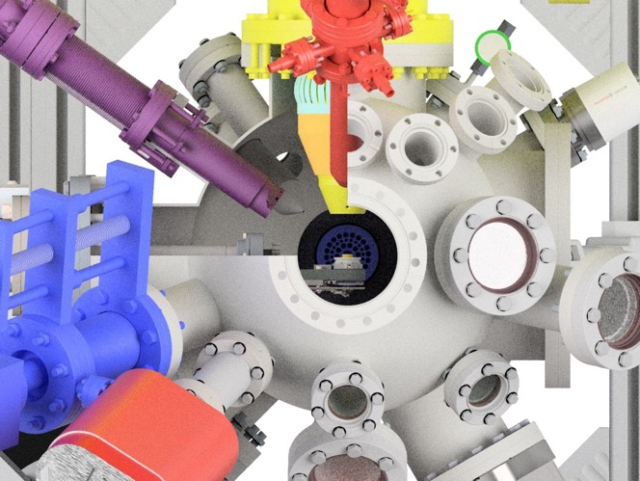
Ion-Gas-Neutral Interactions with Surfaces (IGNIS) Facility
True in-situ, in-operando analysis of surfaces.
Chemistry analysis (HR-XPS, HR-ISS) at NAP (UHV to 1 mTorr OP).
Wide experimental parameters space:
  Temperature LN to 1000 ºC.
  Plasma irradiations; noble and reactive gas (250 eV – 2 keV)

Slide 6
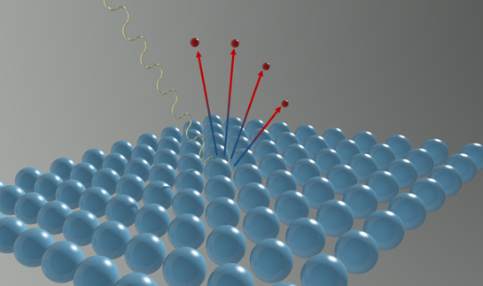
Chemical identification of components via XPS
Emission of photoelectrons under incident soft X-ray beam
Probe top 1 – 10 nm of sample
Elemental identification in survey scans
Region scans allow quantitative analysis (at.%)
Region scans
Oxygen
Carbon
e⁻
hν
Survey scan

Slide 7
XPS OLD sample – Highest oxygen and boron concentration at OSP region
Core C18 – OLD sample
High presence of oxides throughout the whole experiment
Highest boron concentration of all cores (~20%) in analyzed depth (~100 nm)
Also highest oxygen concentration in depth ( as much as 40%)
3.5x10¹⁷ Ar⁺/cm²
1x10¹⁵ Ar⁺/cm²
As is

Slide 8
XPS ILD sample – Evidence of presence of impurities on surfaces in PFR region
Core B17 – ILD sample
High presence of oxides throughout the whole experiment
Presence of a new XPS peak, attributed to Cl, possible NSTX-U impurity
B-B and B-C (non-oxidized) states observable following Ar⁺ irradiation
3.5x10¹⁷ Ar⁺/cm²
1x10¹⁵ Ar⁺/cm²
As is

Slide 9
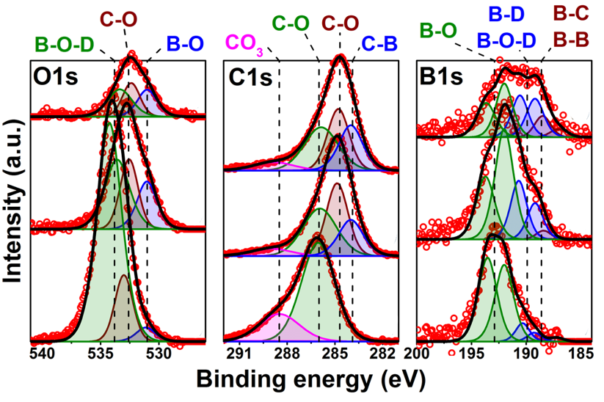
XPS CS sample – Different chemistry in CS and LD
Core A18 – CS Sample
Initial high presence of oxides (lower concentration than other cores)
B-B and B-C states visible after Ar⁺
Post-cleaning state has the closest resemblance to post-boronized state from MAPP
3.5x10¹⁷ Ar⁺/cm²
1x10¹⁵ Ar⁺/cm²
As is

Slide 10
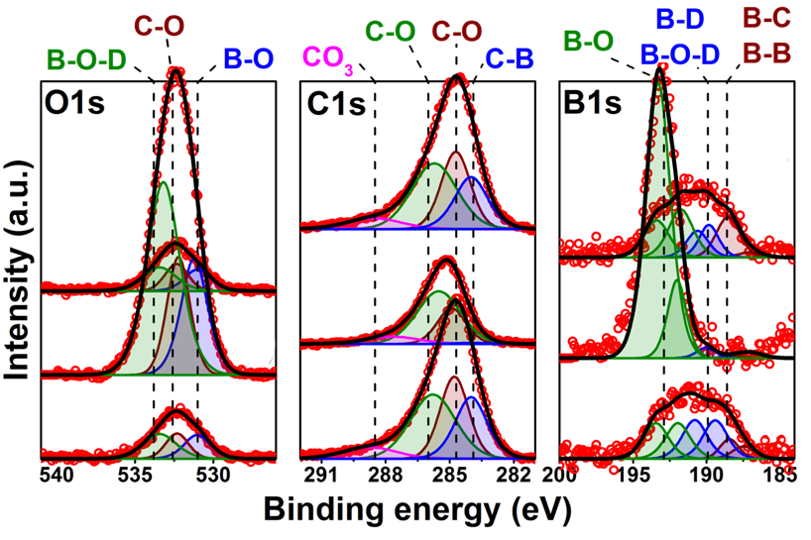
XPS CS sample - D⁺ Irradiation drives oxidation
Core A18 – D⁺ Irradiation
Deuterium irradiation drives oxidation of the B coatings, the oxides can be easily removed with additional irradiation.
Similar to what we observed in NSTX-U with MAPP !!
2.0x10¹⁷ Ar⁺/cm²
6x10¹⁶ D⁺/cm²
3.5x10¹⁷ Ar⁺/cm²

Slide 11
Conclusions
Samples manufactured from tiles extracted from NSTX-U were characterized post-mortem using XPS and ion beam etching
The boron concentrations on the three samples were different, implying possible non-uniform deposition during boronization.
D⁺ irradiation of clean post-mortem sample showed similar behavior to that observed in MAPP:
  Deuterium ions driven oxidation
  Plasma (Ar⁺) induced sputtering and oxides removal

