Slide 1




Elemental and topographical imaging of microscopic variations in deposition on NSTX-U and DIII-D samples
C.H. Skinnerª, R. Bellª, R. Kaitaª, C.P. Chrobak^{b},
W.R. Wampler^{c}, B.E. Koel^{d}
ªPrinceton Plasma Physics Laboratory, ^{b}General Atomics, ^{c}Sandia National Laboratory, ^{d}Princeton University
59th Annual Meeting of the APS Division of Plasma Physics
Milwaukee, WI, Oct 23 – 27, 2017
Notes:
Good afternoon.
I would like to talk about elemental and topographical imaging of deposition patterns in NSTX-U and DIII-D samples
I would like to thank all the co-authors without whom this work would not be possible.
Also to note this is a work in progress, and I will be presenting initial results

Slide 2

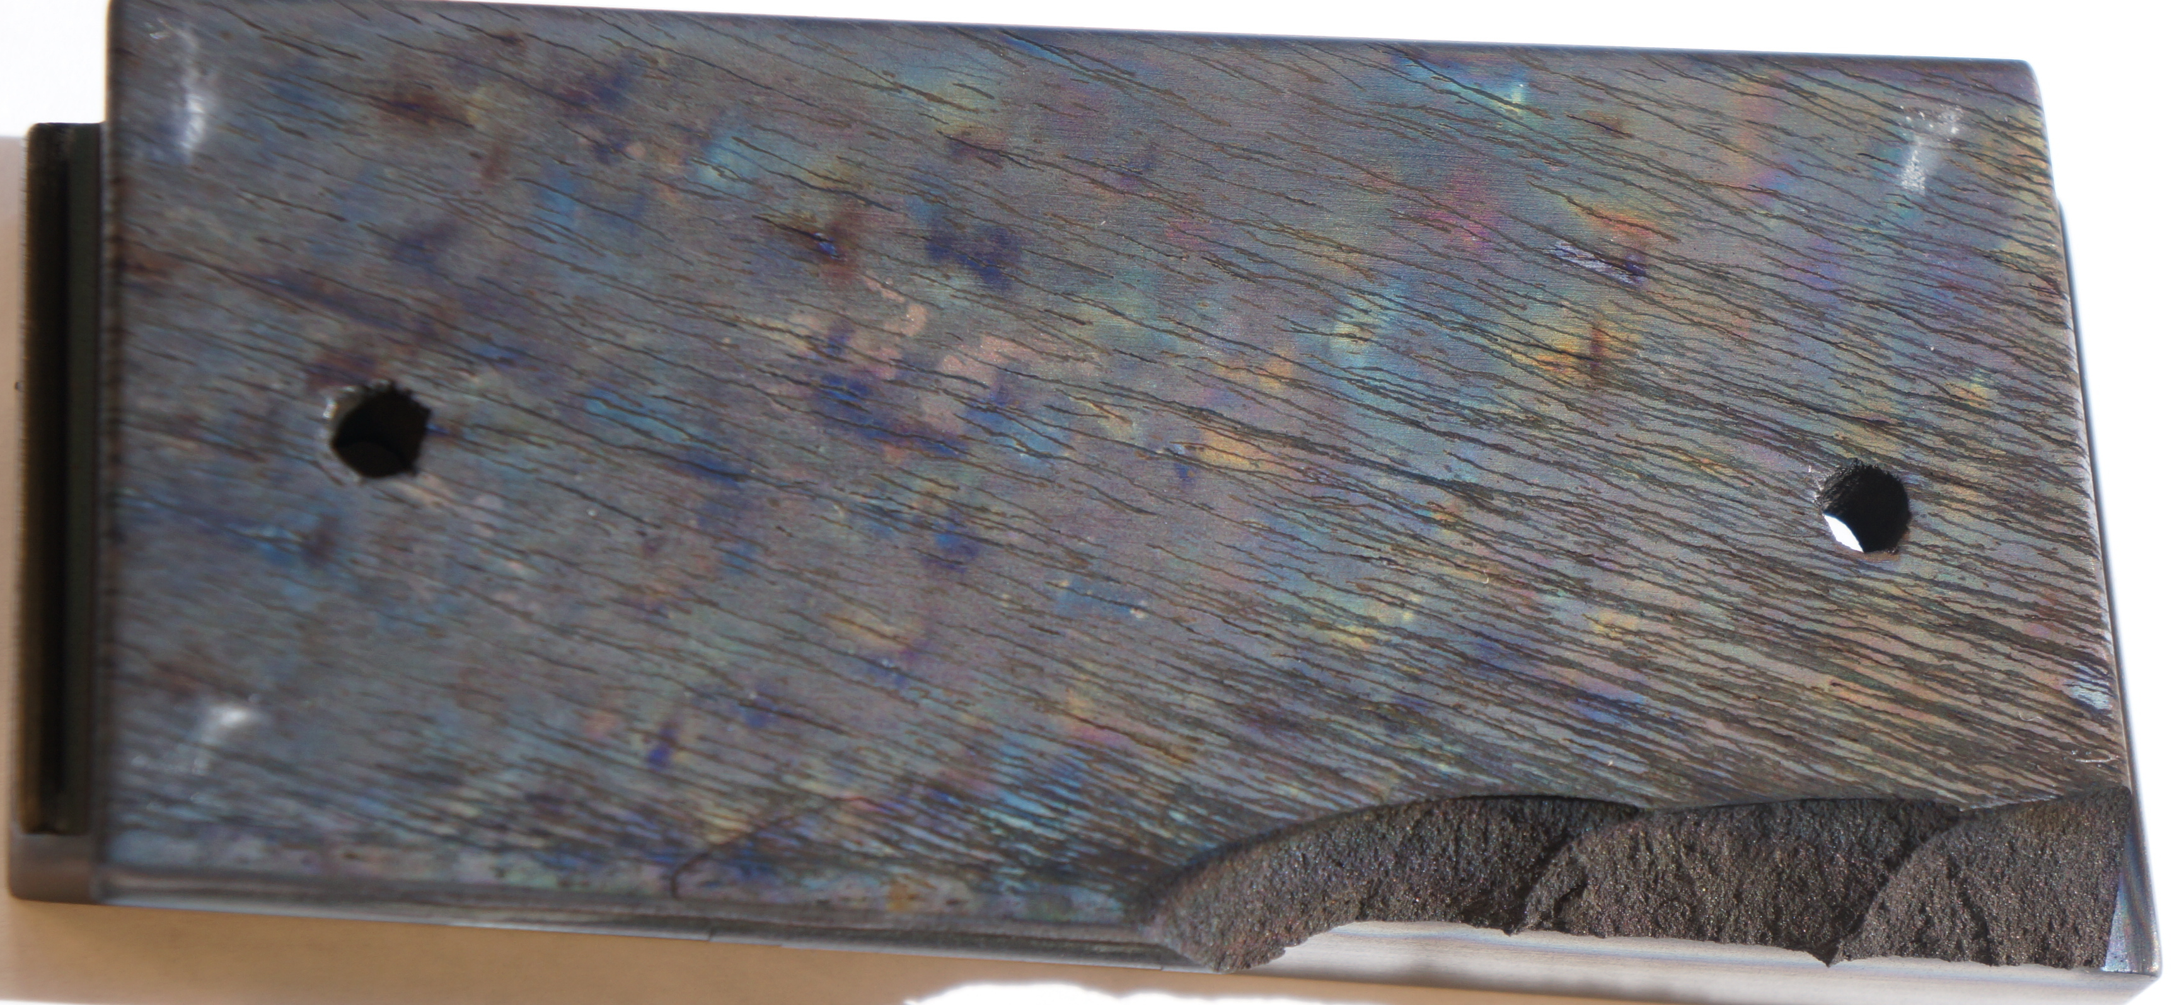
PFC surfaces can be rough.
Erosion / deposition important for PFC lifetime, T retention, dust and plasma contamination
Surface roughness can be a key factor in erosion and redeposition patterns.
Depth
scale
30 µm
0
NSTX-U upper divertor graphite tile with arc tracks
3D images of NSTX-U upper divertor tile from Leica confocal microscope
lineout
2.2”
Notes:
NSTX-U / Coupons Tile retrieval and analysis / Tile broken, shard / ‘1512 broken tile.JPG’
Leica DCM3D confocal microscope / 2017 Leica data / ileSpot2_Objx20_Studiable.doc
As we all know erosion and deposition of wall material are one of the major issues for the realization of fusion energy. They controls the lifetime of plasma facing components (which can be estimated to be tons/year or m/year for a fusion reactor (Stangby 2011) and are central to tritium retention, dust production and plasma contamination.
Second point is that it has also been known from work on Asdex and Jet and DIII-D and other machines that PFC surface roughness affects erosion and deposition.
Rough surfaces experience more net deposition.
You see on the left a tile from the NSTX-U upper divertor with interference fringes from deposited layers, and also scratches on the surface from arc tracks.
The 3D surface topography is revealed on the right as measured by a confocal microscope.
This talk is about measurements directly connecting these two.
(Knowing that tritium is retained in co-deposits hidden in cracks is important for tritium removal techniques. )

Slide 3
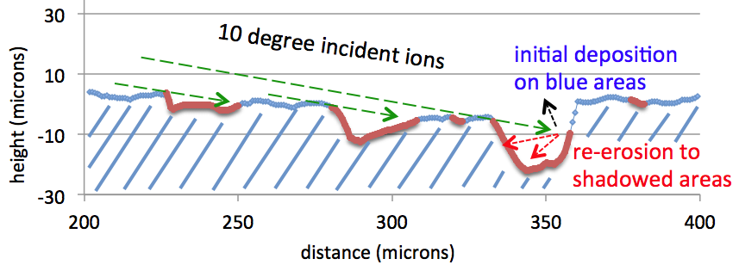
Surface roughness can shadow incident ions.
Ion incidence angle can be close to surface due to magnetic pre-sheath*
Re-eroded ions can deposit in red areas and be shadowed from further erosion
So far no high resolution elemental measurements of this
Lineout from topographical image of NSTX-U upper divertor tile
*Stangeby NF (2012)
Chrobak NME (2016)
Notes:
Imaging Analysis Center / Leica DCM3D confocal microscope / 2017 Leica data / 20170203 TEM grid and NSTXU tile / ‘TileSpot2_Objx20_ExtractProfileAPS.xlsx’
Mention Stangeby Fluid Model and Chrobak recent work using DiMES.
The plasma interaction with the wall is controlled by the sheath, and recently it was realized that in a divertor geometry where the magnetic field is incident on the surface at an angle of a few degrees, the Chodura or magnetic pre-sheath can result in ions being incident on the surface at low angles, around 10 degrees from the surface. This is different to the non-magnetized situation where the Debye sheath is required for ambipolar flow and sends ions in at normal incidence.
For grazing incidence ions the surface roughness becomes important in erosion and deposition patterns. This is illustrated in the plot which shows a lineout from the surface of an NSTX upper divertor tile as measured with a confocal microscope. The ‘valleys’ are due to arc tracks and you can see significant shadowing from ions incident at 10 degrees would be expected in the red areas.
Stangeby has developed a fluid model of this, and the results were confirmed by a kinetic model by Coulette and Manfredi. Experimental results have been reported from Asdex by Klaus Schmid, from JET by Matej Meyer, and more recently by Chris Chrobak and collaborators at DIII-D. There has been some indirect evidence of inhomogeneous deposition patterns from electron microscopy using secondary and back scattered electrons (BSE are emitted more from high Z atoms) and from Rutherford Backscattering and micro ion beam measurements with 100 micron resolution.
However to date there has not been elemental imaging of the deposition pattern of impurity elements on a rough surface with a micron resolution i.e. the same scale as the micron scale as the surface roughness.
This is the topic of the present talk.
Stangeby NF, Chrobak NF ms, JET.
Debye sheath may no longer be required for ambipolar flow.
Redeposition fraction 25x higher for rough compared to smooth substrates in DiMES.

Slide 4
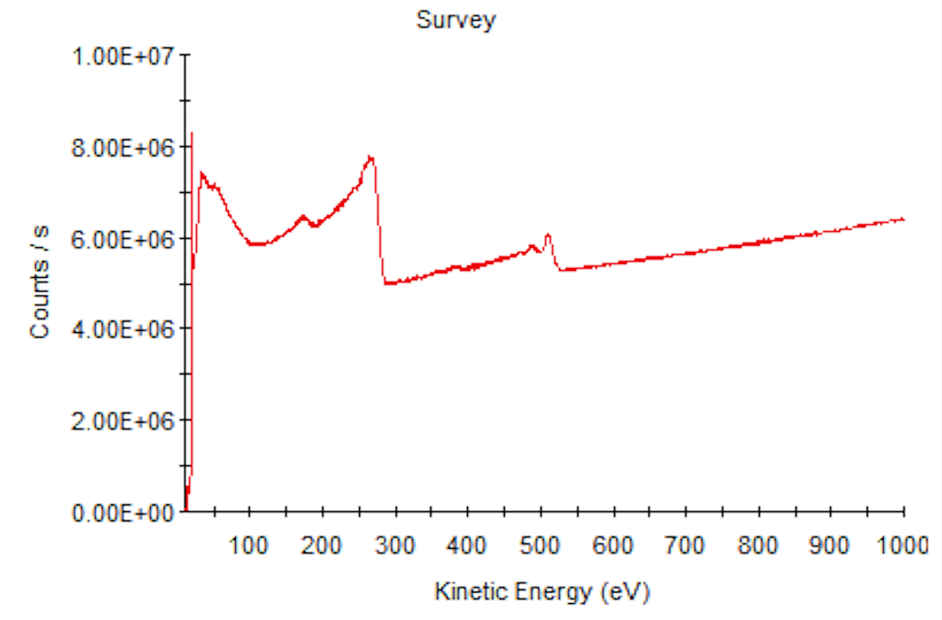
Elemental imaging by Auger microprobe
Auger process
Secondary, backscattered, and Auger electron spectrum
from NSTX-U core sample C-15:
10 keV incident electron in Scanning Electron Microscope
(SEM)
Auger
electron emission
C
B
O
Valence band
Atom on surface
Core electrons
Make SEM image from all electrons, and elemental
image from Auger electrons less background
10 keV electron beam excites core electron
- atom relaxes via 2-electron transition
Auger electron energy is characteristic of element
SEM has sub-micron resolution, cf ≥30 µm XPS, 100 µIBA.
Sampling depth = 3 * inelastic mean free path
B:1nm C:1.5nm O:2.2nm Al:4.7 nm
Notes:
Auger process is from Presentations ‘17 / ‘Lecture on PMI / PFC for Bruce's course 2017’ / ‘SkinnerLecture2017a slide27.pptx’
Survey Spectrum is from 20171016 Auger Point3 PV.PNG
Or / 20170920 NSTX-U Core 15 line scan / Expt T1 clips Depth Profile & linescan / ‘Auger Line at peak boron % PV.PNG’
Boron detector mapping energies from 20170921 NSTX-U core C15 256pixel boron map / ‘Boron detector mapping.pptx’ slide 4
As you know an SEM rasters an electron beam across a surface and creates an image by plotting the secondary electron emission vs. E-beam location.
The surface also emits Auger electrons that are created when a core hole is created by the electron beam.
A scanning Auger microscope is then an SEM with an electron analyser that can detect the Auger electrons of a specific energy.
The Auger energy depends on the atomic structure and by setting the electron energy analyser to the energy of an Auger transition of a specific element, an image of that element can be built up.
One issue is that the Auger electron flux is typically 4 orders of magnitude lower flux than the secondary electrons, so long exposure times are needed – we are talking a few days for a high resolution image.
Also the Auger signal at a particular energy is a few % of the backscattered electron background so the image is created by a differential measurement of the peak minus the adjacent in energy background.
Chrobak: Mention or note on the slide what the depth sensitivity of AES mapped image is for these elements

Slide 5
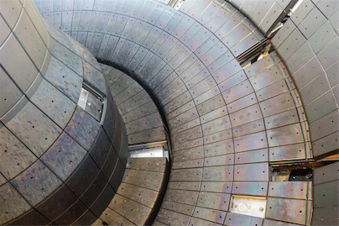
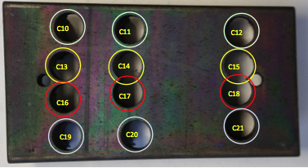
NSTX-U: SEM image of tile core
NSTXU lower divertor tile
20 µm
C18 subject of previous talk, Bedoya et al.,
Notes:
Images:
Photos of NSTX- U vessel / Photo survey after 2015 campaign / ‘184_Removed Tiles.jpg’
Coupon Tile retrieval and analysis / Tile coring / ‘NSTXU tile cores.pptx’ slide 7
SEM image is in: SAM data 2017 / 20170922 NSTX-U core C15 512pixel boron map / 20170922 Images / 20170922 Images.pptx slide 1
Original is in: ibid / 20170922 Images / ‘SEM images.docx’ page 3
Core C18 was analyzed in Bedoya Thesis p.93, 102. He gets higher B concentrations.
Note that the 173 eV Auger electron has 1/3 the imfp than the 1253 eV kinetic energy of the XPS photoelectron so AES samples more of the top surface.
XPS of C19 showed B% = 7%. The B% increased x1.5 with ~ 10 s of monatomic Ar etching then decreased to original value.
See p.12 SULI 2017 / Quinn Pratt Avantage data files and more / Thermo K-alpha – NSTX-U sample C19 / 20170718 / ‘20170718 - NSTX Monatomic and Cluster.docx’ for whole story.
Auger boron maging at 512 pixel was done on 20170922 (MAGN 500x) above and again on 20170925 (MAGN 1.6k)
Guess row 3 outboard divertor tile is Bay L
This is work in progress but I show you some of the results so far from analysis of a core sample from NSTX-U and from a DiMES sample from DIII-D.
The upper left image shows the NSTX-U lower divertor with a tile removed from the third row at Bay L.
Below is the tile with some interference fringes from deposition and some surface marks likely from arcs. The circles show the location of core samples that were removed.
This was a delicate operation since if we had simply drilled from the top surface the surface would be full of cutting debris. So we drilled from the back side and devised a special ‘catcher’ that kept the plasma facing surface pristine.
On the right you see an SEM image of a small part of the surface.
Al sputtered primarily by main ions (rather than by impurity ions) Chrobak NF draft p.28.

Slide 6
Auger image of boron 1
Auger line scans show atomic concentration of boron
~ 4% – 16%.
Appears to be higher B concentrations on North facing cliffs and little boron on South facing cliffs (toroidal field direction uncertain)
Area in white square in next slides.
net erosion
net deposition
Notes:
20170922 NSTX-U core C15 512pixel boron map / 20170922 Images / ‘20170922 Images.pptx’ slide 2
Original is in: ibid / 20170922 Images / ‘(Peak-Bkg) _ (Peak+Bkg) levels 0,1,125.tif’
Grey levels adjusted to try to reflect variation in boron concentration in line scans 5% - 9% on 20170920, and 4.6% – 7.3% 20170921, 4.5 – 3.5% on 20170922, 4.7 – 3.5% on 20170925.
Chrobak: On slides 5-6, Indicate/mention BT, R direction on DiMES/NSTX sample images, although Esp. on NSTX image, why was all the B on the north face? Was this consistent with BT direction or ExB direction angling of the ions? If you don't know the direction, or it's campaign-averaged, maybe mention that to lead into the DiMES results where the direction was known and done for one exposure.

Slide 7
SEM higher magnification
Zoom in to white square in previous slide.
Notes:
20170925 NSTX-U Core C15 512 pixel MAGN 1.6k boron map / 20170925 images / SEM.tif

Slide 8
Auger image of boron at higher magnification
Higher magnification image also shows higher B concentrations on ‘north’ facing cliffs and little boron on ‘south’ facing cliffs.
More analysis planned.
Topographical 3D mapping planned with Leica confocal microscope.
net erosion
net deposition
Notes:
20170925 NSTX-U Core C15 512 pixel MAGN 1.6k boron map / 20170925 images / (P-B)_(P+B) levels 0,1.6,125.tif
Grey levels adjusted to try to reflect variation in boron concentration in line scans 5% - 9% on 20170920, and 4.6% – 7.3% 20170921, 4.5 – 3.5% on 20170922, 4.7 – 3.5% on 20170925.
What you are seeing is net deposition of boron on ‘North’ facing slopes in the pore.
Unfortunately the Leica 3D microscope had a problem and is being replaced
Next step is to get a 3D image of the pore and compare the deposition to the topography in detail.

Slide 9
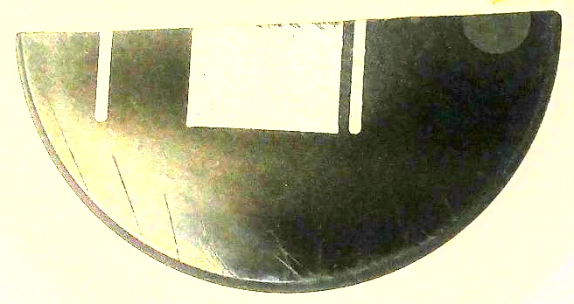
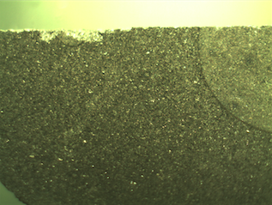
DiMES material migration study SEM image
B_{T}
Al Al Al W
B_{T}
ExB
ExB
Incident He ions
W coated area
Polished graphite 2” dia
Polished carbon surface originally
exposed to
L-mode He plasmas
toroidal field
direction fixed
Optical microscope image of DiMES sample
C
W
Chrobak NME (2016)
100 µm
m.m.
Notes:
DIII-D sample photos / RHe Al5 images / ‘1-0309171130 RHe Al5 leveled for W spot.jpg’
DIII-D DiMES core sampling / Core Samples optical images / Optical microscope images / ‘RHe W semicircle.jpg’
20170619 512 pixel large area Al Auger map RHe Al5 / ‘SEM image MAGN 200x leveled.tif’
Ion direction from: DIII-D Tile analysis (now not part of National Campaign) / Chrobak comments / ‘Chrobak SI-AES-InitialResult_interpretation_reduced.pdf’
Pore profilometry data from
20170616 512 pixel Al map pore1 RHe Al5 /’ Expts 9,10,11 512 pixel SEM&AES view2.pptx’
Switch now to a sample from DiMES on DIII-D.
This is a polished graphite surface with special stripes of Al and W that was exposed to helium L-mode plasmas to study erosion and deposition.
The lower left shows a close up optical image of the tungsten disc and the area just to the left is shown in the SEM image in the right.
Also shown is the direction of incident helium ions.
Now we use aluminum Auger electrons to build up a map of the Al deposition on the surface.

Slide 10
DiMES sample, Auger image of Al deposits
B_{T}
Al Al Al W
B_{T}
Ion direction
ExB
ExB
Incident He ions
Polished graphite 2” dia
Polished carbon surface originally
exposed to
L-mode He plasmas
toroidal field
direction fixed
Optical microscope image of DiMES sample
zoom area
C
W
Chrobak NME (2016)
100 µm
m.m.
Notes:
DIII-D sample photos / RHe Al5 images / ‘1-0309171130 RHe Al5 leveled for W spot.jpg’
DIII-D DiMES core sampling / Core Samples optical images / Optical microscope images / ‘RHe W semicircle.jpg’
20170619 512 pixel large area Al Auger map RHe Al5 / ‘AES image MAGN 200x (Pk-Bk)_(Pk+Bk) leveled.tif’
Chrobak: For DiMES slides, mention Al was not on these SEM areas before, migrated from strips on left.
So you can see that aluminum has been eroded from the strip out of sight to the left and has migrated across the surface.
The net deposition is in the pores with little on the polished surface.
Al found on sides of pores as before, has been eroded off polished surface.
Again focus on the area with the white square and zoom in.

Slide 11
DiMES sample, SEM image of pore:
B_{T}
Al Al Al W
ExB
Incident He ions
Polished graphite 2” dia
Optical microscope image of DiMES sample
C
W
m.m.
6 µm
Notes:
DIII-D sample photos / RHe Al5 images / ‘1-0309171130 RHe Al5 leveled for W spot.jpg’
DIII-D DiMES core sampling / Core Samples optical images / Optical microscope images / ‘RHe W semicircle.jpg’
20170616 512 pixel Al map pore1 RHe Al5 / ‘Expts 9,10,11 512 pixel SEM&AES view2.pptx’
See ridge that appears to be shadowed by the neighboring cliff from erosion and accumulates aluminium
In contrast the ‘mountain top’ in the center is eroded by the incident He ions and any Al deposited is eroded.
In the lower left is another shadowed area with net Al deposition.

Slide 12
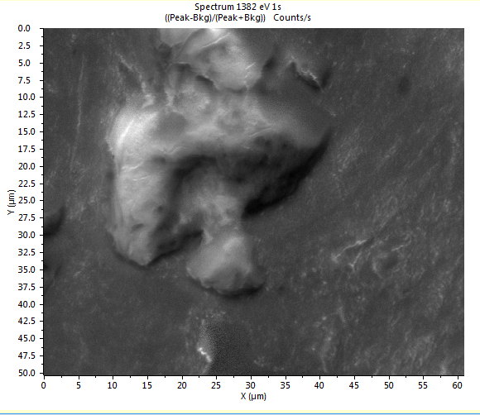
Al Auger image of same pore
Al Auger image of same pore
Incident He ions
Microscopic features of surface affect erosion and redeposition.
net erosion
net deposition
Notes:
20170616 512 pixel Al map pore1 RHe Al5 / Avantage Clips / ‘Expt9 AES Al KL1 512 pixel.PNG’
20170616 512 pixel Al map pore1 RHe Al5 / ‘Expts 9,10,11 512 pixel SEM&AES view2.pptx’
Chrobak email June 21 for incident He and C3+ direction.
This is a direct evidence that the surface topography can shadow some areas from erosion and allow net deposition to build up .
Additionallty the deposition pattern in holes is consistent with the direction of incident helium ions as calculated from the sheath and DIII-D field direction.
See ‘Chrobak Re_ initial Auger mapping results.rtfd’ after 20170609 data
“Additionally, due to the ExB drift of the ions as they cross the sheath, their average direction is deflected from parallel to B to more like 30-45-degrees radially inward with respect to the B direction.
This, too seems to come across in the image you sent, since the darker, eroded edges of the pore are those on the radially inboard side of the pore.”

Slide 13
W Auger image of same pore
W Auger image of same pore
Most W eroded by incident C (not D) and promptly redeposited.
W is migrating upstream
Conclude:
Auger elemental images show how surface affect erosion and redeposition.
Surface topography needs to be taken into account in modeling erosion and redeposition on rough surfaces.
Incident He ions
net deposition
Notes:
20170628 512 pixel Tungsten mapping pore1 RHe Al5 / Avantage Clips / 20170628 W image (P-B)_B leveled 100,1,200.tif
This is an image of the same pore generated from tungsten Auger electrons also showing lots of W net deposition.
W eroded by incident C, unlike Al which can be eroded by D.
Also W is migrating upstream from the tungsten spot to the right.
W accumulation on left not conspicuous in SEM or Al image.
bkg subtraction might add BSE from edges ? Use idl.

Slide 14
Conclusions:
Direct elemental mapping at sub-micron resolution shows net deposition is inhomogeneous in NSTX-U and DiMES samples
Surface morphology on micron scale influences net deposition patterns
Net deposition pattern is consistent with magnetic pre-sheath causing shallow angle incident ions and less erosion on shadowed areas.
3D topographical mapping planned to correlate deposition patterns with detailed topography
Illustrates how surface science can illuminate fundamental sheath physics and fusion energy issues.
Notes:
Future work with pre-patterned pores on flat substrate could be done.
Nice interdisciplinary study between surface science, sheath physics and fusion energy.
Chrobak: As a conclusion, I agree that it would be good to mention how such inhomogeneities would affect conventional XPS measurements or those presented with MAPP. What I mean by this is that in the typical XPS data, could you differentiate between a truly homogeneous, amorphous 50/50 boron/carbon surface and an inhomogeneous one where 50% of the area is 100% boron and 50% of the area is 100% carbon?

Slide 15
Backups
Notes:
NSTXU tile cores.pptx

Slide 16
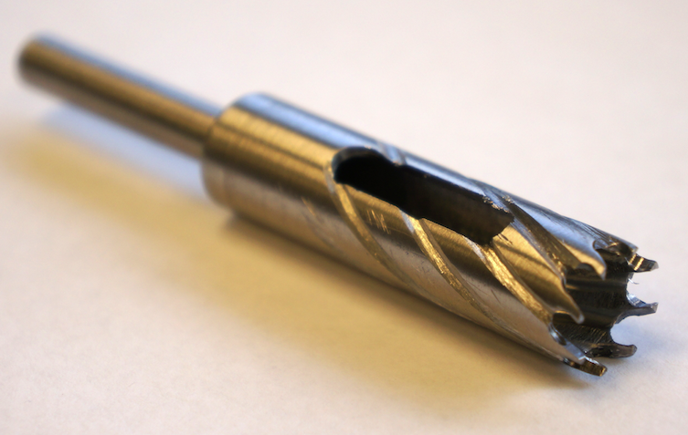
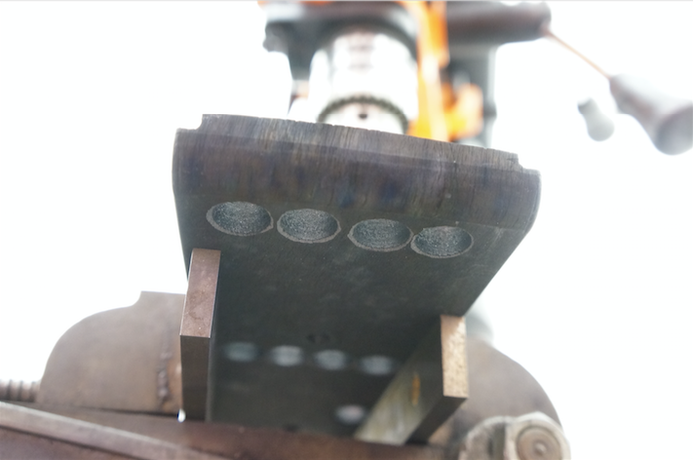
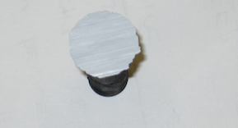
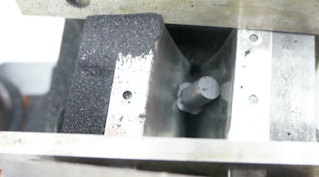
Backups
Precision, custom-made 3/8” i.d. core drill’
Plasma facing surface underneath
Core in 'catcher’
No dust evident on trial sample after coring
Notes:
NSTXU tile cores.pptx

Slide 17
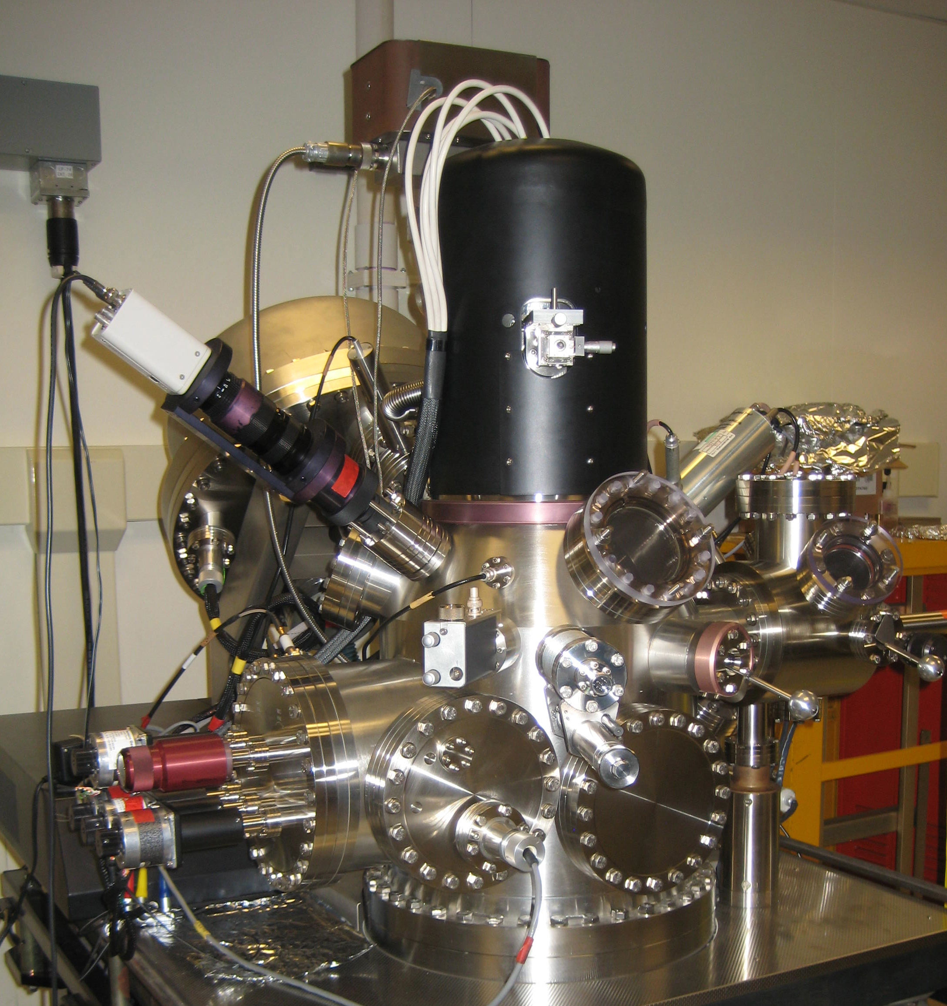
Backups
Scanning Auger Microprobe (SAM) combines:
Secondary electron microscopy (SEM)
Auger electron spectroscopy (AES) for
2D elemental mapping (SAM)
Ion sputtering for surface cleaning
and depth profiling

Slide 18
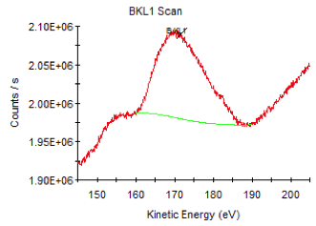
Elemental imaging by Auger microprobe
Auger process
Boron Auger Line:
10 keV incident electron in SEM
Auger
electron emission
Valence band
Atom on surface
Core electrons
5-channel detector Pk, Pk, Pk, Pk, Bkg
Secondary + backscattered + Auger electrons
10 keV electron beam excites core electron
- atom relaxes via 2-electron transition
Auger electron energy is characteristic of element
Images calculated from (Pk-Bkg) / (Pk + Bkg)
Notes:
Auger process is from Presentations ‘17 / ‘Lecture on PMI / PFC for Bruce's course 2017’ / ‘SkinnerLecture2017a slide27.pptx’
Boron Auger line is in 20170920 NSTX-U Core 15 line scan / ‘20170920 NSTX-U Core C15 linescan.doc’ p.6
Or / 20170920 NSTX-U Core 15 line scan / Expt T1 clips Depth Profile & linescan / ‘Auger Line at peak boron % PV.PNG’
Boron detector mapping energies from 20170921 NSTX-U core C15 256pixel boron map / ‘Boron detector mapping.pptx’ slide 4
As you know an SEM rasters an electron beamacross a surface and creates an image by plotting the secondary electron emission vs. E-beam location.
The surface also emits Auger electrons that are created when a core hole is created by the electron beam.
A scanning Auger microscope is then an SEM with an electron analyser that can detect the Auger electrons of a specific energy.
The Auger energy depends on the atomic structure and by setting the electron energy analyser to the energy of an Auger transition of a specific element, an image of that element can be built up.
One issue is that the Auger electron flux is typically 4 orders of magnitude lower flux than the secondary electrons, so long exposure times are needed – we are talking a few days for a high resolution image.
Also the Auger signal at a particular energy is a few % of the backscattered electron background so the image is created by a differential measurement of the peak minus the adjacent in energy background.

Slide 19
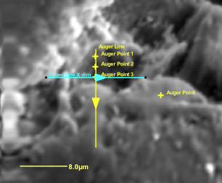
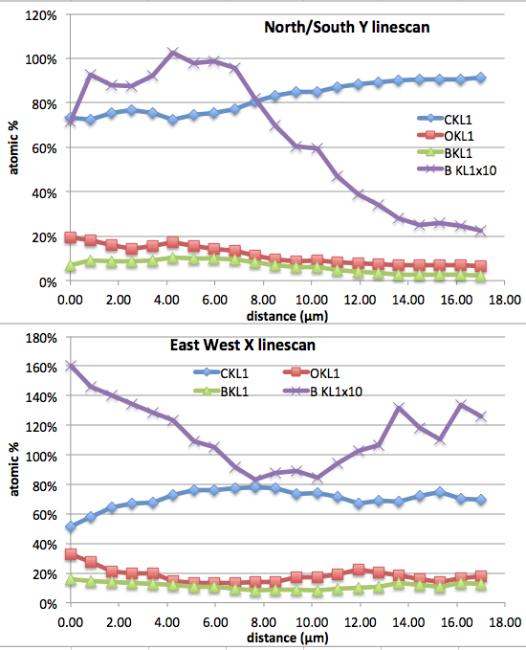
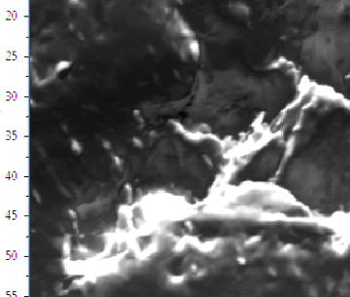
Auger linescans of NSTX-U sample

Slide 20
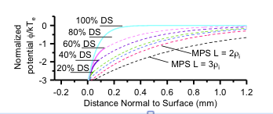
Incident Ion Angle Distribution
Chrobak
Notes:
Chrobak email 20171016 Sorry for taking longer than expected. After re-running the cases for R-He I found an additional parameter that the azimuthal angle distributions was sensitive to. The expression for the MPS density gradient is usually an exponential with a factor of 2 or 3 times the ion larmor radius as the characteristic length. The azimuthal angle distribution is sensitive to this scale length factor, resulting in a ~ 30degree inclination for length L~3*rhoi (longer gradient, weaker E-field) and ~60 degree inclination for length L ~ 2*rhoi (shorter gradient, stronger E-field). The effect of adding a debye sheath (DS) to the mix was small compared to these two.

