Slide 1
Abstract
The Disruption Event Characterization and Forecasting (DECAF) code, being developed to meet the challenging goal of high reliability disruption prediction in tokamaks, automates data analysis to determine chains of events that lead to disruptions and to forecast their evolution. The relative timing of magnetohydrodynamic modes and other events including plasma vertical displacement, loss of boundary control, proximity to density limits, reduction of safety factor, and mismatch of the measured and desired plasma current are considered. NSTX/-U databases are examined with analysis expanding to DIII-D, KSTAR, and TCV. Characterization of tearing modes has determined mode bifurcation frequency and locking points. In an NSTX database exhibiting unstable resistive wall modes (RWM), the RWM event and loss of boundary control event were found in 100%, and the vertical displacement event in over 90% of cases. A reduced kinetic RWM stability physics model [1] is evaluated to determine the proximity of discharges to marginal stability. The model shows high success as a disruption predictor (greater than 85%) with relatively low false positive rate.
[1] J.W. Berkery, et al., Phys. Plasmas 24 (2017) 506103
*Supported by US DOE Contracts DE-FG02-99ER54524, DE-AC02-09CH11466, and DE-SC0016614.

Slide 2
Disruption event chain characterization capability started as next step in disruption avoidance plan
Disruption prediction/avoidance framework
Approach to disruption prevention
  Identify disruption event chains and elements
  Predict events in disruption chains
  Cues disruption avoidance systems to break event chains
    Attack events at several places with active control
  Builds upon both physics and control successes of NSTX
t
[DOE report on Transient events (2015)]

Slide 3
Disruption Event Characterization And Forecasting (DECAF) code is structured to ease parallel development
Physical event modules
Physical event modules
  Present grouping follows work of deVries [P.C. de Vries et al., Nucl. Fusion 51, 053018 (2011)]
  – BUT, easily appended or altered
Warning algorithms
  Present approach follows [S.P. Gerhardt et al., Nucl. Fusion 53, 063021 (2013)]
  More flexible: arbitrary number of tests, thresholds, and user-defined levels and warning points
Code control workbooks
Density Limits
Confinement
Main data structure
Technical issues
Tokamak dynamics
Output processing
Power/current handling
Kinetic RWM analysis used as a reduced stability model in DECAF
Mode stability

Slide 4
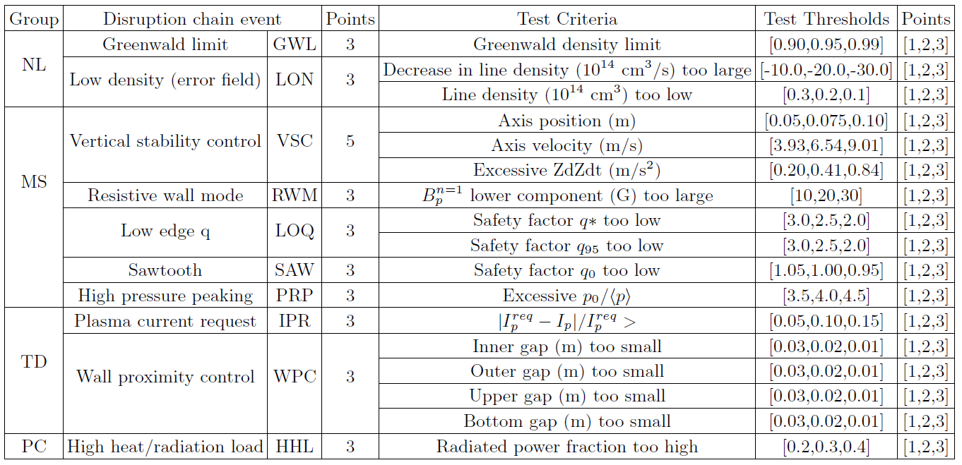
Examples of some threshold tests currently included in DECAF
Update

Slide 5
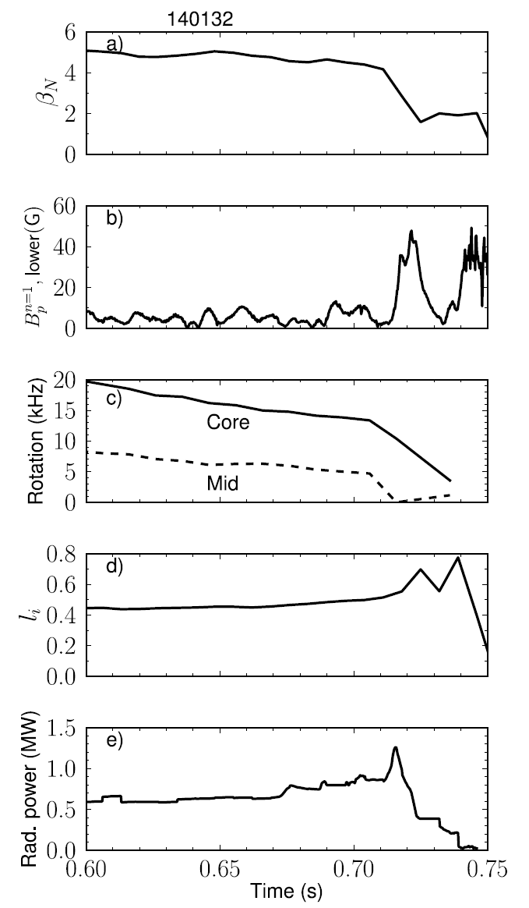
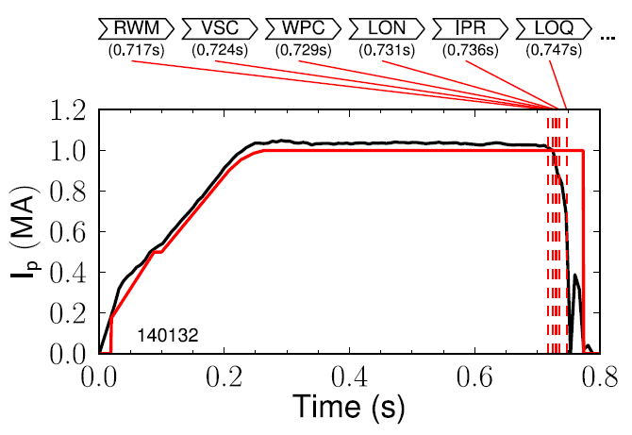
DECAF uses threshold tests and more sophisticated models to declare events and event chains
Example DECAF analysis on single NSTX discharge
  Ex: RWM B_{P}^{n=1} threshold 30G (δB/B0 ~ 0.67%)
NSTX
Disruption Events and Chain

Slide 6
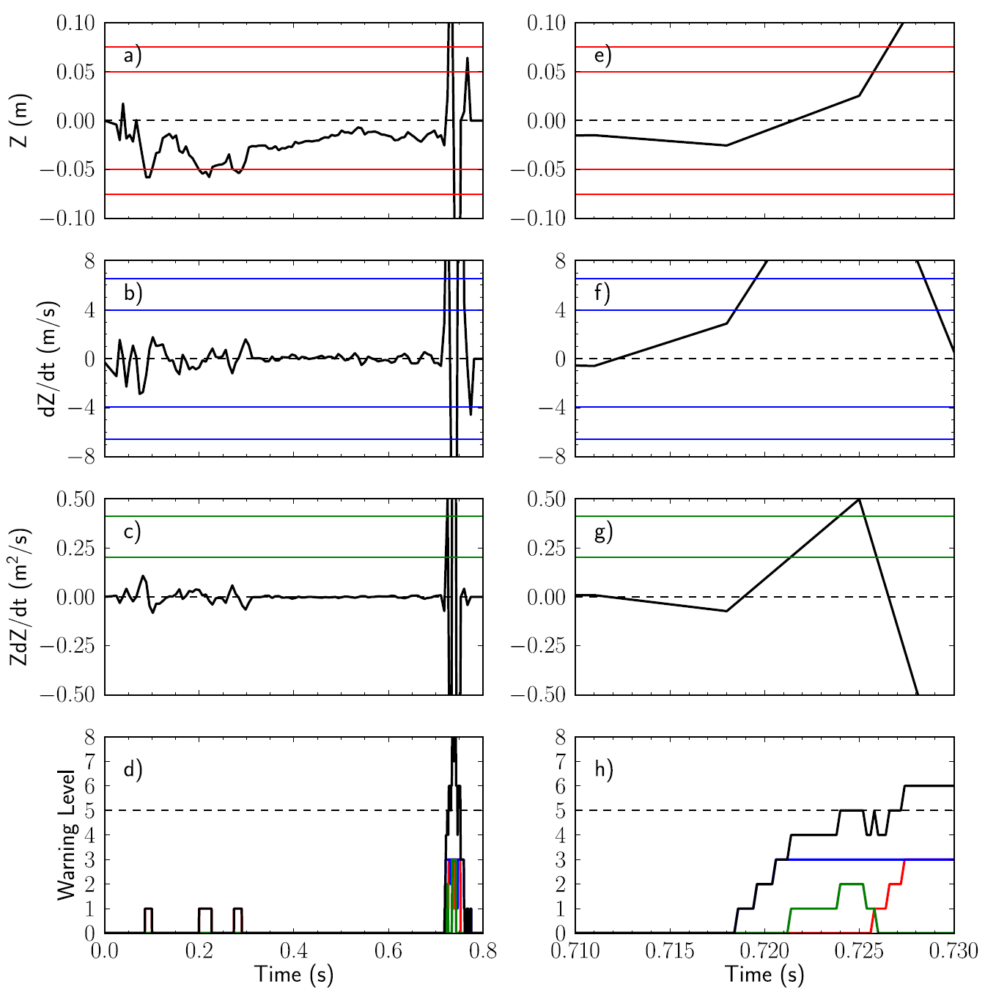
Tests can be combined with “warning points”
Example DECAF analysis on single NSTX discharge
  Ex: VSC uses Z, dZ/dt, and ZdZ/dt
NSTX

Slide 7
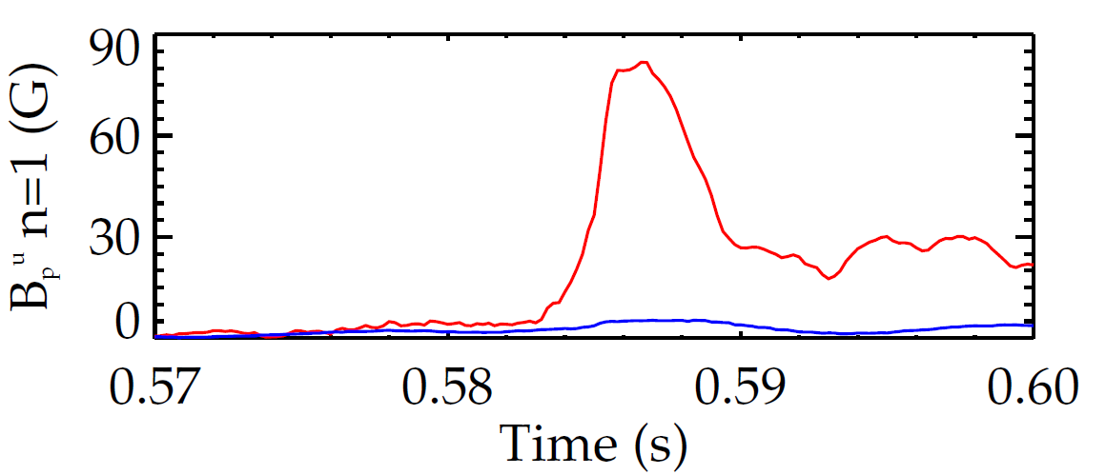
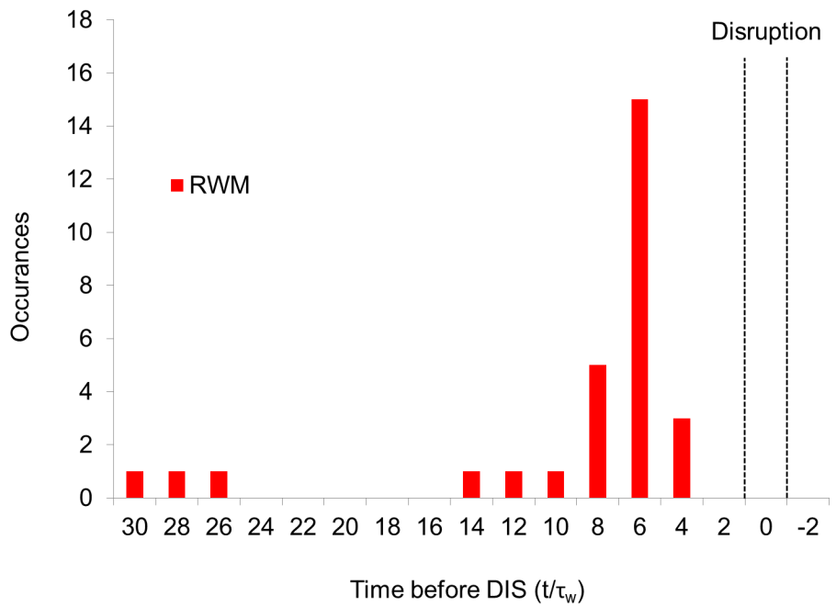
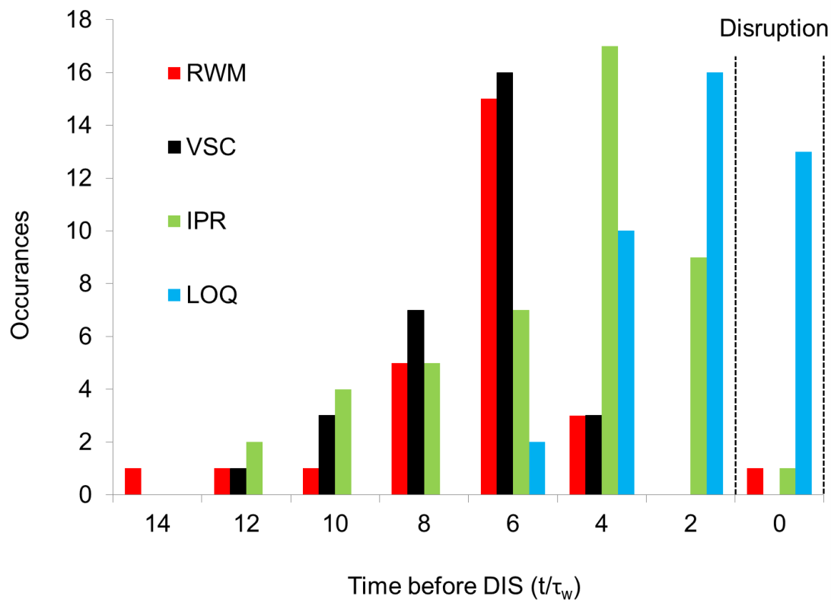
Initial DECAF results detects disruption chain events when applied to dedicated 45 shot NSTX RWM disruption database
RWM B_{P}^{n=1} threshold 30G (δB/B₀ ~ 0.67%)
~58% within 20 τ_{w} of disruption time (τ_{w} = 5 ms)
unstable RWM
NSTX
137722
140102
RWM events in DECAF
Disruption
  RWM: RWM event warning
  VSC: Vertical stability control
  IPR: Plasma current request not met
  LOQ: Low edge q warning

Slide 8
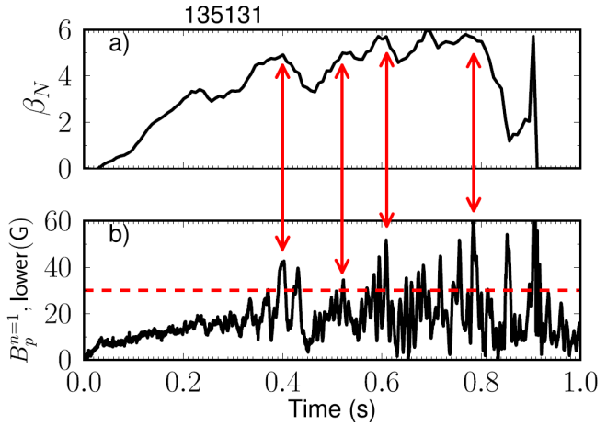
Initial DECAF analysis finding common disruption event chains, giving new insight
Earlier RWM events not false positives
  cause large decreases in β_{N} and stored energy with subsequent recovery (minor disruptions)
Identifying common chains of events can provide insight into how to cue avoidance systems
  5 (out of theoretically 56) two-event combinations followed 77% of RWM cases (that occurred within 20τ_{w} of DIS)
VSC
PRP
30.8%
VSC
WPC
19.2%
RWM
PRP
VSC
11.5%
WPC
VSC
7.7%
IPR
WPC
7.7%
Other
23.1%

Slide 9
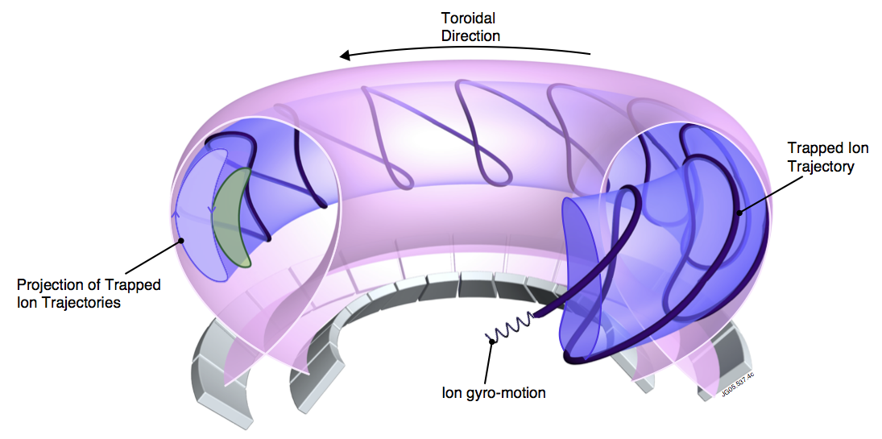

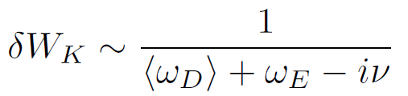
DECAF now incorporates a reduced kinetic MHD stability model for global MHD
MISK code
Solves for RWM growth rate
is solved by using from the drift kinetic equation
[R. Pitts et al., Physics World, March 2006
D. Pace et al., Physics Today 68, 34 (2015)]
Precession Drift
~ Plasma Rotation
Rotational resonance effect
[J. Berkery et al., Phys. Rev. Lett. 104, 035003 (2010)]

Slide 10
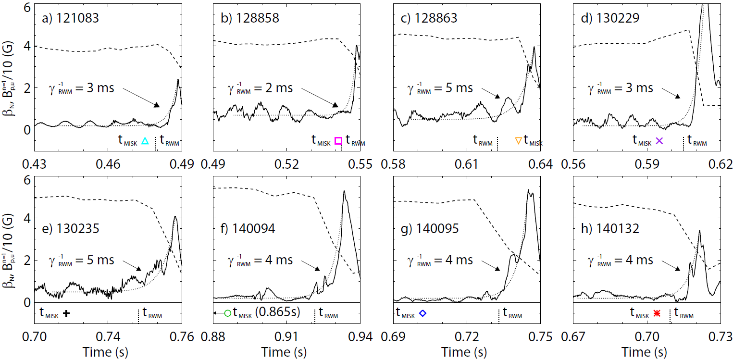
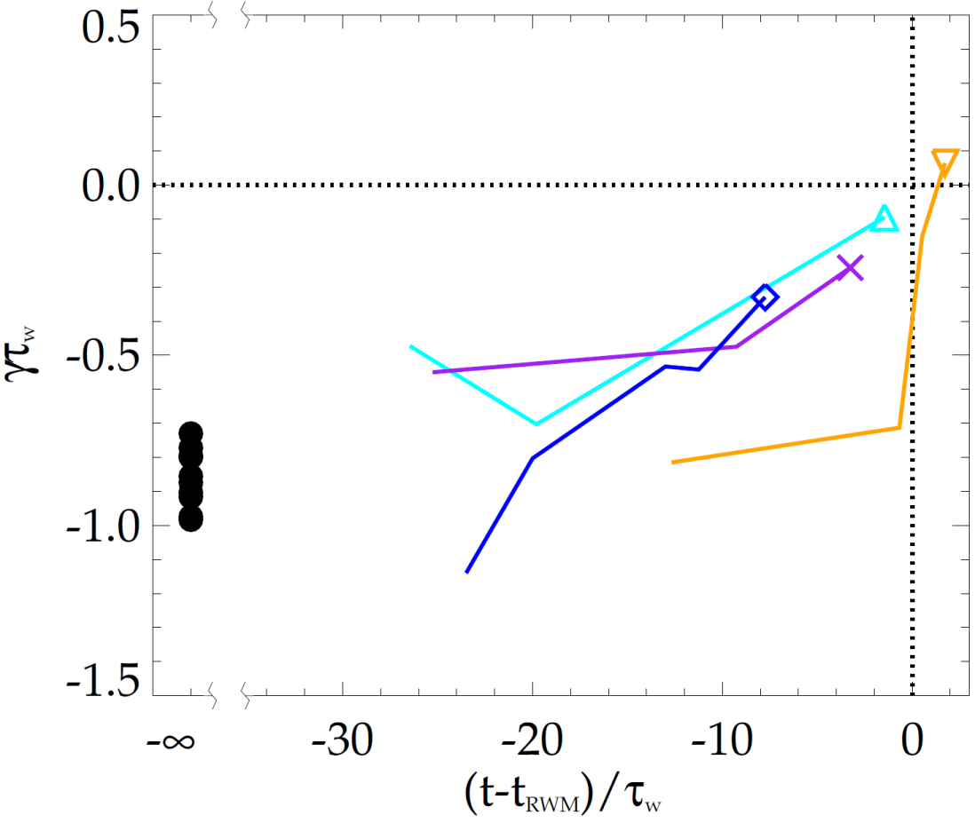
MISK calculations validated against unstable experimental plasmas; reproduce approach towards marginal stability
NSTX
NSTX
unstable
stable
[J. Berkery et al., Nucl. Fusion 55, 123007 (2015)]
MISK calculations including kinetic effects have been tested against many marginally stable NSTX experimental cases
MISK also validated in dedicated DIII-D experiment, analogous to NSTX expts

Slide 11
MISK kinetic stability analysis of KSTAR indicates large stabilizing effect of energetic particles
Unstable region
Without EPs
unstable
stable
Without
EPs
With EPs
With EPs
KSTAR
16325
@11.975s
MISK calculations find the equilibrium is stable to resistive wall modes (consistent with experiment)
  Close to marginal stability with variation of the experimental rotation profile and without considering energetic particles
  Energetic particles contribute large stabilizing effect (due to large EP fraction)

Slide 12
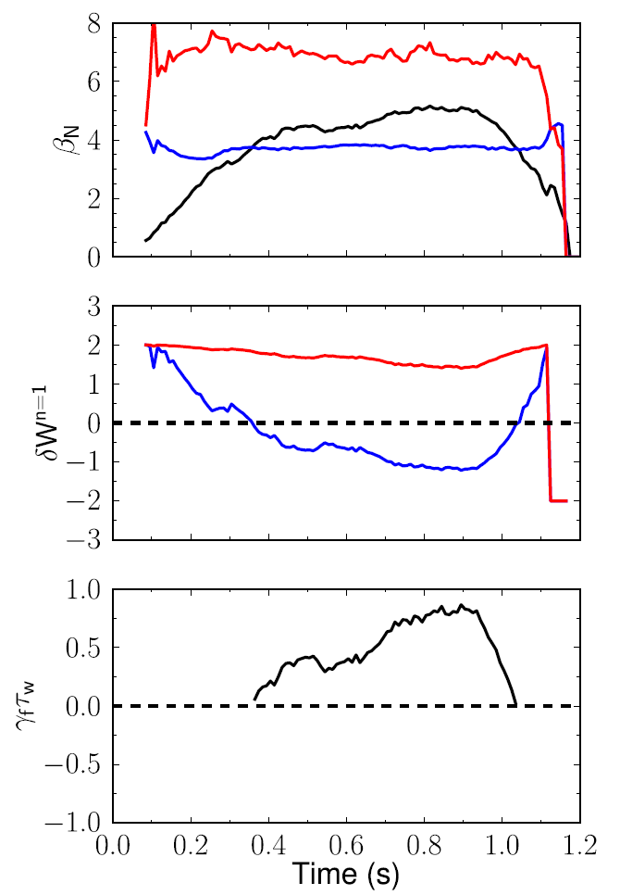
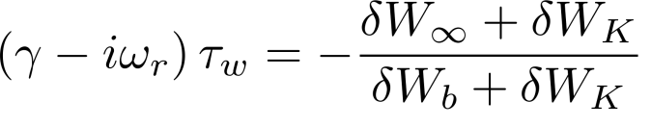
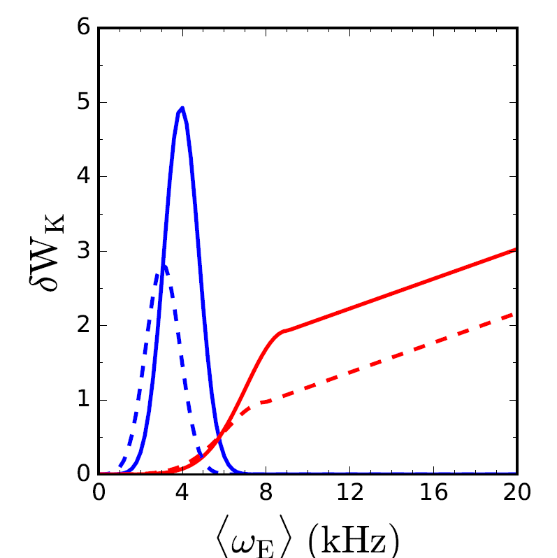
Goal is to forecast mode growth rate in real-time using parameterized reduced models for δW terms
RWM dispersion relation
with-wall limit
Growth rate
Fluid terms
Kinetic effects
β limits
no-wall limit
with-wall limit
[B. Hu et al., Phys. Rev. Lett. 93, 105002 (2004)]
δW
Gaussian functions are used for resonances
no-wall limit
Precession resonance
  Coefficients selected to reflect NSTX experience
Bounce resonances
fluid RWM growth rate
growth
rate
(γτ_{w})
stabilized by kinetic effects
  NSTX 138556
<ν> = 1 kHz

Slide 13
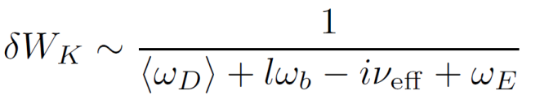
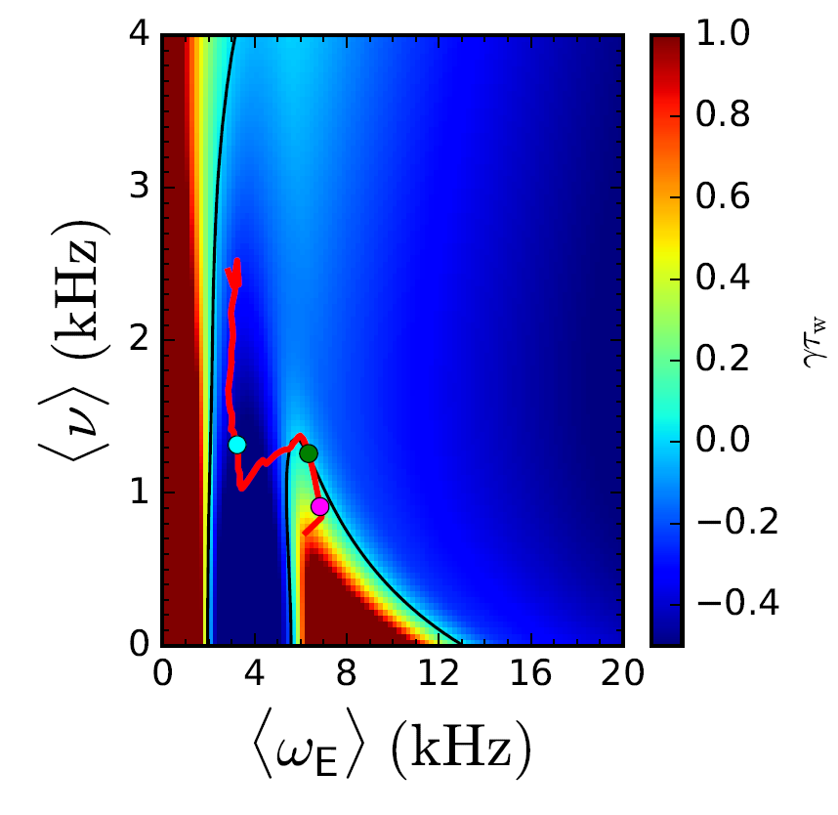
Physics understanding from previous research using full model, used to construct a reduced kinetic model
Goal is to forecast γ in real-time using parameterized reduced models for δW terms
Need δW_{K} as a function of the most important, real-time measurable quantities
[J.W. Berkery et al., Nucl. Fusion 55, 123007 (2015)]
MISK² Calculations
  Benchmarked⁸
  Compared to Experiments^{3,4,6,7,9}
Fluid terms¹⁰
Kinetic effects¹:
Collisionality⁵
Rotation³
+ Energetic
Particles⁴
Reduced Kinetic Model
References
[1] B. Hu et al., Phys. Rev. Lett. 93, 105002 (2004)
[2] B. Hu et al., Phys. Plasmas 12, 057301 (2005)
[3] J. Berkery et al., Phys. Rev. Lett. 104, 035003 (2010)
[4] J. Berkery et al., Phys. Plasmas 17, 082504 (2010)
[5] J. Berkery et al., Phys. Rev. Lett. 106, 075004 (2011)
[6] H. Reimerdes et al., Phys. Rev. Lett. 106, 215002 (2011)
[7] J. Berkery et al., Phys. Plasmas 21, 056112 (2014)
[8] J. Berkery et al., Phys. Plasmas 21, 052505 (2014)
[9] S. Sabbagh APS invited (2014)
[10] J. Berkery et al., Nucl. Fusion 55, 123007 (2015)
… more

Slide 14
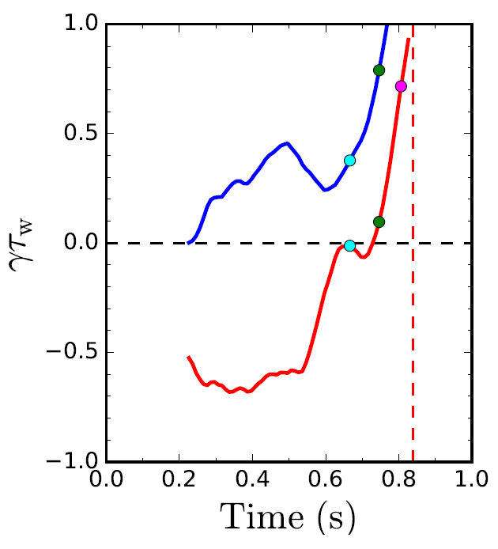
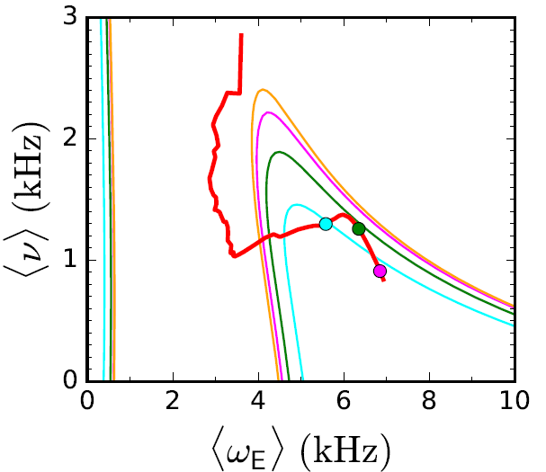

DECAF contains modeled kinetic quantities for generation of stability maps
Stability diagram shows trajectory of a discharge towards unstable regions
Normalized growth rate vs. time
C_{β} = (β_{N} – β_{N}^{no-wall})/
(β_{N}^{with-wall} – β_{N}^{no-wall})
Fluid
C_{β}
unstable
stable
Fluid + Kinetic
unstable
region
  NSTX 139514
[J. Berkery et al., Physics of Plasmas 24, 056103 (2017)]

Slide 15
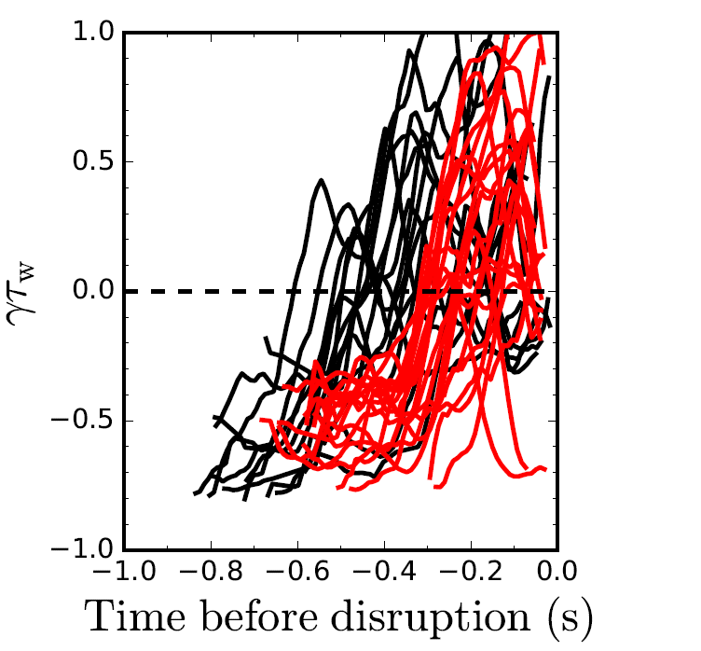
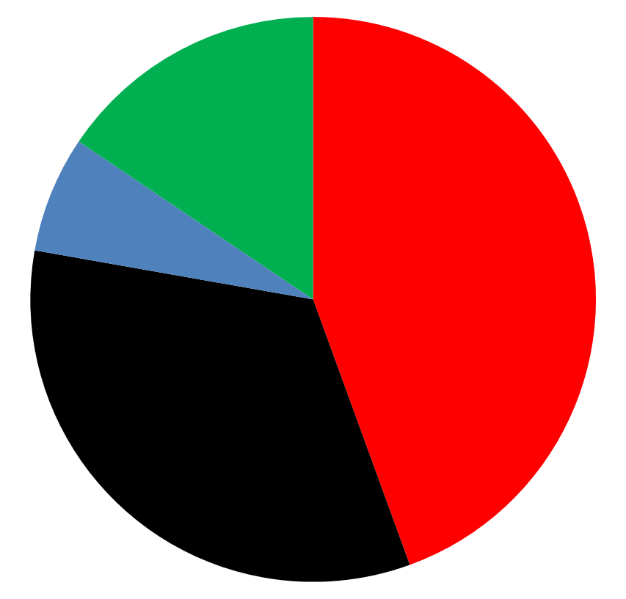
DECAF reduced kinetic model results initially tested on a database of NSTX discharges with unstable RWMs
Normalized growth rate vs. time
Predicted instability statistics (45 shots)
Stable
(16%)
Instability < 320 ms
before disruption
(44%)
(7%) False
positives
unstable
Instability within 100 ms of minor
disruption
(33%)
stable
84% of shots are predicted unstable
44% predicted unstable < 320 ms (approx. 60τ_{w}) before current quench
33% predicted unstable within 100 ms of a minor disruption
[J. Berkery et al., Physics of Plasmas 24, 056103 (2017)]

Slide 16
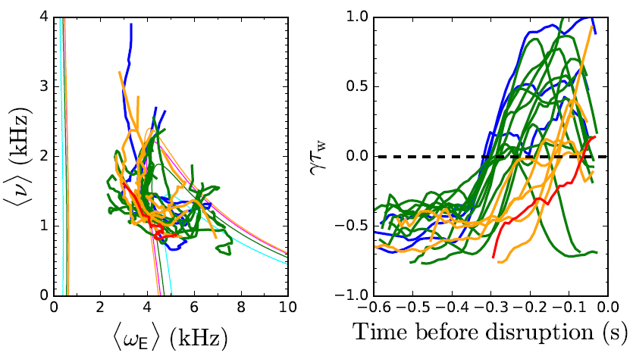
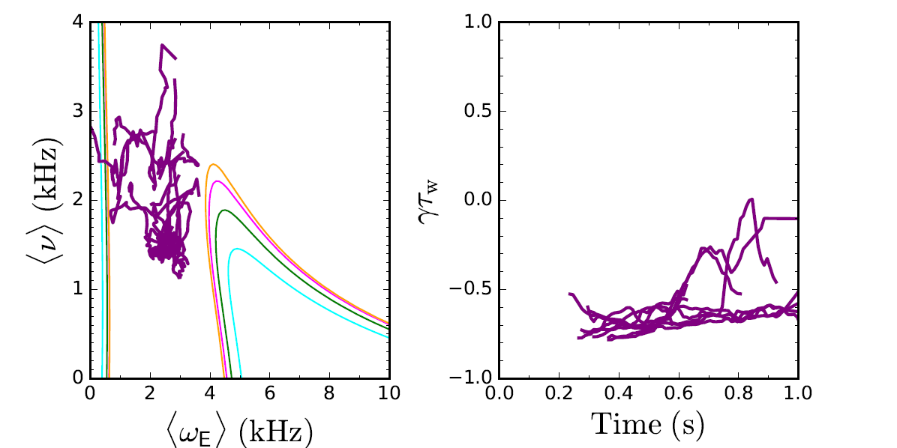
Reduced kinetic model distinguishes between stable and unstable NSTX discharges
Unstable cases
If <ω_{E}> ~ 0 warnings are eliminated, 10/13, or 77%, of stable cases are stable in the model
Model is successful in first incarnation - development continues to improve forecasting performance
Stable cases
[J. Berkery et al., Physics of Plasmas 24, 056103 (2017)]

Slide 17
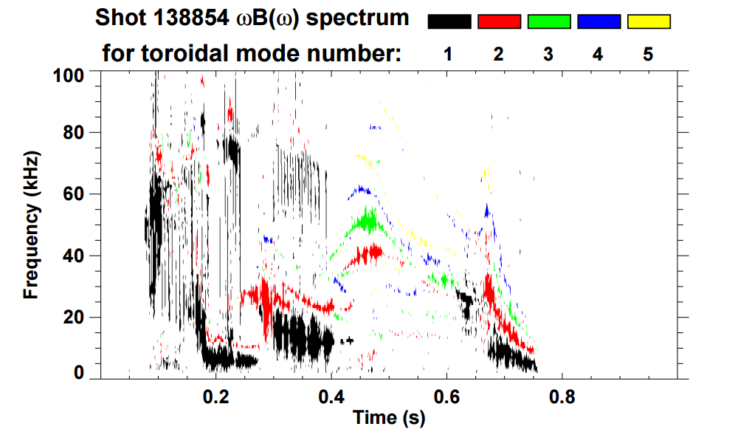
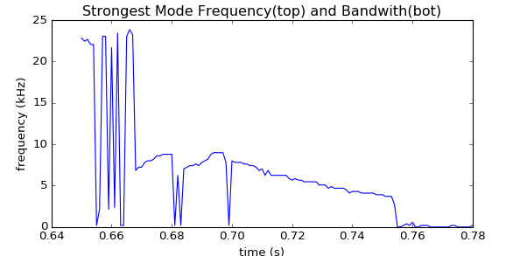
      Essential new step for DECAF analysis of general tokamak data: Identification of rotating MHD (e.g. NTMs)
Magnetic spectrogram of rotating MHD in NSTX
Initial goals
  Create portable code to identify existence of rotating MHD modes
  Track characteristics that lead to disruption
    e.g. rotation bifurcation, mode lock
Approach
  Apply FFT analysis to determine mode frequency, bandwidth evolution
  Determine bifurcation and mode locking
n = 1 mode frequency vs. time
(initial code)
ω₀ ~ 9 kHz
bifurcation ~ 4 kHz

Slide 18
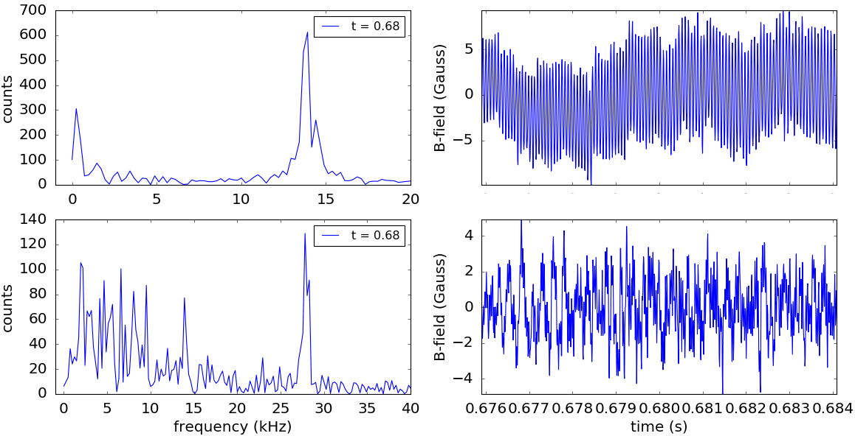
Fast Fourier transforms used to find mode peak frequency within a time interval
FFTs
Odd-n
Signals
Even-n
Reveals potential issues handling multiple frequency peaks
Now adding processing of toroidal array / n number discrimination

Slide 19
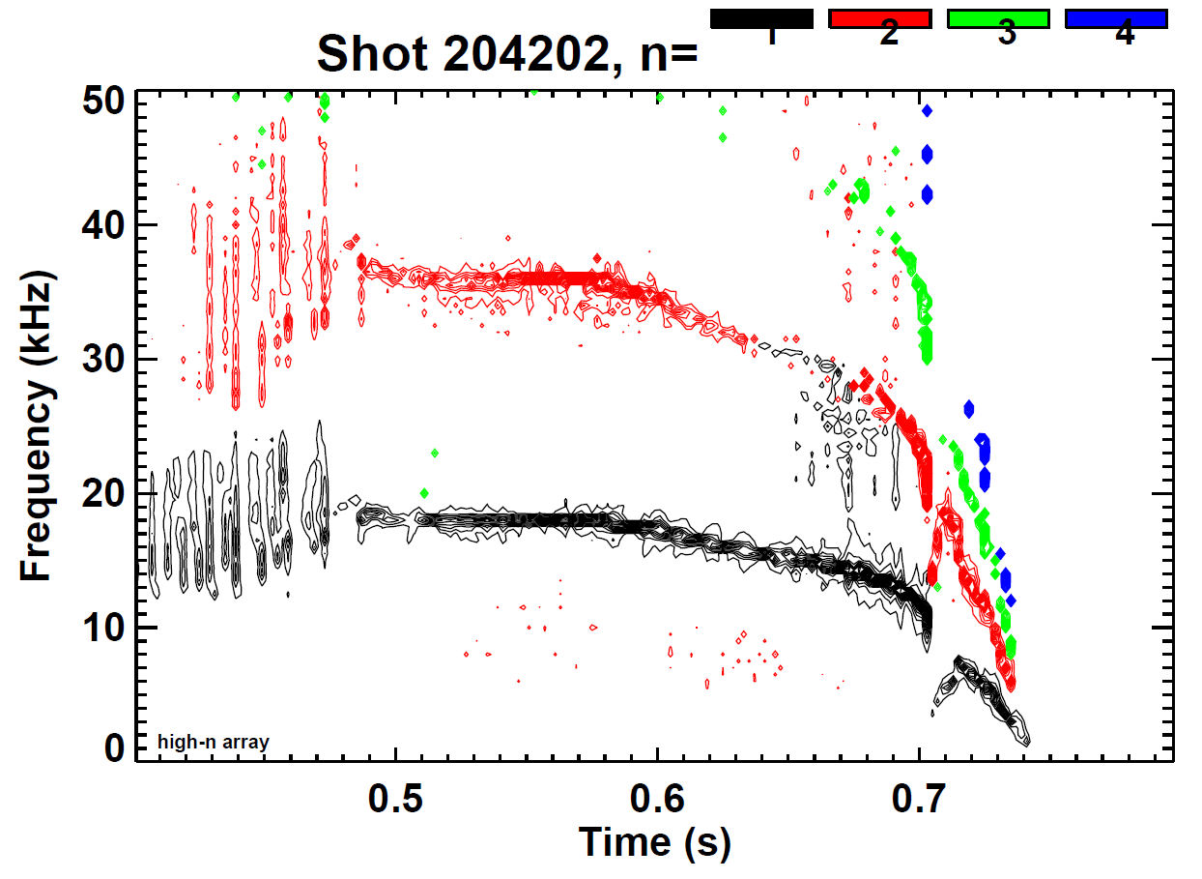
      Many shots with rotating MHD (e.g. NTMs) examined for NSTX and NSTX-U – two illustrated here
Magnetic spectrogram of rotating MHD mode locking termination
NSTX 138854
NSTX-U 204202
NSTX “stable periods” – enhanced by high elongation (κ ~ 2.7), lithium wall conditioning
NSTX-U: rotating MHD at lower κ ~ 2.3 , no Li wall conditioning

Slide 20
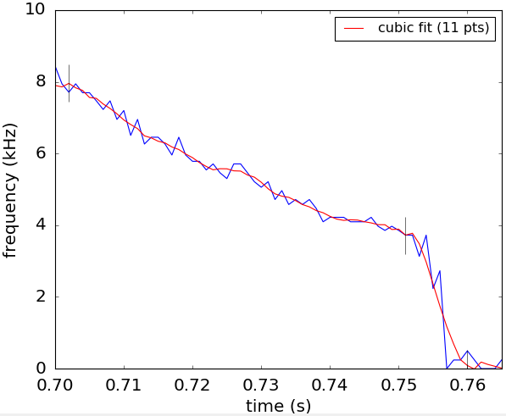
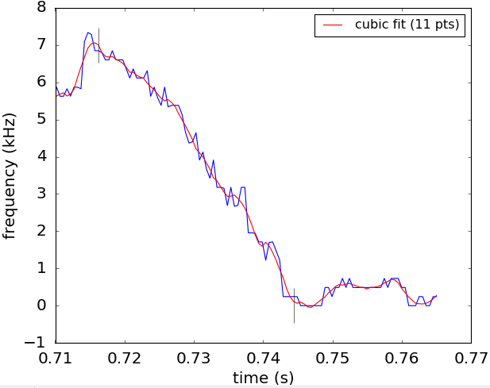
The characterization algorithm shows that the expected bifurcation and locking events can be found
Algorithm written looks for a “quasi-steady state” period, a potential bifurcation, and possible mode locking
odd-n peak frequencies
odd-n peak frequencies
Mode frequency
NSTX shot 138854
NSTX-U shot 204202
bifurcates
lock
lock

Slide 21
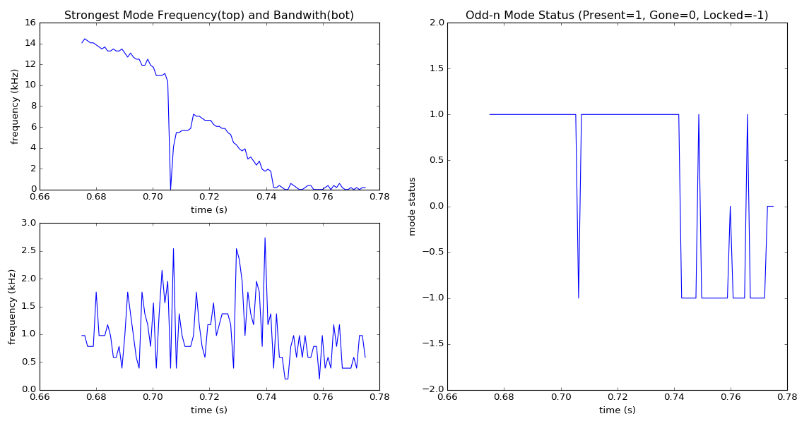
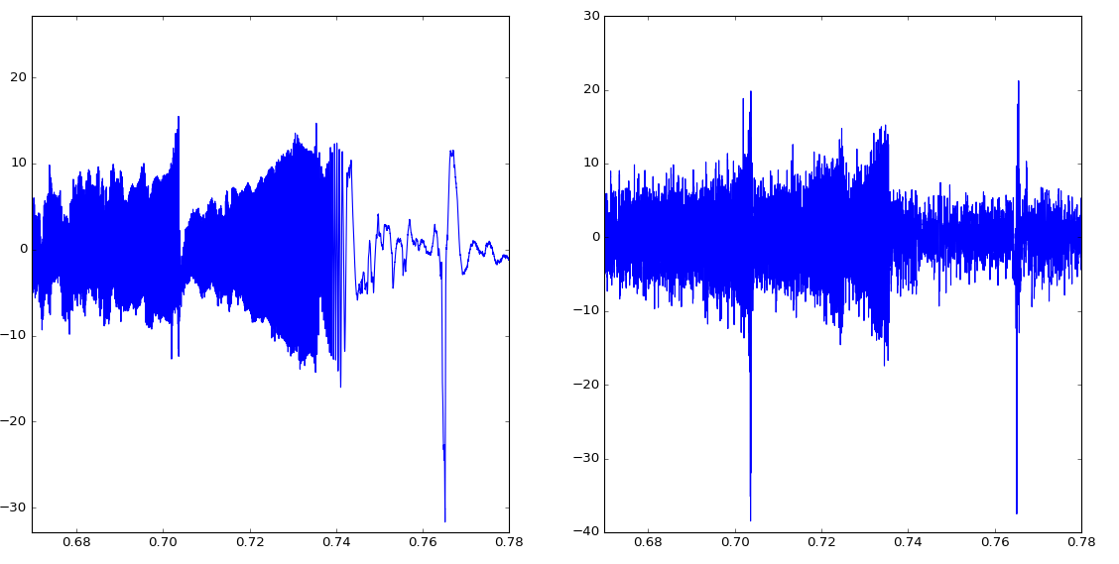
      DECAF rotating MHD analysis identifies the state of the modes found (n = 1)
Magnetic signal / analysis (mode locking / unlocking)
Frequency vs. time
DECAF mode status
16
2
n = 1 mode
12
1 = mode rotating
frequency (kHz)
8
1
4
0
0 = No mode
0
20
10
B (G)
0
-1
-10
-20
mode lock
-30
204202
-1 = mode locked
t (s)
-2
t (s)
0.68
0.70
0.72
0.74
0.76
0.78
0.66
0.70
0.74
0.78
NSTX-U

Slide 22
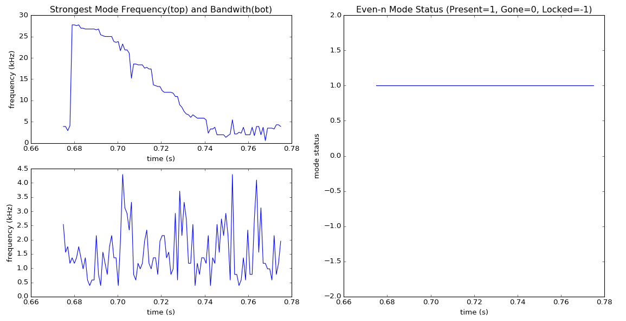
      DECAF rotating MHD analysis identifies the state of the modes found (n = 2)
Magnetic signal / analysis (mode present, not locked)
30
2
Frequency vs. time
DECAF mode status
20
n = 2 mode
1 = Mode present
frequency (kHz)
1
10
0
0 = No mode
0.66
0.68
0.70
0.72
0.74
0.76
0.78
0
Signal
30
20
10
-1
-1 = Mode locked
B (G)
0
-10
-20
-30
-2
204202
0.66
0.70
0.74
0.78
0.68
0.70
0.72
0.74
0.76
0.78
t (s)
NSTX-U
t (s)

Slide 23
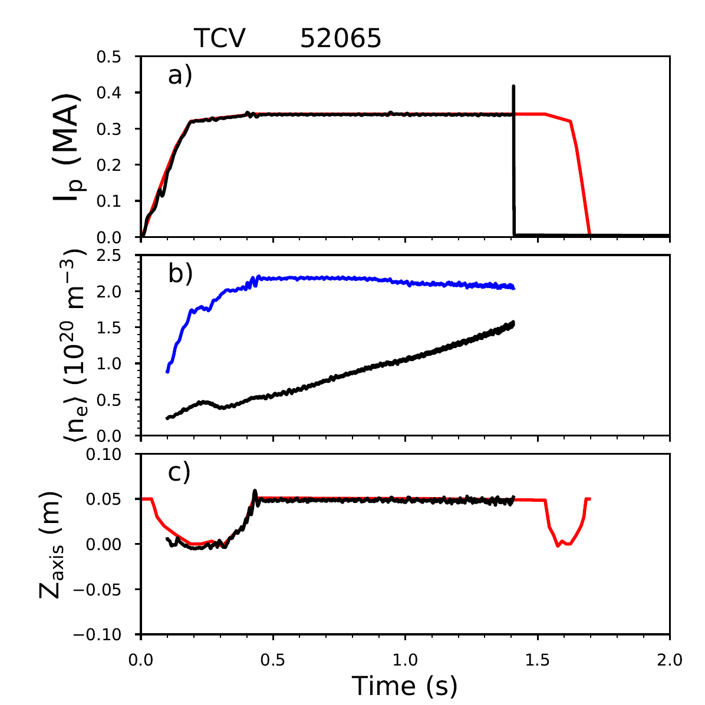
DECAF now being tested on TCV tokamak data, including detection of MHD
DECAF events implemented:
TCV advantages:
  Excellent real time measurement and control capabilities
  Capability to detect modes (also in real time)
IPR
(I_{p} not meeting request)
Measured I_{p}
Requested I_{p}
GWL (Greenwald density limit)
Measured <n_{e}>
Greenwald <n_{e}>
VSC
(Vertical stability control)
Measured z_{axis}
Requested z_{axis}
MHD (presence of an MHD mode)
[C. Galperti et al., IEEE TNS 64, 1446 (2017)]

Slide 24
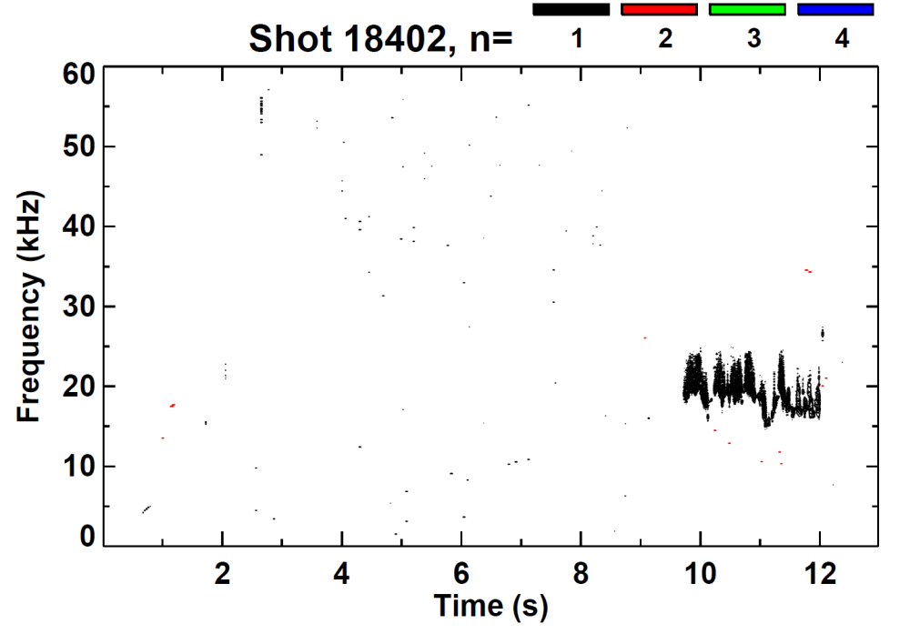
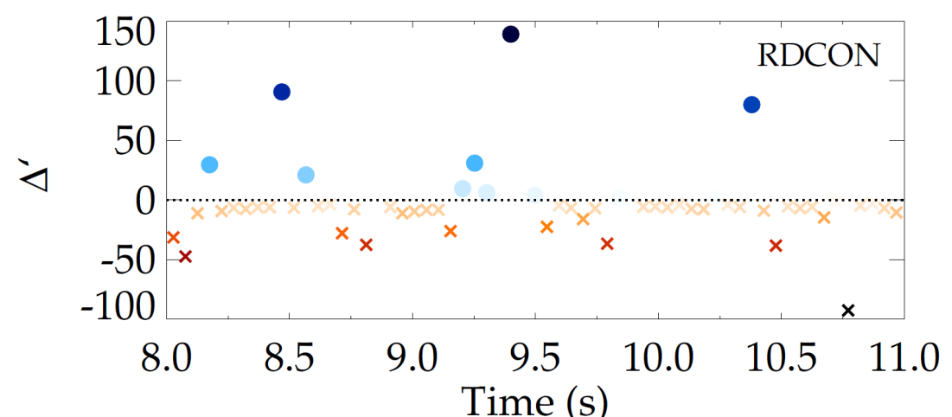
New tool for MHD stability analysis, resistive DCON, used on KSTAR for the first time
New resistive DCON code used to calculate the q=2 Δ’ for a KSTAR case with sudden appearance of n=1 mode
  Positive Δ’ would indicate classical instability at q=2
Calculation shows a near marginal Δ’ around time of mode onset
  Requires further analysis
Resistive DCON capability could be used for future DECAF mode onset warning
Resistive DCON
?
Resistive DCON: [A. H. Glasser et al., Physics of Plasmas 23, 112506 (2016)]

Slide 25
Summary and next steps
The Disruption Event Characterization and Forecasting code (DECAF)
  Focuses on quantitative characterization, based on physics models, of the chains of events which most often lead to disruption of plasmas
  The goal is to provide forecasts which integrate with a disruption avoidance system and are ultimately utilized in real-time during a device's operation
Reduced kinetic model for disruption avoidance is implemented
  Success rate is surprisingly high for the initial analysis
Rotating MHD is common, causes disruptions; Identification essential
  Characterization algorithm utilizes FFT, finds expected bifurcation and locking
Next steps to the development and usage of DECAF include:
  Continued improvement of accuracy of event determination
  Significant expansion of events and event chains
  Expansion of the dataset to multiple devices (including DIII-D, TCV, KSTAR)
*This work supported by the US DOE contracts DE-AC02-09CH11466,
DE-FG02-99ER54524,
and DE-SC0016614

Slide 26
Related talk/posters
Observation of the Generalized Neoclassical Toroidal Viscosity Offset Rotation Profile in KSTAR – S.A. Sabbagh, 10:54am Wednesday
Automated Identification of MHD Mode Bifurcation and Locking in Tokamaks – J.D. Riquezes
Kinetic equilibrium reconstruction of KSTAR plasmas including internal pitch angle profile measurement – Y. Jiang
Transport and stability analyses supporting disruption prediction in high beta KSTAR plasmas – J.H. Ahn
MHD stability analysis and global mode identification preparing for high beta operation in KSTAR – Y.S. Park
Thursday afternoon posters

Slide 27
Sign up for a copy

Slide 28


Disruption Event Characterization and Forecasting in Tokamaks
Jack Berkery
Columbia University
S.A. Sabbagh¹, Y.S. Park¹, J.H. Ahn¹, Y. Jiang¹, J.D. Riquezes¹, S.P. Gerhardt², C.E. Meyers²
¹Columbia University, ²Princeton Plasma Physics Laboratory
59th Annual Meeting of the APS Division of Plasma Physics
Milwaukee, Wisconsin, October 23-27, 2017
*This work supported by the US DOE contracts DE-AC02-09CH11466 and DE-FG02-99ER54524

Slide 29
Another TCV slide?

