Slide 1


Energy Transport via
Compressional Alfven Eigenmodes Coupling to Kinetic Alfven Waves
Z.- H. Deng,¹ NA Crocker,^{1,} Y Ren²
¹UCLA, ²PPPL
59th Annual Meeting of the APS Division of Plasma Physics
Milwaukee, Wisconsin
October 23 - 27, 2017
*Supported by US DOE Contracts DE­SC0011810 & DE­AC02­09CH11466
Notes:
The topic of my research is focused on the energy transport by the interaction between CAEs and KAWs

Slide 2
Energy confinement is important in fusion
Confinement is the challenge
  Tokamaks are hot (150 million degrees)
    Need magnetic confinement
  Heat/Energy is escaping
Loss mechanisms are an area of intense investigation
Tokamaks often are heated by beams which excite coherent waves contributing to loss of energy

Slide 3
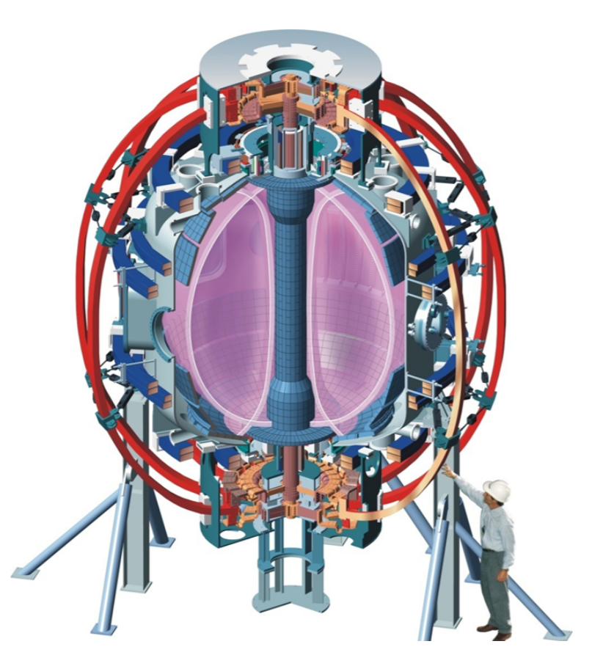

NSTX investigates fusion physics
Spherical Tokamak
D+ plasmas
Temperatures ~ 1 KeV
B ~ 0.35 - 0.55 T
Current ~ 1 Mamp
Density ~ ${10}^{20} m^{−3}$

Slide 4
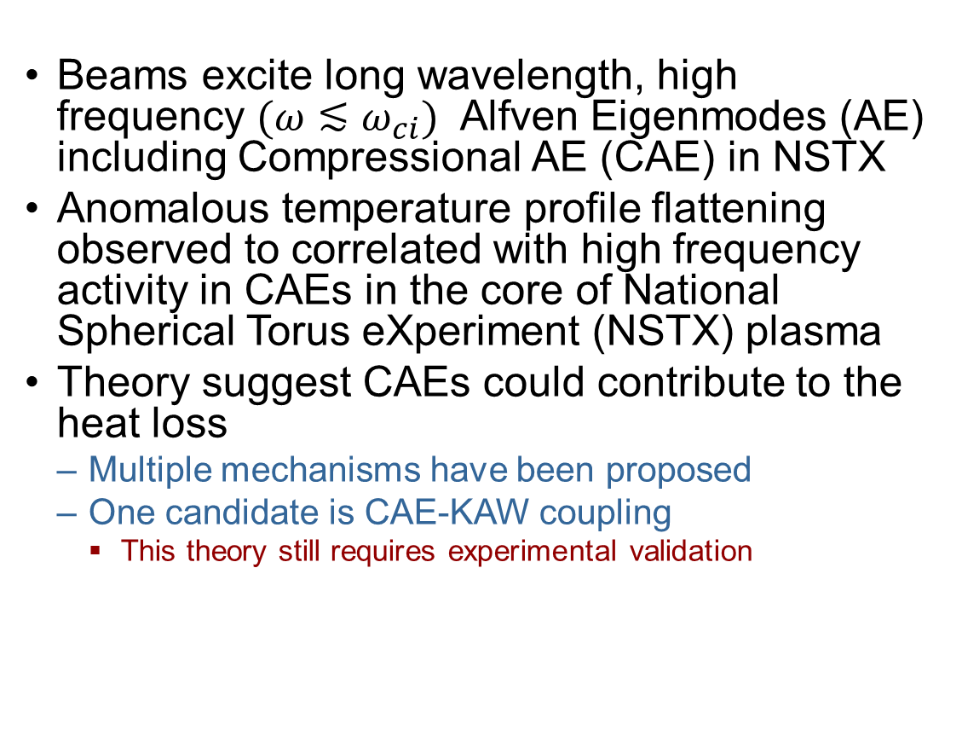
Compressional Alfven Eigenmodes(CAEs) could play a significant role in plasma energy confinement
Beams excite long wavelength, high frequency $(ω≲ω_{ci})$ Alfven Eigenmodes (AE) including Compressional AE (CAE) in NSTX
Anomalous temperature profile flattening observed to correlated with high frequency activity in CAEs in the core of National Spherical Torus eXperiment (NSTX) plasma
Theory suggest CAEs could contribute to the heat loss
  Multiple mechanisms have been proposed
  One candidate is CAE-KAW coupling
    This theory still requires experimental validation
Stutman, PRL 2009
Notes:
Mystery – Why does the temperature not go up in the center, but does in the mid radius.
From stuntman’s paper, more mode activity occurs at higher Beam power. Wonder if CAE

Slide 5
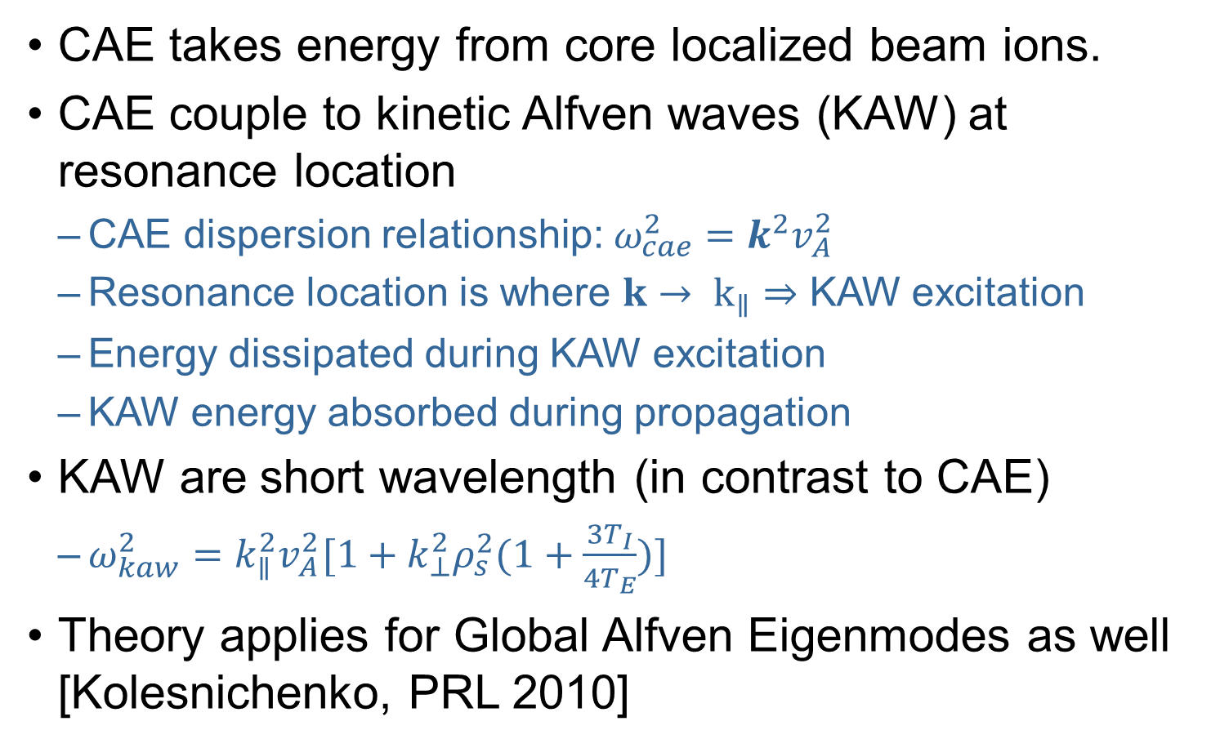
CAE-KAW coupling may explain anomalous flattening
CAE takes energy from core localized beam ions.
CAE couple to kinetic Alfven waves (KAW) at resonance location
  CAE dispersion relationship: ${ω_{cae}^{2}=k}^{2}v_{A}^{2}$
  Resonance location is where $k→ k_{∥}⇒$ KAW excitation
  Energy dissipated during KAW excitation
  KAW energy absorbed during propagation
KAW are short wavelength (in contrast to CAE)
  $ω_{kaw}^{2}=k_{∥}^{2}v_{A}^{2}[1+k_{⊥}^{2}ρ_{s}^{2}(1+\frac{3T_{I}}{4T_{E}})]$
Theory applies for Global Alfven Eigenmodes as well [Kolesnichenko, PRL 2010]
Notes:
Idea is that we don’t rea`lly know if thye are CAE or GAE, so focus on CAE coupling, when GAE can do same thing. GAE seem to be at lower frequency
Ignore fast ions
Not implausible that K_perpRhoS ~ 1-6~

Slide 6
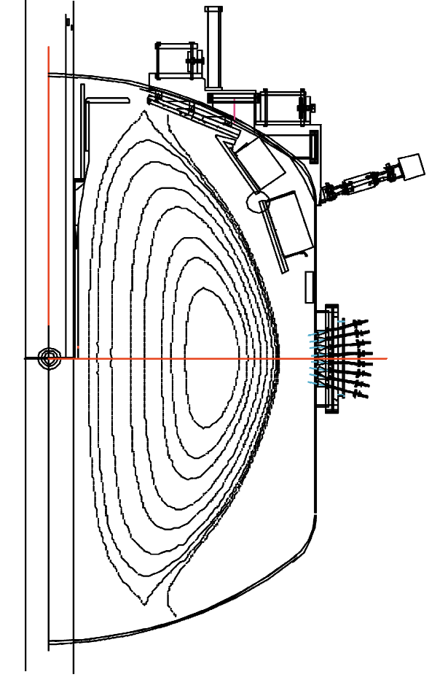
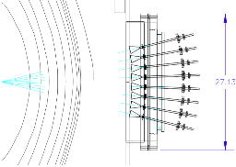
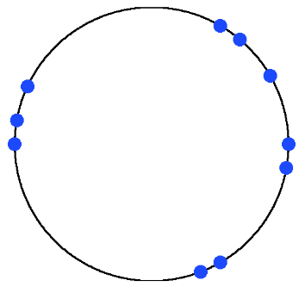
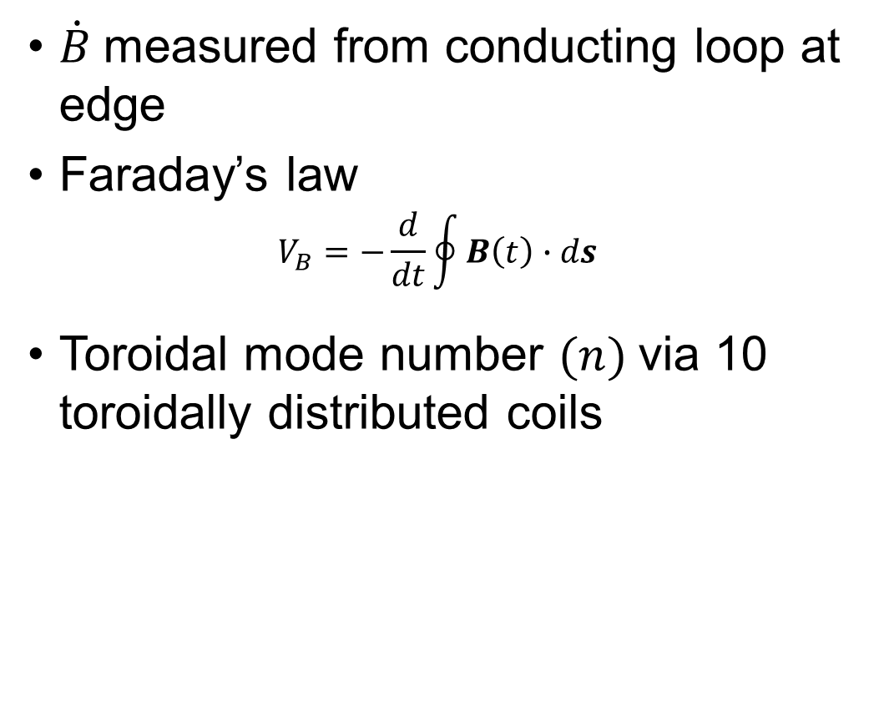
Magnetic diagnostic sensitive to CAEs
$\dot{B}$measured from conducting loop at edge
Faraday’s law
$$V_{B}=−\frac{d}{dt}\oint{B\left(t\right)∙ds}$$
Toroidal mode number $(n)$via 10 toroidally distributed coils
NSTX cross-section
φ
B-dot coil locations
Top Down view of NSTX
Notes:
Diagnostic that may be sensitive to CAE and KAWs
Make point about k roughly in the
W_scatter = W_fluc + W_probe, W_fluc << W_scat,
Point out K_fluc*Rho_S ~ 1

Slide 7
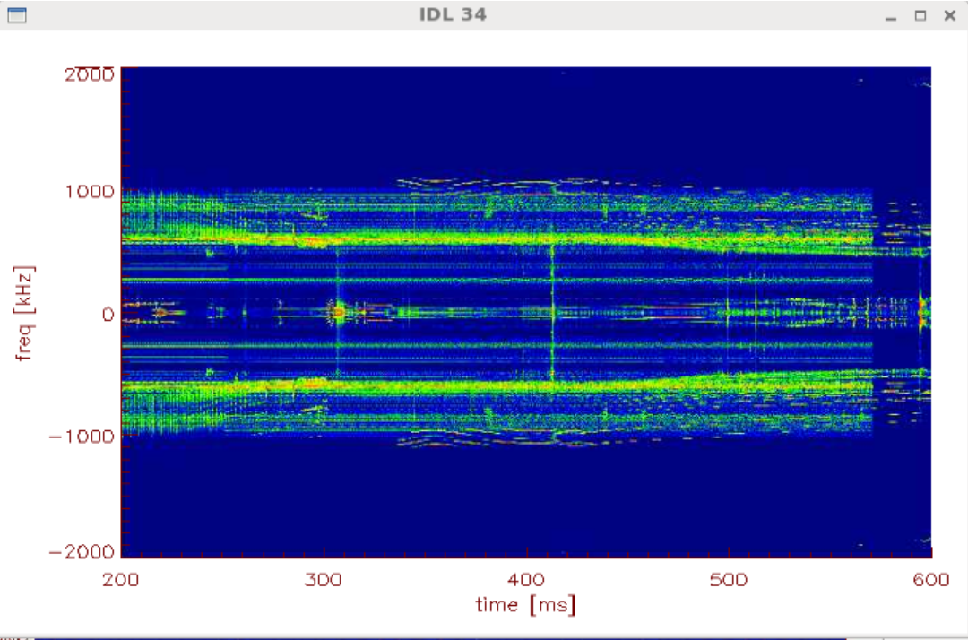
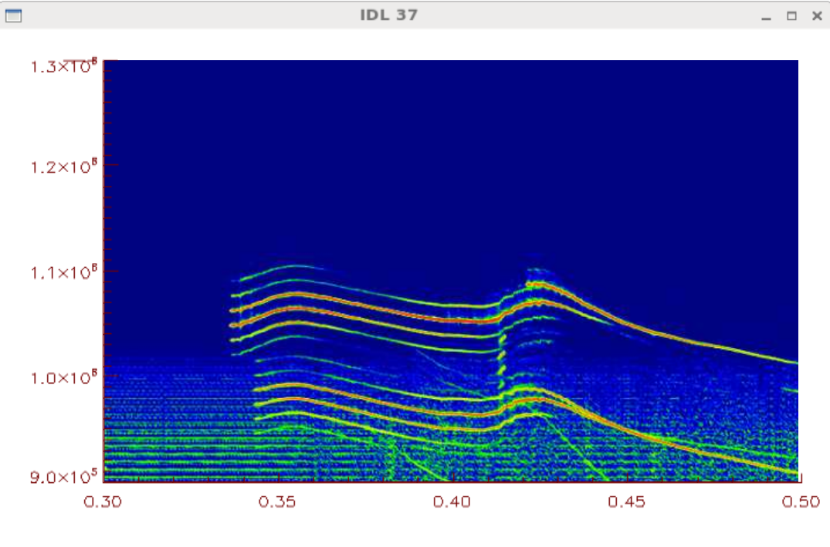
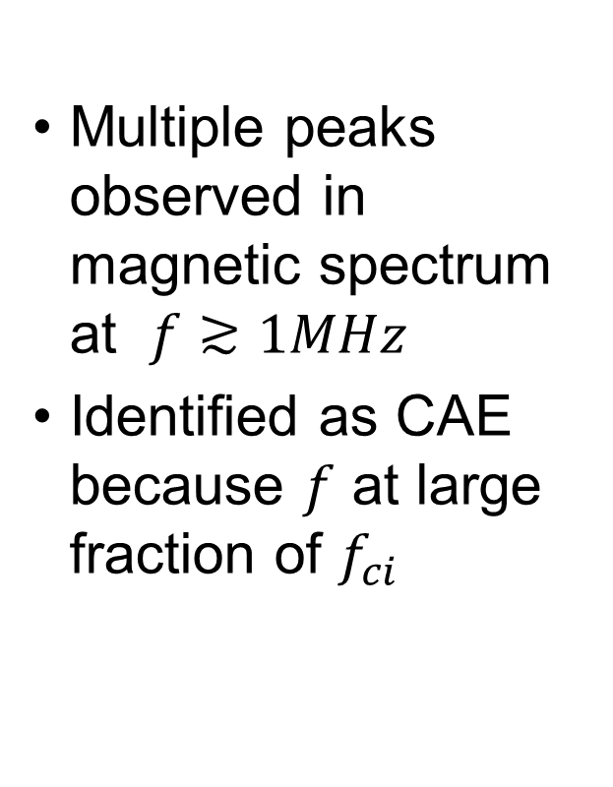
Magnetic diagnostic sensitive to CAEs
Multiple peaks observed in magnetic spectrum at $f≳1MHz$
Identified as CAE because $f$ at large fraction of $f_{ci}$
Notes:
Quote f_{ci} at magnetic axis

Slide 8
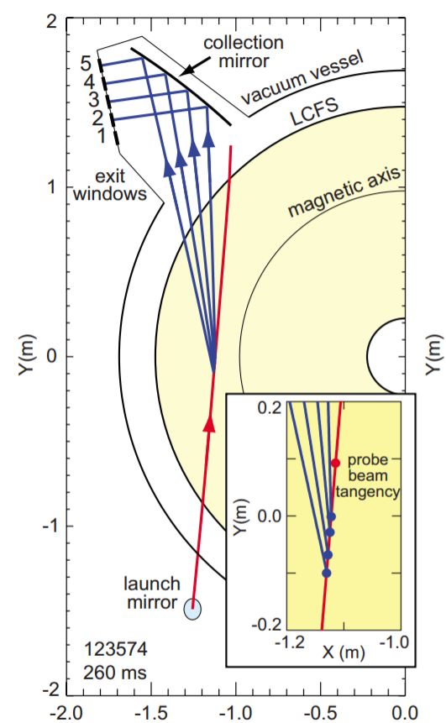
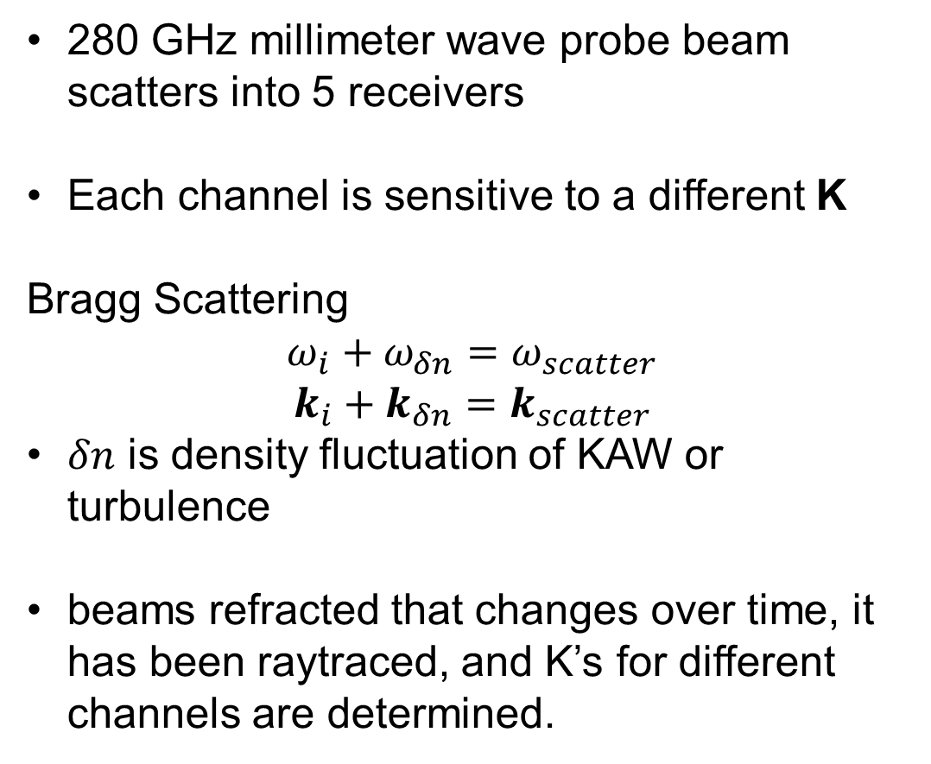
High K-Scattering diagnostic potentially detects KAWs from CAE-KAW coupling
280 GHz millimeter wave probe beam scatters into 5 receivers
Each channel is sensitive to a different K
Bragg Scattering
$$ω_{i}+ω_{δn}=ω_{scatter}$$
$$k_{i}+k_{δn}=k_{scatter}$$
$δn$ is density fluctuation of KAW or turbulence
beams refracted that changes over time, it has been raytraced, and K’s for different channels are determined.
Notes:
Diagnostic that may be sensitive to CAE and KAWs
Make point about k roughly in the
W_scatter = W_fluc + W_probe, W_fluc << W_scat,
Point out K_fluc*Rho_S ~ 1
Electric field is about +280 MHz, but we subtracted input

Slide 9
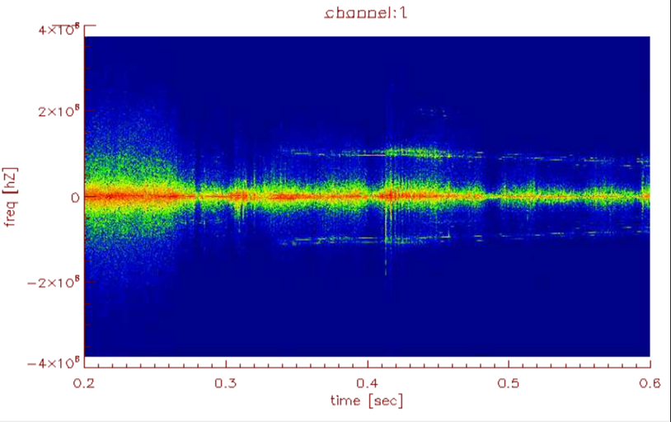
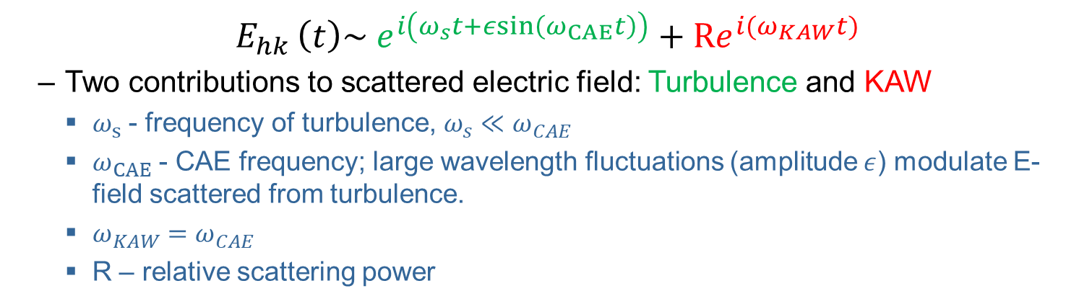
High K-Scattering diagnostic potentially detects KAWs from CAE-KAW coupling
  $E_{hk }\left(t\right)\sim e^{i\left(ω_{s}t+εsin\left(ω_{CAE}t\right)\right)}+{Re}^{i(ω_{KAW}t)}$
  Two contributions to scattered electric field: Turbulence and KAW
    $ω_{s}$ - frequency of turbulence, $ω_{s}{≪ω}_{CAE}$
    $ω_{CAE}$ - CAE frequency; large wavelength fluctuations (amplitude $ε$) modulate E-field scattered from turbulence.
    $ω_{KAW}=ω_{CAE}$
    R – relative scattering power
Notes:
Put reference. From basic scattering theory

Slide 10
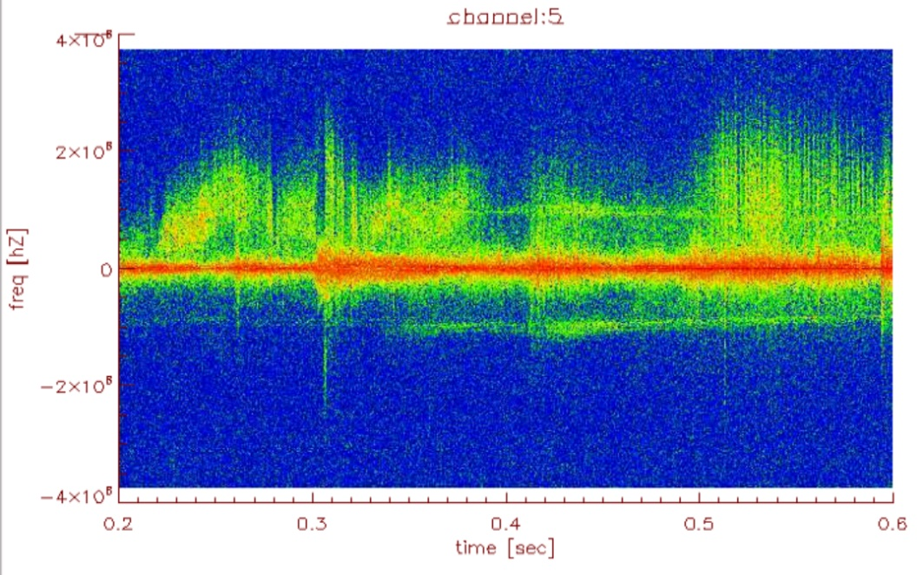

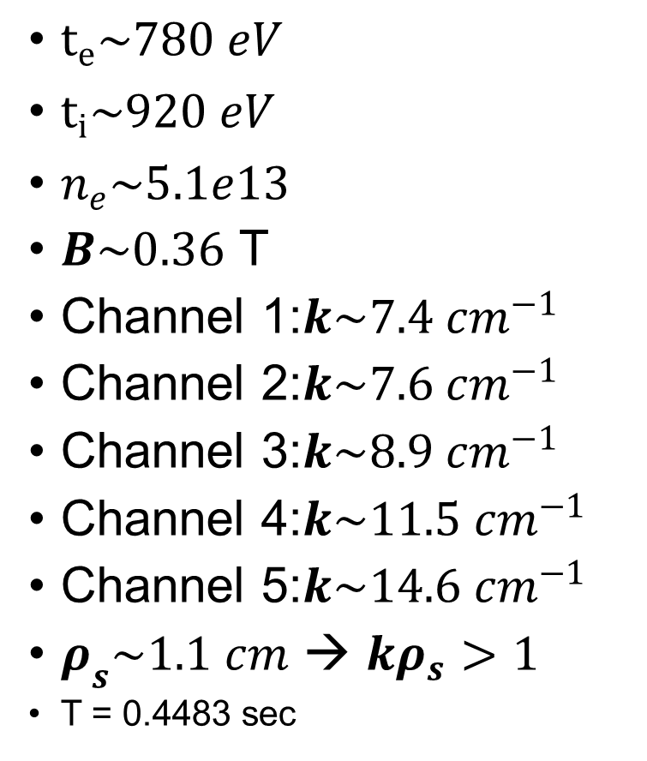
Scattering diagnostic probes KAW wavelengths
$t_{e}\sim 780 eV$
$t_{i}\sim 920 eV$
$n_{e}\sim 5.1e13$
$B\sim 0.36$ T
Channel 1:$k\sim 7.4 cm^{−1}$
Channel 2:$k\sim 7.6 cm^{−1}$
Channel 3:$k\sim 8.9 cm^{−1}$
Channel 4:$k\sim 11.5 {cm}^{−1}$
Channel 5:$k\sim 14.6 {cm}^{−1}$
$ρ_{s}\sim 1.1 cm$ → ${kρ}_{s}>1$
T = 0.4483 sec
Notes:
Oval the mode.
Different K for different channels
GO through Yan ren’s math and give paraemters to justify
B = ?
Rho for plasma = ?
Temperature = ?
Density = ?

Slide 11
High K combined with magnetics allows detection of CAE-KAW coupling
Both diagnostic show peaks at similar frequency in CAE range → CAE-KAW coupling?
Expect coupling to produce KAW coherent with CAE→ must be verified with analysis
Verify peak in high k spectrum results from scattering.
Verify if detected k consistent with KAW theory.
  Some Channels see peaks, other’s don’t.

Slide 12
Establishing coherence of high k spectrum peak with magnetic peak is a multistep process
Isolates mode oscillation from each signal.
  Determine f(t) for peak → filter signals to isolate mode
Using SVD, isolate global mode oscillation (from mag)
Calculate coherence of global signal with mode oscillation in scattering signal
  Test statistical significance for each high-k channel.

Slide 13
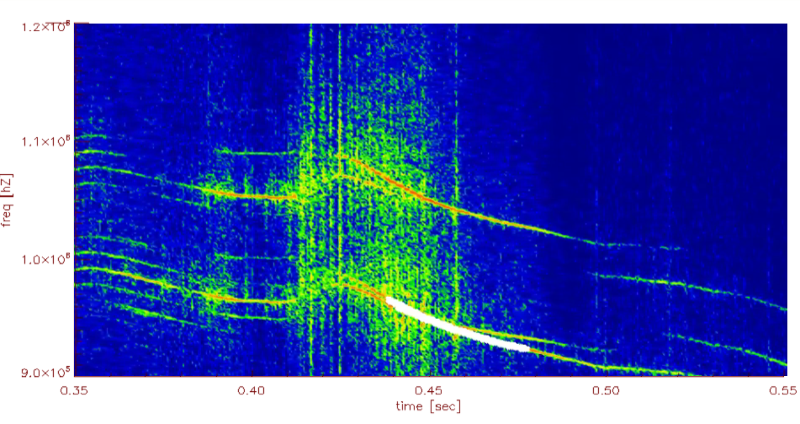
Filtering: Determine times and frequencies with image feature analysis
Track time evolution of mode by choosing a time, frequency range, and a frequency bandwidth.
Identified f(t) can be used to create filter to isolate mode.
Feature analysis finds mode in spectrum.

Slide 14
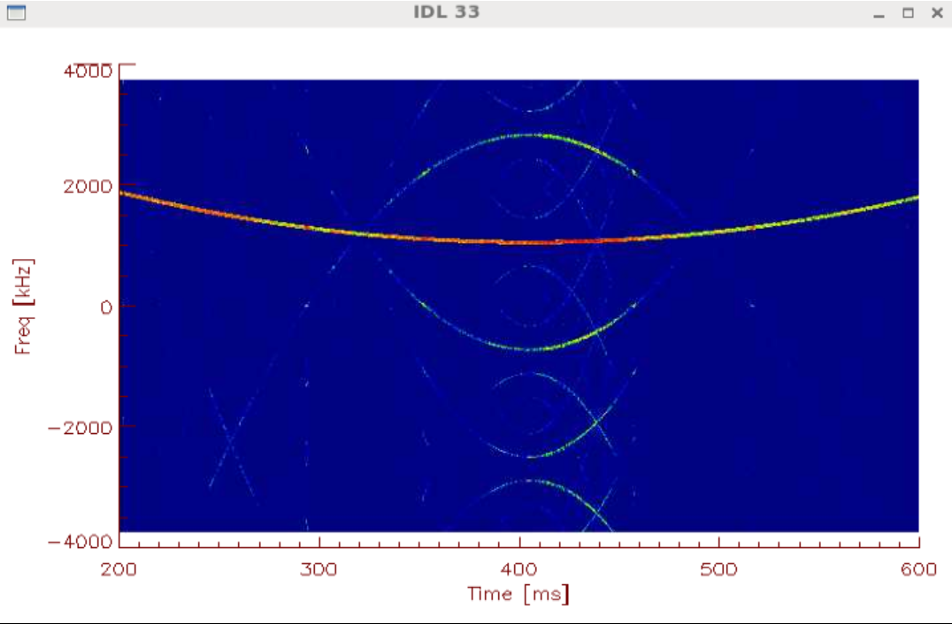
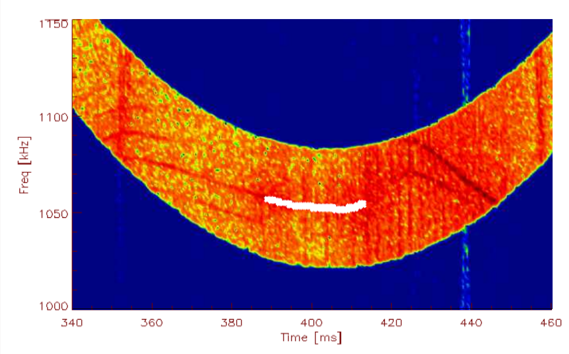
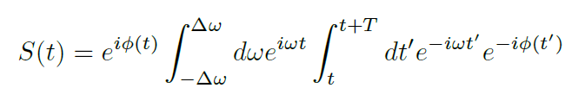
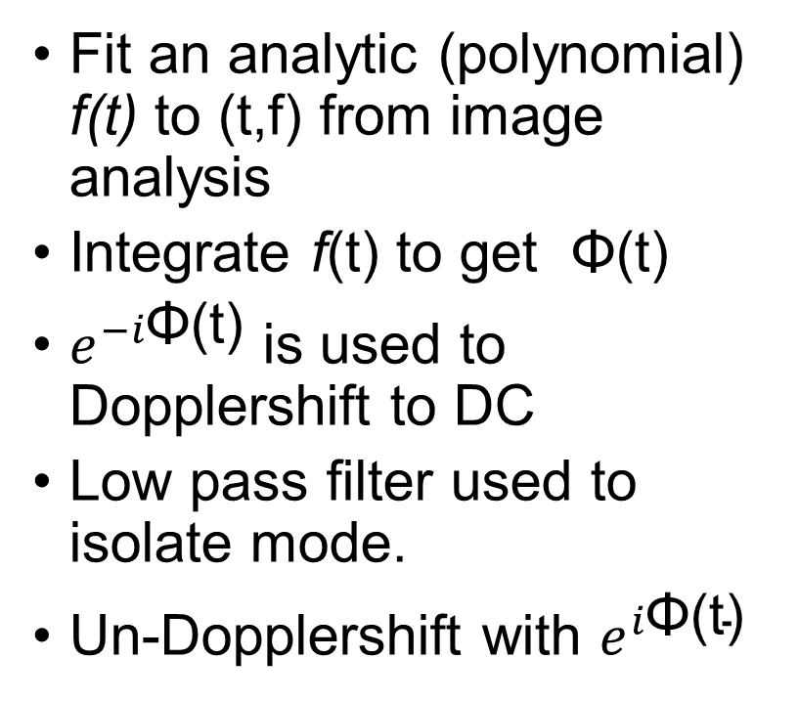
Filtering: Construct time dependent bandpass filter from times and frequencies
Fit an analytic (polynomial) f(t) to (t,f) from image analysis
Integrate f(t) to get Φ(t)
$e^{−i\text{Φ}\text{(}\text{t}\text{)}}$ is used to Dopplershift to DC
Low pass filter used to isolate mode.
Un-Dopplershift with $e^{i\text{Φ}\text{(}\text{t}\text{)}}$
Notes:
Cannot isolated mode over a long period of time
Simple bandpass filter (freq) would

Slide 15
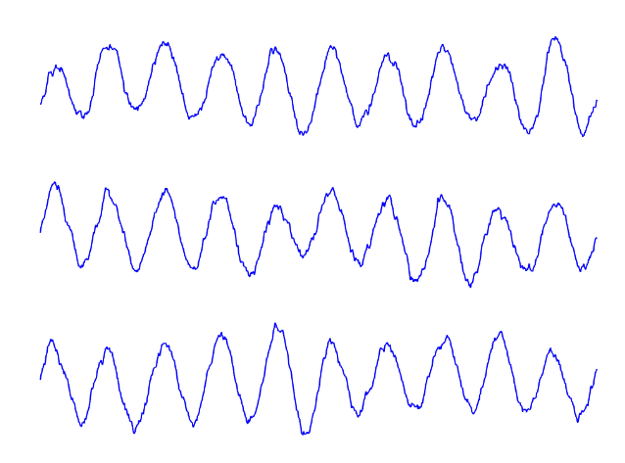
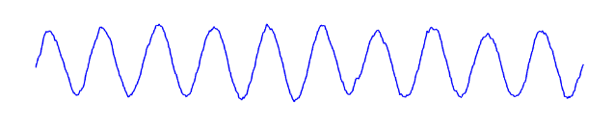
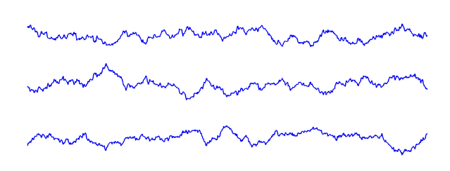
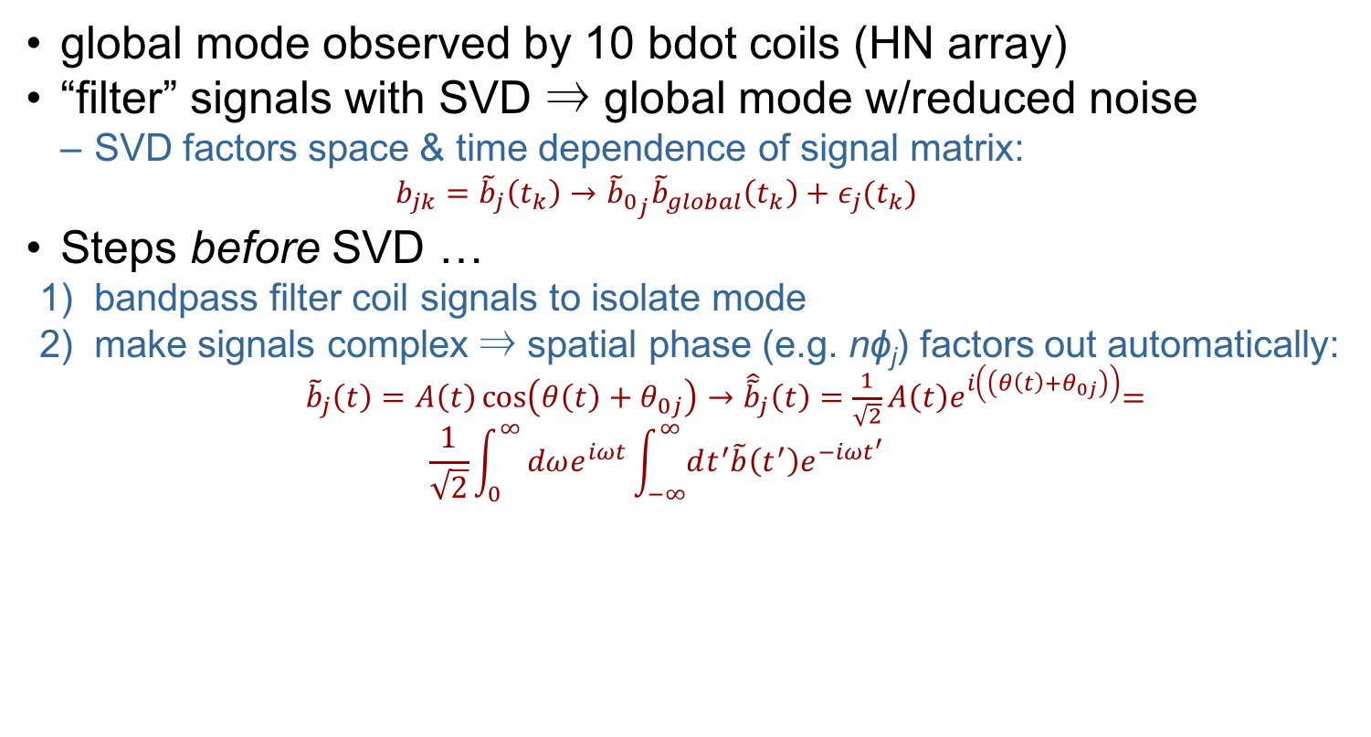
SVD:Singular value decomposition gives better “global mode” δb
bdot coil signals
“global mode”
SVD
“noise”
global mode observed by 10 bdot coils (HN array)
“filter” signals with SVD ⇒ global mode w/reduced noise
  SVD factors space & time dependence of signal matrix:
    $$b_{jk}={\tilde{b}}_{j}\left(t_{k}\right)→{{\tilde{b}}_{0}}_{j}{\tilde{b}}_{global}\left(t_{k}\right)+ε_{j}(t_{k})$$
Steps before SVD …
  bandpass filter coil signals to isolate mode
  make signals complex ⇒ spatial phase (e.g. nϕ_{j}) factors out automatically:
    ${\tilde{b}}_{j}\left(t\right)=A\left(t\right)\cos\left(θ\left(t\right)+θ_{0j}\right)→{\hat{\tilde{b}}}_{j}\left(t\right)=\frac{1}{\sqrt{2}}A\left(t\right)e^{i\left(\left(θ\left(t\right)+θ_{0j}\right)\right)}$=
    $$\frac{1}{\sqrt{2}}\int_{0}^{∞}{dωe^{iωt}\int_{−∞}^{∞}{dt^{′}\tilde{b}\left(t^{′}\right)e^{−iωt^{′}}}}$$
Notes:
SVD uses 10 signals and finds common mode, subtract the common mode, and subtract from 10 channels to get noise.

Slide 16
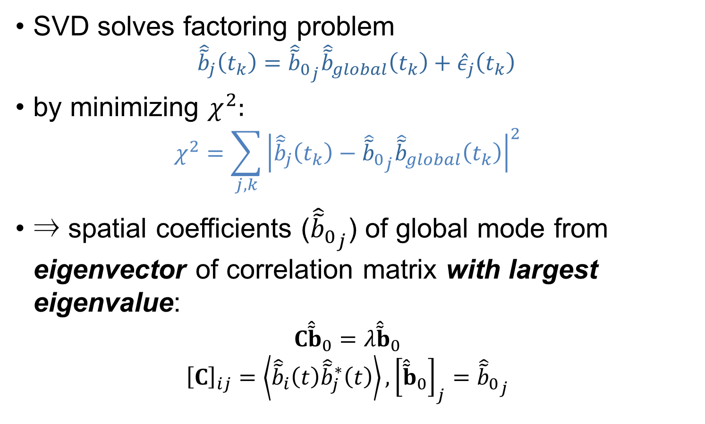
SVD: finds global mode from eigenvector of signal correlation matrix
SVD solves factoring problem
  $${\hat{\tilde{b}}}_{j}\left(t_{k}\right)={{\hat{\tilde{b}}}_{0}}_{j}{\hat{\tilde{b}}}_{global}\left(t_{k}\right)+{\hat{ε}}_{j}\left(t_{k}\right)$$
  by minimizing $χ^{2}:$
  $$χ^{2}=\sum_{j,k}{{\left|{\hat{\tilde{b}}}_{j}\left(t_{k}\right)−{{\hat{\tilde{b}}}_{0}}_{j}{\hat{\tilde{b}}}_{global}\left(t_{k}\right)\right|}^{2}}$$
  ⇒ spatial coefficients (${{\hat{\tilde{b}}}_{0}}_{j}$) of global mode from eigenvector of correlation matrix with largest eigenvalue:
  $$C{\hat{\tilde{b}}}_{0}=λ{\hat{\tilde{b}}}_{0}$$
  $${\left[C\right]}_{ij}=\left\langle {\hat{\tilde{b}}}_{i}\left(t\right){\hat{\tilde{b}}}_{j}^{∗}\left(t\right)\right\rangle ,{\left[{\hat{\tilde{b}}}_{0}\right]}_{j}={{\hat{\tilde{b}}}_{0}}_{j}$$

Slide 17
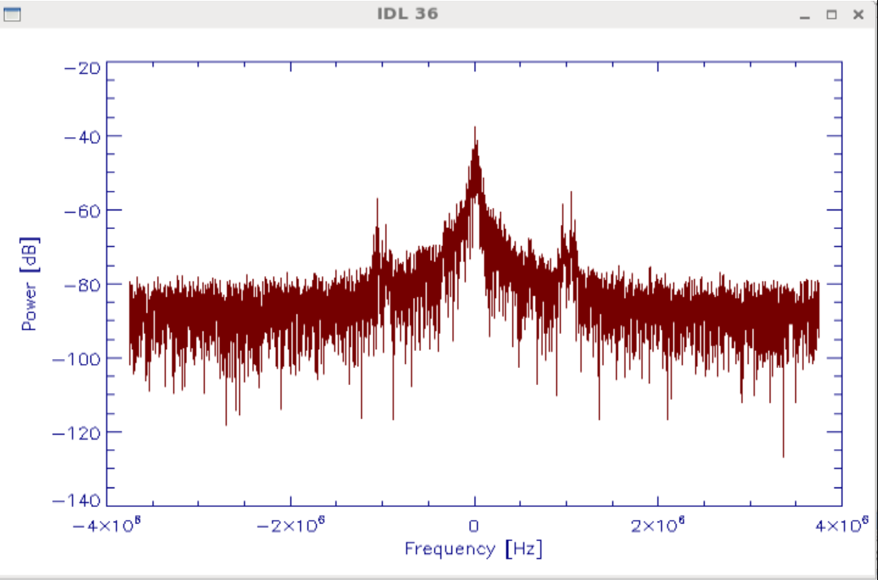

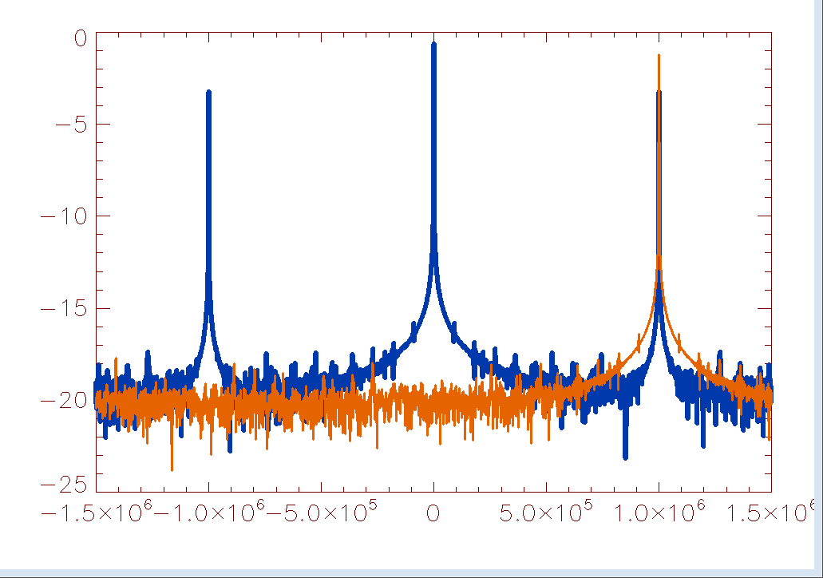
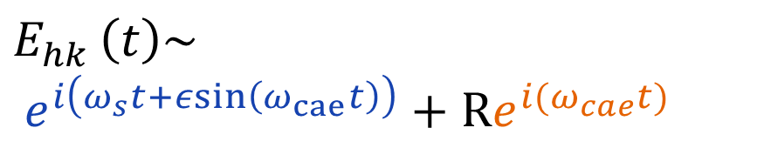
Scattering Verification: Scattering produces an asymmetric spectrum
Peaks at CAE frequency observed for 2 reasons.
  Sidebands of scattering from low frequency turbulence
  Scattering from KAW
                $$E_{hk }\left(t\right)\sim \\ e^{i\left(ω_{s}t+εsin\left(ω_{cae}t\right)\right)}+{Re}^{i(ω_{cae}t)}$$
Notes:
${Re}^{i(ω_{cae}t)}$ ← from KAW
$ε$ = 0.1
CAE is 1e6 Hz

Slide 18
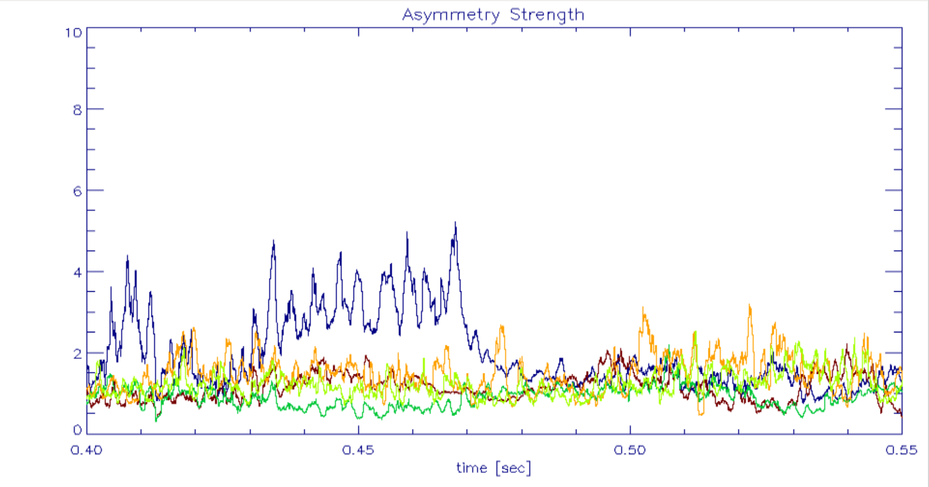



Scattering Verification: Scattering produces an asymmetric spectrum
Asymmetry strength across different channels is determined by dividing power at positive mode frequency by power by negative mode frequency
$A(t)=P\left(ω_{CAE}(t), t\right)/P\left({−ω}_{CAE}(t), t\right)$
Channel
1
2
3
4
5
$$A(t)$$
$$P\left(ω, t\right)$$

Slide 19
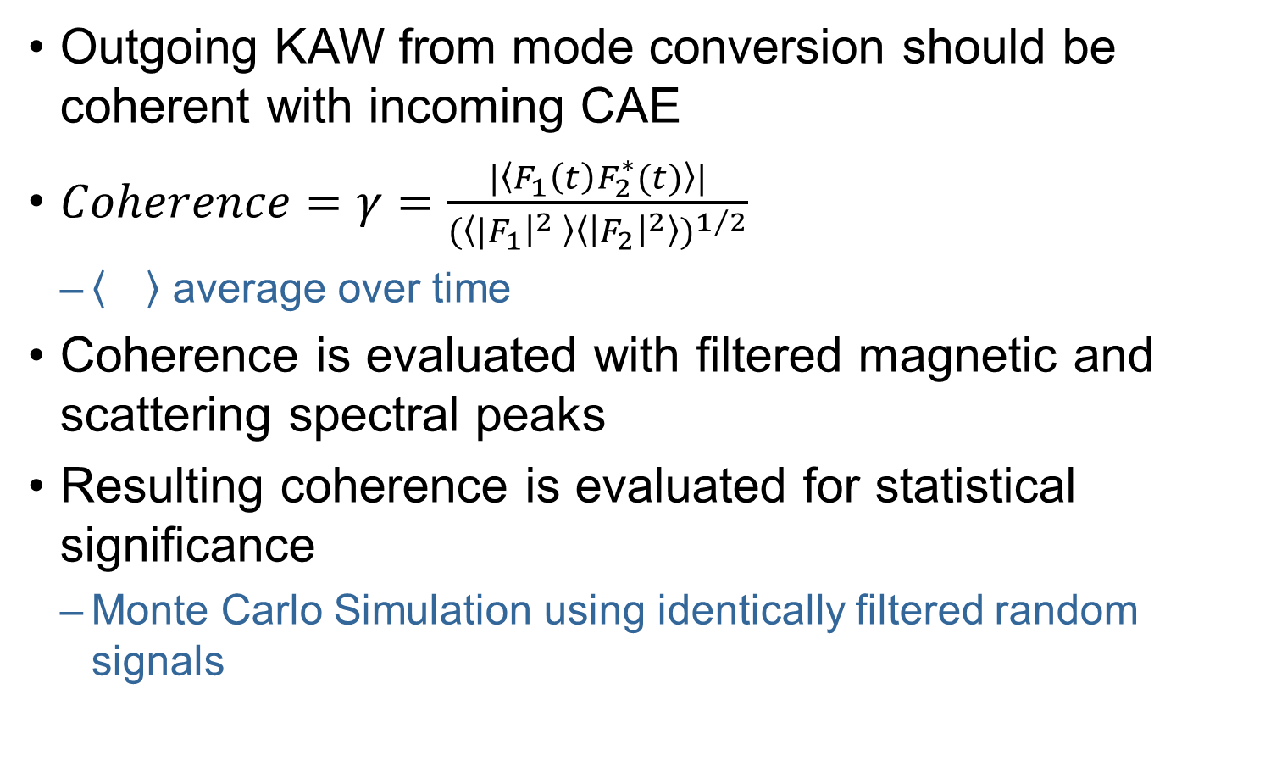
Coherence: Is scattering peak is coherent with magnetic peak as expected?
Outgoing KAW from mode conversion should be coherent with incoming CAE
$Coherence=γ=\frac{|\left\langle F_{1}\left(t\right)F_{2}^{∗}(t)\right\rangle |}{{(\left\langle {|F}_{1}{\left.​\right|}^{2} \right\rangle \left\langle {\left|F_{2}\right|}^{2}\right\rangle )}^{1/2}}$
  average over time
Coherence is evaluated with filtered magnetic and scattering spectral peaks
Resulting coherence is evaluated for statistical significance
  Monte Carlo Simulation using identically filtered random signals

Slide 20


Comparison of high k channels shows peak at CAE frequency has well defined k
Expect to see KAW predominantly in only one channel
Channel sensitive to peak should correspond to k from theory
Possible to have asymmetry from turbulence with low coherence

Slide 21

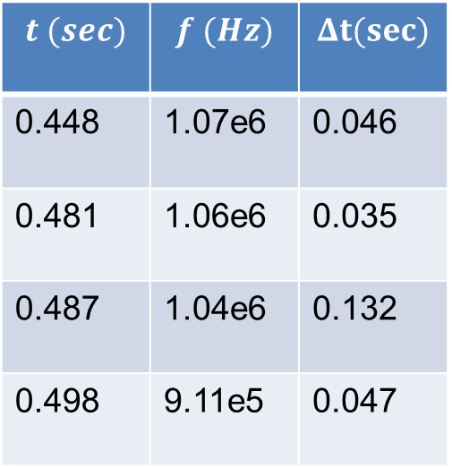
CAEs observed in shot 139395, analyzed for evidence of KAW coupling
several modes identified
  10KHz bandwidth for filtering
t = 0.4483
$$t (sec)$$ | $$f (Hz)$$ | $$Δt(sec)$$
0.448 | 1.07e6 | 0.046
0.481 | 1.06e6 | 0.035
0.487 | 1.04e6 | 0.132
0.498 | 9.11e5 | 0.047
Notes:
$$Show spectra$$

Slide 22
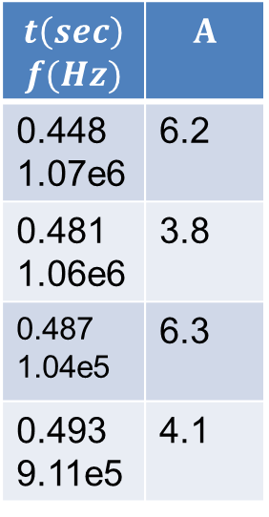
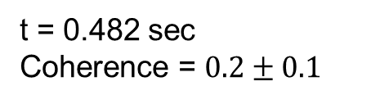

Asymmetry varies with scattered k, as expected
$$t\left(sec\right)$$ $$f(Hz)$$ | $$A$$
0.448 1.07e6 | 6.2
0.481 1.06e6 | 3.8
0.487 1.04e5 | 6.3
0.493 9.11e5 | 4.1
Channel
1
2
3
4
5
t = 0.482 sec
Coherence = $0.2±0.1$
Channel one $\left(k=760 m^{−1}\right)$ typically demonstrate a high asymmetry at times where mode is present.
Notes:
Suggest higher k c
Peak should show up by modulation
Mode jagged because mode is jaggeded
Draw a line, formula (<p_+(t)>) P_+(t) = power @ +- peak

Slide 23
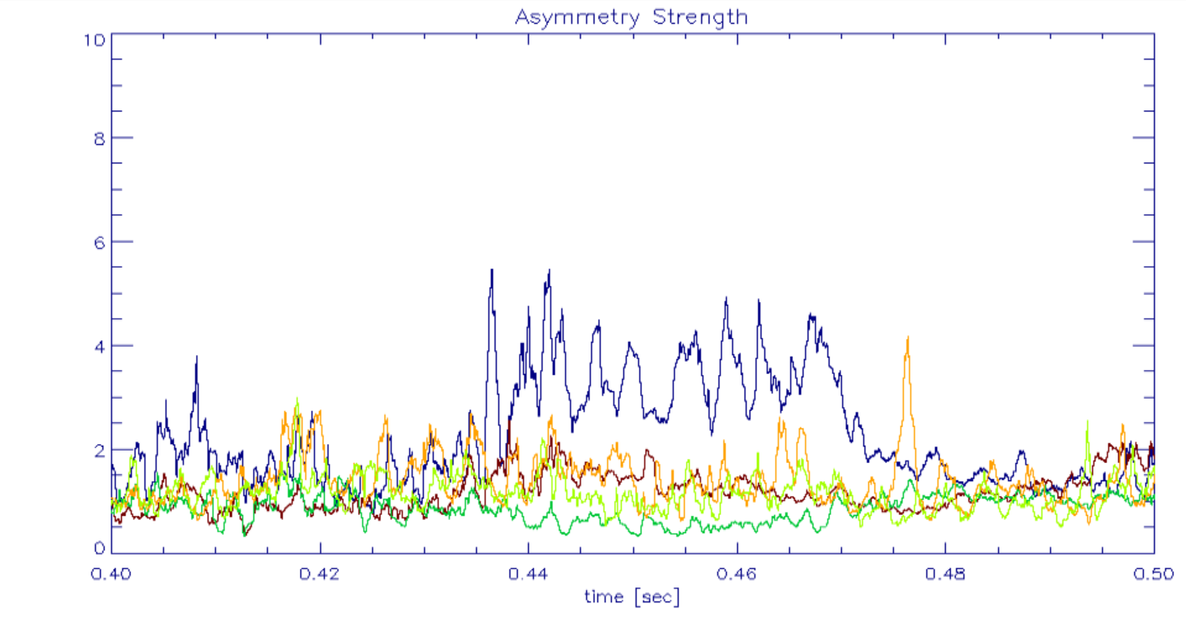
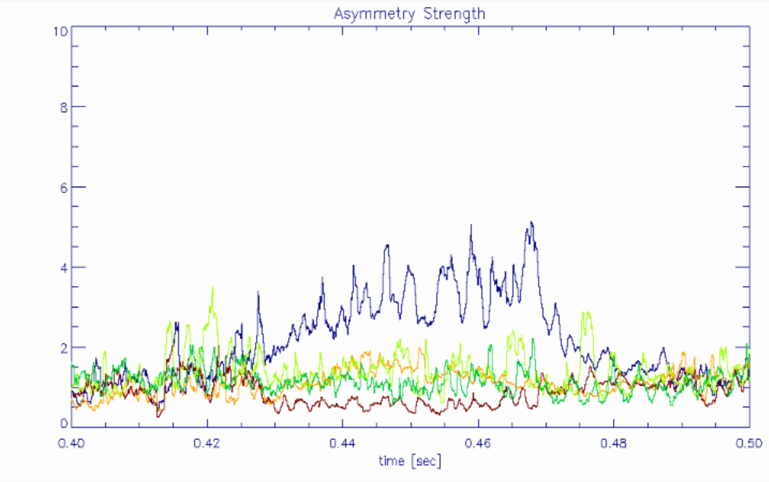
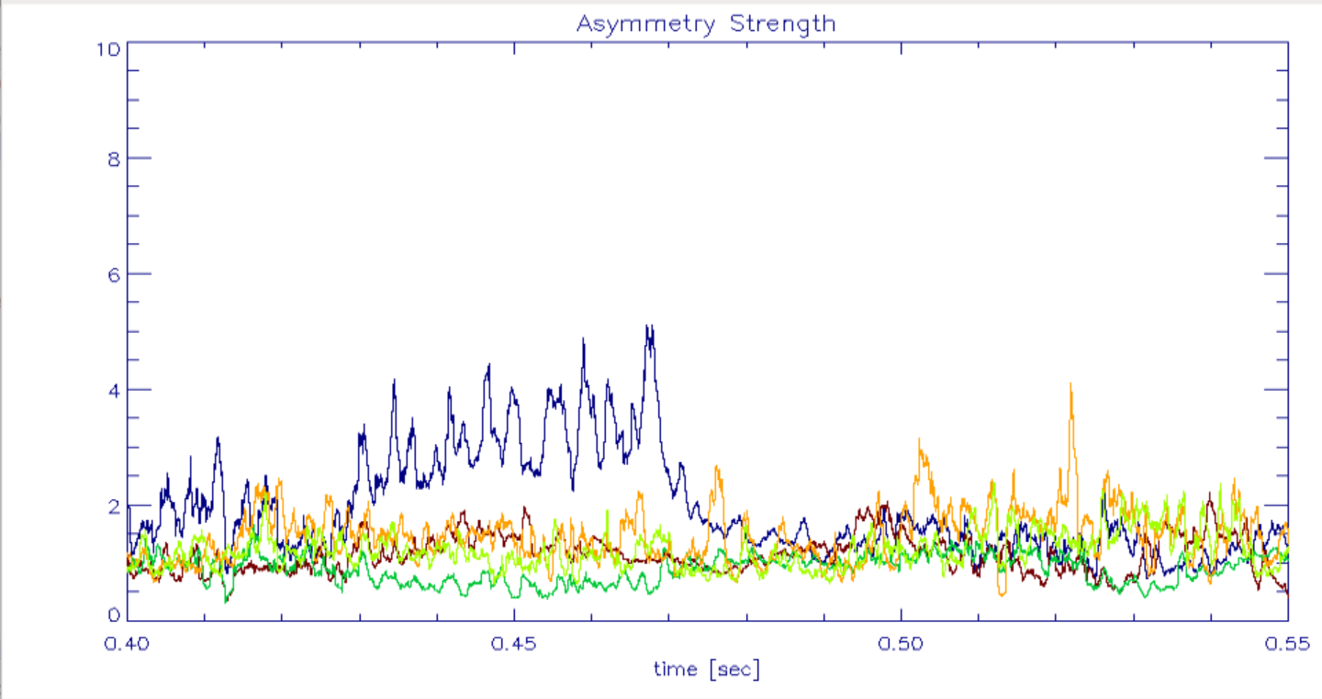
Asymmetry observed in high k channels for multiple modes
Channel
1
2
3
4
5

Slide 24
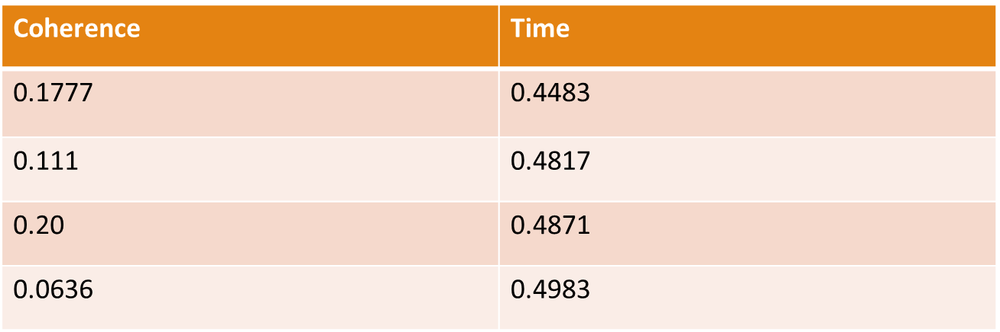
Coherence found between magnetics and scattering found for following modes

Slide 25
Observation consistent with CAE-KAW coupling
Peaks at same frequency in magnetic and scattering signal are coherent
Comparison of scattering signals at different k demonstrate well defined k for peaks at CAE freq
Peaks at lower k spectra demonstrate high asymmetry, in contrast with high k spectra
Coherence + Asymmetry strongly implies scattering from KAW

Slide 26
Future work
Compare scattering measurement with expectation from KAW dispersion relationship
  Predict which channels see KAWs as profiles evolve
  Assess absorption to determine if significant power can reach measurement location
Evaluate potential contamination of scattering signal by refraction of probe beam.
  Beam tracing

Slide 27
Request Electronic Copy

