Slide 1


Power exhaust scenarios & control for projected high-power NSTX-U operation
J.E. Menard, S.P. Gerhardt, C.E. Myers, A. Brooks, M. Mardenfeld (PPPL)
M.L. Reinke (ORNL)
NSTX-U Research and Engineering teams
59th Annual Meeting of the APS Division of Plasma Physics
Milwaukee, WI
October 23 – 27, 2017

Slide 2
Abstract / Motivation
An important goal of the NSTX Upgrade (NSTX-U) research program is to characterize energy confinement in the low-aspect-ratio spherical tokamak configuration over a significantly expanded range of plasma current, toroidal field, and heating power, while increasing flattop durations to ~5 seconds.
However, the narrowing of the scrape-off layer at higher current combined with an improved understanding of expected halo-current loads has motivated a significant re-design of NSTX-U plasma facing components in the high-heat-flux regions of the divertor.
In order to reduce the expected divertor heat flux to acceptable levels, a combination of mitigation techniques will be used: increased divertor poloidal flux expansion and divertor radiation, and controlled strike-point sweeping.
The machine requirements for these various mitigation techniques are studied here using a newly implemented reduced heat-flux model.
Systematic equilibrium scans are used to quantify the required divertor coil currents and to verify vertical stability for a range of plasma shapes.
Free-boundary control schemes to constrain the strike-point location and field-line angle-of-incidence are also described.

Slide 3
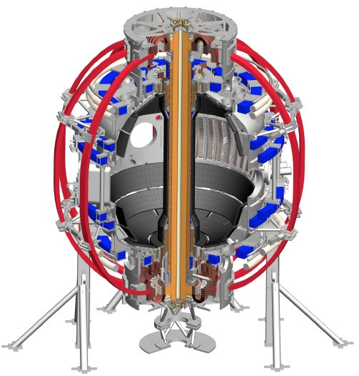
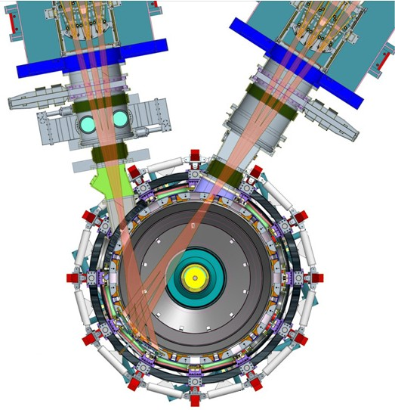
NSTX facility upgraded to access new physics using 2 major new tools:
1. New Central Magnet
2. Tangential 2nd Neutral Beam
Higher T, low ν* from low to high β
→ Unique regime, study new transport and stability physics
Full non-inductive current drive
→ Not demonstrated in ST at high-β_{T}
Essential for any future steady-state ST

Slide 4
NSTX-U integrated performance goals
1. New Central Magnet
2. Tangential 2nd Neutral Beam
➢2× heating power (5 → 10MW)
➢4× divertor heat flux (→ ITER levels)
➢Up to 10× higher nTτ_{E} (~MJ plasmas) and energy injected into vessel
➢2× toroidal field (0.5 → 1T)
➢2× plasma current (1 → 2MA)
➢5× longer pulse (1 → 5s)

Slide 5
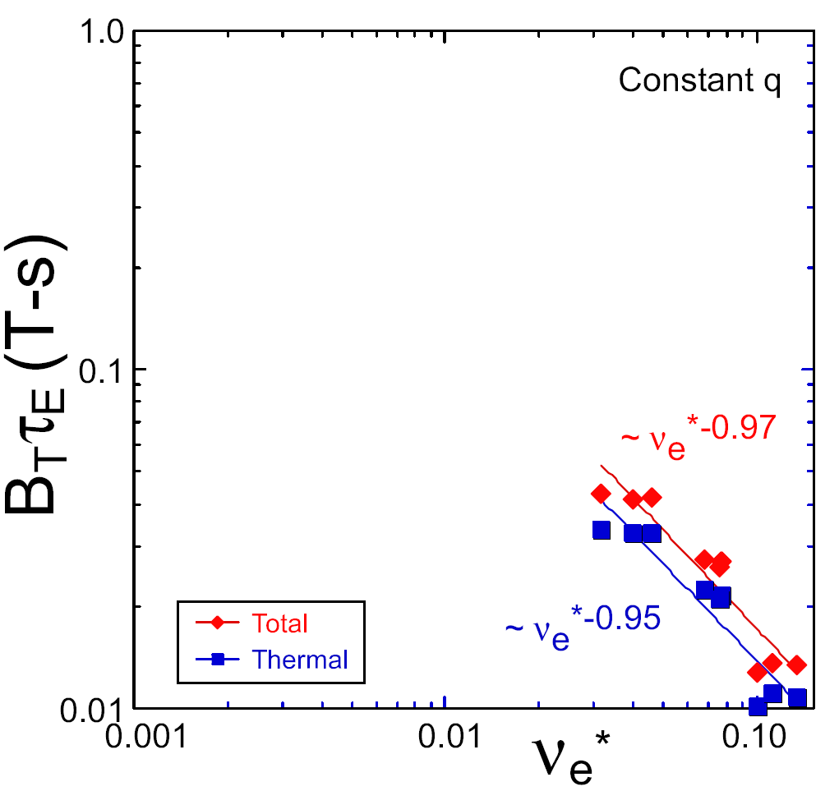
NSTX confinement increased at higher T_{e}
ST-FNSF
constant q, β, ρ∗
NSTX Upgrade
?
NSTX
ITER-like scaling
Normalized electron collisionality ν_{e}* ∝ n_{e} / T_{e}²
Will confinement trend continue, or look like conventional A?

Slide 6

Rationale for 1T, 2MA, 10MW requirement
2× increase in plasma current I_{P} and toroidal field B_{T} sufficient to differentiate between conventional (ITER 98y,2) and low-A (ST) H-mode confinement time τ at higher plasma temperature and/or density:
2× heating power P needed to access high enough stored energy to access wide range of β at 2× higher field and current: β_{N} ≤ ~4.5-5.5, β_{T} ≤ ~15-20%

Slide 7
NSTX-U magnet pulse duration requirement arises from goal of achieving current profile equilibration
Current redistribution time τ_{CR} ∝ T_{e}^{3/2} → longest for highest confinement, lowest density
Physics ranges of interest:
  Normalized confinement: H_{98y2} = 1-1.5, H_{ST} ≤ 1
  Normalized density f_{GW} = 0.5-1 – lower range for low ν*
Longest τ_{CR} ~1.8s - for H_{98y2} = 1.4-1.5, f_{GW} = 0.5-0.6
  This H_{98y2} and f_{GW} combo accessed only transiently on NSTX
  Significant physics R&D needed to access such plasmas
Access then measure stationary profiles → Δt_{flat} ~3τ_{CR}
3τ_{CR} ~ 5-5.5s → motivates goal of 5s I_{P} flat-top

Slide 8
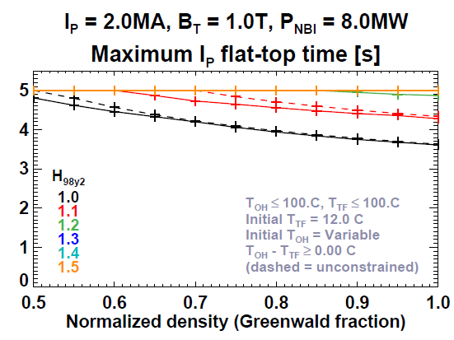
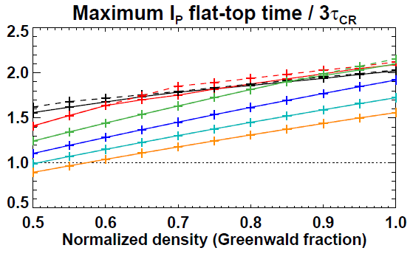
Achievable pulse-lengths and Δt_{flat} / τ_{CR}
Constraint: maximum I_{P} flat-top duration = 5s (set by TF)
H_{98y2} ≥ 1.2: Δt_{flat} = 5s for all f_{GW}
Δt_{flat} < 5s at lower H (high f_{GW})
Note: NSTX-U accessed H_{98y2} ~ 1.1-1.15 during initial ops
Flat-top durations range from ~2.7 to ~6.3 τ_{CR}
Nearly all cases (97%) meet or exceed ~3 τ_{CR}

Slide 9
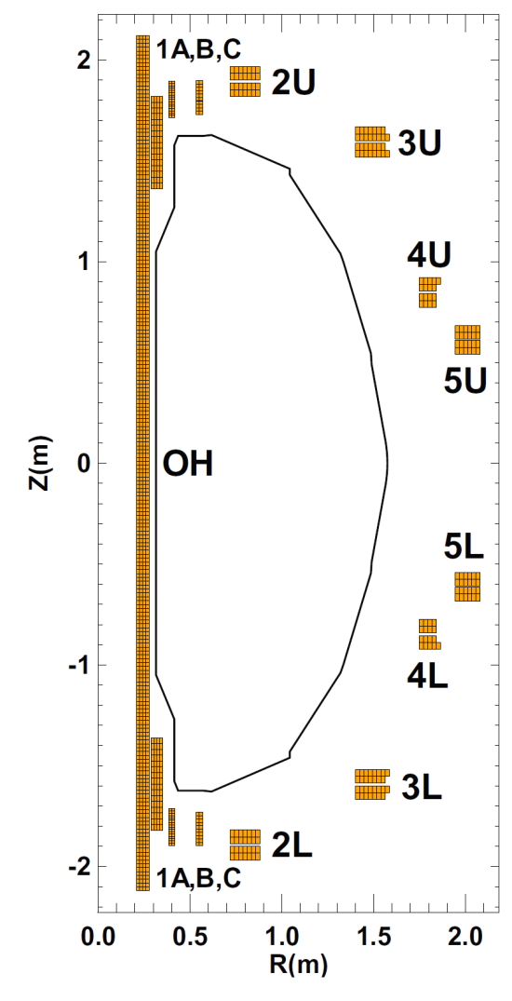
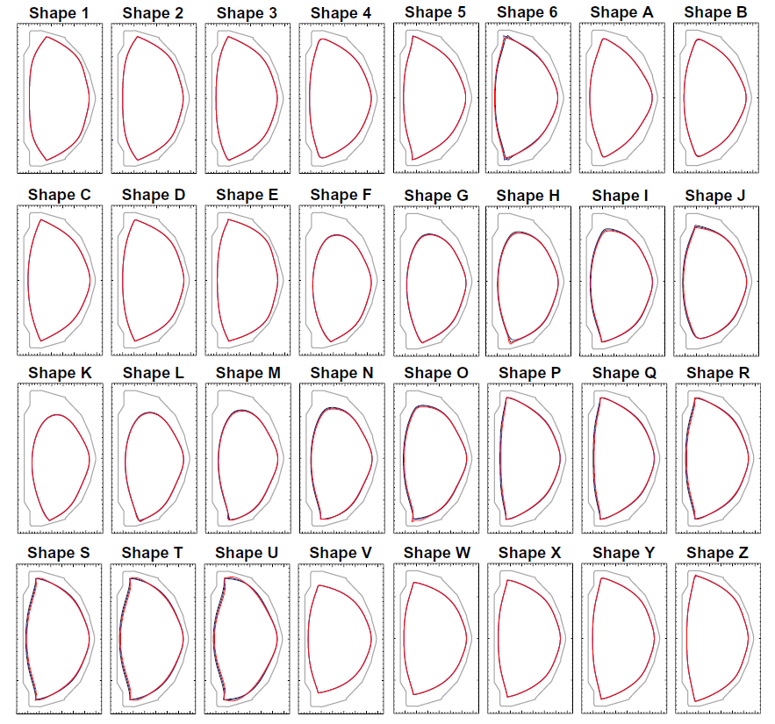
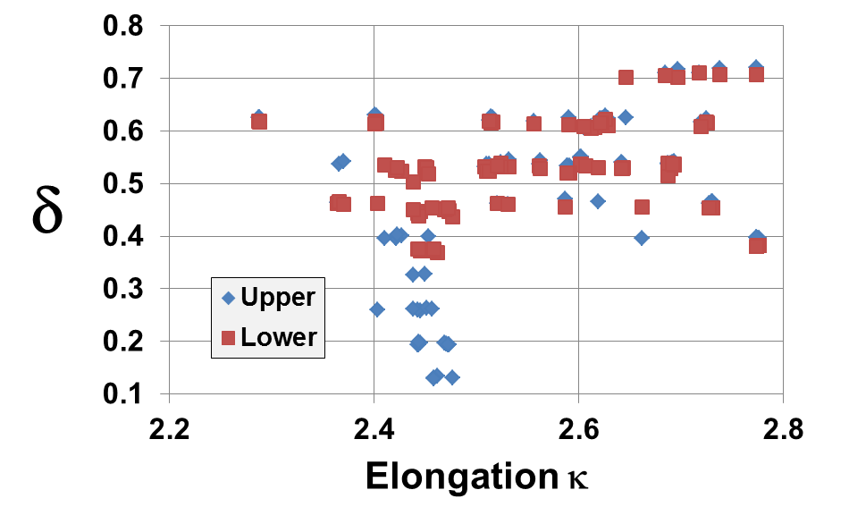
Boundary shaping flexibility drives PF coil and structural requirements for plasma operation
2MA, 1T: 32 shapes × 3 OH states = 96 equilibria

Slide 10
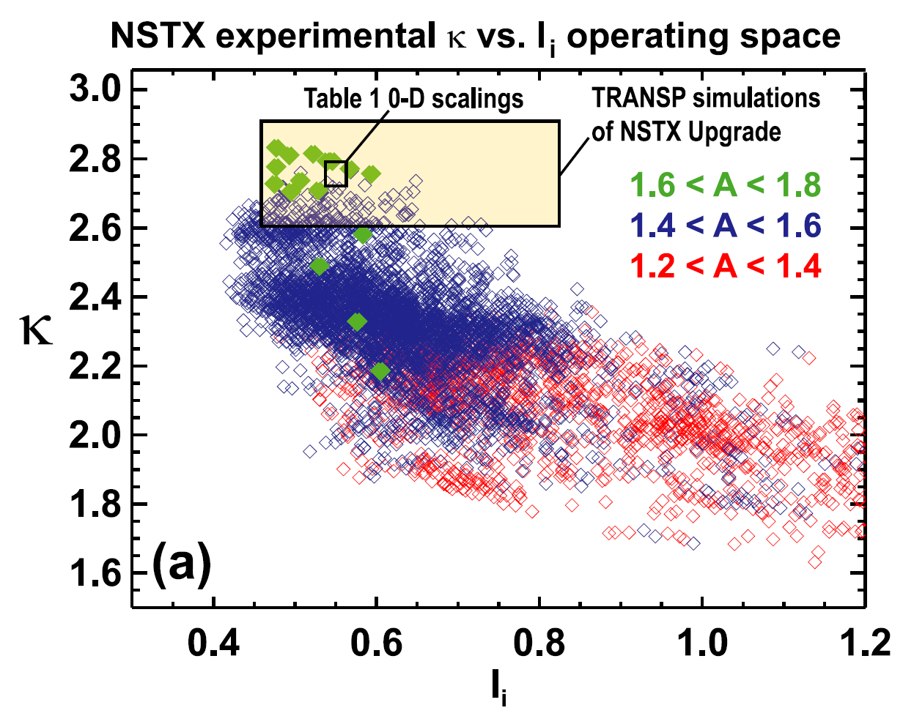
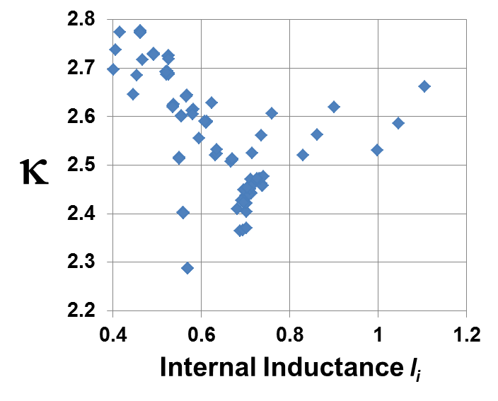
96 scenarios primarily higher-κ, lower-l_{i} high-performance H-modes (β_{N} ~ 5)
2MA, 1T: 32 shapes / 96 scenarios
Higher l_{i} ~1-1.5 L-modes not included in design requirements → L-mode I_{P} < 2MA, Δt_{flat} < 5s

Slide 11
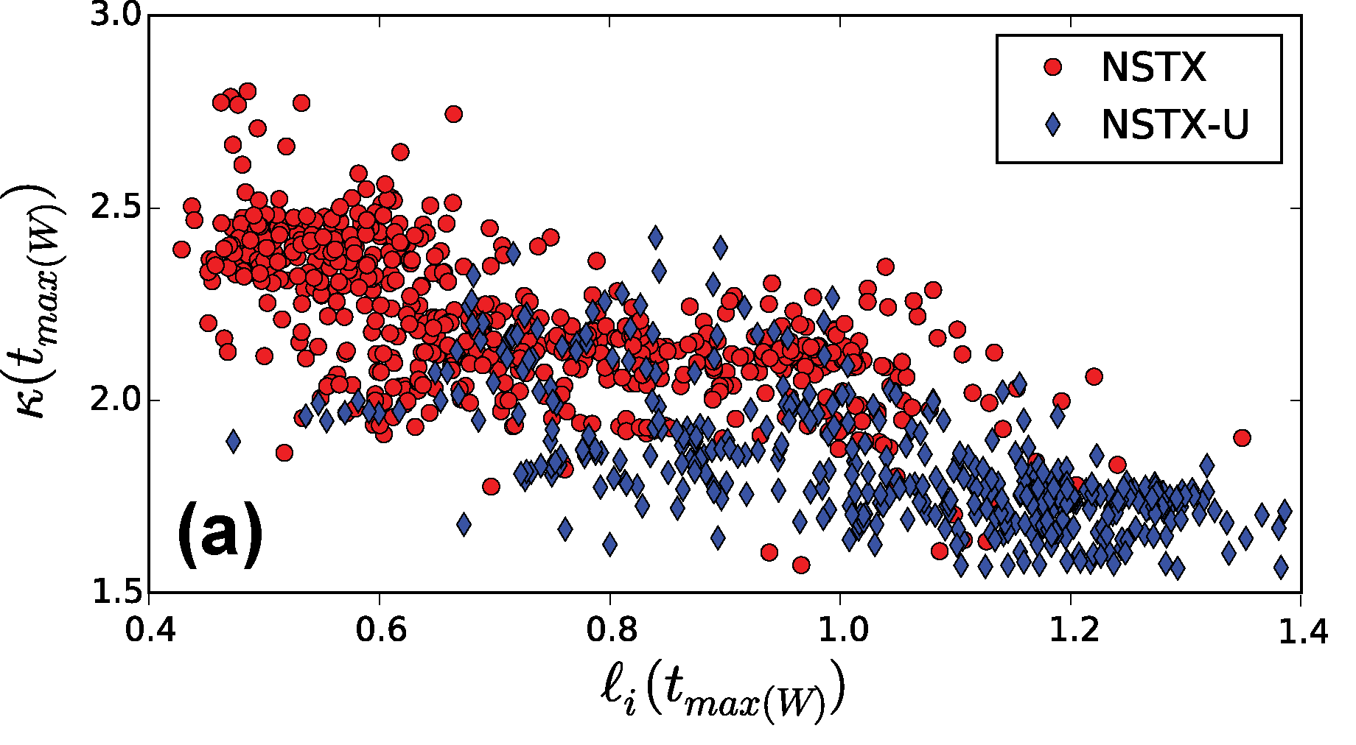
Operating κ depends on range of stable internal inductance
(& impacts power-exhaust solution)
Internal inductance depends on bootstrap and NBI current profiles which depend on thermal transport
Risk: No NSTX-U transport data yet at high B_{T}, I_{P}, κ
  This confinement physics data is a key motivation for the Upgrade in the first place!
κ = 2.8
κ = 2.5

Slide 12
Reduced heat flux model

Slide 13
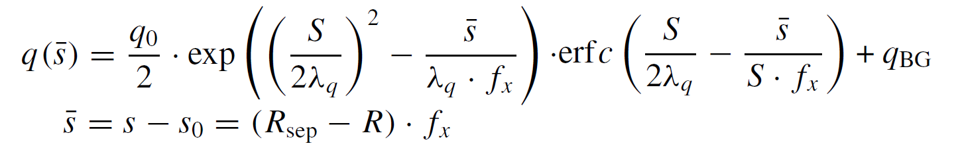
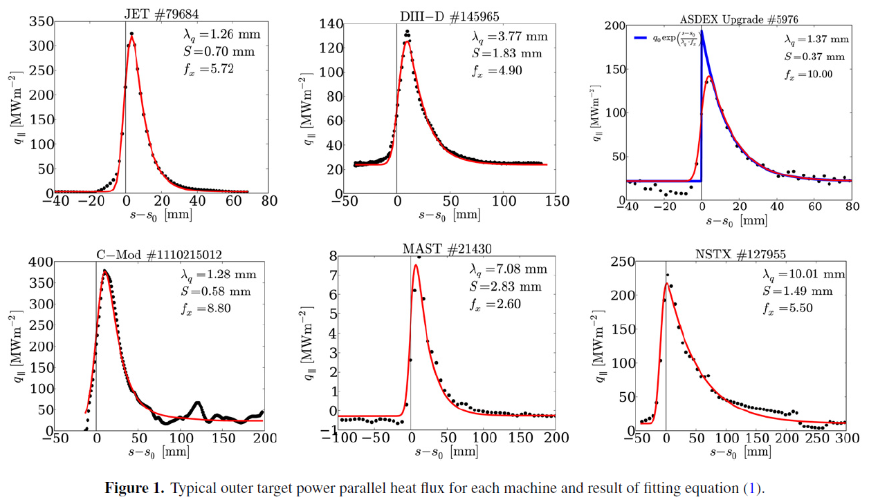
Parametric fits to divertor heat flux
T. Eich, et al., Nucl. Fusion 53 (2013) 093031, Eqn 1

Slide 14
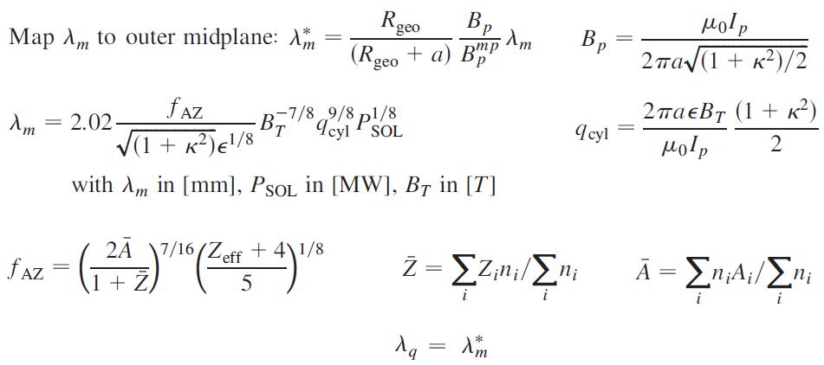
Model for SOL heat flux width λ_{q}
T. Eich, et al., Phys. Rev. Lett. 107 (2011) 215001
  Equations 5, 7-10 → Goldston heuristic drift model for λ_{q}
Use

Slide 15
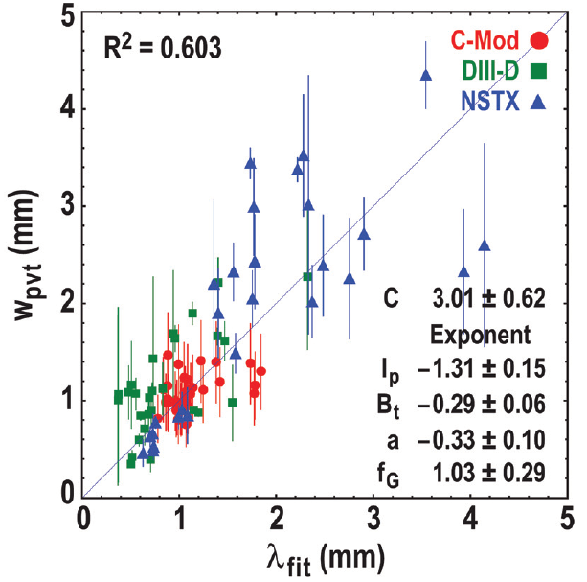
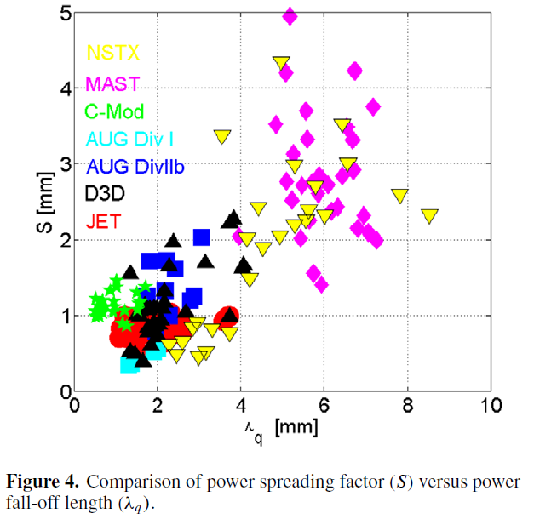
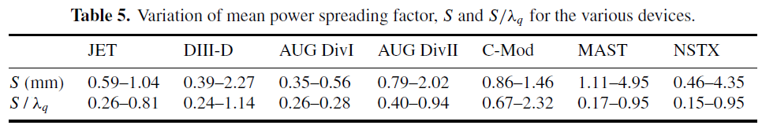
Data for private flux region width w_{pvt}=S
M. Makowski et al., Phys. Plasma 19, 056122 (2012)
T. Eich, et al., Nucl. Fusion 53 (2013) 093031

Slide 16
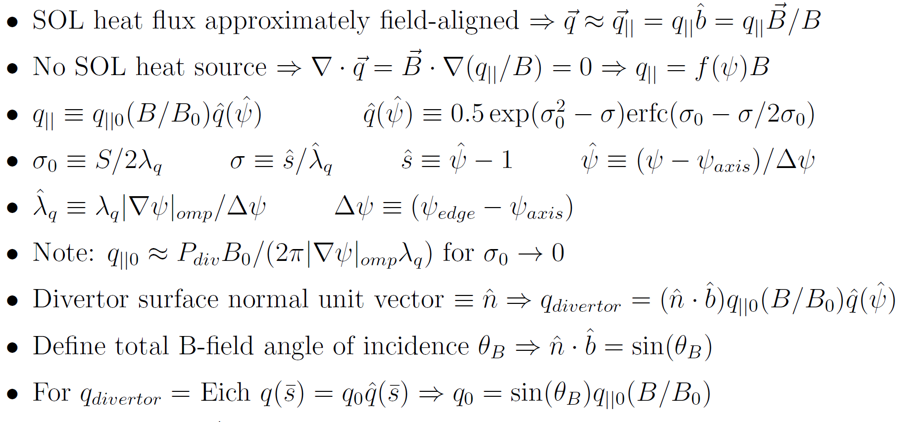
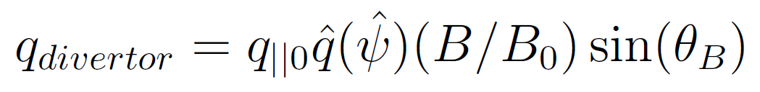
Generalized divertor heat-flux model consistent with Eich parametric fitting

Slide 17
Choice of S for NSTX-U calculations
Options:
  S_{Mak} = S from Makowski scaling
  S_{rel} = MIN(S / λ_{q}) × λ_{q} = 0.15 × λ_{q}
    MIN(S / λ_{q}) = 0.15, 0.17 for NSTX, MAST
  S_{fix} = fixed / constant value of S
NSTX-U model uses combination of all these options as follows:
  First set S = MIN( [S_{Mak}, S_{rel}] )
  Then enforce S_{min} ≤ S ≤ S_{max}
    S_{min} = 0.1mm, S_{max} = 0.5mm
  S typically set by S = S_{rel} ≈ 0.2-0.3mm
  S = 0.15 × λ_{q} ≈ S_{mak}(f_{G} = 0.4, 2MA, 1T)
    ➔ Consistent w/ physics/ops goal f_{G} ≥ 0.5

Slide 18
Model for power conducted to divertor target
P_{heat} = total heating power (ohmic + auxiliary + alpha)
f_{rad} = fraction of heating power radiated from core
  For NSTX-U projections assume f_{rad} = 0.3
P_{rad} = f_{rad} × P_{heat} = power radiated from core
P_{sol} = P_{heat} × (1-f_{rad}) = power into SOL
N_{div} = Number of in/out divertor legs connected to target
  N_{div} = 1 for single null (SN), N_{div} = 2 for double null (DN)
f_{obl} = fraction of power to outboard divertor leg(s)
  For NSTX-U projections assume f_{obl} = 0.8 for DN, 0.65 for SN
f_{ibl} = (1-f_{obl}) = fraction of power to inboard divertor leg
f_{leg} = f_{obl} or f_{ibl} = fraction of power to chosen divertor leg
P_{div} = P_{sol} f_{leg} / N_{div} = power conducted to divertor target

Slide 19
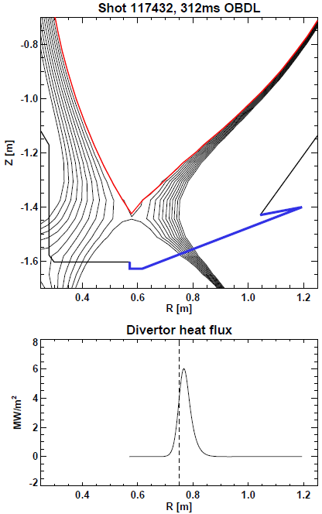
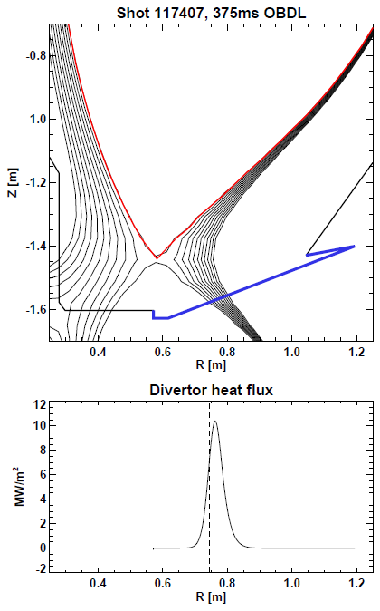
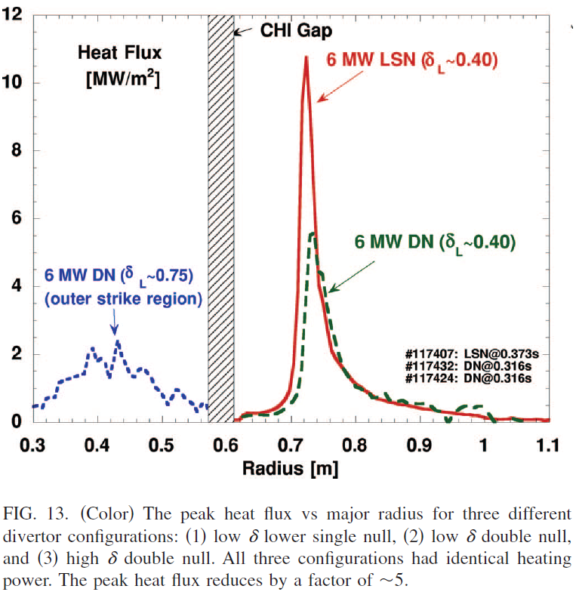
NSTX example: low δ, I_{P} = 0.8MA
D. Gates et al. Phys. Plasmas 13 (2006) 056122
EFIT02
I_{P} = 0.8 MA
P_{heat} = 6 MW
f_{rad} = 0.3
f_{obl} = 0.8
f_{G} = 0.624
S = S_{Mak}
EFIT02
I_{P} = 0.8 MA
P_{heat} = 6 MW
f_{rad} = 0.2
f_{obl} = 0.65
f_{G} = 0.605
S = S_{Mak}

Slide 20
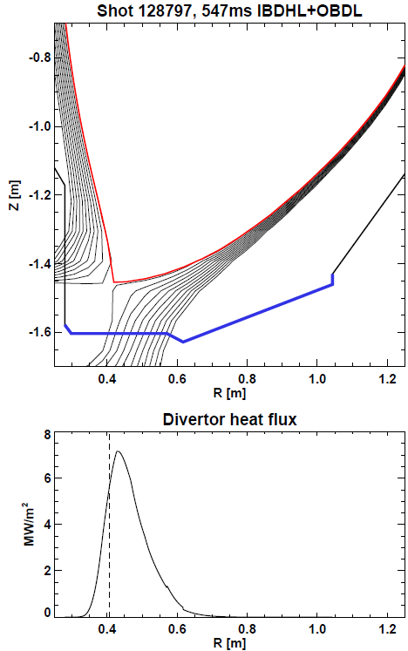
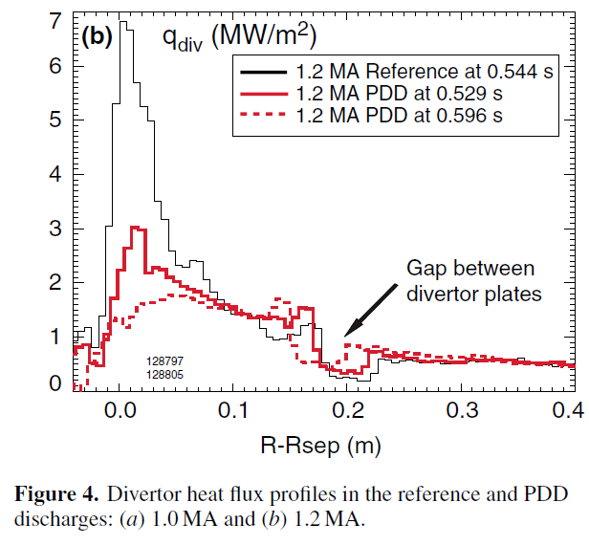
NSTX example: high δ, I_{P}= 1.2MA
V.A. Soukhanovskii et al Nucl. Fusion 49 (2009) 095025
LRDFIT06
I_{P} = 1.2 MA
P_{heat} = 6 MW
f_{rad} = 0.3
f_{obl} = 0.65
f_{G} = 0.6
S = S_{Mak}

Slide 21
Strategies for Mitigating Heat Fluxes
Increase poloidal flux expansion
  changes the amount of wetted area on divertor, but also makes for shallow angles
Strikepoint sweeping in time
  use PF coils to move the strike point back and forth across the surface
Increase radiation fraction (30% assumed in models)
  contingency due to uncertainty of compatibility w/ physics goals
  adding new divertor fueling locations to help us exploit radiative exhaust
Energy Conf. Time
Div. Temperature, Heat Flux
how we move on this plot is a research focus of the fusion program worldwide

Slide 22
Comments on comparison to NSTX and extrapolation to NSTX-U
Have looked at very limited number of NSTX cases
  f_{rad} = 0.2-0.3 and S = S_{Mak} might be reasonable scaling assumption for NSTX / NSTX-U
    Peak heat fluxes can match, but exact profile shapes differ
    There is substantial uncertainty in both f_{rad} and S_{Mak}
  Need DIVSOL TSG to identify more cases for comparison
  More detailed analysis of NSTX S-scaling would be valuable
For scaling to NSTX-U, use more conservative (i.e. smaller) S = S_{rel} = 0.15 × λ_{q}
Detachment is option for reducing NSTX-U heat-flux
  Showed reduction of q⊥ by ~50-70% in NSTX
  Prefer not to rely on detachment for NSTX-U scenarios
    Beneficial to have more operating margin if PFCs will allow

Slide 23
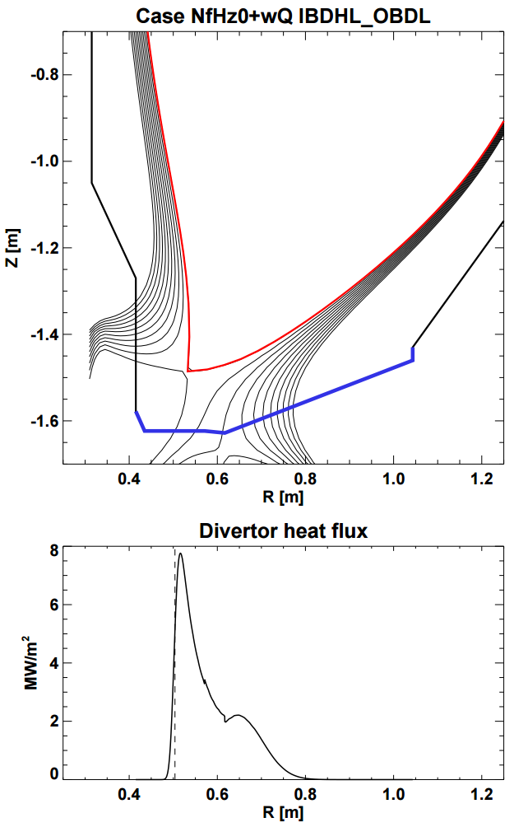
NSTX-U projection example: high δ,
I_{P} = 2MA with high flux expansion divertor
A = 1.75, κ = 2.74, balanced DN
I_{P} = 2MA, B_{T} = 1T, P_{heat} = 10MW
λ_{q-mid} =1.97mm, S/λ_{q} = 0.15
Poloidal flux expansion = 36
  Also assume B-field angle of incidence θ_{B} must be ≥ 1° (tile alignment / leading edge tolerance)
Radiation fraction = 30%
80% of power to outboard
50-50 split between upper/lower
P_{div} ~ 2.8MW to divertor target
q_{div-peak} = 7.8 MW/m²
PF1A, C used
PF1B not used
θ_{B} = 1.1°

Slide 24
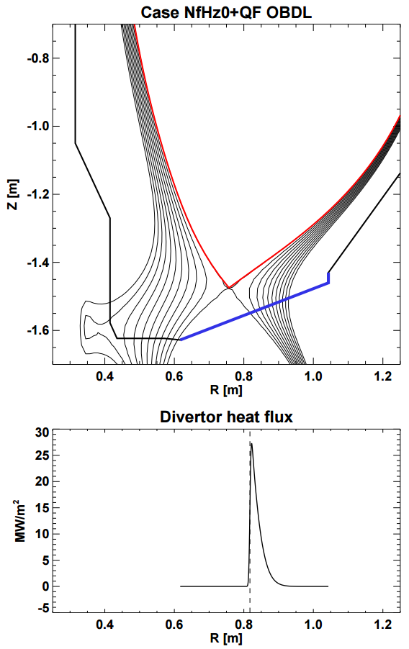
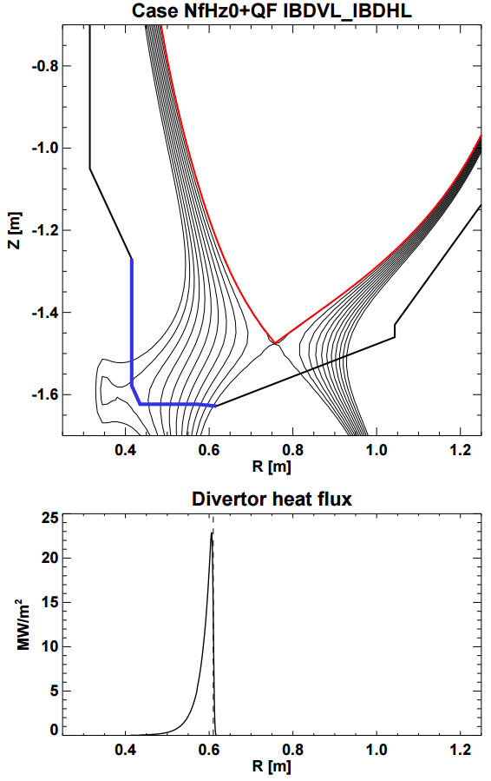
Example case from 96 with high I_{PF1A}
A=1.84, κ=2.5, δ_{U, L} = 0.193, 0.375, I_{OH}=0, I_{PF1AU,L} = 15, 7kA
q_{peak} ~20-25MW/m²
Δt_{flat} < 1s without sweeping or other mitigation

Slide 25
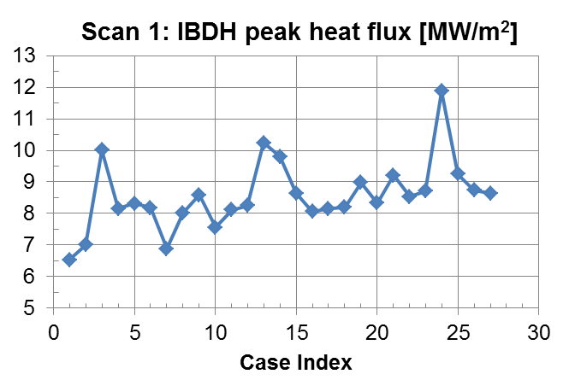
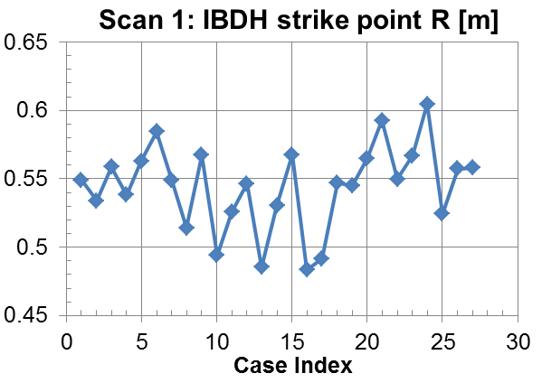
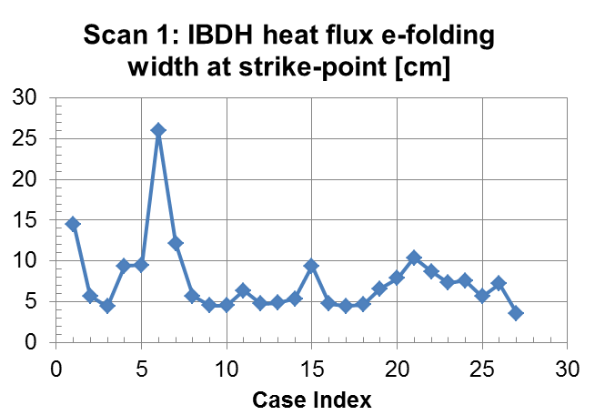
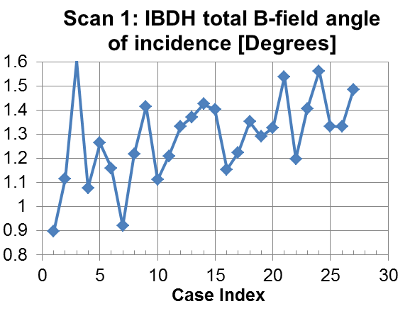
Example: Scan 1: No PF1B, use PF1C for high flux expansion
IBDH tile heat flux projections
HD model λ_{q}
S / λ_{q} = 0.15
f_{rad} = 0.3

Slide 26
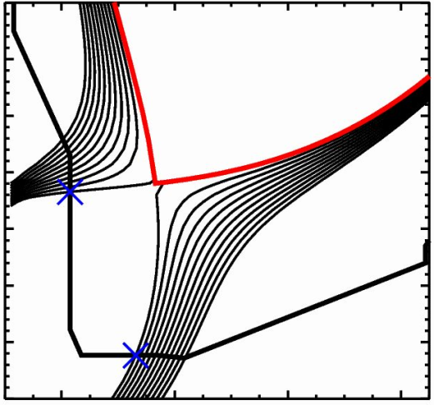
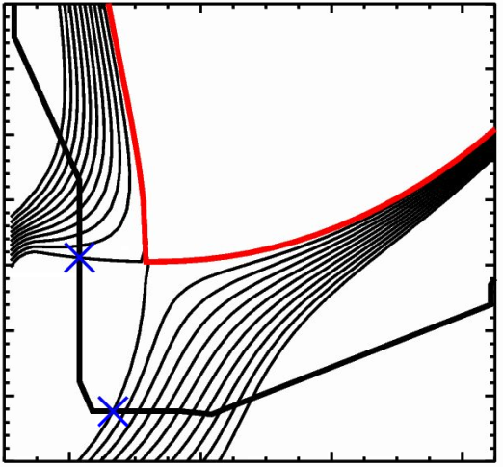
Elongation Impacts Use of Poloidal Flux Expansion
Low-κ shapes have x-point far from PFCs have useful scientific value
  I_{p} = 1 MA, P_{NBI} = 3 MW L-mode
  flux expansion < 3, field line angles > 10 deg
  high stationary heat flux (> 6 MW/m²)
Increasing kappa and moving x-point closer to targets can mean higher I_{p}, P_{NBI} are ‘easier’
  I_{P}=1.00 MA, B_{T}=0.75 T, 7.5 MW: q_{peak} ~ 12 MW/m²
  I_{P}=1.25 MA, B_{T}=0.75 T, 8.0 MW: q_{peak} ~ 7 MW/m²
Shape/heat flux coupling stronger in STs
q_{peak} ~ 12 MW/m²
q_{peak} ~ 7 MW/m²

Slide 27
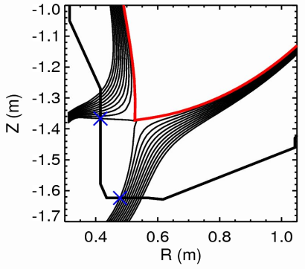
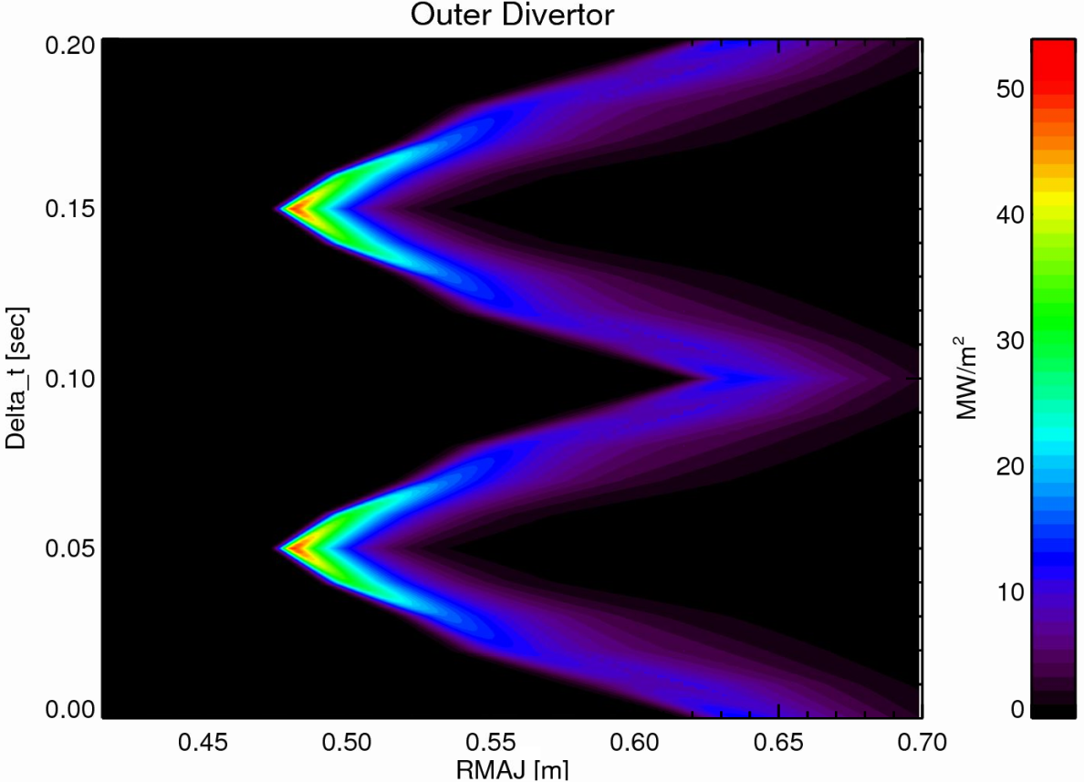
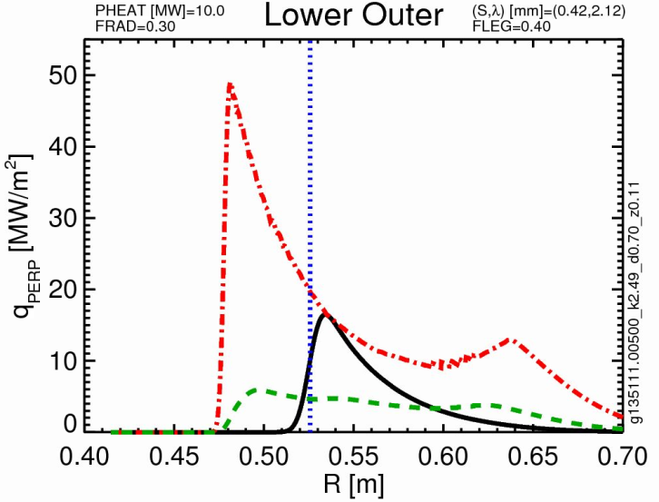
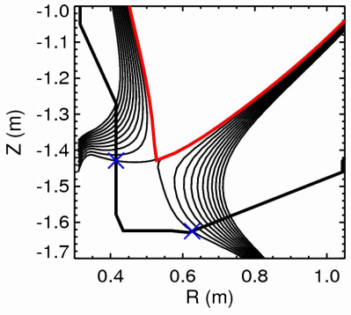
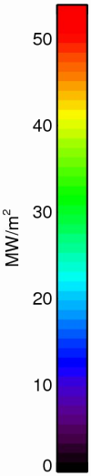
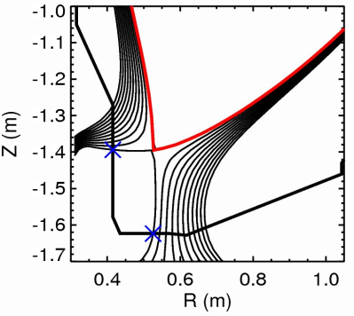
Initial Modeling of Sweeping Shows Benefits
(Implemented in reduced model by M. Reinke, ORNL)
assemble individual equilibria and interpolate
q_{perp}
A
C
2 MA
1 T
10 MW
A
B
B
C
Single Equilibrium
Peak Across Scan
Time Averaged
C

Slide 28
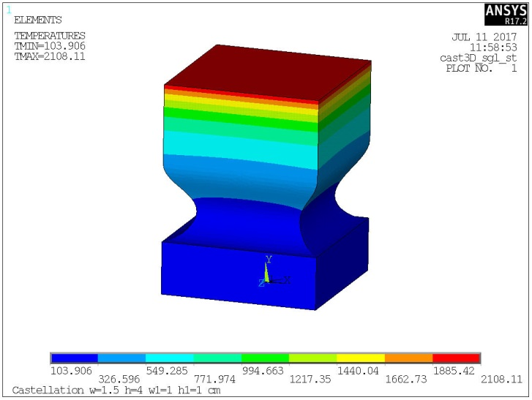
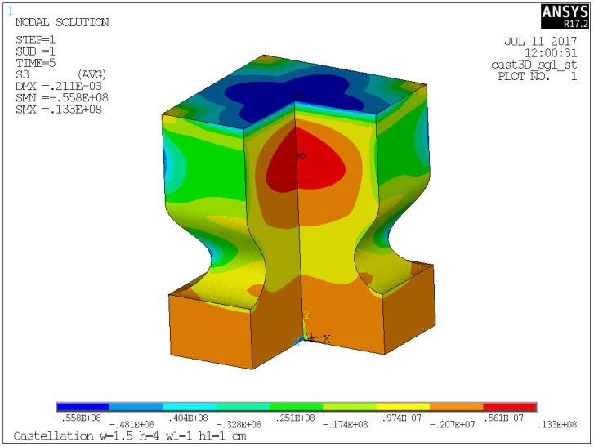
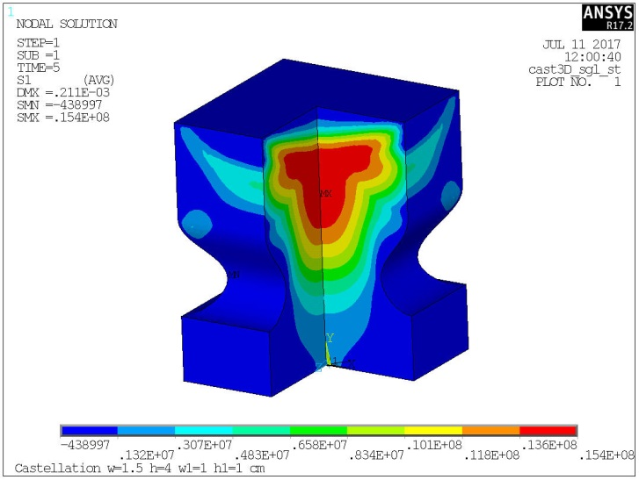
HHF Tile Designs Converged to ‘Small Cubes’
temperature
compressive stress
tensile stress
40 mm
30 mm
ANSYS simulation of 10 MW/m² for 5 sec onto isotropic graphite at normal incidence
larger tiles ‘bow’, enhancing stress, small cubes relieve this by ‘mushrooming’
design criteria using T_{limit} ~ 1600 ºC, and allowable stresses of 50% material limit
scoping simulation show T_{max} = 2100 ºC, max compressive stress of 55.8 MPa (86% of allowable) and max tensile stress of15.4 MPa (51% of allowable)
  example of design that is ‘temperature limited’ and not ‘stress limited’

Slide 29
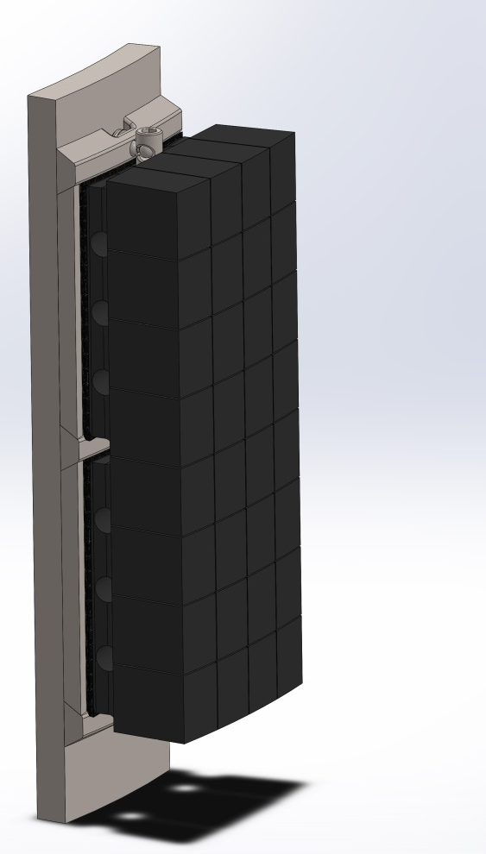
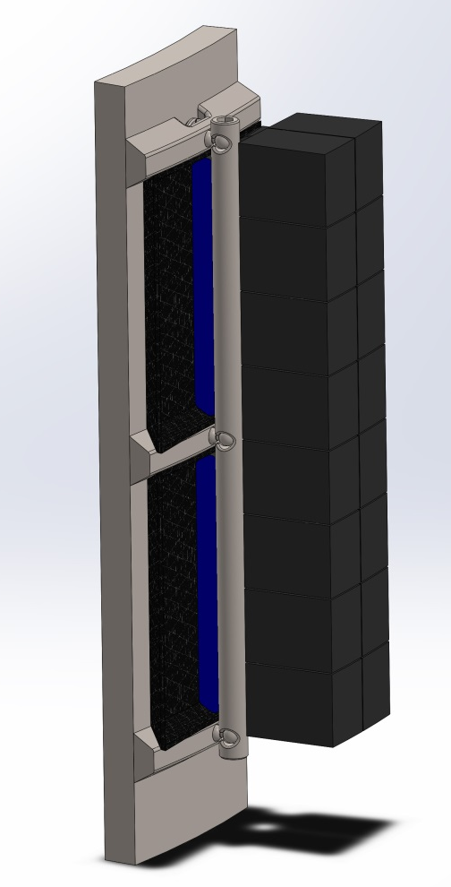
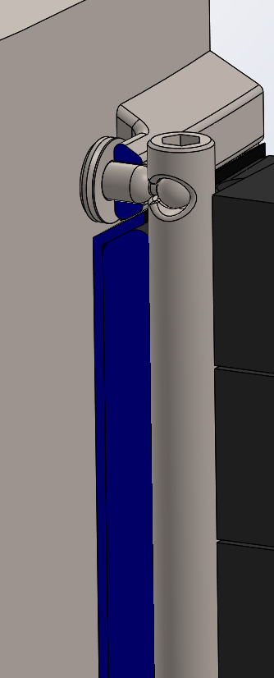
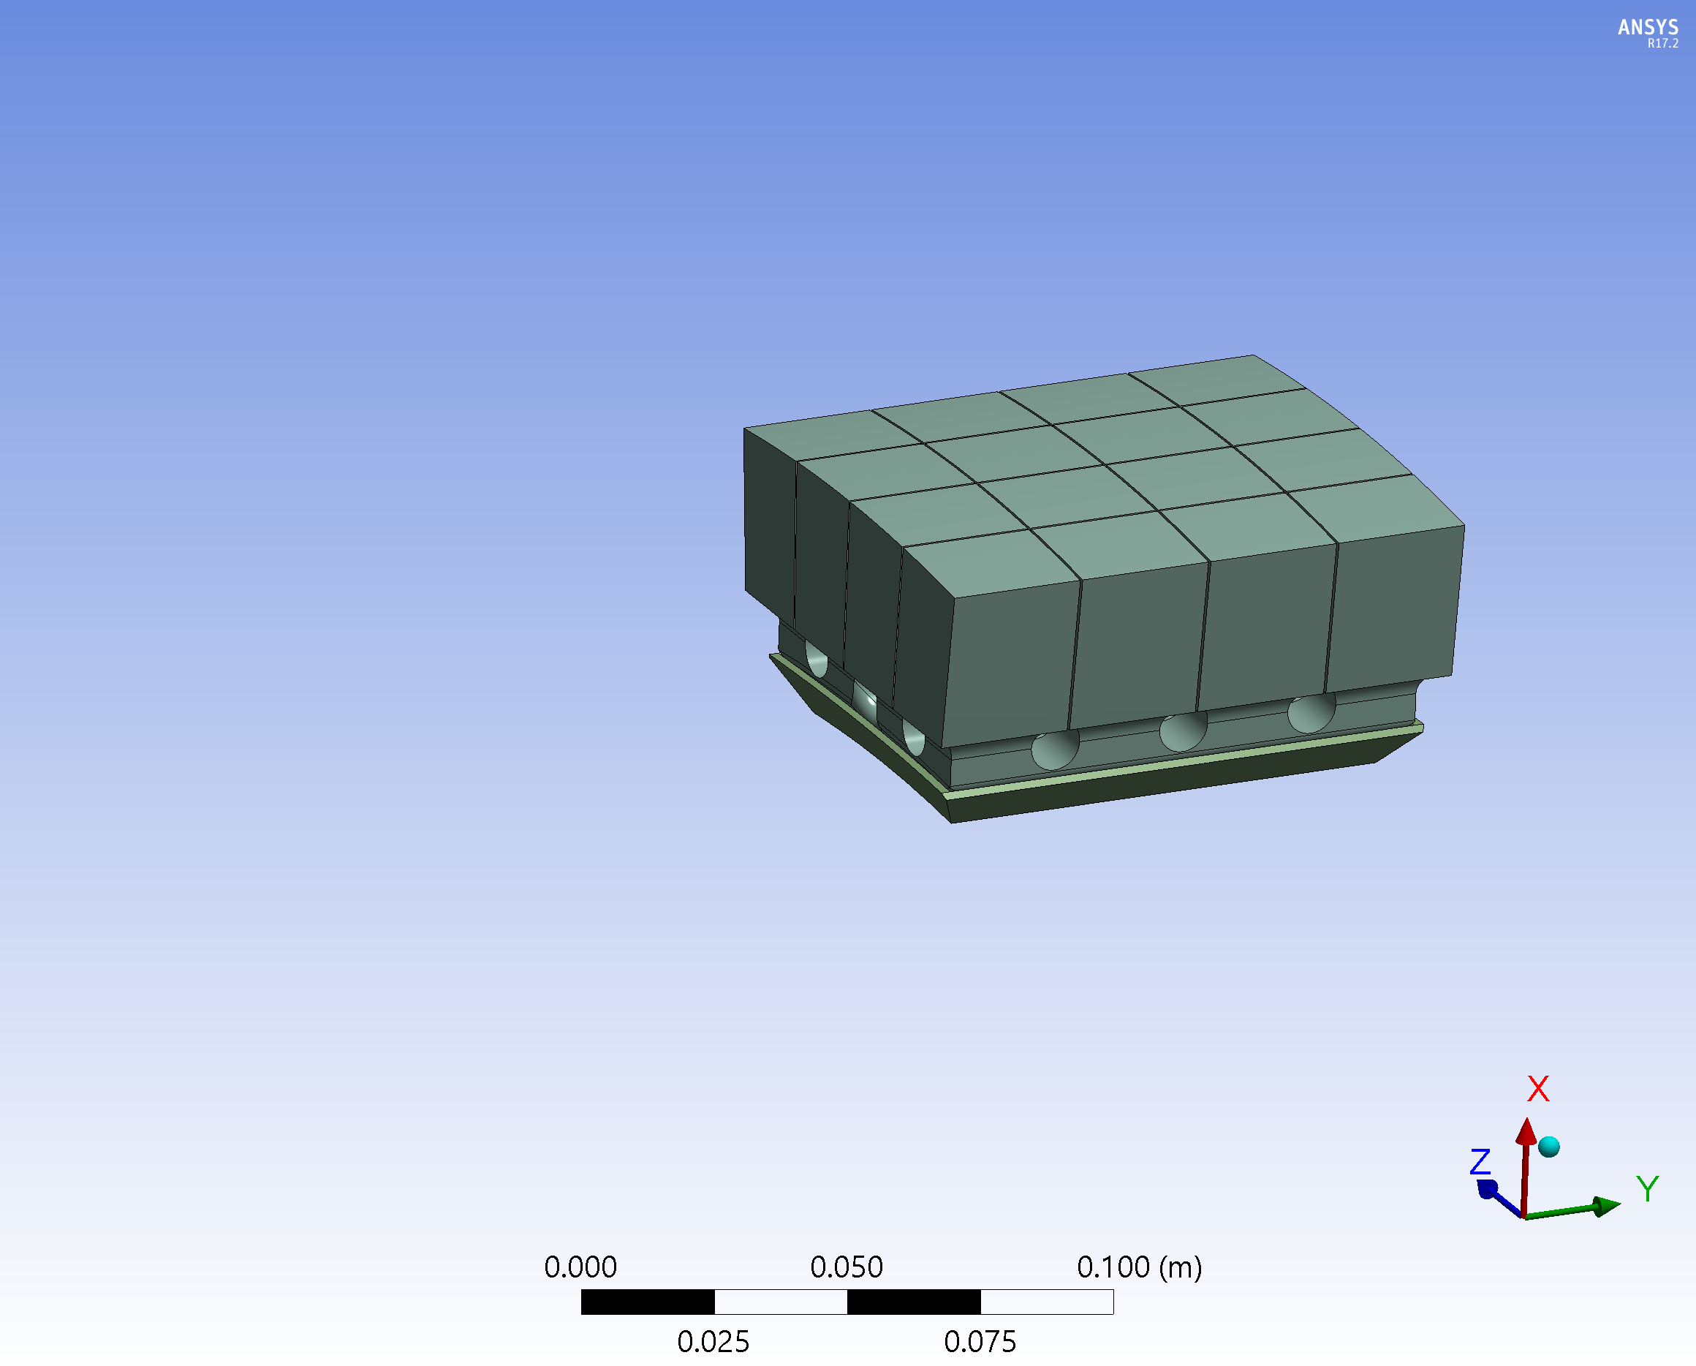
Developing Designs Using Castellated Tiles
Designs working to avoid front-surface holes in HHF regions
Side-access through removing low-heat flux tiles w/ front surface holes
Ex: cam-like action secures tiles against mounting plate/vessel
Beginning designs for inter/intra-tile diagnostics
cover HHF surfaces using 100 mm x 100 mm tiles made of 4 x 4 castellated ‘small cubes’
example vertical divertor

Slide 30
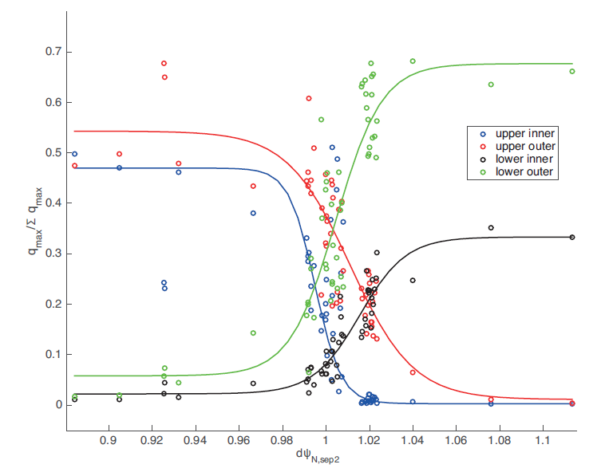
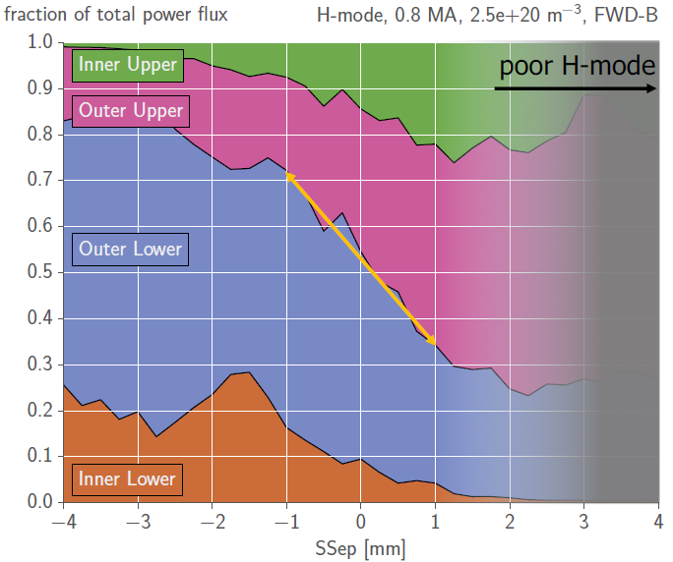
Empirically Motivated Divertor Power Sharing
(Implemented in reduced model by M. Reinke, ORNL)
NSTX only measured the outer, lower divertor heat flux
  model uses inner/outer split of 70/30 LSN and 55/45 USN, smooth transition in-between
MAST L-mode; Wenninger, IAEA 2016
C-Mod H-mode; Brunner APS 2016
UPPER NULL
LOWER NULL

Slide 31
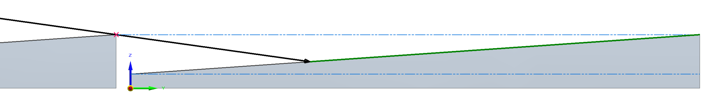
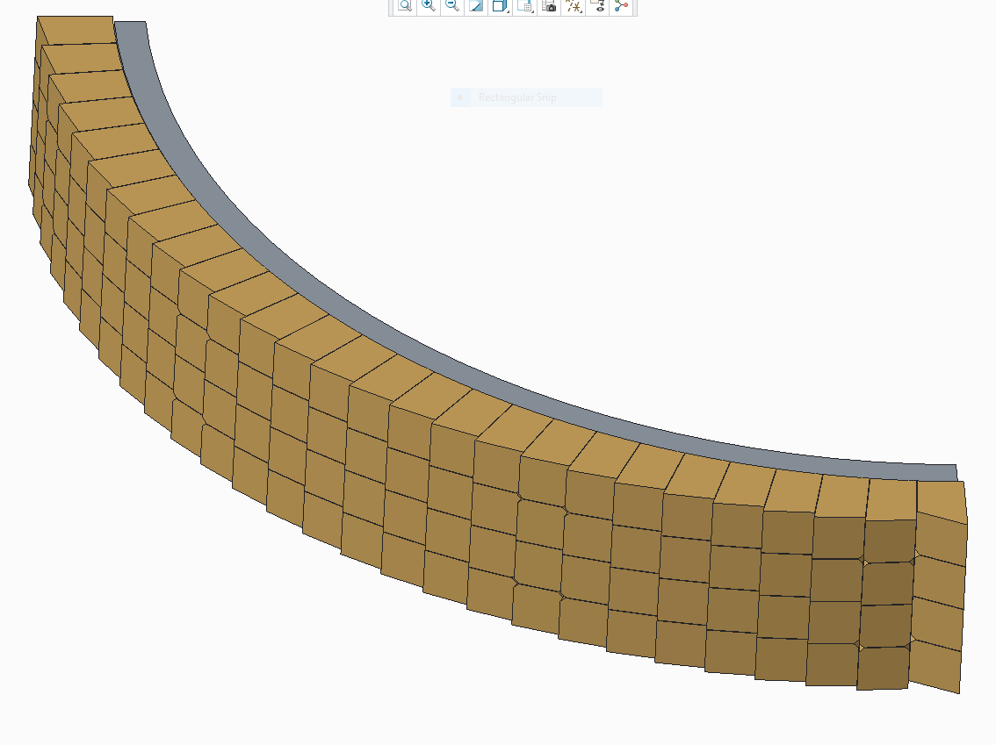








Tile Shaping Used to Avoid Leading Edges
$$\hat{φ}$$
$$w+g$$
$$α_{heat}$$
$$β$$
$$l_{wet}$$
$$\tan{β=\frac{δz+g\tan{α_{max}}}{w}}$$
Small ramp toroidally, $β\sim 1^{o}$
  driven by max field line expected, $α_{max}$
  impacted by alignment uncertainty, $δz$
This reduces wetted area (increases $\vec{B}⋅\hat{n})$ : ‘enhancement factor (EF)’
Large poloidal expansion leads to shallow attack angles, $α_{heat} \sim 1^{o}$
$$EF \sim 1+\frac{\sin{β}}{{\sin{α}}_{heat}}$$
exaggerated example

Slide 32

Method for simultaneously controlling strike-point position and angle of incidence
Z
B_{P}
τ
α_{p}
⟨
Divertor target
n
⟨
R
Implemented in PPPL IDL-ISOLVER: Works well with all 3 divertor PF1 coils

Slide 33
Summary
NSTX-U redesign of high-heat-flux PFCs motivated by projected narrowing of SOL at high I_{P} and improved understanding of expected halo-current loads
Systematic equilibrium scans used to quantify the required divertor coil currents and to verify vertical stability for a range of plasma shapes
Tile designs developed to handle high heat fluxes
Free-boundary control schemes developed to constrain the strike-point location and field-line angle-of-incidence → supports use of fish-scaled tiles
Can support core confinement studies at the highest current, power, duration projected for NSTX-U

