Slide 1


59th Annual Meeting of the APS DPP, October 2017; Milwaukee, WI
Numerical simulations of Global Alfven Eigenmode (GAE) stabilization in NSTX-U
E. V. Belova¹, E. D. Fredrickson¹, N. A. Crocker², and the NSTX-U team
1) Princeton Plasma Physics Laboratory, Princeton NJ, USA
2) University of California, Los Angeles, California 90095, USA

Slide 2
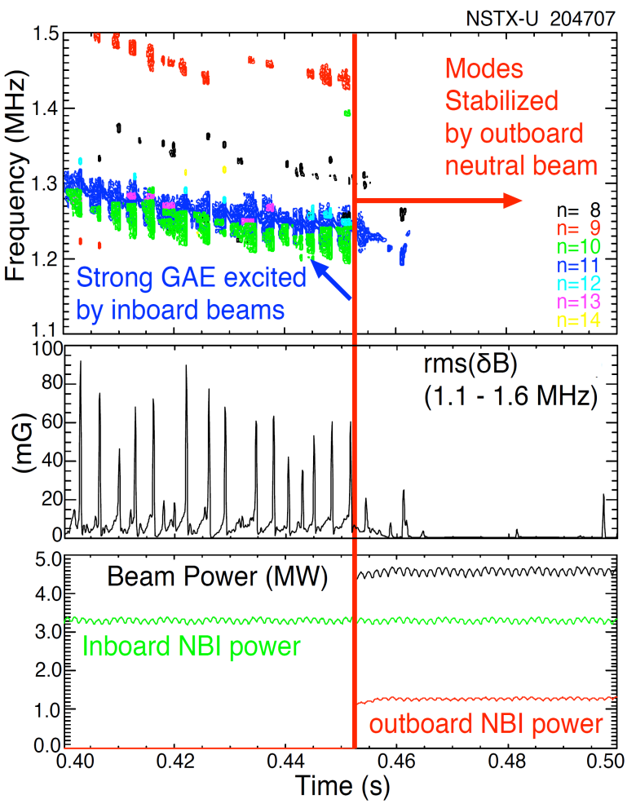
NSTX-U off-axis neutral beam suppresses Global Alfven Eigenmodes (GAEs) [E. Fredrickson, PRL 2017]
Counter-propagating GAEs are frequently observed in the sub-cyclotron frequency range of 0.1f_{ci} up to 0.5f_{ci}, in NSTX and NSTX-U.
Driven by cyclotron resonance with beam ions.
New neutral beam sources -> ability to control the fast ion distribution.
Off-axis neutral beams inject fast ions onto trajectories largely parallel to the magnetic field, with pitch 0.8<V||/V<1.
Reliable suppression of the counter-propagating GAE when an additional 1.3MW is injected using the outboard beam.
GAE stabilization has been well documented for many shots.

Slide 3
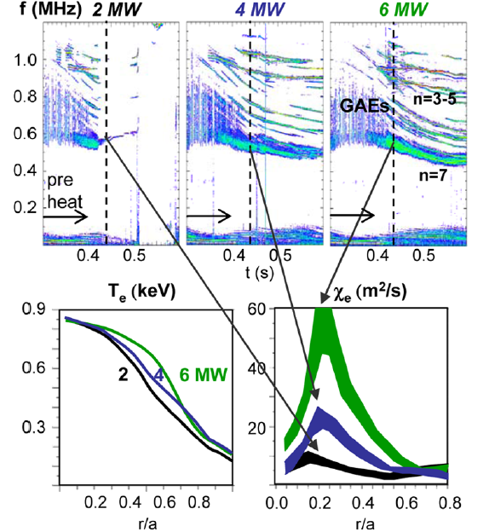
Correlation between strong GAE/CAE activity and flattening of the electron temperature profile has been observed in NSTX [Stutman, PRL 2009]
Intense GAE/CAE activity (0.5-1.1MHz).
Flattening of T_{e} profile with
- increased beam power;
- beam energy scanned between 60 and 90 keV
[Stutman, PRL 2009].
Was attributed to
- enhanced electron transport due to orbit
stochasticity in the presence of multiple GAEs
[Gorelenkov, NF 2010].
- energy channeling due to CAE coupling to KAW
[Belova, PRL 2015].
Anomalously low T_{e} potentially can have
significant implications for future fusion devices,
especially low aspect ratio tokamaks.
Correlation between GAE activity, T_{e} flattening, and central electron heat diffusivity χ_{e} in NSTX H modes with 2, 4, and 6MW neutral beam.

Slide 4
HYM – HYbrid and MHD code
Applications
NSTX
- Sub-cyclotron frequency Alfven eigenmodes (GAE and CAE)
ICC Theory and Modeling
- Hybrid simulations of spheromak merging
- FRC: Effects of beam ions on stability
- Rotation control
- n=2 rotational and n=1 wobble modes
Code description
3-D nonlinear.
Physical models:
- Resistive MHD & Hall-MHD
- Hybrid (fluid electrons, particle ions)
- MHD/particle (one-fluid thermal plasma, + energetic particle ions)
- Drift-kinetic particle electrons
Full-orbit kinetic ions.
For particles: delta-f / full-f numerical scheme.
Parallel (3D domain decomposition, MPI)

Slide 5
Self-consistent MHD + fast ions coupling scheme
Background plasma - fluid:
Fast ions – delta-F scheme:
- particle weight
ρ, V and p are thermal plasma density, velocity and pressure, n_{b} and j_{b} are beam ion density and current, and n_{b} << n_{e} – is assumed.

Slide 6
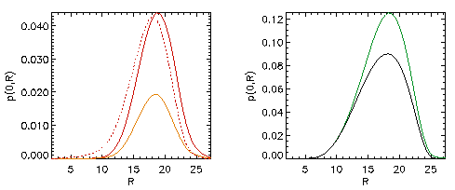
Self-consistent anisotropic equilibrium including the NBI ions
Grad-Shafranov equation for two-component plasma:
MHD plasma (thermal) and fast ions [Belova et al, Phys. Plasmas 2003].
, G – poloidal stream
function
Beam effects
Beam
Modifications of equilibrium due to beam ions:
more peaked current profile,
anisotropic pressure,
increase in Shafranov shift
might have indirect effect on stability.

Slide 7
Fast ions – delta-f scheme: F₀=F₀(ε,μ,p_{φ})
Equilibrium distribution function F₀ = F₁(v) F₂(λ) F₃(p_{φ},v)
where v₀ = 2-5v_{A}, v*= v₀ /2, λ= μB₀/ε – pitch angle parameter, λ₀= 0.5-0.7,
and μ= μ₀ + μ₁ includes first-order corrections [Littlejohn’81]:
Parameters are chosen to match TRANSP beam profiles.

Slide 8
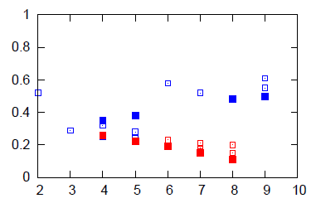
HYM simulations reproduce frequency range of unstable GAE and CAE modes observed in NSTX
Experimental analysis:
Detailed measurements of GAE and CAE amplitudes and mode structure for H-mode plasma in NSTX shot 141398 [N. Crocker, NF 2013].
CAEs: f>600 kHz, and |n|≤5.
GAEs: f<600 kHz, and |n|~6-8.
Co- and counter-rotating CAEs with f~1.2-1.8 MHz, and n=6-14 also observed in the same shot [E. Fredrickson, PoP 2013].
■ - HYM
- Experiment
CAE
GAE
|n|
Frequency versus toroidal mode number for unstable GAEs (red) and CAEs (blue), from HYM simulations and experiment, f_{ci}=2.5MHz.
HYM simulations:
For n=5-7 most unstable are counter-rotating GAEs, with f= 380-550 kHz.
For n=4 and n=8, 9 most unstable are co-rotating CAEs with f= 870-1200 kHz.

Slide 9
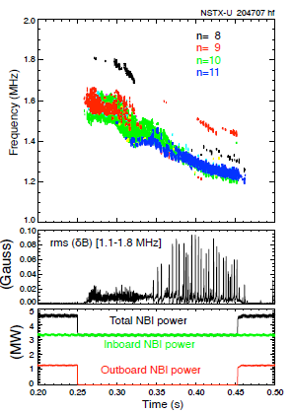
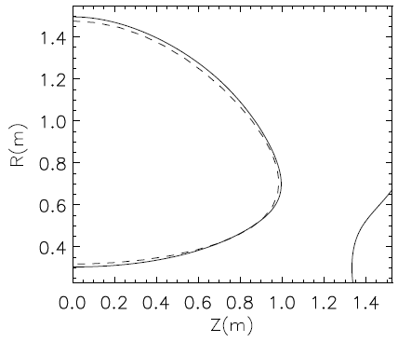
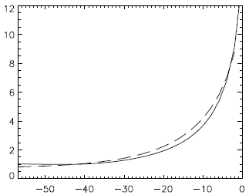
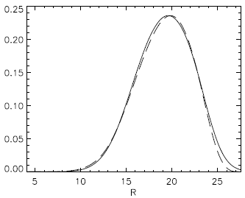
Simulations have been performed to study the excitation and stabilization of GAEs in the NSTX-U
⎯⎯ HYM
- - - - TRANSP
Simulations using the HYM code have been performed for NSTX-U shot #204707 right before (t=0.44s) and shortly after (t=0.47s) the additional off-axis beam injection.
Plasma and beam profiles have been chosen to match TRANSP profiles for t=0.44s and t=0.47s.
The beam ion distribution function matches TRANSP data, with pitch distribution in the form F_{b}~ exp[-(λ-λ₀(ε))²/Δλ(ε)²].
q(ψ)
ψ
n_{b}/n₀(R)
t=0.44
t=0.47
0.3 0.5 1.0 1.5 R(m)
(a) Spectrogram on magnetic fluctuations (n=8-11 counter-GAEs).
(b) Rms magnetic fluctuations;
(c) Injected beam power.
Plasma shape, q- and n_{b} profiles for NSTX-U shot 204707 t=0.44 from TRANSP and HYM GS solver + FREE_FIX.

Slide 10
HYM reproduces experimentally observed unstable GAEs
HYM #204707 t=0.44
Simulations reproduce most unstable toroidal mode numbers and GAEs frequencies.
HYM overestimates growth rates compared experimental analysis
Growth rates are sensitive to distribution function parameters – resonance particles are in ‘tail’ of distribution.
γ/ω_{ci}
ω/ω_{ci}
n
(a) Growth rates and (b) frequencies of unstable counter-GAEs from HYM simulations for t=0.44s. Blue line is Doppler-shift corrected frequencies, points – experimental values.
t=0.44
t=0.47
(a) Spectrogram on magnetic fluctuations (n=8-11 counter-GAEs).
(b) Rms magnetic fluctuations;
(c) Injected beam power.

Slide 11
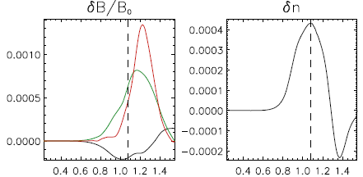
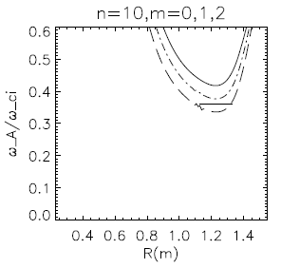
NSTX-U simulations: n=10 counter-GAE (t=0.44s)
dB┴
dB||
R(m)
R(m)
Radial profile of δB and δn for n=10 counter-GAE.
Radial profile of ω_{A}/ω_{ci} for n=10, m=0-2; location of GAE.
Unstable modes are counter-rotating and have shear Alfven polarization.
Located near min of ω_{A.}

Slide 12
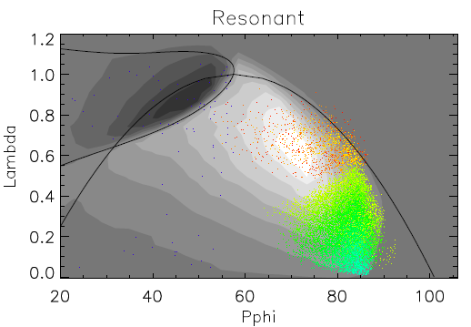
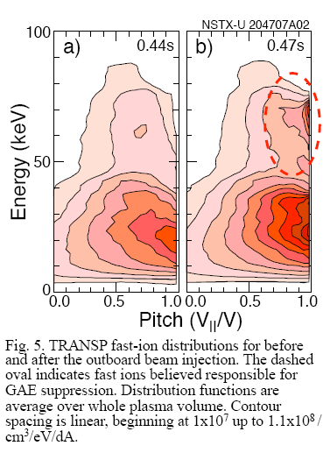
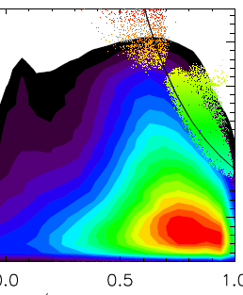
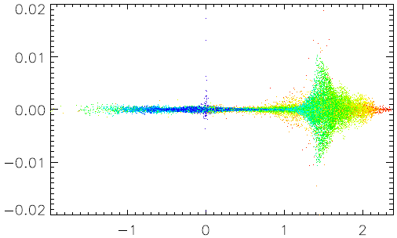
Improved F_{beam} fit allows more accurate description
cyclotron
resonance
δF/F
V||/V
TRANSP fast-ion distribution before the outboard beam injection t=0.44. Exp. estimated γ_{dr}~0.5%ω_{ci} for n=11 GAE;
HYM fast-ion distribution from n=-10 GAE simulations; dots show resonant particles.
Improved F_{beam} reduces growth rate γ~1.5%ω_{ci}.
V||/V_{A}
Location of resonant particles in phase space: λ=μB₀/ε vs p_{φ}.
Particle weight w ~ δF/F vs orbit-averaged parallel velocity. Particle color corresponds to different energies: from E=0 (purple) to E=90keV (red).

Slide 13
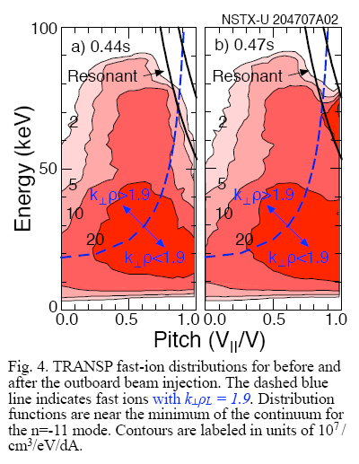
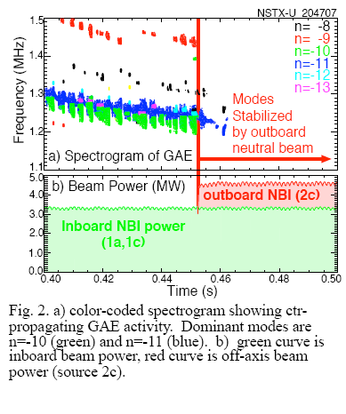
Off-axis beam injection strongly suppresses all unstable GAEs
TRANSP fast-ion distribution before and after the outboard beam injection. Fast ions with pitch v||/v~1 are responsible for GAE suppression.
Analytical instability condition: 2 < k⊥ρ_{b}< 4 [Gorelenkov,2003].

Slide 14
HYM simulations reproduce experimental finding: off-axis neutral beam injection reliably and strongly suppresses unstable GAEs
The beam ion distribution function with pitch distribution in the form F_{b}~ exp[-(λ-λ₀(ε))²/Δλ(ε)²].
Additional off-axis beam injection modeled by adding beam ions with distribution F_{add}~ exp[-λ²/Δλ_{a}(ε)²], i.e. with λ₀=0, Δλ_{a}<Δλ and about 1/3 of the total beam ion inventory.
HYM shows complete stabilization of n= 7-12 counter-GAEs by additional off-axis beam injection.
HYM #204707 t=0.47
|dB |²
t=0.44s
t=0.47s
tω_{ci}
Time evolution of magnetic energy of n=10 GAE from HYM simulations for t=0.44s (red), and t=0.47s (blue).

Slide 15
Summary and Future Work
HYM simulations show range of toroidal mode numbers, and frequencies of unstable GAEs that match the experimentally observed GAEs in NSTX-U.
Growth rate of GAE is sensitive to details of beam ion distribution.
Simulations reproduce experimental finding, namely it is shown that off-axis neutral beam injection reliably and strongly suppresses all unstable GAEs.
A robust physical mechanism for stabilizing GAEs - threshold for stabilization for additional beam is less than 25% of total beam power.
Future work:
Understanding instability conditions for excitation of counter-GAEs – comparison with analytical condition.
Bulk plasma rotation and Hall term can have effect on GAE stability and mode structure.
Comparison with experimental results including mode structure, saturation amplitudes and etc for several shots.

