Slide 1




Likelihood for Alfvénic instability bifurcation in experiments
Vinícius Duarte^{1,2}
In collaboration with
Nikolai Gorelenkov¹, Herb Berk³, Eric Fredrickson¹, Mia Schneller¹, Stan Kaye¹, Mario Podestà¹,
Raffi Nazikian¹, Mike Van Zeeland⁴, David Pace⁴ and Bill Heidbrink⁵
¹Princeton Plasma Physics Laboratory, USA
²University of São Paulo, Brazil
³University of Texas, Austin, USA
⁴General Atomics, USA
⁵University of California, Irvine, USA
APS-DPP Meeting – October 25th 2017
1

Slide 2
Outline
Introduction on Alfvénic spectral characteristics induced by energetic particles
The cubic equation (Berk-Breizman model) and a criterion for onset of chirping
Micro-turbulence as a mediator for chirping onset in DIII-D and NSTX
Predictions for ITER

Slide 3
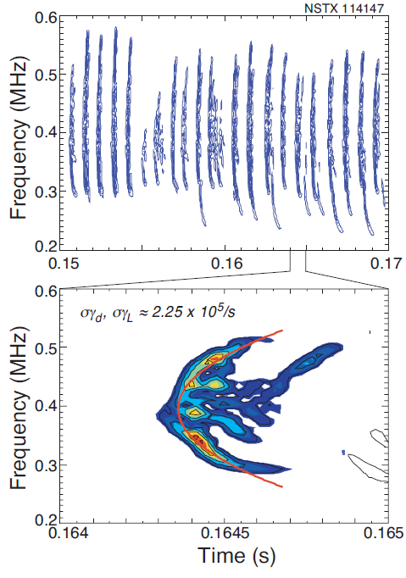
Alfvén waves can exhibit a range of bifurcations upon their interaction with fast ions
Typical scenarios:
fixed frequency and frequency splitting-> frequency is mostly determined by the equilibrium
chirping and avalanches -> frequency is highly affected by the fast ions nonlinear response
NSTX
bursting/chirping
frequency
splitting
NSTX
JET
Fasoli, PRL 1998
Podestà, NF 2011
2
Fredrickson, PoP 2006

Slide 4
Prediction of character of energetic-particle-driven transport in tokamaks
What tools can be used to model each type of transport?
Diffusive transport (typical for fixed-frequency modes)
can be modelled using reduced theories, such as quasilinear
typical in conventional tokamaks
Convective transport (typical for chirping frequency modes)
needs to retain full nonlinear features of the wave, is sustained by nonlinear phase-space structures
typical in spherical tokamaks
Both can lead to similar fast ion loss levels, up to 40% in present-day experiments
In this talk:
development of a criterion for the likelihood of each nonlinear scenario and its comparison with NSTX and DIII-D
Predictions for TAE in ITER elmy and hybrid scenarios
3

Slide 5
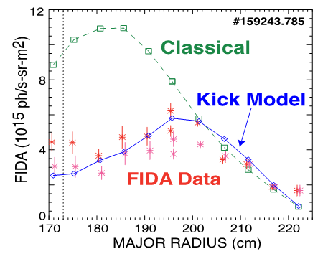
The study of the conditions that lead to fully nonlinear scenarios helps to understand the applicability of reduced models
DIII-D discharge 153072
Need for predictive/efficient interpretive capabilities motivates the development of phase-space resolved, self-consistent quasilinear approach
Diffusive module of the Resonance Broadening Quasilinear (RBQ) code, for the case of two overlapping resonances
[Detailed description of the RBQ code in N. Gorelenkov’s poster]
[Resonance broadening parametric dependencies in G. Meng’s poster]
4
Notes:
Mention they are RSAEs
don't spend time on this

Slide 6
Outline
Introduction on Alfvénic spectral characteristics induced by energetic particles
The cubic equation (Berk-Breizman model) and a criterion for onset of chirping
Micro-turbulence as a mediator for chirping onset in DIII-D and NSTX
Predictions for ITER

Slide 7

Weak nonlinear dynamics of driven kinetic systems can be used to develop a criterion to distinguish between fixed-frequency and chirping responses
Starting point: kinetic equation plus wave power balance
Assumptions:
Perturbative procedure for ( )
Truncation at third order due to closeness to marginal stability
Bump-on-tail modal problem, uniform mode structure
Cubic equation: lowest-order nonlinear correction to the evolution of mode amplitude A:
If nonlinearity is weak: linear stability, solution saturates at a low level and f merely flattens (system not allowed to further evolve nonlinearly).
If solution of cubic equation explodes: system enters a strong nonlinear phase with large mode amplitude and can be driven unstable (precursor of chirping modes).
Berk, Breizman and Pekker, PRL 1996 Lilley, Breizman and Sharapov, PRL 2009
-_
-_
stabilizing
destabilizing (makes integral sign flip)
5
Notes:
people don't know what omega_b is

Slide 8

A criterion for the likelihood of chirping onset in tokamaks
Using an action and angle formulation, the previous weak nonlinear theory leads to
>0: fixed-frequency solution likely
<0: chirping likely to occur
Phase space integration
Resonance surfaces:
Eigenstructure information:
Criterion was incorporated into NOVA-K code:
nonlinear prediction from linear physics elements
The criterion ( ) predicts that micro-turbulence should be key in determining the likely nonlinear character of a mode, e.g., fixed-frequency or chirping
6

Slide 9
Outline
Introduction on Alfvénic spectral characteristics induced by energetic particles
The cubic equation (Berk-Breizman model) and a criterion for onset of chirping
Micro-turbulence as a mediator for chirping onset in DIII-D and NSTX
Predictions for ITER

Slide 10
Correlation between chirping onset and a marked reduction of the turbulent activity in DIII-D
The thermal ion heat conductivity is used as a proxy for the fast ion anomalous transport
This observation motivated DIII-D experiments to be designed to further test the hypothesis of low turbulence associated with chirping
Duarte et al, NF 2017.
7

Slide 11
Dedicated experiments showed that chirping is more prevalent in negative triangularity DIII-D shots
Transport coefficients calculated in TRANSP are 2-3 times lower in negative triangularity, as compared to the the usual positive triangularity/oval shots;
Chirping found to exist in positive triangularity at the bottom of RSAEs evolution, where an ITB is expected.
[Detailed description of the negative triangularity experiments given in M. Van Zeeland’s talk this morning]
8
Notes:
The TCV results showed that the eigenmodes are more sheared and that contributes to reduce turbulence
zoom the chirping and the fixed-freq

Slide 12
DIII-D: chirping criterion evaluation in negative vs positive triangularity
>0: fixed-frequency solution likely
<0: chirping likely to occur
9

Slide 13
Correlation between chirping onset and a marked reduction of the turbulent activity in NSTX, as computed by TRANSP
The thermal ion heat conductivity is used as a proxy for the fast ion anomalous transport
GTS code is being used to verify earlier publications on the EP turbulence-induced anomalous scattering
10

Slide 14
GTS* global gyrokinetics analyses show turbulence reduction for rare NSTX TAE transitions from fixed-frequency to chirping
Electrostatic turbulence fluctuation
Before chirping, 265ms
Peak of the most intense mode
During chirping, 290ms
Electrostatic turbulence fluctuation
Before chirping, 265ms
Peak of the most intense mode
During chirping, 300ms
*W.X. Wang et al., PoP 13, 092505 (2006)
11

Slide 15
Examples of the chirping criterion evaluation: spherical vs conventional tokamaks
chirping, NSTX
fixed-frequencies, DIII-D and TFTR
Alfvén wave
chirping
quantitatively
agrees with
the criterion
Arrows represent the turbulent diffusion that adds up to pitch-angle scattering
Chirping is ubiquitous in NSTX but rare in DIII-D, which is consistent with the inferred fast ion micro-turbulent levels
12

Slide 16
Outline
Introduction on Alfvénic spectral characteristics induced by energetic particles
The cubic equation (Berk-Breizman model) and a criterion for onset of chirping
Micro-turbulence as a mediator for chirping onset in DIII-D and NSTX
Predictions for ITER

Slide 17
Predictions for n=7-11 TAEs¹ in ITER are near threshold between steady and chirping
Based on TRANSP/TSC analysis, requiring Q>10
Approximate rate of radial turbulence diffusion to the collisional pitch-angle scattering^{2,3}
¹ DOE OFES Theory Joule Milestone FY2007,
Gorelenkov et al, PPPL Preprint number 4287 (2008).
²Lang & Fu, PoP 2010.
³Duarte et al, NF 2017.
13
Notes:
Ratio

Slide 18
Summary
Criterion gives confidence in the application of quasilinear modeling;
The gyrokinetic code GTS confirms transition from/to chirping is likely mediated by a change of turbulence;
Experiments with negative triangularity on DIII-D give credence to the proposed chirping criterion predictions;
Predicted response for ITER (similarly to DIII-D predictions) appears to be around the borderline between fixed-frequency and chirping.
13

