Slide 1


Effect of Sawtooth Crashes on Fast-ion Distribution in NSTX-U
D. Liu, W. W. Heidbrink, G. Z. Hao
University of California, Irvine
M. Podesta, E. D. Fredrickson, D. S. Darrow and D. Kim
Princeton Plasma Physics Laboratory
59th Annual Meeting of the APS Division of Plasma Physics
Milwaukee, Wisconsin
October 23-27 2017

Slide 2
Motivation: Is Sawtooth Behavior in Spherical Tokamak Similar to that in Conventional Tokamak?
Sawtooth in conventional tokamaks can cause significant fast ion transport and lead to degradation of fusion production and losses of fast ion to the wall
Measurements on TEXTOR, DIII-D, ASDEX-Upgrade suggest that passing particles are more susceptible to sawtooth-induced transport than trapped particles.
Measurements show fast ion redistribution during sawtooth depends on energy, pitch
Kadomtsev sawtooth model within TRANSP code qualitatively agrees with measurements.
Theory predicts two regimes of fast ion transport:
(1) transport by flux attachment → flattening fast ion density profile inside sawtooth mixing radius; (2) transport by resonance → flattening the density profile at resonance
Sawtooth study on Spherical Tokamak (ST) can complement that in large-aspect-ratio and high field tokamaks.
Large fast ion orbit width in ST, representative of alpha particles in fusion devices
Extend the sawtooth database for code validation and model development

Slide 3
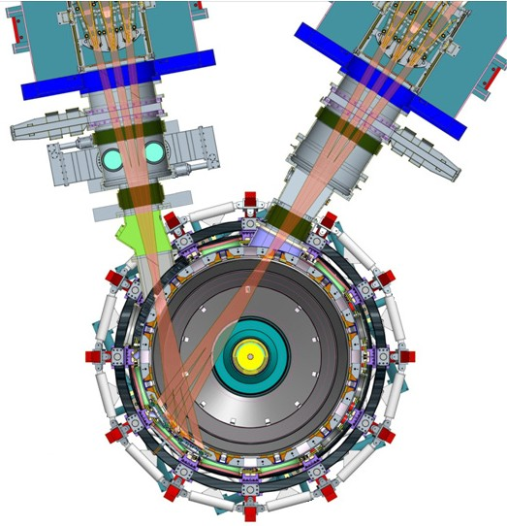
Long Sawtoothing Discharges are Achieved on NSTX-U with the New 2nd NBI & Central Solenoid
NB #2
NB #1
No data
[Menard, NF 2012]
[Gerhardt, NF 2012]
Reproducible sawtoothing L-mode discharges are obtained on NSTX-U
Neutron rate can drop as large as ~15% at sawtooth crash
Flattening of T_{e} in the core indicated by Thomson scattering and Soft x-ray diagnostics
No MSE measurement is available for these discharges

Slide 4
A Comprehensive Set of Fast Ion Diagnostics can Measure Sawtooth-Induced Fast Ion Transport
Neutron detectors
dominated by beam-plasma reactions, volume integrated
Fast-Ion D-alpha (FIDA) spectrometers
sensitive to a small region in velocity space, spatial profile
Solid State Neutral Particle Analyzer (SSNPA) arrays
very localized in pitch angle range, spatial profile, fast time resolution
Scintillator-based Fast Loss Ion Probe
lost fast ions, narrow in pitch angle

Slide 5
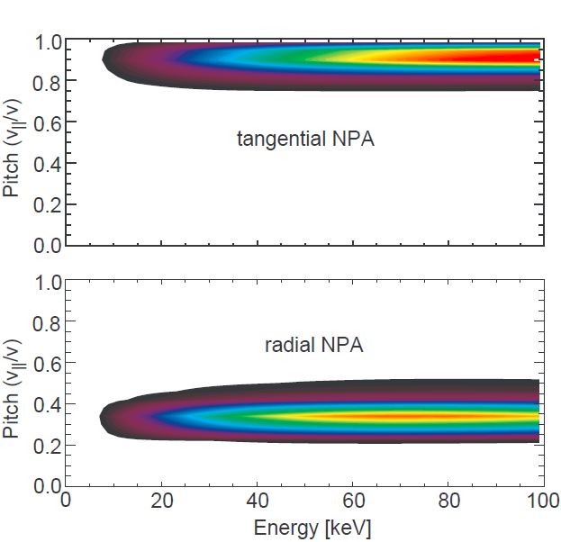
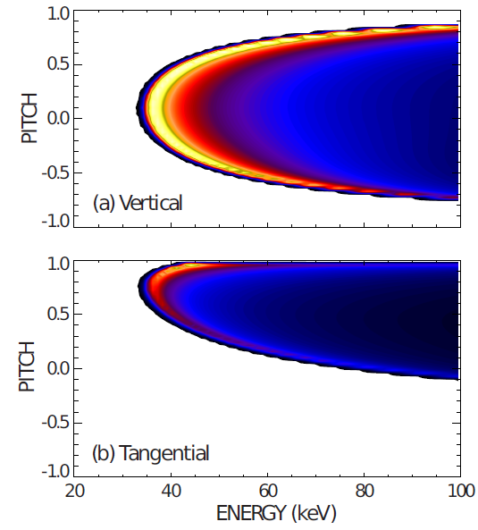
FIDA and SSNPA Diagnostics Can Separate the Response of Passing and Trapped Particles
Weight Function
v-FIDA
Tangential NPA
Radial NPA
t-FIDA
Localization in velocity space depends on geometric layout
Tangential views (t-SSNPA, t-FIDA): mainly sensitive to passing fast ions
Radial or vertical views (r-SSNPA, v-FIDA): mainly trapped fast ions
Reference views monitor passive signals from the plasma edge

Slide 6
Experimental Observations

Slide 7
SSNPA Observation: Passing Particles are Expelled from Core to Edge, Small Depletion for Trapped Particles (1/2)
NB source 1B injects steady, active source for r-SSNPA arrays
Low density L-mode, no Alfven eigenmode or fishbone detected
SSNPA observations
p-SSNPA observes small signal increase
t-SSNPA observes big spikes
r-SSNPA observes small depletion
→Passing particles are strongly expelled from core to edge; much weaker transport for trapped particles
(database analysis see next slide)
p-SSNPA
t-SSNPA
r-SSNPA
[Liu, RSI 2016]

Slide 8
SSNPA Observation: Passing Particles are Expelled from Core to Edge, Small Depletion for Trapped Particles (2/2)
Strong correlation between SSNPA signal change and neutron rate drop at sawtooth crash
Large increase in passive t-SSNPA →passing particles are expelled to edge
Similar change in p-SSNPA and D_{α}
  →the change of p- SSNPA signal is due to edge neutral density change
Small drop of r-SSNPA
→ some depletion of trapped particles
SSNPA arrays with different energy threshold observe similar behavior →sawteeth affect a wide energy range
All channels in the same port observe similar behavior, unable to infer dependence on space

Slide 9
t-FIDA Observation: Decrease in the Core, Increase in the Edge (1/2)
t-FIDA spectra, core channel
t-FIDA spectra, edge channel
Mirnov
Neutron
t-FIDA
t-FIDA observes signal drop in the core and increase at the edge
Passing fast ions are redistributed from core to edge
V-FIDA signal is relatively weak, almost no change before and after sawtooth → trapped particles are weakly affected

Slide 10

t-FIDA Observation: Decrease in the Core, Increase in the Edge (2/2)
Soft x-ray
Change of t-FIDA signal $∝δ(nfi∗nn)$
t-FIDA signal: ~25% decrease in the core, ~35% increase in the edge
The crossover point is close to sawtooth inversion radius (~125cm)
As estimated from Soft x-ray data, sawtooth crash time is typically ~40μs, sawtooth period is ~25ms

Slide 11
Comparison with Sawtooth Modeling

Slide 12
Conditional Average Reconstruction is Applied for TRANSP’s Input Profiles
n_{i}
n_{e}
Raw experimental data have insufficient time resolution for accurate time dependent modeling
n_{e}, T_{e} from MPTS Thomson scattering diagnostic (60Hz sampling rate)
T_{i}, v_{tor} from CHERS (100Hz sampling rate)
TRANSP runs use thermal profiles from conditional averaging reconstruction
Combine CHERS & real-time velocity data for T_{i}, v_{tor}, n_{D}
Re-sample results from MPTS measurments
All profiles resampled on 1 ms time-scale
T_{i} (eV)
T_{e} (eV)
Conditional average plasma profile

Slide 13
TRANSP Simulations Indicate ~50% of Total Neutron Drop is Due to Thermal Profile Evolution
Fast ion density
Neutron rate
In TRANSP simulation
Sawtooth model ON for q-profile evolution
Sawtooth model OFF for fast ions
Little modulation in fast ion density profile
Neutron drops caused by thermal plasma profile evolution can be ~50% of the measured neutron rate drop.

Slide 14
Standard Kadomtsev Model Overestimates Neutron Rate Drop at Sawtooth
Fast ion density
Neutron rate
NMIX_KDSAW=1
XSWFRAC_BEAM=1.0
TRANSP with standard Kadomtsev model
XSWFRAC_BEAM: fraction of beam fast ions participating in mixing
Standard Kadomtsev sawtooth model overestimated neutron rate drops at sawteeth
NMIX_KDSAW=1
XSWFRAC_BEAM=0.5

Slide 15
Tuning the Parameters of Porcelli Model can Reasonably Match the Neutron Rate
Fast ion density
Neutron rate
NMIX_KDSAW=3
FPORCELLI = 1.0D0
XSWFRAC_BEAM=0.5
Porcelli Model
Incomplete reconnection model
Neutron rate from TRANSP simulation with Porcelli model can agree with measurements, but not sensitive to fraction of reconnection (FPORCELLI in namelist).

Slide 16
Simulations with Porcelli Model Suggest that Fast Ions are Redistributed from Core to Edge
Change of fast ion density
TRANSP simulations with Porcelli model show ~20% decrease of fast ion density in the core.
Porcelli model shows passing particles are strongly affected compared with trapped particles although all fast ions are treated thermally and redistributed according to the rearrangement of flux surfaces. This is mainly because most fast ions in the core are passing particles.

Slide 17
TRANSP+FIDAsim Simulations With Porcelli Model Partially Agree with FIDA Measurements
Simulated t-FIDA spatial profile
Simulated t-FIDA spectra, core channel
Simulated t-FIDA spectra, edge channel
TRANSP+FIDASIM simulations suggest
10% decrease of FIDA signal in core channels
Little increase or no change at outer channels at sawtooth crash; Decrease after sawtooth crash.
Partially agree with FIDA measurements. The FIDA data shows a signal drop in the core, but an increase at the edge, see slide 9 and 10

Slide 18
Observed Differences in Passing and Trapped Particles Qualitatively Agrees with Theory
Kolesnichenko and Yakovenko [NF 1996] describes fast ion transport during sawtooth with three time scales
  Crash time τ_{cr}
  Particle longitudinal motion:τ_{ψ} (period about the perturbed flux surface)
  →attachment to evolving flux surfaces → strong redistribution
  Toroidal drift motion: τ_{pr}
  →decorrelation between particle and mode → weak redistribution
  Conditions for strong transport: Passing: τ_{ψ} << τ_{pr} , Trapped: τ_{cr} << τ_{pr}
  or in terms of E, pitch, E <E_{crit}
Preliminary NSTX-U calculations indicate
  Sawtooth crash time ~40 μs, E_{inj}=70keV
  Passing particles: E_{crit}~60keV
  Trapped particles: E_{crit}~15keV
  Passing particles will be strongly redistributed by sawtooth

Slide 19
Other Interesting Observations

Slide 20
Sawtooth Behavior Seems Different when Using Different Neutral Beam Sources (1/2)
Shot 204092
Strong sawtooth during 100ms pulses of NB source 1C (most perpendicular) source
Neutron rate drops at sawtooth crashes
Spikes on edge D_{α} at sawtooth crashes
Big spikes on passive radial reference view (p-SSSNPA) and passive tangential view (t-SSNPA) → comparable passing and trapped particles are redistributed/lost to the edge
Big spikes on passive radial reference view (p-SSSNPA) and small increase in active radial view (r-SSNPA) → some trapped particles are expelled from the core
1C
neutron
p-SSNPA
t-SSNPA
r-SSNPA

Slide 21
Sawtooth Behavior Seems Different when Using Different Neutral Beam Sources (2/2)
Shot 204089
Shot 204090
When beam 2A (most tangential source) is used, sawtooth is weaker or disappears. No obvious neutron rate drop.
Active tangential view (t-SSNPA) shows small drops at sawtooth. Passive radial views (p-SSNPA and r-SSNPA) observe little increase.
  →sawtooth and fast ion transport are strongly reduced when beam 2A is used. Could be because q profile change and/or rotation profile change
1C
2A
2A
neutron
neutron
p-SSNPA
p-SSNPA
t-SSNPA
t-SSNPA
r-SSNPA
r-SSNPA

Slide 22
Summary
Experimental observations of sawtooth on NSTX-U
Sawtooth causes neutron rate drop as large as ~15%.
FIDA signal shows a decrease in the core and an increase at edge
SSNPA observes big spikes on passive tangential view and small changes in radial view; signal changes are strongly correlated with neutron rate drop →passing particles are strongly expelled from core to edge. Trapped particles are much less affected.
  →similar to sawtooth observations in conventional tokamaks
Comparison with sawtooth modeling
Standard Kadomtsev model overestimates the neutron rate drops at sawtooth.
Porcelli model qualitatively agrees with neutron and FIDA measurements when slightly tuning the input parameters. However, it fails to predicts t-FIDA signal increase at edge.
Preliminary analysis suggest the observed response differences of passing and trapped particles qualitatively agrees with Kolesnichenko and Yakovenko’s sawtooth theory
Future work: A new model is being developed to include particle’s energy, pitch and orbit width, see D. Kim’s poster PP11.00049 this session. Simulations will be performed with this new model and will be compared with neutron and FIDA measurements.

