Slide 1

Destabilization of counter-propagating TAEs by co-current, off-axis NBI
M. Podestà, E. D. Fredrickson, M. Gorelenkova
and NSTX-U Team
(PPPL, Princeton NJ)
59th APS-DPP Meeting
Milwaukee, WI
October 23-27, 2017

Slide 2
Abstract
Neutral Beam injection (NBI) is a common tool to heat the plasma and drive current non-inductively in fusion devices. Energetic particles (EP) resulting from NBI can drive instabilities that are detrimental for the performance and the predictability of plasma discharges. A broad NBI deposition profile, e.g. by off-axis injection aiming near the plasma mid-radius, is often assumed to limit those undesired effects by reducing the radial gradient of the EP density, thus reducing the “universal” drive for instabilities. However, this work presents new evidence that off-axis NBI can also lead to undesired effects such as the destabilization of Alfvénic instabilities, as observed in NSTX-U plasmas. Experimental observations indicate that counter propagating toroidal AEs are destabilized as the radial EP density profile becomes hollow as a result of off-axis NBI. Time-dependent analysis with the TRANSP code, augmented by a reduced fast ion transport model (known as kick model), indicates that instabilities are driven by a combination of radial and energy gradients in the EP distribution. Understanding the mechanisms for wave-particle interaction, revealed by the phase space resolved analysis, is the basis to identify strategies to mitigate or suppress the observed instabilities.
Work supported by the U.S. Department of Energy, Office of Science, Office of Fusion Energy Sciences
under contract number DE-AC02-09CH11466

Slide 3
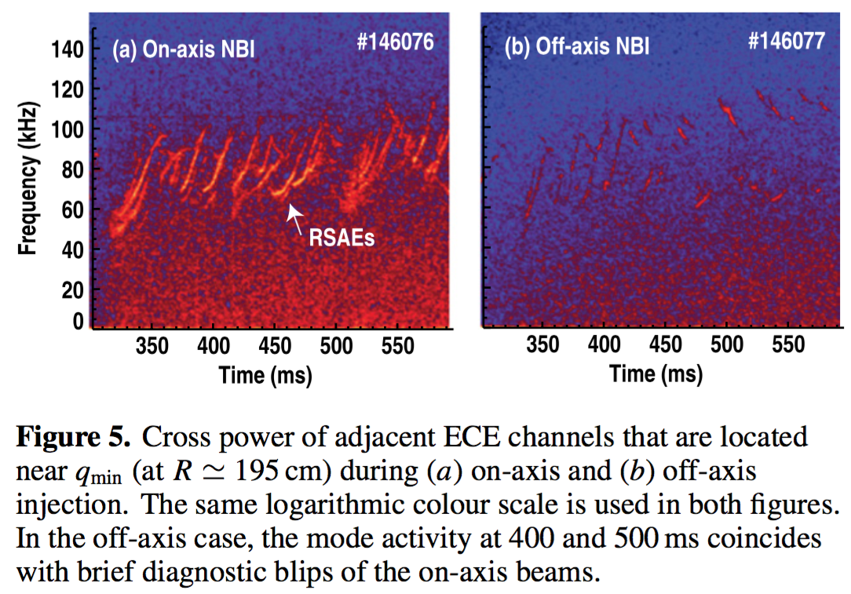
Off-axis NBI is generally assumed to be an effective tool to reduce *AE activity
Broad pressure and current profiles
  good for MHD stability
Broad fast ion density profile
  reduce gradients near peak of fast ion pressure -> reduce “universal drive”
[Kramer, NF 2017]
[Heidbrink, NF 2013]

Slide 4
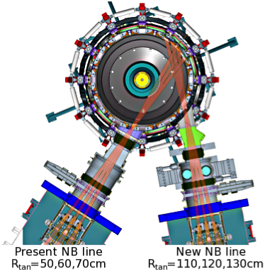
New off-axis NBI on NSTX-U enables exploration of AE stability vs NB geometry
Major radius 0.95 m
Aspect ratio 1.5
Elongation 2.7
Triangularity 0.8
Plasma current <2 MA
Toroidal field <1.0 T
Pulse length ~1-5 s
6 Neutral Beam sources:
P_{NBI}≤ 12 MW, E_{injection} ≤ 95 keV
[Menard, NF 2012]
[Gerhardt, NF 2012]
Complement previous studies in a small-aspect-ratio geometry with super-Alfvénic fast ions
  Large EP orbit width (mimic alphas in fusion reactor)
  Numerous AE resonances accessible by super-Alfvénic EP population

Slide 5
Counter-propagating TAEs are observed during co-NBI with deposition r/a~0.5
Injection from NB source 2A, aimed at mid-radius (outboard)
B_{t}~0.65T
I_{p}~0.8MA (flat-top)
n_{e,i}~2-3x10¹⁹m⁻³
T_{e,i}~1keV
P_{nb}<1MW
  Much lower than typical P_{nb} expected for routine NSTX-U operation

Slide 6
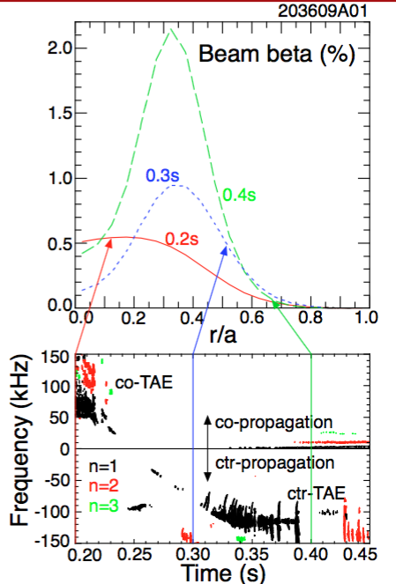
Simple explanation: cntr-TAEs correlate with hollow NB ion density profiles
Reversed radial gradient of EP density favors drive of cntr-TAEs
Similar effects predicted/observed for inversion of energy gradient (NBI+RF)
Is this the whole story?
  Cntr-TAEs also seen in NSTX-U discharges with ~flat central EP profiles!
[Wong, Phys. Lett. A 1999]
[Fredrickson, PoP 2000]

Slide 7
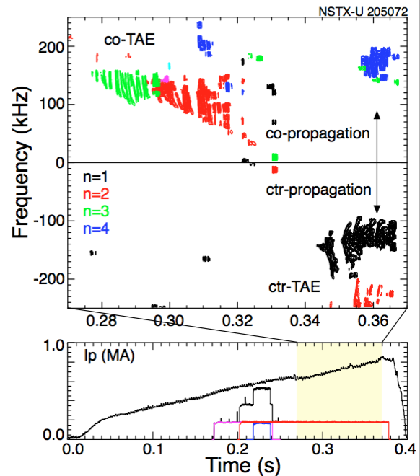
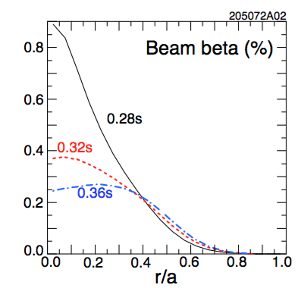
Experiments suggest a more complicated interpretation
Hollow EP density profile not always observed when cntr-TAEs are destabilized

Slide 8
Conditions for destabilization of cntr-TAEs are explored via TRANSP analysis
TRANSP is a comprehensive code for integrated, time dependent simulations of tokamak discharges
Its NUBEAM module is the work-horse for simulations including fast ions (NB injection, alphas)
  “Classical” physics is assumed for fast ion evolution (e.g. scattering, slowing down)
Additional modules can be invoked in NUBEAM to introduce non-classical fast ion transport
Here we use the ‘kick model’ in NUBEAM to mimic enhanced fast ion transport by instabilities:
  Physics-driven, phase space resolved model

Slide 9
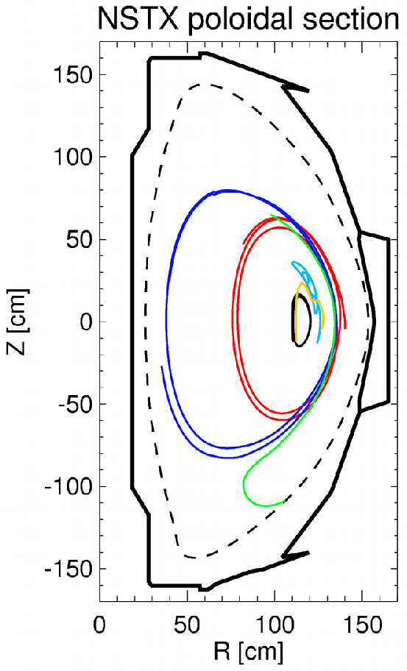
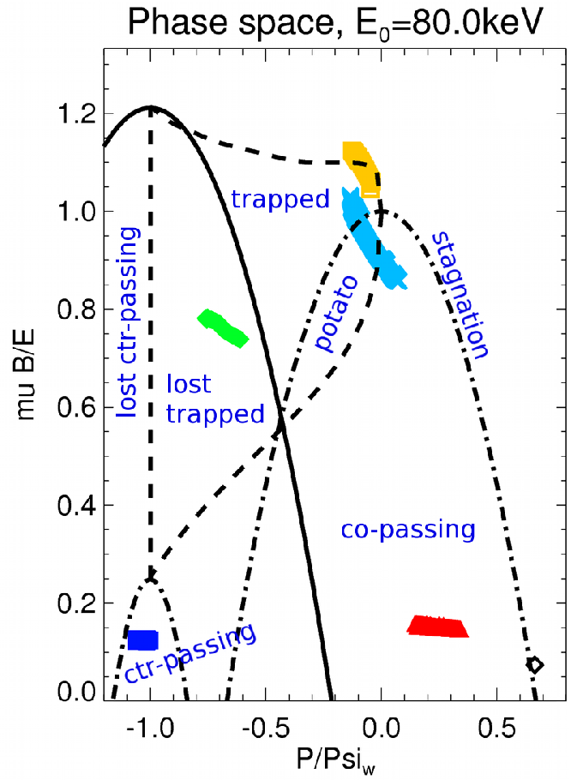
Constants of motion (E,P_{ζ},μ) are the natural variables to describe wave-particle interaction
Effects of multiple TAE modes
R. B. White, Theory of toroidally confined plasmas,
Imperial College Press (2014)
P_{ζ}

Slide 10
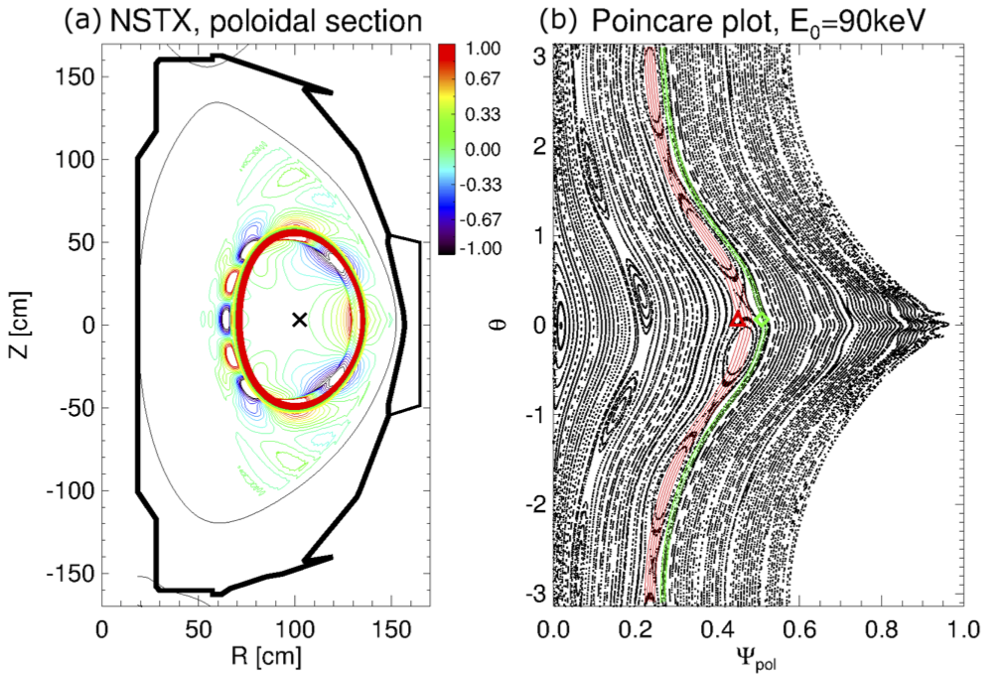
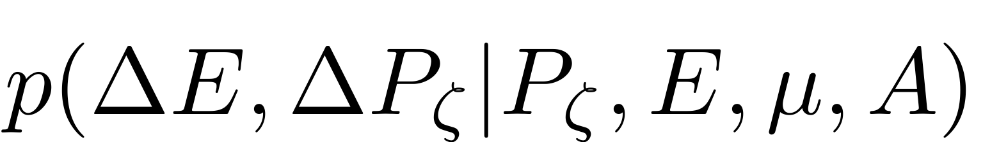
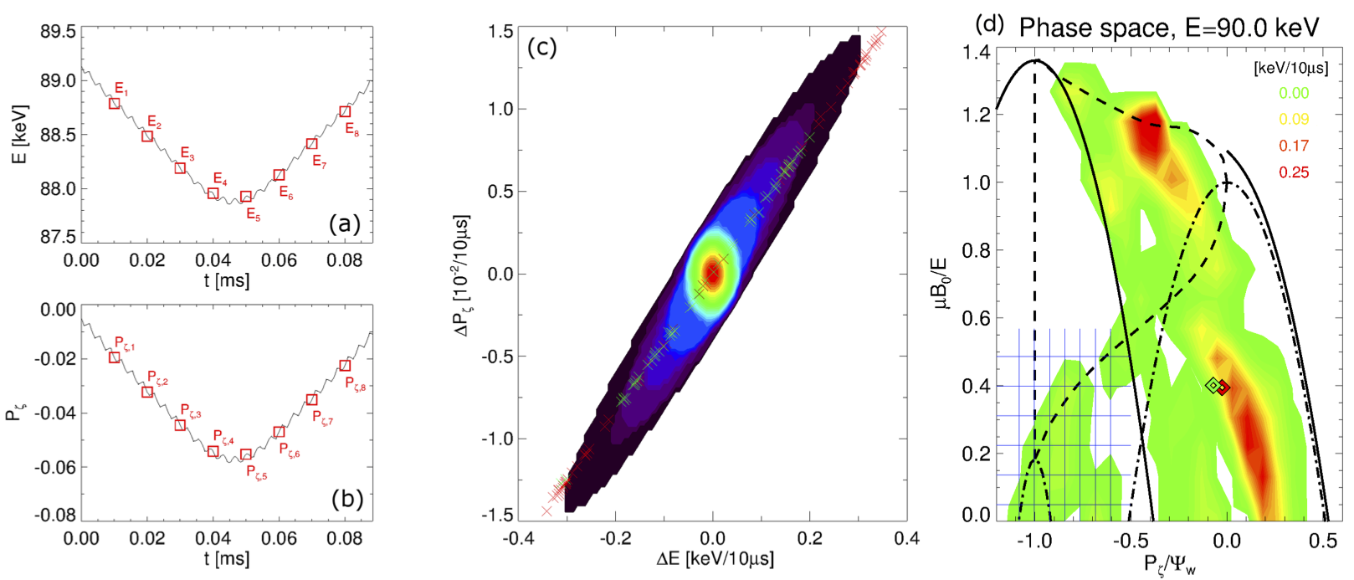
ORBIT code used to infer “kick probability matrix” associated with each mode from NOVA
Initialize test particles uniformly in phase space
Record energy, P_{ζ} variations at fixed intervals
Combine E, P_{ζ} from same phase space bin into PDF
Repeat for all phase space bins to infer 5D matrix

Slide 11
Kick model implementation includes estimate of energy exchanged between EPs and waves
Kick model computes P_{fi,j} for each mode j as sum of energy “kicks” during orbiting time steps δt
Once P_{fi,j} is known, use simple equation for amplitude vs time:
Wave energy evolution for j-th mode
Effective growth rate, drive - damping
Amplitude A_{wav,j} ~ E_{wav,j}²
Damping rates from NOVA-K
Need a positive P_{fi,j} for a mode to be “unstable”
  Check: are A_{wav,j} assumptions and P_{fi,j} results energetically consistent?
  A_{wav,j}(Pf_{i,j}) can be used to infer “saturation amplitude”
Condition at saturation

Slide 12
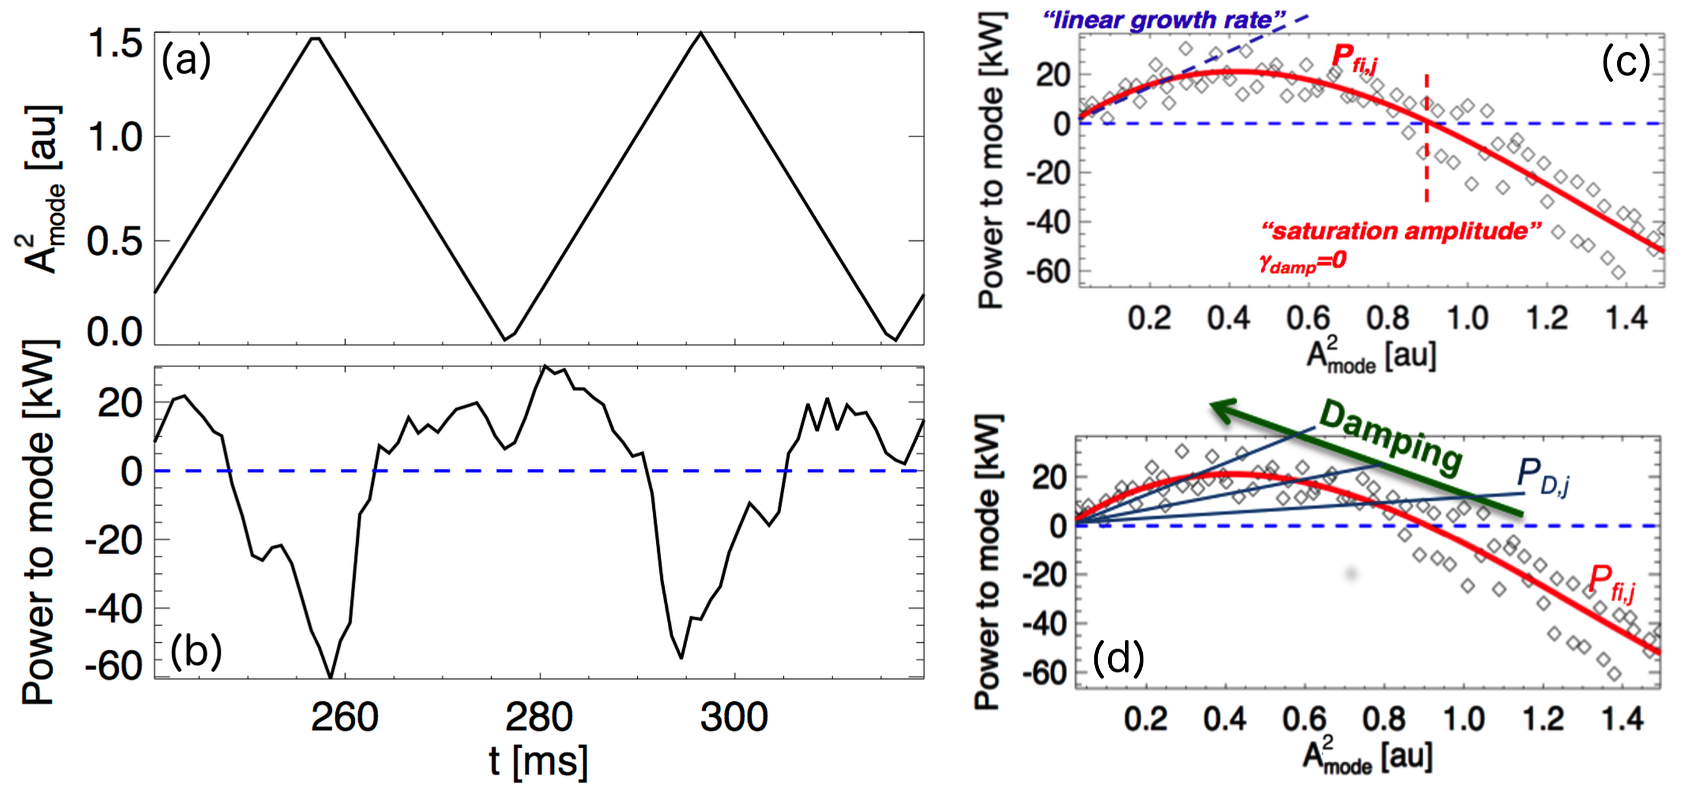
Time-dependent mode stability properties can be obtained from kick model
Method: probe EP response to modes at different amplitude level through power balance analysis
> infer “linear growth rate” & “saturated amplitude”

Slide 13
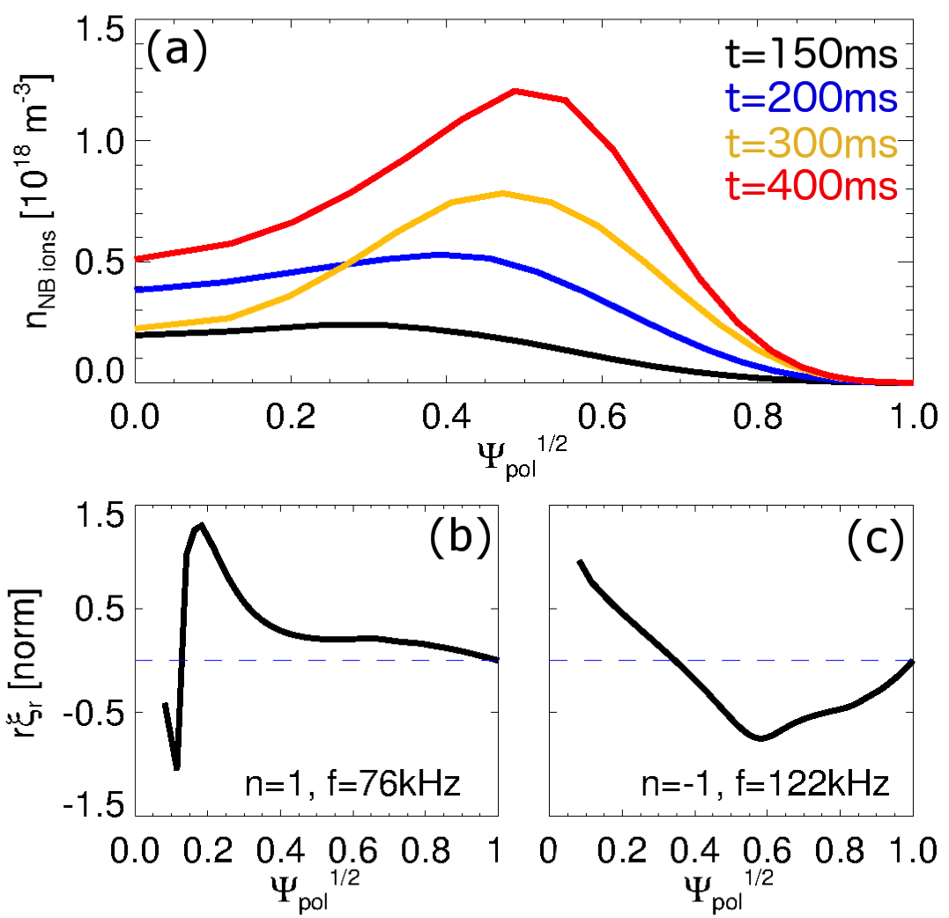
NOVA provides n=1 eigenmodes at two representative times (co- vs cntr-TAEs)
First step: compute eigenmodes at time of max co- vs cntr-TAE activity
Use ideal MHD code NOVA/NOVA-K
Use experimental density, electron temperature profiles
Assume T_{e}~T_{i}
Assume rotation ~0 (!!)
  No CHERS data available

Slide 14
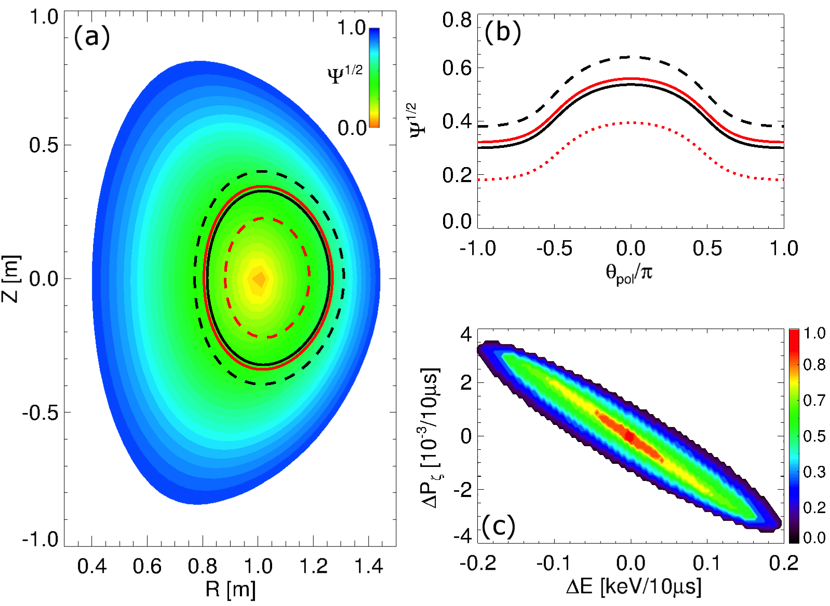
ORBIT code used to infer “kick probability matrix” associated with each mode from NOVA
Account for large orbit width, small aspect ratio
Mimic FLR corrections by averaging perturbation over Δρ~ρ_{L,i}

Slide 15
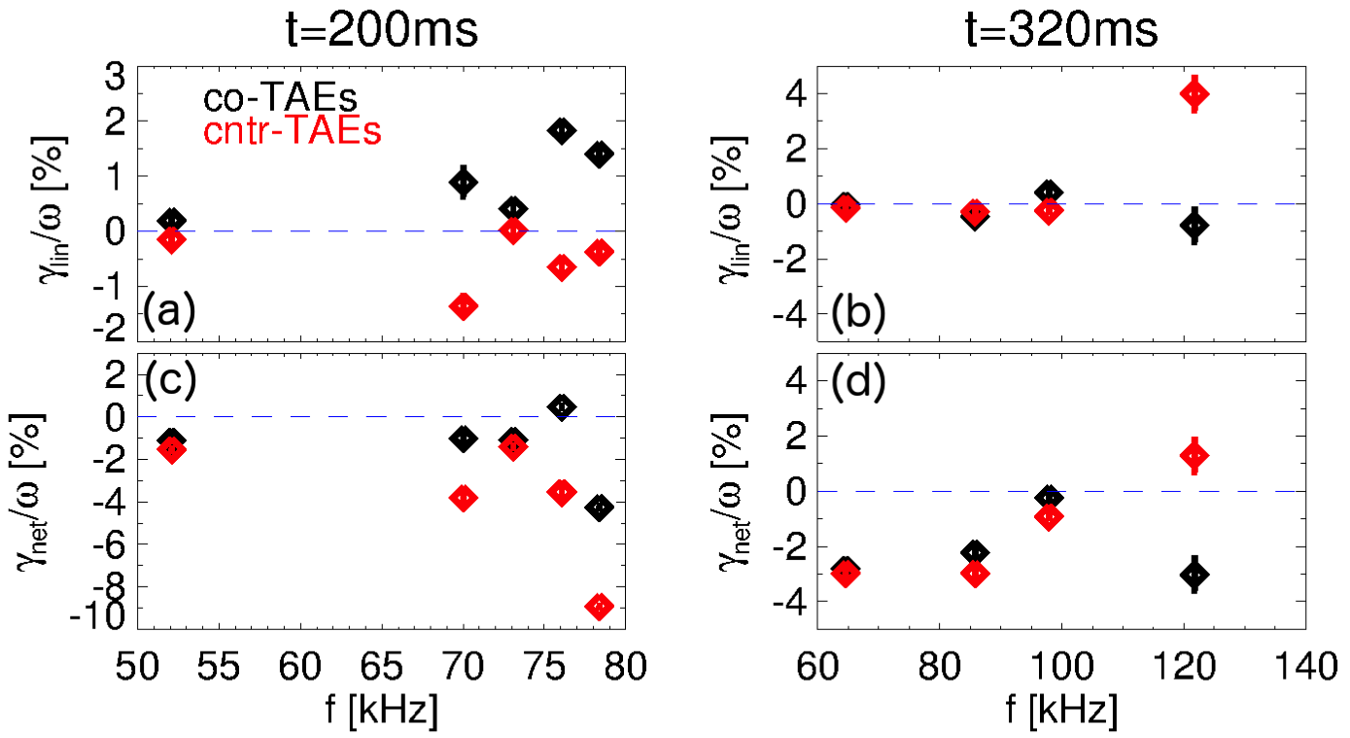
Kick model + damping rate from NOVA identifies two linearly unstable n=1 modes
Run TRANSP + kick model with mode amplitude -> 0 to infer linear stability
  Use realistic EP distribution function, profile evolution
  Identify time range for validity of results based on evolution of “phase space boundaries”

Slide 16
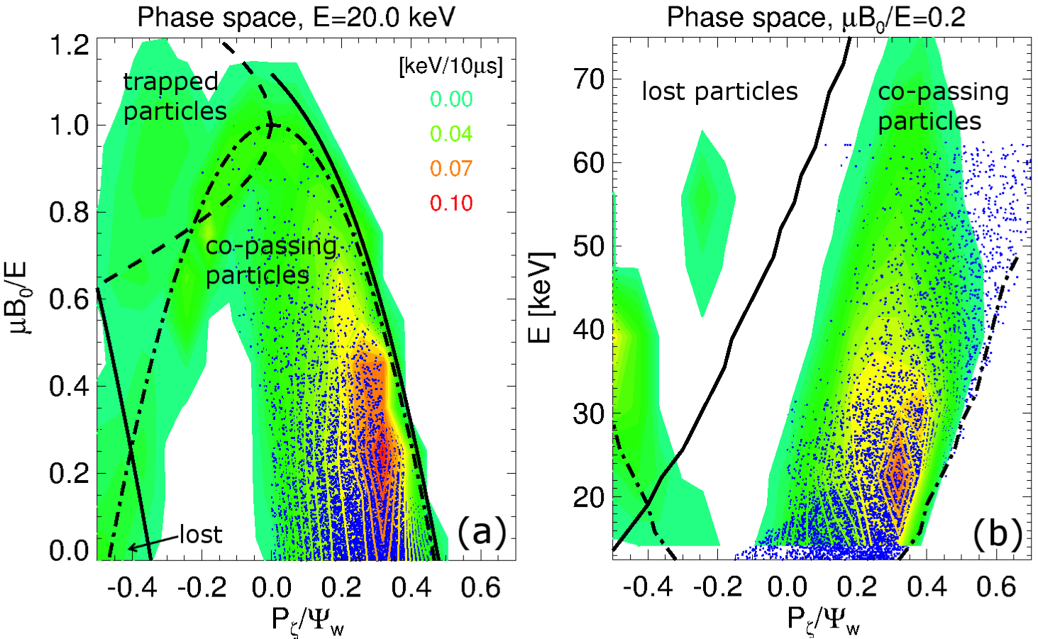
Unstable cntr-TAE has significant overlap with mode resonances for realistic F_{nb}
EP distribution function from NUBEAM
  Large variations of AE-induced EP transport in phase space

Slide 17
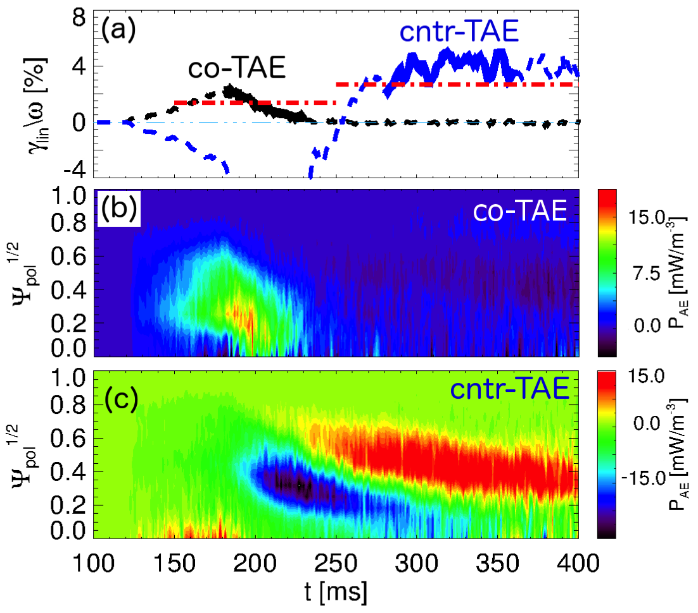
Linear stability vs time from kick model is roughly consistent with experiment
damping (NOVA-K)
Timing of most unstable |n|=1 modes nearly OK
Keep in mind: large uncertainties in (continuum) damping rate from NOVA-K

Slide 18
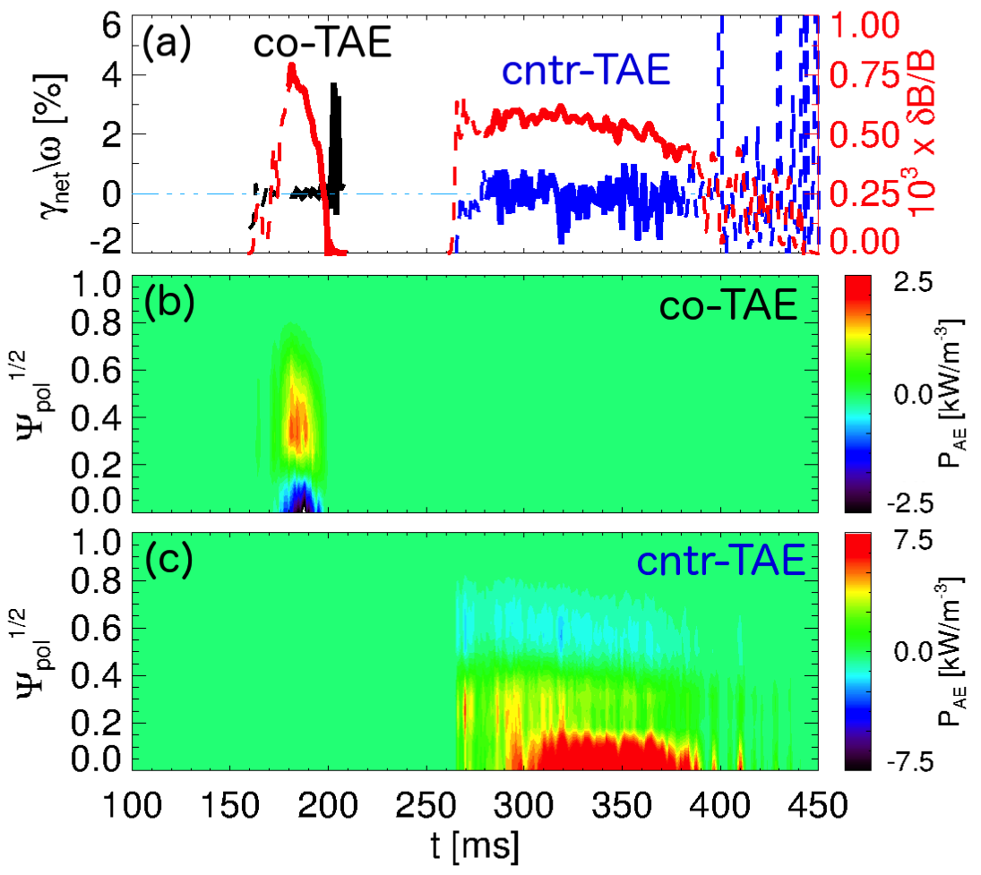
Saturation condition from kick model gives small amplitudes δB/B<10⁻³
Consistent with low injected NB power
No direct measurements of mode amplitude available

Slide 19
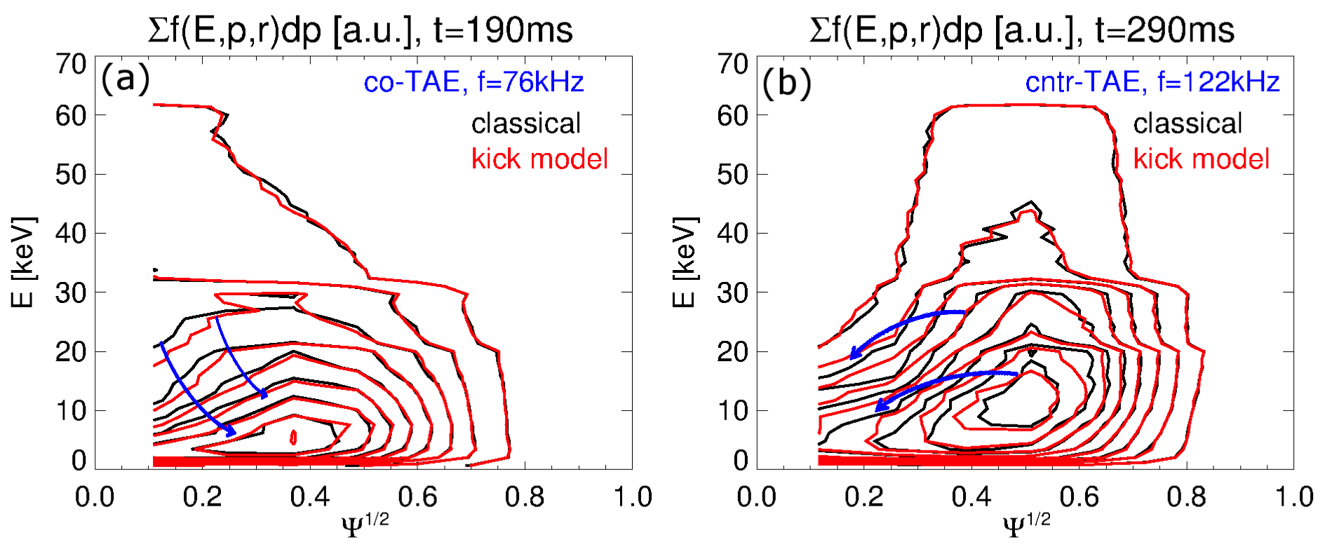
TRANSP computes substantially different effects from co- vs cntr-TAEs
Co-TAE: flatten EP density profile, move particles outward
Cntr-TAE: flatten EP density profile, move particles inward

Slide 20
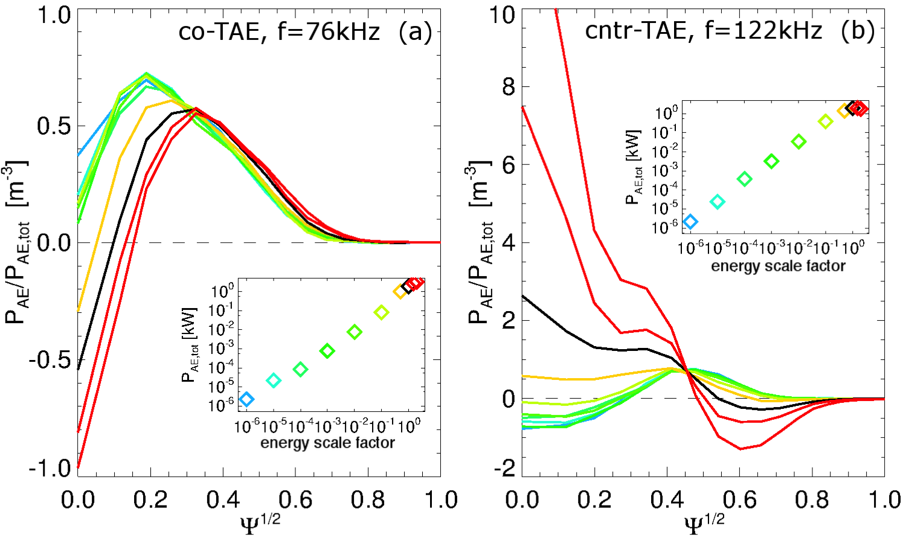
Wave-particle interaction near saturation differs considerably from “linear” phase
“Linear” phase not representative of what modes will do once they grow to finite amplitude
Can’t use linear growth rates to estimate/project transport in saturated phase

Slide 21
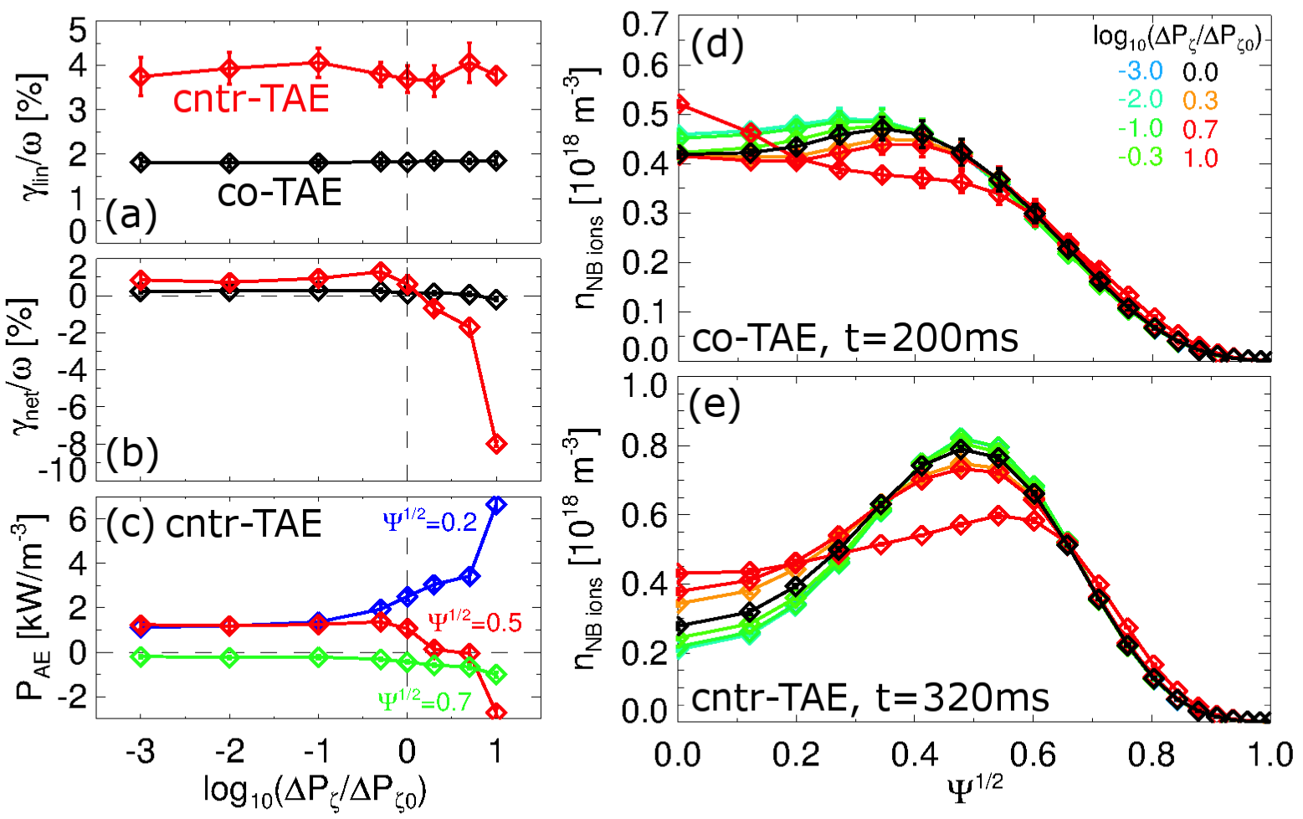
TRANSP + kick model shows competition between gradients in EP phase space
EP distribution from NB injection has complex phase space dependency
Both P_{ζ} (~”radial”) and energy gradients are important to assess mode’s linear stability & saturation amplitude

Slide 22
Summary
Counter-propagating TAEs can be destabilized by co-injected, off-axis NBI
TRANSP + kick model analysis recovers main experimental observations
  Transition from co- to cntr-TAEs during current ramp
TAE drive is a combination of phase space gradients
  Drive may be enhanced by combined NBI+RF (e.g., ITER)
  Instability already observed at low P_{nb}~1MW
  Relevant for scenarios with limited flexibility in NBI deposition (e.g. ITER)
  Relevant for current ramp-up scenarios assisted by NB-CD
  Points to limitations of reduced models solely based on “universal drive” by EP density gradient

