Slide 1


Radiative divertor optimization for NSTX Upgrade based on open geometry standard divertor experiments in NSTX
V. A. Soukhanovskii, O. Izacard, F. Scotti, LLNL
R. Maingi, R. E. Bell, R. Kaita, S. Kaye, B. P. LeBlanc, J. E. Menard,
D. Mueller, PPPL
Poster PP11.00055
59th Annual Meeting of the APS Division of Plasma Physics
25 October 2017
Milwaukee, Wisconsin

Slide 2
Abstract
Recent analyses of NSTX divertor experiments suggest a way to optimize the standard open geometry divertor configuration for partial detachment with deuterium puffing and intrinsic carbon radiation. Results from the NSTX experiments and the divertor transport and radiation model obtained with the multi-fluid code UEDGE are used to show that detachment onset and properties are sensitive to 1) placing the neutral gas source in the vicinity of the strike point, 2) directing the recycling neutrals toward the separatrix by adjusting the poloidal separatrix angle, and 3) entrapping neutrals by plasma plugging via the high poloidal magnetic flux expansion configuration. These findings will be tested in NSTX Upgrade, where H-mode scenarios with 2 MA, 1 T, 10 MW NBI-heated discharges and 5 s flattop are predicted to produce unmitigated peak divertor heat fluxes above 10 MW/m2, necessitating the scrape-off layer power sharing between upper and lower divertors and inducing dissipative losses.
Supported by the US DOE under Contracts DE-AC52-07NA27344 and DE-AC02-09CH11466.

Slide 3
Summary
Compact ST divertor geometry in combination with high plasma current and high input power present significant difficulties for radiative detachment regimes
NSTX experiments suggest that optimization (for detachment) of an open unpumped divertor may be possible via standard magnetic divertor configuration
ST plasma configurations with high-triangularity naturally produce high-flux expansion divertor with “vertical-plate divertor” characteristics (despite being an open horizontal plate divertor)
ITER vertical target baffled divertor
NSTX open horizontal
target divertor (rotated 45 degrees)

Slide 4
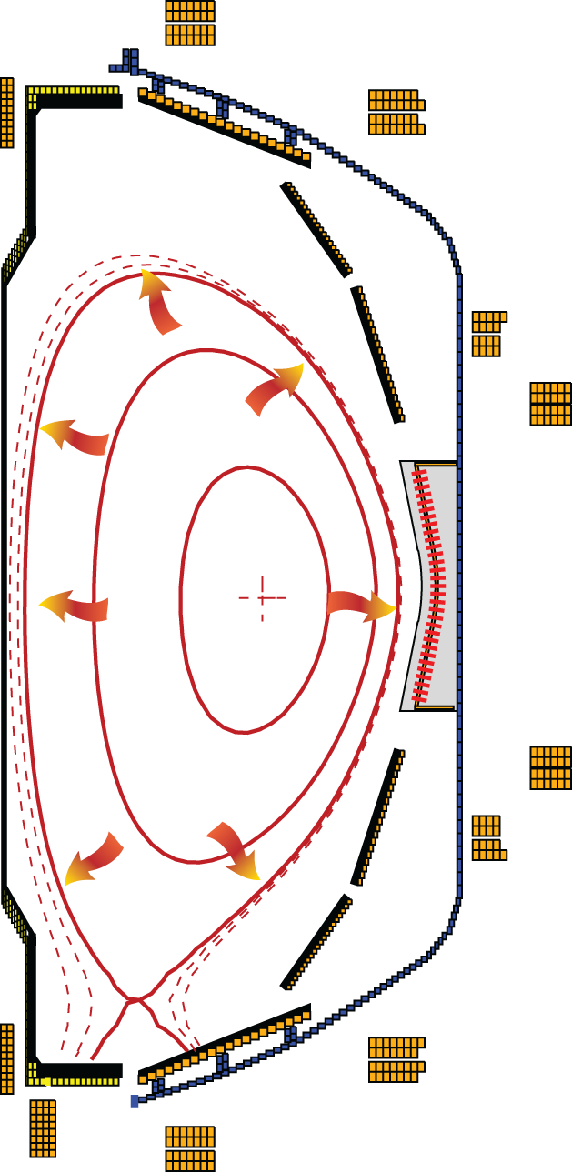

Significant gaps exist between present divertor solutions and future device requirements
Critical divertor tasks
  Power exhaust
  D/T and He pumping
  Impurity source reduction
  Impurity screening
Outstanding issues
  Steady-state heat flux
    Technological limit q_{peak} ≤ 5-15 MW/m²
    ITER: q_{peak} ≤ 10 MW/m² (Mitigated)
    DEMO: q_{peak} ≤ 150 MW/m² (Unmitigated)
  ELM energy, target peak temperature
    Melting limit 0.1-0.5 MJ/m²
    DEMO: Unmitigated, ≥ 10 MJ/m²
  Impurity erosion
    Divertor target T_{e} < 5-10 eV

Slide 5
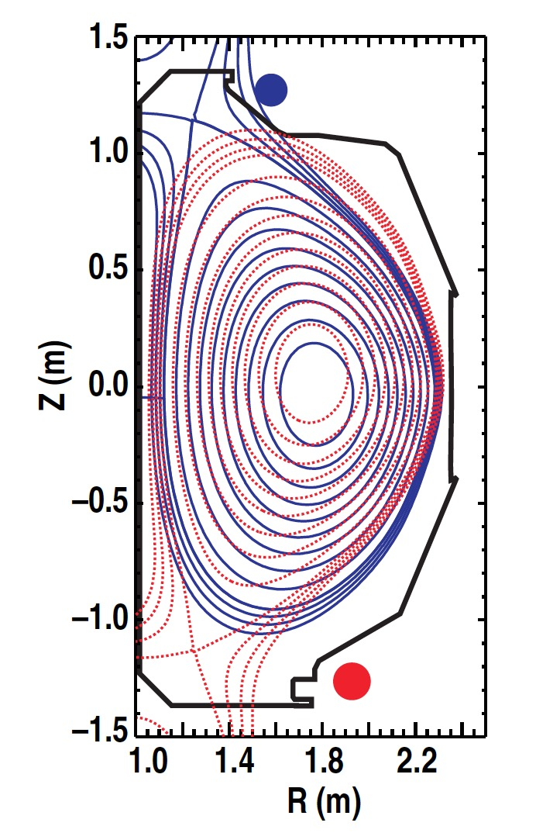
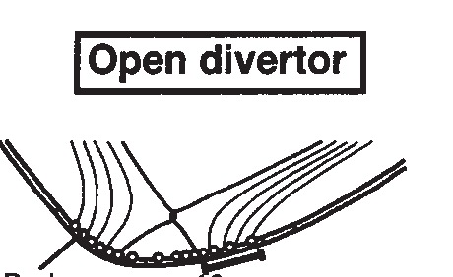
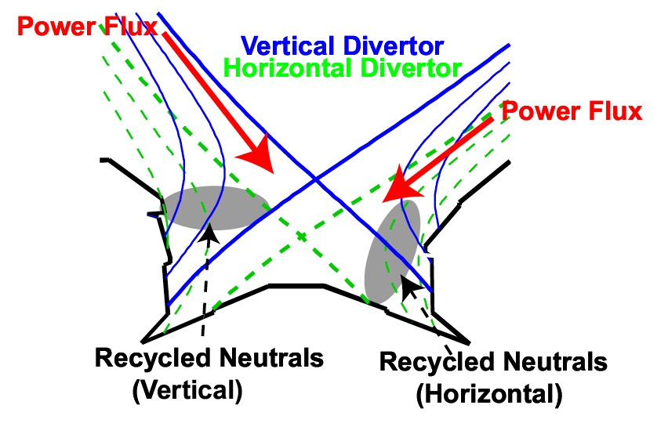
Divertor plasma facing component and hardware geometry plays critical role in detachment
Open divertor
Baffled divertor
Vertical target divertor
A. Loarte, Plasma Phys. Control. Fusion 43 (2001) R183–R224
B. Lipschultz, Fus. Sci. Tech. 51 (2007) 379

Slide 6


Magnetic geometry impacts heat fluxes q_{peak} (divertor target), q|| (divertor SOL) and detachment
In high-recycling conditions
Detachment criteria
Divertor physics is inherently 2D or even 3D
  Parallel / cross-field transport and turbulence
  Radiation front (detachment) stability
  Neutral pressure / density distribution
Pitcher C S and Stangeby P C 1997 Plasma Phys. Control. Fusion 39 779
B. Lipschultz, Fus. Sci. Tech. 51 (2007) 379

Slide 7
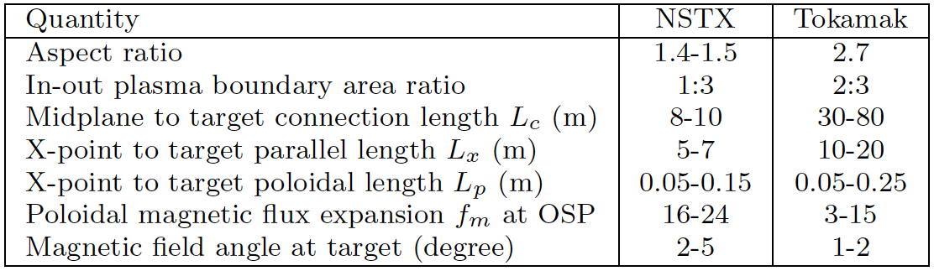
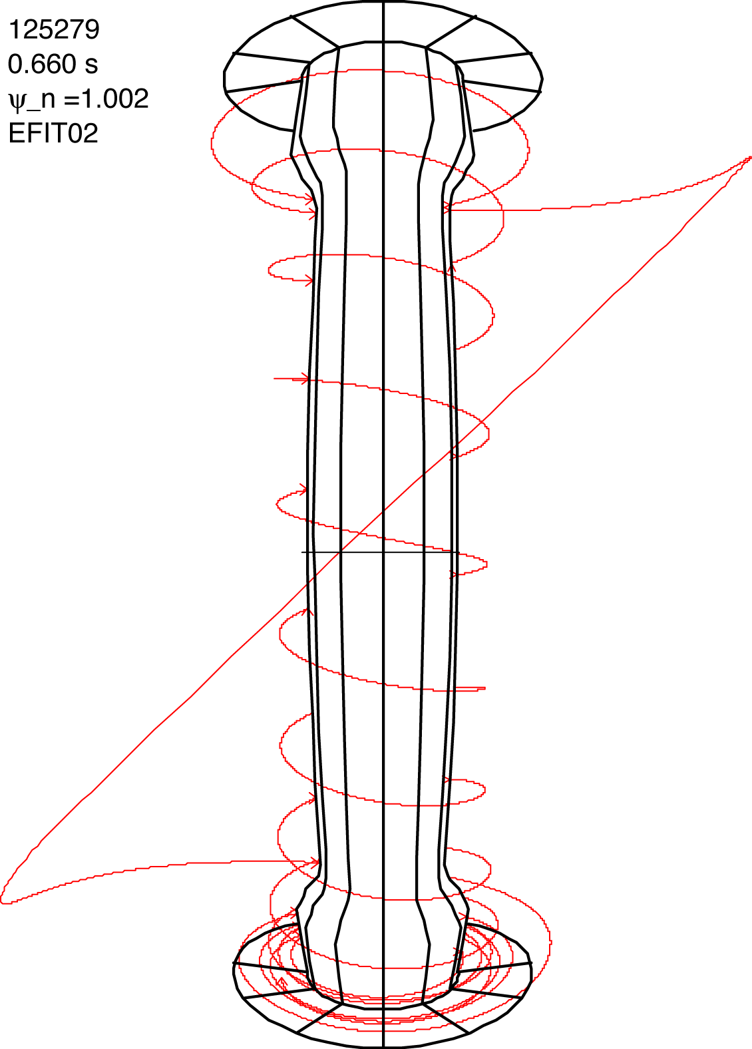
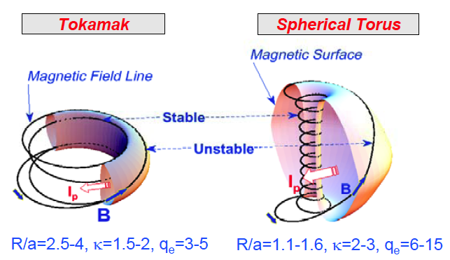
SOL / divertor geometric properties are different in spherical tori and large aspect ratio tokamaks
D

Slide 8
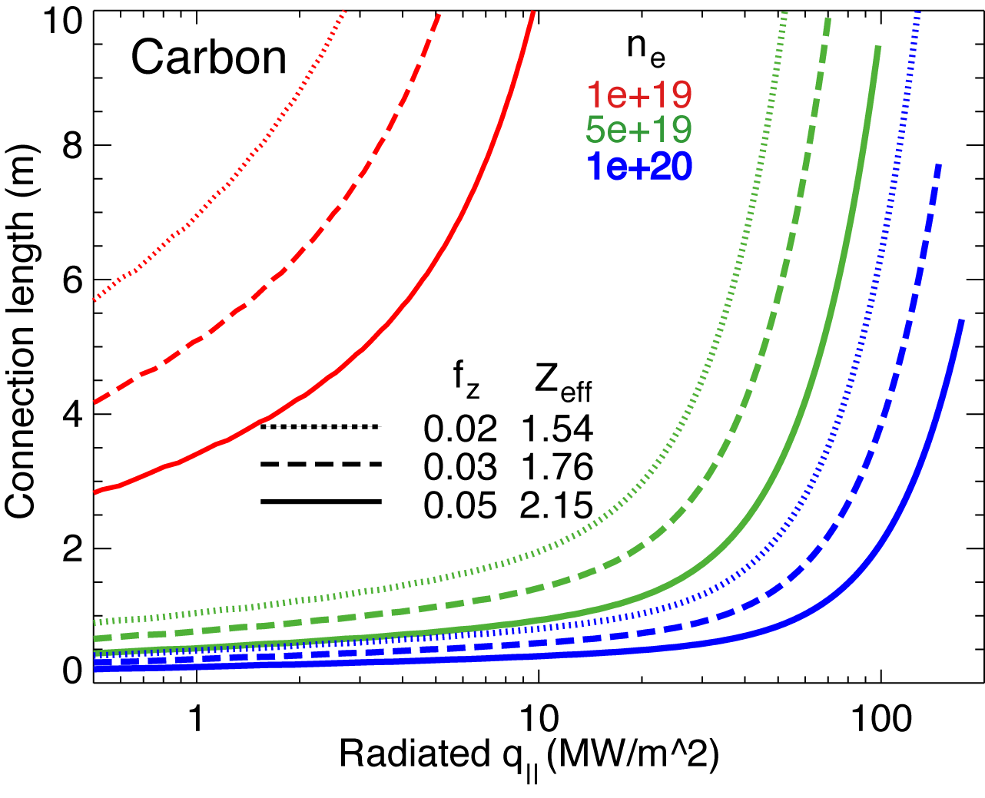
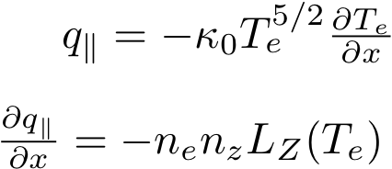
High f_{rad} can be achieved with carbon in NSTX divertor at high n_{e} and n_{z}
Hulse-Post non-coronal radiative cooling curves for low Z impurities for n₀/n_{e}, n_{e}-τ_{recy}
Calculate max q|| that can be radiated
Express max q|| as function of distance from heat source for range of f_{z}
(Post JNM 220-222, 1014 (1995) )
Power losses due to deuterium P_{rad} and ionization not considered
For NSTX, use n₀ = 0.1 % and n_{e}-τ_{recy} = n_{e} x 1e-3 s

Slide 9
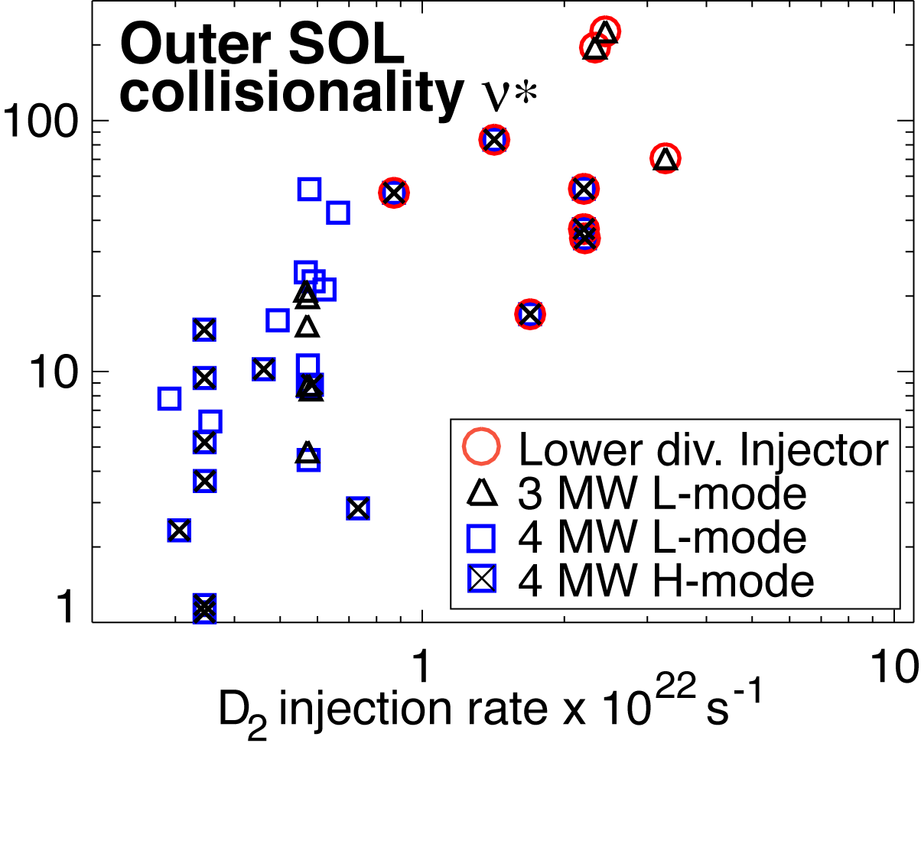
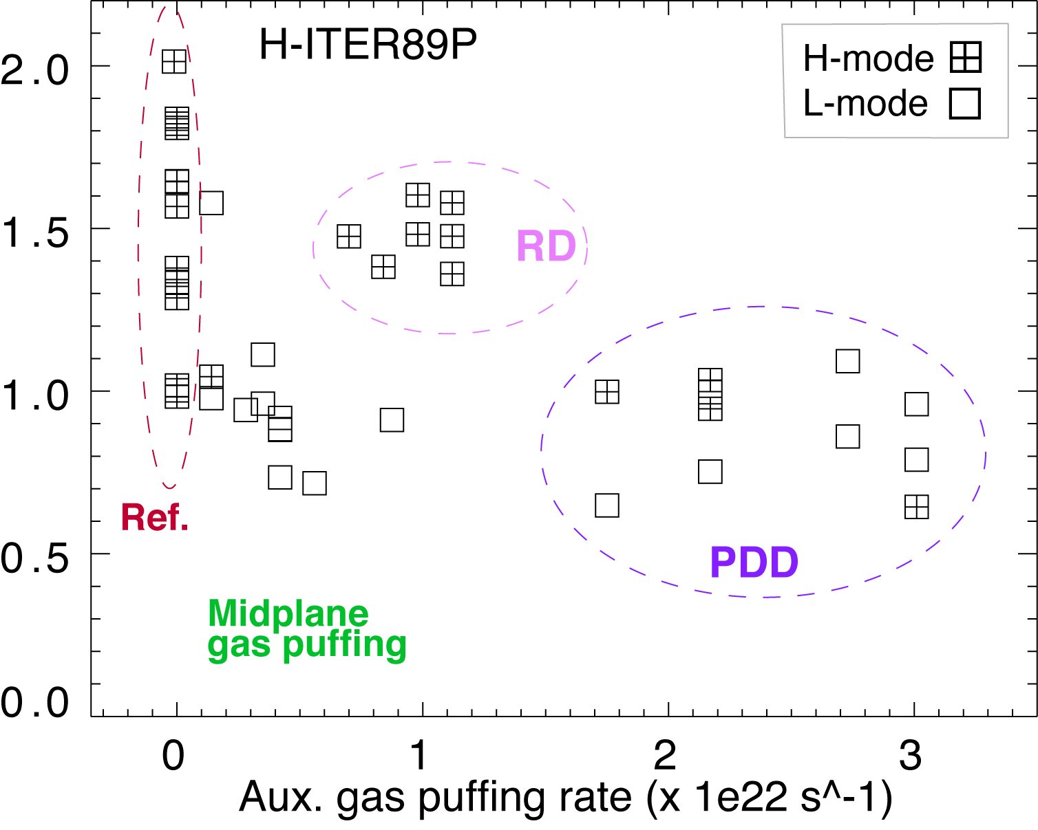
Divertor detachment sensitive to gas injection location and divertor configuration in NSTX
Gas injection location
  Only divertor gas injection led to partial OSP detachment compatible with core confinement
  q||≤ 150 MW/m² and q_{pk}=6-12 MW/m²
  Large radiated power and momentum losses needed
High flux expansion divertor
  High flux expansion divertor may be less transparent to neutrals, better recycling neutrals retention, “plasma plugging”
Divertor separatrix angle with PFCs
  Lower angle leads to more recycling neutrals directed toward the separatrix (cf. angle > 90 deg. - neutrals away from separatrix)
  Similar to “vertical plate” divertor ?

Slide 10
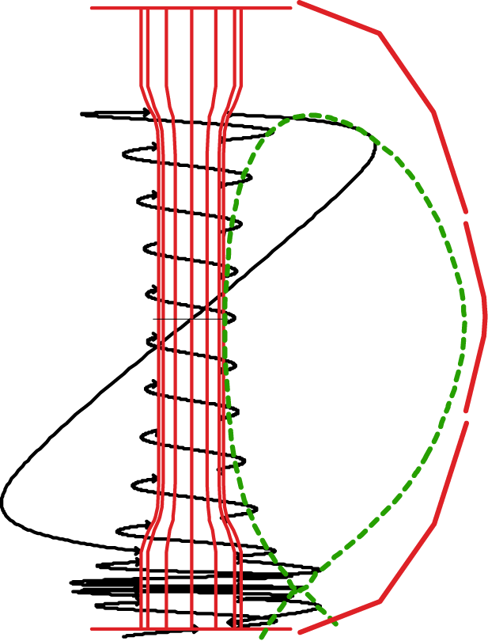
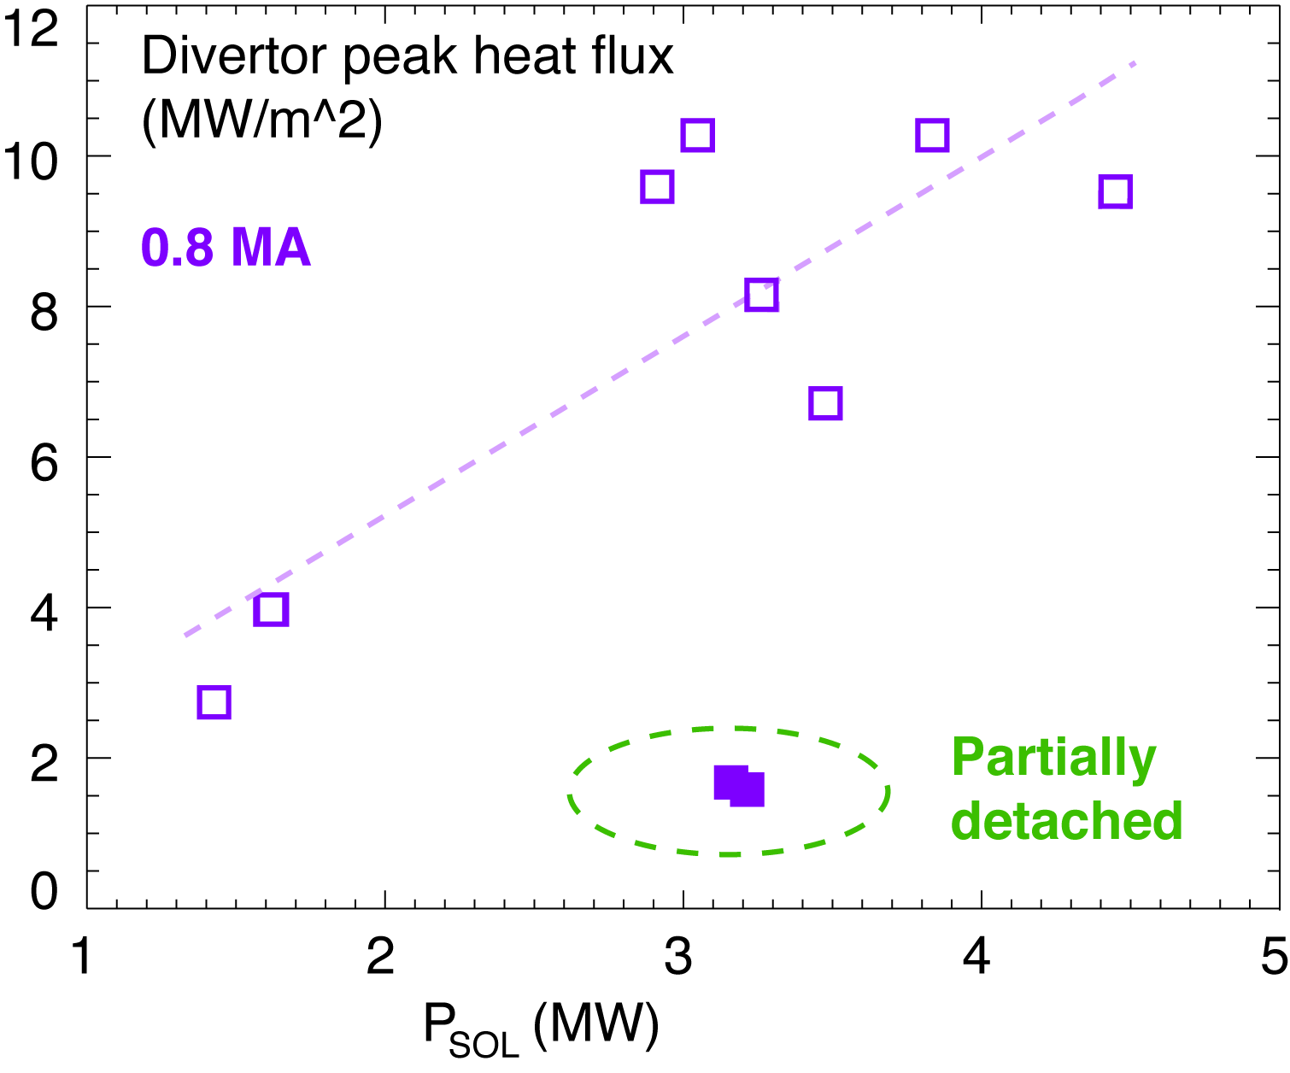
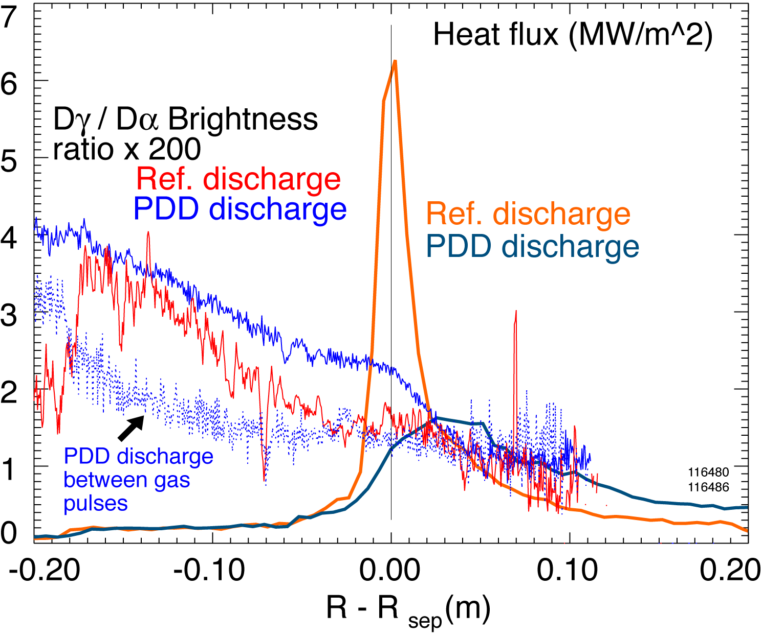
In low κ, δ configuration with rad. divertor, q_{peak} reduced albeit with confinement degradation
Peak heat flux in outer divertor (Maingi JNM 363-365, 196 (2007)):
  ITER-level q_{out}< 10 MW/m²
  Scaling of q_{peak}: linear with P_{sol} (P_{NBI}), linear-monotonic with I_{p}
  Large q_{peak} asymmetry - 2-10; inner divertor always detached
Experiments using D₂ injection (Soukhanovskii IAEA 2006):
  q_{peak} reduced by up to 60 % in transient PDD regime
  X-point MARFE degraded confinement within 2-3 x τ_{E}

Slide 11
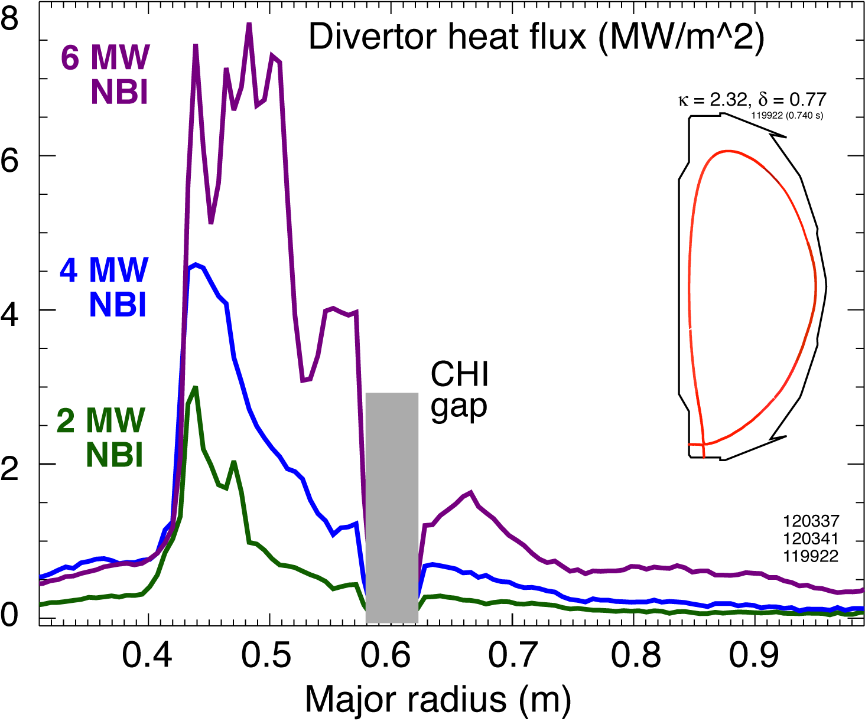
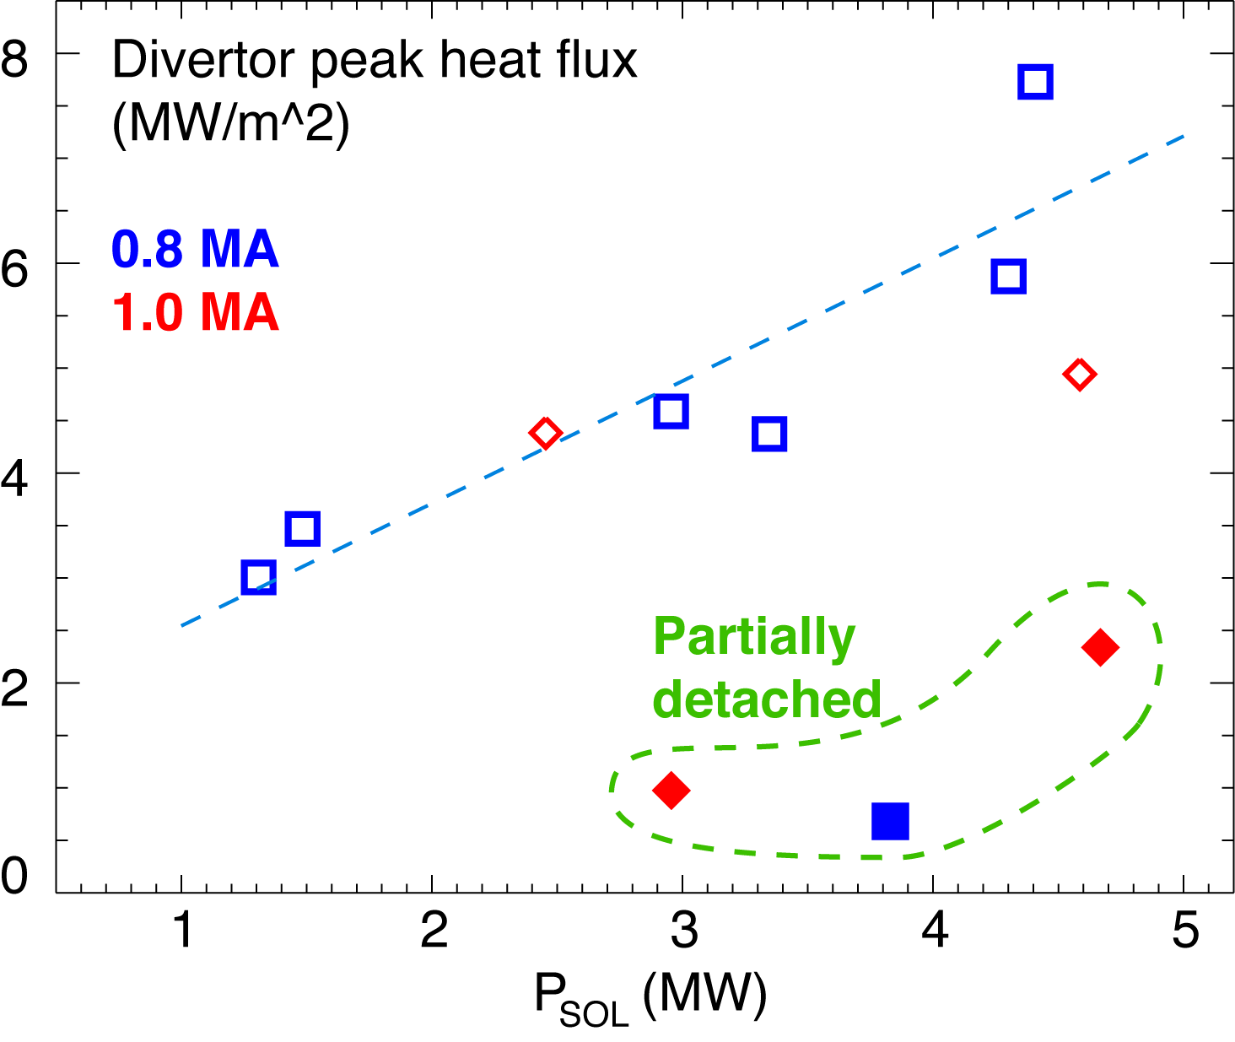
Good core plasma performance and significant q_{peak} reduction with PDD obtained at high κ, δ
Experiments conducted in 0.8-1.0 MA 4-6 MW NBI discharges with κ=2.2-2.3, δ=0.6-0.75 (Soukhanovskii APS 2007)
Obtained partially detached divertor (PDD) outer strike point using divertor D₂ injection, however, P_{rad} due to intrinsic carbon and helium
q_{peak} reduced by 60 - 80 % in PDD phase with min. confinement degradation

Slide 12
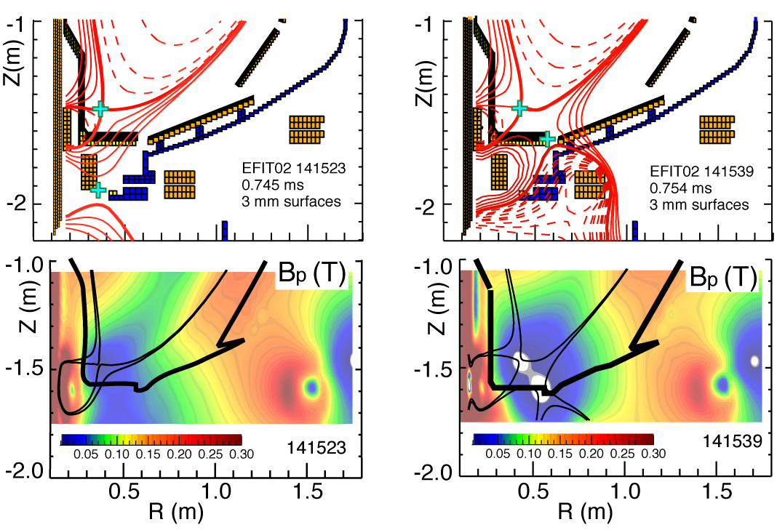
Snowflake divertor configurations obtained in NSTX show very high f_{exp} and l||
Standard
Snowflake
f_{exp}
B_{p}

Slide 13
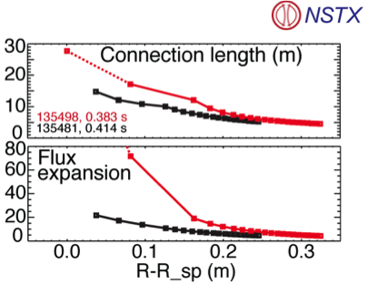
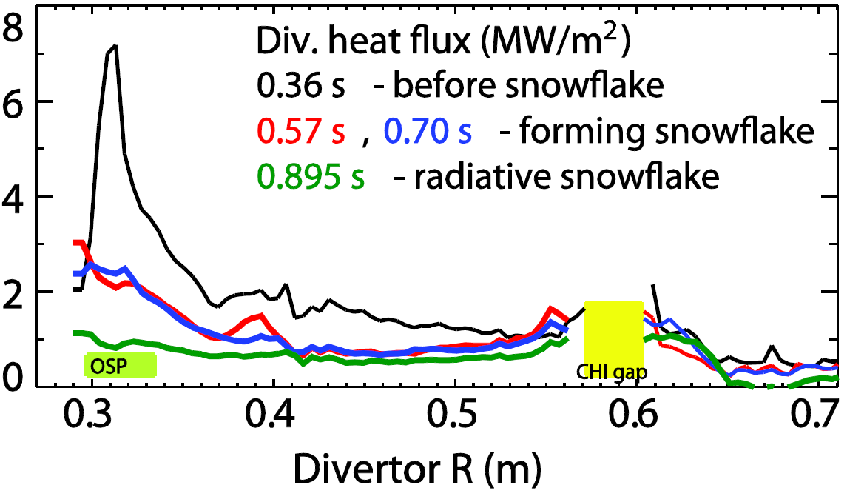
Natural partial detachment in NSTX snowflake otherwise inaccessible with standard divertor
Standard Snowflake

Slide 14
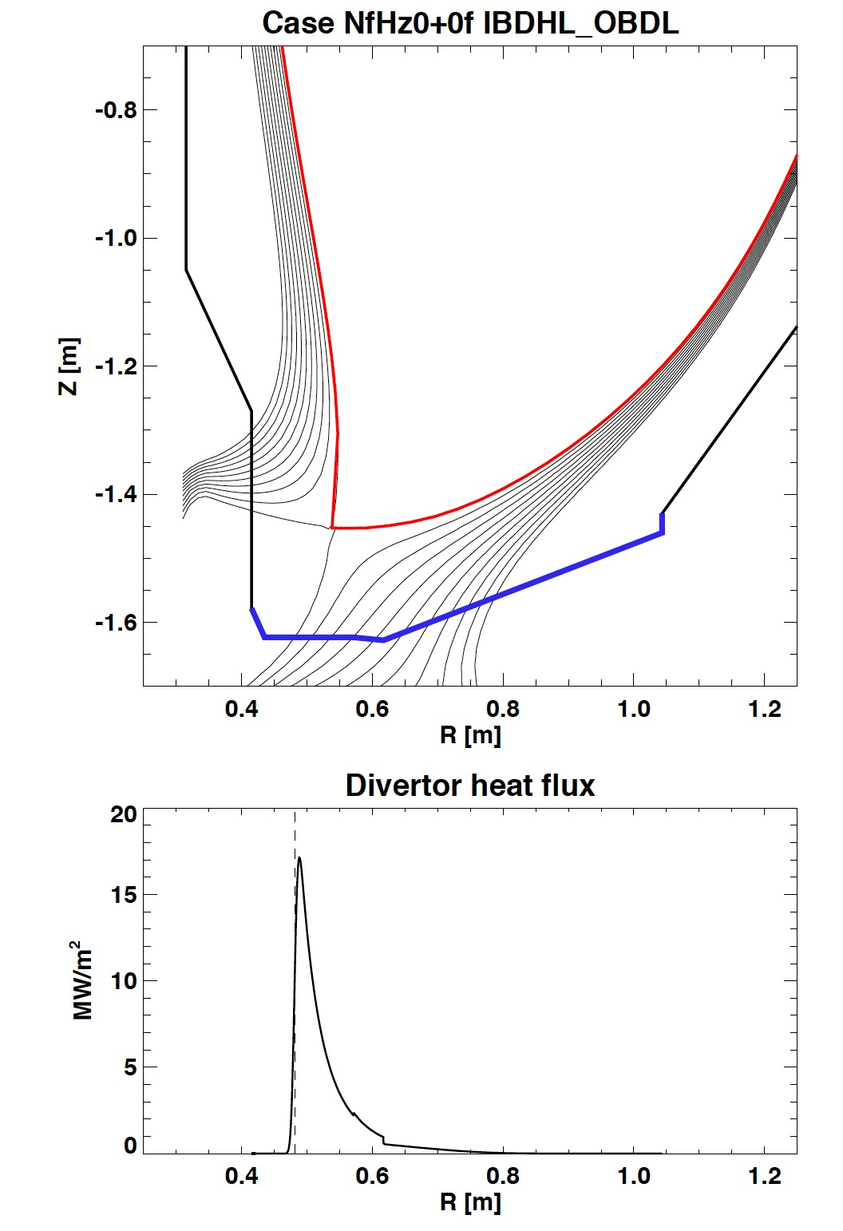
Open divertor with graphite PFCs will be used in initial years in NSTX-U
Open divertor geometry
  Low neutral and impurity compression
No active divertor pumping
  Lithium coatings for reduced recycling
  Planned cryopump in future years
Graphite plasma facing components
  Physical and chemical erosion, dust
  Max P_{rad} fraction limited by carbon radiation efficiency
Unbearable divertor heat fluxes in 2 MA, 10 MW, 5 s H-mode discharges are predicted – see J. E. Menard, Poster PP11 43

Slide 15
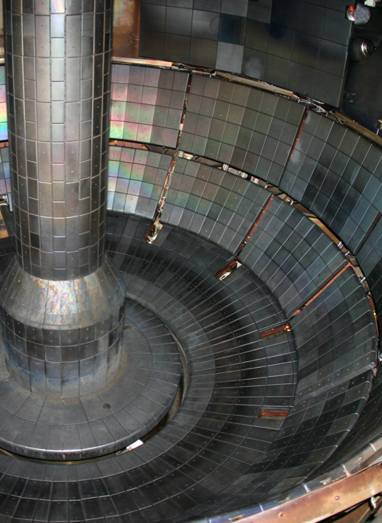
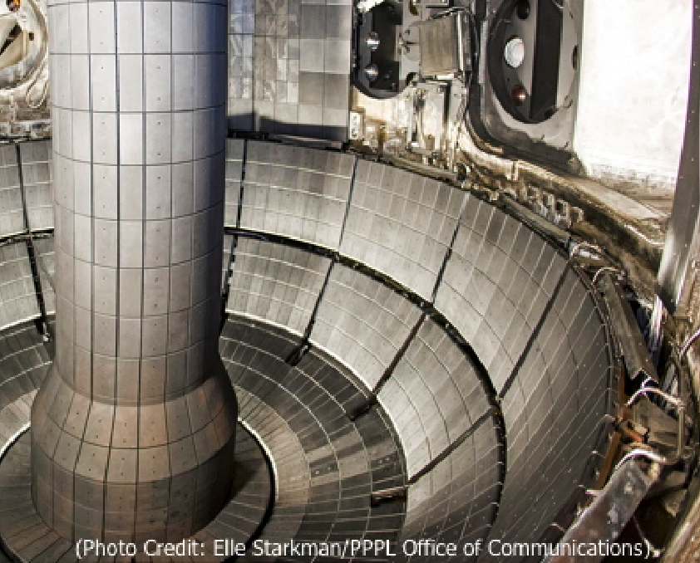
NSTX-U divertor will present additional challenges
Main divertor differences between NSTX and NSTX-U for particles
  Geometry changed
    Vacuum vessel volume decreased
    Inner wall (CS) area increased
    Pumping duct volume decreased
    Divertor area decreased
  Divertor and main wall power density to increase
  Pulse length to increase
  SOL power and particle channel width (decreased?)
  Two NBI boxes and two NBI cryopumps
These changes likely to lead to modified operating space w.r.t. recycling, impurity flux, pedestal stability and ELMs, etc
NSTX
NSTX-U

Slide 16
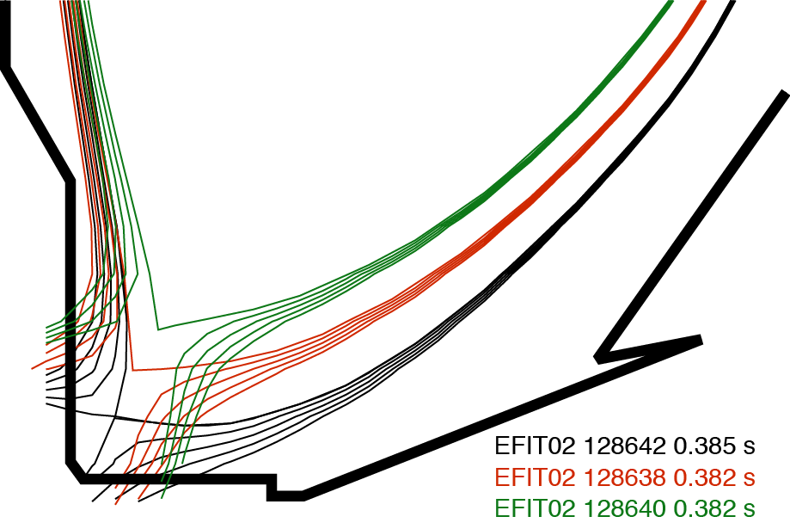
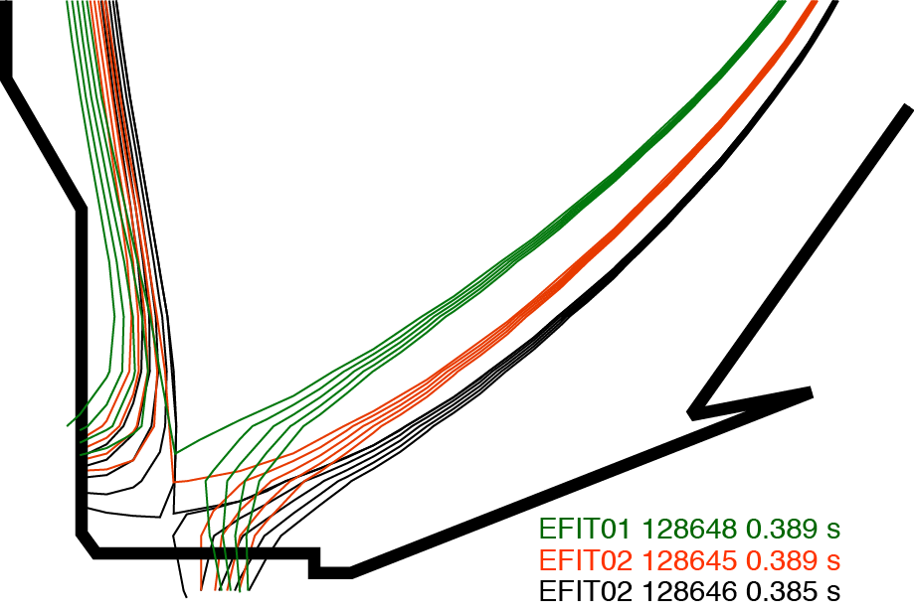
Two divertor configurations with different magnetic geometries were obtained in NSTX experiment
Configuration A
Configuration B
PF1A
Configuration | Coils | X-pt height | OSP major radius
A ⬛️ | PF1AL | 6-23 cm | 0.30-0.39 m
B ⚫️ | PF1AL & PF1B | 4-11 cm | 0.42-0.45 m

Slide 17
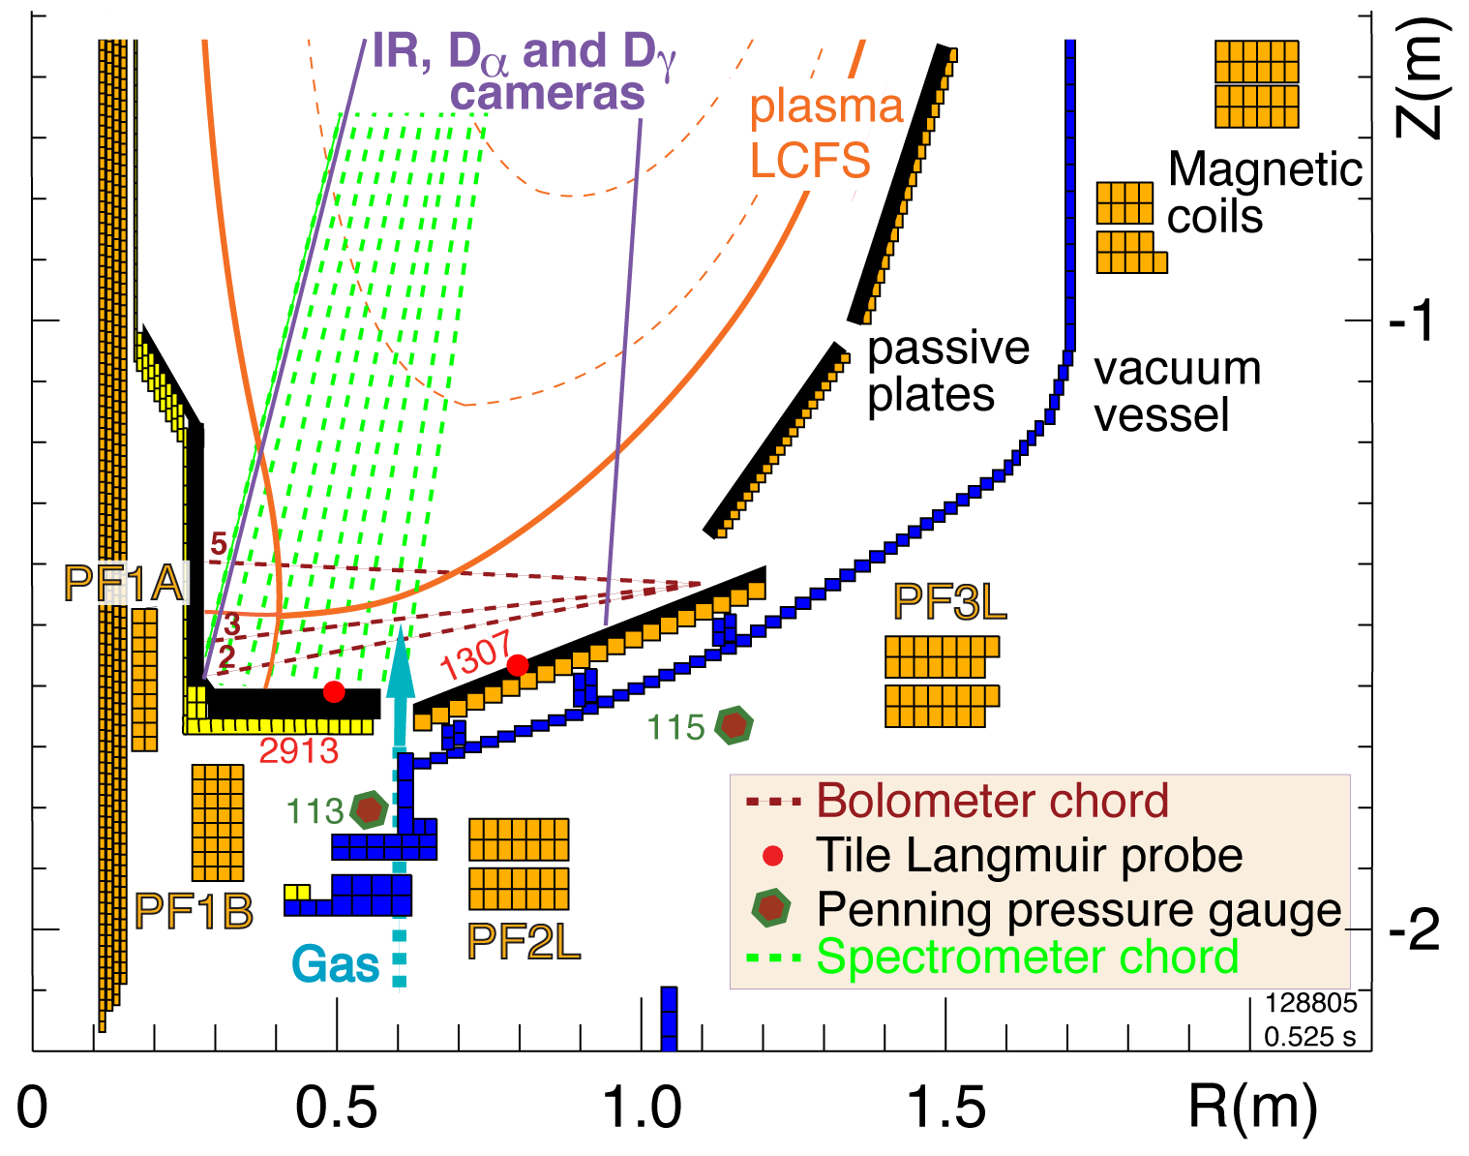
Steady-state H-mode discharges with various X-point heights were used for conf. A and B
Color coded X-point height:
Low (6-7 cm)
Medium (9-12 cm)
High (20-22 cm)
1 MA, 6 MW NBI-heated H-mode
Small ELM regime
Similar plasma shape parameters
  Elongation 2.20-2.40, triangularity 0.7-0.85, drsep ~ 5 – 10 mm
X-point height was changed by shifting the plasma up and down by several cm using PF1A divertor coil

Slide 18
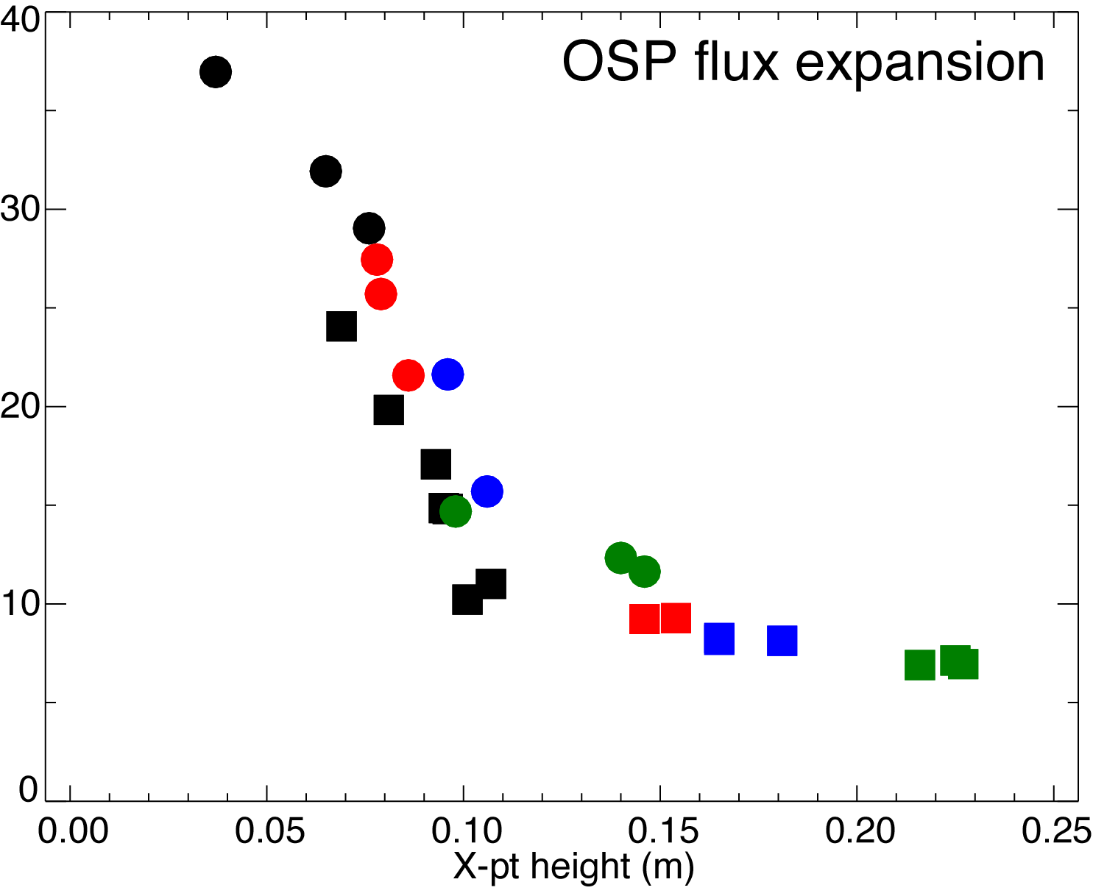
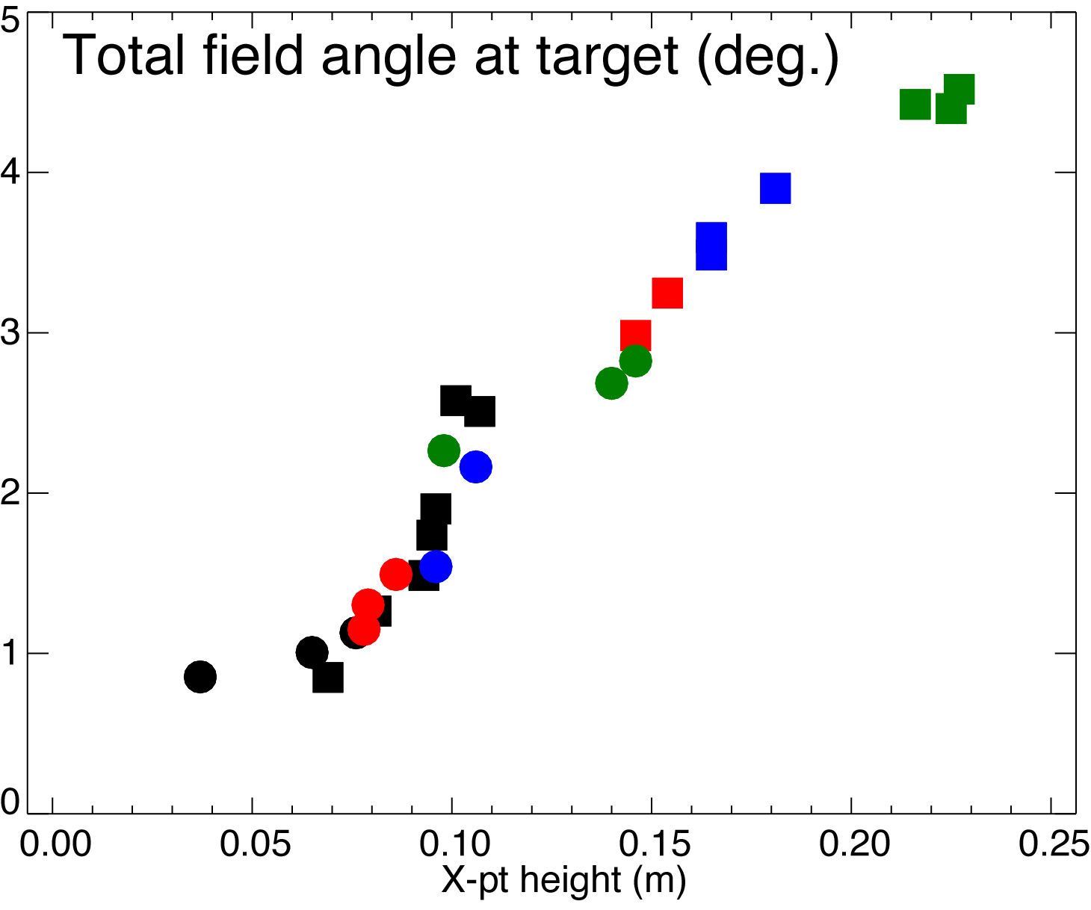
Flux expansion and total magnetic field angle scale with X-point height similarly in conf. A and B
Configuration
A ⬛️
B ⚫️

Slide 19
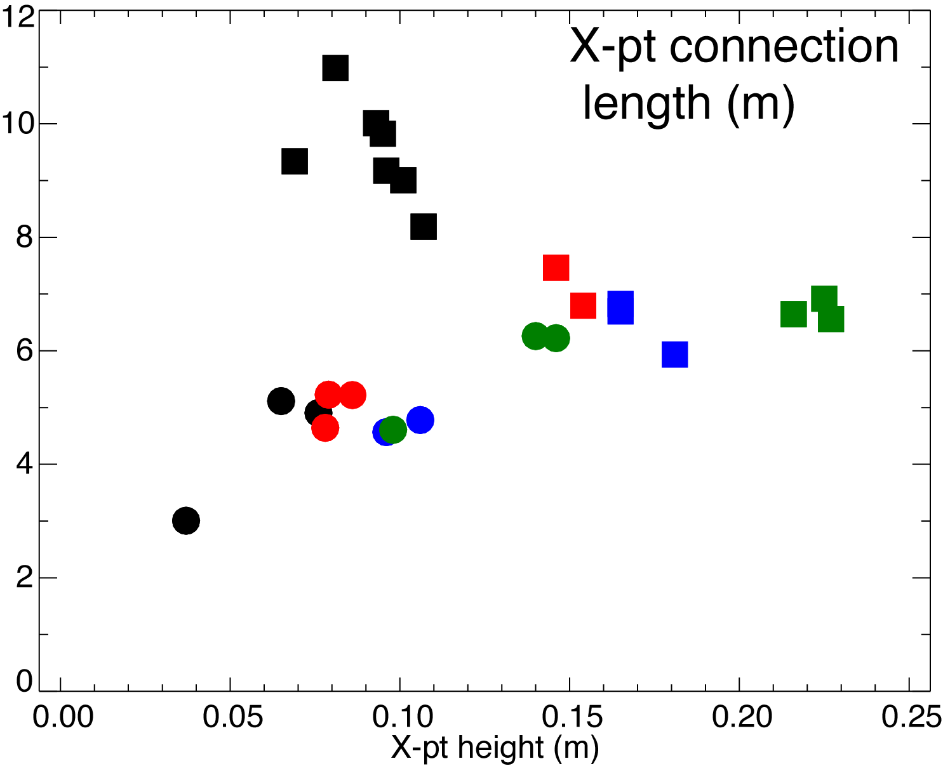
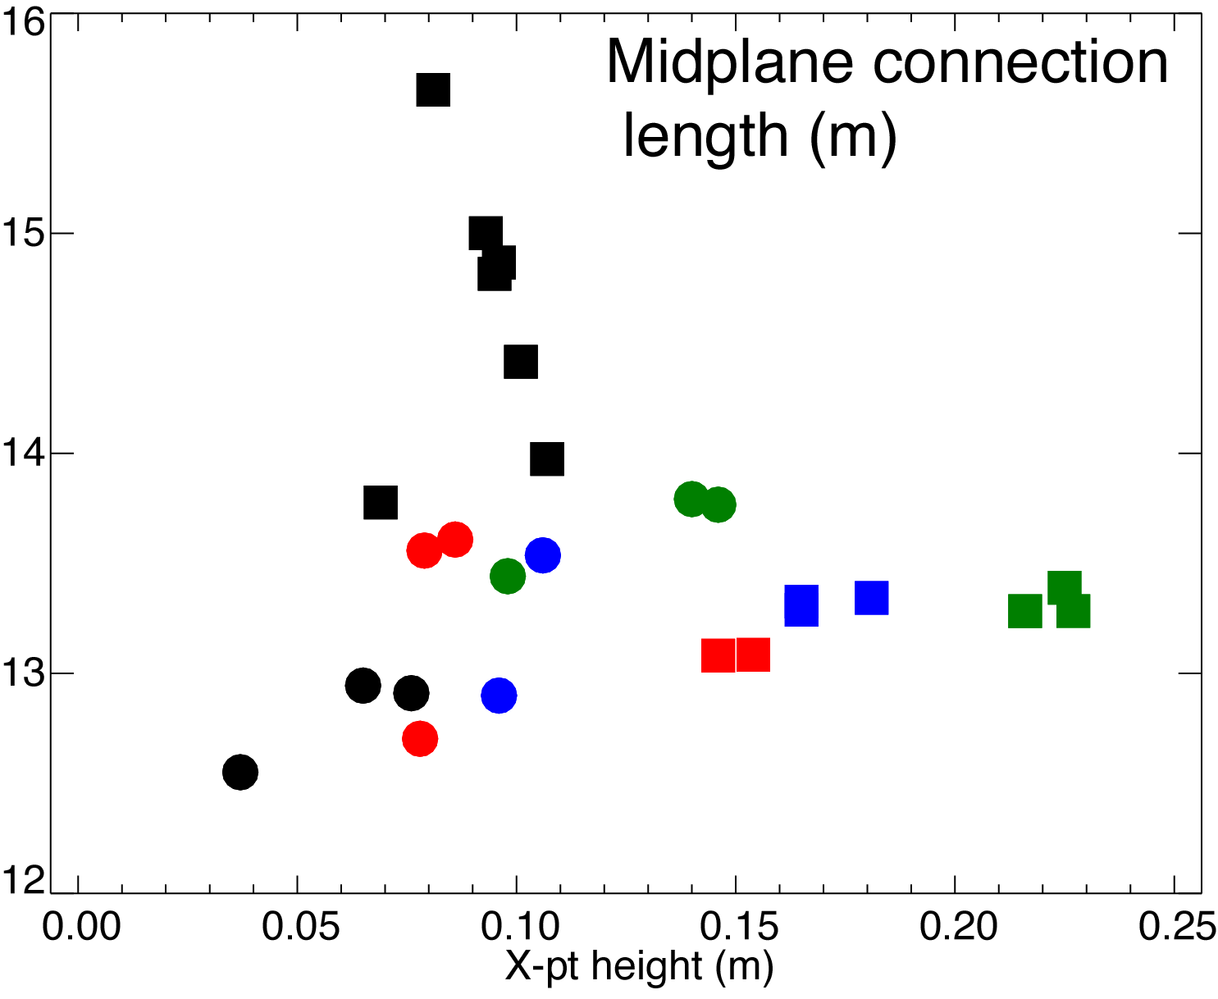
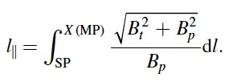
Midplane and X-point connection lengths different in configurations A and B
In config. B, l|| is proportional to X-point height
In config. A, l|| is inversely proportional to X-point (unintuitively)
Configuration
A ⬛️
B ⚫️

Slide 20
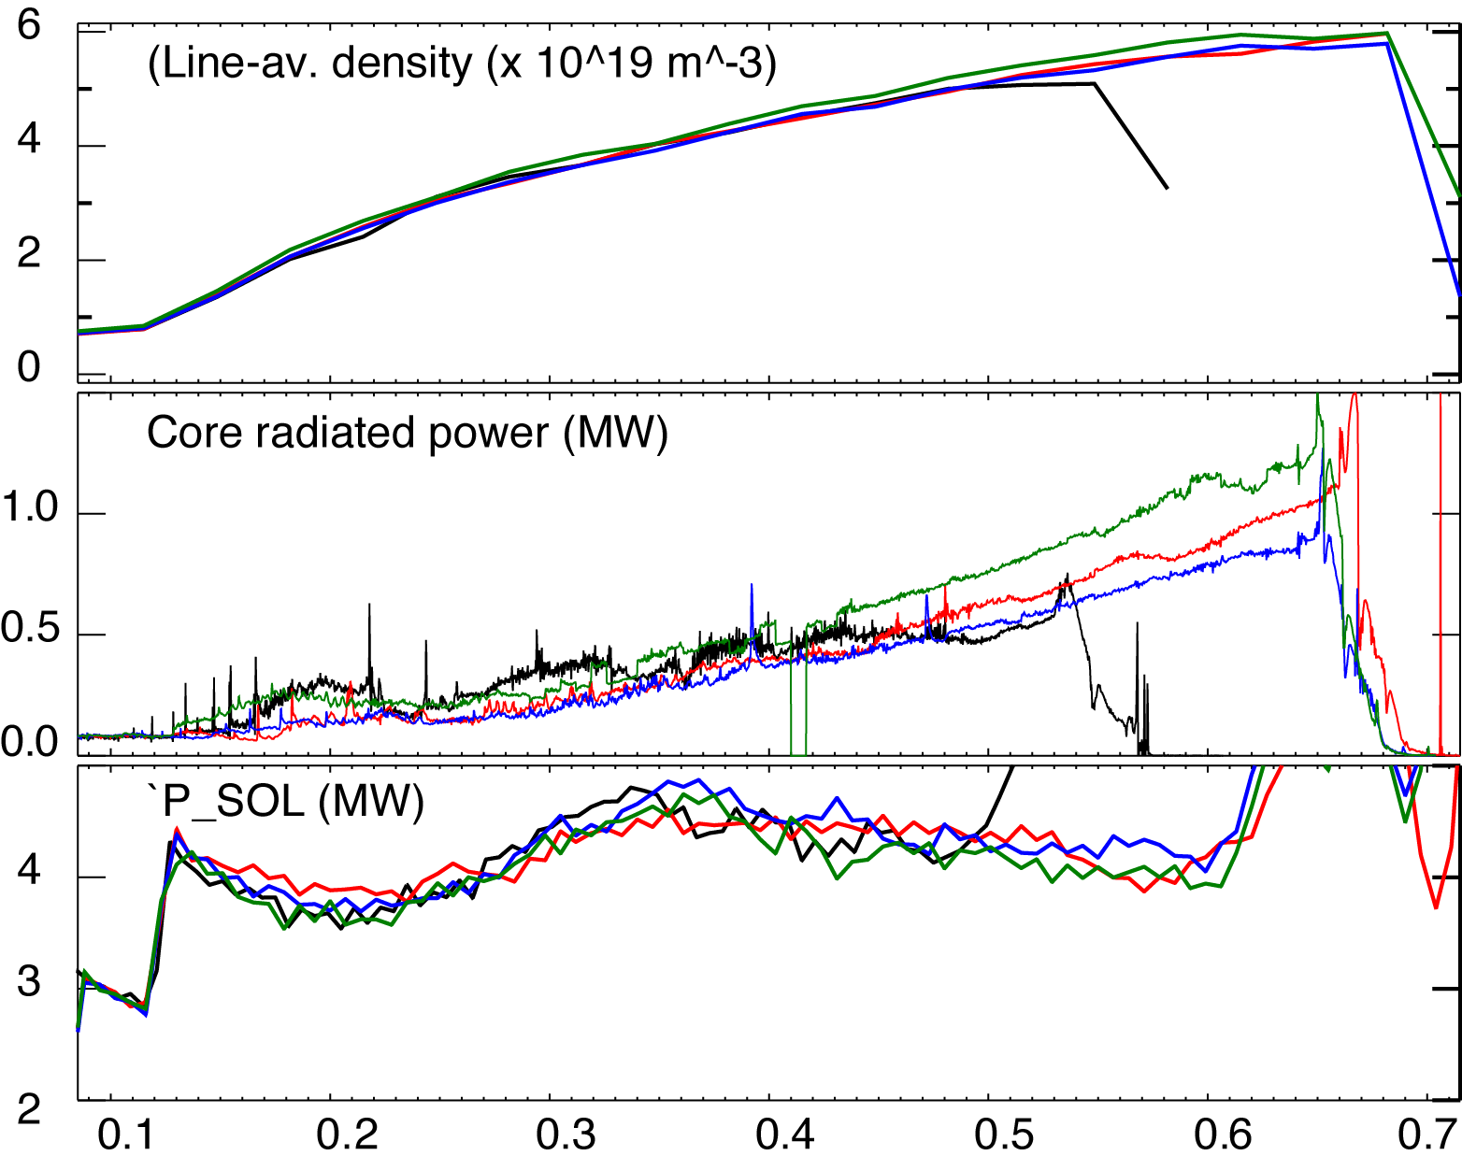
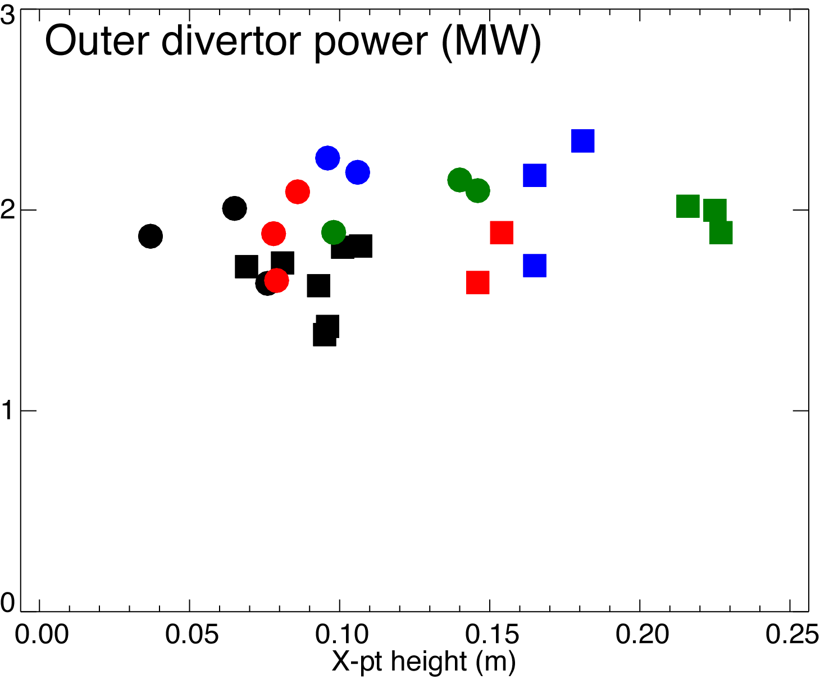
Steady-state H-mode discharges with various X-point heights were used for conf. A and B
Color coded X-point heigh:
Low (6-7 cm)
Medium (9-12 cm)
High (20-22 cm)
Configuration
A ⬛️
B ⚫️

Slide 21
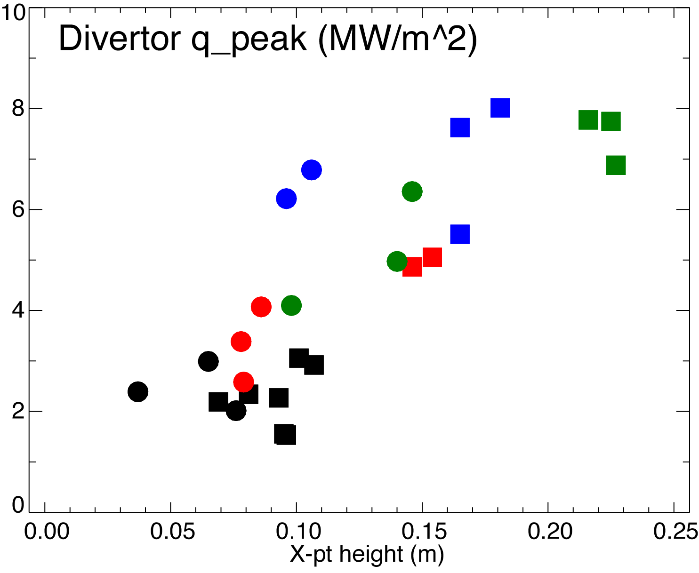
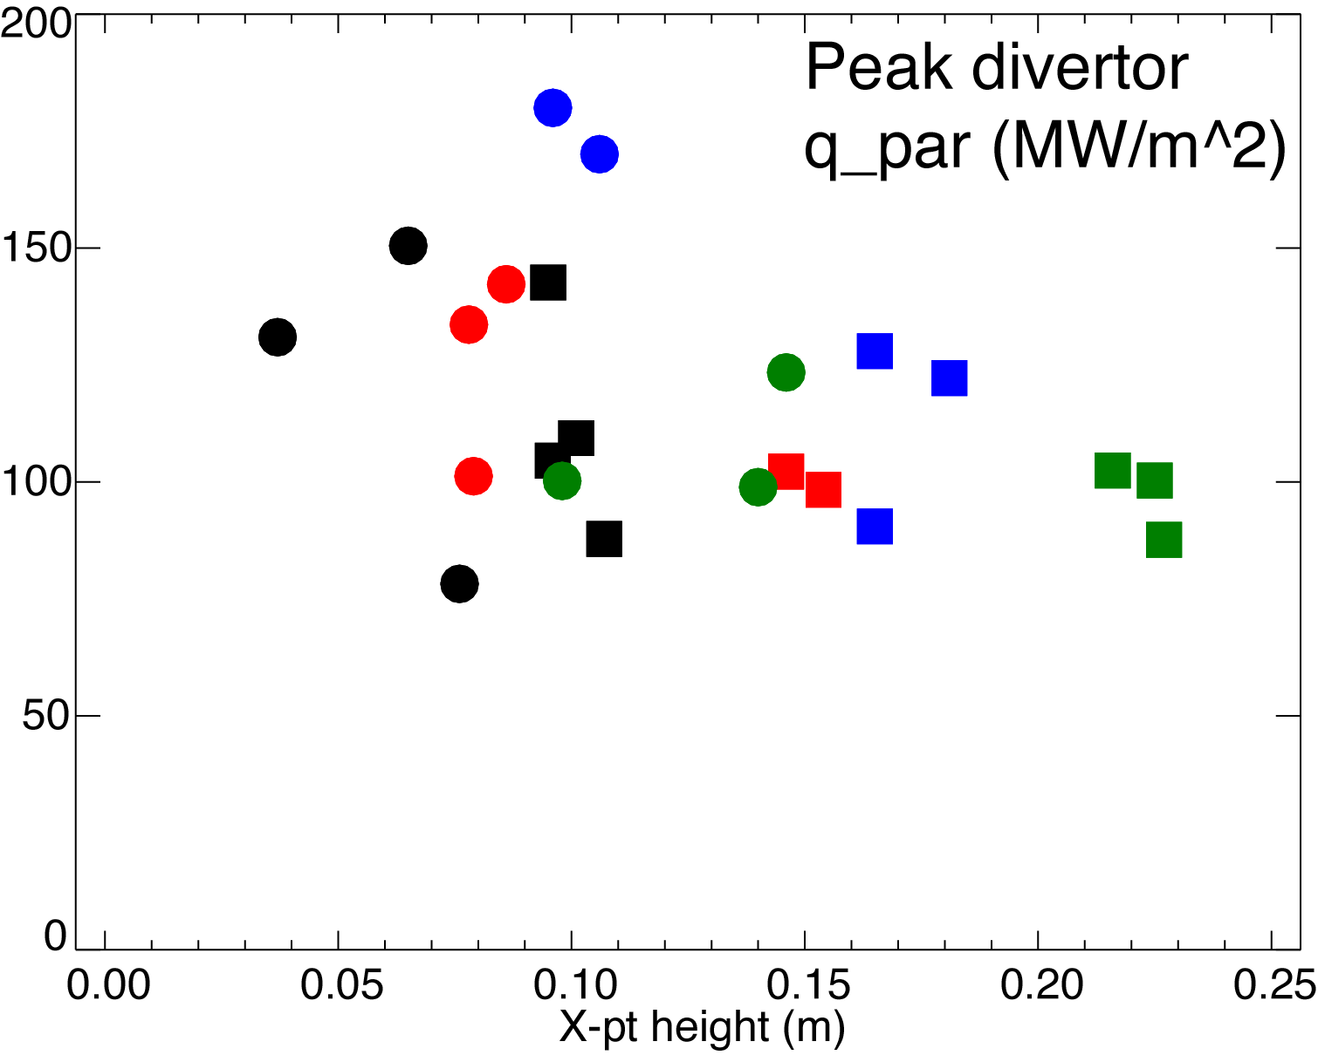
Parallel heat fluxes at OSP are higher in configuration B
Configuration
A ⬛️
B ⚫️

Slide 22
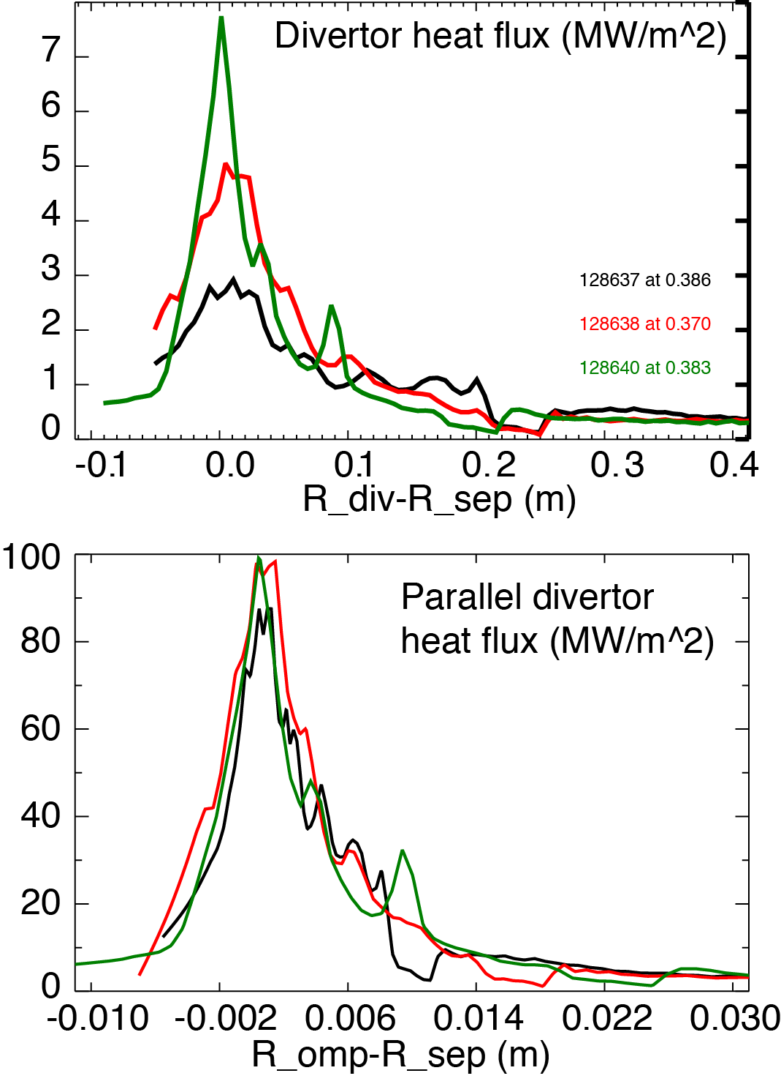
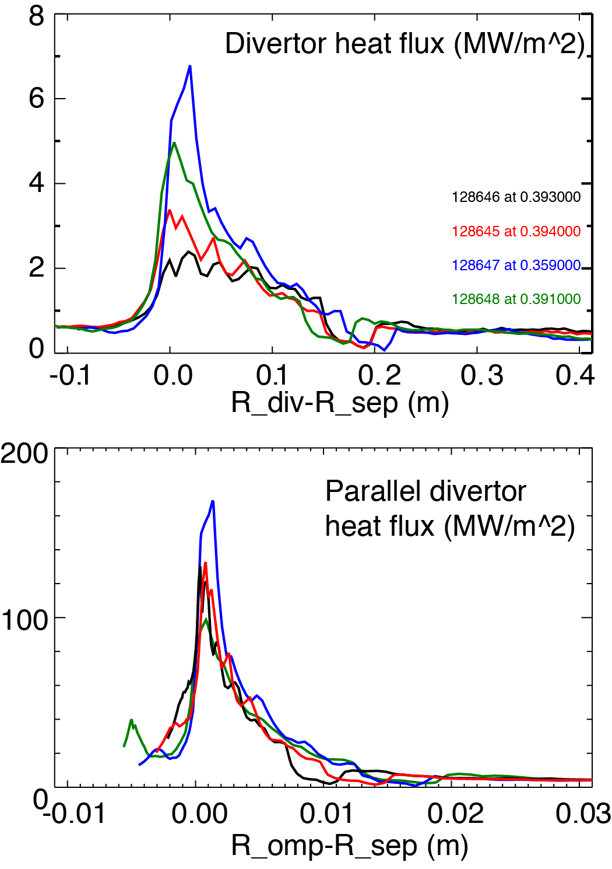
Parallel heat fluxes higher in configuration B
A
B

Slide 23
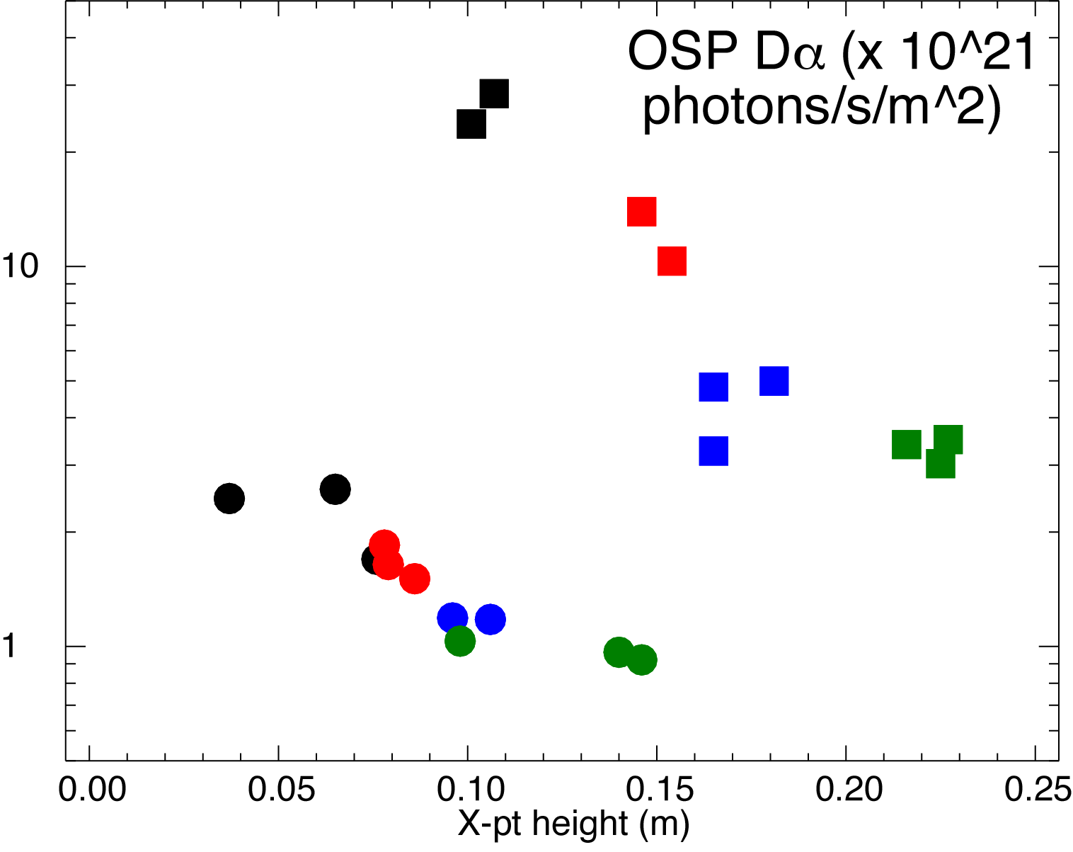
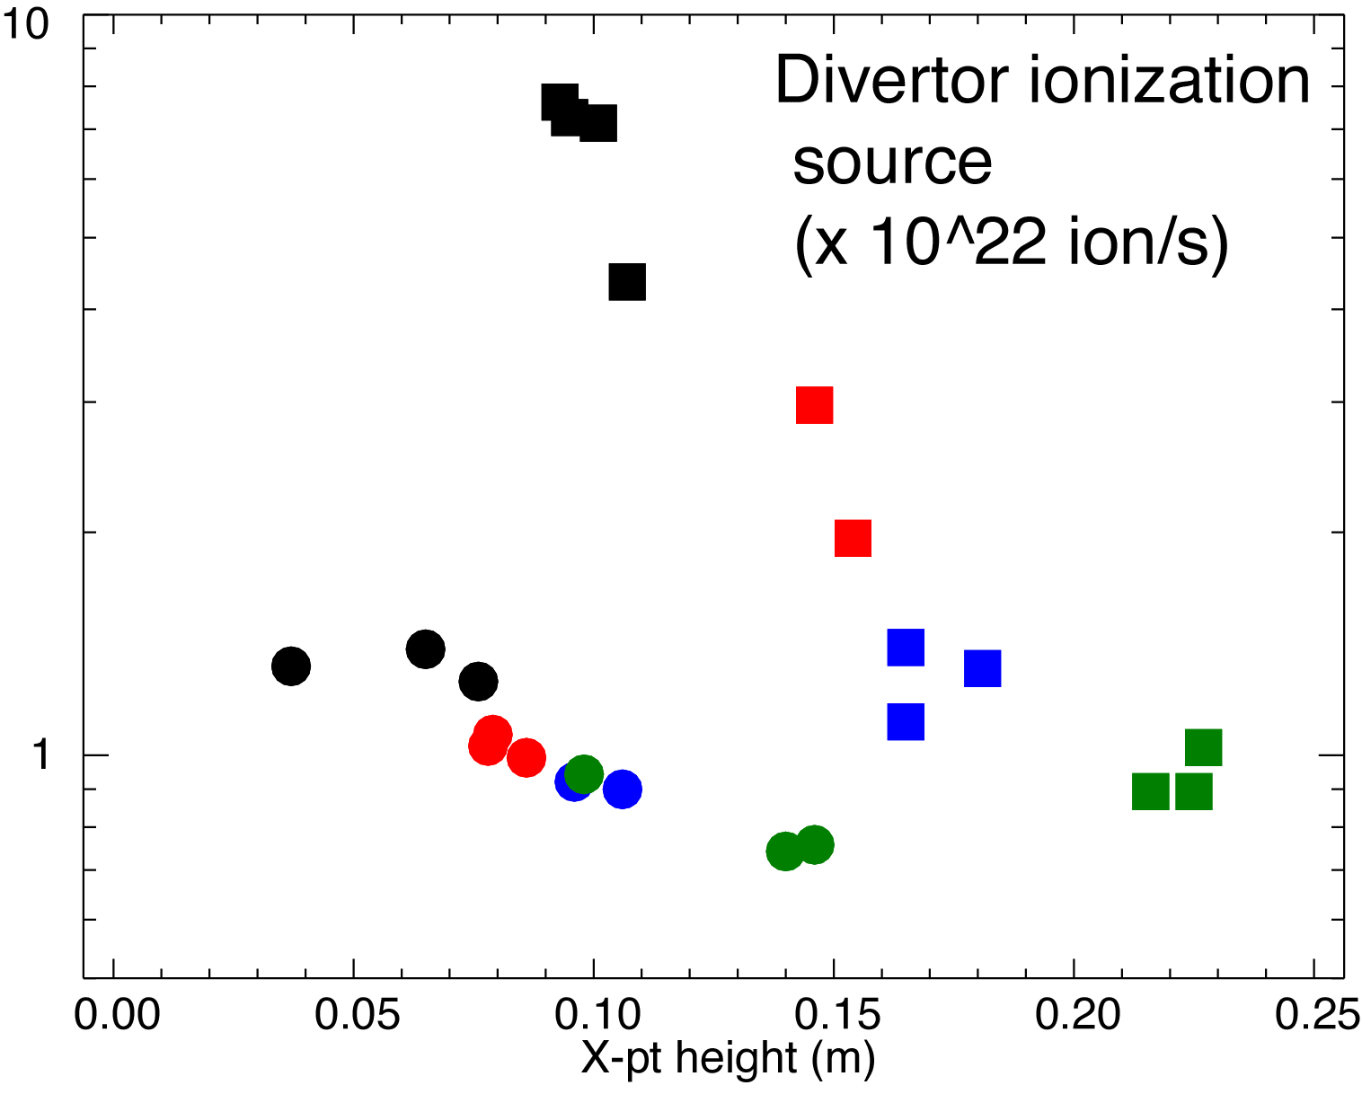
Divertor D-alpha and ionization source higher in configuration A
Divertor Dα profiles measured by photometrically calibrated camera
Ionization source inferred using S/XB=30 from ADAS by spatially integrating divertor Dα brightness profiles over one λ_{q}
Configuration
A ⬛️
B ⚫️

Slide 24
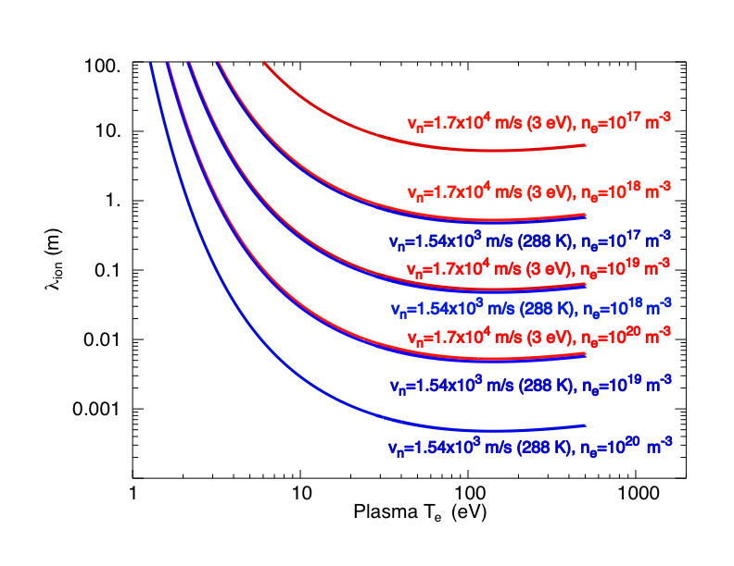
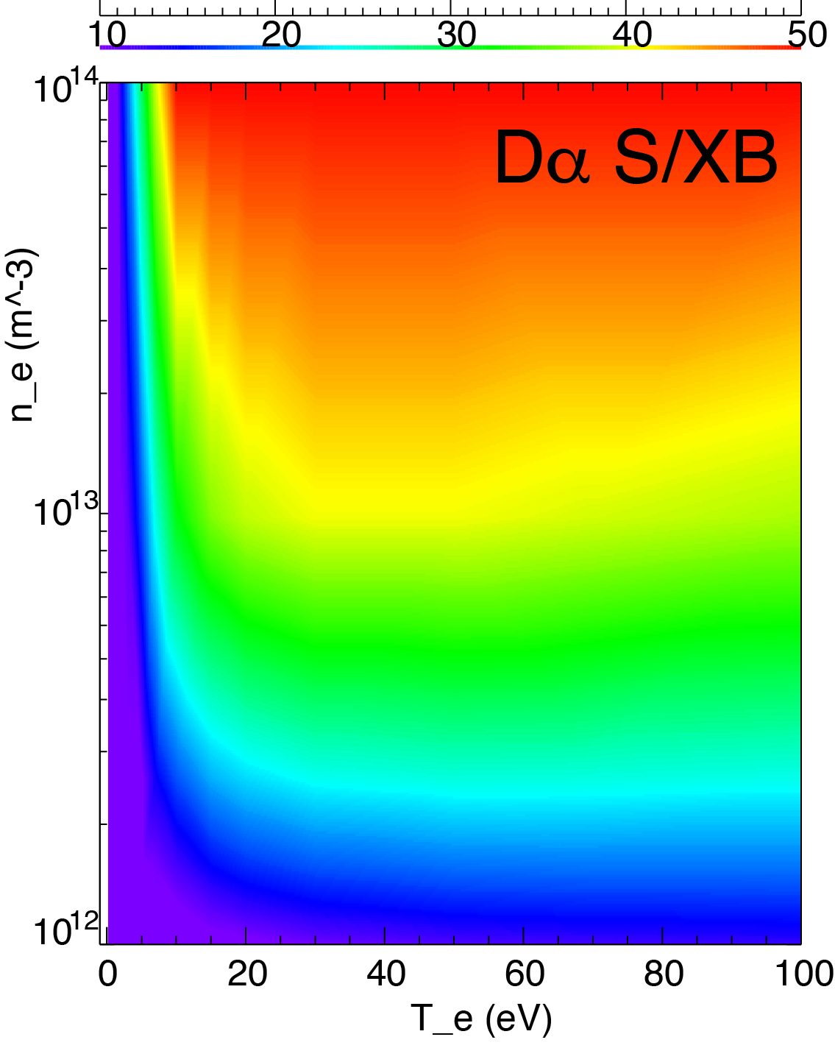
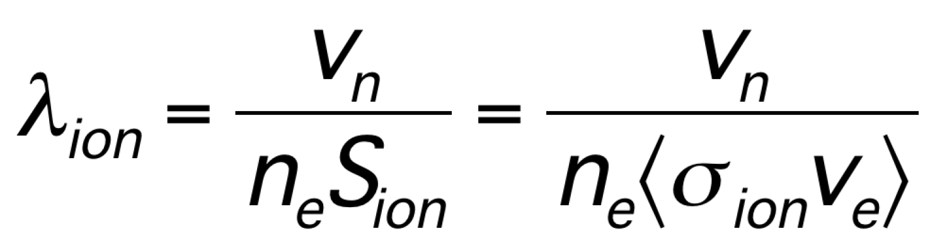
Neutral ionization length lower than divertor leg size (X-point height) in configurations A and B
ADAS S/XB for D n=3-2 transition (Dα)
Shown D atomic ionization length only - atomic CX length scales similarly

Slide 25
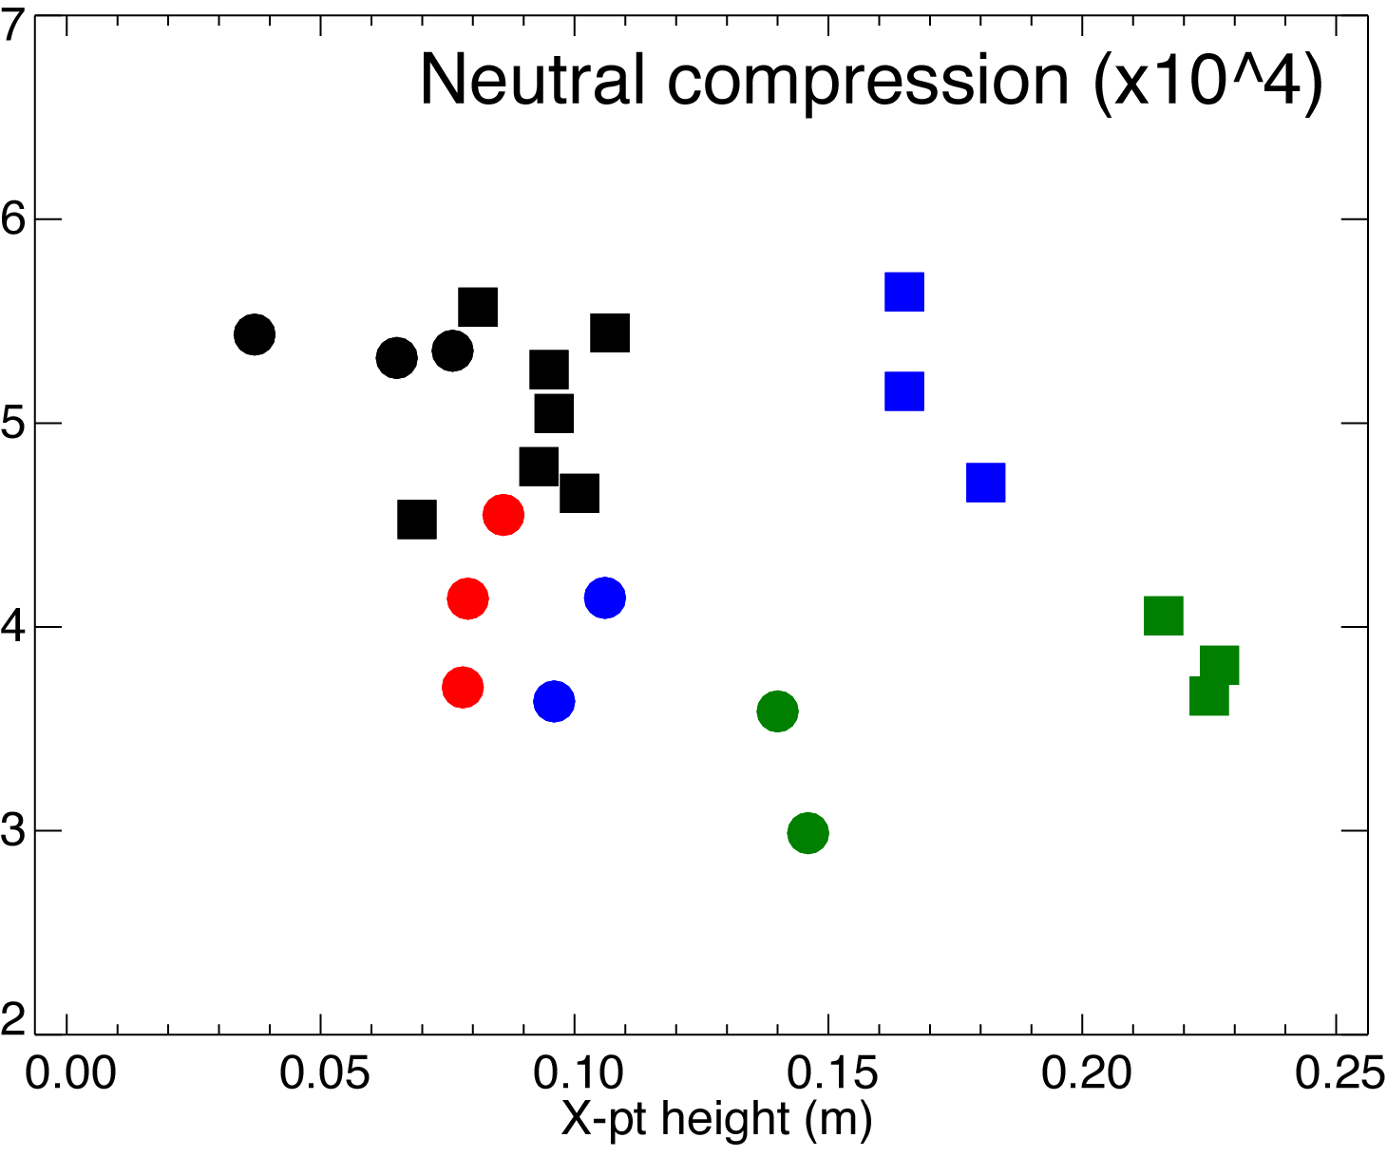

Neutral compression higher in conf. A
Neutral compression inferred from midplane microion and divertor Penning pressure gauge measurements
P_div/P_mid
Neutral pressure of 2-3 mTorr is needed for detachment to explain plasma pressure drop of dp/dx = 9-10 Pa/m
Configuration
A ⬛️
B ⚫️

Slide 26
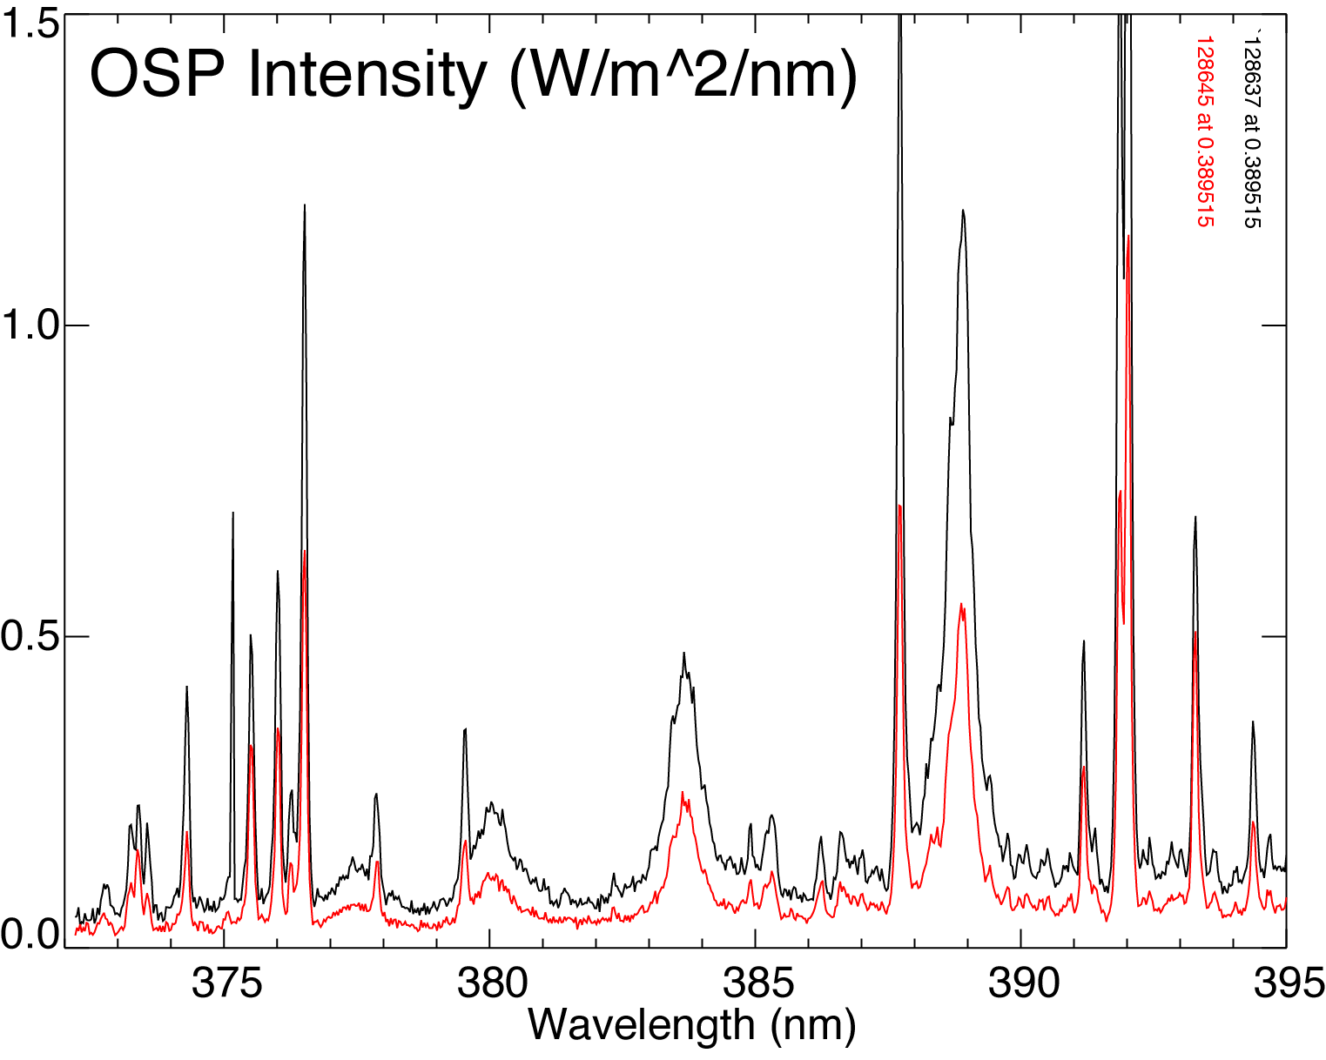
Recombination rate is inferred from high-n Balmer line divertor intensities
Intensities of B9-B11 are low
At T_{e} > 10 eV, likely to be due to excitations, not recombinations
Electron-ion recombination rate depends on divertor ion residence time
  Ion recombination time: τ_{ion}~ 1−10 ms at T_{e} =1.3 eV
  Ion residence time: τ_{ion} ≤ 1 ms
During detachment, intensities are x100 higher
High-n upper levels are populated by 3-body recombination

Slide 27
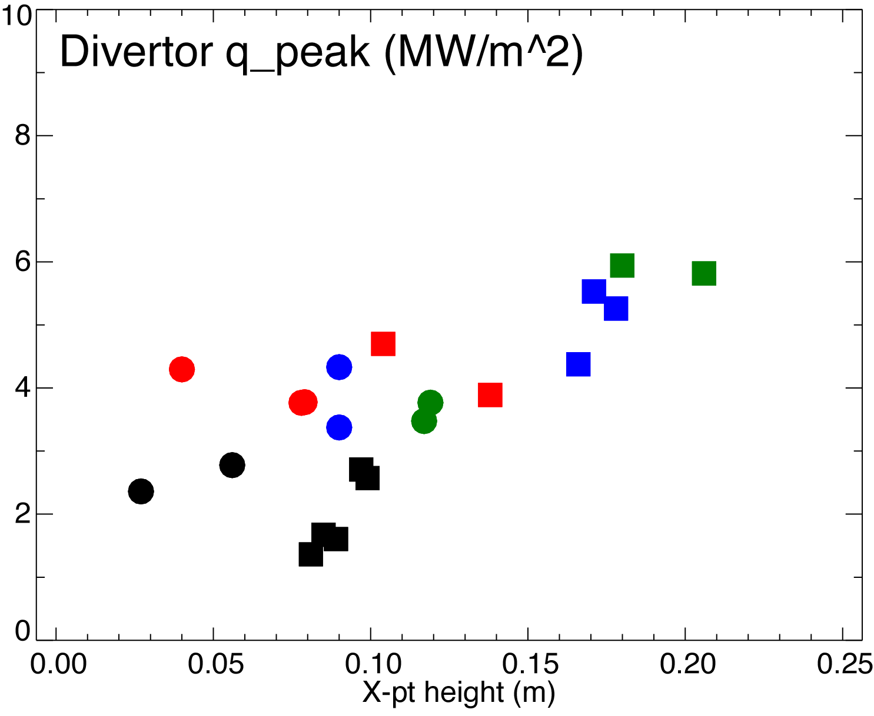
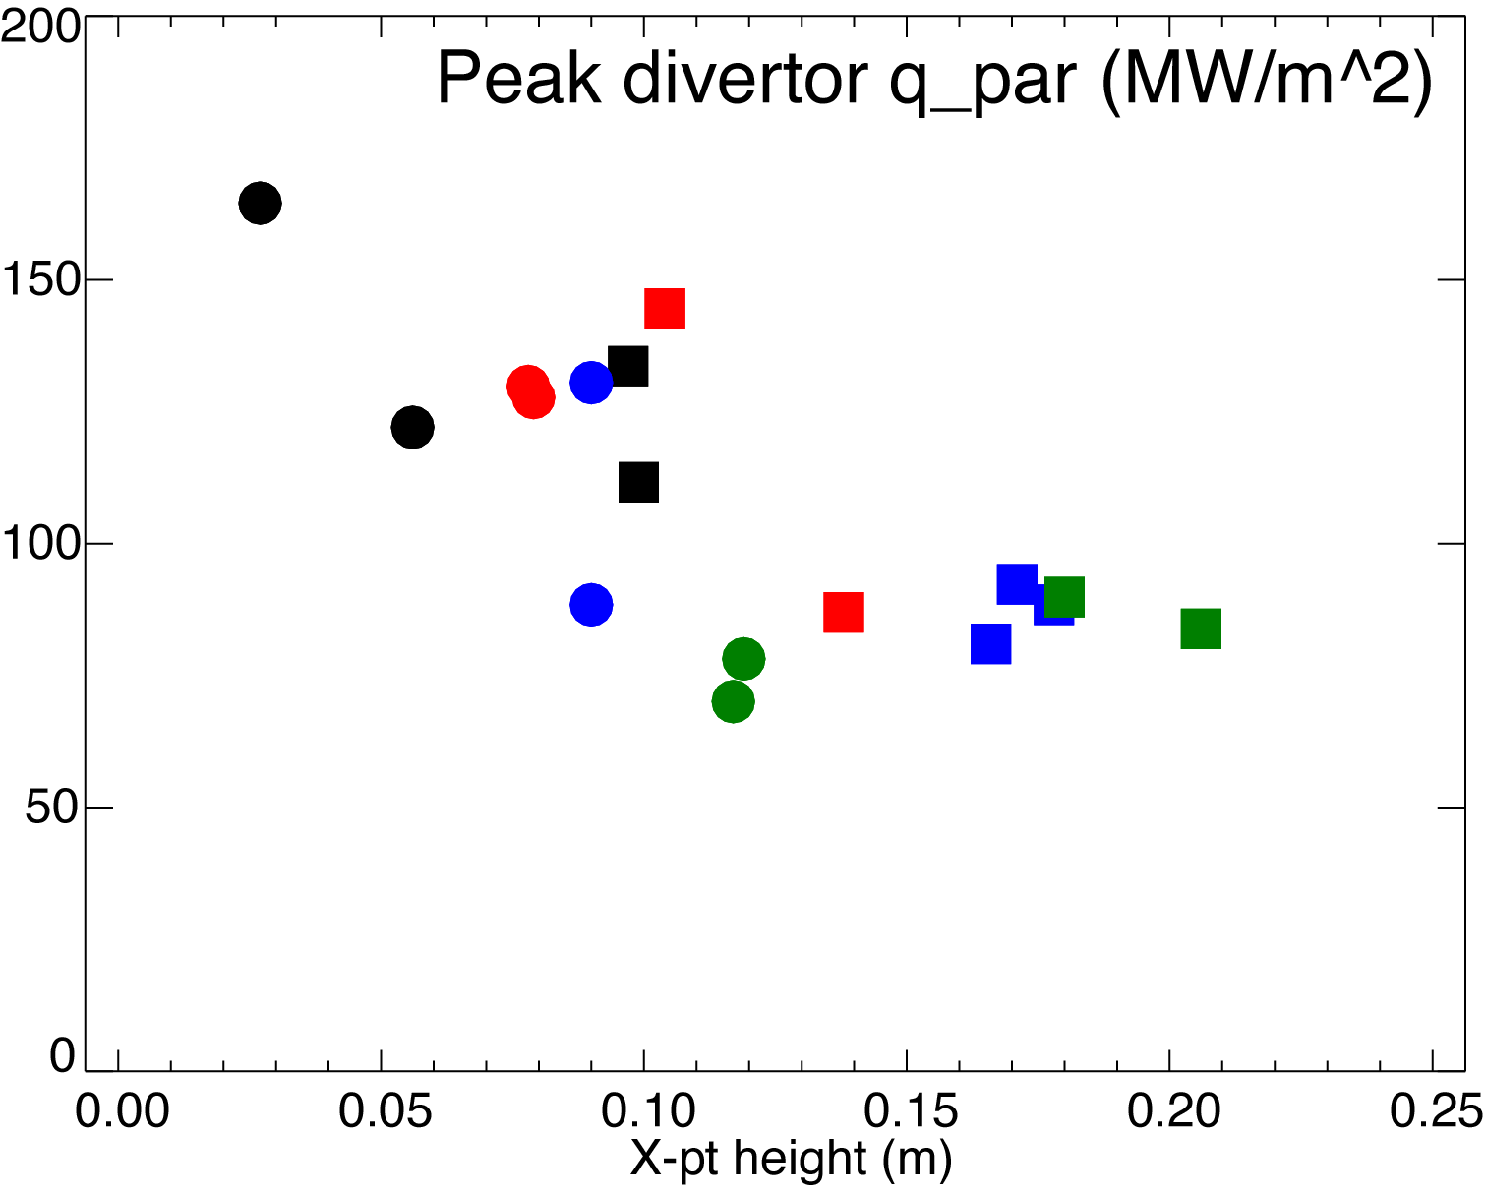
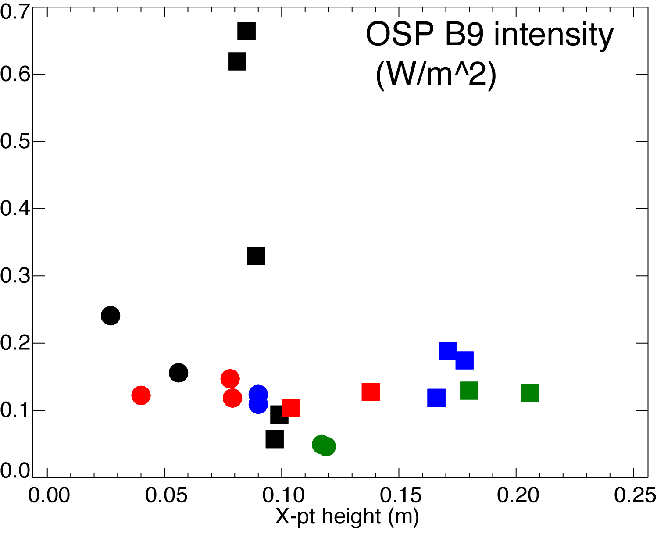
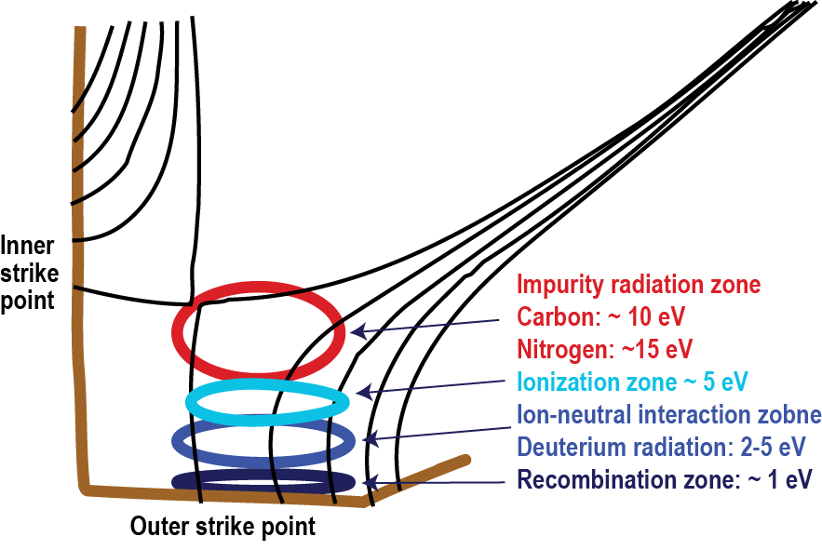
At higher upstream density, q_{peak} and q|| are further decreased
Configuration
A ⬛️
B ⚫️
However, no OSP detachment evident

Slide 28
UEDGE is used to model divertor plasma conditions in conf. A
Transport coefficients D (particles) and χ_{e,i} (energy) are adjusted to produce experiment-like upstream profiles
Divertor plate recycling R=0.99
Charge-state resolved impurity model with constant D, physical and chemical sputtering

Slide 29
Lowest X-point height configuration A reaches detachment conditions faster
Medium and high X-point height configurations reach detachment conditions abruptly (”cliff-like”)

Slide 30
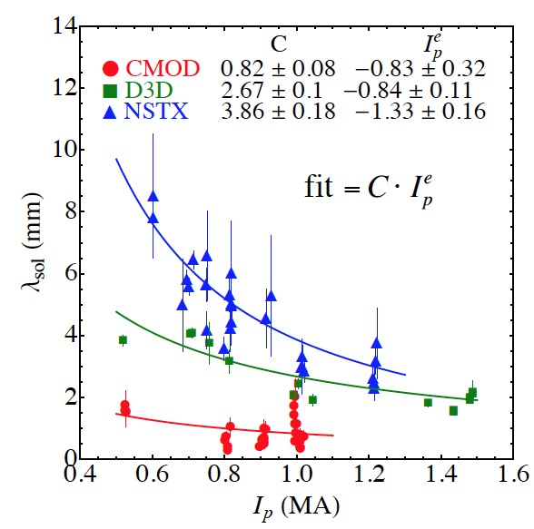
NSTX SOL power width λ
From Makowski, PoP 2015

