Slide 1




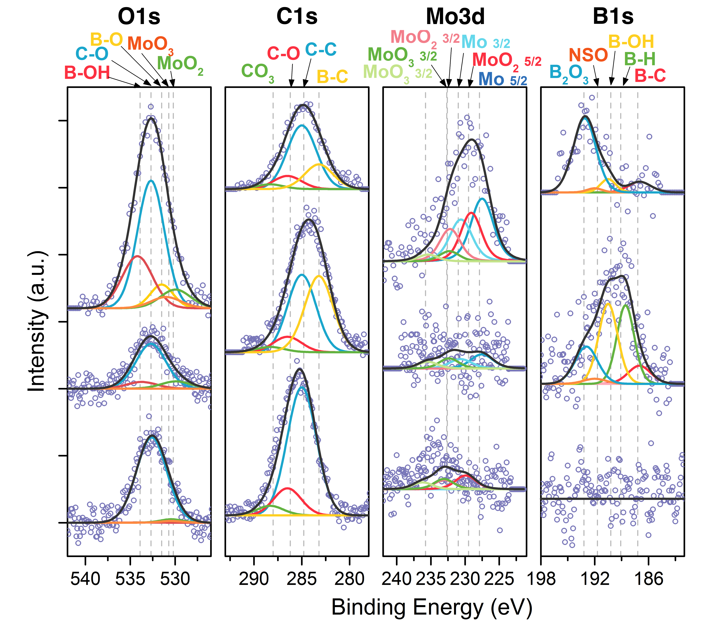
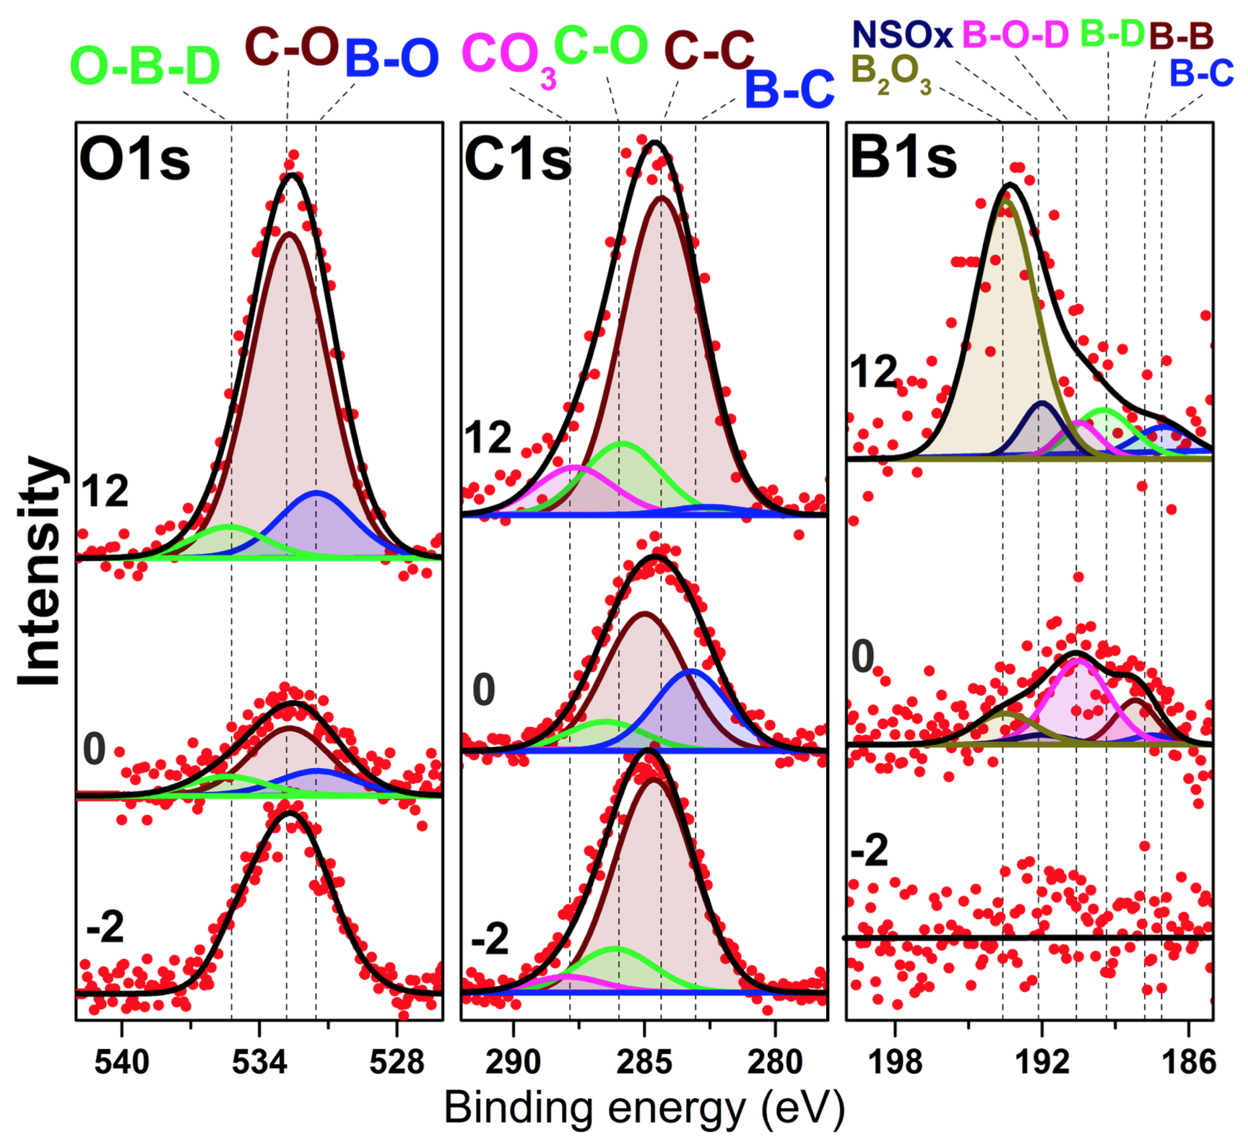
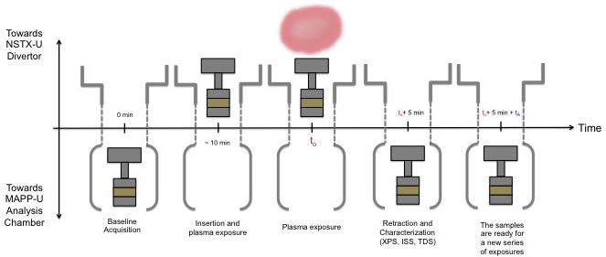
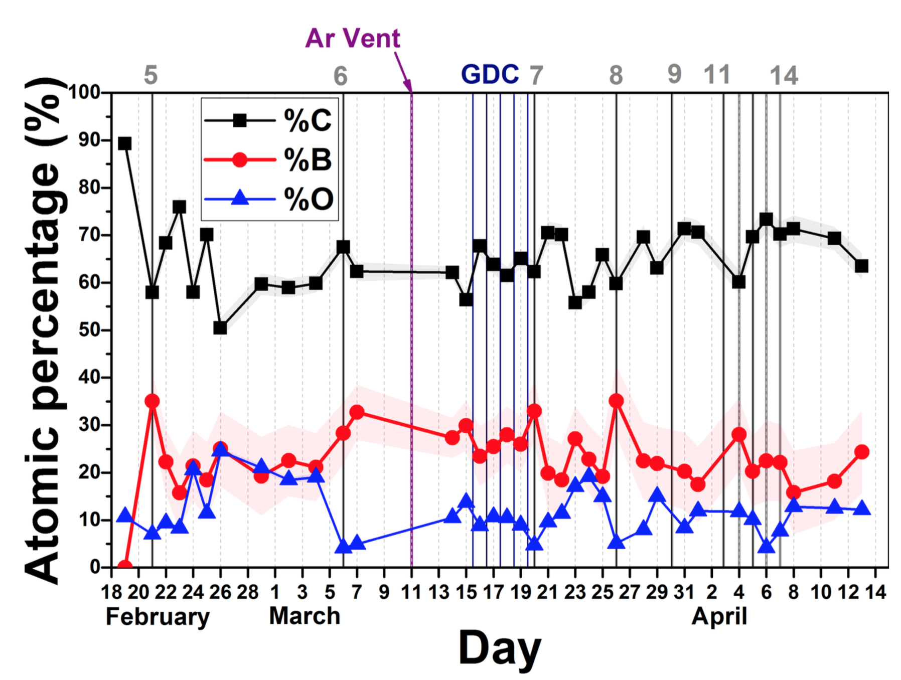
Surface chemistry analysis of TZM and graphite during plasma operations
H. Schamis^{1＊}, F. Bedoya³, J. P. Allain¹, R. Kaita²
1 University of Illinois, Urbana, IL 61801; 2 Princeton Plasma Physics Laboratory, Princeton, NJ 08540; 3 MIT Plasma Science and Fusion Center, Cambridge, MA 02139
Introduction
MAPP is a materials characterization technique used in NSTX-U to study the evolution of the surface chemistry of the plasma-facing components.
It has the present capability of conducting X-ray Photoelectron Spectroscopy (XPS) in vacuo.
The probe is not exposed to atmospheric conditions, and can take measurements on a day-to-day basis.
Plasma-facing component conditioning is used to minimize the emission of impurities, fuel recycling, erosion, and redeposition.
During the 2015-2016 NSTX-U experimental campaign, deuterated-trimethlyborane (d-TMB; B(CD₃)₃) was used to condition the PFCs.
This study shows the chemical composition of TZM and ATJ graphite as it is exposed to plasma and boronizations.
MAPP: The Materials Analysis and Particle Probe
MAPP is located in the lower divertor region.
The samples are not exposed to air in between plasma exposures, making the data obtained using MAPP an accurate representation of the PFCs in the lower divertor region
Results
XPS data of TZM and ATJ graphite samples was taken with MAPP during 2016.
XPS data fitting
The XPS data obtained using MAPP gives information on the chemical composition of up to 5 nm of the surface of the samples.
The samples were scanned in four regions (B1s, Mo3d, C1s and O1s).
The data peaks were deconvoluted and fit according to the following constraints:
▷ Position/Binding energy: obtained from previous
controlled experiments [1-3].
▷ FWHM of the spectral fits
▷ Area relation between doublets (in Mo3d 5/2 and 3/2)
Future Work
MAPP analysis chamber will be transported to UIUC for upgrades and testing:
▷ Optimization of low energy ion scattering spectroscopy (LEISS) and thermal desorption spectroscopy (TDS)
▷ Implementation of direct recoil spectroscopy (DRS), which
will allow H/D retention measurements
▷ New analyzer will improve energy resolution in MAPP.
Summary
With MAPP, PFC material evolution can be studied in ways not previously possible.
The data shows that boron is deposited on the surfaces of ATJ graphite and TZM
The variations in the atomic concentrations could be the result of migration, sputtering, and redeposition during plasma shots between boronizations.
03/04
02/21
Schematic of the exposure sequence of MAPP
02/19
Above: Surface chemistry evolution of TZM (left) and ATJ graphite (right). The bottom spectra were taken after the samples are inserted into NSTX-U with MAPP, before boronization and/or plasma operations. Middle spectra were taken immediately following boronization, and indicate appearance of boron compounds. Top spectra were taken after plasma operations.
Below: atomic concentration evolution of TZM (left) and ATJ graphite (right). Trends are similar in both cases: O concentration reduction following boronization, then increase following plasma operations.
Concentration (%)
Days since insertion of sample
Acknowledgments
Work supported by US DOE Contract No. DE-AC02-09CH11466, and US DOE Contract No. DE-SC0010717.
References
[1] Ghezzi, et al., “XPS, SIMS and FTIR-ATR characterization of boronized graphite from the thermonuclear plasma device RFX-mod”, Appl. Surf. Sci., 2015.
[2] Brox and Olefjord, “ESCA studies of MoO2 and MoO3”, Surf. Interface Anal.,1988.
[3] Scanlon, et al., “Theoretical and Experimental Study of Electronic Structures of MoO3 and MoO2” J. Phys. Chem. C, 2010.
Left: Cross section of NSTX-U Bay K. The probe is highlighted with the circle.
Upper right: MAPP probe and analysis chamber location with respect to the divertor.
Lower right: Detailed schematic of the MAPP analysis chamber and diagnostic tools.
Above: XPS depth-profile data of the TZM sample (off-line, after removing the sample). Data shows presence of boron deposits on the TZM substrate. High concentration of metallic molybdenum compared to molybdenum oxides suggests oxidation occurs primarily in boron.
CPMI
Center for Plasma-Materials Interactions
University of Illinois at Urbana - Champaign
＊ schamis2@illinois.edu
Notes:
Future work: analyzer (see DIII-D Proposal). Figure 8.

